Slide 1
THE SLT 2021 CHILDREN SPEECH RECOGNITION CHALLENGE: OPEN DATASETS, RULES AND BASELINES
17201094 - Mashuk Arefin Pranjol
18101213 - Jahidul Hasan
18301001 - Farhin Rahman
18301007 - Saiadul Arfain
19101350 - Bushra Yesmeen Anika
20101214 - Tanjib Ahmed
20101298 - Ehsanur Rahman Rhythm
20141003 - Rajvir Ahmed Shuvo
20141046 - Md. Abdullah Al Masum Anas

Slide 2
Introduction
Advanced considerably thanks to deep learning and massive amounts of data.
Human-computer interaction (HCI), online education, and audio content analysis applications need a robust voice recognition system.
Deep neural network (DNN) provided a great improvement to the acoustic model.
The children Speech Recognition Challenge (CSRC) is a
flagship satellite event of IEEE SLT 2021 workshop1.
Overview of datasets, rules, assessment methods, and baselines are the authors provided by the authors.

Slide 3
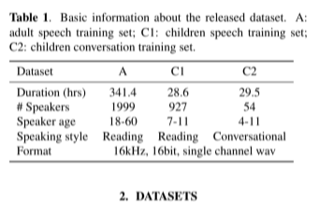
Dataset and Results
Single-channel adult speech, child reading and conversational speech for training (totally 400 hours)
Vocal tract length normalization (VTLN)
Hybrid DNN-HMM CSR system vs GMM
Performance ranking is based on the character error rate (CER)

Slide 4

Track setting and Evaluation
We set up two tracks for participants to study children speech recognition with different limits on the scope of training data.
In the first track, participants can only use the data provided by the challenge to train acoustic and language models.
Note that the language model training in the second track allows the use of transcripts associated with the provided speech data and the external speech data in openslr.
Besides for the second track, participants need to provide a list of additional data used during training.
We use edit distance based CER to evaluate the model performance for both track 1 and 2.

Slide 5
BASELINE SYSTEMS

Slide 6
Chain-model based hybrid system
Chain model: Type of DNN-HMM model
Difference with common DNN model-
1. chain model uses the log-probability.
2. has a special state accepting phoneme only once and another state accepting silence zero or more times.
Uses the MMI criterion
Difference with common HMM
a 3-state left-to right HMM that can be traversed in a minimum of 3 frames.

Slide 7
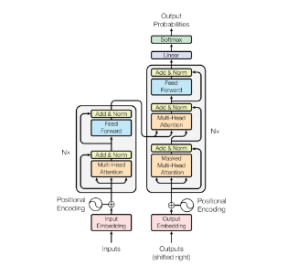
Transformer system
Based on an encoder-decoder structure with an attention mechanism.
The commonly used modeling units are phoneme, syllable, character, grapheme or wordpiece.
In order to enable the model to make rational use of the location in- formation of the sequence, it is necessary to add the position coding structure
This helps to obtain the location information of the corresponding symbols of the whole sequence.

Slide 8
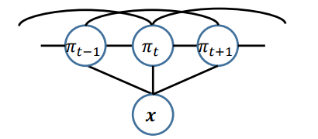
CTC-CRF based system
Uses a hidden state sequence to obtain the alignment between the label sequence and input feature sequence.
Hidden state sequence is mapped to a unique label sequence by removing consecutive repetitive labels and blanks.
Node potential is the same as CTC, and the edge potential is
realized by an n-gram LM of labels.
Notes:
My previous groupmates talked about, Chain-model based hybrid system and Transformer system. Now, I will be talking about the third baseline method. The third baseline method is based on the CTC-CRF, which was recently proposed. The CTC-CRF algorithm is similar to CTC in that it uses a hidden state sequence to determine the alignment between a label sequence and an input feature sequence, and the hidden state sequence is then mapped to a unique label sequence by removing consecutive repetitive labels and blanks from the input feature sequence. The conditional random field (CRF) defines the posteriori of the hidden state sequence, and the potential function of the CRF is defined as the sum of the node potential and the edge potential. The notion of node potential is the same as that of CTC, and the realization of edge potential is accomplished by an n-gram LM of labeled data. In CTC, conditional independence between hidden states is avoided by including the likelihood of the phrase into the potential, which is a logical consequence of doing so.

Slide 9
Experiment Setup
400 Hours of speech.
1 percent data as development set.
Three baseline system.

Slide 10
Experiment setup(first baseline)
71-dimensional melfilterbanks features as the input of the acoustics model.
single convolutional layer with the kernel of 3.
19 hidden layers of a 256-dimensional Time Delay Neural Network (TDNN).
1280-dimensional fully connection layer with activation function of ReLU.
Tri-gram language model.
After combining the HMM model, the size of the final ‘HCLG‘ graph is 384M.

Slide 11
Experiment setup(Second baseline)
ESPnet end-to-end speech processing toolkit.
12-layer encoder and 6-layer decoder.
Whole network is trained for 50 epochs.
5140 commonly used Chinese characters as the modeling units.

Slide 12
Experiment Setup(third baseline)
CAT to build CTC-CRF baseline.
AM network is two blocks of VGG layers.
6-layer BLSTM.
3 input channels.
BLSTM has 512 hidden units per direction and the total number of parameters is 37M.
dropout probability of 0.5 is applied to the LSTM.
CTC loss with a weight 0.01 is combined with the CRF.
Aishell lexicon.
tri-gram word based language model.
The size of decoding graph is 142M.

Slide 13
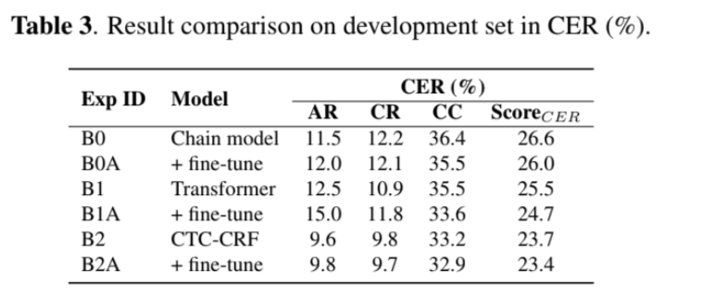
Results and Analysis
The CER on CC is significantly worse which suggest children’s conversational speech is more challenging to recognize.
It can be observed that compared with AR, phoneme discriminators are more likely to confuse similar phonemes on the CR set.

Slide 14
Challenge Rules
Data augmentation is allowed
Prohibition of using evaluation datasets
Multi-system is not allowed
Lower computation complexity is better is case of same CER
Force alignment must be trained
Shallow fusion is allowed: LAS, RNNT, Transformer

Slide 15
Conclusion and Remarks
Introduced the necessity of IEEE SLT 2021 CSRC
Described the datasets, tracks, baselines and rules
Intended to advance children speed recognition
Determined to introduce the best-performing approaches in follow-up research

