Slide 1
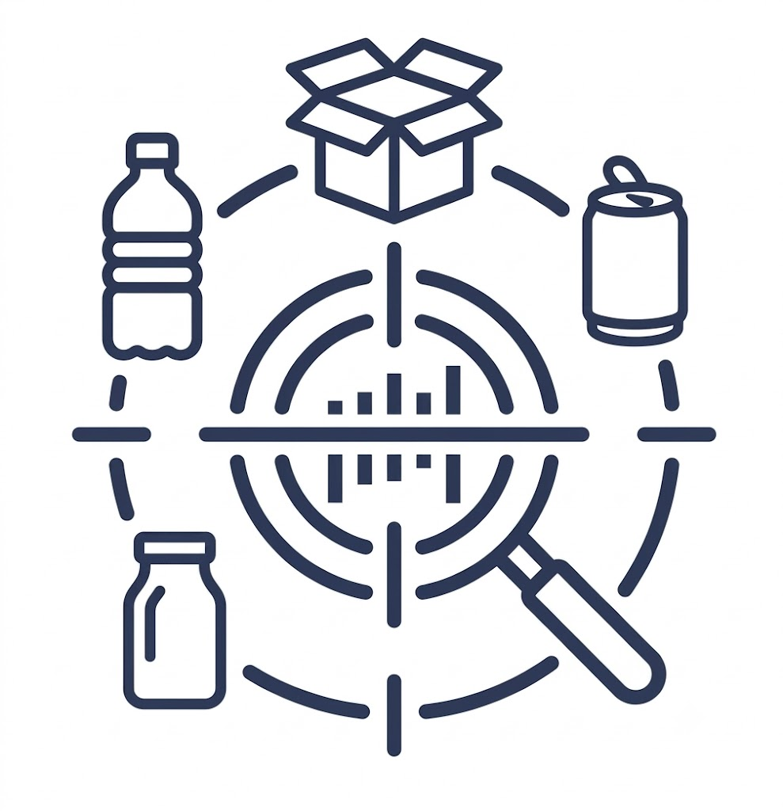
Waste Type Identification
Team 2026_MLinf_gr41
Errico Gioia · Raffaele Cutolo
FINAL SYSTEM: RegNetY-1.6GF + calibrated acquisition augmentation (acq_mild) + flip TTA
1

Slide 2
Setup: Stratified Split, Preprocessing, Training
Split
Preprocessing
Training
Custom stratified 80/20 split preserving every macro-class and sub-class ratio (Clothing = 47.1%, Undifferentiated = 4.5%)
Saved as split.csv, reused unchanged in all experiments
Verified with stratified 5-fold CV: 0.960 ± 0.005
Resize to 224×224 without cropping — aspect ratios are highly variable, cropping would cut objects
ImageNet normalization
Fine-tuning from ImageNet weights
SGD momentum 0.9, lr 0.01, weight decay 1e-4, cosine annealing, 15 epochs
Plain Cross-Entropy loss
Best-epoch checkpoint, seed 1234
2

Slide 3
The Real Problem: A Generalization Gap
0.967
→
0.455
Balanced Accuracy — clean validation
Same model on RealWaste (out-of-distribution)
ResNet18 baseline: 0.967 on validation — but validation shares cameras and post-processing with training
OOD probe on RealWaste (public dataset, used only for evaluation, never for training): accuracy collapses
Failure pattern: Clothing (47% of training) acts as an attractor — uncertain samples fall into the majority class
Consequence: the clean score carries almost no signal; every decision from here on targets robustness under shift
3

Slide 4
Measuring Robustness Without Fooling Ourselves
Built a hard-validation: same images and labels, corrupted along 4 families aligned one-to-one with the assignment — geometric (framing/scale), acquisition (blur, JPEG, jitter, noise), background removal, resolution — at two severities; no model retrained, training set never touched
Hidden bias discovered: an aggregate stress score crowned geo_rrc (RandomResizedCrop) — but only because the probe was dominated by the very perturbation it trains on: a quasi-circular evaluation
Fix: evaluate the 4 families separately with a pre-registered decision rule (primary axis = acquisition; never last in any family; clean-val within 0.005 of best)
The decomposition overturned the choice: light augmentation wins (acquisition 0.920, best 4-family average 0.924)
Aggregate probe → biased winner
→
Decomposed 4-family probe → fair choice
4

Slide 5
One Lever Worked — Everything Else Redistributed
Failed (net zero or negative on OOD)
Worked: acq_mild
Strong photometric augmentation (RealWaste −0.023)
Class-weighted loss; oversampling (organic TPR 0.388 → 0.115)
RandomResizedCrop; CutMix (RealWaste 0.331); RandomErasing
Fine-tuning depth: partial freezing
Confidence-based reject option
Pattern: interventions on the decision boundary or the sampling prior trade TPR between classes — the lever is what the features encode
Light + calibrated mild acquisition block: light blur, mild JPEG recompression, small jitter, light noise — the untested middle of the intensity curve
Assignment primary axis 0.920 → 0.956
RealWaste 0.455 → 0.492 (≈ 6× the noise)
Clothing attractor weakens, minority classes gain — a net gain, dose-dependent (inverted-U)
5

Slide 6
Backbone Selection
4 ImageNet backbones, identical frozen recipe, single varying factor (MobileNetV3 and EffV2-M excluded with motivation)
5 GB training budget met via gradient accumulation: effective batch 64 for everyone, only the physical micro-batch adapts — fair optimization for all
Pre-registered rule: highest hard-val wins; gap ≤ 0.01 = tie → the more efficient model wins
EffV2-S 0.971 vs RegNetY 0.971 → RegNetY wins on efficiency (356 vs 280 img/s, 0.30 vs 0.47 GB, half the parameters); capacity gain grows under shift (RegNetY vs ResNet18: +0.014 clean, +0.029 hard)
Backbone (acq_mild) | Hard-val | Test mem (GB) | fps
EfficientNetV2-S | 0.971 | 0.47 | ~280
RegNetY-1.6GF | 0.971 | 0.30 | ~356
ConvNeXt-Tiny | 0.951 | 0.53 | ~200
ResNet18 | 0.935 | 0.29 | ~1186
6

Slide 7
Final System and Numbers
0.971
0.582
0.30 GB
≈178 img/s
Hard-val Balanced Acc. (clean 0.980)
RealWaste Balanced Acc.
Test memory (budget: 4 GB)
Throughput
RegNetY-1.6GF fine-tuned under acq_mild + horizontal-flip TTA (zero-risk safety margin)
Memory is not the binding constraint — robustness and throughput are
predict(): deterministic Resize(224) + ImageNet normalization, averages input and mirrored input; fully compliant with the required specification (variable batch size, uint8 in/out)
Known residual weak spot: Plastic under the hardest acquisition conditions
7

Slide 8
What We Learned
01
Clean validation was saturated and uninformative: the competition is decided on accuracy under distribution shift.
02
Robustness test reliability: A robustness test is reliable only if the perturbations used to evaluate are independent of those used to train — our own probe fooled us once.
03
Real OOD gains come from improving what features encode (calibrated acquisition augmentation); boundary/prior interventions only redistribute TPR.
04
Augmentation is dose-dependent: too little does nothing, too much destroys the signal, the calibrated middle helps.
05
Extra capacity converts into robust accuracy, not just clean accuracy — and stacks with the recipe gain (RealWaste 0.582 vs 0.492).
8

