Slide 1
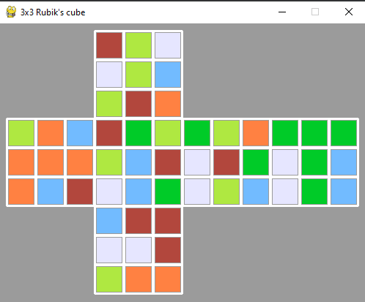
HumanEd - Rubik's Cube Painting Challenge
Team name: Ethan and friends
Team number: 6
Team members: Ethan, Eric, Justin, David

Slide 2
Table of contents
Task 1
Problems we faced
How we solved the problem
What we learned
Task 2
Problems we faced
How we solved the problem
What we did: Error checks
What we learned
Code testing

Slide 3
TASK 1

Slide 4
Problems we faced
How we solved the problem
Overlapping of the cubes
The coloured squares appeared on top of one another
Through this, we learnt how to map coordinates properly so they do not overlap each other
Overlapping of the white borders
We did many trials and got many errors
We studied and located the errors to fix them
We shared information we discovered with each other

Slide 5

What we learned
Everything no matter how complex can become a function
We believe our code could be modified to become a function for performing the operations on any cube.
Learned about pygame
By trial and error we can discover many things

Slide 6
TASK 2

Slide 7
Problems we faced
How we solved the problem
We were unfamiliar with the syntax of python
This helped us understand python a bit better
How to process a string and turn it into the colour we want
Task 2 involved outputting data in a different format to task 1.
We read the syntax of the code several times to properly comprehend it
We studied and located the errors to fix them

Slide 8
What we did: error checks
We checked for erroneous input data to prevent breaking the code
Typing the string with invalid characters
For example: a string with 54 As (‘A’ is an invalid character)
A string with length not equal to number of tiles on the 3x3 rubik’s cube
For example: “abc”

Slide 9
What we learned overall
Learned more about the syntax of Python and how to program in general
Learned to read the given Python code and modify to obtain the results we wanted.
How to share program files and collaborate on a program.
How to divide a task among people.

Slide 10
CODE TESTING

Slide 11
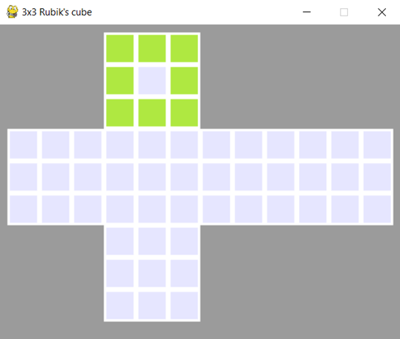
CODE TESTING
COLORATION MATCHING: Face 1 → Yellow ring with white centre
Faces 2-6 → White
INPUT STRING (54 char): yyyywyyyywwwwwwwwwwwwwwwwwwwwwwwwwwwwwwwwwwwwwwwwwwwww

Slide 12
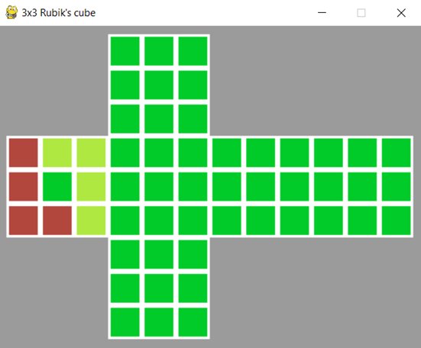
CODE TESTING
COLORATION MATCHING: Face 2 → Red 'L' shape (3 height, 2 width), inverted yellow 'L', green middle
Faces 1, 3-6 → Green
INPUT STRING (54 char): gggggggggryyrgyrrygggggggggggggggggggggggggggggggggggg

Slide 13
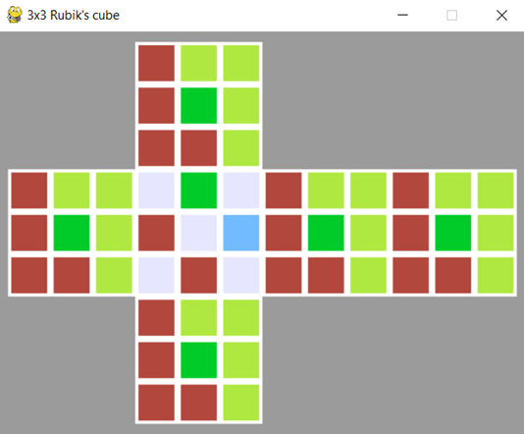
CODE TESTING
COLORATION MATCHING: Face 3 → White ‘X’ shape with remaining squares Green, Blue, Red and Red (clockwise)
Faces 1-2, 4-6 → Red 'L' shape (3 height, 2 width), inverted yellow 'L', green middle
INPUT STRING (54 char): ryyrgyrryryyrgyrrywgwrwbwrwryyrgyrryryyrgyrryryyrgyrry

Slide 14
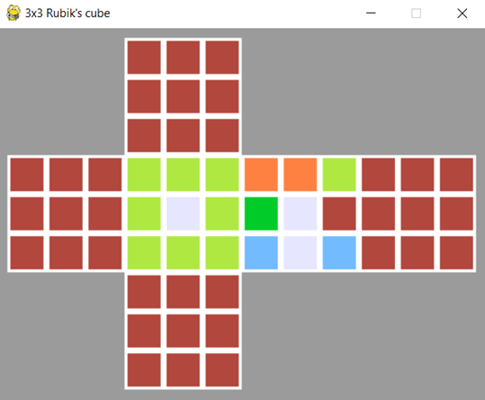
CODE TESTING
COLORATION MATCHING: Faces 1-2, 5-6 → Red
Face 3 → Yellow ring with white centre
Face 4 → Two Orange squares, followed by Yellow, Green and a White column, ending up with blue lower corners.
INPUT STRING (54 char): rrrrrrrrrrrrrrrrrryyyywyyyyooygwrbwbrrrrrrrrrrrrrrrrrr

Slide 15
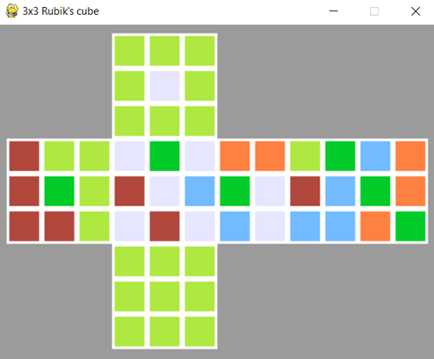
CODE TESTING
COLORATION MATCHING: Face 1 → Yellow ring with white centre
Face 2 → Red 'L' shape (3 height, 2 width), inverted yellow 'L', green middle
Face 3 → White ‘X’ shape with remaining squares Green, Blue, Red and Red (clockwise)
Face 4 → Two Orange squares, followed by Yellow, Green and a White column, ending up with blue lower corners
Face 5 → Green diagonal with Blue and Orange squares intercalated
Face 6 → Yellow
INPUT STRING (54 char): yyyywyyyyryyrgyrrywgwrwbwrwooygwrbwbgbobgobogyyyyyyyyy

Slide 16
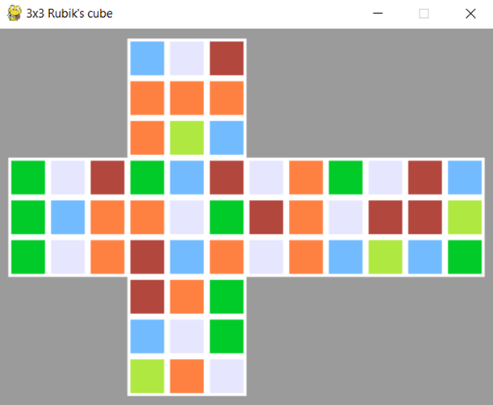
CODE TESTING
COLORATION MATCHING: Faces 1-6 → Random colours (no pattern)
INPUT STRING (54 char): bwrooooybgwrgbogwogbrowgrbowogrowwobwrbrryybgrogbwgyow

Slide 17
THANK YOU

