Slide 1
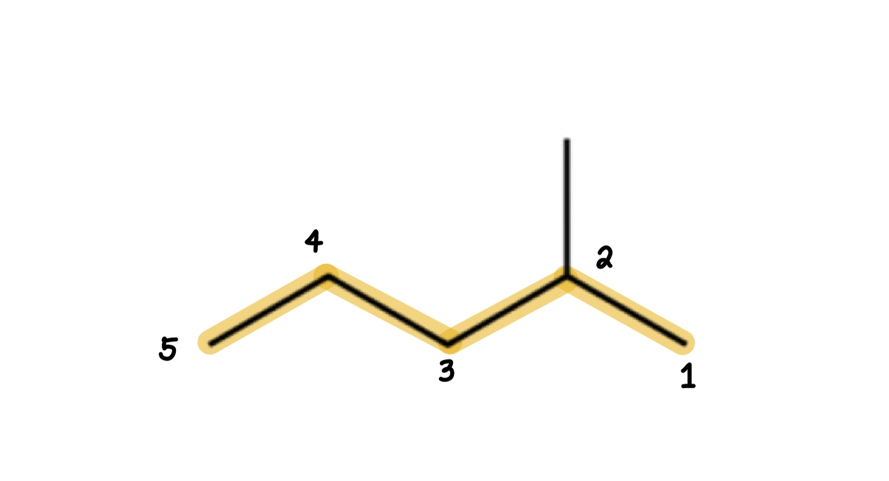
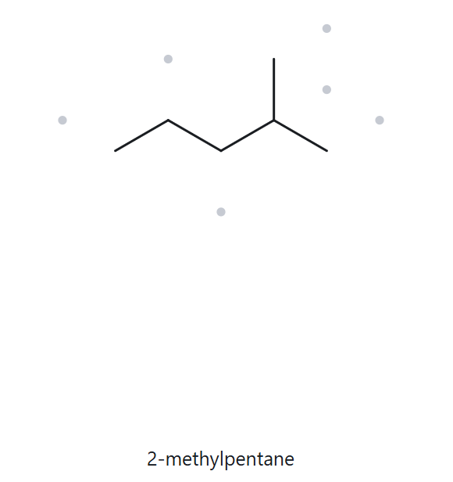


A01 (FOUNDATION): C₆H₁₄
  Numbered Parent
  Naming Trail
Parent: longest chain = 5 C (pentane)
Numbering: left-right gives 4; right-left gives 2
  First Point of Difference: 2 < 4, so number from the right
Substituents: methyl on C-2 → 2-methylpentane
  My Name
  The Alkane Check
2-methylpentane
Returned Name: 2-methylpentane
Check: MATCH
longest chain confirmed
lowest locants
alphabetical
order
punctuation
formula counted

Slide 2
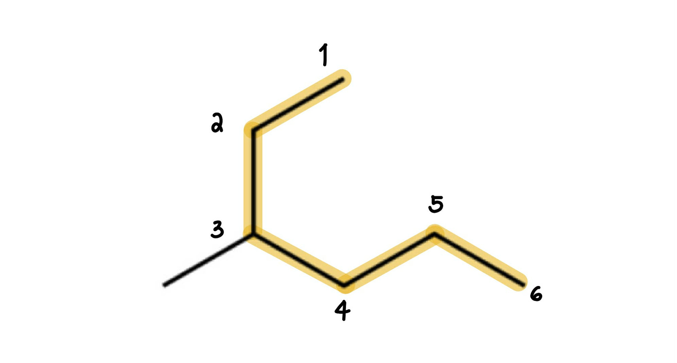
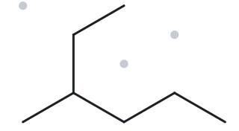

A02 (FOUNDATION): C₇H₁₆
  Numbered Parent
  Naming Trail
Parent: longest chain = 6 C (hexane)
Numbering: left-right gives 3; right-left gives 4
  First Point of Difference: 3 < 4, so number from the left
Substituents: methyl on C-3 → 3-methylhexane
  My Name
  The Alkane Check
3-methylhexane
Returned Name: 3-methylhexane
Check: MATCH
longest chain confirmed
lowest locants
alphabetical
order
punctuation
formula counted

Slide 3
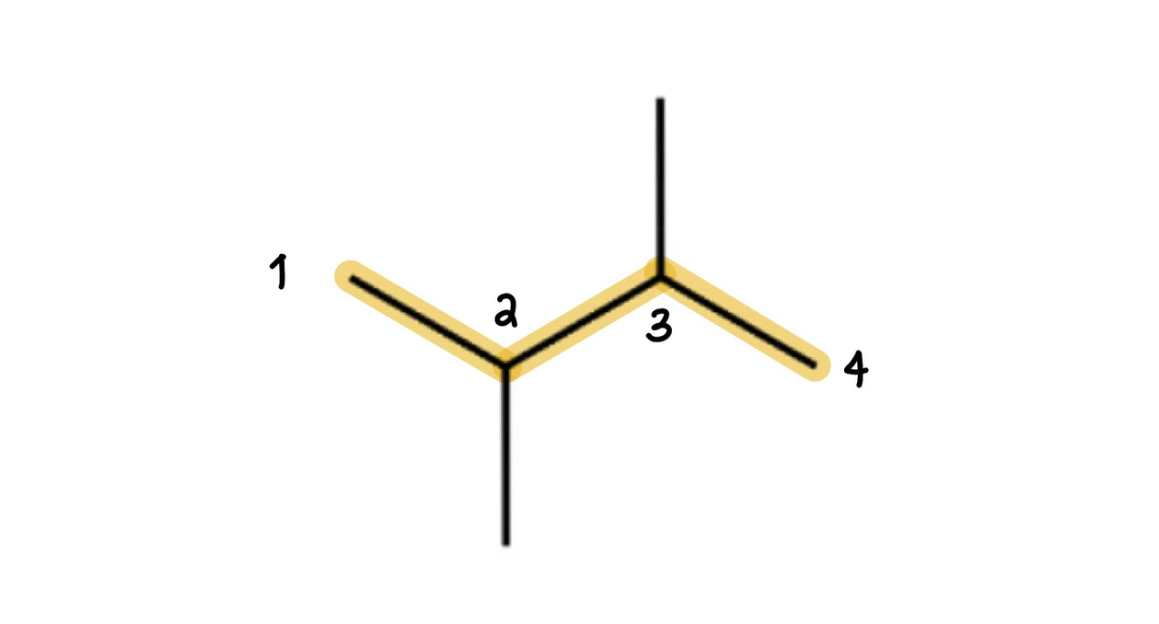
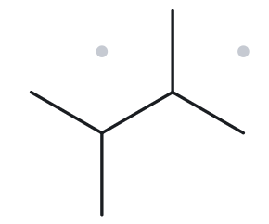

A03 (FOUNDATION): C₆H₁₄
  Numbered Parent
  Naming Trail
Parent: longest chain = 4 C (butane)
Numbering: left-right and right-left give the same locants so either direction is correct.
Substituents: methyl on C-2 and C-3
→ 2,3-dimethylbutane
  My Name
  The Alkane Check
2,3-dimethylbutane
Returned Name: 2,3-dimethylbutane
Check: MATCH
longest chain confirmed
lowest locants
alphabetical
order
punctuation
formula counted

Slide 4
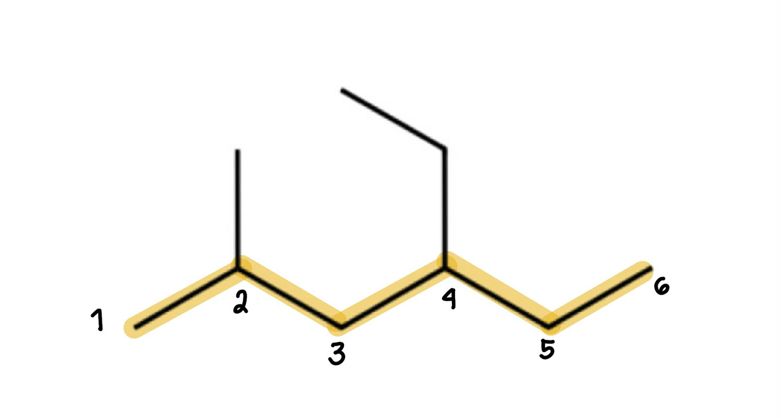
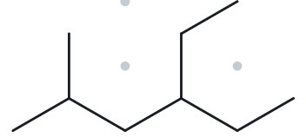

A04 (DEVELOPING): C₉H₂₀
  Numbered Parent
  Naming Trail
Parent: longest chain = 6 C (hexane)
Numbering: left-right gives 2,4 ; right-left gives 3,5
  First Point of Difference: 2 < 3, so number from the left
Substituents: methyl on C-2, ethyl on C-4
→ 4-ethyl-2-methylhexane
  My Name
  The Alkane Check
4-ethyl-2-methylhexane
Returned Name: 4-ethyl-2-methylhexane
Check: MATCH
longest chain confirmed
lowest locants
alphabetical
order
punctuation
formula counted

Slide 5
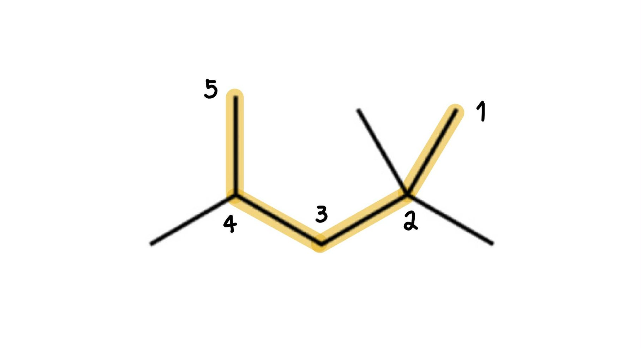
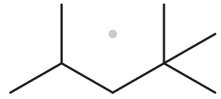

A05 (DEVELOPING): C₈H₁₈
  Numbered Parent
  Naming Trail
Parent: longest chain = 5 C (pentane)
Numbering: left-right gives 2-4-4 ; right-left gives 2-2-4
  First Point of Difference: 2 < 4, so number from the right
Substituents: methyl on C-4 and 2 methyls on C-2
→ 2,2,4-trimethylpentane
  My Name
  The Alkane Check
2,2,4-trimethylpentane
Returned Name: 2,2,4-trimethylpentane
Check: MATCH
longest chain confirmed
lowest locants
alphabetical
order
punctuation
formula counted

Slide 6
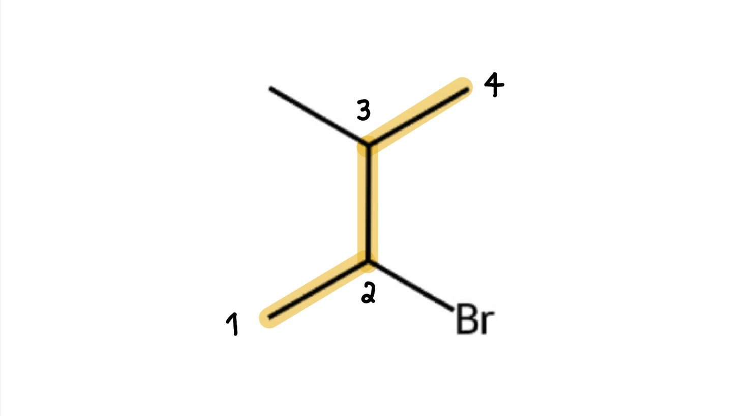
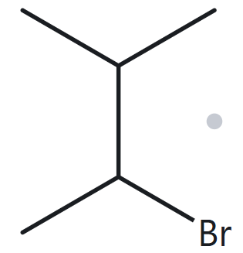

A06 (DEVELOPING): C₅H₁₁Br
  Numbered Parent
  Naming Trail
Parent: longest chain = 4 C (butane)
Numbering: left-right gives 2,3; right-left gives 2,3
  Tie-breaker: Locant sets are identical (2,3), so we number alphabetically (bromo before methyl). Number from left to give bromo the lower number.
Substituents: bromo on C-2 and methyl on C-3
→ 2-bromo-3-methylbutane
  My Name
  The Alkane Check
2-bromo-3-methylbutane
Returned Name: 2-bromo-3-methylbutane
Check: MATCH
longest chain confirmed
lowest locants
alphabetical
order
punctuation
formula counted

Slide 7
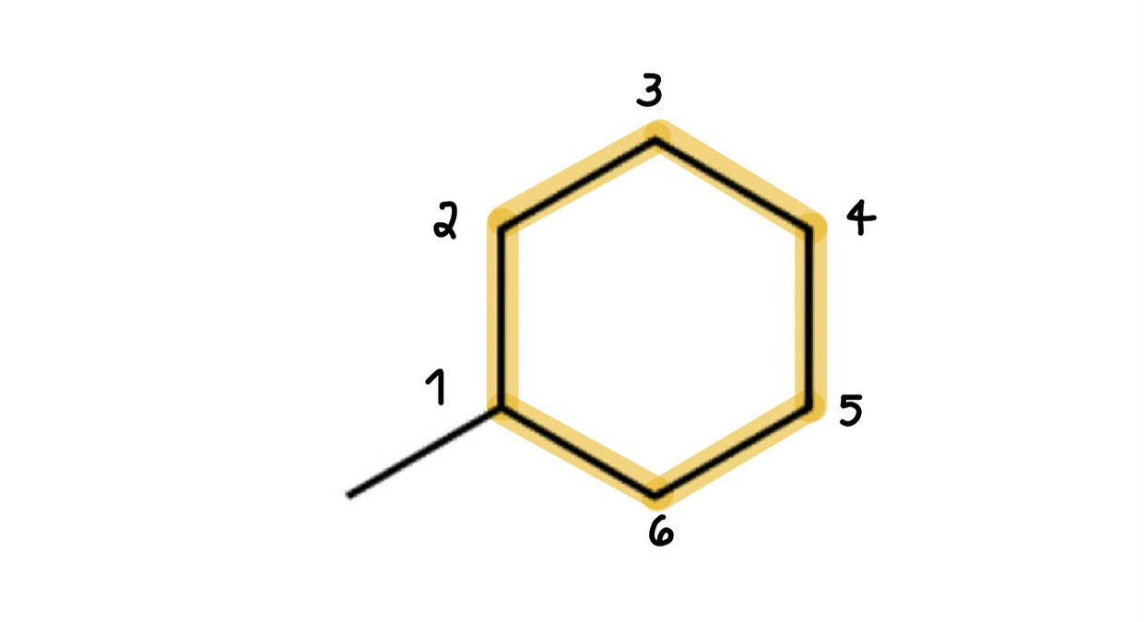
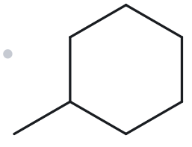

A07 (DEVELOPING): C₇H₁₄
  Numbered Parent
  Naming Trail
Parent: longest chain = 6 C (cyclohexane)
Numbering: Start at the substituent to give it the lowest possible numbering (C-1)
Substituents: Methyl on C-1 → methylcyclohexane
  My Name
  The Alkane Check
methylcyclohexane
Returned Name: methylcyclohexane
Check: MATCH
longest chain confirmed
lowest locants
alphabetical
order
punctuation
formula counted

Slide 8
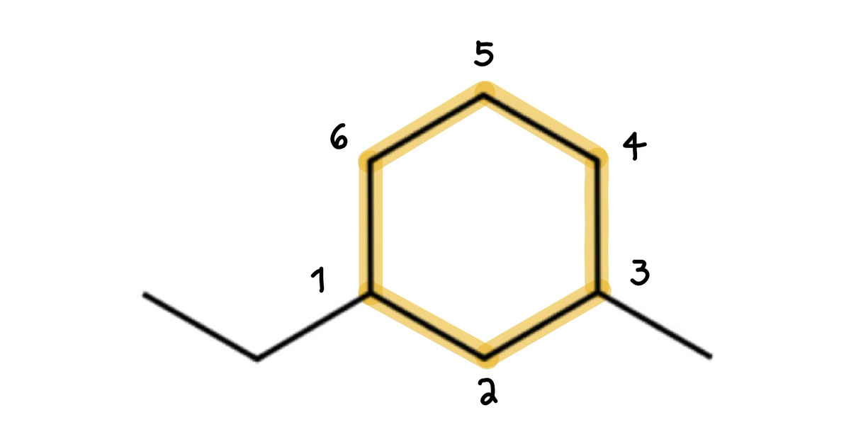
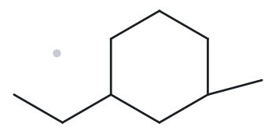

A08 (CHALLENGE): C₉H₁₈
  Numbered Parent
  Naming Trail
Parent: longest chain = 6 C (cyclohexane)
Numbering: Clockwise gives 1,3; Counterclockwise gives 1,3
  Tie-breaker: Locant sets are identical (1,3), so we number alphabetically (ethyl before methyl). Number counterclockwise to give ethyl the lower mumber.
Substituents: Ethyl on C-1 and methyl on C-3
→ 1-ethyl-3-methylcyclohexane
  My Name
  The Alkane Check
1-ethyl-3-methylcyclohexane
Returned Name: 1-ethyl-3-methylcyclohexane
Check: MATCH
longest chain confirmed
lowest locants
alphabetical
order
punctuation
formula counted

Slide 9
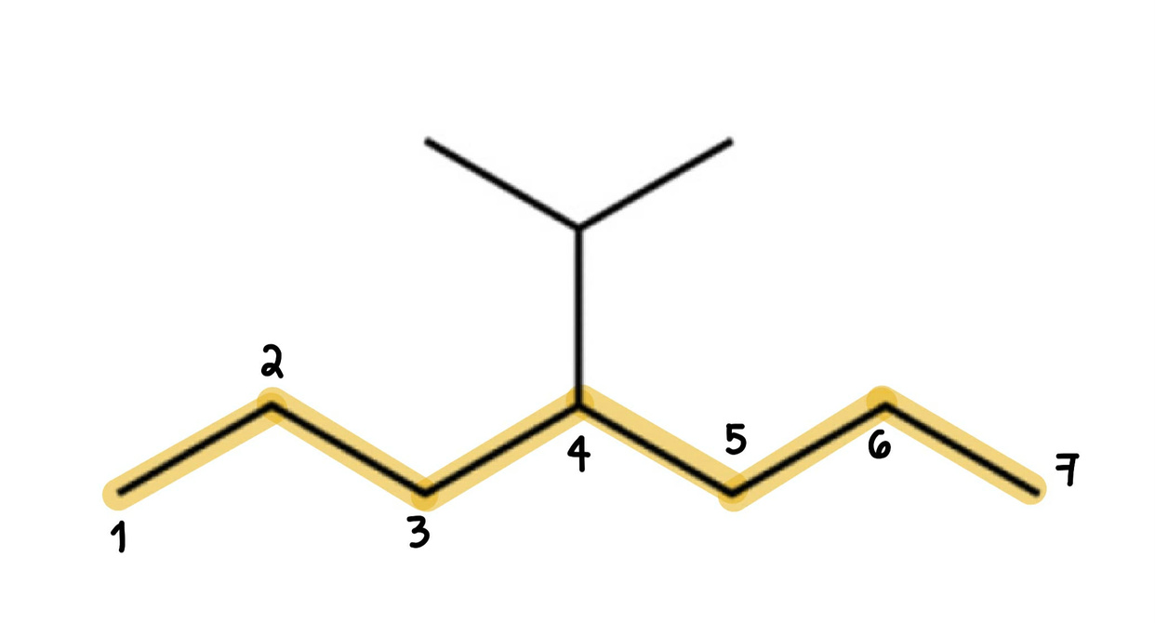
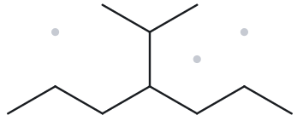

A09 (CHALLENGE): C₁₀H₂₂
  Numbered Parent
  Naming Trail
Parent: longest chain = 7 C (heptane)
Numbering: left-right gives 4; right-left gives 4
  Tie-breaker: Locant sets are identical (4)
Substituents: Isopropyl on C-4
→ 4-isopropylheptane
Alkane Check: (Additional)
  4-isopropylheptane is the correct name because of the Principal Chain Rule
  My Name
  The Alkane Check
4-isopropylheptane
Returned Name: 2-methyl-3-propylhexane
Check: MISMATCH
longest chain confirmed
lowest locants
alphabetical
order
punctuation
formula counted

Slide 10
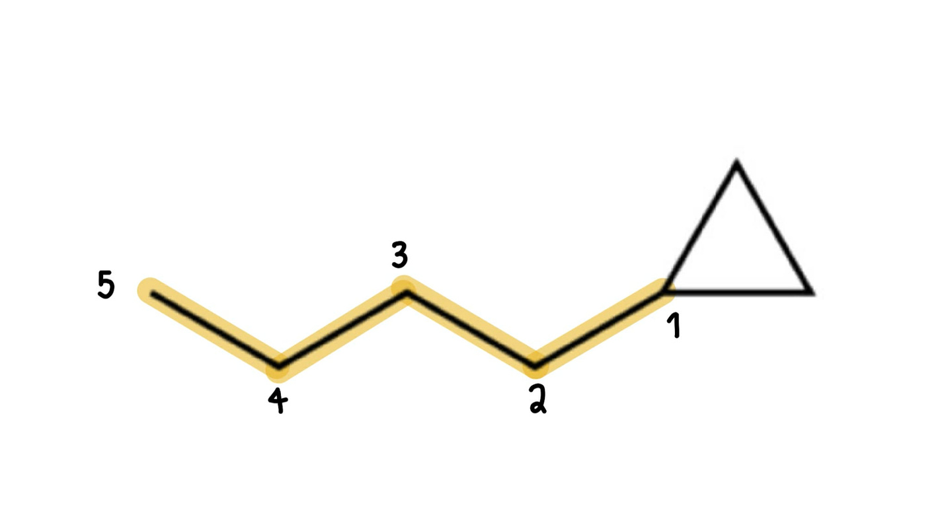
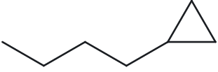

A10 (CHALLENGE): C8H16
  Numbered Parent
  Naming Trail
Parent: longest chain = 5 C (pentane)
Numbering: left-right gives 5; right-left gives 1
  First Point of Difference: 1 < 5, we number the parent chain from the right
Substituents: Cyclopropyl ring on C-1
→ 1-cyclopropylpentane
Alkane Check: (Additional)
  1-cyclopropylpentane is the correct name because of the Principal Chain Rule
  My Name
  The Alkane Check
1-cyclopropylpentane
Returned Name: butylcyclopropane
Check: MISMATCH
longest chain confirmed
lowest locants
alphabetical
order
punctuation
formula counted

Slide 11
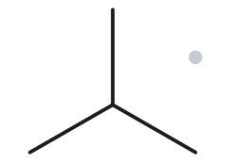

B01 (FOUNDATION): 2-methylpropane
  Name Decoded
  Bond-line Structure (The Alkane)
Parent: propane → a 3-carbon chain
Substituent: Methyl on C-2
Expected formula: 3 + 1 = 4 C; 8 + 2 = 10 H
→ C₄H₁₀
  Formula Check
  Back-check
Counted from the drawing: C₄H₁₀
Propane: C₃H₈
Methyl: CH₃
Minus one H for CH₃ = C₄H₁₀
Returned by the Alkane:
Check: Same as the given name
parent length matches
substituents
positions match
formula
agrees
back-check recorded

Slide 12
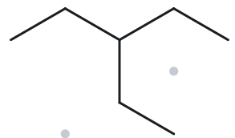

B02 (FOUNDATION): 3-ethylpentane
  Name Decoded
  Bond-line Structure (The Alkane)
Parent: pentane → a 5-carbon chain
Substituent: Ethyl on C-3
Expected formula: 5 + 2 = 7 C; 12 + 4 = 16 H
→ C₇H₁₆
  Formula Check
  Back-check
Counted from the drawing: C₇H₁₆
Pentane: C₅H₁₂
Ethyl: C₂H₅
Minus one H for C₂H₅ = C₇H₁₆
Returned by the Alkane:
Check: Same as the given name
parent length matches
substituents
positions match
formula
agrees
back-check recorded

Slide 13
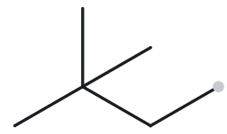

B03 (FOUNDATION): 2,2-dimethylbutane
  Name Decoded
  Bond-line Structure (The Alkane)
Parent: butane → a 4-carbon chain
Substituent: 2 Methyl on C-2
Expected formula: 4 + 2 = 6 C; 10 + 4 = 14 H
→ C₆H₁₄
  Formula Check
  Back-check
Counted from the drawing: C₆H₁₄
Butane: C₄H₁₀
Methyl: 2 CH₃
Minus one H for each CH₃ = C₆H₁₄
Returned by the Alkane:
Check: Same as the given name
parent length matches
substituents
positions match
formula
agrees
back-check recorded

Slide 14
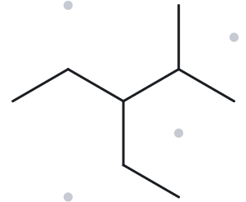

B04 (DEVELOPING): 3-ethyl-2-methylpentane
  Name Decoded
  Bond-line Structure (The Alkane)
Parent: pentane → a 5-carbon chain
Substituent: Ethyl on C-3, Methyl on C-2
Expected formula: 5 + 2 + 1 = 8 C;
12 + 4 + 2 = 18 H
→ C₈H₁₈
  Formula Check
  Back-check
Counted from the drawing: C₈H₁₈
Pentane: C₅H₁₂
Methyl: CH₃
Ethyl: C₂H₅
Minus one H for each CH₃ and C₂H₅ = C₈H₁₈
Returned by the Alkane:
Check: Same as the given name
parent length matches
substituents
positions match
formula
agrees
back-check recorded

Slide 15
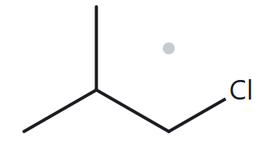

B05 (DEVELOPING): 1-chloro-2-methylpropane
  Name Decoded
  Bond-line Structure (The Alkane)
Parent: propane → a 3-carbon chain
Substituent: Chloro on C-1; Methyl on C-2
Expected formula: 1 Cl; 3 + 1 = 4 C;
8 + 1 = 9 H
→ C₄H₉Cl
  Formula Check
  Back-check
Counted from the drawing: C₄H₉Cl
Propane: C₃H₈
Methyl: CH₃
Minus two H for CH₃ due to presence of Cl
= C₄H₉Cl
Returned by the Alkane:
Check: Same as the given name
parent length matches
substituents
positions match
formula
agrees
back-check recorded

Slide 16
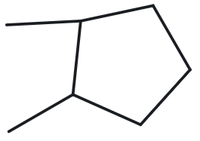

B06 (DEVELOPING): 1,2-dimethylcyclopentane
  Name Decoded
  Bond-line Structure (The Alkane)
Parent: cyclopentane → a 5-carbon ring
Substituent: Methyl on C-1 and C-2
Expected formula: 5 + 2 = 7 C; 10 + 4 = 14 H
→ C₇H₁₄
  Formula Check
  Back-check
Counted from the drawing: C₇H₁₄
Cyclopentane: C₅H₁₀
Methyl: 2 CH₃
Minus H for each CH₃= C₇H₁₄
Returned by the Alkane:
Check: Same as the given name
parent length matches
substituents
positions match
formula
agrees
back-check recorded

Slide 17
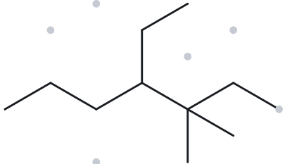

B07 (DEVELOPING): 4-ethyl-3,3-dimethylheptane
  Name Decoded
  Bond-line Structure (The Alkane)
Parent: heptane → a 7-carbon chain
Substituent: Ethyl on C-4; 2 Methyl on C-3
Expected formula: 7 + 2 + 2 = 11 C
→ C₁₁H₂₄
  Formula Check
  Back-check
Counted from the drawing: C₁₁H₂₄
Heptane: C₇H₁₆
Ethyl: C₂H₅
Methyl: 2 CH₃
Minus H for each CH₃= C₁₁H₂₄
Returned by the Alkane:
Check: Same as the given name
parent length matches
substituents
positions match
formula
agrees
back-check recorded

Slide 18
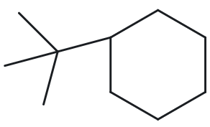

B08 (CHALLENGE): tert-butylcyclohexane
  Name Decoded
  Bond-line Structure (The Alkane)
Parent: cyclohexane→ a 6-carbon ring
Substituent: Tert-butyl on C-1
Expected formula: 6+ 4 = 10 C
→ C₁₀H₂₀
  Formula Check
  Back-check
Counted from the drawing: C₁₀H₂₀
Cyclohexane: C₆H₁₂
Tert-butyl: C₄H₉
Minus H for connection= C₁₀H₂₀
Returned by the Alkane:
Check: Same as the given name since
tert-butyl and 1,1-dimethylethyl is the same
parent length matches
substituents
positions match
formula
agrees
back-check recorded

Slide 19
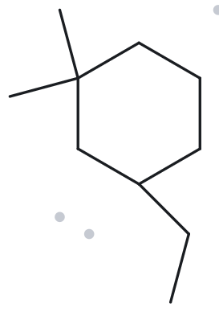

B09 (CHALLENGE): 3-ethyl-1,1-dimethylcyclohexane
  Name Decoded
  Bond-line Structure (The Alkane)
Parent: cyclohexane→ a 6-carbon ring
Substituent: 2 Methyl on C-1 and 1 Ethyl on C-3
Expected formula: 6 + 1 + 1 + 2 = 10 C
→ C₁₀H₂₀
  Formula Check
  Back-check
Counted from the drawing: C₁₀H₂₀
Cyclohexane: C₆H₁₂
Methyl: 2 CH₃
Ethyl: C₂H₅
Minus H for connections = C₁₀H₂₀
Returned by the Alkane:
Check: Same as the given name
parent length matches
substituents
positions match
formula
agrees
back-check recorded

Slide 20
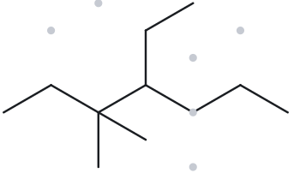

B10 (CHALLENGE): 4-ethyl-3,3-dimethylheptane
  Name Decoded
  Bond-line Structure (The Alkane)
Parent: heptane→ a 7-carbon straight chain
Substituent: 2 Methyl on C-3; Ethyl on C-4
Expected formula: 7 + 1 + 1 + 2 = 11 C
→ C₁₁H₂₄
  Formula Check
  Back-check
Counted from the drawing: C₁₁H₂₄
Heptane: C₇H₁₆
Methyl: 2 CH₃
Ethyl: C₂H₅
Minus H for connections = C₁₁H₂₄
Returned by the Alkane:
Check: Same as the given name
parent length matches
substituents
positions match
formula
agrees
back-check recorded

