Slide 1
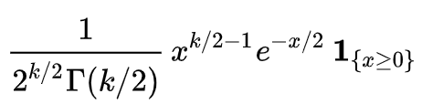
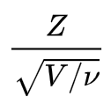
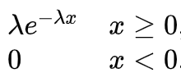
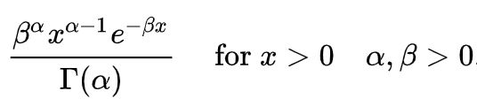


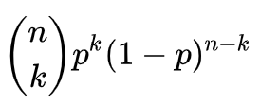
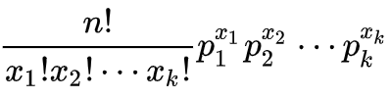
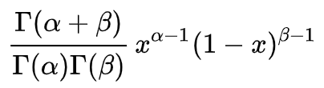
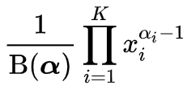

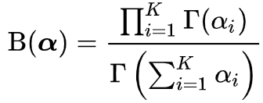
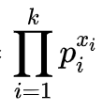


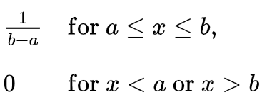




Relationship of distribution probability focused on Deep Learning
Student t
chi-squared
Z is Standard Gaussian $$v degrees of freedom$$
Gaussian
$$(x−μ)/σ$$
$$k=\frac{v}{2}, θ=2$$
Exponential
Gaussian
Mixture
Gamma
α=1
Gaussian
$$\frac{Gam(α,1)}{Gam\left(α,1\right)+Gam(β,1)}=Beta(α,β)$$
multiplication
Dirichlet
MultiNomial
Binomial
Beta
Conjugate
Multi-Bernoulli
(Categorical)
Multi-Class
Bernoulli
α=1, β=1
N Times
Limit
Special Relationship
Uniform(0,1)
(Conditional, etc)
Mathematics Expressions from wikipedia
Copyright 2019 Tae-Hwan Jung(Github @graykode). All rights reserved.

