Slide 1
P.H.M.S
Prapti Bhaukajee
Saja Abualfoul
Kristoffer Edgard Jorge-Munoz
MD Ibrahim Khalil
Team 3

Slide 2
Content
What is PHMS?
Business Objectives
System Objectives
Project Objectives
Assumptions and Constraints

Slide 3
Content
Project Context
UML Diagram
Test cases
Demo
Questions

Slide 4
What is PHMS?
Is an android application that will help users maintain different personal health-related data. The PHMS application will be used to keep track of one’s vital signs, daily medicine intake, or following a diet regiment.
Only people older than 18 can use this product
Only people with not very serious health issues can use this product.

Slide 5
Business Objectives
The functionalities that we have implemented:
▶ Registration
▶ Vital Signs
▶ Medication
▶ Diet
▶ Notes
▶ Search

Slide 6
System Objectives
System is an Android application
IDE used is Android Studio
XML is used for user interface
System is using Java for the programming language.

Slide 7
Project Objectives

Slide 8
Assumptions and Constraints
Assumptions:
Only people older than 18 years old are allowed to use this product.
Only people with not very serious health issues can use this product.
Constraints:
Team lacks android development skills
Schedule was very aggressive

Slide 9
Project Context

Slide 10
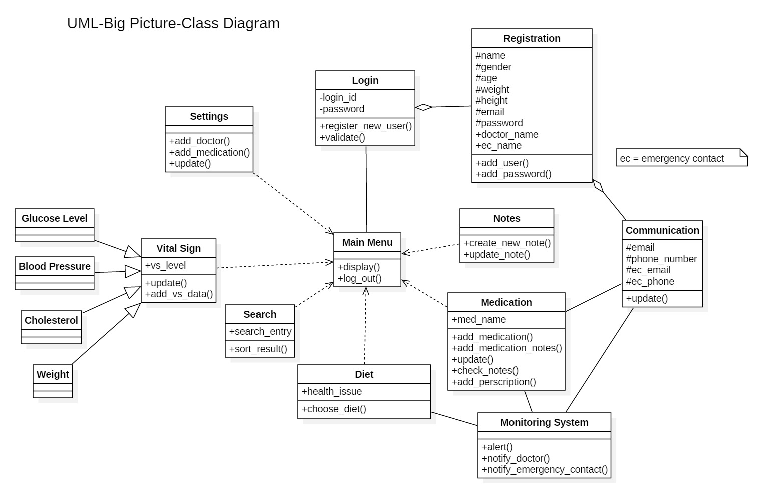
UML diagrams

Slide 11
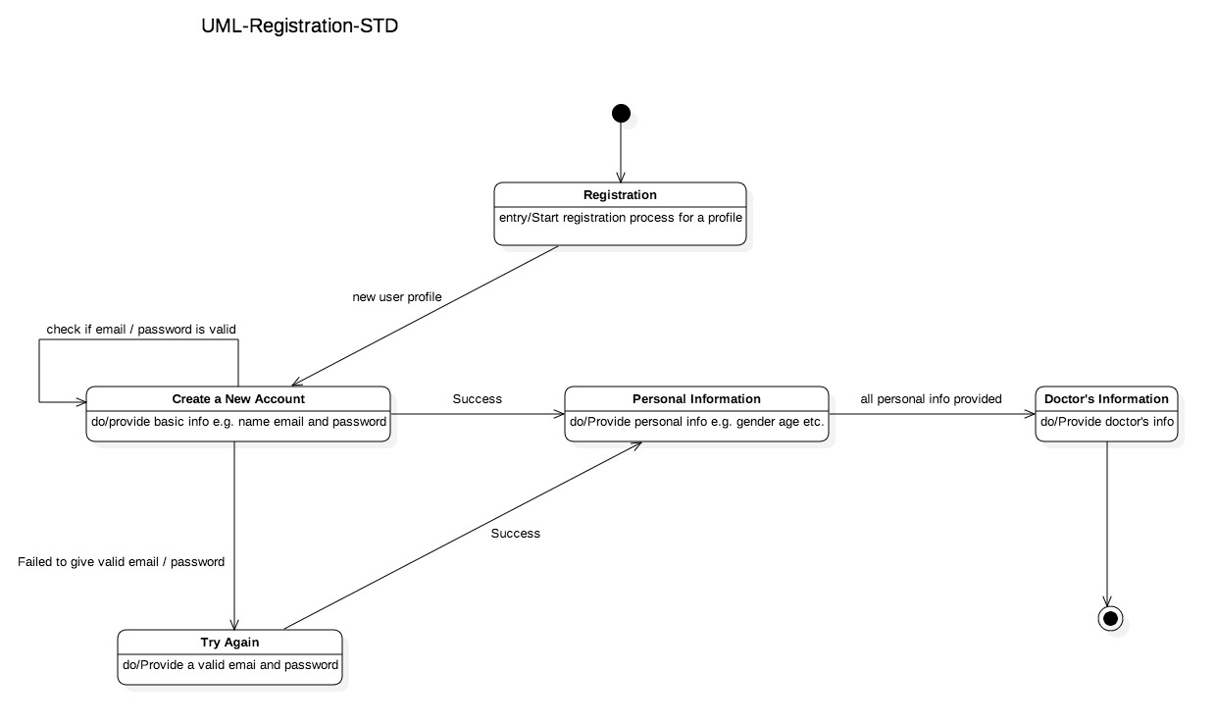
Registration State Transition Diagram

Slide 12
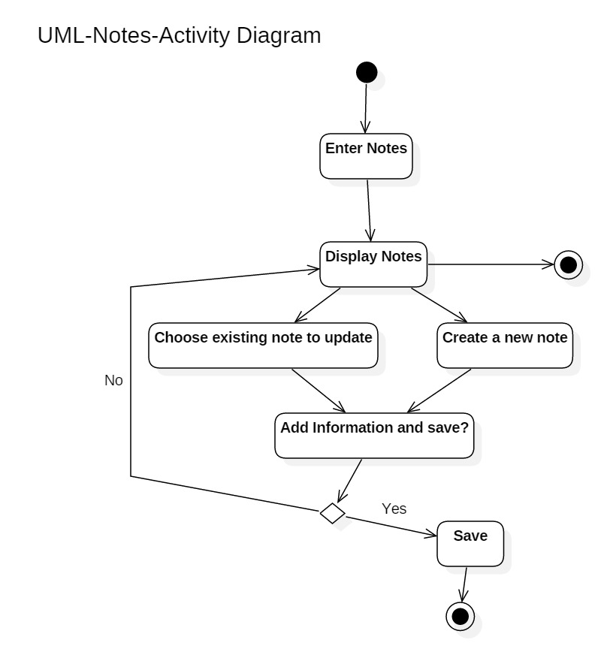
Notes Activity Diagram

Slide 13
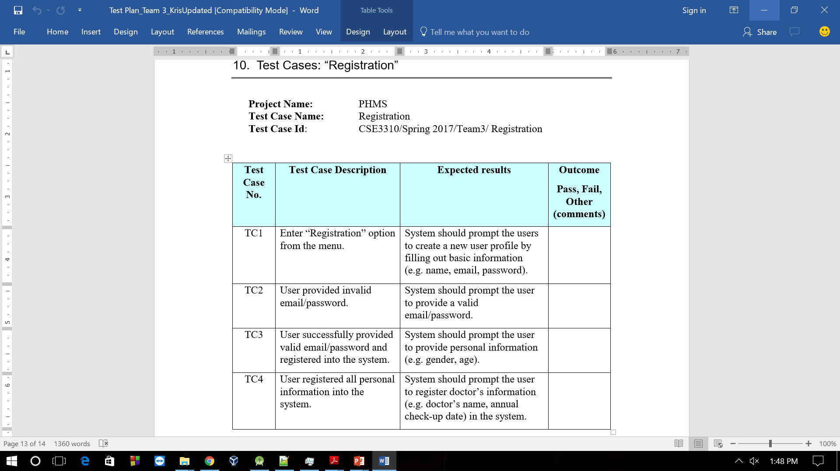
Test Cases

Slide 14
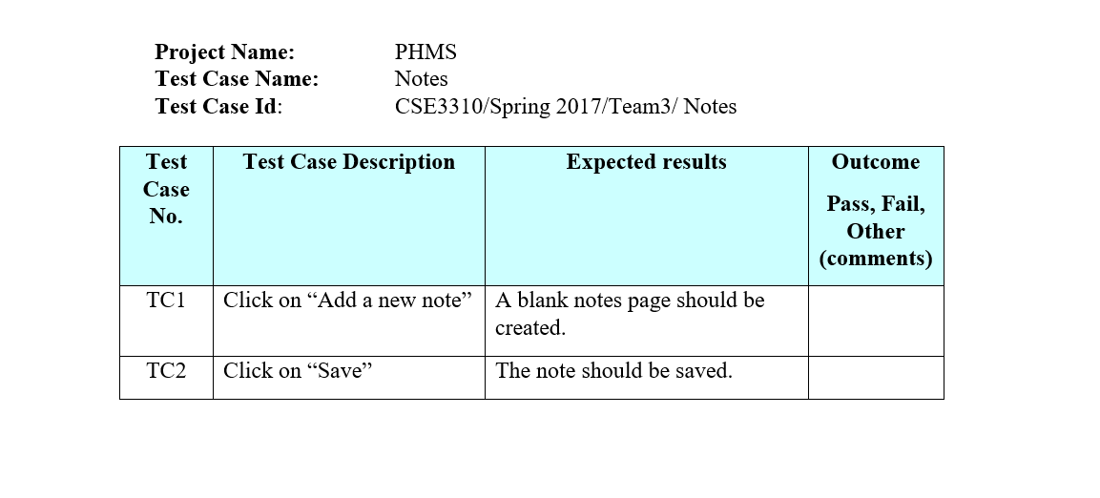
Test Case: “Notes”

Slide 15
Demo

Slide 16
Questions?

