Slide 1
P.H.M.S Personal Health Monitoring System
Prapti Bhaukajee
Saja Abualfoul
Kristoffer Edgard Jorge-Munoz
MD Ibrahim Khalil
Team 3

Slide 2
Content
What is PHMS?
Business Objectives
System Objectives
Project Objectives
Assumptions and Constraints

Slide 3
Content
Project Context
UML Diagram
Test cases
Demo
Questions

Slide 4
What is PHMS?
Is an android application that will help users maintain different personal health-related data. The PHMS application will be used to keep track of one’s vital signs, daily medicine intake, or following a diet regiment.
Only people older than 18 can use this product

Slide 5
Business Objectives
The functionalities that we have implemented:
▶ Registration
▶ Vital Signs
▶ Medication
▶ Diet
▶ Notes
▶ Search

Slide 6
System Objectives
System is an Android application
IDE used is Android Studio
XML is used for user interface
System is using Java for the programming language.

Slide 7
Project Objectives
To build an app that can help you keep track of your health status and to help you stay healthy.

Slide 8
Assumptions and Constraints
Assumptions:
Only people older than 18 years old are allowed to use this product.
Constraints:
Team lacks android development skills
Schedule was very aggressive

Slide 9
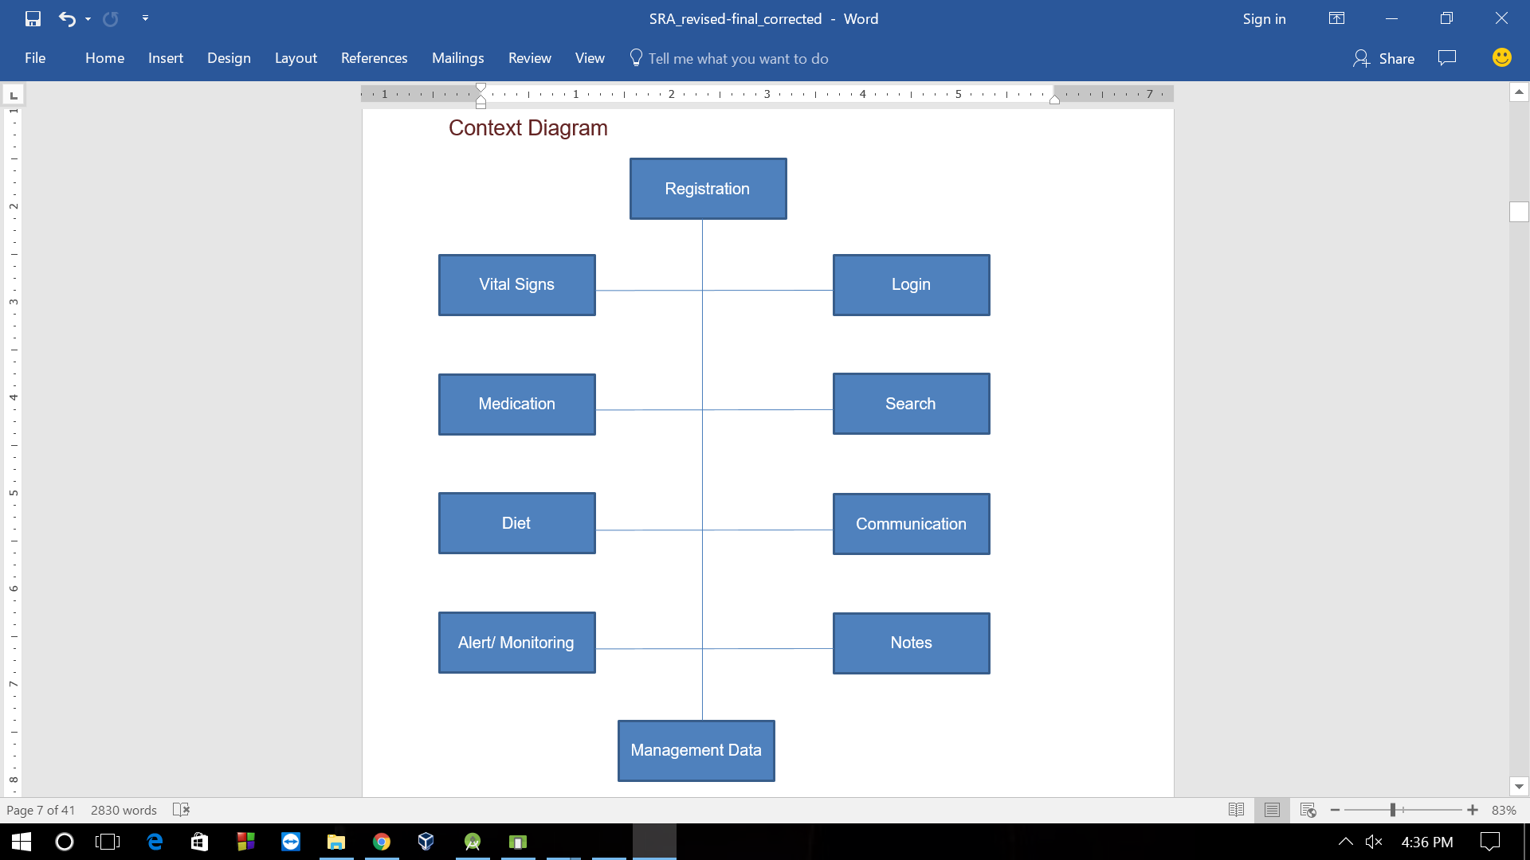
Project Context
PHMS Context Diagram

Slide 10
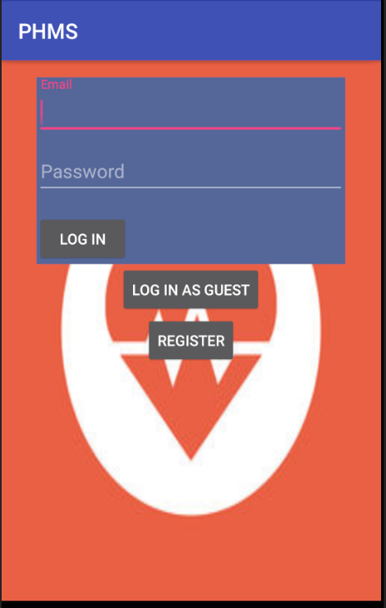
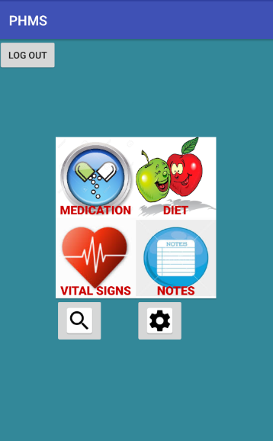
Mockup
LOGIN SCREEN
HOME SCREEN

Slide 11
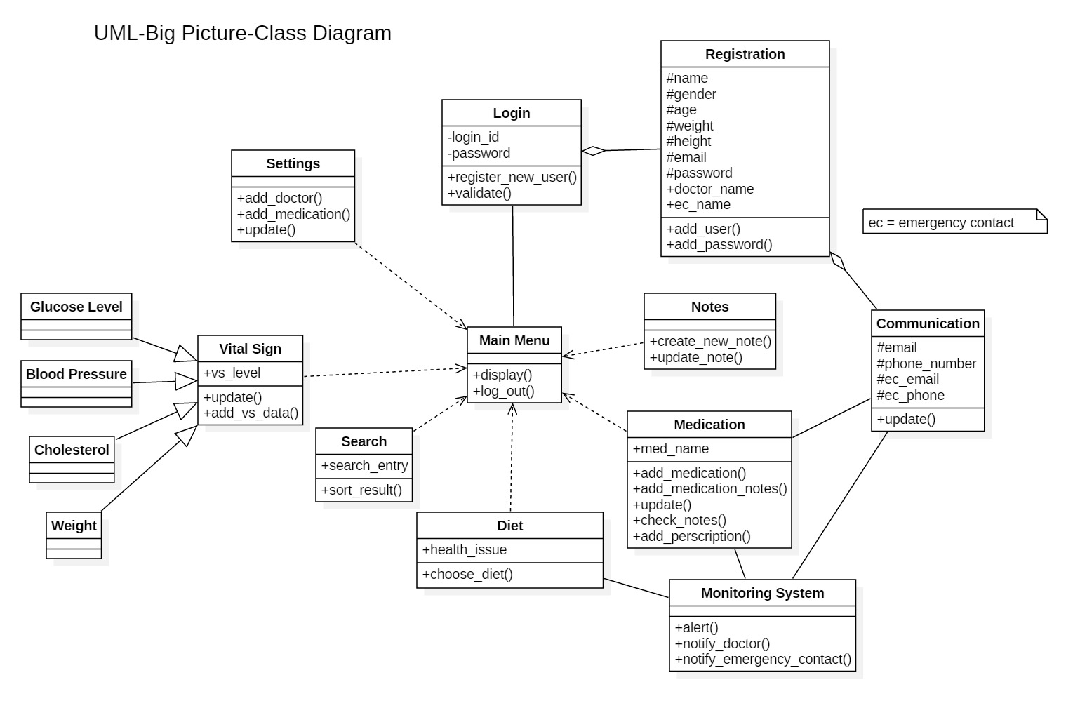
UML diagrams

Slide 12
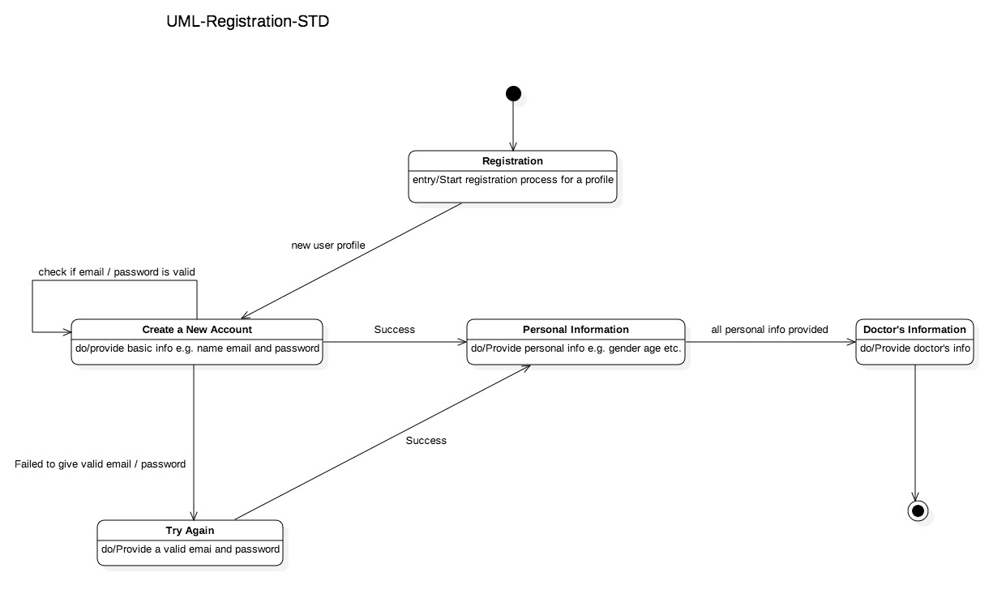
Registration State Transition Diagram

Slide 13
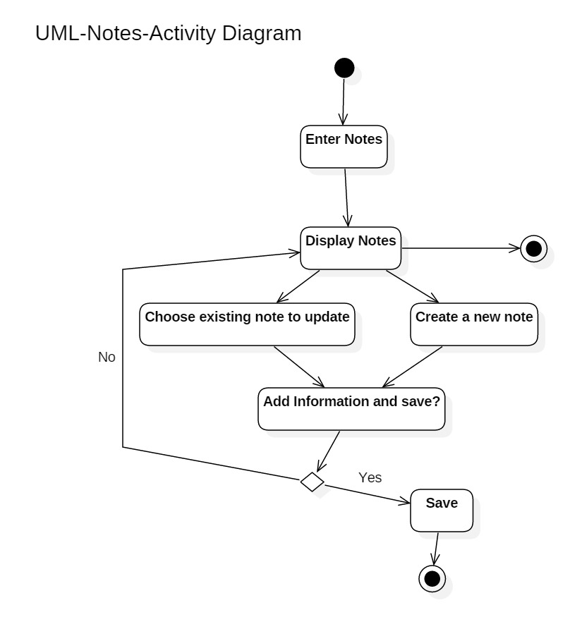
Notes Activity Diagram

Slide 14
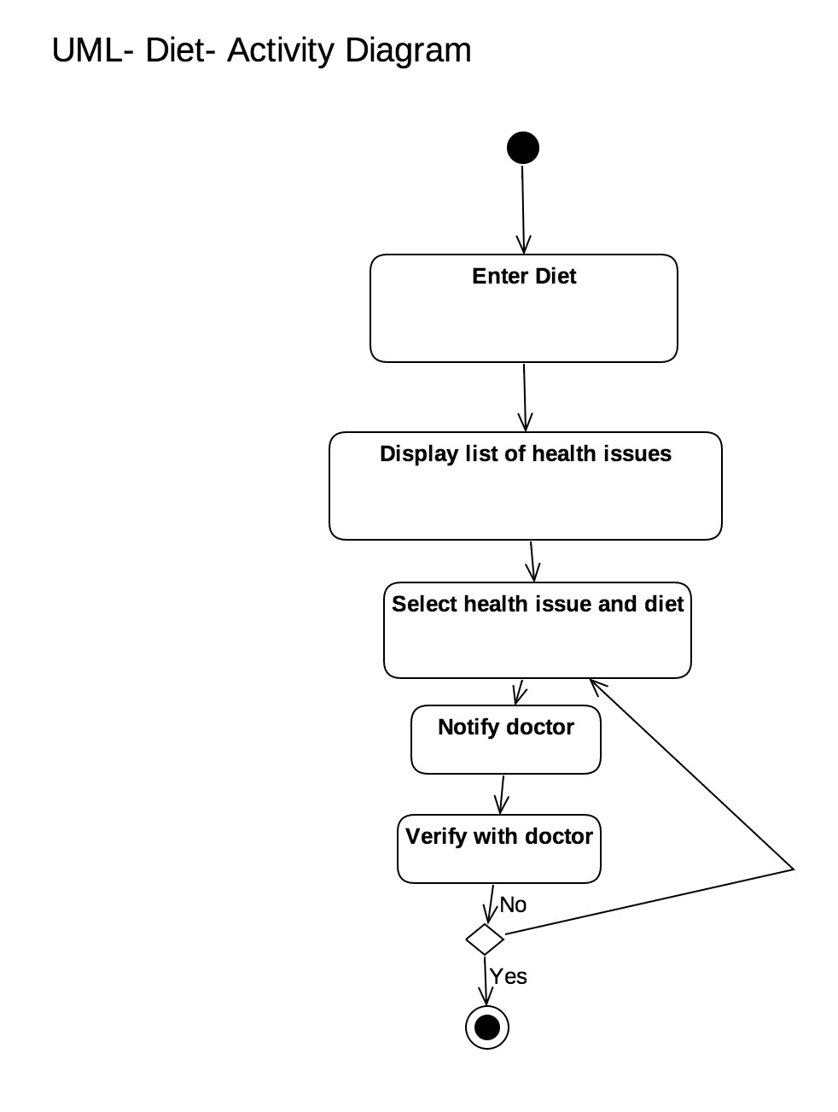
Diet

Slide 15
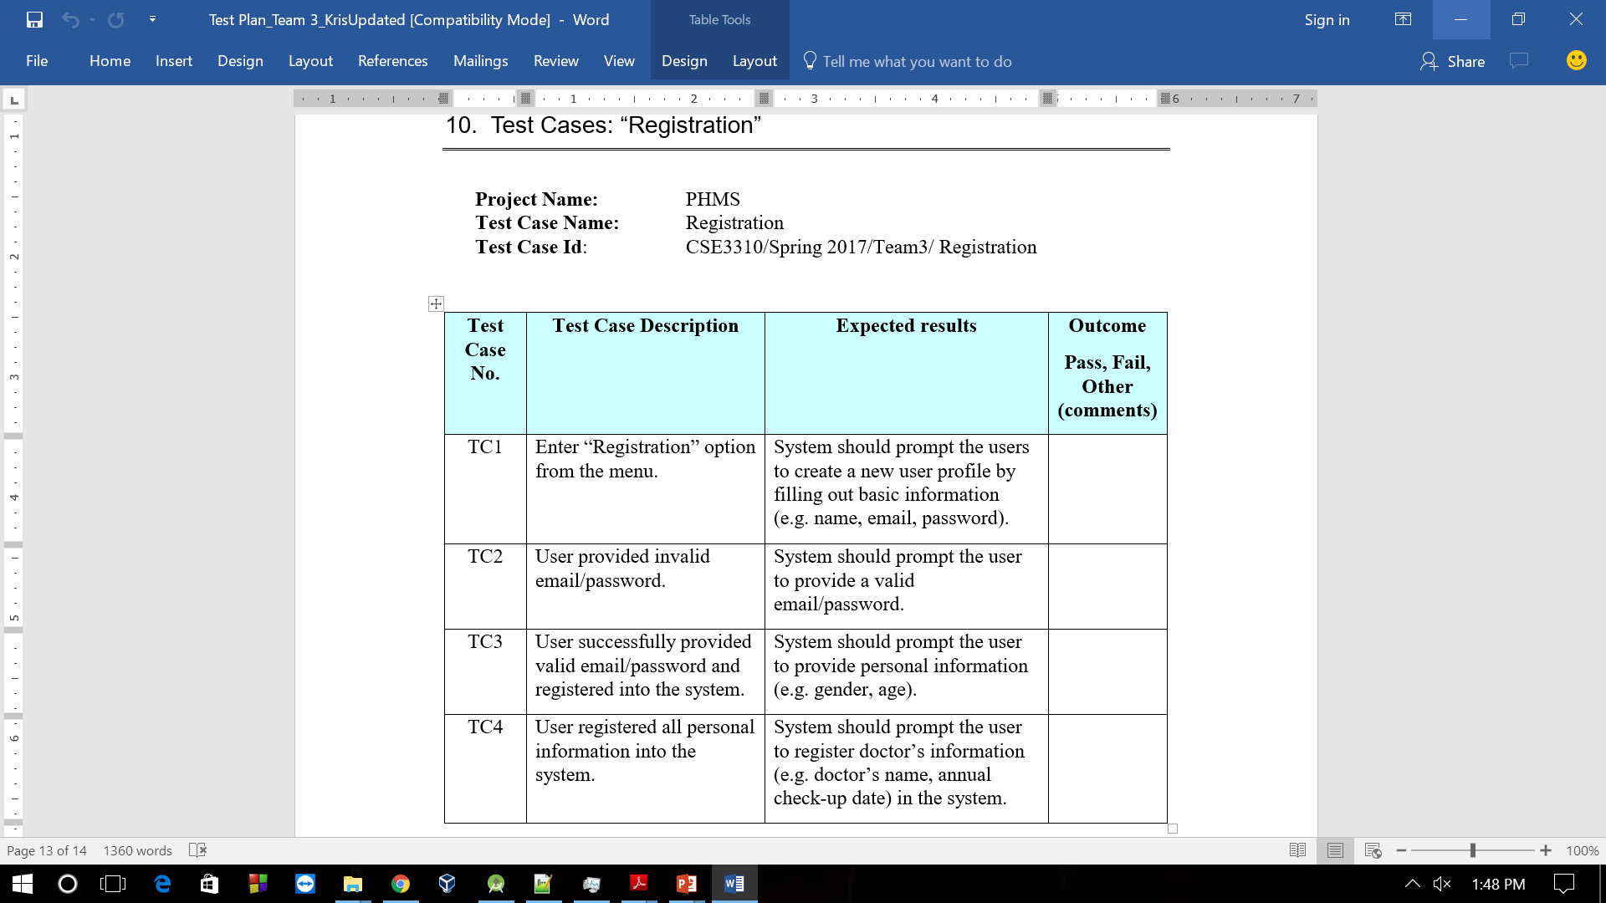
Test Cases: “Registration”

Slide 16
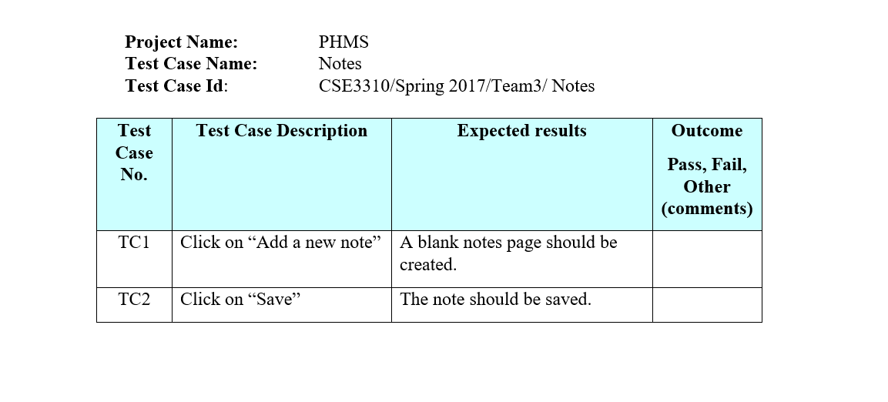
Test Case: “Notes”

Slide 17
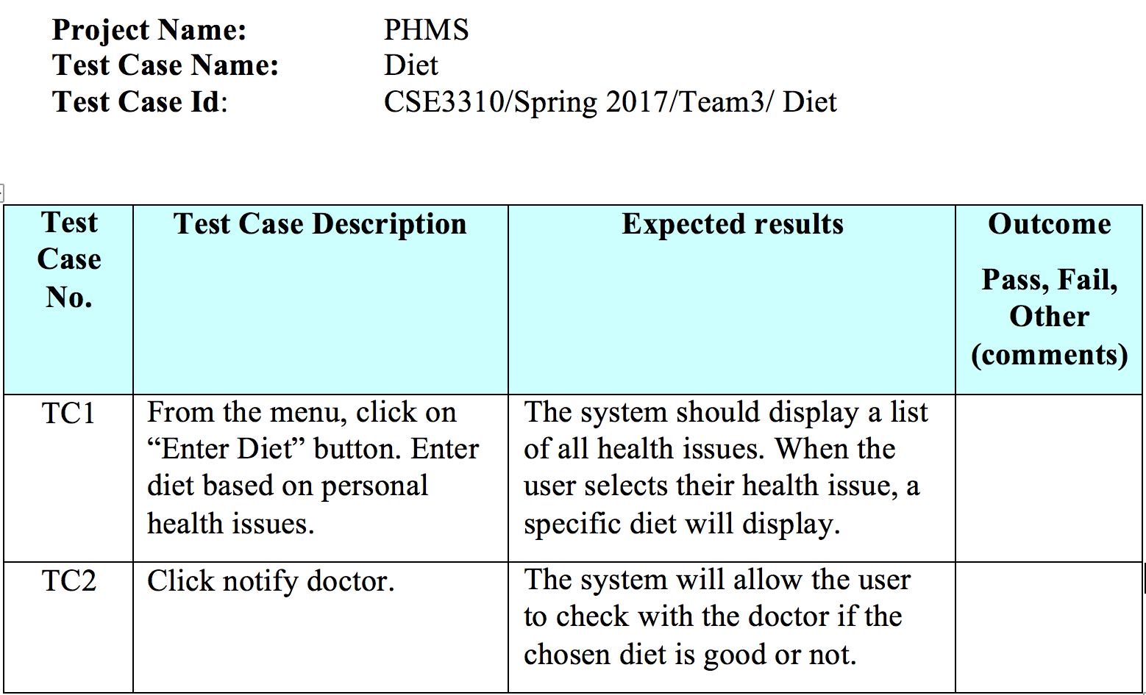
Test Case: “Diet”

Slide 18
Demo

Slide 19
Questions?

