Slide 1
When the not-so-smart manipulation of smart pointers kills performance
Fred Suter, Henri Casanova
ERROR 2023 – 3rd Workshop on
E-science ReseaRch leading tO negative Results
Limassol, Cyprus
October 10, 2023

Slide 2

SimGrid – A scientific instrument on your laptop
https://simgrid.org
Open Project since 1998
2,100+ citations and 500+ usages
Key strengths
Usability: Fast, Reliable, User-oriented APIs
Validated performance models: Predictive Power
Versatility: Grid, P2P, HPC, Cloud, Fog, …
SimGrid’s fundamental concepts
Actors
Activities
Resources
Execute user-provided functions
Program anything you want/need
Computation, communication, I/O
Synchro mechanisms
CPUs, Links, Disks
Hosts, VMs, Netzones, …
Mailboxes
Rendez-vous points between actors

Slide 3
Observed performance issues
Distributed storage for High Energy Physics
Complex simulator
Developed in Wrench
Blamed that simulator
Comparison between SimGrid versions
For a paper summarizing 10 years of dev
v3.10 (11/2013) vs. v3.34 (06/2023)
Simple Coordinator-Worker scheme
Cannot blame anyone else!!!
v3.34 scales very poorly

Slide 4
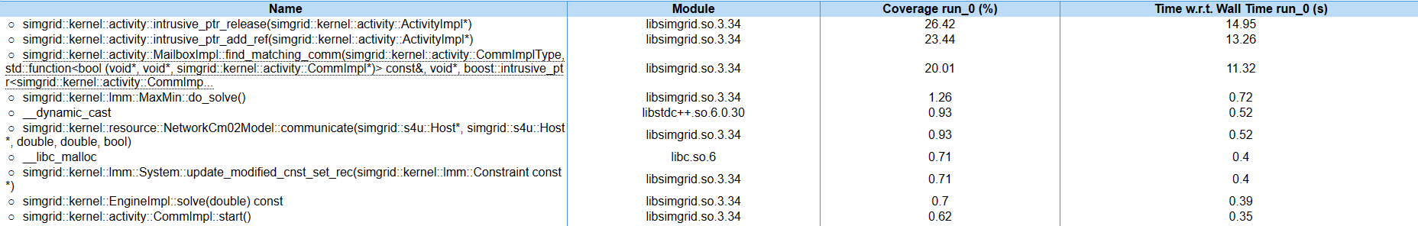
The investigation begins!
Determine which functions are the performance bottlenecks
Refcount management of smart pointers
Matching of simulated communications
Determine which release introduced the performance loss
Build docker of releases since 3.10*
Identify 3.16 as the problem (06/2017)
Version | Simulation time
3.10 | 51.42s
3.14 | 28.39s
3.15 | 29.07s
3.16 | 203.45s
3.20 | 160.78s
3.34 | 158.23
(*) https://github.com/henricasanova/master_worker_flashback

Slide 5
Analyzing the sources
Smart pointers
v3.16 introduces the use of boost::intrusive_ptr
Store a pointer to an object with an embedded reference count
New instance increments the refcount, when refcount becomes 0, object is destroyed
Used for almost all simulated objects
In particular for the kernel implementation of Activities (Computation, Communication, I/O)
Matching simulated comms
Only 2-sided activity: sender and receiver using a common mailbox
Each creates a distinct Comm object and tries to find a match in the mailbox
Each mailbox stores pending and unmatched comms in a queue
Once matched, one of the two Comm objects is deleted

Slide 6
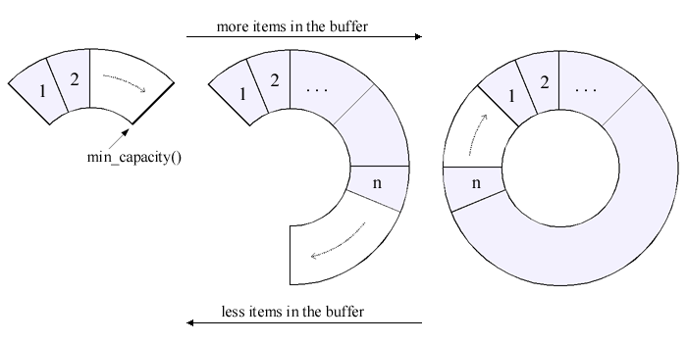
Here comes the not-so-smart choice!
Data structure to store pending/unmatched Comms
Potentially large number of objects to store
Many communications
Asynchronous communications
Let’s use a fancy optimized data structure
boost::circular_buffer_space_optimized seems smart!!
But … there is a catch …
When we remove a matched comm …
It can be at any position …
Elements are shifted to keep them contiguous …
And moving smart pointers messes with their refcount …
Again and again!!!
Let’s use a not-smart std::list, duh!
(it’s a 2-line fix)

Slide 7
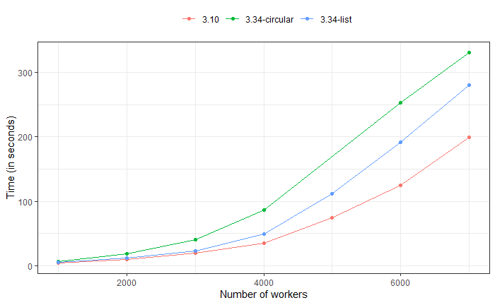
Impact of changing the underlying data structure

Slide 8
Takeaway messages
Mixing advanced objects and data structures
Advantages can be clear and choices well motivated
For each object/data structure … individually
But the interplay of these choices has to be carefully thought
At least more than we did in this particular case!
Importance of performance regression testing
CI/CD is good to detect introduction of bugs
Measuring impact on performance is more difficult
And can be overlooked

