Slide 1

Unit-3
Windows Functions and CTE
T-SQL Querying
# 2501CS302
Prof. Deep C. Padaliya
Computer Engineering Department
deep.padaliya@darshan.ac.in
+91 - 98981 88771 (CSE Department)

Slide 2

Looping
Outline
  Window Function
  Partition By
  Common Table Expression
  COALESCE()
  ISNULL()
  Temporary Table
  Exists

Slide 3
Windows Functions

Slide 4
What is Window Functions ?
Window functions perform calculations on a group of rows.
They do not combine rows like GROUP BY.
Original rows remain visible in output.
Used with OVER() clause.
Window functions help in ranking, calculations, comparisons, and analyzing data without combining rows.

Slide 5
Types of Window Function
Aggregate Window Functions
  SUM(), AVG(), COUNT(), MIN(), MAX()
Ranking Functions
  ROW_NUMBER(), RANK(), DENSE_RANK(), NTILE()
Value / Analytical Functions
  LAG(), LEAD(), FIRST_VALUE(), LAST_VALUE()

Slide 6

Ranking Functions
Ranking functions are used to assign position or rank to records based on values like marks, salary, SPI, etc.
They are very useful in reports, analysis, and top/bottom record queries.
ORDER BY is compulsory in ranking functions.
Easy way to find first, second, or nth highest value.
Types of Ranking Functions
  ROW_NUMBER()
  RANK()
  DENSE_RANK()
  NTILE()

Slide 7
Ranking Functions – Row Number
Gives unique number to each row.
Duplicate values get different numbers.
What is ROW_NUMBER() ?
RollNo | Name | Branch | SPI | Row_Number
101 | Jay | Computer | 9.90 | 1
103 | Riya | Computer | 9.80 | 2
104 | Rahul | Mechanical | 8.70 | 3
105 | Mayank | Mechanical | 8.00 | 4
106 | Vishal | Computer | 7.00 | 5
102 | Akhil | Civil | 7.00 | 6
107 | Hetvi | Civil | 6.00 | 7

Slide 8
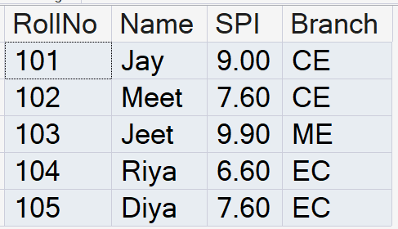

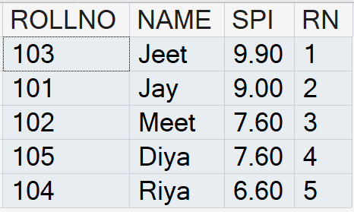
Ranking Functions – Row Number
TABLE: STUDENT
Syntax:
SELECT
COLUMN1,
COLUMN2,
ROW_NUMBER() OVER (ORDER BY COLUMN_NAME) AS ALIAS
FROM TABLENAME;
E.g. Write a query to assign a unique number to each row based on SPI.
SELECT
ROLLNO,
NAME,
SPI,
ROW_NUMBER() OVER (ORDER BY SPI DESC) AS RN
FROM STUDENT;

Slide 9
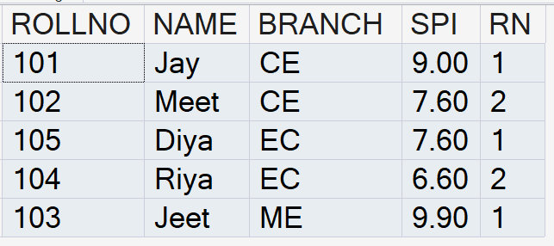
Ranking Functions – Row Number with Partition By
E.g. Write a query to assign a branch wise unique number to each
row based on SPI.
TABLE: STUDENT
  SELECT
  ROLLNO,
  NAME,
  BRANCH,
  SPI,
  ROW_NUMBER() OVER
  (
  PARTITION BY BRANCH
  ORDER BY SPI DESC
  ) AS RN
  FROM STUDENT;

Slide 10
Ranking Functions – Rank
Used to give ranking to rows.
Same values get same rank.
Next rank is skipped after duplicate values.
What is RANK() ?
RollNo | Name | Branch | SPI | RANK
101 | Jay | Computer | 9.90 | 1
103 | Riya | Computer | 9.80 | 2
104 | Rahul | Mechanical | 8.70 | 3
105 | Mayank | Mechanical | 8.00 | 4
106 | Vishal | Computer | 7.00 | 5
102 | Akhil | Civil | 7.00 | 5
107 | Hetvi | Civil | 6.00 | 7

Slide 11
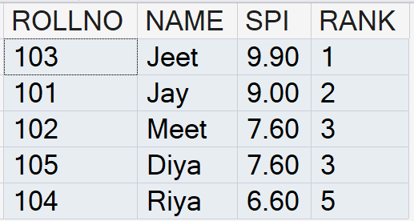
Ranking Functions – Rank
Syntax:
TABLE: STUDENT
SELECT
COLUMN1,
COLUMN2,
RANK() OVER (ORDER BY COLUMN_NAME) AS ALIAS
FROM TABLENAME;
E.g. Write a query to assign a Rank to each row based on SPI.
SELECT
ROLLNO,
NAME,
SPI,
RANK() OVER (ORDER BY SPI DESC ) AS [RANK]
FROM STUDENT;

Slide 12
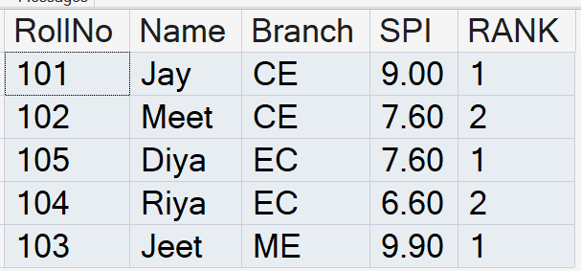
Ranking Functions – Rank with Partition By
E.g. Write a query to assign a branch wise Rank to each row based on SPI.
TABLE: STUDENT
  SELECT
  ROLLNO,
  NAME,
  BRANCH,
  SPI,
  RANK() OVER
  (
  PARTITION BY BRANCH
  ORDER BY SPI DESC
  ) AS [RANK]
  FROM STUDENT;

Slide 13
Ranking Functions – Dense Rank
Used to give ranking to rows.
Same values get same rank but no rank is skipped.
What is DENSE RANK() ?
RollNo | Name | Branch | SPI | DENSE_RANK
101 | Jay | Computer | 9.90 | 1
103 | Riya | Computer | 9.80 | 2
104 | Rahul | Mechanical | 8.70 | 3
105 | Mayank | Mechanical | 8.00 | 4
106 | Vishal | Computer | 7.00 | 5
102 | Akhil | Civil | 7.00 | 5
107 | Hetvi | Civil | 6.00 | 6

Slide 14
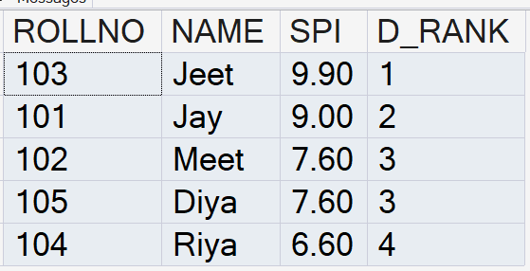
Ranking Functions – Dense Rank
Syntax:
TABLE: STUDENT
SELECT
COLUMN1,
COLUMN2,
DENSE_RANK() OVER (ORDER BY COLUMN_NAME) AS ALIAS
FROM TABLENAME;
E.g. Write a query to assign a Dense Rank to each row based on SPI.
SELECT
ROLLNO,
NAME,
SPI,
DENSE_RANK() OVER ( ORDER BY SPI DESC) AS D_RANK
FROM STUDENT;

Slide 15
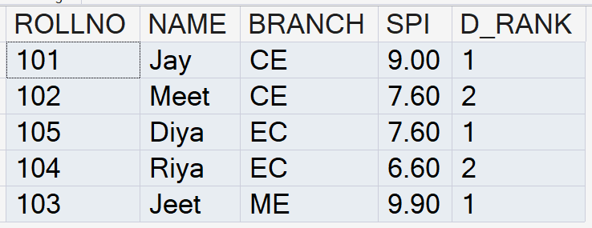
Ranking Functions – Dense Rank with Partition By
E.g. Write a query to assign a branch wise Rank to each row based on SPI.
TABLE: STUDENT
  SELECT
  ROLLNO,
  NAME,
  BRANCH,
  SPI,
  DENSE_RANK() OVER
  (
  PARTITION BY BRANCH
  ORDER BY SPI DESC
  ) AS D_RANK
  FROM STUDENT;

Slide 16
Exercise: Ranking Functions
Display employee details with salary-wise numbering.
Display employee details with salary ranking.
Display employee details with continuous salary ranking.
Display employee details with department-wise numbering.
Display employee details with department-wise salary ranking.
EMPID | NAME | DEPT | SALARY
101 | Jay | HR | 8000
102 | Meet | Admin | 7000
103 | Jeet | Admin | 9000
104 | Riya | HR | 6000
105 | Diya | Admin | 9000
106 | Vishal | HR | 8000

Slide 17
Ranking Function - NTILE
NTILE() is a ranking function used to divide rows into equal groups.
It distributes rows into a specified number of partitions or buckets.
If total rows are odd, some groups may contain one extra row.
RollNo | Name | Branch | SPI | GROUP
101 | Jay | Computer | 9.90 | 1
103 | Riya | Computer | 9.80 | 1
104 | Rahul | Mechanical | 8.70 | 1
105 | Mayank | Mechanical | 8.00 | 1
106 | Vishal | Computer | 7.00 | 2
102 | Akhil | Civil | 7.00 | 2
107 | Hetvi | Civil | 6.00 | 2

Slide 18
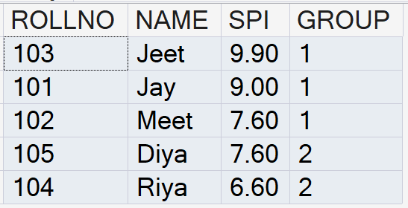
Ranking Functions – NTILE
Syntax:
TABLE: STUDENT
SELECT
COLUMN1,
COLUMN2,
NTILE(NO. OF GROUP) OVER (ORDER BY COLUMN_NAME) AS ALIAS
FROM TABLENAME;
E.g. Write a query to assign a Dense Rank to each row based on SPI.
SELECT
ROLLNO,
NAME,
SPI,
NTILE(2) OVER ( ORDER BY SPI DESC) AS [GROUP]
FROM STUDENT;

Slide 19
Value / Analytical Functions
Value window functions are used to access values from other rows without joining tables.
They are very useful in reports, analysis, and top/bottom record queries.
They help in comparing current row values with previous, next, first, or last rows.
Types of Ranking Functions
  LAG()
  LEAD()
  FIRST_VALUE()
  LAST_VALUE()

Slide 20
Value / Analytical Functions - LAG
LAG() is a value window function used to access the previous row value without using self join.
It helps compare the current row with the previous row.
What is LAG() ?
RollNo | Name | Branch | SPI | Previous_SPI
107 | Hetvi | Civil | 6.00 | NULL
106 | Vishal | Computer | 7.00 | 6.00
102 | Akhil | Civil | 7.00 | 7.00
105 | Mayank | Mechanical | 8.00 | 7.00
104 | Rahul | Mechanical | 8.70 | 8.00
103 | Riya | Computer | 9.80 | 8.70
101 | Jay | Computer | 9.90 | 9.80

Slide 21
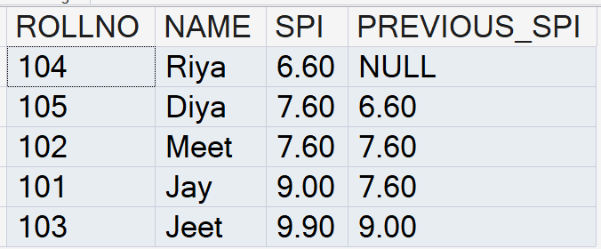
Value / Analytical Functions - LAG
Syntax:
TABLE: STUDENT
SELECT
COLUMN1,
COLUMN2,
LAG(COLUMN NAME) OVER (ORDER BY COLUMN_NAME) AS ALIAS
FROM TABLENAME;
E.g. Display students’ SPI along with previous students SPI.
SELECT
ROLLNO,
NAME,
SPI,
LAG(SPI) OVER ( ORDER BY SPI) AS PREVIOUS_SPI
FROM STUDENT;

Slide 22
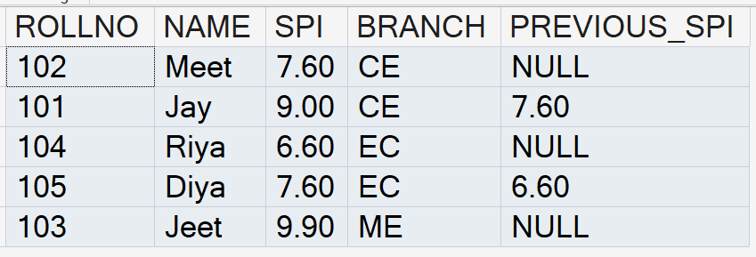
Value / Analytical Functions - LAG
E.g. Display branch wise students’ SPI along with previous students SPI.
TABLE: STUDENT
  SELECT
  ROLLNO,
  NAME,
  SPI,
  BRANCH,
  LAG(SPI) OVER
  (
  PARTITION BY BRANCH
  ORDER BY SPI
  ) AS PREVIOUS_SPI
  FROM STUDENT;

Slide 23
Value / Analytical Functions - LEAD
LEAD() is a value window function used to access the next row value without using self join.
It helps compare the current row with the next row.
What is LEAD() ?
RollNo | Name | Branch | SPI | NEXT_SPI
107 | Hetvi | Civil | 6.00 | 7.00
106 | Vishal | Computer | 7.00 | 7.00
102 | Akhil | Civil | 7.00 | 8.00
105 | Mayank | Mechanical | 8.00 | 8.70
104 | Rahul | Mechanical | 8.70 | 9.80
103 | Riya | Computer | 9.80 | 9.90
101 | Jay | Computer | 9.90 | NULL

Slide 24
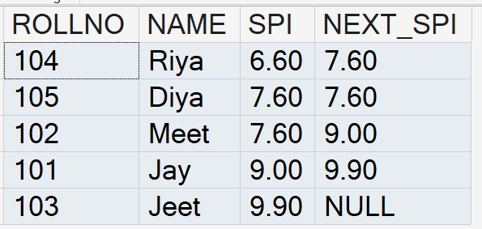
Value / Analytical Functions - LEAD
Syntax:
TABLE: STUDENT
SELECT
COLUMN1,
COLUMN2,
LEAD(COLUMN NAME) OVER (ORDER BY COLUMN_NAME) AS ALIAS
FROM TABLENAME;
E.g. Display students’ SPI along with next students SPI.
SELECT
ROLLNO,
NAME,
SPI,
LEAD(SPI) OVER ( ORDER BY SPI) AS NEXT_SPI
FROM STUDENT;

Slide 25
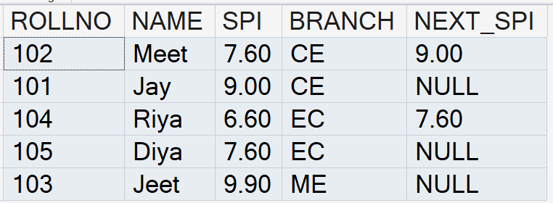
Value / Analytical Functions - LAG
E.g. Display branch wise students’ SPI along with next
students SPI.
TABLE: STUDENT
  SELECT
  ROLLNO,
  NAME,
  SPI,
  BRANCH,
  LEAD(SPI) OVER
  (
  PARTITION BY BRANCH
  ORDER BY SPI
  ) AS NEXT_SPI
  FROM STUDENT;

Slide 26
Value / Analytical Functions – First Value
FIRST_VALUE() returns the first value from the result set based on the sorting order.
It shows the same first value for all rows.
What is FIRST_VALUE () ?
RollNo | Name | Branch | SPI | FIRST_VALUE
107 | Hetvi | Civil | 6.00 | 6.00
106 | Vishal | Computer | 7.00 | 6.00
102 | Akhil | Civil | 7.00 | 6.00
105 | Mayank | Mechanical | 8.00 | 6.00
104 | Rahul | Mechanical | 8.70 | 6.00
103 | Riya | Computer | 9.80 | 6.00
101 | Jay | Computer | 9.90 | 6.00

Slide 27
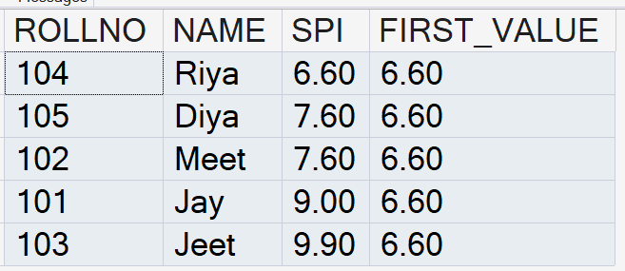
Value / Analytical Functions – First Value
Syntax:
TABLE: STUDENT
SELECT
COLUMN1,
COLUMN2,
FIRST_VALUE(COLUMN NAME) OVER (ORDER BY COLUMN_NAME)
AS ALIAS
FROM TABLENAME;
E.g. Display students’ SPI along with First Value of SPI.
SELECT
ROLLNO,
NAME,
SPI,
FIRST_VALUE(SPI) OVER (ORDER BY SPI ) AS FIRST_VALUE
FROM STUDENT;

Slide 28
Value / Analytical Functions – Last Value
LAST_VALUE() returns the last value from the result set based on the sorting order.
It shows the same last value for all rows.
What is LAST_VALUE() Function ?
RollNo | Name | Branch | SPI | LAST_VALUE
107 | Hetvi | Civil | 6.00 | 9.90
106 | Vishal | Computer | 7.00 | 9.90
102 | Akhil | Civil | 7.00 | 9.90
105 | Mayank | Mechanical | 8.00 | 9.90
104 | Rahul | Mechanical | 8.70 | 9.90
103 | Riya | Computer | 9.80 | 9.90
101 | Jay | Computer | 9.90 | 9.90

Slide 29
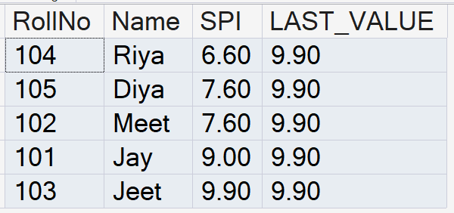
Value / Analytical Functions – Last Value
E.g. Display students’ SPI along with last value of SPI.
TABLE: STUDENT
SELECT
ROLLNO,
NAME,
SPI,
LAST_VALUE(SPI) OVER
(
ORDER BY SPI
ROWS BETWEEN UNBOUNDED PRECEDING
AND UNBOUNDED FOLLOWING
) AS LAST_VALUE
FROM STUDENT;

Slide 30
Common Table Expression (CTE)

Slide 31
Common Table Expression (CTE)
A CTE (Common Table Expression) is a temporary named result set created using the WITH keyword.
It exists only for the duration of a single SQL statement.
It helps write cleaner, more readable, and reusable queries.
It is not permanently stored in the database.

Slide 32
Key Advantages of Common Table Expression (CTE)
Improves Readability – Breaks complex queries into smaller, meaningful parts.
Simplifies Complex Queries – Reduces the need for deeply nested subqueries.
Easy to Maintain – Query logic is organized and easier to modify.
Better Debugging – Makes it easier to identify and fix errors in complex SQL statements.
Reduces Code Duplication – Avoids repeating the same subquery multiple times.
Reusable Within a Query – A CTE can be referenced multiple times in the same SQL statement.

Slide 33
Key Advantages of Common Table Expression (CTE)
Syntax:
  WITH CTE_Name AS
  (
  SELECT column1, column2, ...
  FROM TableName
  WHERE condition
  )
  SELECT column1, column2, ...
  FROM CTE_Name;
CTE Declaration
CTE Definition
Main Query (Using the CTE)

Slide 34
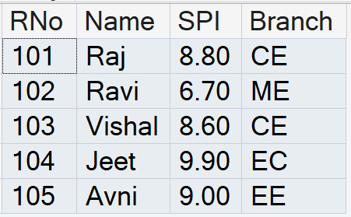
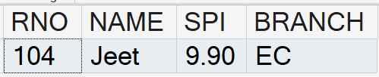
Query - Common Table Expression (CTE)
TABLE: STUDENT
E.g. Display Students details whose SPI greater than 9.
WITH HIGHSPI AS
(
SELECT
RNO,
NAME,
SPI,
BRANCH
FROM STUDENT
WHERE SPI > 9
)
SELECT *
FROM HIGHSPI;

Slide 35
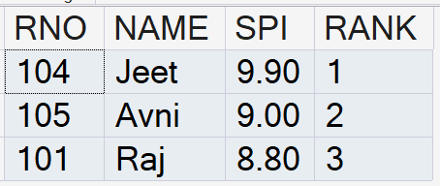
Query - Common Table Expression (CTE)
TABLE: STUDENT
E.g. Display Top 3 Students details based on their SPI.(Use Rank())
WITH STUDENTRANK AS
(
SELECT
RNO,
NAME,
SPI,
RANK() OVER(ORDER BY SPI DESC) AS RANK
FROM STUDENT
)
SELECT *
FROM STUDENTRANK
WHERE RANK_BY_SPI <= 3;

Slide 36
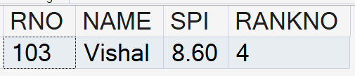
Query - Common Table Expression (CTE)
TABLE: STUDENT
E.g. Display 4th Highest SPI
WITH STUDENTRANK AS
(
SELECT
RNO,
NAME,
SPI,
DENSE_RANK() OVER (ORDER BY SPI DESC)
AS RANKNO
FROM STUDENT
)
SELECT *
FROM STUDENTRANK
WHERE RANKNO = 4;

Slide 37
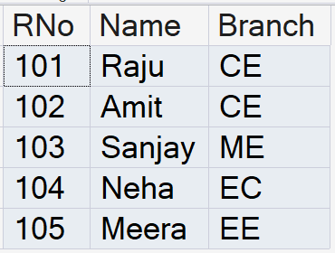
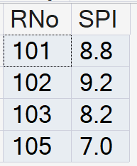
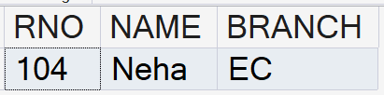
Query - Common Table Expression (CTE)
TABLE: STUDENT
TABLE: RESULT
E.g. Find students who do not have an SPI record.
WITH MISSINGRESULT AS
(
SELECT
S.RNO,
S.NAME,
S.BRANCH
FROM STUDENT S
LEFT JOIN RESULT R
ON S.RNO = R.RNO
WHERE R.RNO IS NULL
)
SELECT *
FROM MISSINGRESULT;

Slide 38
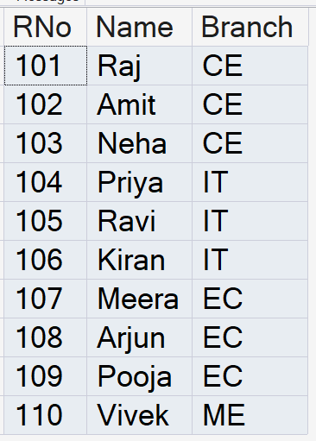
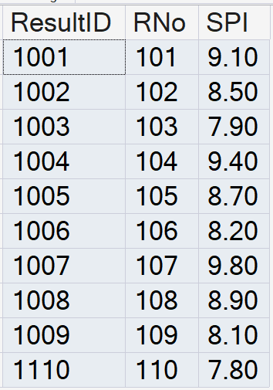
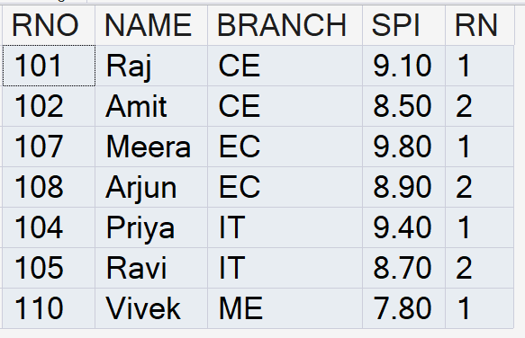
Query - Common Table Expression (CTE)
TABLE: STUDENT
TABLE: RESULT
E.g. Find the top 2 students from each branch.
WITH RANKEDSTUDENTS AS
(
SELECT S.RNO,S.NAME, S.BRANCH,R.SPI,
ROW_NUMBER() OVER
(
PARTITION BY S.BRANCH
ORDER BY R.SPI DESC
) AS RN
FROM STUDENT S
JOIN RESULT R
ON S.RNO = R.RNO
)
SELECT *
FROM RANKEDSTUDENTS
WHERE RN <= 2;

Slide 39
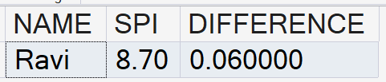
Query - Common Table Expression (CTE)
E.g. Find students whose SPI is closest to the average SPI.
TABLE: RESULT
TABLE: STUDENT
WITH AVGDATA AS
(
SELECT AVG(SPI) AS AVGSPI
FROM RESULT
),
DIFFERENCEDATA AS
(
SELECT S.NAME,R.SPI,
ABS(R.SPI - AVGSPI) AS DIFFERENCE
FROM STUDENT S
JOIN RESULT R
ON S.RNO = R.RNO
CROSS JOIN AVGDATA
)
SELECT TOP 1 * FROM DIFFERENCEDATA
ORDER BY DIFFERENCE;

Slide 40
ISNULL() Function in SQL Server
ISNULL() Function is used to handle NULL values.
If a value is NULL, it replaces it with a given value.
It takes two values:
  Value to check
  Replacement value if it is NULL
Syntax:
ISNULL(VALUE, REPLACEMENT_VALUE)

Slide 41
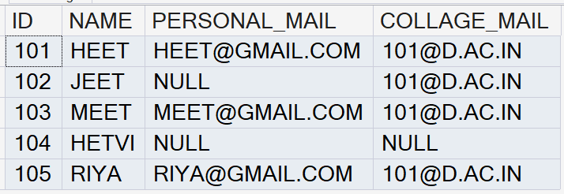
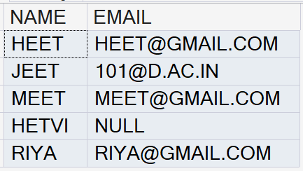
ISNULL() Function in SQL Server
Display the Student Name and Personal Email if the Personal Email is available.
If the Personal Email is not available, display the College Email.
Limitations of ISNULL() Function
It accepts only 2 arguments.
It cannot check multiple alternative values.
TABLE: STUDENT
SELECT NAME, ISNULL(PERSONAL_MAIL,COLLAGE_MAIL) AS EMAIL
FROM STUDENT

Slide 42

COALESCE() Function in SQL Server
COALESCE() is used to handle NULL values.
It checks the given values from left to right.
It returns the first value that is NOT NULL.
If all values are NULL, it returns NULL.
It is commonly used to display a default value when data is missing.
Syntax:
COALESCE(VALUE1, VALUE2, VALUE3, ...)
Example:
SELECT COALESCE(NULL, NULL, 'ABC', 'XYZ');
Output:

Slide 43
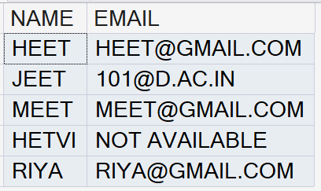
COALESCE() Function in SQL Server
Display the Student Name and Personal Email if the Personal Email is available.
If the Personal Email is not available, display the College Email.
If both emails are not available, display "Email Not Available".
TABLE: STUDENT
SELECT NAME, COALESCE(PERSONAL_MAIL,COLLAGE_MAIL,'NOT AVAILABLE')
FROM STUDENT

Slide 44
Temporary Table

Slide 45
Temporary Table in SQL
A temporary table is used to store data temporarily.
It is mainly used to store intermediate results while working with data.
Temporary tables are stored in TempDB.
They are automatically deleted when they are no longer needed.
They are useful for complex queries and data processing.

Slide 46
Temporary Table in SQL
Types of Temporary Tables
1. Local Temporary Table (#)
Created using a single #.
Available only in the current session.
Example: #TempTable
2. Global Temporary Table (##)
Created using ##.
Can be accessed by multiple sessions.
Example: ##TempTable

Slide 47
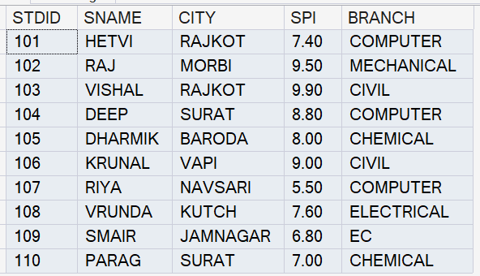
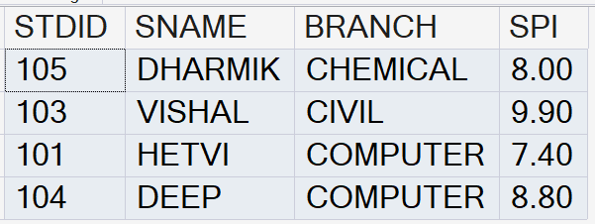
Local Temporary Table (#)
Example: Find students whose SPI is greater than their branch's average SPI.
TABLE: STUDENT
Step 2: Use the Temporary Table
Step 1: Create Temporary Table
SELECT S.STDID, S.SNAME, S.BRANCH, S.SPI
FROM STUDENT S
JOIN #BRANCHAVG B
ON S.BRANCH = B.BRANCH
WHERE S.SPI > B.AVG_SPI;
SELECT BRANCH, AVG(SPI) AS AVG_SPI
INTO #BRANCHAVG
FROM STUDENT
GROUP BY BRANCH;

Slide 48
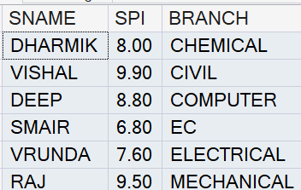
Local Temporary Table (#)
Example: Find Top 1 students from each branch based on their SPI in descending order.
Step 1: Store Branch-wise Ranking in Temporary Table
SELECT SNAME, BRANCH, SPI,
DENSE_RANK() OVER (
PARTITION BY BRANCH
ORDER BY SPI DESC) AS RN
INTO #TopStudents
FROM STUDENT;
OUTPUT
Step 2: Get Top 1 from Each Branch
SELECT SNAME, SPI, BRANCH
FROM #TopStudents
WHERE RN = 1
ORDER BY BRANCH, SPI DESC;

Slide 49
Global Temporary Table (##)
Think of a college placement drive.
Step 1: Create the Global Temporary Table
SELECT *
INTO ##EligibleStudents
FROM STUDENT
WHERE SPI >= 7.5;
Step 2: Placement Team Uses It
SELECT *
FROM ##ELIGIBLESTUDENTS;
Step 3: Interview Team Also Uses It
SELECT SNAME, SPI, BRANCH
FROM ##EligibleStudents;

Slide 50
Exists

Slide 51
EXISTS in SQL Server
EXISTS checks whether at least one record is returned by the subquery.
It returns TRUE when a matching record exists and FALSE when no record exists.
It does not consider the actual values returned by the subquery.
It is commonly used with correlated subqueries to check related records in another table.

Slide 52
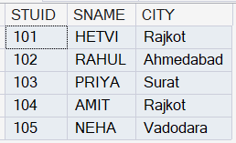
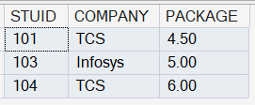
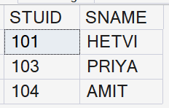
EXISTS in SQL Server (Cont..)
Example: Display students who have been placed.
STUDENT
SELECT S.STUID, S.SNAME
FROM STUDENT S
WHERE EXISTS
(
SELECT 1
FROM PLACEMENT P
WHERE P.STUID = S.STUID
);
PLACEMENT

Slide 53
EXISTS in SQL Server
Why do we write SELECT 1?
Because EXISTS doesn't care about the columns returned.
All of these are logically equivalent for EXISTS:
The purpose is simply: Find out whether at least one row exists.
SELECT 1
SELECT *
SELECT P.STUID

Slide 54
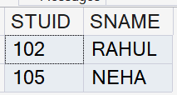
Not EXISTS in SQL Server
Example: Display students who have not been placed.
STUDENT
SELECT S.STUID, S.SNAME
FROM STUDENT S
WHERE NOT EXISTS
(
SELECT 1
FROM PLACEMENT P
WHERE P.STUID = S.STUID
);
PLACEMENT

Slide 55
Thank You

