Slide 1
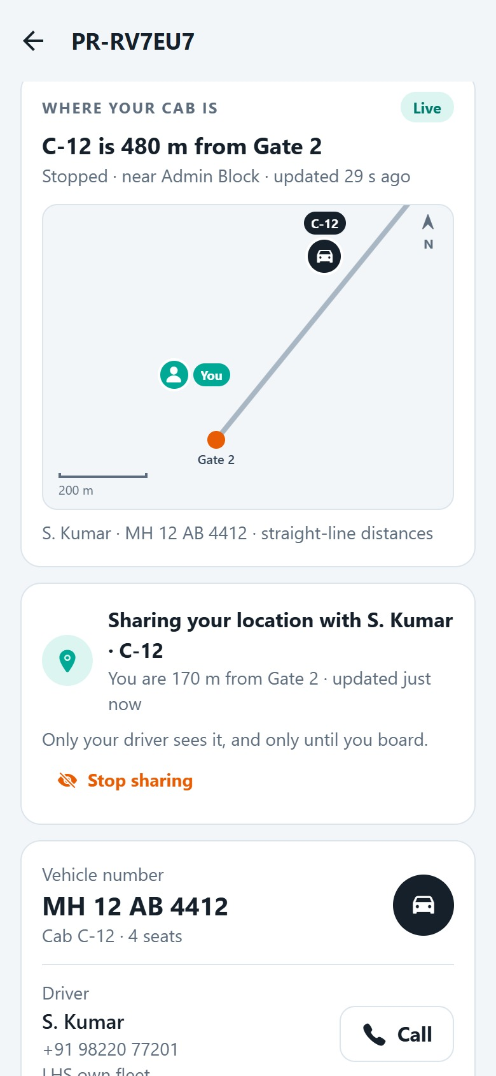
PLANT RIDE · USER JOURNEY ON THE MVP
Rider → Driver journey, screen by screen
One shared ride from Gate 2 to the Blast Furnace, first through the rider’s phone, then through the driver’s.
AR
Rider A. Raghavan · LHS-40218 · Operations · CC-4471
SK
Driver S. Kumar · DRV-2281 · cab C-12 · MH 12 AB 4412
Recorded 1 October 2026 on the running MVP · 30 screens · SRM ECO TECH for LHS
Notes:
One shared ride seen through two phones: A. Raghavan who rides, and S. Kumar who drives cab C-12. Every screen is the running MVP with demo data.

Slide 2
THE JOURNEY AT A GLANCE
Six moments, two phones
1
Shift starts
2
Booking
3
Cab on its way
4
At Gate 2
5
The ride
6
Closing
Signs in; Where to? on the home screen · screens 1–2
Gate 2 → Blast Furnace; C-12 has a seat; matched at once · 3–6
Sees the cab on a map; shares own location · 7–10
Your cab has arrived; shows the OTP · 11
Trip in progress; follows the cab to the drop · 12–13
₹22.86 to CC-4471; rates 5★; alerts · 14–16
AR
Rider
A. Raghavan
Duty check; signs on with C-12; 2 riders waiting · screens 1–4
A third rider joins the queue by itself
Live map of 3 waiting riders; distances, directions · 5–6
Arrival recorded by GPS; boards 3 riders by OTP · 7–9
Drops M. Iyer at Coke Plant; last drop closes the trip · 10–12
Closes duty; GPS km matches the odometer · 13–14
SK
Driver
S. Kumar
Plant Ride · Rider → Driver journey · recorded on the MVP with demo data
2
Notes:
Read down a column to see the same moment on both phones. Screen numbers refer to the rider and driver sections that follow.

Slide 3
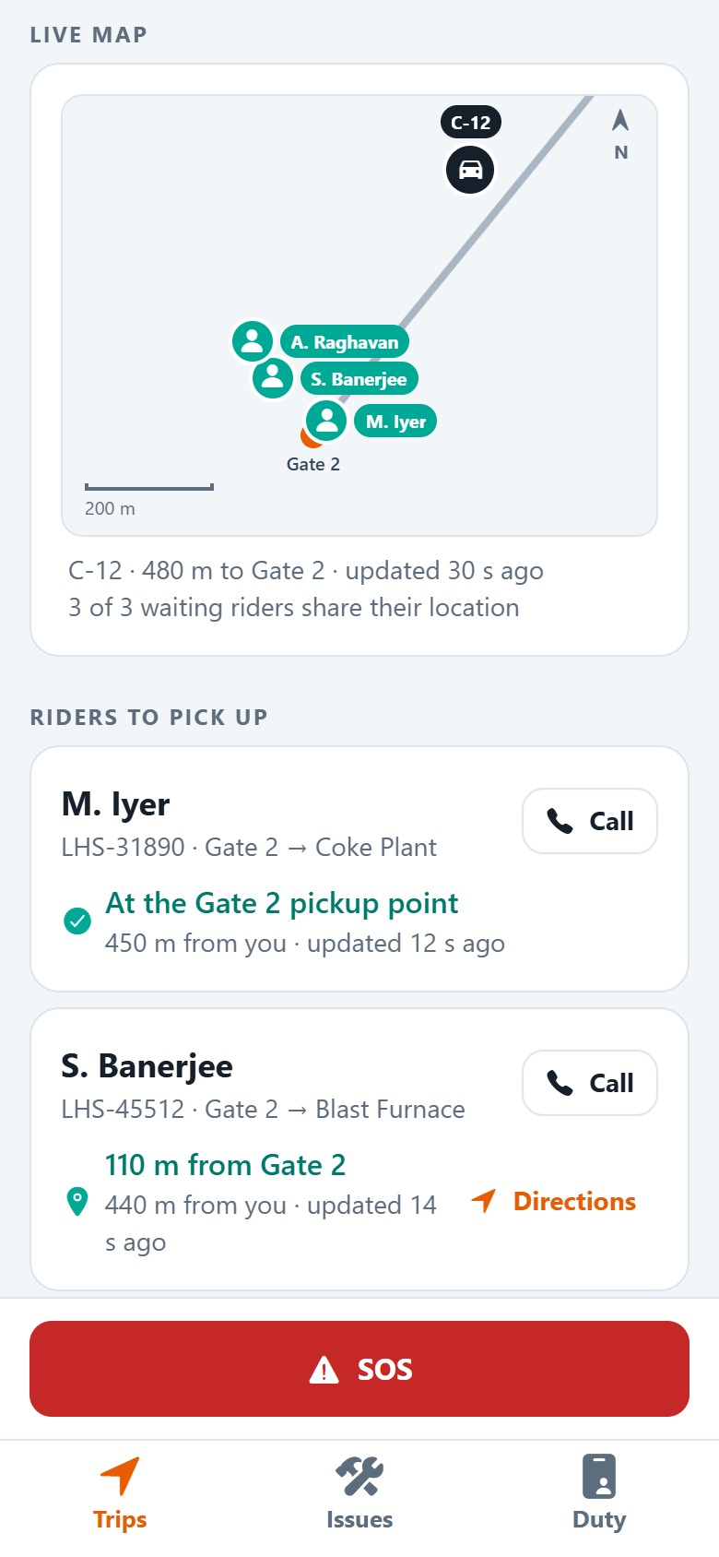
NEW IN THIS BUILD
Live location, both ways
The driver’s phone sends the cab’s position
1
About every 10 seconds on duty, at least every 30 seconds while parked. It drives the riders’ maps and ETAs, and records arrivals inside a stop’s radius.
The rider sees the cab and the driver
2
Distance to the pickup, moving or stopped, nearest stop, how fresh the fix is; the driver’s name, phone, fleet and vehicle.
The driver sees the riders waiting
3
Each rider’s distance from the pickup point and from the cab, with Call and Directions.
Private by design
4
A rider shares only while the cab is on its way, only with that driver, and can stop at any time. The position is deleted at boarding.
Rider · screen 7
Driver · screen 5
Plant Ride · Rider → Driver journey · recorded on the MVP with demo data
3
Notes:
The maps are drawn from coordinates on a schematic of the plant: the plant’s internal roads are not on public maps, and no map key is needed. Fixes more than 5 km from every pickup point are ignored.

Slide 4
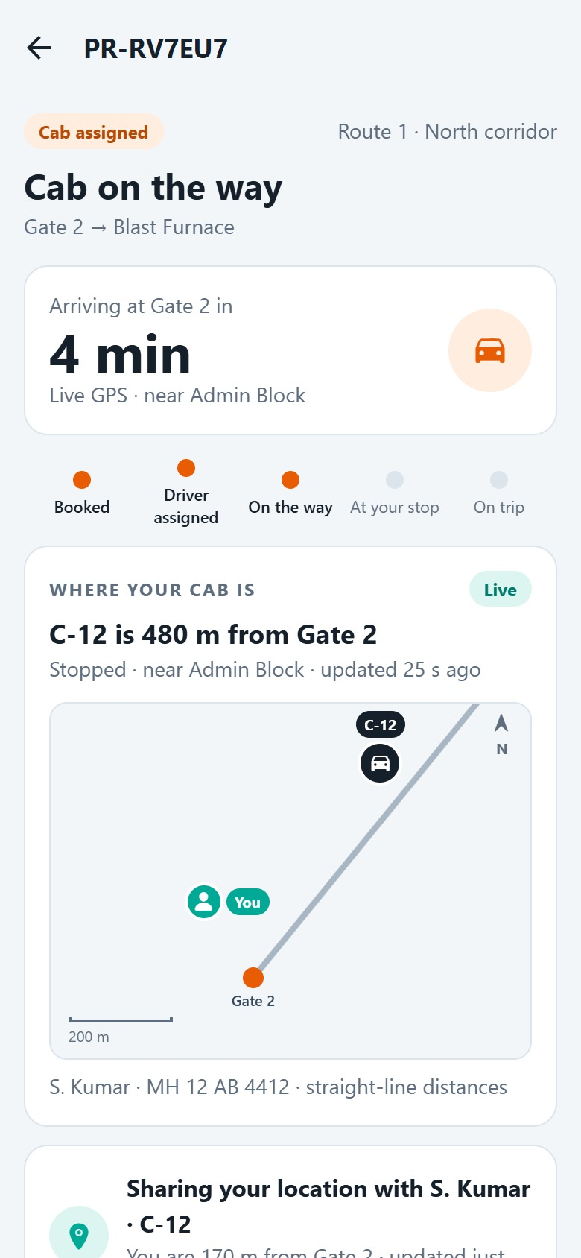
PART 1 OF 2 · RIDER
A. Raghavan books a shared cab and follows it to the drop
AR
A. Raghavan
LHS-40218 · Operations · CC-4471
Books Gate 2 → Blast Furnace and is pooled onto C-12 at once
Watches the cab come closer on a live map, and shares where they are
Boards with a code, rides, and ₹22.86 is charged to CC-4471
Plant Ride · Rider → Driver journey · recorded on the MVP with demo data
4

Slide 5
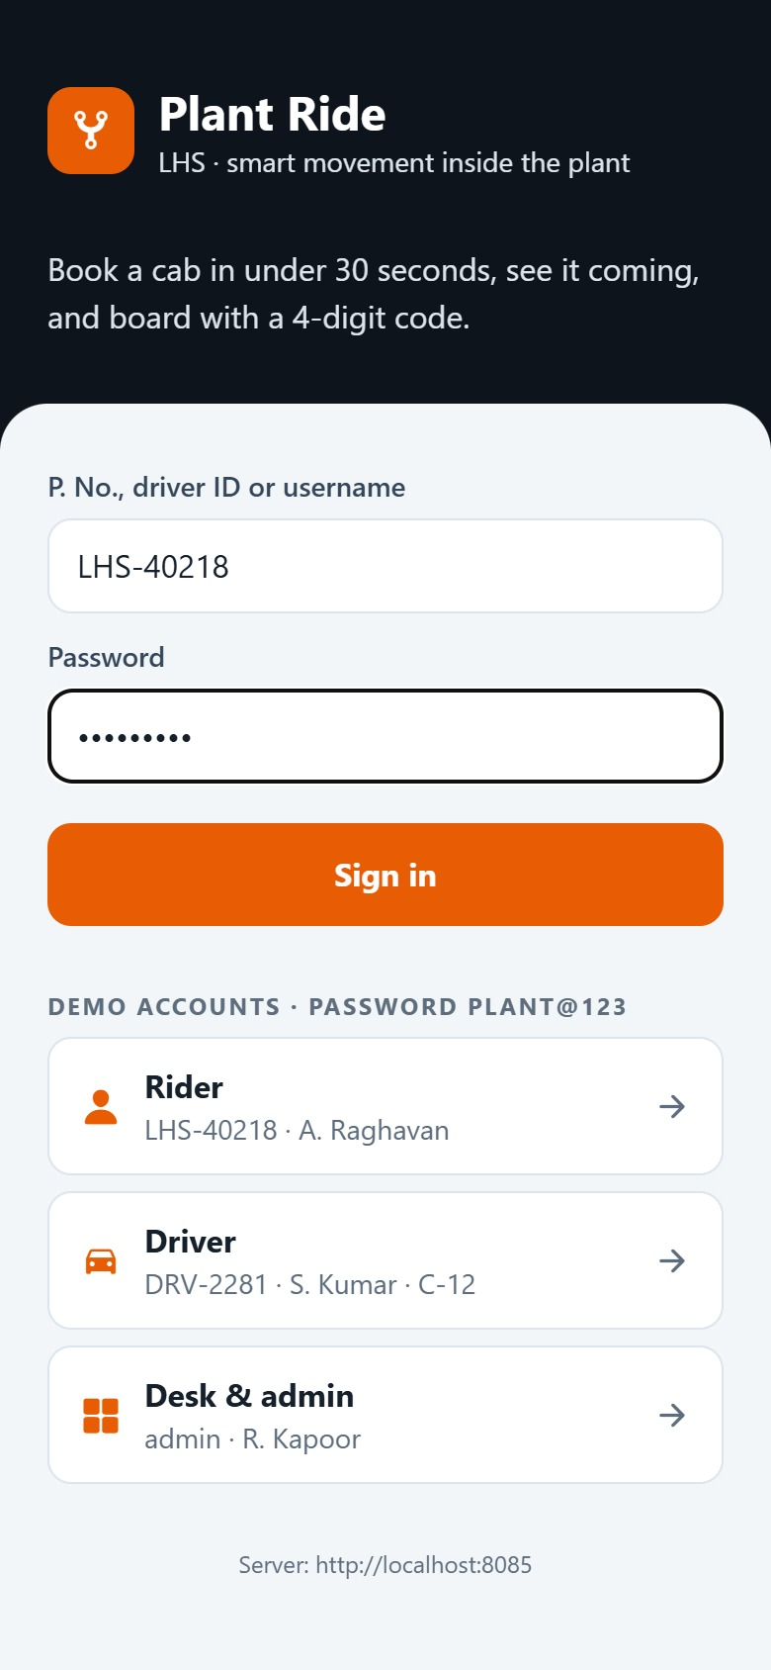
AR
Rider A. Raghavan
Screen 1 of 16
SIGN IN
Sign in with a P. No.
A. Raghavan opens Plant Ride and signs in with a personnel number and password. One app serves riders, drivers and the desk; the login decides which screens open.
1
1
P. No., driver ID or username
LHS-40218, the rider’s personnel number.
2
2
Sign in
3
The session lasts one shift (12 hours).
3
Demo accounts
One-tap logins for the walkthrough; hidden in a pilot build.
Plant Ride · Rider → Driver journey · recorded on the MVP with demo data
5
Notes:
A. Raghavan opens Plant Ride and signs in with a personnel number and password. One app serves riders, drivers and the desk; the login decides which screens open.

Slide 6
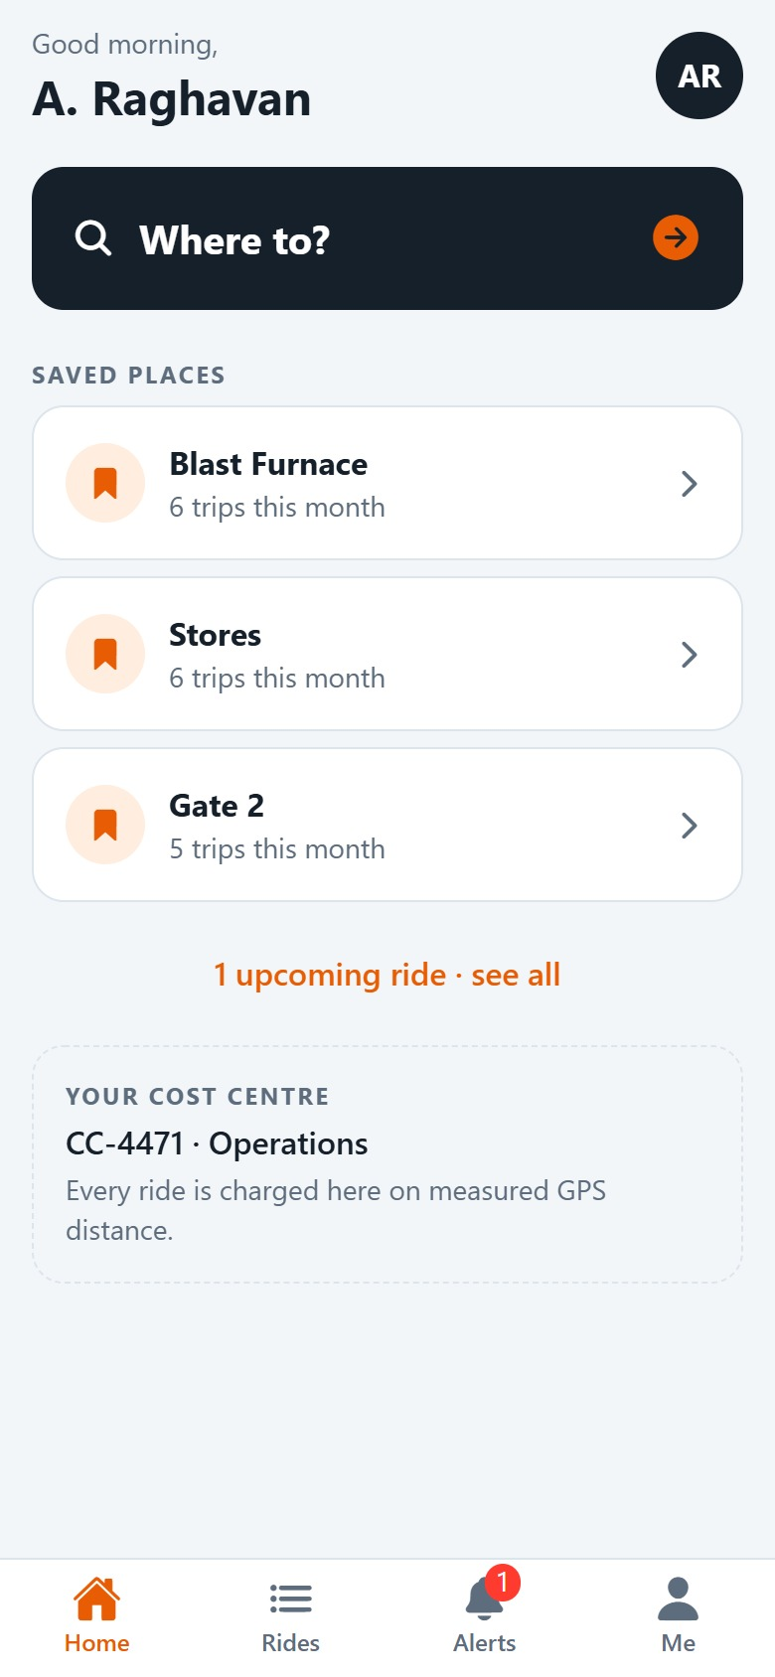
AR
Rider A. Raghavan
Screen 2 of 16
1
HOME
“Where to?” starts every booking
2
The home screen greets the rider by name, offers the places they go most, and shows the cost centre their rides are charged to.
1
Where to?
Opens the booking form.
2
Saved places
Blast Furnace, Stores, Gate 2, with trips there this month.
3
3
CC-4471 · Operations
Every ride is charged here, on measured GPS distance.
Plant Ride · Rider → Driver journey · recorded on the MVP with demo data
6
Notes:
The home screen greets the rider by name, offers the places they go most, and shows the cost centre their rides are charged to.

Slide 7
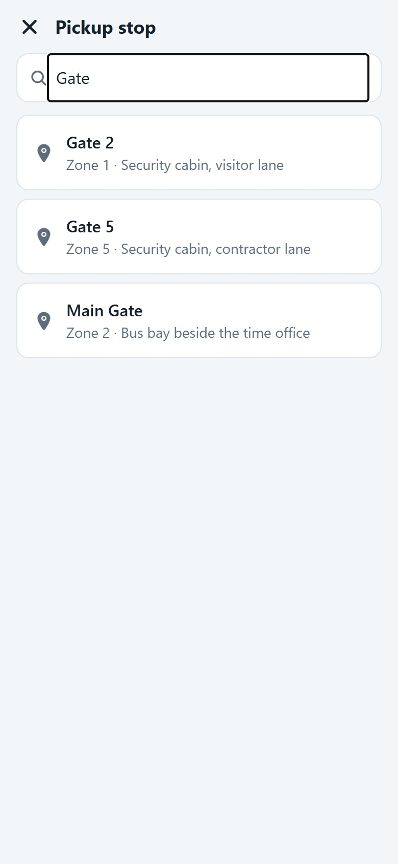
AR
Rider A. Raghavan
1
Screen 3 of 16
2
PICKUP POINT
Pick where to be picked up
3
A. Raghavan types “Gate” and chooses Gate 2. Each pickup point tells riders exactly where to wait.
1
Search
Pickup points filter while typing.
2
Gate 2 · Zone 1
Pickup points and zones are set up by the admin.
3
Security cabin, visitor lane
The landmark where riders wait, so the driver knows where to stop.
Plant Ride · Rider → Driver journey · recorded on the MVP with demo data
7
Notes:
A. Raghavan types “Gate” and chooses Gate 2. Each pickup point tells riders exactly where to wait.

Slide 8
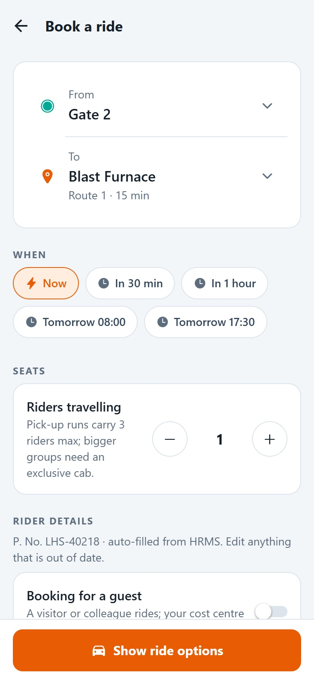
AR
Rider A. Raghavan
Screen 4 of 16
TRIP DETAILS
Gate 2 to Blast Furnace, now, one seat
1
Only stops reachable on a route are offered as drops. The route and ride time show under the destination.
2
1
Blast Furnace · Route 1 · 15 min
The route that serves this pair of stops, and the ride time.
2
Now
3
Or in 30 min, in an hour, or at a shift time tomorrow.
3
Riders travelling: 1
Pick-up runs carry 3 riders max; bigger groups need an exclusive cab.
BEHIND THE SCENES
Name and phone come from HR and stay editable. A guest can be booked on the same cost centre.
Plant Ride · Rider → Driver journey · recorded on the MVP with demo data
8
Notes:
Only stops reachable on a route are offered as drops. The route and ride time show under the destination. Name and phone come from HR and stay editable. A guest can be booked on the same cost centre.

Slide 9
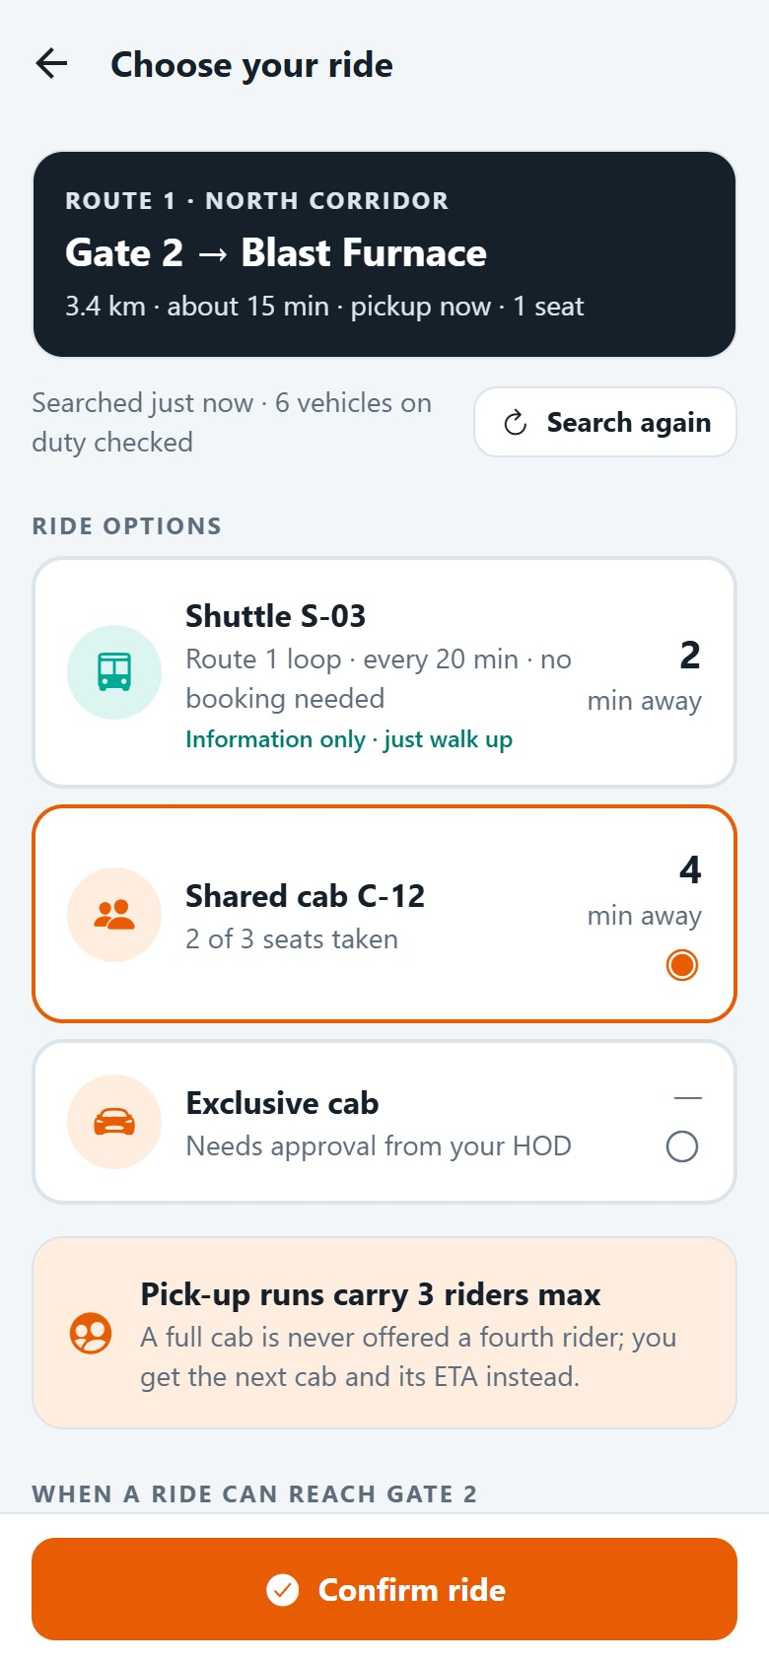
AR
Rider A. Raghavan
Screen 5 of 16
RIDE OPTIONS
Three ways to go, checked live
The app checks every cab on duty against the route and the 3-rider cap, and shows what can take the rider now.
1
1
Shuttle S-03
Walk-up loop every 20 minutes; shown for information, no booking.
2
2
Shared cab C-12 · 4 min away
2 of 3 seats taken: two colleagues are already waiting.
3
3
Exclusive cab
A cab of one’s own, released by the HOD or the transport desk.
BEHIND THE SCENES
Searched just now: 6 vehicles on duty were checked. A. Raghavan taps Confirm ride.
Plant Ride · Rider → Driver journey · recorded on the MVP with demo data
9
Notes:
The app checks every cab on duty against the route and the 3-rider cap, and shows what can take the rider now. Searched just now: 6 vehicles on duty were checked. A. Raghavan taps Confirm ride.

Slide 10
AR
Rider A. Raghavan
Screen 6 of 16
1
BOOKED
Matched to C-12 at once
2
The engine pools A. Raghavan onto C-12 with M. Iyer and S. Banerjee. No call to the transport desk.
3
1
Cab on the way
The booking status in plain words, with the route.
2
Arriving at Gate 2 in 4 min
Worked out from where the cab really is: “Live GPS · near Admin Block”.
3
Progress
Booked, driver assigned, on the way, at your stop, on trip.
BEHIND THE SCENES
Matching checks the route, the 3-rider cap, the detour limit, duty hours and documents, then picks the best cab.
Plant Ride · Rider → Driver journey · recorded on the MVP with demo data
10
Notes:
The engine pools A. Raghavan onto C-12 with M. Iyer and S. Banerjee. No call to the transport desk. Matching checks the route, the 3-rider cap, the detour limit, duty hours and documents, then picks the best cab.

Slide 11
AR
Rider A. Raghavan
1
Screen 7 of 16
2
WHERE YOUR CAB IS
The cab, moving live on the map
The driver’s phone reports C-12’s position every few seconds. The rider sees it on a map of the run, with themselves on it.
3
1
Live
The driver’s phone reported in the last 2 minutes; otherwise the last known position shows in grey.
2
C-12 is 480 m from Gate 2
Straight-line distance to the rider’s pickup point.
3
Plant map
The cab, the pickup (orange), the drop and “You”, north up, with a scale bar.
BEHIND THE SCENES
Every fix brings speed, the nearest stop and how fresh it is: “Stopped · near Admin Block”.
Plant Ride · Rider → Driver journey · recorded on the MVP with demo data
11
Notes:
The driver’s phone reports C-12’s position every few seconds. The rider sees it on a map of the run, with themselves on it. Every fix brings speed, the nearest stop and how fresh it is: “Stopped · near Admin Block”.

Slide 12
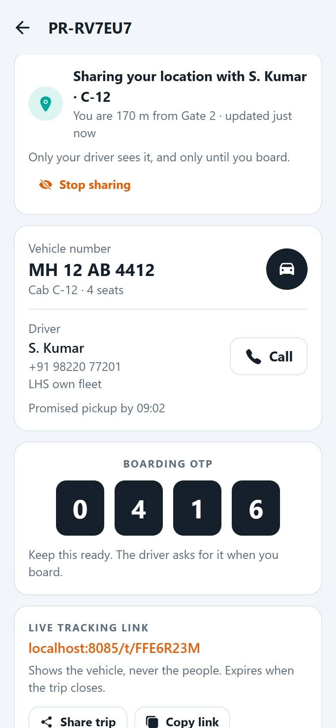
AR
Rider A. Raghavan
Screen 8 of 16
1
SHARE MY LOCATION
Showing the driver where the rider is
2
While the cab is on its way, the rider’s phone shares where they are with S. Kumar, so the driver can find them at a busy gate.
1
Sharing with S. Kumar · C-12
3
“You are 170 m from Gate 2”, updated every few seconds.
2
Stop sharing
One tap deletes the position; the driver stops seeing it at once.
3
Driver and vehicle
S. Kumar, phone number and fleet; MH 12 AB 4412; a Call button.
BEHIND THE SCENES
Only the driver of this cab sees it, and only until boarding. The desk and the tracking link never do.
Plant Ride · Rider → Driver journey · recorded on the MVP with demo data
12
Notes:
While the cab is on its way, the rider’s phone shares where they are with S. Kumar, so the driver can find them at a busy gate. Only the driver of this cab sees it, and only until boarding. The desk and the tracking link never do.

Slide 13
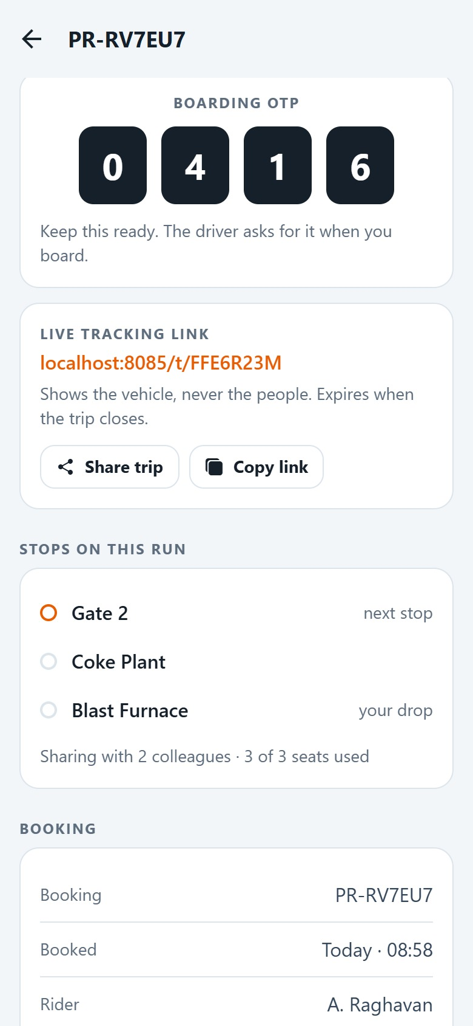
AR
Rider A. Raghavan
1
Screen 9 of 16
BOARDING CODE
A boarding code and a tracking link
A 4-digit code makes sure the right rider boards the right cab. The link can go to a host or family.
2
1
Boarding OTP 0416
Shown to the driver at the pickup.
3
2
Live tracking link
Shows the vehicle, never the people; expires when the trip closes.
3
Stops on this run
Gate 2, Coke Plant, Blast Furnace: sharing with 2 colleagues, 3 of 3 seats.
Plant Ride · Rider → Driver journey · recorded on the MVP with demo data
13
Notes:
A 4-digit code makes sure the right rider boards the right cab. The link can go to a host or family.

Slide 14
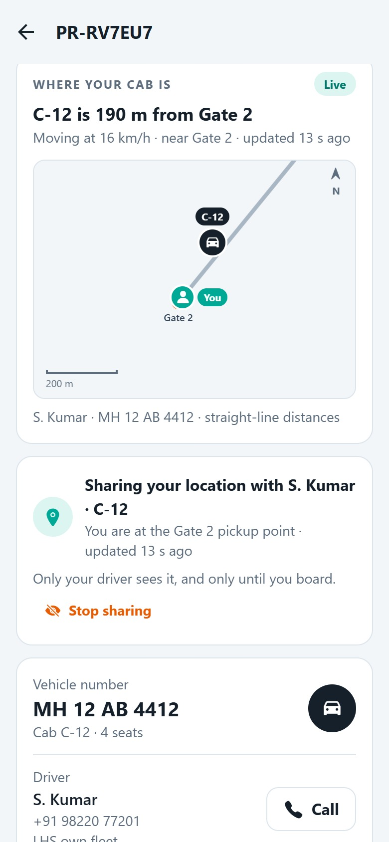
AR
Rider A. Raghavan
Screen 10 of 16
1
CAB APPROACHING
2
The cab comes closer
Moments later C-12 is 190 m away, moving at 16 km/h. A. Raghavan has walked to the pickup point.
1
C-12 is 190 m from Gate 2
The map and distance follow every fix.
2
Moving at 16 km/h · near Gate 2
3
Speed and the nearest stop come from the driver’s phone.
3
You are at the Gate 2 pickup point
The rider’s phone is inside the point’s 40 m arrival radius.
Plant Ride · Rider → Driver journey · recorded on the MVP with demo data
14
Notes:
Moments later C-12 is 190 m away, moving at 16 km/h. A. Raghavan has walked to the pickup point.

Slide 15
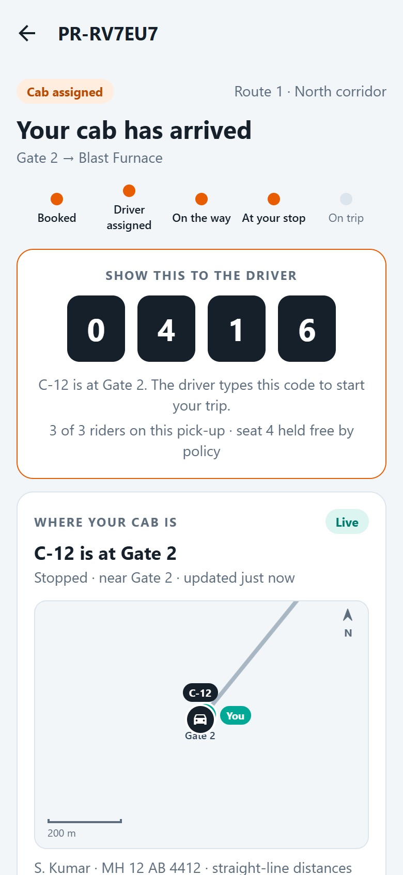
AR
Rider A. Raghavan
Screen 11 of 16
1
CAB ARRIVED
Your cab has arrived
2
C-12’s GPS enters Gate 2’s arrival radius. The rider’s screen changes by itself and shows the code in large digits.
1
Your cab has arrived
3
Nobody had to tap anything: the arrival came from GPS.
2
Show this to the driver
0 4 1 6, readable at arm’s length in sunlight.
3
3 of 3 riders on this pick-up
Seat 4 is held free by policy: the 3-rider cap.
BEHIND THE SCENES
The cab waits 5 minutes before the driver can mark a no-show.
Plant Ride · Rider → Driver journey · recorded on the MVP with demo data
15
Notes:
C-12’s GPS enters Gate 2’s arrival radius. The rider’s screen changes by itself and shows the code in large digits. The cab waits 5 minutes before the driver can mark a no-show.

Slide 16
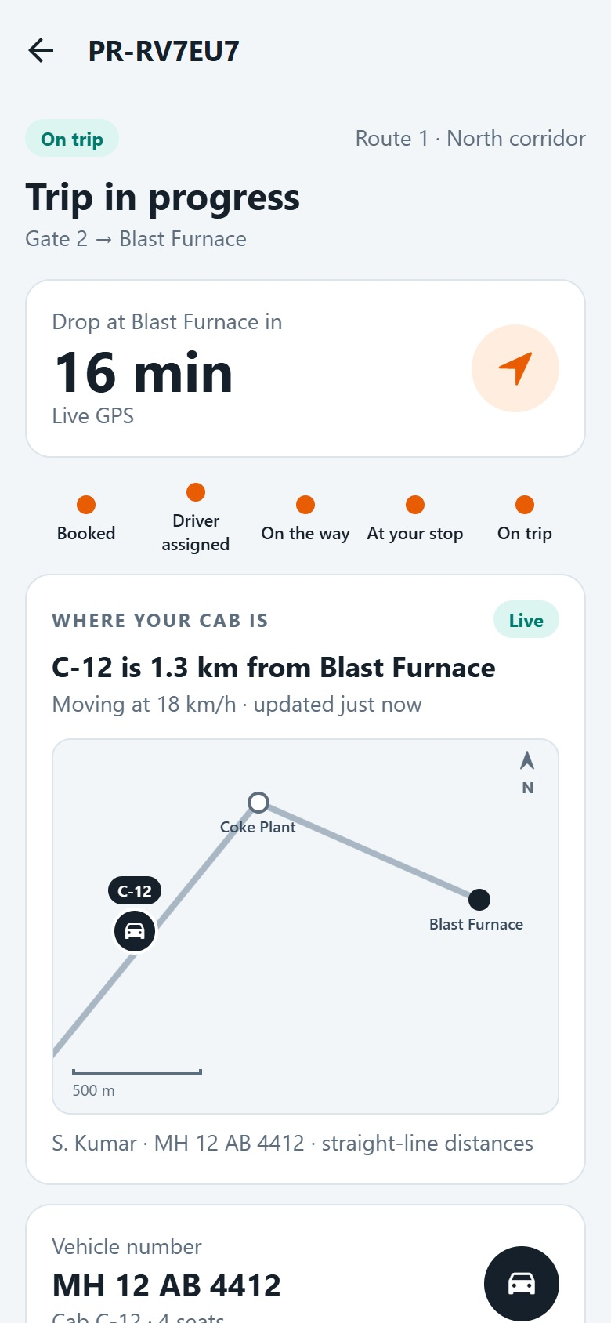
AR
Rider A. Raghavan
Screen 12 of 16
1
2
ON BOARD
Trip in progress
3
The driver accepts the code. The screen switches to the ride, with the drop time first.
1
On trip
Every step of the progress bar is now done.
2
Trip in progress
Starts the moment the driver accepts the code.
3
Drop at Blast Furnace in 16 min
Counts down from the cab’s live position.
Plant Ride · Rider → Driver journey · recorded on the MVP with demo data
16
Notes:
The driver accepts the code. The screen switches to the ride, with the drop time first.

Slide 17
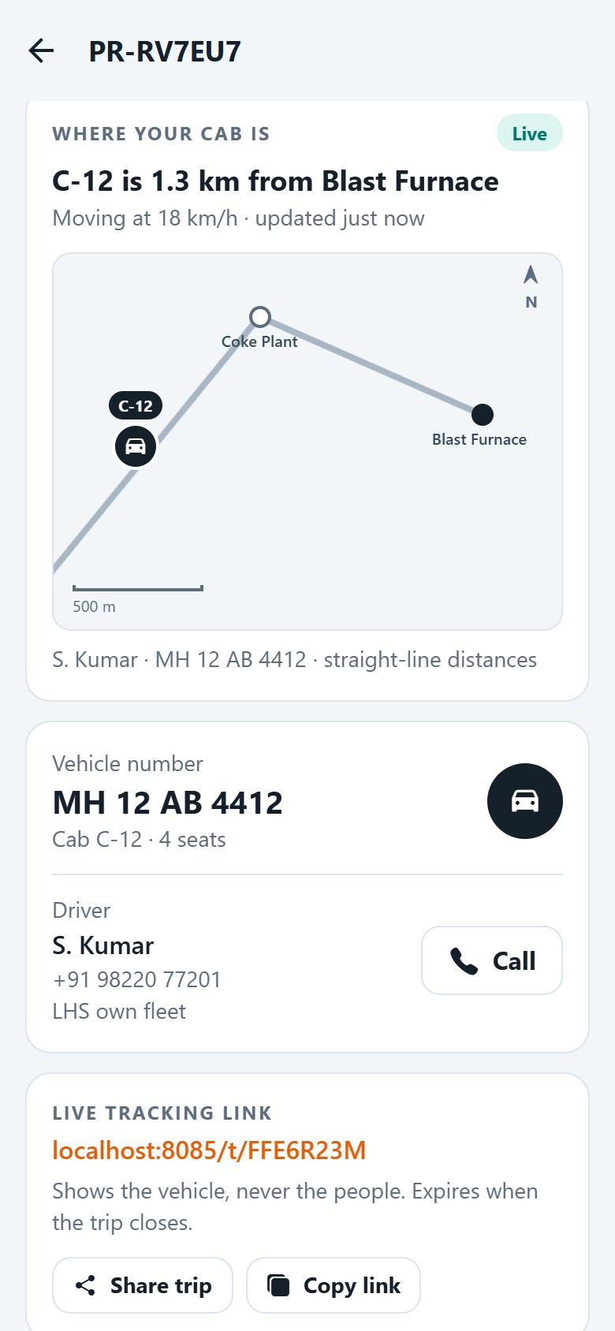
AR
Rider A. Raghavan
Screen 13 of 16
1
ON THE WAY
2
Following the ride on the map
The distance is now measured to the drop. M. Iyer gets off at Coke Plant on the way.
3
1
C-12 is 1.3 km from Blast Furnace
Measured to the drop now that the rider is on board.
2
Moving at 18 km/h
Within the route’s 20 km/h limit; overspeed alerts the desk.
3
Coke Plant, then Blast Furnace
The stops on this shared run, in route order.
BEHIND THE SCENES
The rider’s own position is no longer shared: it was deleted at boarding.
Plant Ride · Rider → Driver journey · recorded on the MVP with demo data
17
Notes:
The distance is now measured to the drop. M. Iyer gets off at Coke Plant on the way. The rider’s own position is no longer shared: it was deleted at boarding.

Slide 18
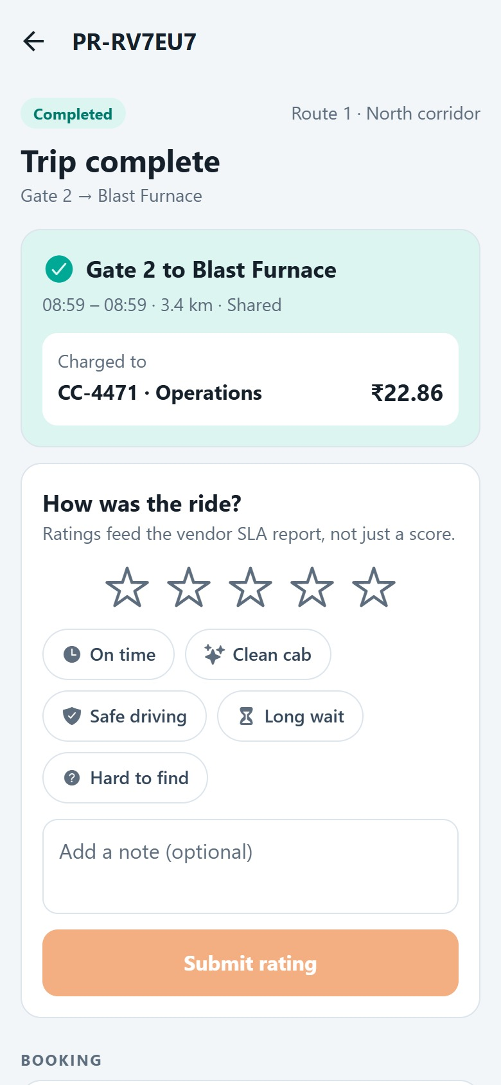
AR
Rider A. Raghavan
Screen 14 of 16
1
TRIP COMPLETE
Dropped, and charged to CC-4471
The last drop closes the trip. The distance is measured and the cost is split between the riders.
2
3
1
Trip complete
Gate 2 to Blast Furnace, 3.4 km, shared.
2
₹22.86 to CC-4471 · Operations
This rider’s share of the trip, split by kilometres ridden.
3
How was the ride?
Stars and tags; ratings feed the vendor SLA report.
Plant Ride · Rider → Driver journey · recorded on the MVP with demo data
18
Notes:
The last drop closes the trip. The distance is measured and the cost is split between the riders.

Slide 19
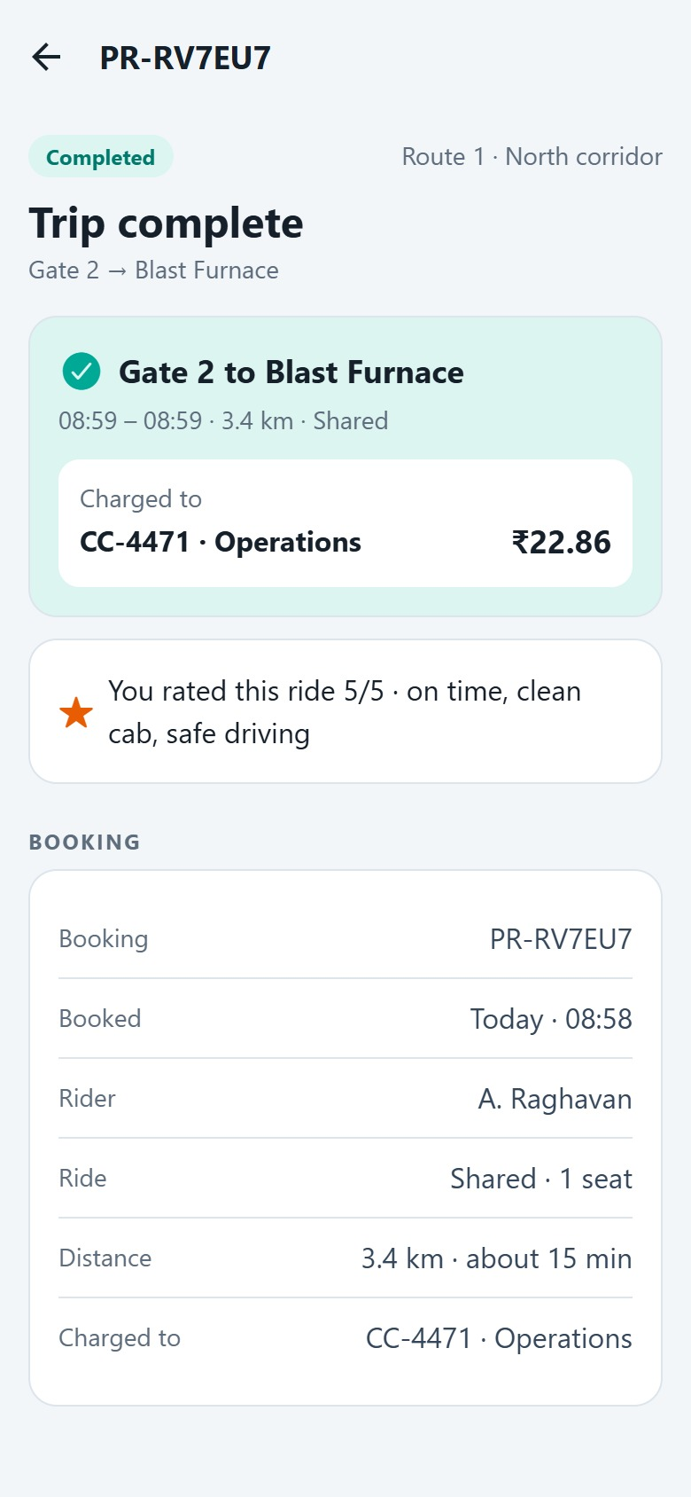
AR
Rider A. Raghavan
Screen 15 of 16
RATING
A 5-star rating
On time, clean cab, safe driving. The rating is stored with the trip and counts towards the vendor’s SLA.
1
1
Charged to CC-4471
2
The charge stays on the booking for good.
2
You rated this ride 5/5
With the tags chosen.
Plant Ride · Rider → Driver journey · recorded on the MVP with demo data
19
Notes:
On time, clean cab, safe driving. The rating is stored with the trip and counts towards the vendor’s SLA.

Slide 20
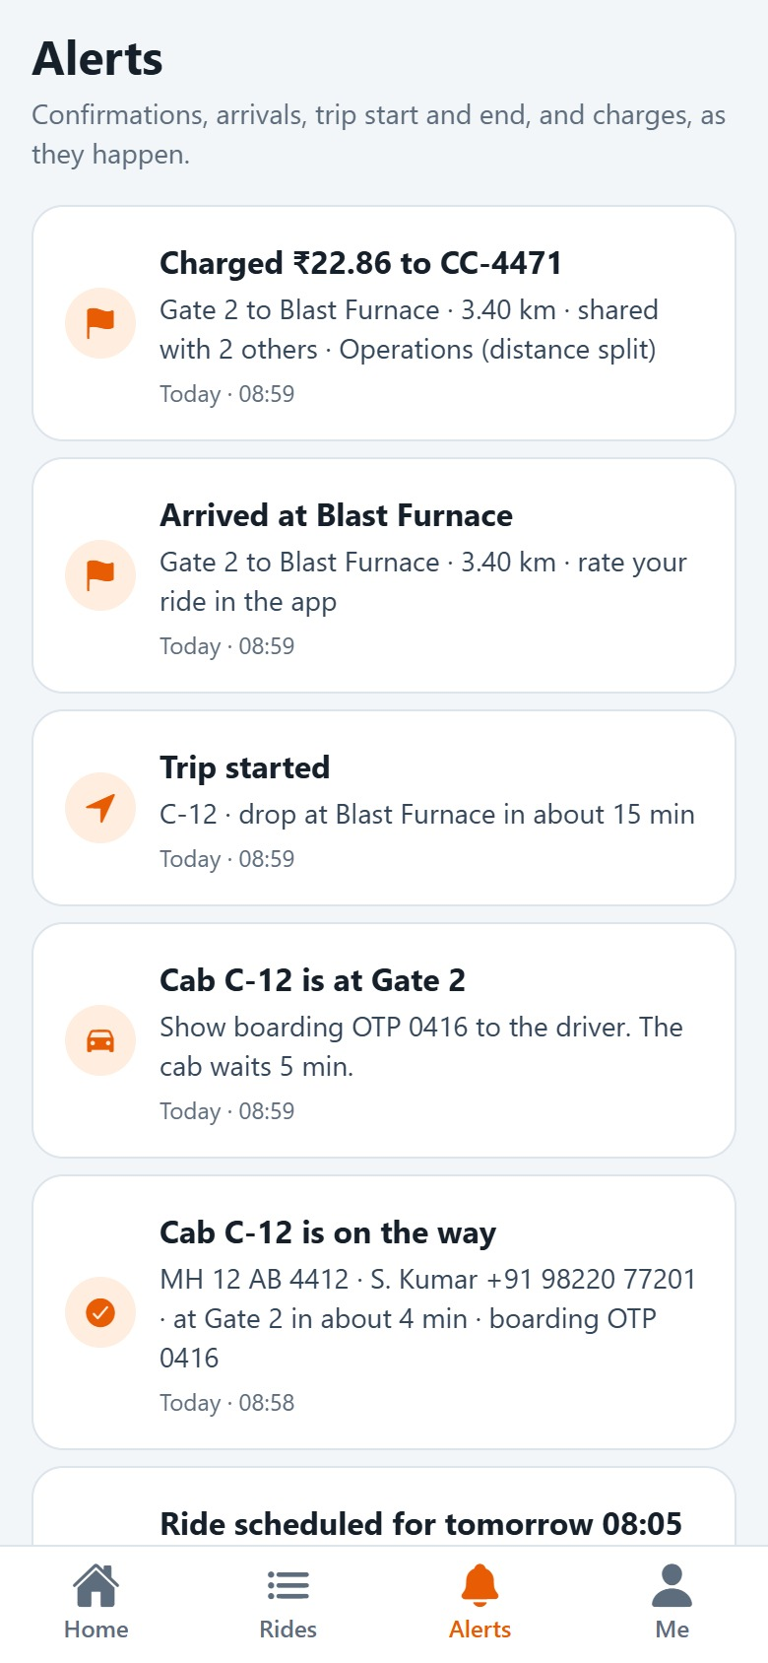
AR
Rider A. Raghavan
Screen 16 of 16
1
ALERTS
Every step, in the rider’s alerts
Notifications record the match, the arrival, the start of the trip, the drop and the charge, as they happen.
2
1
Charged ₹22.86 to CC-4471
With the distance and how the cost was split.
3
2
Trip started
Drop time at Blast Furnace.
3
Cab C-12 is at Gate 2
The boarding code and the 5-minute wait.
Plant Ride · Rider → Driver journey · recorded on the MVP with demo data
20
Notes:
Notifications record the match, the arrival, the start of the trip, the drop and the charge, as they happen.

Slide 21
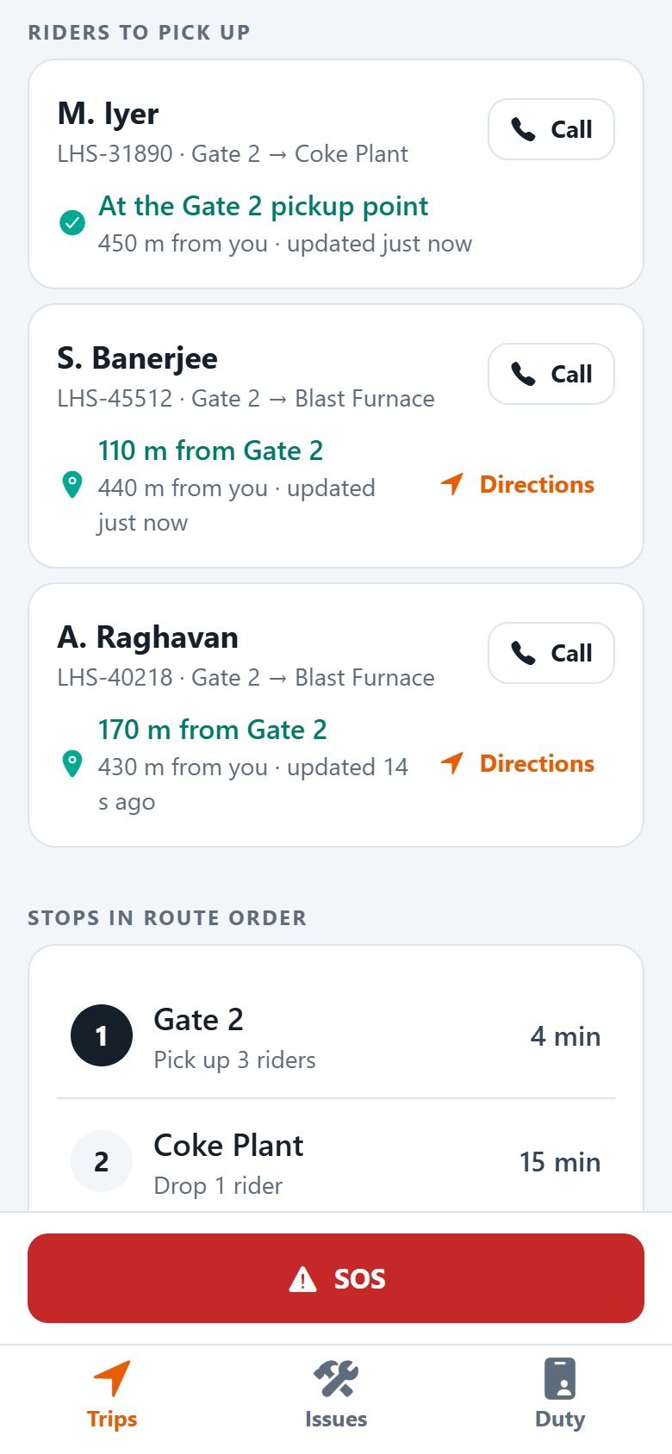
PART 2 OF 2 · DRIVER
S. Kumar signs on, finds the riders and drives the route
SK
S. Kumar
DRV-2281 · cab C-12 · MH 12 AB 4412
Duty check, five vehicle checks and the odometer; riders are matched at sign-on
Sees every waiting rider on a live map, and their distance from the pickup
GPS records the arrivals; riders board by OTP, drops go in route order, then sign-off
Plant Ride · Rider → Driver journey · recorded on the MVP with demo data
21

Slide 22

SK
Driver S. Kumar
Screen 1 of 14
SIGN IN
Sign in with the driver ID
S. Kumar signs in with DRV-2281 on the driver’s phone. The same app opens the driver screens.
1
1
Driver ID DRV-2281
Issued with the gate pass.
2
2
Sign in
Location permission is asked once, on going on duty.
Plant Ride · Rider → Driver journey · recorded on the MVP with demo data
22
Notes:
S. Kumar signs in with DRV-2281 on the driver’s phone. The same app opens the driver screens.

Slide 23
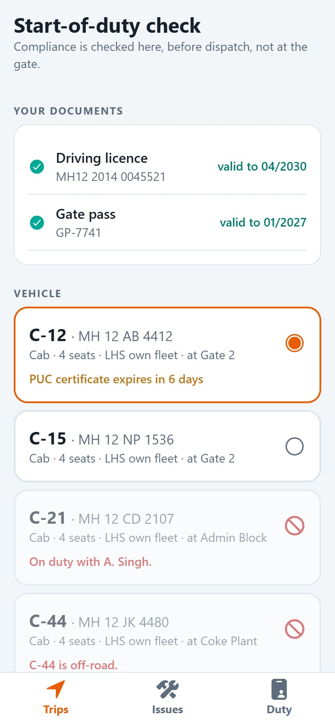
SK
Driver S. Kumar
Screen 2 of 14
1
START-OF-DUTY CHECK
Compliance before dispatch
Documents are checked before a cab can be taken, not at the gate.
1
Your documents
2
Driving licence and gate pass valid.
3
2
C-12 · MH 12 AB 4412
The driver’s usual cab, preselected: 4 seats, LHS own fleet, at Gate 2.
3
PUC certificate expires in 6 days
A warning, not a block; the desk is alerted too.
BEHIND THE SCENES
Cabs with expired documents, off the road, or on duty with another driver cannot be chosen.
Plant Ride · Rider → Driver journey · recorded on the MVP with demo data
23
Notes:
Documents are checked before a cab can be taken, not at the gate. Cabs with expired documents, off the road, or on duty with another driver cannot be chosen.

Slide 24
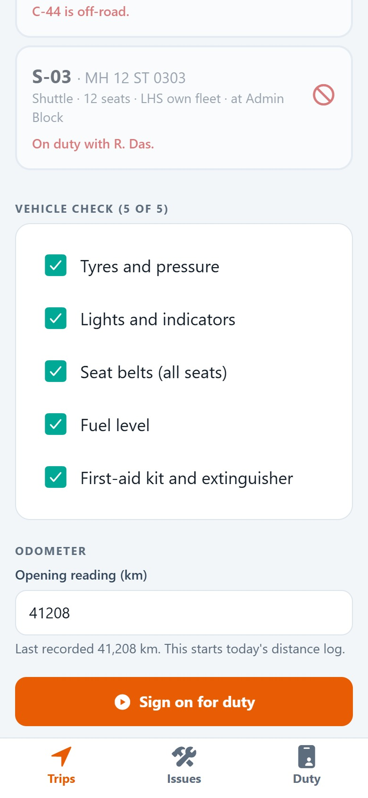
SK
Driver S. Kumar
Screen 3 of 14
VEHICLE CHECK
Five checks and the odometer
1
Big tick boxes for the vehicle check, and the opening odometer that starts the day’s distance log.
1
Vehicle check (5 of 5)
Tyres, lights, seat belts, fuel, first aid.
2
Opening reading 41,208 km
Filled in from the last record; it cannot go below it.
2
3
Sign on for duty
Enabled only when every check is ticked.
3
Plant Ride · Rider → Driver journey · recorded on the MVP with demo data
24
Notes:
Big tick boxes for the vehicle check, and the opening odometer that starts the day’s distance log.

Slide 25
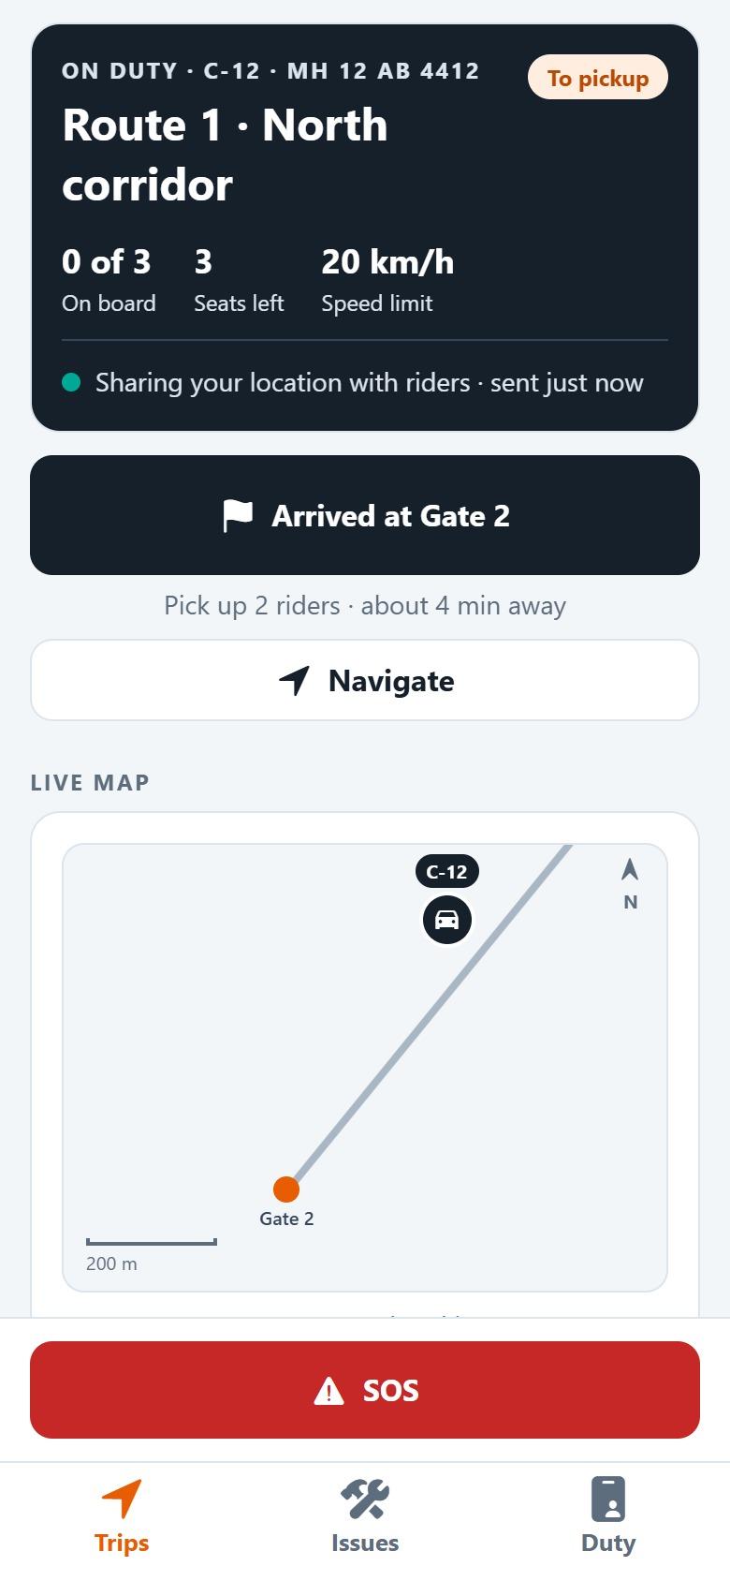
SK
Driver S. Kumar
Screen 4 of 14
ON DUTY
Two riders waiting at sign-on
1
The engine gives C-12 the two riders already waiting at Gate 2, and the driver’s phone starts sharing the cab’s position.
2
3
1
Sharing your location with riders
About every 10 seconds, and at least every 30 seconds while parked.
2
Arrived at Gate 2
The next stop. GPS can record the arrival by itself.
3
Pick up 2 riders · about 4 min away
Worked out from where the cab really is.
BEHIND THE SCENES
Fixes more than 5 km from every pickup point are ignored, so a GPS glitch never moves the cab.
Plant Ride · Rider → Driver journey · recorded on the MVP with demo data
25
Notes:
The engine gives C-12 the two riders already waiting at Gate 2, and the driver’s phone starts sharing the cab’s position. Fixes more than 5 km from every pickup point are ignored, so a GPS glitch never moves the cab.

Slide 26
SK
Driver S. Kumar
Screen 5 of 14
LIVE MAP
1
The cab and every rider waiting for it
A. Raghavan has booked too. Three riders now, and all three share where they are.
2
1
Live map
3
The cab, the next stop (orange) and each waiting rider by name.
2
C-12 · 480 m to Gate 2
The cab’s distance to the next stop, and how fresh the fix is.
3
3 of 3 waiting riders share their location
Riders who do not share are still listed, at their pickup point.
Plant Ride · Rider → Driver journey · recorded on the MVP with demo data
26
Notes:
A. Raghavan has booked too. Three riders now, and all three share where they are.

Slide 27
SK
Driver S. Kumar
1
Screen 6 of 14
2
RIDERS TO PICK UP
Who is waiting, and where they are now
One card per rider: name, staff number, pickup and drop, and where their phone says they are.
3
1
Call
One tap to phone the rider.
2
At the Gate 2 pickup point
M. Iyer is inside the pickup radius, 450 m from the cab.
3
110 m from Gate 2 · Directions
S. Banerjee is still walking up; Directions opens Google Maps.
Plant Ride · Rider → Driver journey · recorded on the MVP with demo data
27
Notes:
One card per rider: name, staff number, pickup and drop, and where their phone says they are.

Slide 28
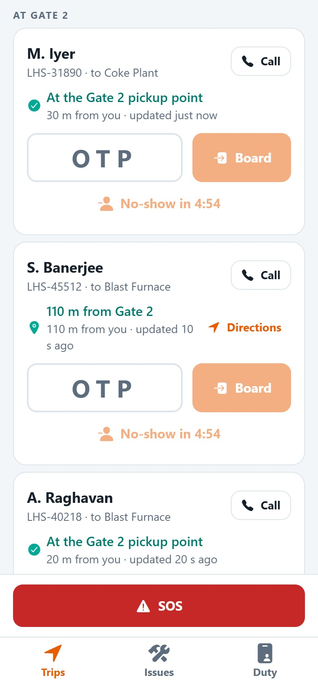
SK
Driver S. Kumar
Screen 7 of 14
1
AT GATE 2
Arrival recorded by GPS
2
3
C-12 enters Gate 2’s 40 m arrival radius and the arrival is recorded by itself. The riders are told the cab is here.
1
At the Gate 2 pickup point · 30 m from you
M. Iyer is right there.
2
OTP box
For the code each rider shows.
3
No-show in 4:54
Allowed only after the route’s 5-minute wait.
Plant Ride · Rider → Driver journey · recorded on the MVP with demo data
28
Notes:
C-12 enters Gate 2’s 40 m arrival radius and the arrival is recorded by itself. The riders are told the cab is here.

Slide 29
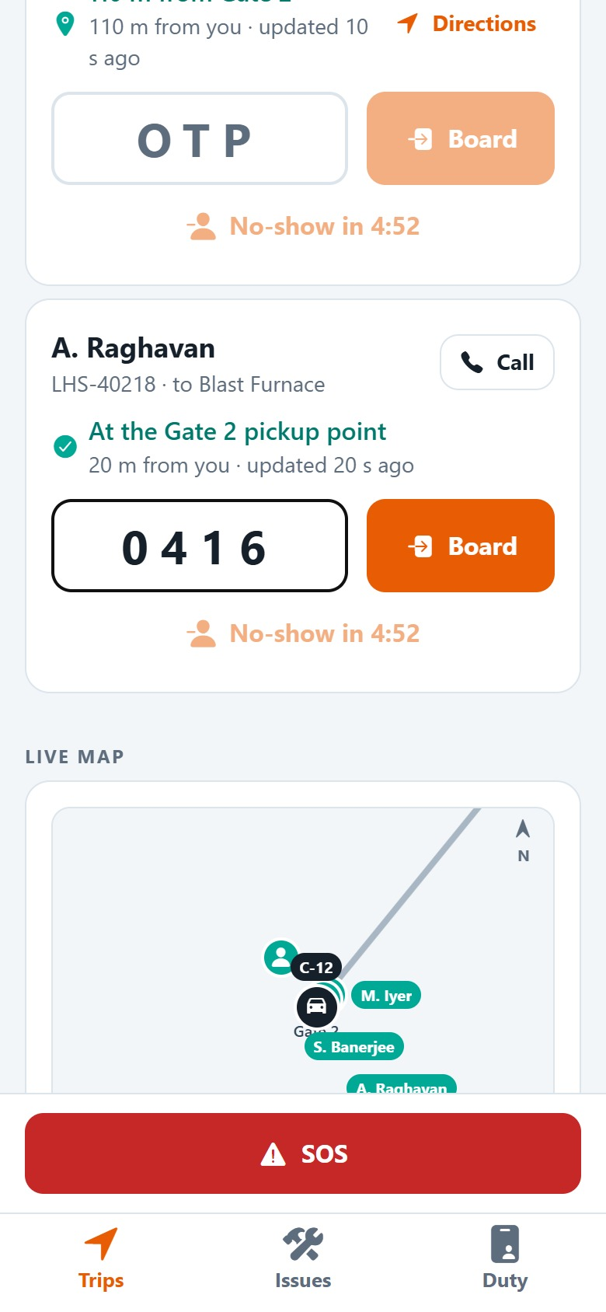
SK
Driver S. Kumar
Screen 8 of 14
BOARDING
Board each rider by OTP
1
A. Raghavan shows 0416. The driver types it and taps Board. A wrong code is refused; after 5, boarding locks for the desk.
2
3
1
A. Raghavan · to Blast Furnace
At the Gate 2 pickup point, 20 m from the cab.
2
0 4 1 6
The code from the rider’s screen.
3
Board
The right rider, in the right cab.
Plant Ride · Rider → Driver journey · recorded on the MVP with demo data
29
Notes:
A. Raghavan shows 0416. The driver types it and taps Board. A wrong code is refused; after 5, boarding locks for the desk.

Slide 30
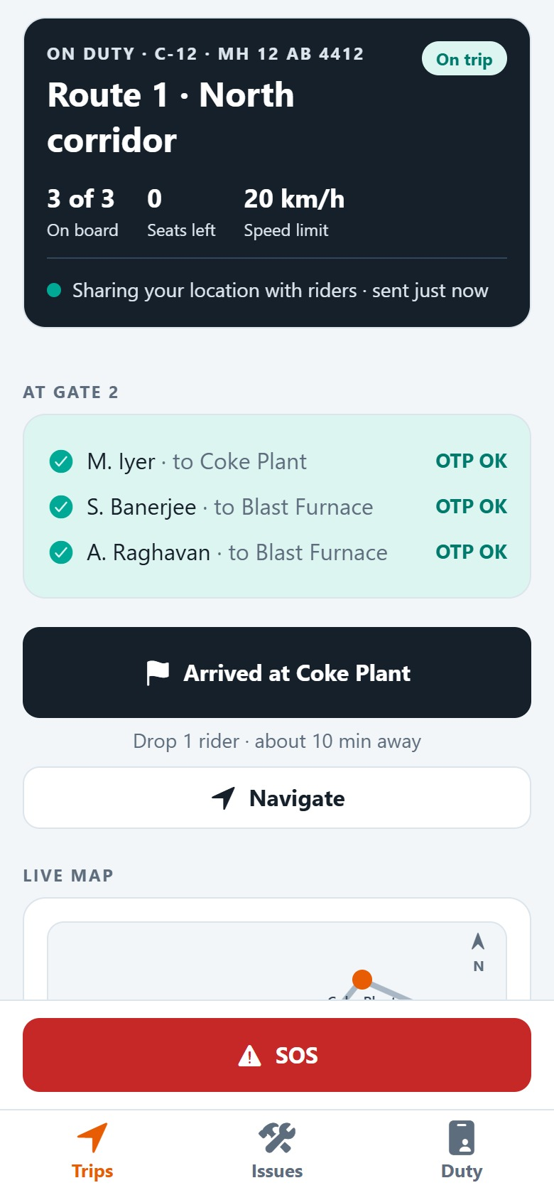
SK
Driver S. Kumar
1
Screen 9 of 14
ON TRIP
2
3 of 3 on board
All three codes check out. The trip starts and the next stop is the first drop.
1
On trip
The riders’ screens switch to “Trip in progress”.
2
3 of 3 on board · 0 seats left
3
The 3-rider cap is reached.
3
Arrived at Coke Plant
Drop 1 rider, about 10 minutes away.
Plant Ride · Rider → Driver journey · recorded on the MVP with demo data
30
Notes:
All three codes check out. The trip starts and the next stop is the first drop.

Slide 31
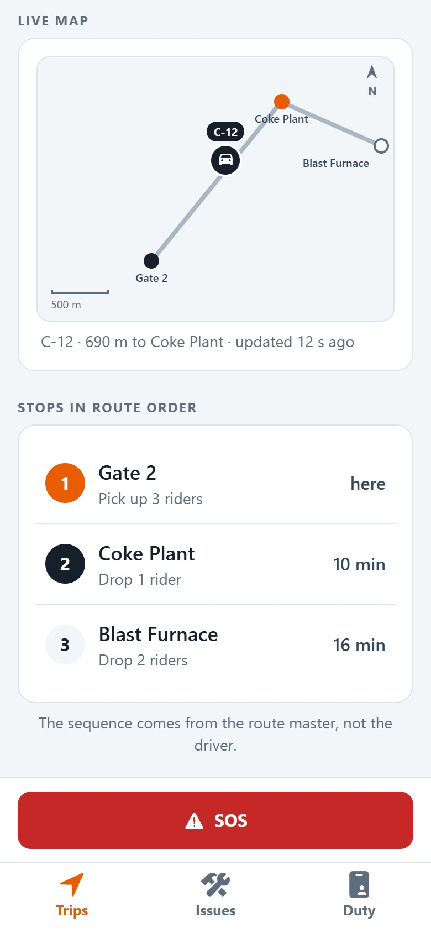
SK
Driver S. Kumar
Screen 10 of 14
ON THE WAY
1
Driving to Coke Plant
The map follows the cab along the route; the riders on board see the same position.
2
1
Live map
Gate 2 done (dark), Coke Plant next (orange), Blast Furnace after.
2
C-12 · 690 m to Coke Plant
Updated with every fix from the driver’s phone.
Plant Ride · Rider → Driver journey · recorded on the MVP with demo data
31
Notes:
The map follows the cab along the route; the riders on board see the same position.

Slide 32
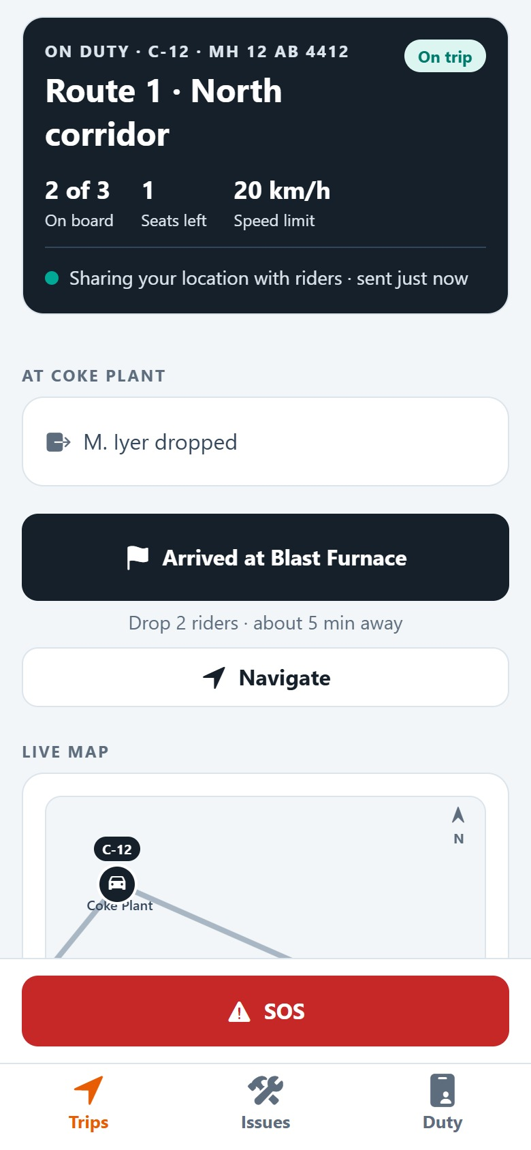
SK
Driver S. Kumar
Screen 11 of 14
FIRST DROP
1
M. Iyer gets off at Coke Plant
GPS records the arrival at Coke Plant and M. Iyer’s ride completes. Two riders stay on board.
2
1
2 of 3 on board
3
One seat free again.
2
M. Iyer dropped
That ride is closed and charged.
3
Arrived at Blast Furnace
Drop 2 riders, about 5 minutes away.
Plant Ride · Rider → Driver journey · recorded on the MVP with demo data
32
Notes:
GPS records the arrival at Coke Plant and M. Iyer’s ride completes. Two riders stay on board.

Slide 33
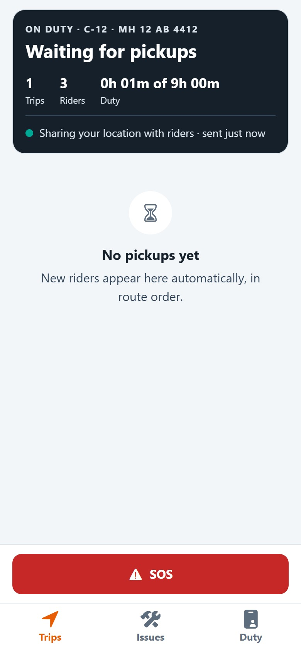
SK
Driver S. Kumar
Screen 12 of 14
1
LAST DROP
The last drop closes the trip
At the Blast Furnace A. Raghavan and S. Banerjee get off. The trip is costed and charged, and the queue waits for new pickups.
2
1
1 trip · 3 riders
The duty totals update at once.
2
No pickups yet
New riders appear here automatically, in route order.
Plant Ride · Rider → Driver journey · recorded on the MVP with demo data
33
Notes:
At the Blast Furnace A. Raghavan and S. Banerjee get off. The trip is costed and charged, and the queue waits for new pickups.

Slide 34
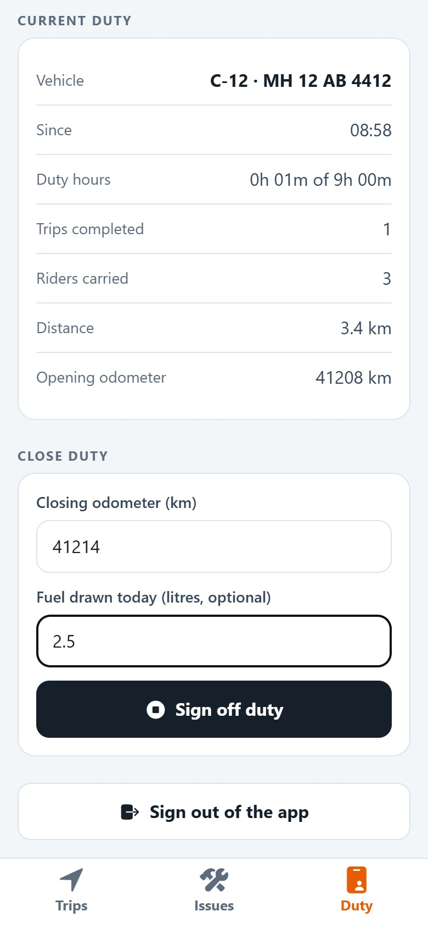
1
SK
Driver S. Kumar
Screen 13 of 14
CLOSE DUTY
End of shift: close duty
S. Kumar enters the closing odometer and the fuel drawn.
1
Current duty
Vehicle, start time, trips, riders, distance, opening odometer.
2
Closing odometer 41,214 km
2
Must not be below the opening reading.
3
Sign off duty
Blocked while a rider is still on board.
3
Plant Ride · Rider → Driver journey · recorded on the MVP with demo data
34
Notes:
S. Kumar enters the closing odometer and the fuel drawn.

Slide 35
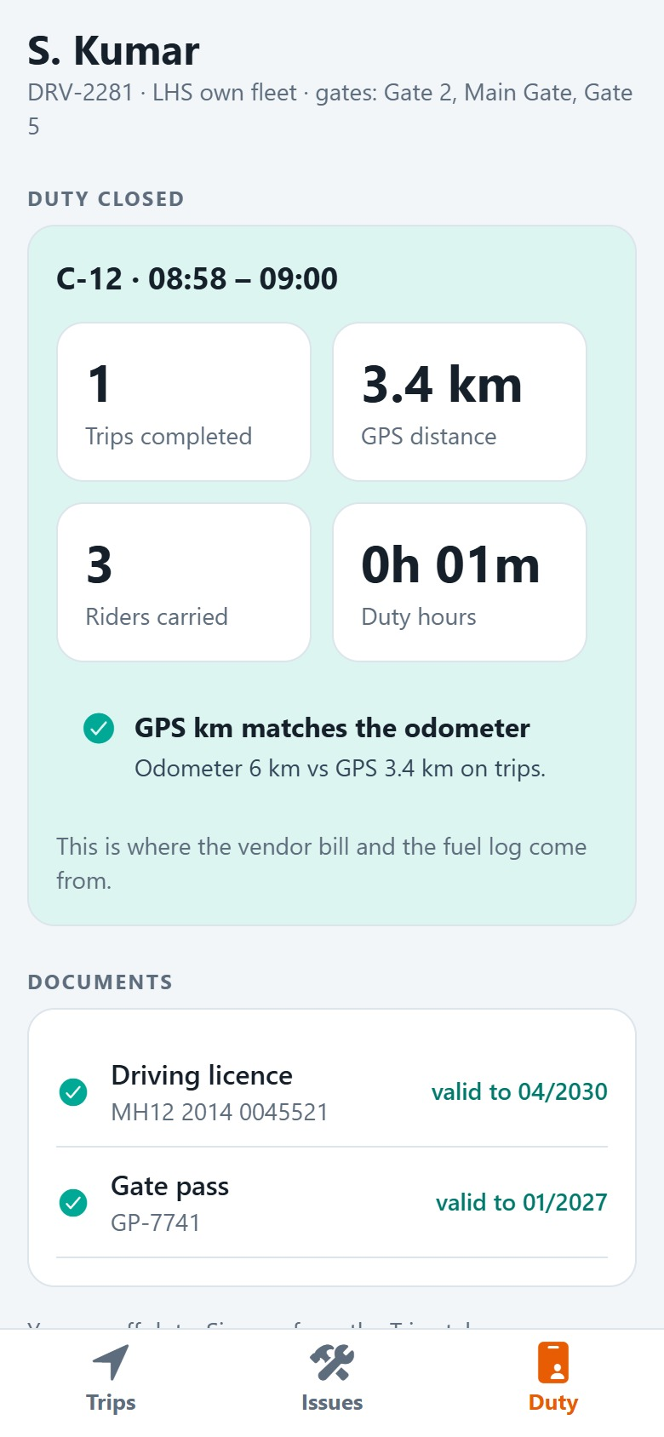
SK
Driver S. Kumar
Screen 14 of 14
1
SIGNED OFF
GPS matches the odometer
2
The duty summary is the record the vendor bill and the fuel log are checked against.
1
Duty closed · C-12
3
Start and end of the duty.
2
1 trip · 3.4 km GPS · 3 riders
Measured, not typed in.
3
GPS km matches the odometer
The odometer may include runs between trips, never less than GPS.
Plant Ride · Rider → Driver journey · recorded on the MVP with demo data
35
Notes:
The duty summary is the record the vendor bill and the fuel log are checked against.

Slide 36
WHAT THE JOURNEY SHOWS
One ride, two phones, no phone calls
3 of 3
₹22.86
~10 s
3
riders pooled on C-12, inside the 3-rider cap
charged to CC-4471 · Operations for 3.4 km, split by distance
between the driver’s position updates while on duty
stops recorded by GPS: Gate 2, Coke Plant, Blast Furnace
The rider knew where the cab was from the moment of booking, and the driver knew where each rider was waiting. Codes put the right riders in the right cab, and the charge landed on the right cost centre.
Plant Ride · Rider → Driver journey · recorded on the MVP with demo data
36

Slide 37
Thank you
Plant Ride MVP · SRM ECO TECH for LHS
HOW THIS WAS RECORDED
Every screen is the running MVP with its demo data, in Chrome at phone size; nothing is mocked or edited.
Rider and driver are one continuous run, so the booking, the OTP and the charge are the same on both phones.
The clock was set to a morning shift change (about 08:40) and phone positions were set along Route 1, the way the phones would report them.
The drive itself was compressed to seconds, so trip times read the same minute. Plant coordinates in the demo data are fictional.
Plant Ride · Rider → Driver journey · recorded on the MVP with demo data
37

