Slide 1
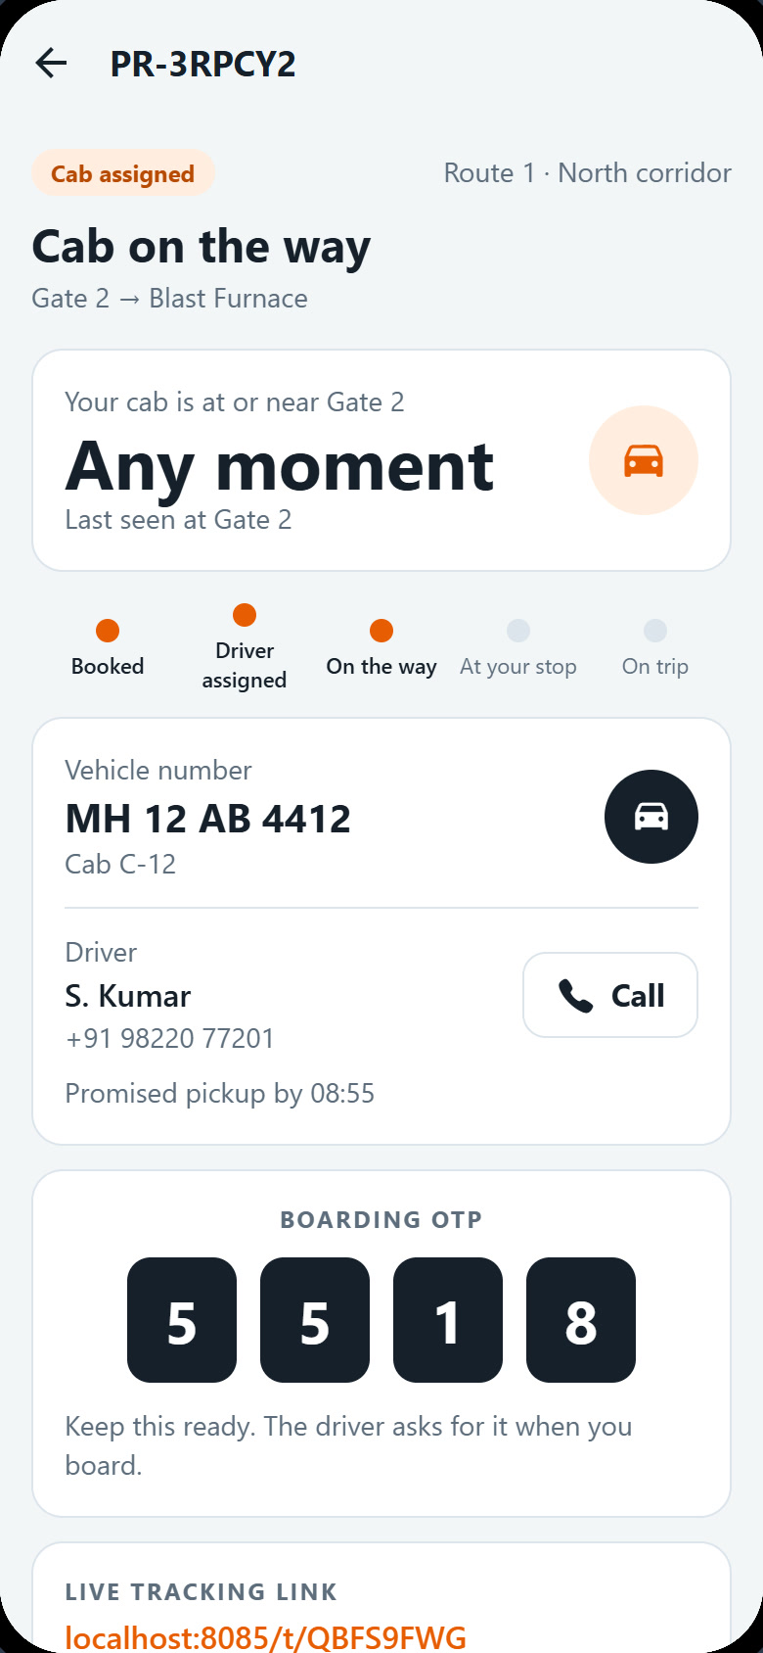
PLANT RIDE · A JOURNEY RECORDED ON THE MVP
Morning shift change at Gate 2
One rider, one driver and the transport desk follow the same booking from start to finish.
AR
Rider A. Raghavan · LHS-40218 · Operations · CC-4471
SK
Driver S. Kumar · DRV-2281 · cab C-12 · MH 12 AB 4412
RK
Admin R. Kapoor · Fleet admin and transport desk
Wednesday 30 September 2026 · demo data · SRM ECO TECH for LHS
Notes:
A single booking seen by three people: A. Raghavan who rides, S. Kumar who drives cab C-12, and R. Kapoor at the transport desk. Everything shown was recorded on the running MVP.

Slide 2
THE SCENARIO
A meeting at 09:00, and no cab free at 08:40
A. Raghavan (Operations) is at Gate 2 and needs to reach the Blast Furnace. Every cab is busy or full, and the next driver has not signed on yet.
He books anyway. The app tells him when a ride can come and which cabs are near, and keeps searching. When S. Kumar signs on with cab C-12, the engine pools him with two colleagues already waiting. He boards with an OTP, rides, is charged to his cost centre and rates the trip. The desk sees every step.
Knows when a ride can come
1
Even with no cab free: the earliest cab, the shuttle, and nearby pickup points.
Matched without a call
2
The engine pools waiting riders the moment a driver signs on.
Right rider, right cab
AR
Rider · A. Raghavan
3
Each rider boards with a 4-digit OTP; three riders fill the 3-seat cap.
LHS-40218 · Operations · CC-4471
SK
Driver · S. Kumar
DRV-2281 · cab C-12 · MH 12 AB 4412
Every rupee on a cost centre
4
₹22.86 of the ₹61.20 trip goes to CC-4471 · Operations.
RK
Admin · R. Kapoor
Fleet admin and transport desk
Plant Ride · Morning shift change at Gate 2
Notes:
The cast are demo accounts in the MVP. Password for all: Plant@123.

Slide 3
JOURNEY AT A GLANCE
One booking, three screens, six moments
1
Books, no cab free
2
Driver signs on
3
Cab at Gate 2
4
On the way
5
Dropped
6
Settled
Rider
A. Raghavan
Sees when a ride can come; waits in the queue
Matched to C-12: vehicle, driver, OTP
Shows his OTP
Trip in progress, drop in 16 min
Charged ₹22.86 to CC-4471; rates 5★
Alerts record every step
AR
Driver
S. Kumar
Not on duty yet
Duty check, sign on: 3 riders at Gate 2
Boards each rider by OTP
Drops M. Iyer at Coke Plant
Last drop closes the trip
Signs off: GPS matches odometer
SK
Admin
R. Kapoor
Queue explains why no cab
Queue clears by itself
C-12 on trip, 3 of 3
Live board, KPIs, alerts
Cost split by distance
Audit trail, who and when
RK
Plant Ride · Morning shift change at Gate 2
Notes:
Read across a column to see the same moment on all three screens.

Slide 4
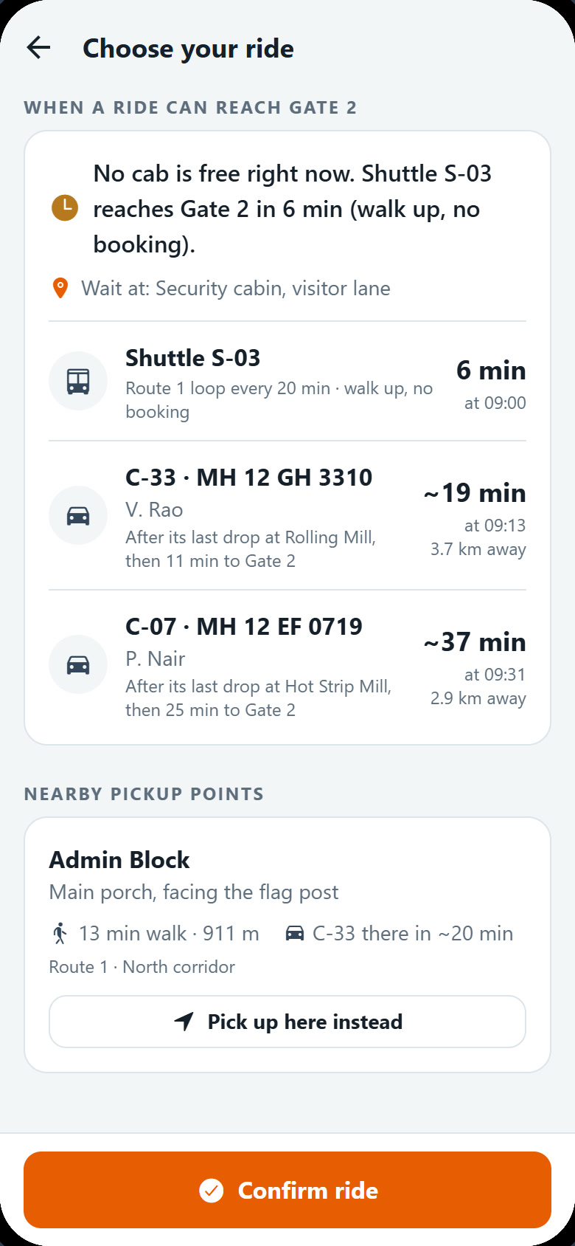
CHAPTER 1 OF 3 · RIDER
A. Raghavan books, waits, and is matched automatically
AR
A. Raghavan
LHS-40218 · Operations · CC-4471
Books Gate 2 → Blast Furnace with no cab free
Sees when a ride can come and which cabs are near
Matched to C-12, boards by OTP, charged ₹22.86 to CC-4471
Plant Ride · Morning shift change at Gate 2

Slide 5
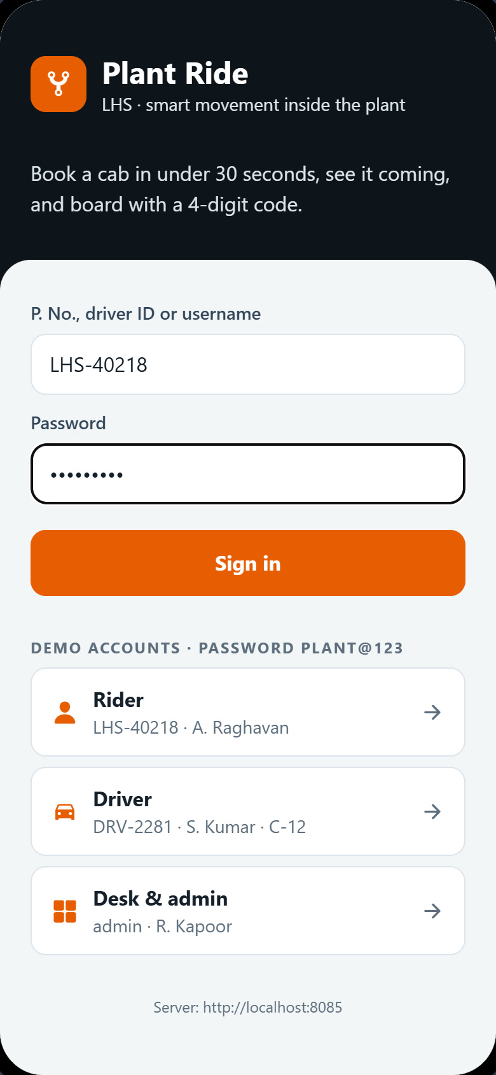
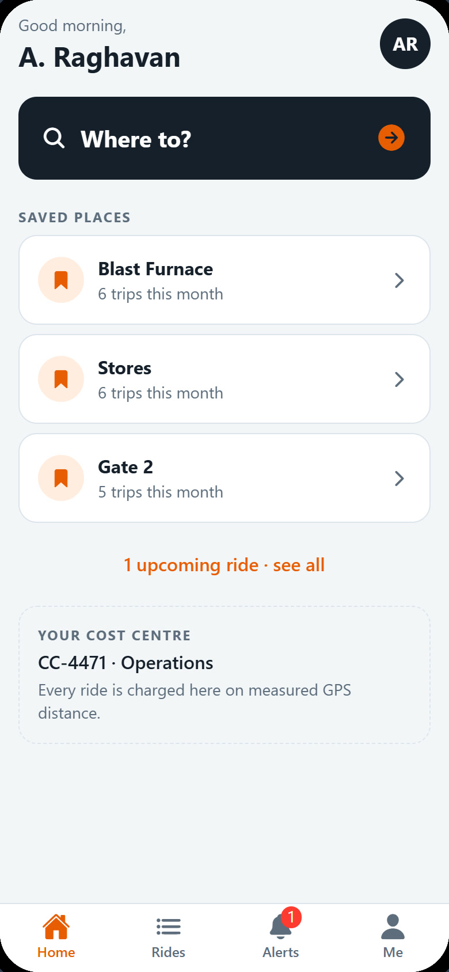
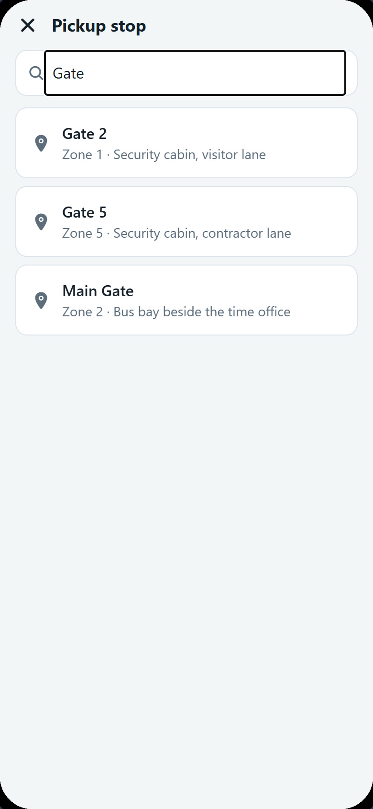
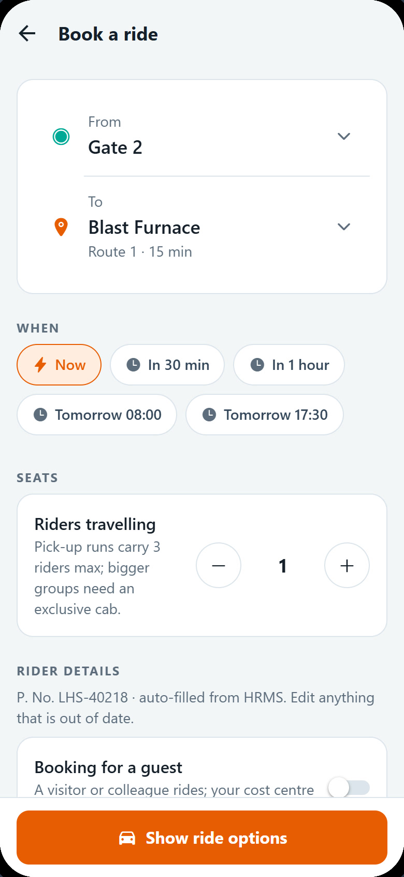
AR
RIDER · STEPS 1 TO 4
Sign in and book Gate 2 to the Blast Furnace
1
Sign in
2
Home
3
Pick the stop
4
Trip details
P. No. and password; one tap on a demo account.
Saved places and the cost centre every ride is charged to.
Each pickup point shows exactly where to wait.
Gate 2 → Blast Furnace, now, 1 seat; details from HR.
Plant Ride · Morning shift change at Gate 2

Slide 6
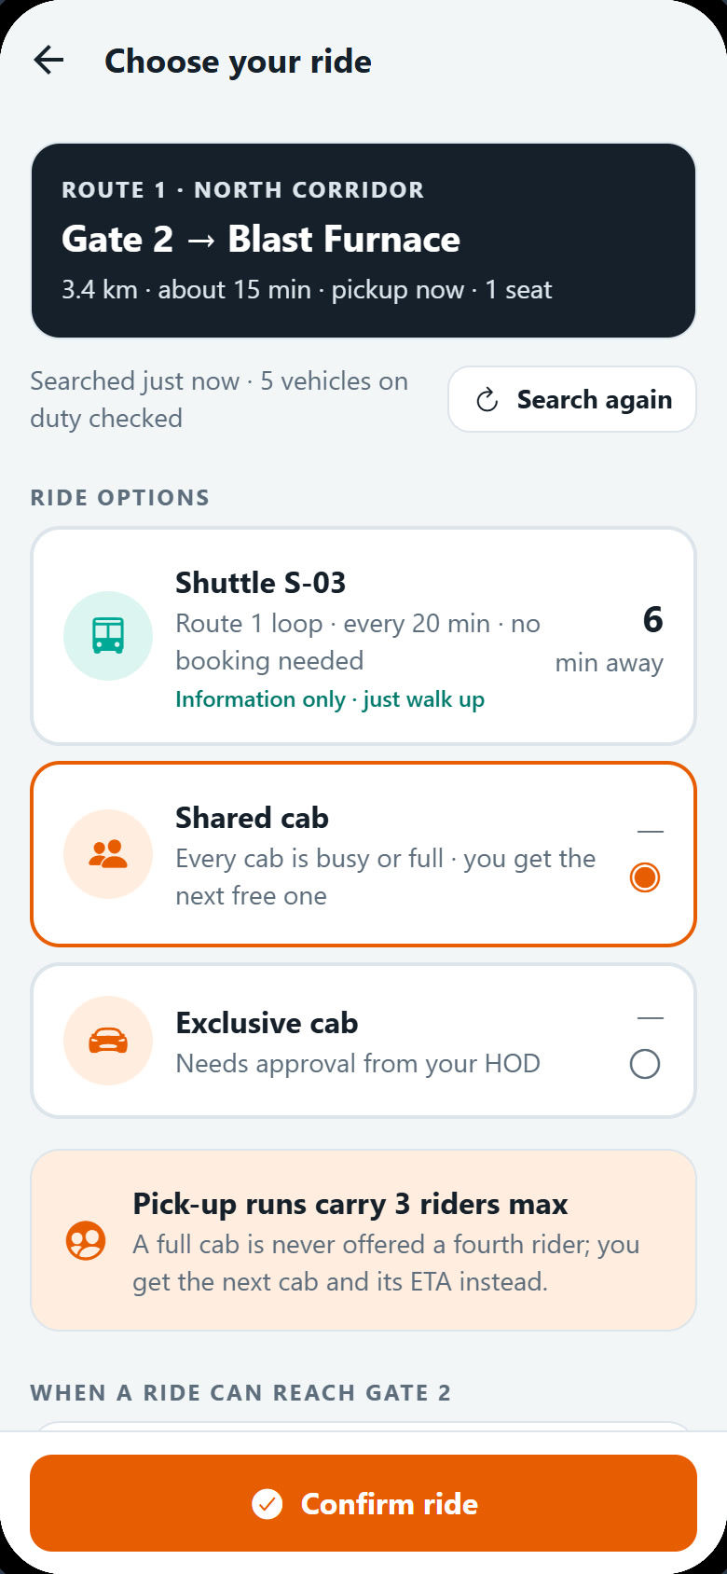
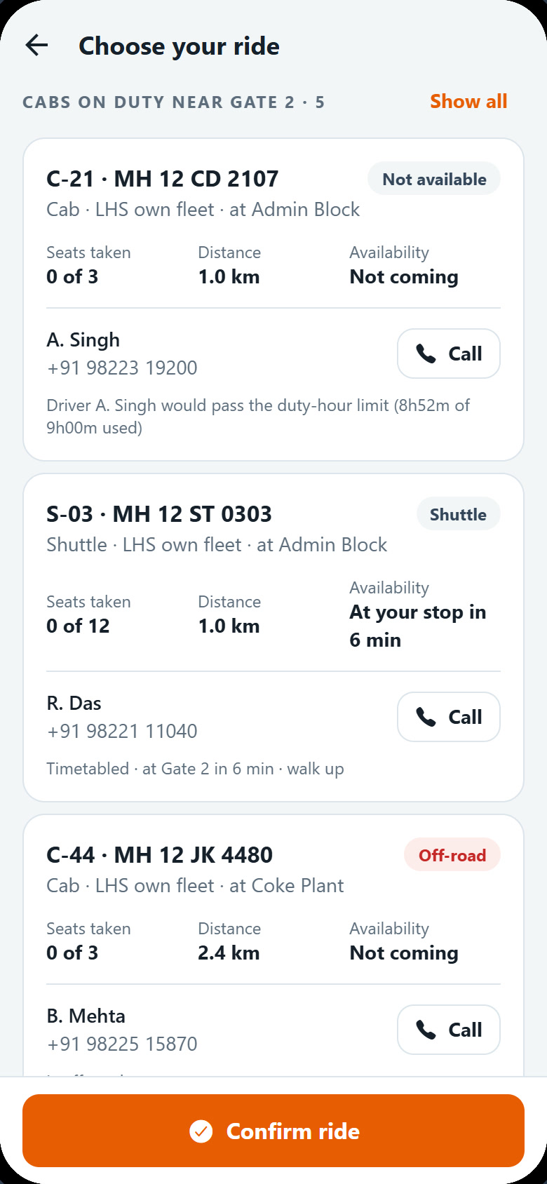
AR
RIDER · STEPS 5 TO 7
No cab free, but he knows when one can come
5
Search
6
When a ride can come
7
Cabs on duty
Every cab on duty, free seats within the cap, and arrival times are checked.
The shuttle, and each busy cab after its last drop, with times and distances.
Driver, phone, seats taken, distance and why each can or cannot come now.
Plant Ride · Morning shift change at Gate 2
Notes:
This is the new availability view: it answers "when will a ride reach me" even when the shared option says every cab is busy or full.

Slide 7
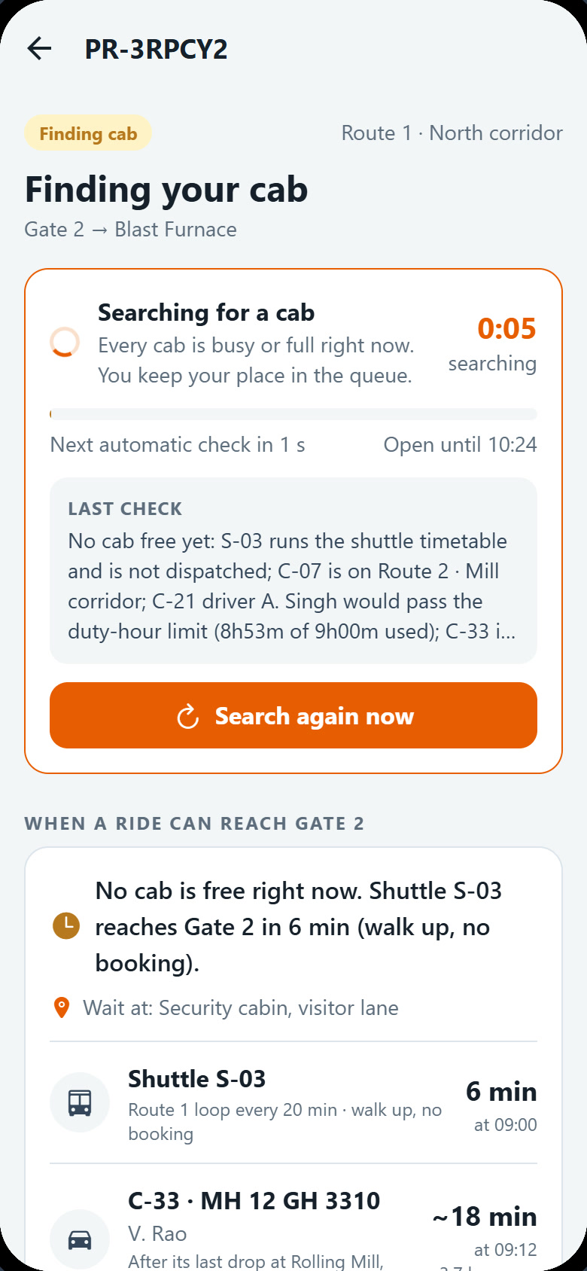
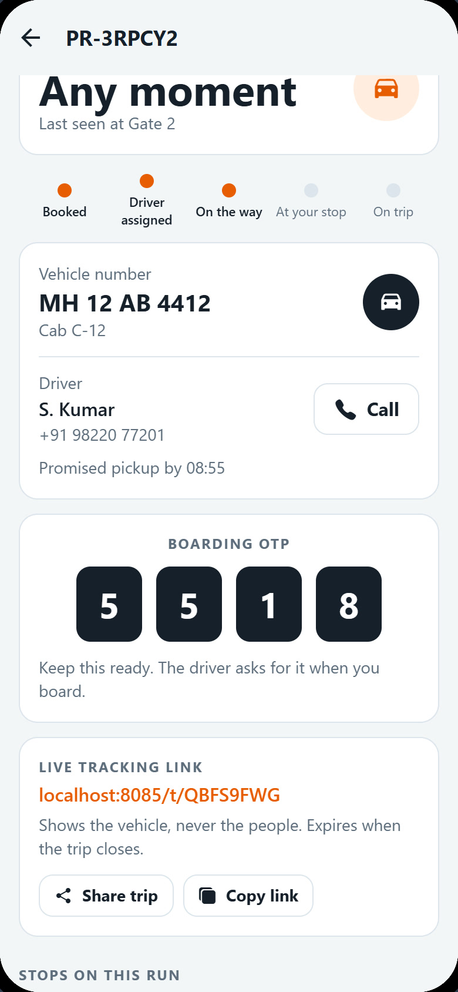
AR
RIDER · STEPS 8 TO 10
He keeps his place, then C-12 is his
8
Searching
9
Matched to C-12
10
OTP and tracking
A live timer, the next automatic check, and Search again now.
S. Kumar signs on; the engine assigns the cab. No phone call.
A 4-digit boarding code and a link that shows the cab, never the people.
Plant Ride · Morning shift change at Gate 2

Slide 8
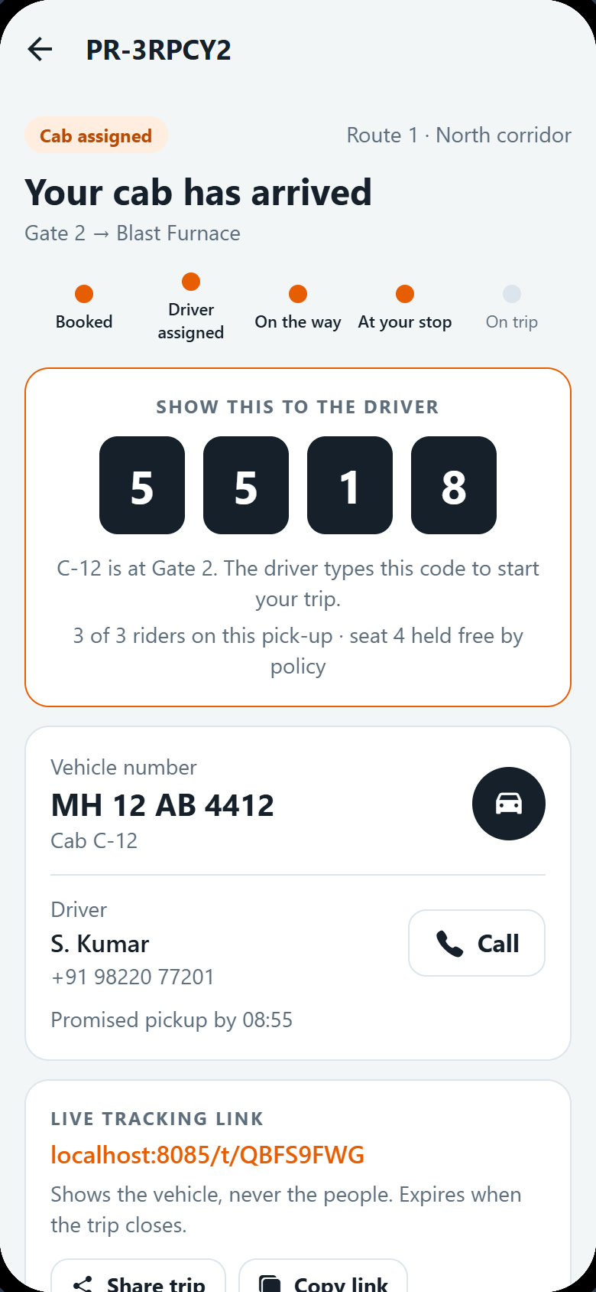
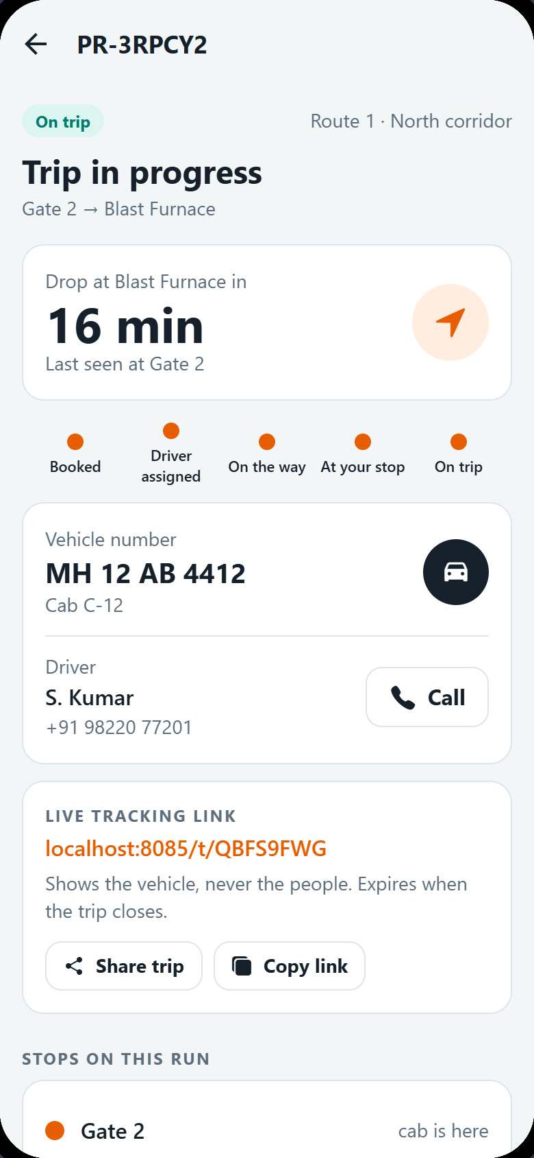
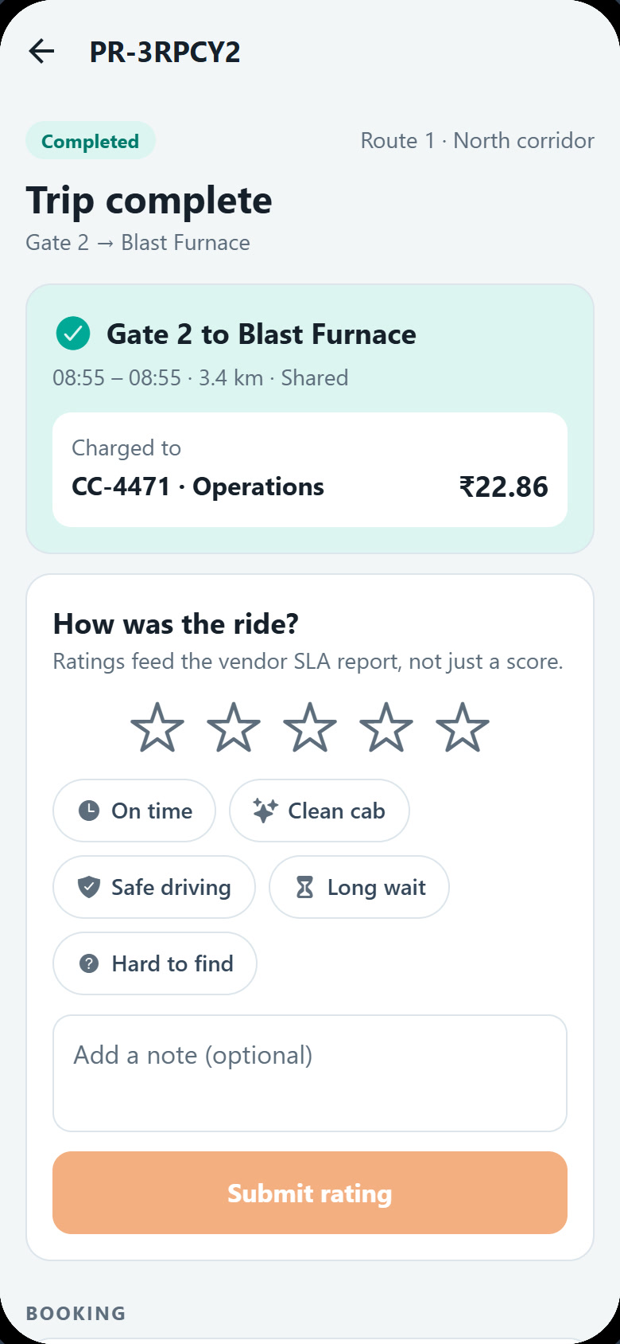
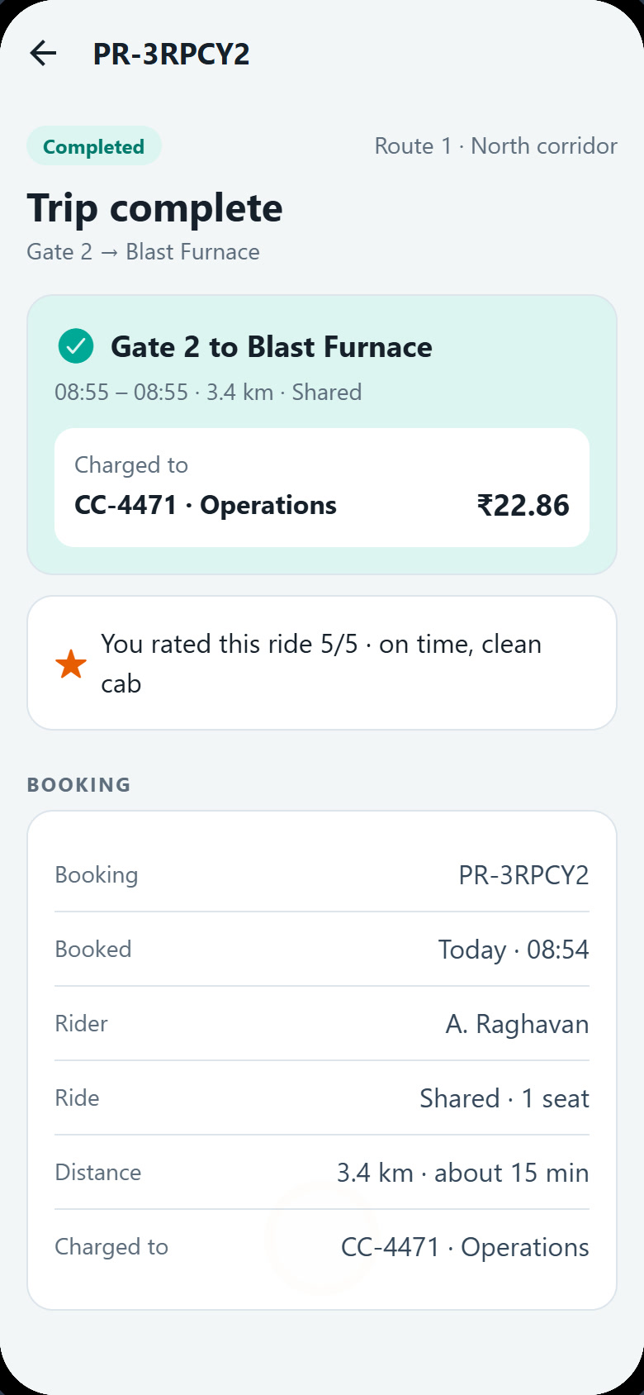
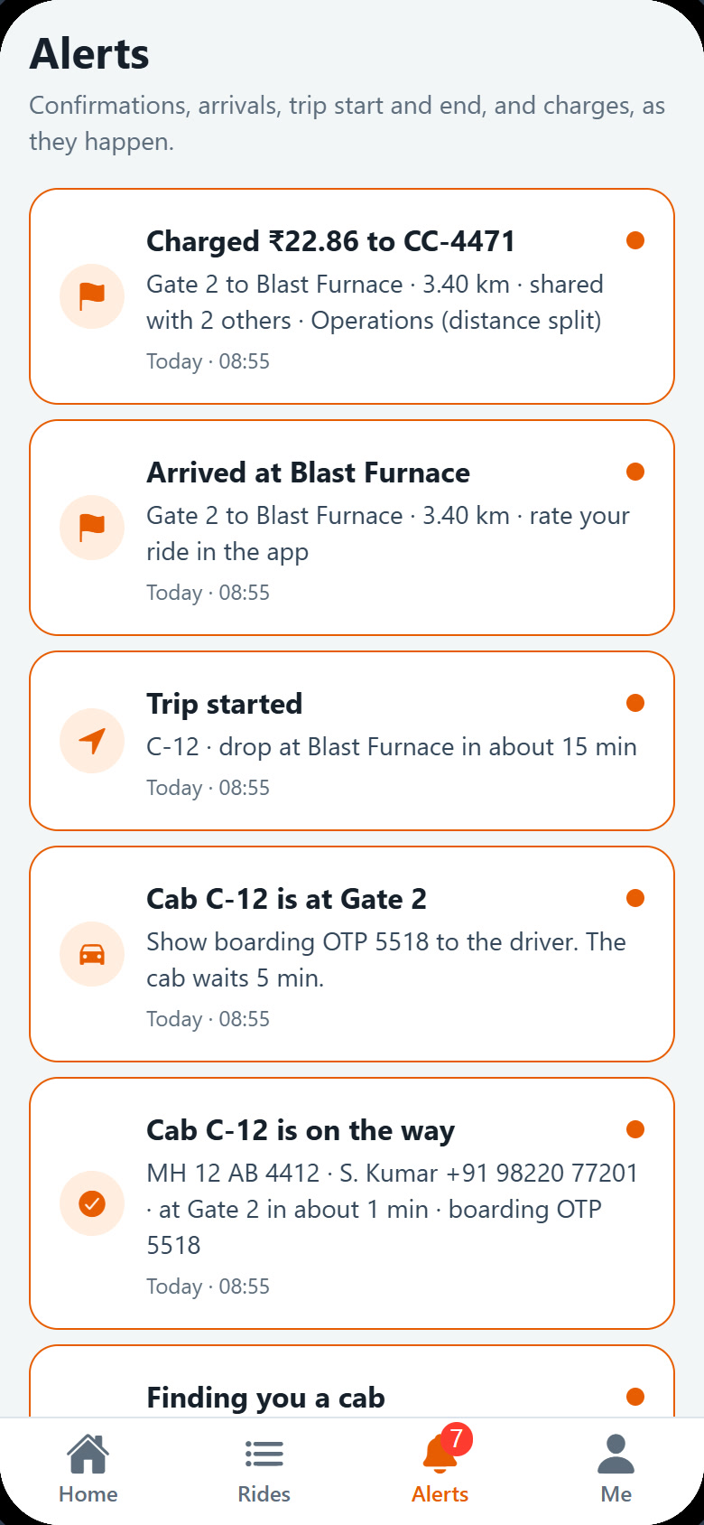
AR
RIDER · STEPS 11 TO 15
Board, ride, pay the right cost centre, rate
11
Cab arrived
12
On trip
13
Trip complete
14
Rated 5★
15
Alerts
The code in big digits for the driver.
Drop time, the cab and the shared stops.
3.4 km; ₹22.86 to CC-4471.
On time, clean cab; feeds the vendor SLA.
Every step recorded as a notification.
Plant Ride · Morning shift change at Gate 2

Slide 9
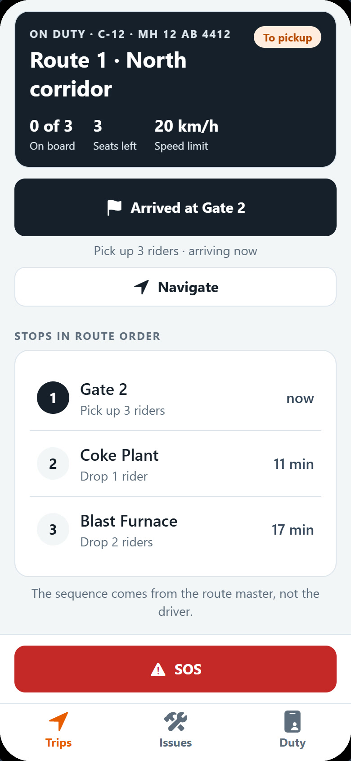
CHAPTER 2 OF 3 · DRIVER
S. Kumar signs on and three riders are waiting for him
SK
S. Kumar
DRV-2281 · cab C-12 · MH 12 AB 4412
Start-of-duty check: documents, five vehicle checks, odometer
The waiting riders are pooled onto C-12 at once
Boards by OTP, drops in route order, signs off with a GPS check
Plant Ride · Morning shift change at Gate 2

Slide 10

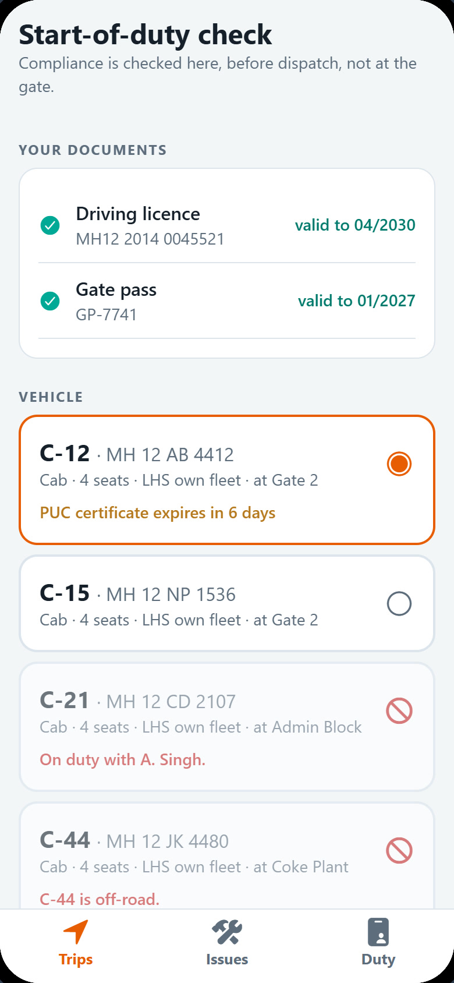
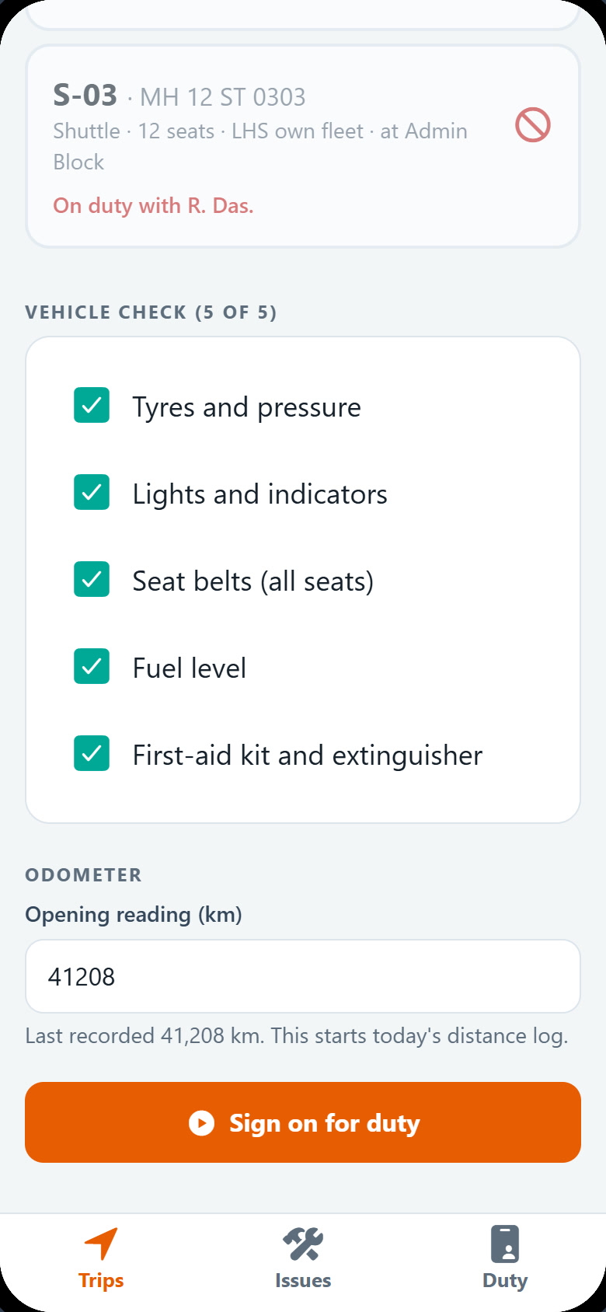
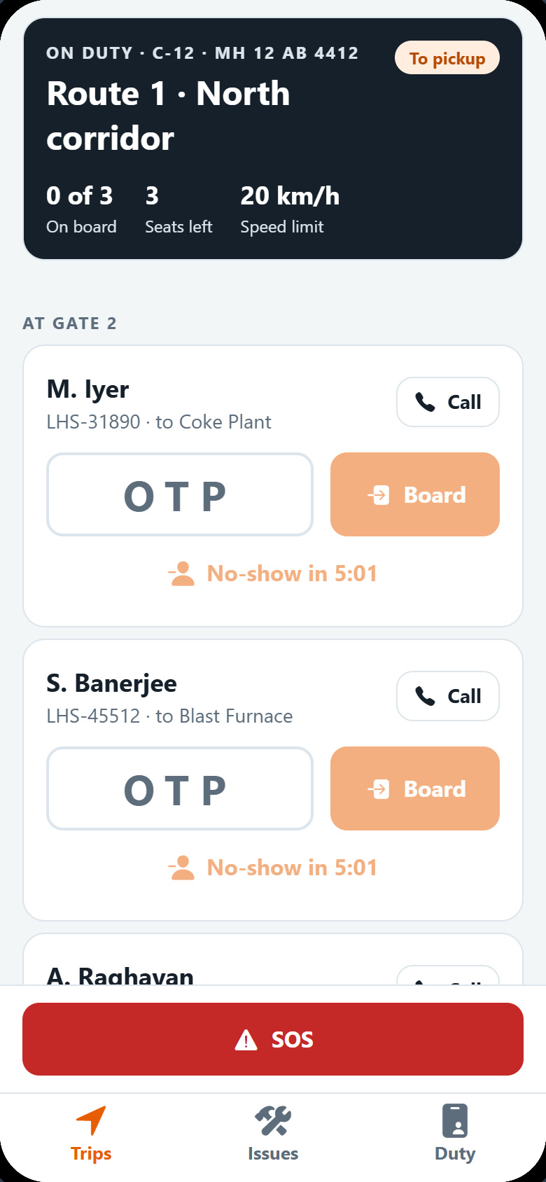
SK
DRIVER · STEPS 1 TO 5
From sign-in to the Gate 2 pickup
1
Sign in
2
Duty check
3
Vehicle check
4
Three riders
5
At Gate 2
Driver ID DRV-2281.
Licence and gate pass valid; C-12 preselected.
Five checks and the opening odometer.
Matched at sign-on, in route order.
OTP box, call button, no-show timer.
Plant Ride · Morning shift change at Gate 2

Slide 11
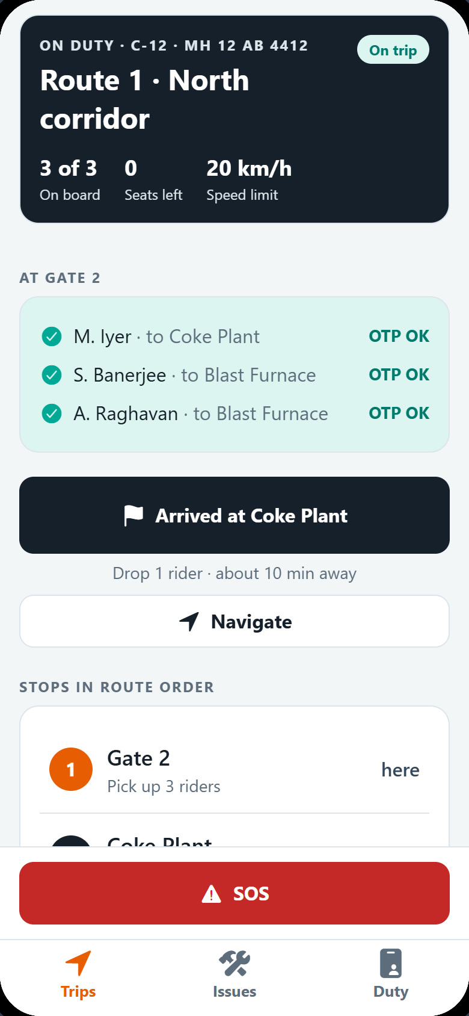
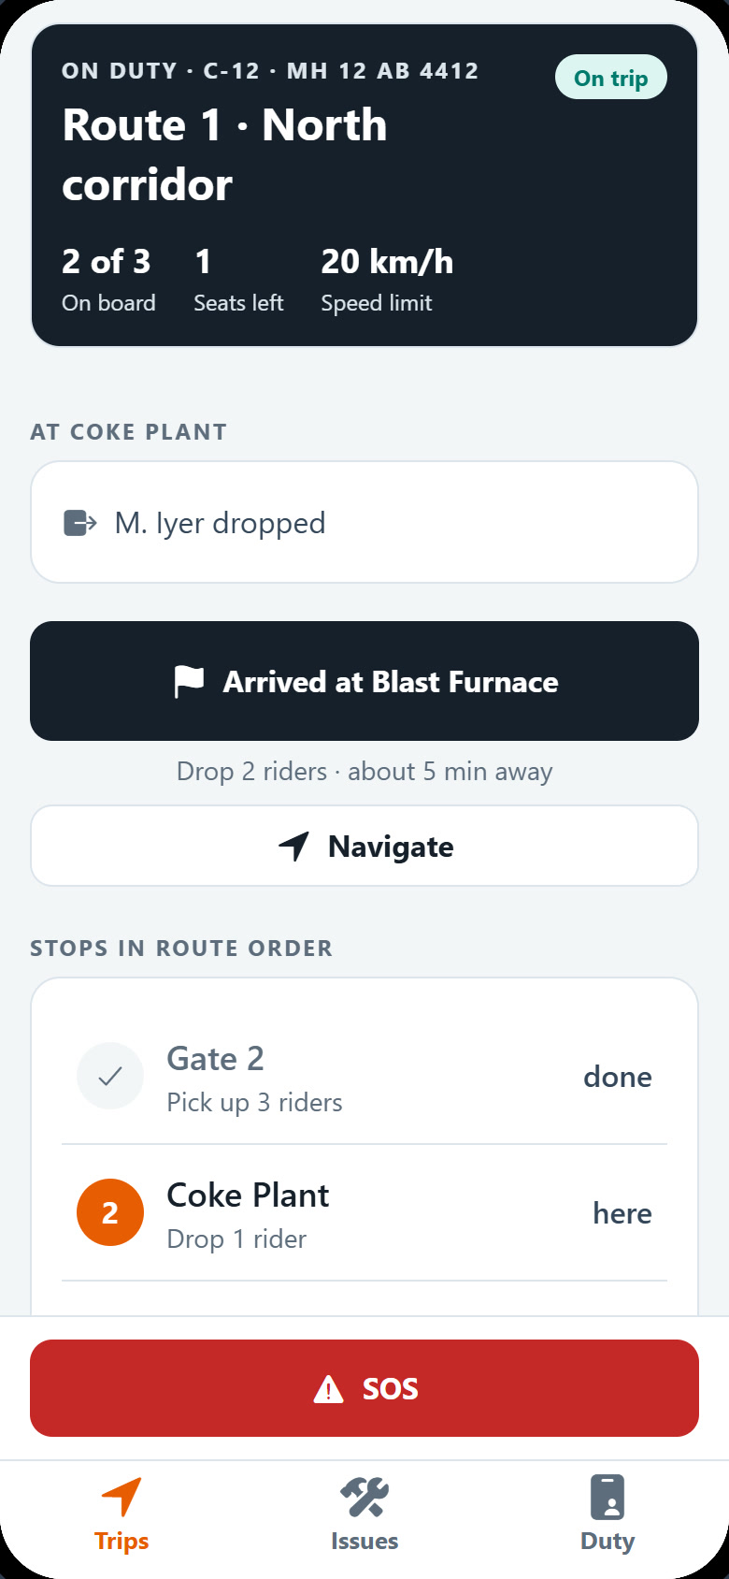
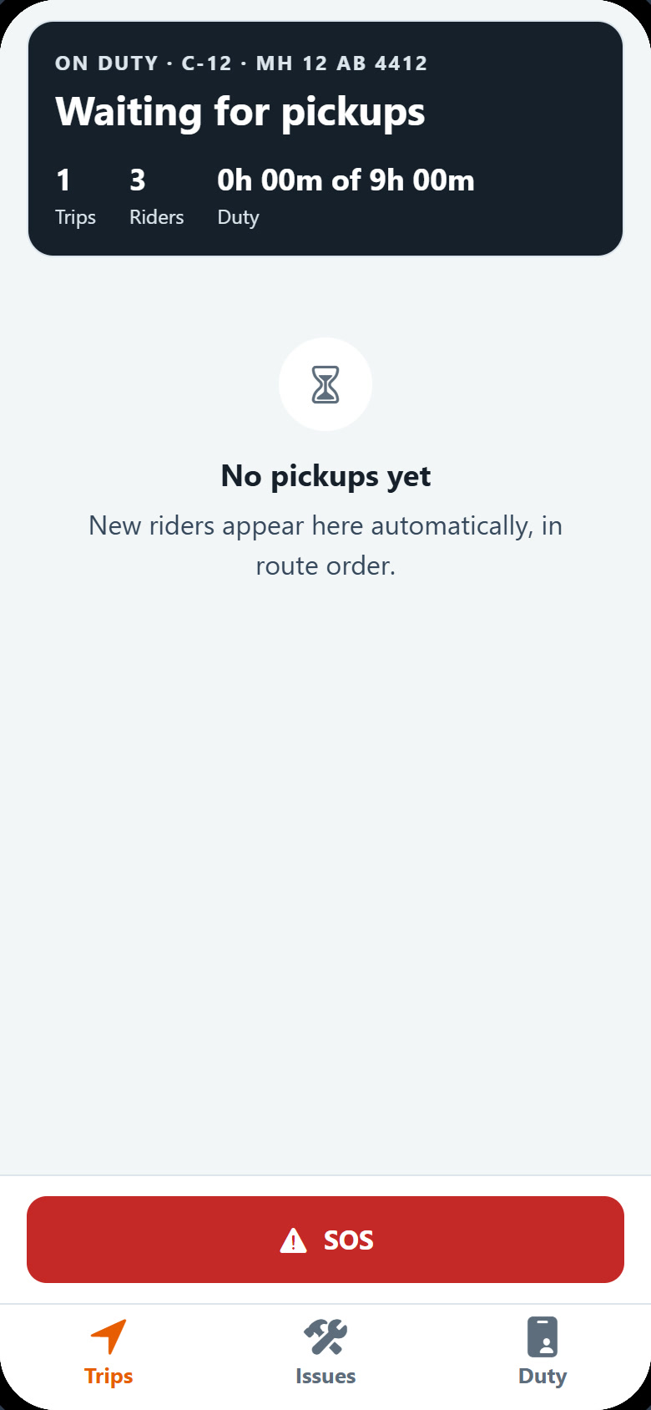
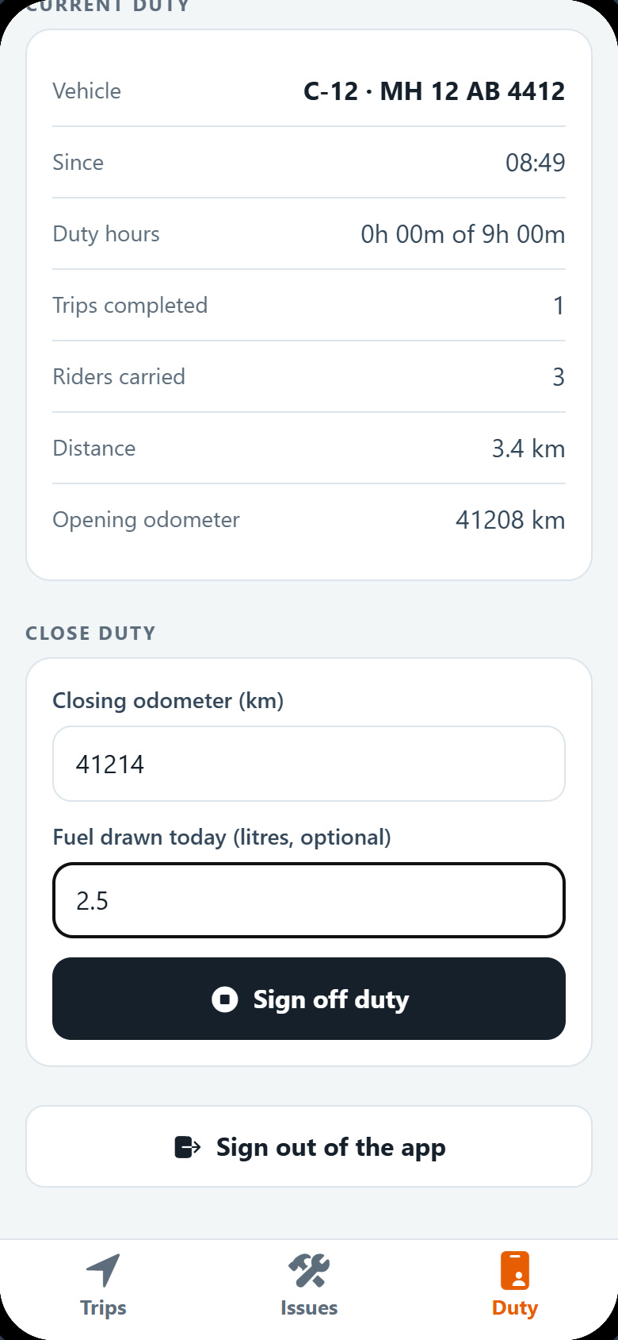
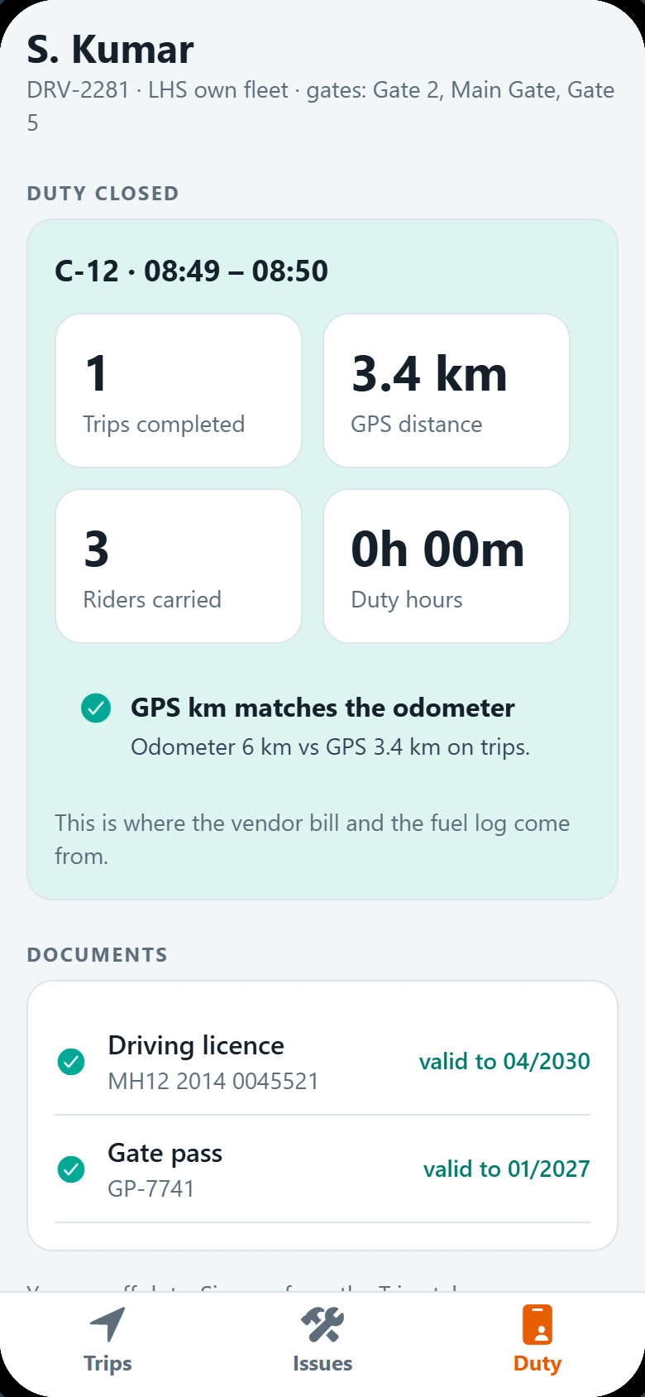
SK
DRIVER · STEPS 6 TO 10
Board by OTP, drop in order, sign off
6
Boarded
7
Coke Plant
8
Trip closed
9
Close duty
10
Signed off
Three codes checked: 3 of 3 on board.
M. Iyer dropped; two riders stay on.
Last drop at the Blast Furnace.
Closing odometer and fuel.
GPS km matches the odometer.
Plant Ride · Morning shift change at Gate 2

Slide 12
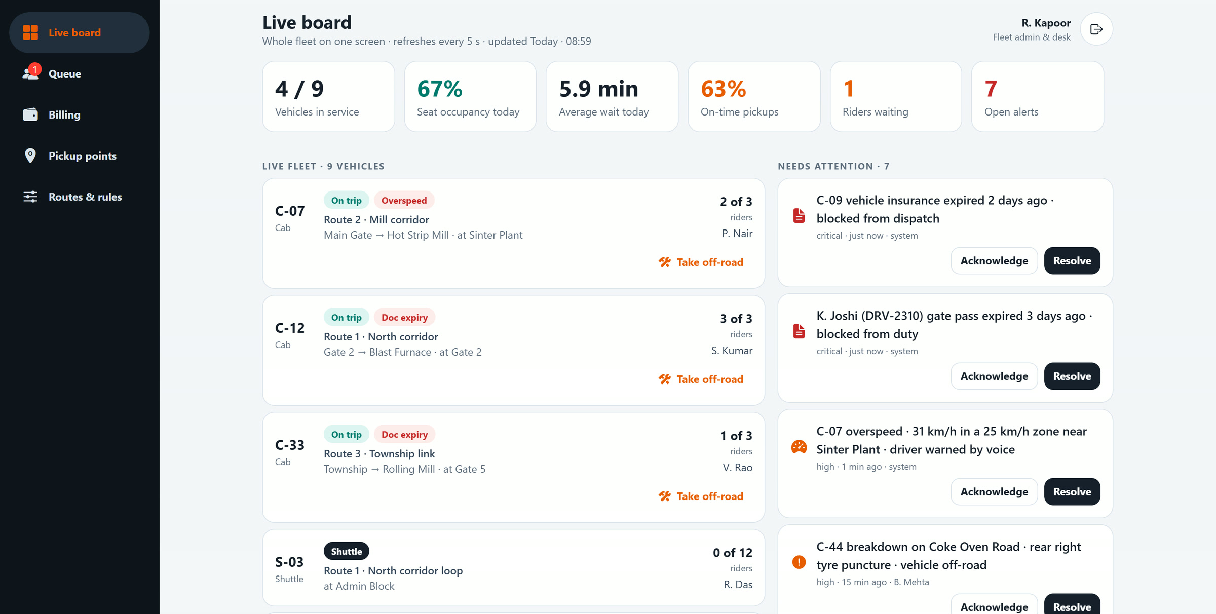
CHAPTER 3 OF 3 · ADMIN
R. Kapoor sees it all from the desk, without a phone call
RK
R. Kapoor
Fleet admin and transport desk
The queue explains why no cab was free
Riders leave the queue by themselves at sign-on
Cost lands on cost centres; the audit trail has every step
Plant Ride · Morning shift change at Gate 2

Slide 13
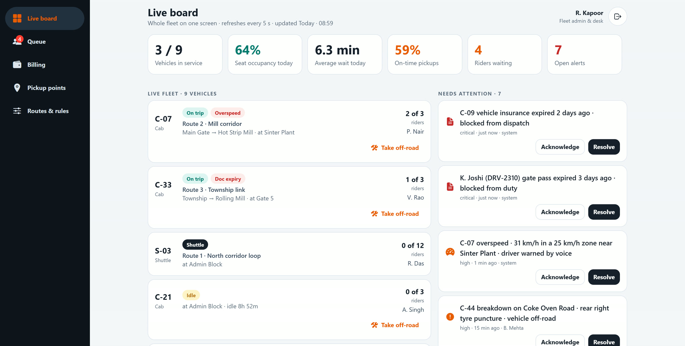
RK
ADMIN · STEP 1 OF 7
Riders waiting at the shift change
1
Live board
The whole fleet on one screen, refreshed every 5 seconds: KPIs, vehicles, alerts and the riders waiting.
Riders waiting at Gate 2, A. Raghavan among them
No cab free for them yet: C-12 is not on duty
Plant Ride · Morning shift change at Gate 2

Slide 14
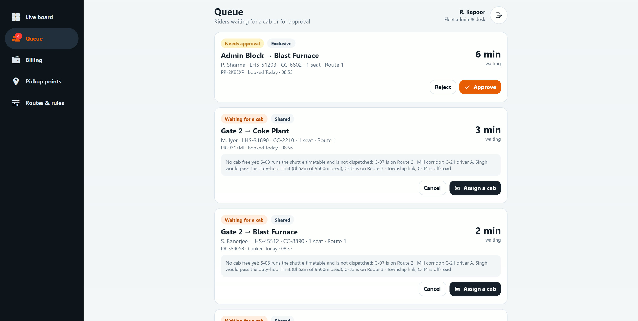
RK
ADMIN · STEP 2 OF 7
The queue explains itself
2
Queue
For each waiting rider, the matching engine says why no cab can take them right now.
Other cabs are on Route 2 and Route 3
C-21 would pass the 9-hour duty limit; C-44 is off-road
Plant Ride · Morning shift change at Gate 2

Slide 15
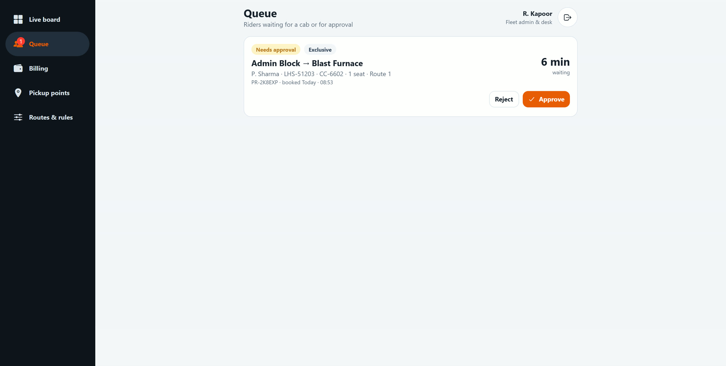
RK
ADMIN · STEP 3 OF 7
Matched without a phone call
3
Queue clears by itself
When S. Kumar signs on with C-12, the three Gate 2 riders are pooled onto his cab straight away.
Only an exclusive request awaiting approval is left
Nobody on the desk had to assign anything
Plant Ride · Morning shift change at Gate 2

Slide 16
RK
ADMIN · STEP 4 OF 7
C-12 on trip, 3 of 3
4
Live board
The riders boarded by OTP. C-12 shows on trip with three riders, inside the 3-rider cap.
Seat occupancy rises on the KPI tiles
Alerts stay visible alongside
Plant Ride · Morning shift change at Gate 2

Slide 17
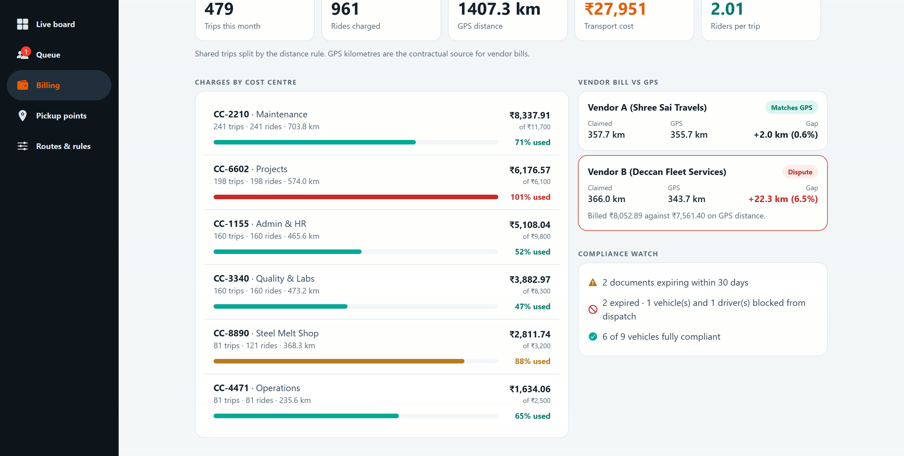
RK
ADMIN · STEP 5 OF 7
Every rupee on a cost centre
5
Billing
The ₹61.20 trip is split by kilometres ridden: ₹22.86 goes to CC-4471 · Operations.
Vendor bills are checked against GPS kilometres
Export to SAP as CSV
Plant Ride · Morning shift change at Gate 2

Slide 18
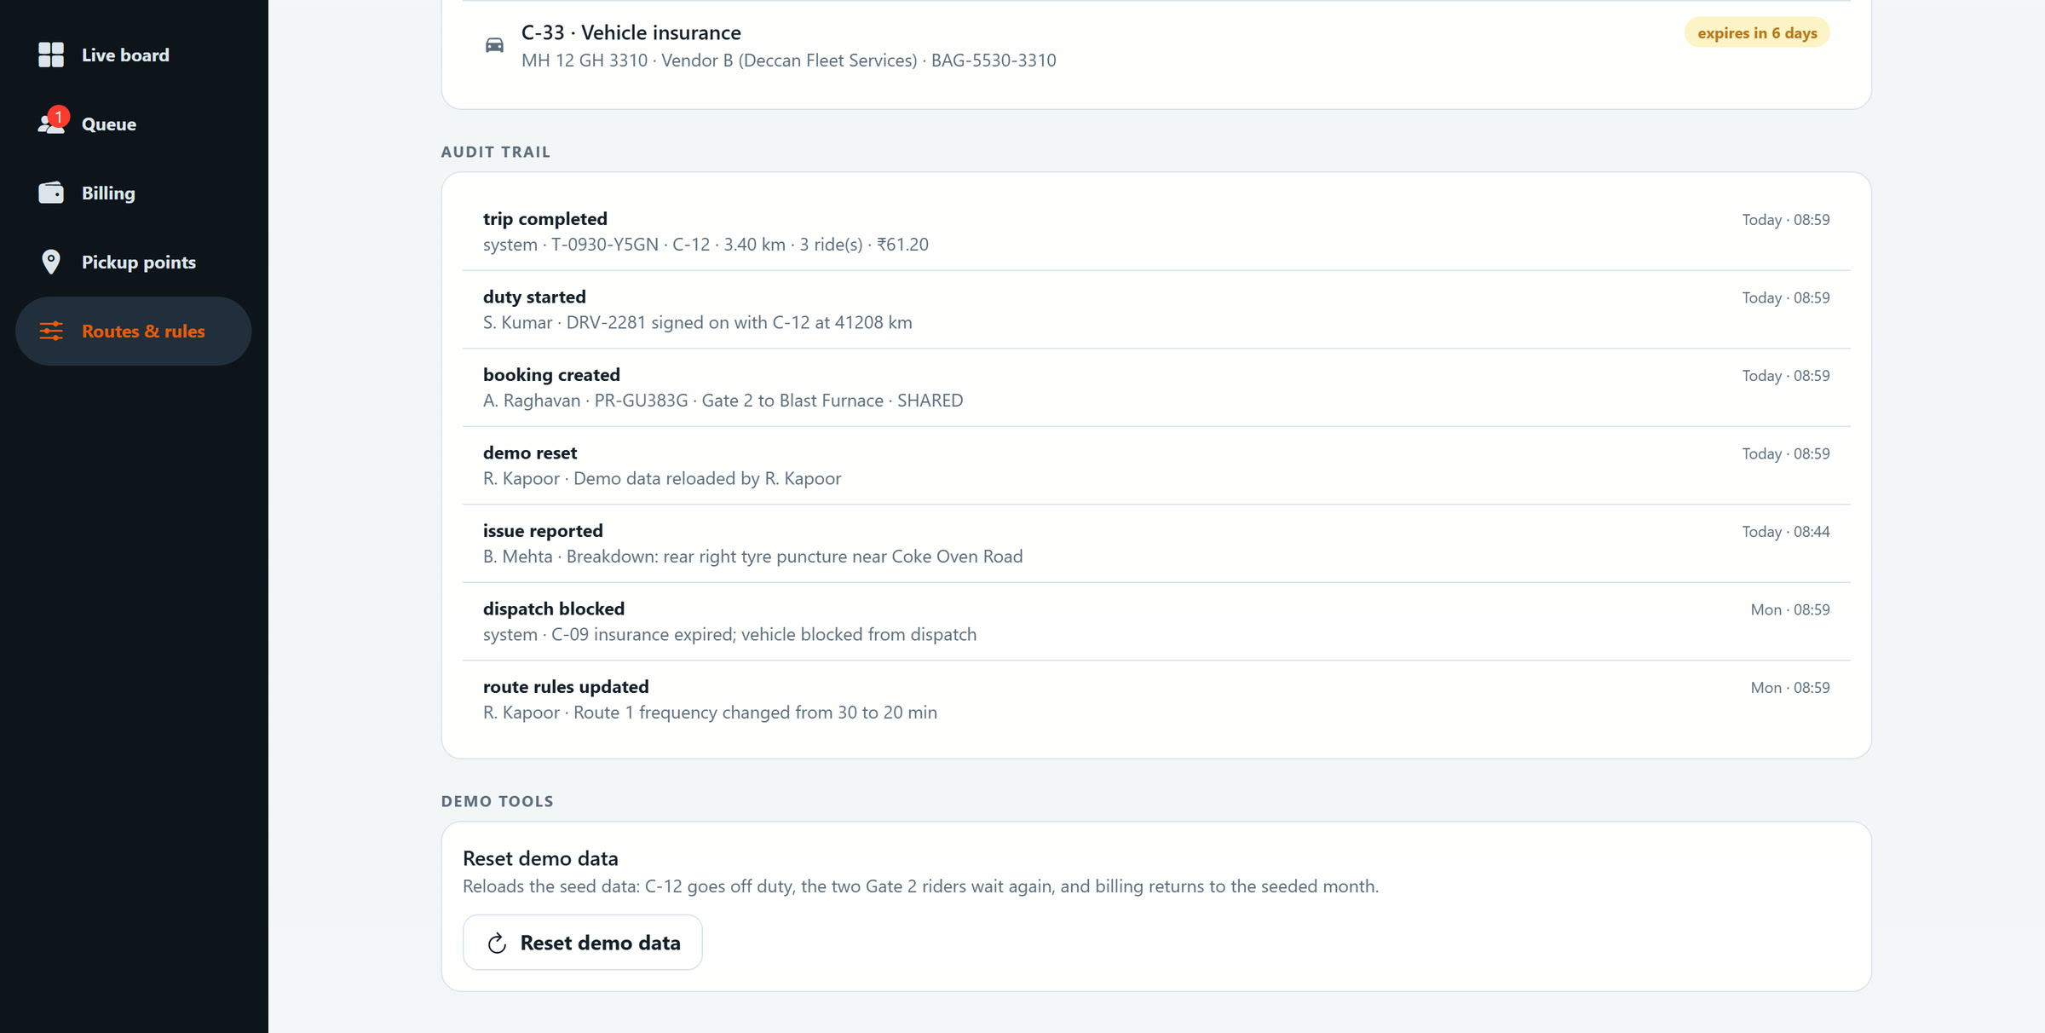
RK
ADMIN · STEP 6 OF 7
The whole journey in the audit trail
6
Audit trail
Booking created, duty started, trip completed: every change with who made it and when.
Written by the server, not the screens
Answers "who did what, when" in one place
Plant Ride · Morning shift change at Gate 2

Slide 19
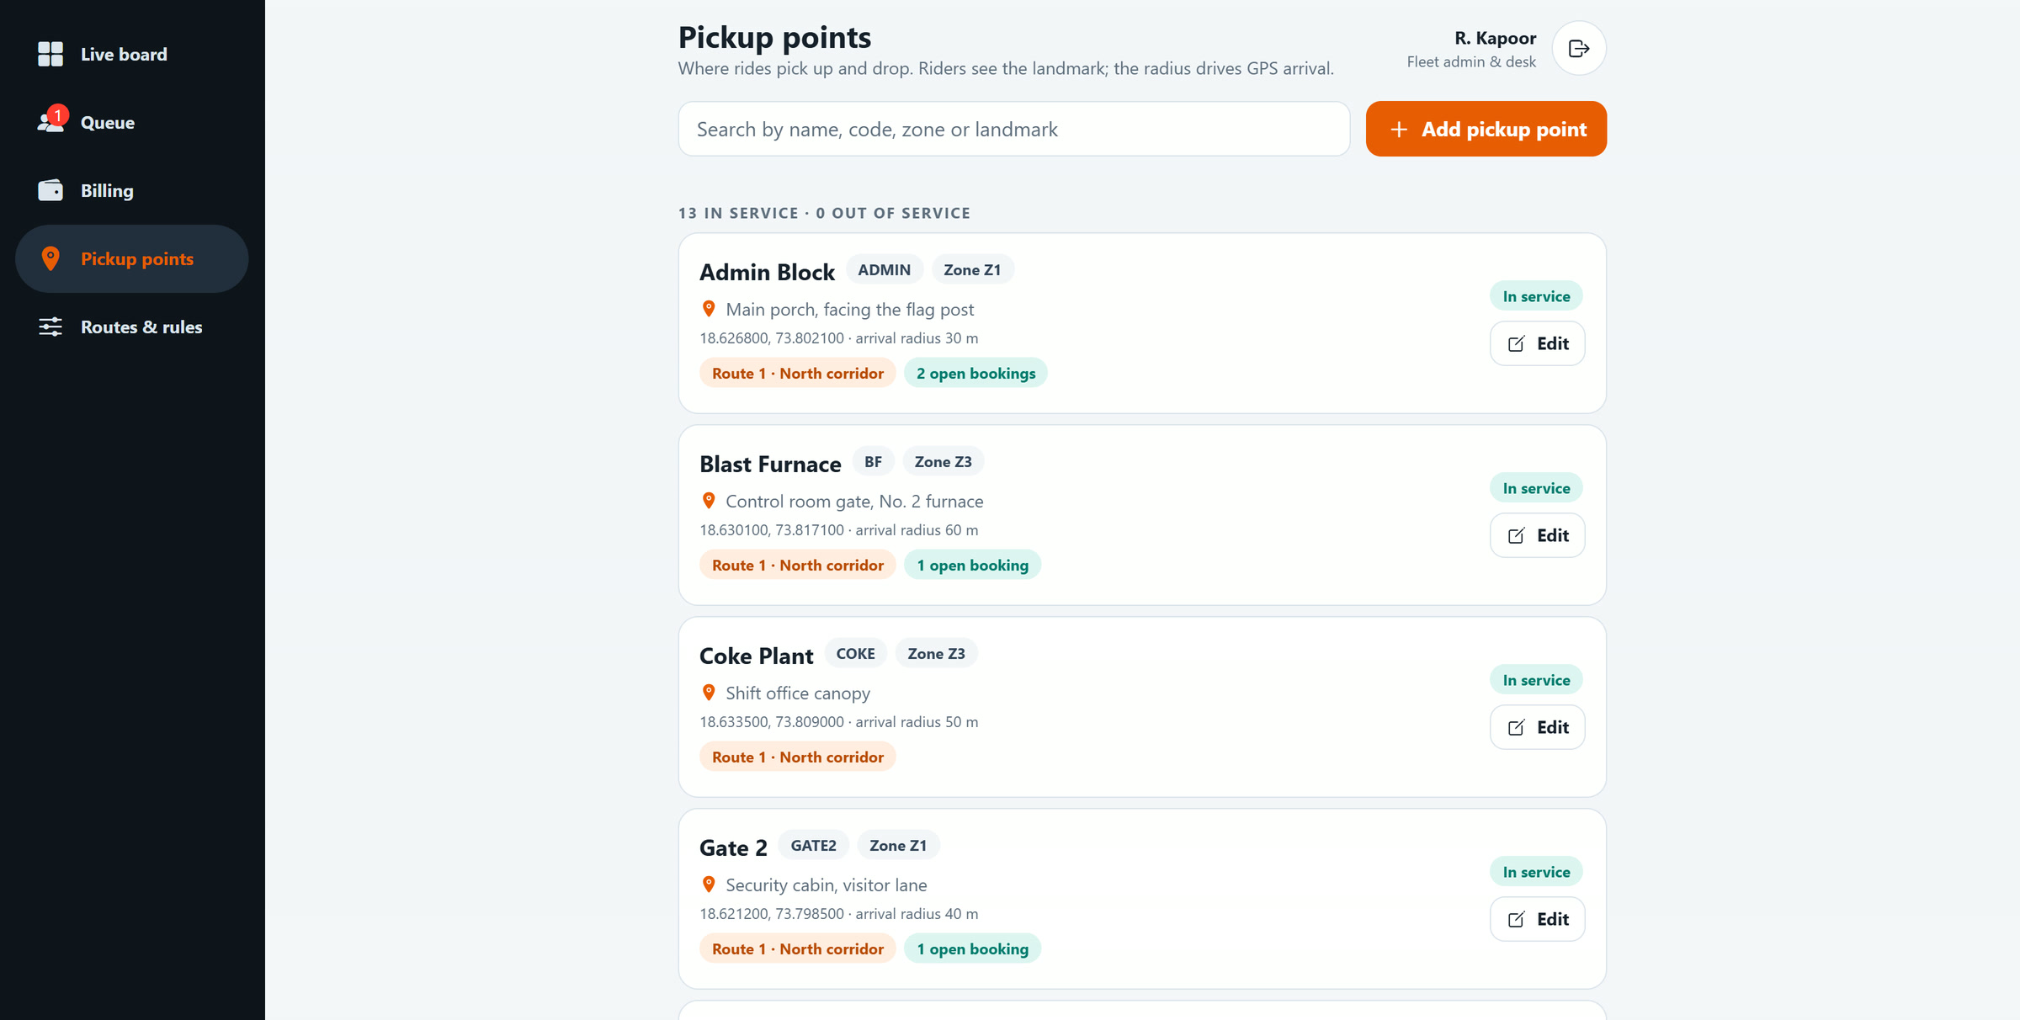
RK
ADMIN · STEP 7 OF 7
Where riders wait is configured by the admin
Landmark
Where exactly to wait, shown to riders: "Security cabin, visitor lane".
Arrival radius
GPS arrival is recorded inside it, 10 to 500 m.
Routes and bookings
Which routes serve the point, and its open bookings.
Safe to change
7
Pickup points
A point on a route or with open bookings cannot be taken out of service.
Plant Ride · Morning shift change at Gate 2

Slide 20
WHAT THE JOURNEY SHOWS
One booking, three screens, no phone calls
3 of 3
₹22.86
3.4 km
0
riders pooled on C-12, inside the 3-rider cap
charged to CC-4471 · Operations (trip ₹61.20, split by distance)
measured ride distance, the basis for the charge
phone calls to the transport desk
The rider knew when a ride could come before any cab was free, kept his place in the queue, and was matched the moment a driver signed on. The driver boarded the right riders by OTP. The desk saw every step and every rupee.
Plant Ride · Morning shift change at Gate 2

Slide 21
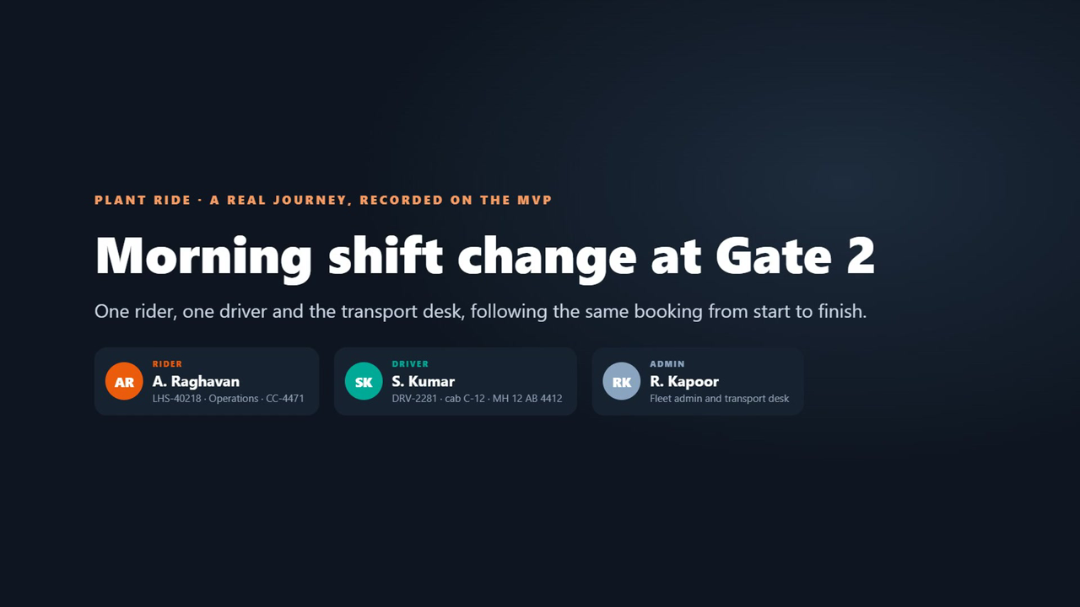
WATCH THE JOURNEY
The whole scenario on video, 4 min 49 s
0:00
Rider
A. Raghavan books, waits and rides
2:10
Driver
S. Kumar signs on, boards and drops
3:32
Admin
R. Kapoor watches from the desk
Plant-Ride-Scenario-Walkthrough.mp4 · 1920 × 1080 · chapters built in
Plant Ride · Morning shift change at Gate 2
Notes:
The video is embedded; click it in Slide Show to play. The same file is in the folder next to this deck.

Slide 22
Thank you
Plant Ride MVP · SRM ECO TECH for LHS
HOW THIS WAS RECORDED
Every screen is the running MVP with its demo data, driven in Chrome; nothing is mocked or edited.
The clock was set to a morning shift change (about 08:40 on 30 September) so the shuttle runs and billing shows the month.
The ride itself happens in seconds on camera, so its start and end times both read the same minute.
Each chapter is its own run from the same starting data, so booking codes and OTPs differ between chapters.
Plant Ride · Morning shift change at Gate 2

