Slide 1

How Much Does Body Pose Help Pedestrian Trajectory Forecasting?
A Seed-Replicated Study and Auxiliary-Loss Audit on Waymo
Pose-conditioned Motion Transformer (MTR) on the Waymo Open Motion Dataset
Author · Advisor · Date

Slide 2
Question, Setup & Roadmap
▸ Question — Forecasters (MTR) use position, velocity, HD-map geometry but ignore body pose, which plausibly encodes intent. Does conditioning MTR on past SMPL poses help — and what drives the gain?
▸ Setup — MTR + pose branch (past 11 SMPL poses, 6-D rotations; GRU or cross-attention encoder) + auxiliary future-pose losses · Waymo pedestrian subset (579 train scenes; 6,688 eval pedestrians) · LiDAR-derived SMPL pseudo-GT (Waymo-3DSkelMo) · minADE/minFDE over 6 modes; MR@2m as external anchor.
▸ Roadmap — a result and THREE corrections of our own results: the −7.6% geodesic claim, the −3.5% “stable encoder” claim, and the PE-ordering mechanism were all seed artifacts, each caught by seed replication (now 5 seeds per configuration, clean code provenance).
▸ Bottom line up front — pose helps in exactly one configuration (HD map × cross-attention+PE), by ~1.6% (p<1e-4), and control ablations show that benefit is genuine body-configuration signal — not heading, not a frame artifact. Context (map −26%, pretraining −23%) dominates.

Slide 3
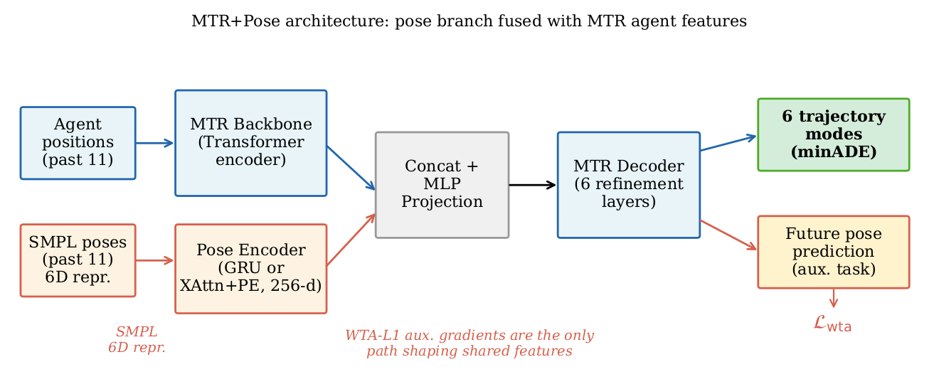
Architecture: What We Changed in MTR
▸ Pose encoder — 2-layer GRU (or cross-attention + sinusoidal PE) over the past 11 SMPL poses (144-D, 6-D rotations) → 256-D pose feature.
▸ Pose fusion — concatenated with the MTR agent feature and projected by an MLP “fuser”; a residual zero-init variant preserves a pretrained backbone when fine-tuning.
▸ Auxiliary pose heads — per decoder layer, predict future poses (24 joints × 6-D, 6 modes) plus a pose-mode classifier.
▸ Auxiliary pose losses — WTA-L1, geodesic, MPJPE, classification (w = 0.1). Our audit shows these are inert on 10-fps data.
▸ Correctness & evaluation — future-pose validity mask; per-pedestrian paired + hierarchical (seed) bootstrap.
MTR + pose branch. Our additions are the pose pathway (blue); the MTR context encoder, map attention, and GMM trajectory decoder are unchanged.

Slide 4

Part 1 — Auxiliary-Loss Audit: an Inert Loss Credited With the Headline
An earlier draft claimed: "geodesic SO(3) supervision is the critical ingredient" → −7.6% minADE.
Why this is impossible: in the 10 fps data, future-pose targets are absent — only 5 of 91,520 future-pose steps are non-zero.
A zero 6-D target maps to the all-zero rotation ⇒ geodesic loss ≡ arccos(−½), a constant with identically zero gradient (verified numerically).
The two "different" configurations compared were the same experiment under different seeds.
Check 1: Target Coverage
Check 2: Per-Term Gradient
Audit every loss against the data — verify that targets are actually non-zero before crediting any improvement.
Inspect per-term gradients on a real batch — a constant loss produces identically zero gradients and cannot drive learning.
The −7.6% minADE headline was a seed artifact. Two cheap checks — target coverage and per-term gradient inspection — would have caught it immediately.

Slide 5
Part 2 — Seed Replication Dissolves Two More Effects
Encoder (no map) | minADE (mean ± std, n=5) | per-seed
No pose (baseline) | 0.6604 ± 0.0143 | .655 .683 .664 .654 .646
GRU + WTA-L1 | 0.6853 ± 0.0651 | .639 .785 .629 .717 .657
GRU, no auxiliary | 0.6545 ± 0.0271 | .696 .665 .639 .626 .647
Cross-attention + PE | 0.6648 ± 0.0381 | .640 .634 .637 .710 .703
▸ At n = 3, cross-attention+PE looked like a stable −3.5% (σ = 0.0026). Both additional seeds fail (0.710 / 0.703, same code): at n = 5 the cell is +0.7% vs baseline, p = 0.83 — our corrected headline was itself a small-sample artifact.
▸ The PE “ordering” mechanism dissolves too: no-PE (0.6705 ± 0.0336) vs +PE indistinguishable (p = 0.76).
▸ No no-map configuration beats the baseline. 26% of no-map pose runs (9/35) converge to minADE ≥ 0.70 — GRU and attention alike.

Slide 6
The One Pose Benefit — Genuine Body Configuration, Not Heading
▸ Survives (the only one): HD map × cross-attention+PE = −1.57% minADE (p < 0.0001; 5 seeds both arms; stable, σ = 0.004). GRU + map does not separate (−0.6%, p = 0.30); pretrained pose collapses at n = 5 (−0.7…−0.8%, n.s., both encoders).
▸ Mechanism control 1 — root orientation zeroed (with map): 0.4800 ± 0.0046 ≈ full pose (p = 0.58), still −1.55% vs no-pose+map → the benefit does NOT ride on the heading-coupled root channel.
▸ Mechanism control 2 — agent-centric pose frame: 0.4801 ± 0.0056 (p = 0.65) → no world-frame confound.
▸ Interpretation: with the map already supplying routing and heading context, the residual pose signal is body configuration. (In the no-map condition the earlier “heading re-entry” reading is moot — there is no established gain to decompose.)
▸ Reference cells: no-pose+map 0.4854 ± 0.0047 · GRU+map 0.4823 ± 0.0058 · xattn+PE+map 0.4778 ± 0.0041.

Slide 7

What Actually Drives Accuracy: Context, Not Pose
−26%
−23%
~1.6%
HD Map
Full-Waymo Pretraining
Pose (Best Case)
minADE improvement (p < 1e-4). Large, seed-robust, trajectory-only — independent of pose.
Further minADE improvement (p < 1e-4). Large, seed-robust, trajectory-only — independent of pose.
An order of magnitude smaller than map or pretraining — and fragile across seeds and configurations.
Both HD map and full-Waymo backbone pretraining are large, seed-robust, and trajectory-only — independent of pose. Pose's best case (~1.6%) is an order of magnitude smaller — and the only seed-robust one.

Slide 8
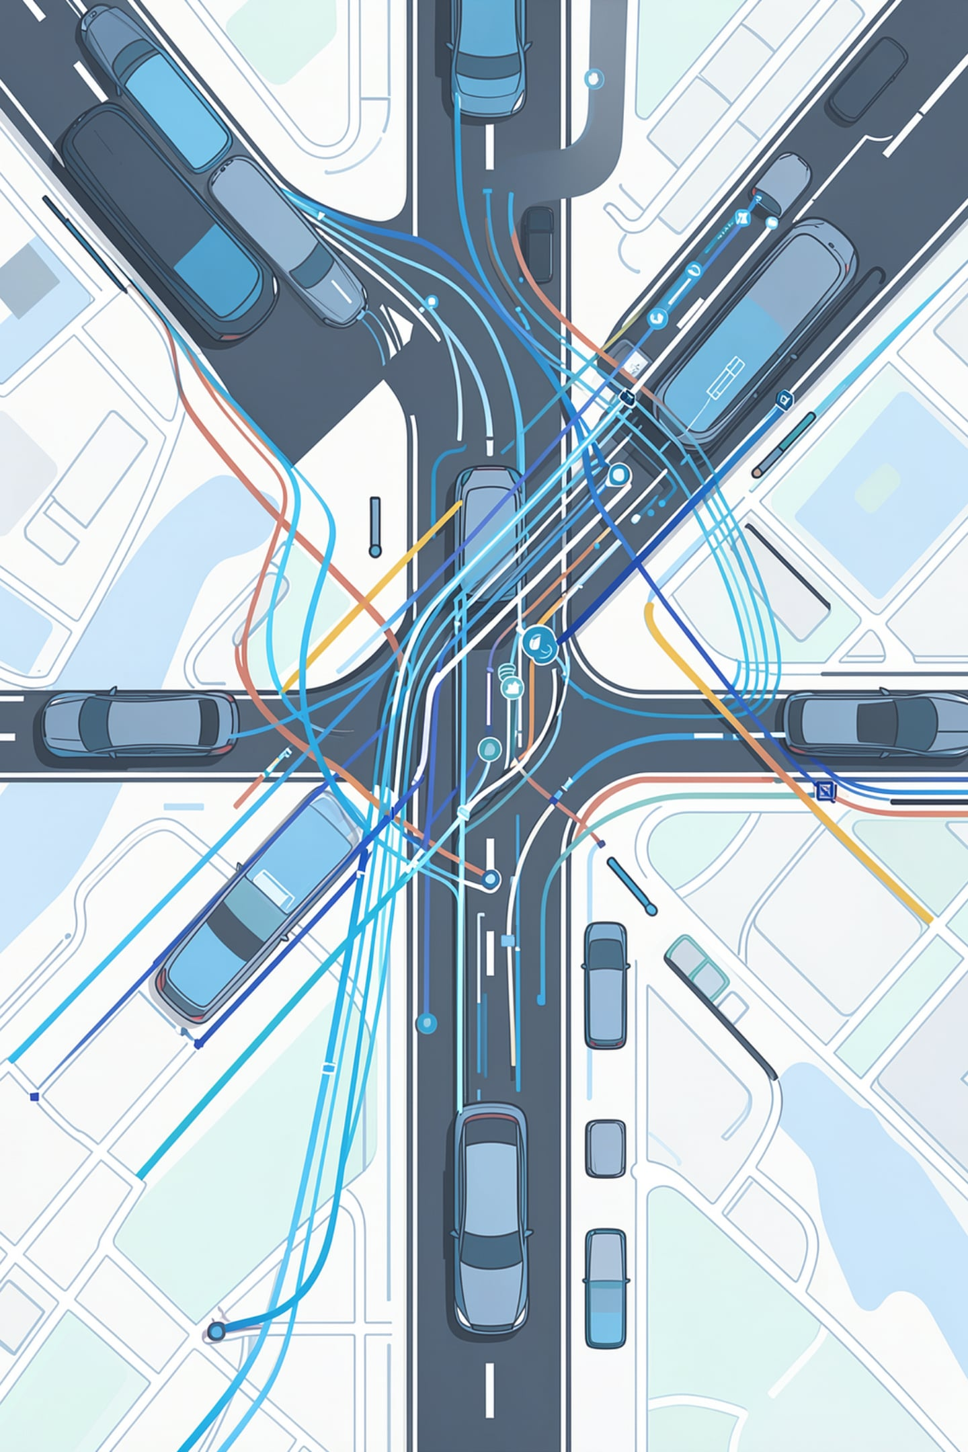


Qualitative Examples (map + pretrained scale)
Four validation scenes selected from the largest per-pedestrian improvements — illustrative of what pose can fix, not typical magnitudes:
1
Long-Distance
No-pose stops the prediction at ~5 m; pose follows the full ~25 m walk.
2
Curved Path
No-pose underestimates displacement; pose follows the curve.
Mode Coverage
3
Both top modes underestimate, but pose has a secondary mode aligned with the ground truth.
4
Stationary
No-pose wrongly predicts motion; pose correctly stays near the origin.

Slide 9
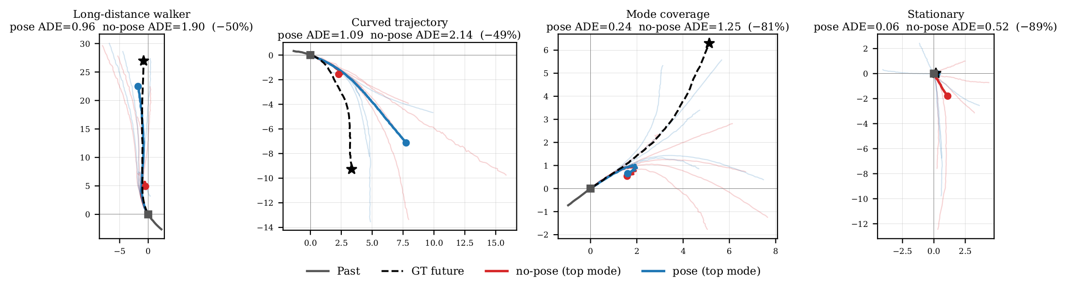
Qualitative Examples — No-Pose (red) vs Pose (blue)
Four validation scenes (map + pretrained scale), selected from the largest per-pedestrian improvements — illustrative, not typical. Past in gray; GT future dashed with ★; top-scoring mode highlighted (red = no-pose, blue = pose). Left→right: long-distance, curved, mode coverage, stationary.

Slide 10
Methodology, the Mask Fix & Reproducibility
▸ What caught three headline effects: target-coverage + per-term gradient checks; seed replication 3 → 5 (small benchmarks are heavy-tailed; a tight n=3 cluster is exactly how artifacts look); hierarchical bootstrap (resample seeds, then pedestrians) as the conservative test; ~30 pairs uncorrected — relied-upon effects (p ≤ 1e-4) survive Bonferroni.
▸ Mask fix (released code): masking the future-pose losses removes the WTA-specific catastrophic tail (worst seed 0.897 → 0.679) but adds no signal — at n = 5 no masked cell differs from the masked baseline (all p ≥ 0.15), and degraded seeds occur even with no active auxiliary. Baseline unchanged (0.6605 vs 0.6604, p = 0.90).
▸ Code provenance: pre-fix cells were extended with pre-fix code (pinned worktree) — the xattn+PE collapse replicates under clean provenance (0.710/0.703), so the retraction is provenance-proof.
▸ External anchor: MR@2m = 0.239 (no map) → 0.145 (map) → 0.093 (pretrained); pose moves it ≤ 0.005 anywhere. Official Waymo mAP not reported: full predictions not retained by the per-epoch protocol.

Slide 11
Conclusion & Limitations
▸ 1. The geodesic −7.6% was an inert loss + seed noise (zero gradient vs absent targets).
▸ 2. No-map: nothing beats the no-pose baseline at 5 seeds; the −3.5% encoder claim and the PE-ordering mechanism were artifacts #2 and #3; training is heavy-tailed (26% failures).
▸ 3. Pose helps in exactly one configuration: map × cross-attention+PE, −1.6% (p < 1e-4) — and controls show it is genuine body-configuration signal (robust to root-zeroing and frame change).
▸ 4. Context dominates: HD map −26%, full-Waymo pretraining −23%, both trajectory-only. Mechanism: past-pose encoding, not future-pose prediction (30 fps supervision null, −0.5%, p = 0.60).
▸ Limitations: pose GT exists only for the 579-scene subset (full-scale pose-conditioning infeasible); LiDAR pseudo-GT; single validation split; best-checkpoint selection; 3–5-seed hierarchical bootstrap is coarse.
▸ Lasting contribution: the audit + seed-replication methodology — it caught three of our own headline effects.

Slide 12
Backup — “But the 30 fps Version Has Future Poses?”
▸ Yes — tested, seed-replicated (5 seeds each). Both versions share the same ~7 real pose observations (~0.6 s); 30 fps fills the future with a motion prior (predicted pseudo-GT, not measured). 10 fps: 5 of 91,520 future-pose steps non-zero → losses inert. 30 fps: 88,909 non-zero → real gradients.
Condition (full loss set) | minADE (n=5) | per-seed
10 fps — future losses inert | 0.6618 ± 0.0366 | .668 .674 .630 .623 .714
30 fps — future losses active | 0.6586 ± 0.0292 | .656 .654 .634 .641 .708
▸ Result: activating the future-pose losses: −0.5%, hierarchical p = 0.60 → not significant; both conditions carry the same heavy-tailed seeds as every other no-map cell.
▸ ⇒ Even with real gradients, future-pose supervision doesn't help; the (map-only) benefit comes from encoding past body configuration.

