Slide 1
EgoPed
Ego-Conditioned Pedestrian Body Motion Generation via Latent Diffusion
Generating realistic 3D full-body pedestrian motion conditioned on vehicle ego trajectory — for AV simulation.
Backbone: Motion Latent Diffusion (MLD), 263-D HumanML3D. Data: AVA + nuScenes + Waymo (11,954 samples).
Best system: EgoPed-IA — FID 2.880, a 40% improvement over pooled conditioning (unified evaluation).
Validated on four independent axes: FID · held-out split · trajectory ADE/FDE · behavioral probe.

Slide 2
WHY EGO CONDITIONING
Problem & Motivation
• AV simulation needs diverse, plausible pedestrian behavior to stress-test perception and planning.
• Existing 3D motion generators condition on text or action labels → context-agnostic: a crossing looks identical whether a car approaches at 50 km/h or is stopped.
• Real pedestrian behavior is coupled to the ego vehicle — speed, proximity and trajectory shape whether a person crosses, waits, accelerates or turns.
• Gap: ego-conditioned FULL-BODY synthesis is unexplored (prior work: 2D trajectories, or 3D bodies from text).
• Core question: how should the ego trajectory be injected into a latent-diffusion denoiser?

Slide 3
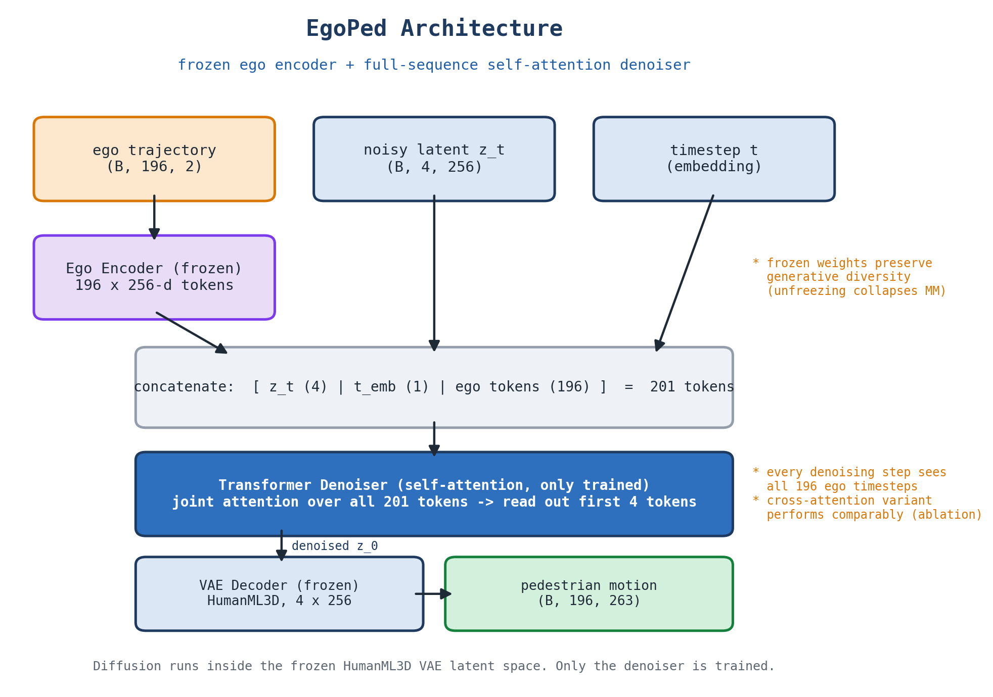
METHOD
Approach
• MLD backbone: diffuse in a frozen HumanML3D VAE latent (263-D → 4 tokens × 256-D). Only the denoiser trains.
• Ego encoder: transformer maps the 196-step ego trajectory → conditioning tokens; contrastively pretrained, then FROZEN.
• Studied: pooled (1 mean-pooled token) vs full-sequence (all 196 per-timestep tokens).
• Full-sequence: 196 ego + timestep + 4 latent tokens jointly self-attended → per-timestep temporal resolution at every denoising step.
• CFG at inference; DDIM, 50 steps.

Slide 4
CONTRIBUTION MAP
What We Changed vs. Base MLD
Ego trajectory
196 × 2
Ego Encoder
pretrained · FROZEN
196 ego tokens
vs 1 pooled token
Denoiser
self-attn · ONLY TRAINED
Frozen VAE decoder
→ 263-D motion
• Replaced text/CLIP conditioning with vehicle ego-trajectory conditioning (VAE, denoiser backbone and evaluators retained).
• New frozen ego encoder, contrastively pretrained against VAE motion latents.
• Changed conditioning granularity: all 196 per-timestep tokens vs one pooled token — the source of the gain.
• New interaction-aware data pipeline (scoring, weighted sampling, closest-approach cropping) — ablated, not assumed.

Slide 5
A NEW EGO–PEDESTRIAN BENCHMARK
Dataset
• nuScenes + Waymo supply scale and diversity; AVA (our sensor vehicle) adds a small, deliberately STAGED high-interaction subset.
• Pipeline: MS3D annotation → per-camera 3D SMPL (adapted OmniRe) → stitch → 263-D HumanML3D → paired with ego odometry, pedestrian-centric frame.
• Interaction score = travel × (%frames within 5 m) × relative-bearing change → weighted sampling + closest-approach crop.
Source | Train | Val | Total
AVA (ours) | 27 | 7 | 34
nuScenes | 3,637 | 943 | 4,580
Waymo | 5,876 | 1,464 | 7,340
Total | 9,540 | 2,414 | 11,954
Splits are scene-disjoint. A scene-disjoint half of validation is further held out and never used for model or checkpoint selection.

Slide 6
UNIFIED EVALUATION · 3 REPLICATIONS
Main Results
System | FID ↓ | R@1 | MM | Diversity
EgoPed-IA (ours, + interaction sampling) | 2.880 ±0.084 | 0.323 | 3.37 | 5.67
EgoPed / H4 (ours, full-sequence) | 3.392 ±0.179 | 0.548 | 3.96 | 5.79
H6 (unfrozen encoder) | 5.079 ±0.034 | 0.352 | 2.62 | 6.06
H2 (pooled baseline) | 5.620 ±0.117 | 0.665 | 3.71 | 5.82
H3 (latent-8 VAE) | 6.677 ±0.135 | 0.663 | 3.37 | 5.89
Ground truth | — | — | — | 5.50
• 40% FID improvement over pooled conditioning under a UNIFIED evaluation pipeline (identical eval-time processing for all systems).
• Verified conservative: the baseline additionally got interaction-aware training AND its best-of-3 seeds.
• Interaction-aware sampling improves the full-sequence model further, at 1/3 the training epochs.

Slide 7
INTERACTION-SAMPLING 2×2
Disentangling Architecture from Data
FID ↓ | − interaction sampling | + interaction sampling
H2 (pooled) | 6.214 ±0.105 | 5.620 ±0.117
H4 (full-sequence) | 3.392 ±0.179 | 2.880 ±0.084
• Conditioning granularity dominates: ≈2.7–2.8 FID in BOTH columns — about 5× the pipeline effect.
• The two interventions are approximately ADDITIVE (−0.59 pooled, −0.51 full-sequence): data curation helps, but it is not what drives the result.
• Why it matters: the original comparison mixed both factors. Separating them shows the headline was conservative, not inflated.

Slide 8
WHAT ACTUALLY MATTERS
Ablations
Question | Finding | Verdict
Bigger VAE latent (8 vs 4)? | 6.677 vs 5.620 FID | 19% WORSE — reject
Unfreeze the ego encoder? | MM collapses 3.96 → 2.62 | Freezing is critical
Skip encoder pretraining? | FID 4.968, R@1 = chance | ≈ unconditional prior
Cross-attention instead of self-attn? | 3.490 vs 3.338 (p = 0.33) | No difference
Different training seed? | 3.39 / 4.72 / 4.80 | Real variance — reported
• The encoder design is bracketed from BOTH sides: pretraining injects the ego information, freezing preserves generative diversity.
• The attention mechanism is NOT the source of the gain — full-sequence conditioning is (self-attention and cross-attention tie).
• Seed spread is reported honestly: single-seed point estimates overstate precision in this setting.

Slide 9
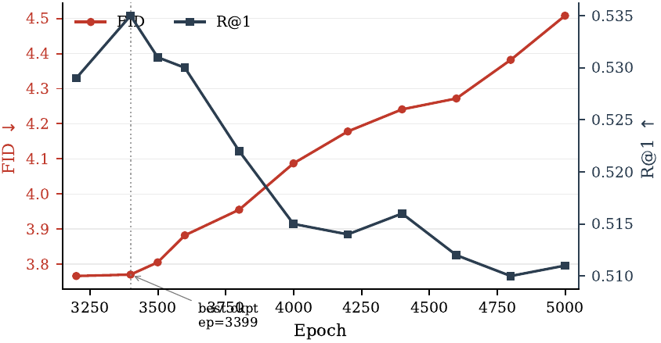
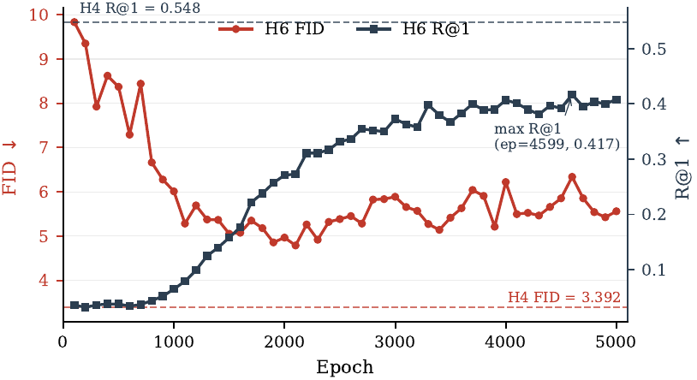
TRAINING DYNAMICS
Checkpoint Selection & the Unfreeze Failure
• Left: FID does not improve monotonically — the final checkpoint is NOT the best checkpoint. Early stopping on validation FID is essential.
• Right: unfreezing the encoder never approaches the frozen model at any point in 5,000 epochs.

Slide 10
DOES THE R@1 GAP MEAN WORSE CONDITIONING? NO.
Evaluator-Independent Validation
Model | ADE ↓ | FDE ↓ | minADE₅ ↓ | minFDE₅ ↓
EgoPed / H4 (full-sequence) | 2.320 | 4.826 | 1.291 | 2.591
H2 (pooled) | 2.434 | 4.990 | 1.482 | 2.979
Unconditional (ego zeroed) | 2.880 | 5.876 | 1.228 | 2.454
• Root-trajectory displacement error uses NO learned evaluator and no model-specific embedding — directly comparable across architectures.
• H4 beats the pooled baseline on ALL FOUR metrics (paired over 1,190 held-out conditions; 3 of 4 significant) DESPITE its lower R-Precision.
• → the R@1 gap is an embedding-space artifact, not worse conditioning. Conditioning also demonstrably helps: 2.88 → 2.32 vs the unconditional prior.

Slide 11
DOES THE MODEL COUPLE BEHAVIOR TO THE EGO?
Behavioral Validity
Model | Separation ↑ | Entropy | Brier ↓
EgoPed / H4 | 0.333 | 0.238 | 0.149
H2 (pooled) | 0.285 | 0.297 | 0.178
H6 (unfrozen) | 0.364 | 0.178 | 0.178
Unconditional | 0.021 | 0.533 | 0.199
• Probe: automatic stop/walk labels from root trajectories; compare each model's sampled p(stop | ego) against ground truth (K = 5 samples per condition).
• Sanity ✓ — the unconditional model is behaviorally ego-blind (separation ≈ 0), validating the probe.
• H4 couples behavioral decisions to the ego better than pooled, with the best calibration — a THIRD independent axis favouring full-sequence conditioning.
• H6 reveals its MultiModality collapse in behavior space: highest separation at the LOWEST entropy — it commits to one behavior per condition, overconfidently.

Slide 12
WHAT ELSE COULD YOU DO INSTEAD?
External Baselines: the Capability Ladder
Approach | FID ↓ | Reading
EgoPed-IA (ours) | 2.880 | in-domain, ego-conditioned
Unconditional prior (ego zeroed) | 5.18 | conditioning is worth 34% FID
VAE latent interpolation | 7.91 | the learned prior matters
Pretrained text-to-motion MLD | 14.07 | off-the-shelf T2M does not transfer
Raw-space diffusion (MDM-style) | 26.43 | justifies the latent backbone
Ego→motion regressor (deterministic) | 35.47 | L2-optimal, yet unrealistic
Trajectory + static body | 47.7–49.6 | task needs articulated motion
• The regressor minimizes expected L2 by construction (ADE 1.80) but produces collapsed, unrealistic motion — while EgoPed's minADE₅ (1.29) beats it WITH realism.
• Pretrained MLD reported as the BEST of three prompts (14.07; the ladder spanned 14.07–24.84) — deliberately generous to the baseline.
Retrieval (copying training motions) reaches FID 0.06 — a memorization sanity check, not a competitor.

Slide 13
IN PROGRESS · TEXT VS TRAJECTORY
How Much Conditioning Information Is Needed?
Conditioning signal | Information | FID ↓
Unconditional | 0 bits | 5.18 (prior) · training now
Body text (no vehicle) | 2.99 bits | — (optional rung)
Ego text (vehicle verbalized) | 6.09 bits | training now
Ego trajectory (ours) | continuous 196 × 2 | 2.880
• We synthesize captions deterministically from kinematics (no human annotation, no LLM): 14,172 captions, measured at 2.99 bits (body) and 6.09 bits (ego vocabulary).
• This turns the central claim into a QUANTITATIVE one: if the trajectory beats a ~6-bit linguistic description of the same interaction, fine-grained temporal conditioning carries information language cannot.
• Both runs are queued on the cluster; the comparison removes the domain gap that confounds the off-the-shelf text baseline.

Slide 14
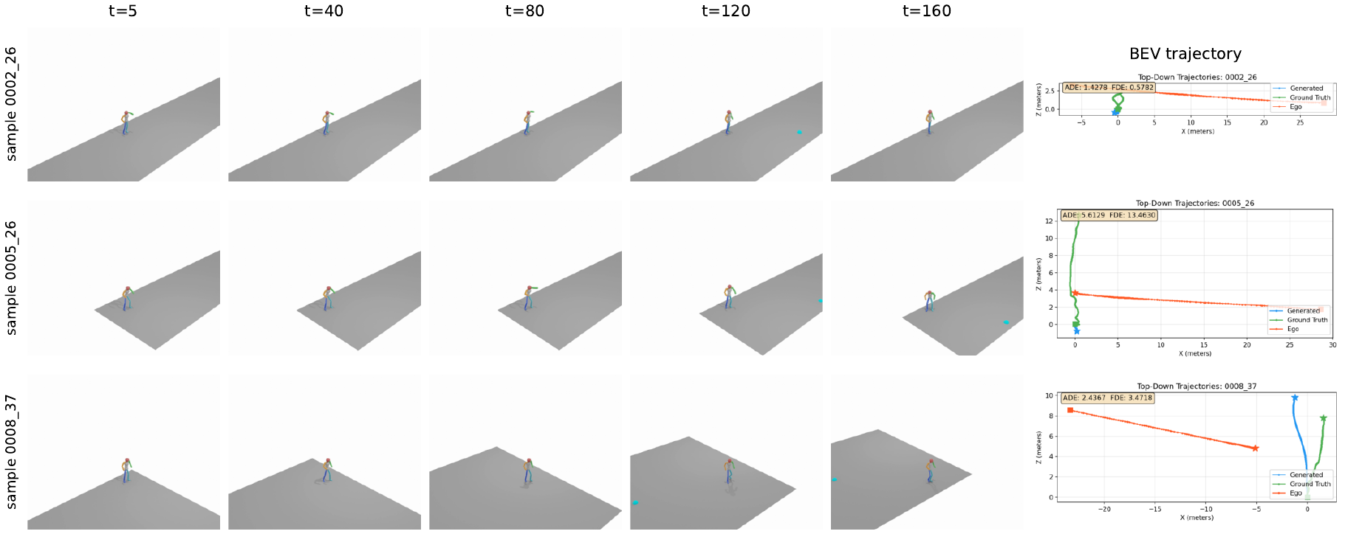
EGOPED · CFG = 10
Qualitative Results
Generated 3D body motion with bird's-eye trajectories: predicted (blue), ground truth (orange), ego vehicle (red).

Slide 15
WHAT TO TAKE AWAY
Design Recipe & Contributions
• First system generating full 3D HumanML3D body motion conditioned on vehicle ego odometry (AVA + nuScenes + Waymo).
• Full-sequence temporal conditioning beats pooled conditioning by 40% FID — robust to CFG, to the attention mechanism, and amplified by interaction-aware sampling.
• The frozen, contrastively pretrained ego encoder is essential: pretraining injects the ego information, freezing preserves generative diversity.
• Recipe:
– Pretrain the ego encoder against frozen VAE latents → freeze it → condition the denoiser on the FULL ego sequence.
– Use CFG ≈ 10; select checkpoints on validation FID, never the final epoch.
– Add interaction-aware sampling for a further gain at a third of the training cost.

Slide 16
STATUS
Limitations & Next Steps
• Pose labels are estimated (OmniRe), not ground-truth 3D — label-quality audit outstanding.
• Conditioning uses 2D ego trajectory only; relative geometry, velocity profile and map context are unexplored.
• Seed sensitivity is real (FID 3.39 / 4.72 / 4.80); EgoPed-IA is reported from a single seed.
• No physics constraints (foot sliding), single benchmark, and no human perceptual study yet.
• In flight: unconditional and ego-text training runs to complete the information ladder.
EgoPed — full-sequence ego conditioning + frozen pretrained encoder: FID 2.880, validated on four independent axes.

