Slide 1
EgoPed
Ego-Conditioned Pedestrian Body Motion Generation via Latent Diffusion
Generating realistic 3D full-body pedestrian motion conditioned on vehicle ego trajectory — for autonomous-driving simulation.
Backbone: Motion Latent Diffusion (MLD) on the 263-D HumanML3D representation.
Data: AVA (our sensor vehicle) + nuScenes + Waymo. | Research progress update.

Slide 2
WHY EGO-CONDITIONED PEDESTRIAN MOTION
Problem & Motivation
• AV simulation needs diverse, plausible pedestrian behaviors to stress-test perception & planning before deployment.
• Existing 3D motion generators are text/action conditioned → context-agnostic: a crossing looks identical whether a car approaches at 50 km/h or is stopped.
• In reality, pedestrian behavior is coupled to the ego vehicle — its speed, proximity, and trajectory shape whether a person crosses, waits, accelerates, or turns.
• Gap: ego-conditioned FULL-BODY synthesis is unexplored — prior work generates 2D trajectories, or 3D bodies from text, but not 3D bodies from ego context.
• Core question: how should the ego trajectory be injected into a latent-diffusion denoiser?

Slide 3
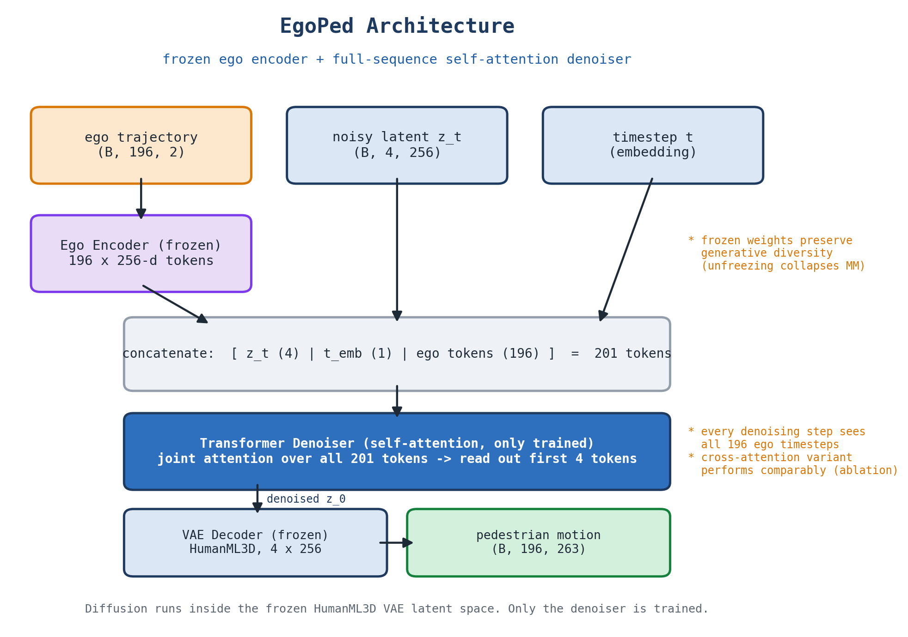
METHOD
Approach: Ego-Conditioned Latent Diffusion
• MLD backbone: diffuse in a frozen HumanML3D VAE latent (263-D → L=4 tokens × 256-D). Only the denoiser is trained.
• Ego encoder: transformer maps the 196-step ego trajectory → conditioning tokens; pretrained to align with VAE latents, then FROZEN.
• Studied: pooled (1 mean-pooled token) vs full-sequence (all 196 per-timestep tokens).
• Full-sequence: 196 ego + timestep + 4 latent tokens jointly self-attended → per-timestep temporal resolution at every denoising step.
Architecture: frozen VAE + frozen ego encoder; only the denoiser is trained.

Slide 4
EGOPED VS. THE BASE MLD TEXT-TO-MOTION MODEL
Architectural Overview — What We Changed
Ego trajectory
input · 196 × 2
Ego Encoder
transformer · pretrained · FROZEN
Full 196-token ego sequence
vs. 1 pooled token (H2)
Diffusion Denoiser
self-attn [z, t, ego] · ONLY TRAINED
Frozen VAE decoder
4×256 latent → 263-D motion
New / changed by us
Reused & frozen (HumanML3D VAE + evaluators)
Replaced text/CLIP conditioning with vehicle ego-trajectory conditioning (retain MLD's VAE, denoiser backbone, evaluators).
New frozen ego encoder — a transformer pretrained to align ego trajectories with the VAE motion latents, then frozen during diffusion.
Changed conditioning granularity: the denoiser sees all 196 per-timestep ego tokens (vs. a single pooled token) — the source of the 40% FID gain (unified evaluation, verified conservative).
New interaction-aware data pipeline (scoring, weighted oversampling, closest-approach crops) — used for VAE + pooled-baseline training; the main model trains with uniform sampling (isolation ablation in progress).
Unchanged only the denoiser is trained; the HumanML3D VAE and the pretrained ego encoder stay frozen throughout.

Slide 5
DATA
Dataset: A New Ego–Pedestrian Benchmark
• Three sources: nuScenes + Waymo (scale, diversity) and AVA — our sensor vehicle contributing a small, deliberately STAGED high-interaction subset (close-range encounters rare in public data). Pipeline: MS3D annotation → per-camera 3D SMPL (adapted OmniRe) → stitch → 263-D HumanML3D → pair with ego odometry (pedestrian-centric frame).
• Interaction-aware processing: score = travel × (%frames within 5 m) × relative-bearing change → weighted sampling + closest-approach crop (used for VAE + pooled baseline; main model: uniform sampling, random windows).
• 11,954 paired samples, scene-disjoint train/val split:
Source | Train | Val | Total
AVA (ours) | 27 | 7 | 34
nuScenes | 3,637 | 943 | 4,580
Waymo Open Dataset | 5,876 | 1,464 | 7,340
Total | 9,540 | 2,414 | 11,954

Slide 6
−40% FID (UNIFIED EVAL) · BEST SYSTEM EGOPED-IA 2.88
Main Result: Full-Sequence Conditioning Wins
Method | FID ↓ | R@1 | MM | Diversity
H2 Pooled (baseline) | 5.620 ± 0.117 | 0.665 | 3.71 | 5.82
H4 Full-sequence (ours) | 3.392 ± 0.179 | 0.548 | 3.96 | 5.79
EgoPed-IA (+ interaction sampling) | 2.880 ± 0.084 | 0.323 | 3.37 | 5.67
Ground truth (reference) | — | — | — | 5.50
• 40% FID improvement under a UNIFIED evaluation pipeline (all models, identical eval-time processing) — non-overlapping CIs; verified conservative (pipeline handicap + baseline best-seed).
• H4's best checkpoint occurs EARLIER in training (epoch 3399 vs 4399) → the gain is not from extra compute.
• Evaluation: HumanML3D protocol (FID, R-Precision@1, MultiModality, Diversity); 3 replications, 95% CI.
2×2 control complete (definitive): granularity dominates (~2.7 FID in both columns); interaction-aware sampling adds ~0.5-0.6 to BOTH architectures (additive). EgoPed-IA is single-seed (stated).

Slide 7
FULL-SEQUENCE CONDITIONING IS CFG-ROBUST
Guidance-Scale Behavior
CFG scale | H2 Pooled FID ↓ | H4 Full-sequence FID ↓
5 | 6.603 | 3.842
10 | 6.963 | 3.392 (best)
15 | 7.400 | 3.547
• Full-sequence conditioning is nearly INSENSITIVE to the CFG scale; pooled conditioning degrades steeply at higher guidance.
• The rich 196-token ego signal is over-determined, so higher guidance amplifies an already high-fidelity signal rather than forcing mode collapse onto a coarse pooled token.

Slide 8
H3: LATENT DIM 8 VS 4
Ablation 1 — Larger Latent (rejected)
• Hypothesis: a larger VAE latent (dim 8 vs 4) gives more capacity and better generation.
• Result: latent-8 is 19% WORSE FID (6.677 vs 5.620, unified eval) at matched epoch & CFG; R-Precision essentially unchanged (0.663 vs 0.665).
• Lesson: increasing latent dimension without scaling the denoiser is counterproductive — the conditioning bottleneck is the ego representation, not the latent size.

Slide 9
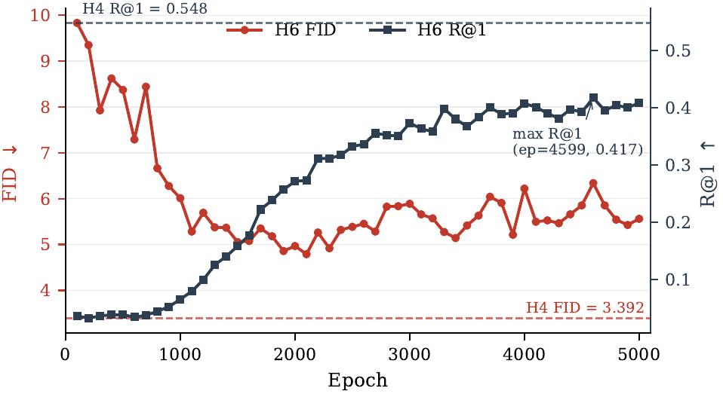
FREEZING IS CRITICAL
Ablation 2 — Frozen vs Unfrozen Ego Encoder
System | FID ↓ | R@1 | MM
H4 (frozen ego encoder) | 3.392 | 0.548 | 3.96
H6 (unfrozen ego encoder) | 5.079 | 0.352 | 2.618
• Unfreezing is WORSE on all metrics; MultiModality collapses −34% (2.62 vs 3.96).
• The encoder over-specializes to discriminative per-condition features, narrowing generation.
• Matches the frozen-encoder paradigm (CLIP in Stable Diffusion; ControlNet / IP-Adapter).
H6 training trajectory: FID never approaches H4's operating point (dashed).

Slide 10
THE MECHANISM DOESN'T MATTER; THE FULL SEQUENCE DOES
Ablation 3 — Self-Attention vs Cross-Attention
Denoiser (full 196-token ego) | FID ↓ | R@1 | MM
Self-attention over concatenation (ours) | 3.338 ± 0.190 | 0.537 | 4.14
Cross-attention (queries / keys-values) | 3.490 ± 0.059 | 0.501 | 4.61
• Matched control: same frozen VAE + ego encoder, same data, same effective batch; evaluated on the held-out test split.
• The two are STATISTICALLY COMPARABLE (95% CIs [3.15, 3.53] vs [3.43, 3.55] overlap) — cross-attention gives no advantage.
• Takeaway: the improvement comes from exposing the denoiser to the FULL per-timestep ego sequence, not from the specific attention mechanism.

Slide 11
VALIDATION
Held-Out Test & Reference Baselines
• Generalization: on a scene-disjoint held-out test split, the best system reproduces its headline number (FID 3.38 vs 3.39 on full validation) → not a selection artifact.
• Reference baselines that bound the metric space (FID ↓):
– Retrieval — copy nearest-ego training motion: 0.06 (memorization sanity check, non-generative).
– Unconditional prior (ego zeroed): 5.18 → ego conditioning improves it to 3.39 (−34%).
– VAE latent interpolation: 7.91. Trajectory + static/mean body: 48–50 (task needs articulated motion).
• Unconditional R@1 = 0.031 = exactly chance (1/32): retrieval protocol sanity check passes.

Slide 12
WHAT WE RECOMMEND
Design Recipe & Contributions
• First system to generate full 3D HumanML3D body motion conditioned on vehicle ego odometry (AVA + nuScenes + Waymo).
• Full-sequence temporal conditioning beats pooled by 40% FID (unified eval, verified conservative) — robust to CFG and attention mechanism; interaction-aware sampling amplifies it to FID 2.88 (EgoPed-IA).
• Frozen ego encoder is critical — unfreezing collapses generation diversity.
• Recommended recipe:
– Pretrain the ego encoder contrastively on frozen VAE latents → freeze it → condition the denoiser on the full ego sequence.
– Use CFG ≈ 10; select checkpoints on validation FID (not the final checkpoint).

Slide 13
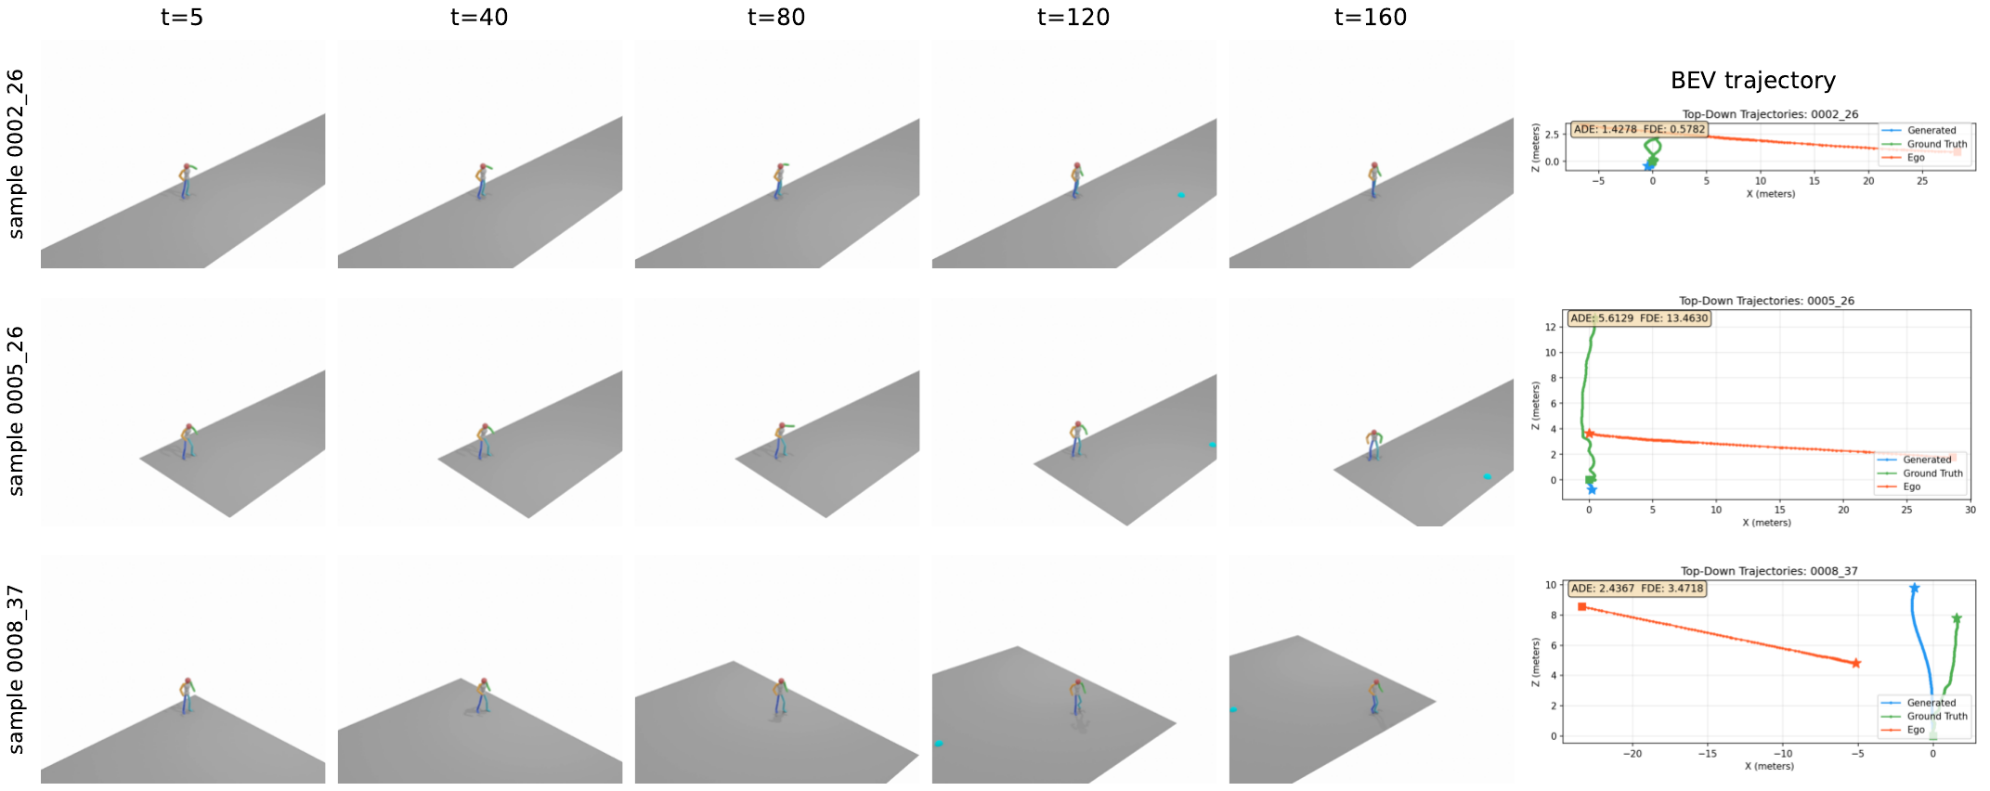
H4, EPOCH 3399, CFG = 10
Qualitative Results
Generated 3D body motion + bird's-eye trajectory: predicted (blue), ground-truth (orange), ego vehicle (red).

Slide 14
STATUS & OUTLOOK
Limitations & Next Steps
• Estimated (not ground-truth) 3D pose labels → noise in training targets.
• Conditioning scope: only 2D ego trajectory; relative pedestrian–ego geometry, velocity, or map elements could improve fidelity.
• R@1 gap (0.548 vs pooled 0.671) — a real conditioning-vs-diversity tradeoff; adapter-style tuning is a promising next step.
• No physics constraints; single benchmark; no human perceptual study yet.
• Hardening complete: pipeline 2×2 (granularity dominates ~5×; sampling additive ~0.5 FID both), seed spread reported (3.39/4.72/4.80 — best-seed stated), random-init encoder = unconditional (pretraining essential).
• Three evaluator-independent validations: held-out split (ranking preserved), trajectory ADE/FDE (H4 beats pooled on all 4), behavioral probe (H4 couples stop/walk decisions to ego best; collapsed H6 overcommits).
• External baselines: raw-space diffusion 26.4, deterministic regressor 36 (L2-optimal yet unrealistic; EgoPed minADE-5 beats it WITH realism).
• Status: main results, three ablations, and held-out validation complete; paper draft in progress.
EgoPed — full-sequence ego conditioning + frozen encoder: a strong, validated recipe. Thank you — questions & discussion welcome.

