Slide 1
Mini-Project
‘Standalone webserver’,
‘Data visualization’
using Flask and Grafana
-Lomesh Mahajan
-Saurabh Patil
-Sanket Desai

Slide 2
Requirements
-Devices:
ESP32
DHT11
RaspberryPi -3B
-Databases:
SQLite
MYSQL
- Data visualization on ‘Grafana’

Slide 3
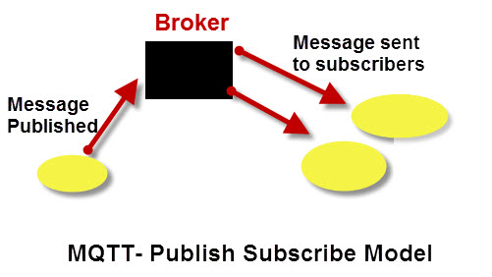
MQTT
Light weight PubSub messaging protocol.
Runs on 1883 / 8883(SLL)
Low overhead for low network
bandwidth application
Runs on connection-oriented TCP
Uses ‘mosquitto’ as a broker

Slide 4
SQLite
Embedded sql database engine
Serverless – access disk directly
Cross platform architecture
Python supports an in-built support for sqlite

Slide 5

Flask
A open source micro-framework for python
Web Server Gateway Interface (WSGI)
‘WSGI is adopted as standard for python web application development’
Easy configure and code

Slide 6
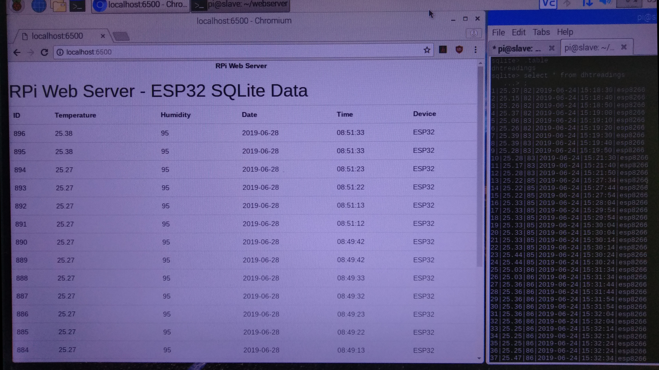
SQLite

Slide 7

Grafana
open source software for time series analytics
Advanced and rich metrics dashboard than chronograf
Better visualization
Alert notification feature
Runs on port 3000

Slide 8
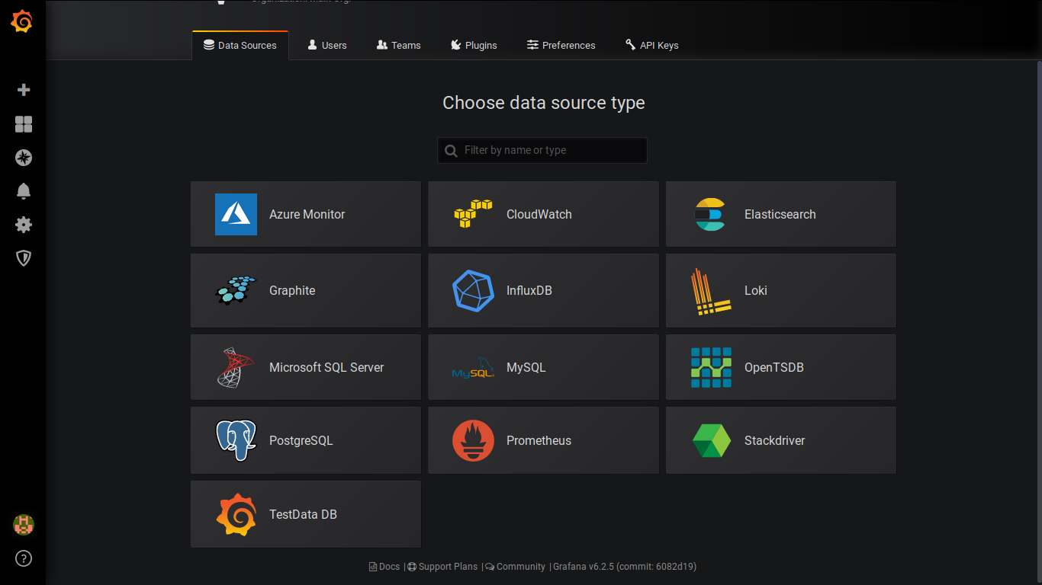
Database support

Slide 9
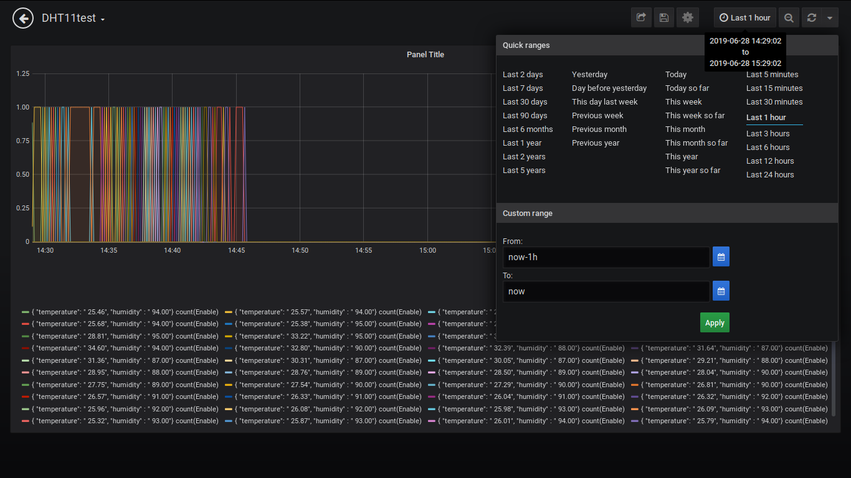
MySQL

