Slide 1
DOCKER

Slide 2
Docker Networking
Docker networking enables a user to link a Docker container to as many networks as he/she requires. Docker Networks are used to provide complete isolation for Docker containers.

Slide 3
Advantages of Docker Networking
Some of the major benefits of using Docker Networking are:
They share a single operating system and maintain containers in an isolated environment.
It requires fewer OS instances to run the workload.
It helps in the fast delivery of software.
It helps in application portability.

Slide 4
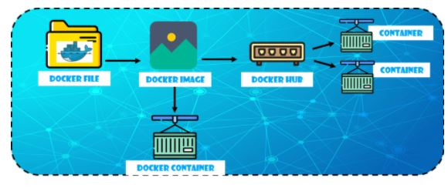
How Does Docker Networking Work?

Slide 5
Docker File builds the Docker Image.
Docker Image is a template with instructions, which is used to build Docker Containers.
Docker has its own cloud-based registry called Docker Hub, where users store and distribute container images.
Docker Container is an executable package of an application and its dependencies together.
Functionalities of the different components:
Docker File has the responsibility of building a Docker Image using the build command

Slide 6
Container Network Model
Network Sandbox
Endpoints
Docker Engine

Slide 7
Network Sandbox
It is an isolated sandbox that holds the network configuration of containers
Sandbox is created when a user requests to generate an endpoint on the network

Slide 8
Endpoints
An endpoint is a remote computing device that communicates back and forth with a network to which it is connected.
It can have several endpoints in a network, as it represents a container’s network configuration such as IP-address, MAC-address, DNS, etc.
The endpoint establishes the connectivity for container services (within a network) with other services
It helps in providing connectivity among the endpoints that belong to the same network and isolate them from the rest. So, whenever a network is created, or configuration is changed, the corresponding Network Driver will be notified with an event

Slide 9
Docker Engine
It is the base engine installed on your host machine to build and run containers using Docker components and services
Its task is to manage the network with multiple drivers
It provides the entry-point into lib network to maintain networks, whereas lib network supports multiple virtual drivers
So, those were the key concepts in the container network model. Going ahead, let’s have a look at the network drivers.

Slide 10
Network Drivers
Docker supports networking for its containers via network drivers. These drivers have several network drivers
1.Bridge
2.Host
3. None

Slide 11
Bridge
It is a private default network created on the host
Containers linked to this network have an internal IP address through which they communicate with each other easily
The Docker server (daemon) creates a virtual ethernet bridge docker0 that operates automatically, by delivering packets among various network interfaces
These are widely used when applications are executed in a standalone container

Slide 12
Host
It is a public network
It utilizes the host’s IP address and TCP port space to display the services running inside the container
It effectively disables network isolation between the docker host and the docker containers, which means using this network driver a user will be unable to run multiple containers on the same host

Slide 13
None
In this network driver, the Docker containers will neither have any access to external networks nor will it be able to communicate with other containers
This option is used when a user wants to disable the networking access to a container
In simple terms, None is called a loopback interface, which means it has no external network interfaces

