Slide 1
Module: Advanced Programming Group: A Examiner: Prof. Dr. Jürgen Jung
By
Amine Amzil, Jan Leonardi, Edgar Meilinger, Karsten Rudolf, Ersan Ünsal
SoSe 2021

Slide 2
Agenda
1
Task
2
Requirements & Software Architecture
3
Sprint planning
4
Presentation of the program

Slide 3

Task
Creating an application landscape tool
User Stories:
Display applications
Application properties
Data flows
Data objects
Persistent storage

Slide 4
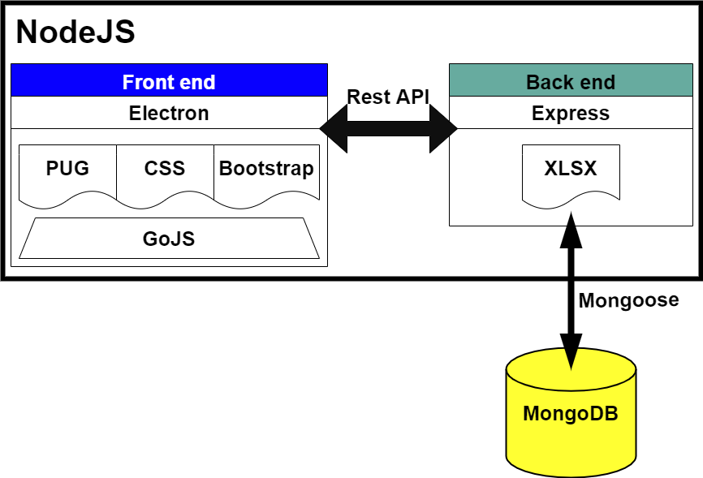
Software Architecture
Requirement
GoJS

Slide 5

Sprint planning
Agile Projectmanagement
Supervisor: Prof. Dr. Jürgen Jung
Task & Risk Log
VCS: GitHub
Communication network: WhatsApp & Discord

Slide 6

Presenting the program…
Connecting to a database with credentials
Being able to create or load multiple diagrams
Creating applications and a dataflow
Properties: applications, dataflows / data objects
Export as CSV
Import from Excel
Manage data objects

