Slide 1
Finding the best bang for your buck: Ames Housing Machine Learning Analysis
Emmy Danforth

Slide 2
Research Questions
Which house features are the strongest predictors of sale price?
Based on the strongest model, which homes have predicted values above their true sale prices? What can this data tell potential buyers about how to identify undervalued homes?

Slide 3
Preprocessing
Impute missing values
Lot Frontage: use relationship between Lot Frontage and Lot Area
Masonry Veneer Area: impute with 0s (no veneer)
Basement Bathrooms and SF: impute with 0s (no basement)
Garage Area and Cars: impute with mean values
Garage Year Built: impute with house year built
All categorical variables: impute with ‘None’
Convert MSSubClass to categorical variable

Slide 4
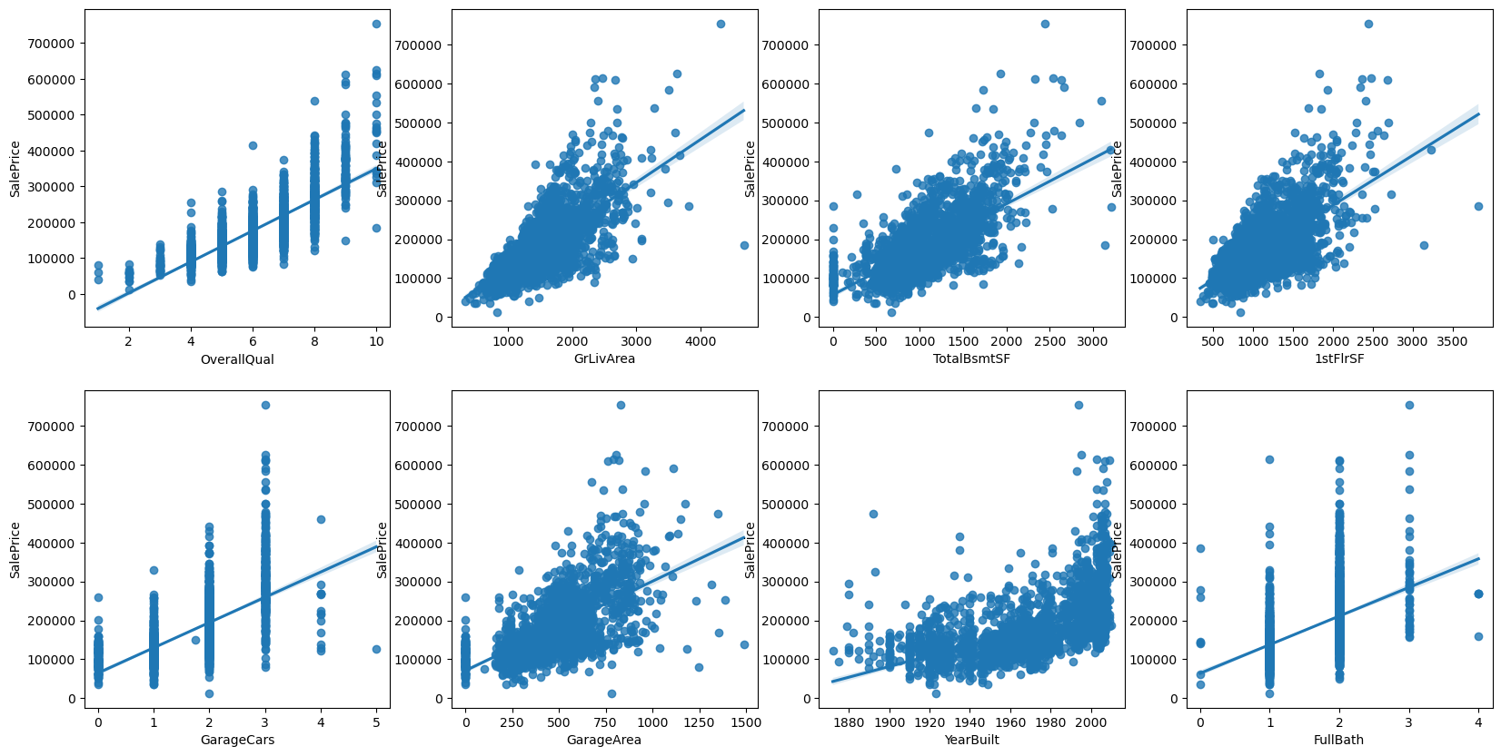
Exploratory Data Analysis: Correlation

Slide 5
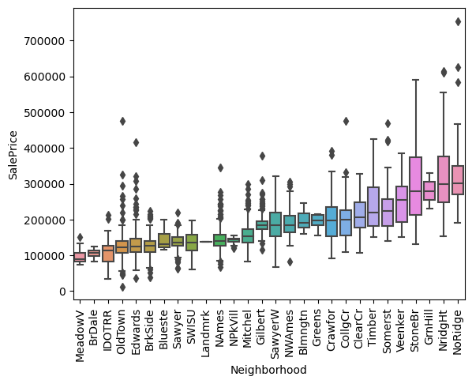
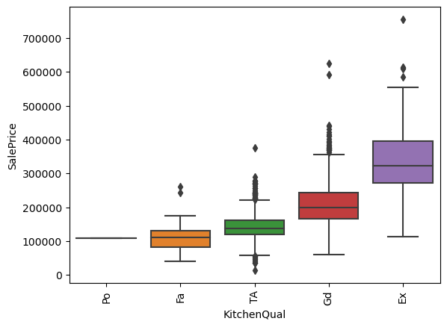
Exploratory Data Analysis: Categorical variables

Slide 6
Feature Engineering
Response Variable
Log Sale Price
Binary Variables
Remodel: Y/N
Garage: Small/Large
Variations on Living Area Sq. Ft.
GrLivArea ^ 2
LotPercent = 1stFlrSF / LotArea
Proxy for yard / privacy
Neighborhood_Num
Ranking by median GrLivArea
Proxy for neighborhood value
Interaction Terms
Remodel * OverallQual
Remodel * GrLivArea
Remodel * FullBath
Remodel * KitchenQual

Slide 7
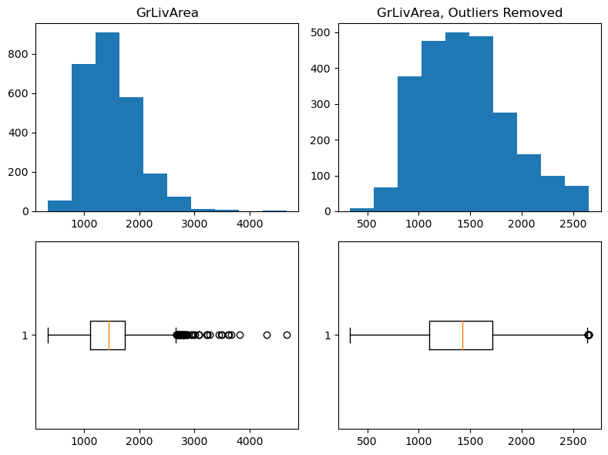
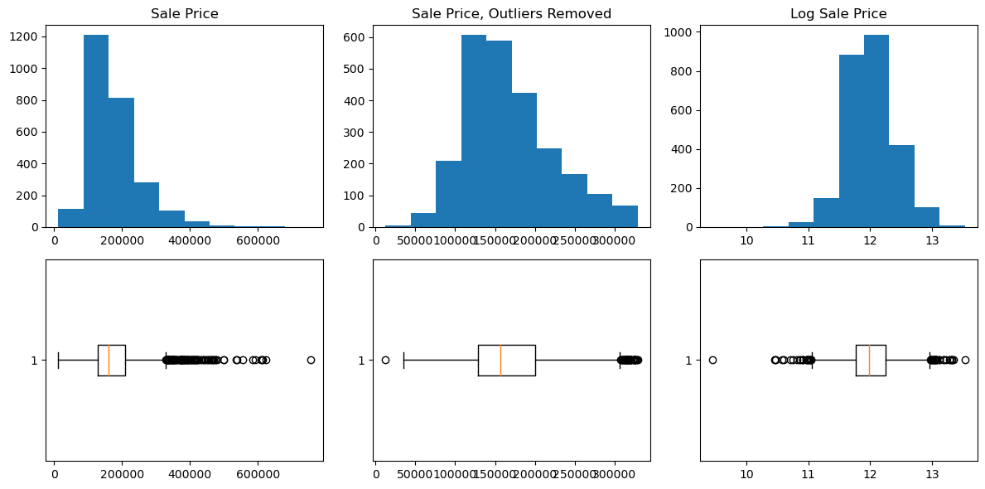
Addressing outliers
Response variable: compare using IQR to remove observations and taking log transformation
Independent variable: use IQR to remove outliers from distribution, removing 2.2% of observations

Slide 8
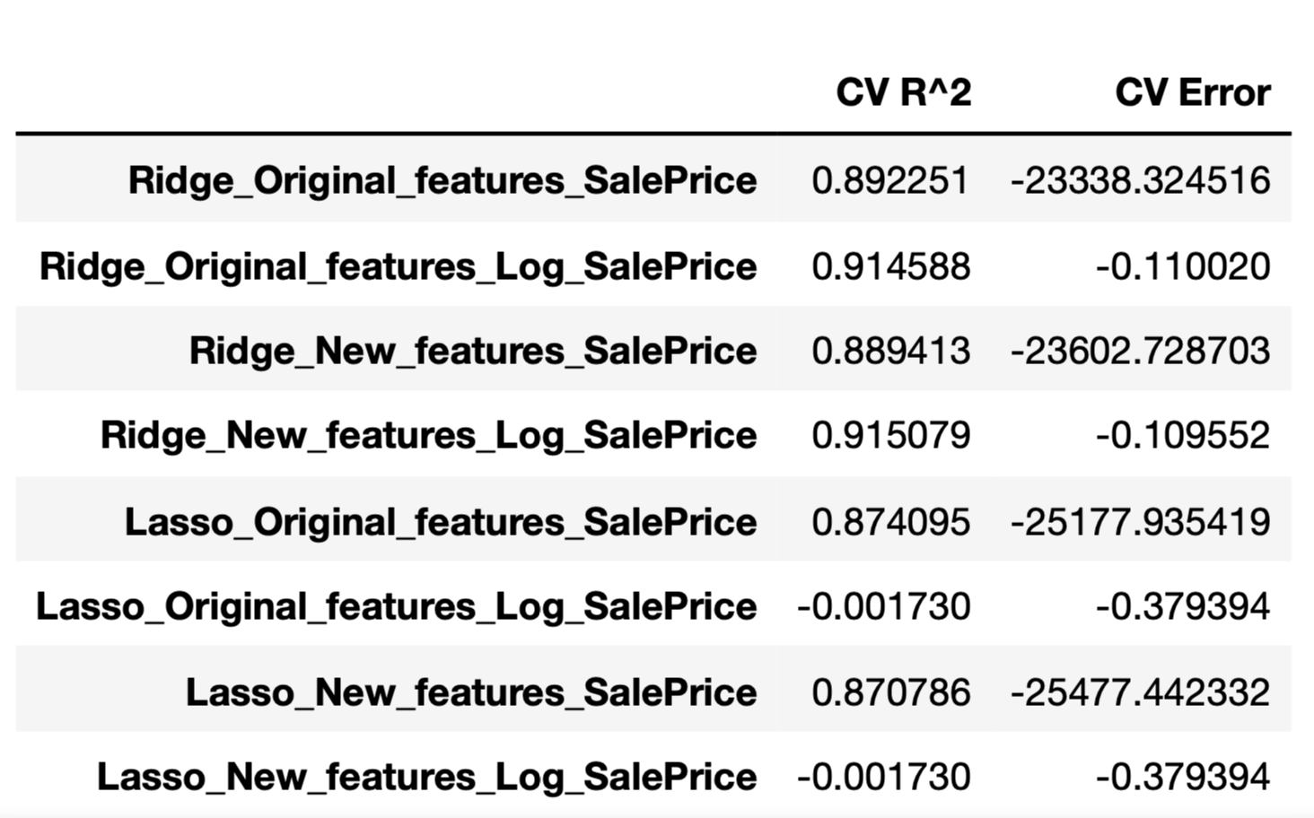
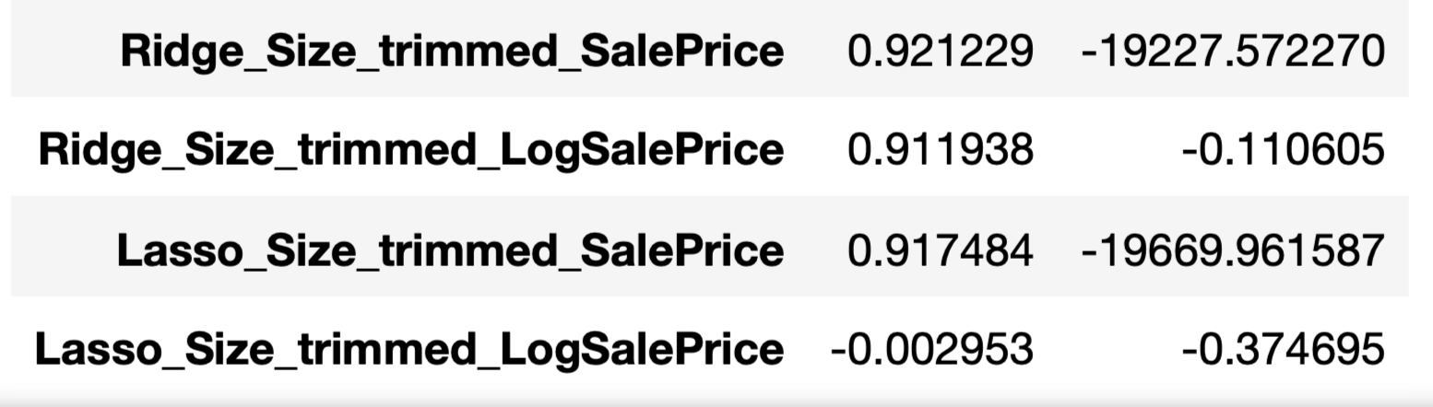
Model Comparison: Linear Models
Feature sets
Original features
New features
Outliers removed (sale price or living area)
Targets
SalePrice
LogSalePrice
Pipeline
1) ColumnTransformer: StandardScaler + OneHotEncoder
2) Regression: Ridge or Lasso
Cross Validation
10 folds using X_train, y_train
Further Testing: PCA, Polynomial Features

Slide 9
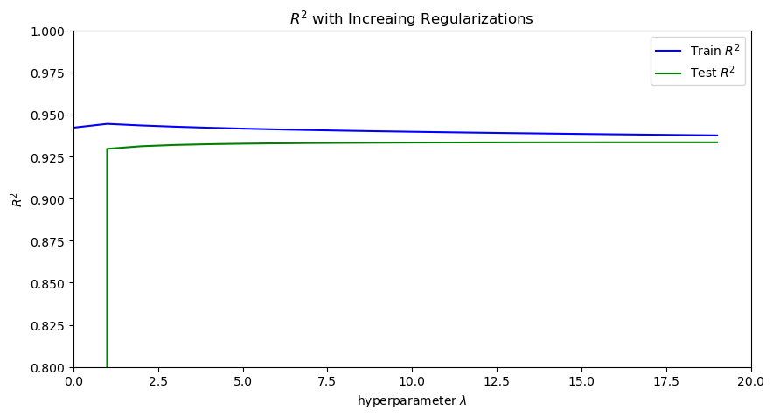
Model Tuning: Ridge and lasso
Use GridSearchCV to determine optimal value for lambda

Slide 10
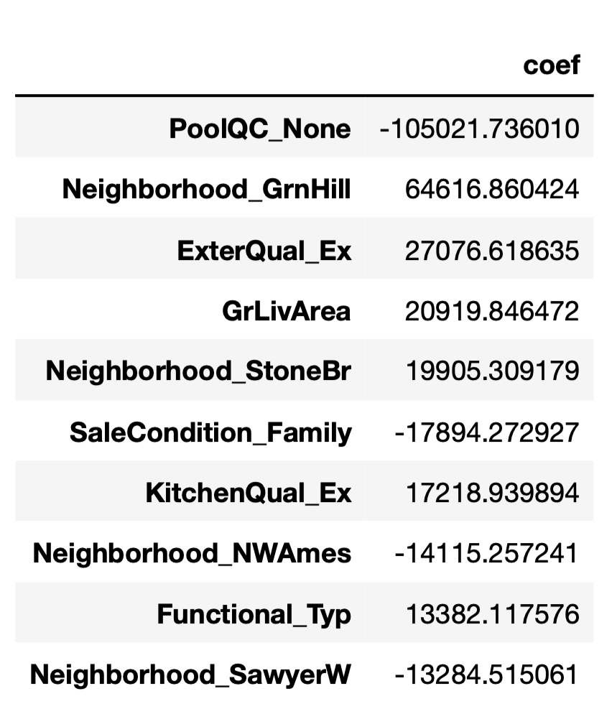
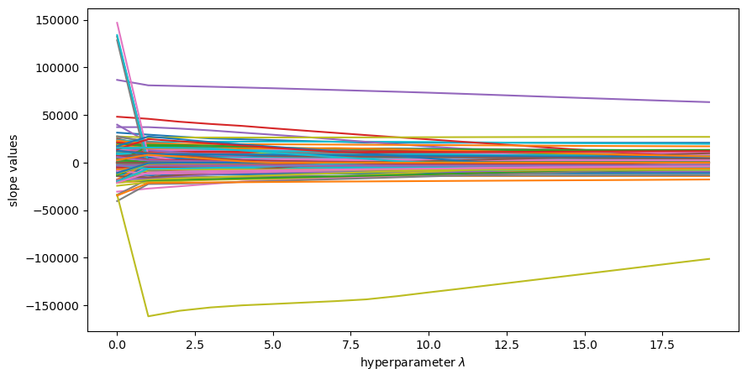
Lasso Regression coefficients
Coefficients with Increasing Lambda
Final Coefficients
Tuned Lasso regression selected 135 features
Top 10 features with the greatest magnitude

Slide 11
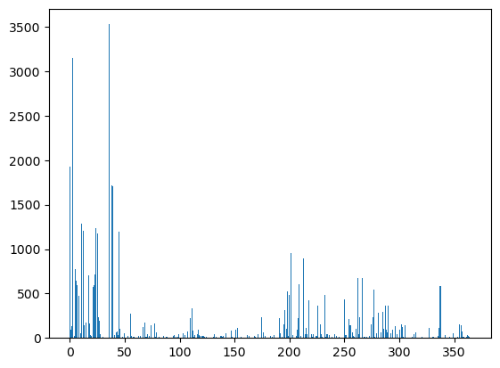
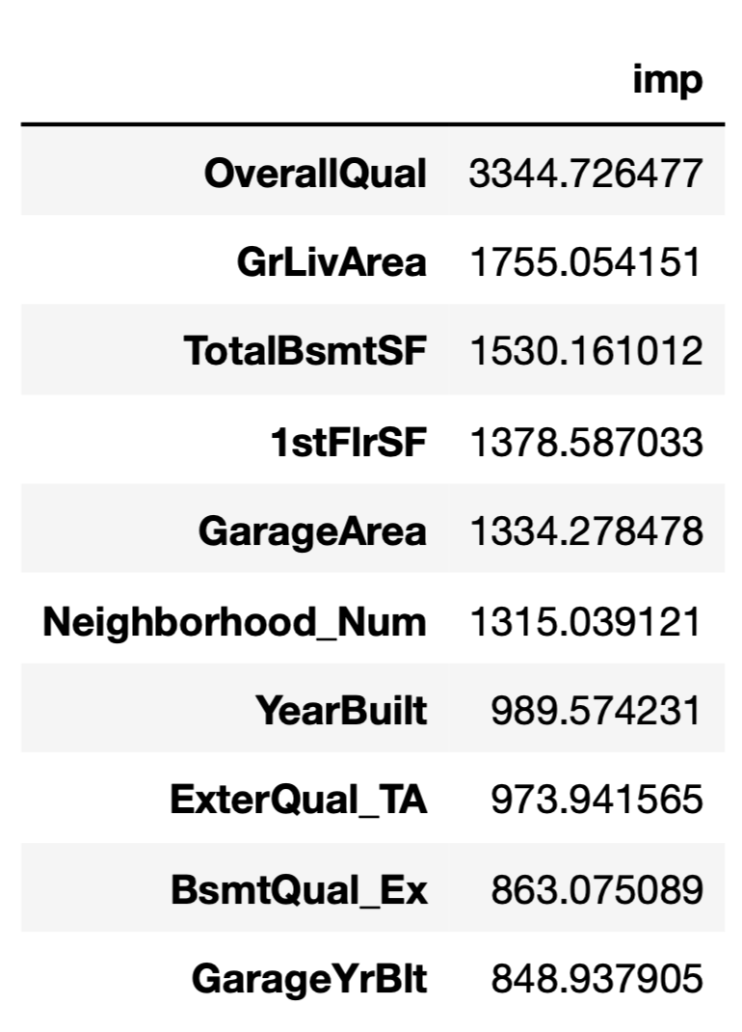
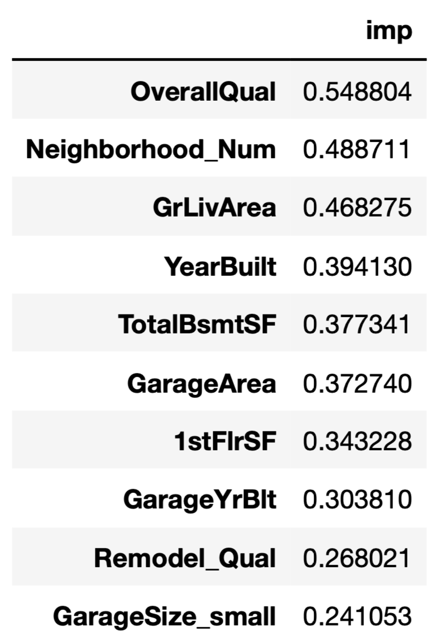
Feature Importance
Feature importance
Top 10 Scores (f_regression)
Top 10 Scores (mutual_info_regression)

Slide 12
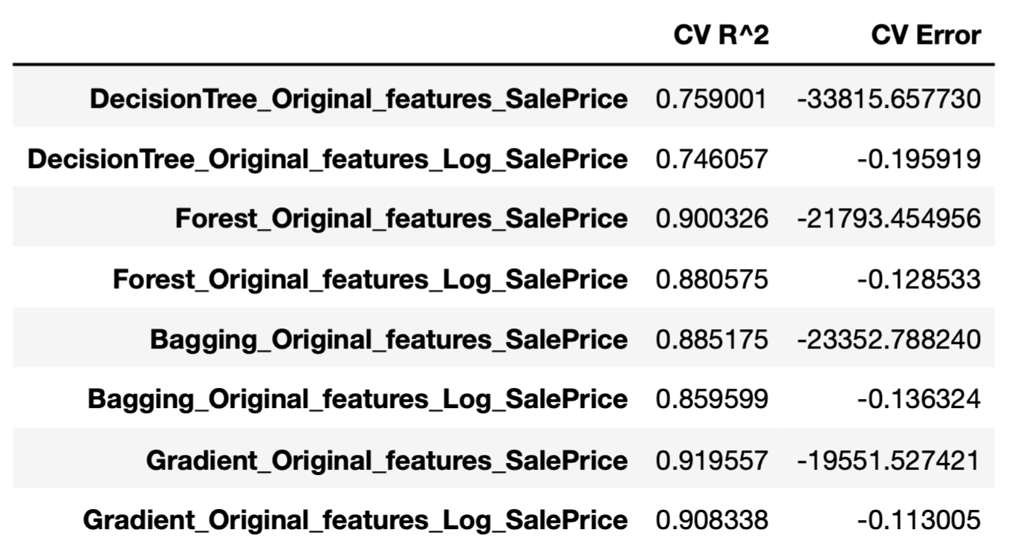
Model Comparison: Tree-based Models
Feature sets
Original features
New features
Targets
SalePrice
LogSalePrice
Pipeline
1) LabelEncoder
2) Regression: DecisionTree, RandomForest, Bagging, GradientBoosting, XGBoost
Cross Validation
10 folds

Slide 13
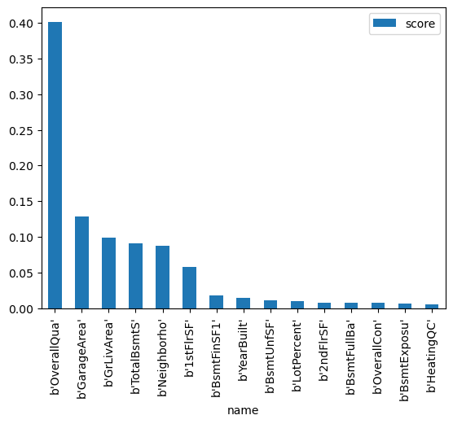
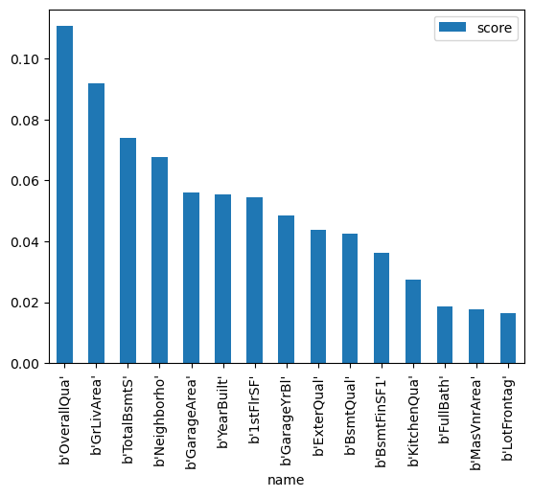
Feature Importance
Decision Tree
Random Forest

Slide 14
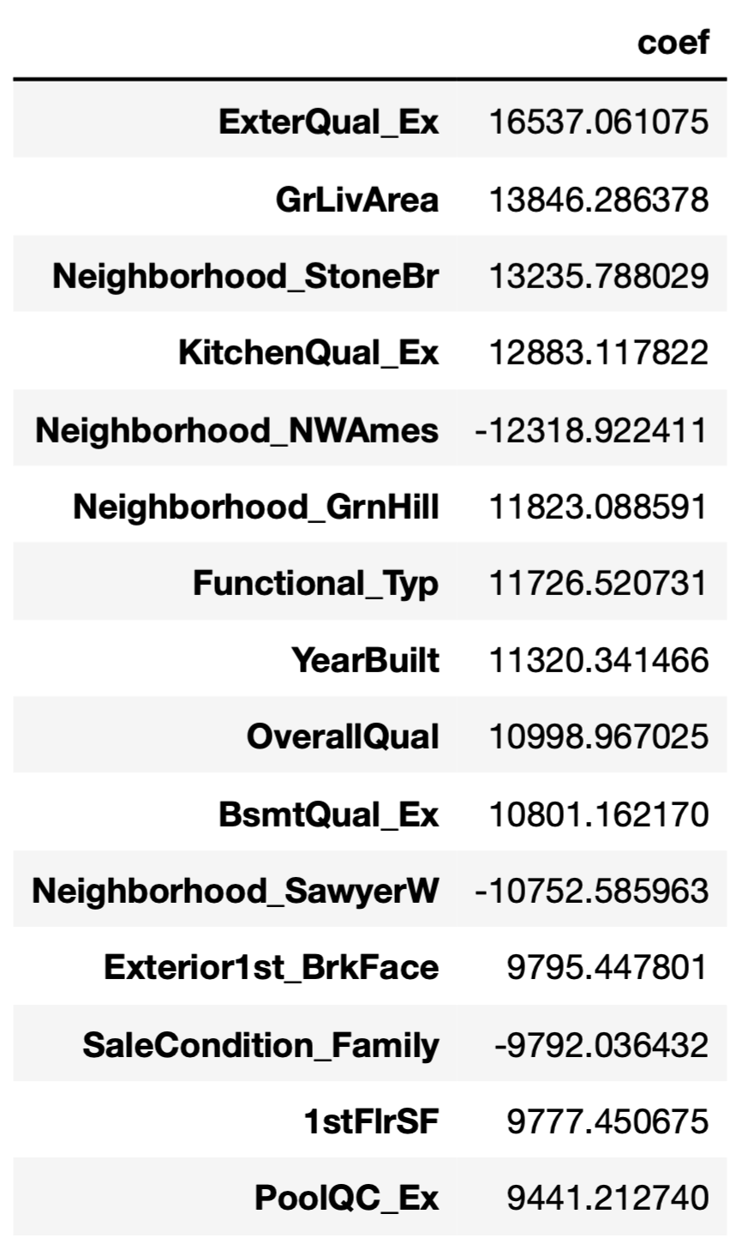
Interpretation: Ridge Regression on Sale Price
Coefficients with greatest absolute value
Exterior Quality: Excellent condition is associated with + $16k in sale price
Above Ground Living Area: each sq.ft. associated with + $13k in sale price
Values range from 300-2600
Kitchen Quality: Excellent condition associated with + $12k in sale price
Year Built: each additional year associated with + $11k in price
Neighborhoods
Stone Brook, NW Ames, Green Hills, Sawyer West each associated with +/- $10-13k in sale price

Slide 15
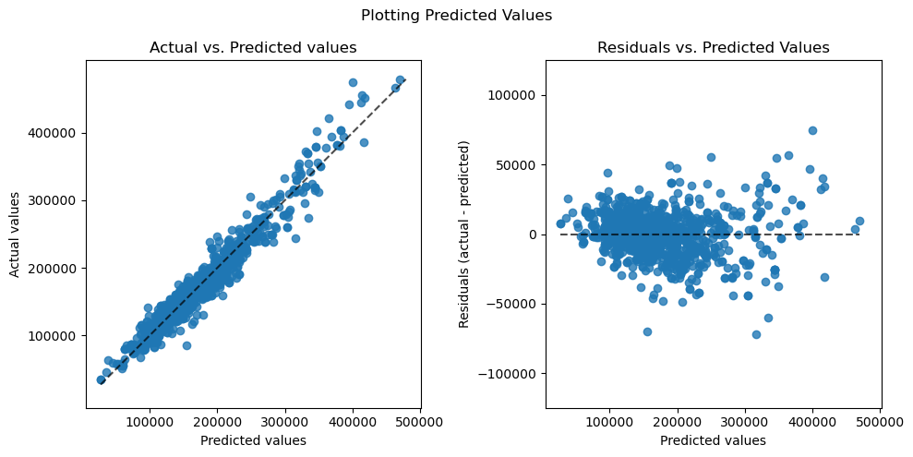
Model evaluation
Tuned model has 93.3% R² on test set
Residuals are more dispersed for higher values of response variable
Mean of residuals is -117

Slide 16
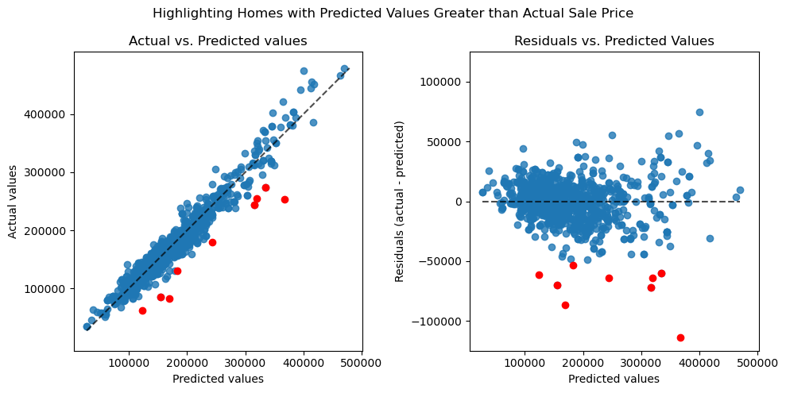
Which homes have true sale price below predicted value?
Negative residuals represent homes where predicted value is greater than true value
These homes are undervalued in sale price, according to the model
The 9 highlighted points have a $50k disparity between true and predicted value

Slide 17
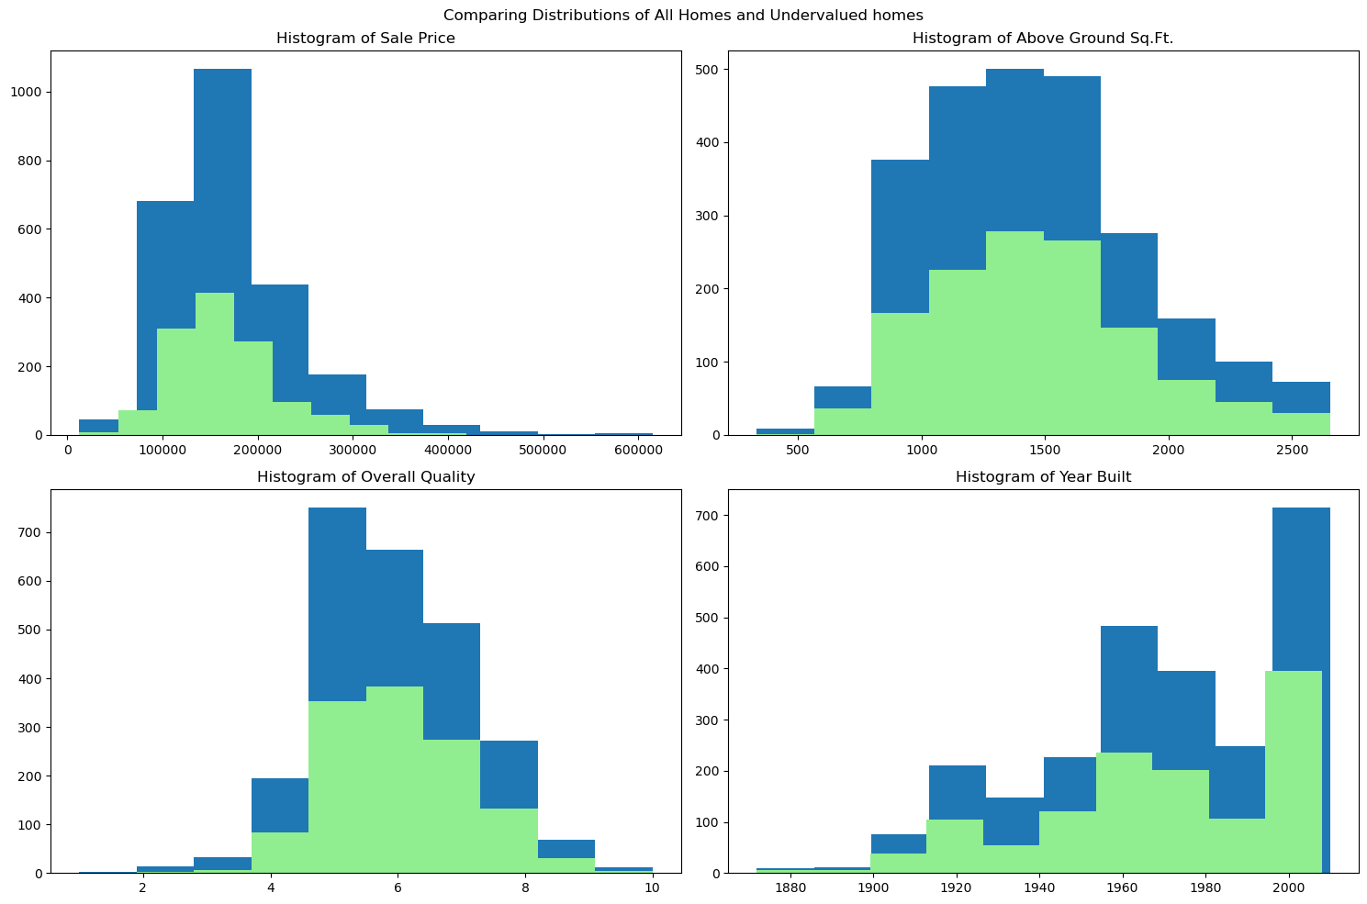
What do undervalued homes have in common?
Overall, the subset of undervalued homes have similar distributions to all homes
A correlation analysis also shows that sale price for these homes have similar relationships to features

Slide 18
Conclusions & Next Steps
Takeaways
Further Analysis
With a strong predictive model (capturing 93% of variance in response variable), homebuyers, investors, and renovators can be confident in accurately predicting a home’s sale price based on its features
The undervalued homes with the greatest negative residuals represent an opportunity to buy and resell for at least $50k profit
While there are no clear trends to discern undervalued homes in the data, further market research could provide clues as to how to spot homes that may be undervalued with current pricing
Continued feature engineering
Simplifying skewed categorical variables to binary
Using binary variables for interaction effects
Mapping to visualize home price across geographies
Research to determine common trends amongst undervalued homes

