Slide 1
Citi Bike Supply and Demand Across NYC
Emmy Danforth
June 9, 2023

Slide 2
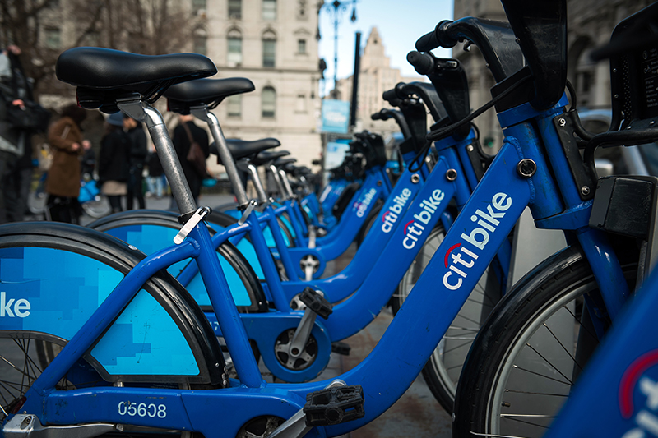
Motivation and Background
CitiBike is the country’s largest bikeshare program, providing more than 25,000 bikes at over 1,500 stations in NYC and New Jersey
CitiBike provides an affordable and sustainable alternative to the subway and rideshare/taxi services
To meet shifts in demand throughout the day and in different locations, CitiBike uses a predictive algorithm to manage their bike “rebalancing” efforts

Slide 3
Data Sources
June 2020 NYC CitiBike System Data
Records of 1.8 million individual trips
Station IDs for trip start and end
Station latitude/longitude coordinates
Date and time for trip start and end
User age and gender
User type (subscription or single-ride)
NYC Zipcode Shapefile (NYC Open Data)

Slide 4
Research Questions
When and where do New Yorkers move around by CitiBike?
How does demand for bikes differ by time of day and location?
How does CitiBike employ their rebalancing efforts to keep up with supply and demand for bikes?

Slide 5
Data Processing
Remove outlier trips with end locations in New Jersey
Convert trip data to GeoDataFrame, mapping latitude and longitude to spatial points
Use spatial join to match each point to zipcode shapefile so that data can be aggregated by neighborhood

Slide 6
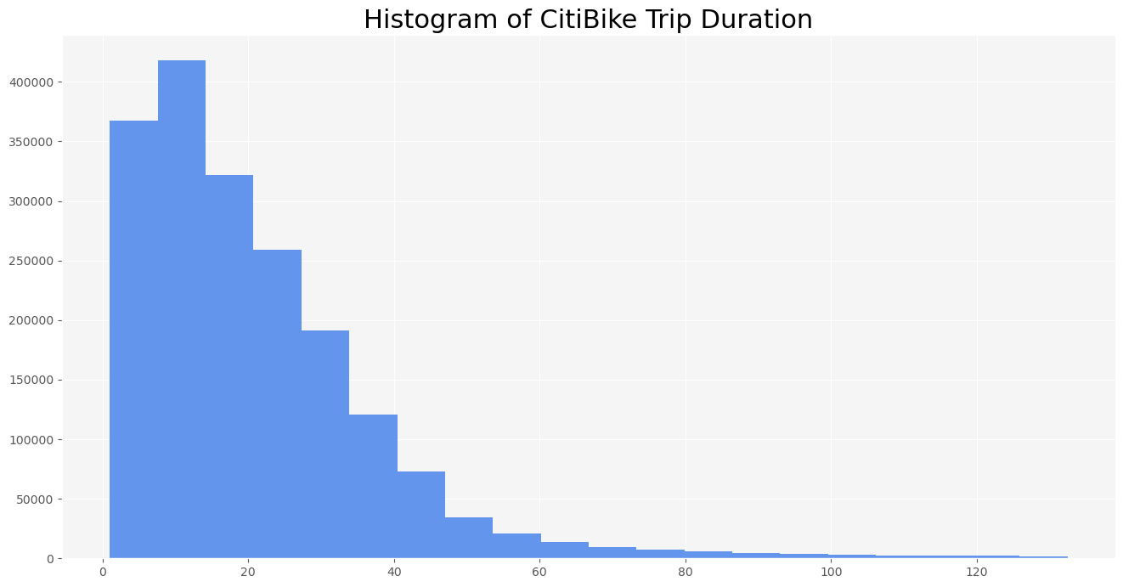

Slide 7
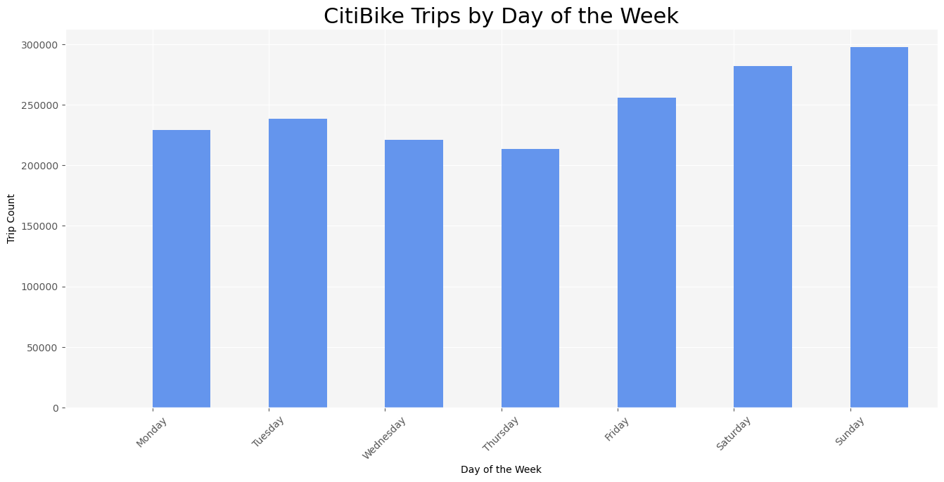

Slide 8
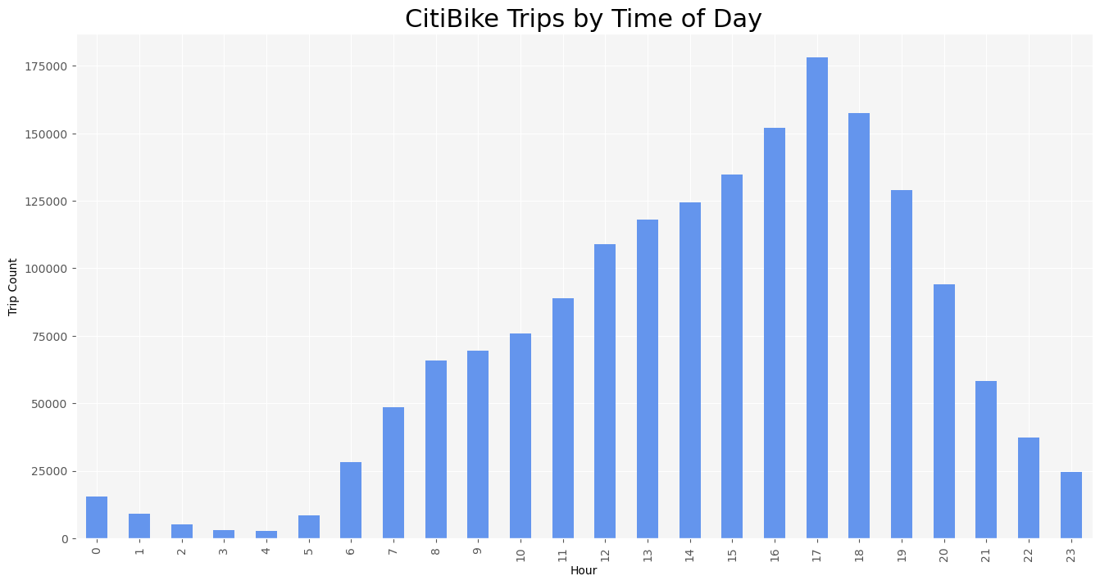

Slide 9
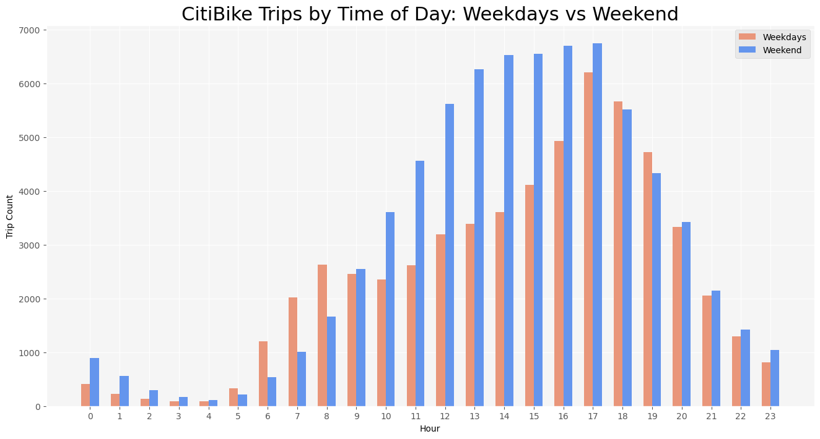

Slide 10
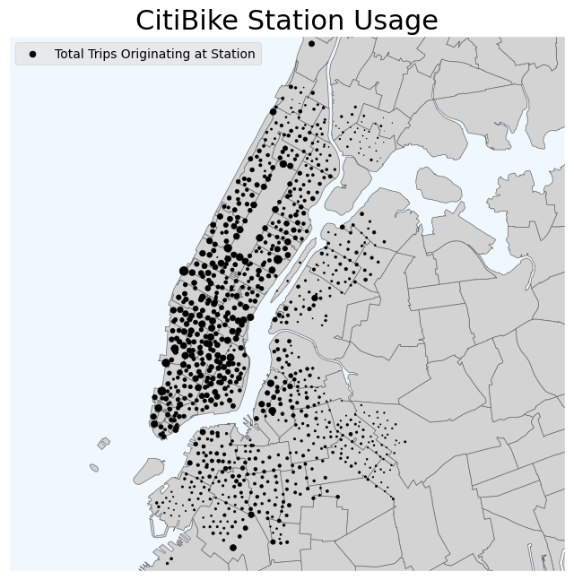

Slide 11
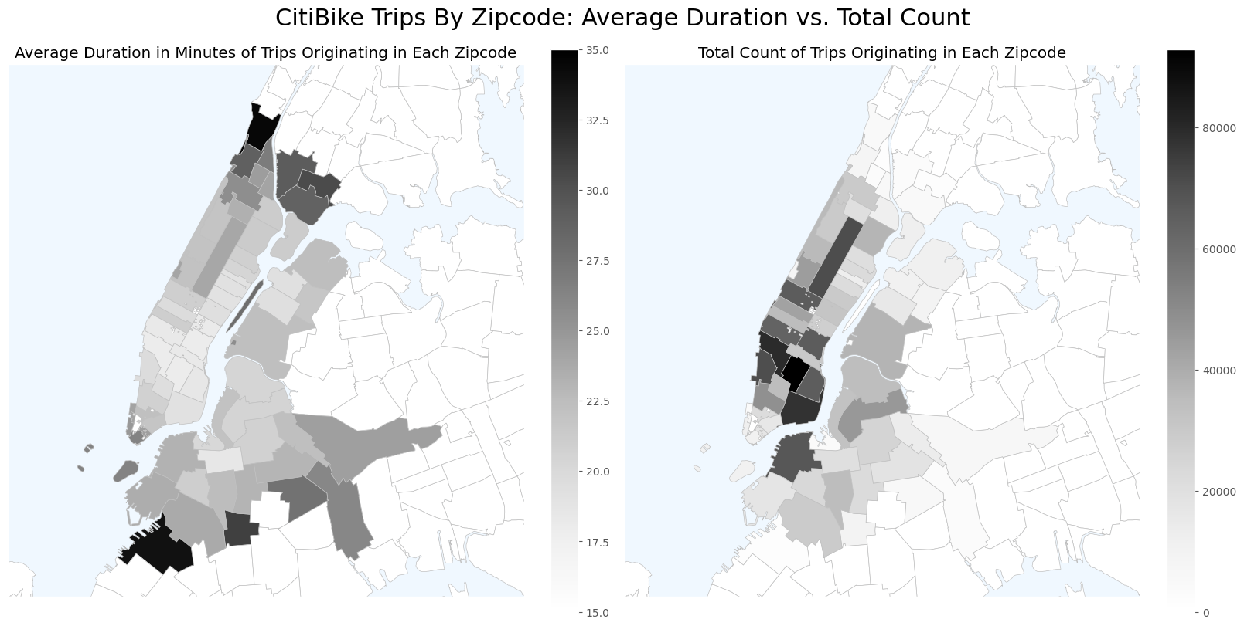

Slide 12
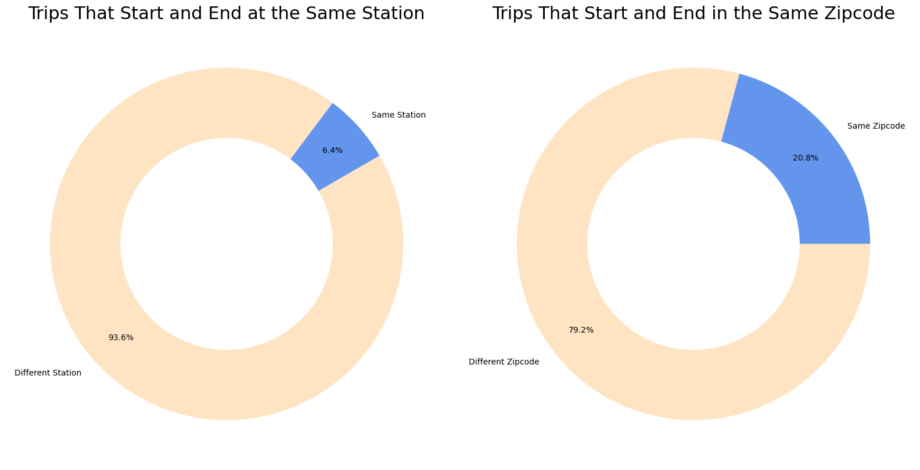

Slide 13
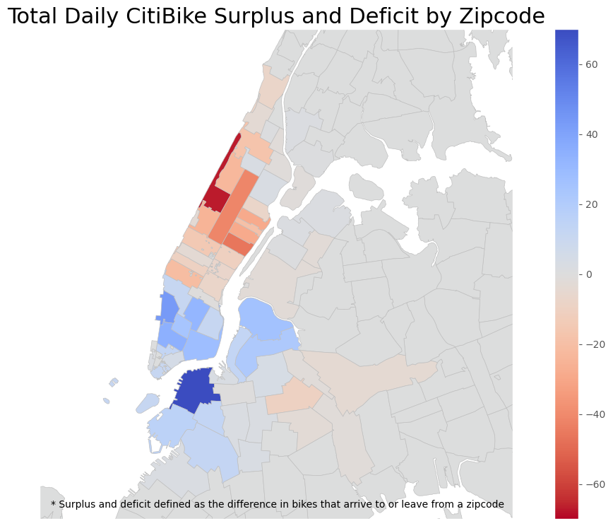

Slide 14
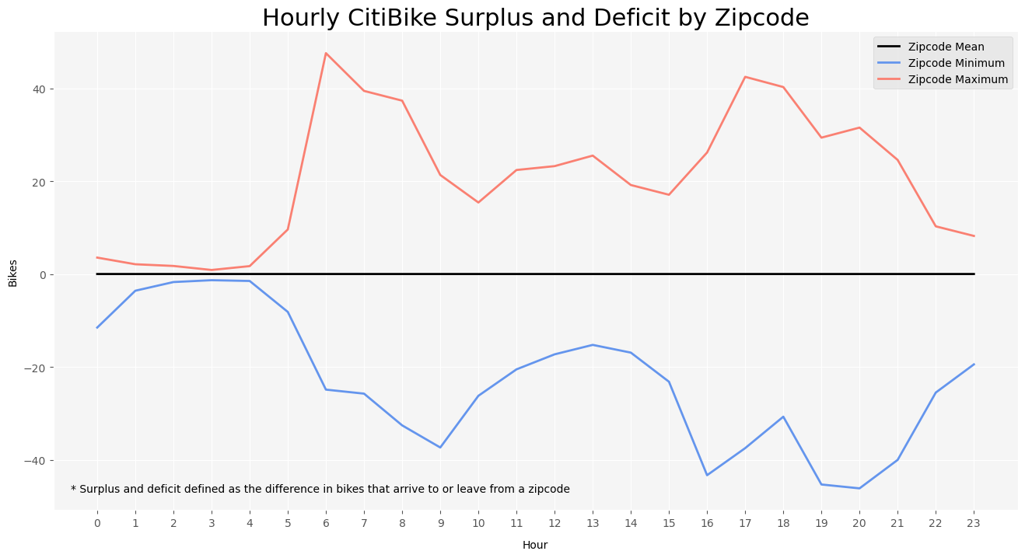

Slide 15
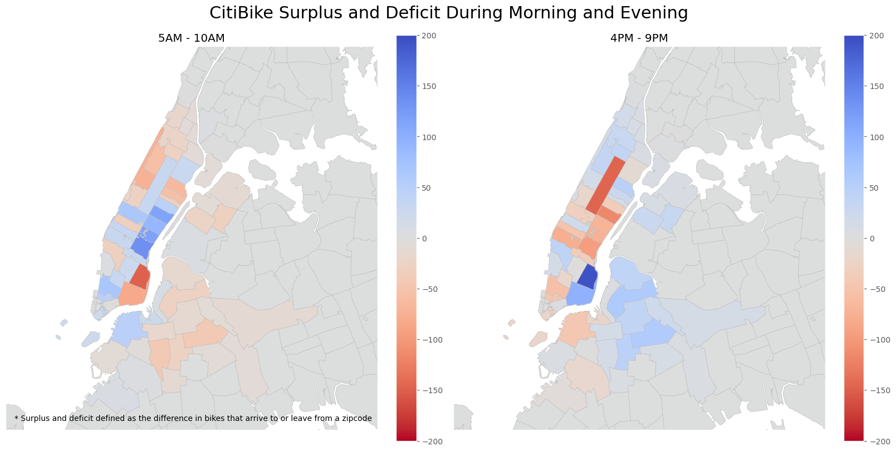

Slide 16
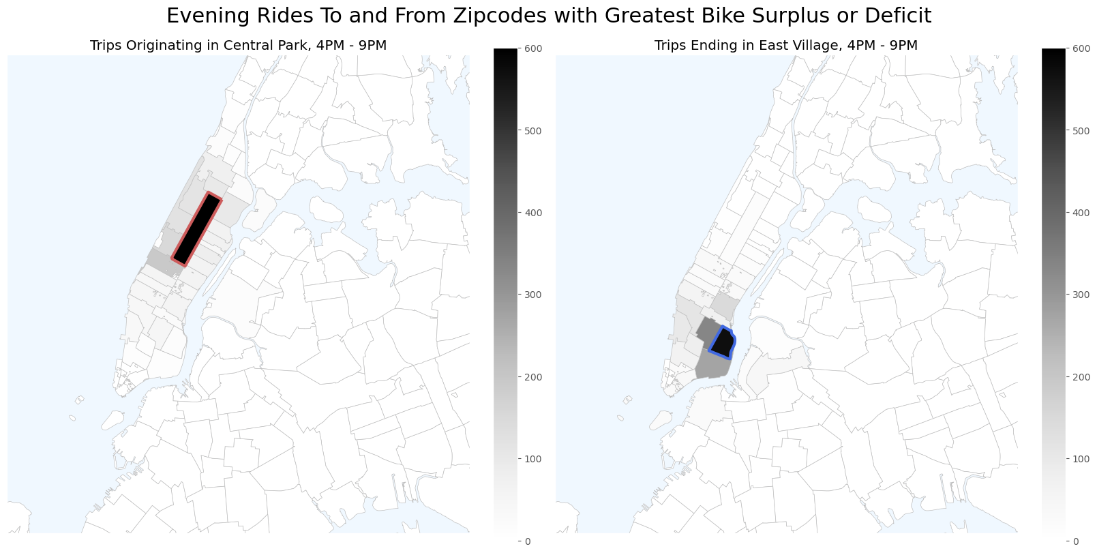

Slide 17
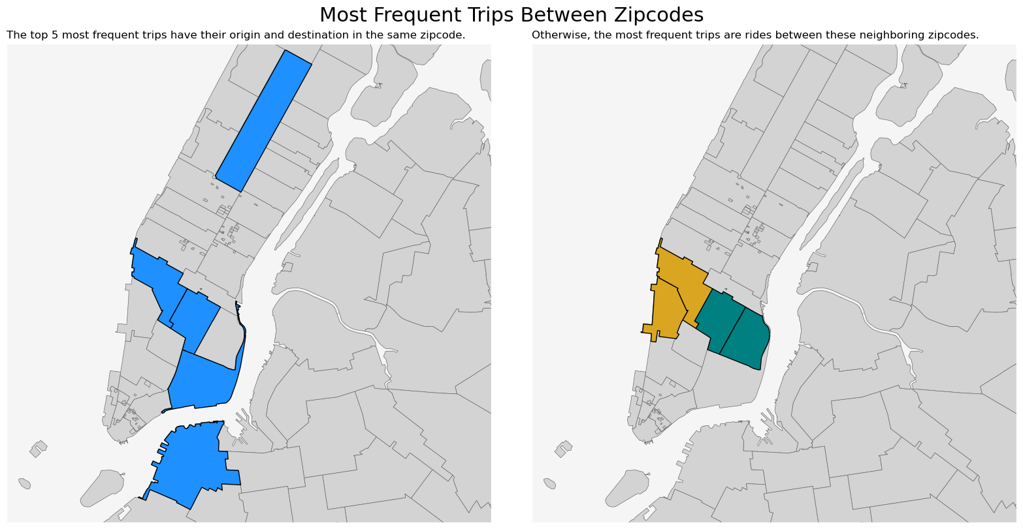

Slide 18
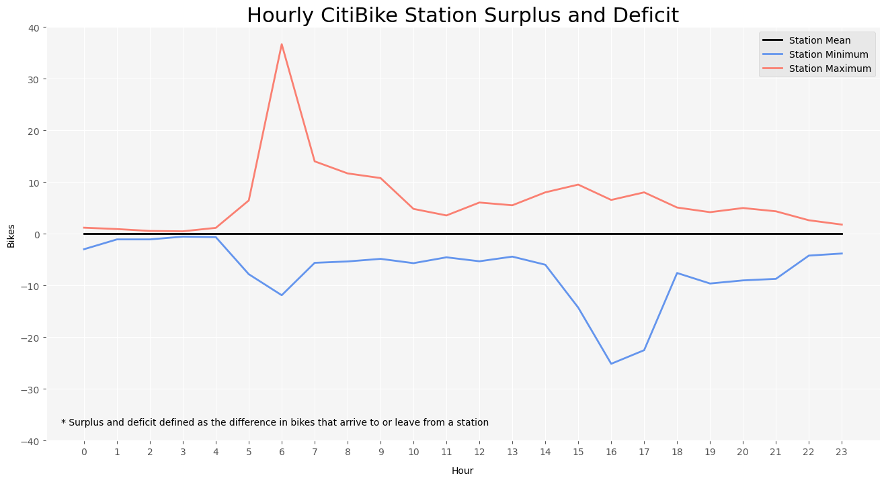

Slide 19
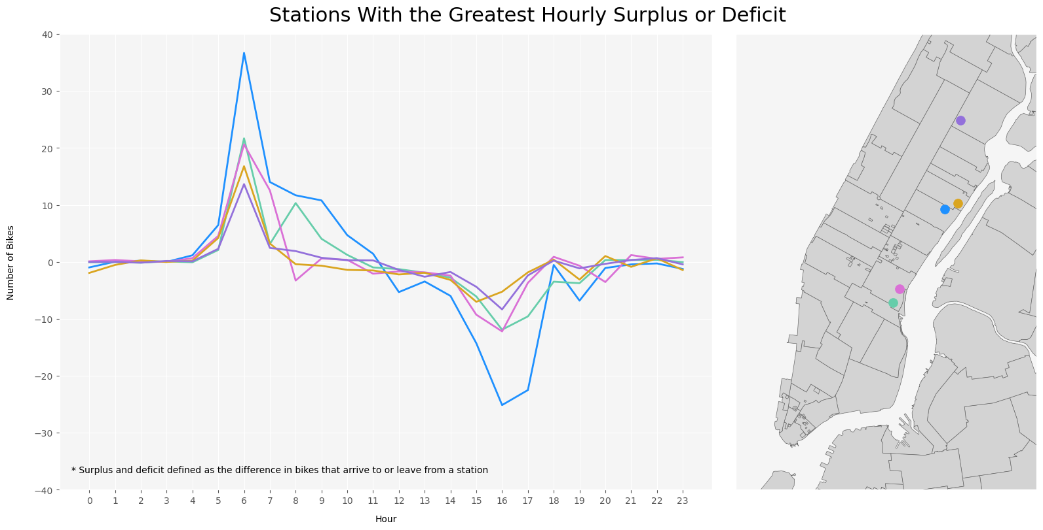

Slide 20
conclusions
The presence of large surpluses and deficits both at individual stations and within certain neighborhoods is evidence of CitiBike’s rebalancing in action
While the most frequent individual trip paths are local, trips across zipcodes are far more common overall
Although the visualizations suggest a direction of travel through aggregate movement of bikes in and out of neighborhoods, they don’t offer insight into trip destinations or length
User behavior varies greatly by time of day, neighborhood, and by individual stations

Slide 21
Further Analysis
How has CitiBike usage changed since 2020, given further station expansion into the outer boroughs?
To what extent are NYC bike lanes correlated with common CitiBike paths?
Train a model to approximate CitiBike’s rebalancing algorithm to predict trip destinations
Logistic regression – classification of whether trip starts and ends in same location
K-mean clustering – group trips by shared features to determine likelihood of different destinations

