Slide 1


Continuous Integration/Deployment with Gitlab CLI
August 2021
Phumudzo V Neluheni: Collections Optimisation Bevan H Tucker: Collections Optimisation

Slide 2
Aim
The aim is to improve efficiency by allowing seamless collaboration between process owners

Slide 3
Agenda
Introduction
Continuous Integration
Continuous Delivery and Deployment
About Gitlab
Gitlab CI
About Gitlab CI
Stages and Pipeline
UI
Runners
CI as Code
.

Slide 4

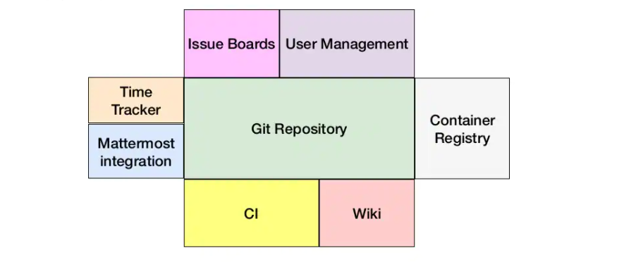
Gitlab What is it?
How:
Git based hosting and collaboration platform
Hosted on prem
Actively maintained
Keep builds fast
Keep the build on the CI Machine (Server)
Test in a clone or production environment
Make it fast for everyone to get the latest executable
Make the process transparent for everyone
Why:
Detect development problems earlier
Reduce risk of cost, schedule and budget
Find and remove bugs earlier
Deliver new features and get user feedback more rapidly

Slide 5
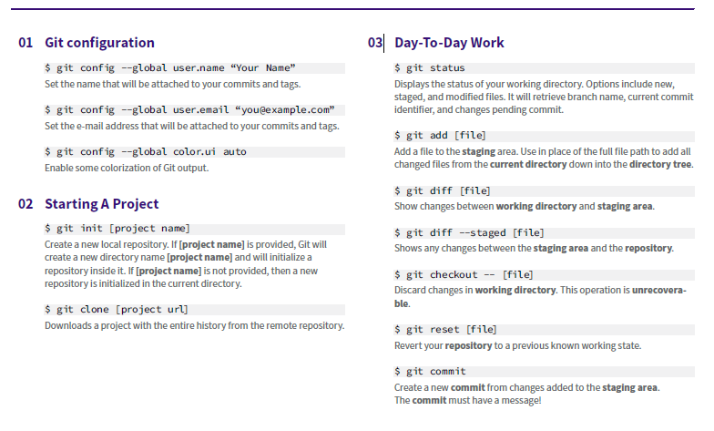
General Commands

Slide 6
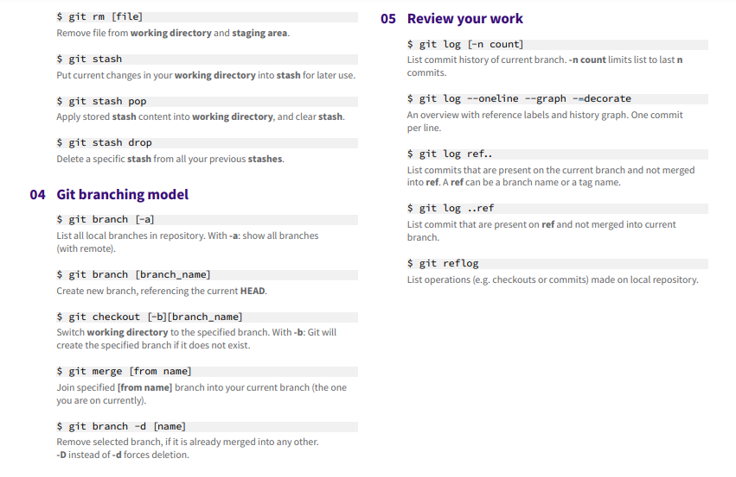
General Commands

Slide 7
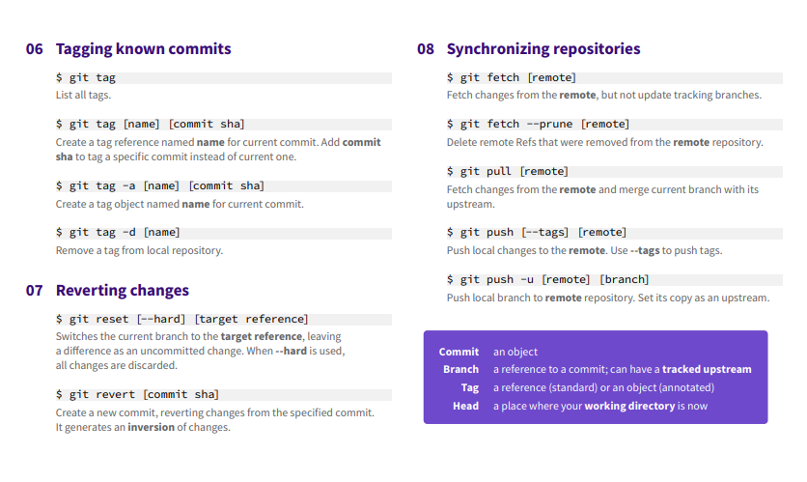
General Commands

Slide 8
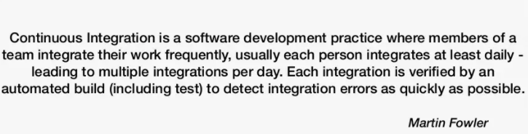
Continuous Integration Defintion

Slide 9
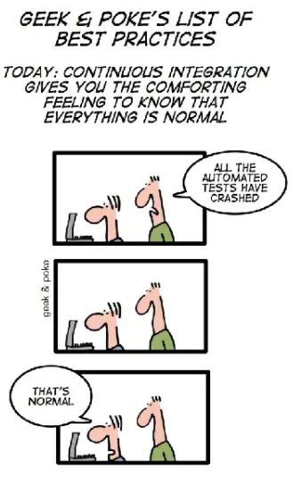
Continuous Integration How and Why?
How:
Maintain a single soure repository
Automate the build
Make the build self-testing
Keep builds fast
Keep the build on the CI Machine (Server)
Test in a clone or production environment
Make it fast for everyone to get the latest executable
Make the process transparent for everyone
Why:
Detect development problems earlier
Reduce risk of cost, schedule and budget
Find and remove bugs earlier
Deliver new features and get user feedback more rapidly

Slide 10
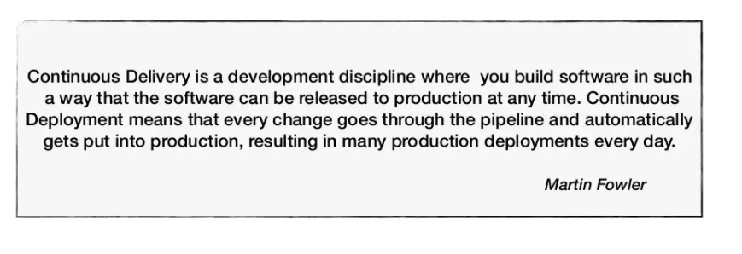
Continuous Delivery
Definition

Slide 11
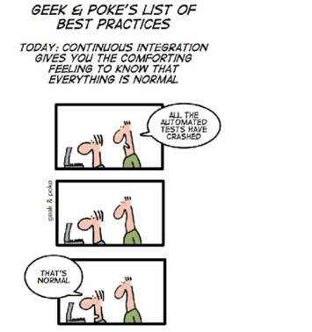
Continuous Delivery/ Deployment How and Why?
How:
Continuously integrating the processes done by the ream
Run automated tests
Push build to production-like environment
Why:
Decrease deployment risks
Change the version in production more rapidly
Deliver new features and get feedback more rapidly

Slide 12
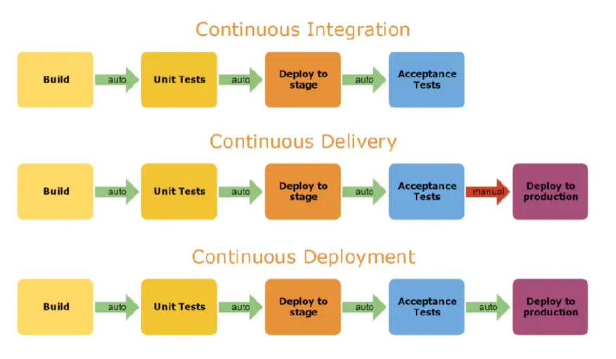
Continuous Delivery/ Deployment Summary

Slide 13
Gitlab CI What and why?
What:
Fully integrated with GitLab
Build script fully hosted in repo
Git hooks
Hosted (free) on premise
Actively maintained
Why:
Code and scripts in the same repo
Easy to start
Scalable
Isolated test environment

Slide 14
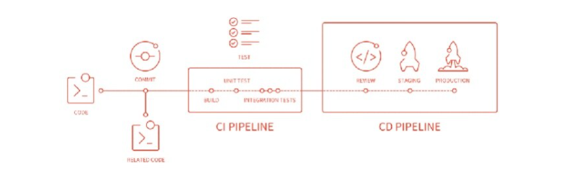
Gitlab CI Pipelines and stages?
A pipeline is a group of jobs that get executed in stages(batches)
All the jobs in a stage are executed in parallel, and if they all succeed, the pipeline moves on to the next stage
If one of the jobs fails, the next stage is not executed
Pipelines get defined in gitlab-ci yaml by specifying jobs in stages

Slide 15
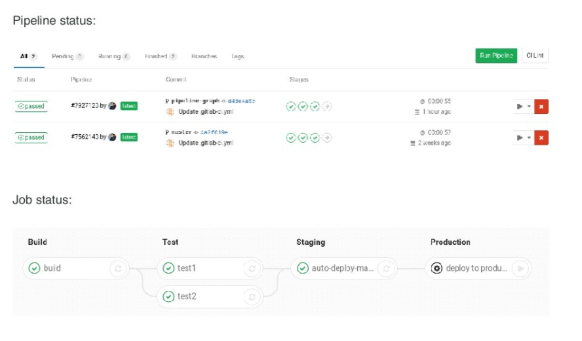
Gitlab CI UI

Slide 16
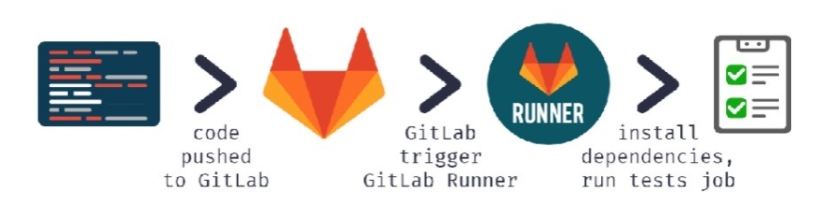
Gitlab CI Runners
Gitlab is an application, that processes builds
Receives commands from Gitlab CI
It is possible to tag runners so jobs run on runners which can process them (eg different OS)
Works with Linux and Windows
Works as a docker container
Shared or specific
Docker – In Docker container
Shell – locally
Docker SSH – In Docker container over SSH
SSH – remote using SSH

Slide 17
Gitlab CI Pros and Cons
Pros
Parallel Builds
Docker Integration
Fully Integrated in Gitlab
Configurability per branch already on jobs-level
Permission inheritance (Repository Manager)
Cons
Integrated only in Gitlab

Slide 18
Gitlab CI Other Features?
Environments
Auto DevOps
Review Processes
Trigger Pipelines through the Gitlab API
Trigger Pipelines on a schedule
Deploy Boards – Check current health
BUT NOT TODAY !!!

Slide 19


Slide 20
Sources
https://asciinema.org/a/368473
https://about.gitlab.com/features/gitlab-ci-cd
https://www.docker.com

