Slide 1


Practical Application 2 Machine Learning
Escuela Técnica Superior de Ingenieros Informáticos
Jan Cerezo Pomykol
j.cerezo@alumnos.upm.es
Notes:
1

Slide 2
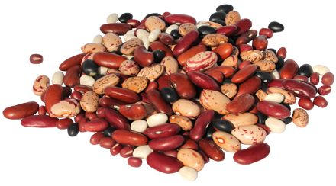
Problem Description
Dry Bean Dataset:
13611 instances
16 variables
7 classes
Area
Perimeter
Major axis length
Minor axis length
Aspect ratio
Eccentricity
Convex area
Equivalent diameter
Extent
Solidity
Roundness
Compactness
ShapeFactor1
ShapeFactor2
ShapeFactor3
ShapeFactor4
Seker
Barbunya
Bombay
Cali
Dermosan
Horoz
Sira
https://archive.ics.uci.edu/ml/datasets/Dry+Bean+Dataset#
Practical Application 2
2

Slide 3

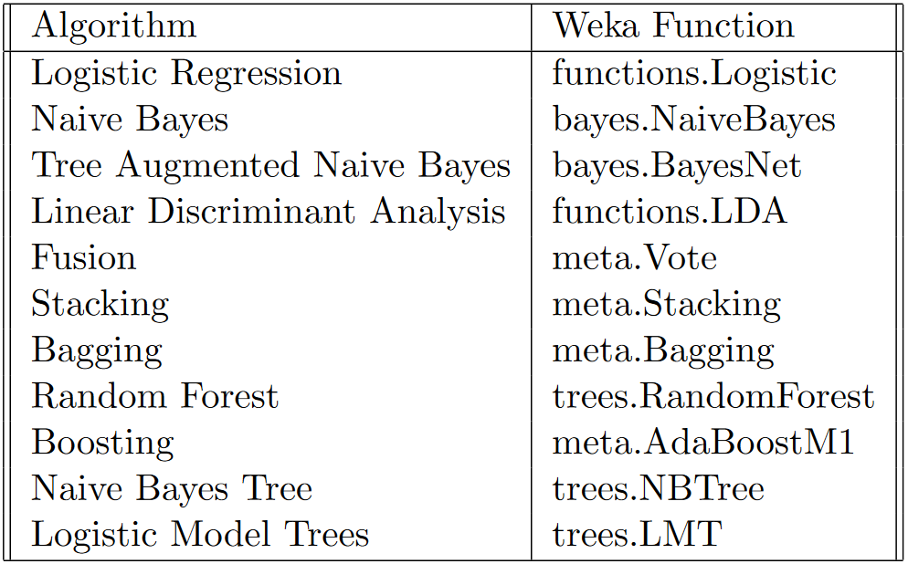
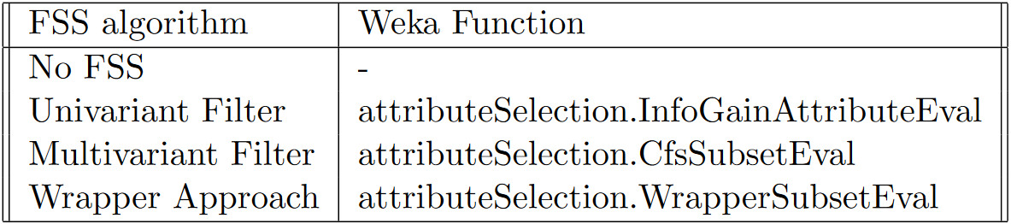
Methodology
Software: Weka
Classification algorithms:
Logistic Regression
Naïve Bayes
Tree Augmented Naive Bayes
Linear Discriminant Analysis
Fusion, Stacking, Bagging, Random Forest, Boosting, NBT, LMT.
Feature Subset Selection:
No FSS
Univariant Filter
Multivariant Filter
Wrapper Approach
Practical Application 2
3

Slide 4
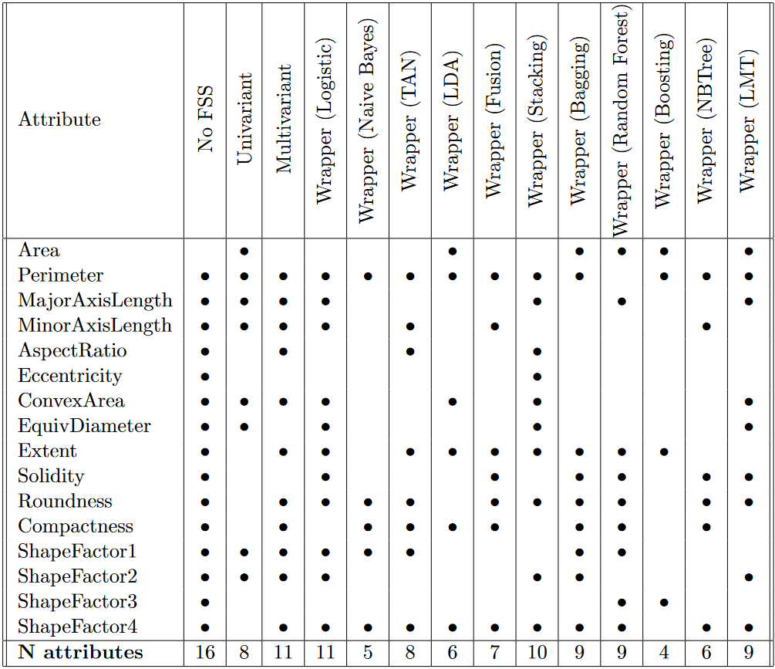
Results
Selected attributes
Practical Application 2
4

Slide 5
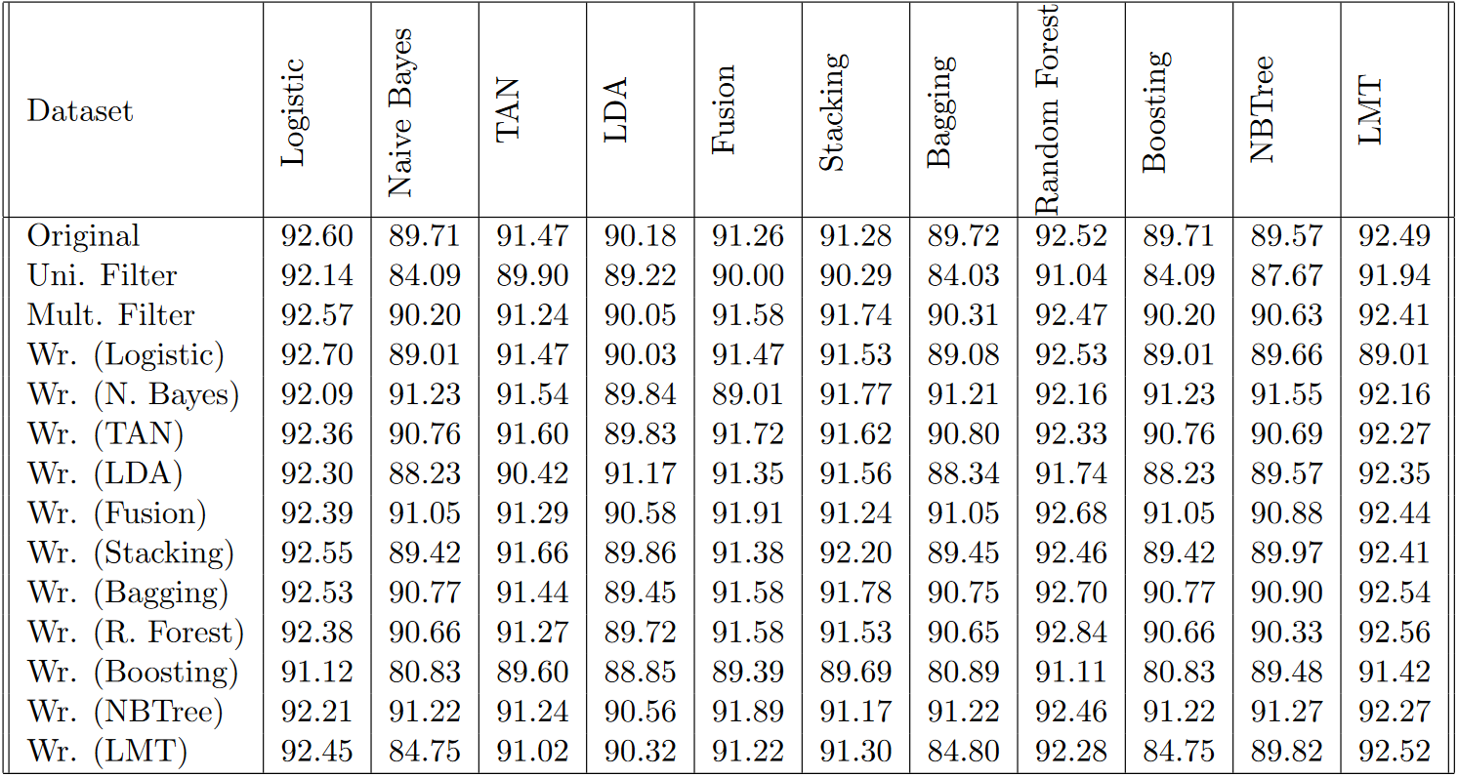
Results
Classifier scores
Practical Application 2
5

Slide 6
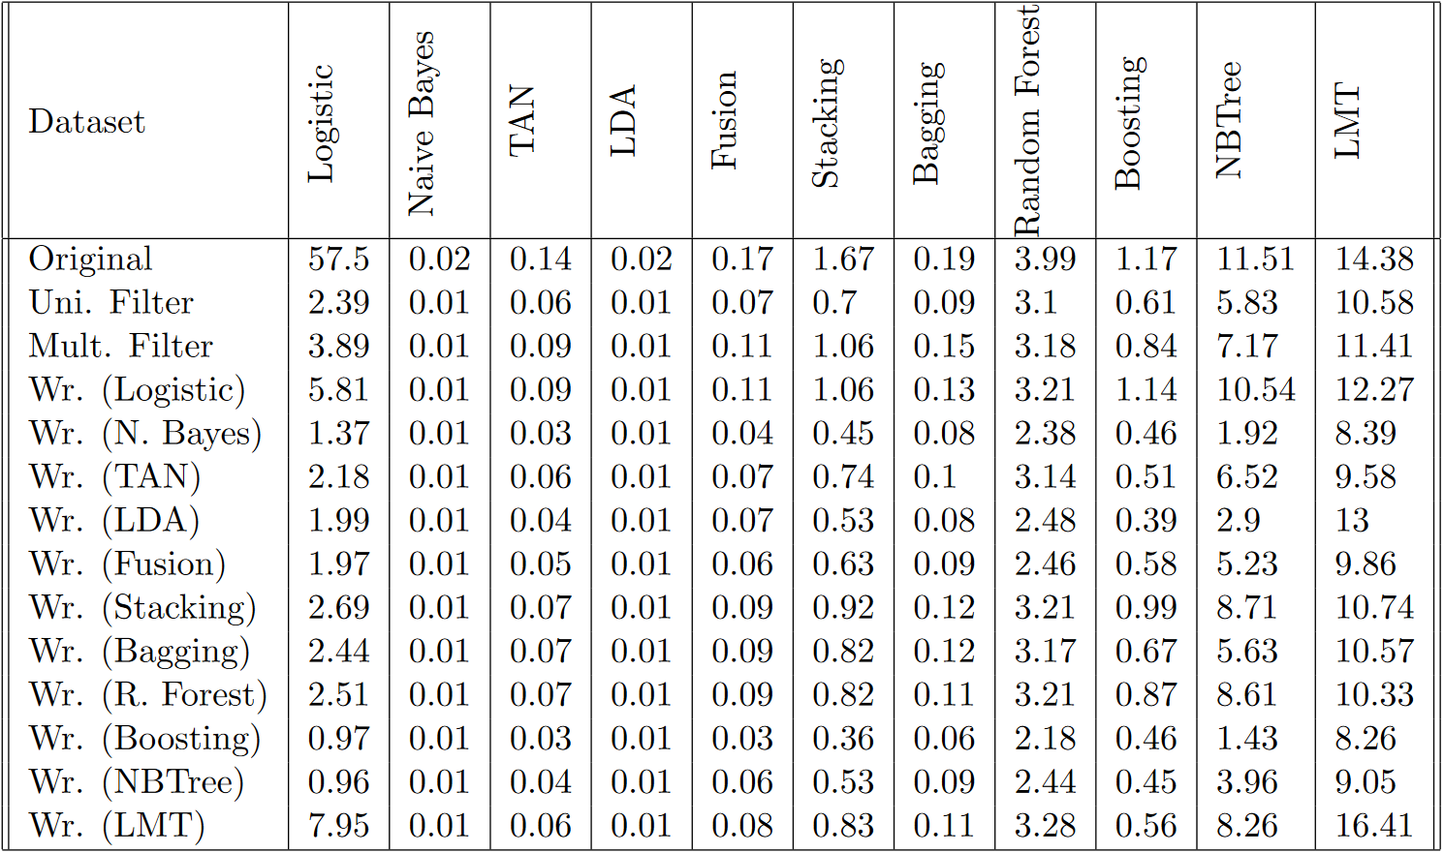
Results
Training time
Practical Application 2
6

Slide 7
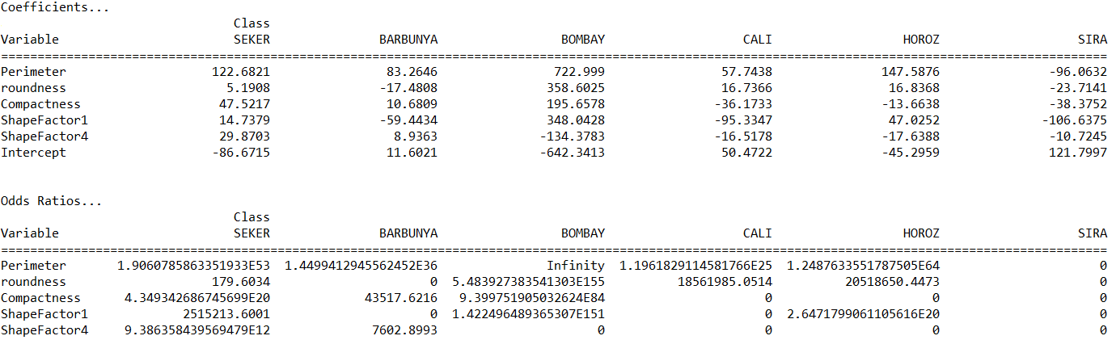
Results
Logistic Regression
Practical Application 2
7

Slide 8
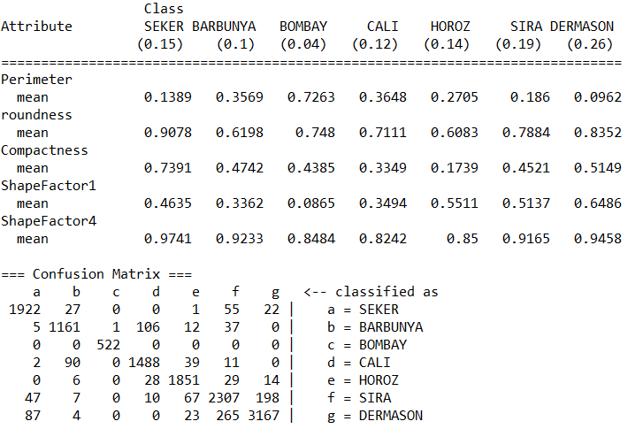
Results
Naive Bayes
Practical Application 2
8

Slide 9
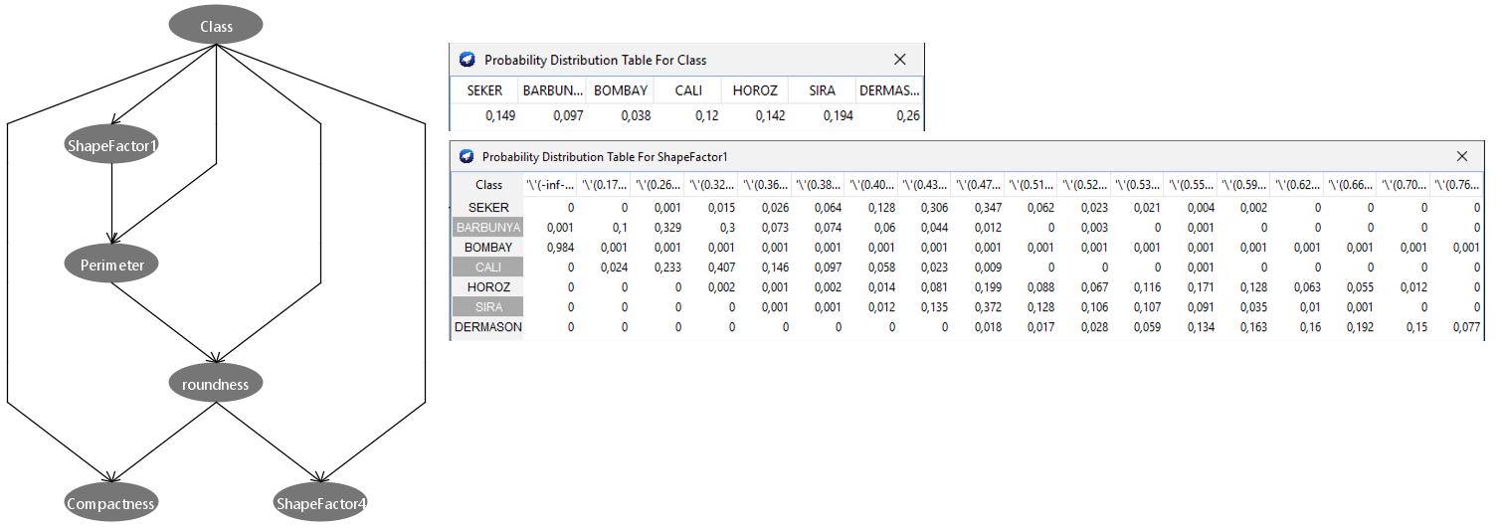
Results
Tree Augmented Naive Bayes
Practical Application 2
9

Slide 10
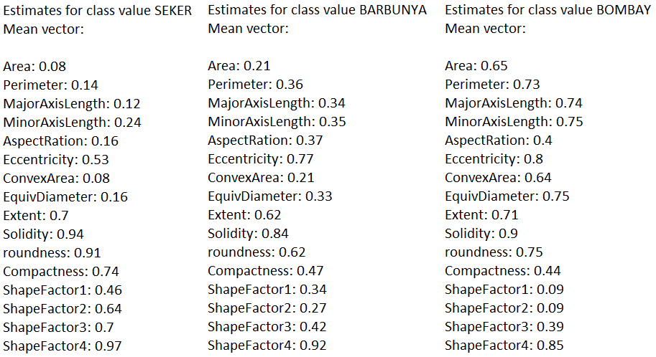
Results
Linear Discriminant Analysis
Practical Application 2
10

Slide 11
Practical Application 2 Machine Learning
Escuela Técnica Superior de Ingenieros Informáticos
Jan Cerezo Pomykol
j.cerezo@alumnos.upm.es
Notes:
11

