Slide 1


Practical Application 1 Machine Learning
Escuela Técnica Superior de Ingenieros Informáticos
Jan Cerezo Pomykol
j.cerezo@alumnos.upm.es
Notes:
1

Slide 2
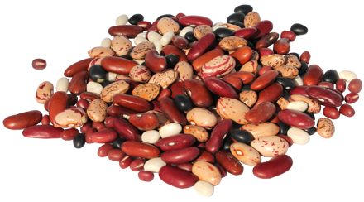
Problem Description
Dry Bean Dataset:
13611 instances
16 variables
7 classes
Area
Perimeter
Major axis length
Minor axis length
Aspect ratio
Eccentricity
Convex area
Equivalent diameter
Extent
Solidity
Roundness
Compactness
ShapeFactor1
ShapeFactor2
ShapeFactor3
ShapeFactor4
Seker
Barbunya
Bombay
Cali
Dermosan
Horoz
Sira
https://archive.ics.uci.edu/ml/datasets/Dry+Bean+Dataset#
Practical Application 1
2

Slide 3

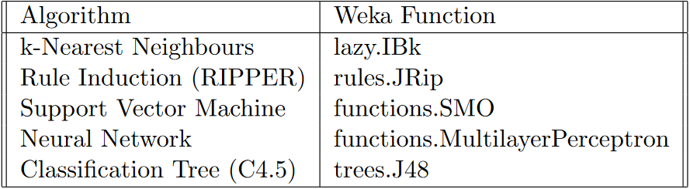
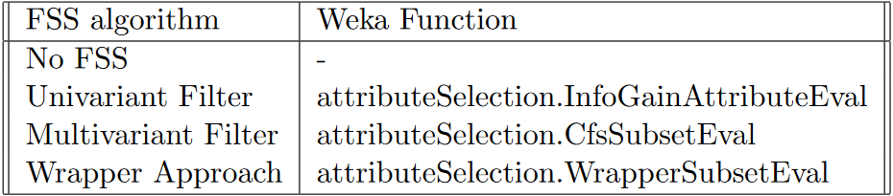
Methodology
Software: Weka
Classification algorithms:
k-Nearest Neighbour
Rule Induction – RIPPER
Support Vector Machine
Neural Network
Classification Tree – C4.5
Feature Subset Selection:
No FSS
Univariant Filter
Multivariant Filter
Wrapper Approach
Practical Application 1
3

Slide 4
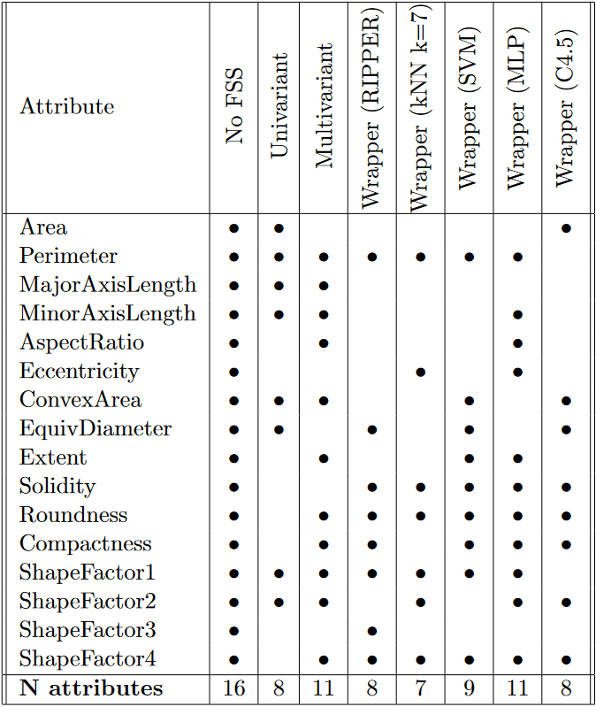
Results
Selected attributes
Practical Application 1
4

Slide 5
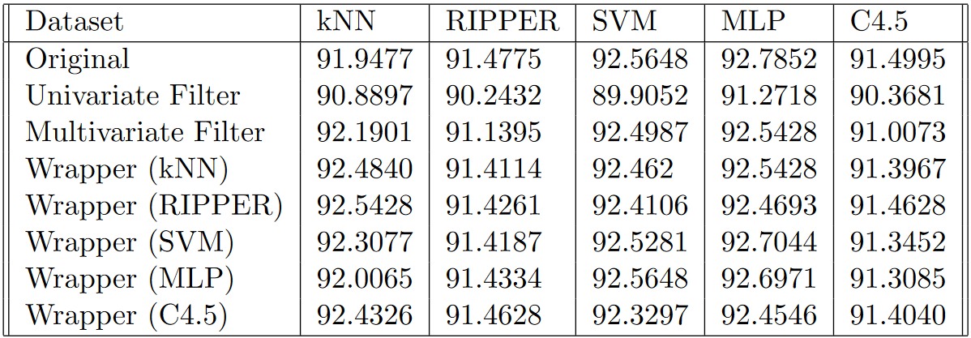
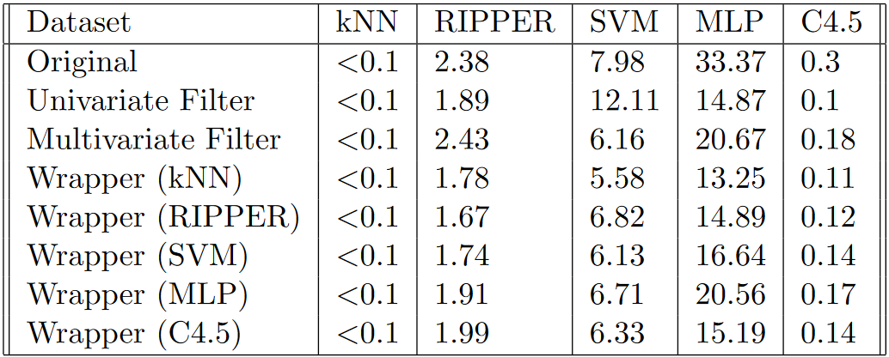
Results
Classifier scores
Training time
Practical Application 1
5

Slide 6
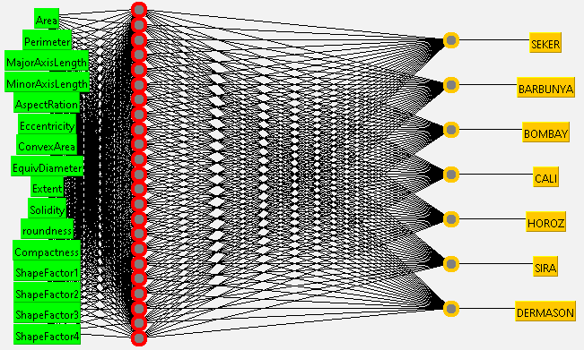
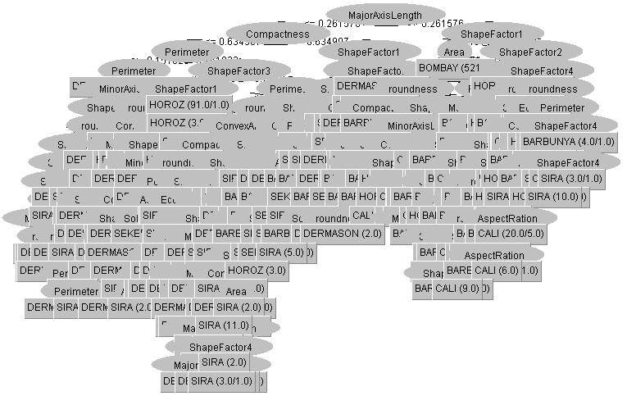
Results
Multilayer Perceptron Network
C4.5 Tree
Practical Application 1
6

Slide 7
Practical Application 1 Machine Learning
Escuela Técnica Superior de Ingenieros Informáticos
Jan Cerezo Pomykol
j.cerezo@alumnos.upm.es
Notes:
7

