Slide 1
AI2050 Progress Update
8 January 2025

Slide 2
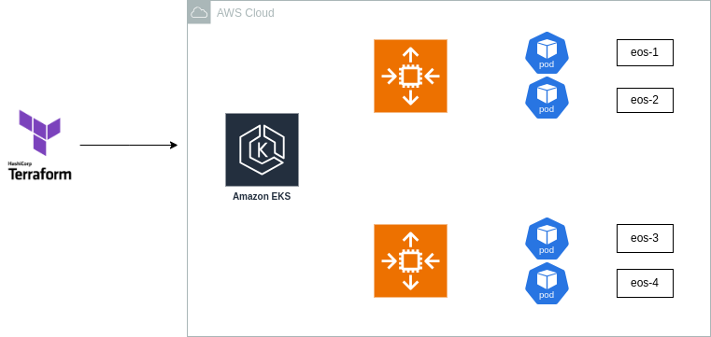
Online Platform Development
AWS Deployment types
EC2 vs ECS and EKS
Cost comparisons
Costs of each deployment were relatively similar
EKS selected: More flexibility, customizability, and automation

Slide 3
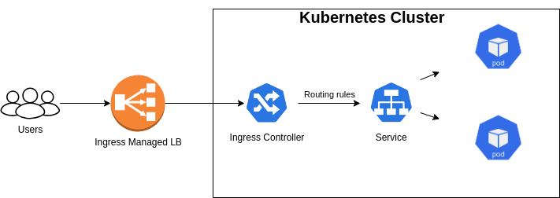
Ingress Controller
Simplifies management of complex ingress processes
Cost effective
When implemented correct
Handles various routing scenarios:
Host-based routing or path-based routing
Load balancing

