Slide 1
AI2050 Progress Update
5 December 2024

Slide 2
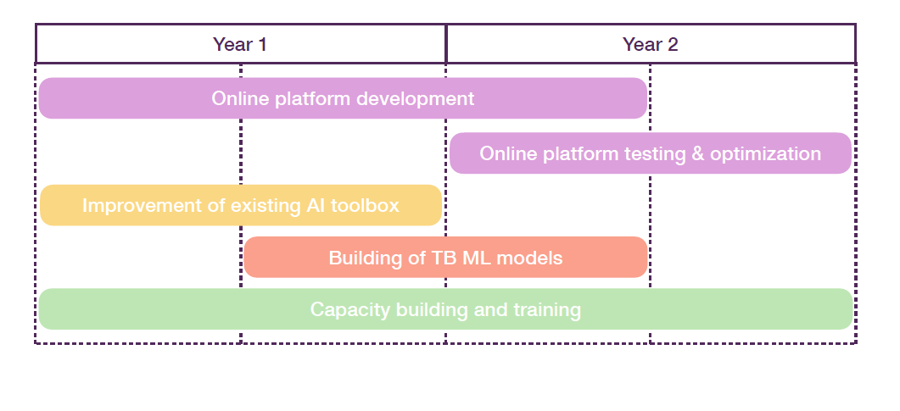
Project Milestones
Dev Ops position filled – welcome to Edmore Mlotshwa.
Online platform delayed but AWS cloud infrastructure now in progress.
AI toolbox improvements ongoing:
Olinda pipeline complete
ZairaChem updates in progress (refactoring, interpretability, regression)

Slide 3
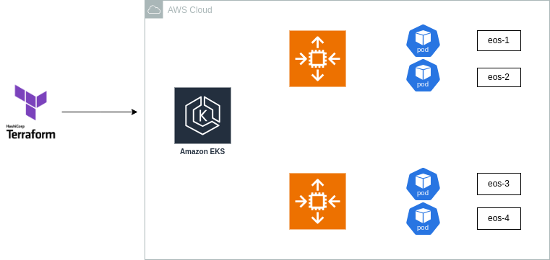
Online Platform Development
AWS Deployment types
EC2 vs ECS and EKS
Cost comparisons
Costs of each deployment were relatively similar
EKS selected: More flexibility, customizability, and automation

Slide 4
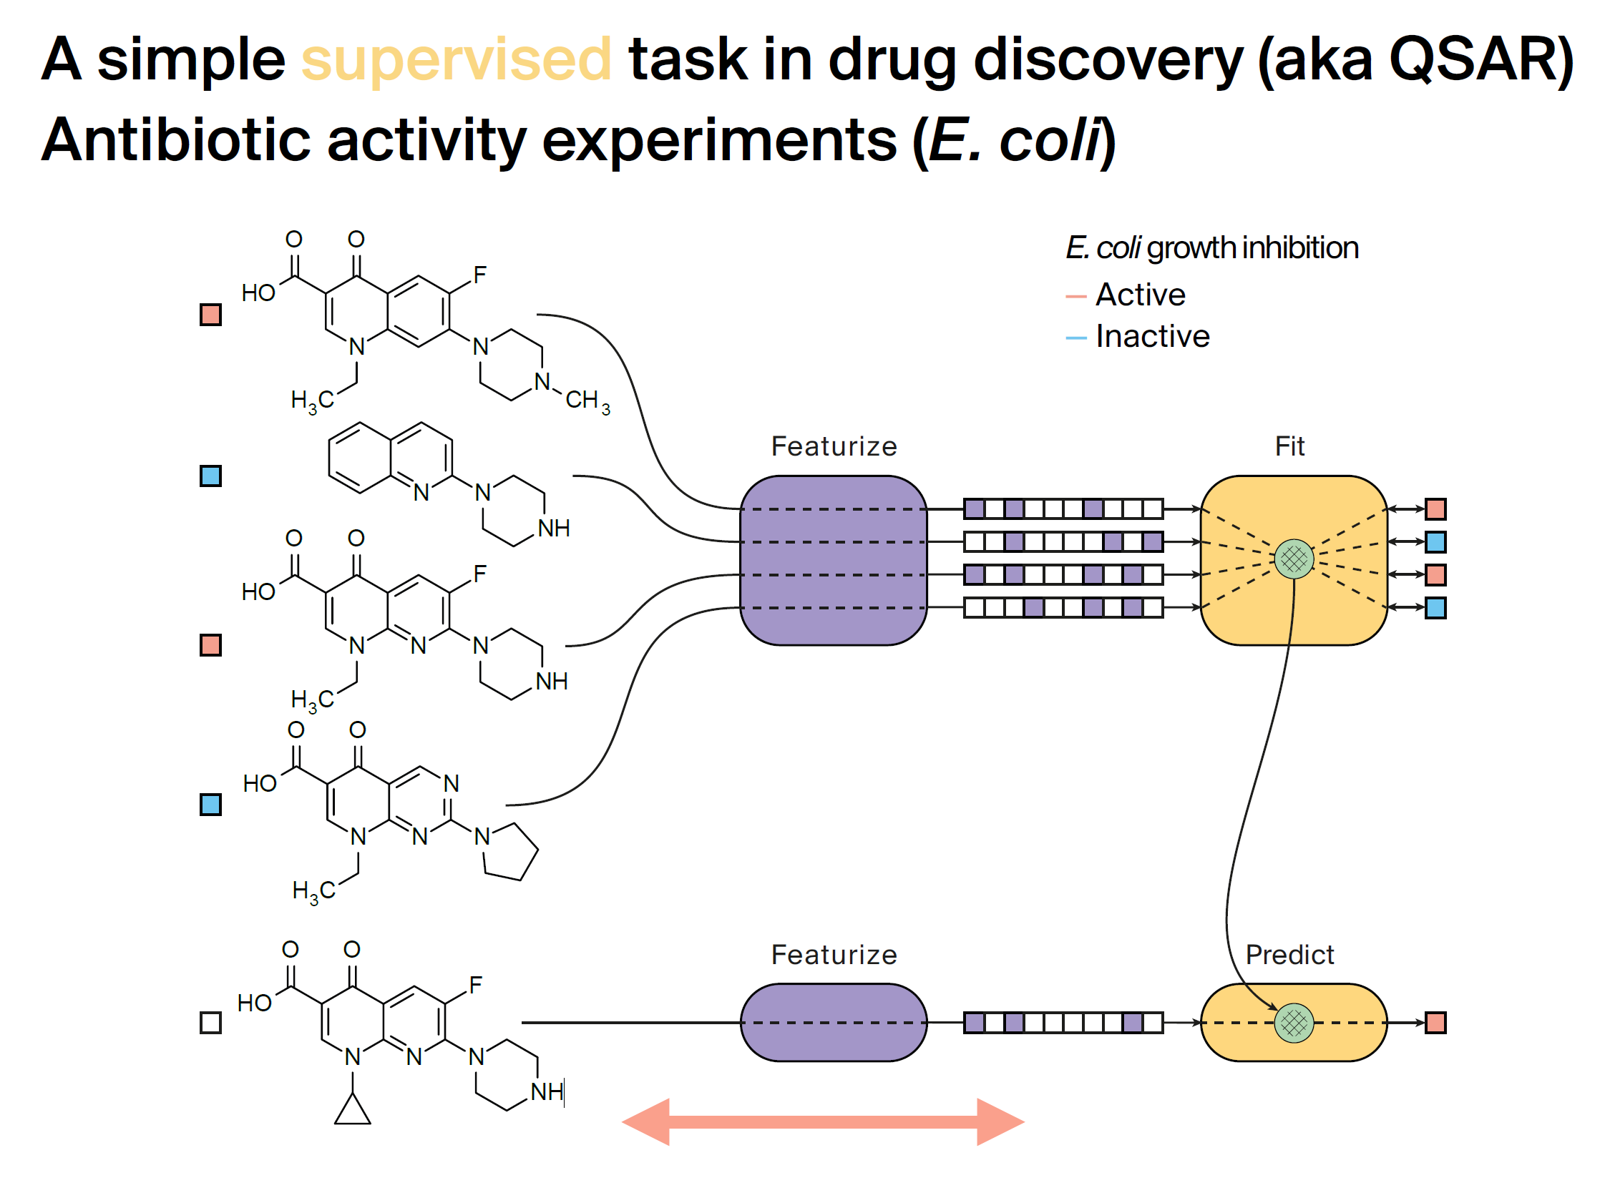
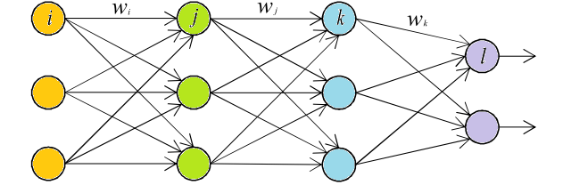
AI Toolbox: Olinda
ZairaChem Model
X
y
X_{ref}
y’_{ref}
y’_{pred}
ZairaChem model learns relationship between X and y with sophisticated modelling pipeline.
Olinda model then learns the relationship between X and predicted ZairaChem value (y’) with a simpler neural network.
Olinda Model

Slide 5
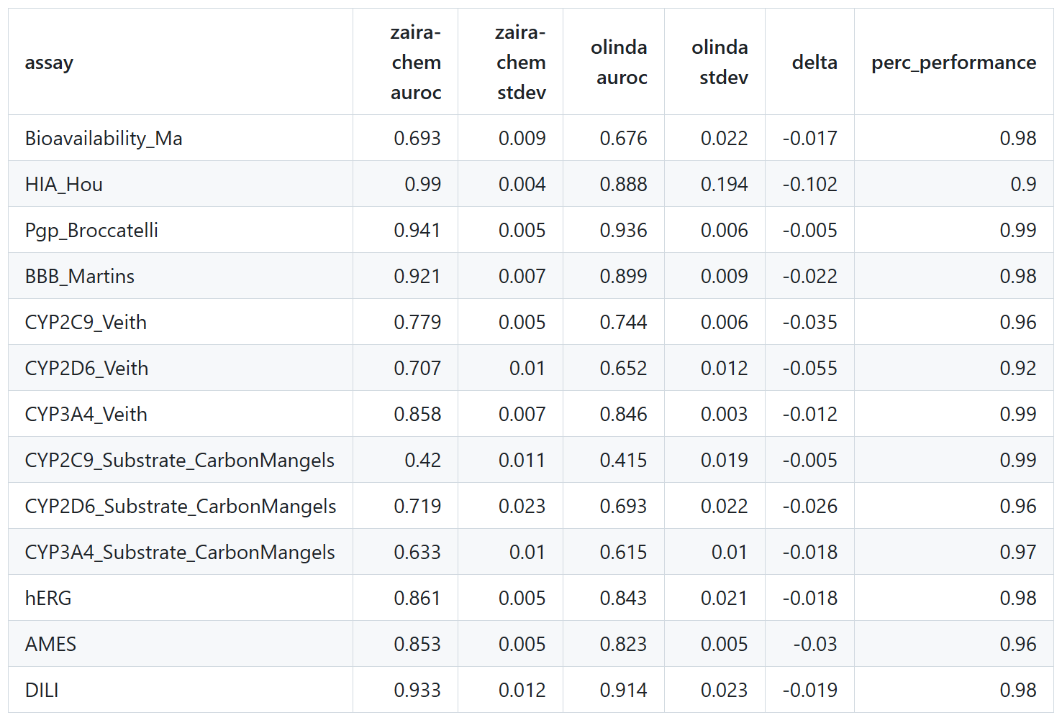
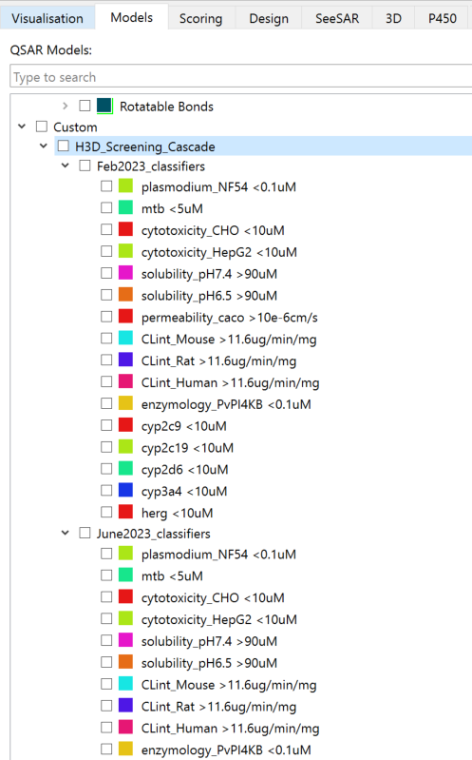
AI Toolbox: Olinda
TDC Benchmarks: 5-fold cross-validation
Olinda models maintain >= 90% of the ZairaChem model AUROC performance with a > 100x speed-up and final model is < 10 Mb in size.
Majority of H3D models in StarDrop are now Olinda models.
Protocols paper for Olinda planned early 2025.

Slide 6
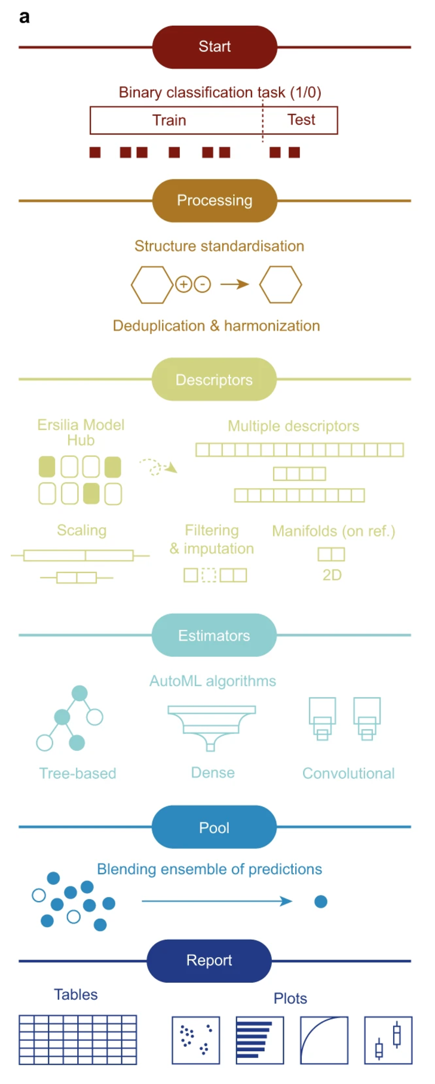
AI Toolbox Improvements
ZairaChem undergoing modularity improvements and refactoring to make for easier deployment and code maintenance (a lot of work).
Addition of new ZairaChem modules in progress (interpretability and regression functionality).
Ersilia Model Hub has had significant technical improvements to increase model speed and decrease model size.
Future work:
Update ZairaChem descriptors with the latest developments in literature.
Ersilia Model Hub: ?
ZairaChem Pipeline Steps

Slide 7
Capacity Building
Kenya workshop in the planning stage for 8-11 July 2025 in Nairobi.
Teaching resources to be re-used from Ghana workshop, only with incremental updates from learnings.
AI2050 collaboration grant with Connor Coley (MIT) awarded.
Internal workshop to be planned for H3D staff on SPARROW synthesis planning tool and usage of AI models in StarDrop.

