Slide 1
Ersin ÇEBİ DENSE VS FOCUSED ON DQN FOR REINFORCEMENT LEARNING
FMV Işık University
Dr. F. Boray TEK

Slide 2
Introduction
Reinforcement Learning is under unsupervised learning technique. In unsupervised learning, the training data is unlabeled. The system tries to learn without a teacher. So basically the agent observers the environment and learns how to reach the endpoint or the goal that defined.
The purpose of this system is to design a reinforcement learning application and compare the Dense and Focusing layer’s efficiency.
The focus idea is coming from the paper (Tek, 2018)[1]. This thesis is about implementing and examining Focused Neuron Model on reinforcement learning.

Slide 3
Literature Review
There are plenty of ways of reinforcement learning. One is q learning, this approach uses dynamic programming principles. Firstly we set random actions for states in the environment, this is called creating q-table. Q-table is a nested array that contains, actions on a specific state. Then we run our test on that table and get a Q value on every iteration.
There is another way of q-learning, it’s called Deep Q-learning [9]. In deep learning, each level learns to transform its input data into a slightly more abstract and composite representation. In an agent training application, the raw input may be a matrix of actions; the first representational layer may abstract the action and encode states; the second layer may compose and encode arrangements of states; the third layer may encode an action on a state, and the fourth layer may predict a proper outcome that the action of the current state.

Slide 4
Literature Review
A policy defines the guidelines for an agent's behavior at a given state [9]. In mathematical terms, a policy is a mapping from a state of the agent to the action to be taken at that state. As a coder of the agent, we expect the best outcome from it, but the policy is not always deterministic, by mean that, it is possible that the policy takes only random actions, there is a chance policy does not observe the environment, it is called a stochastic policy.
DQN has some variants, one is fixed q-value targeting. Deep Q Networks take as input the state of the environment and output a Q value for each possible action. The maximum Q value determines, which action the agent will perform. But the same weights apply to both the target and the predicted value. It is like making circles around the same path.

Slide 5
Proposed Method
The Focused layer implementation allows people to test the datasets by trained Focused layer.
In this project, we replace the dense layers in deep q learning with focused neurons. For each environment observation space taken for input size and action space taken as output size.
In our tests, we use three different gym-environment to create train-test data. we run both Focused layer and Dense layers and take several graphs, such as loss and reward, we create score graphs for each Focused layer, Dense runs, also search for a trend.

Slide 6
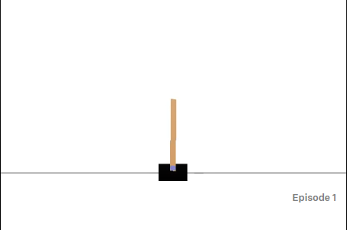
Train and Test Environments
In this project, we replace the dense layers in deep q learning with focused neurons. We will construct deep q-networks of focusing neurons for the following problems:
1)CartPole:
- A pole is attached by an un-actuated joint to a cart, which moves along a frictionless track. The pendulum starts upright, and the goal is to prevent it from falling over by increasing and reducing the cart's velocity.
- There are two actions taken, right and left moves, respect to these observation points is called Box() observation in the OpenAI Gym, and they are not discrete; Cart Position, Cart Velocity, Pole Angle, Pole Velocity At Tip

Slide 7
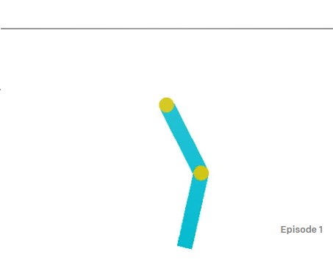
Train and Test Environments
2)Acrobot:
- Acrobot is a 2-link pendulum with only the second joint actuated. Initially, both links point downwards. The goal is to swing the end-effector at a height at least the length of one link above the base.
- The observation space is a numpy array in this environment. State calculation, [cos(theta1) sin(theta1) cos(theta2) sin(theta2) thetaDot1 thetaDot2]
- The action is either applying +1, 0 or -1 torque on the joint between the two pendulum links.

Slide 8
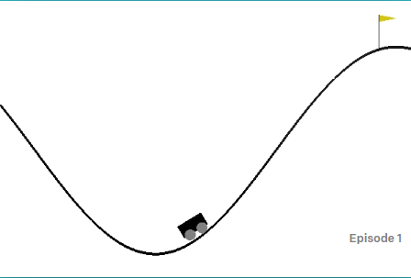
Train and Test Environments
3)MountainCar:
- A car is on a one-dimensional track, positioned between two mountains. The goal is to drive up the mountain.
- The observation space is a two dimensions that contains position and velocity.
- The action space is push left, right, and no push. The action space is takes floating values between +1 and -1. It is not discrete so we need to discretize the action space to 10.

Slide 9
Train and Test Examinations
Neuron Type | Sigma | Areas | Mean | Standard Deviation
Dense | - | 22990.0 | 38.490 | 44.217
Focused | 0.05 | 57696.0 | 96.333 | 80.598
Focused | 0.1 | 18919.0 | 31.705 | 34.317
Focused | 0.2 | 24641.0 | 41.241 | 49.684
Focused | 0.25 | 38196.0 | 63.833 | 66.866
In this part we will discuss the train results for each environment. As sigma value we use .25, .2, .1 and .05 to evaluate the results.
1)CartPole Training:
we decided to sigma value .05 is better to solve this problem. Lets also see the score trend comparison with dense neuron of focused neuron with sigma .05.
In Figures, we compare the loss graphics of both focused and dense neurons the area of dense 1797.24 and area of focused: 921.12. In here more the area is less means the neuron has learned the problem more efficient and accurate.
We can observe the values are oscillating in the loss graphic in figures. It is because, in DQN during the q value calculation, we calculate our target q-value with the random samples we gathered before, afterwards we calculate the next q- value and compare those two q-values. That is why we see an oscillating graphic.
Lets also put our results into t-test to see whether our hypothesis is true or not. Our t-test results are follows:
- statistic: -15.399402902553792
- pvalue: 5.8536936390293696e-49
Here we can see the p-value is less than 0.05. Means that our hypothesis is true, and focused neuron type solved the problem more accurate.

Slide 10
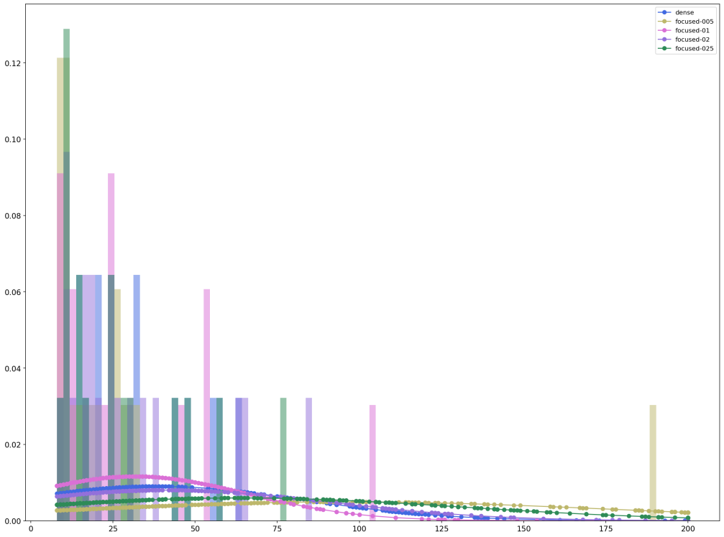
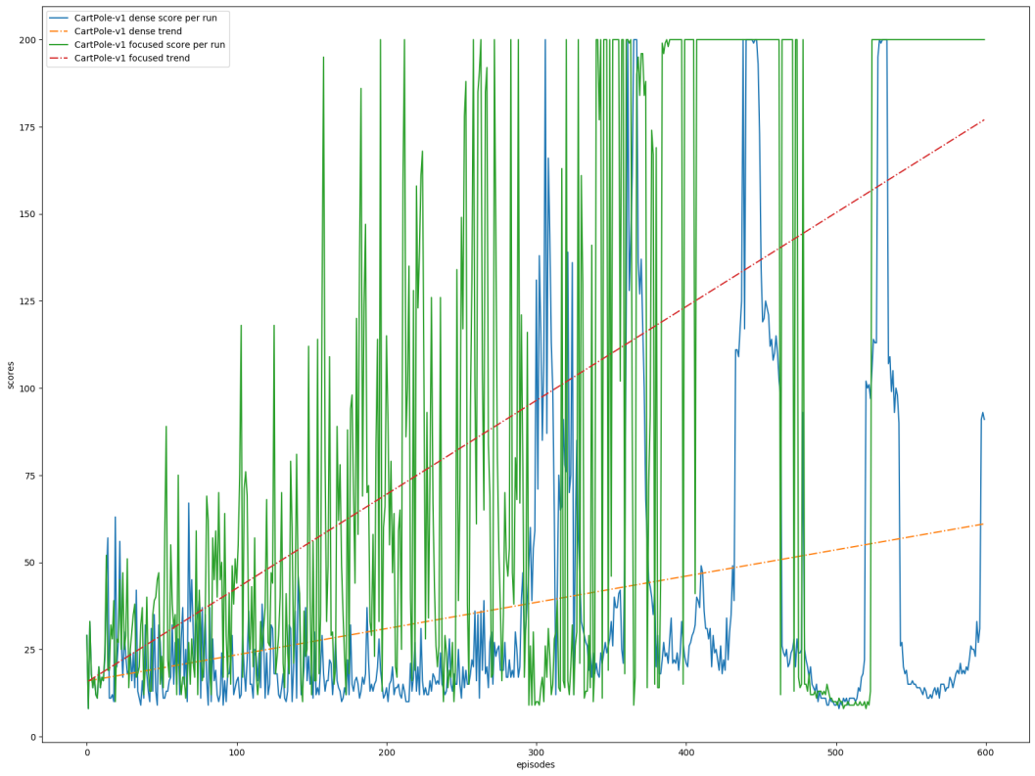
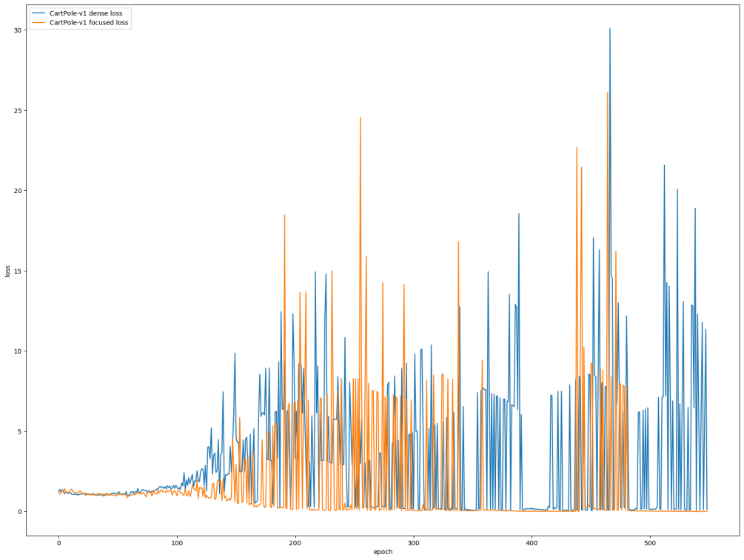
Neuron Type | Sigma | Areas | Mean | Standard Deviation
Dense | - | 22990.0 | 38.490 | 44.217
Focused | 0.05 | 57696.0 | 96.333 | 80.598
Focused | 0.1 | 18919.0 | 31.705 | 34.317
Focused | 0.2 | 24641.0 | 41.241 | 49.684
Focused | 0.25 | 38196.0 | 63.833 | 66.866

Slide 11
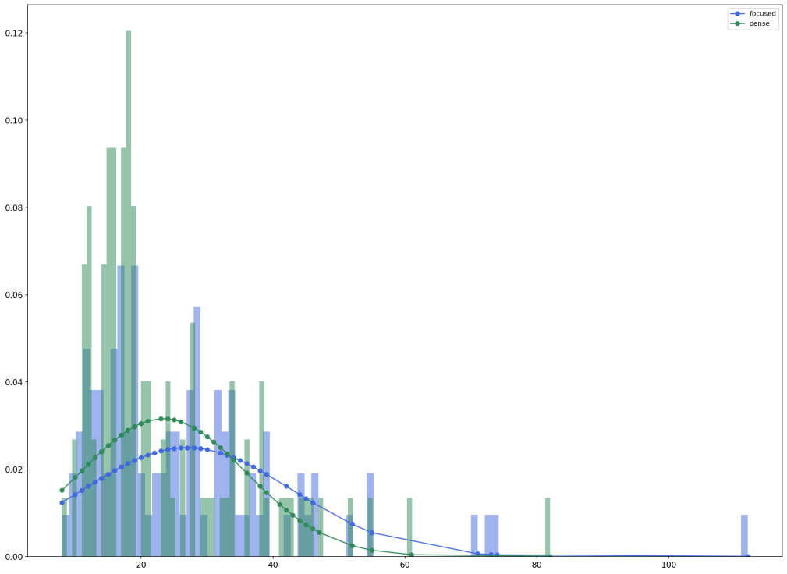
CartPole Test:
In fıgure, dense test mean of score is 23.33 and standard deviation is 12.64, for focused test mean of score is 27.0 and standard deviation is 16.02. Lets see also t-test results for the training results.
- statistic: -1.7885389189084273
- pvalue: 0.07521799109053397
The p-value is over 0.05 according to t-test, so we cannot reject the null hypothesis.

Slide 12
Neuron Type | Sigma | Areas | Mean | Standard Deviation
Dense | - | 22990.0 | 38.490 | 44.217
Focused | 0.05 | 57696.0 | 96.333 | 80.598
Focused | 0.1 | 18919.0 | 31.705 | 34.317
Focused | 0.2 | 24641.0 | 41.241 | 49.684
Focused | 0.25 | 38196.0 | 63.833 | 66.866
2)MountainCarTraining:
In this environment, there is a special case. In this environment penalty is higher for not reaching the goal. The car between two mountain, makes an oscillating movement to reach the goal, thus until the car reaches the goal point, it takes lots of penalty. So all scores are below zero. So we take a the value closest the zero as the best. In this case it is the focused with sigma 0.1.
t-test on the results:
- statistic: -11.151027489360999
- pvalue: 1.5226142272798123e-27
In the t-test results, we can see the p-value is less than 0.05. Means that our hypothesis is true, and focused neuron type solved the problem more accurate.

Slide 13
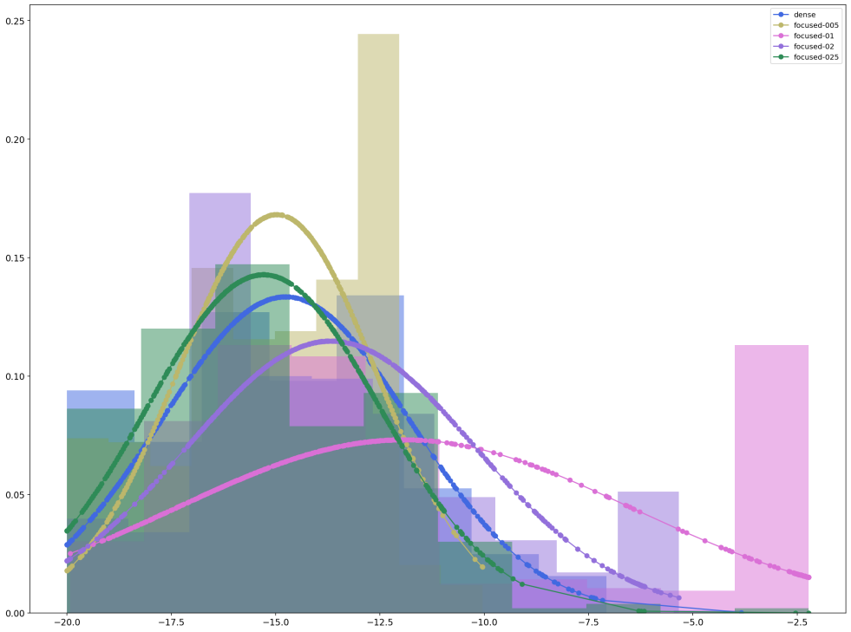
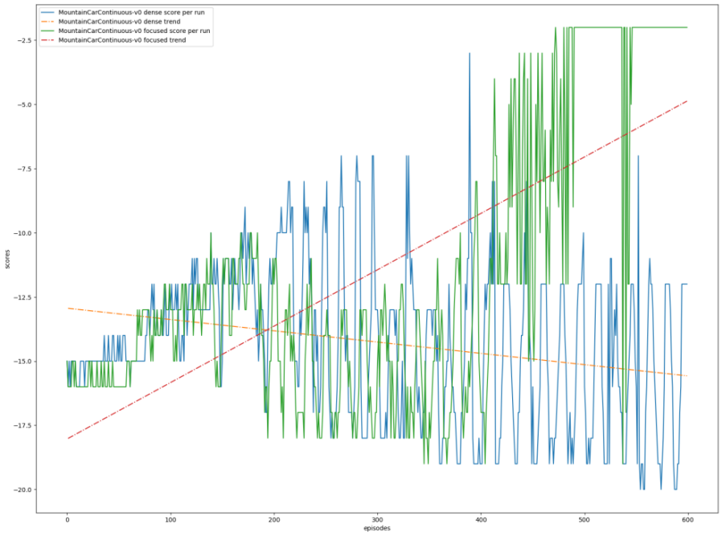
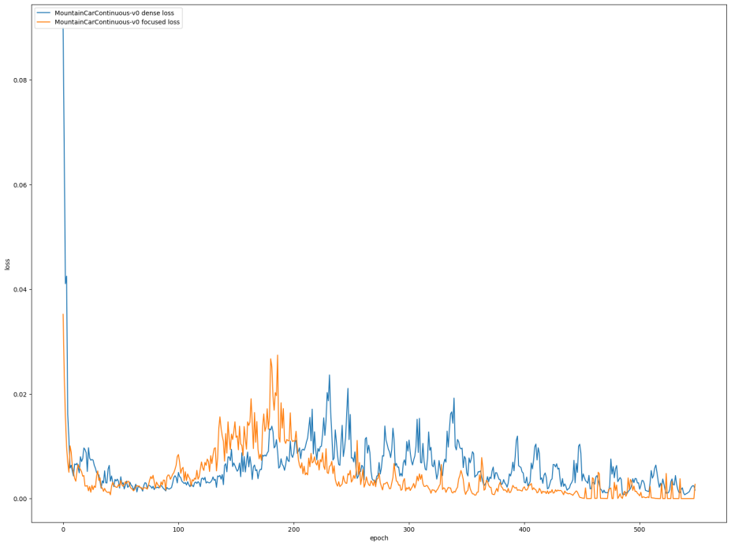
Neuron Type | Sigma | Areas | Mean | Standard Deviation
Dense | - | -8847.269 | -14.765 | 2.989
Focused | 0.05 | -8969.718 | -14.974 | 2.372
Focused | 0.1 | -7147.111 | -11.930 | 5.456
Focused | 0.2 | -8194.177 | -13.678 | 3.475
Focused | 0.25 | -9165.748 | -15.294 | 2.794

Slide 14
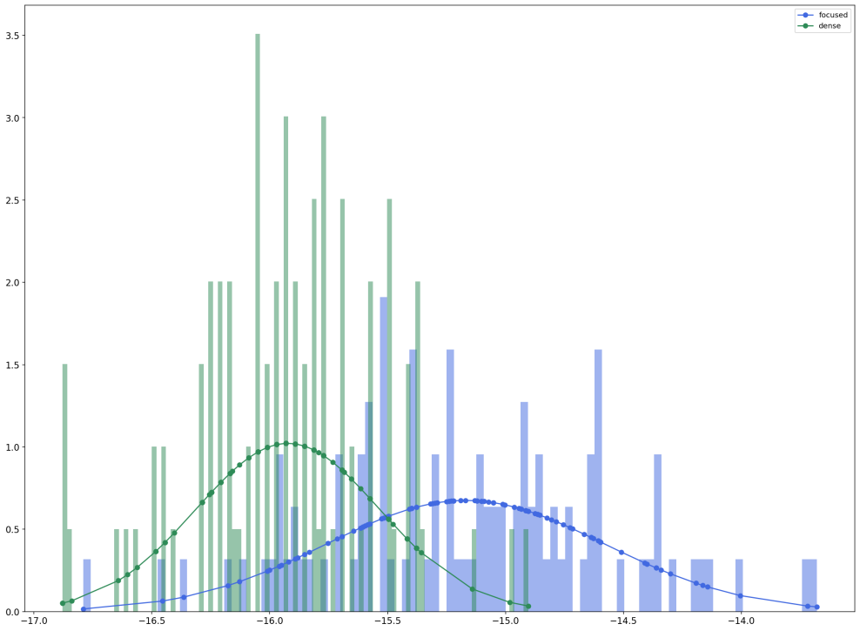
MountainCar Test:
In fıgure, dense test mean of score is -15.92 and standard deviation is 0.40, for focused test mean of score is -15.17 and standard deviation is 0.59. Lets see also t-test results for the training results.
- statistic: -10.589982583360232
- pvalue: 4.728857463367546e-21
The p-value is under 0.05 according to t-test, so we can accept that focused test results are better than dense test results.

Slide 15
Neuron Type | Sigma | Areas | Mean | Standard Deviation
Dense | - | 22990.0 | 38.490 | 44.217
Focused | 0.05 | 57696.0 | 96.333 | 80.598
Focused | 0.1 | 18919.0 | 31.705 | 34.317
Focused | 0.2 | 24641.0 | 41.241 | 49.684
Focused | 0.25 | 38196.0 | 63.833 | 66.866
3)Acrobot Training:
In the Table as we can observe, the same special case is valid for this environment. Again we take a the value closest the zero as the best. In this case it is the focused with sigma 0.2.
Again we can observe here loss of focused with sigma 0.2 is not better than dense neuron type. But for being sure lets apply t-test to see the results:
- statistic: -13.277667545492406
- pvalue: 1.2347315664584795e-37
In the t-test results, we can see the p-value is less than 0.05. Means that our hypothesis is true, and focused neuron type solved the problem more accurate.

Slide 16
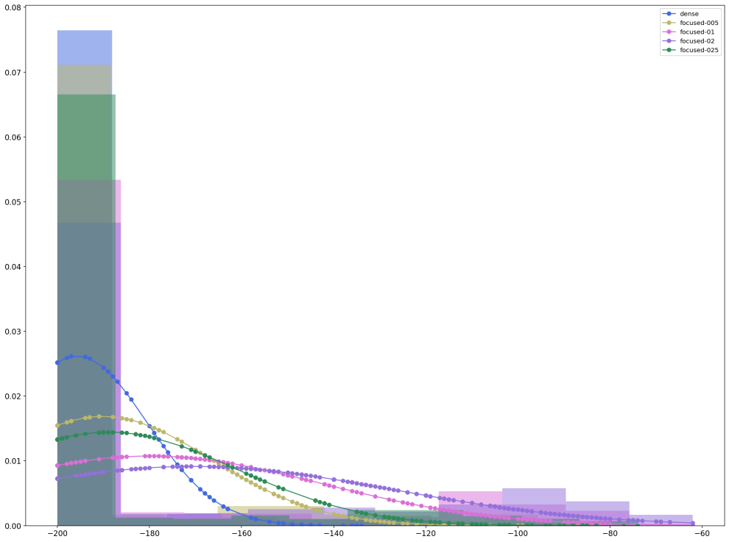
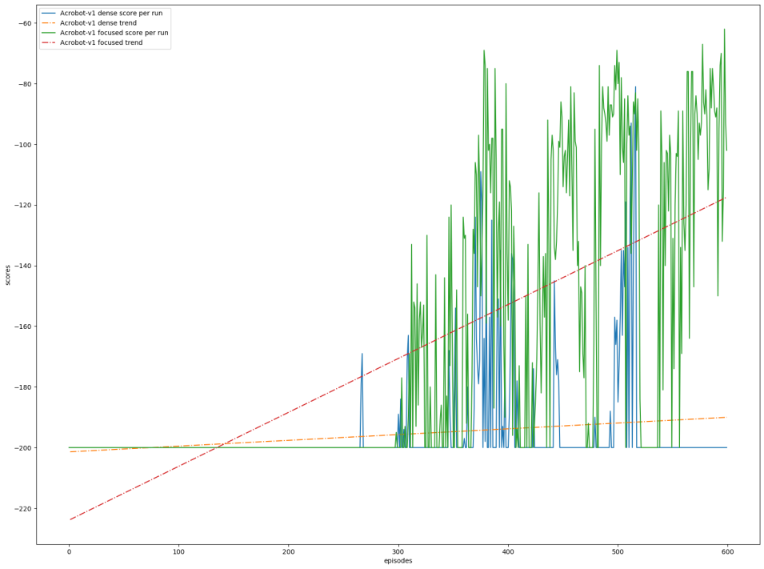
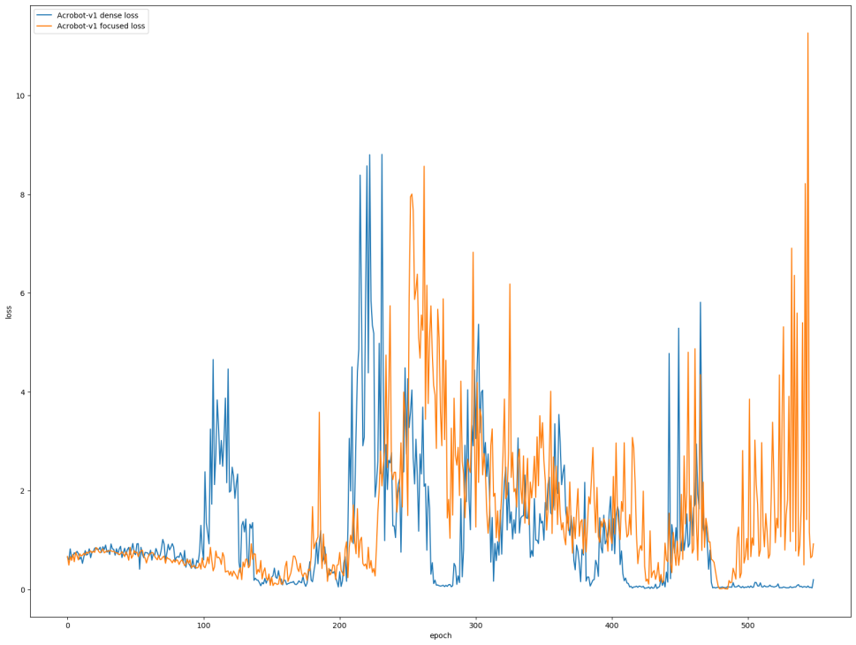
Neuron Type | Sigma | Areas | Mean | Standard Deviation
Dense | - | -117293.5 | -195.723 | 15.218
Focused | 0.05 | -113961.0 | -190.171 | 23.654
Focused | 0.1 | -107789.0 | -179.866 | 37.103
Focused | 0.2 | -102255.0 | -170.643 | 43.652
Focused | 0.25 | -113158.0 | -188.825 | 27.638

Slide 17
Neuron Type | Sigma | Areas | Mean | Standard Deviation
Dense | - | 22990.0 | 38.490 | 44.217
Focused | 0.05 | 57696.0 | 96.333 | 80.598
Focused | 0.1 | 18919.0 | 31.705 | 34.317
Focused | 0.2 | 24641.0 | 41.241 | 49.684
Focused | 0.25 | 38196.0 | 63.833 | 66.866
3)Acrobot Test:
In this environment training results were good, in test phase the agent could not show any improvements. If we examine the test data, dense test mean is -200.0, standard deviation is 0.0 and for focused test mean -200.0, standard deviation is also 0.0.
This might occur the random initialization of the environment. If we check the figure 5-8 score graphics we can see that the agent couldn’t do anything until the 300th episode.

Slide 18
Conclusion and Future Work
In this thesis, we cover the DQN model training and comparison for Dense and Focused neuron type. One of the main objectives is proving the focused neuron is working better than a dense layer.
The most important thing was tuning and deciding the right parameters, μ is the main coefficients of focusing structure. For making sure the focusing layer working right or not, a way to evaluate is making loss comparison. By taking loss values on every q-value calculation and try to estimate according to those values, the same evaluation can be run.
It would be very interesting to use an image as an observation space. The logic is here, the behavior of the focusing layer requires too many values. In our test, the environments have four observations and it is very limited and unnecessary to use the focusing layer as the input layer. Thus we use dense layers as the input layers. But if we use an image on a given time as an input, our observation will be larger and we can use the focusing layer as the input layer.

Slide 19
THANK YOU

