Slide 1



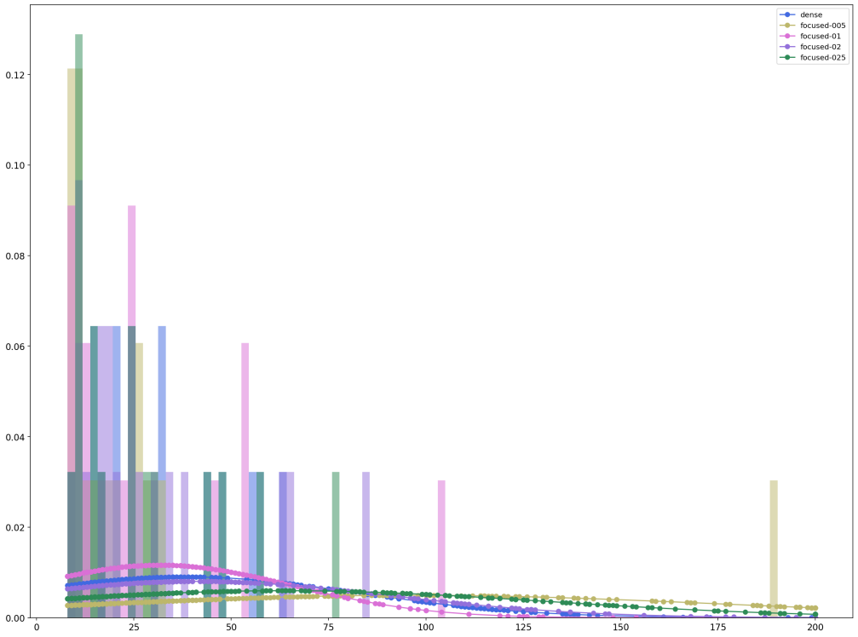
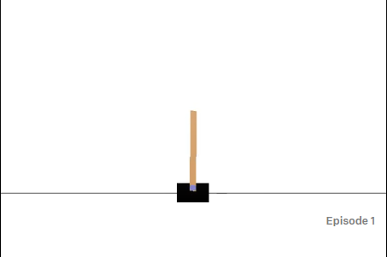
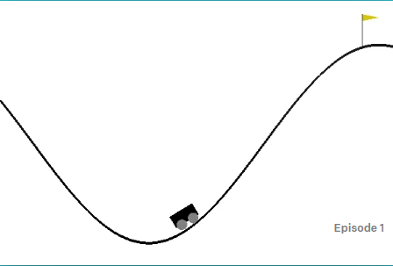
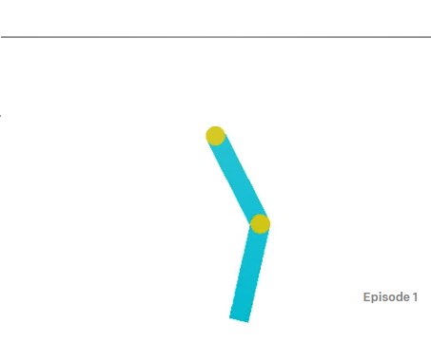
DENSE VS FOCUSED ON DQN FOR REINFORCEMENT
LEARNING
REPLACE THIS BOX WITH YOUR ORGANIZATION’S
HIGH RESOLUTION LOGO
REPLACE THIS BOX WITH YOUR ORGANIZATION’S
HIGH RESOLUTION LOGO
Ersin ÇEBİ, Bachelor's Degree Thesis¹
¹FMV Işık University, ²Software Engineering
Abstract
Methods and Materials
The development of adaptive and efficient AI algorithms has been a longstanding challenge. Although in the past RL had some success, previous approaches lacked scalability and were inherently limited to relatively low-dimensional issues. This is because RL algorithms have the same complexity problem as other algorithms: memory complexity, computational complexity, and sample complexity, for machine-learning algorithms. The objective of this system is to develop an application for reinforcement learning and compare the efficiency of dense and focus layers.
Focusing neurons can generate unique connection maps for a problem.The new model uses the back-propagation algorithm to learn its focus parameters which control the receptive field locations and apertures.
The Focused layer implementation allows people to test the datasets by trained Focused layer. It trained faster than the Dense layer and comparable accuracy rate to Dense.
In this project, we replace the dense layers in deep q learning with focused neurons. For each environment observation space taken for input size and action space taken as output size.
We use three different gym-environment to create train-test data. we run both Focused layer and Dense layers and take several graphs, such as loss and accuracy, also create score graphs for each Focused layer, Dense runs, also search for a trend.
These environments are CartPole, Acrobot and MountainCarContinuous.
Chart 1. Label in 24pt Calibri.
Introduction
Results
Discussion
There are supervised and unsupervised learning techniques, Reinforcement Learning is under unsupervised learning technique. In unsupervised learning, the training data is unlabeled. The system tries to learn without a teacher. So basically the agent observers the environment and learns how to reach the endpoint or the goal that defined.
Reinforcement Learning agents have clear goals, they can feel the characteristics of their environment and choose the actions that will be effective in their environment. In the basic structure, the agent shows an action according to the environment, it is called policy and expects a response from the environment. The resulting reactions are subject to a predefined reward system. In line with the award won, the agent is trained and understands how wrong or right he is doing. The agent should try various actions and gradually choose the ones that look best. The purpose of this system is to design a reinforcement learning application and compare the Dense and Focusing layer’s efficiency.
The focus idea is coming from the paper (Tek, 2018)[1]. This thesis is about implementing and examining Focused Neuron Model on reinforcement learning.
Since we have limited area on this page, lets only review one of the environments. We will evaluate CartPole environment.
We will discuss the train results for each environment. For focused layer we will use sigma values of 25, .2, .1 and .05 to evaluate the results.
In Chart 1 representation we see the score distributions of the CartPole problem. Also we measure the score curve area to decide which sigma value is better for solving this problem.
According Table 1, results we decided to sigma value .05 is better to solve this problem. Lets also see the score trend comparison with dense neuron of focused neuron with sigma .05.
Lets also put our results into t-test to see whether our hypothesis is true or not. Our t-test results are follows:
statistic: -15.399402902553792
pvalue: 5.8536936390293696e-49
Here we can see the p-value is less than 0.05. Means that our hypothesis is true, and focused neuron type solved the problem more accurate.
In this thesis, we cover the DQN model training and comparison for Dense and Focused neuron type. One of the main objectives is proving the focused neuron is working better than a dense layer.
The most important thing was tuning and deciding the right parameters, μ is the main coefficients of focusing structure. For making sure the focusing layer working right or not, a way to evaluate is making loss comparison. By taking loss values on every q-value calculation and try to estimate according to those values, the same evaluation can be run.
It would be very interesting to use an image as an observation space. The logic is here, the behavior of the focusing layer requires too many values. In our test, the environments have four observations and it is very limited and unnecessary to use the focusing layer as the input layer. Thus we use dense layers as the input layers. But if we use an image on a given time as an input, our observation will be larger and we can use the focusing layer as the input layer.
Table 1. CartPole results curve areas.
Conclusions
Neuron Type | Sigma | Areas | Mean | Standard Deviation
Dense | - | 22990.0 | 38.490 | 44.217
Focused | 0.05 | 57696.0 | 96.333 | 80.598
Focused | 0.1 | 18919.0 | 31.705 | 34.317
Focused | 0.2 | 24641.0 | 41.241 | 49.684
Focused | 0.25 | 38196.0 | 63.833 | 66.866
Our score, loss, and test results are better than the dense neuron. Another thing is time efficiency, Focused layer model is working faster than Dense Layer model.
Many different adaptations, tests, and experiments have been left for the future due to lack of time. Future work concerns deeper analysis of particular mechanisms, new proposals to try different methods, or simply curiosity.
Figure 1. CartPole-v1.
Figure 2. MountainCarContinuous-v0
Figure 3. Acrobot-v1.
Contact
References
Ersin ÇEBİ
FMV Işık University
Email: ersincebi@ersincebi.com
Website: https://ersincebi.com
Phone:
Tek, F. Boray \An Adaptive Locally Connected Neuron Model: Focusing Neuron." ArXiv.org, 31 July 2019, https://arxiv.org/abs/1809.09533.
Géron, Aurélien. “Neural Networks and Deep Learning.” Mar. 2018, https://learning.oreilly.com/library/view/neural-networks-and/9781492037354/.
McCulloch, Warren S., and Walter Pitts. ”A logical calculus of the ideas immanent in nervous activity.” The bulletin of mathematical biophysics 5.4 (1943): 115-133.
Rosenblatt, Frank. ”The perceptron: a probabilistic model for information storage and organization in the brain.” Psychological review 65.6 (1958): 386.
VanderPlas, Jake. Python data science handbook: essential tools for working with data. ” O’Reilly Media, Inc.”, 2016.
Farhadi, Farnoush. Learning Activation Functions in Deep Neural Networks, ProQuest Dissertations Publishing, 2017.
Géron, Aurélien. Hands-on machine learning with Scikit-Learn and TensorFlow: concepts, tools, and techniques to build intelligent systems. " O'Reilly Media, Inc.", 2017.
Hasselt, Hado van, Guez, Arthur, and Silver, David “Deep Reinforcement Learning with Double Q-learning.” ArXiv.org, 22 Sep 2015, https://arxiv.org/abs/1509.06461

