Slide 1


Developing the essential skills
for career success
Assessment Debrief
© 2018 Capsim Management Simulations, Inc.

Slide 2
Introduction to the Debrief
First, congratulations on beginning your path to professional development!
Table of Contents
What was assessed in CapsimInbox?
Why should I care about?
How was my performance determined?
How should I interpret my feedback?
What should I do next?

Slide 3
What was Assessed in CapsimInbox?
A simulation-based assessment that measures five essential "soft skills" required for success in today's organizations, while providing actionable feedback that is critical for your individual development
Skills:
Initiating, Problem Solving, Organizing, Leading, Communicating

Slide 4
Why Should I Care About
1. Leadership, communication, problem solving, time management, initiative are always ‘Top 5 Attributes’
Examples of recent surveys:
Bloomberg Business
1,251 recruiters, 547 companies
Graduate Management Admission Council
565 employers, 44 countries
National Assoc. of Colleges & Employers
260 employers
LinkedIn
2 million+ members
Immediate Employability
and Future Promotability
✗
Problems with interpersonal relationships
2. Extensive research also shows the lack of these capabilities is a primary ‘derailer’ of career progress
✗
Failure to meet business objectives
✗
Inability to build and lead a team
✗
Inability to develop or adapt
✗
Too functionally or technically oriented

Slide 5
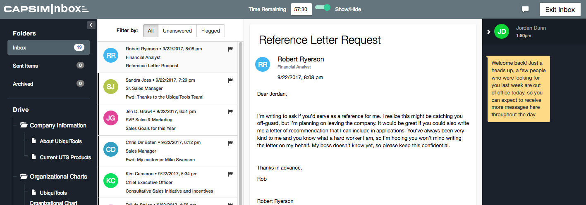
How Was My Performance Determined?
You assumed an important managerial role that required you to respond to variety of requests, problems, and information related to general business management
These situations were presented as emails, instant messages, and shared documents

Slide 6
How Was My Performance Determined?
The various requests and problems that you faced were designed to elicit a pattern of responses that reveal your current level of proficiency on the five CapsimInbox skills
Each skill was assessed by multiple responses to show and diagnose your levels of proficiency

Slide 7
How Was My Performance Determined?
What does each skill represent?
Skill | Definition
Organizing | How well you engaged in planning, prioritizing, scheduling, time management, and delegation
Leading | How effectively you used influence to achieve goals, empower and motivate employees, provide individualized consideration, and foster fairness
Problem solving | How well you showed situational awareness, collected and analyzed information, and made effective evidence-based decisions
Communicating | How effectively you presented information to others by considering the audience and delivery mechanism, identifying core ideas, and developing supportive arguments
Initiating | How well you “showed initiative” by proactively taking action to influence events or others and making decisions that do not require additional input

Slide 8
How Was My Performance Determined?
What do high levels of skill look like?
Skill | Decisions that show you are…
Organizing | Giving priority to more important topics, requests, and emails Scheduling assignments that align with company directives and budgets Delegating proper decision making, based on an employee’s competence Managing others’ time by recognizing whether or not they need to be involved
Leading | Motivating by delivering specific feedback and social recognition Empowering employees by knowing when to allow them the space to perform Balancing administrative compliance with personal empathy and justice Considering individual circumstances while giving fair explanations to others
Problem solving | Recognizing the need to gather more information before making decisions Reviewing documentation to detect errors and to take corrective actions Analyzing data in order to determine optimal choices Weighting or emphasizing data to ensure decisions align with priorities
Communicating | Identifying with whom to first communicate to maximize information value Diagnosing communication problems in company materials and initiatives Delivering feedback to people, while being sensitive to organizational hierarchy Developing persuasive talking points that emphasize experience and/or logic
Initiating | Taking proactive steps to setup advance planning meetings Showing initiative to deal with problems before being asked to do so Displaying a willingness provide extra service or support to others Taking action to resolve errors even when made by others

Slide 9
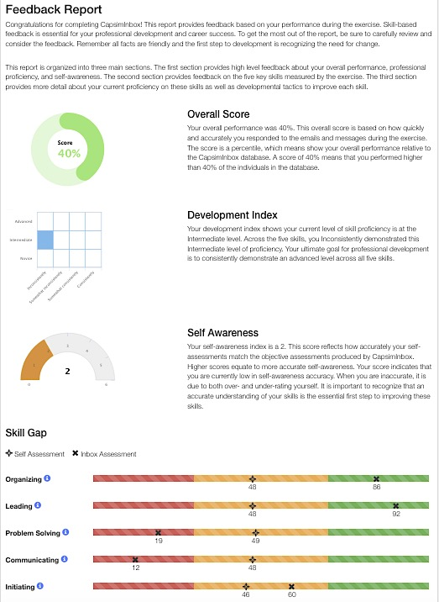
How Should I Interpret My Feedback?
The report is designed to be self-explanatory and provides results in numerical and graphical formats
Scores are percentiles. For example, a score of 40 means you scored higher than 40% of the database population
The report has four main sections:
Overall Score (your total performance)
Development Index (consistency of your skill levels across the five skills)
Self Awareness (alignment of self-ratings with the objective skill scores)
Skill Gap (specific skill scores and self-ratings)

Slide 10
How Should I Interpret My Feedback?
Tips for productively receiving feedback
✓
Think deeply about the results
Feedback is for development…all facts are friendly
✓
Ask ‘what’s my role’ or ‘what do I own’?
Self-manage your change…take ownership
✓
Check your assumptions
Keep an open mind…don’t be defensive
✓
Avoid “skill shock”
Your self-views of skills are likely to be inaccurate…

Slide 11
How Should I Interpret My Feedback?
Avoid ”Skill Shock”
Decades of research shows:
The vast majority of people overrate their ability
Virtually no one rates themselves below average (50th percentile)
The least skilled overrate the most (left-side of the graph)
100
“Dunning-Kruger Effect”
Actual Ability
Self-views of Ability
Average
50
10
Bottom
Second
Third
Top
Performance Quartile

Slide 12
How Should I Interpret My Feedback?
Avoid ”Skill Shock”
Overrating happens in CapsimInbox too
Organizing
Leading
Self-ratings
1-24%
25-49%
50-74%
75-100%
Problem solving
Communicating
Initiating
43% of participants rate themselves in the top 25%
16% of participants rate themselves as below average
Takeaway: The first step is to close your self-awareness gap

Slide 13
What Should I Do Next?
Review your customized feedback report
Print the report for future reference
Complete the self-directed “IDP Builder”
Print your personalized development plan
Continue your path to professional development
www.capsim.com | 312.477.7200 | support@capsim.com

