Slide 1


Developing the essential skills
for career success
Introduction
© 2018 Capsim Management Simulations, Inc.

Slide 2
Introduction
Table of Contents
What is CapsimInbox?
Why should I care?
What should I expect?

Slide 3
What was Assessed in CapsimInbox?
A simulation-based assessment that measures five essential "soft skills" required for success in today's organizations, while providing actionable feedback that is critical for your individual development
Skills:
Initiating, Problem Solving, Organizing, Leading, Communicating

Slide 4
Why Should I Care About
1. Leadership, communication, problem solving, time management, initiative are always ‘Top 5 Attributes’
Examples of recent surveys:
Bloomberg Business
1,251 recruiters, 547 companies
Graduate Management Admission Council
565 employers, 44 countries
National Assoc. of Colleges & Employers
260 employers
LinkedIn
2 million+ members
Immediate Employability
and Future Promotability
✗
Problems with interpersonal relationships
2. Extensive research also shows the lack of these capabilities is a primary ‘derailer’ of career progress
✗
Failure to meet business objectives
✗
Inability to build and lead a team
✗
Inability to develop or adapt
✗
Too functionally or technically oriented

Slide 5


Experience

Slide 6
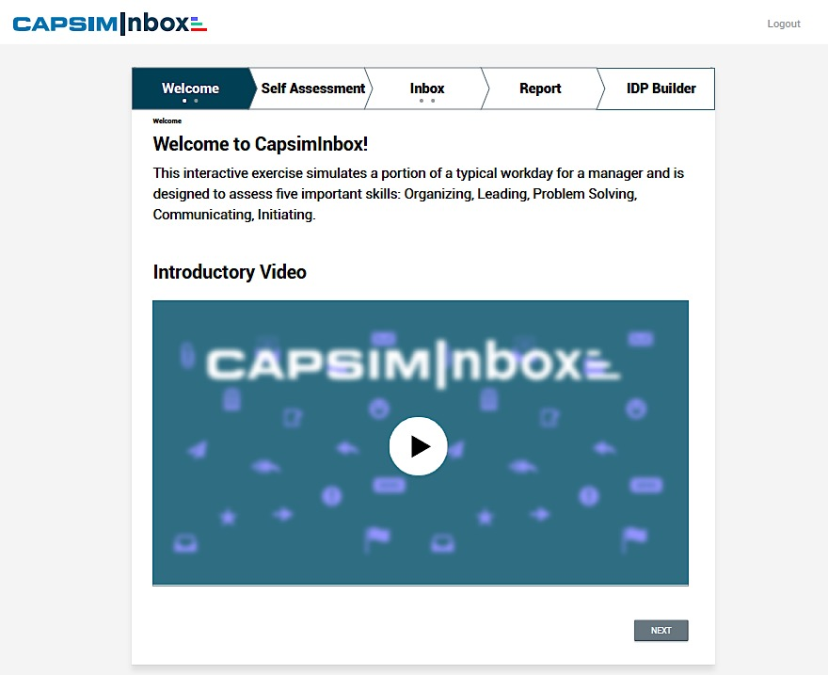
Welcome
Easy To Follow Dashboard and Process
Watch

Slide 7
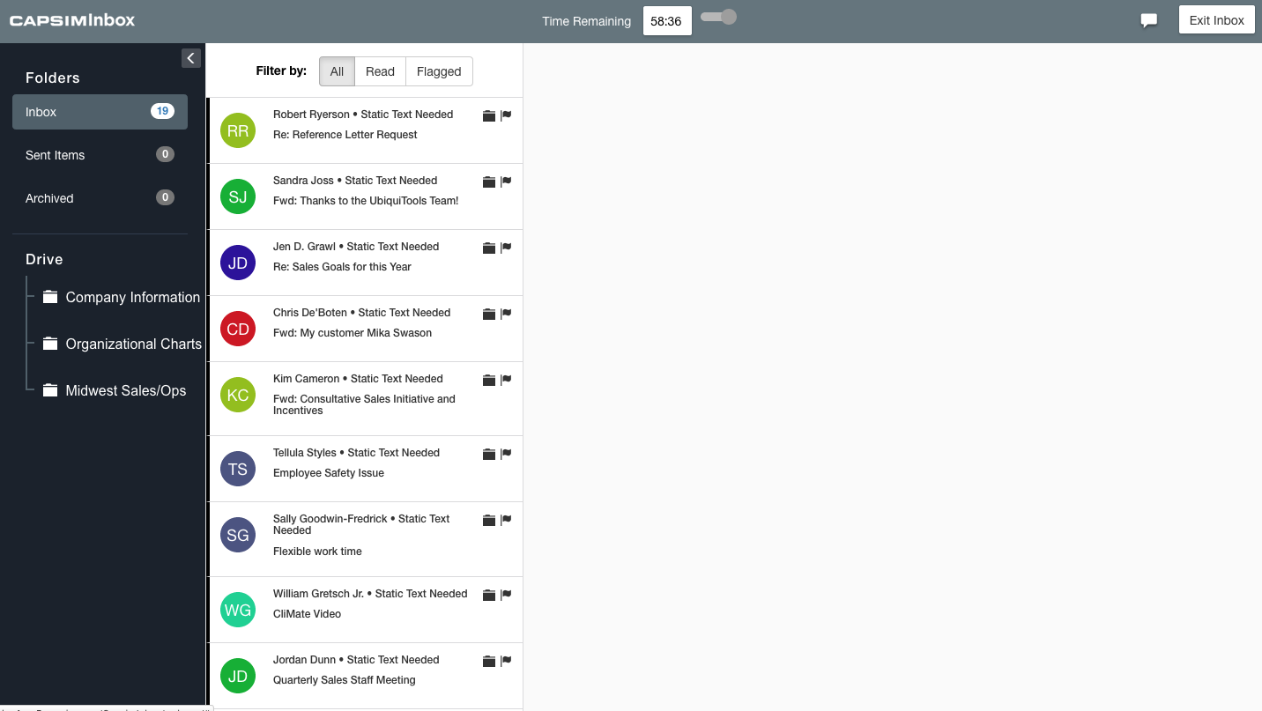
Interface
Email List
Messages
Reading Pane
File Drive

Slide 8
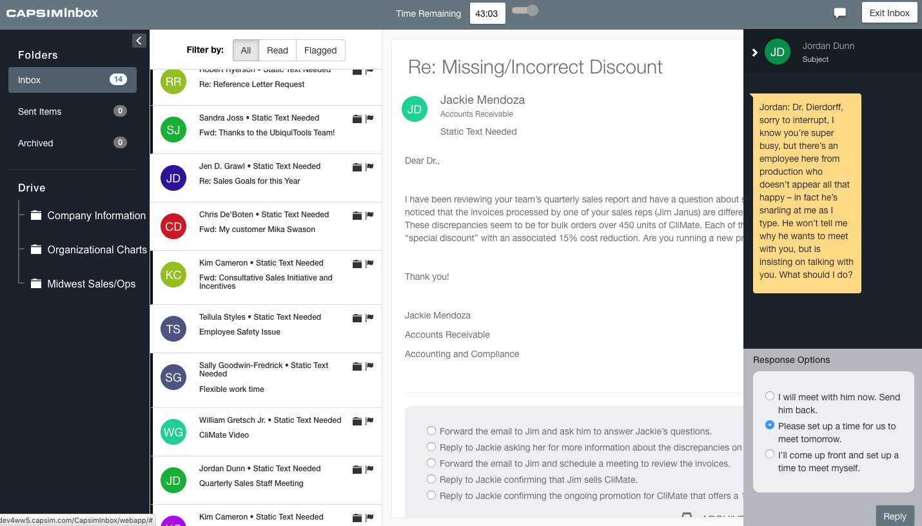
Interface

Slide 9
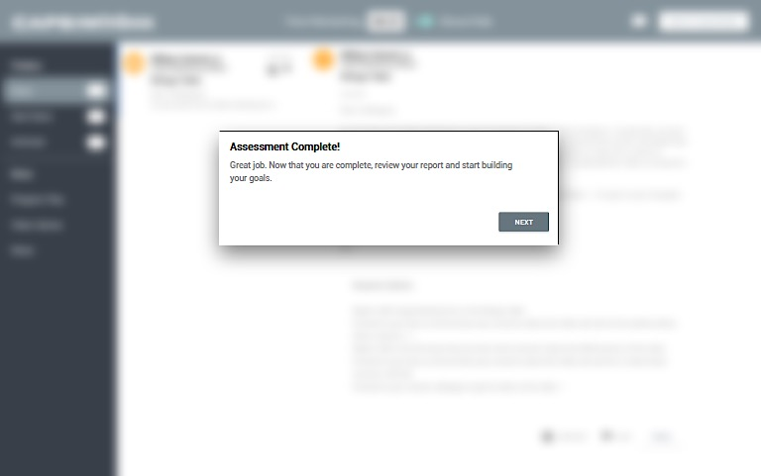
Assessment Completion

Slide 10
A Few Tips for Success
Be mindful of your time
Read and think carefully about your choices
Be engaged, it produces more useful feedback
Have fun and do your best!

