Slide 1
ansible
ow

Slide 2
intro
Ansible provides open-source automation that reduces complexity and runs everywhere. Using Ansible lets you automate virtually any task. Here are some common use cases for Ansible:
Eliminate repetition and simplify workflows
Manage and maintain system configuration
Continuously deploy complex software
Perform zero-downtime rolling updates

Slide 3
..
Agent-less architecture : Low maintenance overhead by avoiding the installation of additional software across IT infrastructure.
Simplicity: Automation playbooks use straightforward YAML syntax for code that reads like documentation. Ansible is also decentralized, using SSH with existing OS credentials to access to remote machines.
Scalability and flexibility :Easily and quickly scale the systems you automate through a modular design that supports a large range of operating systems, cloud platforms, and network devices.
Idempotence and predictability :When the system is in the state your playbook describes Ansible does not change anything, even if the playbook runs multiple times.

Slide 4
Building an inventory
Inventories organize managed nodes in centralized files that provide Ansible with system information and network locations. Using an inventory file, Ansible can manage a large number of hosts with a single command.
To complete the following steps, you will need the IP address or fully qualified domain name (FQDN) of at least one host system. For demonstration purposes, the host could be running locally in a container or a virtual machine. You must also ensure that your public SSH key is added to the authorized_keys file on each host.

Slide 5
..
Create a file named inventory.ini
Add a new [myhosts] group to the inventory.ini file and specify the IP address or fully qualified domain name (FQDN) of each host system.
[myhosts]
192.0.2.50
192.0.2.51
192.0.2.52

Slide 6
..
Verify your inventory.
ansible-inventory -i inventory.ini --list
Ping the myhosts group in your inventory.
ansible myhosts -m ping -i inventory.ini

Slide 7
Inventories in INI or YAML format
You can create inventories in either INI files or in YAML. In most cases, such as the example in the preceding steps, INI files are straightforward and easy to read for a small number of managed nodes.
myhosts:
hosts:
my_host_01:
ansible_host: 192.0.2.50
my_host_02:
ansible_host: 192.0.2.51

Slide 8
Tips for building inventories
Ensure that group names are meaningful and unique. Group names are also case sensitive.
Avoid spaces, hyphens, and preceding numbers (use floor_19, not 19th_floor) in group names.
Group hosts in your inventory logically according to their What, Where, and When.
What
Group hosts according to the topology, for example: db, web, leaf, spine.
Where
Group hosts by geographic location, for example: datacenter, region, floor, building.
When
Group hosts by stage, for example: development, test, staging, production

Slide 9
playbook
Playbooks are automation blueprints, in YAML format, that Ansible uses to deploy and configure managed nodes.
Playbook
A list of plays that define the order in which Ansible performs operations, from top to bottom, to achieve an overall goal.
Play
An ordered list of tasks that maps to managed nodes in an inventory.
Task
A reference to a single module that defines the operations that Ansible performs.
Module
A unit of code or binary that Ansible runs on managed nodes. Ansible modules are grouped in collections with a Fully Qualified Collection Name (FQCN) for each module.

Slide 10
..
- name: My first play
hosts: myhosts
tasks:
- name: Ping my hosts
ansible.builtin.ping:
- name: Print message
ansible.builtin.debug:
msg: Hello world

Slide 11
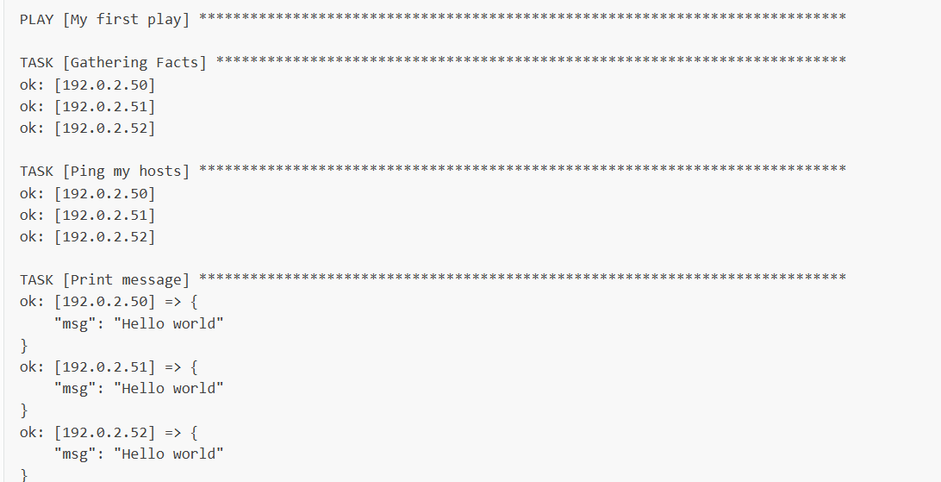
..
ansible-playbook -i inventory.ini playbook.yaml

Slide 12
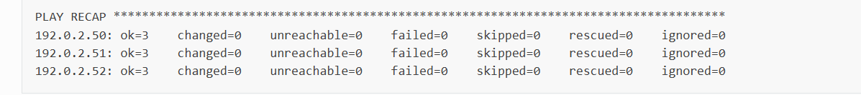
..
The names that you give the play and each task. You should always use descriptive names that make it easy to verify and troubleshoot playbooks.
The “Gathering Facts” task runs implicitly. By default, Ansible gathers information about your inventory that it can use in the playbook.
The status of each task. Each task has a status of ok which means it ran successfully.
The play recap that summarizes results of all tasks in the playbook per host. In this example, there are three tasks so ok=3 indicates that each task ran successfully.

