Slide 1
Stress Testing Facial Recognition with Adversarial Examples
Emily Strong
CSYE 7245: Big Data Systems & Intelligence Analytics
Spring 2018

Slide 2
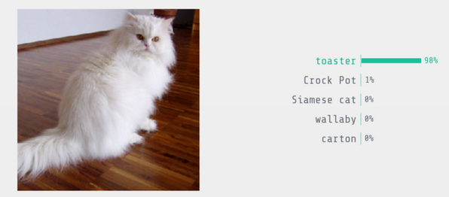
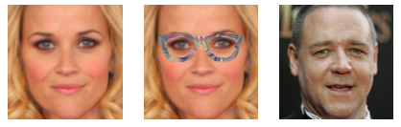
What are adversarial examples?
Image modified to “trick” neural network
Challenge is making the modification subtle
Facial recognition uses morphology measurements not pixel detection but is still vulnerable to this type of attack
Image Source: https://medium.com/@ageitgey/machine-learning-is-fun-part-8-how-to-intentionally-trick-neural-networks-b55da32b7196
Left: Reese Witherspoon, Right: Russell Crowe
Image Source: Sharif et al (2016)

Slide 3
Facial Recognition Pipeline
Face Detection
Affine Transformation & Normalization
Morphology Embedding CNN
Classification
Image
Notes:
The exact pipeline I am using was created by the OpenFace project to work with their pre-trained model: https://cmusatyalab.github.io/openface/setup/

Slide 4
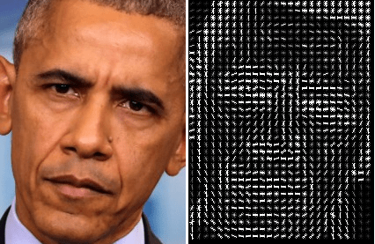
Face Detection
dlib Face Detector API
Converts image to Histogram of Oriented Gradients (HOG)
Runs SVM classifier
Image source: http://www.hackevolve.com/face-recognition-deep-learning/

Slide 5
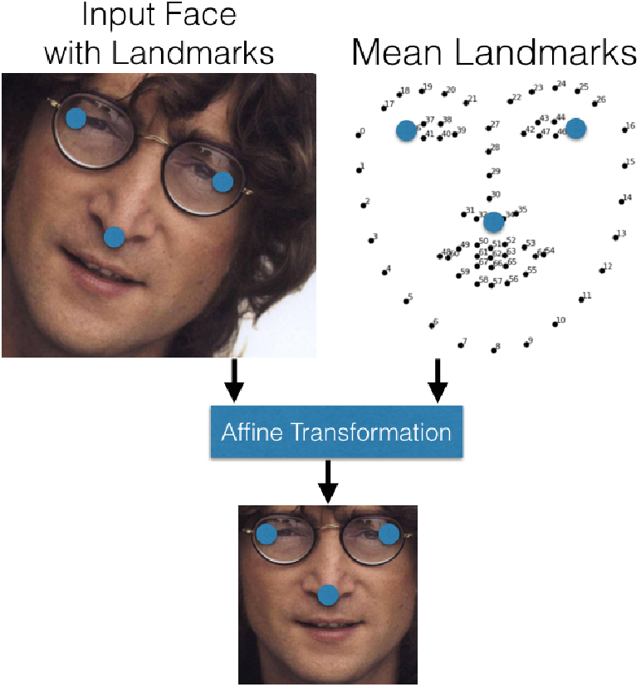
Affine Transformation & Normalization
OpenFace AlignDlib API
Image is cropped to detected face area
Facial landmarks are detected
Image is transformed to have outer eyes and nose in a standard position
Image is resized
Image source: Amos, Ludwiczuk & Satyanarayanan (2016)

Slide 6
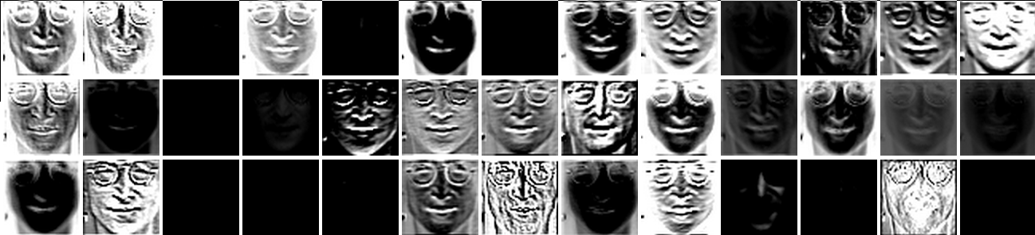
Face Morphology Embedding
OpenFace pre-trained CNN
39 layers encode face morphology
Output is 128 measurements of distances between facial features
Image source: https://cmusatyalab.github.io/openface/visualizations/

Slide 7
Classification
SVM to match measurements to name
Example output for demo data set that comes with the model:
Name | In Training Set? | Output
Steve Carell | yes | Predict SteveCarell with 0.97 confidence.
John Lennon | no | Predict SteveCarell with 0.50 confidence.”

Slide 8
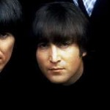
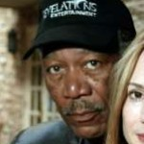

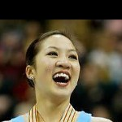

Data Set: Labeled Faces in the Wild (LFW)
Public data set with 13k labeled images of 5k famous people
Used for benchmarking facial recognition algorithms
Images are unconstrained (angle, expression, lighting)
Data set is heavily biased (78% men, 83% white)
Have to supplement for test cases insufficiently represented

Slide 9
Adversarial Tasks
Modify images to trick OpenFace to incorrectly classify image:
Case 1: Incremental changes to decrease image quality
Case 2: People with similar faces (same race, same gender)
Case 3: People with dissimilar faces (same race, same gender)
Case 4: People with different genders
Case 5: People of different races
Case 6: People of different races and genders
Case 7: Non-human face
Case 8: No face
Each test case will be run twice using a limited data set of only the test subjects (easy scenario) and the full LFW (difficult scenario)

Slide 10
Code Demo
https://github.com/erstrong/BigDataSystemsandIntelligenceAnalytics/tree/master/AdversarialFaceRecognition

Slide 11
Progress
Face recognition workflow is running and embedding model is complete for the limited data set
Training Data Set | Keira Knightley | Natalie Portman | Meryl Streep | Tom Hanks | Morgan Freeman | cat | bicycle
Test Subjects Only | 51% 88% 96% | 64% 98% 87% | 86% | 71% | 79% | Exception: Unable to find a face | Exception: Unable to find a face
Full LFW | 5% 2% 9% | 3% 13% 6% | 1% | Predict Mahmoud Abbas with 0.01 confidence | Predict Kofi Annan with 0.02 confidence | Exception: Unable to find a face | Exception: Unable to find a face

Slide 12
Next Steps
Obtain additional images for test subjects and retrain on LFW set (in progress)
Script for test case 1 (in progress)
Script for test cases 2-8
Determine feasibility of particle swarm
Collect and analyze trial data
Overall success of test case
Number of trials required to achieve success with limited data set
Number of trials required to achieve success with full LFW
Are the changes detectable to the human eye?

Slide 13
References
Amos, Brandon, Bartosz Ludwiczuk and Mahadev Satyanarayanan. “OpenFace: A general-purpose face recognition library with mobile applications.” CMU School of Computer Science (2016).
Gary B. Huang, Manu Ramesh, Tamara Berg, and Erik Learned-Miller. Labeled Faces in the Wild: A Database for Studying Face Recognition in Unconstrained Environments. University of Massachusetts, Amherst, Technical Report 07-49, October, 2007.
Sharif, Mahmood, Sruti Bhagavatula, Lujo Bauer, and Michael K. Reiter. "Accessorize to a crime: Real and stealthy attacks on state-of-the-art face recognition." In Proceedings of the 2016 ACM SIGSAC Conference on Computer and Communications Security, pp. 1528-1540. ACM, 2016.

