Slide 1
Progress Report: Stress testing facial recognition with Adversarial Examples
Emily Strong
CSYE 7245: Big Data Systems & Intelligence Analytics
Spring 2018

Slide 2
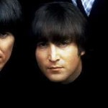


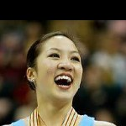

Data Set: Labeled Faces in the Wild
Public data set with 13k labeled images of 5k famous people
Images are unconstrained (angle, expression, lighting)
Data set is heavily biased (78% men, 83% white)
Have to supplement for test cases insufficiently represented
Used for benchmarking facial recognition algorithms

Slide 3
Facial Recognition Workflow
Face Detection CNN
Affine Transformation & Normalization
Morphology Embedding CNN
Classification
Image

Slide 4
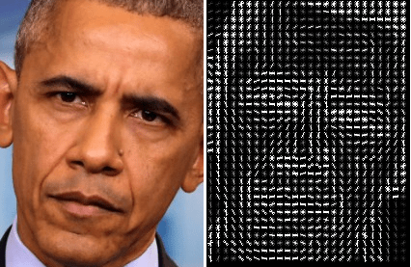
Face Detection
dlib CNN Face Detector API
Converts image to Histogram of Oriented Gradients (HOG)
Runs SVM classifier
Image source: http://www.hackevolve.com/face-recognition-deep-learning/

Slide 5
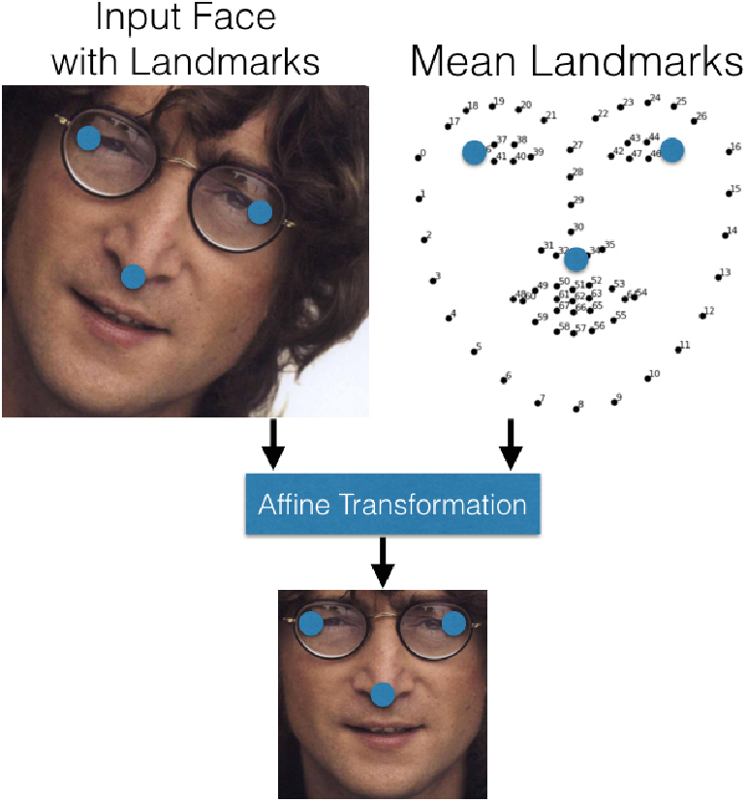
Affine Transformation & Normalization
OpenFace AlignDlib API
Image is cropped to detected face area
Facial landmarks are detected
Image is transformed to have outer eyes and nose in a standard position
Image is resized
Image source: Amos, Ludwiczuk & Satyanarayanan (2016)

Slide 6
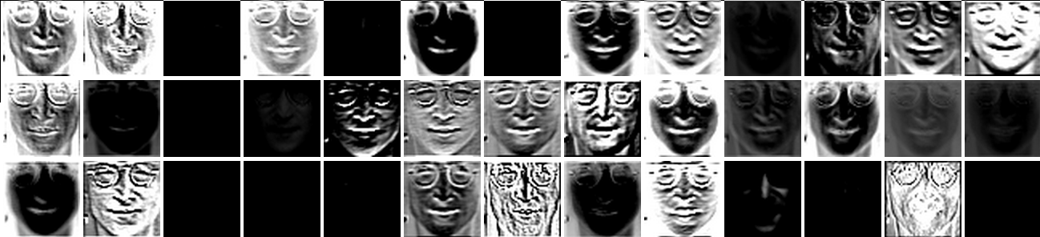
Face Morphology Embedding
OpenFace pre-trained CNN
Has 92.92% accuracy on LFW
39 layers encode face morphology
Output is 128 measurements of distances between facial features
Image source: https://cmusatyalab.github.io/openface/visualizations/

Slide 7
Classification
SVM to match measurements to name
Example output for demo data set that comes with the model:
Name | In Set? | Output
Steve Carell | yes | Predict SteveCarell with 0.97 confidence.
John Lennon | no | Predict SteveCarell with 0.50 confidence.”

Slide 8
Adversarial Examples
Image has noise added
Noise confuses model
Images is given incorrect label
Challenge is making the noise subtle

Slide 9
Adversarial Tasks
Use particle swarm algorithm to modify images to trick OpenFace to incorrectly classify image:
Case 1: Incremental changes to decrease image quality
Case 2: People with similar faces (same race, same gender)
Case 3: People with dissimilar faces (same race, same gender)
Case 4: People with different genders
Case 5: People of different races
Case 6: People of different races and genders
Case 7: Non-human face
Case 8: No face
Each test case will be run twice using a limited data set (easy) and the full LFW (difficult)

Slide 10
Progress
Face recognition workflow set up and supplemental images collected
Test image validation with limited data set:
Image | Confidence Level | Image | Confidence Level
Keira Knightley 1 | 51% | Meryl Streep | 86%
Keira Knightley 2 | 88% | Tom Hanks | 71%
Keira Knightley 3 | 96% | Morgan Freeman | 79%
Natalie Portman 1 | 64% | cat | Exception: Unable to find a face
Natalie Portman 2 | 98% | bicycle | Exception: Unable to find a face
Natalie Portman 3 | 87%

Slide 11
Next Steps
Train model for full LFW set (in progress)
Script for test case 1
Script for test cases 2-8 with particle swarm
Collect and analyze trial data
Overall success of test case
Number of trials required to achieve success with limited data set
Number of trials required to achieve success with full LFW
Are the changes detectable to the human eye?

Slide 12
References
Amos, Brandon, Bartosz Ludwiczuk and Mahadev Satyanarayanan. “OpenFace: A general-purpose face recognition library with mobile applications.” CMU School of Computer Science (2016).
Gary B. Huang, Manu Ramesh, Tamara Berg, and Erik Learned-Miller. Labeled Faces in the Wild: A Database for Studying Face Recognition in Unconstrained Environments. University of Massachusetts, Amherst, Technical Report 07-49, October, 2007.

