Slide 1
Corporacion Favorita Grocery Sales Forecasting
Emily Strong and Raksha Kaverappa

Slide 2
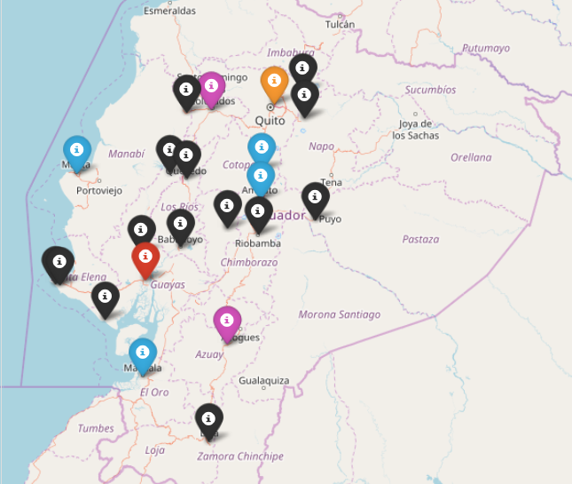
About
Corporacion Favorita is a grocery chain in Ecuador with over 100 stores
They are holding a Kaggle competition to develop a model for predicting unit sales of items for each of their stores to improve inventory management

Slide 3
Process
Data Wrangling:
Python Scripts
Exploratory Data Analysis and Feature Selection:
Jupyter Notebook
Model Building:
Jupyter Notebook
Azure ML Studio Rest APIs
And Pickled Models
Flask App

Slide 4
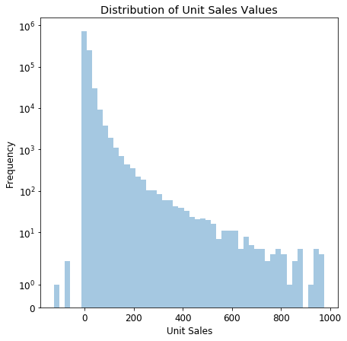
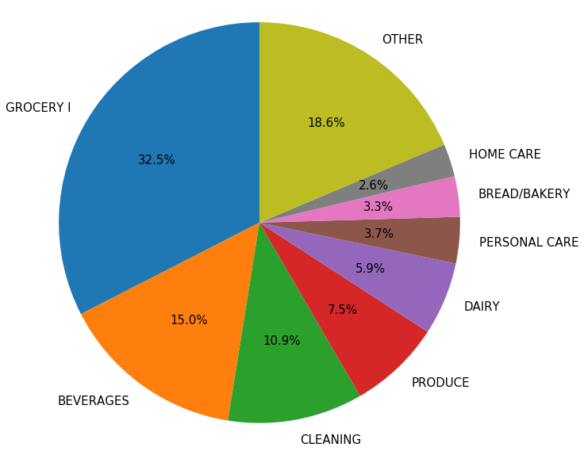
Exploratory Data Analysis

Slide 5
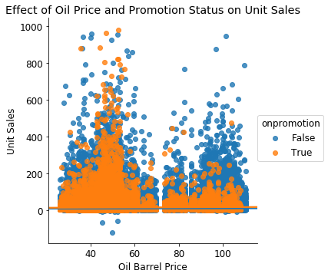
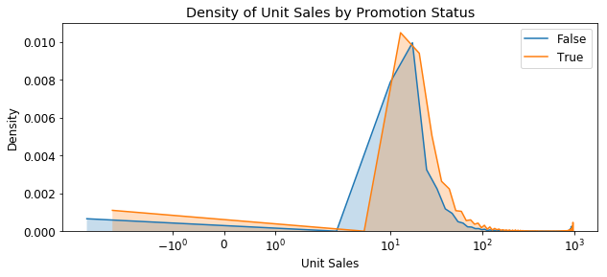
Exploratory Data Analysis

Slide 6
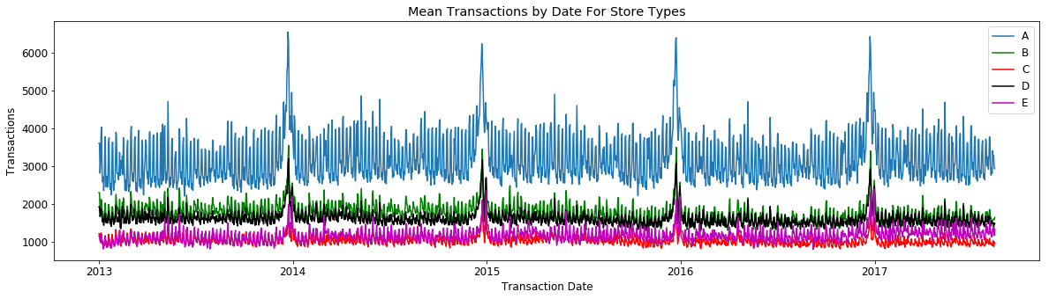
Exploratory Data Analysis

Slide 7
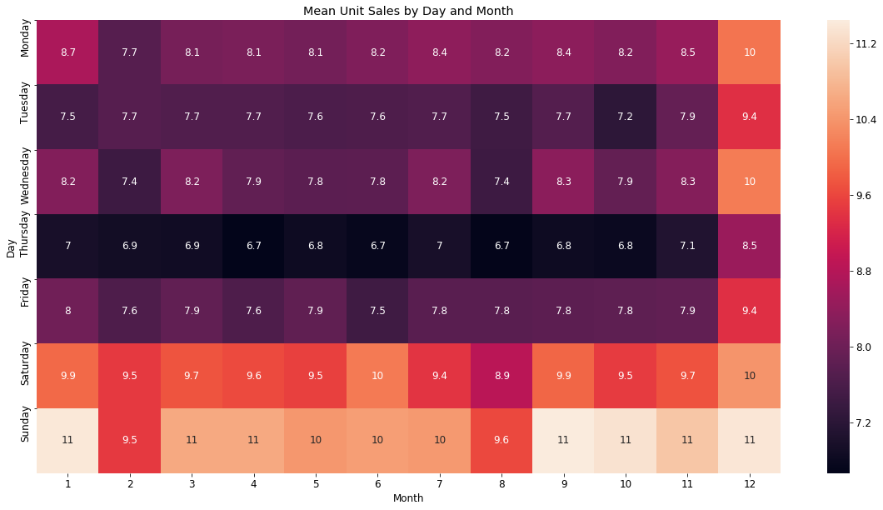
Exploratory Data Analysis

Slide 8
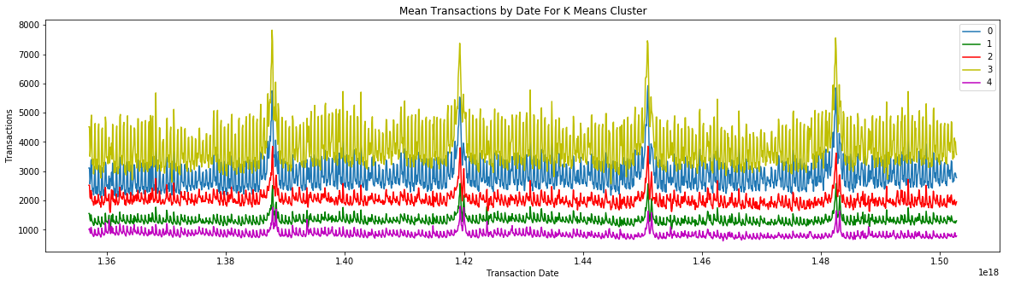
Clustering
Unit Sales were clustered by the mean value for their item class
Store transactions were clustered based on their time series

Slide 9
Unit Sales Prediction
Cluster | MAE-Train | MAE-Test | MAPE-Train | MAPE-Test
Cluster 0 | 1.09045943211 | 1.09007295475 | 60.472444309 | 60.5225811096
Cluster 1 | 2.1046738779 | 2.1046738779 | 87.8291263265 | 87.8361760686
Cluster 2 | 4.94627656152 | 5.00750308326 | 115.838648041 | 117.783078074
Cluster 3 | 3.69877857453 | 3.69564205273 | 118.355929414 | 118.107319756
Cluster 4 | 1.60452993812 | 1.60753634475 | 75.6795277545 | 75.8338208977
Cluster 5 | 0.522646305249 | 0.534347661827 | 36.9559092456 | 37.3638001872
Cluster 6 | 2.6238135117 | 2.61366682971 | 99.1629727511 | 98.8520829999
Cluster 7 | 6.73416341233 | 6.73520174937 | 153.053919285 | 154.79421774
Cluster 8 | 3.28522056073 | 3.28369014909 | 109.630326372 | 109.850182934
Cluster 9 | 4.81458060488 | 4.82504755436 | 132.063044691 | 132.02729994

Slide 10
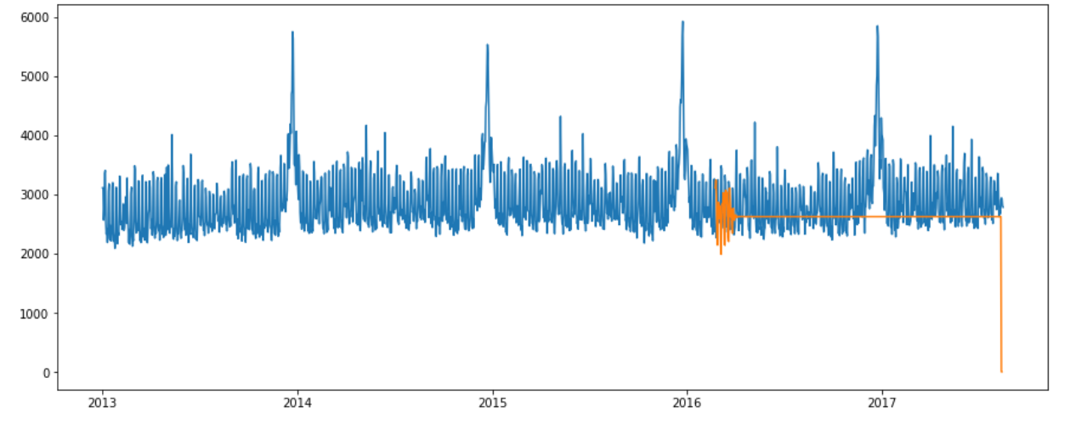
Transaction Time Series
Arima Model | Cluster 0 | Cluster 1 | Cluster 2 | Cluster 3 | cluster 4
Mean Forcast error | 2917.716282 | 1331.051354 | 1998.506271 | 3925.654602 | 790.403602
Mean Absolute error | 2919.97953 | 1331.701283 | 1997.410354 | 3927.966568 | 790.815995
RMSE | 1157.3588 | 493.0613 | 1570.2317 | 1433.6683 | 186.9574

Slide 11
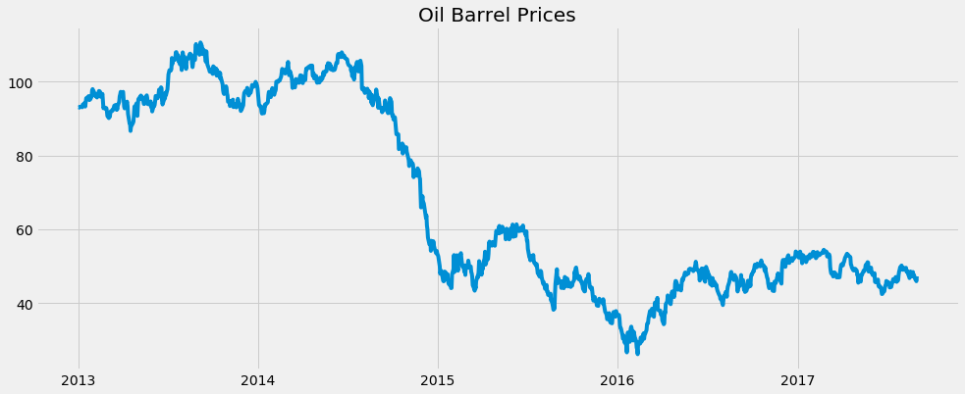
Oil Time Series

Slide 12
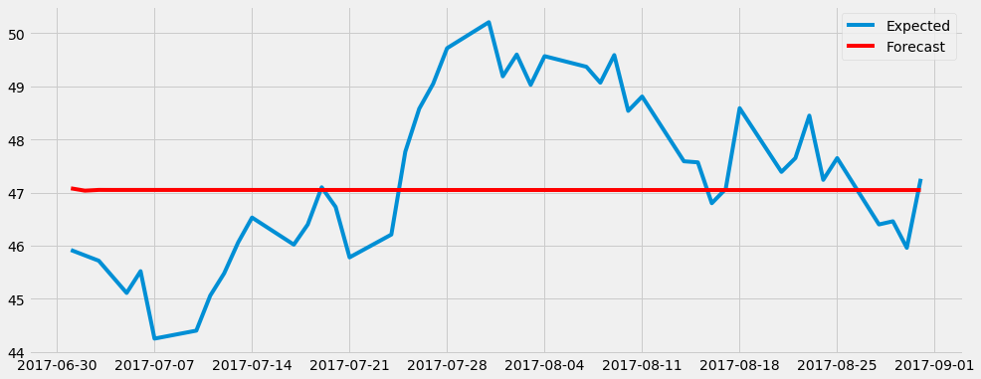
Oil Time Series
RMSE 1.6363822749071801 MAE 1.38464484829 BIAS 47.3115416632

Slide 13
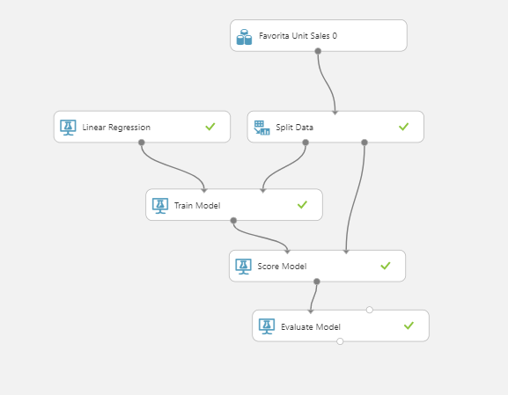
Azure Deployment
MAE values matched those from our Python models

Slide 14
Best Predictors
We performed step-wise feature selecton on each cluster and found the following most important:
Store transaction count
Oil barrel price
Day of week (every model selected at least one)
Month (every model selected at least one)
No feature of those we considered was eliminated from all clusters: on promotion, state, holidays and events, item class

Slide 15
Contributions
We each contributed equal time to the project
Data wrangling – Emily 50%, Raksha 50%
EDA –Emily 50%, Raksha 50%
Clustering – Emily
Unit sales prediction – Emily
Transactions time series – Raksha
Oil time series – Emily
Web app – Emily 75%, Raksha 25%
Report – Raksha 75%, Emily 25%

