Slide 1
Corporación Favorita Grocery Sales Forecasting: Status Update
Team 4: Raksha Kaverappa and Emily Strong

Slide 2
About The Project
Corporación Favorita is an Ecuadorian grocery chain with over 100 stores
Currently use heuristics for sales forecasting
They are holding a Kaggle competition to develop machine-learning-based forecasting
Kaggle Goals: predict sales by store for existing products and for new products
Additional Project Goal: predict best and worst selling items by store

Slide 3
About The Data Sets
Time series:
Training data: unit sales by date, store, and item with a promotion flag
Represents 54 stores and 4000+ items
January 1, 2013 – August 15, 2017
Test set includes new items
Total transactions per store
Oil barrel prices
The Ecuadorian economy is dependent on oil
Ecuadorian holidays
No information on whether stores were open or closed that day

Slide 4
About The Data Sets
Dictionaries:
Store dictionary provided with city and internal clustering information
We don’t know the store location beyond city
We don’t know how the clusters are defined
Item dictionary provided with general family (grocery, deli, etc), perishable flag, and internal clustering information
We don’t know what the items are
We don’t know how the clusters are defined

Slide 5
Timeline
Days | Deliverable | Status
1-4 | Data wrangling and EDA | Wrangling: Complete EDA: in progress
5-8 | Model building and selection | Clustering started
9 | API deployment
10-12 | Web application
13 | Catch-up for any deliverables that take longer than expected
14-15 | Documentation and presentation

Slide 6
Data Cleansing
Naïve approach: interpolate all missing values
Zeros were omitted from the data sets
We don’t have inventory counts so we don’t know if 0 unit sales for an item means it was out of stock
All stores have 0 transactions for December 25, most have 0 for January 1
Normalize item unit sales to total store transactions then take the mean
Pro: fewer models to create
Con: removes regional variations

Slide 7
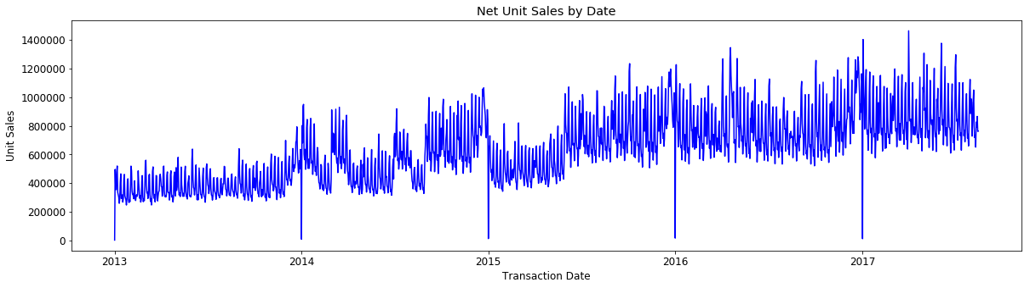
EDA Insights - Trend

Slide 8
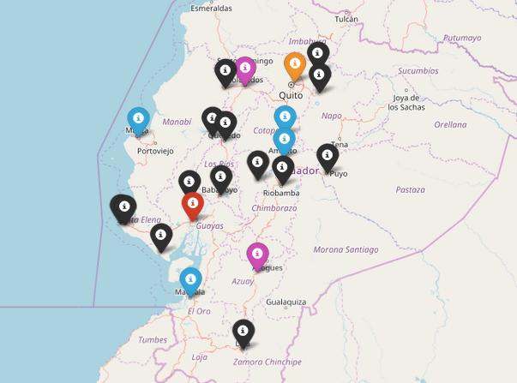
Clustering - Stores

Slide 9
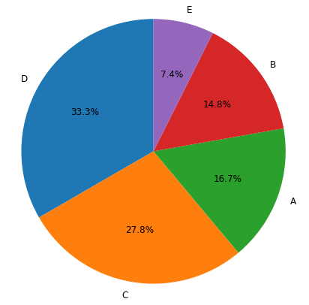
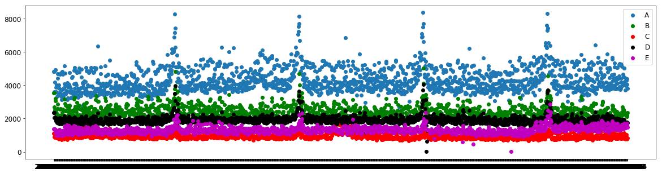
Clustering - Stores

Slide 10
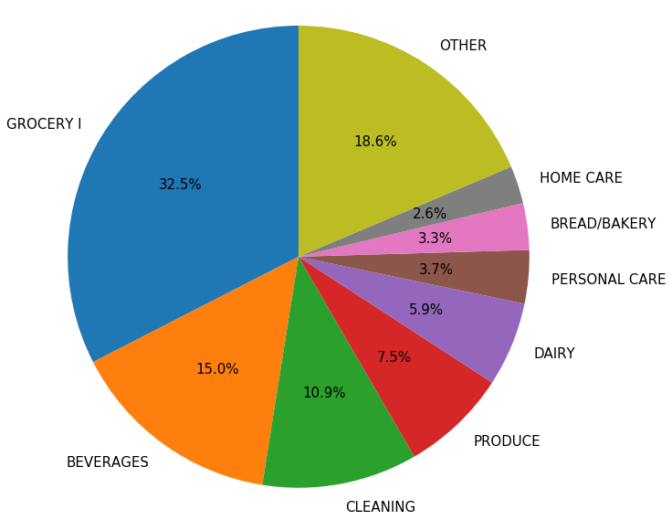
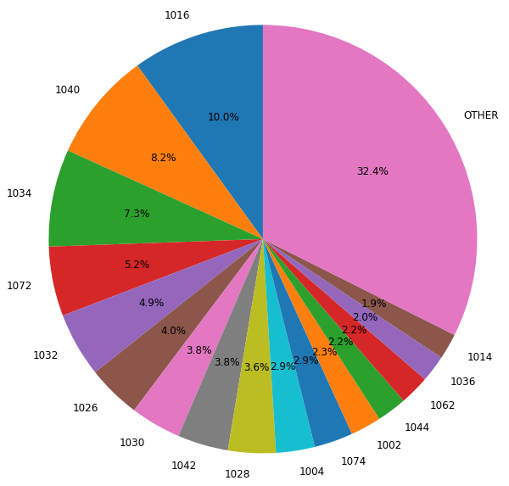
Clustering - Items

