Slide 1
Academic Library Database
By Emily Strong and Shawn Kilpatrick

Slide 2
Mission Statement
Maintain the data used to generate and support school library operations
Enable patrons to perform limited functions: searching titles, authors and course reserves, placing holds

Slide 3
Objectives
Maintain data related to catalog items, patron transactions, acquisition orders, and course reserves
Perform searches on these data for library operations and patron use
Track status of transactions such as holds and acquisition orders
Track status of catalog items
Track data for collection maintenance
Reporting for communication with patrons
Reporting for collection maintenance
Reporting for operational tasks

Slide 4
Business Requirements
Allow library staff and patrons to search the catalog using multiple criteria and provide information to help patrons find particular items in the library stacks
Facilitate acquisitions by tracking orders and vendor relationships
Allow faculty and students to view reserves lists for their courses and identify the location of the course reserves.
Allow patrons to check out items and place holds, as well as view the items they currently have checked out or on hold and their existing fines
Define different borrowing privileges based on patron types
Facilitate contacting patrons about overdue items and holds that are ready for pick-up
Balance operational needs with protecting patron confidentiality under the US Patriot Act

Slide 5
Business Rules
Each edition may have more than one copies
A copy can only be associated with one edition, and an edition with only one title
An author can have many titles, and a title many authors
A copy can belong to only one collection at any one time, a collection can have many copies
Each edition can have only one publisher/imprint
Each copy can only have one active checkout transaction
Each copy can have zero or more holds on it
Each course can have many copies on its reserves list and each copy may be on zero or more reserves list.

Slide 6
Business Rules (continued)
Each patron has one patron type
Each patron can have zero or more copies checked out
Each patron can have zero or more fines
Each title can have many subjects and each subject can have many titles
No history is kept of past checkout transactions, holds, or fines. When a copy is checked in, when a hold is picked up or canceled, or when a fine is paid that entry is deleted from the relevant tables

Slide 7
Design - Entities
Title
Author
Subject
Edition (Call Number)
Publisher Imprint
Vendor
Acquisition Order
Copy (Barcode)
Collection
Borrowing Policy
Course
Course Reserve List
Patron
Patron Type
Hold
Fine
Checkout Transaction
Address

Slide 8
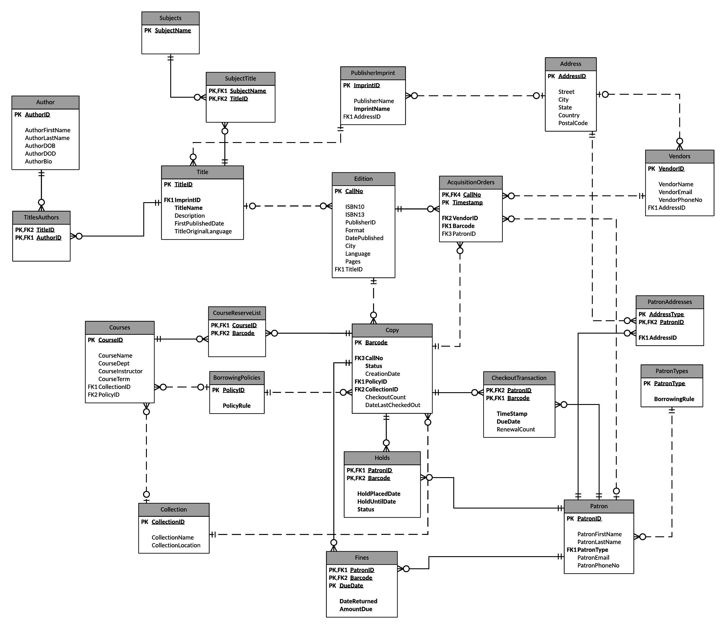

Slide 9
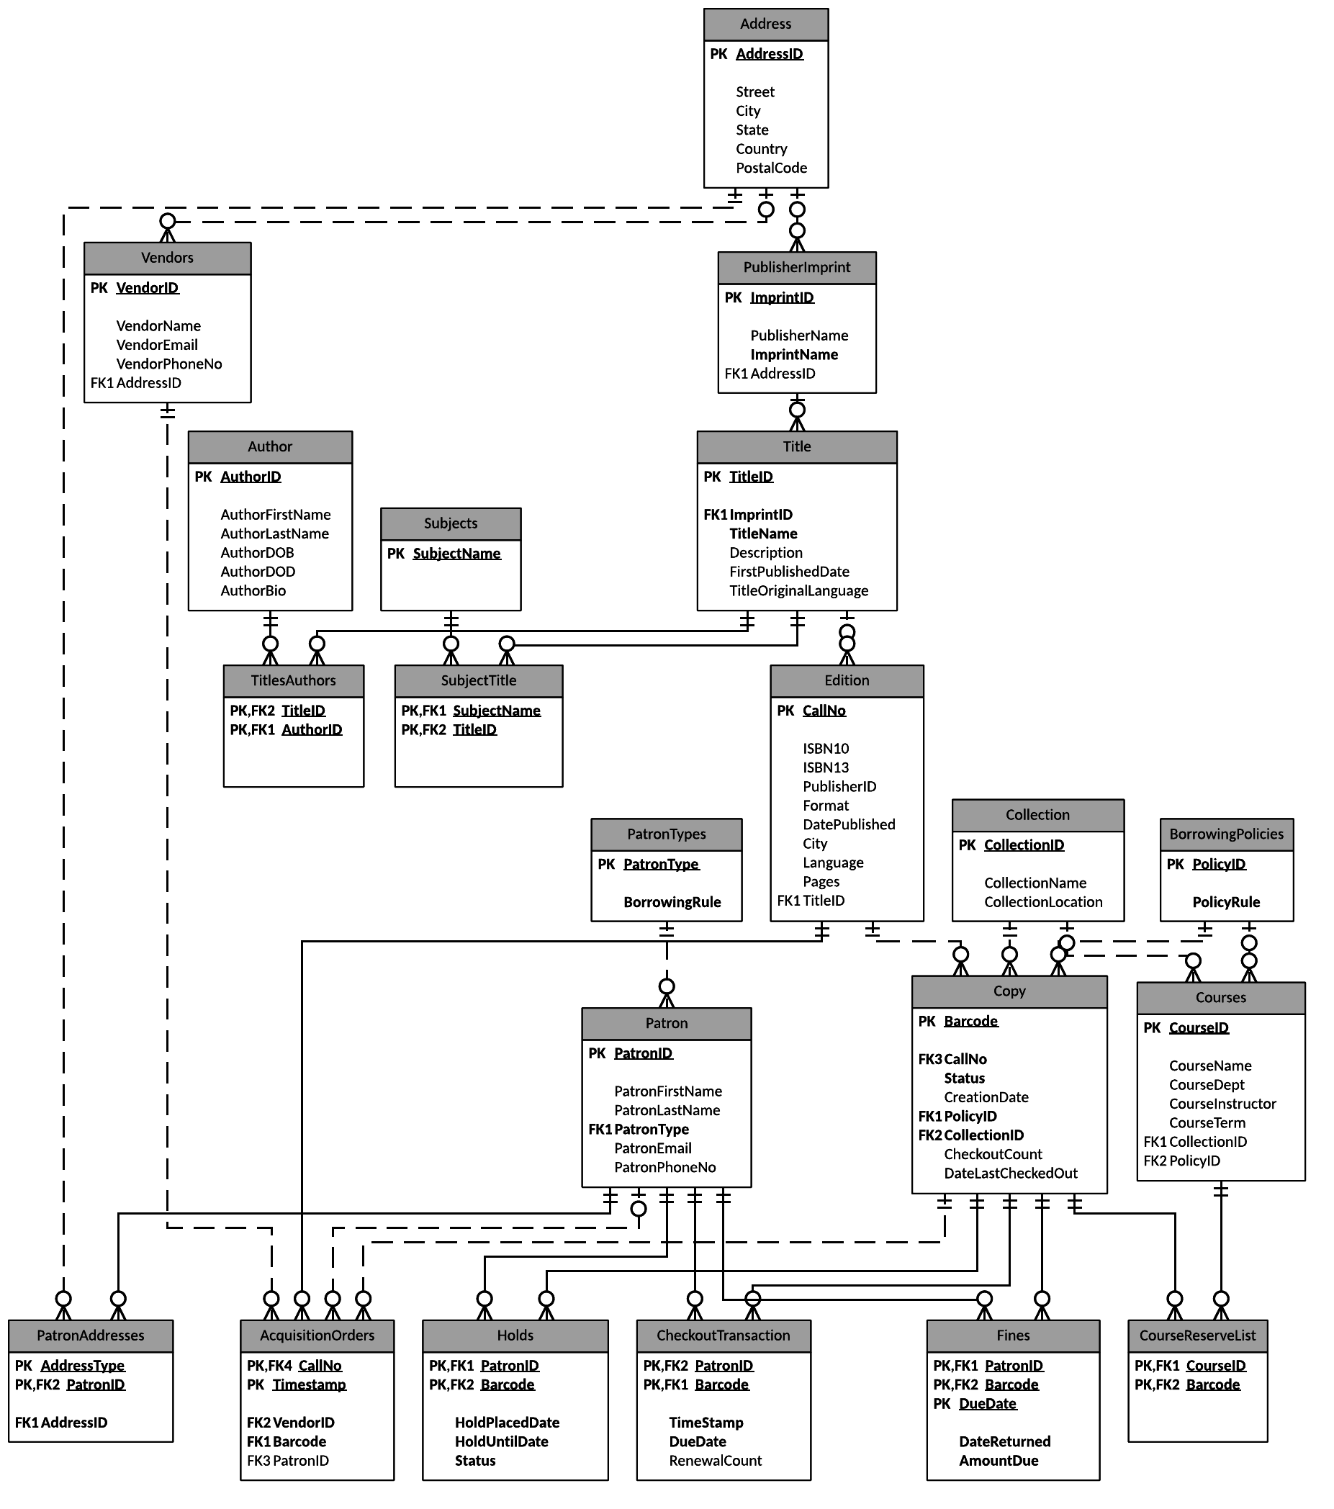

Slide 10
DDL Statements
create table edition (
CallNo varchar(50) not null,
ISBN10 char(10) not null,
ISBN13 char(13) not null,
ImprintID int not null,
[format] varchar(15) not null,
DatePublished date not null,
City varchar(20),
[Language] varchar(20),
Pages int,
TitleID varchar(10) not null,
primary key (CallNo)
);
Notes:
Example create
Comment on column names

Slide 11
DDL Statements
create table Copy(
Barcode varchar(12) not null primary key,
CallNo varchar(50) not null foreign key references Edition(CallNo),
Status varchar(20) not null,
CreationDate date,
PolicyID varchar(10) not null foreign key references BorrowingPolicies(PolicyID),
CollectionID varchar(12) not null foreign key references Collection(CollectionID),
CheckoutCount int,
DateLastCheckedOut date
CHK_CopyStatus CHECK (Status in ('AVAILABLE','ON HOLD','CHECKED OUT','OVERDUE','ON RESERVE','MISSING','IN REPAIR','ON ORDER'))
);

Slide 12
DDL Statements
create table CheckoutTransaction(
PatronID varchar(9) not null foreign key references Patron(PatronID),
Barcode varchar(12) not null foreign key references Copy(Barcode),
CheckoutTimestamp datetime not null,
DueDate datetime not null,
RenewalCount int,
constraint PK_CheckoutTransaction primary key (PatronID,Barcode)
);

Slide 13
Stored Procedures

Slide 14
Views

Slide 15
PowerBI Reports

