Slide 1
Video Summarization & Object Detection
Efforts by:
Suheb Ali

Slide 2
Introduction
According to a recent report by Sandvine, video content now accounts for 65% of all internet traffic. This is up from 56% in 2021 and 41% in 2020.
It is estimated that by 2025, the amount of video content uploaded to the internet every second will take an individual over 5 million years to watch.
In a survey conducted by HubSpot, it was found that 54% of consumers want to see more video content from brands and businesses they support.
According to Facebook, 500 million people watch videos on their platform every day.
A study conducted by Microsoft found that humans have an attention span of just 8 seconds, which is lower than that of a goldfish.
Notes:
These statistics highlight the overwhelming amount of video content that is available online and the importance of having an effective method of summarizing it. It also shows that the demand for video content is high and that users have a limited attention span, making it crucial to provide them with relevant and concise content.
Suppose you want to learn how to bake a cake and you search for a video tutorial on YouTube. You come across multiple videos that show you how to bake a cake, but each video has a different length and covers various aspects of the process. Some videos might show you the entire baking process from start to finish, while others might focus on specific steps or techniques. If you have limited time or attention span, watching all these videos might be overwhelming and time-consuming.

Slide 3




Project Stages
Video input selection and compatibility checking.
Object detection for identifying and tracking objects.
Keyframe selection algorithms for significant change identification.
Supervised learning using a CNN-based LSTM model.
Unsupervised learning techniques (e.g., K-means clustering).
Bounding box integration for object highlighting.
Summary video generation with keyframes.
Output video saving capability.
Project Goal
To automatically generate concise video summaries by leveraging object detection and keyframe selection techniques, enhancing content understanding and facilitating efficient video browsing.
About Project
Video Summarization using Object Detection and Keyframe Selection
Input/Output
The project takes a video file as input, supporting various formats, and containing diverse objects, scenes, and actions.
The project generates a summarized version of the input video by selecting keyframes representing important content. The output includes a video file with keyframes, bounding boxes, and labels for detected objects. Playback control options enable users to interact with the video.
Notes:
Our project focuses on developing an object detection and video summarization system based on the YOLOv3 object detection algorithm. Using computer vision techniques and machine learning models, we aim to detect objects in a video and generate a concise summary by selecting keyframes. To achieve this, we employ unsupervised learning with K-means clustering and supervised learning with a CNN-based LSTM model. The system identifies significant changes between frames and utilizes the trained models to determine the most representative frames for summarization. Additionally, we incorporate object detection to provide contextual information in the form of bounding boxes and labels. The project aims to offer an efficient solution for video summarization tasks, utilizing both visual features and temporal dynamics for accurate and concise summaries.
The problem we aim to address with our project is the need for efficient video summarization techniques. As the amount of video content continues to grow rapidly, it becomes increasingly challenging for users to consume and extract meaningful information from lengthy videos. Manual video analysis is time-consuming and impractical for large-scale video datasets. Therefore, there is a need for an automated system that can effectively summarize videos by selecting keyframes that capture the most important content. Our project aims to tackle this problem by combining object detection and video summarization techniques using supervised and unsupervised learning approaches, providing a practical solution for efficient video summarization.

Slide 4
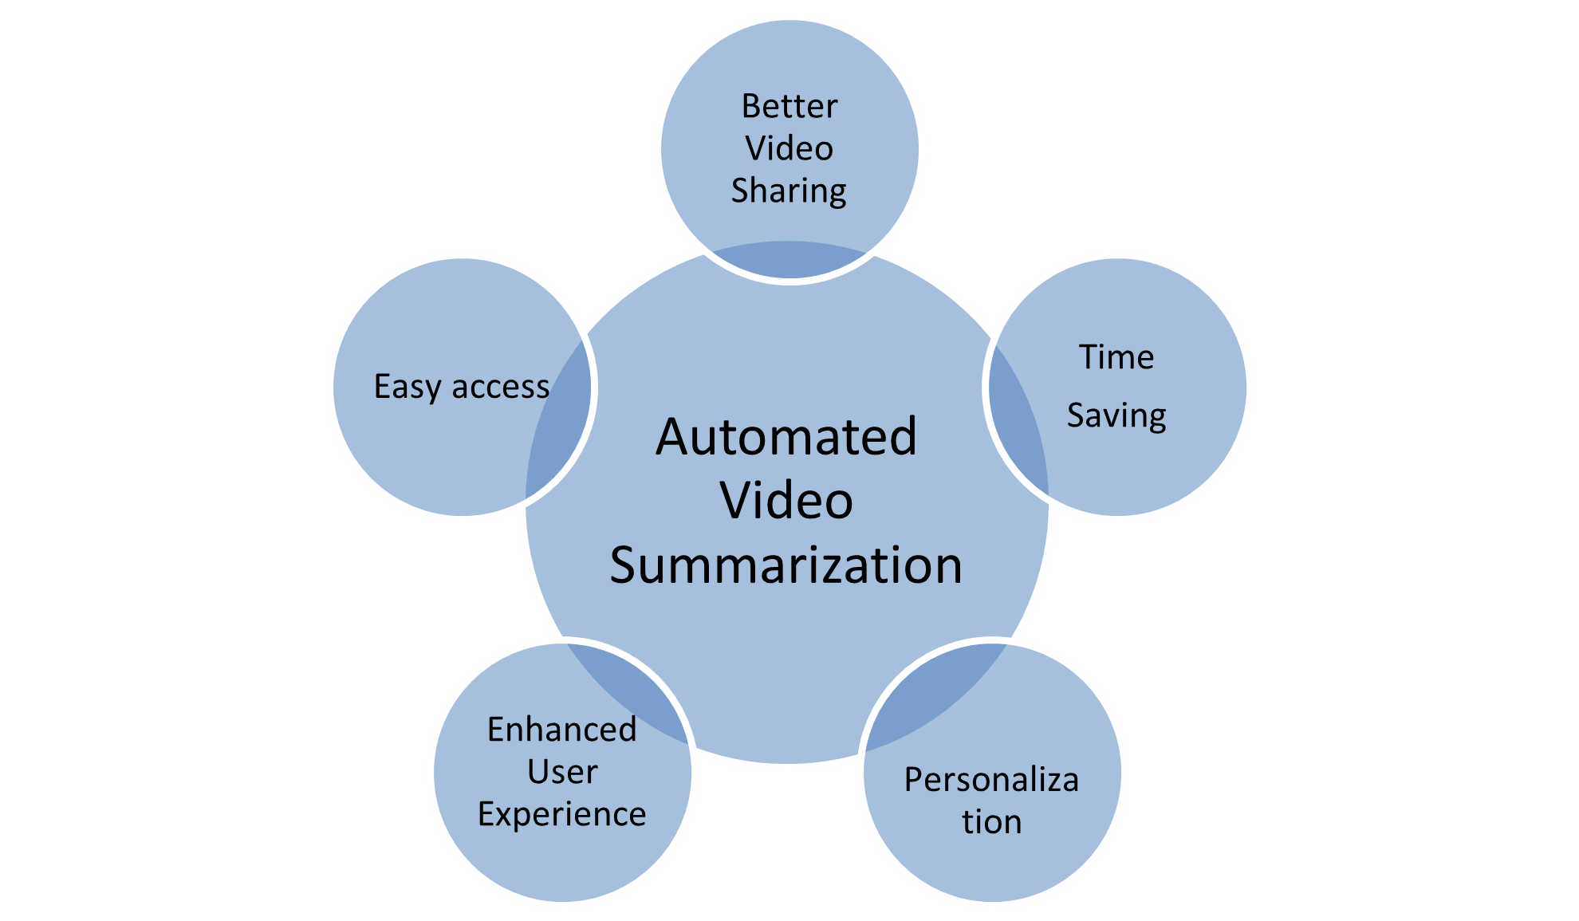
Need for Automated Video Summarization
Notes:
In this scenario, video summarization can be useful as it provides a concise overview of the video's content, enabling you to quickly understand the important aspects of the process. This way, you can save time and effort by only watching the relevant parts of the video, thereby enhancing your overall user experience.

Slide 5
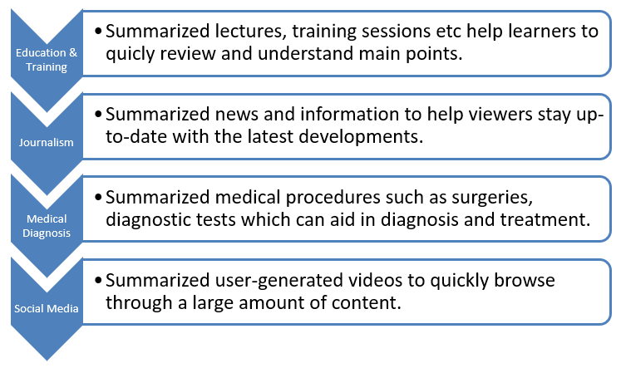
Applications
Notes:
Video summarization has various applications in different fields, some of them are:
Entertainment: Video summarization can be used to create highlights or recaps of sporting events, concerts, and other live performances. It can also be used to create trailers and teasers for movies and TV shows.
Surveillance and Security: In surveillance and security systems, video summarization can be used to quickly identify events of interest from a large amount of video footage, such as criminal activity or security breaches.
Education and Training: Video summarization can be used to create summaries of lectures, training sessions, and educational videos, which can help learners to quickly review and understand the main points.
Journalism: In news reporting, video summarization can be used to create summaries of news events, making it easier for viewers to stay up-to-date with the latest developments.
Medical Diagnosis: Video summarization can be used to create summaries of medical procedures, such as surgeries or diagnostic tests, which can aid in medical diagnosis and treatment.
Social Media: Video summarization can be used in social media platforms to generate summaries of user-generated videos, making it easier for users to quickly browse through a large amount of content.
These are just a few examples of the many applications of video summarization.

Slide 6
Proposed Approach
Utilize advanced computer vision techniques and machine learning models to automatically detect objects in videos and generate concise summaries.
Combine the power of YOLOv3 algorithm for object detection with supervised and unsupervised learning approaches for effective video summarization.
Select keyframes representing the overall content of the video using unsupervised K-means clustering and a CNN-based LSTM model to capture visual features and temporal dynamics.
Enhance the user experience with playback control functionality and provide additional contextual information through object detection visualizations and labels.
Notes:
Proposed Approach for Object Detection and Video Summarization System:
Input Video Processing:
Accept various video formats as input.
Split the video into frames for further processing.
Object Detection:
Utilize the YOLOv3 algorithm for accurate and efficient object detection.
Apply object detection on each frame to identify and track objects.
Draw bounding boxes and labels around detected objects.
Keyframe Selection:
Identify significant changes between frames to determine potential keyframes.
Apply unsupervised learning using K-means clustering to group similar frames.
Select keyframes that represent the overall content of the video.
Video Summarization:
Employ supervised learning with a CNN-based LSTM model.
Extract visual features using CNNs and capture temporal dynamics using LSTM.
Train the model on the SumMe dataset to learn relationships between frames.
Predict the importance of each frame to generate a summary.
Contextual Information:
Use object detection to provide additional contextual information.
Draw bounding boxes and labels around objects in each keyframe.
Playback Control:
Implement functionality for users to play, pause, and close the video window.
Enable keyboard inputs for easy control of video playback.
Output Generation:
Write the keyframes, object detection visualizations, and labels to an output video file.
Generate a concise summary video that preserves the most important information.
Future Enhancements:
Improve object detection accuracy and performance.
Explore additional video summarization techniques.
Expand support for various video platforms and formats.
By following this proposed approach, the Object Detection and Video Summarization System aims to automate the process of summarizing videos by selecting keyframes and providing contextual information through object detection.

Slide 7
Overview
Purpose: Automated video summarization for efficient content analysis.
Programming language: Python.
Technology Used: Computer vision, machine learning, and deep learning.
Libraries: OpenCV, TensorFlow, Keras, YOLOv3, Scikit-learn.
Benefits: Time-saving video analysis, accurate object detection, concise video summaries, enhanced user experience.
Notes:
In summary, the project combines object detection with video summarization techniques, incorporating both supervised and unsupervised learning approaches. By leveraging the YOLOv3 algorithm, K-means clustering, and a CNN-based LSTM model, the system generates concise summaries of input videos. The inclusion of object detection enriches the summary with additional contextual information. The project offers a practical solution for automated video summarization tasks, utilizing both visual features and temporal dynamics for efficient and informative summaries.

Slide 8
Diagrams
SRS
Architecture Diagram
Flowchart Diagram
Dataflow Diagram
Collaboration Diagram
System Sequence Diagram
Notes:
This flowchart diagram represents the sequential flow of the project's main steps. It starts with the "Start" node and progresses through the different stages, including selecting a video, performing object detection, identifying significant changes, applying K-means clustering, applying CNN-based LSTM, generating keyframes, drawing bounding boxes, generating a video summary, playback control, saving the output video, and finally reaching the "End" node.
This detailed Data Flow Diagram represents the flow of data between different components and processes in the project.
The Collaboration Diagram, also known as the Communication Diagram, illustrates the interactions and relationships between objects in a system. Since my project involves multiple components, here's a simplified example of a Collaboration Diagram for my project.
A System Sequence Diagram (SSD) illustrates the interactions between actors and the system in terms of the sequence of messages exchanged.
In this SSD, the user initiates the process by selecting a video. The system then interacts with various components, such as VideoInput, ObjectDetection, KeyframeSelection, VideoSummarization, PlaybackControl, and OutputGeneration, to perform the necessary operations. Finally, the system sends the output video to the user.

Slide 9
Methodology (Unsupervised)
Data Collection
Feature Extraction
Clustering
Summary Generation
Creating Keyshots using Keyframes
Keyframe Extraction

Slide 10
Clustering: K-Means Clustering
Initialization
Assigning data points to clusters
Updating centroids
Repeating steps 2 and 3
Output
Randomly select k points from the dataset as the initial centroids.
For each data point, calculate the distance to each centroid and assign it to the cluster associated with the closest centroid.
Calculate the new centroid for each cluster as the mean of all the data points assigned to that cluster.
Repeat steps 2 and 3 until the centroids no longer change or a maximum number of iterations is reached.
The final k clusters and their respective centroids.
Notes:
K-means clustering is an unsupervised machine learning algorithm used for partitioning a dataset into k clusters based on similarity in the data points. This algorithm works by iteratively assigning each data point to the closest centroid and then updating the centroid based on the new members in the cluster until convergence. This algorithm is widely used for clustering and has many practical applications, such as image segmentation, customer segmentation, and anomaly detection. However, it has some limitations, such as its sensitivity to initialization and the need to specify the number of clusters k in advance.

Slide 11
Conclusion
The Object Detection and Video Summarization System offers a practical and efficient solution for automating the process of summarizing videos, saving time and effort for users.
By integrating state-of-the-art techniques such as the YOLOv3 algorithm, K-means clustering, and CNN-based LSTM models, the system achieves accurate object detection and generates concise video summaries.
The inclusion of playback control functionality and contextual information through object detection visualizations enhances the user experience and provides a comprehensive understanding of the video content.
With potential future enhancements to improve object detection accuracy and explore additional video summarization techniques, the system holds great promise in advancing the field of video analysis and summarization.

Slide 12
Future Scope
Enhancing Object Detection: Continuously improving the accuracy and performance of the object detection component by exploring more advanced algorithms and models to handle complex scenarios and improve object recognition capabilities.
Expanding Summarization Techniques: Exploring and integrating additional video summarization techniques, such as graph-based methods or attention mechanisms, to further enhance the system's ability to capture important video content and generate more informative summaries.
Real-Time Processing: Investigating ways to optimize the system for real-time video processing, enabling it to analyze and summarize videos in real-time or with minimal delay, which would be particularly valuable for applications requiring immediate video analysis.
Cloud-Based Deployment: Adapting the system for deployment on cloud platforms, enabling scalability and accessibility, and allowing users to leverage the power of cloud computing resources for faster processing and analysis of large-scale video datasets.
Notes:
By focusing on these future directions, the project can continue to evolve and address the evolving needs and challenges in the field of object detection and video summarization, opening up new possibilities for applications in areas such as surveillance, video analytics, and content understanding.

Slide 13


