Slide 1
Create access to team members on IBM cloud
Tutorial based on IBM Assistant Chatbot

Slide 2
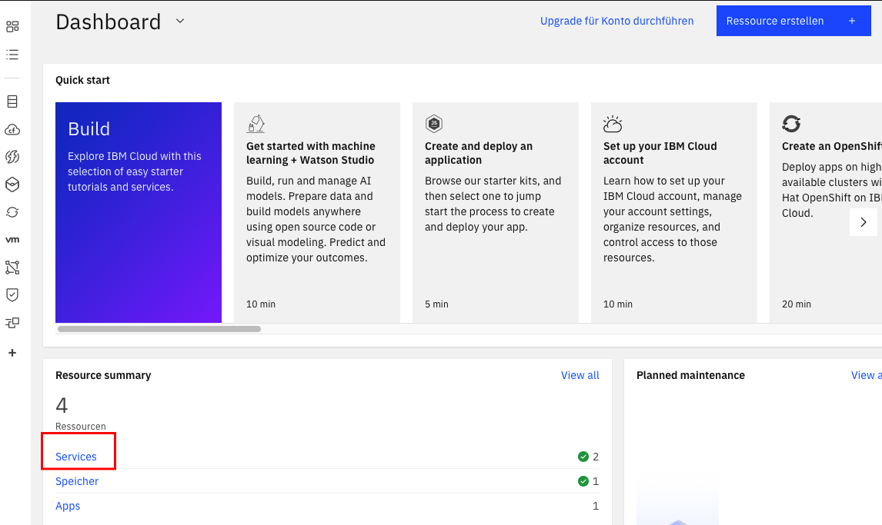
Open your Chatbot via your IBM Dashboard. https://cloud.ibm.com
Use the quick link “Service” under Resource summary.
If you don´t have an account first do a free registration and start a project under:
https://www.ibm.com/watson/how-to-build-a-chatbot

Slide 3
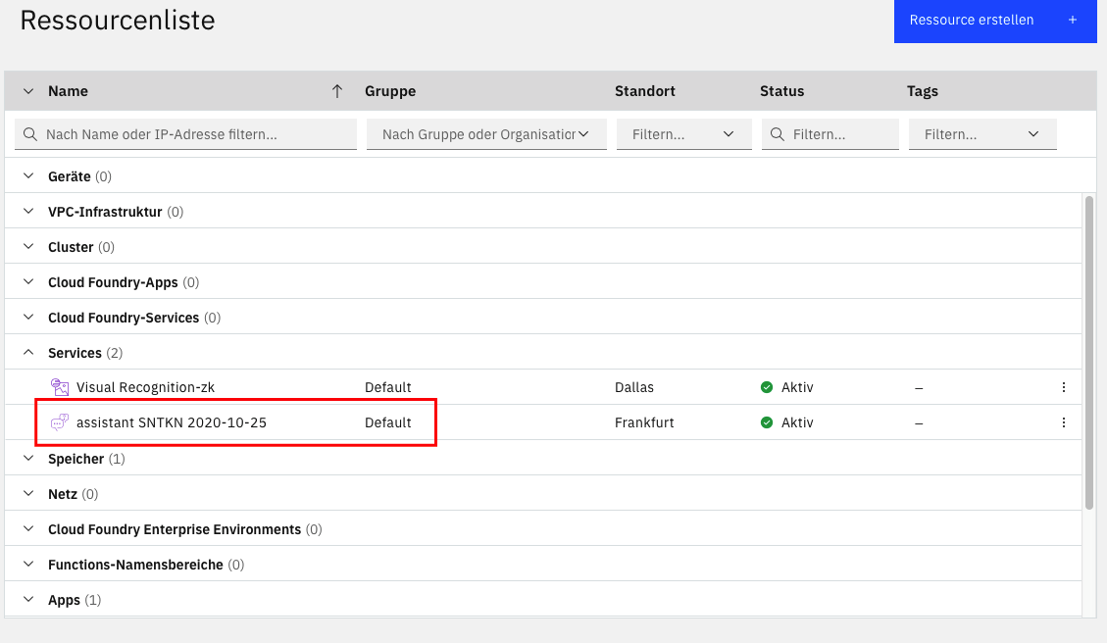
Click on Services to have a list of your current Services.
Choose your Chatbot assistant service.

Slide 4
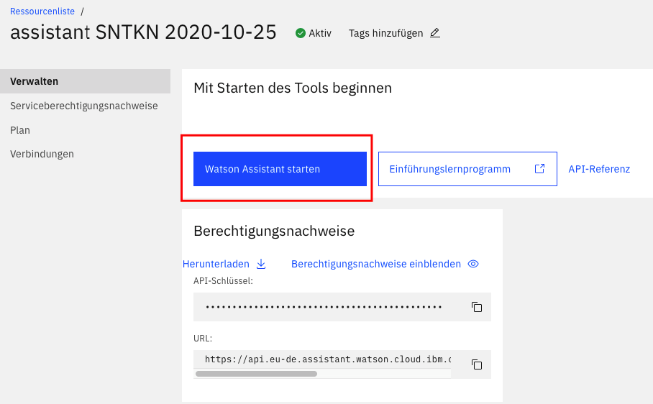
Start your assistant service.

Slide 5
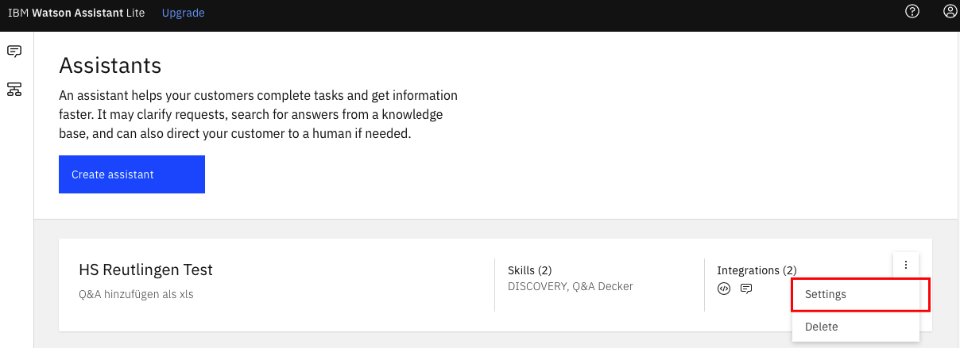
Click on the three dots to open the assistants Settings

Slide 6
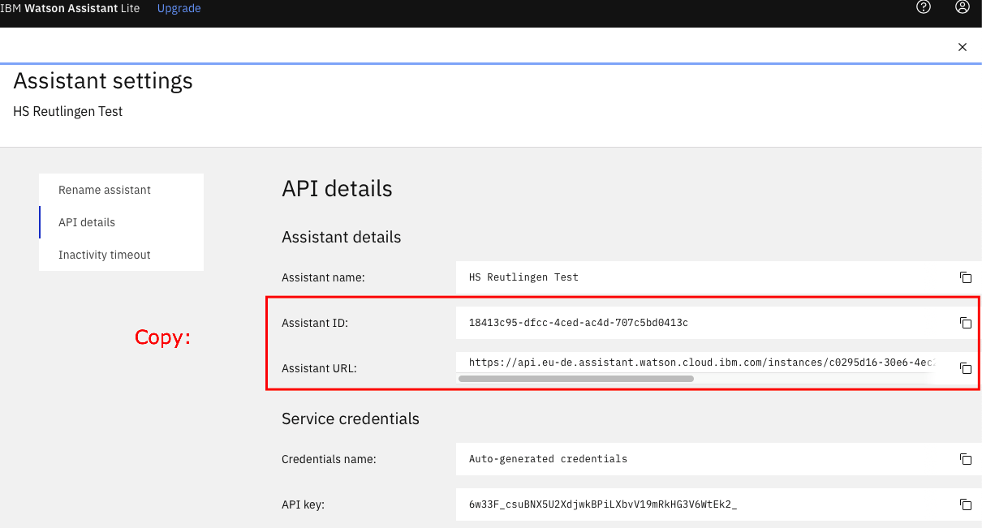
Do a copy of your Assistant ID and Assistant URL, you will need them later to grant your team member access to exactly this assistant.

Slide 7
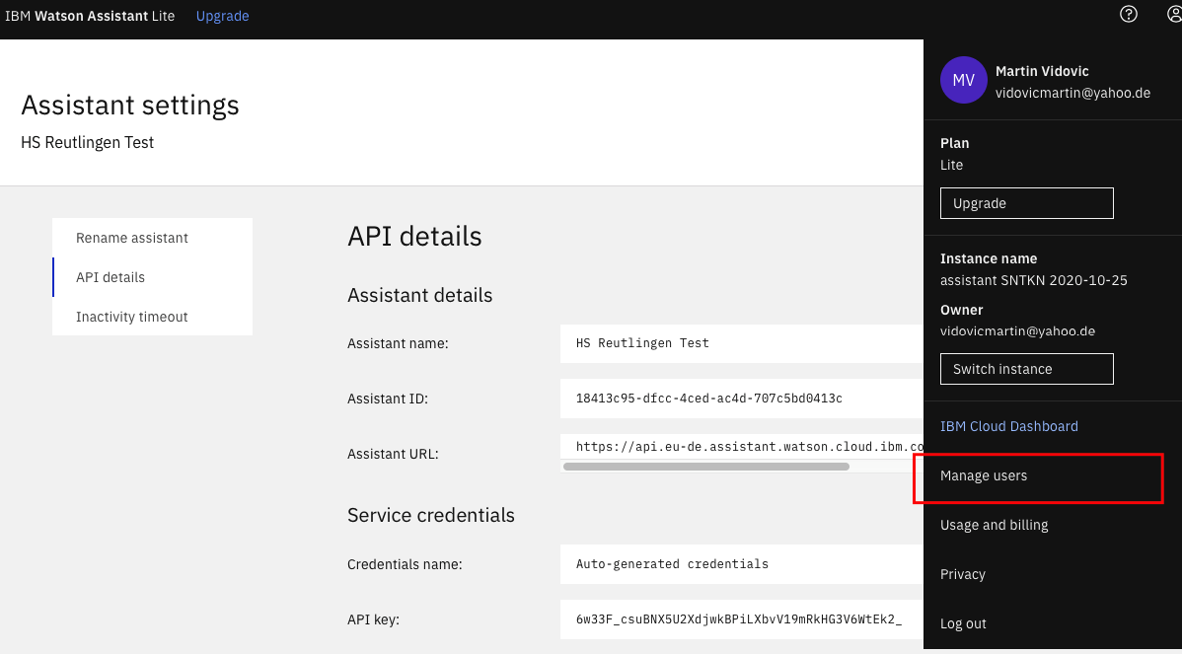
On the top click on the person in circle and open “Manage Users”

Slide 8
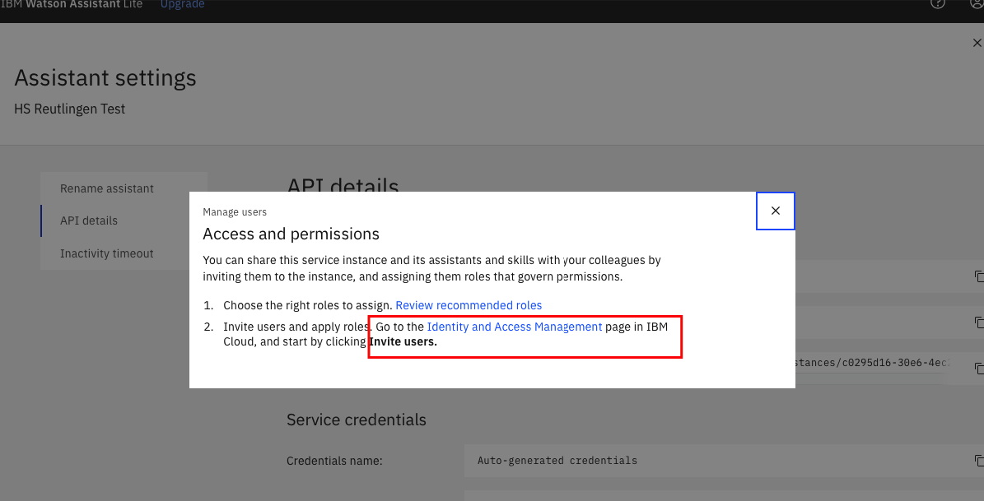
A pop-up appear.
For further information about Roles and Rights click on Review recommended roles.
To grant access to others click on Identity and Access Management

Slide 9
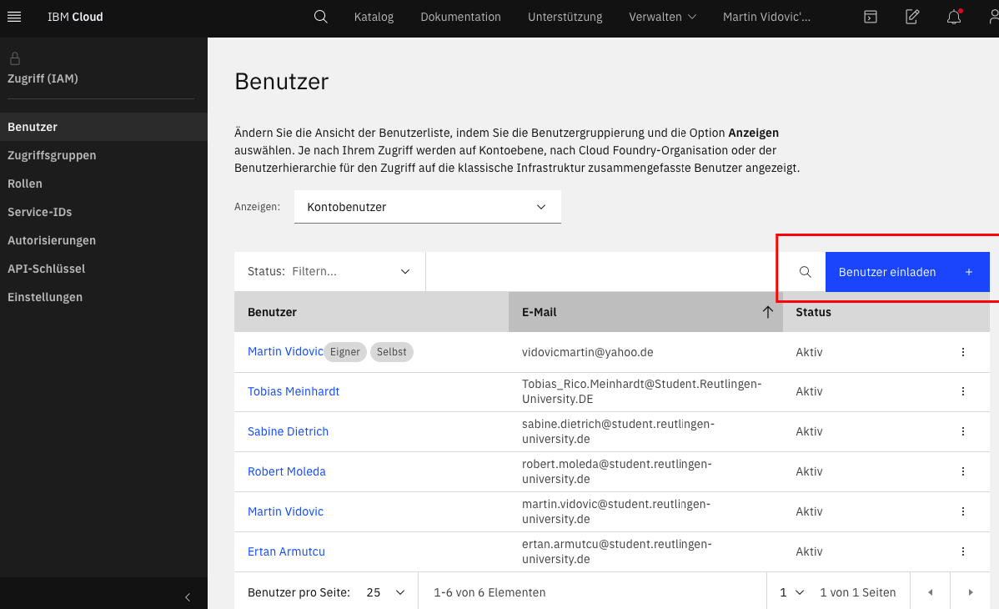
Click on the button “Invite User”

Slide 10
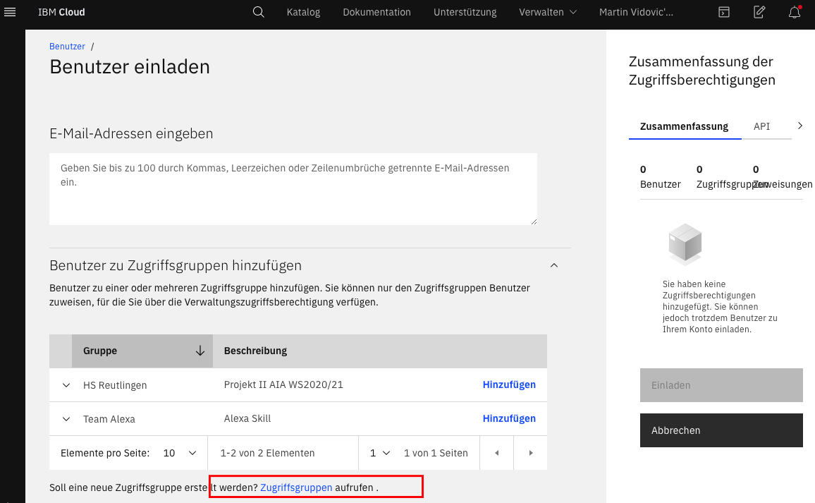
If there is just one invitation to made you can use the first input box to enter the e-mail address. (skip to IAM Service)
Click on access groups to grant a group of people access to this assistant.

Slide 11
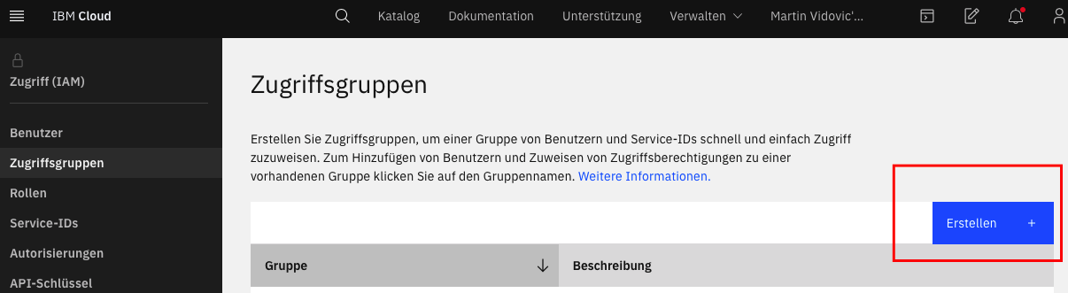

Slide 12
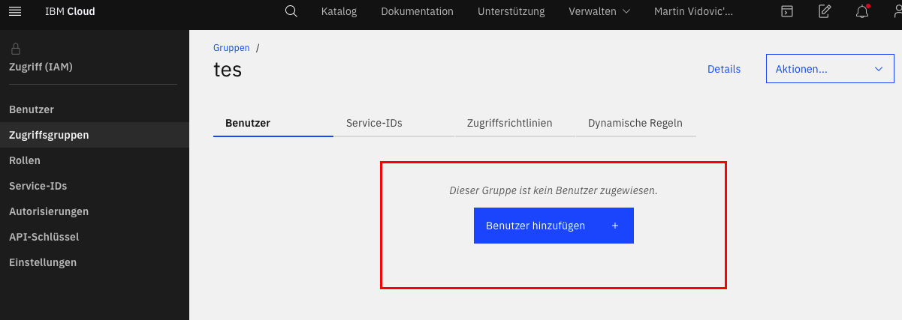
Press the button add users

Slide 13
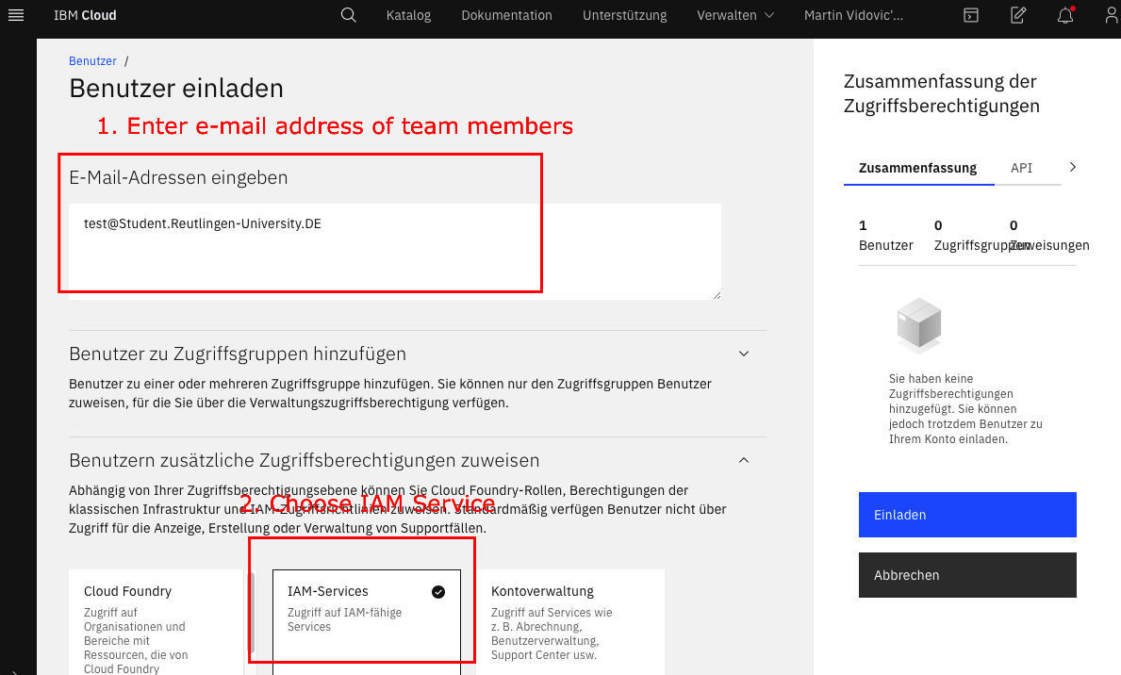
IAM-Services
Use the first input box to enter the e-mail addresses for the invitation, separated by a comma.
Then choose IAM-Services.

Slide 14
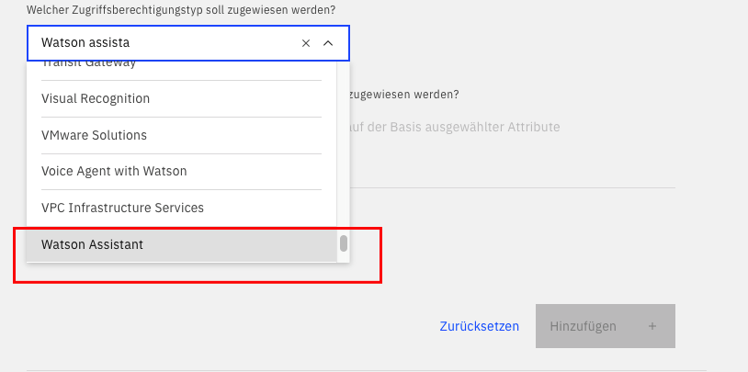
First choose which kind of IBM Service you want to share, in this case Watson Assistant.

Slide 15
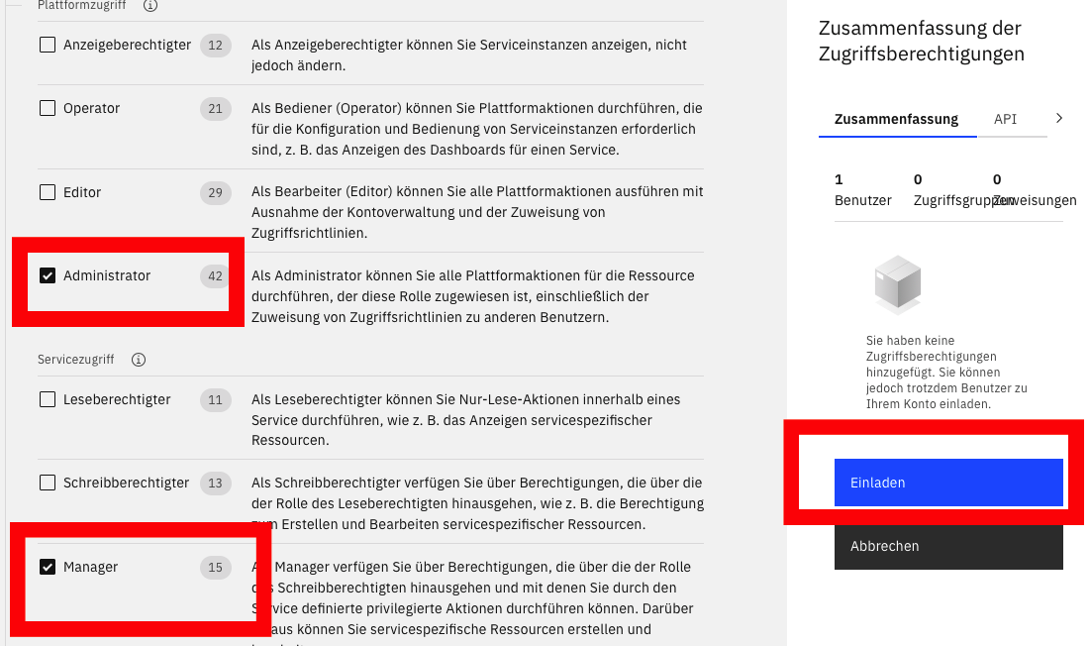
Choose an appropriate role. An Overview of recommendations:
https://cloud.ibm.com/docs/assistant?topic=assistant-access-control#access-control-recommendations
Press the “Invite” button to grant

Slide 16
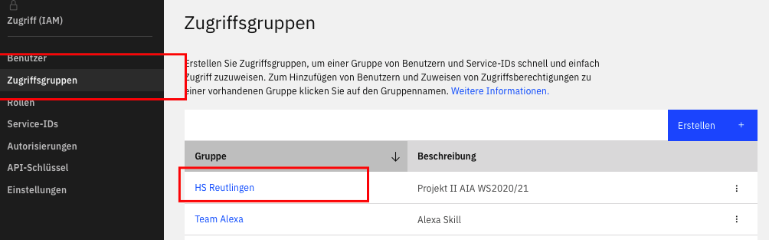
Click on the group you just made, in this case HS Reutlingen.

Slide 17
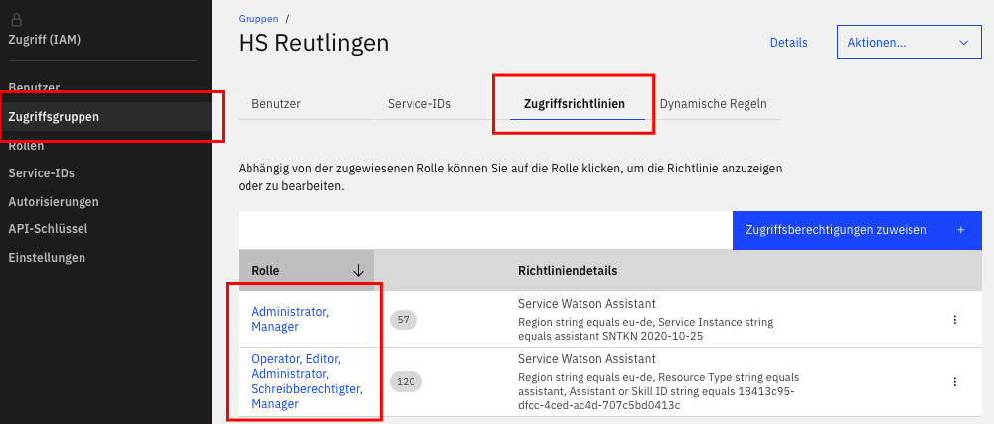
Open the Access Privilege and click on the listed roles.

Slide 18
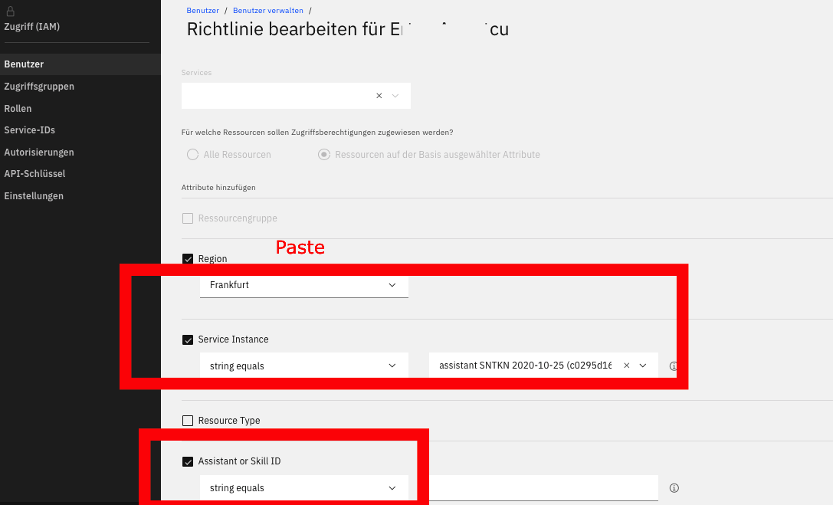
Choose your Service and paste your Assistant ID.
Save your changes.

