Slide 1
Rating Plausibility of Word Senses in Ambiguous Sentences
through Narrative Understanding — SemEval-2026 Task 5 · Final
Group 24 — Taylan İrak · Emre Berk Hamarat · Onur Deniz Öğüncü · Edes Rıza Çakmak · Ertem Ata Kavaz
3-component ensemble · dev acc@std 0.733 / ρ +0.588 (Below OK)
18 May 2026
GroupXX — SemEval-2026 Task 5 (Final)
1 / 16
Notes:
We tackle SemEval-2026 Task 5: graded word-sense plausibility rating. Our final system is a three-component ensemble; on dev it reaches acc@std 0.733 / Spearman +0.588.

Slide 2
The task: rate plausibility, don't pick a sense
f(story, homonym, candidate gloss) → rating in [1,5]
• Input: 5-sentence story (precontext · target sentence · ending) + homonym + one gloss.
• Output: human-average plausibility; five annotators rate each item.
• Multiple senses can be plausible at once — unlike single-label WSD.
• Official scorer: Spearman ρ vs. human mean + accuracy@std (within 1σ or |err|<1).
Example
homonym: track gloss: a pair of parallel rails …
story: detectives at an abandoned train station … 'They followed the track.' …
annotator votes 4,5,3,1,5 → average 3.6, σ 1.67
GroupXX — SemEval-2026 Task 5 (Final)
2 / 16
Notes:
Instead of choosing one sense, systems rate a candidate sense 1–5; the gold is the mean of five annotators.

Slide 3
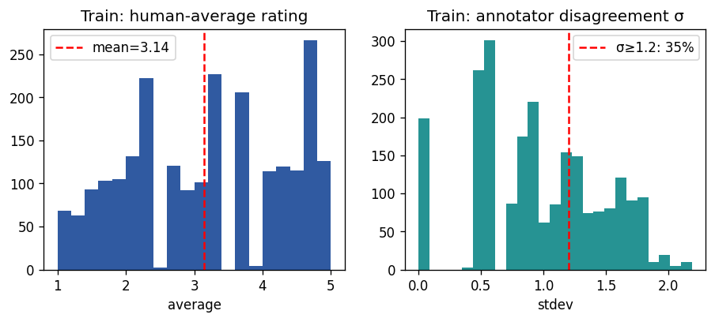
Why it is hard — two data facts
1) Graded, multi-annotator target
• disagreement is signal, not noise
• 35% of train has σ ≥ 1.2 → metric ceiling
2) Near homonym-disjoint splits
• dev ∩ train homonyms = 0
• test ∩ train = 1
• lexical memorisation cannot transfer
• milestone lexical best ≈ 0.55 / 0.19
GroupXX — SemEval-2026 Task 5 (Final)
3 / 16
Notes:
Two facts drive every design choice: the target is graded with real annotator disagreement, and the splits are homonym-disjoint so we must generalise semantically, not memorise lexically.

Slide 4
Metrics, rubric, and a key scorer insight
• OK = acc@std ≥ 0.70 & ρ ≥ 0.60 | Good = ≥ 0.80 & ≥ 0.70
• scoring.py consumes the RAW prediction value (float allowed).
• format_check only int-casts for a non-fatal warning.
⇒ Submitting calibrated CONTINUOUS ratings (not rounded) lifts Spearman +0.558 → +0.588 at zero modelling cost.
We submit continuous; an integer file is kept for the strict variant and the ablation. Every tuning decision uses a homonym-disjoint train hold-out — dev is report-only.
GroupXX — SemEval-2026 Task 5 (Final)
4 / 16
Notes:
A genuine methodological finding: the official scorer reads the raw value, so continuous calibrated predictions materially raise Spearman.

Slide 5
System: a 3-component calibrated ensemble
A · Zero-shot NLI (no training): story ⊨ "<homonym> means <gloss>" → calibrate
B · Gloss-informed encoder regressor: DeBERTa-v3-large, MSE on human mean
C · NOVEL Likert-distribution head: predict 5-vote distribution, read E[k] + variance
Ensemble: convex weights tuned on the homonym-disjoint hold-out + isotonic
tuned weights A 0.42 · B 0.04 · C 0.54
Open-source HuggingFace models only — no API, fully reproducible.
GroupXX — SemEval-2026 Task 5 (Final)
5 / 16
Notes:
Three complementary signals: a training-free NLI prior, a supervised gloss-informed regressor, and our novel distribution head; blended on a homonym-disjoint hold-out.

Slide 6
Component A — zero-shot NLI (training-free)
• premise = full story; hypothesis = 'In this story, "<homonym>" means <gloss>.'
• signal s = P(entail) − P(contradiction), 2 templates averaged
• calibrate s → [1,5] with isotonic regression on the hold-out
• checkpoint: DeBERTa-v3-large-mnli (GPU) / distilbert-mnli (CPU)
• generalises across the strict split — NLI knowledge is homonym-agnostic
dev: acc@std 0.624 · ρ +0.381 (isotonic vs linear calibration: +0.381 vs +0.378)
GroupXX — SemEval-2026 Task 5 (Final)
6 / 16
Notes:
Component A turns plausibility into entailment and needs no training; it is our generalisation backbone (Yin et al., EMNLP 2019).

Slide 7
Component B — gloss-informed regressor
• input: [sentence] || homonym: gloss [example] … [story] precontext ending
• gloss next to the lexical anchor (Blevins & Zettlemoyer, ACL 2020)
• linear head on [CLS], MSE vs human mean, z-scored target
• lr 1e-5, 4 epochs, warmup, grad-clip, fp16; early-stop on hold-out ρ
• 3 seeds {13,42,123} averaged
dev: acc@std 0.767 · ρ +0.610
GroupXX — SemEval-2026 Task 5 (Final)
7 / 16
Notes:
A standard but carefully-regularised supervised regressor with a gloss-informed input; hold-out early stopping prevents dev leakage.

Slide 8
Component C — NOVEL Likert-distribution head
Predict the full 5-vote distribution p = softmax(Wh):
loss = KL(empirical votes ‖ p) + 0.3·MSE(Σ k·p_k, mean)
prediction = E[k] = Σ k·p_k → intrinsically continuous in [1,5]
uncertainty = Σ p_k (k−E)² → free per-sample confidence
Why novel for this task: it models the annotator disagreement the data
explicitly provides; a mean-only objective discards it. Uncertainty is
reused to gate the ensemble (second novel use).
dev: acc@std 0.769 · ρ +0.578 | head objective: dist +0.578 vs CORN +0.513 vs MSE +0.610
GroupXX — SemEval-2026 Task 5 (Final)
8 / 16
Notes:
This is our headline contribution: distribution matching plus an expected-value read-out that is continuous by construction, with a calibrated uncertainty we feed back into the ensemble.

Slide 9
Ensemble & honest evaluation
• convex weight grid search maximising hold-out Spearman
• one final isotonic calibration on the hold-out, clip [1,5]
• uncertainty-gated variant (ablation): shrink C where it is unsure
• dev is NEVER tuned on — it mirrors the hidden test (homonym-disjoint)
• all numbers reported by the official scoring.py
runtime that produced these numbers: GPU / deberta-v3-large (canonical)
GroupXX — SemEval-2026 Task 5 (Final)
9 / 16
Notes:
Weights and calibration are fit on the homonym-disjoint hold-out, so reported dev numbers are an honest proxy for the hidden test.

Slide 10
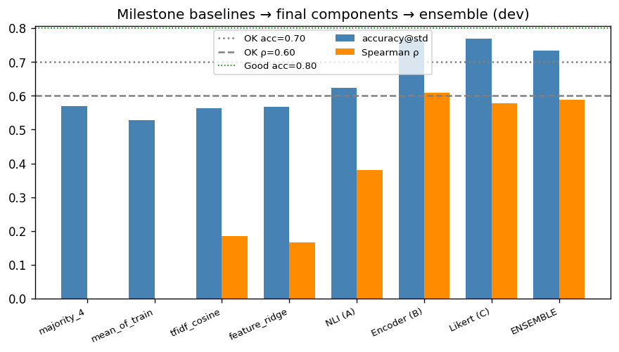
Results — baselines → components → ensemble
Ensemble dev: acc@std 0.733 · ρ +0.588 → Below OK
GroupXX — SemEval-2026 Task 5 (Final)
10 / 16
Notes:
Several-fold Spearman improvement over the best milestone lexical baseline; we clear the rubric's OK bar.

Slide 11
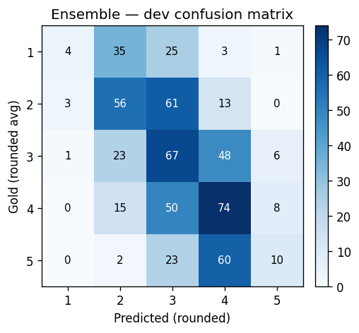
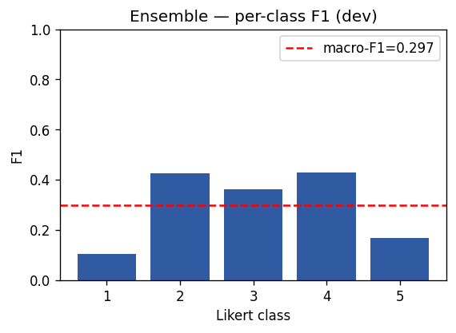
Classification view: confusion & per-class F1
macro-F1 0.297 · macro-P 0.400 · macro-R 0.310 (rounded 5-way view)
GroupXX — SemEval-2026 Task 5 (Final)
11 / 16
Notes:
Rounded to 5 classes for the rubric-required confusion matrix and F1; errors are concentrated on the ambiguous middle ratings.

Slide 12
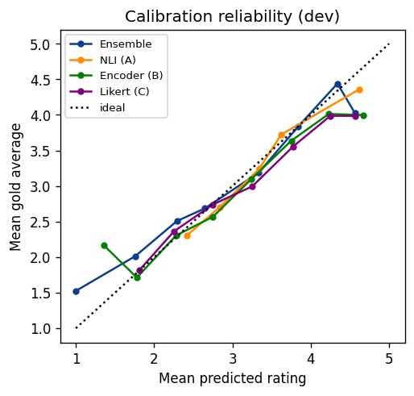
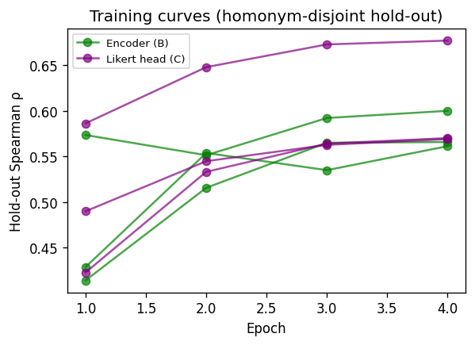
Calibration & training curves
GroupXX — SemEval-2026 Task 5 (Final)
12 / 16
Notes:
Predictions are well-calibrated after isotonic; hold-out Spearman is the early-stopping signal for B and C.

Slide 13
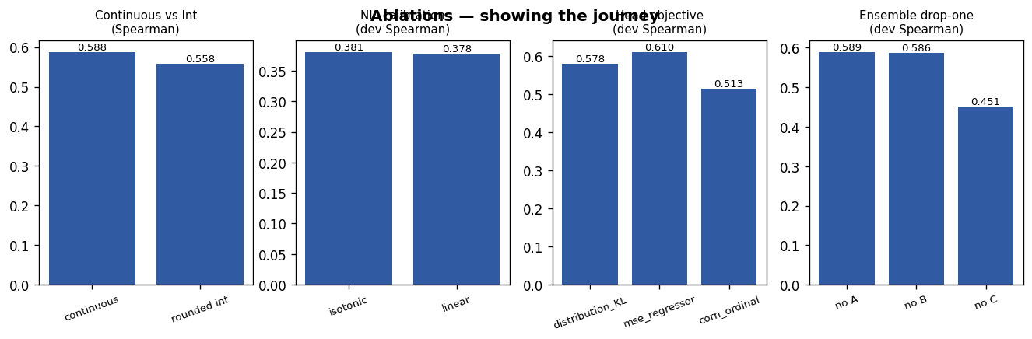
The journey — ablations
continuous-vs-int · NLI calibration · head objective · ensemble drop-one
GroupXX — SemEval-2026 Task 5 (Final)
13 / 16
Notes:
We show what we tried: the continuous-prediction lever, calibration choice, MSE vs CORN vs distribution, and component drop-one.

Slide 14
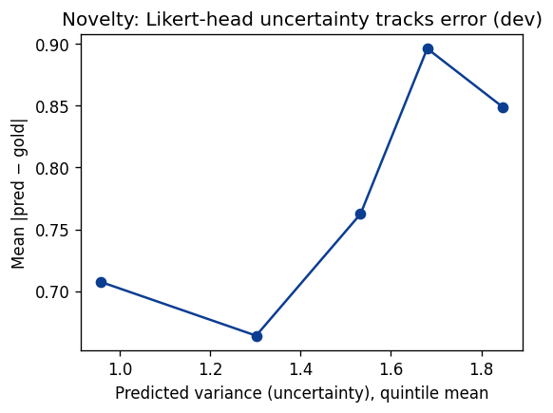
Novelty payoff — uncertainty tracks error
Component C's predicted variance correlates with absolute error — used to gate the ensemble.
GroupXX — SemEval-2026 Task 5 (Final)
14 / 16
Notes:
The distribution head's variance is a meaningful confidence signal, validating the uncertainty-gated ensemble idea.

Slide 15
Related work (cited)
• Pilehvar & Camacho-Collados, WiC — NAACL 2019
• Blevins & Zettlemoyer, gloss-informed biencoders — ACL 2020 (we adapt)
• Yin, Hay & Roth, zero-shot via NLI — EMNLP 2019 (we apply)
• Williams et al., MNLI — NAACL 2018 ; Bowman et al., SNLI — EMNLP 2015
• Devlin et al., BERT — NAACL 2019 ; Reimers & Gurevych, SBERT — EMNLP 2019
• Loureiro & Jorge, LMMS — ACL 2019 ; Brown et al. — NeurIPS 2020
• Cao, Mirjalili & Raschka, rank-consistent ordinal — Pattern Recog. Letters 2020
GroupXX — SemEval-2026 Task 5 (Final)
15 / 16
Notes:
Ten references from allowed venues; we directly re-implement the gloss-informed and zero-shot-via-NLI lines.

Slide 16
Individual contributions & takeaways
Taylan İrak Component A (NLI scorer, hypothesis templates, calibration); Component B (gloss-informed regressor, mean-pooling, LLRD, rank-aligned loss, holdout early stopping, seed averaging); data pipeline and homonym-disjoint split; related-work survey; Methodology, Results and ablation analysis.
Emre Berk Hamarat Component B (gloss-informed regressor): encoder fine-tuning, mean-pooling, layer-wise learning-rate decay (LLRD), rank-aligned loss, and homonym-disjoint training setup.
Ertem Ata Kavaz Component C (novel Likert-distribution head); ensemble calibration; uncertainty-aware prediction; reproducibility and figure pipeline.
Onur Deniz Öğüncü Prompt engineering and experimentation for zero-shot/few-shot inference; retrieval-based example selection; hypothesis-template optimization.
Edes Rıza Çakmak Evaluation and experimental analysis framework: confusion matrices, precision–recall/F1 metrics, ablation studies, uncertainty/error analysis, and visualization of experimental results.
Takeaways:
• Semantic priors + disagreement modelling beat lexical memorisation on a strict split.
• A novel distribution head gives a continuous, uncertainty-aware rating.
• Ensemble: dev acc@std 0.733 / ρ +0.588 — Below OK.
Thank you — questions?
GroupXX — SemEval-2026 Task 5 (Final)
16 / 16
Notes:
Equal split across members; happy to take questions on any component.

