Slide 1
DSP3 Project 2: Additive Synthesizer
A presentation by Nathan Erthal

Slide 2
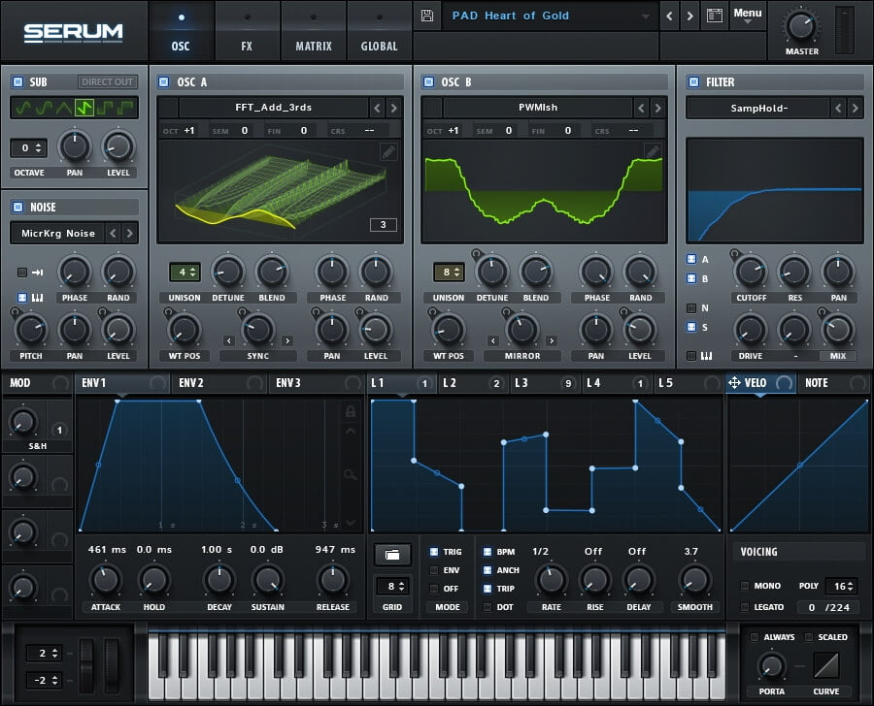
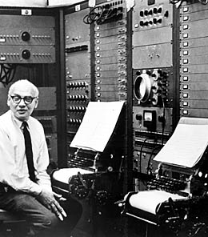
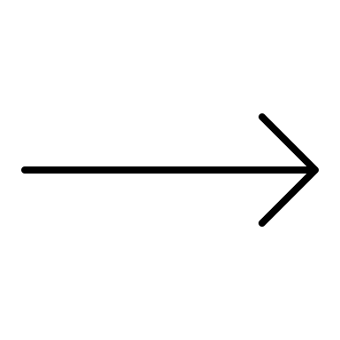
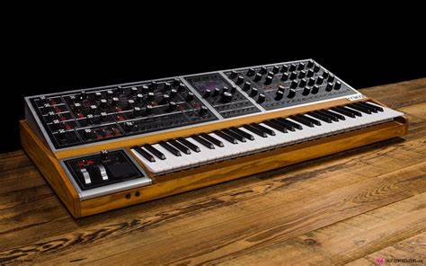
DSP3 Project 1: Tape Delay Plugin
Area of Exploration:
Digital Recreation of musical Instruments
In this case a synthesizer
Originally sound synthesizers were analog, and now are commonly used digitally

Slide 3
DSP3 Project 1: Tape Delay Plugin
Tool for execution:
A Synthesizer is composed of a collection of oscillators
These oscillators can very from different wave shapes such as:
Sine
Triangle
Square
Sawtooth

Slide 4
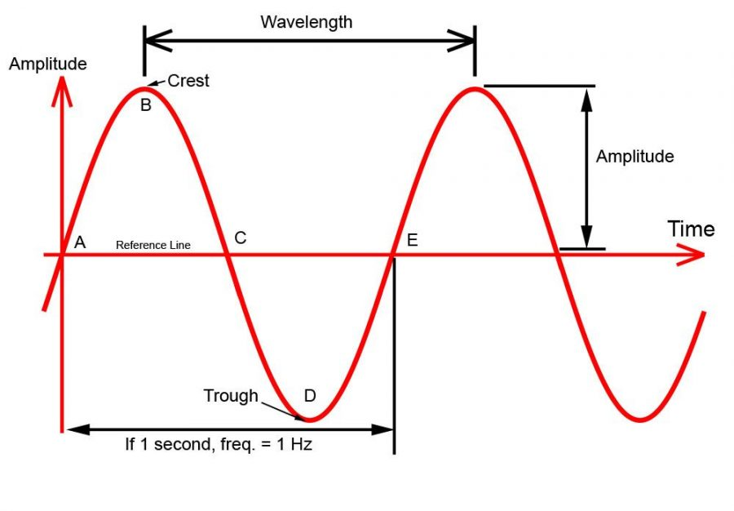
DSP3 Project 1: Tape Delay Plugin
An example Oscillator:
Sine wave:
Digitally represented as:
Sin ( 2 * pi * f * t )
Where:
f is your frequency of oscillation (Hz)
t is your time variable
In our digital representation, t gets incremented each sample.
The amount of increment is dependent on our sample rate:
t increment = 1 / (sample rate)

Slide 5
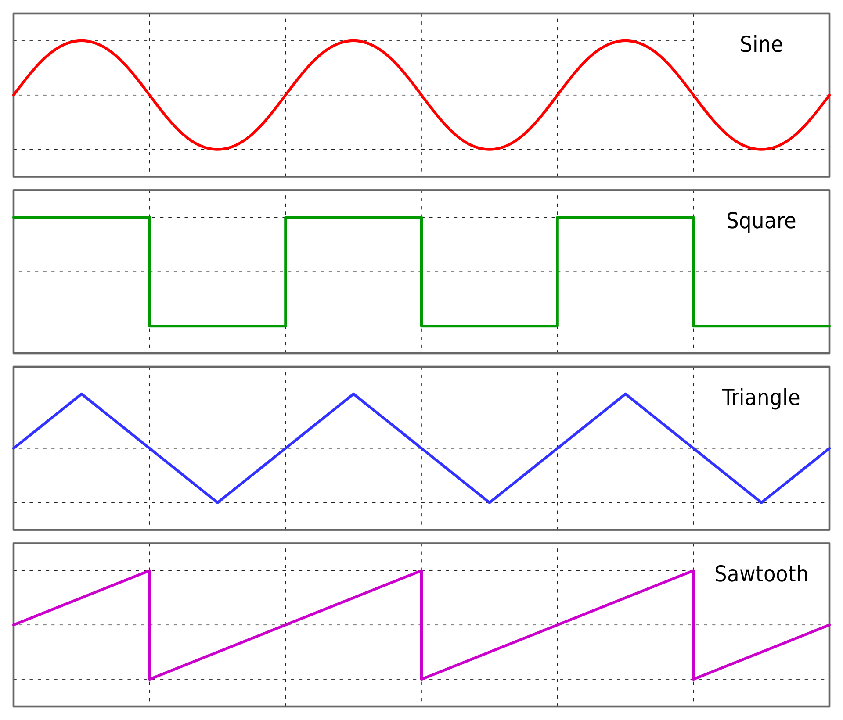
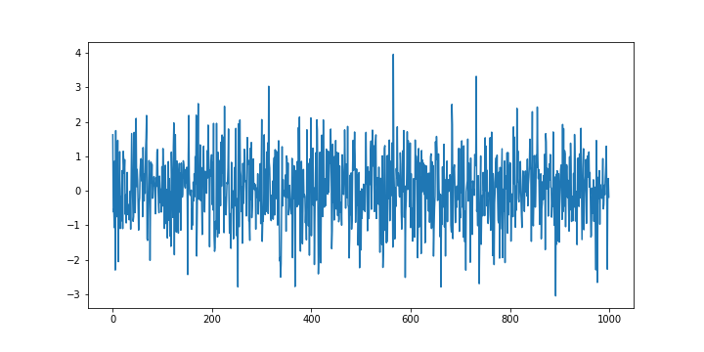
DSP3 Project 1: Tape Delay Plugin
Other types of oscillators:
Square wave:
1 if sine wave is positive,
-1 if sine wave is negative
Triangle wave:
(2 / pi) * Asin( sin( 2 * pi * f * t )
Sawtooth wave:
2 * f * t -1
White noise:
Generate any random value from -1 to 1

Slide 6
DSP3 Project 1: Tape Delay Plugin
Effects for our synth:
Frequency modulation
Pitch shifting
Pitch gliding

Slide 7
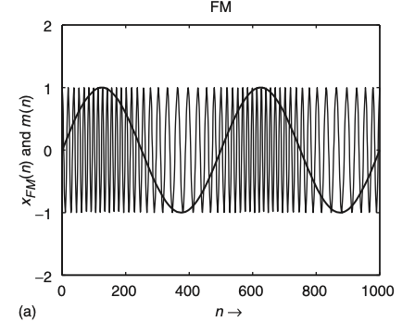
DSP3 Project 1: Tape Delay Plugin
LFO (Low Frequency Oscillator):
We don’t only have to use the output of an oscillator to be our audio. We can also use them as other variables within our system.
We can use the output of this oscillator to modulate the frequency of our audio-generating oscillators
As the name suggests, the frequency for this can be anywhere from a fraction of 1Hz up to 20Hz, and can be any shape we choose ie a sine wave
Our LFO frequency parameter will determine how fast we are modulating our pitch
Our LFO amplitude parameter will determine how much we are modulating our pitch

Slide 8
DSP3 Project 1: Tape Delay Plugin
Pitch shifting:
What if while playing the same note, we want to set different pitch values to different oscillators?
We can have a parameter for this effect that determines how many half steps we want to shift our note up/down by.
function mult = halfStepToFreqMultiplyer(halfSteps)
if (halfSteps>0)
mult = 1+(1/12)*halfSteps;
else
mult = 1+(0.04166666667*halfSteps);
end
end

Slide 9



DSP3 Project 1: Tape Delay Plugin
Pitch shifting:
What if while playing the same note, we want to set different pitch values to different oscillators?
We can have a parameter for this effect to determine how many half steps to shift our note up/down by.
This function takes in our number of half-steps (can be -12 to 12, from one octave lower to one octave higher)
Outputs a variable to use as our multiplier for our current oscillator frequency.
float halfStepToFreqMult(int halfSteps)
{
if (halfSteps > 0)
return 1 + (1/12) * halfSteps;
else
return 1 + (0.04166666667 * halfSteps);
}

Slide 10
DSP3 Project 1: Tape Delay Plugin
Pitch gliding:
void setTargetValue(float targetValue){
this->targetValue = targetValue;
if (timeInSamples==0)
{
step = 0;
currentValue=targetValue;
}
else
step = (targetValue - currentValue) / (timeInSamples);
}
float getNextValue(){
if ( currentValue != targetValue )
currentValue += step;
return currentValue;
}
When playing a new note, how can I have my oscillator’s frequency slowly approach the new one, making a glide effect?
We can achieve this effect by linear interpolation from our current frequency to our target frequency at speed of “glide time” set by the user:
timeInSamples = glideTime * sampleRate

Slide 11
DSP3 Project 1: Tape Delay Plugin
With all these tools,
We can now put together an additive synth by summing outputs of different oscillators and applying our effects!…

Slide 12
DSP3 Project 1: Tape Delay Plugin
But first …why?

Slide 13



DSP3 Project 1: Tape Delay Plugin
Question:
Why would any producer/musician want to use an additive synthesizer?
Answer:
For starters, synthesizers are obviously another way to allow users to express their musical expressions with an instrument.
Not only does the synthesizer allow the user to play notes, melodies, chords, etc.…
It also grants the user the ability to shape the sound being generated from the instrument, allowing a whole new factor of musical expression.

Slide 14
Code Walkthrough for MATLAB
then
C++ with JUCE implementation

Slide 15
User feedback:
Kartik:
Make GUI overall more intuitive (Has been revised post presentation)
Good sounds, features
Aiman:
Have Half-steps shown as the value for pitch-shift
Have presets
Stefan:
Maybe have a modulator for each oscillator
Instead of having to bring the volume down to 0, have an oscillator option of None

Slide 16
Future plans:
Modify plugin structure to work as a wavetable synth, instead of generating values from sin functions each sample
Add filters
Add ADSR
Add a chorus

