Slide 1
Final Project
Eric Tran

Slide 2
Final Project
Eric Tran

Slide 3
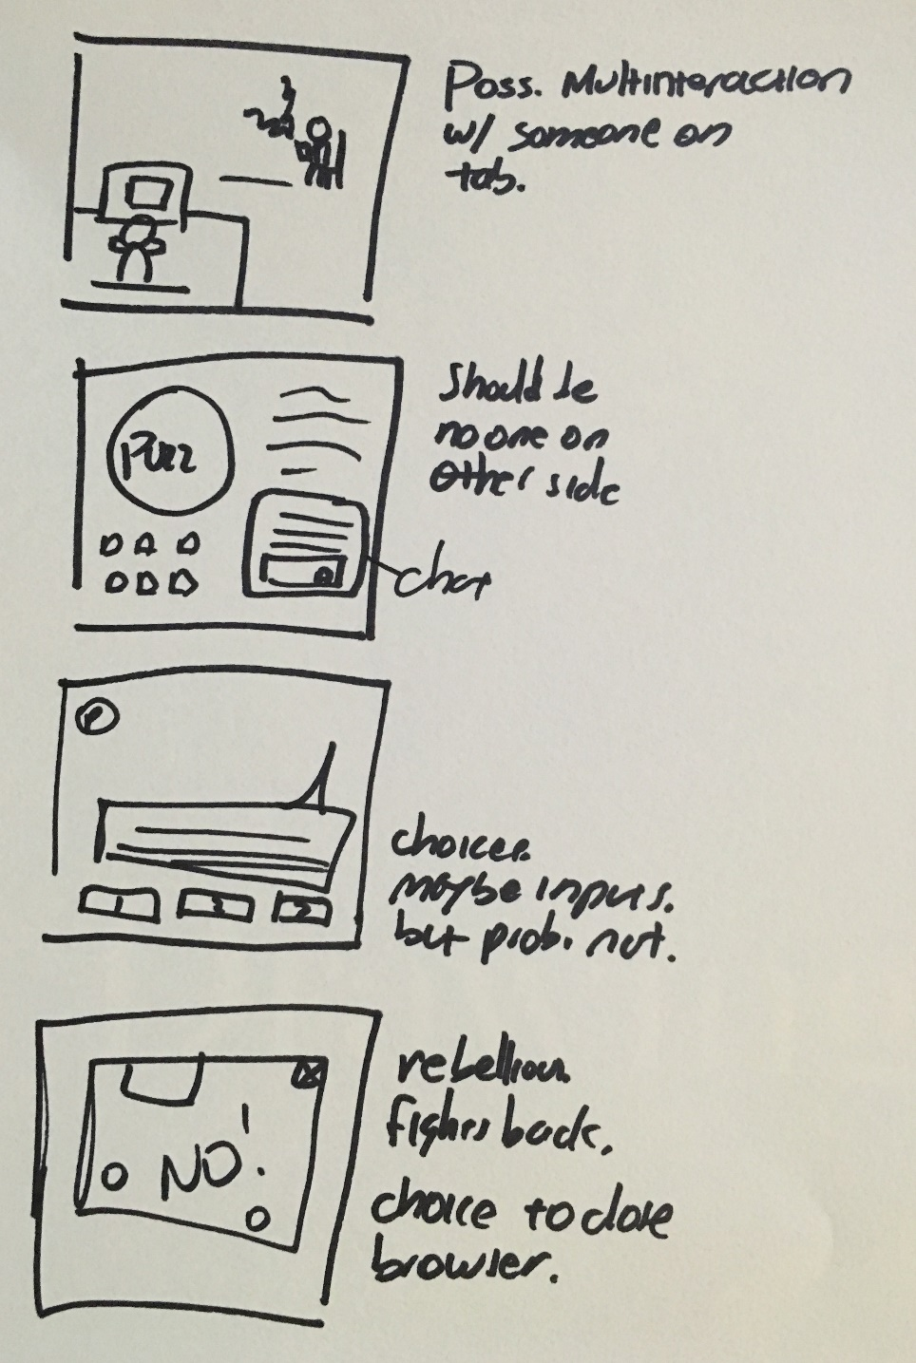
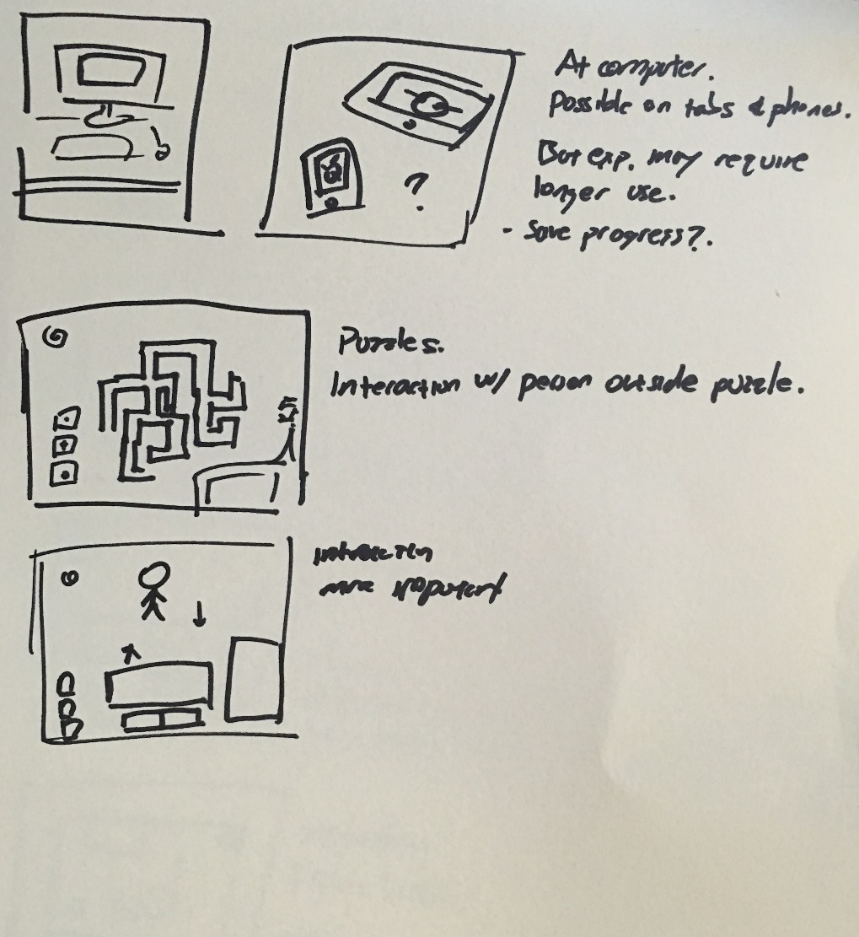

Slide 4
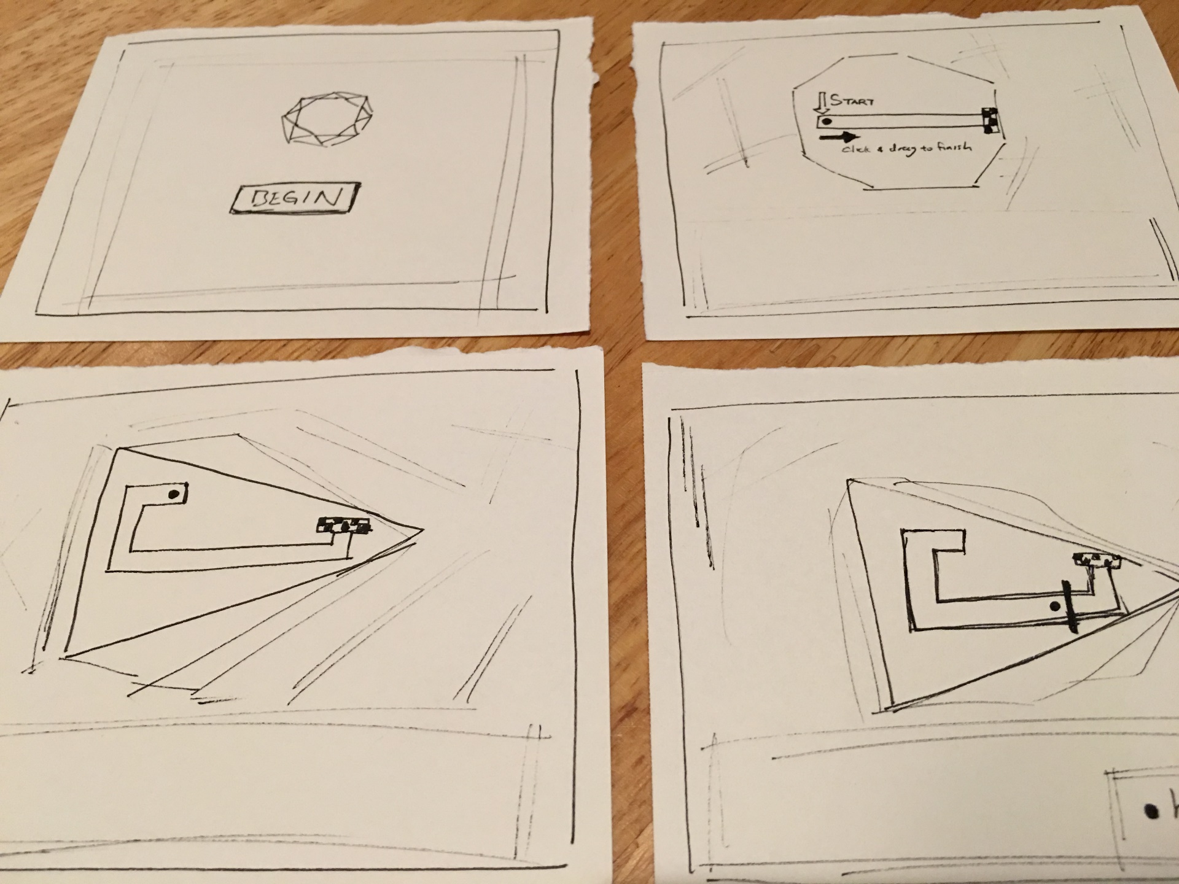
Final Project
Eric Tran

Slide 5


