Slide 1
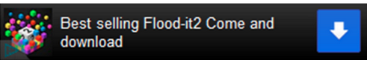
BACCARAT
CRACKER
START
Tutorial

Slide 2




168
Cards Left: 432
A 2 3 4 5 6 7 8 9 10 J Q K
Predict:
Banker:
Player:
0
Banker
Player
Tie
pair
A
2
3
C
4
5
6
_
7
8
9
Undo
10
J
Calc
Q
K

Slide 3
168
Cards Left: 432
A 2 3 4 5 6 7 8 9 10 J Q K
Initial Game
Choose the first jump card
Predict:
Banker:
Player:
0
Banker
Player
Tie
pair
A
2
3
4
5
6
7
8
9
10
A
2
3
C
J
Q
K
4
5
6
_
7
8
9
Undo
10
J
Calc
Q
K

Slide 4
168
Cards Left: 432
A 2 3 4 5 6 7 8 9 10 J Q K
Predict:
Banker:
5.3
A
J
2.4
Player:
0
Banker
Player
Tie
pair
2
Q
10
-3.5
-7.4
A
2
3
C
4
5
6
_
7
8
9
Undo
10
J
Calc
Q
K

Slide 5

Setting
Deck Number: 8
The gain by win with every 100$ bet
Banker: 100:95
Player: 100:100
Tie: 100:800
Pair 100:1200
Casino portion per every 100$ bet
Choushui: 100:20
Casino portion per bet
Choushui: $20

Slide 6


Statistics
Player:34 Banker:13 Tie:3 Pair:6
✖ | ✔ | ✖
✔ | ✖ | ✖
✔ | ○ | ✔
 | ✔ | ✖
 |  | ✔
Big Eye Road
Small Road
Cockroach Road

Slide 7
Store
168
Free
7777
777
$6666.66
$699.99
77
7
$82.88
$8.88

Slide 8
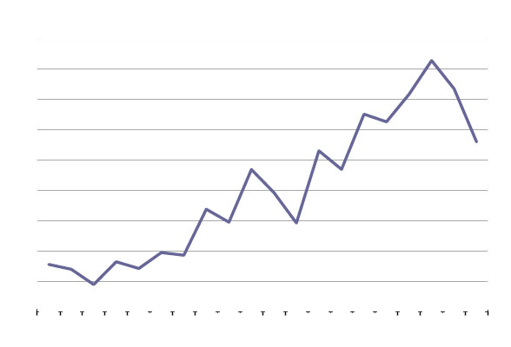
Statistics
Player Win |  | Banker Win
Tie Win |  | Pair Win
Player Win % |  | Banker Win
Tie Win % |  | Pair Win %
Total Game |  | Predict Gain
Predict Accuracy

