Slide 1
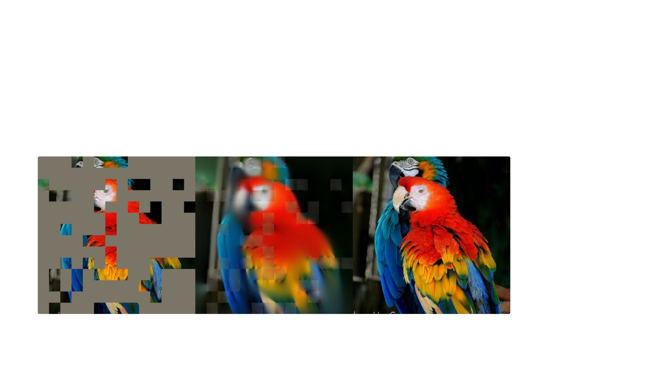
Masked Autoencoders Are Scalable Vision
Learners
Kaiming He, Xinlei Chen, Saining Xie, Yanghao Li, Piotr Dollár, Ross Girshick
Facebook AI Research, CVPR 2022
An ImageNet validation image with 75 percent of the patches removed, the MAE reconstruction, and the original. Figure 10 in the paper.
Ertugrul Senturk · University of Rochester · September 2026

Slide 2
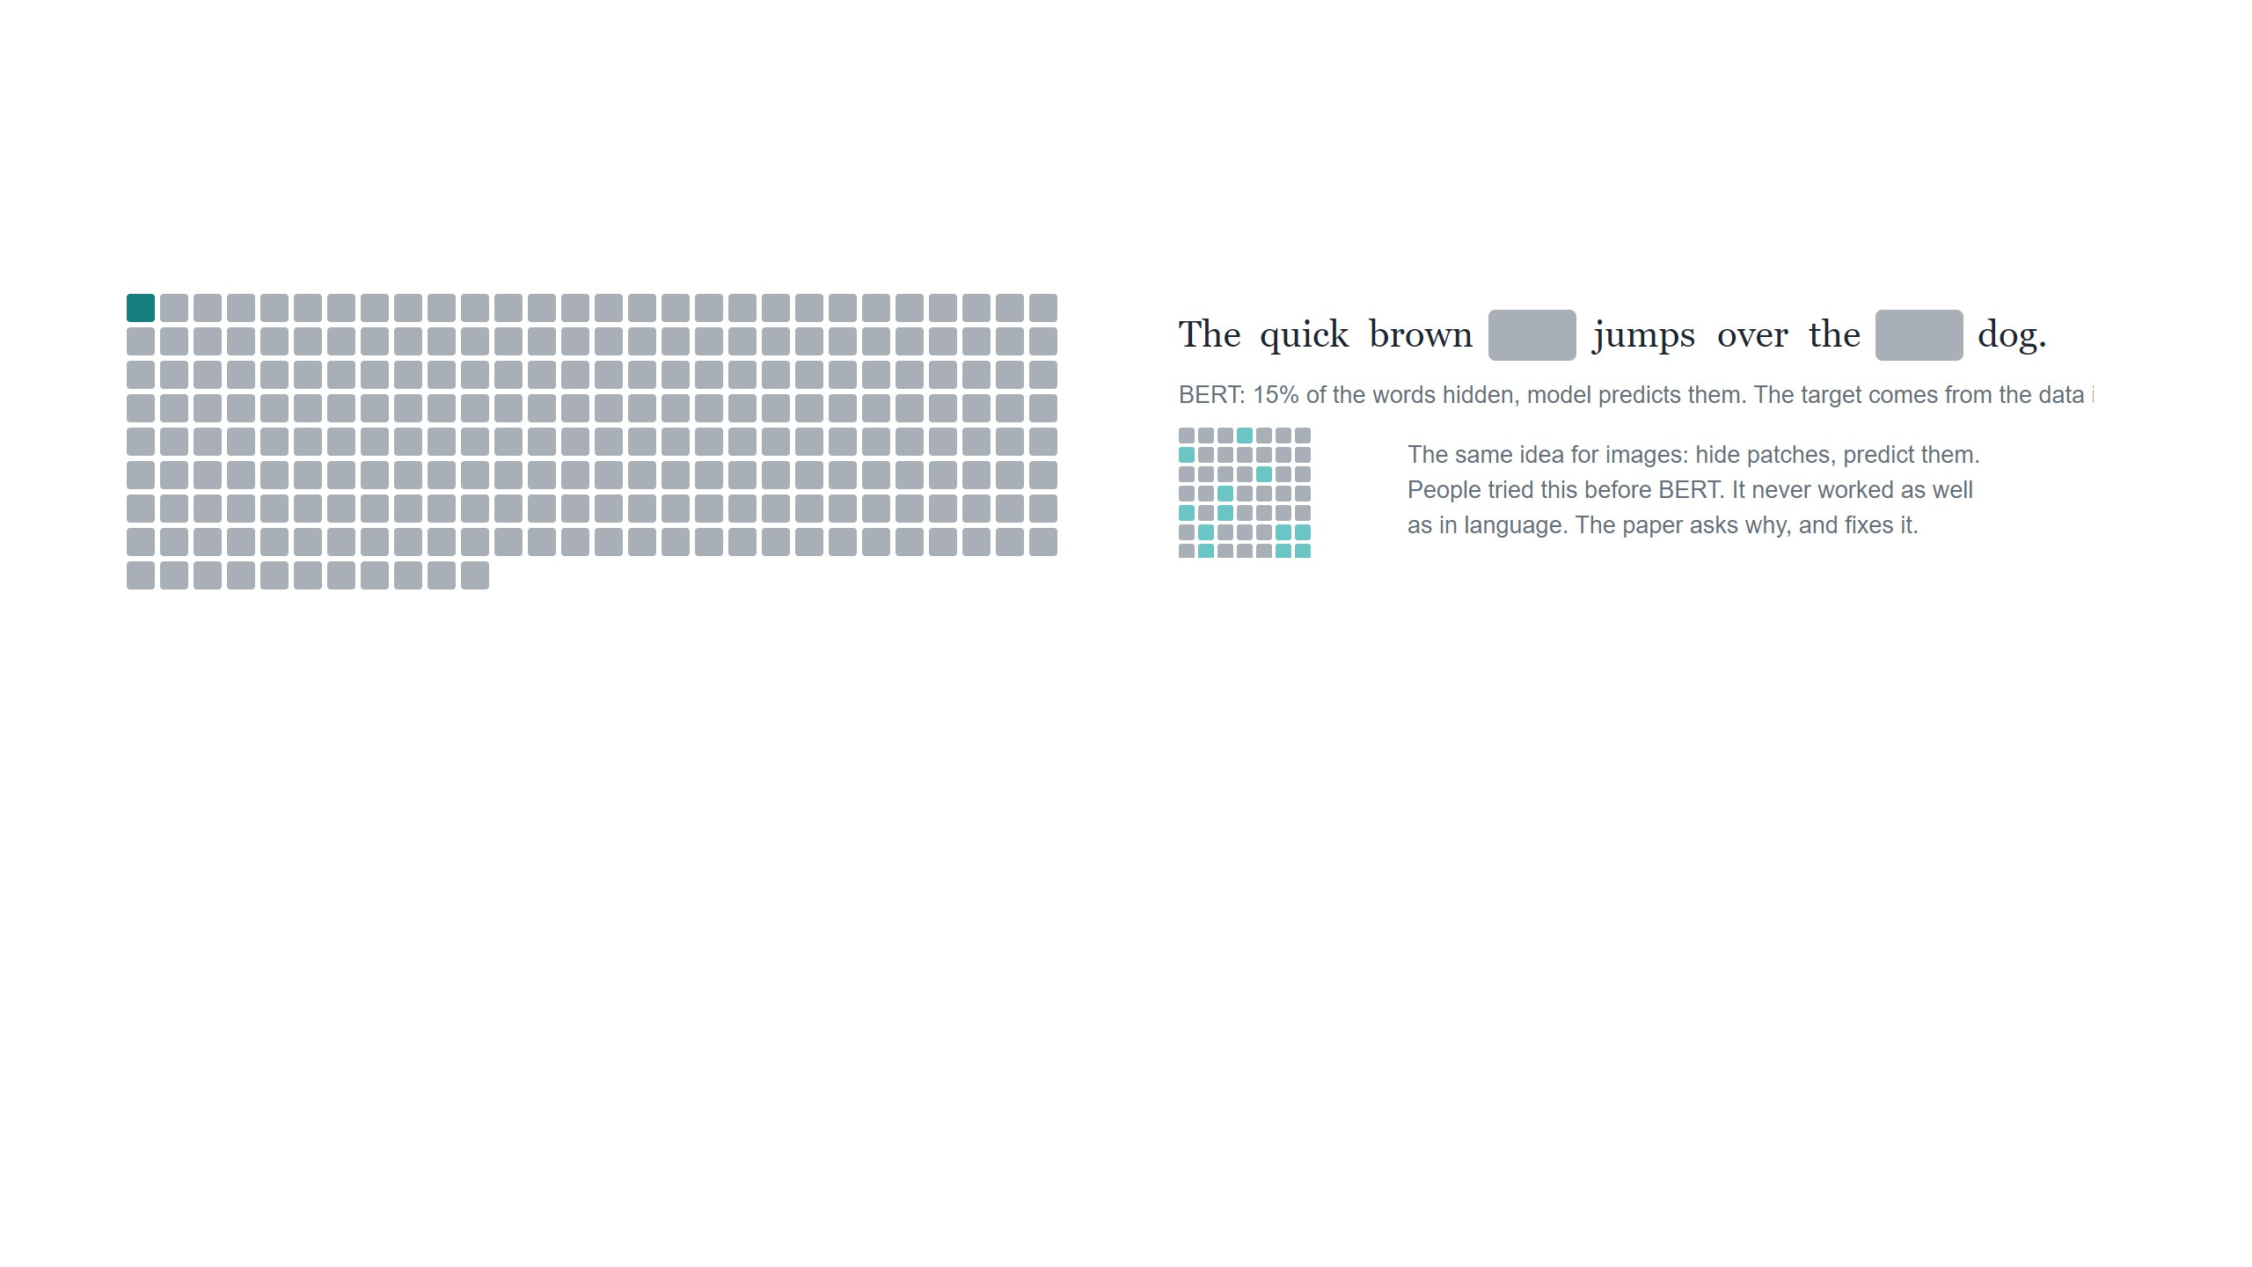
The problem, and an idea from language
Labels are the bottleneck
Hide part of the data, predict it
Each square is 1.28 million labeled images. Teal: ImageNet-1K, public. Gray: JFT-300M,
Google-internal, used to pretrain ViT.
No one writes a label for a hidden word. Predicting it turns
out to require understanding the sentence, and that
understanding transfers to every downstream task. GPT and
BERT scale to hundreds of billions of parameters this way.
ViT-Large is big enough to memorize ImageNet. Trained
from scratch on it, it overfits and lands below a ResNet. It
only works well after pretraining on JFT-300M, which nobody
else has. The question is whether ImageNet alone can be
enough, without any extra labels.
2 / 17

Slide 3
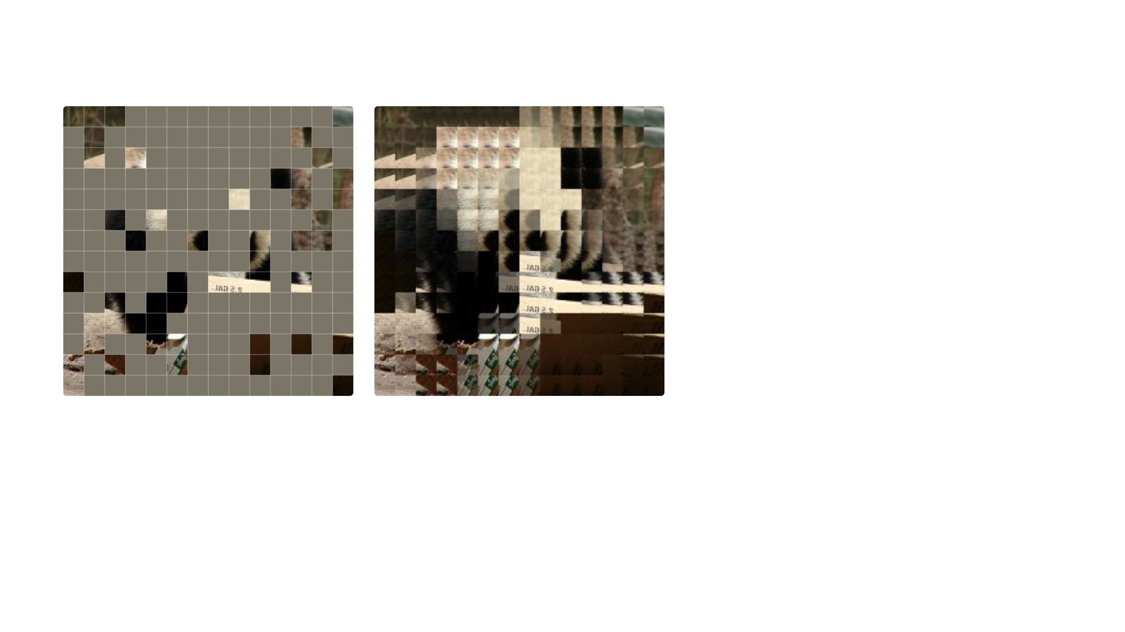
Why hide 75 percent of the image?
Images are redundant. At BERT's 15 percent
every hidden patch has visible neighbors, and
simply averaging them already gives the picture
back. A network trained on that task learns to
average.
At 75 percent averaging gives a smear. To fill
these gaps you have to know what a train looks
like. That is the paper's argument for masking
most of the image, and its explanation for why
earlier work with 20 to 50 percent masking got
weak features.
what the network is given
what averaging the visible neighbors recovers, no
learning involved
masking ratio
patches the encoder sees
75%
49of 196
Masking ratio 75 percent, patches chosen at random.
encoder cost vs. full image
masked patches with no visible
neighbor
24% of FLOPs
58of 147
3 / 17

Slide 4
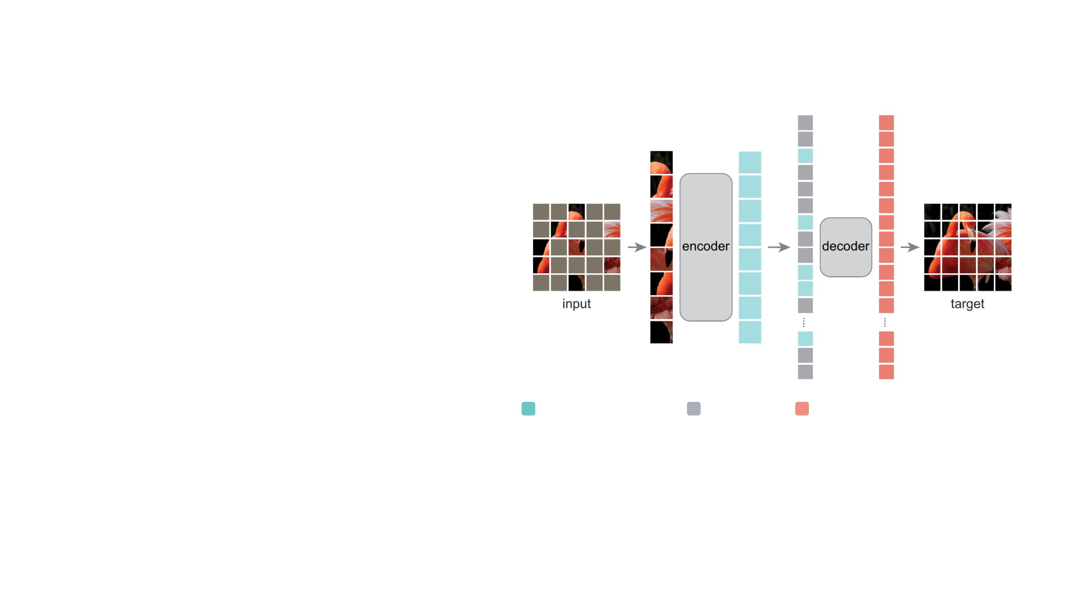
Architecture
The image is split into a 14 × 14 grid, 196 patches. 147 of
them are removed at random. The encoder, a normal ViT,
gets only the 49 that remain.
The decoder gets the encoder output plus a mask token at
each of the 147 missing positions, and predicts the missing
pixels. The pixel error is the only training signal.
After pretraining the decoder is dropped. The encoder is
used on full images for recognition.
Two choices make this work: the encoder never sees a
mask token, which keeps it cheap, and the masking ratio is
high, which keeps the task hard.
encoded visible patch
mask token
reconstructed patch
Figure 1 in the paper. These three colors are used the same way on every slide.
4 / 17

Slide 5
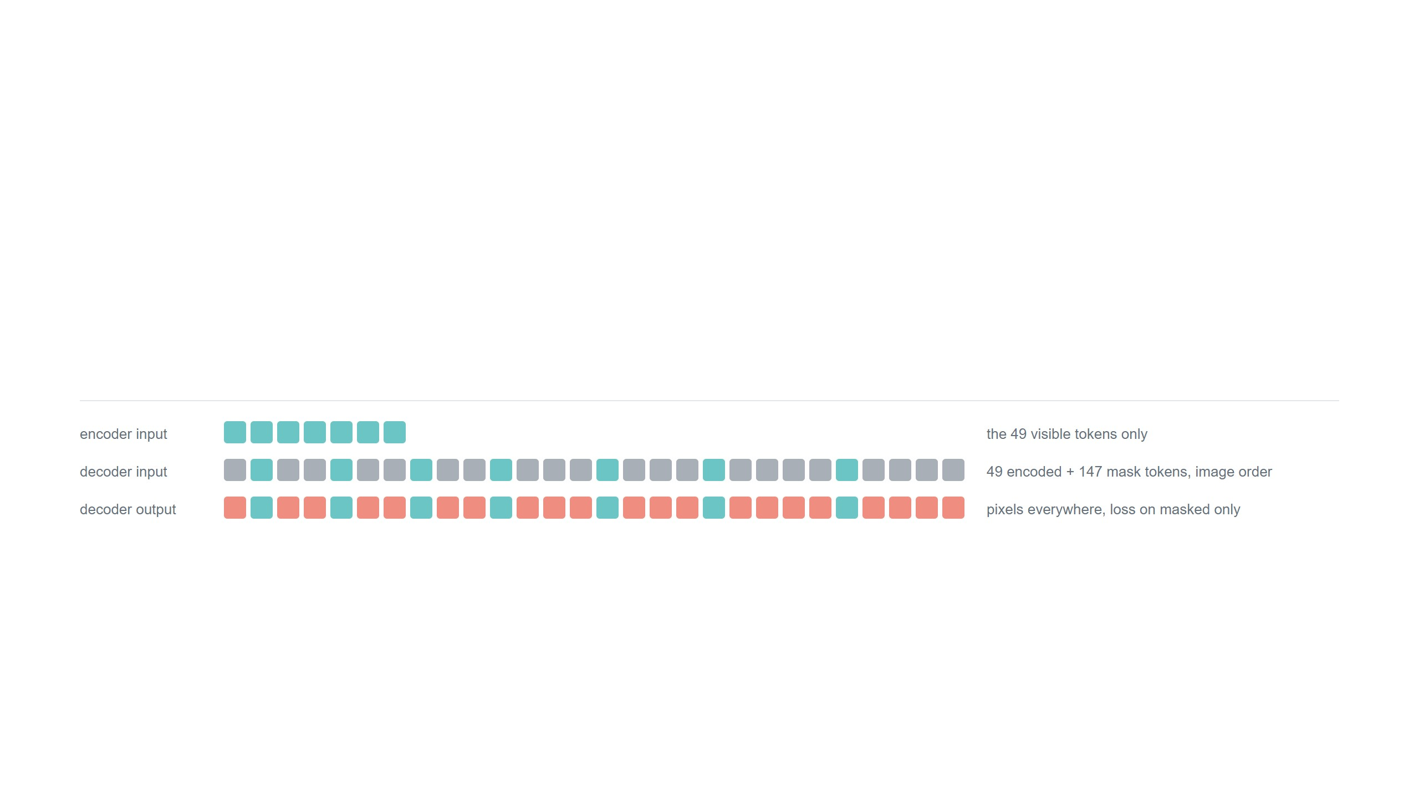
Encoder and decoder
Encoder: the large ViT, 24 blocks, width 1024
Decoder: 8 blocks, width 512, under 10% of the
encoder's compute per token
Only the 49 visible patches go in, each with its positional
embedding. Attention compares every token with every other, so
its cost grows with the square of the sequence length. A quarter
of the tokens costs much less than a quarter of the compute.
It turns the encoder output into pixels. If it were large it could do
the understanding itself and the encoder could stay lazy. Kept
small, it pushes the work into the encoder, which is the part we
keep.
5 / 17

Slide 6
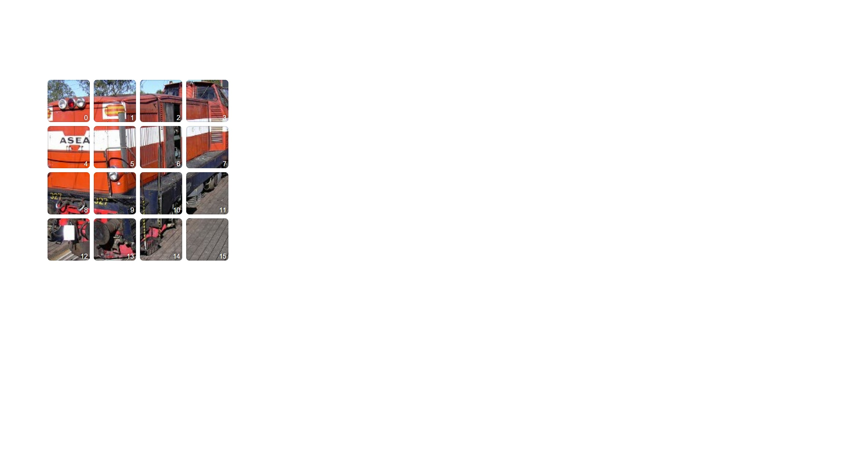
Implementation
the image as 4 × 4 patches, for illustration
0
Each patch becomes a token: a linear projection plus a positional embedding. 16 patches shown instead of 196.
6 / 17

Slide 7
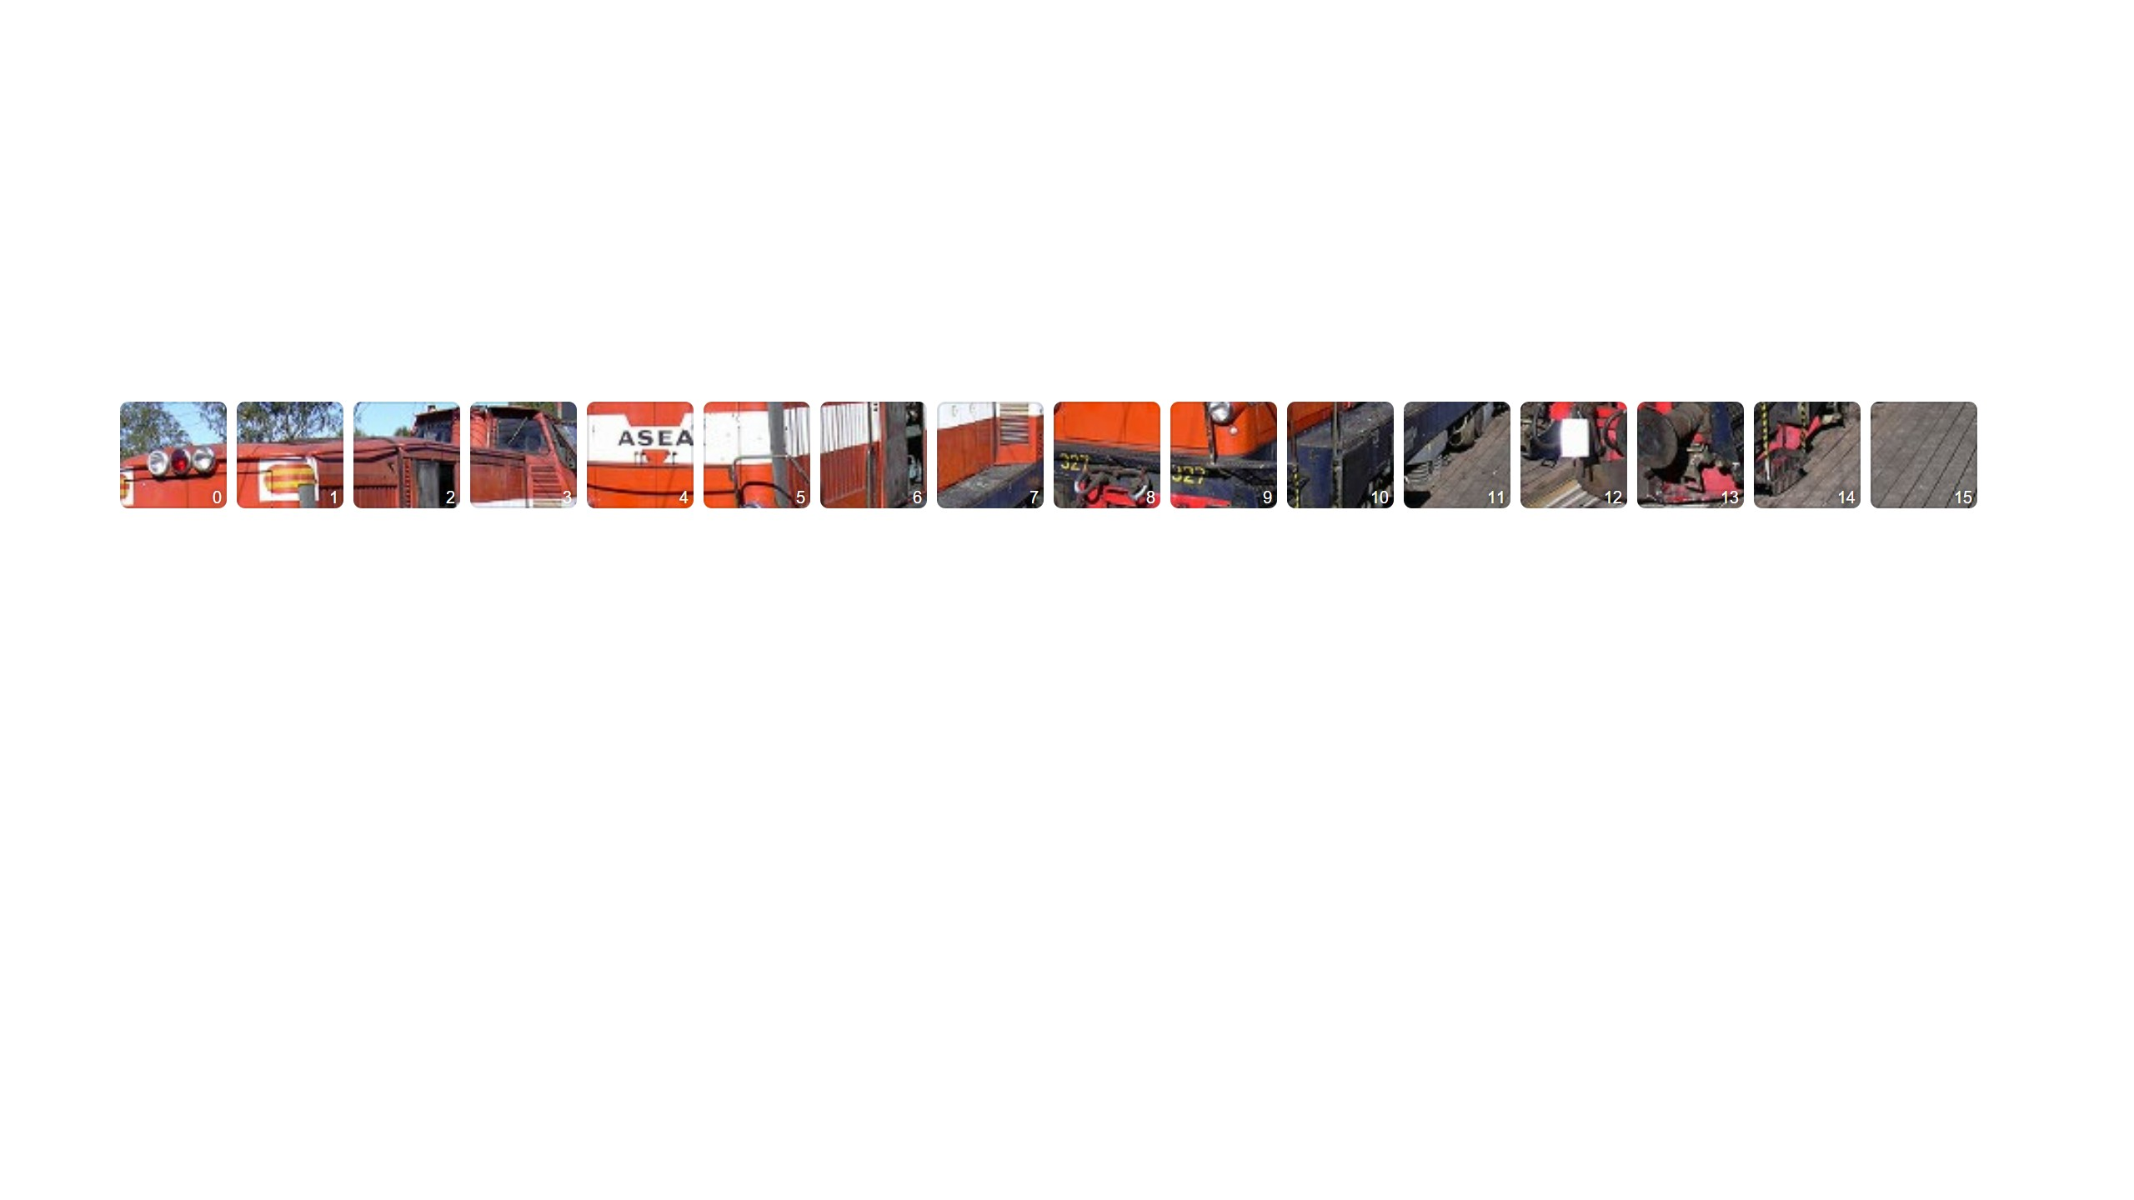
Implementation
1
The tokens form a list, in natural order.
6 / 17

Slide 8
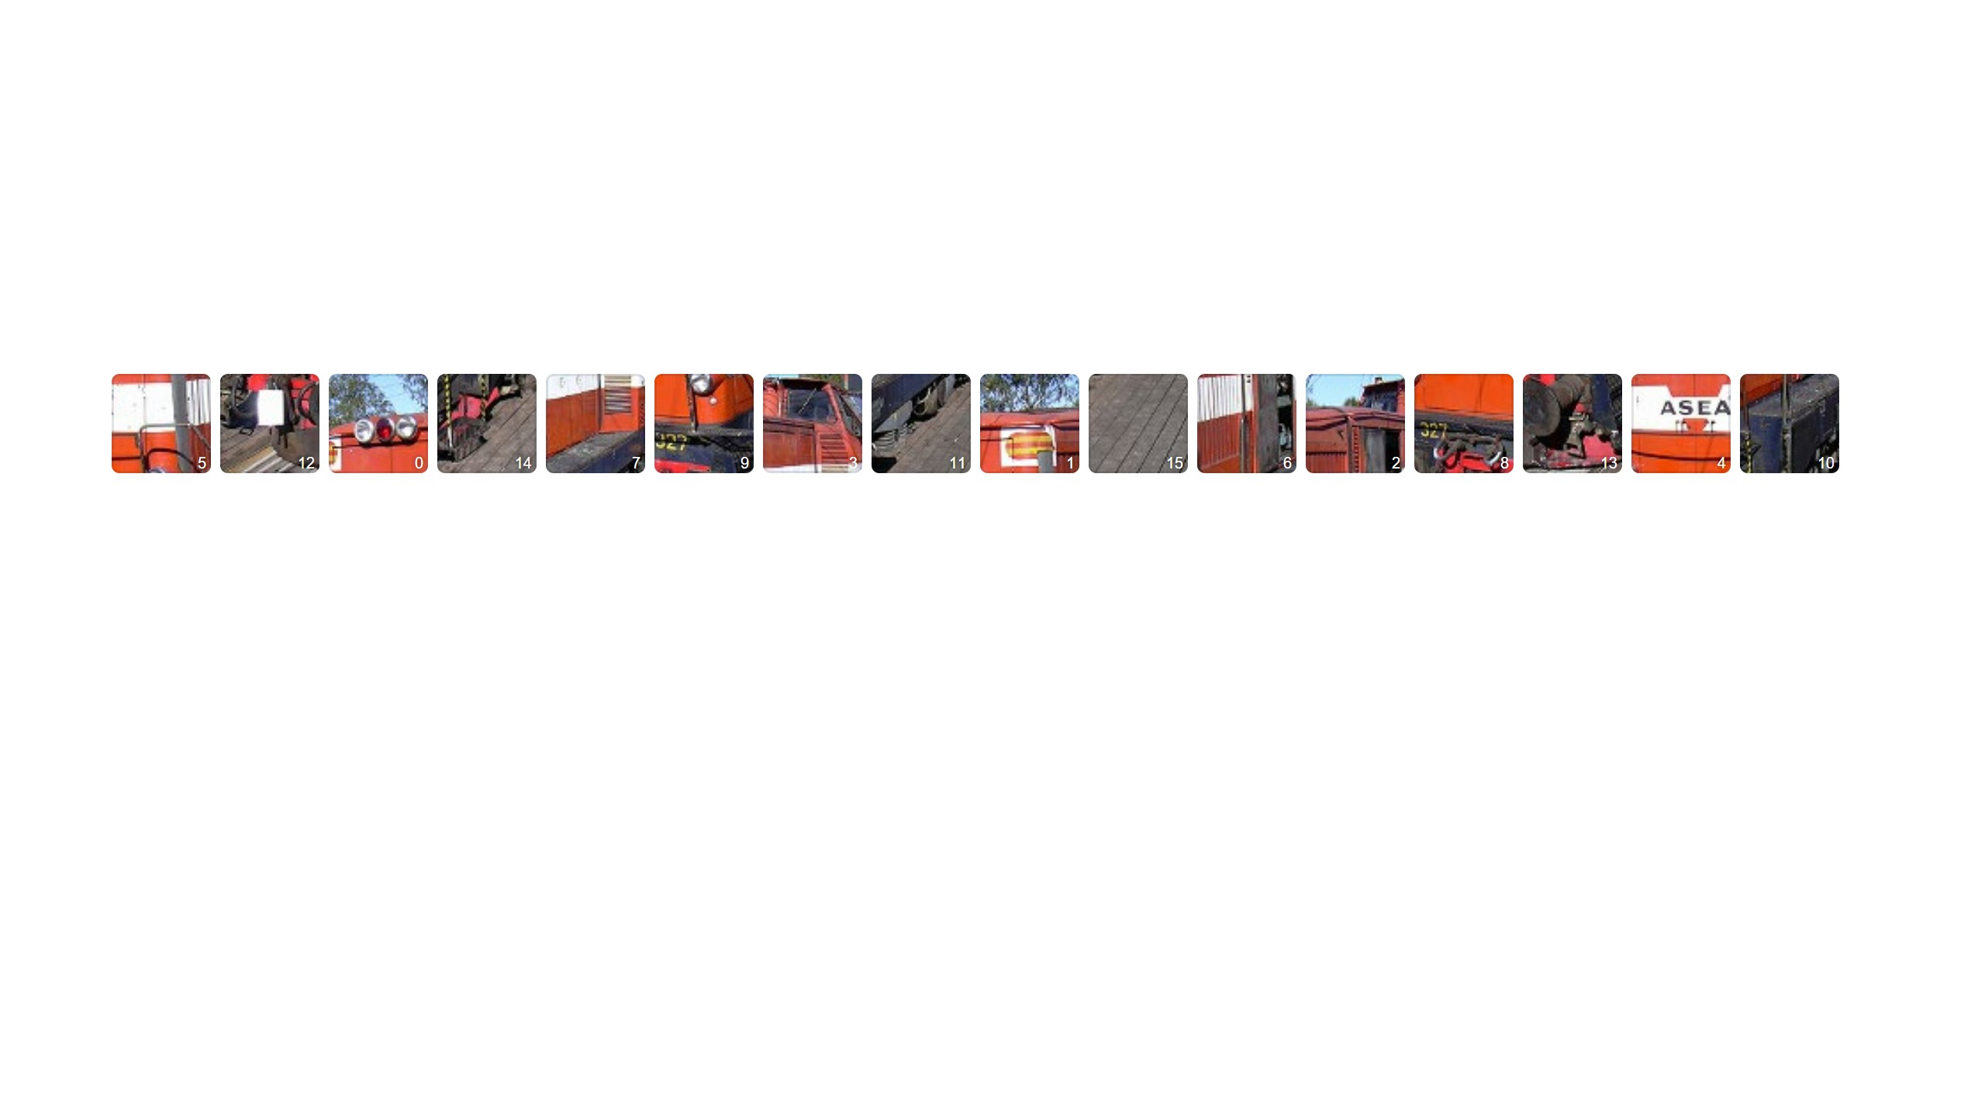
Implementation
2
Shuffle the list randomly and remember the permutation.
6 / 17

Slide 9
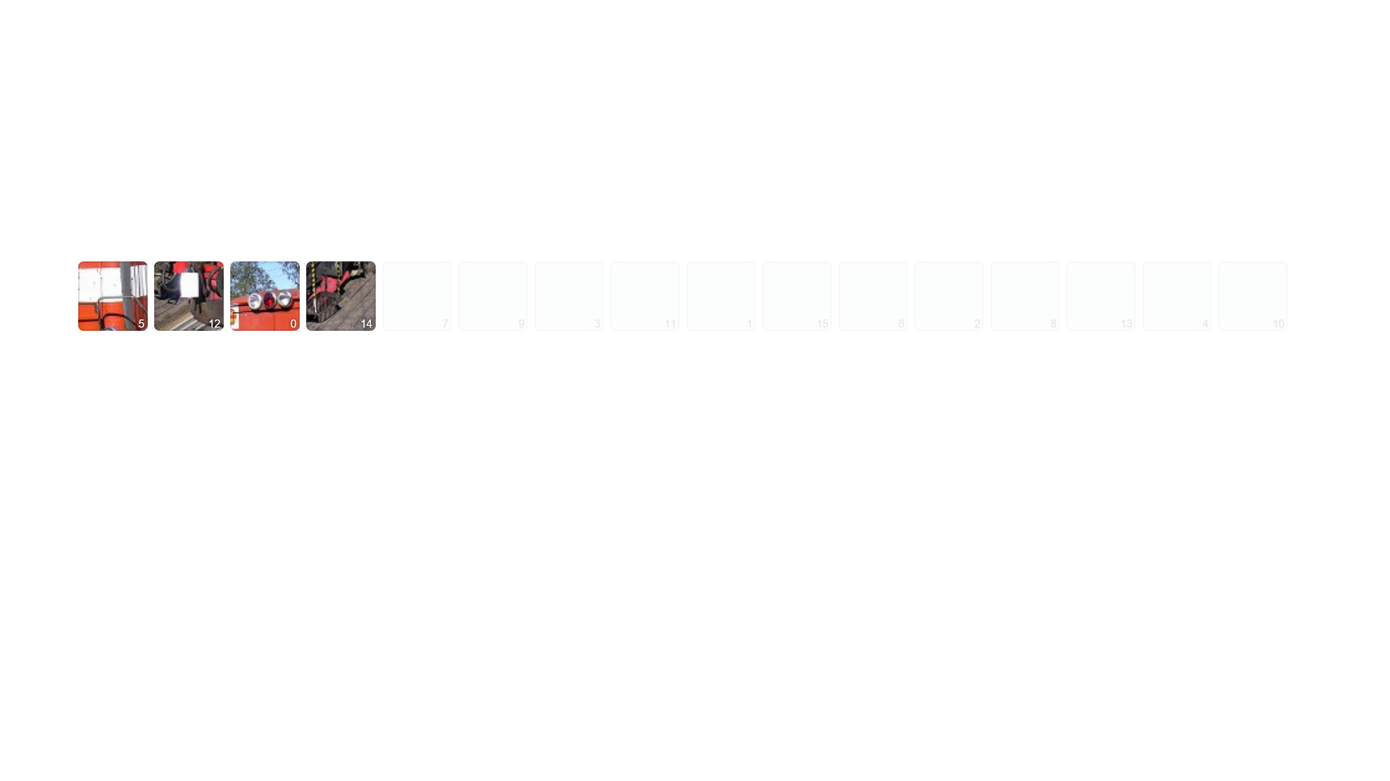
Implementation
3
Drop the last 75 percent. The first quarter of a random permutation is a uniform sample without replacement.
6 / 17

Slide 10
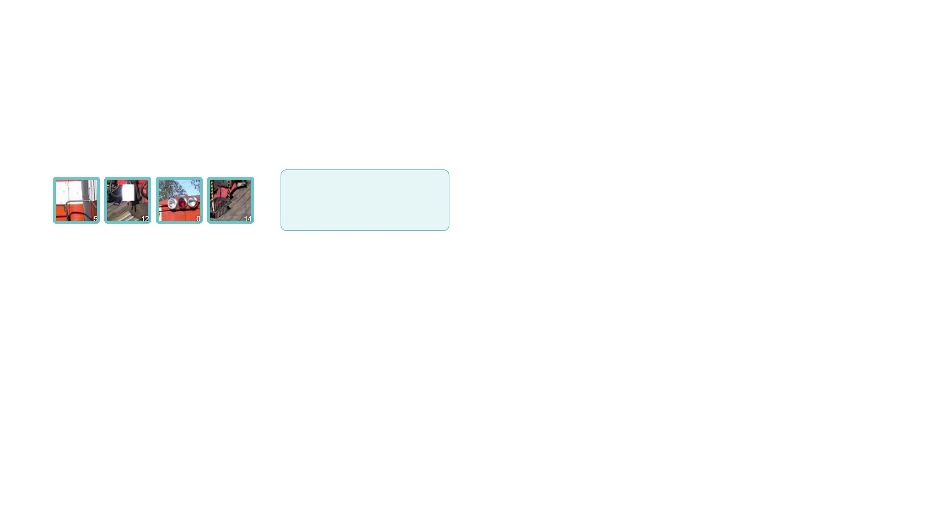
Implementation
encoder, a standard ViT
4
Encode what is left. Four times fewer tokens, roughly sixteen times less attention compute.
6 / 17

Slide 11
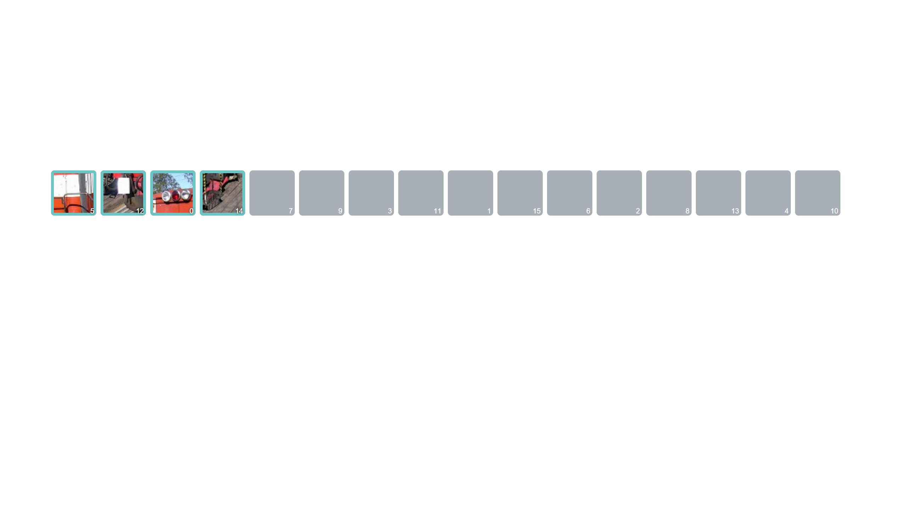
Implementation
5
Append mask tokens, all copies of one learned vector, to get the full length back.
6 / 17

Slide 12
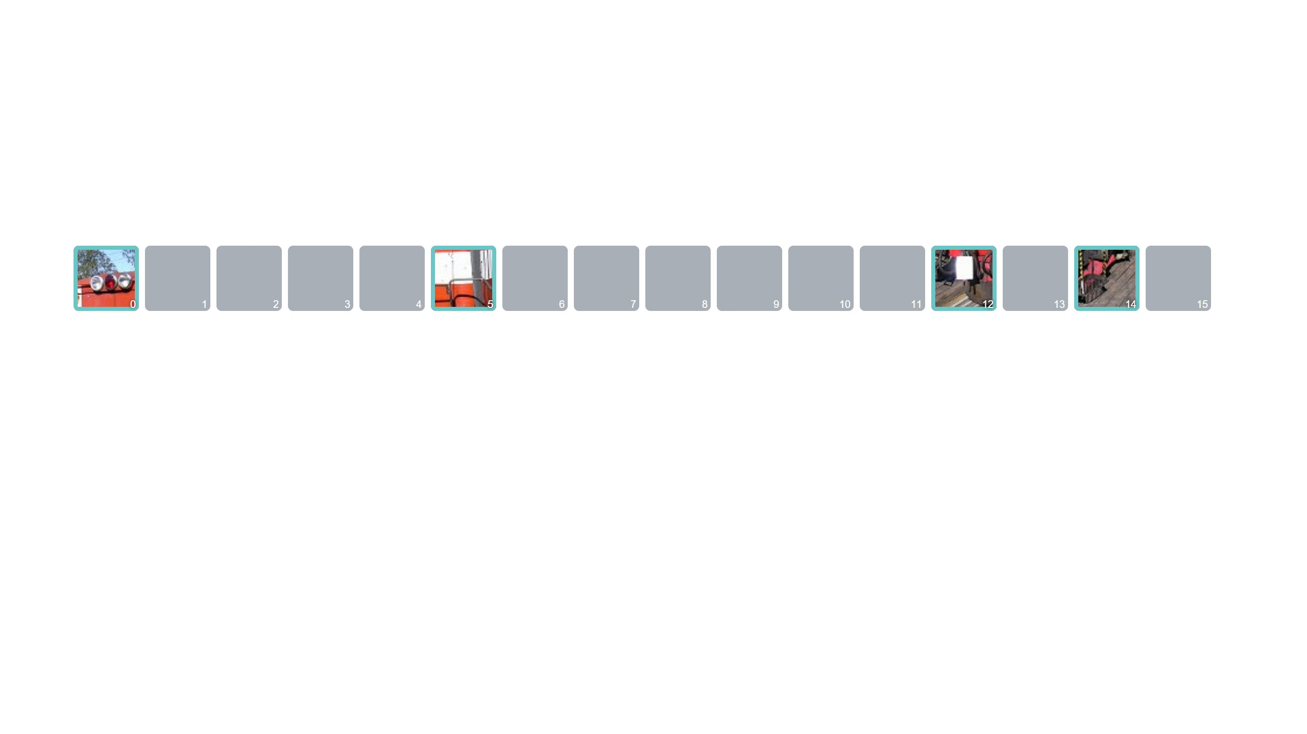
Implementation
6
Unshuffle with the inverse permutation. Every token is back at its true position. Add positional embeddings.
6 / 17

Slide 13
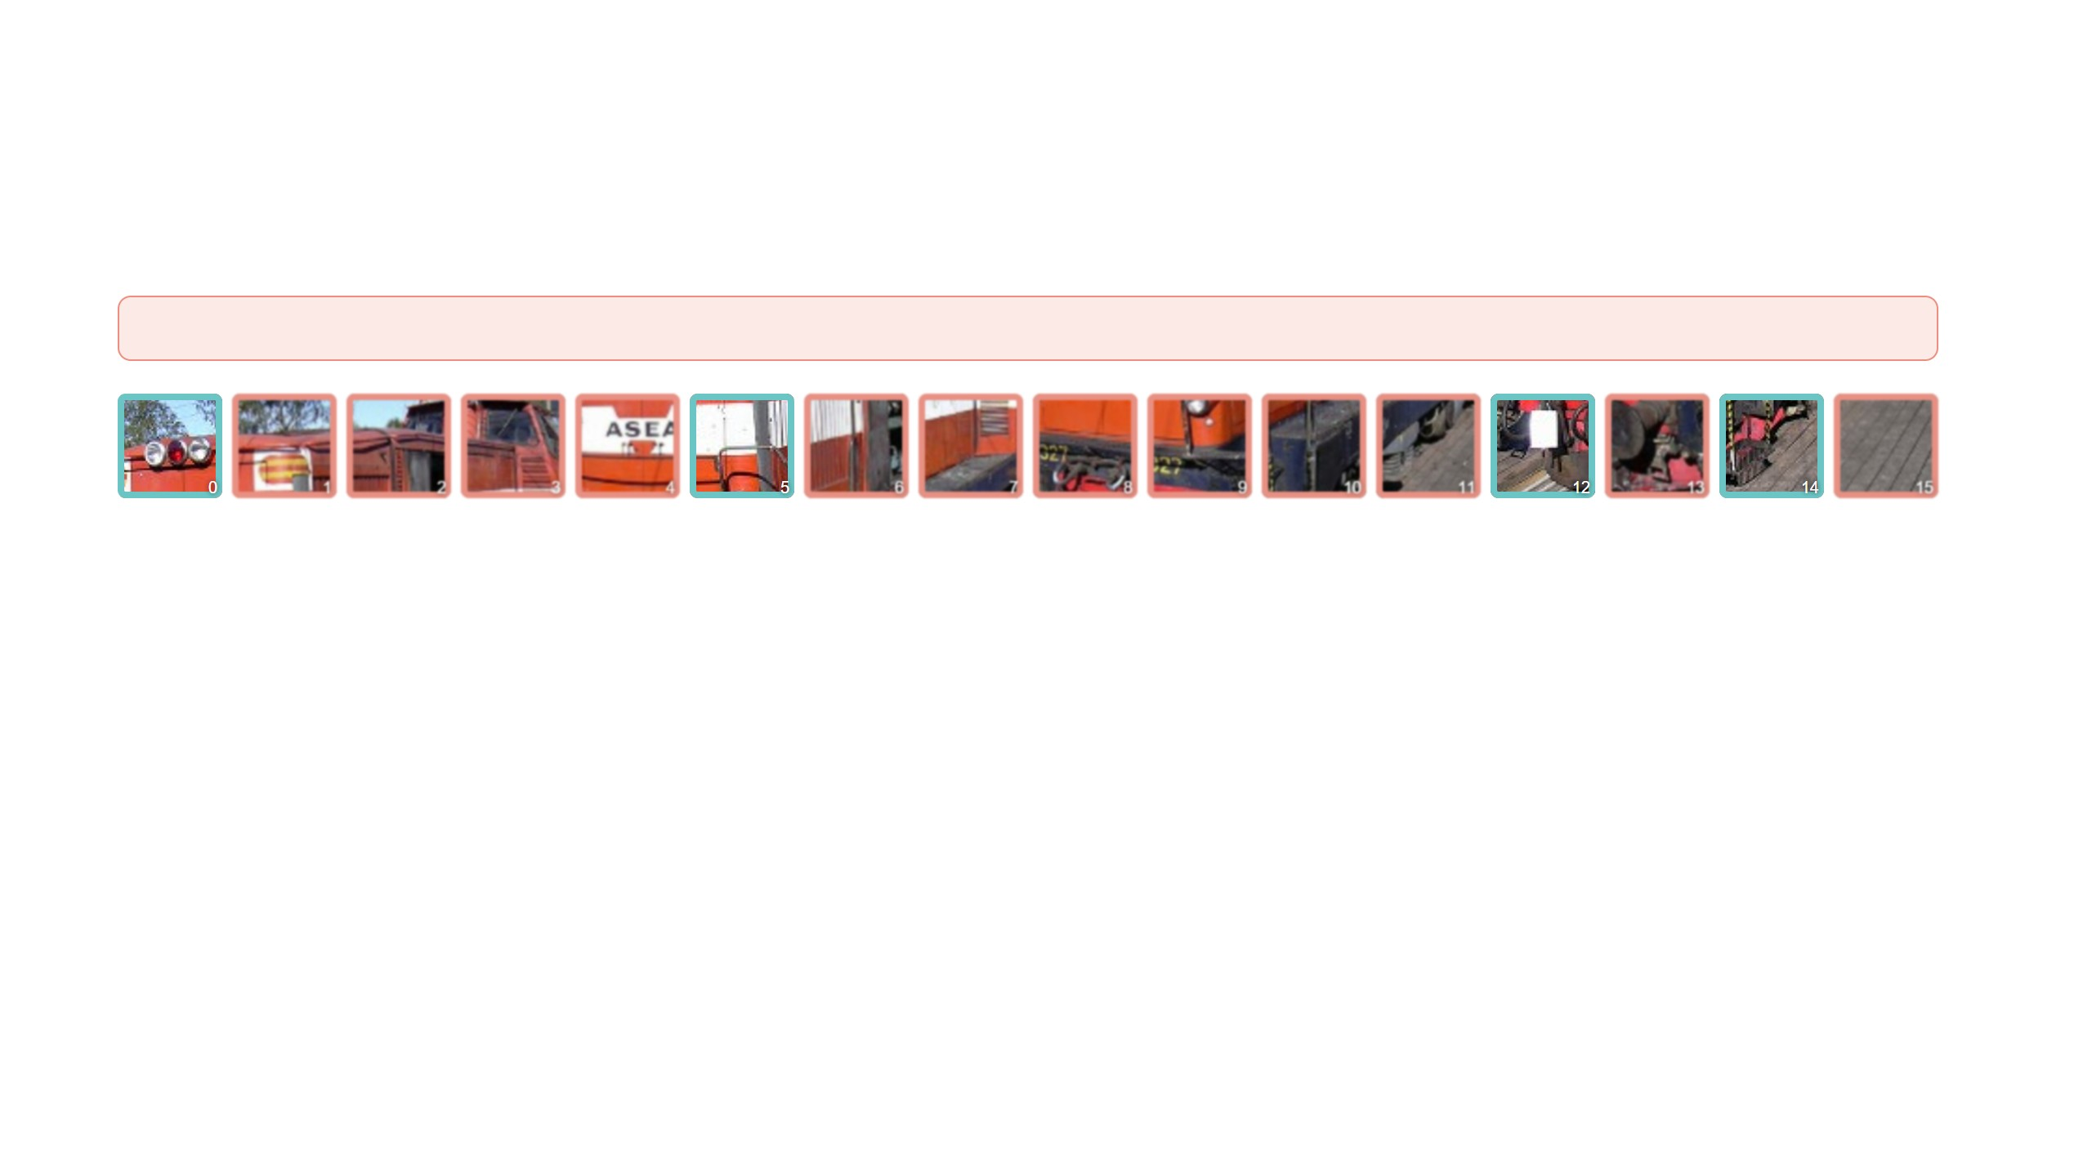
Implementation
decoder
7
The decoder predicts a patch of pixels for every position. The loss is taken only on the masked ones, in salmon.
6 / 17

Slide 14
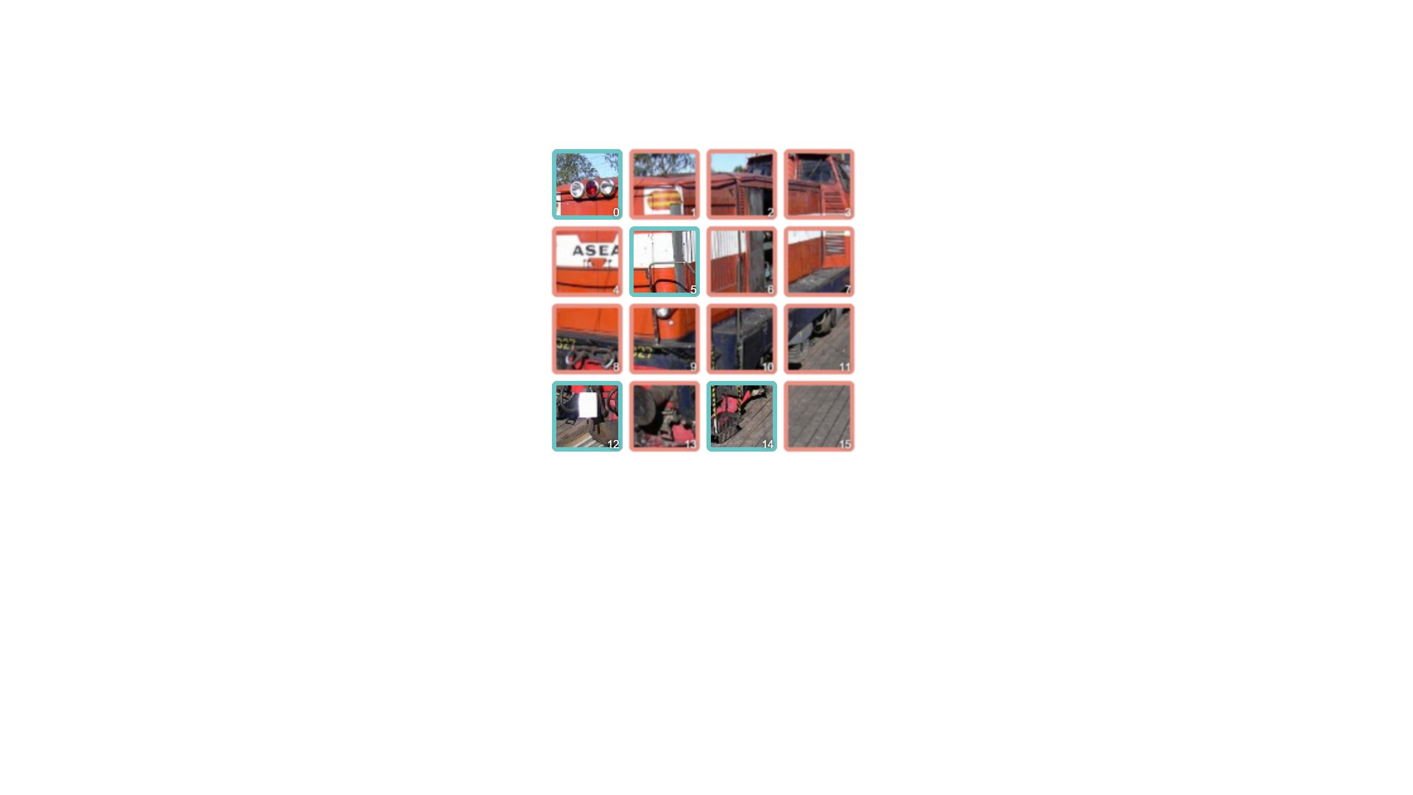
Implementation
reconstructed image
8
Reshape into an image.
6 / 17

Slide 15
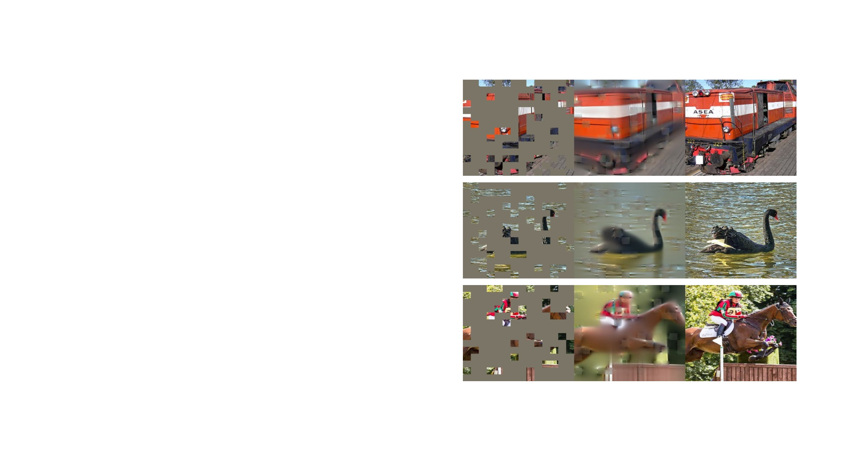
Reconstruction target and loss
The decoder's last layer outputs 16 × 16 × 3 values per token, which
reshape into an image. The loss is the mean squared error against
the original, computed on the masked patches only. Computing it on
all patches costs about half a point of accuracy.
Normalizing each target patch by its own mean and standard
deviation gives the best results in the paper.
Reconstructions are blurry, since squared error rewards the average,
but they are structurally right. They stay plausible on COCO images
the model never saw, which is the first sign that the encoder learned
something general.
All at 75 percent: two ImageNet validation images (Figure 10) and a COCO image
(Figure 3). Visible patches look worse in the output because no loss is applied to
them; the authors show the raw output on purpose.
7 / 17

Slide 16
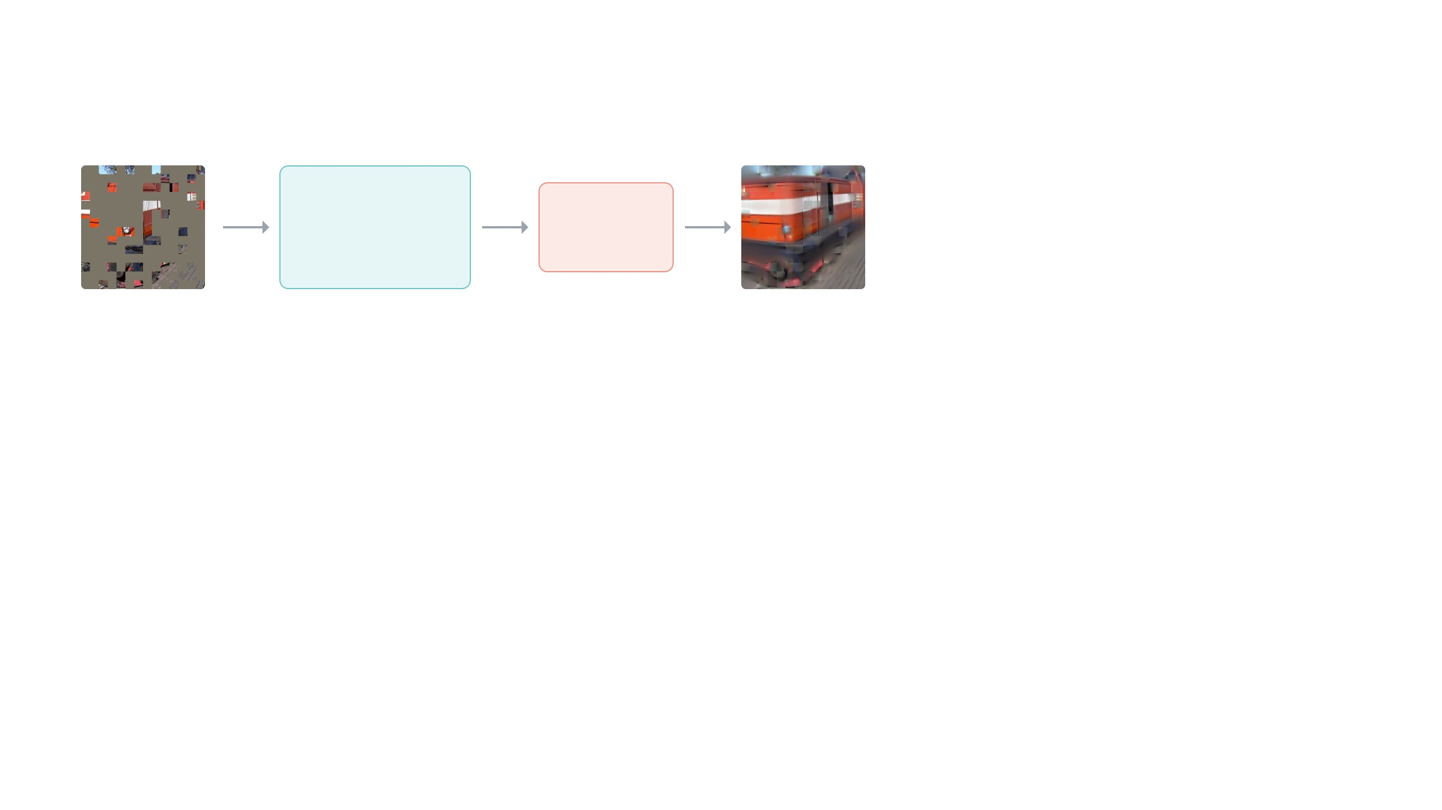
Pretraining, then fine-tuning
pretraining · 1.28 million ImageNet images · labels not used · 800 to 1600 epochs
encoder
decoder
squared error against the original,
masked patches only
large ViT
8 blocks
75% masked
prediction
0
Pretraining. Mask 75 percent, encode the visible patches, predict the missing pixels, take the squared error on the masked
patches. Repeat over ImageNet for 800 to 1600 epochs without touching a label.
8 / 17

Slide 17
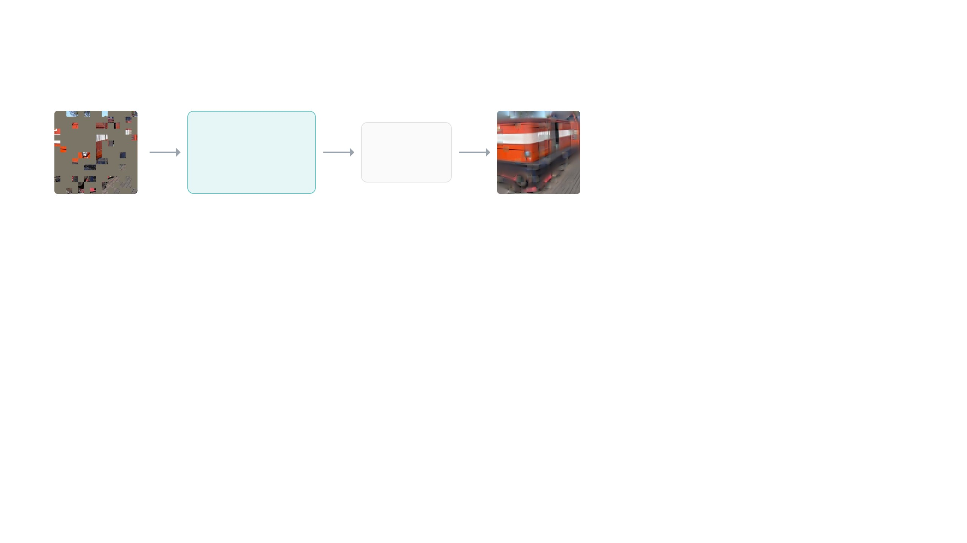
Pretraining, then fine-tuning
pretraining · 1.28 million ImageNet images · labels not used · 800 to 1600 epochs
encoder
decoder
squared error against the original,
masked patches only
large ViT
8 blocks
kept, with its weights
discarded
75% masked
prediction
1
Afterwards the decoder is thrown away. The encoder is kept, with everything it learned.
8 / 17

Slide 18
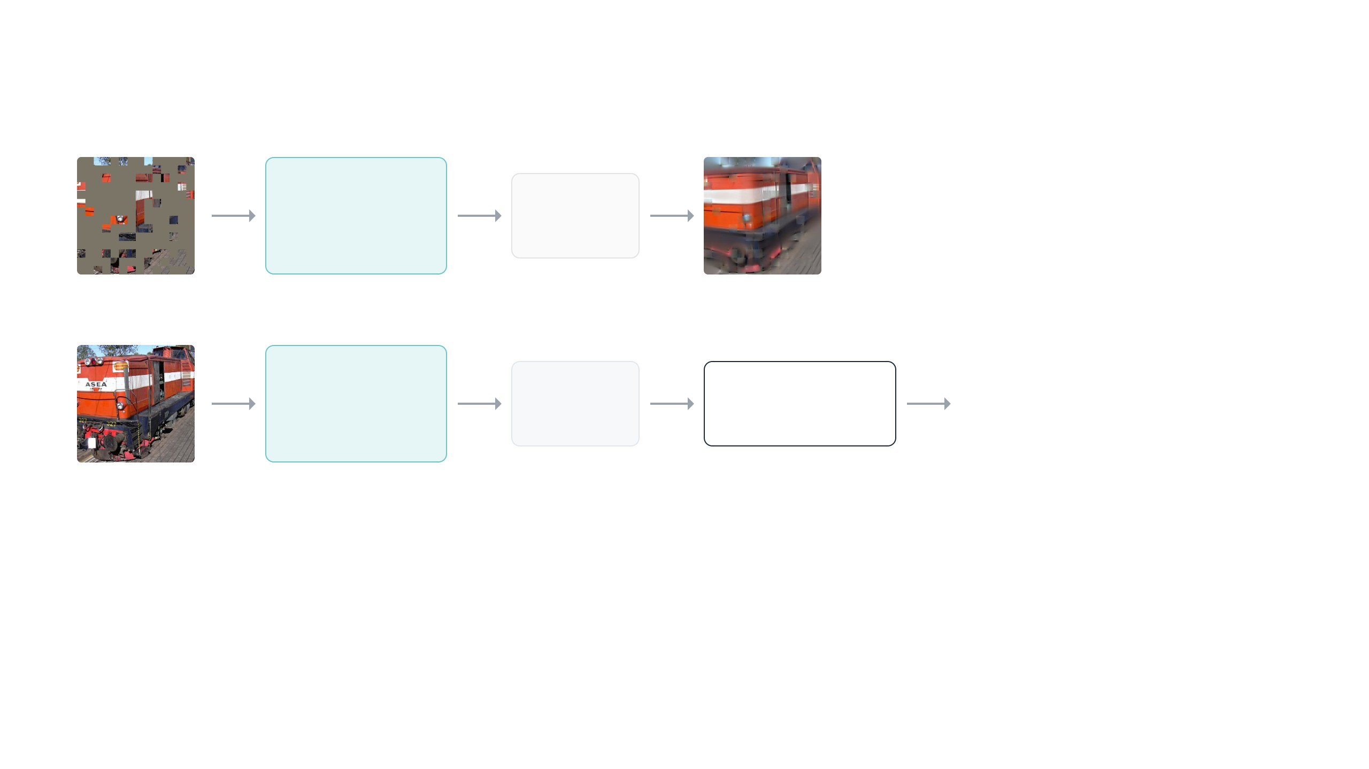
Pretraining, then fine-tuning
pretraining · 1.28 million ImageNet images · labels not used · 800 to 1600 epochs
encoder
decoder
squared error against the original,
masked patches only
large ViT
8 blocks
kept, with its weights
discarded
75% masked
prediction
fine-tuning · the same images, now with their labels · 50 epochs
encoder
average
linear layer
label: "electric locomotive"
cross-entropy loss
same weights, updated a
little
196 tokens → 1
vector
1024 → 1000 classes, new
full image
2
Fine-tuning. The same images, now with their labels. A full image goes through the encoder, the 196 output tokens are averaged,
and a new linear layer maps that vector to the 1000 classes. Everything is trained with the classification loss: the new layer from
scratch, the encoder only nudged. 50 epochs are enough.
8 / 17

Slide 19

Pretraining, then fine-tuning
pretraining · 1.28 million ImageNet images · labels not used · 800 to 1600 epochs
fine-tuning all weights are trained
linear probing encoder frozen,
only the linear layer is trained
encoder
decoder
squared error against the original,
masked patches only
large ViT
8 blocks
kept, with its weights
discarded
75% masked
prediction
fine-tuning · the same images, now with their labels · 50 epochs
encoder
average
linear layer
label: "electric locomotive"
cross-entropy loss
same weights, updated a
little
196 tokens → 1
vector
1024 → 1000 classes, new
full image
3
Two ways to evaluate, used throughout the paper. Fine-tuning trains everything: 84.9 percent for the large ViT, against 82.5
trained from scratch for 200 epochs. Linear probing freezes the encoder and trains only the linear layer, so it measures how
linearly separable the frozen features are.
8 / 17

Slide 20
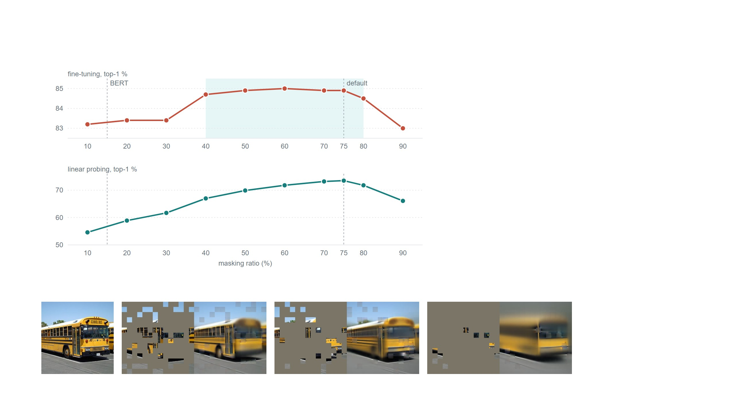
Masking ratio
Each point is a separate pretraining run with that
ratio, then measured two ways. Fine-tuning:
anything from 40 to 80 percent works, and every
point is above the 82.5 percent of the same
model trained from scratch.
Linear probing keeps improving up to 75 percent,
with almost twenty points between the two ends.
BERT uses 15 percent. Earlier masked image
methods used 20 to 50.
Large ViT on ImageNet, 800 pretraining epochs per point, top-1 accuracy. Figure 5 in the paper.
One model trained at 75
percent, tested with 75, 85 and
95 percent hidden. With nine
visible patches it still draws a
bus. Figure 4.
9 / 17

Slide 21

Decoder depth and mask tokens
Decoder depth in Transformer blocks, Table 1a. Both bars
share the same axis.
Decoder depth matters for linear probing and barely for fine-tuning. A
deeper decoder takes over the reconstruction-specific layers, so the
encoder output stays more abstract. With fine-tuning the encoder's last
blocks adapt anyway.
If the mask tokens are kept in the encoder instead of being dropped, linear
probing falls by 14 points, because the encoder then trains on inputs full of
placeholders it never sees at test time. It also costs 3.3 times the
compute.
90
84.9
80
73.5
70
60
encoder
decoder blocks
fine-tune acc.
hours
speedup
fine-tuning
linear probing
Large, mask tokens kept in the encoder
8
84.2
42.4
–
Eight blocks, the default: 9 percent of ViT-L FLOPs per token, best linear
probing.
Large
8
84.9
15.4
2.8×
Large
1
84.8
11.6
3.7×
Huge
8
85.8
34.5
3.5×
Huge
1
85.9
29.3
4.1×
Training time for 800 epochs on the same hardware. Large and Huge are the ViT sizes. Table 2.
10 / 17

Slide 22
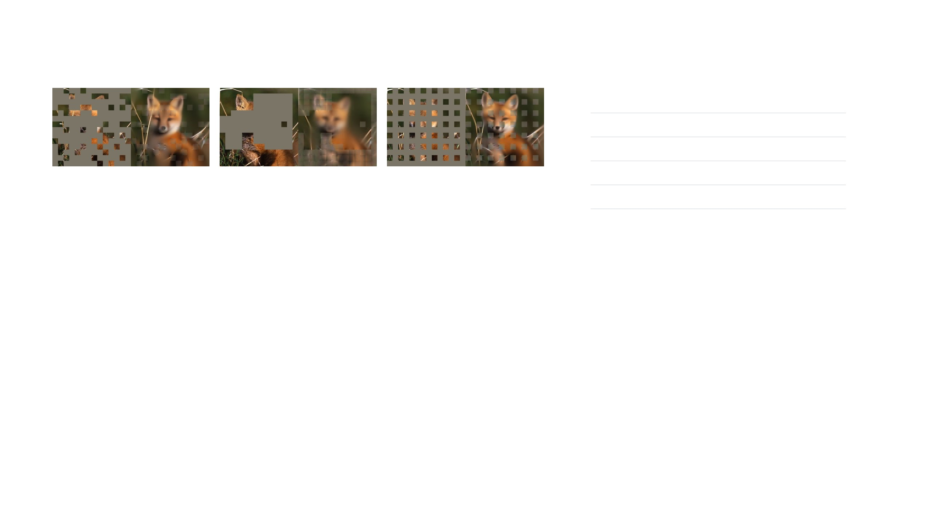
Mask sampling and data augmentation
augmentation
fine-tuning
linear probing
none, center crop only
84.0
65.7
crop, fixed size
84.7
73.1
random 75%
84.9 · 73.5
block 50%
83.9 · 72.3
grid 75%
84.0 · 66.0
crop, random size
84.9
73.5
crop + color jitter
84.3
71.9
Figure 6 and Table 1f, numbers are fine-tuning · linear probing. Block masking at 75%: 82.8 · 63.9.
Table 1e.
Block masking removes large regions. The task gets harder, the loss higher, the
output blurrier, and at 75 percent it breaks down. Grid masking keeps one patch in
four, which is easy: sharp reconstructions, worse features. Random sampling is the
only one that tolerates a high ratio, and the high ratio is where the speed comes
from.
MAE barely needs augmentation. With no
augmentation at all it loses less than a point in
fine-tuning. Contrastive methods depend on it:
SimCLR loses 28 points with cropping only,
and with no augmentation its two views are
identical and there is nothing to learn. In MAE,
a new random mask every iteration already
gives a new training sample from the same
image.
11 / 17

Slide 23

What should the decoder predict?
The simplest choice is the pixels themselves, and that is what MAE does.
The alternative, used by BEiT, a masked image method published a few
months earlier, is to predict a code instead of pixels. A separate network
first maps every patch to one of 8192 codes, a kind of visual vocabulary.
The model then guesses the code of each hidden patch, the way BERT
guesses a word. The argument was that codes are more meaningful than
pixels.
fine-
tuning
linear
probing
what the decoder predicts
raw pixels
84.9
73.5
pixels, normalized per patch
85.4
73.9
compressed patch (96 PCA components)
84.6
72.3
visual codes, as in BEiT
85.3
71.6
Table 1d. Normalizing per patch means subtracting the patch's own mean
and dividing by its standard deviation before comparing.
On MAE, codes turn out slightly better than raw pixels, no better than
normalized pixels, and worse for linear probing. Predicting a compressed
version of the patch is worse than predicting the full patch, so the fine
detail is useful too.
The code network also has to be pretrained on 250 million extra images
and adds 40 percent to training compute. Pixels are enough.
12 / 17

Slide 24
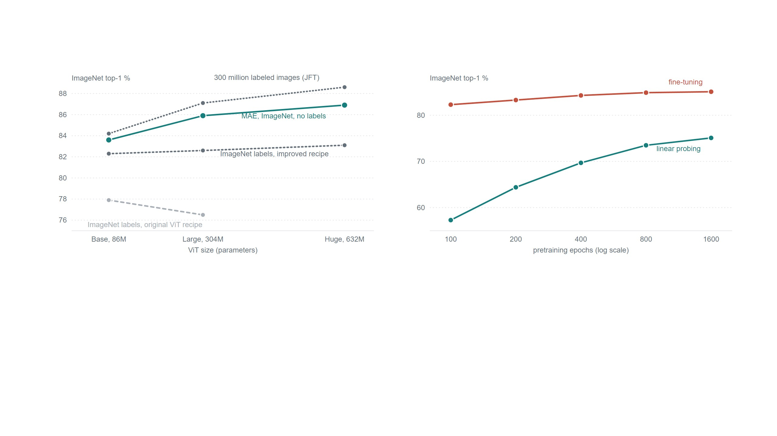
Scaling
ImageNet accuracy after fine-tuning, for three ViT sizes. Figure 8 in the paper.
Accuracy of the large ViT against how long it was pretrained. Each point is a separate full run.
Figure 7.
Trained with labels on ImageNet, a bigger ViT does not get better. Pretrained with MAE it does, and the gain per step in size matches
what Google got from 300 million labeled images. The largest model, fine-tuned at higher resolution, reaches 87.8 percent, the best
result at the time with no data outside ImageNet. Longer pretraining also keeps helping, with no flattening at 1600 epochs, where
contrastive methods on ViT stop improving around 300. Since the encoder only sees a quarter of one image per step, 1600 MAE
epochs still take less time than 300 contrastive ones.
13 / 17

Slide 25
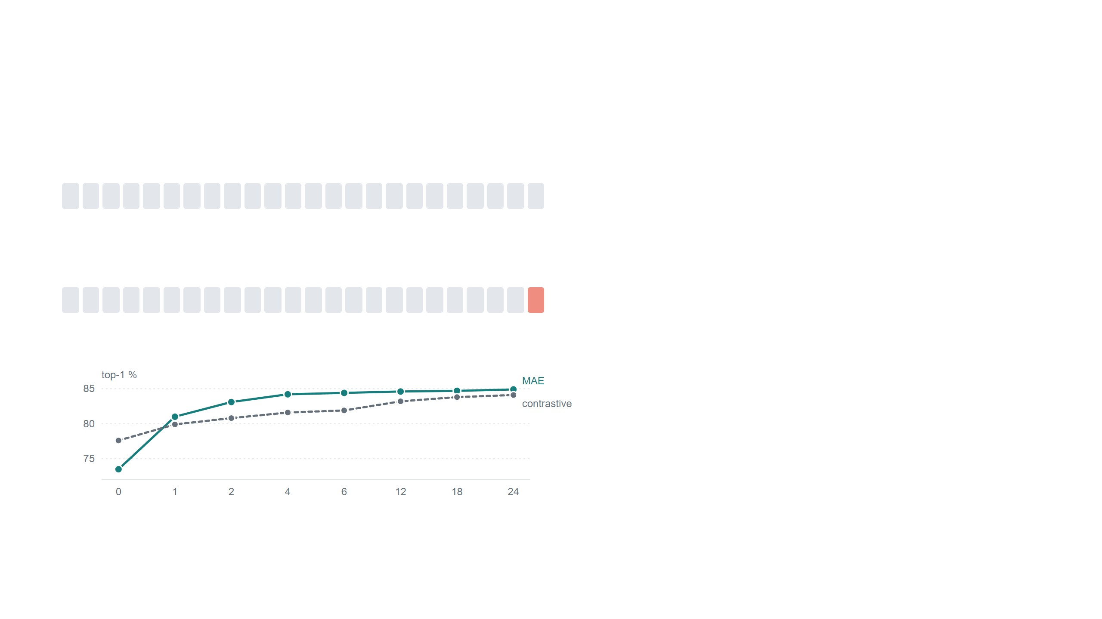
Partial fine-tuning
Number of blocks fine-tuned, counted from the top of the large ViT. 0 is
linear probing, 24 is full fine-tuning.
The comparison is with MoCo v3, a contrastive method from
the same family as SimCLR, trained on the same ViT. With the
encoder frozen, its features are four points better. Tune a single
block and MAE goes from 73.5 to 81.0 and stays ahead from
there on. Tuning just the feed-forward half of the last block
already gives 79.1.
0 blocks tuned · linear probing, all 24 frozen
MAE
contrastive (MoCo v3)
difference
73.5
77.6
−4.1
1 block tuned · the last block, in salmon
So the MAE features are there, they are just not arranged so a
single linear layer can separate them. The authors argue that
linear probing, the usual test in contrastive work, misses exactly
this, and suggest tuning the last few blocks as a fairer middle
ground. In language modeling nobody evaluates with a frozen
encoder anyway.
MAE
contrastive (MoCo v3)
difference
81.0
79.9
+1.1
Figure 9.
14 / 17

Slide 26

Transfer to other tasks
detection, COCO
Base
segmentation, ADE20K
Base
Does the ImageNet gain carry over to other tasks? Yes,
and it grows with model size. On detection, MAE is 2.4
points above training with labels for the base model and
4.0 for the large one. The contrastive method gives no
gain at all here, even though it looked better under a
linear probe. Segmentation shows the same pattern.
pretraining
Large
Large
ImageNet labels
47.9
49.3
47.4
49.9
contrastive (MoCo v3)
47.9
49.3
47.3
49.1
visual codes (BEiT)
49.8
53.3
47.1
53.3
MAE
50.3
53.3
48.1
53.6
Detection is box AP, segmentation is mean IoU; higher is better for both. Base and Large are the ViT
sizes. Standard detection and segmentation heads, all methods fine-tuned the same way. Tables 4 and
5.
On fine-grained species classification the huge model
beats the previous record by more than five points.
Huge, 448
px
previous
best
The robustness rows are the most striking. On the
adversarial set, the huge MAE model scores 68.2
where the same model trained with labels scores 33.1.
MAE, after ImageNet fine-tuning
Base
Large
Huge
iNaturalist 2018, species classification
75.4
80.1
83.0
86.8
81.2
ImageNet-A, images that fool classifiers
35.9
57.1
68.2
76.7
35.8
ImageNet-R, paintings and sketches
48.3
59.9
64.4
66.5
48.7
The last two rows use the ImageNet-fine-tuned model as is, with no extra training. Tables 6 and 13.
15 / 17

Slide 27

Summary
What MAE does: hide 75 percent of the patches, run only the visible ones
through the encoder, let a small decoder fill in the pixels, then throw the
decoder away and keep the encoder.
The patches we hide are not objects, and
the pixels we predict mean nothing on
their own. The encoder still ends up
understanding the image, because there
is no other way to fill in three quarters of
it.
Why it matters: it is simple and fast, it needs almost no augmentation,
and it gets better as the model gets bigger and trains longer, which
contrastive methods on ViT did not. With nothing but ImageNet, a huge
ViT reaches 87.8 percent, and the gains carry over to detection and
segmentation.
Paraphrasing the discussion section of the paper.
One more lesson: linear probing can mislead. MAE looks weak under a
linear probe and strong as soon as a single block is tuned.
see 25%
hide 75%
predict pixels
16 / 17

Slide 28

Thank you
Questions and discussion
He, Chen, Xie, Li, Dollár, Girshick. Masked Autoencoders Are Scalable Vision Learners. CVPR 2022. arXiv:2111.06377.
Figures and tables in this talk are from the paper.

