Slide 1
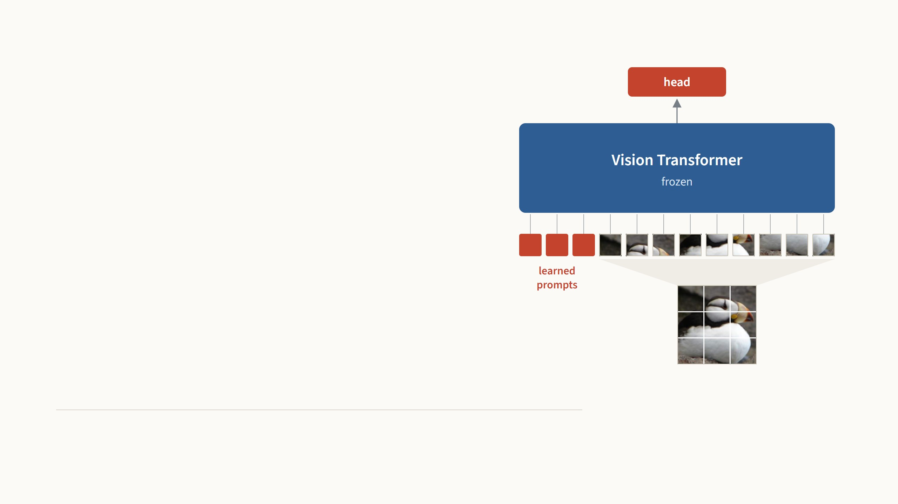
Visual Prompt
Tuning
Teach a frozen Vision Transformer a
new task by learning only a few extra
input vectors.
Menglin Jia, Luming Tang, Bor-Chun Chen, Claire Cardie, Serge Belongie, Bharath Hariharan, Ser-Nam Lim
Cornell University, Meta AI and University of Copenhagen. ECCV 2022.
Presented by Ertugrul Senturk
October 2026
Notes:
Opening paper of a two-part series on parameter-efficient fine-tuning (LoRA is next). The picture is the whole method: the blue Transformer stays frozen, the image goes in as patches, and only the few red vectors in front of them and the red head on top are trained. VPT is the vision paper that took "prompt tuning" from language models and asked whether it works on image encoders. For supervised ViTs it works surprisingly well, and at the end I will run a model I trained with it, live, in this browser. Thirty minutes; please interrupt.

Slide 2
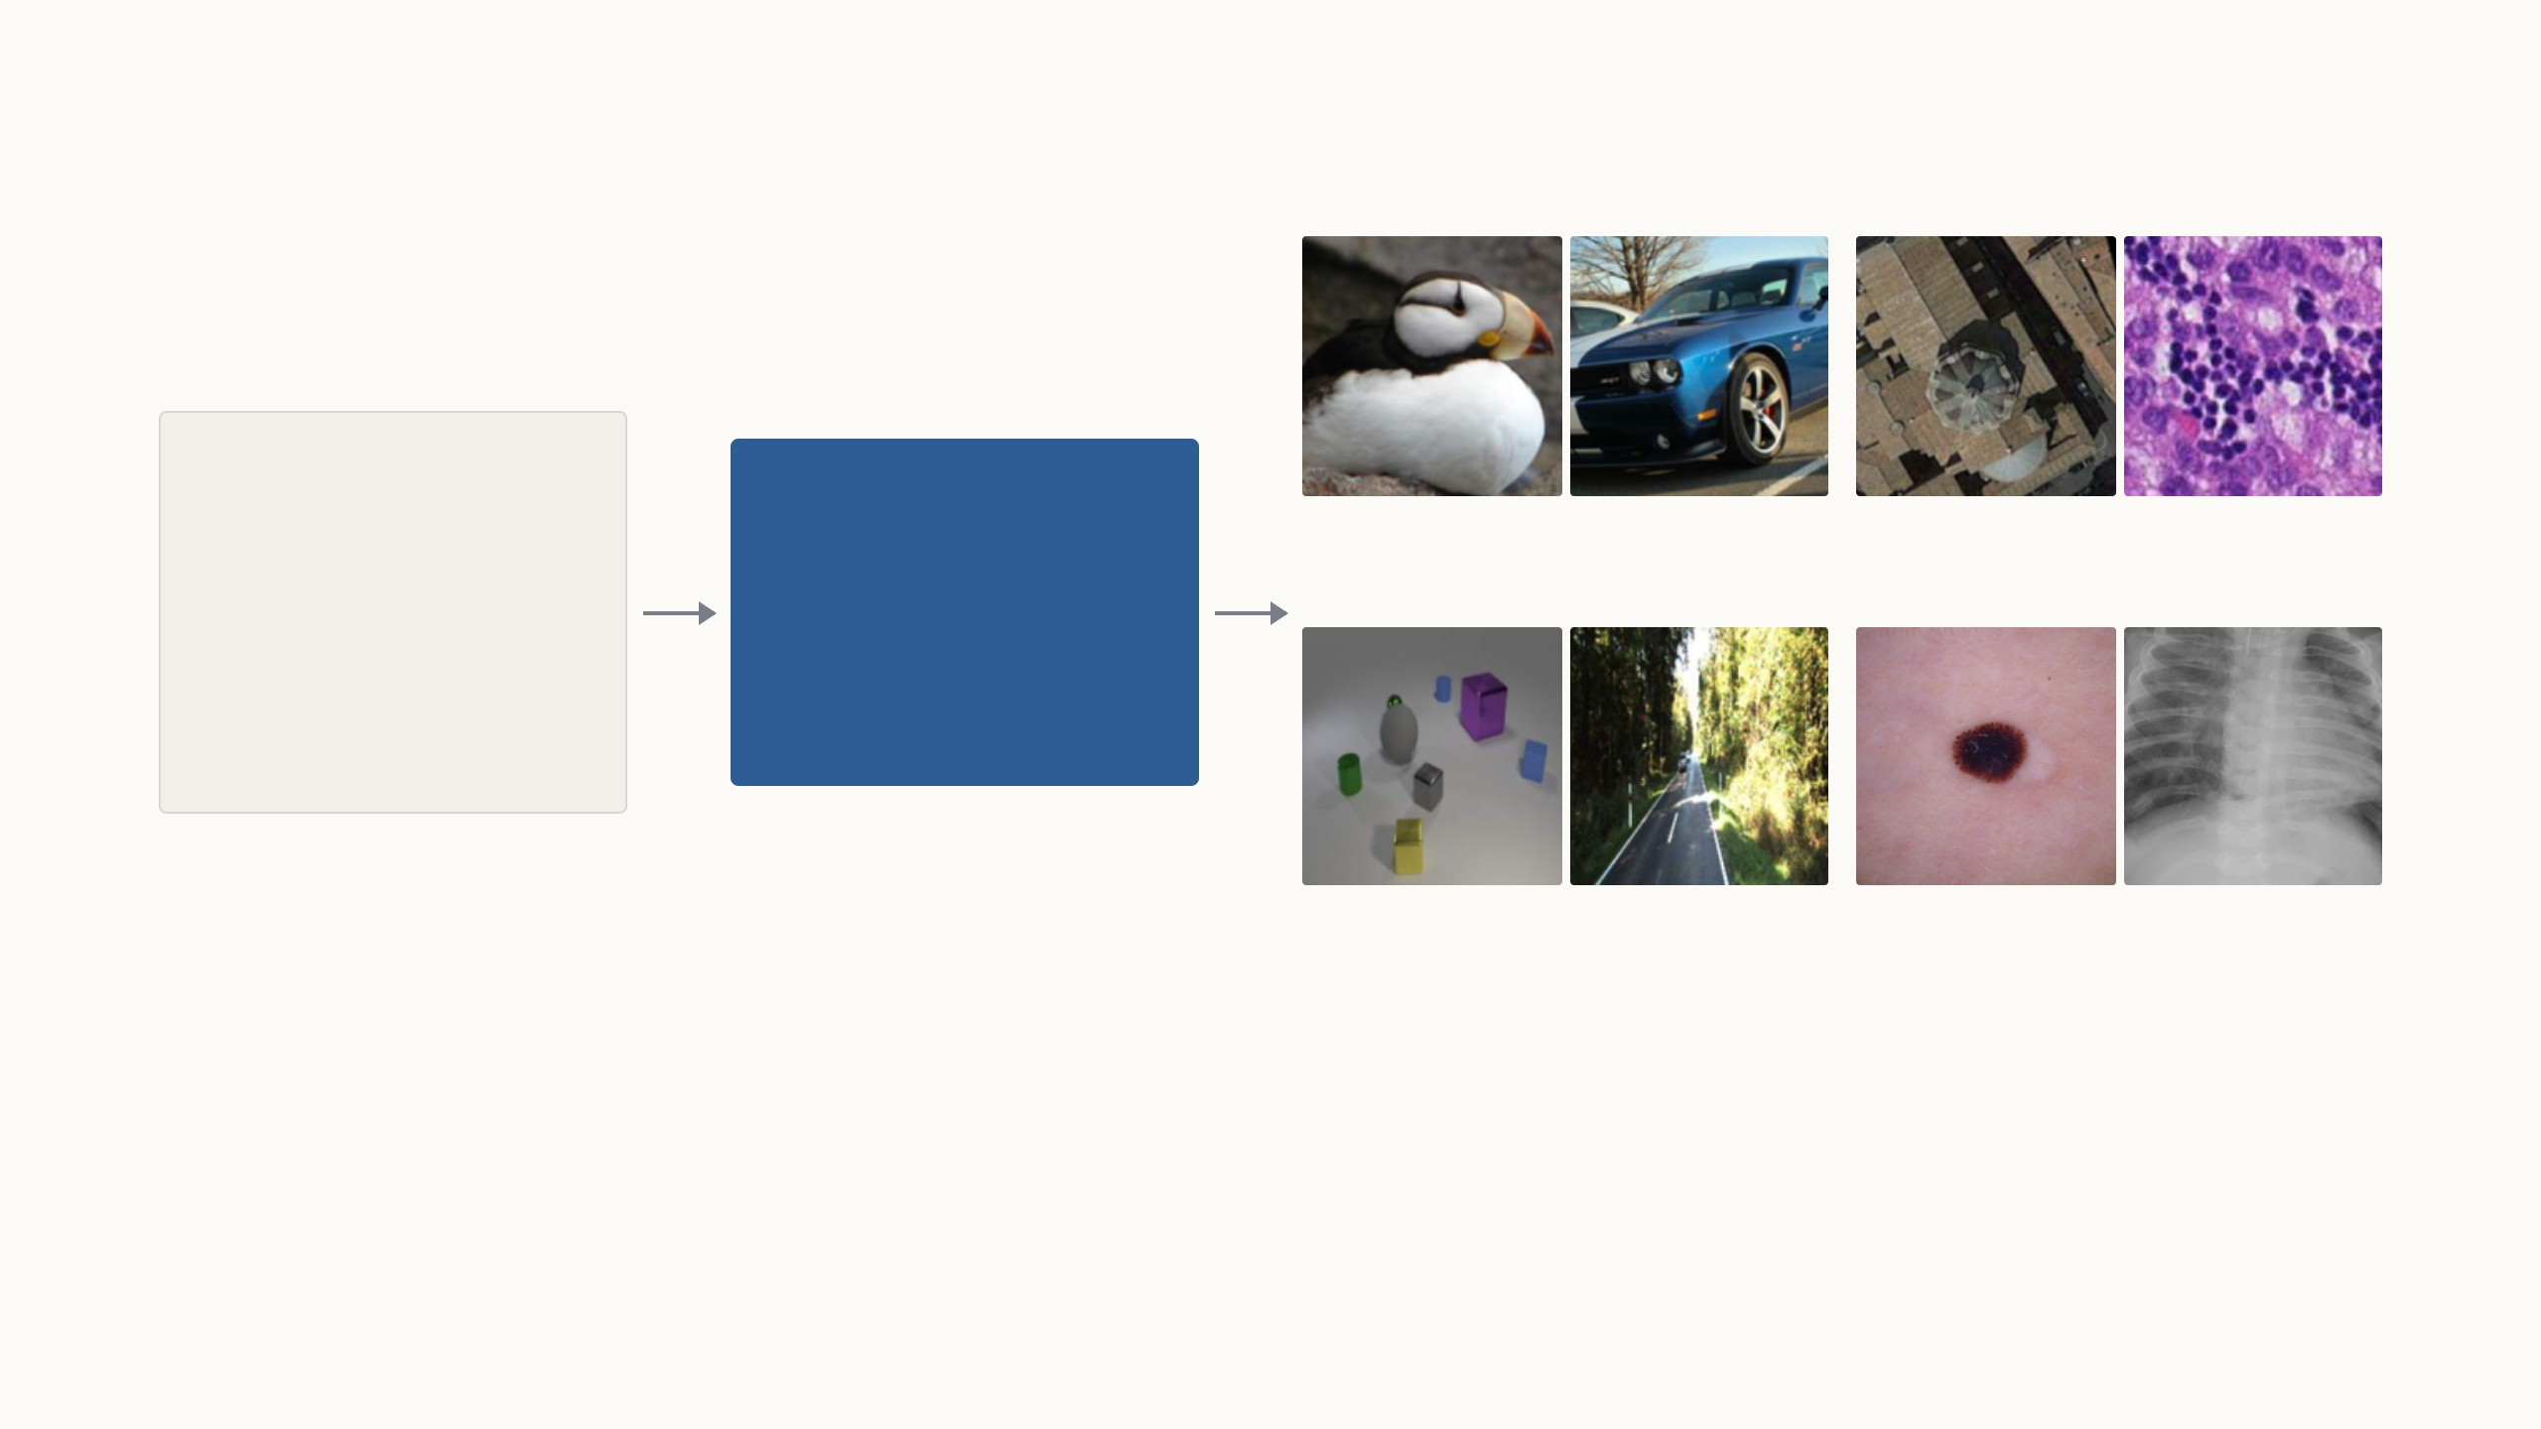
Pretrain one big model once, then adapt it to each task
ImageNet-21k
ViT-B/16
14 million photos in
21,000 everyday
categories. Pretraining
takes weeks and is done
once, by Google.
Fine-grained categories
Satellite and microscope
A Vision Transformer with
85.8 million weights that
has learned general visual
features.
200 bird species, 196 car models
land use from above, tissue slides
Counting and distance
Medical images
how many objects, how far away
my own experiments, shown later
Each new task is small: most tasks in the paper have only 1,000
training images, far too few to train from scratch. So we start
from the pretrained model and adapt it.
The paper asks how to adapt it best: accurately, and cheaply
enough to store for every task. Next, the standard answer and
what it costs, then the cheaper methods tried before VPT.
Dataset examples from Jia et al. 2022, Fig. 10. ViT-B/16: Dosovitskiy et al. 2021. The pretrained checkpoint used here and in the paper is Google's ImageNet-21k ViT-B/16.
2
Notes:
Make sure everyone has the mental model: pretraining is expensive and done once; adaptation is cheap and done for every task. Nothing in this talk touches pretraining. The first three tiles are examples of the paper's task groups (fine-grained, specialised, structured); the fourth, medical images, is what I will show at the end. Then set up the question: which way of adapting is both accurate and cheap to store?

Slide 3
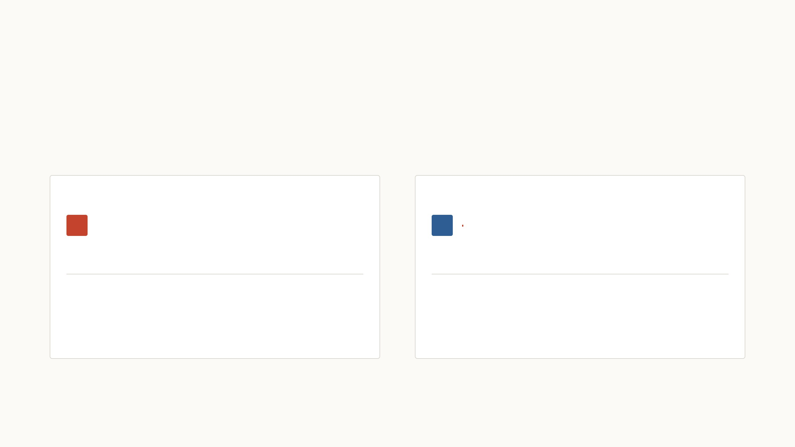
Full fine-tuning stores a new copy of the model per task
Full fine-tuning retrains every weight of the pretrained model on the new
task, and it is usually the most accurate option. The cost is that each task
keeps its own retrained copy, so storage grows with every task and with
the size of the model.
Shown for 1 task on ViT-B, 86 million weights. The
next pages show 24 tasks, then the largest model.
Full fine-tuning: 1 retrained ViT-B copy
VPT: one shared ViT-B plus 1 small file
each red speck is one task file, to scale
343 MB
345 MB
1 copy at 343 MB each
343 MB once, plus 2.2 MB per task
32-bit weights: ViT-B/16 85.8M, ViT-L/16 303M, ViT-H/14 632M. A VPT file is 50 prompts at every layer plus a 102-class head. Squares are sized by area.
3
Notes:
Full fine-tuning is the default and usually the most accurate, but every task gets its own retrained copy. Drag to 24 tasks: about 8 GB of ViT-B copies. Then click ViT-H: about 61 GB, so the problem grows with the model. The right panel is the punchline we are heading for: VPT keeps one shared frozen model (blue) and adds a file of a few megabytes per task (the tiny red specks, drawn to scale).

Slide 4
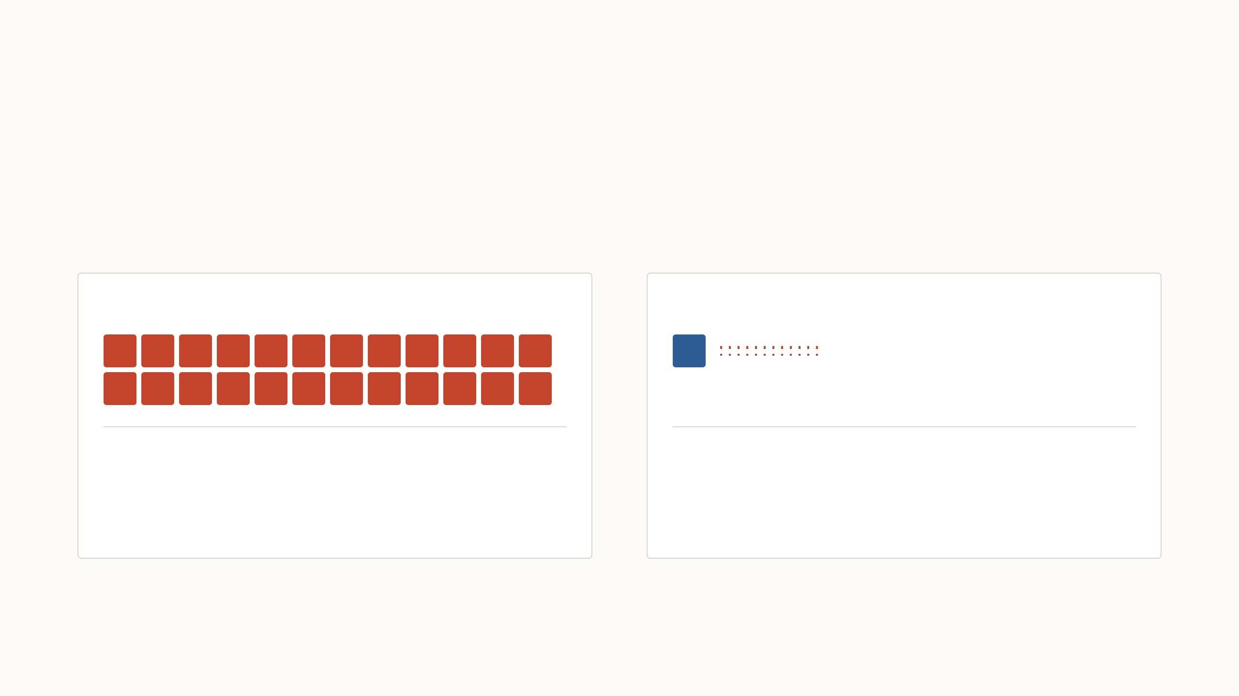
Full fine-tuning stores a new copy of the model per task
Full fine-tuning retrains every weight of the pretrained model on the new
task, and it is usually the most accurate option. The cost is that each task
keeps its own retrained copy, so storage grows with every task and with
the size of the model.
Shown for 24 tasks on ViT-B, 86 million weights.
Full fine-tuning: 24 retrained ViT-B copies
VPT: one shared ViT-B plus 24 small files
each red speck is one task file, to scale
8.2 GB
395 MB
24 copies at 343 MB each
343 MB once, plus 2.2 MB per task
32-bit weights: ViT-B/16 85.8M, ViT-L/16 303M, ViT-H/14 632M. A VPT file is 50 prompts at every layer plus a 102-class head. Squares are sized by area.
3
Notes:
Full fine-tuning is the default and usually the most accurate, but every task gets its own retrained copy. Drag to 24 tasks: about 8 GB of ViT-B copies. Then click ViT-H: about 61 GB, so the problem grows with the model. The right panel is the punchline we are heading for: VPT keeps one shared frozen model (blue) and adds a file of a few megabytes per task (the tiny red specks, drawn to scale).

Slide 5

Full fine-tuning stores a new copy of the model per task
Full fine-tuning retrains every weight of the pretrained model on the new
task, and it is usually the most accurate option. The cost is that each task
keeps its own retrained copy, so storage grows with every task and with
the size of the model.
Shown for 24 tasks on ViT-H, 632 million weights.
Full fine-tuning: 24 retrained ViT-H copies
VPT: one shared ViT-H plus 24 small files
each red speck is one task file, to scale
61 GB
2.7 GB
24 copies at 2.5 GB each
2.5 GB once, plus 8.7 MB per task
32-bit weights: ViT-B/16 85.8M, ViT-L/16 303M, ViT-H/14 632M. A VPT file is 50 prompts at every layer plus a 102-class head. Squares are sized by area.
3
Notes:
Full fine-tuning is the default and usually the most accurate, but every task gets its own retrained copy. Drag to 24 tasks: about 8 GB of ViT-B copies. Then click ViT-H: about 61 GB, so the problem grows with the model. The right panel is the punchline we are heading for: VPT keeps one shared frozen model (blue) and adds a file of a few megabytes per task (the tiny red specks, drawn to scale).

Slide 6

Cheaper methods existed, but none matched full fine-tuning
Mean accuracy (%)
Weights trained
Full fine-tuning
retrain every weight
73.9
100%
Only the top of the model is trained
Partial-1
train the head and the last of 12 layers
66.2
8.35%
Linear probe
train only a new output layer
63.1
0.09%
MLP-3 head
train a bigger, three-layer head
62.8
1.45%
Small parts in or beside the backbone are trained
Bias
train only the bias terms of every layer
71.0
0.21%
Adapter
insert small trainable blocks in every layer
66.7
0.36%
Sidetune
train a small network beside the model
57.0
10.09%
Bias came closest and even beat full fine-tuning on 8 of the 24 tasks, but on average no cheaper method reached it.
VPT takes a third route: it leaves the model alone and changes the input.
Mean test accuracy over the paper's 24 tasks, ViT-B/16 (Jia et al. 2022, Table 1, mean of the four group averages). The right column is the share of weights trained for each task.
4
Notes:
The dashed line is full fine-tuning at 73.9. Two families. The first only changes the top of the model: a new linear layer, a bigger head, or the head plus the last layer. A bigger head does not help, so the frozen features are the bottleneck. The second family trains small parts in or beside the backbone: Bias tunes only the bias vectors, Adapter inserts small MLPs, Sidetune adds a side network. Bias is strong at 71.0, but nothing reaches 73.9. VPT belongs to neither family: it changes the input.

Slide 7
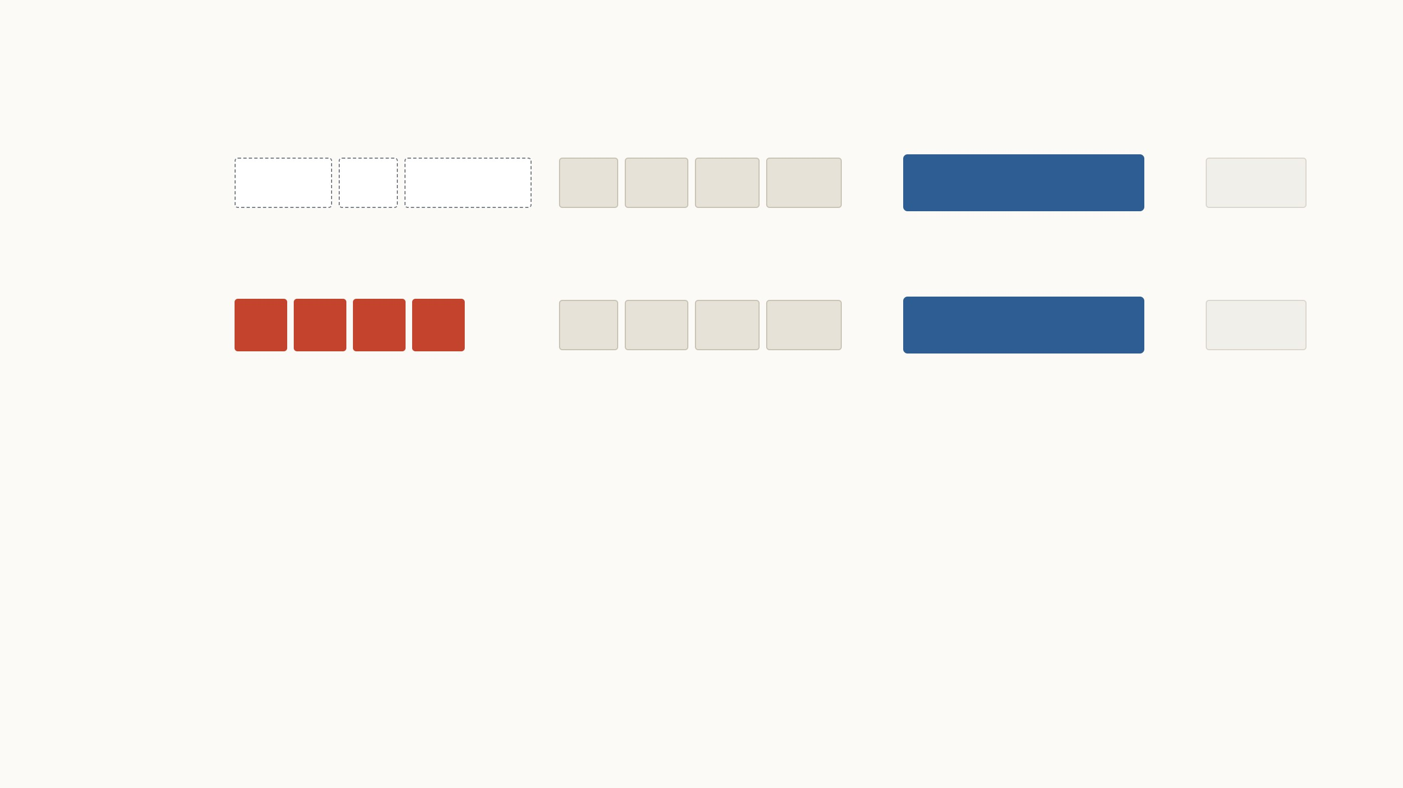
Where the word "prompt" comes from
2020
→
frozen language model
→
Classify
the
sentiment:
the
film
was
great
positive
GPT-3
prompt: words a person chose
input
2021
→
frozen language model
→
the
film
was
great
positive
Prompt tuning
prompt: learned vectors, no words
input
In 2020, a prompt was text. GPT-3, a frozen model with 175
billion weights, was only trained to continue text, yet it does a
new task when you type a description of the task in front of
the input. Not a single weight changes. But words are discrete,
so the only way to improve a prompt is trial and error.
In 2021, prompt tuning (Lester et al.) replaced the words with
learned vectors that correspond to no word. They are trained
by gradient descent on the task's examples while the model
stays frozen, and they are all you store per task. Prefix-tuning
(Li & Liang) does the same at every layer.
The sentiment example is illustrative. Brown et al. 2020 (GPT-3); Lester, Al-Rfou, Constant 2021 (prompt tuning, T5); Li & Liang 2021 (prefix-tuning).
5
Notes:
Two steps, one idea. In 2020, GPT-3 showed that a frozen language model does new tasks if you type a description of the task in front of the input; that text is the prompt, and no weight changes. Its weakness: words are discrete, so you can only improve a prompt by trial and error. In 2021, prompt tuning kept the frozen model and replaced the words with vectors trained by gradient descent: the red squares correspond to no word at all. Per task you store k vectors of 1,024 numbers, roughly 20,000 numbers instead of billions. Prefix-tuning does the same at every layer. LoRA, the next talk, also dates from 2021 but takes a different route: it changes the weights, not the input.

Slide 8
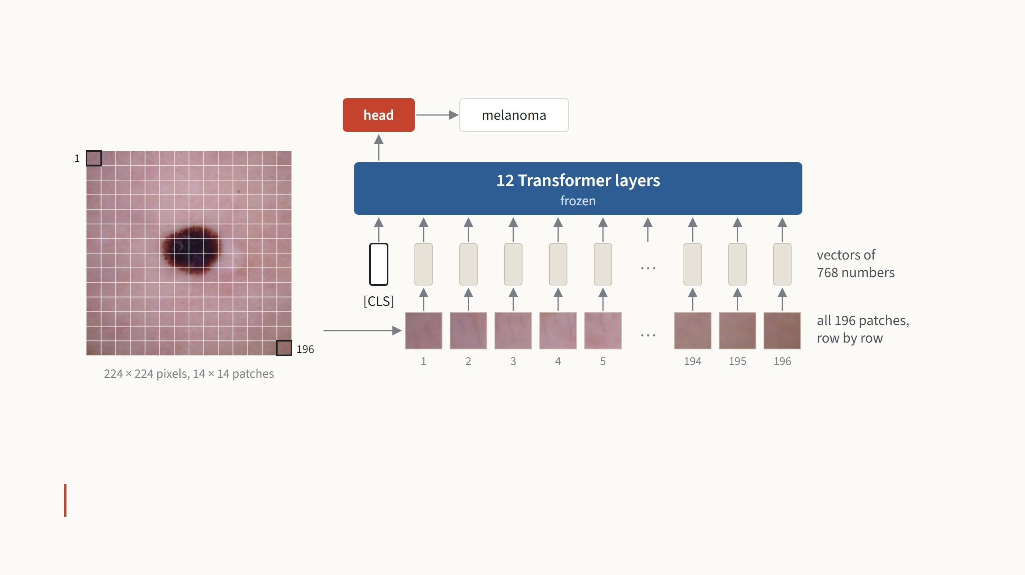
How a Vision Transformer reads an image
A fixed grid cuts the image into 196 patches of 16 × 16 pixels, and each patch, read row by row, becomes a vector of 768
numbers. One extra vector, [CLS], goes in front to collect a summary of the whole image: the 12 layers mix all 197 vectors, and
the head reads only [CLS] to name the class.
The layers only see a sequence of vectors, so we can add a few more.
ViT-B/16: 12 layers, vectors of 768 numbers, 85.8 million weights. Dosovitskiy et al., ICLR 2021. Image: a melanoma from DermaMNIST, 224 × 224 pixels.
6
Notes:
Spend a minute here, it pays off. Walk the picture from left to right and up: a fixed grid cuts the image into 14 by 14 patches, whatever the image shows; nothing is selected, all 196 go in, read row by row from patch 1 at the top left to 196 at the bottom right. Each patch, 16 × 16 × 3 = 768 pixel values, goes through one linear layer to become a grey vector of 768 numbers (the two 768s are a coincidence of ViT-B), with a position vector added so the model knows where it came from. In front sits one extra learned vector, [CLS], which carries no image content and collects a summary as it goes up. The 12 Transformer layers, blue because they will stay frozen in VPT, let every vector look at every other one. At the top, only the [CLS] vector goes to the head, the one task-specific part, which outputs melanoma. The point for VPT: the Transformer does not care how long the sequence is or where a vector came from, so we can add our own vectors.

Slide 9
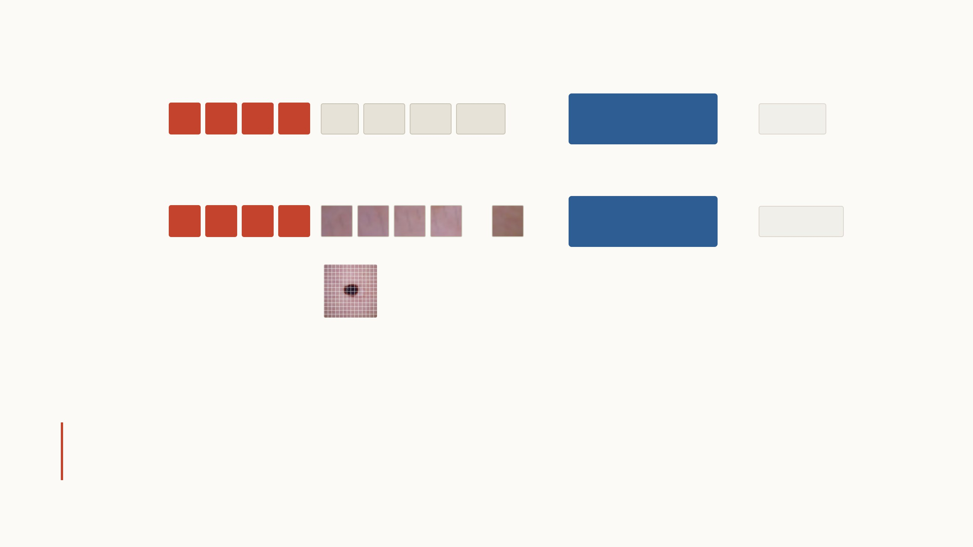
A visual prompt is the same idea applied to image patches
Language
→
frozen language
model
→
the
film
was
great
positive
Lester et al. 2021
learned prompt: random at
first, trained for the task,
same for every input
↑
“the film was great”
Vision
…
→
frozen Vision
Transformer
→
melanoma
Jia et al. 2022
learned prompt: random at
first, trained for the task,
same for every image
↑
all 196 patches
of the image
The grey vectors come from the input, as before. The red ones do not: they start as random numbers, are trained on the task's
examples while the model stays frozen, and are then put in front of every input of that task. A visual prompt is therefore not
text and not a pattern painted on the pixels, only learned numbers in the model's input space.
In language, prompt tuning matched full fine-tuning only once the model had about 10 billion
weights. VPT beats full fine-tuning on 20 of 24 tasks with an 86-million-weight ViT-B.
Lester et al. 2021 (T5); Jia et al. 2022, Table 1. Not to be confused with CoOp (Zhou et al. 2021, text prompts for CLIP) or Bahng et al. 2022 (a pixel pattern).
7
Notes:
The one-sentence version: VPT is prompt tuning for a Vision Transformer. Both rows learn vectors in the model's input space and leave the model alone; the only difference is where the other vectors come from, words or image patches. Say plainly what it is not: not the text prompts for CLIP that CoOp learns, and not a learned pattern painted on the pixels as in Bahng et al.; the paper tests the pixel version too and it is clearly weaker. Then the surprise: in language, learned prompts needed about 10 billion weights to match full fine-tuning; VPT beats it on 20 of 24 tasks with 86 million. The authors themselves suggest vision prompts may behave differently from language prompts. Point at the labels under each row: the grey vectors come from the input, the red ones never do; they start random, are trained on the task, and the same set goes in front of every image of that task.

Slide 10
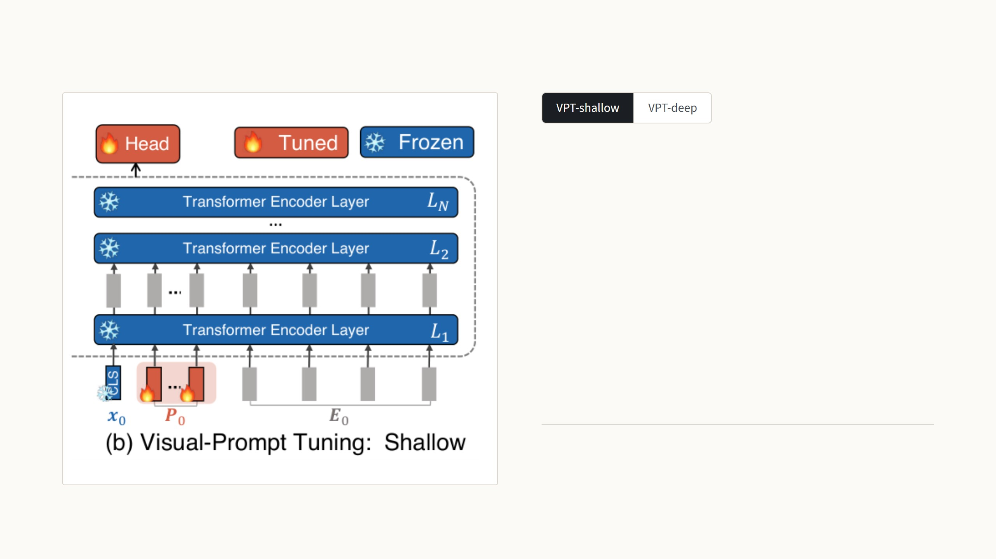
VPT trains a few extra input vectors and the head
The p prompt vectors P are added once, before the first
layer. After that they pass through the 12 frozen layers like
any other token.
[x1, Z1, E1] = L1([x0, P, E0])prompts enter once
[xi, Zi, Ei] = Li([xi−1, Zi−1, Ei−1])i = 2 … 12
y = Head(x12)
Per task, only the red parts are trained and saved: 50 prompt
vectors and the head, 0.14% of the model.
Figures: Jia et al. 2022, Fig. 2. Equations (6) and (8) of the paper: x class token, E patch vectors, P prompts, Z the prompt positions after a layer, Li layer i.
8
Notes:
Shallow first: p red vectors are put in front of the patch vectors once, before layer 1. They then travel through all 12 frozen layers like any other token; the paper calls their outputs Z. Only P and the head are trained, about 0.14% of the model for 50 prompts and a 102-class head. Press the arrow key for deep: every layer gets its own fresh set of p vectors, and whatever came out of the previous layer at those positions is thrown away, the blank in the equation. Twelve times the parameters, still only half a percent of the model, and deep is the variant that beats full fine-tuning. Position does not matter because prompts are added after the position embedding.

Slide 11
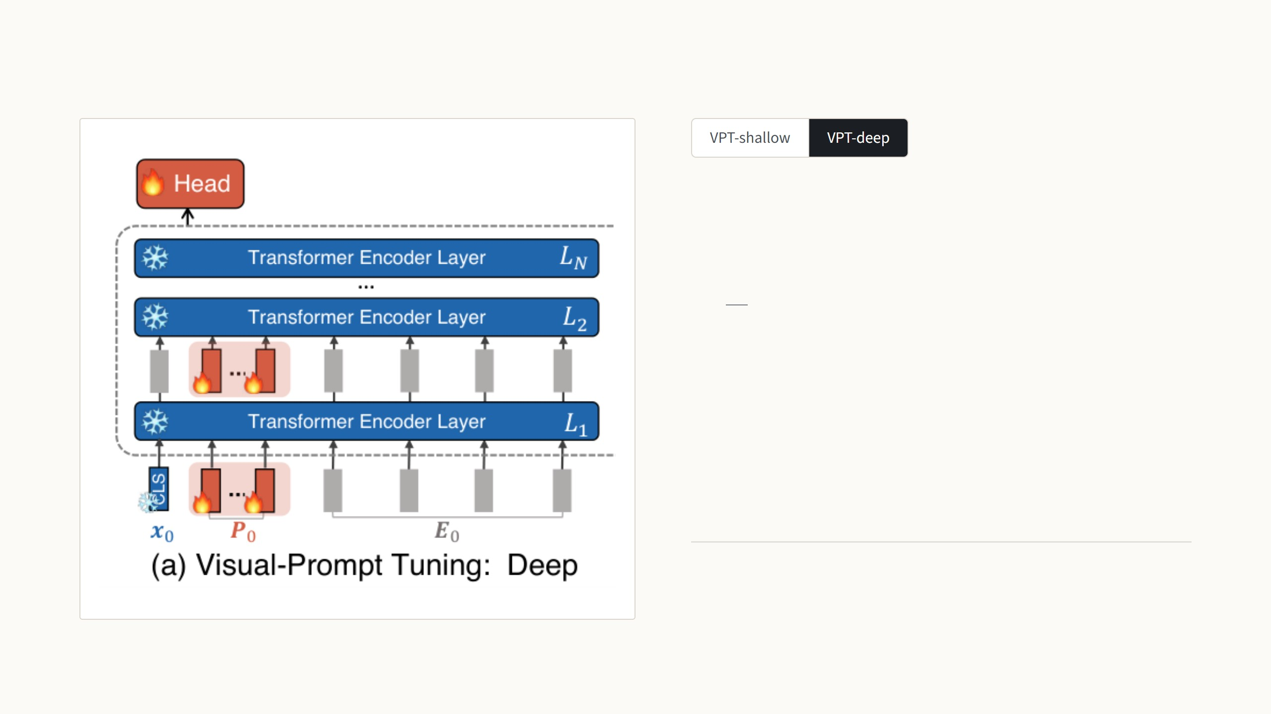
VPT trains a few extra input vectors and the head
Every layer gets its own fresh set of p prompt vectors. What
the previous layer produced at those positions is thrown
away: the blank in the equation.
[xi, , Ei] = Li([xi−1, Pi−1, Ei−1])i = 1 … 12
y = Head(x12)
Per task, only the red parts are trained and saved: 50 prompt
vectors for each layer and the head, 0.63% of the model.
Figures: Jia et al. 2022, Fig. 2. Equations (6) and (8) of the paper: x class token, E patch vectors, P prompts, Z the prompt positions after a layer, Li layer i.
8
Notes:
Shallow first: p red vectors are put in front of the patch vectors once, before layer 1. They then travel through all 12 frozen layers like any other token; the paper calls their outputs Z. Only P and the head are trained, about 0.14% of the model for 50 prompts and a 102-class head. Press the arrow key for deep: every layer gets its own fresh set of p vectors, and whatever came out of the previous layer at those positions is thrown away, the blank in the equation. Twelve times the parameters, still only half a percent of the model, and deep is the variant that beats full fine-tuning. Position does not matter because prompts are added after the position embedding.

Slide 12
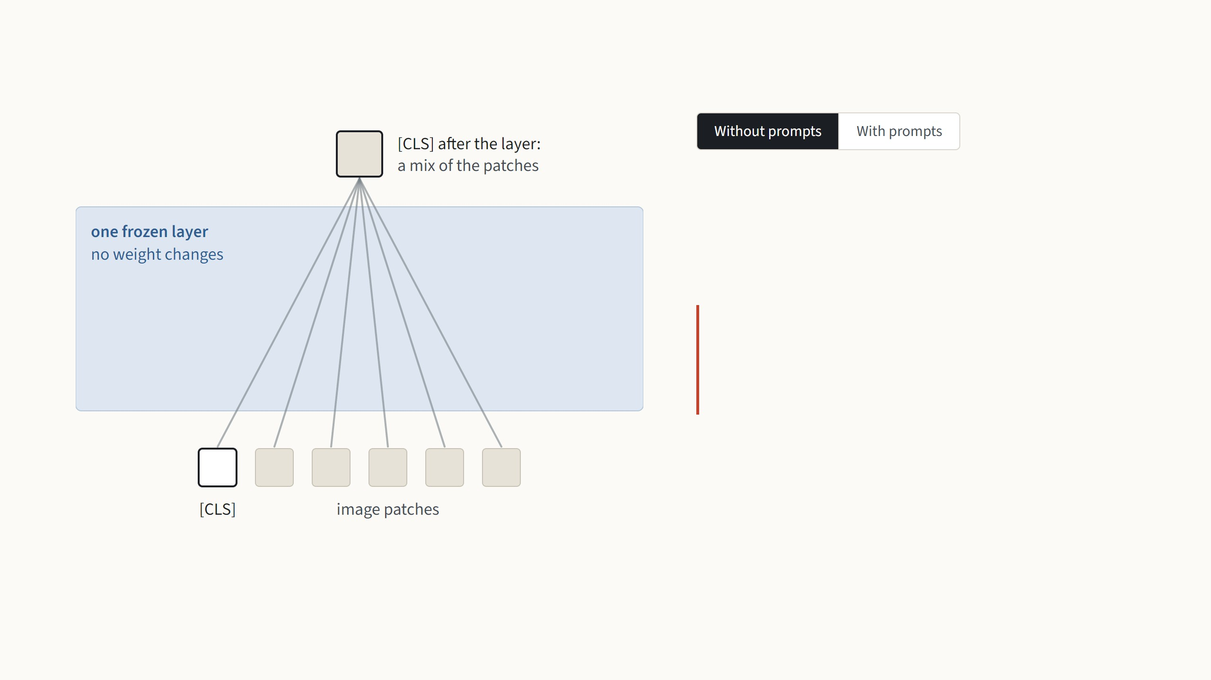
Why a few extra tokens can steer a frozen network
In every layer, each token takes in information from all
the other tokens; this is attention. With prompts in the
sequence, [CLS] and every patch also take in
information from the prompts.
So training the prompts changes what the
frozen network computes, without
changing a single weight.
Mechanism: Sec. 3 of Jia et al. 2022; Appendix B relates it to prefix-tuning ("VPT-prefix"). Line widths and the red share of [CLS] are illustrative, not measured.
9
Notes:
The intuition people need: a frozen function can still be steered if you control part of its input. Start without prompts: inside a frozen layer, the [CLS] token collects a mix of the patch tokens. Press the arrow key: the red prompts join the sequence, and now part of what [CLS] collects comes from them. Every other token sees the prompts too, at every layer. No weight changes, and nothing is read from the prompt outputs themselves; in VPT-deep they are discarded after each layer. If asked: the paper points out this is equivalent to prepending learned keys and values inside attention, which is what prefix-tuning does in NLP.

Slide 13
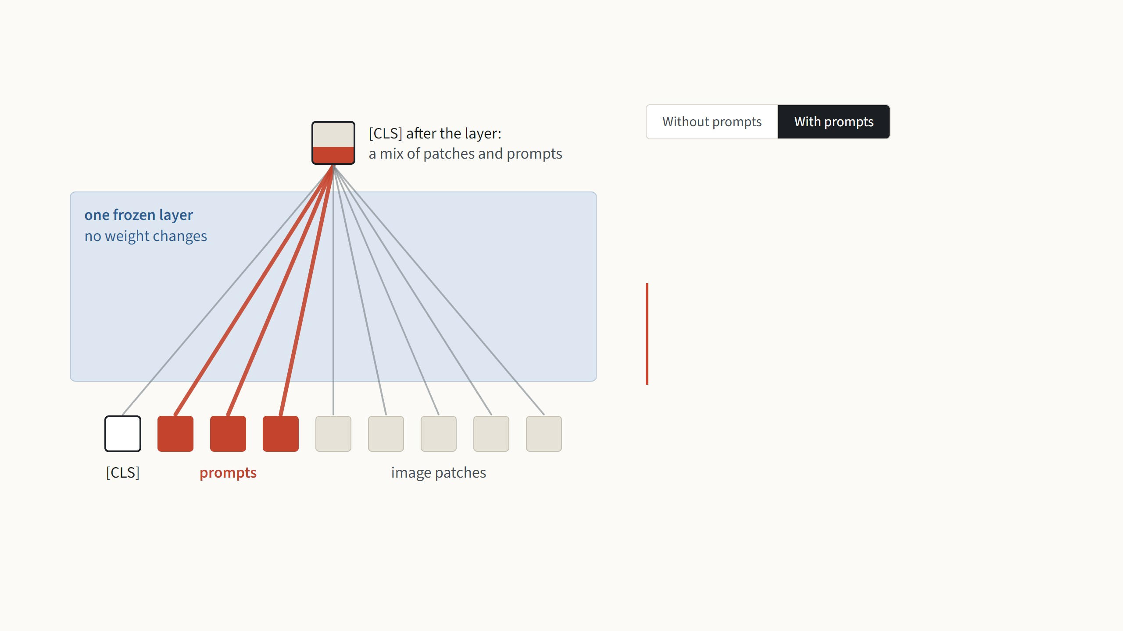
Why a few extra tokens can steer a frozen network
In every layer, each token takes in information from all
the other tokens; this is attention. With prompts in the
sequence, [CLS] and every patch also take in
information from the prompts.
So training the prompts changes what the
frozen network computes, without
changing a single weight.
Mechanism: Sec. 3 of Jia et al. 2022; Appendix B relates it to prefix-tuning ("VPT-prefix"). Line widths and the red share of [CLS] are illustrative, not measured.
9
Notes:
The intuition people need: a frozen function can still be steered if you control part of its input. Start without prompts: inside a frozen layer, the [CLS] token collects a mix of the patch tokens. Press the arrow key: the red prompts join the sequence, and now part of what [CLS] collects comes from them. Every other token sees the prompts too, at every layer. No weight changes, and nothing is read from the prompt outputs themselves; in VPT-deep they are discarded after each layer. If asked: the paper points out this is equivalent to prepending learned keys and values inside attention, which is what prefix-tuning does in NLP.

Slide 14
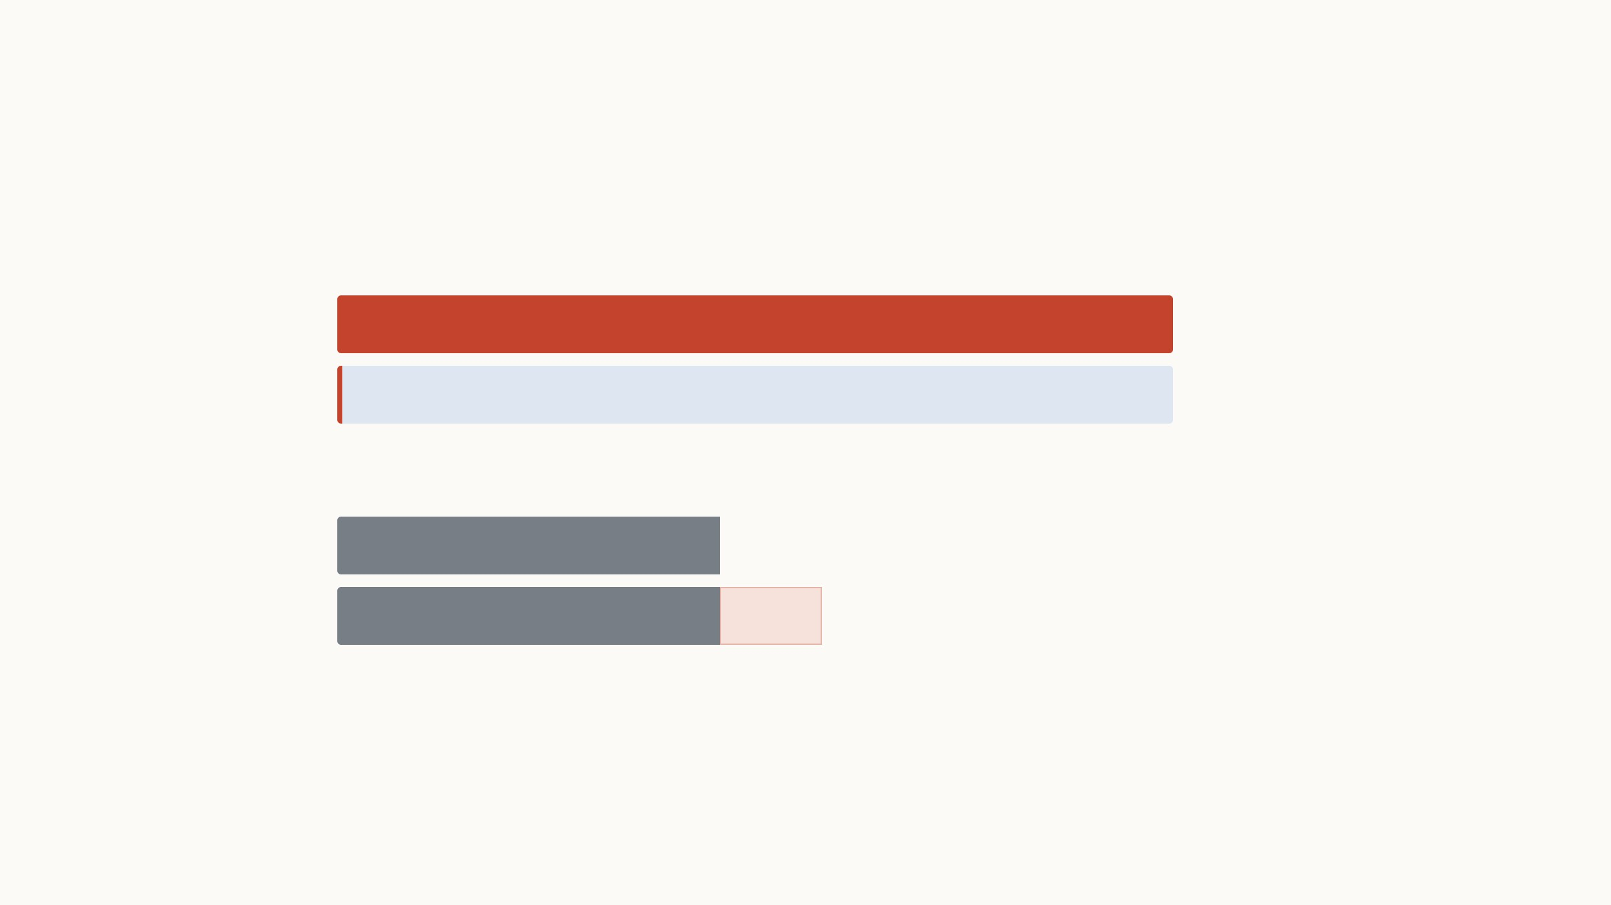
How much VPT trains and stores per task
N · p · d = 12 × 50 × 768 = 460,800prompt numbers, plus 78,438 for a 102-class head
Numbers trained and stored per task
Full fine-tuning
all 85.8 million weights, retrained for this task
343 MB100%
VPT-deep
the same 85.8 million weights, frozen and shared by every task
2.2 MB0.63%
Compute per image
Plain ViT
197 tokens
1.00×
VPT-deep
197 tokens
1.27×+50 prompt tokens
Shown for p = 50; at p = 200 the file is 7.7 MB and compute is about 2.1×. More prompts keep the file small, but every image carries them
through all 12 layers.
ViT-B/16, N = 12 layers, d = 768, 32-bit numbers. Compute counts multiply-adds per layer for n tokens (12nd² + 2n²d). The paper measures about 2× test latency at p = 200 (Jia et
al. 2022, Table 12).
10
Notes:
Section 3.2 in numbers. With 50 prompts at each of the 12 layers, VPT trains 12 × 50 × 768 = 460,800 prompt numbers plus a 78,438-number head for 102 classes: about 0.6% of the model, a 2.2 MB file per task instead of a 343 MB retrained copy. The red sliver is to scale. The honest cost is compute: the prompts are extra tokens, so each image now has 247 tokens instead of 197. Click p = 200: the file is still under 8 MB, but compute is about twice the plain ViT, which matches the roughly 2× test latency the paper measures in Table 12.

Slide 15
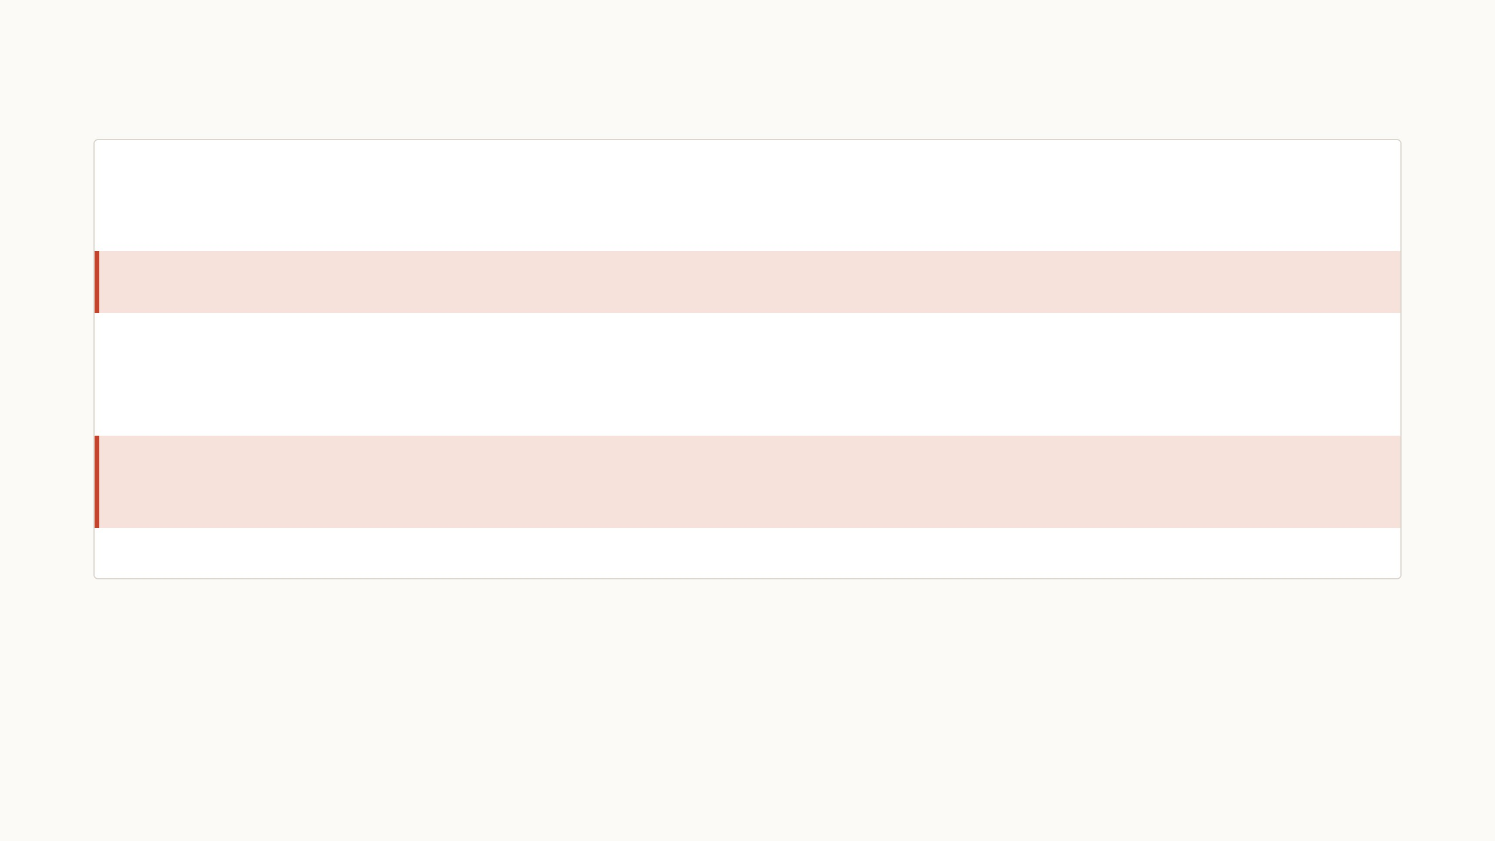
VPT in code: a few lines and one new hyperparameter
# VPT-deep on a frozen ViT-B/16, simplified from demo/vpt/vpt_model.py
vit = timm.create_model(BACKBONE, pretrained=True) # ImageNet-21k ViT-B/16
vit.requires_grad_(False) # backbone frozen
prompts = nn.Parameter(torch.empty(12, p, 768).uniform_(-b, b)) # trained: 12 layers × p × 768
head = nn.Linear(768, num_classes) # trained: the classifier
def forward(img):
x = vit._pos_embed(vit.patch_embed(img)) # [CLS] + 196 patch vectors
for i, layer in enumerate(vit.blocks):
rest = x[:, 1:] if i == 0 else x[:, 1 + p:] # drop last layer's prompts
P = prompts[i].expand(len(x), -1, -1) # this layer's prompts
x = layer(torch.cat([x[:, :1], P, rest], dim=1)) # frozen layer on [CLS, P, rest]
return head(vit.norm(x)[:, 0]) # classify from [CLS]
The prompts start random, with Xavier-
uniform values as in the official code. The
paper tried smarter starts, such as class
prototypes, and random did as well or better.
Training is plain SGD with momentum for 100
epochs on a cosine schedule. Learning rate
and weight decay are picked on a validation
split, for every method alike.
The one new hyperparameter is the prompt
length p, chosen per task from {1, 5, 10, 50,
100, 200} on the validation split.
Recipe: Jia et al. 2022, Sec. 4.1 and Appendix A. Code is my re-implementation, which reproduces the paper's Oxford Flowers result (99.1% vs the paper's 99.0%).
11
Notes:
The code is there to make it concrete, not to read line by line. The red lines are the whole method: a prompt tensor of 12 × p × 768 numbers, a head, and three lines inside the layer loop. The first of those slices away what the previous layer produced at the prompt positions, then this layer's fresh prompts go in next to [CLS] and the patches, and the frozen layer runs as usual. Underneath: random initialisation is fine, the optimiser is standard SGD, and the only new knob is p, picked on validation.

Slide 16
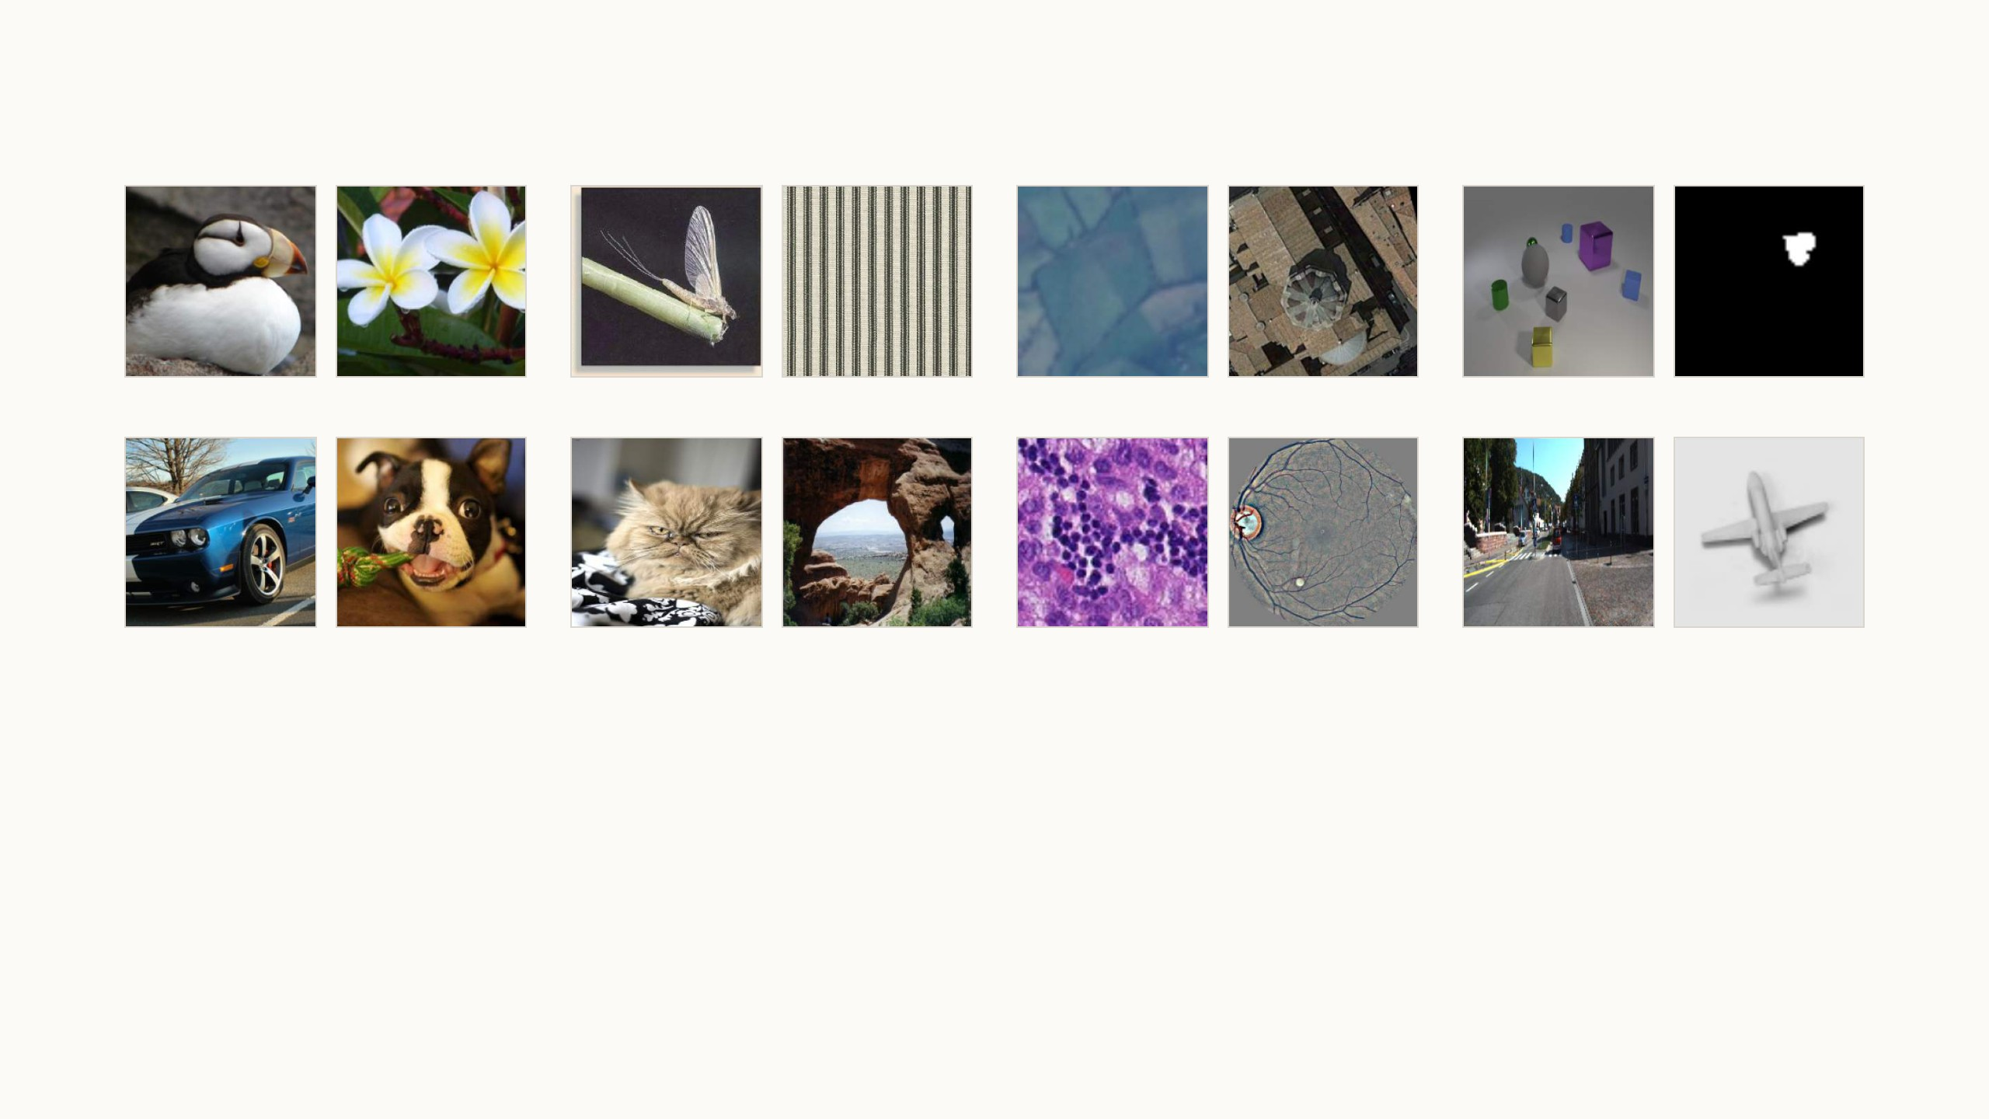
The paper tests VPT on 24 very different tasks
CUB-200
Oxford Flowers
Caltech101
DTD
EuroSAT
Resisc45
CLEVR count
dSprites location
Stanford Cars
Stanford Dogs
Oxford Pets
SUN397
Patch Camelyon
Retinopathy
KITTI distance
SmallNORB azimuth
FGVC, 5 tasks
VTAB Natural, 7 tasks
VTAB Specialized, 4 tasks
VTAB Structured, 8 tasks
Fine-grained categories, such as
200 bird species, with thousands
of training images.
Ordinary photos of objects,
textures, animals and scenes,
close to the pretraining data.
Images from special sensors:
satellites, tissue slides under a
microscope, and retina cameras.
Geometry instead of categories,
such as counting objects or
judging distance.
All 24 tasks use the same frozen ViT-B/16, pretrained on ImageNet-21k. The 19 VTAB tasks have only 1,000 training images each.
Images: Jia et al. 2022, Fig. 10, four example tasks per group. VTAB-1k: Zhai et al. 2019.
12
Notes:
Four groups, four example tasks each, 24 tasks in all. FGVC is fine-grained recognition with plenty of data: bird species, flowers, car models, dog breeds. The other 19 come from VTAB and have only 1,000 training images each, so this is a low-data benchmark. Natural is ordinary photos, closest to what the backbone saw in pretraining. Specialized is special sensors: satellite images, tissue slides, retina scans. Structured asks about geometry, such as how many objects there are or how far away the car in front is, and it is furthest from ImageNet, so it is the group to watch. The backbone is the same frozen ViT-B/16 for every task. Hyperparameters are picked on an 800/200 split of the 1,000 images, then the model is retrained on all 1,000.

Slide 17
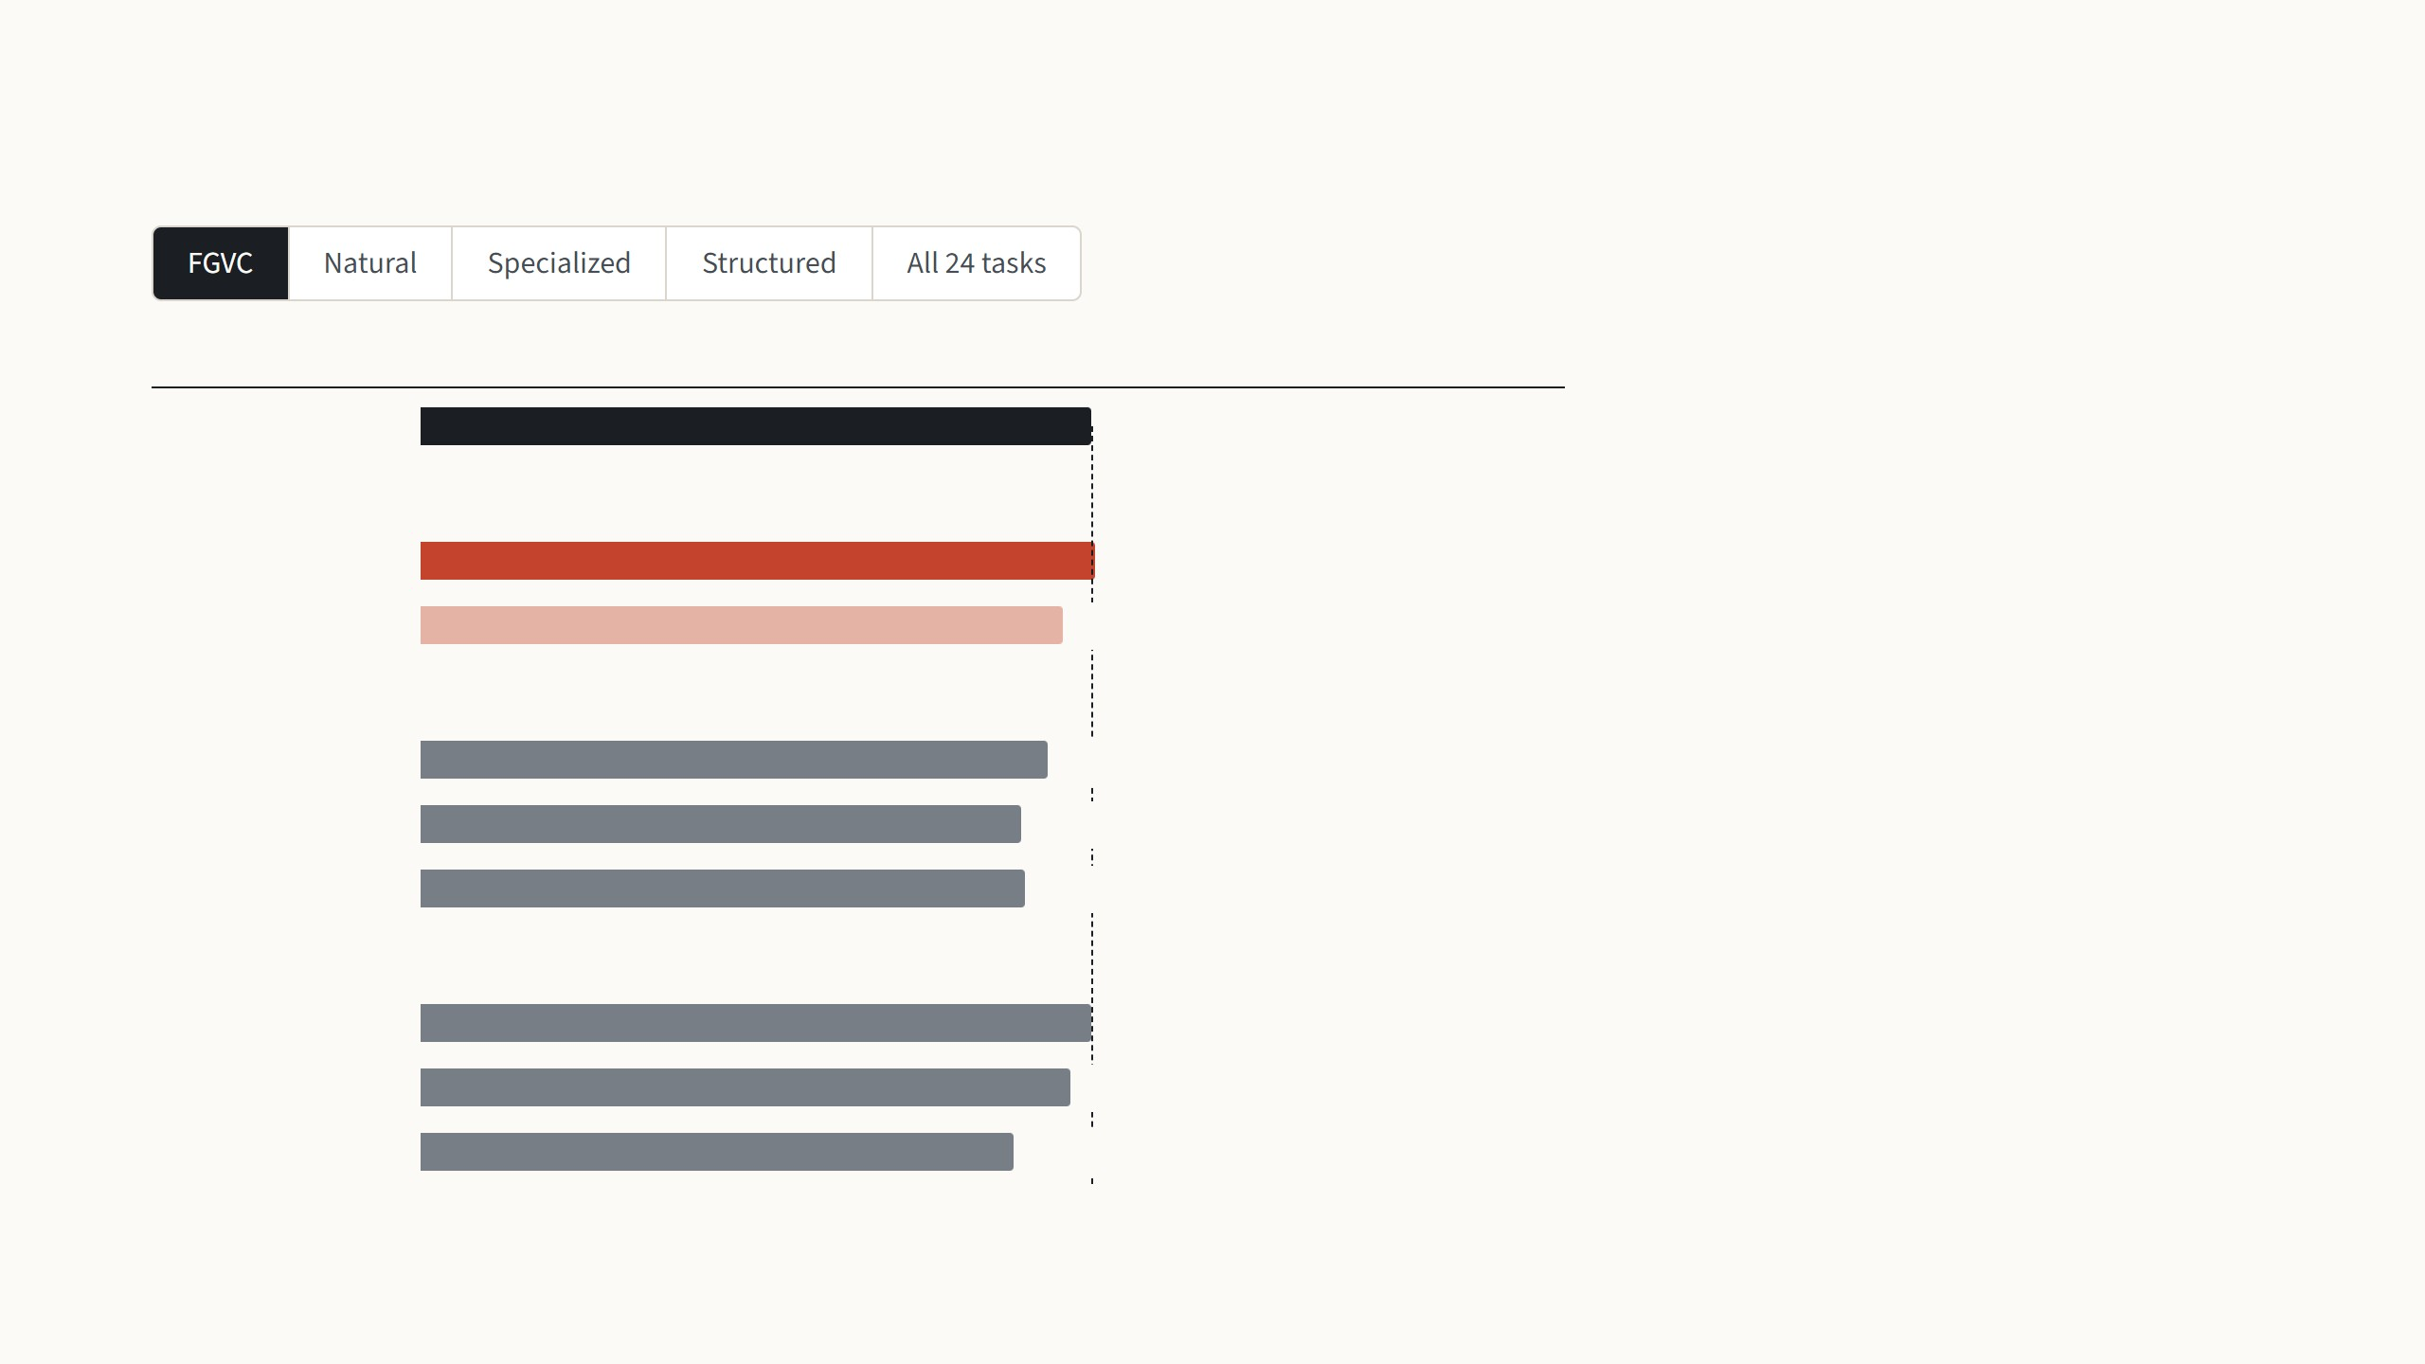
VPT-deep beats full fine-tuning on 20 of 24 tasks
Mean accuracy (%)
Beats full fine-tuning on
These five tasks ask the model to tell
apart 200 bird species, 196 car models,
120 dog breeds or 102 kinds of flower,
with thousands of training images per
task.
Full fine-tuning
88.5
Extra input vectors are trained
VPT-deep
89.1
4 of 5 tasks
VPT-shallow
84.6
1 of 5 tasks
Every method does well on such photos,
and VPT-deep only edges out full fine-
tuning, 89.1 against 88.5.
Only the top of the model is trained
Partial-1
82.6
0 of 5 tasks
Linear probe
79.3
0 of 5 tasks
MLP-3 head
79.8
0 of 5 tasks
Small parts in or beside the backbone are trained
Bias
88.4
3 of 5 tasks
Adapter
85.7
2 of 5 tasks
Sidetune
78.3
0 of 5 tasks
Jia et al. 2022, Table 1 and Tables 13–14: ViT-B/16 pretrained on ImageNet-21k, mean test accuracy within each group. For all 24 tasks, the mean of the four group averages.
13
Notes:
Step through the four groups with the arrow keys, then the summary. The chart keeps the families from the cheaper-methods slide: full fine-tuning on top with the dashed line at its score, VPT in red, the older cheap methods in grey. The right column counts the tasks on which a method beats full fine-tuning. FGVC: everyone is strong, VPT-deep edges ahead, 89.1 vs 88.5, and loses only Stanford Cars. Natural: only 1,000 training images, so full fine-tuning overfits; VPT-deep wins 6 of 7, losing SVHN, and even VPT-shallow is above full. Specialized: the one group VPT-deep loses on average, 82.4 vs 83.4, losing Resisc45 and Retinopathy; medical images come back in my own results. Structured: the biggest gap, 55.0 vs 47.6, all 8 tasks won; the linear probe collapses to 26.8, so the frozen features alone do not hold this information, and the prompts make the frozen network compute it. All 24: VPT-deep is the only cheap method above full fine-tuning, 76.3 vs 73.9, with 20 wins, and its total storage for 24 tasks is 1.18 backbones against 24.02.

Slide 18
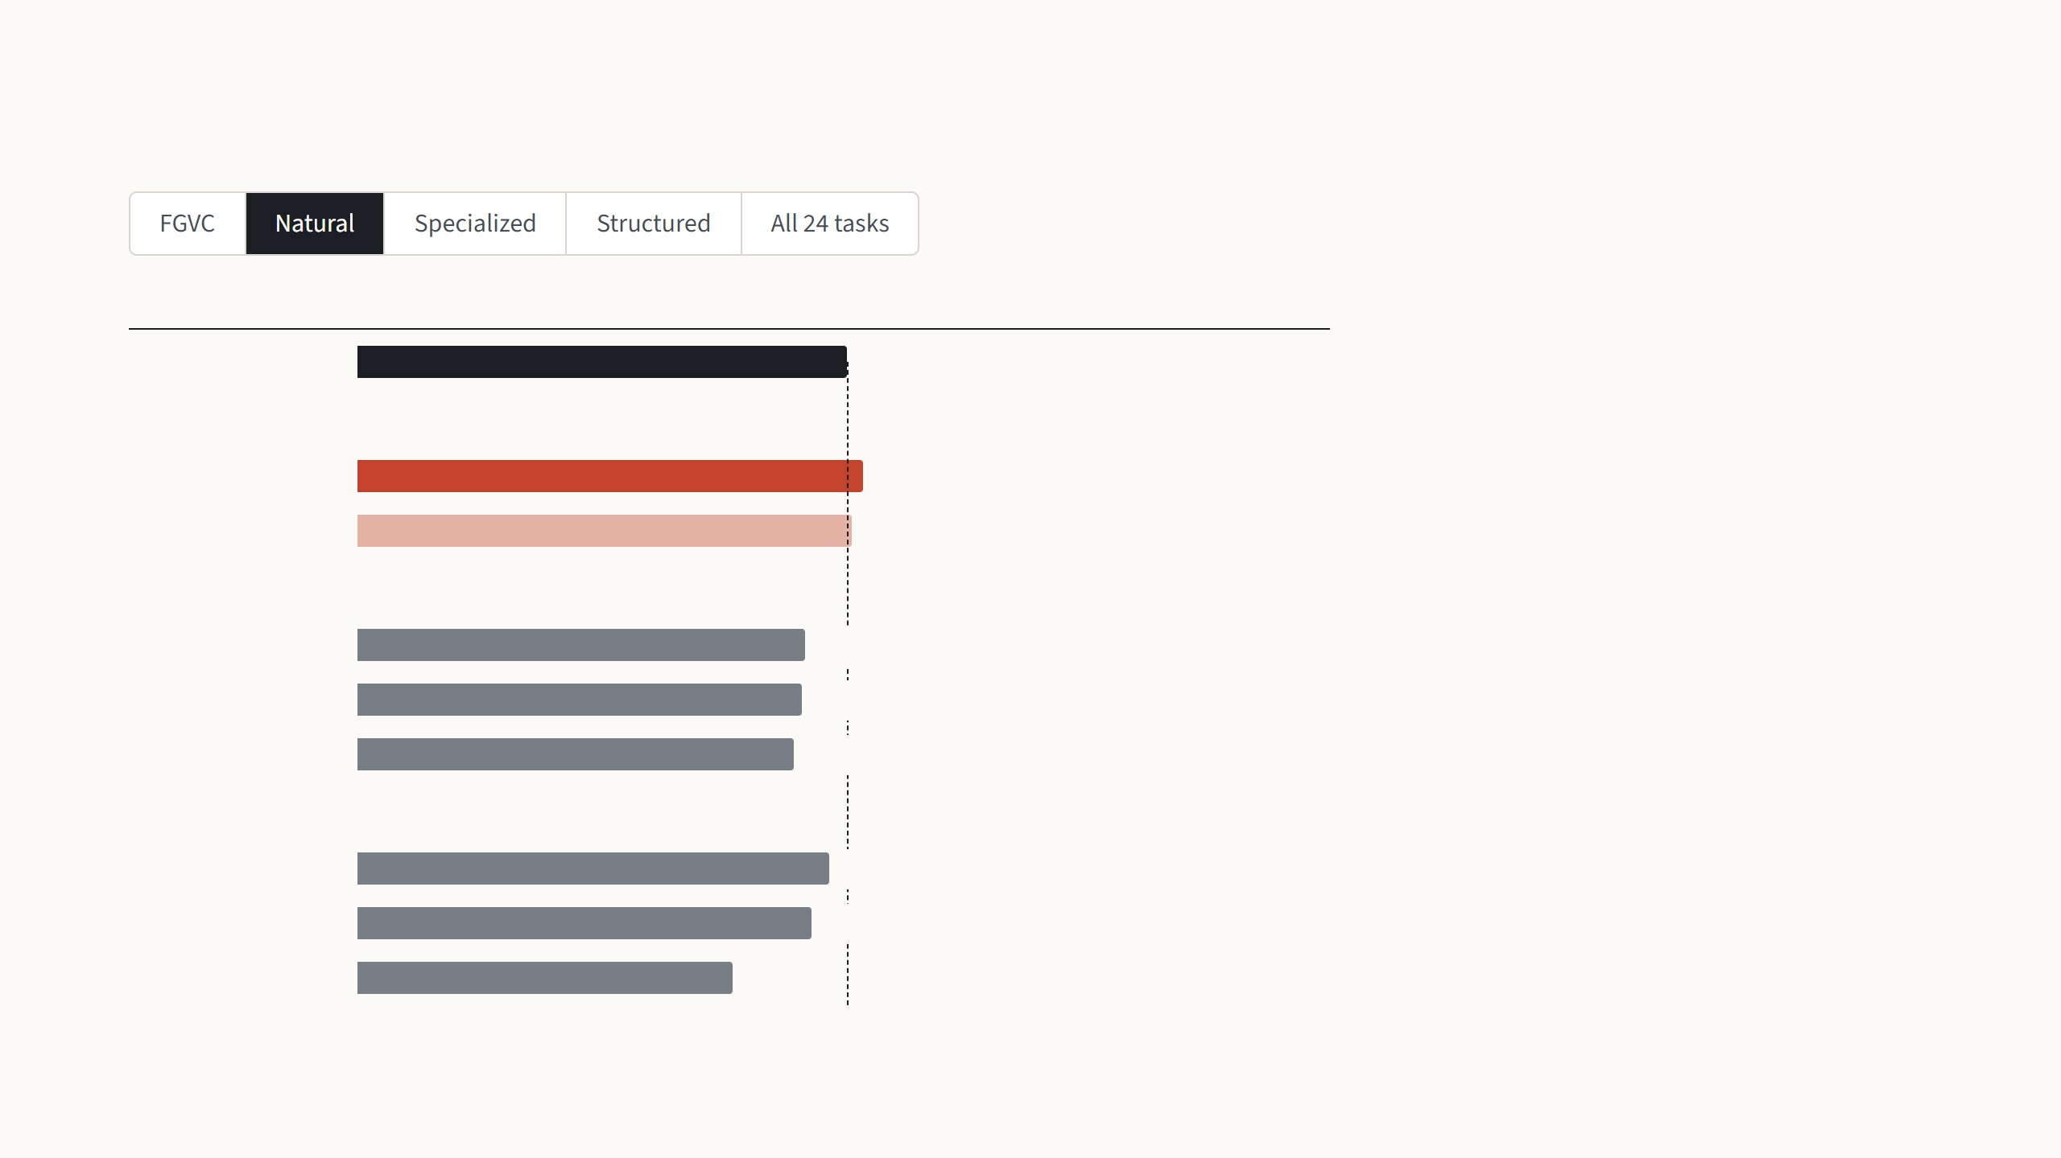
VPT-deep beats full fine-tuning on 20 of 24 tasks
Mean accuracy (%)
Beats full fine-tuning on
These seven tasks use ordinary photos of
objects, pets, textures, scenes and house
numbers, close to what the model saw in
pretraining, but with only 1,000 training
images each.
Full fine-tuning
75.9
Extra input vectors are trained
VPT-deep
78.5
6 of 7 tasks
VPT-shallow
76.8
4 of 7 tasks
With so little data, retraining all 86 million
weights overfits, so even VPT-shallow
beats full fine-tuning here.
Only the top of the model is trained
Partial-1
69.4
2 of 7 tasks
Linear probe
68.9
1 of 7 tasks
MLP-3 head
67.8
2 of 7 tasks
Small parts in or beside the backbone are trained
Bias
73.3
3 of 7 tasks
Adapter
70.4
4 of 7 tasks
Sidetune
58.2
0 of 7 tasks
Jia et al. 2022, Table 1 and Tables 13–14: ViT-B/16 pretrained on ImageNet-21k, mean test accuracy within each group. For all 24 tasks, the mean of the four group averages.
13
Notes:
Step through the four groups with the arrow keys, then the summary. The chart keeps the families from the cheaper-methods slide: full fine-tuning on top with the dashed line at its score, VPT in red, the older cheap methods in grey. The right column counts the tasks on which a method beats full fine-tuning. FGVC: everyone is strong, VPT-deep edges ahead, 89.1 vs 88.5, and loses only Stanford Cars. Natural: only 1,000 training images, so full fine-tuning overfits; VPT-deep wins 6 of 7, losing SVHN, and even VPT-shallow is above full. Specialized: the one group VPT-deep loses on average, 82.4 vs 83.4, losing Resisc45 and Retinopathy; medical images come back in my own results. Structured: the biggest gap, 55.0 vs 47.6, all 8 tasks won; the linear probe collapses to 26.8, so the frozen features alone do not hold this information, and the prompts make the frozen network compute it. All 24: VPT-deep is the only cheap method above full fine-tuning, 76.3 vs 73.9, with 20 wins, and its total storage for 24 tasks is 1.18 backbones against 24.02.

Slide 19
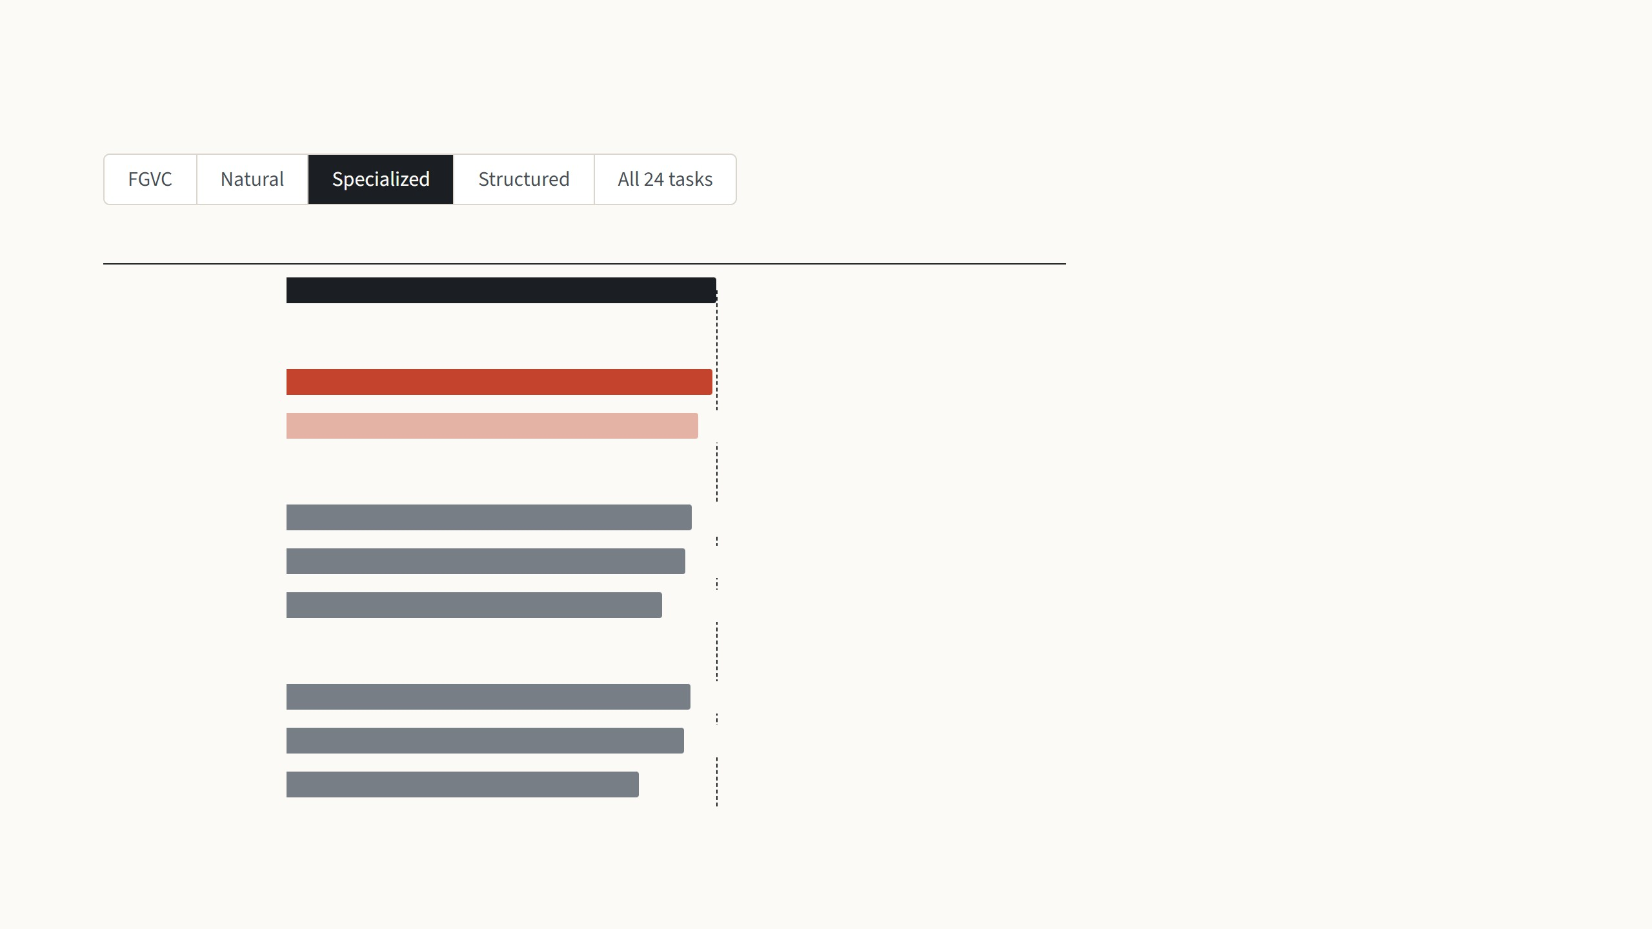
VPT-deep beats full fine-tuning on 20 of 24 tasks
Mean accuracy (%)
Beats full fine-tuning on
These four tasks come from special
cameras: satellite images of land use,
microscope slides of tumour tissue and
photos of the retina, with 1,000 training
images each.
Full fine-tuning
83.4
Extra input vectors are trained
VPT-deep
82.4
2 of 4 tasks
VPT-shallow
79.7
0 of 4 tasks
This is the one group where full fine-
tuning stays ahead, by one point, but
VPT-deep is still the best of the cheap
methods.
Only the top of the model is trained
Partial-1
78.5
0 of 4 tasks
Linear probe
77.2
1 of 4 tasks
MLP-3 head
72.8
0 of 4 tasks
Small parts in or beside the backbone are trained
Bias
78.3
0 of 4 tasks
Adapter
77.1
0 of 4 tasks
Sidetune
68.1
0 of 4 tasks
Jia et al. 2022, Table 1 and Tables 13–14: ViT-B/16 pretrained on ImageNet-21k, mean test accuracy within each group. For all 24 tasks, the mean of the four group averages.
13
Notes:
Step through the four groups with the arrow keys, then the summary. The chart keeps the families from the cheaper-methods slide: full fine-tuning on top with the dashed line at its score, VPT in red, the older cheap methods in grey. The right column counts the tasks on which a method beats full fine-tuning. FGVC: everyone is strong, VPT-deep edges ahead, 89.1 vs 88.5, and loses only Stanford Cars. Natural: only 1,000 training images, so full fine-tuning overfits; VPT-deep wins 6 of 7, losing SVHN, and even VPT-shallow is above full. Specialized: the one group VPT-deep loses on average, 82.4 vs 83.4, losing Resisc45 and Retinopathy; medical images come back in my own results. Structured: the biggest gap, 55.0 vs 47.6, all 8 tasks won; the linear probe collapses to 26.8, so the frozen features alone do not hold this information, and the prompts make the frozen network compute it. All 24: VPT-deep is the only cheap method above full fine-tuning, 76.3 vs 73.9, with 20 wins, and its total storage for 24 tasks is 1.18 backbones against 24.02.

Slide 20
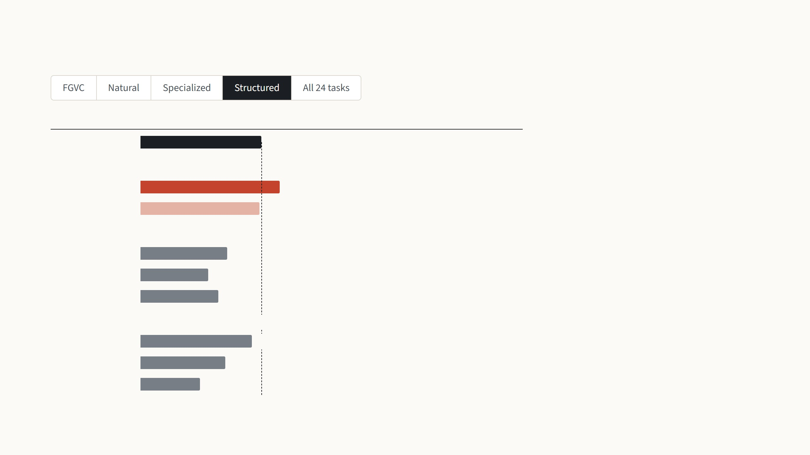
VPT-deep beats full fine-tuning on 20 of 24 tasks
Mean accuracy (%)
Beats full fine-tuning on
These eight tasks ask about geometry
rather than objects: how many things
there are, how far away, at what angle.
Most are synthetic scenes, far from
ImageNet.
Full fine-tuning
47.6
Extra input vectors are trained
VPT-deep
55.0
8 of 8 tasks
VPT-shallow
47.0
4 of 8 tasks
Here VPT-deep wins all eight, 55.0 against
47.6, while the linear probe falls to 26.8,
so the frozen features alone do not hold
this information.
Only the top of the model is trained
Partial-1
34.2
0 of 8 tasks
Linear probe
26.8
0 of 8 tasks
MLP-3 head
30.6
0 of 8 tasks
Small parts in or beside the backbone are trained
Bias
44.1
2 of 8 tasks
Adapter
33.4
0 of 8 tasks
Sidetune
23.4
0 of 8 tasks
Jia et al. 2022, Table 1 and Tables 13–14: ViT-B/16 pretrained on ImageNet-21k, mean test accuracy within each group. For all 24 tasks, the mean of the four group averages.
13
Notes:
Step through the four groups with the arrow keys, then the summary. The chart keeps the families from the cheaper-methods slide: full fine-tuning on top with the dashed line at its score, VPT in red, the older cheap methods in grey. The right column counts the tasks on which a method beats full fine-tuning. FGVC: everyone is strong, VPT-deep edges ahead, 89.1 vs 88.5, and loses only Stanford Cars. Natural: only 1,000 training images, so full fine-tuning overfits; VPT-deep wins 6 of 7, losing SVHN, and even VPT-shallow is above full. Specialized: the one group VPT-deep loses on average, 82.4 vs 83.4, losing Resisc45 and Retinopathy; medical images come back in my own results. Structured: the biggest gap, 55.0 vs 47.6, all 8 tasks won; the linear probe collapses to 26.8, so the frozen features alone do not hold this information, and the prompts make the frozen network compute it. All 24: VPT-deep is the only cheap method above full fine-tuning, 76.3 vs 73.9, with 20 wins, and its total storage for 24 tasks is 1.18 backbones against 24.02.

Slide 21
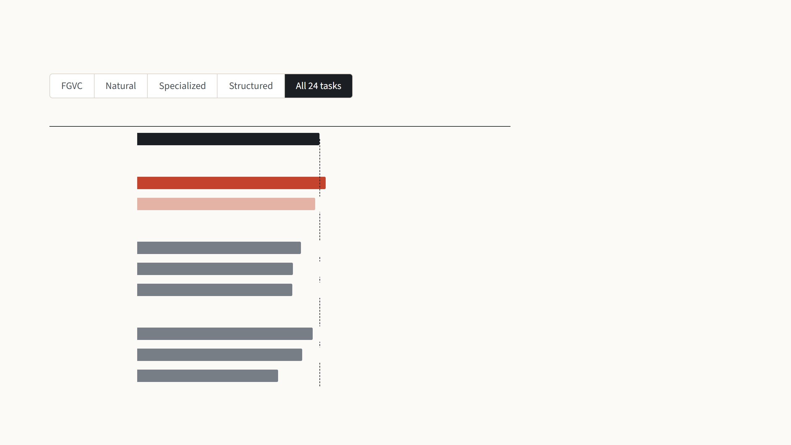
VPT-deep beats full fine-tuning on 20 of 24 tasks
Mean accuracy (%)
Beats full fine-tuning on
Averaged over all 24 tasks, VPT-deep is
the only cheap method above full fine-
tuning, 76.3 against 73.9.
Full fine-tuning
73.9
Extra input vectors are trained
VPT-deep
76.3
20 of 24 tasks
It gets there while storing 1.18
backbones' worth of weights for the 24
tasks, where full fine-tuning stores 24.
VPT-shallow
72.0
9 of 24 tasks
Only the top of the model is trained
Partial-1
66.2
2 of 24 tasks
Linear probe
63.1
2 of 24 tasks
MLP-3 head
62.8
2 of 24 tasks
Small parts in or beside the backbone are trained
Bias
71.0
8 of 24 tasks
Adapter
66.6
6 of 24 tasks
Sidetune
57.0
0 of 24 tasks
Jia et al. 2022, Table 1 and Tables 13–14: ViT-B/16 pretrained on ImageNet-21k, mean test accuracy within each group. For all 24 tasks, the mean of the four group averages.
13
Notes:
Step through the four groups with the arrow keys, then the summary. The chart keeps the families from the cheaper-methods slide: full fine-tuning on top with the dashed line at its score, VPT in red, the older cheap methods in grey. The right column counts the tasks on which a method beats full fine-tuning. FGVC: everyone is strong, VPT-deep edges ahead, 89.1 vs 88.5, and loses only Stanford Cars. Natural: only 1,000 training images, so full fine-tuning overfits; VPT-deep wins 6 of 7, losing SVHN, and even VPT-shallow is above full. Specialized: the one group VPT-deep loses on average, 82.4 vs 83.4, losing Resisc45 and Retinopathy; medical images come back in my own results. Structured: the biggest gap, 55.0 vs 47.6, all 8 tasks won; the linear probe collapses to 26.8, so the frozen features alone do not hold this information, and the prompts make the frozen network compute it. All 24: VPT-deep is the only cheap method above full fine-tuning, 76.3 vs 73.9, with 20 wins, and its total storage for 24 tasks is 1.18 backbones against 24.02.

Slide 22
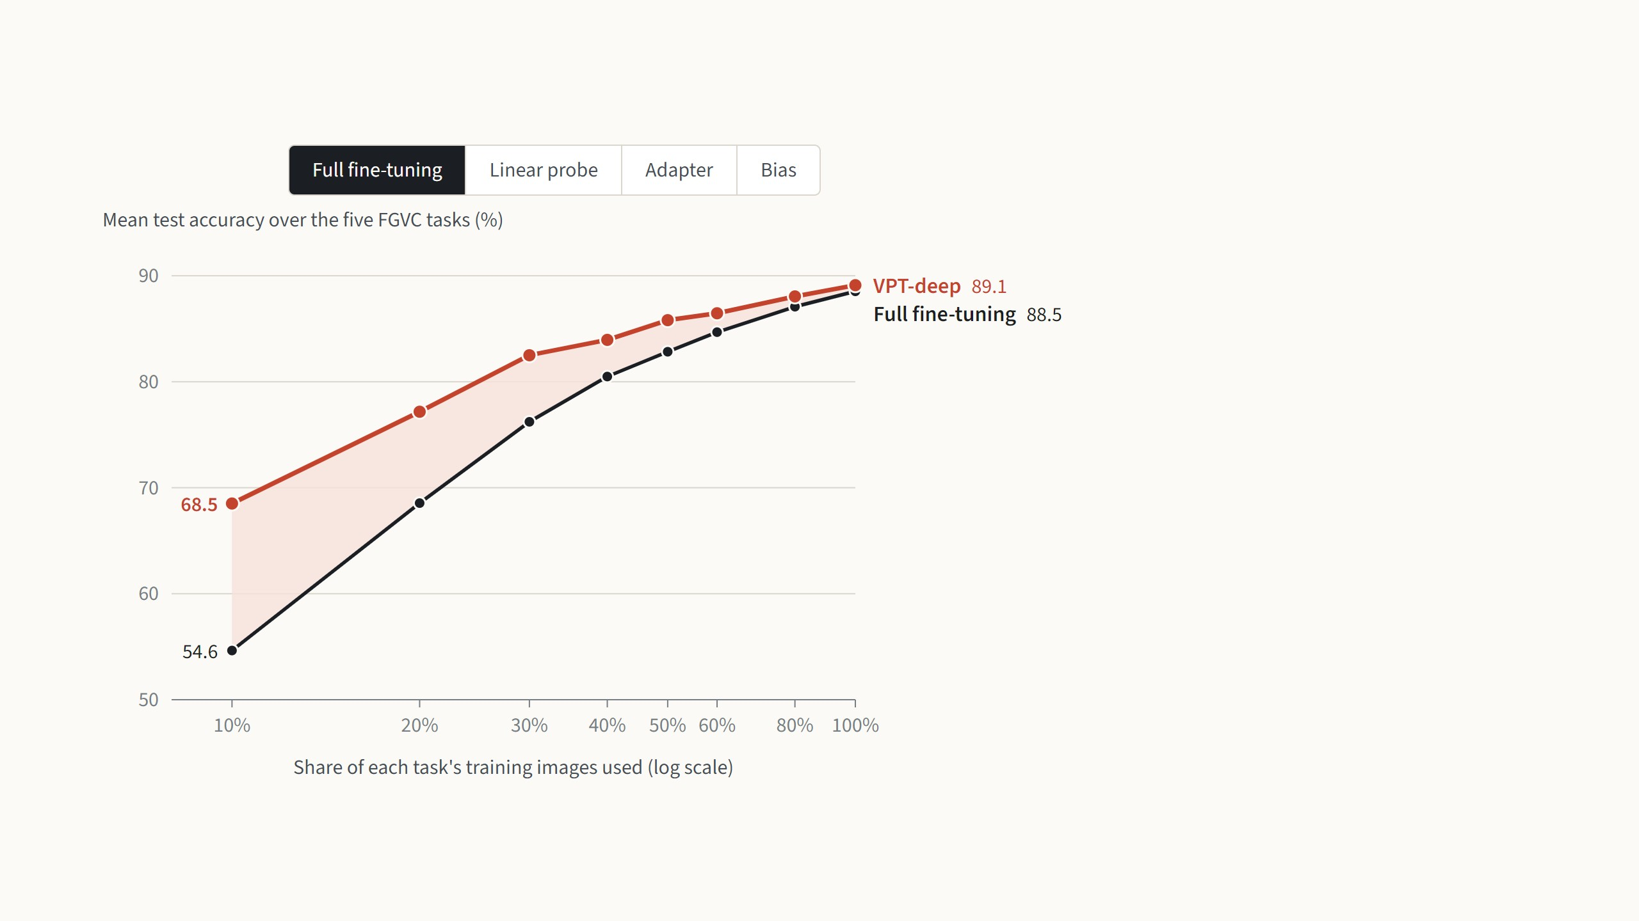
VPT leads with little data and stays ahead with more
VPT-deep against
With a tenth of the training images,
full fine-tuning has too many weights
to fit and falls 14 points behind
VPT-deep.
The gap shrinks as the data grows,
but VPT-deep stays ahead all the way
to the full training set.
Jia et al. 2022, Fig. 3: ViT-B/16, mean test accuracy over the five FGVC tasks, each method trained on a share of every task's training images. The paper gives these values only as a
figure; they were read from its vector drawing in the PDF, and the 100% points match Table 1.
14
Notes:
This is the paper's Fig. 3, redrawn one comparison at a time. Each point is the average test accuracy over the five FGVC tasks when the method is trained on 10% up to 100% of every task's training images; the axis is logarithmic, as in the paper. Start with full fine-tuning: with 10% of the images it falls to 54.6 against 68.5 for VPT-deep, because it has 86 million weights to fit with very few examples. With all the data the two almost meet, 89.1 against 88.5, but VPT-deep is never below. Then step through the baselines. The linear probe is the classic low-data trick: good at 10%, overtaken by full fine-tuning from 30% on. The adapter is overtaken from 40% on. Bias is the strongest rival and beats full fine-tuning up to 80% of the data, but VPT-deep is above it at every point. So VPT is not just a low-data trick. VPT-shallow is left out to keep the chart readable; it always sits between the linear probe and VPT-deep. If asked: the paper publishes these numbers only as a figure; I read them from the figure's vector data in the PDF, and the 100% points match Table 1 to within 0.01.

Slide 23
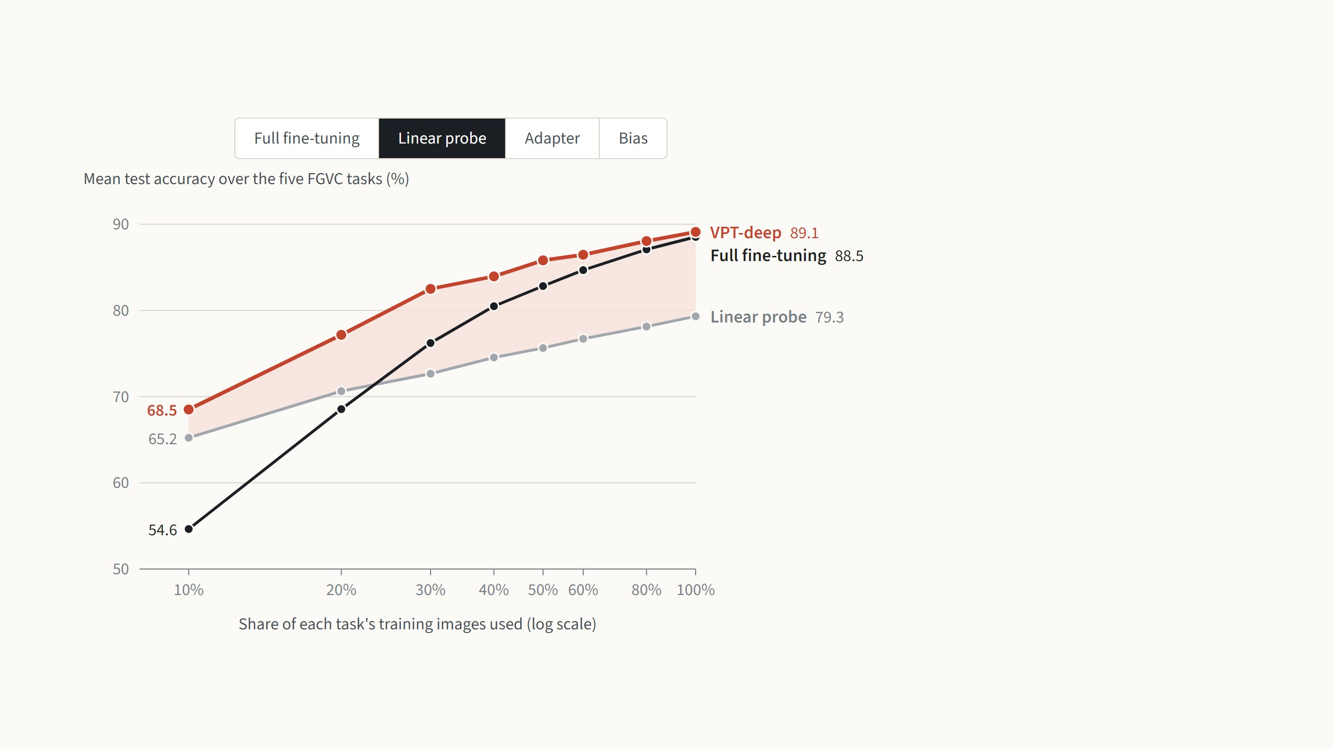
VPT leads with little data and stays ahead with more
VPT-deep against
The linear probe trains only a new
output layer, so it does well when
data is scarce.
From 30% of the data on, full
fine-tuning overtakes it, and with all
the data it trails VPT-deep by almost
10 points.
Jia et al. 2022, Fig. 3: ViT-B/16, mean test accuracy over the five FGVC tasks, each method trained on a share of every task's training images. The paper gives these values only as a
figure; they were read from its vector drawing in the PDF, and the 100% points match Table 1.
14
Notes:
This is the paper's Fig. 3, redrawn one comparison at a time. Each point is the average test accuracy over the five FGVC tasks when the method is trained on 10% up to 100% of every task's training images; the axis is logarithmic, as in the paper. Start with full fine-tuning: with 10% of the images it falls to 54.6 against 68.5 for VPT-deep, because it has 86 million weights to fit with very few examples. With all the data the two almost meet, 89.1 against 88.5, but VPT-deep is never below. Then step through the baselines. The linear probe is the classic low-data trick: good at 10%, overtaken by full fine-tuning from 30% on. The adapter is overtaken from 40% on. Bias is the strongest rival and beats full fine-tuning up to 80% of the data, but VPT-deep is above it at every point. So VPT is not just a low-data trick. VPT-shallow is left out to keep the chart readable; it always sits between the linear probe and VPT-deep. If asked: the paper publishes these numbers only as a figure; I read them from the figure's vector data in the PDF, and the 100% points match Table 1 to within 0.01.

Slide 24
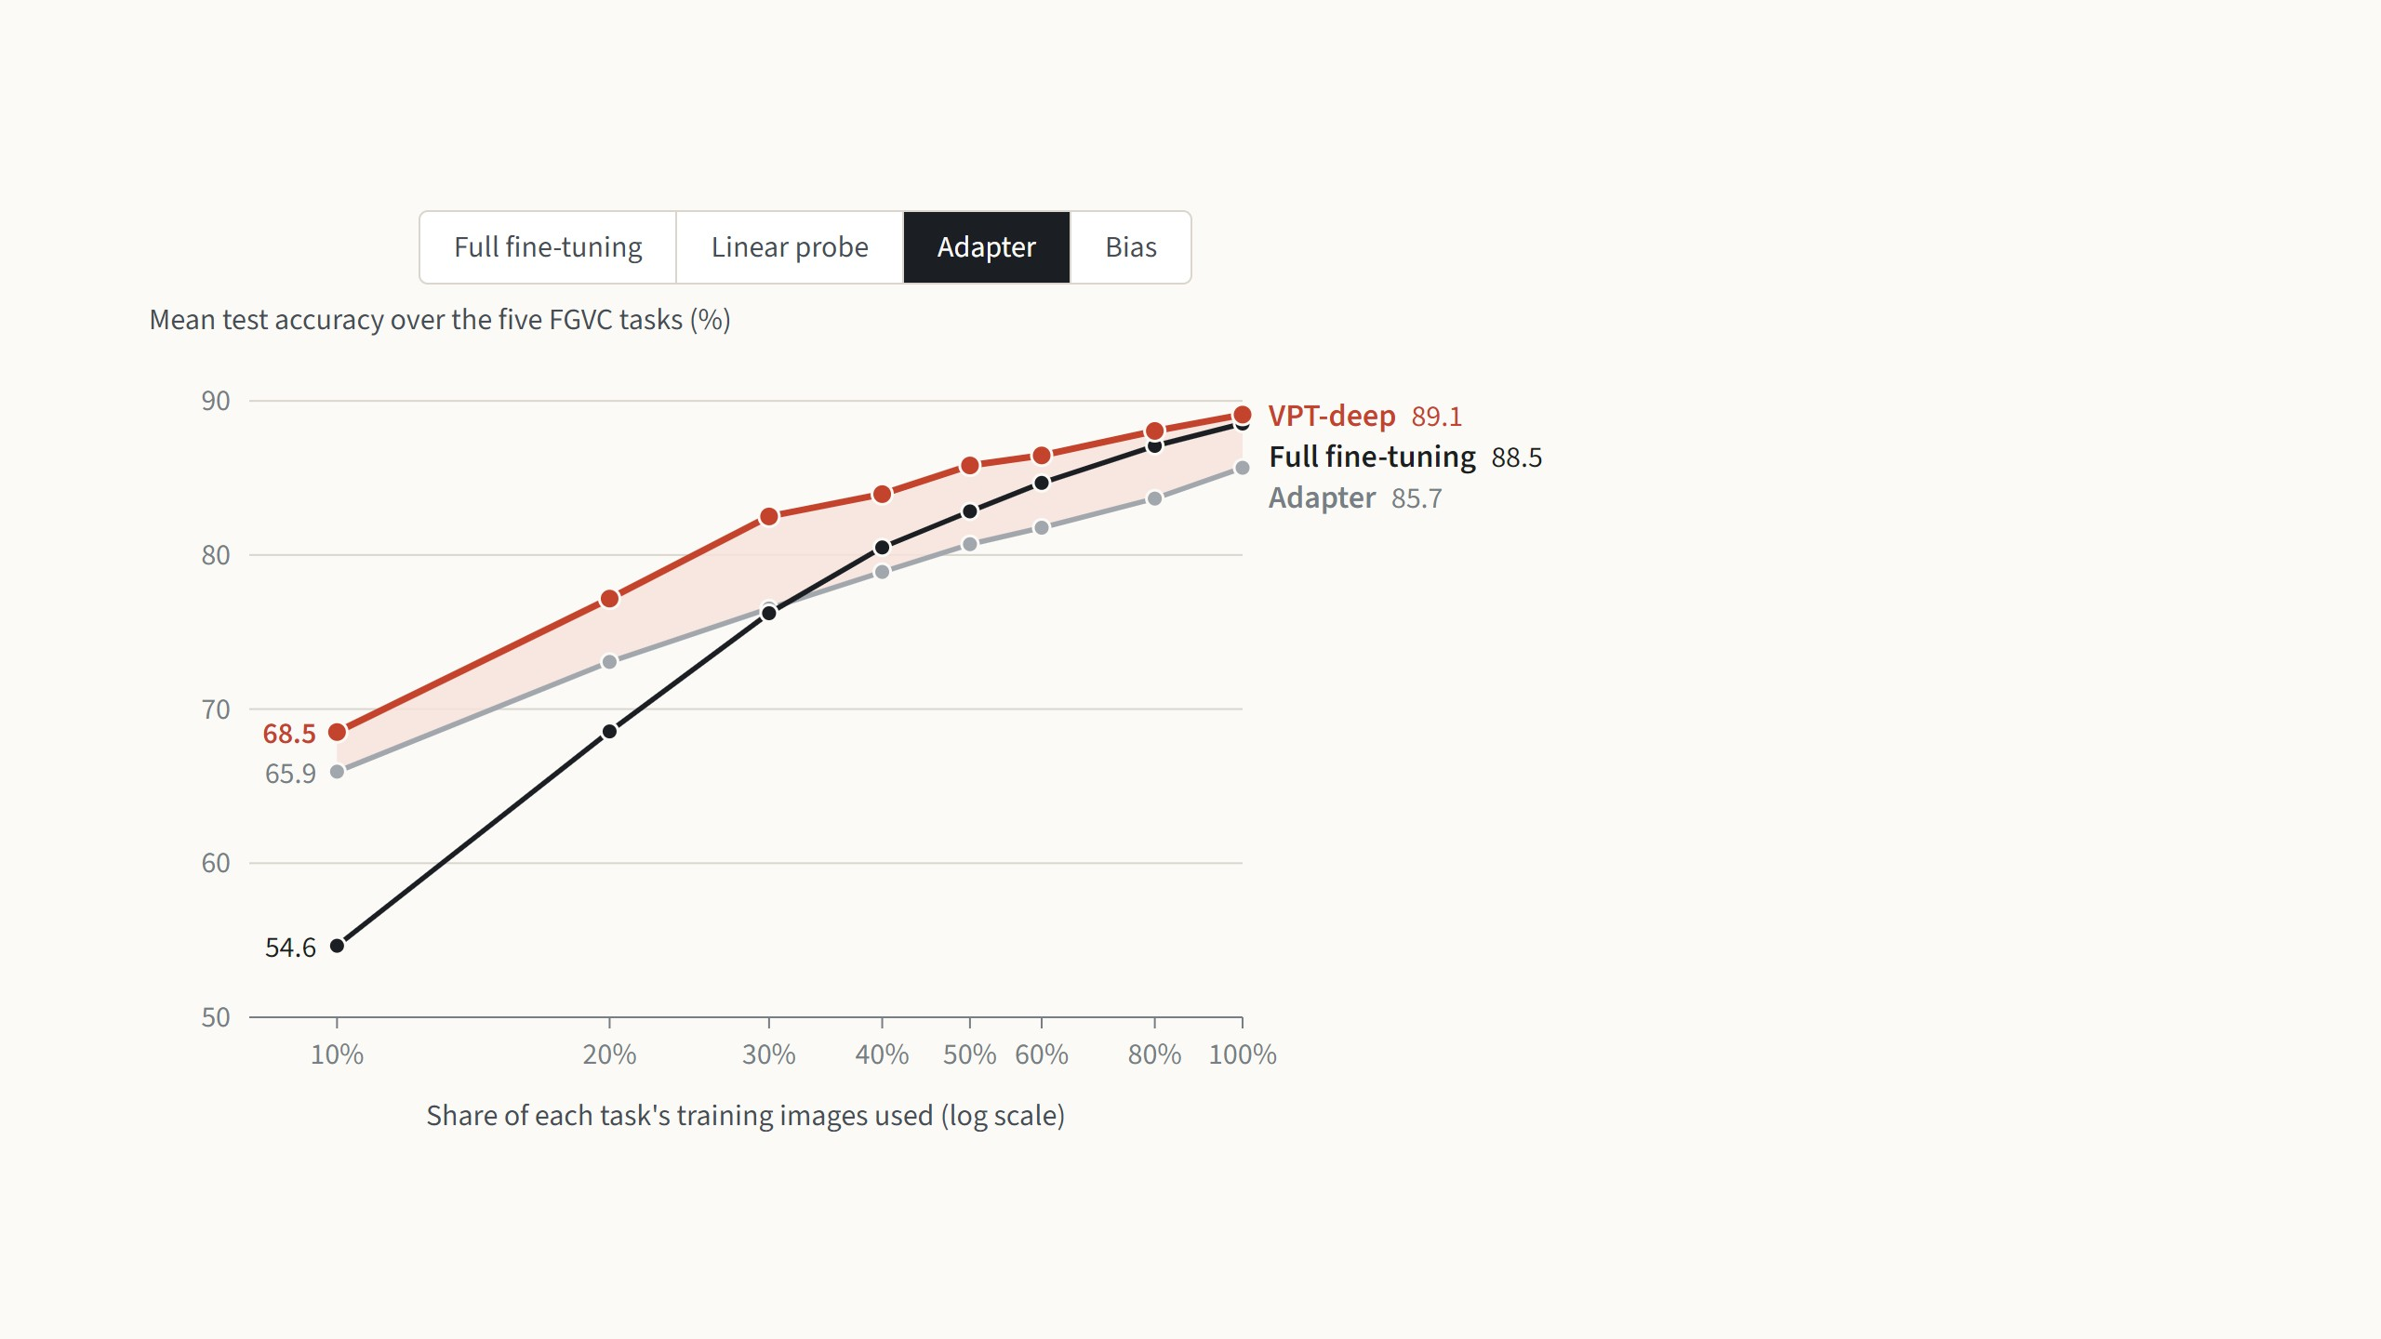
VPT leads with little data and stays ahead with more
VPT-deep against
The adapter inserts small trained
blocks into every layer, and it too
beats full fine-tuning on little data.
Full fine-tuning passes it at 40% of the
data, while VPT-deep stays 3 to 6
points above it throughout.
Jia et al. 2022, Fig. 3: ViT-B/16, mean test accuracy over the five FGVC tasks, each method trained on a share of every task's training images. The paper gives these values only as a
figure; they were read from its vector drawing in the PDF, and the 100% points match Table 1.
14
Notes:
This is the paper's Fig. 3, redrawn one comparison at a time. Each point is the average test accuracy over the five FGVC tasks when the method is trained on 10% up to 100% of every task's training images; the axis is logarithmic, as in the paper. Start with full fine-tuning: with 10% of the images it falls to 54.6 against 68.5 for VPT-deep, because it has 86 million weights to fit with very few examples. With all the data the two almost meet, 89.1 against 88.5, but VPT-deep is never below. Then step through the baselines. The linear probe is the classic low-data trick: good at 10%, overtaken by full fine-tuning from 30% on. The adapter is overtaken from 40% on. Bias is the strongest rival and beats full fine-tuning up to 80% of the data, but VPT-deep is above it at every point. So VPT is not just a low-data trick. VPT-shallow is left out to keep the chart readable; it always sits between the linear probe and VPT-deep. If asked: the paper publishes these numbers only as a figure; I read them from the figure's vector data in the PDF, and the 100% points match Table 1 to within 0.01.

Slide 25
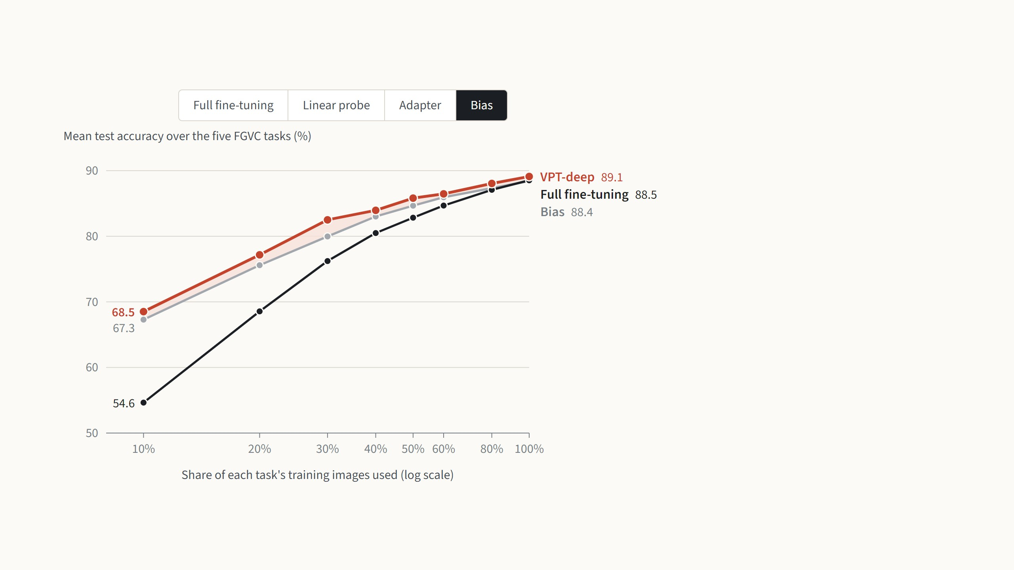
VPT leads with little data and stays ahead with more
VPT-deep against
Bias trains only the bias terms and is
the closest rival: it beats full
fine-tuning up to 80% of the data.
VPT-deep is still ahead at every point,
by half a point to 2.5 points.
Jia et al. 2022, Fig. 3: ViT-B/16, mean test accuracy over the five FGVC tasks, each method trained on a share of every task's training images. The paper gives these values only as a
figure; they were read from its vector drawing in the PDF, and the 100% points match Table 1.
14
Notes:
This is the paper's Fig. 3, redrawn one comparison at a time. Each point is the average test accuracy over the five FGVC tasks when the method is trained on 10% up to 100% of every task's training images; the axis is logarithmic, as in the paper. Start with full fine-tuning: with 10% of the images it falls to 54.6 against 68.5 for VPT-deep, because it has 86 million weights to fit with very few examples. With all the data the two almost meet, 89.1 against 88.5, but VPT-deep is never below. Then step through the baselines. The linear probe is the classic low-data trick: good at 10%, overtaken by full fine-tuning from 30% on. The adapter is overtaken from 40% on. Bias is the strongest rival and beats full fine-tuning up to 80% of the data, but VPT-deep is above it at every point. So VPT is not just a low-data trick. VPT-shallow is left out to keep the chart readable; it always sits between the linear probe and VPT-deep. If asked: the paper publishes these numbers only as a figure; I read them from the figure's vector data in the PDF, and the 100% points match Table 1 to within 0.01.

Slide 26
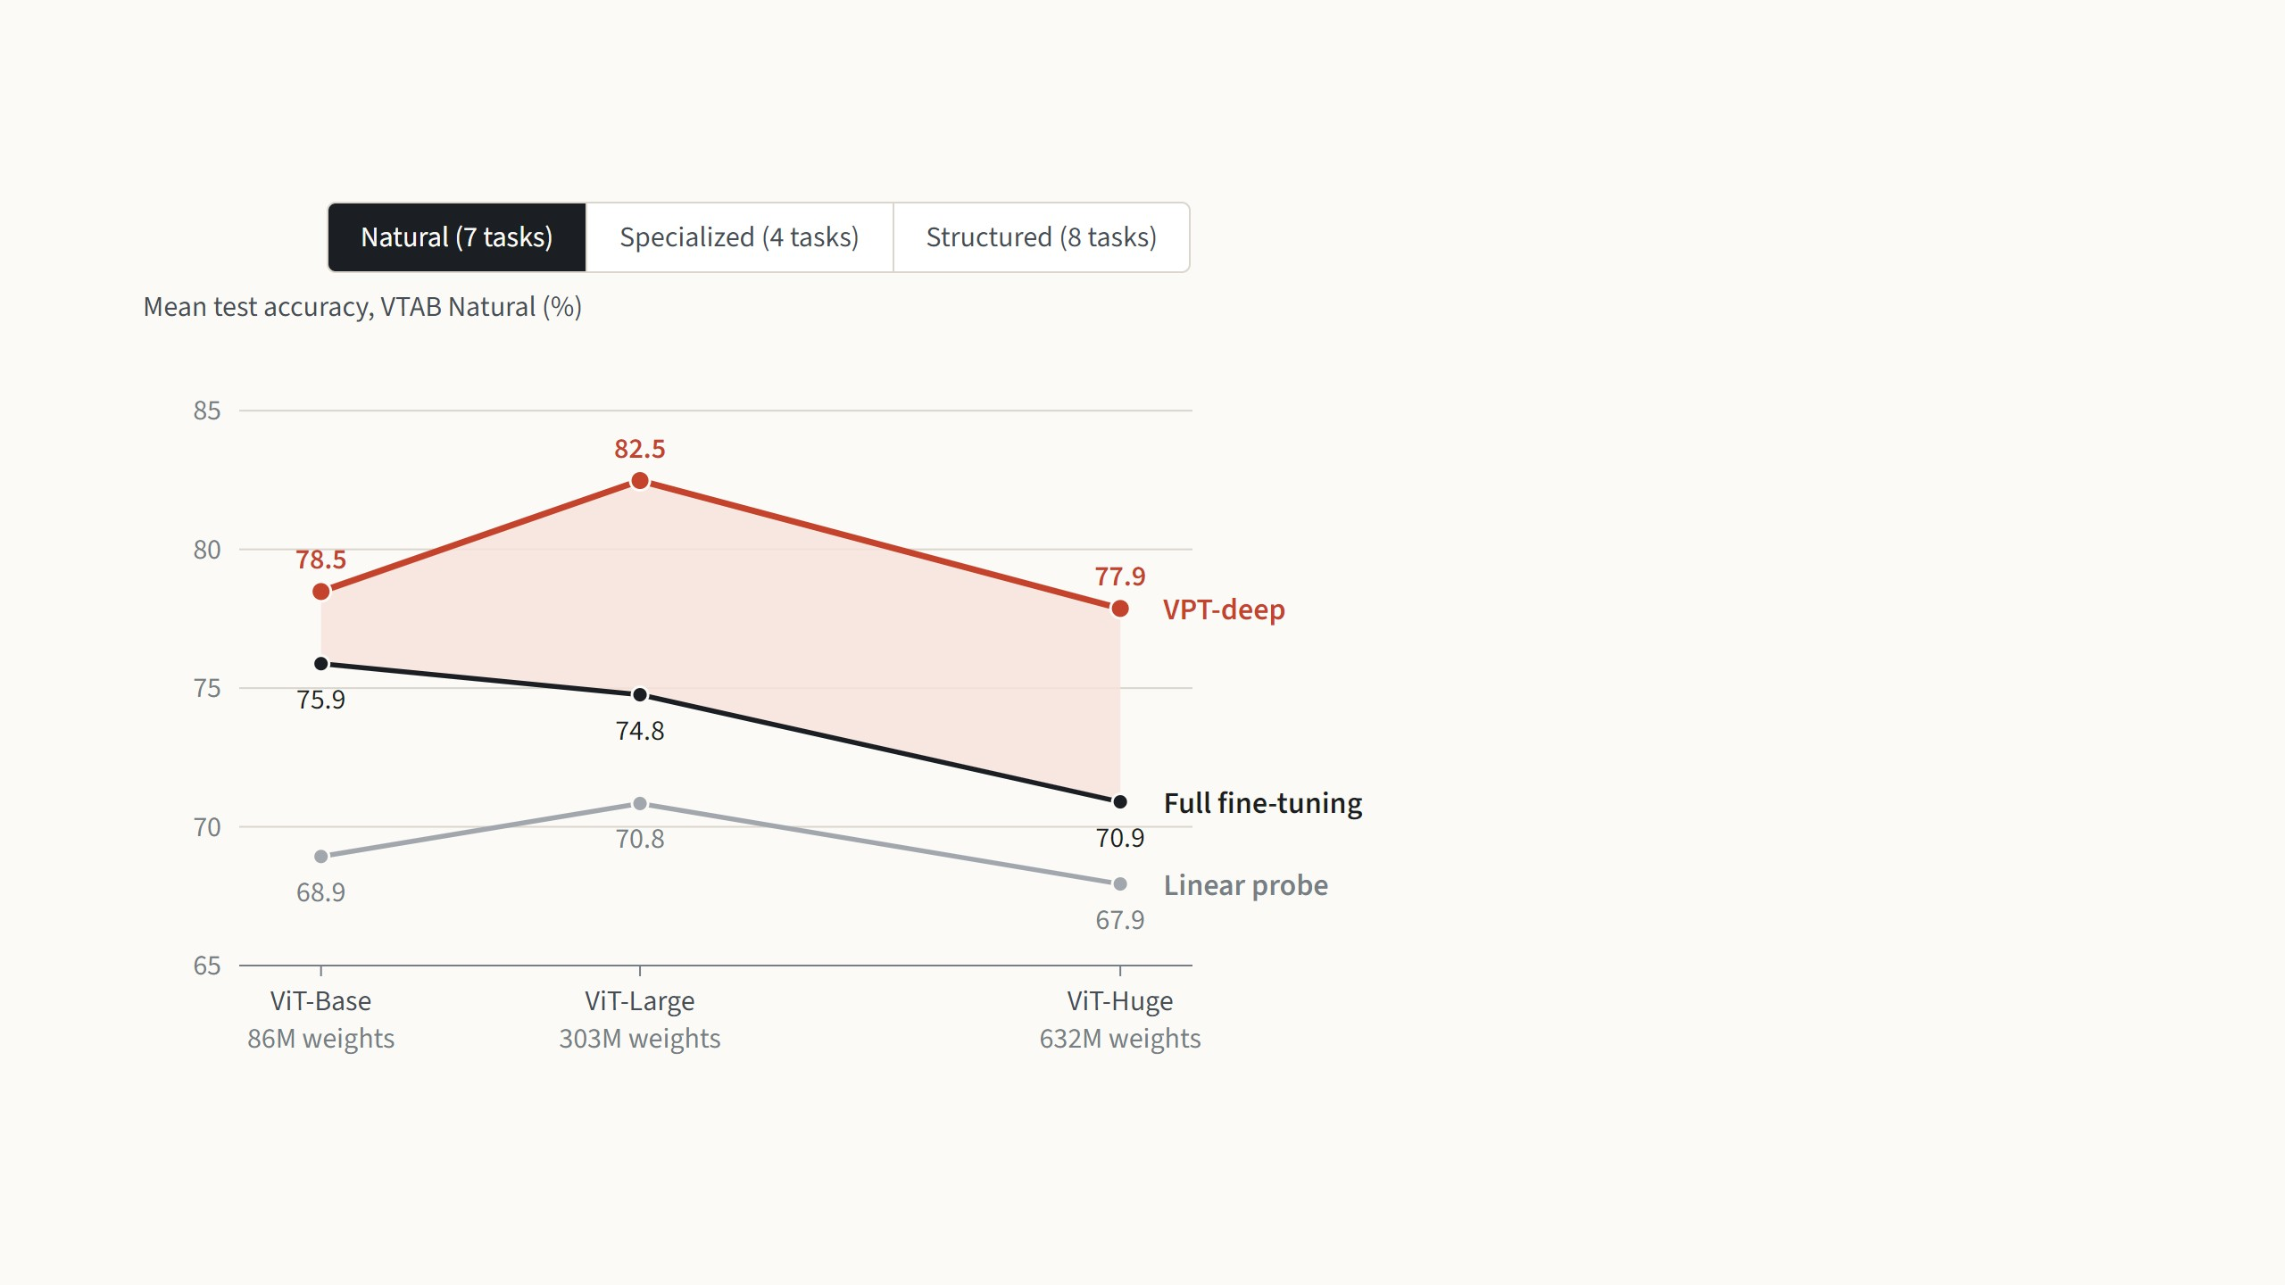
The result holds for larger backbones too
VTAB group
On ordinary photos, VPT-deep beats
full fine-tuning with all three
backbones: by 2.6 points on ViT-Base
and by 7 to 8 points on the larger two.
Full fine-tuning even gets worse as
the model grows, from 75.9 to 70.9.
Jia et al. 2022, Fig. 4: VTAB-1k, mean test accuracy per group, backbones pretrained on ImageNet-21k. The paper gives these values only as a figure; they were read from its
vector drawing in the PDF, and the ViT-B points match Table 1.
15
Notes:
The paper's Fig. 4, redrawn one group at a time: the same VTAB-1k tasks with three backbones, ViT-Base, ViT-Large and ViT-Huge, all pretrained on ImageNet-21k; the horizontal axis is the number of weights. Natural: VPT-deep wins with every backbone, and the gap grows from 2.6 points to about 7, because full fine-tuning gets worse as the model grows, from 75.9 to 70.9, with only 1,000 training images per task. Specialized: a tie, within one point everywhere, the same picture as on ViT-Base. Structured: VPT-deep leads by 6 to 7 points with every backbone, and the linear probe stays near 26, so the frozen features alone do not solve these tasks at any size. Why this matters: the storage argument grows with the model. A fully fine-tuned ViT-Huge is about 2.5 GB per task, while 50 prompts at each of its 32 layers take about 8 MB. It does not hold for every backbone, though, as we will see shortly.

Slide 27
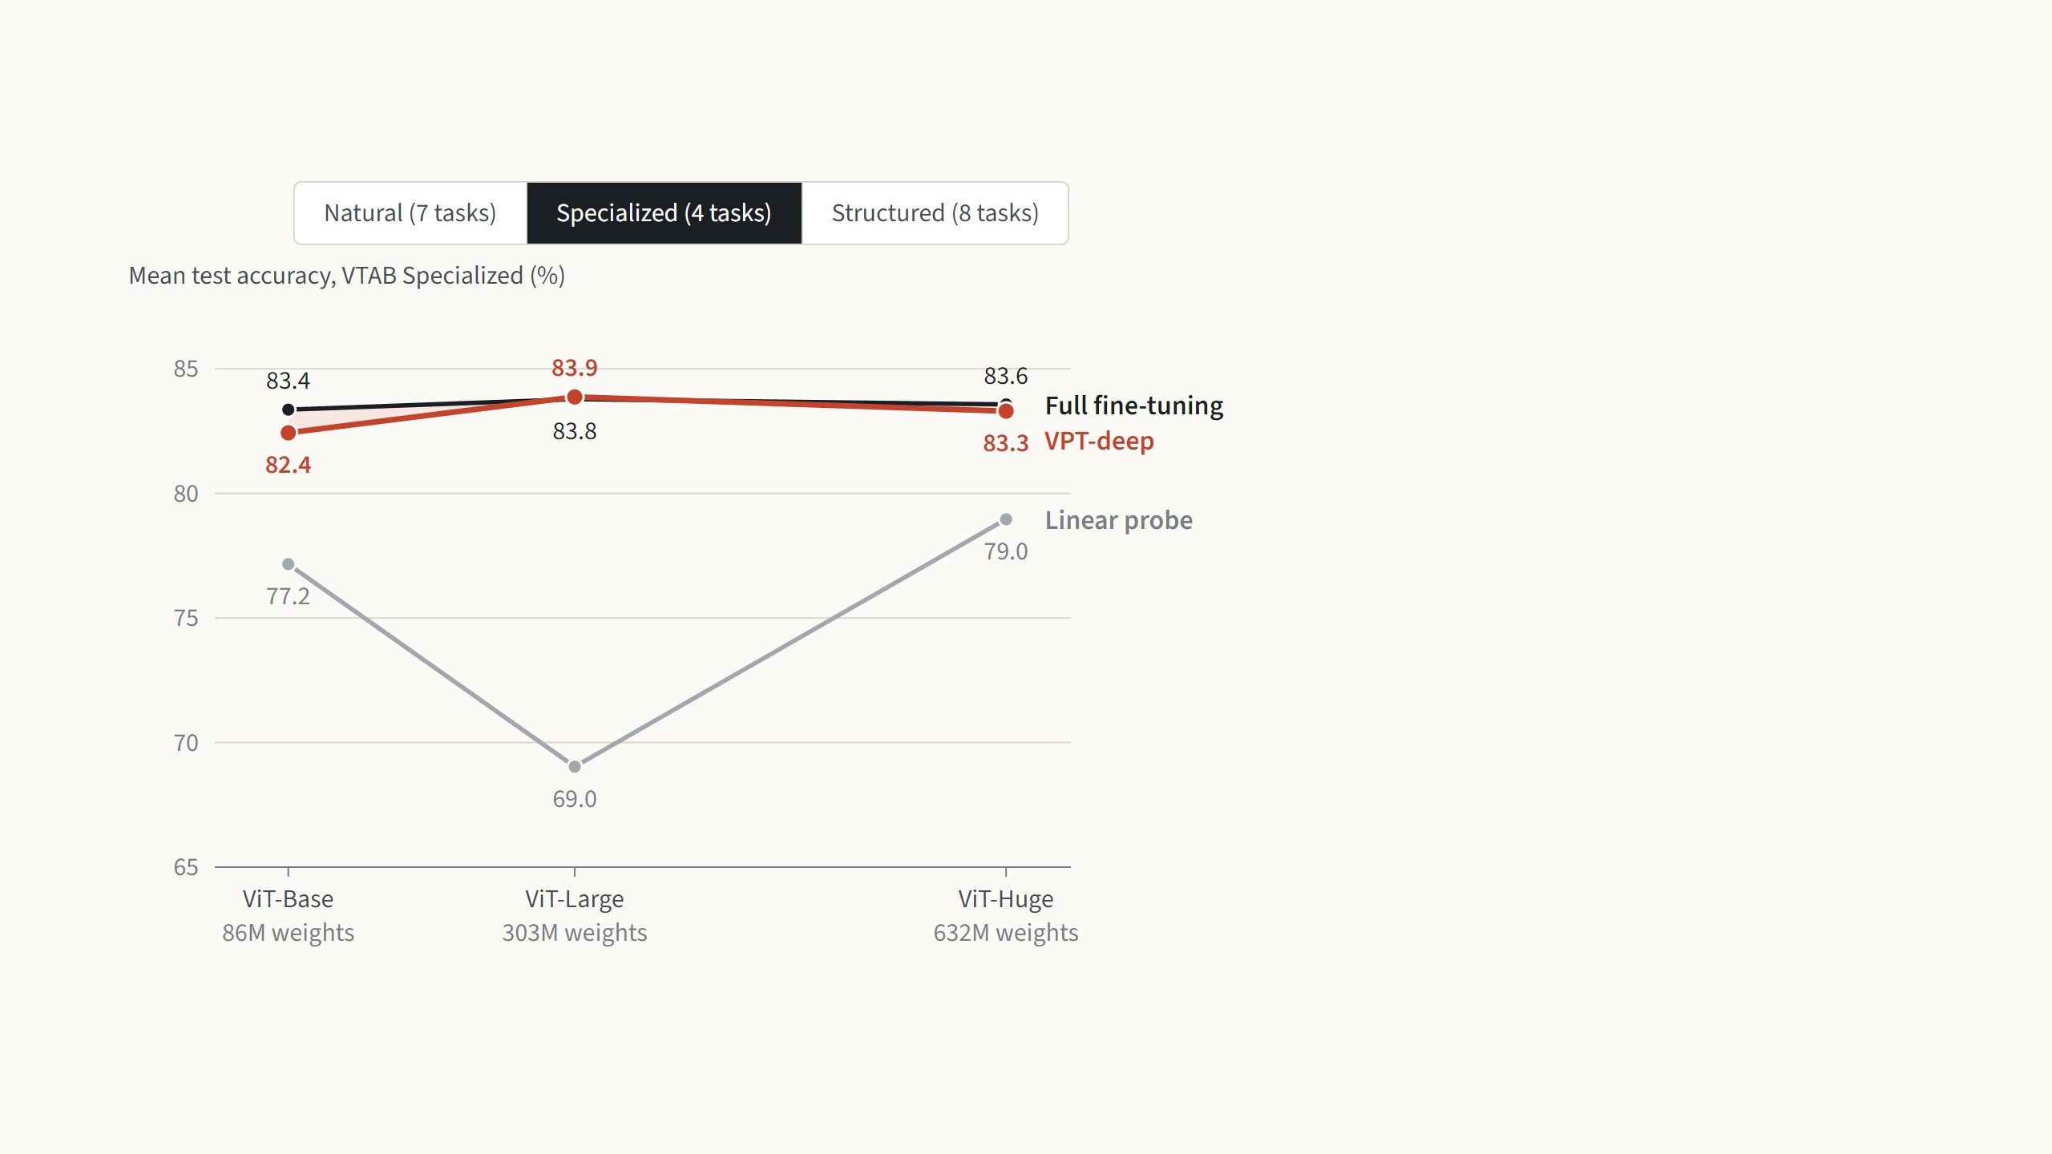
The result holds for larger backbones too
VTAB group
On medical and satellite images, the
two are level with every backbone
and never differ by more than one
point.
This was already the one group where
full fine-tuning kept a small lead on
ViT-Base, and larger backbones do
not change that.
Jia et al. 2022, Fig. 4: VTAB-1k, mean test accuracy per group, backbones pretrained on ImageNet-21k. The paper gives these values only as a figure; they were read from its
vector drawing in the PDF, and the ViT-B points match Table 1.
15
Notes:
The paper's Fig. 4, redrawn one group at a time: the same VTAB-1k tasks with three backbones, ViT-Base, ViT-Large and ViT-Huge, all pretrained on ImageNet-21k; the horizontal axis is the number of weights. Natural: VPT-deep wins with every backbone, and the gap grows from 2.6 points to about 7, because full fine-tuning gets worse as the model grows, from 75.9 to 70.9, with only 1,000 training images per task. Specialized: a tie, within one point everywhere, the same picture as on ViT-Base. Structured: VPT-deep leads by 6 to 7 points with every backbone, and the linear probe stays near 26, so the frozen features alone do not solve these tasks at any size. Why this matters: the storage argument grows with the model. A fully fine-tuned ViT-Huge is about 2.5 GB per task, while 50 prompts at each of its 32 layers take about 8 MB. It does not hold for every backbone, though, as we will see shortly.

Slide 28
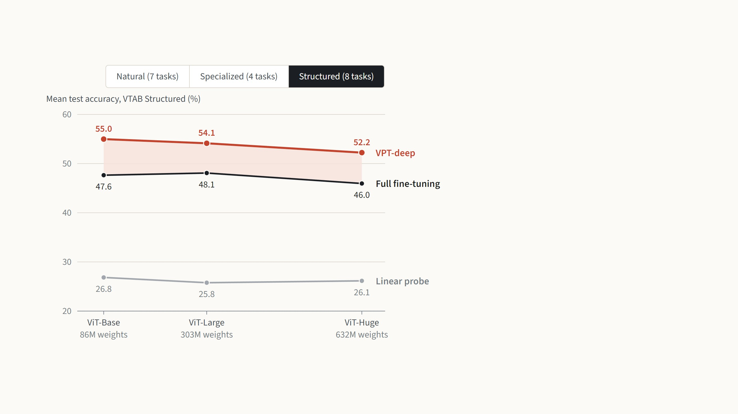
The result holds for larger backbones too
VTAB group
On counting and distance tasks,
VPT-deep leads by 6 to 7 points with
every backbone.
The linear probe stays near 26%, so
the frozen features alone are not
enough here, at any size.
Jia et al. 2022, Fig. 4: VTAB-1k, mean test accuracy per group, backbones pretrained on ImageNet-21k. The paper gives these values only as a figure; they were read from its
vector drawing in the PDF, and the ViT-B points match Table 1.
15
Notes:
The paper's Fig. 4, redrawn one group at a time: the same VTAB-1k tasks with three backbones, ViT-Base, ViT-Large and ViT-Huge, all pretrained on ImageNet-21k; the horizontal axis is the number of weights. Natural: VPT-deep wins with every backbone, and the gap grows from 2.6 points to about 7, because full fine-tuning gets worse as the model grows, from 75.9 to 70.9, with only 1,000 training images per task. Specialized: a tie, within one point everywhere, the same picture as on ViT-Base. Structured: VPT-deep leads by 6 to 7 points with every backbone, and the linear probe stays near 26, so the frozen features alone do not solve these tasks at any size. Why this matters: the storage argument grows with the model. A fully fine-tuned ViT-Huge is about 2.5 GB per task, while 50 prompts at each of its 32 layers take about 8 MB. It does not hold for every backbone, though, as we will see shortly.

Slide 29
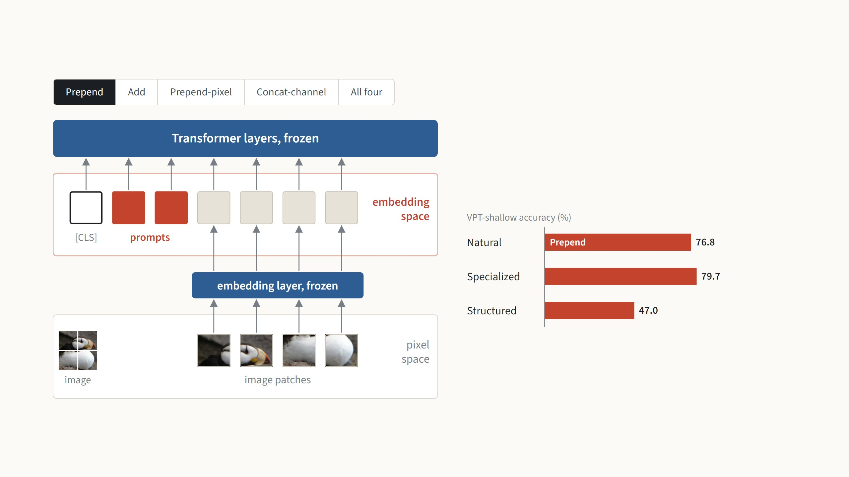
Four places to put the prompt
This is the default. The prompts are extra vectors placed next
to the patch vectors, after the embedding layer, so every
layer can attend to them as tokens of their own.
Numbers from Jia et al. 2022, Fig. 5 (ViT-B/16, prompts in the first layer only); "All four" is the mean of the three groups. Diagrams redrawn.
16
Notes:
The question: where should the learned numbers enter the network? Two places in principle: in the embedding space, as vectors next to the patch vectors, or in pixel space, as part of the image before the embedding layer. Prepend is the default we have seen: extra tokens after the embedding. Add: the prompts are added onto patch vectors, so the sequence is not longer; it loses in all three groups, 8 points on Structured, and the deep version loses too (43.2 against 55.0 on Structured). Prepend-pixel: learned pixel patches next to the image patches, then the frozen embedding layer; loses everywhere, 5 points on Natural. Concat-channel: a learned fourth channel on the image, the embedding layer trained to read it; it collapses, 30 points lower on Natural and below even a linear probe there (68.9). Summary: separate tokens in the embedding space are the right place. All numbers are VPT-shallow because that is the only setting where the paper tests all four options.

Slide 30
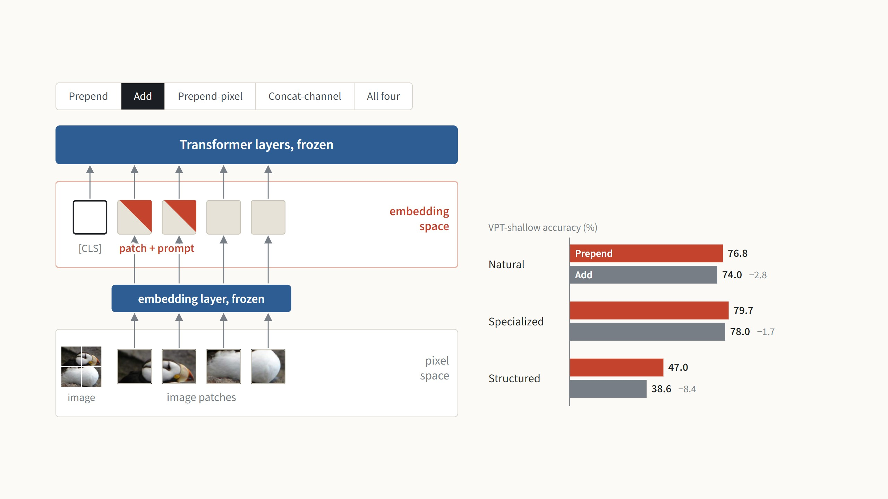
Four places to put the prompt
Here each prompt vector is added onto a patch vector, so the
sequence keeps its length. This scores lower in all three
groups, by 8.4 points on Structured.
Numbers from Jia et al. 2022, Fig. 5 (ViT-B/16, prompts in the first layer only); "All four" is the mean of the three groups. Diagrams redrawn.
16
Notes:
The question: where should the learned numbers enter the network? Two places in principle: in the embedding space, as vectors next to the patch vectors, or in pixel space, as part of the image before the embedding layer. Prepend is the default we have seen: extra tokens after the embedding. Add: the prompts are added onto patch vectors, so the sequence is not longer; it loses in all three groups, 8 points on Structured, and the deep version loses too (43.2 against 55.0 on Structured). Prepend-pixel: learned pixel patches next to the image patches, then the frozen embedding layer; loses everywhere, 5 points on Natural. Concat-channel: a learned fourth channel on the image, the embedding layer trained to read it; it collapses, 30 points lower on Natural and below even a linear probe there (68.9). Summary: separate tokens in the embedding space are the right place. All numbers are VPT-shallow because that is the only setting where the paper tests all four options.

Slide 31
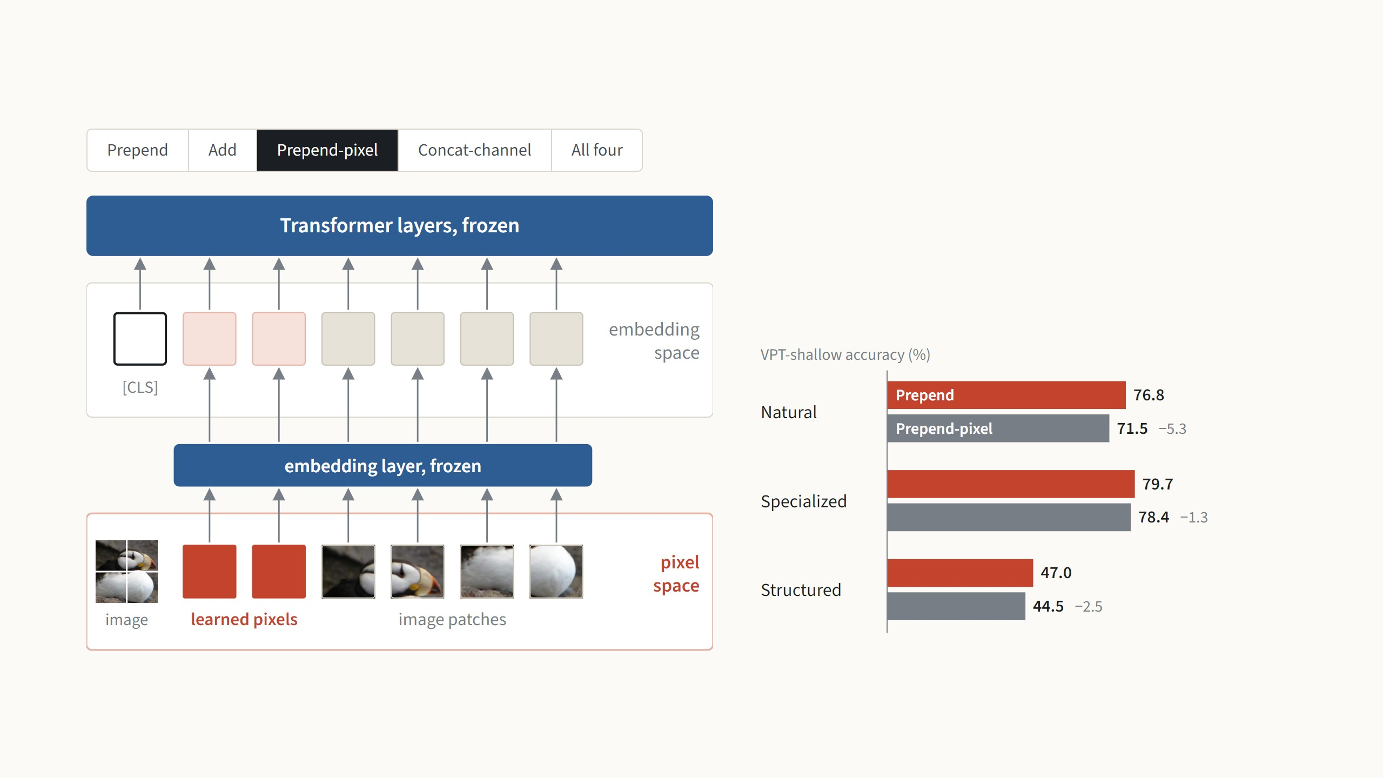
Four places to put the prompt
Here the prompts are learned pixel patches, placed next to
the image patches before the frozen embedding layer. This
also scores lower in every group, by 5.3 points on Natural.
Numbers from Jia et al. 2022, Fig. 5 (ViT-B/16, prompts in the first layer only); "All four" is the mean of the three groups. Diagrams redrawn.
16
Notes:
The question: where should the learned numbers enter the network? Two places in principle: in the embedding space, as vectors next to the patch vectors, or in pixel space, as part of the image before the embedding layer. Prepend is the default we have seen: extra tokens after the embedding. Add: the prompts are added onto patch vectors, so the sequence is not longer; it loses in all three groups, 8 points on Structured, and the deep version loses too (43.2 against 55.0 on Structured). Prepend-pixel: learned pixel patches next to the image patches, then the frozen embedding layer; loses everywhere, 5 points on Natural. Concat-channel: a learned fourth channel on the image, the embedding layer trained to read it; it collapses, 30 points lower on Natural and below even a linear probe there (68.9). Summary: separate tokens in the embedding space are the right place. All numbers are VPT-shallow because that is the only setting where the paper tests all four options.

Slide 32
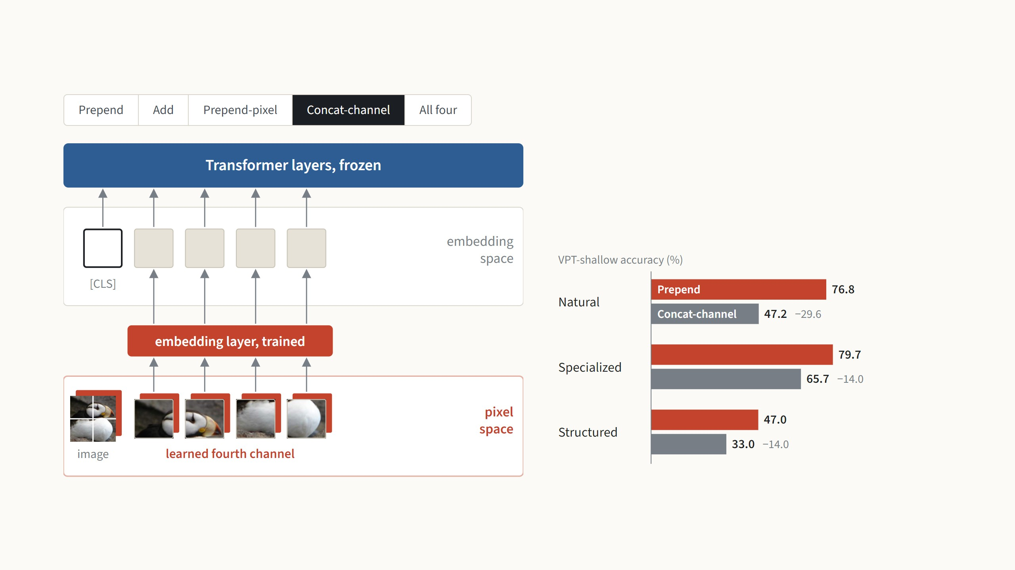
Four places to put the prompt
Here the prompt is a learned fourth colour channel on the
image, and the embedding layer is trained to read it. This is
by far the worst: 29.6 points lower on Natural, below even a
linear probe there.
Numbers from Jia et al. 2022, Fig. 5 (ViT-B/16, prompts in the first layer only); "All four" is the mean of the three groups. Diagrams redrawn.
16
Notes:
The question: where should the learned numbers enter the network? Two places in principle: in the embedding space, as vectors next to the patch vectors, or in pixel space, as part of the image before the embedding layer. Prepend is the default we have seen: extra tokens after the embedding. Add: the prompts are added onto patch vectors, so the sequence is not longer; it loses in all three groups, 8 points on Structured, and the deep version loses too (43.2 against 55.0 on Structured). Prepend-pixel: learned pixel patches next to the image patches, then the frozen embedding layer; loses everywhere, 5 points on Natural. Concat-channel: a learned fourth channel on the image, the embedding layer trained to read it; it collapses, 30 points lower on Natural and below even a linear probe there (68.9). Summary: separate tokens in the embedding space are the right place. All numbers are VPT-shallow because that is the only setting where the paper tests all four options.

Slide 33
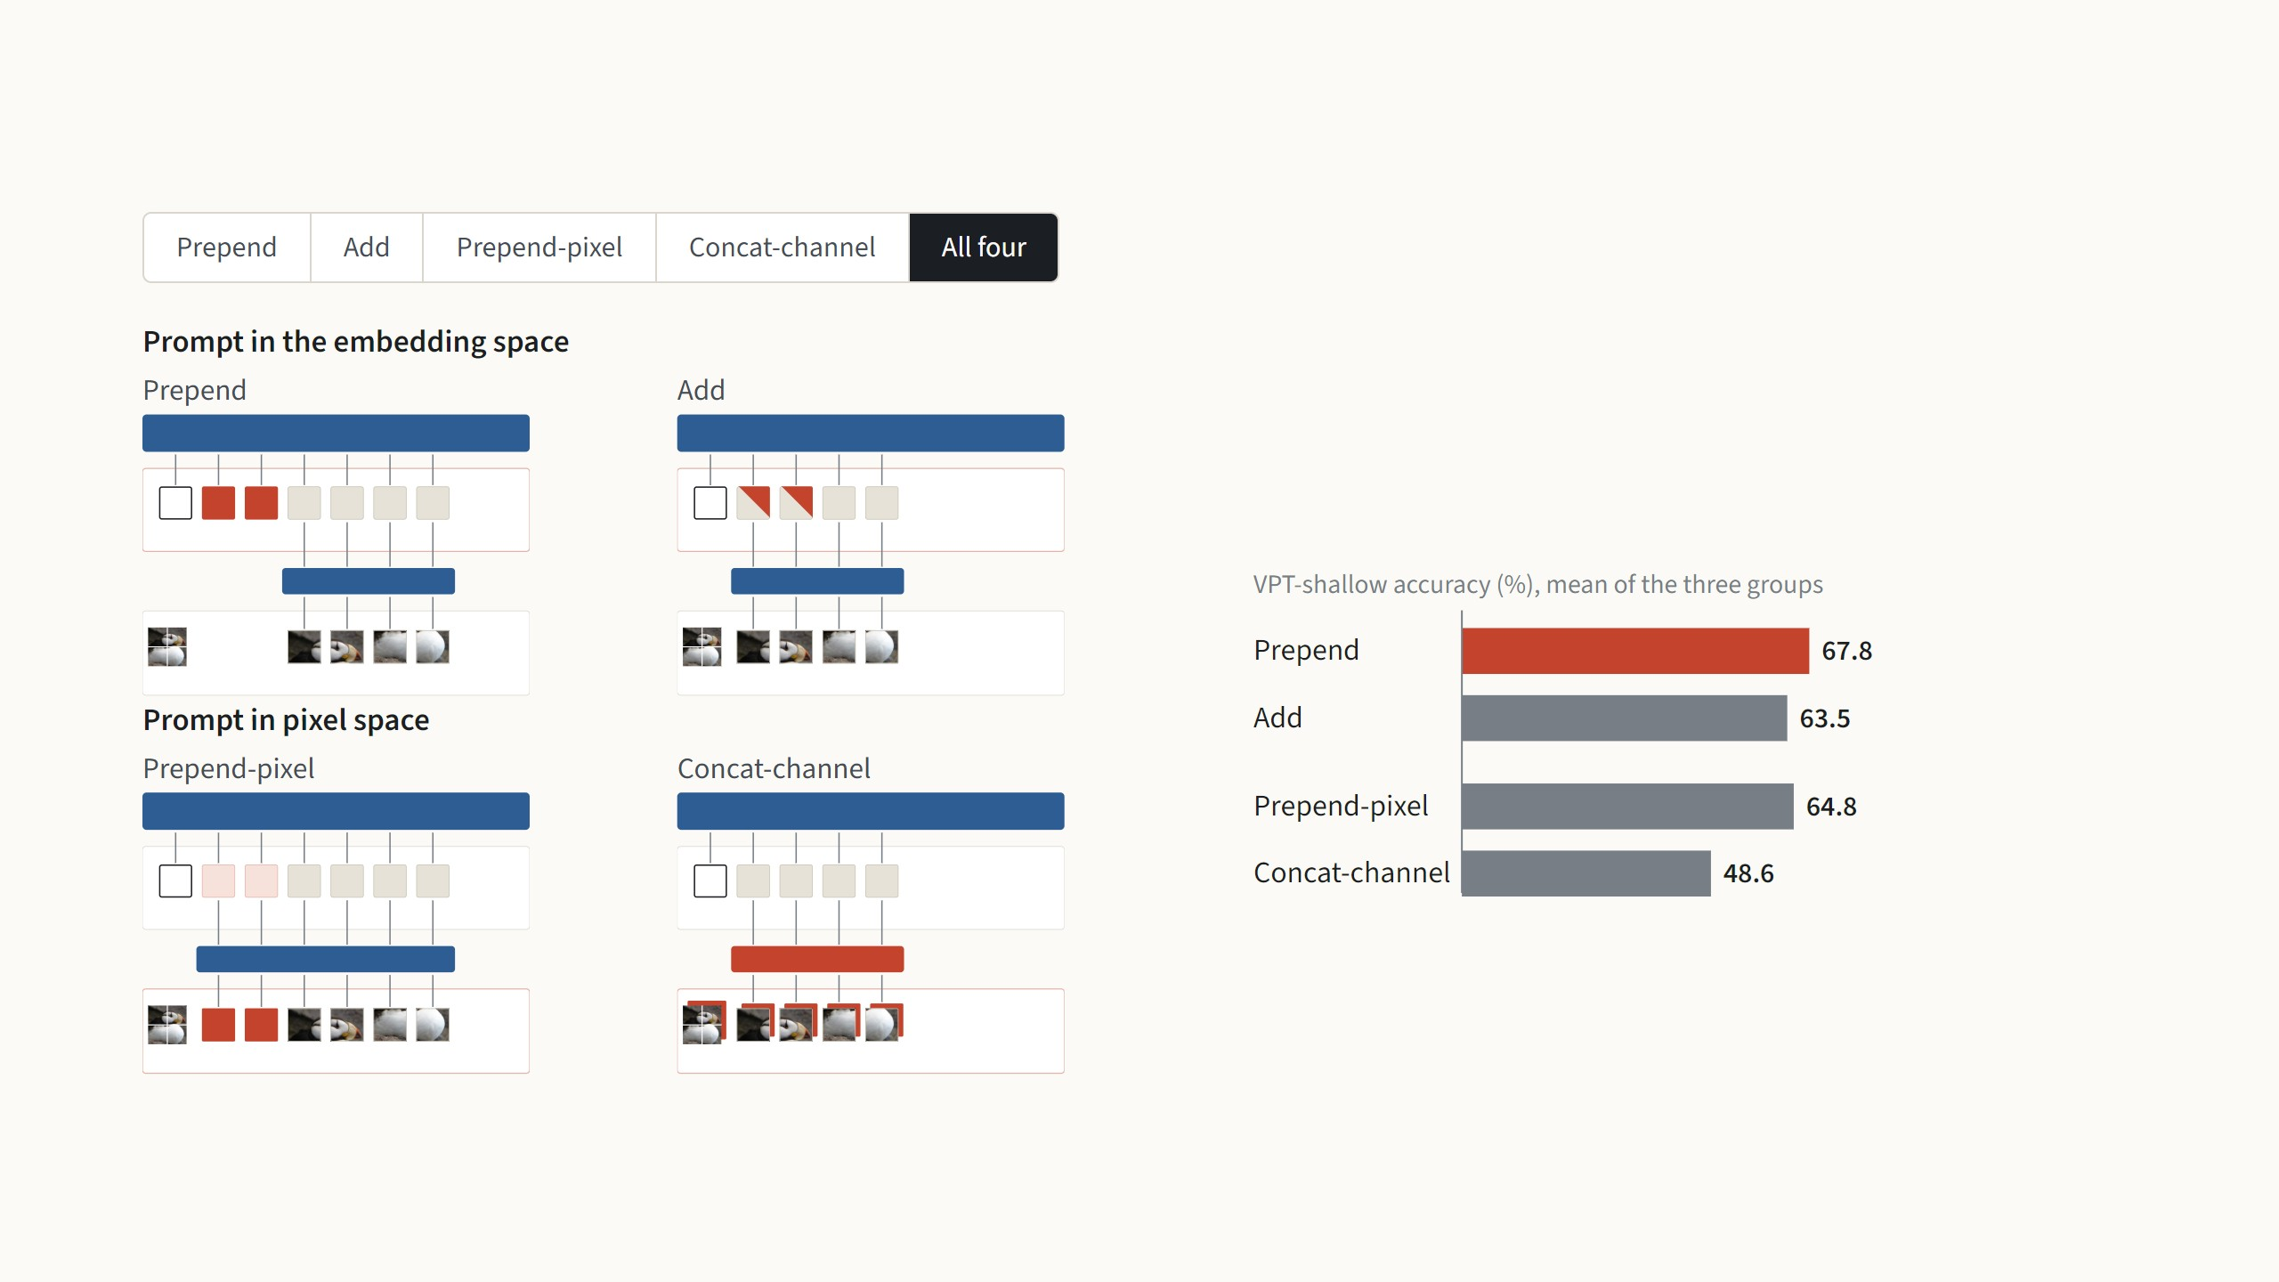
Four places to put the prompt
Prepend scores highest in every group. A prompt works best
as separate vectors in the embedding space; adding it onto
the patches or moving it into the pixels costs accuracy.
Numbers from Jia et al. 2022, Fig. 5 (ViT-B/16, prompts in the first layer only); "All four" is the mean of the three groups. Diagrams redrawn.
16
Notes:
The question: where should the learned numbers enter the network? Two places in principle: in the embedding space, as vectors next to the patch vectors, or in pixel space, as part of the image before the embedding layer. Prepend is the default we have seen: extra tokens after the embedding. Add: the prompts are added onto patch vectors, so the sequence is not longer; it loses in all three groups, 8 points on Structured, and the deep version loses too (43.2 against 55.0 on Structured). Prepend-pixel: learned pixel patches next to the image patches, then the frozen embedding layer; loses everywhere, 5 points on Natural. Concat-channel: a learned fourth channel on the image, the embedding layer trained to read it; it collapses, 30 points lower on Natural and below even a linear probe there (68.9). Summary: separate tokens in the embedding space are the right place. All numbers are VPT-shallow because that is the only setting where the paper tests all four options.

Slide 34
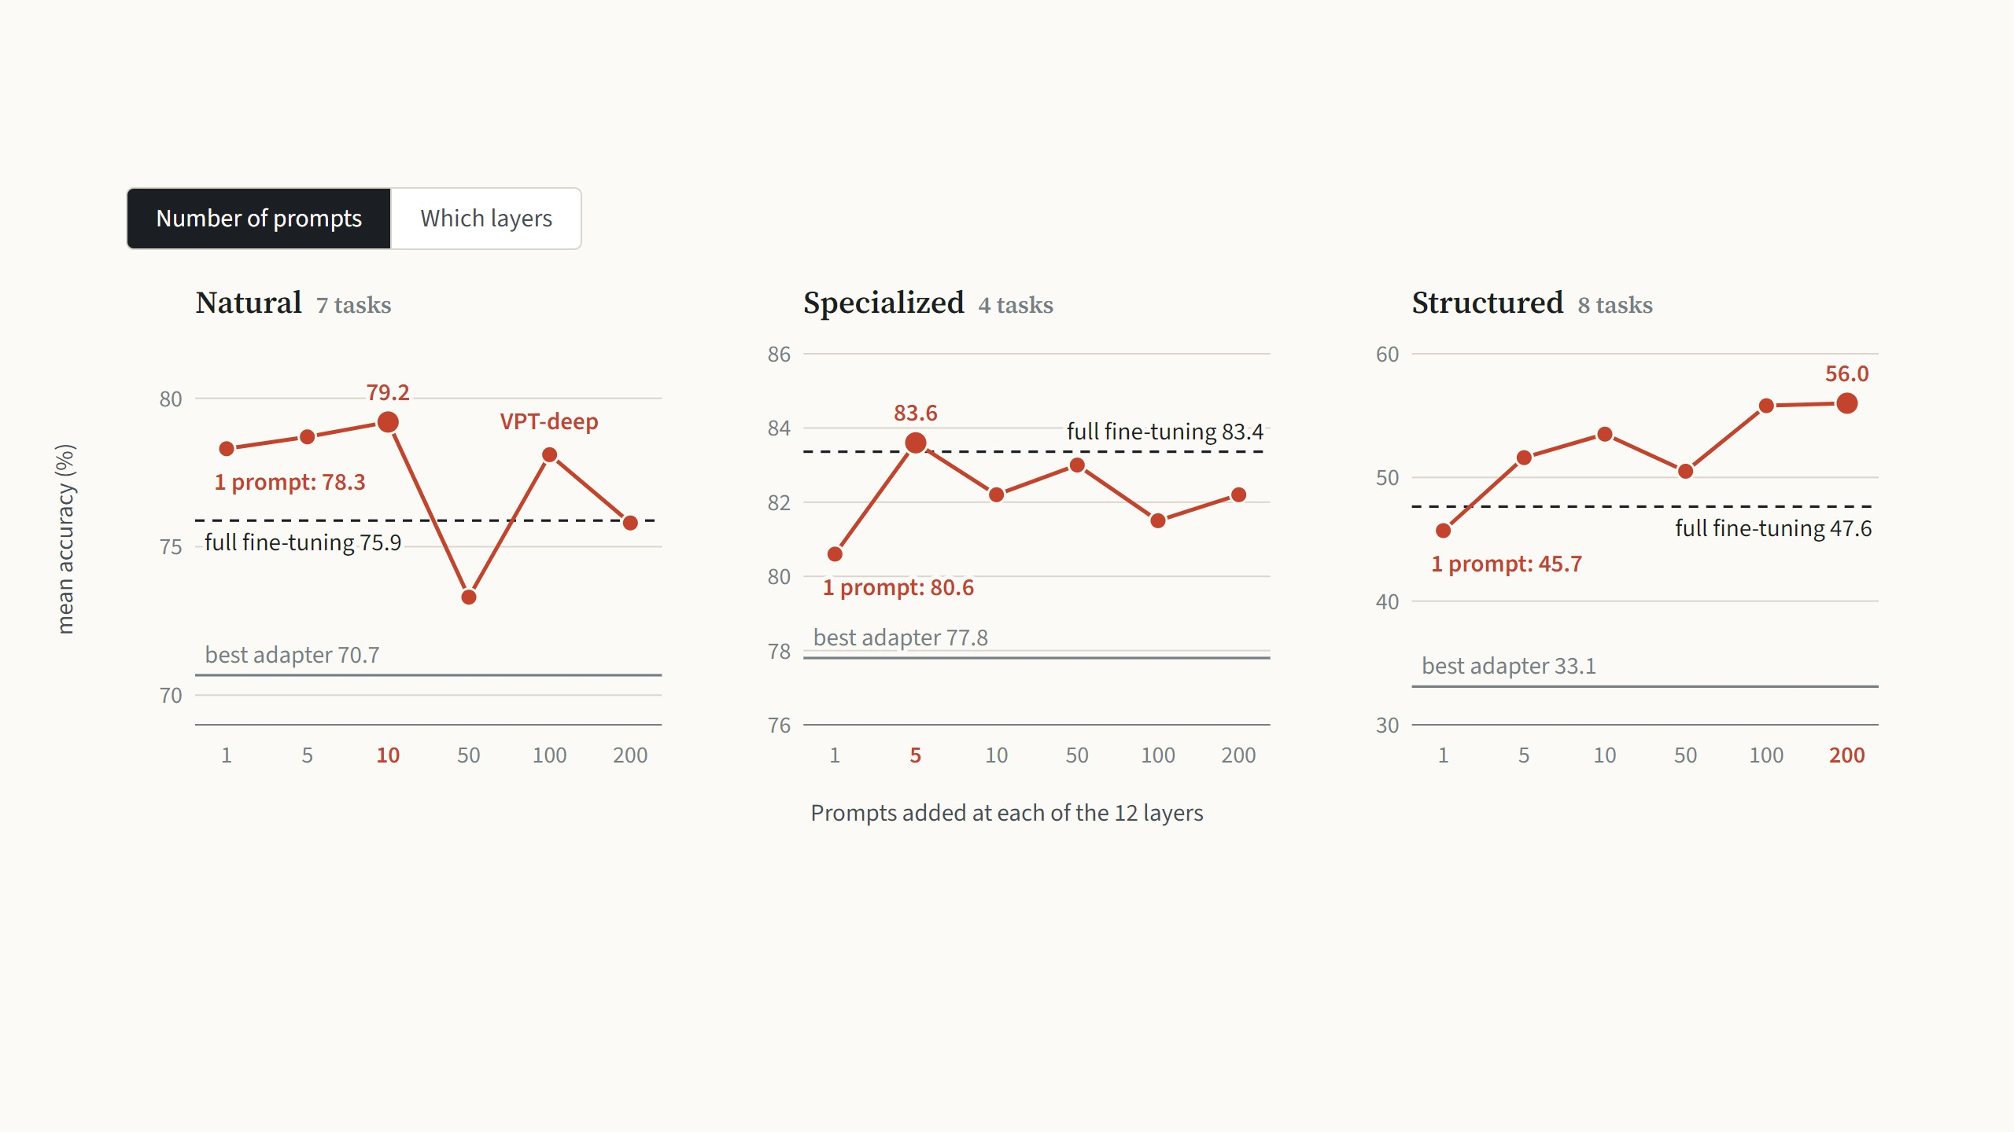
How many prompts, and at which layers
Each group prefers a different number: Natural does best with 10 prompts per layer, Specialized with 5 and Structured with 200.
Even a single prompt per layer beats the best adapter in every group, and on Natural it already beats full fine-tuning.
Jia et al. 2022, Fig. 6: VPT-deep on ViT-B/16, mean test accuracy per VTAB group. The paper gives these only as a figure; values are read off its plotted points. Full fine-tuning and
the adapter (best of three sizes): Table 13.
17
Notes:
First, the number of prompts, the one new hyperparameter. Each panel is one VTAB group: the red line is VPT-deep with 1 to 200 prompts at every layer, the dashed line is full fine-tuning, the grey line the best adapter. The best number is different in every group, 10 on Natural, 5 on Specialized, 200 on Structured, and per task it varies even more, from 5 prompts for Oxford Flowers to 200 for Stanford Cars (Table 14). That is why the paper picks p per task on the validation set. Even a single prompt per layer beats the adapter everywhere, and on Natural it already beats full fine-tuning. Press the arrow key for which layers. The red line adds prompts from the input upwards: layer 1 alone is VPT-shallow, all twelve layers is VPT-deep. The grey line adds them from the output downwards. More prompted layers generally help, and the input side wins: on Structured, prompts in layers 1 to 3 give 50.6, prompts in layers 9 to 12 only 37.6. The authors point out that this is the opposite of what was seen with text prompts. The paper has no table for these two experiments, so the values are read off the plotted points of its figures; the end points match VPT-shallow and VPT-deep in Table 13.

Slide 35
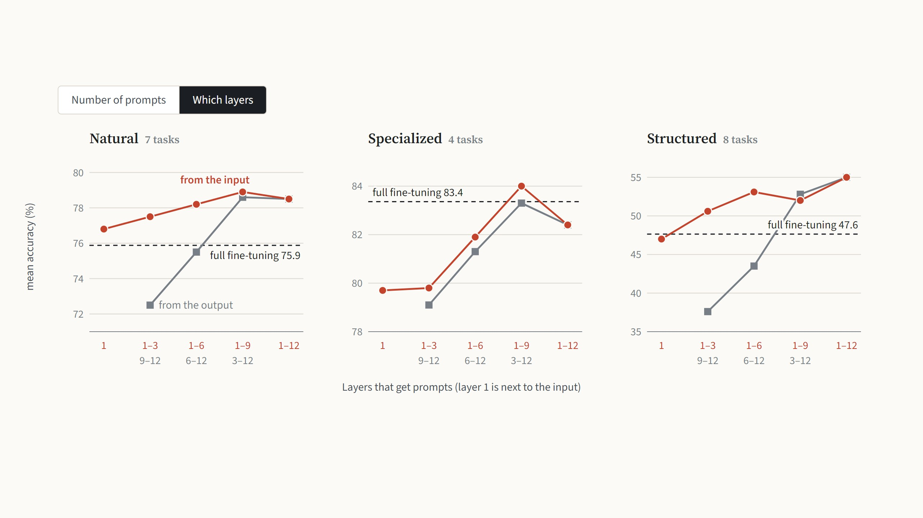
How many prompts, and at which layers
Prompting more layers generally helps: layer 1 alone is VPT-shallow, all twelve is VPT-deep. Layers next to the input matter most:
prompts placed only in the layers near the output score lower, the opposite of what was found for text prompts.
Jia et al. 2022, Fig. 7, each variant with its best prompt length. Values are read off the figure’s plotted points; layer 1 alone and layers 1–12 match VPT-shallow and VPT-deep in
Table 13.
17
Notes:
First, the number of prompts, the one new hyperparameter. Each panel is one VTAB group: the red line is VPT-deep with 1 to 200 prompts at every layer, the dashed line is full fine-tuning, the grey line the best adapter. The best number is different in every group, 10 on Natural, 5 on Specialized, 200 on Structured, and per task it varies even more, from 5 prompts for Oxford Flowers to 200 for Stanford Cars (Table 14). That is why the paper picks p per task on the validation set. Even a single prompt per layer beats the adapter everywhere, and on Natural it already beats full fine-tuning. Press the arrow key for which layers. The red line adds prompts from the input upwards: layer 1 alone is VPT-shallow, all twelve layers is VPT-deep. The grey line adds them from the output downwards. More prompted layers generally help, and the input side wins: on Structured, prompts in layers 1 to 3 give 50.6, prompts in layers 9 to 12 only 37.6. The authors point out that this is the opposite of what was seen with text prompts. The paper has no table for these two experiments, so the values are read off the plotted points of its figures; the end points match VPT-shallow and VPT-deep in Table 13.

Slide 36
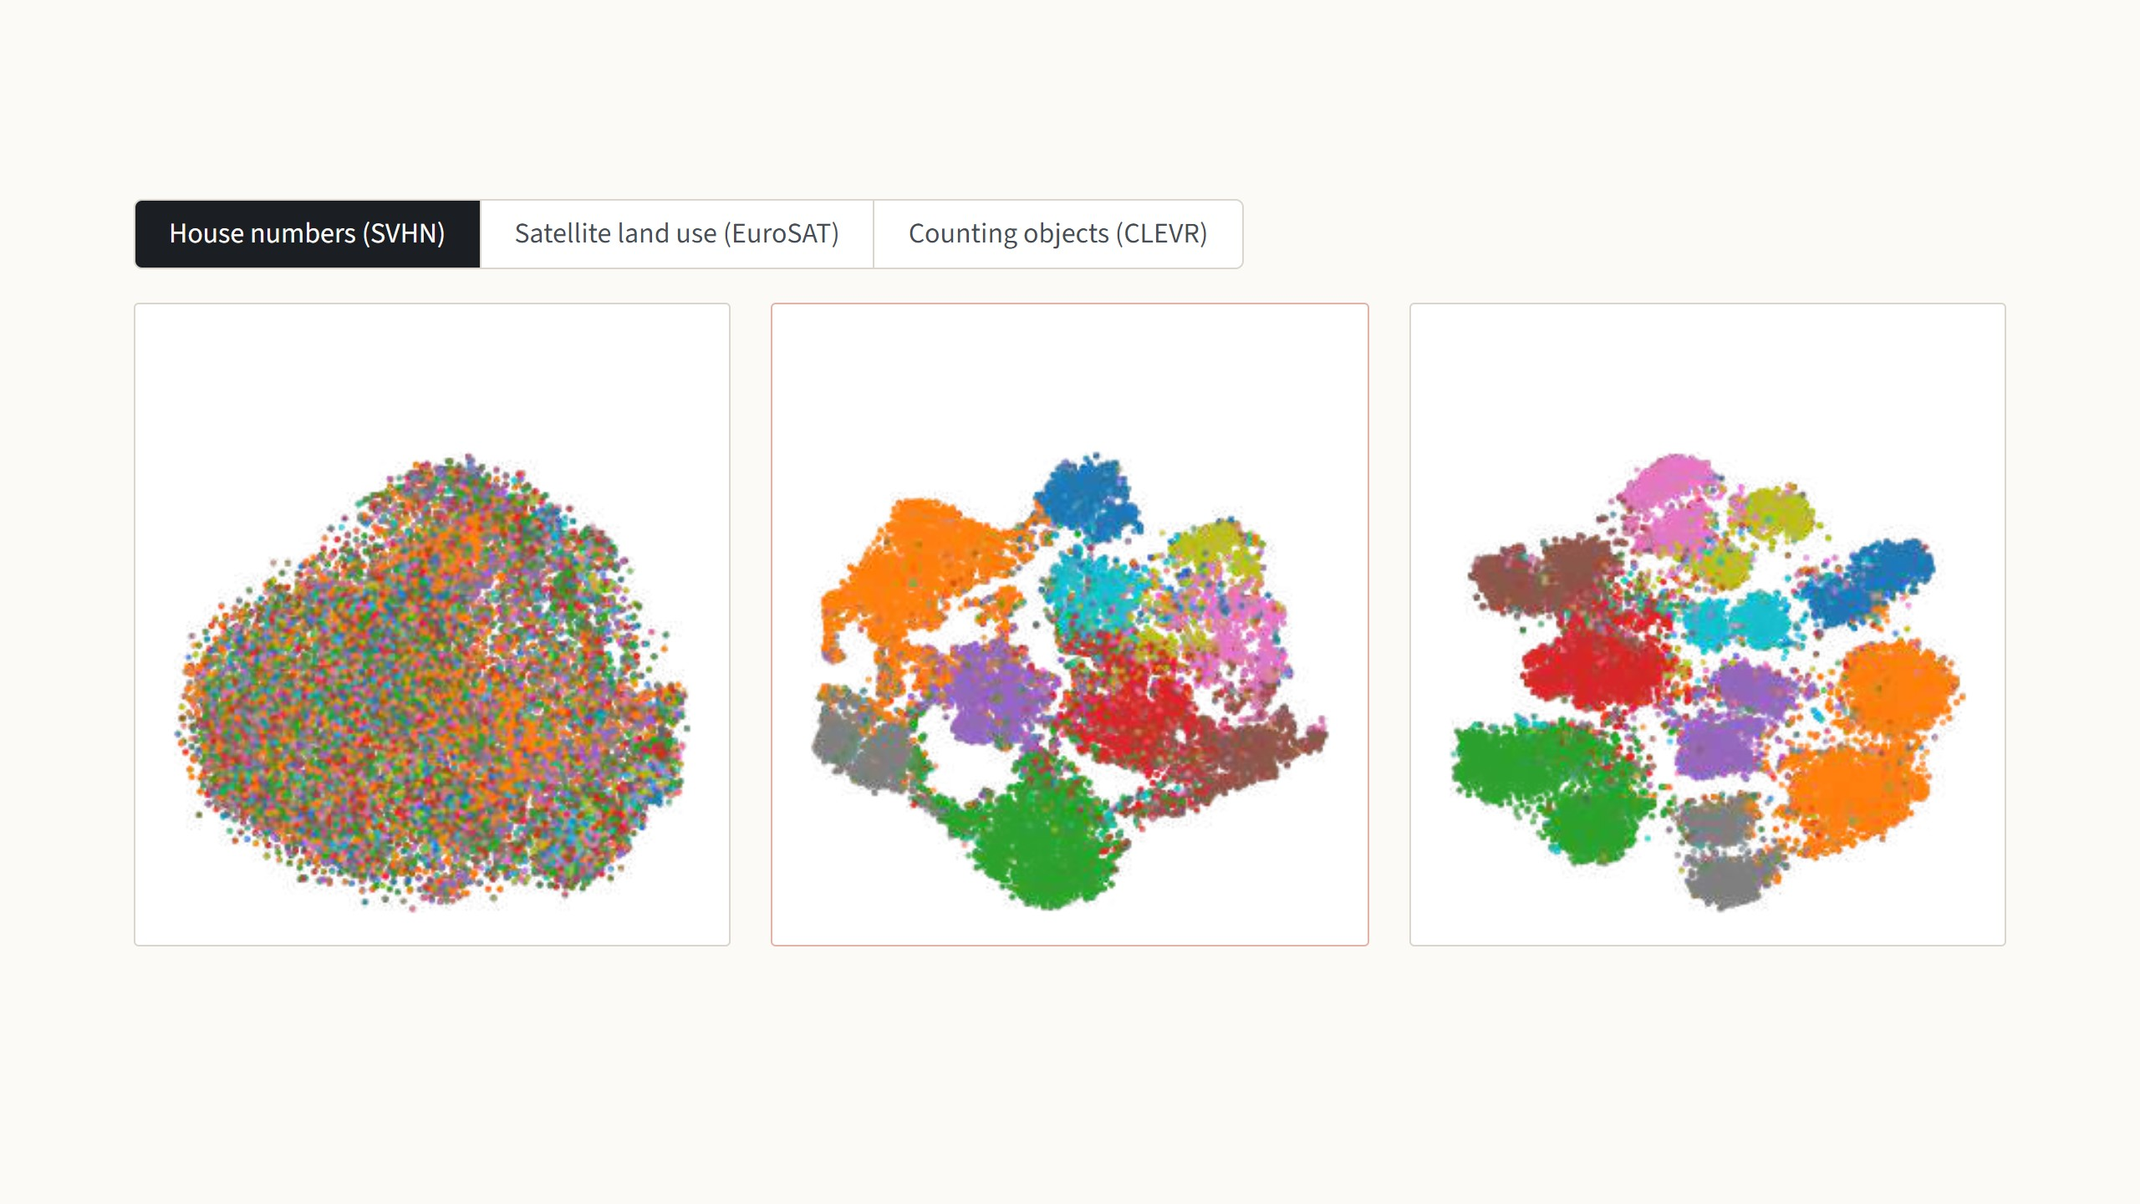
With prompts, the same frozen network separates the classes
Linear probe
36.6%
VPT-deep
78.1%
Full fine-tuning
87.4%
frozen network, no prompts
same frozen network, with prompts
every weight retrained
Each dot is one test image, coloured by its true class; the number is test accuracy. With the frozen features alone, the classes overlap. With
prompts, the same frozen network produces clearly separated groups, so a simple linear head can tell them apart.
t-SNE maps of the final [CLS] vector, test set, from Jia et al. 2022, Fig. 9. Accuracies from Fig. 9 and Table 13.
18
Notes:
This is the payoff of the "why it can work" slide: same weights, different input, completely different output. Each map is a 2-D t-SNE picture of the 768-number [CLS] vector the head receives. House numbers: the frozen features are one mixed blob, 36.6%; with prompts the ten digits form islands, 78.1%. Full fine-tuning is still better here, 87.4%, so be honest about that. Press the arrow key for satellite images: the frozen features are already half sorted, 87.5%, and VPT-deep gives clean clusters, 96.1%, slightly above full fine-tuning at 95.7%. Press again for counting objects in CLEVR: the frozen features know nothing about the count, 34.3%; VPT-deep reaches 68.5%, well above full fine-tuning at 56.3%, and arranges the images along a band that follows the object count. If asked: VPT-shallow sits in between (74.5, 92.0, 50.5); it is in the paper's figure.

Slide 37
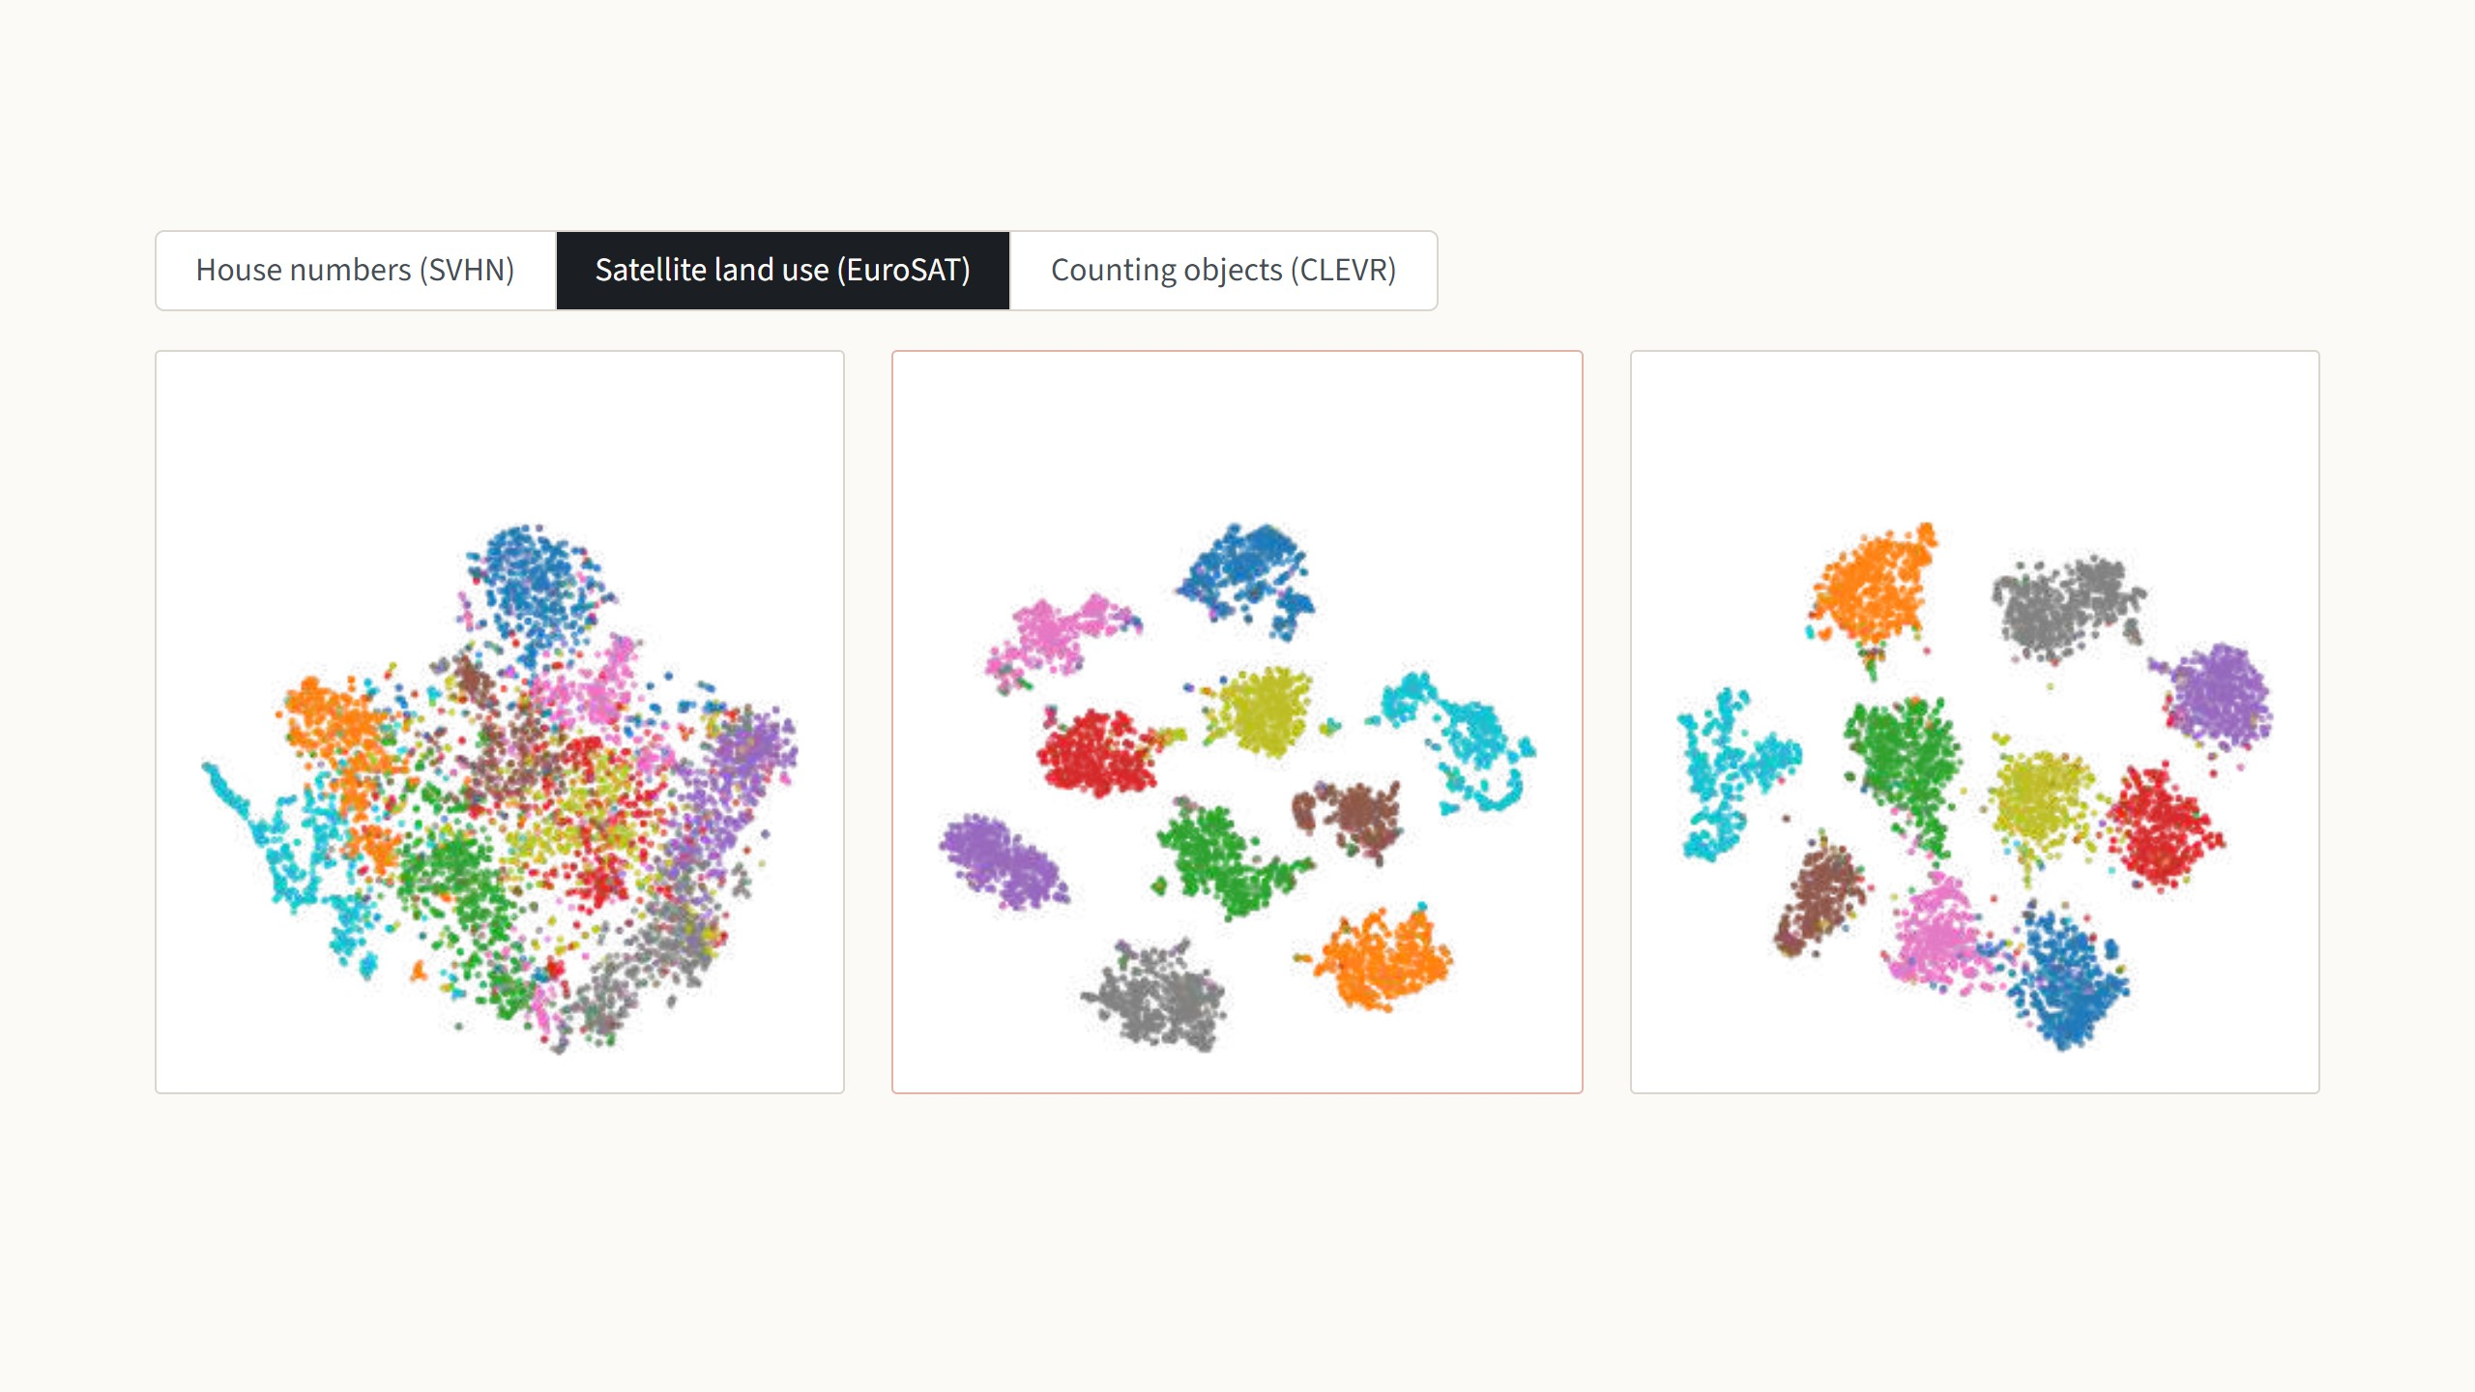
With prompts, the same frozen network separates the classes
Linear probe
87.5%
VPT-deep
96.1%
Full fine-tuning
95.7%
frozen network, no prompts
same frozen network, with prompts
every weight retrained
Each dot is one test image, coloured by its true class; the number is test accuracy. With the frozen features alone, the classes overlap. With
prompts, the same frozen network produces clearly separated groups, so a simple linear head can tell them apart.
t-SNE maps of the final [CLS] vector, test set, from Jia et al. 2022, Fig. 9. Accuracies from Fig. 9 and Table 13.
18
Notes:
This is the payoff of the "why it can work" slide: same weights, different input, completely different output. Each map is a 2-D t-SNE picture of the 768-number [CLS] vector the head receives. House numbers: the frozen features are one mixed blob, 36.6%; with prompts the ten digits form islands, 78.1%. Full fine-tuning is still better here, 87.4%, so be honest about that. Press the arrow key for satellite images: the frozen features are already half sorted, 87.5%, and VPT-deep gives clean clusters, 96.1%, slightly above full fine-tuning at 95.7%. Press again for counting objects in CLEVR: the frozen features know nothing about the count, 34.3%; VPT-deep reaches 68.5%, well above full fine-tuning at 56.3%, and arranges the images along a band that follows the object count. If asked: VPT-shallow sits in between (74.5, 92.0, 50.5); it is in the paper's figure.

Slide 38
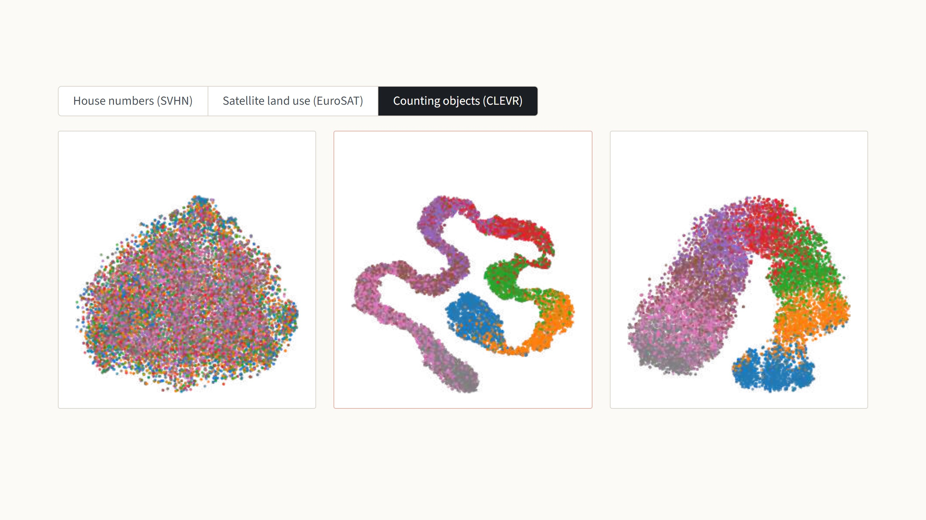
With prompts, the same frozen network separates the classes
Linear probe
34.3%
VPT-deep
68.5%
Full fine-tuning
56.3%
frozen network, no prompts
same frozen network, with prompts
every weight retrained
Each dot is one test image, coloured by its true class; the number is test accuracy. With the frozen features alone, the classes overlap. With
prompts, the same frozen network produces clearly separated groups, so a simple linear head can tell them apart.
t-SNE maps of the final [CLS] vector, test set, from Jia et al. 2022, Fig. 9. Accuracies from Fig. 9 and Table 13.
18
Notes:
This is the payoff of the "why it can work" slide: same weights, different input, completely different output. Each map is a 2-D t-SNE picture of the 768-number [CLS] vector the head receives. House numbers: the frozen features are one mixed blob, 36.6%; with prompts the ten digits form islands, 78.1%. Full fine-tuning is still better here, 87.4%, so be honest about that. Press the arrow key for satellite images: the frozen features are already half sorted, 87.5%, and VPT-deep gives clean clusters, 96.1%, slightly above full fine-tuning at 95.7%. Press again for counting objects in CLEVR: the frozen features know nothing about the count, 34.3%; VPT-deep reaches 68.5%, well above full fine-tuning at 56.3%, and arranges the images along a band that follows the object count. If asked: VPT-shallow sits in between (74.5, 92.0, 50.5); it is in the paper's figure.

Slide 39
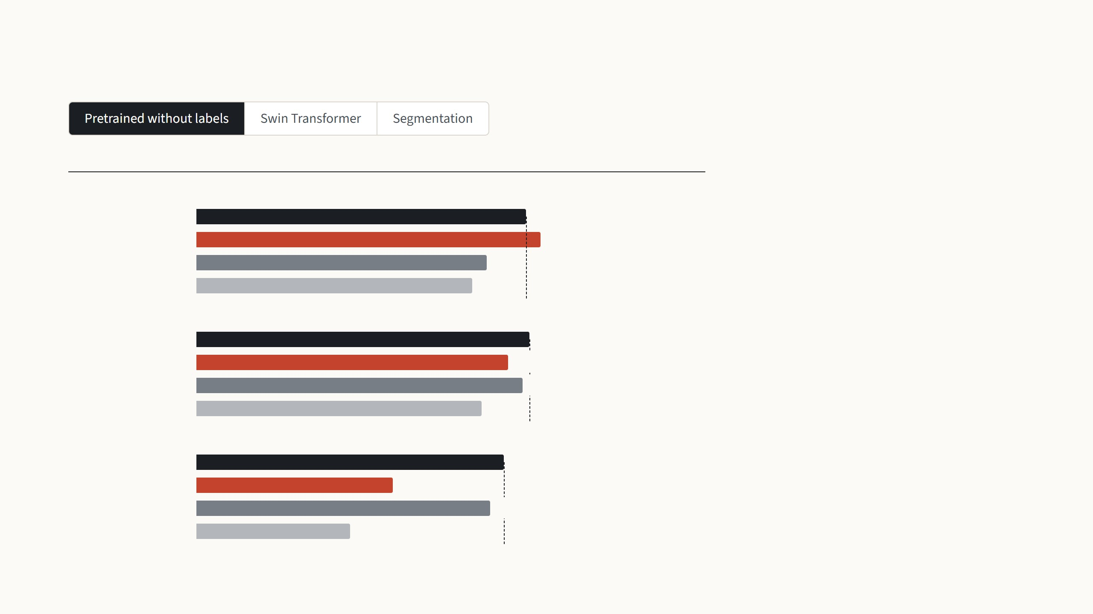
Where VPT falls short
Mean VTAB-1k accuracy (%)
Supervised on ImageNet-21k, with labels
Everything so far used a ViT pretrained
with labels. The paper also tries the same
ViT-B pretrained without labels, and there
VPT loses its lead.
Full fine-tuning
69.0
VPT-deep
72.0
Partial-1
60.7
Linear probe
57.6
With MoCo v3 it ends four points behind
full fine-tuning. With MAE it drops
towards the linear probe, while Partial-1,
which retrains only the last block, stays
close to full fine-tuning. The authors
leave the reason open.
MoCo v3, without labels
Full fine-tuning
69.6
VPT-deep
65.2
Partial-1
68.3
Linear probe
59.6
MAE, without labels
Full fine-tuning
64.3
VPT-deep
41.1
Partial-1
61.5
Linear probe
32.1
Jia et al. 2022, Table 1 (with labels) and Table 4 (MoCo v3, MAE): ViT-B/16, mean of the three VTAB-1k group averages.
19
Notes:
Be honest here; it is what a reading group is for. Three settings where the main result does not carry over. First, the pretraining. Everything so far used a ViT-B pretrained with labels on ImageNet-21k. The paper repeats VTAB-1k with the same architecture pretrained without labels on ImageNet-1k, by MoCo v3 (contrastive) and by MAE (masked autoencoder). The chart shows the mean of the three VTAB group averages. With labels, VPT-deep leads full fine-tuning, 72.0 against 69.0. With MoCo v3 it is 65.2 against 69.6, and Bias (69.2), Partial-1 (68.3) and the adapter (68.2) are all ahead of it. With MAE it collapses to 41.1, closer to the linear probe at 32.1 than to full fine-tuning at 64.3, while Partial-1, which retrains only the last block, reaches 61.5. The authors only say these self-supervised ViTs are fundamentally different and leave the reason open. It connects to the MAE paper from last time: MAE features are known to probe badly, and a few input tokens apparently cannot reorganise them the way retraining the last block can. Press the arrow key for Swin, a hierarchical Transformer that attends within local windows and merges patches in deeper layers; the prompts sit in the windows and are dropped at patch merging. VPT still beats the other cheap methods (Bias, linear probe, Partial, MLP-3) in every group, but full fine-tuning is ahead of VPT-deep in all three, by 6.3 points on Structured. Oddly, VPT-shallow does slightly better than full fine-tuning on Natural, 79.9 against 79.1; it is left out of the chart to keep it simple. Press again for segmentation: ADE20K, 150 classes per pixel, SETR on a ViT-L pretrained on ImageNet-21k; mIoU is the mean overlap between predicted and true regions. The decoder head is trained in every method, which is why even "head only" trains 13 million weights. VPT-deep gets 42.1 against 48.3, a little below Bias at 43.4; prompts plus biases give 44.0, within 1.5 of a fully fine-tuned ResNet-101 with four times the trained weights. This is also where LoRA will come in: it edits weights, so it does not depend on the input space being "steerable".

Slide 40
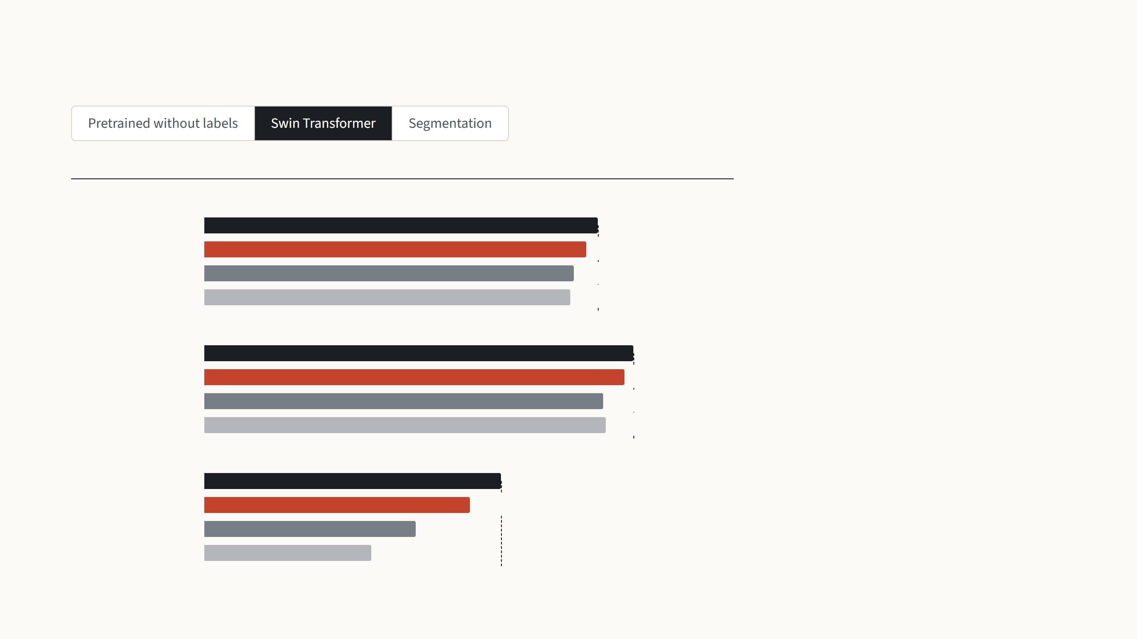
Where VPT falls short
Mean accuracy (%)
Natural, 7 tasks
Swin is a vision Transformer that looks at
small windows of the image and merges
patches as it goes deeper.
Full fine-tuning
79.1
VPT-deep
76.8
Bias
74.2
Linear probe
73.5
On Swin, VPT still beats the other cheap
methods. But full fine-tuning is ahead of
VPT-deep in all three groups, by 6.3
points on Structured.
Specialized, 4 tasks
Full fine-tuning
86.2
VPT-deep
84.5
Bias
80.1
Linear probe
80.8
Structured, 8 tasks
Full fine-tuning
59.7
VPT-deep
53.4
Bias
42.4
Linear probe
33.5
Jia et al. 2022, Table 2: Swin-B pretrained on ImageNet-21k with labels, mean test accuracy per VTAB-1k group.
19
Notes:
Be honest here; it is what a reading group is for. Three settings where the main result does not carry over. First, the pretraining. Everything so far used a ViT-B pretrained with labels on ImageNet-21k. The paper repeats VTAB-1k with the same architecture pretrained without labels on ImageNet-1k, by MoCo v3 (contrastive) and by MAE (masked autoencoder). The chart shows the mean of the three VTAB group averages. With labels, VPT-deep leads full fine-tuning, 72.0 against 69.0. With MoCo v3 it is 65.2 against 69.6, and Bias (69.2), Partial-1 (68.3) and the adapter (68.2) are all ahead of it. With MAE it collapses to 41.1, closer to the linear probe at 32.1 than to full fine-tuning at 64.3, while Partial-1, which retrains only the last block, reaches 61.5. The authors only say these self-supervised ViTs are fundamentally different and leave the reason open. It connects to the MAE paper from last time: MAE features are known to probe badly, and a few input tokens apparently cannot reorganise them the way retraining the last block can. Press the arrow key for Swin, a hierarchical Transformer that attends within local windows and merges patches in deeper layers; the prompts sit in the windows and are dropped at patch merging. VPT still beats the other cheap methods (Bias, linear probe, Partial, MLP-3) in every group, but full fine-tuning is ahead of VPT-deep in all three, by 6.3 points on Structured. Oddly, VPT-shallow does slightly better than full fine-tuning on Natural, 79.9 against 79.1; it is left out of the chart to keep it simple. Press again for segmentation: ADE20K, 150 classes per pixel, SETR on a ViT-L pretrained on ImageNet-21k; mIoU is the mean overlap between predicted and true regions. The decoder head is trained in every method, which is why even "head only" trains 13 million weights. VPT-deep gets 42.1 against 48.3, a little below Bias at 43.4; prompts plus biases give 44.0, within 1.5 of a fully fine-tuned ResNet-101 with four times the trained weights. This is also where LoRA will come in: it edits weights, so it does not depend on the input space being "steerable".

Slide 41
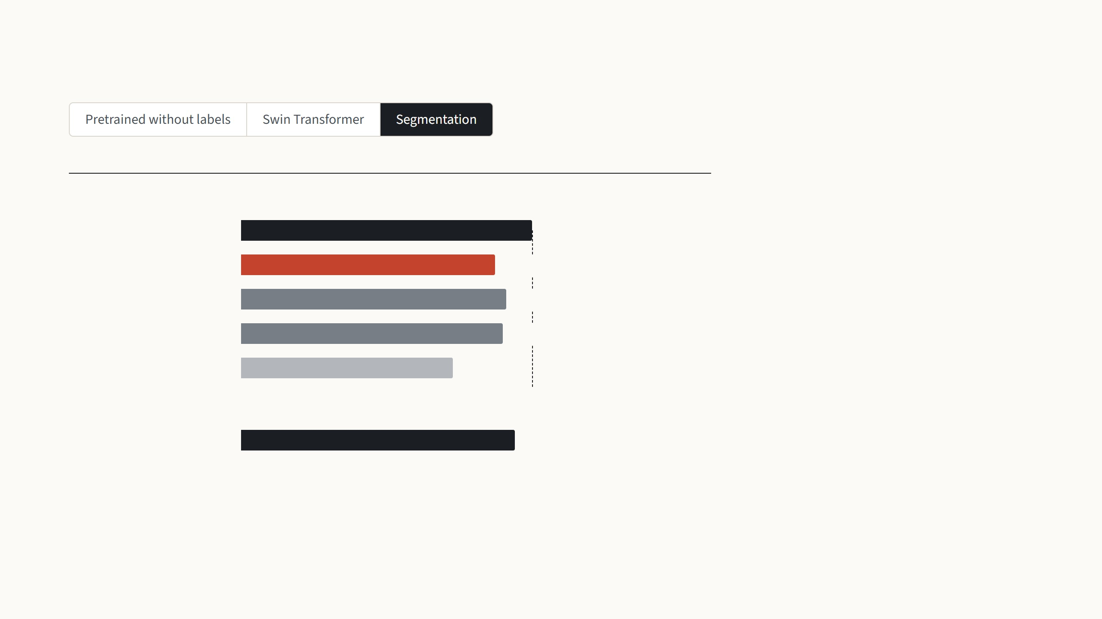
Where VPT falls short
mIoU on ADE20K (%)
Weights trained
ViT-L pretrained on ImageNet-21k
Segmentation labels every pixel of a
scene. The score, mIoU, measures how
well the predicted regions overlap the
true ones.
Full fine-tuning
48.3
318.3 M
VPT-deep
42.1
13.4 M
VPT + Bias
44.0
15.8 M
Here VPT-deep reaches 42.1 against 48.3
for full fine-tuning, about the same as
tuning only the biases. Prompts and
biases together come within 1.5 points of
a fully fine-tuned ResNet-101.
Bias
43.4
13.5 M
Head only
35.1
13.2 M
ResNet-101, a ConvNet
Full fine-tuning
45.5
63.0 M
Jia et al. 2022, Table 3: ADE20K validation, SETR decoder, single-scale mIoU. ResNet-101: DeepLab v3+ (Chen et al. 2018).
19
Notes:
Be honest here; it is what a reading group is for. Three settings where the main result does not carry over. First, the pretraining. Everything so far used a ViT-B pretrained with labels on ImageNet-21k. The paper repeats VTAB-1k with the same architecture pretrained without labels on ImageNet-1k, by MoCo v3 (contrastive) and by MAE (masked autoencoder). The chart shows the mean of the three VTAB group averages. With labels, VPT-deep leads full fine-tuning, 72.0 against 69.0. With MoCo v3 it is 65.2 against 69.6, and Bias (69.2), Partial-1 (68.3) and the adapter (68.2) are all ahead of it. With MAE it collapses to 41.1, closer to the linear probe at 32.1 than to full fine-tuning at 64.3, while Partial-1, which retrains only the last block, reaches 61.5. The authors only say these self-supervised ViTs are fundamentally different and leave the reason open. It connects to the MAE paper from last time: MAE features are known to probe badly, and a few input tokens apparently cannot reorganise them the way retraining the last block can. Press the arrow key for Swin, a hierarchical Transformer that attends within local windows and merges patches in deeper layers; the prompts sit in the windows and are dropped at patch merging. VPT still beats the other cheap methods (Bias, linear probe, Partial, MLP-3) in every group, but full fine-tuning is ahead of VPT-deep in all three, by 6.3 points on Structured. Oddly, VPT-shallow does slightly better than full fine-tuning on Natural, 79.9 against 79.1; it is left out of the chart to keep it simple. Press again for segmentation: ADE20K, 150 classes per pixel, SETR on a ViT-L pretrained on ImageNet-21k; mIoU is the mean overlap between predicted and true regions. The decoder head is trained in every method, which is why even "head only" trains 13 million weights. VPT-deep gets 42.1 against 48.3, a little below Bias at 43.4; prompts plus biases give 44.0, within 1.5 of a fully fine-tuned ResNet-101 with four times the trained weights. This is also where LoRA will come in: it edits weights, so it does not depend on the input space being "steerable".

Slide 42
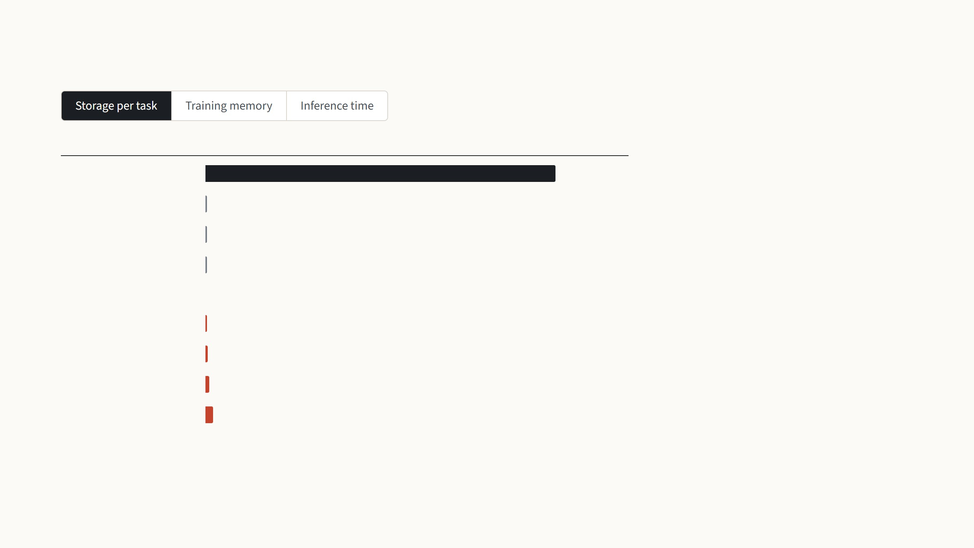
VPT saves storage, not training memory or inference time
Stored per task (MB)
A task trained with VPT-deep keeps only
its prompts and its head: 0.35 MB with
one prompt per layer, 7.7 MB with 200. A
fully fine-tuned copy is 343 MB for every
task.
Full fine-tuning
343 MB
Linear probe
0.31 MB
Bias
0.72 MB
Adapter
1.2 MB
All tasks share one frozen backbone, so
this is the real saving, and it grows with
every task.
VPT-deep, with this many prompts at each layer
1 prompt
0.35 MB
50 prompts
2.2 MB
100 prompts
4.0 MB
200 prompts
7.7 MB
Trained numbers at 4 bytes each. Bias and adapter (r = 64): their share of tuned weights in Jia et al. 2022, Table 12. VPT-deep: 12 × p × 768 prompt numbers plus a 102-class head.
20
Notes:
Easy to miss in the main paper: the saving is disk, not GPU. Three arrow-key steps, same rows each time: full fine-tuning in dark with the dashed line at its value, the cheap baselines in grey, VPT-deep in red with 1, 50, 100 and 200 prompts per layer. Storage: a task keeps only what it trained, so VPT-deep is 0.35 MB with one prompt per layer and 7.7 MB with 200, against 343 MB for a full copy; bias and adapter are as small, so storage is what all these methods buy, and it is VPT's real win. Training memory: no saving. The prompts in the first layer only get a gradient if it travels back through all twelve frozen layers, so their activations are kept, as in full fine-tuning; with 200 prompts the longer sequence makes it 25.8 GB against 11.7. Only the linear probe, 0.9 GB, avoids this. Training time per image is not shown: one prompt trains faster than full fine-tuning, 214 against 359 ms, but 200 prompts are as slow, 360 ms. Inference time: every test image carries the prompts through all twelve layers. Fifty prompts take the sequence from 197 to 247 tokens and the time from 70 to 82 ms; 200 prompts double it, 141 ms. The paper notes this is far from the 4x one would expect from quadratic attention. The prompts cannot be folded into the weights, so the cost stays; the paper's prefix variant, which puts the prompts only into the keys and values, recovers some of it (Fig. 19). LoRA, next time, merges its update into the weights and costs nothing at test time. If asked: the table has only 1 and 200 prompts; the 50 and 100 values are read off Fig. 18's plotted points, and the 1 and 200 points of that figure match the table. If someone asks "why not just use this for everything", this is the answer.

Slide 43
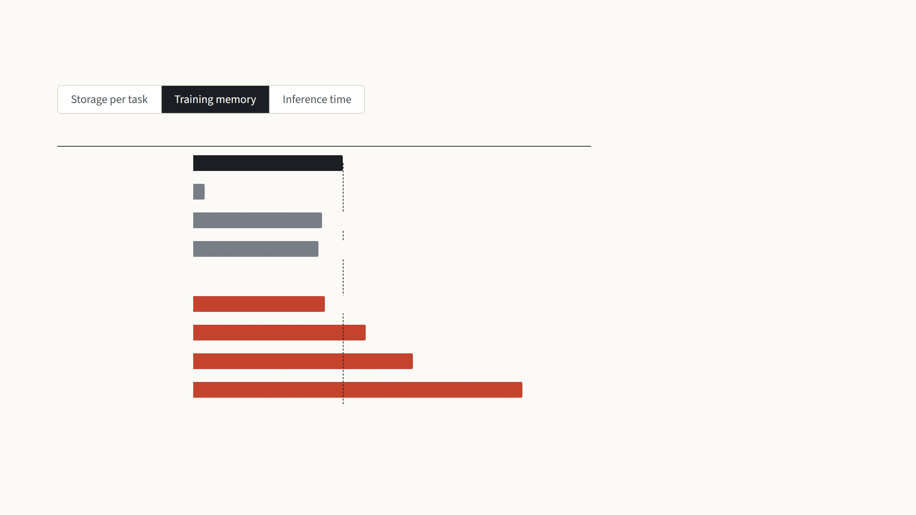
VPT saves storage, not training memory or inference time
Peak GPU memory in training (GB)
In training, VPT-deep needs about as
much GPU memory as full fine-tuning,
and with 200 prompts more than twice as
much.
Full fine-tuning
11.7 GB
Linear probe
0.9 GB
Bias
10.1 GB
To train the prompts in the first layer, the
gradient has to travel back through all
twelve frozen layers, so their activations
must be kept, as in full fine-tuning. Only
the linear probe avoids this.
Adapter
9.8 GB
VPT-deep, with this many prompts at each layer
1 prompt
10.3 GB
50 prompts
13.5 GB
100 prompts
17.2 GB
200 prompts
25.8 GB
Jia et al. 2022, Appendix Table 12: ViT-B/16 on one A100 GPU, batch 64. The table has no rows for 50 and 100 prompts; those values are read from its Fig. 18.
20
Notes:
Easy to miss in the main paper: the saving is disk, not GPU. Three arrow-key steps, same rows each time: full fine-tuning in dark with the dashed line at its value, the cheap baselines in grey, VPT-deep in red with 1, 50, 100 and 200 prompts per layer. Storage: a task keeps only what it trained, so VPT-deep is 0.35 MB with one prompt per layer and 7.7 MB with 200, against 343 MB for a full copy; bias and adapter are as small, so storage is what all these methods buy, and it is VPT's real win. Training memory: no saving. The prompts in the first layer only get a gradient if it travels back through all twelve frozen layers, so their activations are kept, as in full fine-tuning; with 200 prompts the longer sequence makes it 25.8 GB against 11.7. Only the linear probe, 0.9 GB, avoids this. Training time per image is not shown: one prompt trains faster than full fine-tuning, 214 against 359 ms, but 200 prompts are as slow, 360 ms. Inference time: every test image carries the prompts through all twelve layers. Fifty prompts take the sequence from 197 to 247 tokens and the time from 70 to 82 ms; 200 prompts double it, 141 ms. The paper notes this is far from the 4x one would expect from quadratic attention. The prompts cannot be folded into the weights, so the cost stays; the paper's prefix variant, which puts the prompts only into the keys and values, recovers some of it (Fig. 19). LoRA, next time, merges its update into the weights and costs nothing at test time. If asked: the table has only 1 and 200 prompts; the 50 and 100 values are read off Fig. 18's plotted points, and the 1 and 200 points of that figure match the table. If someone asks "why not just use this for everything", this is the answer.

Slide 44
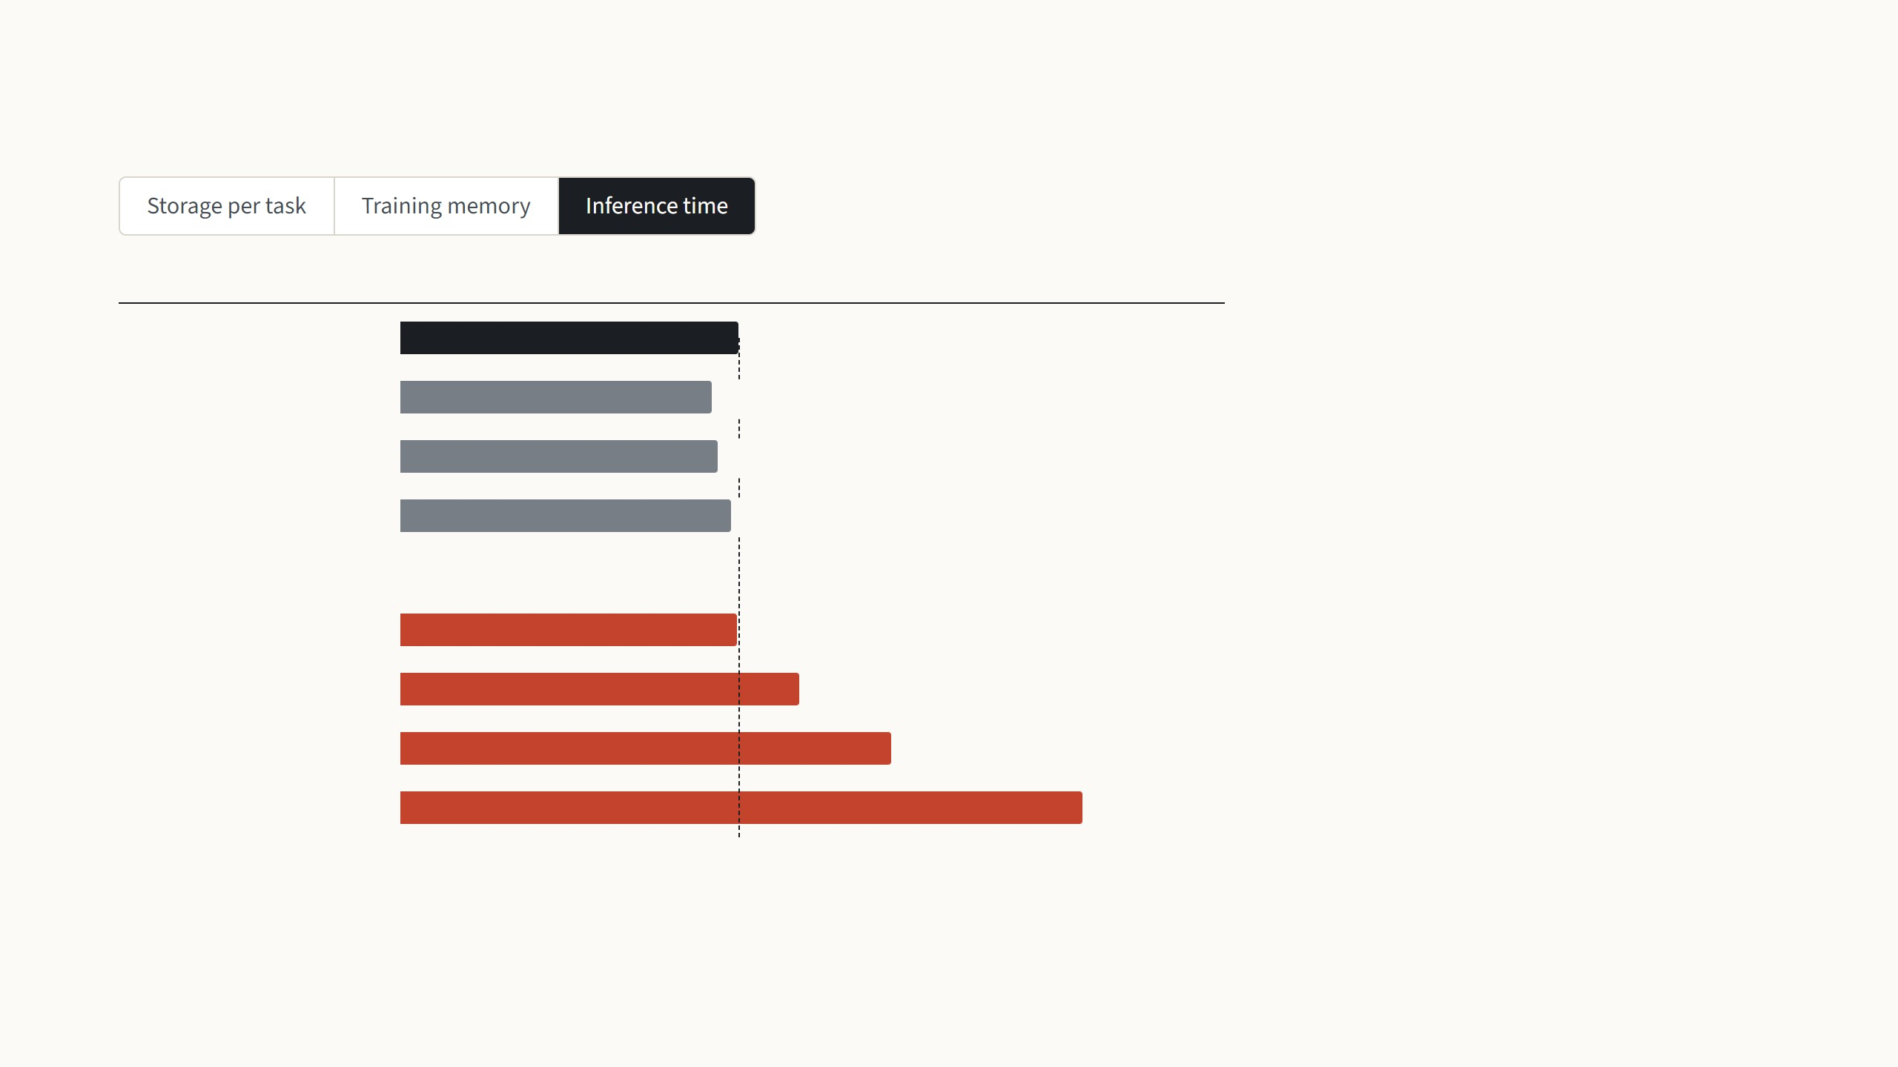
VPT saves storage, not training memory or inference time
Test time per image (ms)
At test time every image carries the
prompts through all twelve layers, so the
sequence is longer. Fifty prompts make it
82 ms instead of 70, and 200 prompts
double it.
Full fine-tuning
70 ms
Linear probe
64 ms
Bias
66 ms
Adapter
68 ms
The prompts cannot be folded into the
weights, so this cost stays. LoRA, the next
paper, avoids it.
VPT-deep, with this many prompts at each layer
1 prompt
69 ms
50 prompts
82 ms
100 prompts
101 ms
200 prompts
141 ms
Jia et al. 2022, Appendix Table 12: ViT-B/16 on one A100 GPU, batch 64. The table has no rows for 50 and 100 prompts; those values are read from its Fig. 18.
20
Notes:
Easy to miss in the main paper: the saving is disk, not GPU. Three arrow-key steps, same rows each time: full fine-tuning in dark with the dashed line at its value, the cheap baselines in grey, VPT-deep in red with 1, 50, 100 and 200 prompts per layer. Storage: a task keeps only what it trained, so VPT-deep is 0.35 MB with one prompt per layer and 7.7 MB with 200, against 343 MB for a full copy; bias and adapter are as small, so storage is what all these methods buy, and it is VPT's real win. Training memory: no saving. The prompts in the first layer only get a gradient if it travels back through all twelve frozen layers, so their activations are kept, as in full fine-tuning; with 200 prompts the longer sequence makes it 25.8 GB against 11.7. Only the linear probe, 0.9 GB, avoids this. Training time per image is not shown: one prompt trains faster than full fine-tuning, 214 against 359 ms, but 200 prompts are as slow, 360 ms. Inference time: every test image carries the prompts through all twelve layers. Fifty prompts take the sequence from 197 to 247 tokens and the time from 70 to 82 ms; 200 prompts double it, 141 ms. The paper notes this is far from the 4x one would expect from quadratic attention. The prompts cannot be folded into the weights, so the cost stays; the paper's prefix variant, which puts the prompts only into the keys and values, recovers some of it (Fig. 19). LoRA, next time, merges its update into the weights and costs nothing at test time. If asked: the table has only 1 and 200 prompts; the 50 and 100 values are read off Fig. 18's plotted points, and the 1 and 200 points of that figure match the table. If someone asks "why not just use this for everything", this is the answer.

Slide 45
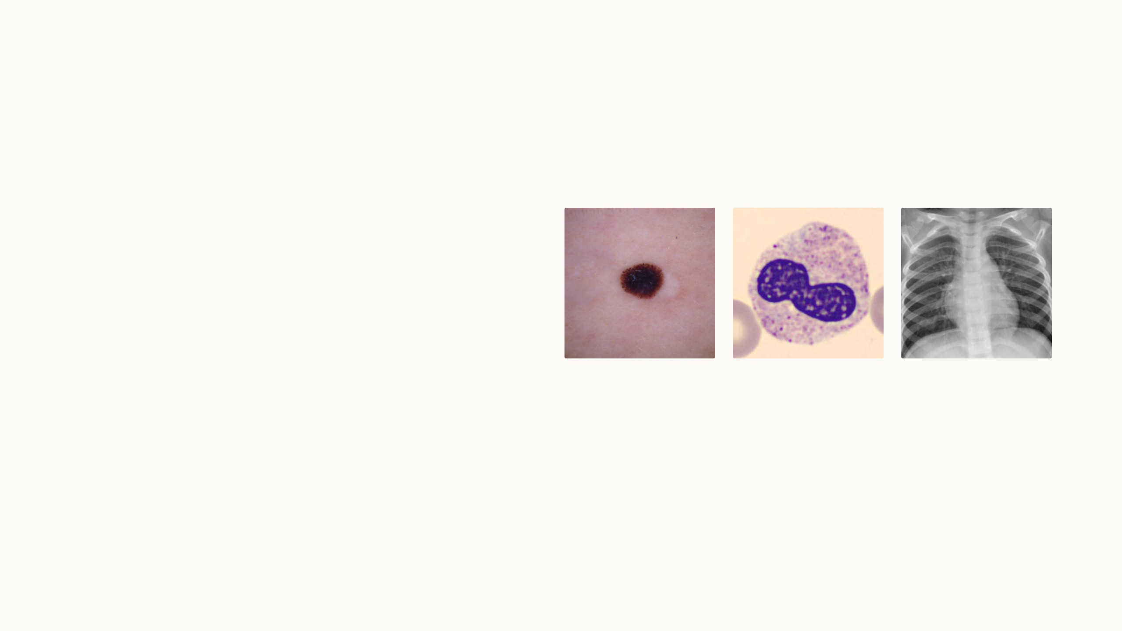
My experiments
I re-implemented VPT and trained it on three
medical imaging datasets from MedMNIST. A
linear probe and full fine-tuning ran next to it,
all three starting from the paper's ViT-B/16.
First the results, then all three models running
live in this browser.
Skin lesions
Blood cells
Chest X-rays
21
Notes:
From here on it is my own work, not the paper. I wrote VPT myself on top of a timm ViT-B/16, the same ImageNet-21k checkpoint the paper uses, and trained it on three MedMNIST tasks: skin lesions, blood cells and chest X-rays. Why medical: these images are far from ImageNet, like the paper's Specialized group, and Oxford Flowers was already at 99%. Next: the setup, then the results, then the live demo.

Slide 46
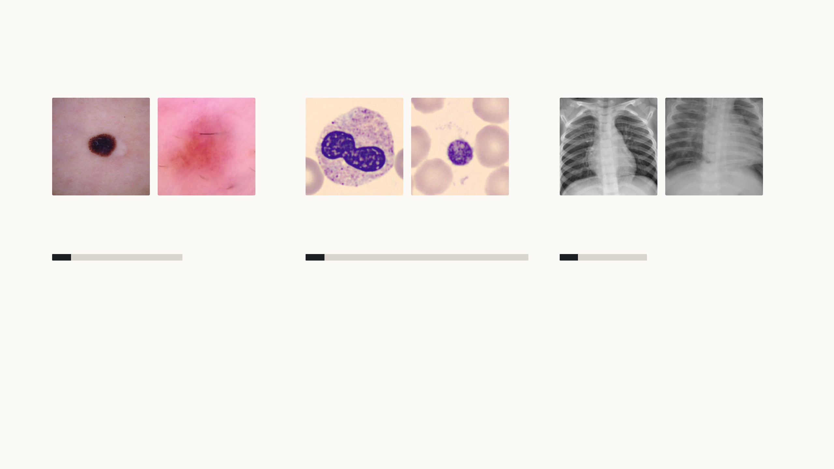
I tested VPT on three medical datasets
Each one was trained twice: on 1,000 images, as in the paper's VTAB-1k, and on its full training set.
melanoma
nevus
neutrophil
platelet
normal
pneumonia
Skin lesions
Blood cells
Chest X-rays
Dermoscopy, 7 classes
Microscopy, 8 cell types
Radiographs, pneumonia or normal
1,000 or all 7,007 training images
1,000 or all 11,959 training images
1,000 or all 4,708 training images
MedMNIST+ at 224 × 224 (Yang et al. 2023); skin lesions from HAM10000 (Tschandl et al. 2018). Trained on an RTX 5070 Ti laptop GPU with the paper's recipe: SGD for linear probe
and VPT, AdamW for full fine-tuning, learning rate picked on validation.
22
Notes:
Three public datasets from MedMNIST+, at 224 × 224 pixels, all far from ImageNet photos. Skin lesions are heavily imbalanced, two thirds are nevi, so I report balanced accuracy, the mean per-class recall: always answering "nevus" would score 67% plain accuracy. Each task was trained twice, on 1,000 random training images, the size of the paper's VTAB-1k, and on the whole training split; the bars show how small 1,000 is next to each full set. Next step: the three methods. All start from the same ViT-B/16 ImageNet-21k checkpoint the paper uses. The linear probe and VPT keep it frozen and train only the red parts; full fine-tuning retrains every weight, so each task needs its own 343 MB copy. Learning rates were picked on the validation split, and the reported model is the one with the best validation balanced accuracy, the same rule for all three methods.

Slide 47
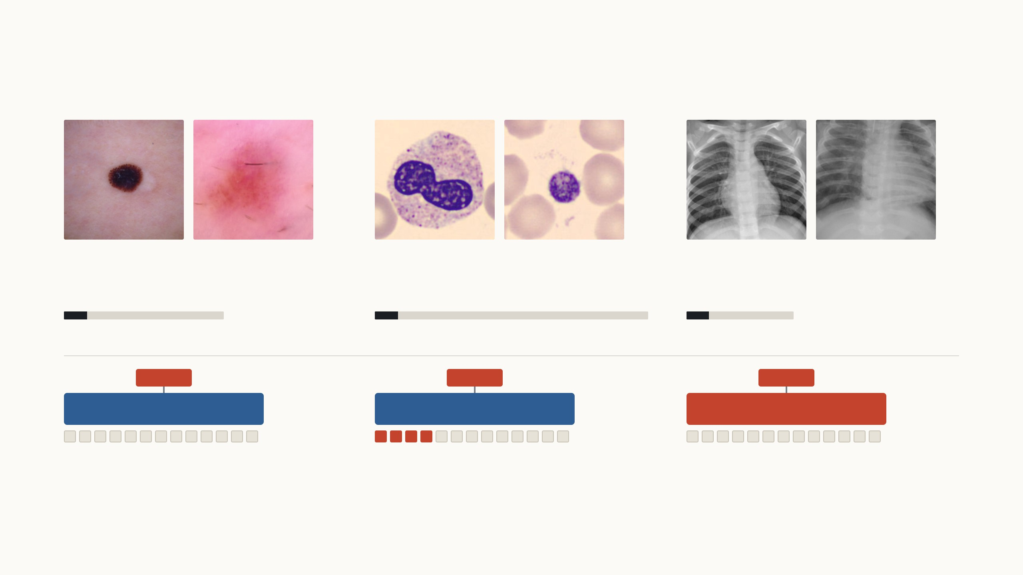
I tested VPT on three medical datasets
Each one was trained twice: on 1,000 images, as in the paper's VTAB-1k, and on its full training set.
melanoma
nevus
neutrophil
platelet
normal
pneumonia
Skin lesions
Blood cells
Chest X-rays
Dermoscopy, 7 classes
Microscopy, 8 cell types
Radiographs, pneumonia or normal
1,000 or all 7,007 training images
1,000 or all 11,959 training images
1,000 or all 4,708 training images
head
head
head
ViT-B/16 frozen
ViT-B/16 frozen
ViT-B/16 retrained
Linear probe
VPT-deep
Full fine-tuning
Trains only a new head.
Trains a head and 50 prompts per layer.
Retrains all 85.8 million weights.
MedMNIST+ at 224 × 224 (Yang et al. 2023); skin lesions from HAM10000 (Tschandl et al. 2018). Trained on an RTX 5070 Ti laptop GPU with the paper's recipe: SGD for linear probe
and VPT, AdamW for full fine-tuning, learning rate picked on validation.
22
Notes:
Three public datasets from MedMNIST+, at 224 × 224 pixels, all far from ImageNet photos. Skin lesions are heavily imbalanced, two thirds are nevi, so I report balanced accuracy, the mean per-class recall: always answering "nevus" would score 67% plain accuracy. Each task was trained twice, on 1,000 random training images, the size of the paper's VTAB-1k, and on the whole training split; the bars show how small 1,000 is next to each full set. Next step: the three methods. All start from the same ViT-B/16 ImageNet-21k checkpoint the paper uses. The linear probe and VPT keep it frozen and train only the red parts; full fine-tuning retrains every weight, so each task needs its own 343 MB copy. Learning rates were picked on the validation split, and the reported model is the one with the best validation balanced accuracy, the same rule for all three methods.

Slide 48
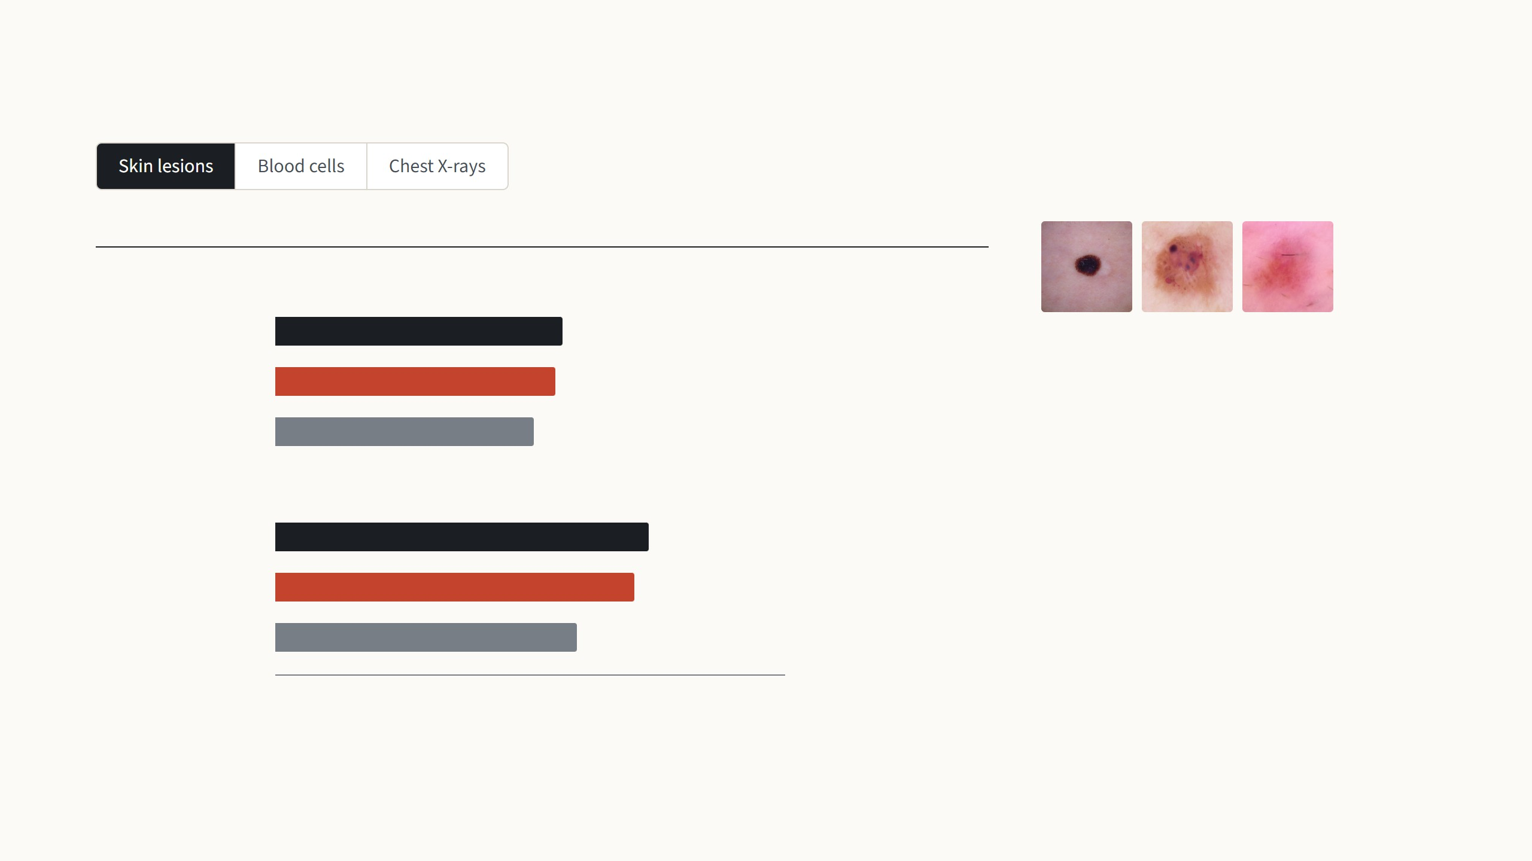
VPT always beat the linear probe and came close to full fine-tuning
Balanced accuracy on the test set (%)
Against VPT-deep
1,000 training images
Full fine-tuning
64.9
1.6 points higher
Seven kinds of skin lesion, and two thirds
of the images show harmless moles. This
is the hardest of the three tasks.
VPT-deep
63.3
Linear probe
58.4
4.9 points lower
With all 7,007 images, VPT-deep is 12.9
points ahead of the linear probe, up from
4.9. Full fine-tuning stays ahead of
VPT-deep, by 1.6 and 3.4 points.
All 7,007 training images
Full fine-tuning
84.4
3.4 points higher
VPT-deep
81.0
Linear probe
68.1
12.9 points lower
0
25
50
75
100
My runs: ViT-B/16 (ImageNet-21k), MedMNIST+ 224 × 224, balanced accuracy on the test set (the mean per-class recall: on skin lesions, always answering "nevus" scores 67%
accuracy but only 14% balanced accuracy), bars start at 0. Each method was trained once with 1,000 images and once with the full training set; there are no points in between.
23
Notes:
Step through the three datasets with the arrow keys. Each tab has only two measured settings, 1,000 training images and the full training set, so they are drawn as two separate groups of bars, not as a line. The score is balanced accuracy on the test set, the mean recall over classes, because skin lesions are so imbalanced. Skin lesions: VPT is 5 points above the linear probe with 1,000 images and 13 points above with all 7,007, because the prompts can reshape the features and a linear head cannot; full fine-tuning stays 2 to 3 points ahead. Blood cells: everything is above 96, and VPT and full fine-tuning are within a few tenths of a point of each other. Chest X-rays: with 1,000 images VPT barely beats the linear probe and trails full fine-tuning by almost 4 points; with all 4,708 it comes out on top. So across all six settings VPT never loses to the linear probe and is never more than 4 points behind full fine-tuning. Unlike the paper, the low-data setting did not favour VPT here; medical images behave like the paper's Specialized group.

Slide 49
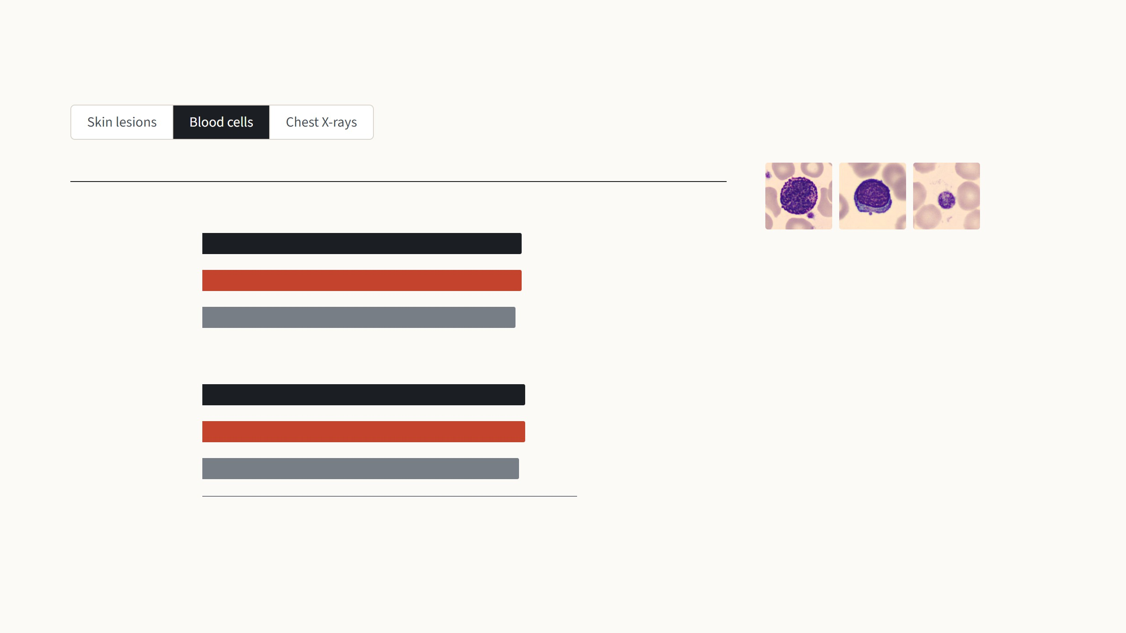
VPT always beat the linear probe and came close to full fine-tuning
Balanced accuracy on the test set (%)
Against VPT-deep
1,000 training images
Full fine-tuning
98.0
0.2 points lower
Eight kinds of blood cell under a
microscope. Every method scores above
96 here, so the bars are almost the same
length.
VPT-deep
98.2
Linear probe
96.1
2.1 points lower
All 11,959 training images
VPT-deep and full fine-tuning are within
0.2 points of each other with either
amount of data.
Full fine-tuning
99.2
0.1 points higher
VPT-deep
99.1
Linear probe
97.4
1.7 points lower
0
25
50
75
100
My runs: ViT-B/16 (ImageNet-21k), MedMNIST+ 224 × 224, balanced accuracy on the test set (the mean per-class recall: on skin lesions, always answering "nevus" scores 67%
accuracy but only 14% balanced accuracy), bars start at 0. Each method was trained once with 1,000 images and once with the full training set; there are no points in between.
23
Notes:
Step through the three datasets with the arrow keys. Each tab has only two measured settings, 1,000 training images and the full training set, so they are drawn as two separate groups of bars, not as a line. The score is balanced accuracy on the test set, the mean recall over classes, because skin lesions are so imbalanced. Skin lesions: VPT is 5 points above the linear probe with 1,000 images and 13 points above with all 7,007, because the prompts can reshape the features and a linear head cannot; full fine-tuning stays 2 to 3 points ahead. Blood cells: everything is above 96, and VPT and full fine-tuning are within a few tenths of a point of each other. Chest X-rays: with 1,000 images VPT barely beats the linear probe and trails full fine-tuning by almost 4 points; with all 4,708 it comes out on top. So across all six settings VPT never loses to the linear probe and is never more than 4 points behind full fine-tuning. Unlike the paper, the low-data setting did not favour VPT here; medical images behave like the paper's Specialized group.

Slide 50
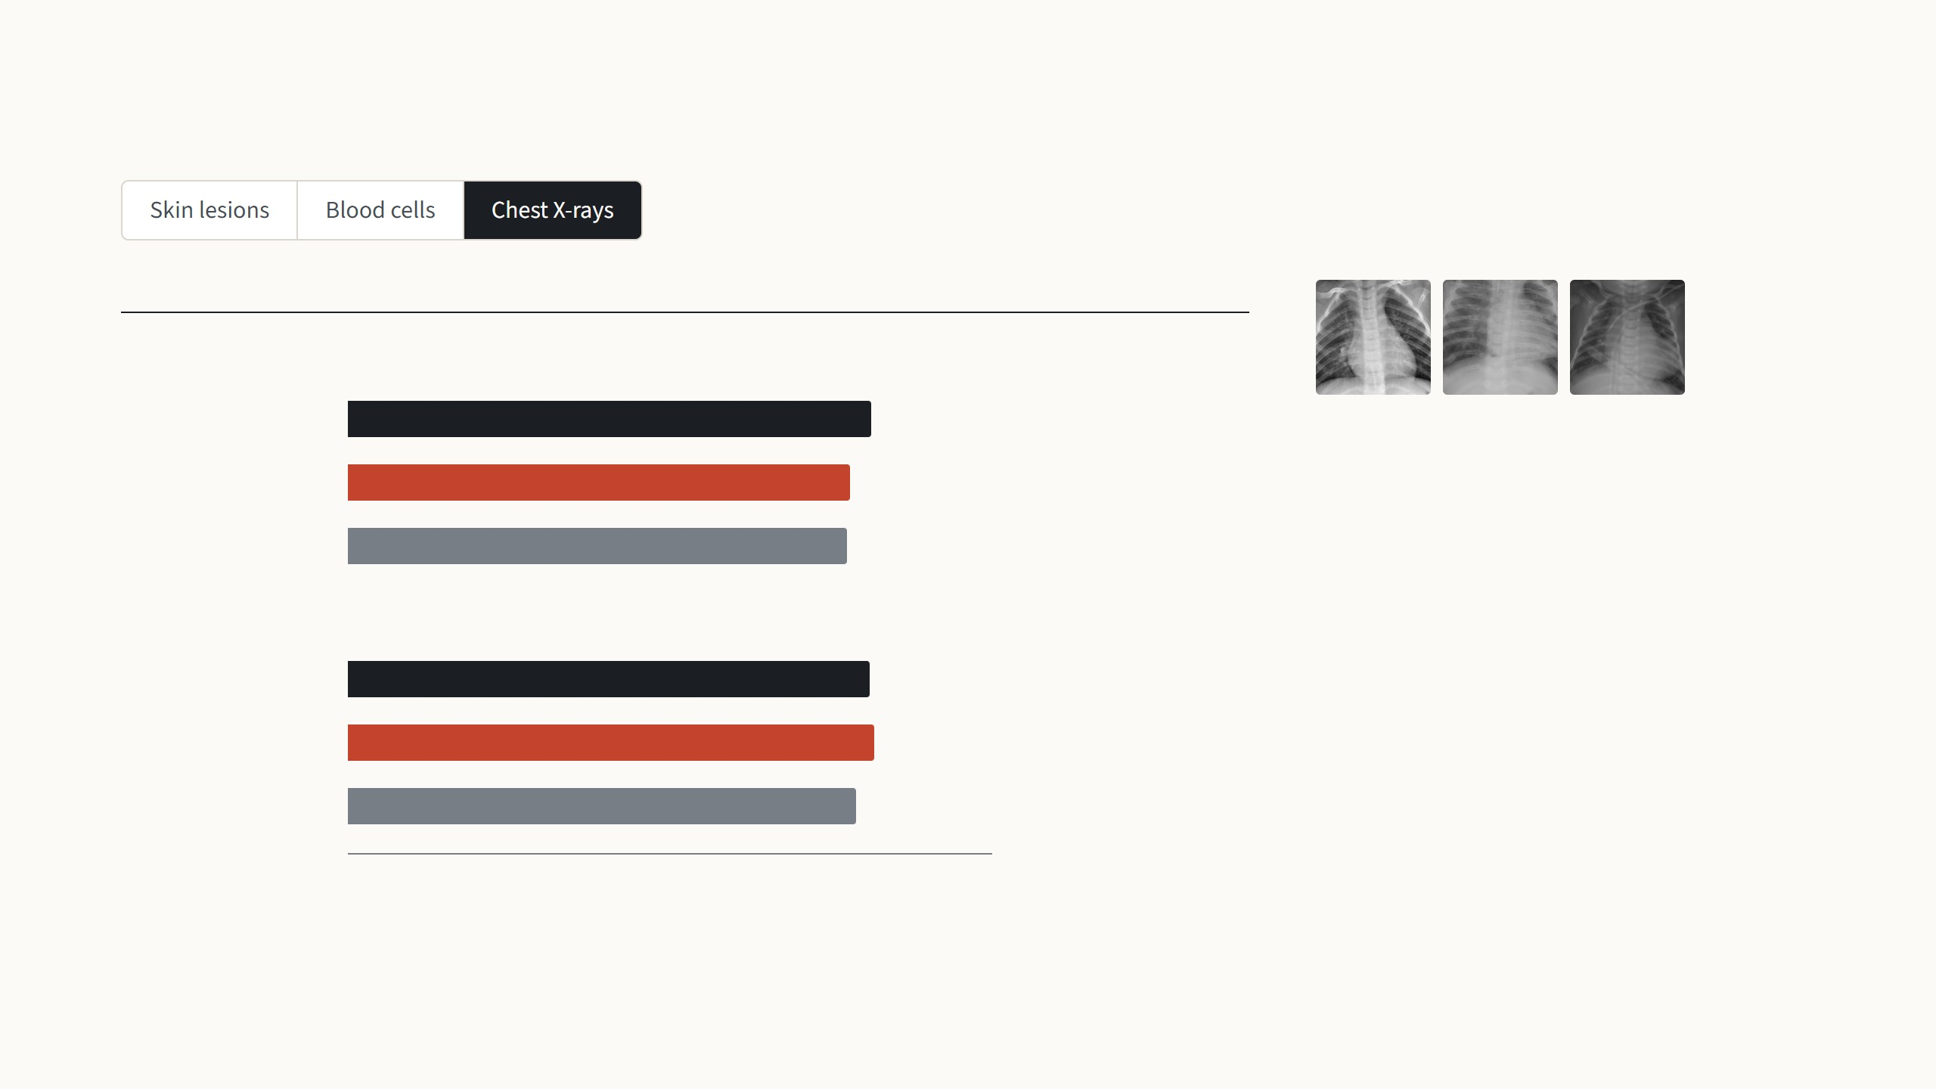
VPT always beat the linear probe and came close to full fine-tuning
Balanced accuracy on the test set (%)
Against VPT-deep
1,000 training images
Full fine-tuning
93.4
3.7 points higher
Chest X-rays of children, labelled normal
or pneumonia.
VPT-deep
89.7
Linear probe
89.2
0.5 points lower
With 1,000 images, VPT-deep is only 0.5
points above the linear probe and 3.7
points behind full fine-tuning. With all
4,708 images it scores highest of the
three.
All 4,708 training images
Full fine-tuning
93.3
0.8 points lower
VPT-deep
94.1
Linear probe
90.9
3.2 points lower
0
25
50
75
100
My runs: ViT-B/16 (ImageNet-21k), MedMNIST+ 224 × 224, balanced accuracy on the test set (the mean per-class recall: on skin lesions, always answering "nevus" scores 67%
accuracy but only 14% balanced accuracy), bars start at 0. Each method was trained once with 1,000 images and once with the full training set; there are no points in between.
23
Notes:
Step through the three datasets with the arrow keys. Each tab has only two measured settings, 1,000 training images and the full training set, so they are drawn as two separate groups of bars, not as a line. The score is balanced accuracy on the test set, the mean recall over classes, because skin lesions are so imbalanced. Skin lesions: VPT is 5 points above the linear probe with 1,000 images and 13 points above with all 7,007, because the prompts can reshape the features and a linear head cannot; full fine-tuning stays 2 to 3 points ahead. Blood cells: everything is above 96, and VPT and full fine-tuning are within a few tenths of a point of each other. Chest X-rays: with 1,000 images VPT barely beats the linear probe and trails full fine-tuning by almost 4 points; with all 4,708 it comes out on top. So across all six settings VPT never loses to the linear probe and is never more than 4 points behind full fine-tuning. Unlike the paper, the low-data setting did not favour VPT here; medical images behave like the paper's Specialized group.

Slide 51
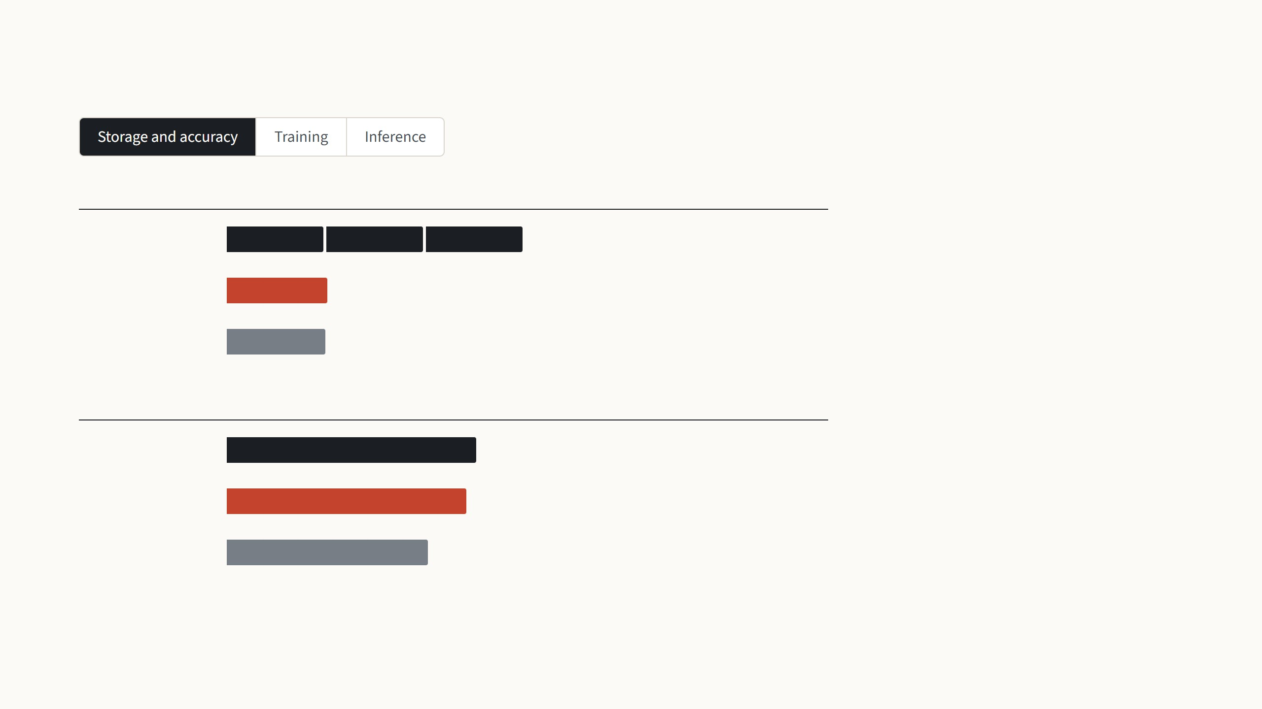
What each method costs on skin lesions
Stored for all three tasks
VPT stores 1.9 MB per task instead of
343 MB, because every task shares
one frozen copy of the base model.
For three tasks that is 349 MB instead
of 1,030 MB.
Full fine-tuning
1,030 MB3 separate models of 343 MB
VPT-deep
349 MBone base model + 3 × 1.9 MB
Linear probe
343 MBone base model + 3 × 22 KB
It reaches 81.0% balanced accuracy, a
few points below full fine-tuning at
84.4%, and far above the linear probe
at 68.1%.
Balanced accuracy on the test set
Full fine-tuning
84.4%
VPT-deep
81.0%
Linear probe
68.1%
Skin lesions (DermaMNIST), all 7,007 training images. RTX 5070 Ti Laptop GPU; CPU inference on 2 threads; 32-bit weights.
24
Notes:
Three steps, one cost each, all measured on my laptop for skin lesions trained on the full training split; every number on the slide is read from the training logs and the benchmark file. Storage first: this is the paper's argument, and it holds. Linear probe and VPT keep one copy of the base model and add a small file per task, kilobytes or about 2 MB, while full fine-tuning needs a whole new 343 MB model per task; the accuracy panel is the price, a few points below full fine-tuning but far above the linear probe. Training: VPT is cheaper than full fine-tuning but much more expensive than the linear probe, because the error signal has to travel back through all twelve frozen layers to reach the prompts, so the activations must be kept. That is the same pattern as the paper's Table 12 on an A100. Inference: VPT is the only method that is slower than the original model, because every layer processes 50 extra tokens, and unlike a weight update the prompts cannot be merged into the model after training. Linear probe and full fine-tuning run the same network, so their small difference is noise. Accuracy for all three tasks and both data sizes is on the previous slide.

Slide 52
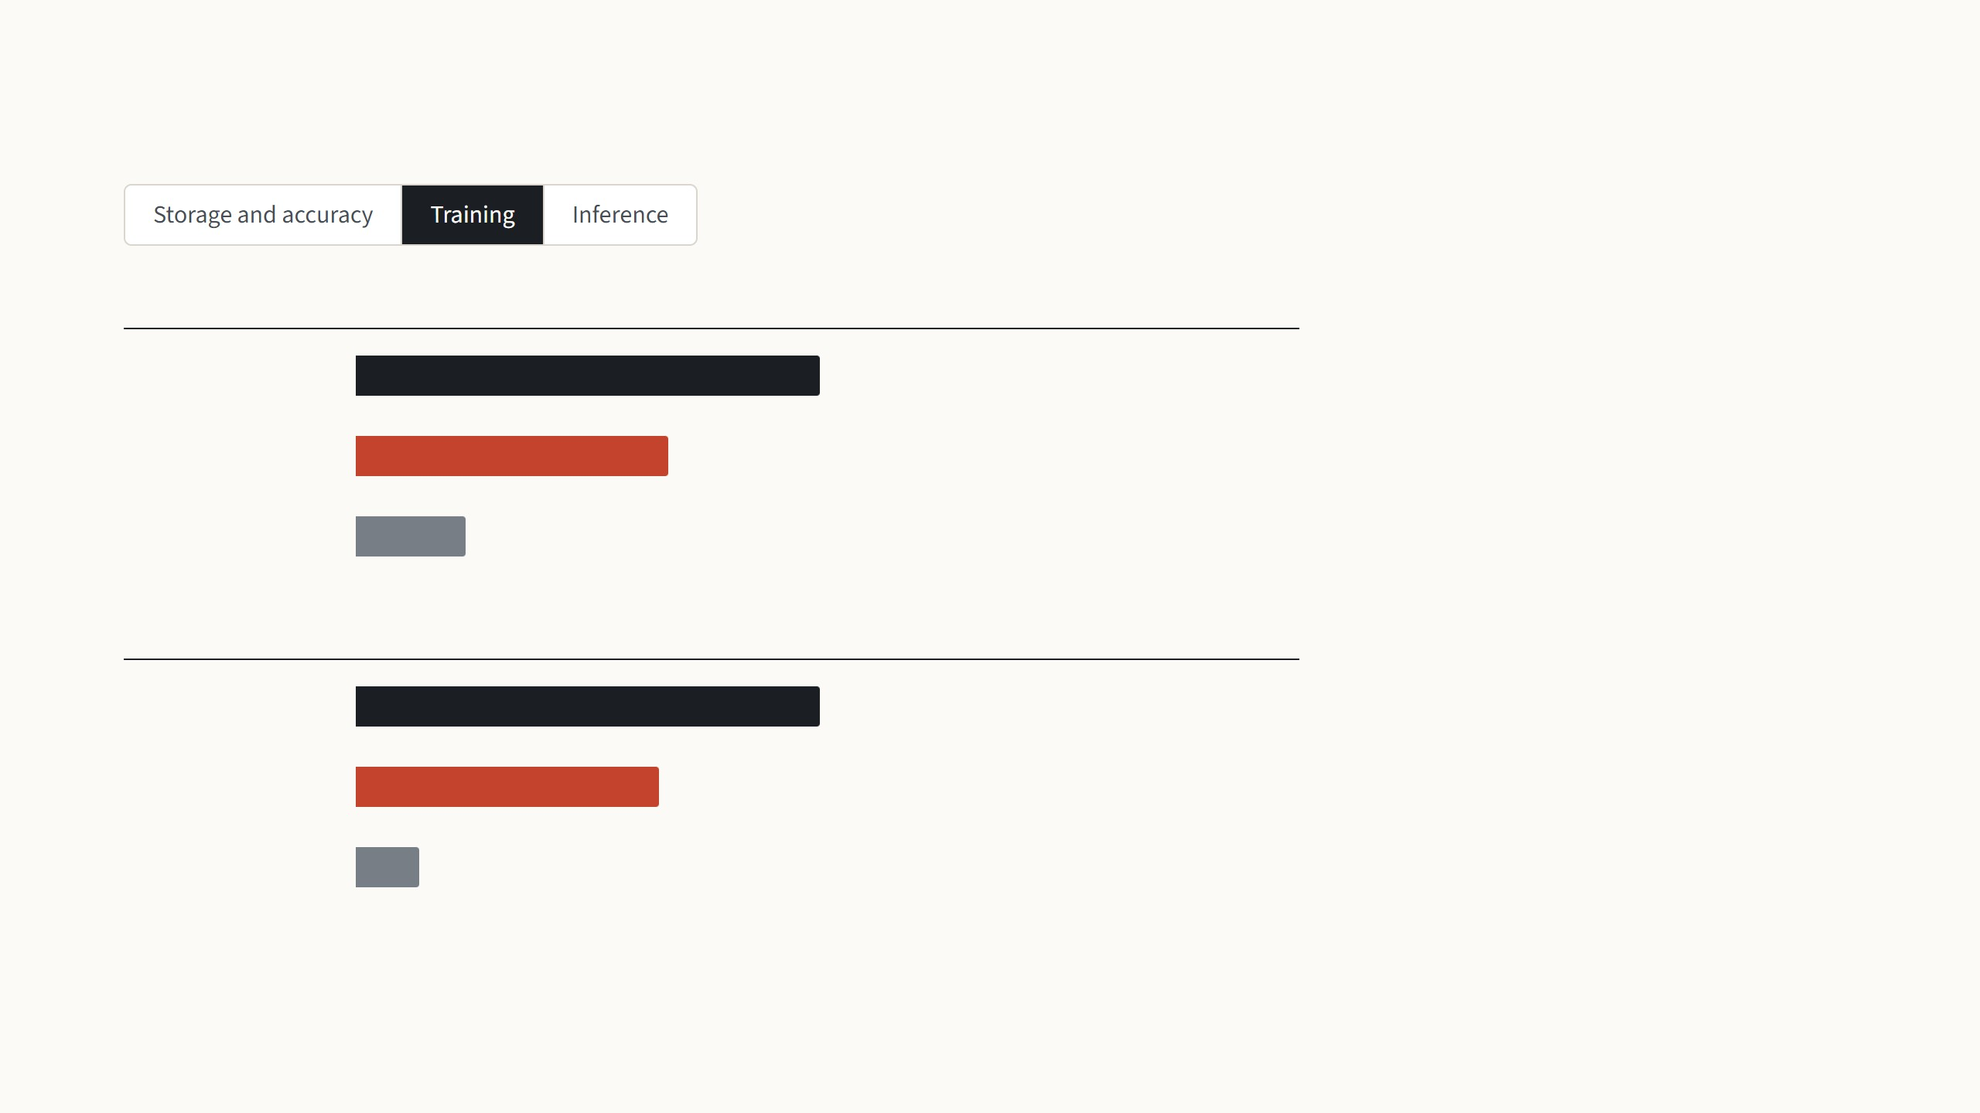
What each method costs on skin lesions
Training time, 30 epochs on 7,007 images
Training VPT took 14 minutes and 2.3
GB of GPU memory, against 20
minutes and 3.5 GB for full fine-
tuning.
Full fine-tuning
20 min
VPT-deep
14 min
Only the linear probe is really cheap.
To reach the prompts, the error signal
still has to pass back through all
twelve frozen layers, the same
pattern as the paper's Table 12.
Linear probe
5 min
Peak GPU memory during training, batch 32
Full fine-tuning
3.5 GB
VPT-deep
2.3 GB
Linear probe
0.5 GB
Skin lesions (DermaMNIST), all 7,007 training images. RTX 5070 Ti Laptop GPU; CPU inference on 2 threads; 32-bit weights.
24
Notes:
Three steps, one cost each, all measured on my laptop for skin lesions trained on the full training split; every number on the slide is read from the training logs and the benchmark file. Storage first: this is the paper's argument, and it holds. Linear probe and VPT keep one copy of the base model and add a small file per task, kilobytes or about 2 MB, while full fine-tuning needs a whole new 343 MB model per task; the accuracy panel is the price, a few points below full fine-tuning but far above the linear probe. Training: VPT is cheaper than full fine-tuning but much more expensive than the linear probe, because the error signal has to travel back through all twelve frozen layers to reach the prompts, so the activations must be kept. That is the same pattern as the paper's Table 12 on an A100. Inference: VPT is the only method that is slower than the original model, because every layer processes 50 extra tokens, and unlike a weight update the prompts cannot be merged into the model after training. Linear probe and full fine-tuning run the same network, so their small difference is noise. Accuracy for all three tasks and both data sizes is on the previous slide.

Slide 53

What each method costs on skin lesions
Time per image on the CPU, 2 threads
On the CPU, VPT needs 227 ms per
image, 19% more than the fine-tuned
model.
Full fine-tuning
190 ms
VPT-deep
227 ms
Every layer has to process 50 extra
tokens, and the prompts cannot be
merged into the weights after
training. The other two run the
unchanged network, so they take
about the same time.
Linear probe
185 ms
Tokens that every layer processes
Full fine-tuning
197image patches and [CLS]
VPT-deep
247197 + 50 prompts
Linear probe
197image patches and [CLS]
Skin lesions (DermaMNIST), all 7,007 training images. RTX 5070 Ti Laptop GPU; CPU inference on 2 threads; 32-bit weights.
24
Notes:
Three steps, one cost each, all measured on my laptop for skin lesions trained on the full training split; every number on the slide is read from the training logs and the benchmark file. Storage first: this is the paper's argument, and it holds. Linear probe and VPT keep one copy of the base model and add a small file per task, kilobytes or about 2 MB, while full fine-tuning needs a whole new 343 MB model per task; the accuracy panel is the price, a few points below full fine-tuning but far above the linear probe. Training: VPT is cheaper than full fine-tuning but much more expensive than the linear probe, because the error signal has to travel back through all twelve frozen layers to reach the prompts, so the activations must be kept. That is the same pattern as the paper's Table 12 on an A100. Inference: VPT is the only method that is slower than the original model, because every layer processes 50 extra tokens, and unlike a weight update the prompts cannot be merged into the model after training. Linear probe and full fine-tuning run the same network, so their small difference is noise. Accuracy for all three tasks and both data sizes is on the previous slide.

Slide 54

Live demo: one image, three models
Skin lesion, one test image, models
trained on all training images.
Linear probe
VPT-deep
Full fine-tuning
shared frozen model + head
shared frozen model + prompts
its own retrained model
68.5% test accuracy
81.0% test accuracy
84.4% test accuracy
melanocytic nevi
73.7%
melanoma
99.5%
melanoma
97.7%
melanoma
23.8%
benign keratosis-like
0.3%
melanocytic nevi
2.2%
benign keratosis-like
2.1%
melanocytic nevi
0.1%
benign keratosis-like
0.0%
Wrong
Correct
Correct
139 ms per image
173 ms per image
141 ms per image
Test accuracy is balanced accuracy on the whole test set, for exactly these models. Changing the
training set swaps one 1.9 MB file for VPT-deep, but a whole second 172 MB model for full fine-tuning.
True label: melanoma
A recorded run. In the HTML version of this deck the three models run live in the browser.
Research demo, not a diagnostic tool
25
Notes:
Every click runs the image through all three models right here in the browser, with onnxruntime-web. Linear probe and VPT-deep use the very same frozen copy of the base model in memory; full fine-tuning retrained every weight, so it is a separate model per task. The percentage under each name is that model's balanced accuracy on the whole test set. Now switch to 1,000 training images: most accuracies drop, by far the most on skin lesions. For linear probe and VPT only a small head and a 1.9 MB prompt file change, so it is instant. Full fine-tuning has to download and load a second whole model, 172 MB here because the browser copies use 16-bit weights (343 MB at 32-bit). That is the storage argument, live. The thumbnails are random test images, not picked to look good, so a wrong answer can happen; say so. Research demo, not a diagnostic tool.

Slide 55

Live demo: one image, three models
Skin lesion, one test image, models
trained on 1,000 training images.
Linear probe
VPT-deep
Full fine-tuning
shared frozen model + head
shared frozen model + prompts
its own retrained model
58.1% test accuracy
62.5% test accuracy
64.8% test accuracy
melanocytic nevi
84.5%
melanoma
69.2%
melanocytic nevi
95.1%
benign keratosis-like
7.9%
melanocytic nevi
30.8%
melanoma
4.2%
melanoma
7.5%
dermatofibroma
0.0%
benign keratosis-like
0.2%
Wrong
Correct
Wrong
174 ms per image
206 ms per image
145 ms per image
Test accuracy is balanced accuracy on the whole test set, for exactly these models. Changing the
training set swaps one 1.9 MB file for VPT-deep, but a whole second 172 MB model for full fine-tuning.
True label: melanoma
A recorded run. In the HTML version of this deck the three models run live in the browser.
Research demo, not a diagnostic tool
25
Notes:
Every click runs the image through all three models right here in the browser, with onnxruntime-web. Linear probe and VPT-deep use the very same frozen copy of the base model in memory; full fine-tuning retrained every weight, so it is a separate model per task. The percentage under each name is that model's balanced accuracy on the whole test set. Now switch to 1,000 training images: most accuracies drop, by far the most on skin lesions. For linear probe and VPT only a small head and a 1.9 MB prompt file change, so it is instant. Full fine-tuning has to download and load a second whole model, 172 MB here because the browser copies use 16-bit weights (343 MB at 32-bit). That is the storage argument, live. The thumbnails are random test images, not picked to look good, so a wrong answer can happen; say so. Research demo, not a diagnostic tool.

Slide 56

Summary
0.6%
of the weights are trained: a few vectors among the patch tokens and a
small head, while the Transformer stays frozen.
20of 24
tasks where VPT-deep beat full fine-tuning, on a ViT-B pretrained with
labels.
99.4%
less storage per task than a fully fine-tuned copy: 2.2 MB instead of 343
MB. Training memory and inference time are not saved.
average balanced accuracy of VPT-deep on my three medical datasets,
against 88.8% for full fine-tuning and 83.3% for the linear probe (both
training-set sizes).
87.6%
Jia et al. 2022, Table 1 (24 tasks, ViT-B/16) and Table 12 (memory, test time); 0.6% is VPT-deep with 50 prompts and a 102-class head. Medical datasets: my runs, balanced
accuracy on the test set.
26
Notes:
This is the slide to leave up while summing up and taking questions: four points, each with the one number to remember. First, what a visual prompt is. Not text and not pixels, but learned vectors among the patch tokens of a frozen ViT; with 50 prompts at every layer and the head that is about 0.6% of the weights. Second, the headline: on a ViT-B pretrained with labels, VPT-deep beat full fine-tuning on 20 of the 24 tasks, and all 24 tasks together cost 1.18 models of storage instead of 24. Third, the limits: it saves storage only, 99.4% less per task than a fully fine-tuned copy. Training memory is about the same as full fine-tuning, inference is slower because the sequence is longer, and on self-supervised backbones it loses, 23 points behind on MAE. That is the opening for LoRA next time. Fourth, my own runs: averaged over the three medical datasets and both training-set sizes, VPT-deep is about a point behind full fine-tuning and clearly ahead of the linear probe, as the demo showed.

Slide 57

References
This paper
Models
Jia, Tang, Chen, Cardie, Belongie, Hariharan & Lim 2022. Visual prompt tuning. ECCV.
arXiv:2203.12119.
Dosovitskiy et al. 2021. An image is worth 16×16 words: Transformers for image
recognition at scale (ViT). ICLR.
Prompting before VPT
Liu et al. 2021. Swin Transformer: hierarchical vision Transformer using shifted
windows. ICCV.
Brown et al. 2020. Language models are few-shot learners (GPT-3). NeurIPS.
Chen, Xie & He 2021. An empirical study of training self-supervised vision Transformers
(MoCo v3). ICCV.
Lester, Al-Rfou & Constant 2021. The power of scale for parameter-efficient prompt
tuning. EMNLP.
He et al. 2022. Masked autoencoders are scalable vision learners (MAE). CVPR.
Li & Liang 2021. Prefix-tuning: optimizing continuous prompts for generation. ACL.
Zheng et al. 2021. Rethinking semantic segmentation from a sequence-to-sequence
perspective with Transformers (SETR). CVPR.
Zhou et al. 2021. Learning to prompt for vision-language models (CoOp).
arXiv:2109.01134; IJCV 2022.
Chen et al. 2018. Encoder-decoder with atrous separable convolution for semantic
image segmentation (DeepLab v3+). ECCV.
Bahng et al. 2022. Exploring visual prompts for adapting large-scale models.
arXiv:2203.17274.
Datasets
Parameter-efficient methods
Zhai et al. 2019. A large-scale study of representation learning with the visual task
adaptation benchmark (VTAB). arXiv:1910.04867.
Houlsby et al. 2019. Parameter-efficient transfer learning for NLP (Adapter). ICML.
Ben Zaken, Goldberg & Ravfogel 2022. BitFit: simple parameter-efficient fine-tuning for
Transformer-based masked language-models (Bias). ACL.
Zhou et al. 2019. Semantic understanding of scenes through the ADE20K dataset. IJCV.
Yang et al. 2023. MedMNIST v2: a large-scale lightweight benchmark for 2D and 3D
biomedical image classification. Scientific Data.
Zhang et al. 2020. Side-tuning: a baseline for network adaptation via additive side
networks (Sidetune). ECCV.
Tschandl, Rosendahl & Kittler 2018. The HAM10000 dataset, a large collection of multi-
source dermatoscopic images of common pigmented skin lesions. Scientific Data.
Hu et al. 2022. LoRA: low-rank adaptation of large language models. ICLR.
27
Notes:
Leave this up for questions. Every work named on a slide or in a source line is here, grouped by role: the paper itself, the language-model prompting it builds on, the cheaper methods it is compared with plus LoRA for next time, the backbones and segmentation models, and the datasets, including the medical ones from my own runs. The backup slide with every measured number follows.

