Slide 1
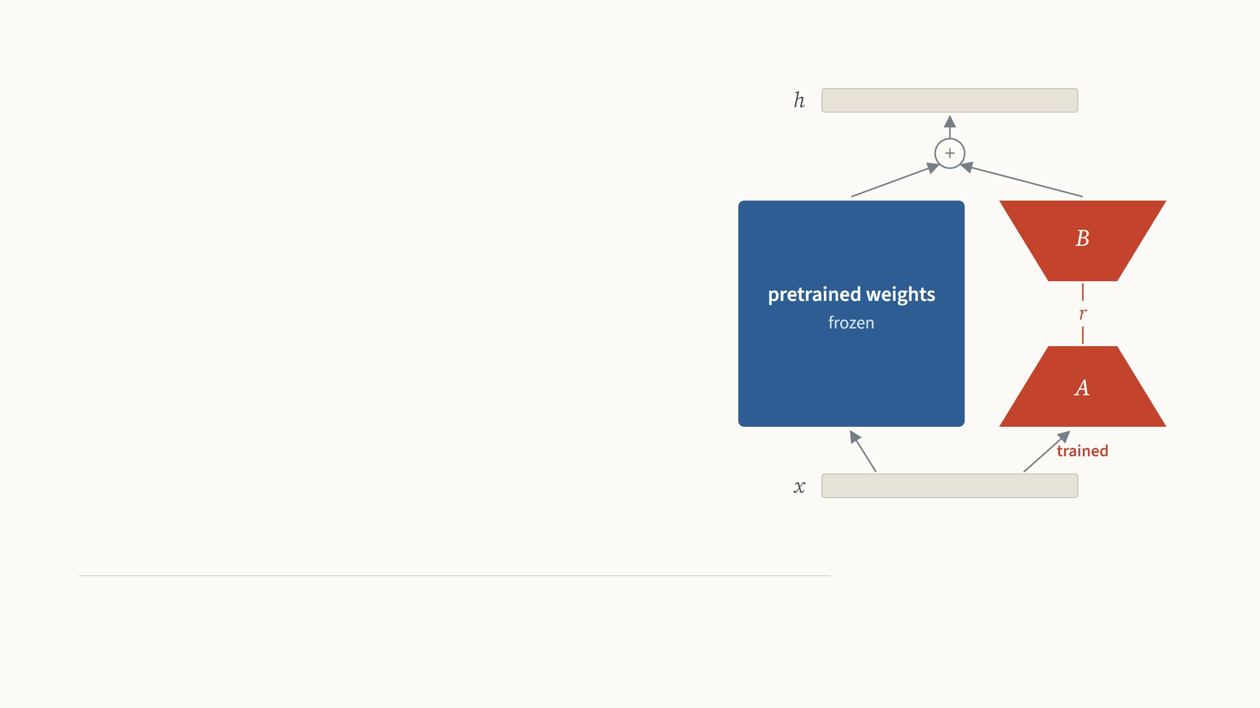
Low-Rank
Adaptation
Teach a frozen model a new task by
learning a small, low-rank change to its
weights.
Edward J. Hu, Yelong Shen, Phillip Wallis, Zeyuan Allen-Zhu, Yuanzhi Li, Shean Wang, Lu Wang, Weizhu Chen
Microsoft. ICLR 2022. Results on images from Zhang, Zhou & Liu 2022 and Zhu et al. 2024.
Presented by Ertugrul Senturk
October 2026
Notes:
Second paper of the parameter-efficient fine-tuning series, after VPT. The picture is the whole method: the input goes through the frozen pretrained weight, the blue square, and in parallel through two thin trained matrices, A and B, in red; the two results are added. LoRA was written for language models, at Microsoft, and the paper itself has no image experiments. So the deck has two halves: the method and the paper's own evidence, then what happened when vision groups applied it to Vision Transformers, on the same benchmark and backbone as VPT last time, and on medical images. About thirty minutes; please interrupt.

Slide 2
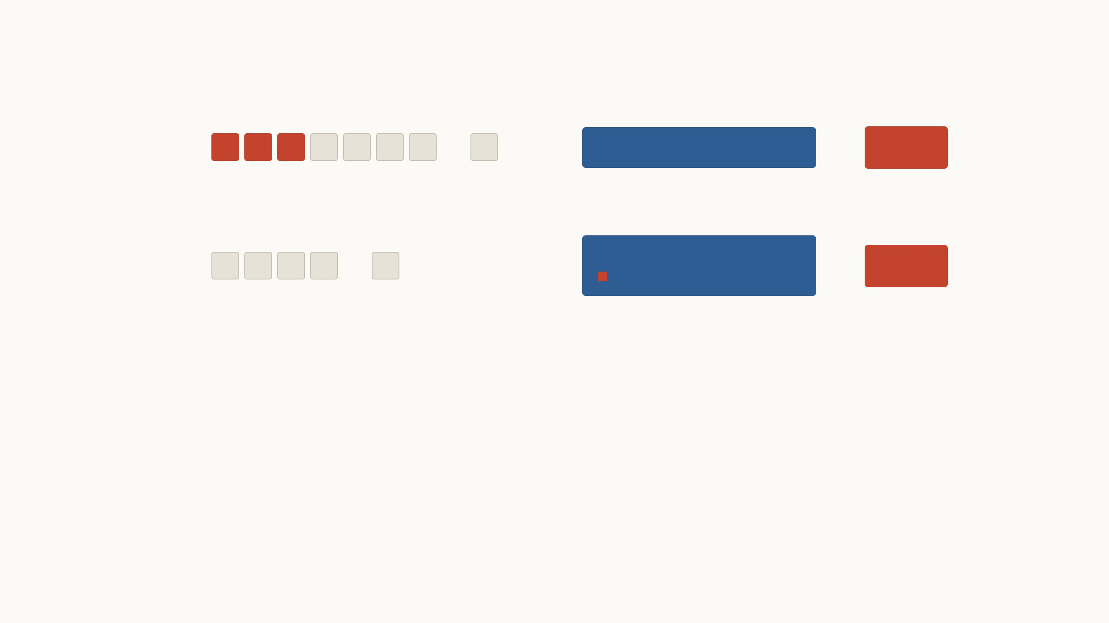
From VPT to LoRA
VPT
…
→
frozen Vision Transformer
→
head
last time
Learned vectors join the image patches, so every image carries a longer sequence through every layer.
LoRA
…
→
frozen Vision Transformer
→
small trained change to its weights
head
today
The input stays as it is. A small change to the weights is learned, and after training it is added into them.
VPT trained 0.6% of the weights and beat full fine-tuning on 20
of 24 tasks. But its prompts make every image slower, and
they can never be folded into the model.
LoRA leaves the input alone and changes the weights instead.
It ends up storing about as little per task as VPT, while the
model runs exactly as fast as before.
VPT: Jia et al., ECCV 2022 (0.6% of the weights with 50 prompts per layer and a 102-class head; 20 of 24 tasks, Table 1). LoRA: Hu et al., ICLR 2022, first posted in June 2021.
2
Notes:
A one-slide bridge from last time, for anyone who missed it. Top row: VPT put learned vectors, red, in front of the image patches, grey, and left the Vision Transformer frozen. It worked well, 20 of 24 tasks above full fine-tuning, but the cost section showed what it does not save: every image now carries 50 extra tokens through all twelve layers, 82 instead of 70 ms, and the prompts cannot be merged into anything. Bottom row: LoRA keeps exactly the same input. The thing it learns lives inside the weights, and after training it is added into them, so the model at test time is an ordinary ViT. LoRA was posted in mid-2021 for language models, VPT in 2022 for vision; both were published in 2022.

Slide 3

Every fine-tuned copy is as big as the model
The paper starts from the largest model of its time, GPT-3, with 175
billion weights. Each fine-tuned copy takes 350 GB, so a service with a
hundred tasks would store 35 TB. LoRA keeps one shared model and only
a small file per task, and the frozen weights also need no optimizer state,
which cuts training memory from 1.2 TB to 350 GB.
Shown for 1 task on ViT-B/16, 86 million weights.
The next pages show 100 tasks, then GPT-3.
Full fine-tuning: 1 retrained ViT-B copy
LoRA: one shared ViT-B plus 1 small file
each red speck is one task file, to
scale
343 MB
345 MB
1 copy at 343 MB each
343 MB once, plus 1.5 MB per task
GPT-3 in 16-bit numbers: 350 GB per copy, 35 MB per LoRA file at rank 4 on the query and value weights (Hu et al. 2022, Sec. 4.2). ViT-B/16 in 32-bit: 343 MB per copy; its LoRA file
is rank 8 on the same weights plus a 102-class head. Squares are sized by area.
3
Notes:
The motivation in the paper is about scale. GPT-3 has 175 billion weights; one fine-tuned copy is 350 GB in 16-bit. Drag the slider to 100 tasks: 35 TB of copies against 354 GB for one shared model plus a hundred 35 MB LoRA files. Then switch to ViT-B, the model we used last time and will use again: a copy is 343 MB, a LoRA file of rank 8 with a head is 1.5 MB, slightly smaller than VPT's 2.2 MB. The red specks are drawn to scale; for GPT-3 they are far below a pixel, so they are drawn at the minimum size. The training-memory point is new compared with VPT: with Adam, every trained weight needs two extra numbers of optimizer state, so freezing 99.99% of GPT-3 cut training memory from 1.2 TB to 350 GB, and training was 25% faster.

Slide 4
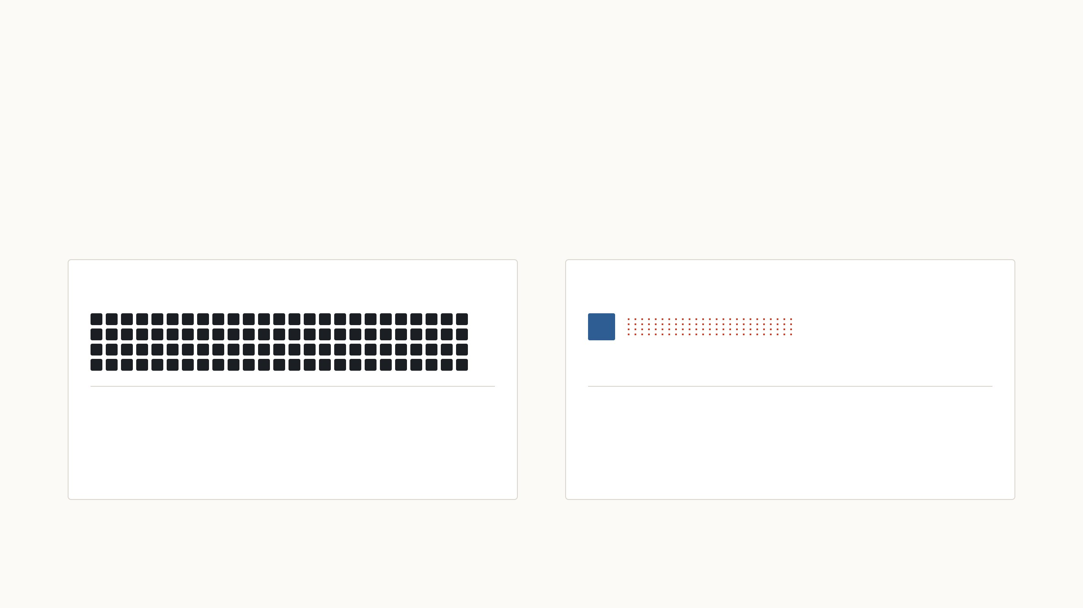
Every fine-tuned copy is as big as the model
The paper starts from the largest model of its time, GPT-3, with 175
billion weights. Each fine-tuned copy takes 350 GB, so a service with a
hundred tasks would store 35 TB. LoRA keeps one shared model and only
a small file per task, and the frozen weights also need no optimizer state,
which cuts training memory from 1.2 TB to 350 GB.
Shown for 100 tasks on ViT-B/16, 86 million
weights.
Full fine-tuning: 100 retrained ViT-B copies
LoRA: one shared ViT-B plus 100 small files
34 GB
493 MB
100 copies at 343 MB each
343 MB once, plus 1.5 MB per task
GPT-3 in 16-bit numbers: 350 GB per copy, 35 MB per LoRA file at rank 4 on the query and value weights (Hu et al. 2022, Sec. 4.2). ViT-B/16 in 32-bit: 343 MB per copy; its LoRA file
is rank 8 on the same weights plus a 102-class head. Squares are sized by area.
3
Notes:
The motivation in the paper is about scale. GPT-3 has 175 billion weights; one fine-tuned copy is 350 GB in 16-bit. Drag the slider to 100 tasks: 35 TB of copies against 354 GB for one shared model plus a hundred 35 MB LoRA files. Then switch to ViT-B, the model we used last time and will use again: a copy is 343 MB, a LoRA file of rank 8 with a head is 1.5 MB, slightly smaller than VPT's 2.2 MB. The red specks are drawn to scale; for GPT-3 they are far below a pixel, so they are drawn at the minimum size. The training-memory point is new compared with VPT: with Adam, every trained weight needs two extra numbers of optimizer state, so freezing 99.99% of GPT-3 cut training memory from 1.2 TB to 350 GB, and training was 25% faster.

Slide 5

Every fine-tuned copy is as big as the model
The paper starts from the largest model of its time, GPT-3, with 175
billion weights. Each fine-tuned copy takes 350 GB, so a service with a
hundred tasks would store 35 TB. LoRA keeps one shared model and only
a small file per task, and the frozen weights also need no optimizer state,
which cuts training memory from 1.2 TB to 350 GB.
Shown for 100 tasks on GPT-3, 175 billion weights.
Full fine-tuning: 100 retrained GPT-3 copies
LoRA: one shared GPT-3 plus 100 small files
35 TB
354 GB
100 copies at 350 GB each
350 GB once, plus 35 MB per task
GPT-3 in 16-bit numbers: 350 GB per copy, 35 MB per LoRA file at rank 4 on the query and value weights (Hu et al. 2022, Sec. 4.2). ViT-B/16 in 32-bit: 343 MB per copy; its LoRA file
is rank 8 on the same weights plus a 102-class head. Squares are sized by area.
3
Notes:
The motivation in the paper is about scale. GPT-3 has 175 billion weights; one fine-tuned copy is 350 GB in 16-bit. Drag the slider to 100 tasks: 35 TB of copies against 354 GB for one shared model plus a hundred 35 MB LoRA files. Then switch to ViT-B, the model we used last time and will use again: a copy is 343 MB, a LoRA file of rank 8 with a head is 1.5 MB, slightly smaller than VPT's 2.2 MB. The red specks are drawn to scale; for GPT-3 they are far below a pixel, so they are drawn at the minimum size. The training-memory point is new compared with VPT: with Adam, every trained weight needs two extra numbers of optimizer state, so freezing 99.99% of GPT-3 cut training memory from 1.2 TB to 350 GB, and training was 25% faster.

Slide 6
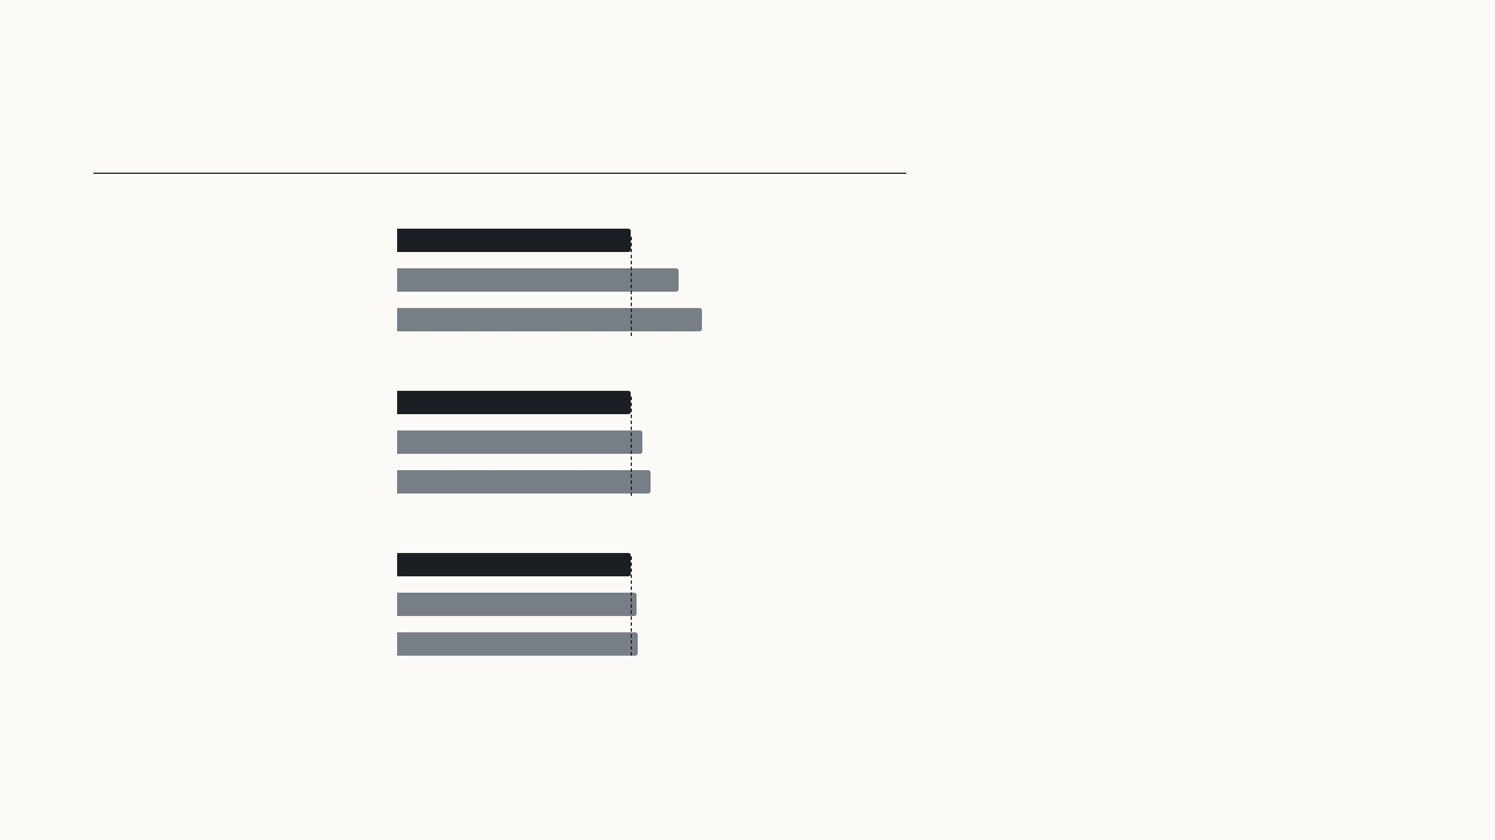
Earlier cheap methods cost time or sequence length
Time for one forward pass
Extra time
Adapters insert small extra layers into every
block. They have few weights, but an image or a
sentence must pass through them one after
another, so serving a single input takes 20 to
30% longer. With large batches the gap shrinks
to 2 or 3%.
One input of 128 tokens
Fine-tuned, or LoRA merged
19.8 ms
Adapter, one per block
23.9 ms
+20.7%
Adapter, two per block
25.8 ms
+30.3%
16 inputs of 256 tokens
Prompt methods such as prefix tuning and VPT
lengthen the input instead. That leaves less
room for the real input and costs compute in
every layer, and on GPT-3 prefix tuning got
worse beyond 256 prompt tokens.
Fine-tuned, or LoRA merged
338 ms
Adapter, one per block
354.8 ms
+5.0%
Adapter, two per block
366.3 ms
+8.4%
32 inputs of 512 tokens
Fine-tuned, or LoRA merged
1449.4 ms
LoRA adds no layer and no token at test time.
Adapter, one per block
1482 ms
+2.2%
Adapter, two per block
1492.2 ms
+3.0%
Hu et al. 2022, Table 1: one forward pass of GPT-2 medium, mean of 100 trials on one NVIDIA Quadro RTX 8000; bars are drawn relative to the fine-tuned model in each setting.
Prefix tuning: Sec. 5.5 and Table 15.
4
Notes:
Section 3 of the paper, "aren't existing solutions good enough?". Two families existed. Adapters, the small bottleneck networks of Houlsby et al., add depth: GPU latency depends on how many layers run one after another, so even a tiny adapter adds time when there is only one input to process, the online case. Measured on GPT-2 medium with one input of 128 tokens: 19.8 ms for the plain or fine-tuned model, 23.9 ms with one adapter per block, 25.8 ms with two. With large batches the overhead almost disappears, 2–3%. The second family is prompts, which we know from VPT: they reserve part of the sequence and every layer has to process them; the paper also found them hard to optimise. LoRA's design goal is to avoid both: nothing extra at test time.

Slide 7
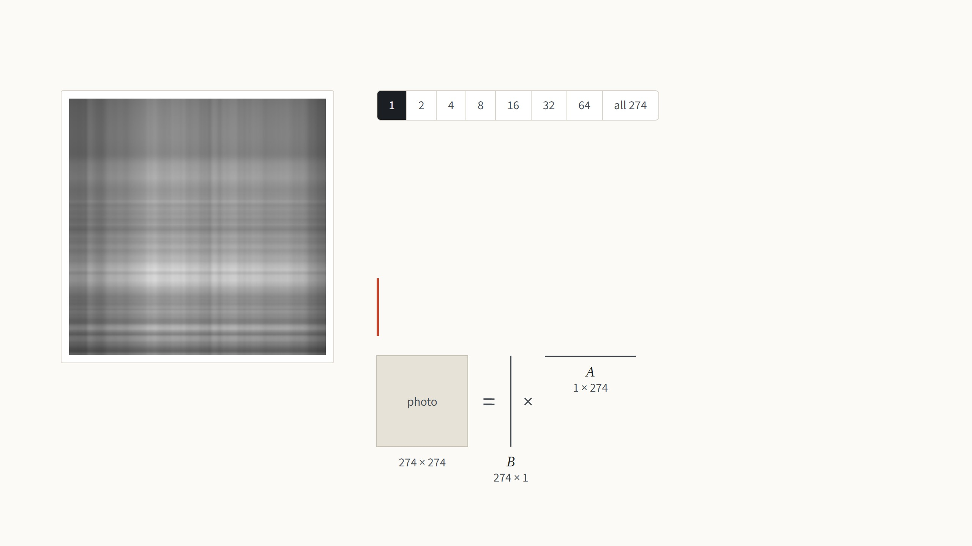
What a low-rank matrix is
A grayscale photo is a matrix of 274 × 274 brightness values. Any matrix can be
written as a sum of simple pieces, where each piece is one column of numbers
times one row. The rank is the number of pieces.
One piece gives only bands of light and dark, because every row of it is the same
pattern, scaled.
LoRA bets that the change fine-tuning makes to a weight
matrix is like this photo: a few pieces carry almost all of it.
Rank 1: 1 × (274 + 274) = 548 numbers, 0.7% of
the photo's 75,076
Not from the paper: the best rank-r approximation (SVD) of an Oxford Pets photo, Jia et al. 2022, Fig. 10. The low-rank bet follows Li et al. 2018 and Aghajanyan et al. 2021.
5
Notes:
One minute of linear algebra, because the whole paper rests on the word rank. Treat the photo as a matrix of brightness values. A rank-one matrix is a column times a row: every row of the image is the same pattern, just scaled, so you get bands. Step through with the arrow keys. Each step doubles the number of pieces. The pieces are ordered by how much they contribute, so the first few capture the big shapes and the later ones only fine detail. At rank 16 the cat is recognisable, from 12% of the numbers; at 64 it is hard to tell from the original, from 47%. Storing r pieces costs r times (rows plus columns) numbers instead of rows times columns. The drawing under the text shows the same thing as matrices, to scale: the r columns side by side are a tall matrix B, the r rows stacked are a wide matrix A, and B times A rebuilds the photo; at rank 1 they are a single line each, at all 274 they are as big as the photo itself. That is the trade LoRA makes for the weight change, with the same names B and A from now on. Why expect the change to be low-rank? Two earlier papers measured the "intrinsic dimension" of fine-tuning: you can freeze the model, train only a few hundred or thousand numbers, map them through a fixed random projection onto all the weights, and still get most of the accuracy. LoRA's assumption is the matrix version of that: each weight change has a low rank, so it can be written as B times A with a small r, chosen by hand.

Slide 8
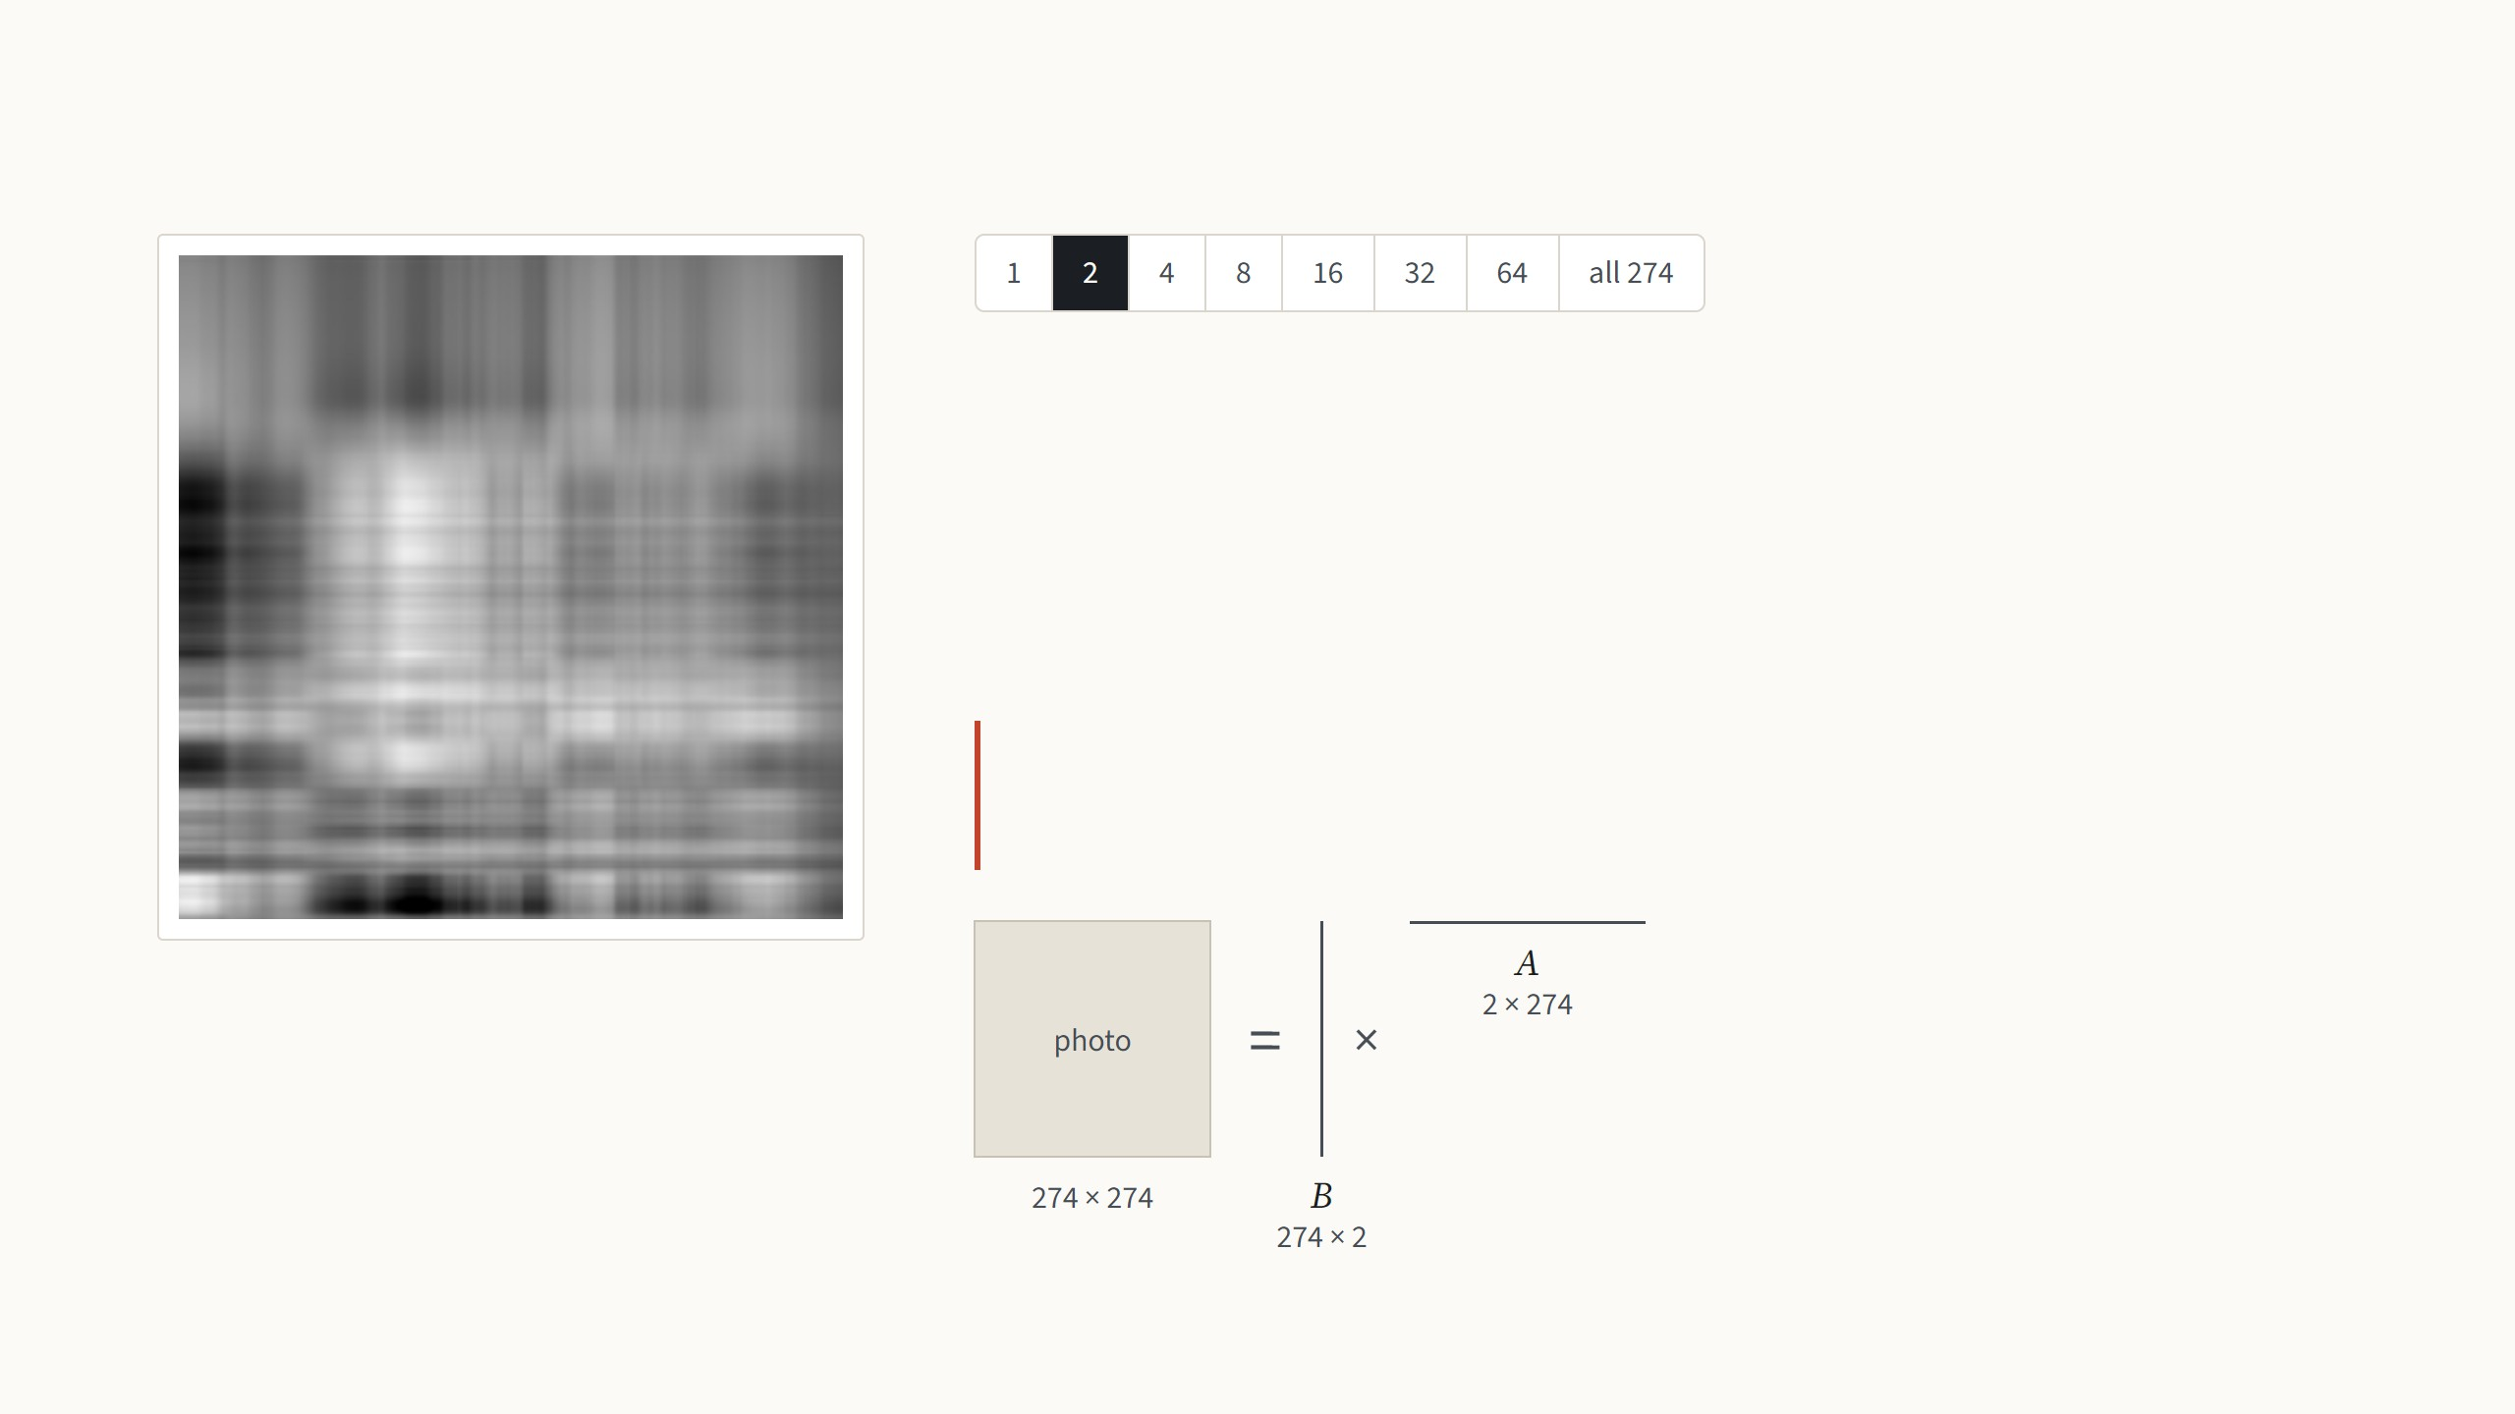
What a low-rank matrix is
A grayscale photo is a matrix of 274 × 274 brightness values. Any matrix can be
written as a sum of simple pieces, where each piece is one column of numbers
times one row. The rank is the number of pieces.
Two pieces are still mostly bands, now in two patterns.
LoRA bets that the change fine-tuning makes to a weight
matrix is like this photo: a few pieces carry almost all of it.
Rank 2: 2 × (274 + 274) = 1,096 numbers, 1.5%
of the photo's 75,076
Not from the paper: the best rank-r approximation (SVD) of an Oxford Pets photo, Jia et al. 2022, Fig. 10. The low-rank bet follows Li et al. 2018 and Aghajanyan et al. 2021.
5
Notes:
One minute of linear algebra, because the whole paper rests on the word rank. Treat the photo as a matrix of brightness values. A rank-one matrix is a column times a row: every row of the image is the same pattern, just scaled, so you get bands. Step through with the arrow keys. Each step doubles the number of pieces. The pieces are ordered by how much they contribute, so the first few capture the big shapes and the later ones only fine detail. At rank 16 the cat is recognisable, from 12% of the numbers; at 64 it is hard to tell from the original, from 47%. Storing r pieces costs r times (rows plus columns) numbers instead of rows times columns. The drawing under the text shows the same thing as matrices, to scale: the r columns side by side are a tall matrix B, the r rows stacked are a wide matrix A, and B times A rebuilds the photo; at rank 1 they are a single line each, at all 274 they are as big as the photo itself. That is the trade LoRA makes for the weight change, with the same names B and A from now on. Why expect the change to be low-rank? Two earlier papers measured the "intrinsic dimension" of fine-tuning: you can freeze the model, train only a few hundred or thousand numbers, map them through a fixed random projection onto all the weights, and still get most of the accuracy. LoRA's assumption is the matrix version of that: each weight change has a low rank, so it can be written as B times A with a small r, chosen by hand.

Slide 9
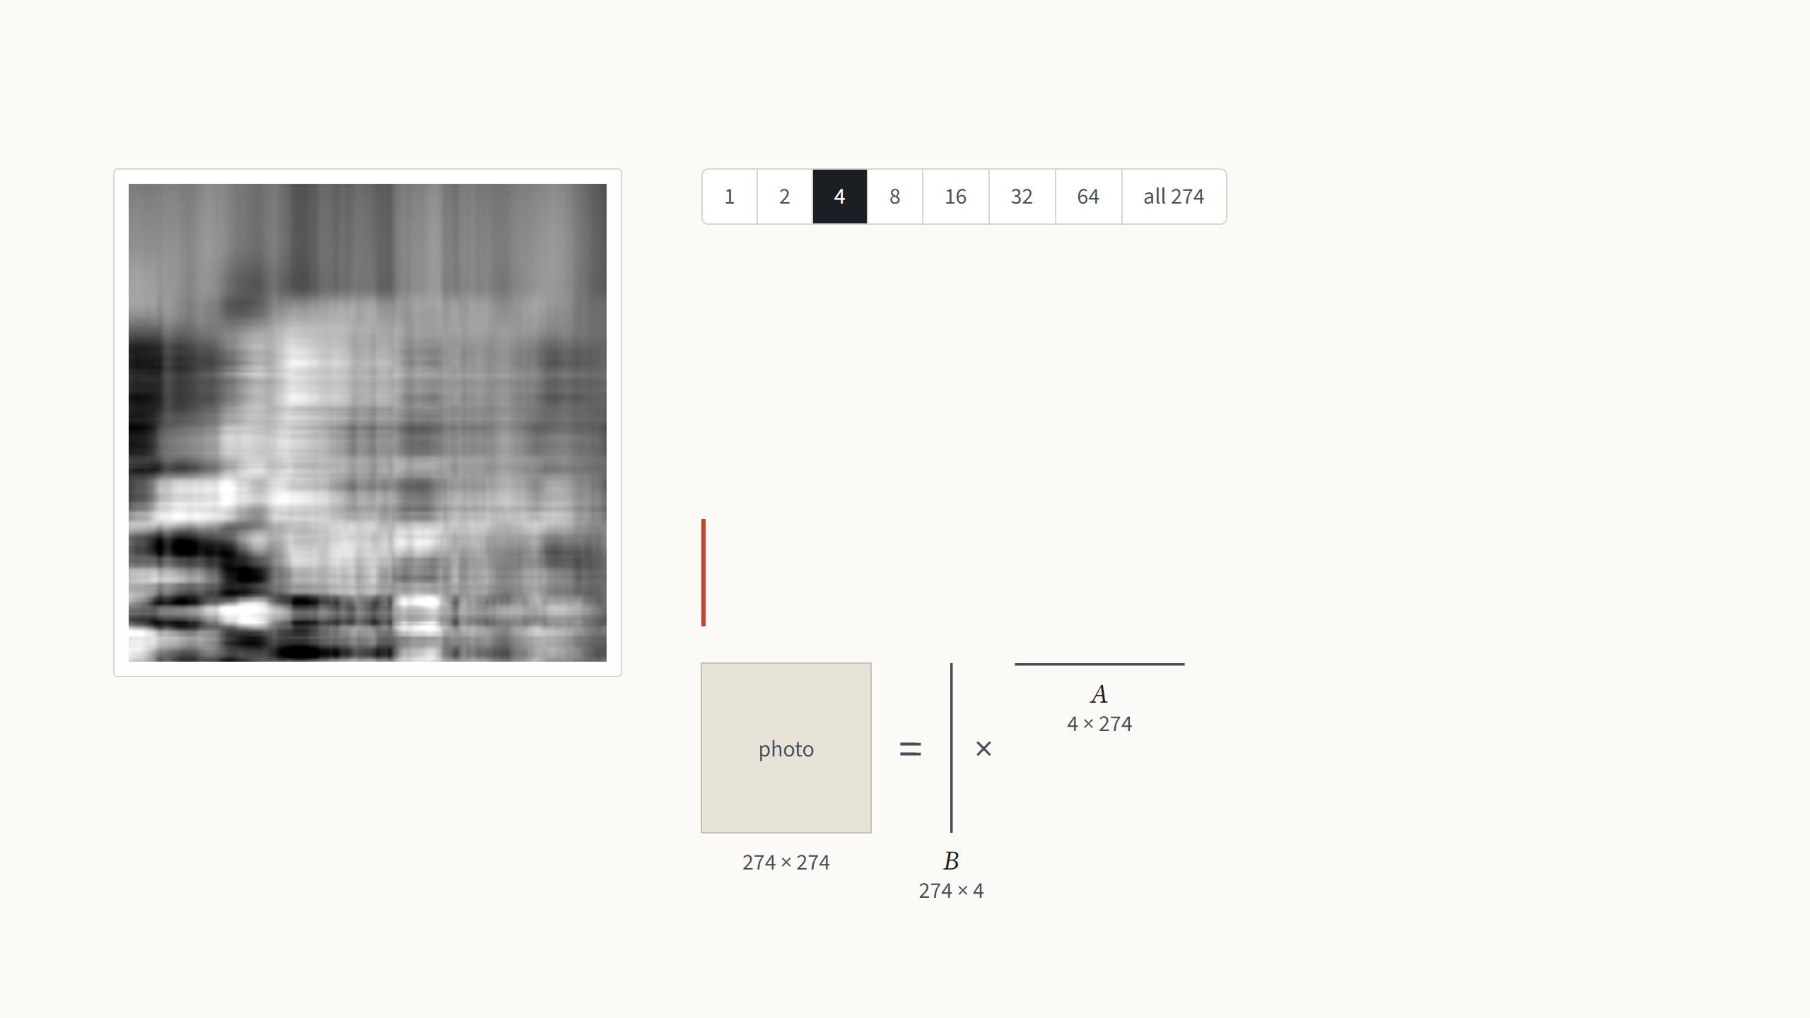
What a low-rank matrix is
A grayscale photo is a matrix of 274 × 274 brightness values. Any matrix can be
written as a sum of simple pieces, where each piece is one column of numbers
times one row. The rank is the number of pieces.
With four pieces the main light and dark areas appear.
LoRA bets that the change fine-tuning makes to a weight
matrix is like this photo: a few pieces carry almost all of it.
Rank 4: 4 × (274 + 274) = 2,192 numbers, 2.9%
of the photo's 75,076
Not from the paper: the best rank-r approximation (SVD) of an Oxford Pets photo, Jia et al. 2022, Fig. 10. The low-rank bet follows Li et al. 2018 and Aghajanyan et al. 2021.
5
Notes:
One minute of linear algebra, because the whole paper rests on the word rank. Treat the photo as a matrix of brightness values. A rank-one matrix is a column times a row: every row of the image is the same pattern, just scaled, so you get bands. Step through with the arrow keys. Each step doubles the number of pieces. The pieces are ordered by how much they contribute, so the first few capture the big shapes and the later ones only fine detail. At rank 16 the cat is recognisable, from 12% of the numbers; at 64 it is hard to tell from the original, from 47%. Storing r pieces costs r times (rows plus columns) numbers instead of rows times columns. The drawing under the text shows the same thing as matrices, to scale: the r columns side by side are a tall matrix B, the r rows stacked are a wide matrix A, and B times A rebuilds the photo; at rank 1 they are a single line each, at all 274 they are as big as the photo itself. That is the trade LoRA makes for the weight change, with the same names B and A from now on. Why expect the change to be low-rank? Two earlier papers measured the "intrinsic dimension" of fine-tuning: you can freeze the model, train only a few hundred or thousand numbers, map them through a fixed random projection onto all the weights, and still get most of the accuracy. LoRA's assumption is the matrix version of that: each weight change has a low rank, so it can be written as B times A with a small r, chosen by hand.

Slide 10

What a low-rank matrix is
A grayscale photo is a matrix of 274 × 274 brightness values. Any matrix can be
written as a sum of simple pieces, where each piece is one column of numbers
times one row. The rank is the number of pieces.
With eight pieces, 6% of the numbers, the rough shape of the cat appears, because
the first pieces carry most of the picture.
LoRA bets that the change fine-tuning makes to a weight
matrix is like this photo: a few pieces carry almost all of it.
Rank 8: 8 × (274 + 274) = 4,384 numbers, 5.8%
of the photo's 75,076
Not from the paper: the best rank-r approximation (SVD) of an Oxford Pets photo, Jia et al. 2022, Fig. 10. The low-rank bet follows Li et al. 2018 and Aghajanyan et al. 2021.
5
Notes:
One minute of linear algebra, because the whole paper rests on the word rank. Treat the photo as a matrix of brightness values. A rank-one matrix is a column times a row: every row of the image is the same pattern, just scaled, so you get bands. Step through with the arrow keys. Each step doubles the number of pieces. The pieces are ordered by how much they contribute, so the first few capture the big shapes and the later ones only fine detail. At rank 16 the cat is recognisable, from 12% of the numbers; at 64 it is hard to tell from the original, from 47%. Storing r pieces costs r times (rows plus columns) numbers instead of rows times columns. The drawing under the text shows the same thing as matrices, to scale: the r columns side by side are a tall matrix B, the r rows stacked are a wide matrix A, and B times A rebuilds the photo; at rank 1 they are a single line each, at all 274 they are as big as the photo itself. That is the trade LoRA makes for the weight change, with the same names B and A from now on. Why expect the change to be low-rank? Two earlier papers measured the "intrinsic dimension" of fine-tuning: you can freeze the model, train only a few hundred or thousand numbers, map them through a fixed random projection onto all the weights, and still get most of the accuracy. LoRA's assumption is the matrix version of that: each weight change has a low rank, so it can be written as B times A with a small r, chosen by hand.

Slide 11

What a low-rank matrix is
A grayscale photo is a matrix of 274 × 274 brightness values. Any matrix can be
written as a sum of simple pieces, where each piece is one column of numbers
times one row. The rank is the number of pieces.
With 16 pieces the cat is recognisable, from 12% of the numbers.
LoRA bets that the change fine-tuning makes to a weight
matrix is like this photo: a few pieces carry almost all of it.
Rank 16: 16 × (274 + 274) = 8,768 numbers,
11.7% of the photo's 75,076
Not from the paper: the best rank-r approximation (SVD) of an Oxford Pets photo, Jia et al. 2022, Fig. 10. The low-rank bet follows Li et al. 2018 and Aghajanyan et al. 2021.
5
Notes:
One minute of linear algebra, because the whole paper rests on the word rank. Treat the photo as a matrix of brightness values. A rank-one matrix is a column times a row: every row of the image is the same pattern, just scaled, so you get bands. Step through with the arrow keys. Each step doubles the number of pieces. The pieces are ordered by how much they contribute, so the first few capture the big shapes and the later ones only fine detail. At rank 16 the cat is recognisable, from 12% of the numbers; at 64 it is hard to tell from the original, from 47%. Storing r pieces costs r times (rows plus columns) numbers instead of rows times columns. The drawing under the text shows the same thing as matrices, to scale: the r columns side by side are a tall matrix B, the r rows stacked are a wide matrix A, and B times A rebuilds the photo; at rank 1 they are a single line each, at all 274 they are as big as the photo itself. That is the trade LoRA makes for the weight change, with the same names B and A from now on. Why expect the change to be low-rank? Two earlier papers measured the "intrinsic dimension" of fine-tuning: you can freeze the model, train only a few hundred or thousand numbers, map them through a fixed random projection onto all the weights, and still get most of the accuracy. LoRA's assumption is the matrix version of that: each weight change has a low rank, so it can be written as B times A with a small r, chosen by hand.

Slide 12
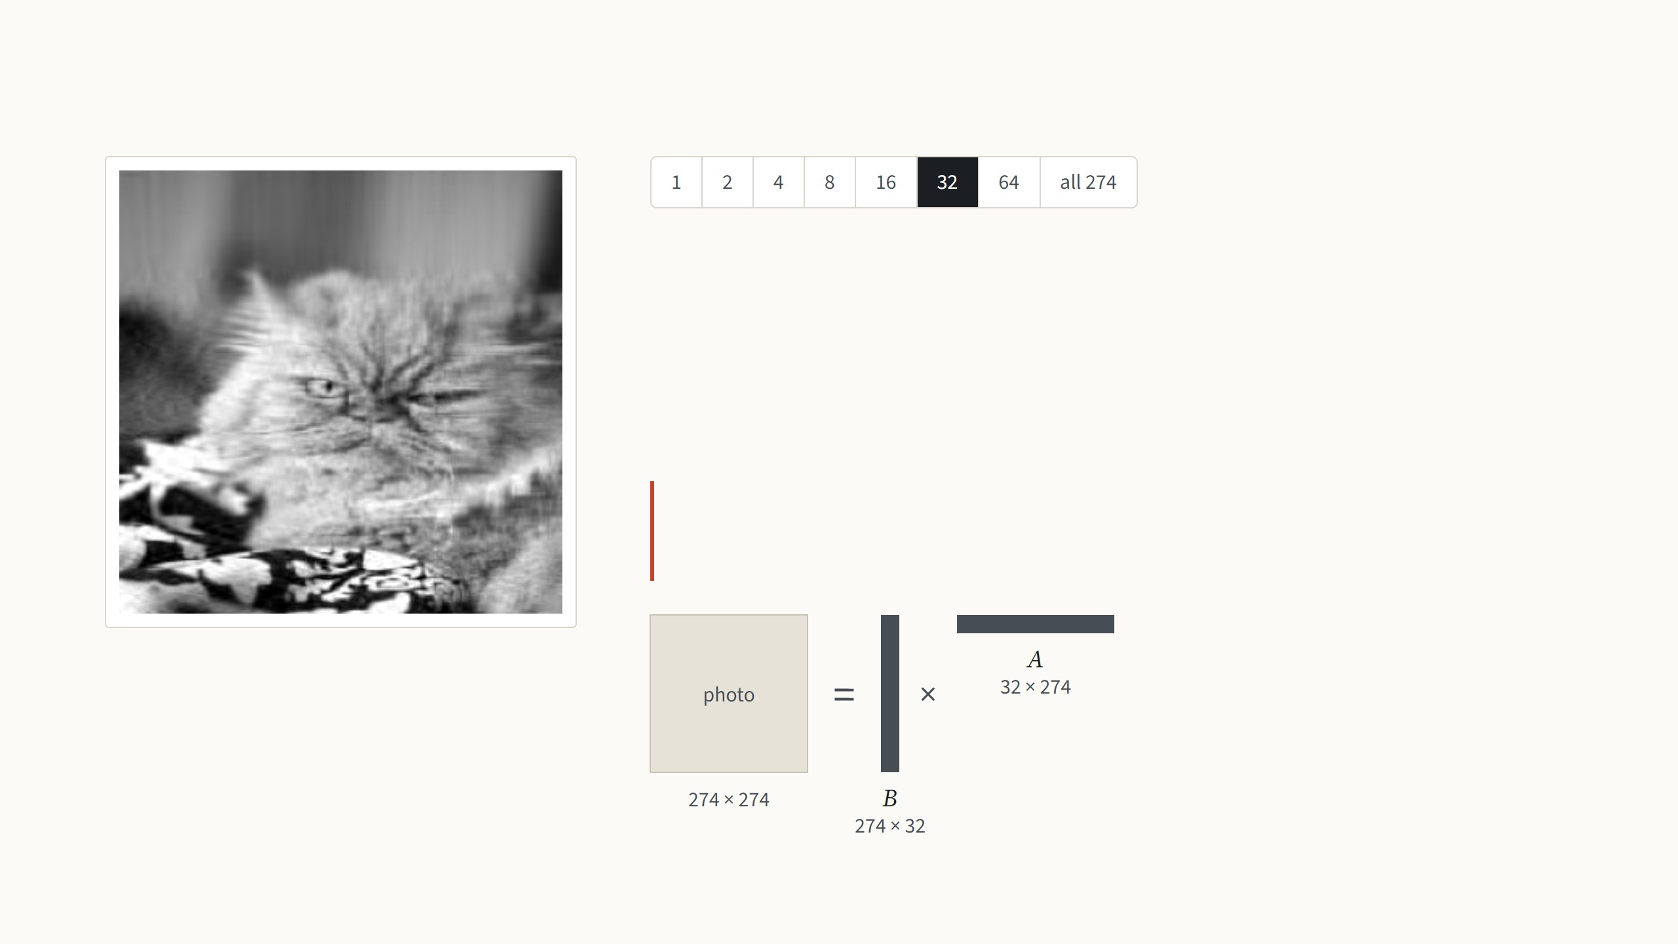
What a low-rank matrix is
A grayscale photo is a matrix of 274 × 274 brightness values. Any matrix can be
written as a sum of simple pieces, where each piece is one column of numbers
times one row. The rank is the number of pieces.
With 32 pieces the face and the fur appear.
LoRA bets that the change fine-tuning makes to a weight
matrix is like this photo: a few pieces carry almost all of it.
Rank 32: 32 × (274 + 274) = 17,536 numbers,
23.4% of the photo's 75,076
Not from the paper: the best rank-r approximation (SVD) of an Oxford Pets photo, Jia et al. 2022, Fig. 10. The low-rank bet follows Li et al. 2018 and Aghajanyan et al. 2021.
5
Notes:
One minute of linear algebra, because the whole paper rests on the word rank. Treat the photo as a matrix of brightness values. A rank-one matrix is a column times a row: every row of the image is the same pattern, just scaled, so you get bands. Step through with the arrow keys. Each step doubles the number of pieces. The pieces are ordered by how much they contribute, so the first few capture the big shapes and the later ones only fine detail. At rank 16 the cat is recognisable, from 12% of the numbers; at 64 it is hard to tell from the original, from 47%. Storing r pieces costs r times (rows plus columns) numbers instead of rows times columns. The drawing under the text shows the same thing as matrices, to scale: the r columns side by side are a tall matrix B, the r rows stacked are a wide matrix A, and B times A rebuilds the photo; at rank 1 they are a single line each, at all 274 they are as big as the photo itself. That is the trade LoRA makes for the weight change, with the same names B and A from now on. Why expect the change to be low-rank? Two earlier papers measured the "intrinsic dimension" of fine-tuning: you can freeze the model, train only a few hundred or thousand numbers, map them through a fixed random projection onto all the weights, and still get most of the accuracy. LoRA's assumption is the matrix version of that: each weight change has a low rank, so it can be written as B times A with a small r, chosen by hand.

Slide 13
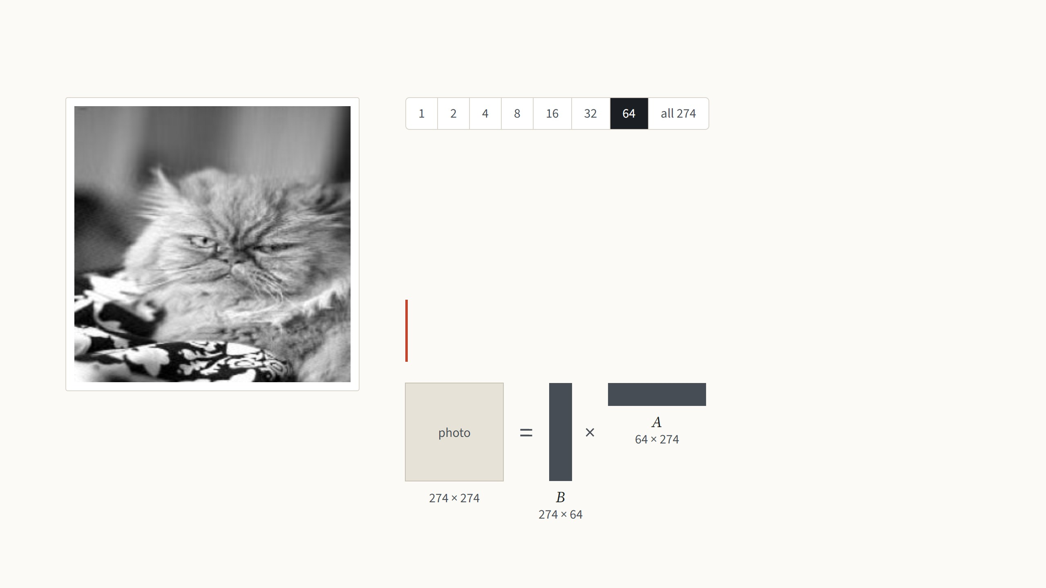
What a low-rank matrix is
A grayscale photo is a matrix of 274 × 274 brightness values. Any matrix can be
written as a sum of simple pieces, where each piece is one column of numbers
times one row. The rank is the number of pieces.
With 64 pieces it is hard to tell from the original.
LoRA bets that the change fine-tuning makes to a weight
matrix is like this photo: a few pieces carry almost all of it.
Rank 64: 64 × (274 + 274) = 35,072 numbers,
46.7% of the photo's 75,076
Not from the paper: the best rank-r approximation (SVD) of an Oxford Pets photo, Jia et al. 2022, Fig. 10. The low-rank bet follows Li et al. 2018 and Aghajanyan et al. 2021.
5
Notes:
One minute of linear algebra, because the whole paper rests on the word rank. Treat the photo as a matrix of brightness values. A rank-one matrix is a column times a row: every row of the image is the same pattern, just scaled, so you get bands. Step through with the arrow keys. Each step doubles the number of pieces. The pieces are ordered by how much they contribute, so the first few capture the big shapes and the later ones only fine detail. At rank 16 the cat is recognisable, from 12% of the numbers; at 64 it is hard to tell from the original, from 47%. Storing r pieces costs r times (rows plus columns) numbers instead of rows times columns. The drawing under the text shows the same thing as matrices, to scale: the r columns side by side are a tall matrix B, the r rows stacked are a wide matrix A, and B times A rebuilds the photo; at rank 1 they are a single line each, at all 274 they are as big as the photo itself. That is the trade LoRA makes for the weight change, with the same names B and A from now on. Why expect the change to be low-rank? Two earlier papers measured the "intrinsic dimension" of fine-tuning: you can freeze the model, train only a few hundred or thousand numbers, map them through a fixed random projection onto all the weights, and still get most of the accuracy. LoRA's assumption is the matrix version of that: each weight change has a low rank, so it can be written as B times A with a small r, chosen by hand.

Slide 14
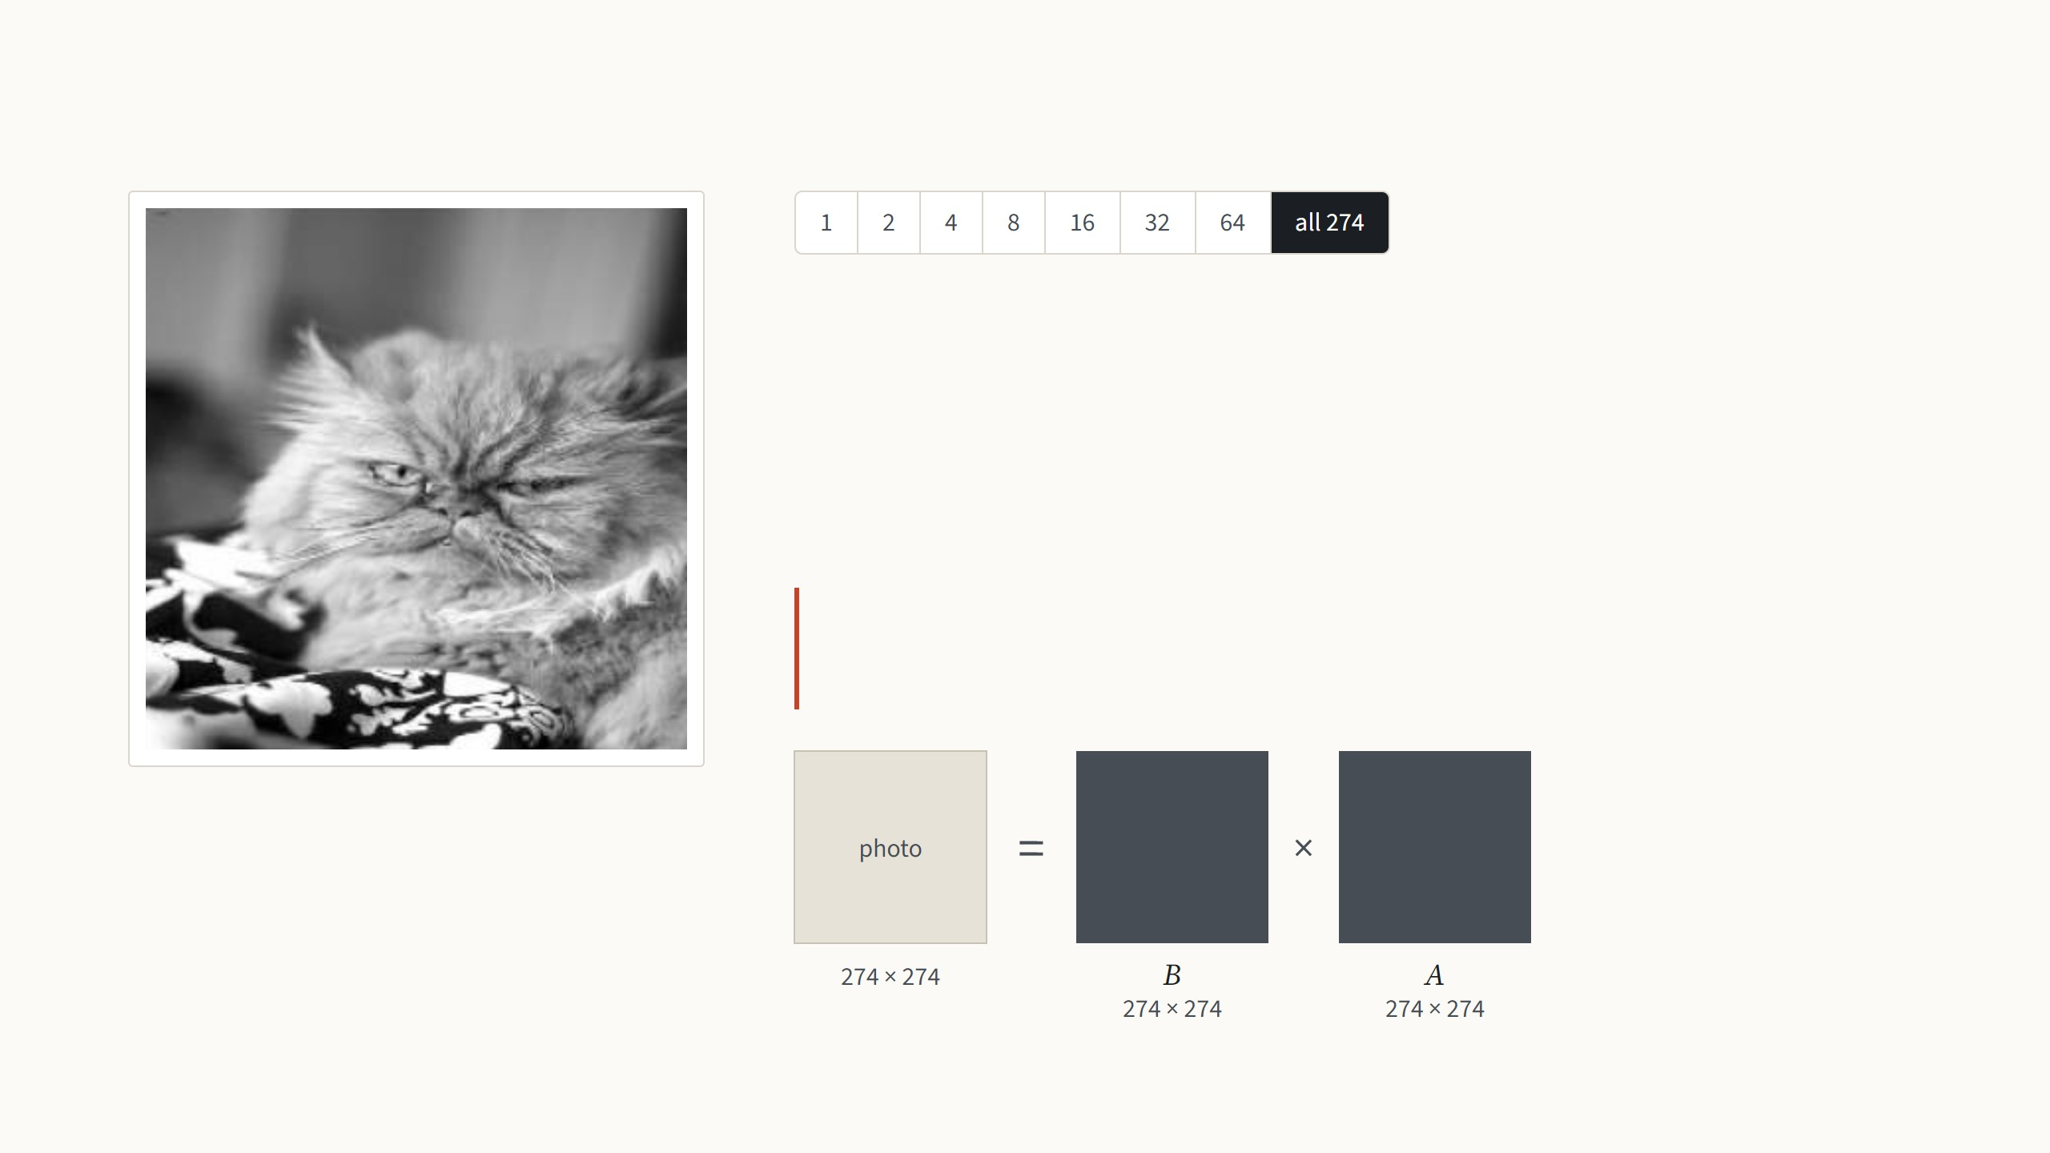
What a low-rank matrix is
A grayscale photo is a matrix of 274 × 274 brightness values. Any matrix can be
written as a sum of simple pieces, where each piece is one column of numbers
times one row. The rank is the number of pieces.
All 274 pieces give back the photo exactly.
LoRA bets that the change fine-tuning makes to a weight
matrix is like this photo: a few pieces carry almost all of it.
75,076 numbers: the full photo
Not from the paper: the best rank-r approximation (SVD) of an Oxford Pets photo, Jia et al. 2022, Fig. 10. The low-rank bet follows Li et al. 2018 and Aghajanyan et al. 2021.
5
Notes:
One minute of linear algebra, because the whole paper rests on the word rank. Treat the photo as a matrix of brightness values. A rank-one matrix is a column times a row: every row of the image is the same pattern, just scaled, so you get bands. Step through with the arrow keys. Each step doubles the number of pieces. The pieces are ordered by how much they contribute, so the first few capture the big shapes and the later ones only fine detail. At rank 16 the cat is recognisable, from 12% of the numbers; at 64 it is hard to tell from the original, from 47%. Storing r pieces costs r times (rows plus columns) numbers instead of rows times columns. The drawing under the text shows the same thing as matrices, to scale: the r columns side by side are a tall matrix B, the r rows stacked are a wide matrix A, and B times A rebuilds the photo; at rank 1 they are a single line each, at all 274 they are as big as the photo itself. That is the trade LoRA makes for the weight change, with the same names B and A from now on. Why expect the change to be low-rank? Two earlier papers measured the "intrinsic dimension" of fine-tuning: you can freeze the model, train only a few hundred or thousand numbers, map them through a fixed random projection onto all the weights, and still get most of the accuracy. LoRA's assumption is the matrix version of that: each weight change has a low rank, so it can be written as B times A with a small r, chosen by hand.

Slide 15
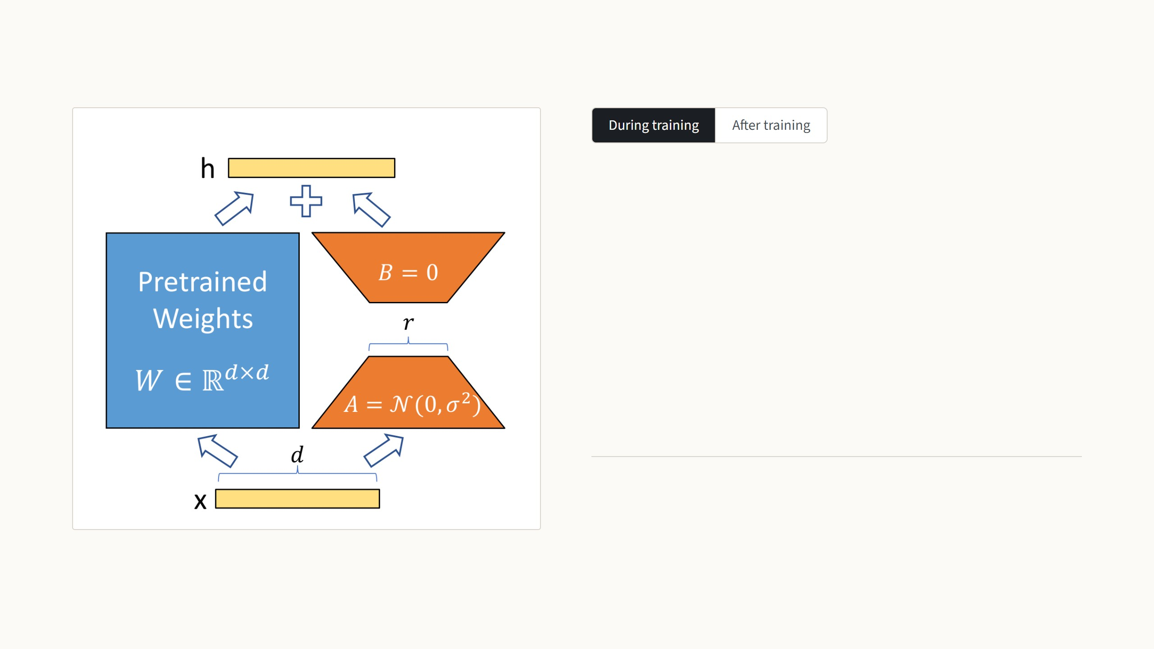
LoRA adds a trainable bypass to a frozen weight
The input goes through the frozen weight W0 and, in parallel,
through A and B, which are trained. The two results are added.
The full change ΔW is never built; LoRA trains the thin matrices
directly, with a rank r chosen by hand.
h = W0x + (α/r) BAx
B starts at zero, so training begins exactly at the pretrained model.
Only A and B get gradients and optimizer state.
Figure: Hu et al. 2022, Fig. 1, where orange is trained. Equation (3) and Sec. 4.1. The paper sets α to the first r it tries and does not tune it.
6
Notes:
The paper's own figure; orange there is what we call red, the trained part. During training: x goes through the frozen W0 as before, and in parallel through A, which squeezes it down to r numbers, and B, which expands it back. The outputs are added. Two details matter. B starts at zero, so at step one the model is exactly the pretrained model and training starts from a known good point. And the bypass is scaled by alpha over r, so that changing the rank does not mean re-tuning the learning rate. Press the arrow key: after training, B times A is just a d × d matrix, so we add it into W0 once and throw A and B away. The model is again a single matrix per layer, same size, same speed. To switch task you subtract this task's BA and add another task's, a cheap operation. That is the property VPT did not have.

Slide 16
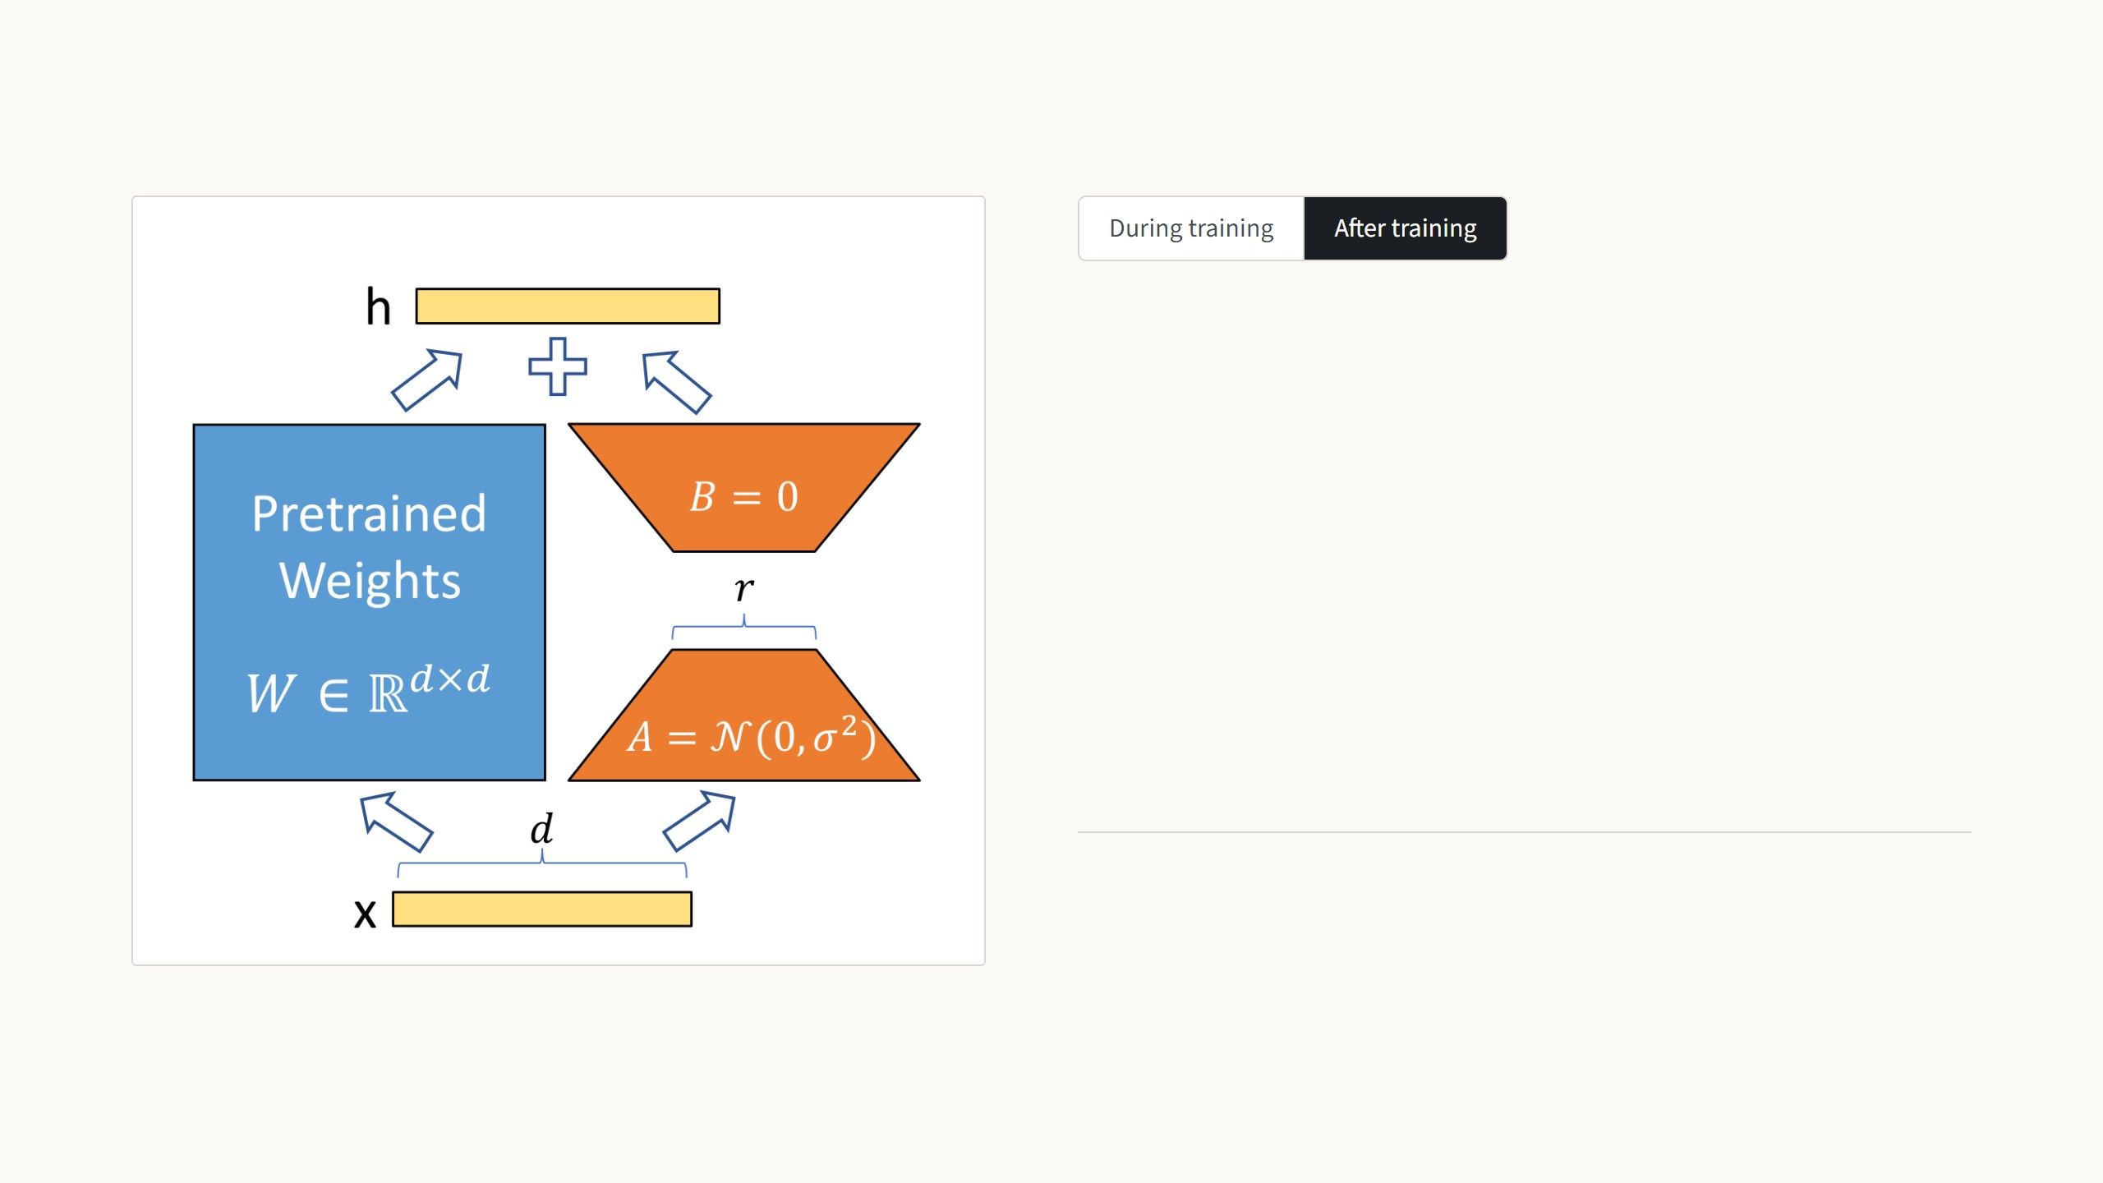
LoRA adds a trainable bypass to a frozen weight
After training, the product BA is added into the weight once. The
model is again one matrix per layer, of the same size, so it runs
exactly as fast as before.
W = W0 + (α/r) BA
h = Wx
To switch task, subtract this BA and add that task's B′A′. Per task,
only A and B are stored.
Figure: Hu et al. 2022, Fig. 1, where orange is trained. Equation (3) and Sec. 4.1. The paper sets α to the first r it tries and does not tune it.
6
Notes:
The paper's own figure; orange there is what we call red, the trained part. During training: x goes through the frozen W0 as before, and in parallel through A, which squeezes it down to r numbers, and B, which expands it back. The outputs are added. Two details matter. B starts at zero, so at step one the model is exactly the pretrained model and training starts from a known good point. And the bypass is scaled by alpha over r, so that changing the rank does not mean re-tuning the learning rate. Press the arrow key: after training, B times A is just a d × d matrix, so we add it into W0 once and throw A and B away. The model is again a single matrix per layer, same size, same speed. To switch task you subtract this task's BA and add another task's, a cheap operation. That is the property VPT did not have.

Slide 17
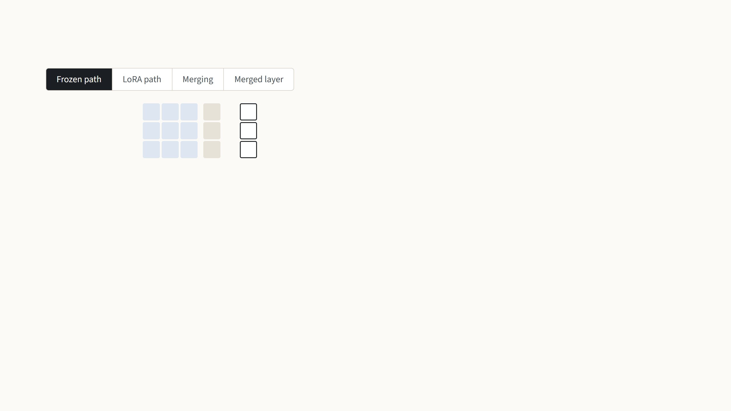
LoRA on a 3 × 3 weight matrix
2
0
1
1
5
During training
1
3
0
2
=
7
0
1
2
3
8
W
x
Wx
After training, once
At test time
Take a tiny weight W and an input x. The frozen path is just the pretrained layer, and Wx gives 5, 7 and 8.
Made-up numbers with rank r = 1 and α/r = 1, so every product can be checked by eye. In ViT-B the same happens with 768 × 768 weights and r = 8.
7
Notes:
Made-up numbers, rank 1, so every product can be checked by eye. First the frozen path: the pretrained layer computes W times x, which gives 5, 7 and 8. Next step: LoRA adds a second path. A is one row of three numbers, so A times x is a single number, 1 + 2 + 0 = 3; the input is squeezed down to r numbers. B is a column of three, so B times 3 gives 3, 0 and 6, back to full size. The two paths are added: 8, 7, 14. During training only these six red numbers would change. Next step: after training we multiply B by A once. A column times a row is a full 3 × 3 matrix, the same shape as W, so we can add it to W; the red cells are the ones that changed. Last step: the merged W′ times x gives 8, 7, 14 again, exactly the training-time output, because W x + B(A x) equals (W + BA) x. So A and B are deleted and the layer is one ordinary matrix. The point people often miss: B and A are never multiplied with W. They are multiplied with each other, and the product is added to W.

Slide 18
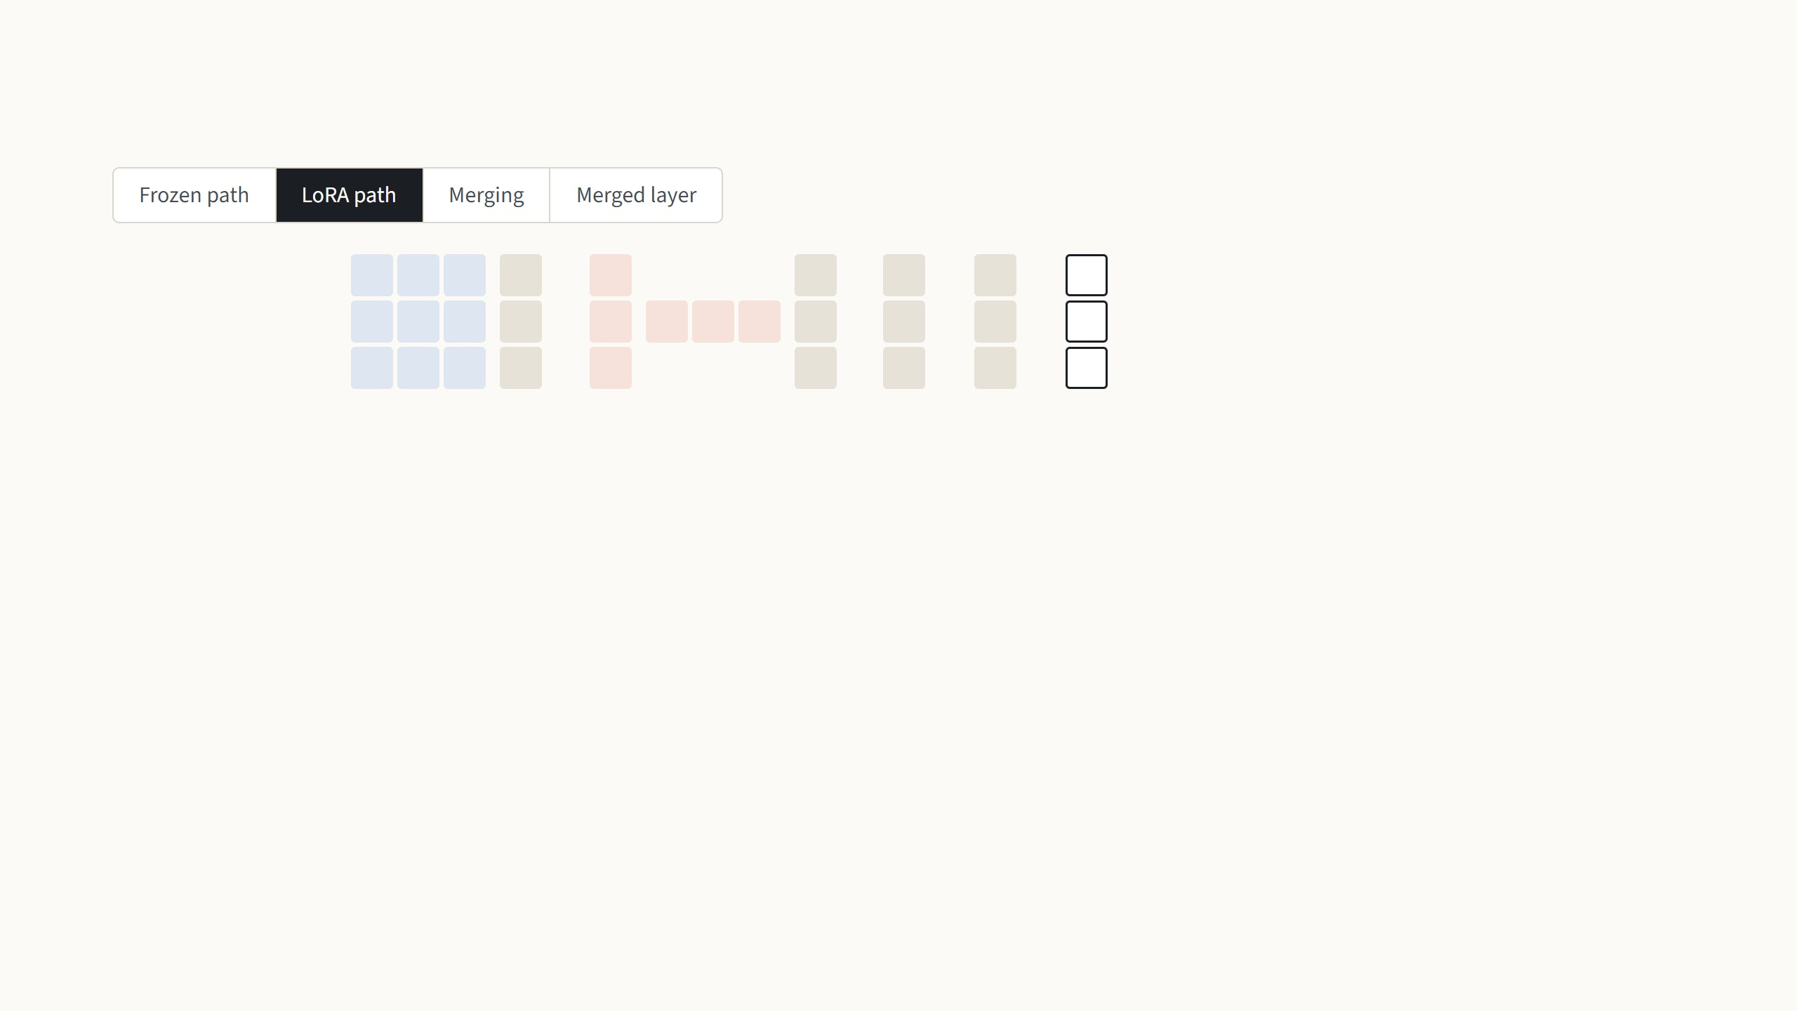
LoRA on a 3 × 3 weight matrix
2
0
1
1
1
1
5
3
8
During training
1
3
0
2
+
0
1
1
0
2
=
7
+
0
=
7
0
1
2
3
2
3
8
6
14
W
x
B
A
x
Wx
BAx
h
After training, once
At test time
LoRA adds a second path. A squeezes the input to r numbers, here a single 3, and B expands it back to three; the two paths are
added. In training, only the six red numbers change.
Made-up numbers with rank r = 1 and α/r = 1, so every product can be checked by eye. In ViT-B the same happens with 768 × 768 weights and r = 8.
7
Notes:
Made-up numbers, rank 1, so every product can be checked by eye. First the frozen path: the pretrained layer computes W times x, which gives 5, 7 and 8. Next step: LoRA adds a second path. A is one row of three numbers, so A times x is a single number, 1 + 2 + 0 = 3; the input is squeezed down to r numbers. B is a column of three, so B times 3 gives 3, 0 and 6, back to full size. The two paths are added: 8, 7, 14. During training only these six red numbers would change. Next step: after training we multiply B by A once. A column times a row is a full 3 × 3 matrix, the same shape as W, so we can add it to W; the red cells are the ones that changed. Last step: the merged W′ times x gives 8, 7, 14 again, exactly the training-time output, because W x + B(A x) equals (W + BA) x. So A and B are deleted and the layer is one ordinary matrix. The point people often miss: B and A are never multiplied with W. They are multiplied with each other, and the product is added to W.

Slide 19
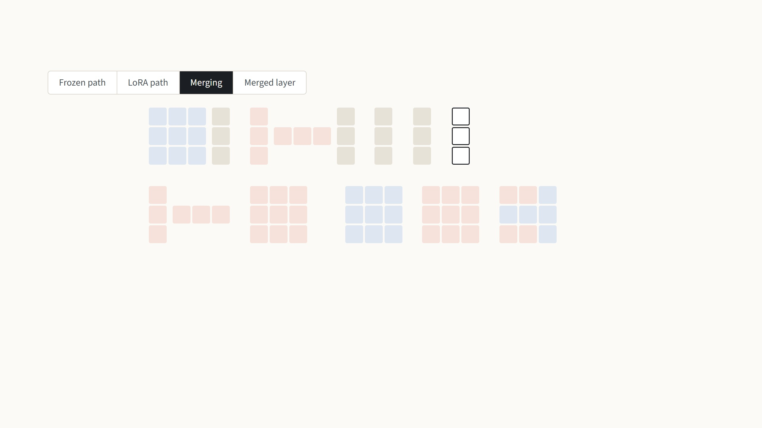
LoRA on a 3 × 3 weight matrix
2
0
1
1
1
1
5
3
8
During training
1
3
0
2
+
0
1
1
0
2
=
7
+
0
=
7
0
1
2
3
2
3
8
6
14
W
x
B
A
x
Wx
BAx
h
1
1
1
0
2
0
1
1
1
0
3
1
1
After training, once
0
1
1
0
=
0
0
0
1
3
0
+
0
0
0
=
1
3
0
2
2
2
0
0
1
2
2
2
0
2
3
2
B
A
BA
W
BA
W′
At test time
After training, B times A is worked out once. A column times a row is a full 3 × 3 matrix, the same shape as W, so it is simply added
to it; the red cells are the ones that changed.
Made-up numbers with rank r = 1 and α/r = 1, so every product can be checked by eye. In ViT-B the same happens with 768 × 768 weights and r = 8.
7
Notes:
Made-up numbers, rank 1, so every product can be checked by eye. First the frozen path: the pretrained layer computes W times x, which gives 5, 7 and 8. Next step: LoRA adds a second path. A is one row of three numbers, so A times x is a single number, 1 + 2 + 0 = 3; the input is squeezed down to r numbers. B is a column of three, so B times 3 gives 3, 0 and 6, back to full size. The two paths are added: 8, 7, 14. During training only these six red numbers would change. Next step: after training we multiply B by A once. A column times a row is a full 3 × 3 matrix, the same shape as W, so we can add it to W; the red cells are the ones that changed. Last step: the merged W′ times x gives 8, 7, 14 again, exactly the training-time output, because W x + B(A x) equals (W + BA) x. So A and B are deleted and the layer is one ordinary matrix. The point people often miss: B and A are never multiplied with W. They are multiplied with each other, and the product is added to W.

Slide 20
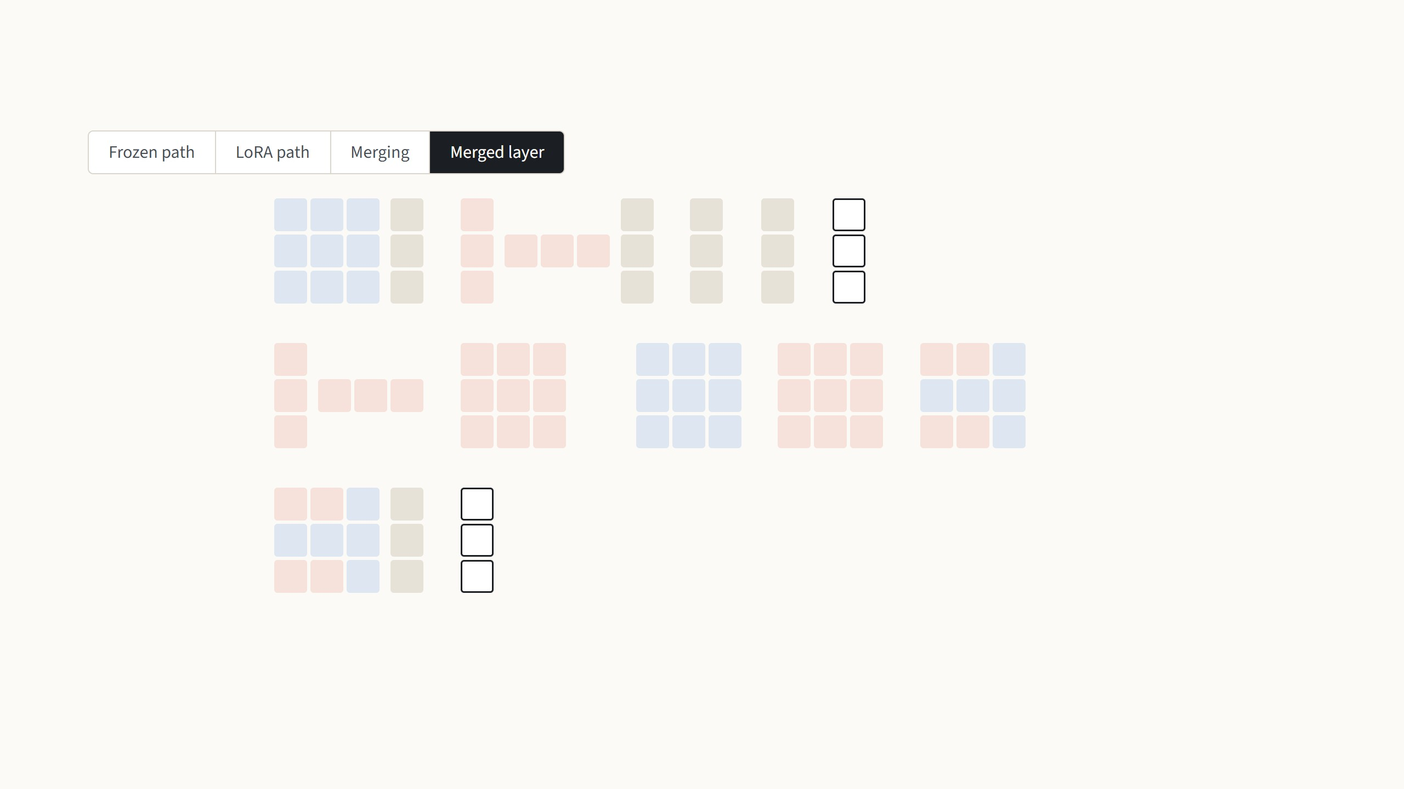
LoRA on a 3 × 3 weight matrix
2
0
1
1
1
1
5
3
8
During training
1
3
0
2
+
0
1
1
0
2
=
7
+
0
=
7
0
1
2
3
2
3
8
6
14
W
x
B
A
x
Wx
BAx
h
1
1
1
0
2
0
1
1
1
0
3
1
1
After training, once
0
1
1
0
=
0
0
0
1
3
0
+
0
0
0
=
1
3
0
2
2
2
0
0
1
2
2
2
0
2
3
2
B
A
BA
W
BA
W′
3
1
1
1
8
At test time
1
3
0
2
=
7
2
3
2
3
14
W′
x
h
The merged weight gives exactly the same output, because Wx + B(Ax) = (W + BA)x. B and A are deleted, and the layer is one
ordinary matrix again.
Made-up numbers with rank r = 1 and α/r = 1, so every product can be checked by eye. In ViT-B the same happens with 768 × 768 weights and r = 8.
7
Notes:
Made-up numbers, rank 1, so every product can be checked by eye. First the frozen path: the pretrained layer computes W times x, which gives 5, 7 and 8. Next step: LoRA adds a second path. A is one row of three numbers, so A times x is a single number, 1 + 2 + 0 = 3; the input is squeezed down to r numbers. B is a column of three, so B times 3 gives 3, 0 and 6, back to full size. The two paths are added: 8, 7, 14. During training only these six red numbers would change. Next step: after training we multiply B by A once. A column times a row is a full 3 × 3 matrix, the same shape as W, so we can add it to W; the red cells are the ones that changed. Last step: the merged W′ times x gives 8, 7, 14 again, exactly the training-time output, because W x + B(A x) equals (W + BA) x. So A and B are deleted and the layer is one ordinary matrix. The point people often miss: B and A are never multiplied with W. They are multiplied with each other, and the product is added to W.

Slide 21
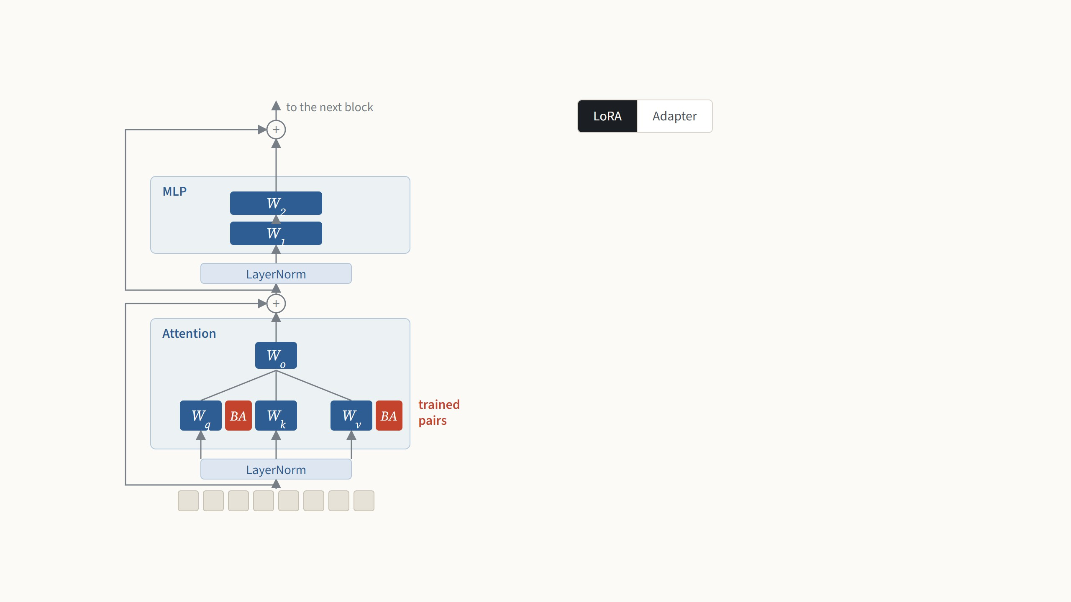
Where LoRA goes in a Vision Transformer
LoRA puts a trained pair B A beside the query and value
weights of the attention, in all 12 blocks. The key and output
weights, the MLP and the layer norms stay frozen. After
merging, the block is exactly the original.
One of the 12 blocks of ViT-B/16. Placement as in Hu et al. 2022, Sec. 4.2, and Houlsby et al. 2019. Zhang et al. 2022, Fig. 1a, draws LoRA, the adapter and VPT in one block.
8
Notes:
Where exactly the pairs go. This is one of the twelve blocks of a ViT, frozen in blue. The attention part has four weight matrices: query, key, value and output; the MLP has two. The paper only adapts attention weights, by default the query and value, and leaves everything else frozen, including the MLP. The red pairs sit beside Wq and Wv in every block, 24 pairs in ViT-B. Press the arrow key for an adapter, for contrast: a small trained two-layer network after the MLP, an extra layer every input has to go through, which is where the latency from the earlier chart comes from. LoRA instead sits beside weights that already exist, so after merging it disappears. VPT, the third option, changes nothing inside the block; the next slide compares it with LoRA step by step. NOAH, the vision paper we will see, searches over all three at once.

Slide 22
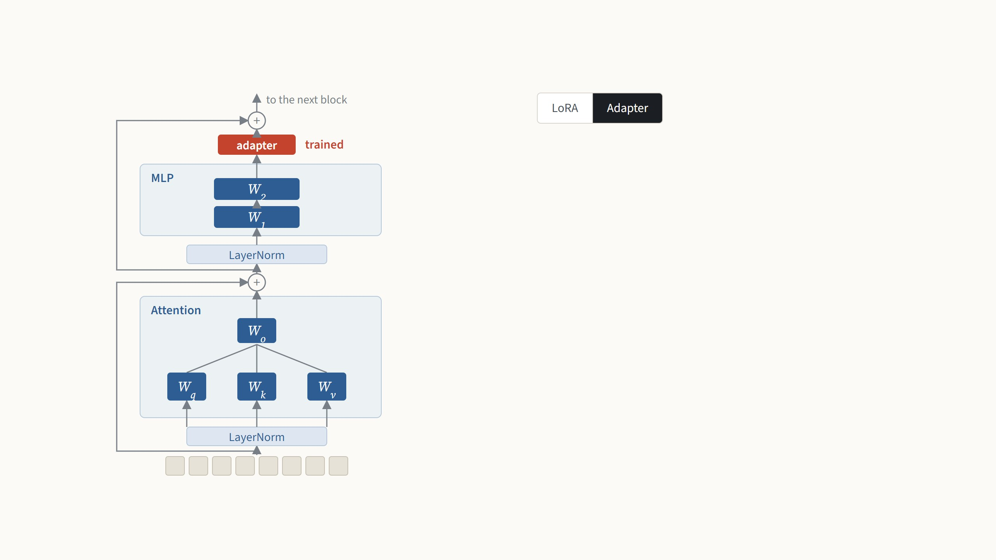
Where LoRA goes in a Vision Transformer
An adapter, for contrast, is a small trained two-layer network
inserted after the MLP. It is an extra layer that every input
must pass through, which is where its extra time comes from;
LoRA sits beside weights that already exist.
One of the 12 blocks of ViT-B/16. Placement as in Hu et al. 2022, Sec. 4.2, and Houlsby et al. 2019. Zhang et al. 2022, Fig. 1a, draws LoRA, the adapter and VPT in one block.
8
Notes:
Where exactly the pairs go. This is one of the twelve blocks of a ViT, frozen in blue. The attention part has four weight matrices: query, key, value and output; the MLP has two. The paper only adapts attention weights, by default the query and value, and leaves everything else frozen, including the MLP. The red pairs sit beside Wq and Wv in every block, 24 pairs in ViT-B. Press the arrow key for an adapter, for contrast: a small trained two-layer network after the MLP, an extra layer every input has to go through, which is where the latency from the earlier chart comes from. LoRA instead sits beside weights that already exist, so after merging it disappears. VPT, the third option, changes nothing inside the block; the next slide compares it with LoRA step by step. NOAH, the vision paper we will see, searches over all three at once.

Slide 23
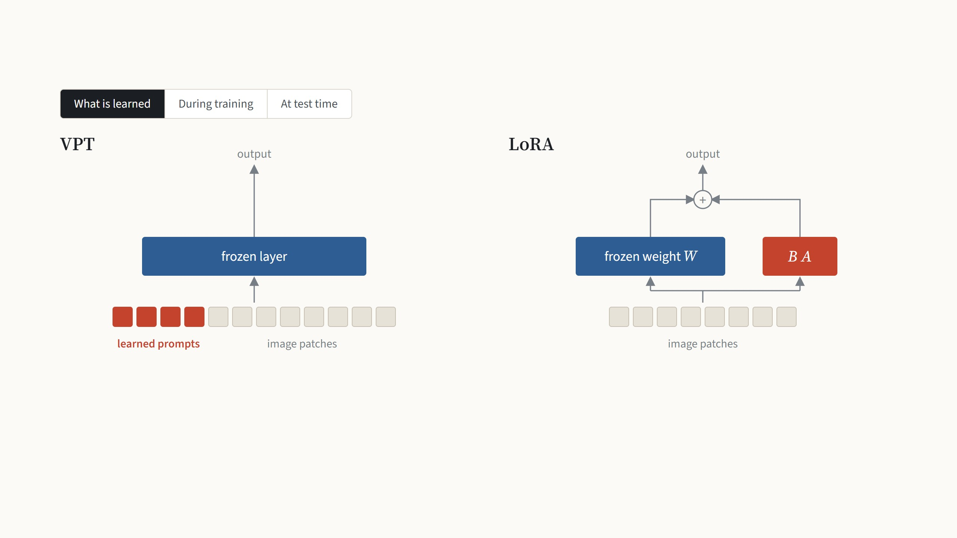
VPT and LoRA side by side
VPT learns extra input vectors. The same 50 per layer are placed
in front of every image of the task; they start random and are
not taken from any image.
LoRA learns a correction to the weights, the pair B and A beside
the query and value weights. It is also one pair for the whole
task, and B starts at zero.
One layer of ViT-B/16 drawn for each. VPT-deep with 50 prompts per layer (Jia et al. 2022); LoRA with rank 8 on the query and value weights (Hu et al. 2022). Both train the same
102-class head.
9
Notes:
This is the slide that puts the two methods next to each other, in three steps. What is learned: VPT learns extra input vectors, 50 per layer, and the same ones are used for every image of the task; they start random, they are not cut from any image. LoRA learns a correction to the weights, the pair B and A beside the query and value weights; it is also one pair for the whole task, not per image, and B starts at zero. Next step, training: in both cases every training image goes through the frozen model, the loss is computed, and gradients flow back. In VPT they end in the prompts and the head; in LoRA in B, A and the head. In both, the pretrained weights never change. Next step, test time, which is where the two differ. VPT's prompts are inputs, so they have to be attached to every test image, and every layer processes 247 tokens instead of 197, 27% more compute. LoRA's correction is a matrix of the same shape as W, so it is added into W once, and the layer is an ordinary layer again, exactly the original cost. The next slide puts numbers on both differences: what each stores per task, and what each image costs.

Slide 24
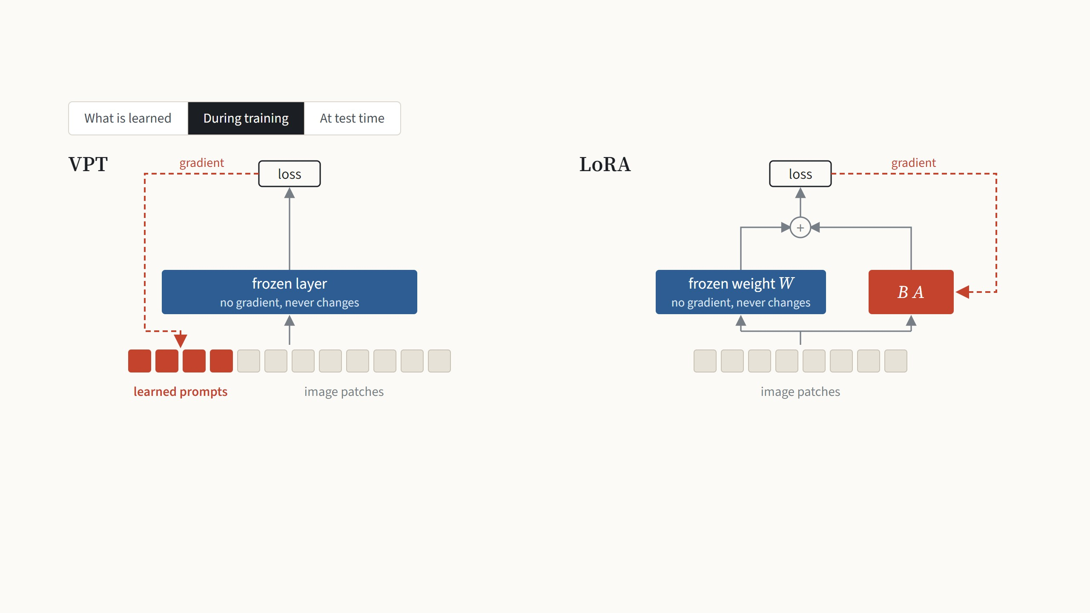
VPT and LoRA side by side
Each training image goes through the frozen model with the
prompts attached. The loss sends gradients back, and only the
prompts and the head change.
Each training image takes both paths, Wx and BAx. Only B, A
and the head change; W never receives a gradient.
One layer of ViT-B/16 drawn for each. VPT-deep with 50 prompts per layer (Jia et al. 2022); LoRA with rank 8 on the query and value weights (Hu et al. 2022). Both train the same
102-class head.
9
Notes:
This is the slide that puts the two methods next to each other, in three steps. What is learned: VPT learns extra input vectors, 50 per layer, and the same ones are used for every image of the task; they start random, they are not cut from any image. LoRA learns a correction to the weights, the pair B and A beside the query and value weights; it is also one pair for the whole task, not per image, and B starts at zero. Next step, training: in both cases every training image goes through the frozen model, the loss is computed, and gradients flow back. In VPT they end in the prompts and the head; in LoRA in B, A and the head. In both, the pretrained weights never change. Next step, test time, which is where the two differ. VPT's prompts are inputs, so they have to be attached to every test image, and every layer processes 247 tokens instead of 197, 27% more compute. LoRA's correction is a matrix of the same shape as W, so it is added into W once, and the layer is an ordinary layer again, exactly the original cost. The next slide puts numbers on both differences: what each stores per task, and what each image costs.

Slide 25
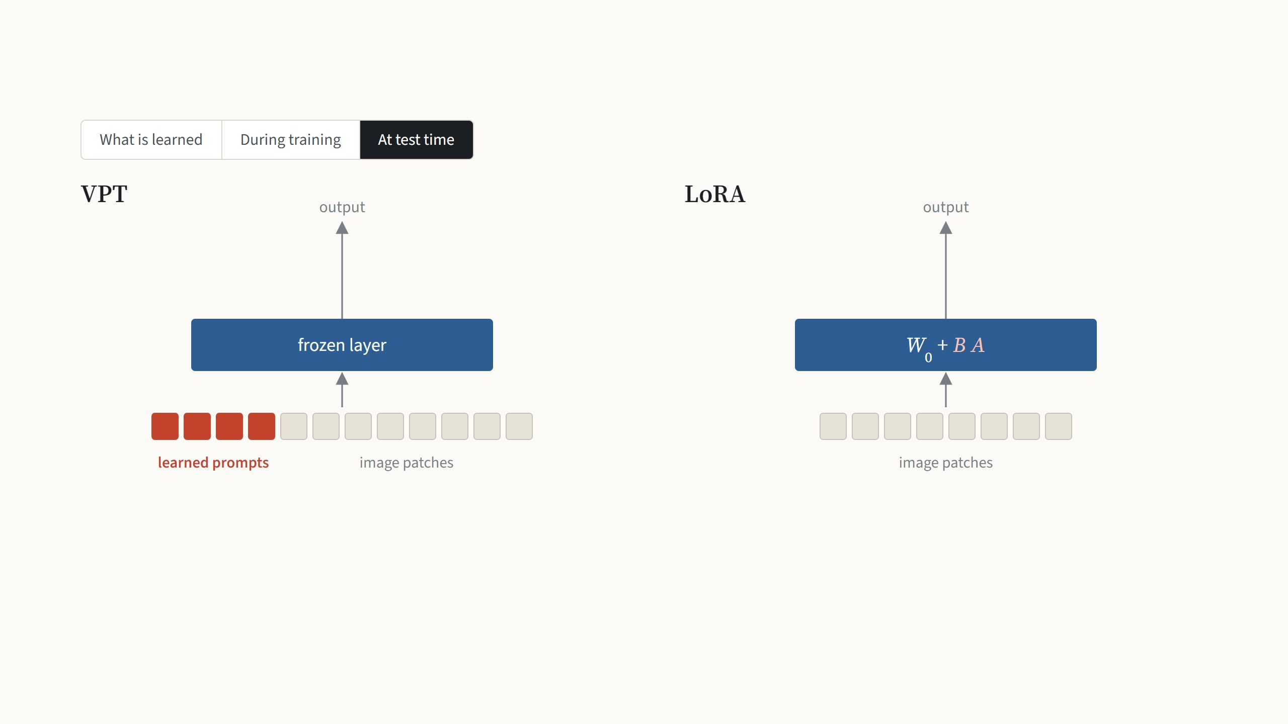
VPT and LoRA side by side
The prompts must be attached to every test image, so each
layer works on 247 tokens instead of 197. They are inputs, so
they can never be folded into the weights.
BA is added into W once, and the layer is one plain matrix
again. The test image goes through exactly the original model.
One layer of ViT-B/16 drawn for each. VPT-deep with 50 prompts per layer (Jia et al. 2022); LoRA with rank 8 on the query and value weights (Hu et al. 2022). Both train the same
102-class head.
9
Notes:
This is the slide that puts the two methods next to each other, in three steps. What is learned: VPT learns extra input vectors, 50 per layer, and the same ones are used for every image of the task; they start random, they are not cut from any image. LoRA learns a correction to the weights, the pair B and A beside the query and value weights; it is also one pair for the whole task, not per image, and B starts at zero. Next step, training: in both cases every training image goes through the frozen model, the loss is computed, and gradients flow back. In VPT they end in the prompts and the head; in LoRA in B, A and the head. In both, the pretrained weights never change. Next step, test time, which is where the two differ. VPT's prompts are inputs, so they have to be attached to every test image, and every layer processes 247 tokens instead of 197, 27% more compute. LoRA's correction is a matrix of the same shape as W, so it is added into W once, and the layer is an ordinary layer again, exactly the original cost. The next slide puts numbers on both differences: what each stores per task, and what each image costs.

Slide 26

How much LoRA trains and stores per task
2 · N · m · d · r = 2 × 12 × 2 × 768 × 8 = 294,912numbers in the pairs, plus 78,438 for a 102-class head
Numbers trained and stored per task
Full fine-tuning
all 85.8 million weights, retrained for this task
343 MB100%
VPT-deep, 50 prompts
frozen and shared by every task
2.2 MB0.63%
LoRA
frozen and shared by every task
1.5 MB0.44%
Compute per image at test time
Plain ViT
197 tokens
1.00×
VPT-deep, 50 prompts
197 tokens
1.27×+50 tokens
LoRA, merged
197 tokens
1.00×nothing extra
Shown for rank 8 on the query and value weights. At rank 64 on all four attention weights the file grows to 19 MB, 5.6% of the model, and the
compute per image does not change.
ViT-B/16: N = 12 blocks, d = 768, m adapted weights per block, 32-bit numbers. VPT-deep as last time. Compute counts multiply-adds per layer for n tokens (12nd² + 2n²d).
10
Notes:
The numbers behind the previous slide, with the same accounting as last time. Each pair has 2 × 768 × r numbers; with query and value in 12 blocks and rank 8 that is 294,912, plus the same 102-class head as before: 0.44% of the model, a 1.5 MB file. VPT-deep with 50 prompts was 0.63% and 2.2 MB, so storage is about the same. The difference is the second chart: VPT made every image 27% more expensive, LoRA after merging costs exactly what the plain ViT costs. Try rank 64 on all four attention weights: the file grows to 19 MB, 5.6% of the model, but the compute bar does not move. If someone asks about training compute: the pairs still have to be computed during training, and the backward pass still goes through every layer, so training is not much cheaper per image than full fine-tuning; what drops is optimizer memory.

Slide 27
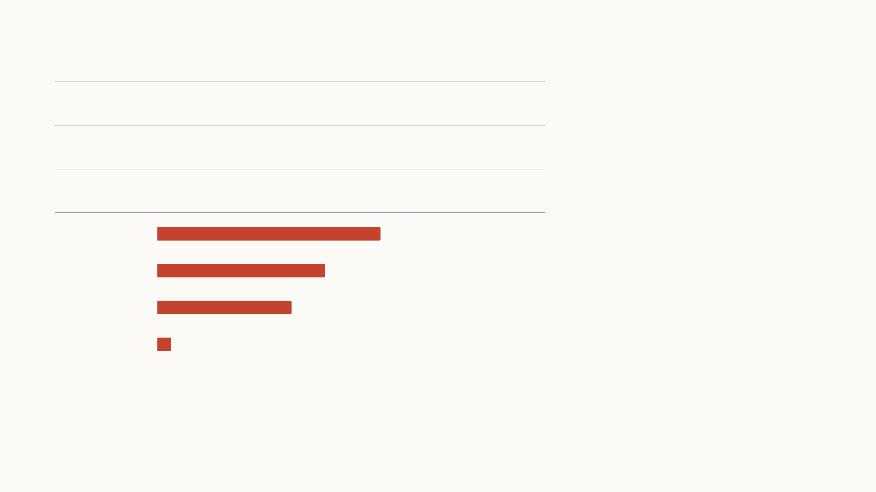
LoRA's saving grows with the width of the model
d × d = d²
A full change to one d × d weight has d²
numbers, while B and A together have 2rd.
Since d is the square root of d², LoRA's cost
grows like the square root of the full size,
times the small constant 2r.
Full change ΔW
589,824 numbers on ViT-B
B and A together
d × r + r × d = 2rd
12,288 numbers on ViT-B
Share of a full weight change stored by B and A, rank 8
width d
So the wider the model, the smaller LoRA's
share. Together with adapting only the query
and value weights, this is why GPT-3's task
file is 10,000 times smaller than a copy.
ViT-B/16
2.08%
768
ViT-L/16
1.56%
1,024
ViT-H/14
1.25%
1,280
GPT-3
0.13%
12,288
One d × d attention weight, rank r = 8 for every model. Widths: ViT-B/16 768, ViT-L/16 1,024, ViT-H/14 1,280 (Dosovitskiy et al. 2021); GPT-3 12,288 (Hu et al. 2022, Sec. 1). 10,000
times: Hu et al. 2022, Sec. 4.2.
11
Notes:
One more way to see the saving. A full change to a d by d weight has d squared numbers. B is d by r and A is r by d, so together 2 r d. Since d is the square root of d squared, LoRA's cost grows like the square root of the full size, multiplied by 2r, and r is a small constant we choose, 1 to 16. The chart keeps the rank fixed at 8 and only changes the width of the model. On ViT-B, 768 wide, the pair is 2.1% of a full change. ViT-H, 1,280 wide, 1.25%. GPT-3 is 12,288 wide, so the same rank is 0.13% of each weight. Add that GPT-3 only gets pairs on two of its weight types per block, and you arrive at the paper's headline: a 35 MB file instead of a 350 GB copy, 10,000 times smaller. For our ViT-B the saving is real but much less dramatic, which is why the file is 1.5 MB and not a few KB.

Slide 28
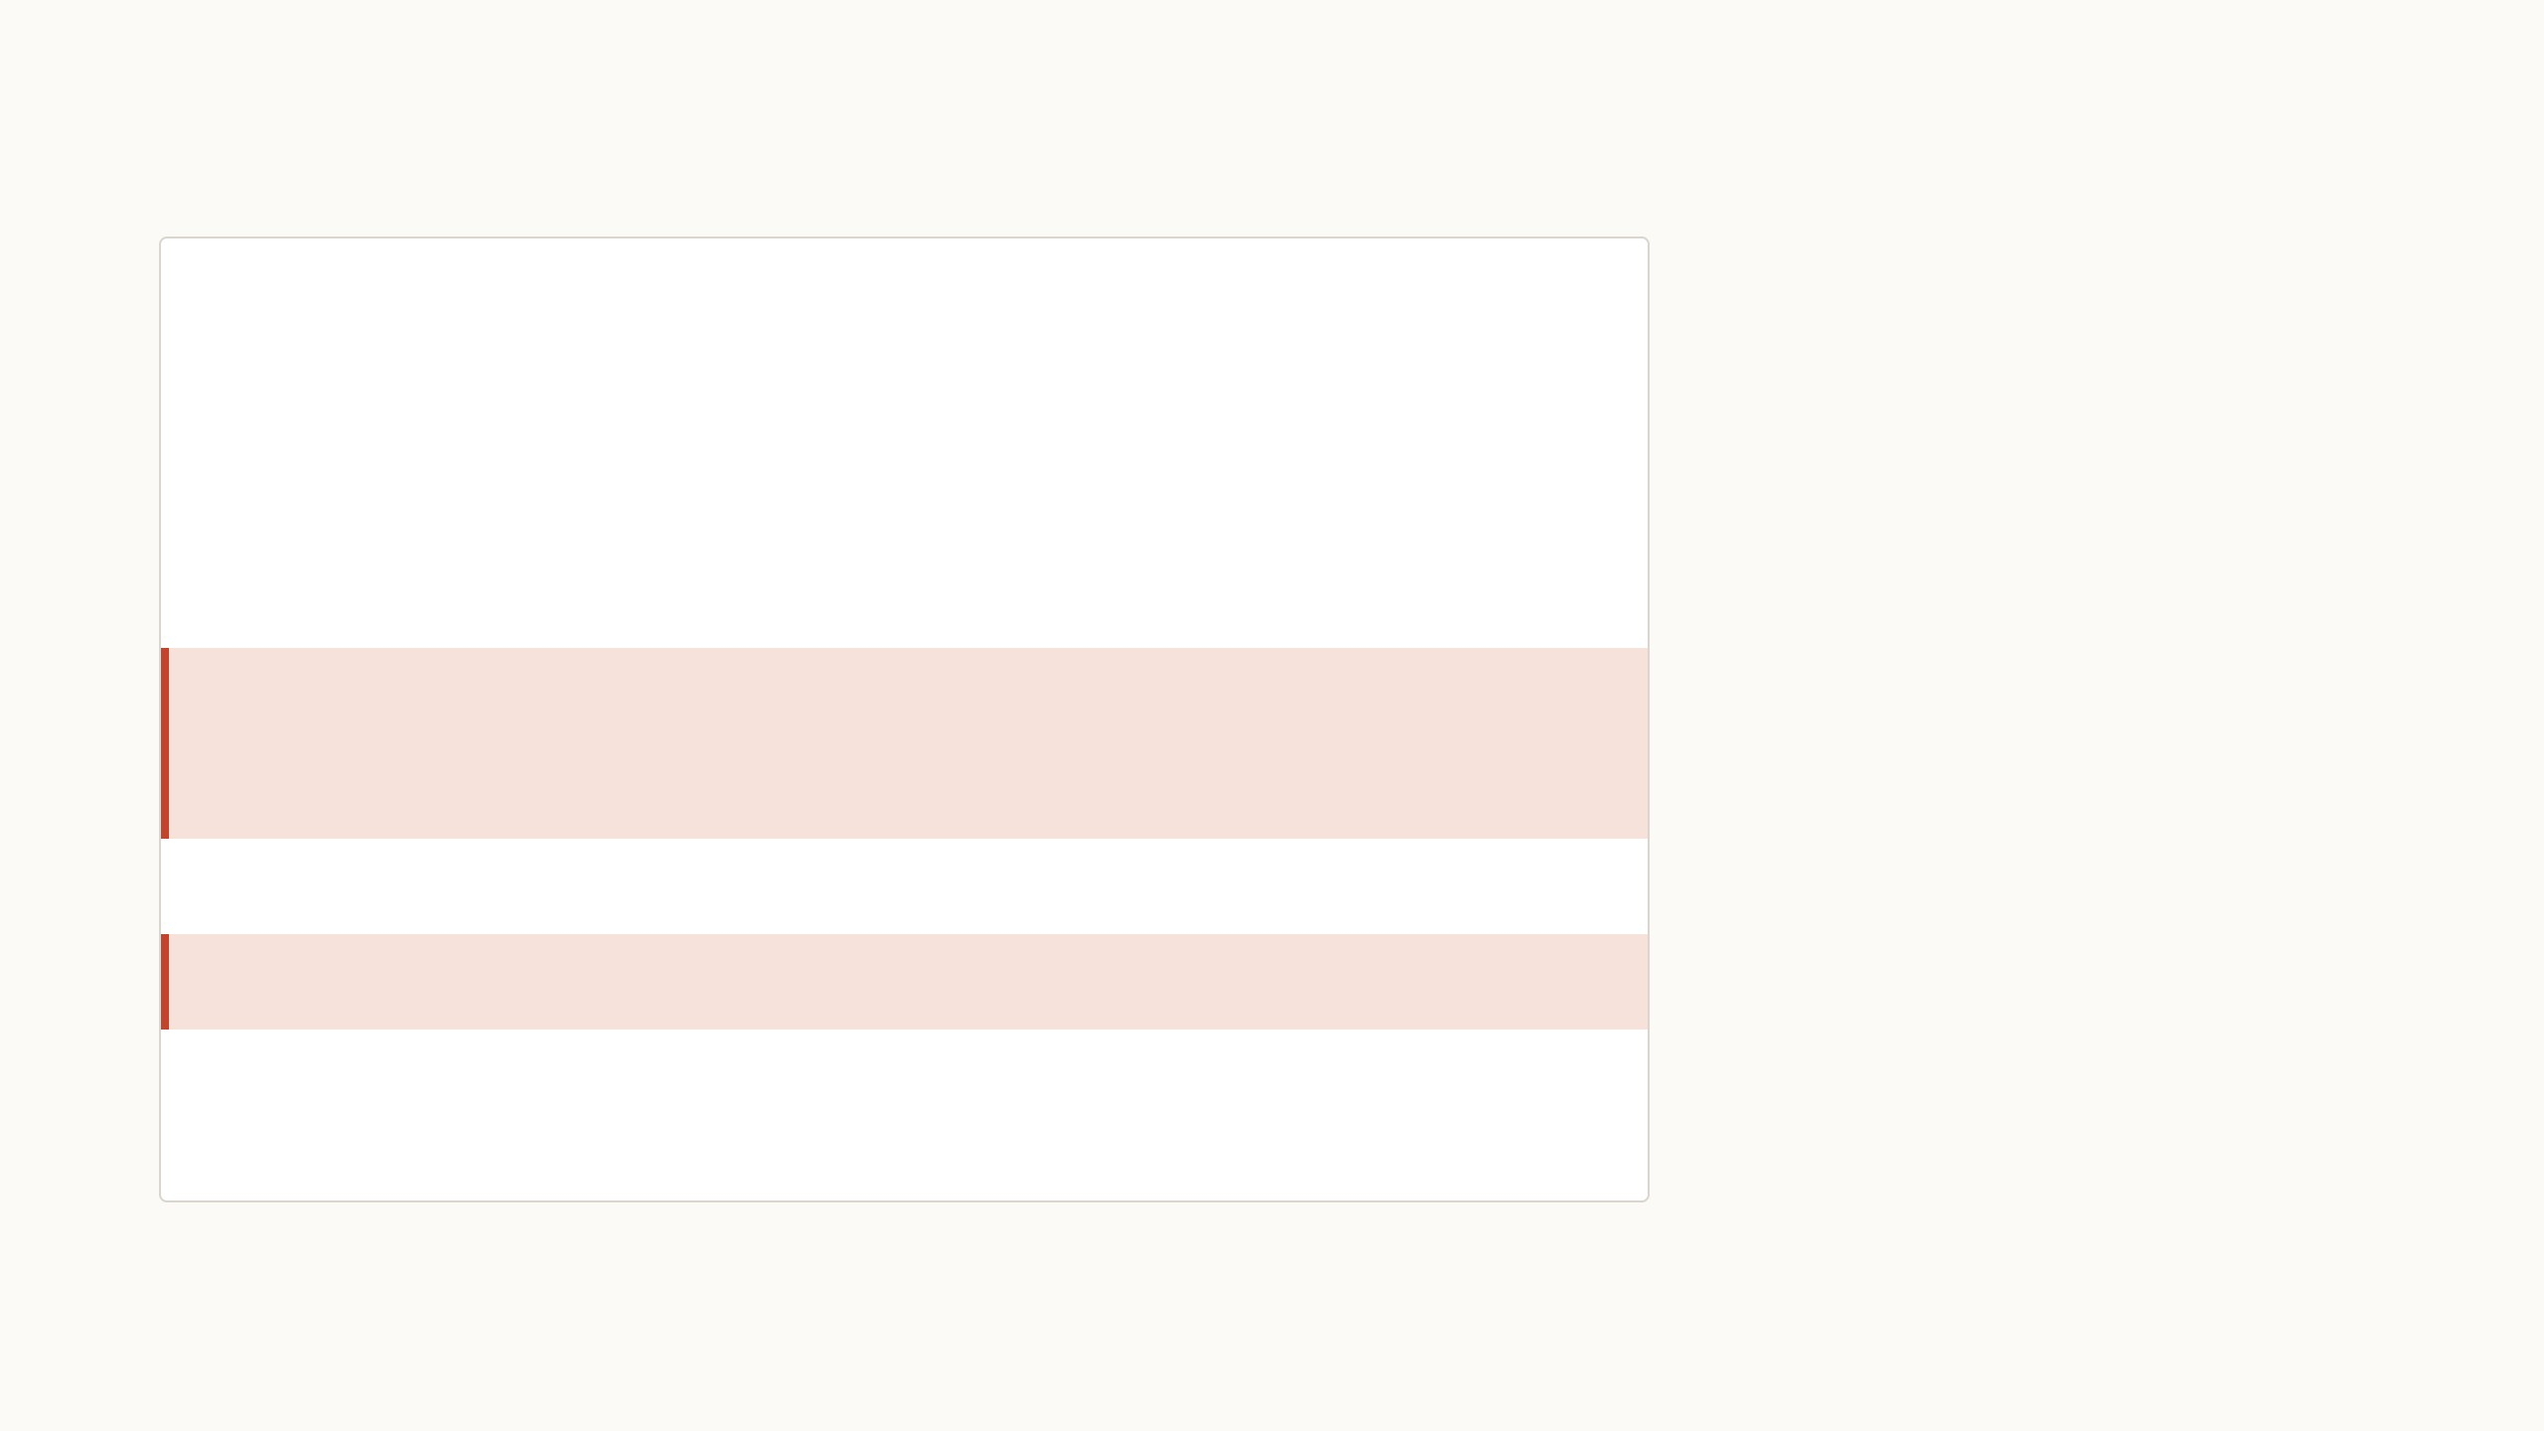
LoRA on a ViT in a few lines
B starts at zero and A at small random
values, so the first forward pass is exactly
the pretrained model.
vit = timm.create_model(BACKBONE, pretrained=True, num_classes=C)
vit.requires_grad_(False); vit.head.requires_grad_(True)
class LoRAqv(nn.Module): # wraps qkv = Linear(768, 2304)
The two new choices are the rank r and
which weights get a pair. On ViT-B, Zhang
et al. use rank 8 with AdamW at a learning
rate of 0.001 for 100 epochs.
def __init__(self, qkv, r=8, alpha=8):
super().__init__()
d = qkv.in_features
self.qkv, self.s = qkv, alpha / r # frozen W0, scale α/r
self.Aq = nn.Parameter(torch.randn(r, d) / d ** 0.5)
self.Av = nn.Parameter(torch.randn(r, d) / d ** 0.5)
After training, each pair is added into its
qkv weight once, and the model is a plain
timm ViT again.
self.Bq = nn.Parameter(torch.zeros(d, r)) # B = 0
self.Bv = nn.Parameter(torch.zeros(d, r))
def forward(self, x):
q, k, v = self.qkv(x).chunk(3, dim=-1) # W0 x
q = q + self.s * x @ self.Aq.T @ self.Bq.T # + B A x
v = v + self.s * x @ self.Av.T @ self.Bv.T
return torch.cat([q, k, v], dim=-1)
for blk in vit.blocks: blk.attn.qkv = LoRAqv(blk.attn.qkv)
My sketch for timm's ViT-B/16: 294,912 trained numbers in the pairs, and identical outputs before and after merging. Official code: loralib, github.com/microsoft/LoRA. Settings:
Hu et al. 2022, Sec. 4.1; Zhang et al. 2022, App. A.2.
12
Notes:
Not to be read line by line. timm stores query, key and value as one fused linear layer of 768 to 2304, so the wrapper splits its output into three, adds the low-rank term to the query and value parts, and puts them back. The red lines are the whole method: four small matrices per block and two additions. The blue lines are frozen. I checked it on timm's ViT-B/16: it has exactly the 294,912 trained numbers from the counting slide, and after folding B times A into the qkv weight the outputs are identical up to rounding. The recipe on ViT from the NOAH paper is ordinary: AdamW, learning rate 1e-3, cosine schedule, 100 epochs, rank 8.

Slide 29
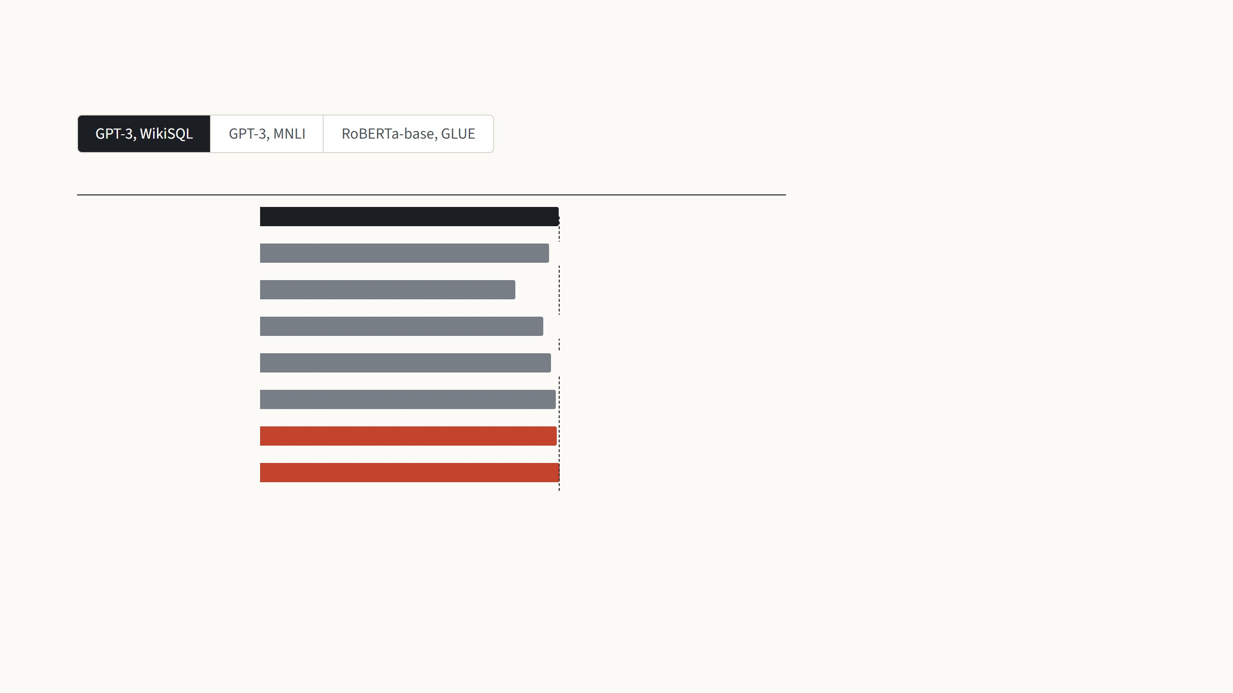
Results in the paper: language models
Validation accuracy (%)
Weights trained
WikiSQL turns a question into an SQL
query. On GPT-3, LoRA with 4.7 million
trained weights, 0.003% of the model, is
within the run-to-run noise of full fine-
tuning, and slightly above it with 37.7
million.
Full fine-tuning
73.8
175 billion
BitFit (biases)
71.3
14.2 M
Prefix-embedding
63.1
3.2 M
Prefix-layer
70.1
20.2 M
Adapter
71.9
7.1 M
The prefix methods are far behind, and the
adapter needs more weights to come
close.
Adapter
73.2
40.1 M
LoRA
73.4
4.7 M
LoRA
74.0
37.7 M
Hu et al. 2022, Table 4: GPT-3 175B, validation accuracy, noise about ±0.5. Adapter: two per block (Houlsby et al.). BitFit trains only the biases.
13
Notes:
The paper's own evidence is all language, so one slide for it. First GPT-3 175B on WikiSQL, turning a question into an SQL query. Full fine-tuning, dashed line, 73.8. LoRA with 4.7 million trained weights gets 73.4, inside the ±0.5 noise the authors report, and 74.0 with 37.7 million. The prefix methods are far behind, the adapter is close but needs more weights to get there. Second step, MNLI, deciding whether one sentence follows from another: LoRA 91.7, two points above full fine-tuning. Third, a model closer in size to ViT-B: RoBERTa-base, 125 million weights, average over the eight GLUE tasks. LoRA with 0.3 million trained weights has the best average, 87.2 against 86.4. The paper also has DeBERTa and GPT-2 results with the same message.

Slide 30
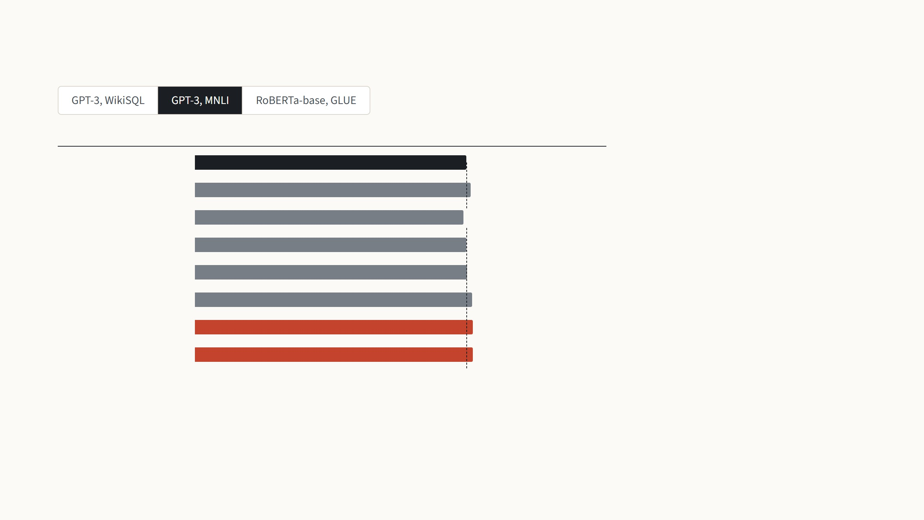
Results in the paper: language models
Validation accuracy (%)
Weights trained
MNLI asks whether one sentence follows
from another. Here LoRA is two points
above full fine-tuning, 91.7 against 89.5,
and above every other cheap method.
Full fine-tuning
89.5
175 billion
BitFit (biases)
91.0
14.2 M
Prefix-embedding
88.6
3.2 M
Prefix-layer
89.5
20.2 M
Adapter
89.8
7.1 M
Adapter
91.5
40.1 M
LoRA
91.7
4.7 M
LoRA
91.6
37.7 M
Hu et al. 2022, Table 4: GPT-3 175B, validation accuracy on MNLI-matched, noise about ±0.1. Adapter: two per block (Houlsby et al.). BitFit trains only the biases.
13
Notes:
The paper's own evidence is all language, so one slide for it. First GPT-3 175B on WikiSQL, turning a question into an SQL query. Full fine-tuning, dashed line, 73.8. LoRA with 4.7 million trained weights gets 73.4, inside the ±0.5 noise the authors report, and 74.0 with 37.7 million. The prefix methods are far behind, the adapter is close but needs more weights to get there. Second step, MNLI, deciding whether one sentence follows from another: LoRA 91.7, two points above full fine-tuning. Third, a model closer in size to ViT-B: RoBERTa-base, 125 million weights, average over the eight GLUE tasks. LoRA with 0.3 million trained weights has the best average, 87.2 against 86.4. The paper also has DeBERTa and GPT-2 results with the same message.

Slide 31
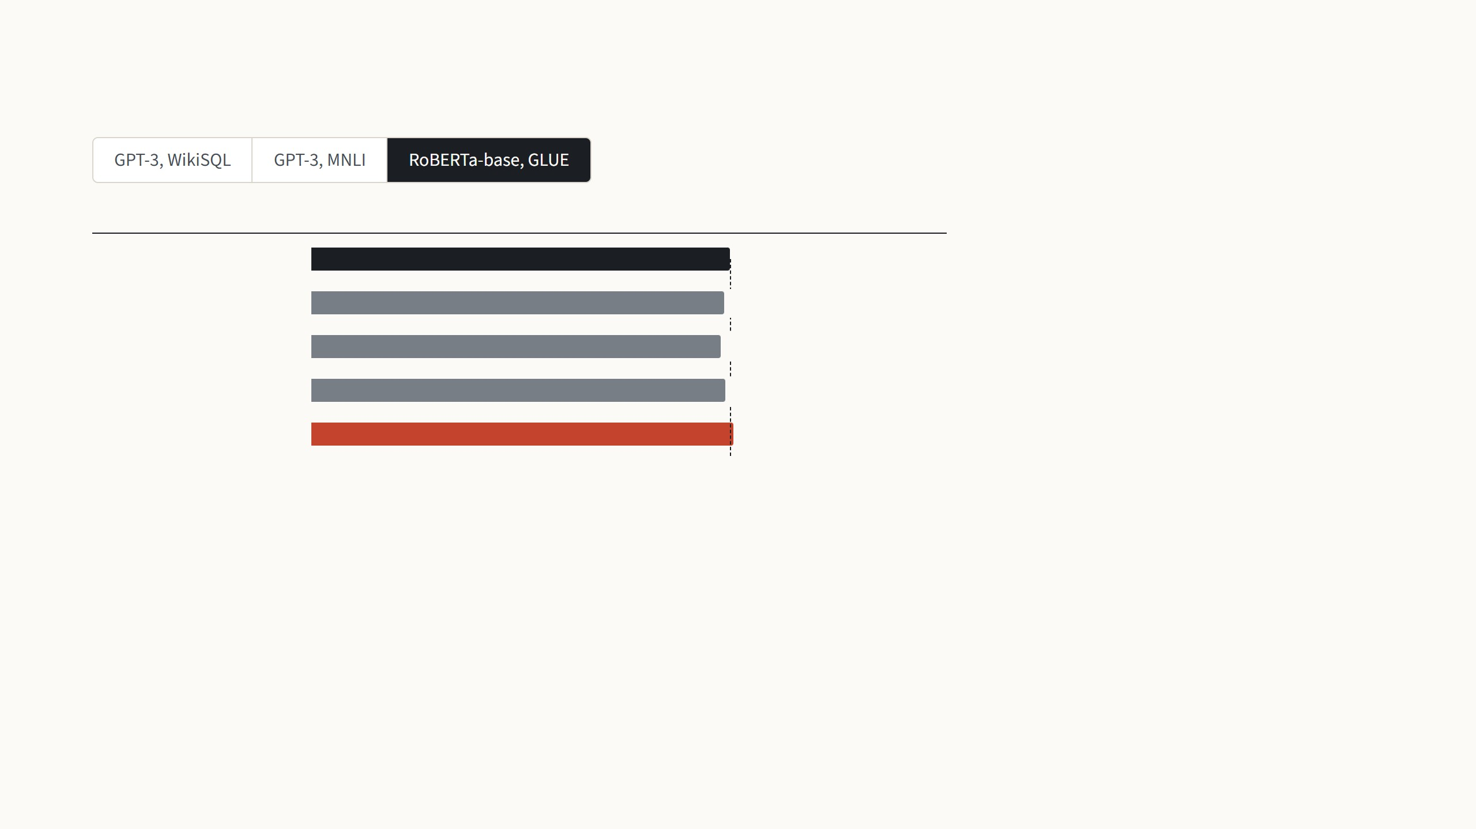
Results in the paper: language models
Mean GLUE score
Weights trained
RoBERTa-base has 125 million weights,
close to ViT-B. Averaged over the eight
GLUE language tasks, LoRA with 0.3 million
trained weights scores 87.2, against 86.4
for full fine-tuning.
Full fine-tuning
86.4
125 M
BitFit (biases)
85.2
0.1 M
AdapterDrop
84.4
0.3 M
AdapterDrop
85.4
0.9 M
LoRA
87.2
0.3 M
Hu et al. 2022, Table 2: RoBERTa-base, mean over the eight GLUE tasks. Full fine-tuning, BitFit and AdapterDrop (Rücklé et al.) as published in earlier work.
13
Notes:
The paper's own evidence is all language, so one slide for it. First GPT-3 175B on WikiSQL, turning a question into an SQL query. Full fine-tuning, dashed line, 73.8. LoRA with 4.7 million trained weights gets 73.4, inside the ±0.5 noise the authors report, and 74.0 with 37.7 million. The prefix methods are far behind, the adapter is close but needs more weights to get there. Second step, MNLI, deciding whether one sentence follows from another: LoRA 91.7, two points above full fine-tuning. Third, a model closer in size to ViT-B: RoBERTa-base, 125 million weights, average over the eight GLUE tasks. LoRA with 0.3 million trained weights has the best average, 87.2 against 86.4. The paper also has DeBERTa and GPT-2 results with the same message.

Slide 32
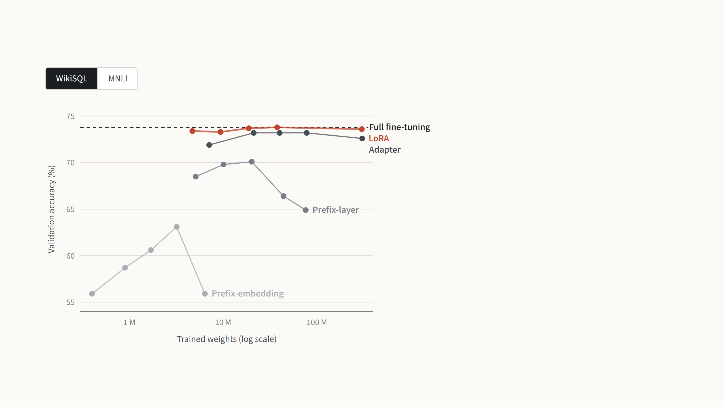
What happens when more weights are trained
Each point is one size of a method. Prefix-
embedding tuning improves up to 256
prompt tokens, then drops from 63.1 to
55.9. Prefix-layer tuning also falls after 20
million weights.
LoRA is flat from rank 1 to rank 64, at the
level of full fine-tuning.
Hu et al. 2022, Table 15 (the points of Fig. 2): GPT-3 175B, validation accuracy; LoRA with equal rank on query and value, from rank 1 to 64. Full fine-tuning trains all 175 billion
weights.
14
Notes:
Each method was run with several sizes; the x axis is the number of trained weights on a log scale. Prompt methods are not monotonic: prefix-embedding tuning improves up to 256 tokens and then falls back from 63.1 to 55.9 at 512; prefix-layer tuning peaks at 20 million weights and then drops. The authors suspect many prompt tokens push the input too far from what the model saw in pretraining. The adapter is good and stable once it has enough weights. LoRA is the flat red line at the top: rank 1 is already as good as rank 64, so the rank is an easy choice, at least here. On MNLI the same picture, with LoRA above full fine-tuning at every size.

Slide 33
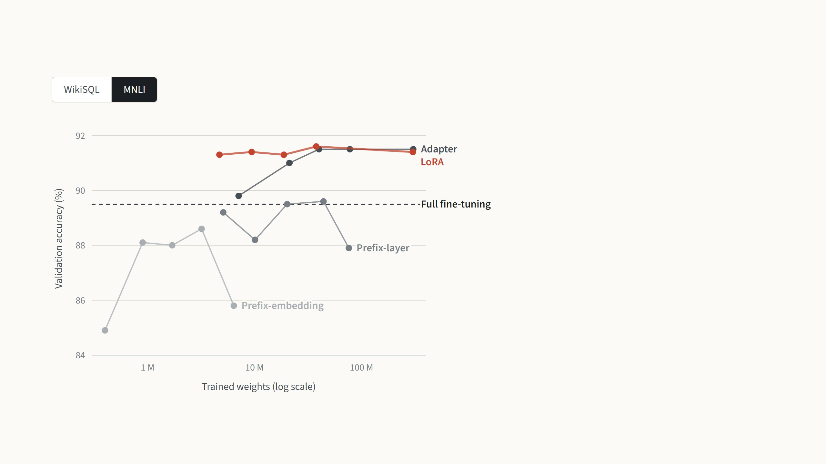
What happens when more weights are trained
On MNLI the prompt methods again rise
and fall, and the adapter needs about 40
million weights to catch up.
LoRA is above full fine-tuning at every size,
so its rank is an easy choice.
Hu et al. 2022, Table 15 (the points of Fig. 2): GPT-3 175B, validation accuracy; LoRA with equal rank on query and value, from rank 1 to 64. Full fine-tuning trains all 175 billion
weights.
14
Notes:
Each method was run with several sizes; the x axis is the number of trained weights on a log scale. Prompt methods are not monotonic: prefix-embedding tuning improves up to 256 tokens and then falls back from 63.1 to 55.9 at 512; prefix-layer tuning peaks at 20 million weights and then drops. The authors suspect many prompt tokens push the input too far from what the model saw in pretraining. The adapter is good and stable once it has enough weights. LoRA is the flat red line at the top: rank 1 is already as good as rank 64, so the rank is an easy choice, at least here. On MNLI the same picture, with LoRA above full fine-tuning at every size.

Slide 34

Which weight matrices to adapt
Validation accuracy (%)
Rank
Every LoRA row trains the same 18 million
weights. Putting them all into the query or
the key weight is about three points worse
than spreading them over query and value
at rank 4.
Full fine-tuning
73.8
One weight type
Query
70.4
8
Key
70.0
8
Value
73.0
8
Adapting all four at rank 2 does as well, so
it pays to adapt more matrices with a
smaller rank.
Output
73.2
8
Two weight types
Query and key
71.4
4
Query and value
73.7
4
Four weight types
All four
73.7
2
Hu et al. 2022, Table 5: GPT-3 175B with the same 18 million trained weights in every LoRA row, validation accuracy (noise ±0.5 on WikiSQL, ±0.1 on MNLI). Full fine-tuning: Table
4.
15
Notes:
A fixed budget of 18 million trained weights, 35 MB, spent in different ways. One weight type at rank 8: the query or the key alone is clearly worse, about three points on WikiSQL. Two types at rank 4: query and value is the best combination. All four at rank 2 is as good. The conclusion the authors draw: it is better to adapt more weight matrices with a smaller rank than one matrix with a large rank, which is also a hint that rank 4 already holds what each matrix needs. This is why query and value became the default, including on ViT.

Slide 35
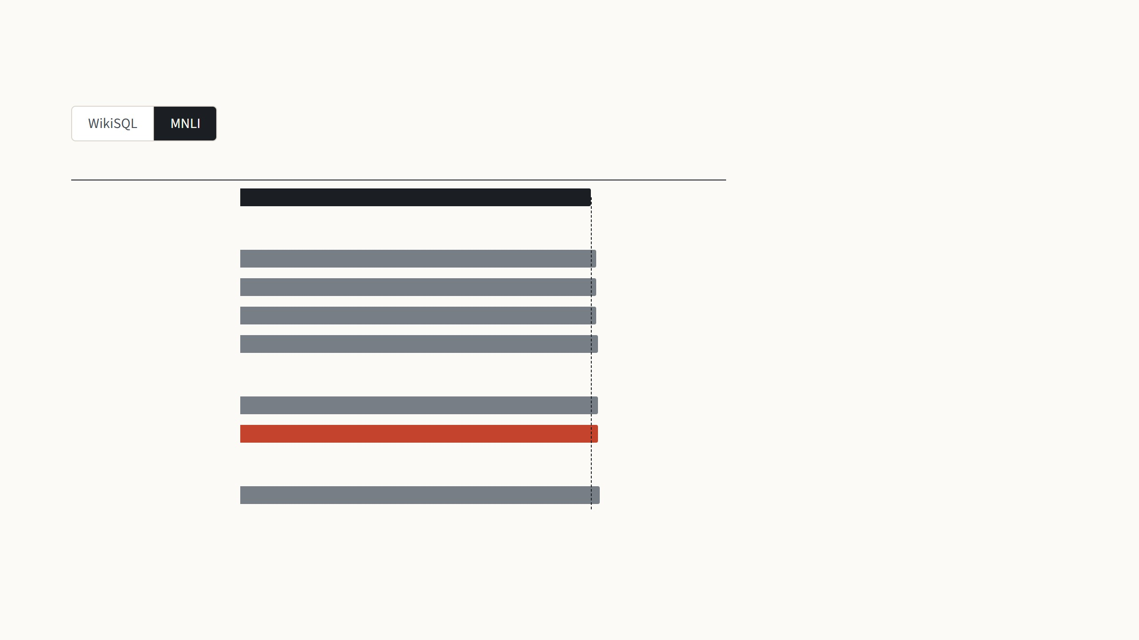
Which weight matrices to adapt
Validation accuracy (%)
Rank
On MNLI the differences are smaller, but
the order is similar: the query or key alone
is lowest, and all four at rank 2 is highest,
91.7.
Full fine-tuning
89.5
One weight type
Query
91.0
8
Key
90.8
8
Every LoRA setting is above full fine-tuning
here.
Value
91.0
8
Output
91.3
8
Two weight types
Query and key
91.3
4
Query and value
91.3
4
Four weight types
All four
91.7
2
Hu et al. 2022, Table 5: GPT-3 175B with the same 18 million trained weights in every LoRA row, validation accuracy (noise ±0.5 on WikiSQL, ±0.1 on MNLI). Full fine-tuning: Table
4.
15
Notes:
A fixed budget of 18 million trained weights, 35 MB, spent in different ways. One weight type at rank 8: the query or the key alone is clearly worse, about three points on WikiSQL. Two types at rank 4: query and value is the best combination. All four at rank 2 is as good. The conclusion the authors draw: it is better to adapt more weight matrices with a smaller rank than one matrix with a large rank, which is also a hint that rank 4 already holds what each matrix needs. This is why query and value became the default, including on ViT.

Slide 36
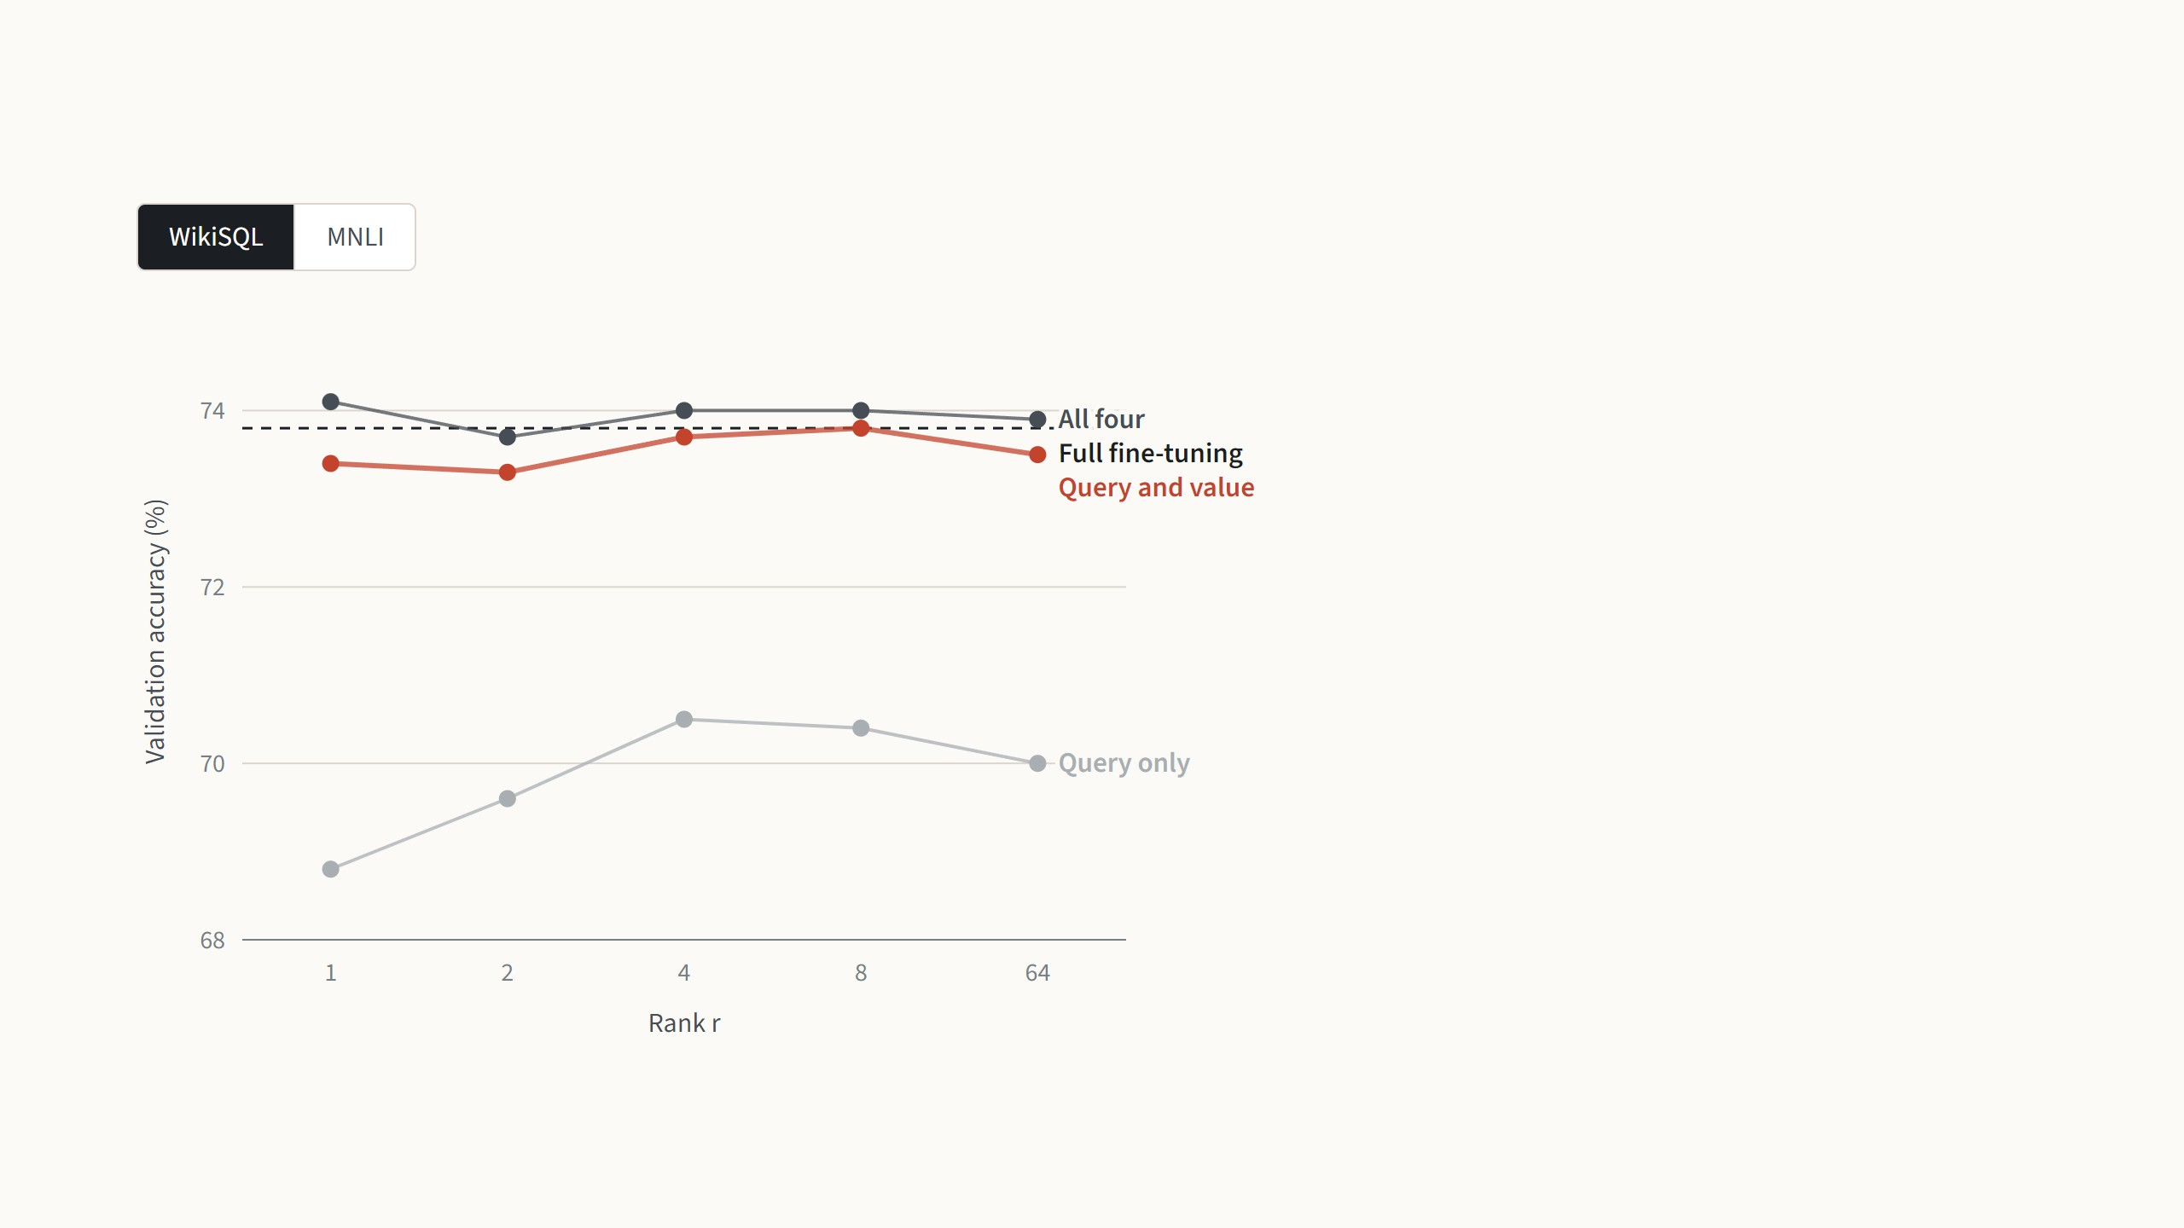
How small the rank can be
With the query and value weights
together, rank 1 already gives 73.4, and no
rank does better than 73.8, inside the
noise of ±0.5.
The query weight alone needs rank 4 to
reach its best, and stays three points
lower.
Hu et al. 2022, Table 6: GPT-3 175B, validation accuracy at five ranks; noise ±0.5 on WikiSQL and ±0.1 on MNLI. On GPT-2 the best rank was between 4 and 16 (App. H.2).
16
Notes:
Five ranks, one dot each; the lines only connect the settings that were run. The surprise of the paper: for query and value together, rank 1 is as good as rank 64 on both tasks; the spread across ranks is at most 0.4 points on WikiSQL, inside its noise, and 0.3 on MNLI. The query weight alone is the exception, it needs rank 4 or more on WikiSQL. The authors are careful: they do not expect a tiny rank to work for every task. If the new task were in a different language than pretraining, retraining everything would likely win. On the smaller GPT-2 the best rank was 4 to 16. For ViT, NOAH used rank 8, which is the setting we will see.

Slide 37
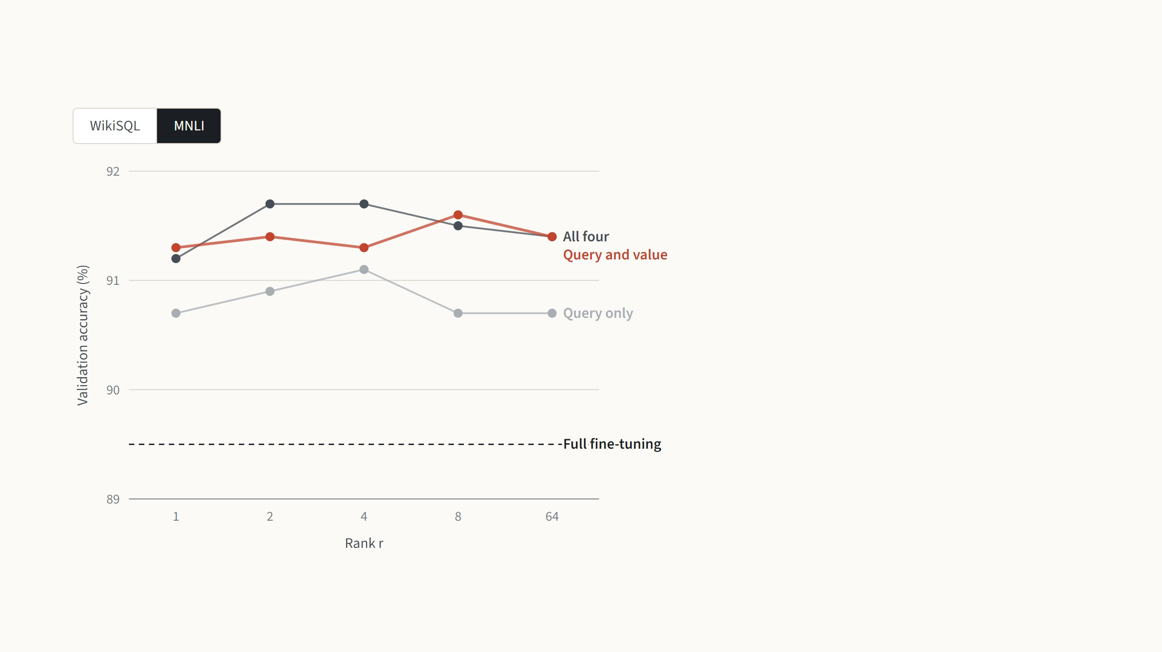
How small the rank can be
On MNLI, too, rank 1 for query and value is
within 0.3 points of the best rank.
So the change fine-tuning needs has very
few real directions, at least on GPT-3.
Hu et al. 2022, Table 6: GPT-3 175B, validation accuracy at five ranks; noise ±0.5 on WikiSQL and ±0.1 on MNLI. On GPT-2 the best rank was between 4 and 16 (App. H.2).
16
Notes:
Five ranks, one dot each; the lines only connect the settings that were run. The surprise of the paper: for query and value together, rank 1 is as good as rank 64 on both tasks; the spread across ranks is at most 0.4 points on WikiSQL, inside its noise, and 0.3 on MNLI. The query weight alone is the exception, it needs rank 4 or more on WikiSQL. The authors are careful: they do not expect a tiny rank to work for every task. If the new task were in a different language than pretraining, retraining everything would likely win. On the smaller GPT-2 the best rank was 4 to 16. For ViT, NOAH used rank 8, which is the setting we will see.

Slide 38
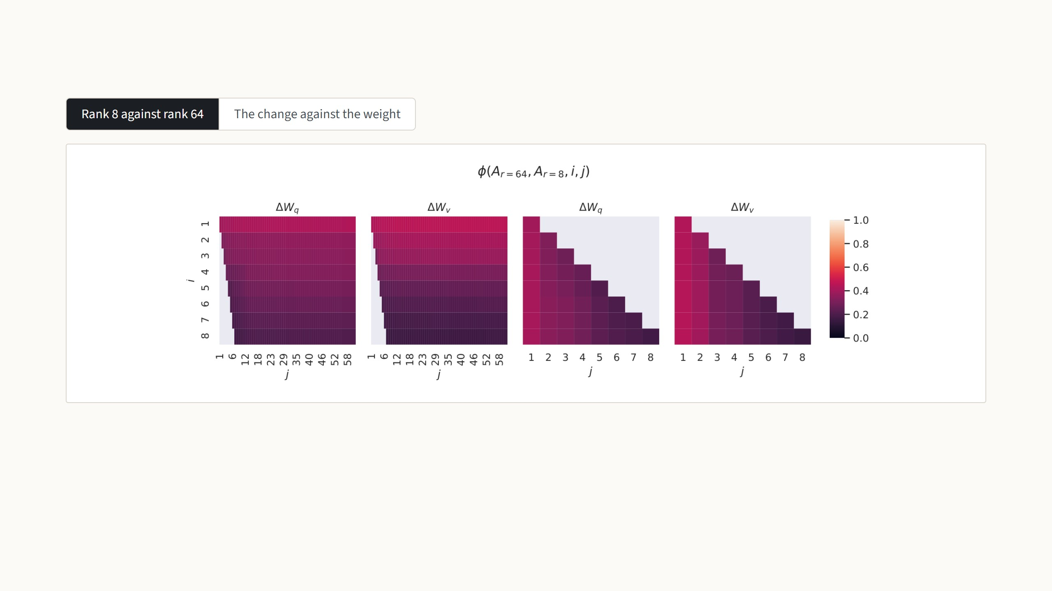
Why a small rank is enough
The authors trained rank 8 and rank 64 separately and compared the directions each learned. Bright means the two runs found
the same direction. Only the first direction is clearly shared, with similarity above 0.5, and the rest overlap little, so most of the
extra rank holds noise.
Hu et al. 2022, Fig. 3 (layer 48 of 96, GPT-3; values are normalized subspace similarity, 0 to 1) and Table 7 (rank 4, Frobenius norms).
17
Notes:
Section 7 asks why this works. First analysis: train rank 8 and rank 64 on the same task, take the directions each one learned, and measure how much the top i directions of one lie inside the top j of the other. In the heat maps rows are rank-8 directions, columns rank-64 directions; colour is overlap from 0 to 1. Only the first row lights up: both runs agree on one direction and disagree on the rest, so the useful part of the change is about one-dimensional and the rest is noise that training accumulates. That explains rank 1 working. Press the arrow key for the second analysis, Table 7. Project the pretrained weight onto the four directions of the learned change: 0.32, small, though larger than for random directions, 0.02. Its own top directions are 21.67, so the change is not about what the model already does strongly. The change itself has strength 6.91 in those directions, an amplification of about 21. The authors' reading: LoRA amplifies features that pretraining learned but did not emphasise, and the task needs. This is measured on GPT-3; nobody in these papers repeats it for ViT.

Slide 39
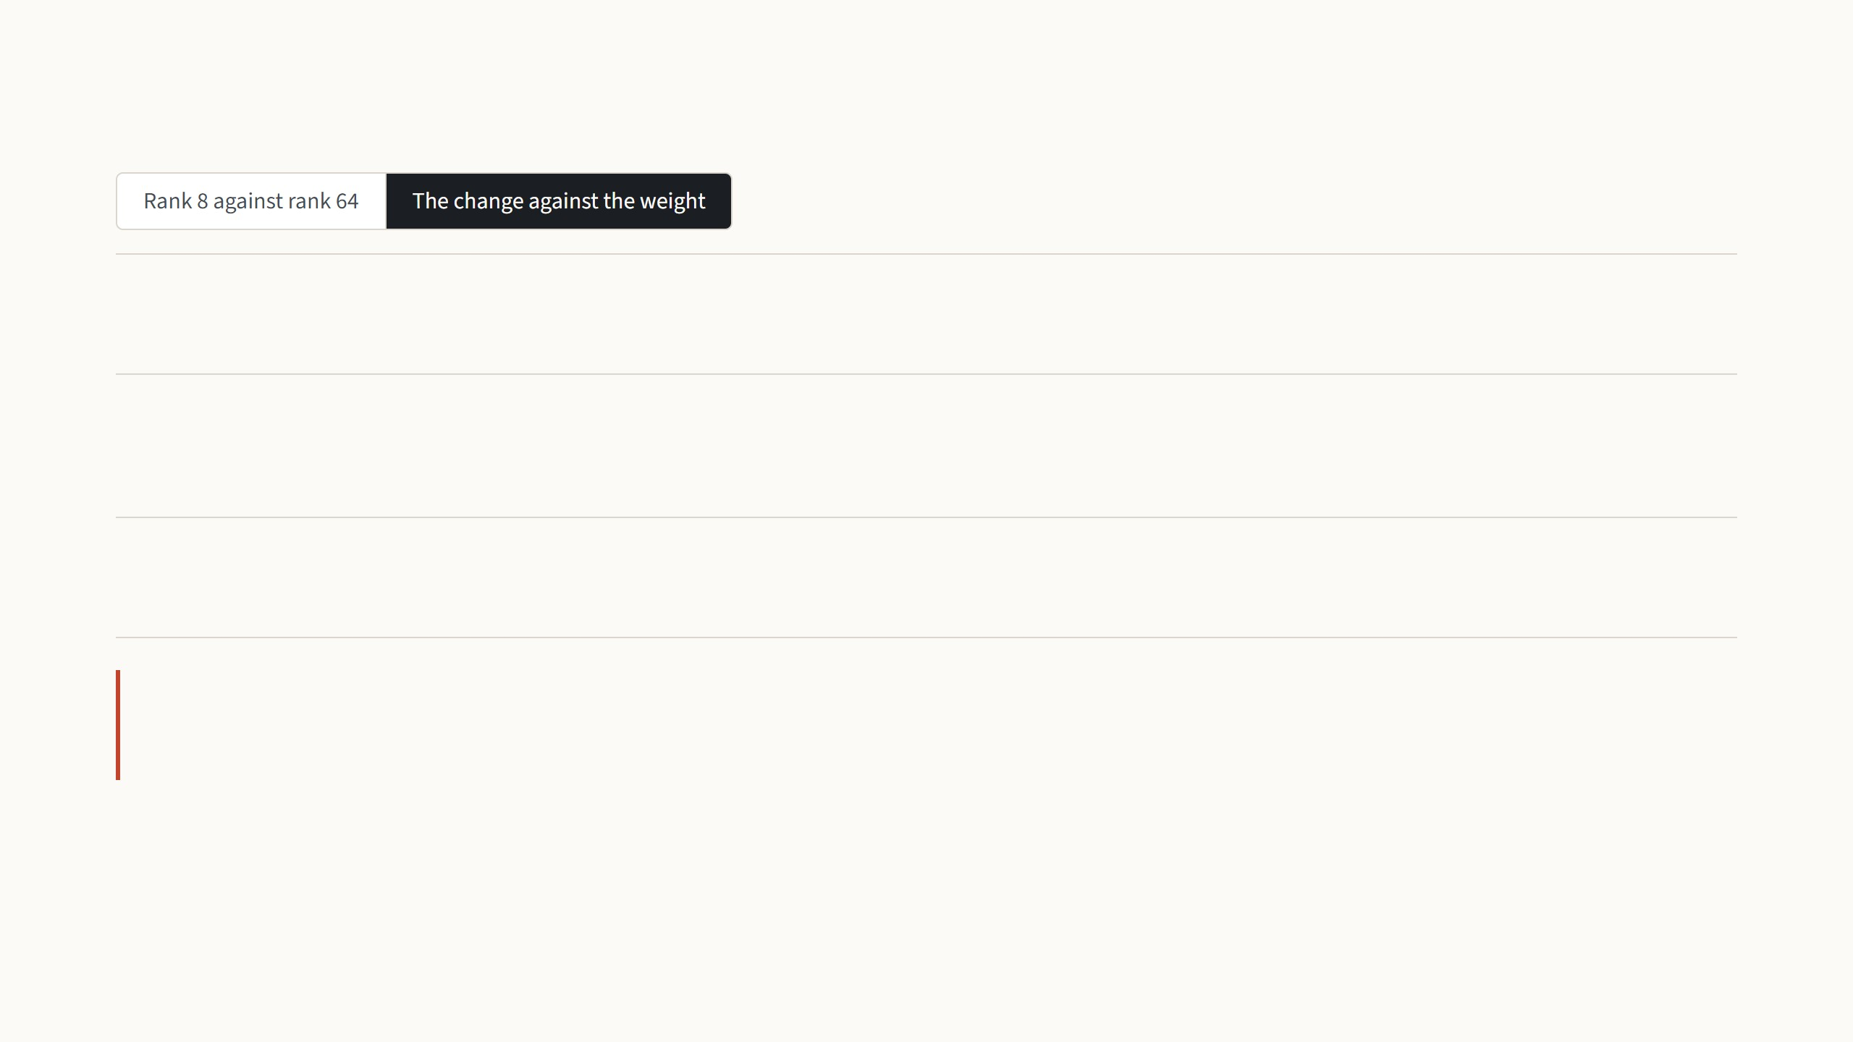
Why a small rank is enough
21.67
is how strongly the pretrained weight Wq acts along its own top 4 directions.
0.32
is how strongly it acts along the 4 directions of the learned change ΔWq: weak, but more than the 0.02 of
random directions.
6.91
is the strength of the change along those directions, about 21 times what the pretrained weight had there.
The change does not repeat what the model already does. It strongly amplifies directions the model
learned in pretraining but used weakly.
Hu et al. 2022, Fig. 3 (layer 48 of 96, GPT-3; values are normalized subspace similarity, 0 to 1) and Table 7 (rank 4, Frobenius norms).
17
Notes:
Section 7 asks why this works. First analysis: train rank 8 and rank 64 on the same task, take the directions each one learned, and measure how much the top i directions of one lie inside the top j of the other. In the heat maps rows are rank-8 directions, columns rank-64 directions; colour is overlap from 0 to 1. Only the first row lights up: both runs agree on one direction and disagree on the rest, so the useful part of the change is about one-dimensional and the rest is noise that training accumulates. That explains rank 1 working. Press the arrow key for the second analysis, Table 7. Project the pretrained weight onto the four directions of the learned change: 0.32, small, though larger than for random directions, 0.02. Its own top directions are 21.67, so the change is not about what the model already does strongly. The change itself has strength 6.91 in those directions, an amplification of about 21. The authors' reading: LoRA amplifies features that pretraining learned but did not emphasise, and the task needs. This is measured on GPT-3; nobody in these papers repeats it for ViT.

Slide 40
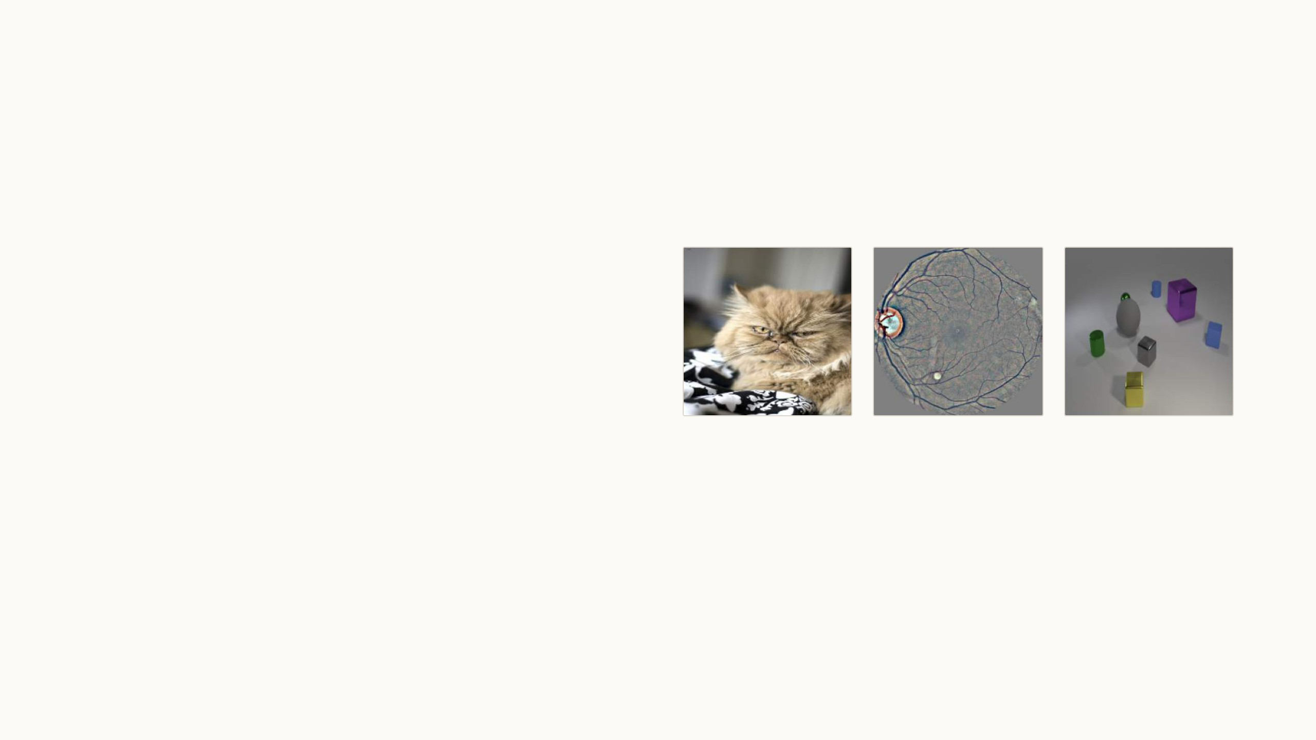
LoRA on images
The paper itself has no image experiments.
Vision groups tested it next, first on the same 19
VTAB-1k tasks as VPT, then on medical images.
Both use a ViT-B/16, so the numbers sit next to
last time's.
Natural
Specialized
Structured
18
Notes:
Second half. Everything so far was the LoRA paper, and its experiments are all on language models. Two papers bring it to images. NOAH, from NTU Singapore in 2022, re-ran LoRA, adapters and VPT on the same ViT-B/16 and the same VTAB-1k benchmark as the VPT paper, which gives a fair three-way comparison. MeLo, at ISBI 2024, applies LoRA to medical image classification. The three images are one example from each VTAB group, the same groups as last time.

Slide 41
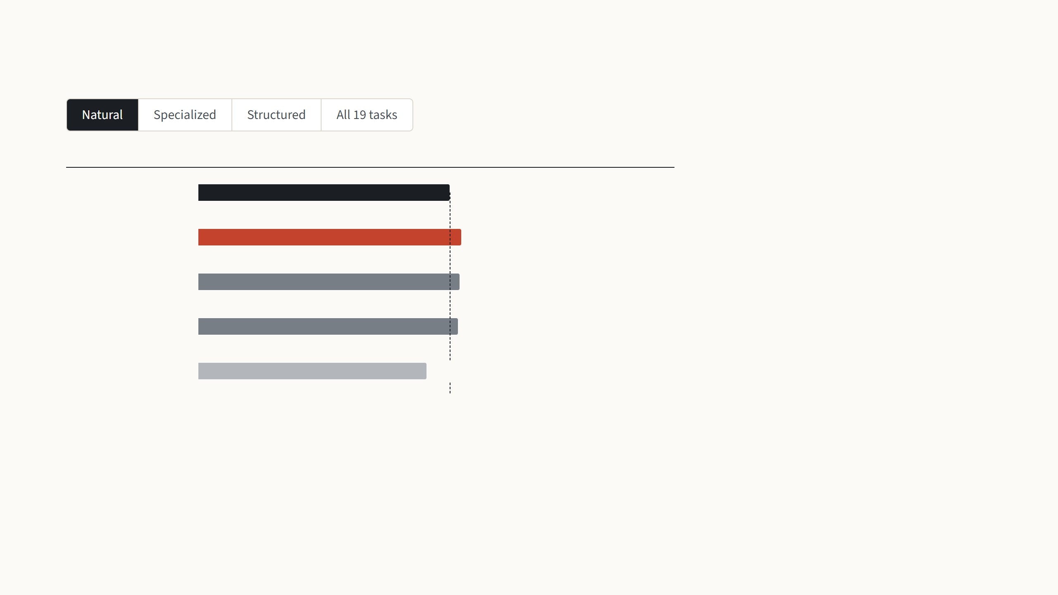
LoRA, VPT and adapters on the same ViT
Mean test accuracy (%)
Beats full fine-tuning on
Ordinary photos, with 1,000 training
images per task. LoRA, the adapter and
VPT-deep all beat full fine-tuning by two to
four points, and LoRA is narrowly the best.
Full fine-tuning
75.9
LoRA
79.5
5 of 7 tasks
Adapter
79.0
6 of 7 tasks
VPT-deep
78.5
6 of 7 tasks
Linear probe
68.9
1 of 7 tasks
Zhang et al. 2022, Table 1: ViT-B/16 pretrained on ImageNet-21k, VTAB-1k test accuracy. LoRA (rank 8) and the adapter were trained by Zhang et al.; the other rows are Jia et al.
2022, Table 1. Group means computed from the per-task values; "all 19" is the mean of the three groups.
19
Notes:
Same backbone and benchmark as the VPT talk: 1,000 training images per task, three groups. The adapter here is NOAH's re-run with the best recipe, which is much stronger than the adapter in the VPT paper's table. Natural: all three cheap methods are two to four points above full fine-tuning, LoRA narrowly best, 79.5. Specialized: LoRA 84.6 and the adapter 84.1 are slightly above full fine-tuning at 83.4; VPT-deep is a point below. Structured: the big gap again, all three beat full fine-tuning on all eight tasks, LoRA the most, 59.8 against 47.6. All 19: LoRA 74.6, adapter 73.9, VPT-deep 72.0, full 69.0. VPT-deep beats full fine-tuning on one more task, 16 against 15, but by smaller margins. Two caveats if asked: NOAH's table prints 87.2 for full fine-tuning on Flowers where the VPT paper has 97.2, so I used the VPT paper's numbers for those rows; and NOAH prints 74.5 for LoRA's average, while its own per-task numbers give 74.6.

Slide 42
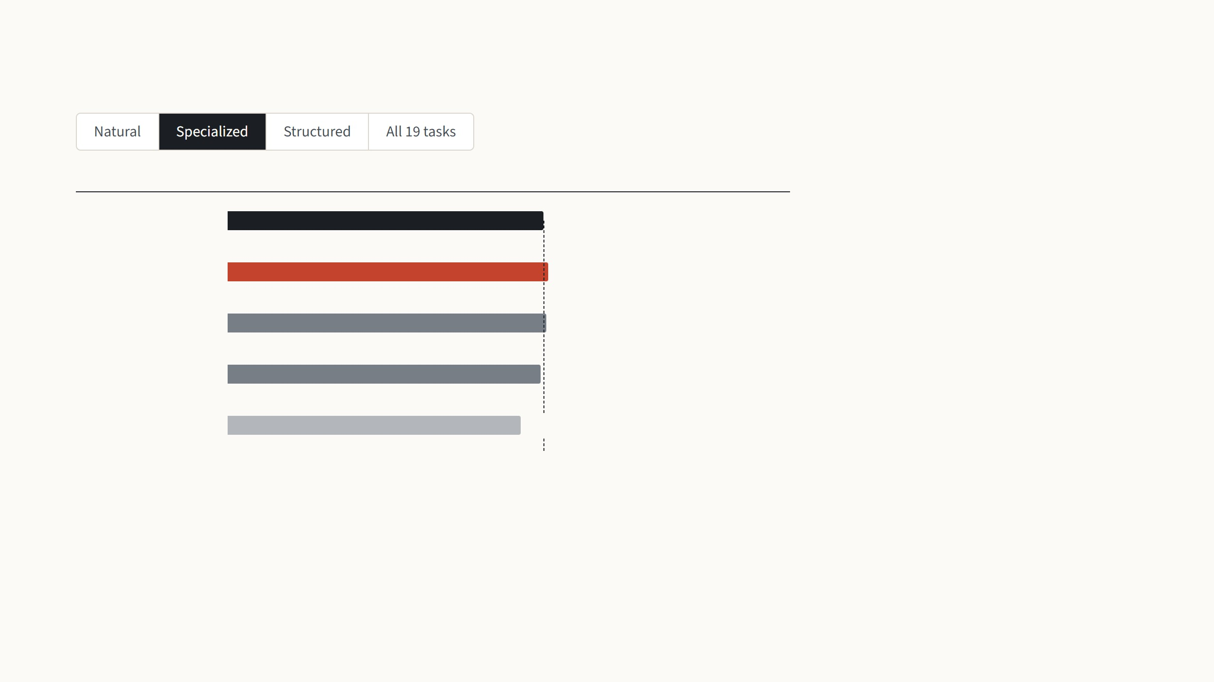
LoRA, VPT and adapters on the same ViT
Mean test accuracy (%)
Beats full fine-tuning on
Satellite, microscope and retina images.
LoRA and the adapter are slightly above
full fine-tuning, 84.6 and 84.1 against 83.4,
while VPT-deep is a point below.
Full fine-tuning
83.4
LoRA
84.6
2 of 4 tasks
Adapter
84.1
2 of 4 tasks
VPT-deep
82.4
2 of 4 tasks
Linear probe
77.2
1 of 4 tasks
Zhang et al. 2022, Table 1: ViT-B/16 pretrained on ImageNet-21k, VTAB-1k test accuracy. LoRA (rank 8) and the adapter were trained by Zhang et al.; the other rows are Jia et al.
2022, Table 1. Group means computed from the per-task values; "all 19" is the mean of the three groups.
19
Notes:
Same backbone and benchmark as the VPT talk: 1,000 training images per task, three groups. The adapter here is NOAH's re-run with the best recipe, which is much stronger than the adapter in the VPT paper's table. Natural: all three cheap methods are two to four points above full fine-tuning, LoRA narrowly best, 79.5. Specialized: LoRA 84.6 and the adapter 84.1 are slightly above full fine-tuning at 83.4; VPT-deep is a point below. Structured: the big gap again, all three beat full fine-tuning on all eight tasks, LoRA the most, 59.8 against 47.6. All 19: LoRA 74.6, adapter 73.9, VPT-deep 72.0, full 69.0. VPT-deep beats full fine-tuning on one more task, 16 against 15, but by smaller margins. Two caveats if asked: NOAH's table prints 87.2 for full fine-tuning on Flowers where the VPT paper has 97.2, so I used the VPT paper's numbers for those rows; and NOAH prints 74.5 for LoRA's average, while its own per-task numbers give 74.6.

Slide 43
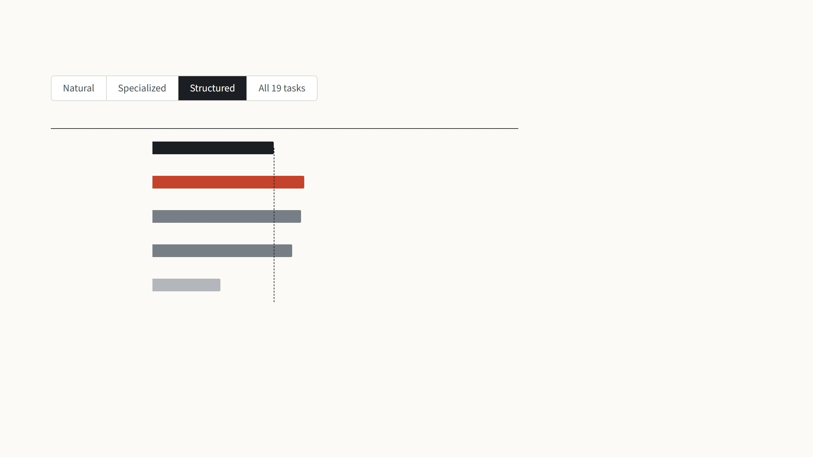
LoRA, VPT and adapters on the same ViT
Mean test accuracy (%)
Beats full fine-tuning on
Counting, distances and angles, far from
ImageNet. All three cheap methods beat
full fine-tuning on all eight tasks, LoRA by
the most: 59.8 against 47.6, with VPT-deep
at 55.0.
Full fine-tuning
47.6
LoRA
59.8
8 of 8 tasks
Adapter
58.5
8 of 8 tasks
VPT-deep
55.0
8 of 8 tasks
Linear probe
26.8
0 of 8 tasks
Zhang et al. 2022, Table 1: ViT-B/16 pretrained on ImageNet-21k, VTAB-1k test accuracy. LoRA (rank 8) and the adapter were trained by Zhang et al.; the other rows are Jia et al.
2022, Table 1. Group means computed from the per-task values; "all 19" is the mean of the three groups.
19
Notes:
Same backbone and benchmark as the VPT talk: 1,000 training images per task, three groups. The adapter here is NOAH's re-run with the best recipe, which is much stronger than the adapter in the VPT paper's table. Natural: all three cheap methods are two to four points above full fine-tuning, LoRA narrowly best, 79.5. Specialized: LoRA 84.6 and the adapter 84.1 are slightly above full fine-tuning at 83.4; VPT-deep is a point below. Structured: the big gap again, all three beat full fine-tuning on all eight tasks, LoRA the most, 59.8 against 47.6. All 19: LoRA 74.6, adapter 73.9, VPT-deep 72.0, full 69.0. VPT-deep beats full fine-tuning on one more task, 16 against 15, but by smaller margins. Two caveats if asked: NOAH's table prints 87.2 for full fine-tuning on Flowers where the VPT paper has 97.2, so I used the VPT paper's numbers for those rows; and NOAH prints 74.5 for LoRA's average, while its own per-task numbers give 74.6.

Slide 44
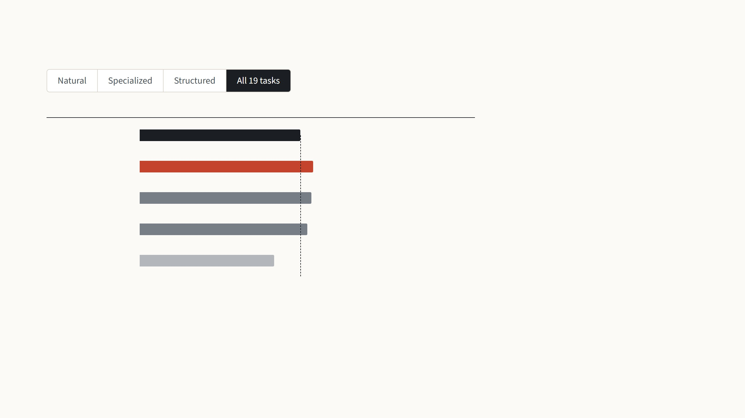
LoRA, VPT and adapters on the same ViT
Mean test accuracy (%)
Beats full fine-tuning on
Over all three groups LoRA reaches 74.6,
VPT-deep 72.0 and full fine-tuning 69.0.
Full fine-tuning
69.0
LoRA trains 0.29 million weights here and
VPT-deep 0.64 million on average, so LoRA
is both smaller and more accurate.
LoRA
74.6
15 of 19 tasks
Adapter
73.9
16 of 19 tasks
VPT-deep
72.0
16 of 19 tasks
Linear probe
57.6
2 of 19 tasks
Zhang et al. 2022, Table 1: ViT-B/16 pretrained on ImageNet-21k, VTAB-1k test accuracy. LoRA (rank 8) and the adapter were trained by Zhang et al.; the other rows are Jia et al.
2022, Table 1. Group means computed from the per-task values; "all 19" is the mean of the three groups.
19
Notes:
Same backbone and benchmark as the VPT talk: 1,000 training images per task, three groups. The adapter here is NOAH's re-run with the best recipe, which is much stronger than the adapter in the VPT paper's table. Natural: all three cheap methods are two to four points above full fine-tuning, LoRA narrowly best, 79.5. Specialized: LoRA 84.6 and the adapter 84.1 are slightly above full fine-tuning at 83.4; VPT-deep is a point below. Structured: the big gap again, all three beat full fine-tuning on all eight tasks, LoRA the most, 59.8 against 47.6. All 19: LoRA 74.6, adapter 73.9, VPT-deep 72.0, full 69.0. VPT-deep beats full fine-tuning on one more task, 16 against 15, but by smaller margins. Two caveats if asked: NOAH's table prints 87.2 for full fine-tuning on Flowers where the VPT paper has 97.2, so I used the VPT paper's numbers for those rows; and NOAH prints 74.5 for LoRA's average, while its own per-task numbers give 74.6.

Slide 45
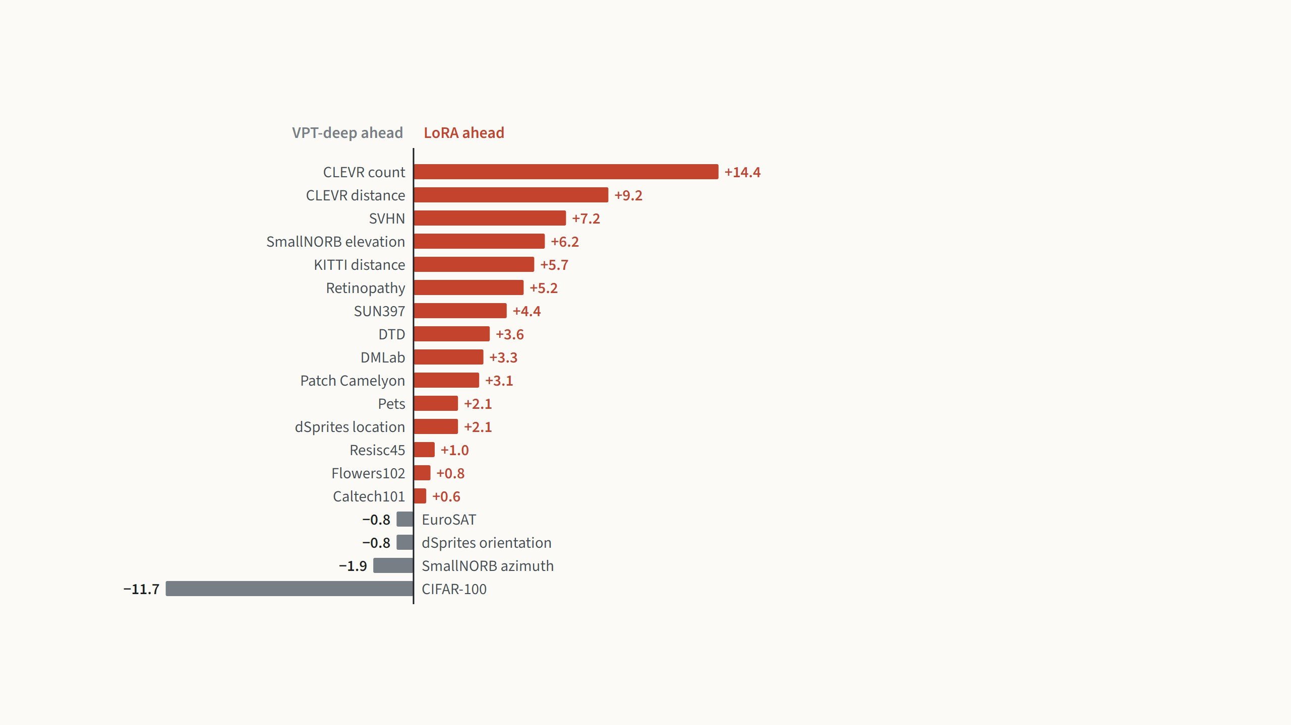
Neither LoRA nor VPT wins every task
LoRA is ahead on 15 of the 19 tasks, by up to
14 points on counting objects in CLEVR. VPT-
deep is ahead on 4, and on CIFAR-100 by 12
points.
Zhang et al. conclude that no single method
fits every task. Their method, NOAH,
searches for a mix of LoRA, adapter and
prompts per task, and reaches 75.5 on
average.
Zhang et al. 2022, Table 1: per-task test accuracy of LoRA minus VPT-deep on VTAB-1k, ViT-B/16. Right of the line, LoRA is ahead.
20
Notes:
The averages hide a lot of spread, so here is every task. Right of the axis, in red, LoRA is better; left, in grey, VPT-deep. LoRA's biggest wins are in the Structured group: counting in CLEVR, distances in CLEVR and KITTI, elevation in SmallNORB, and SVHN digits. VPT's one large win is CIFAR-100, 78.8 against 67.1, which is odd for a natural-image task; NOAH's own result there is also low, 69.6, so it may be a recipe issue in the re-runs rather than a property of LoRA. The authors' answer to this spread is NOAH: put all three modules in every block and search for their sizes per dataset; it gains about one point over LoRA, at the cost of a search. For us the lesson is simpler: LoRA is the stronger single choice on this benchmark, not a universal winner.

Slide 46
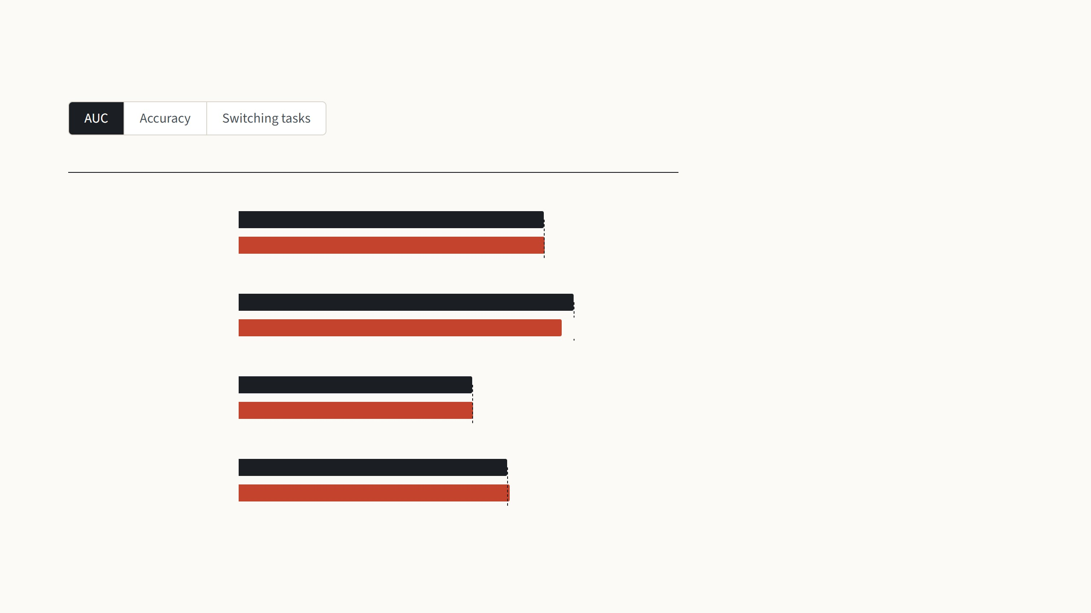
LoRA on medical images
Test AUC (%)
MeLo adds LoRA pairs of rank 4 to the query
and value weights of an ImageNet ViT-B,
training 0.14 million weights, 0.17% of the
model.
Chest X-ray: tuberculosis, 2 classes
Full fine-tuning
89.4
LoRA (MeLo)
89.8
Its AUC is within a point of full fine-tuning on
three tasks and 3.6 points lower on blood
cells.
Microscopy: blood cell type, 4 classes
Full fine-tuning
98.3
LoRA (MeLo)
94.7
Mammography: malignancy, 2 classes
Full fine-tuning
68.4
LoRA (MeLo)
68.7
Chest X-ray: 14 diseases
Full fine-tuning
78.8
LoRA (MeLo)
79.4
Zhu et al. 2024 (MeLo, ISBI), Table 1: ViT-B pretrained on ImageNet, LoRA rank 4 on query and value, single runs on their own test splits. The 14-disease task is multi-label.
21
Notes:
MeLo, ISBI 2024, from ShanghaiTech and Shanghai Jiao Tong: LoRA with rank 4 on the query and value weights of a ViT-B pretrained on ImageNet, applied to four medical tasks: tuberculosis on chest X-rays, four blood cell types, malignancy in mammograms, and 14 thoracic diseases. They train 0.14 million weights, 0.17%. AUC first: within a point of full fine-tuning on three tasks, 3.6 points lower on blood cells. Accuracy, second step: ahead on tuberculosis and blood cells, slightly behind on the other two. The title says "better than fine-tuning", but these are single runs on small test sets, about 80 mammograms for INbreast, so I would read it as "about the same". Third step is their real point, deployment, with a giant CLIP ViT: 25 images from each task in random order. Reloading the right fine-tuned copy for each image takes 218 s for 100 images; keeping all four copies loaded is fast but needs 7 billion weights in GPU memory; one model with four LoRA pairs takes 10.6 s at the memory of a single model.

Slide 47
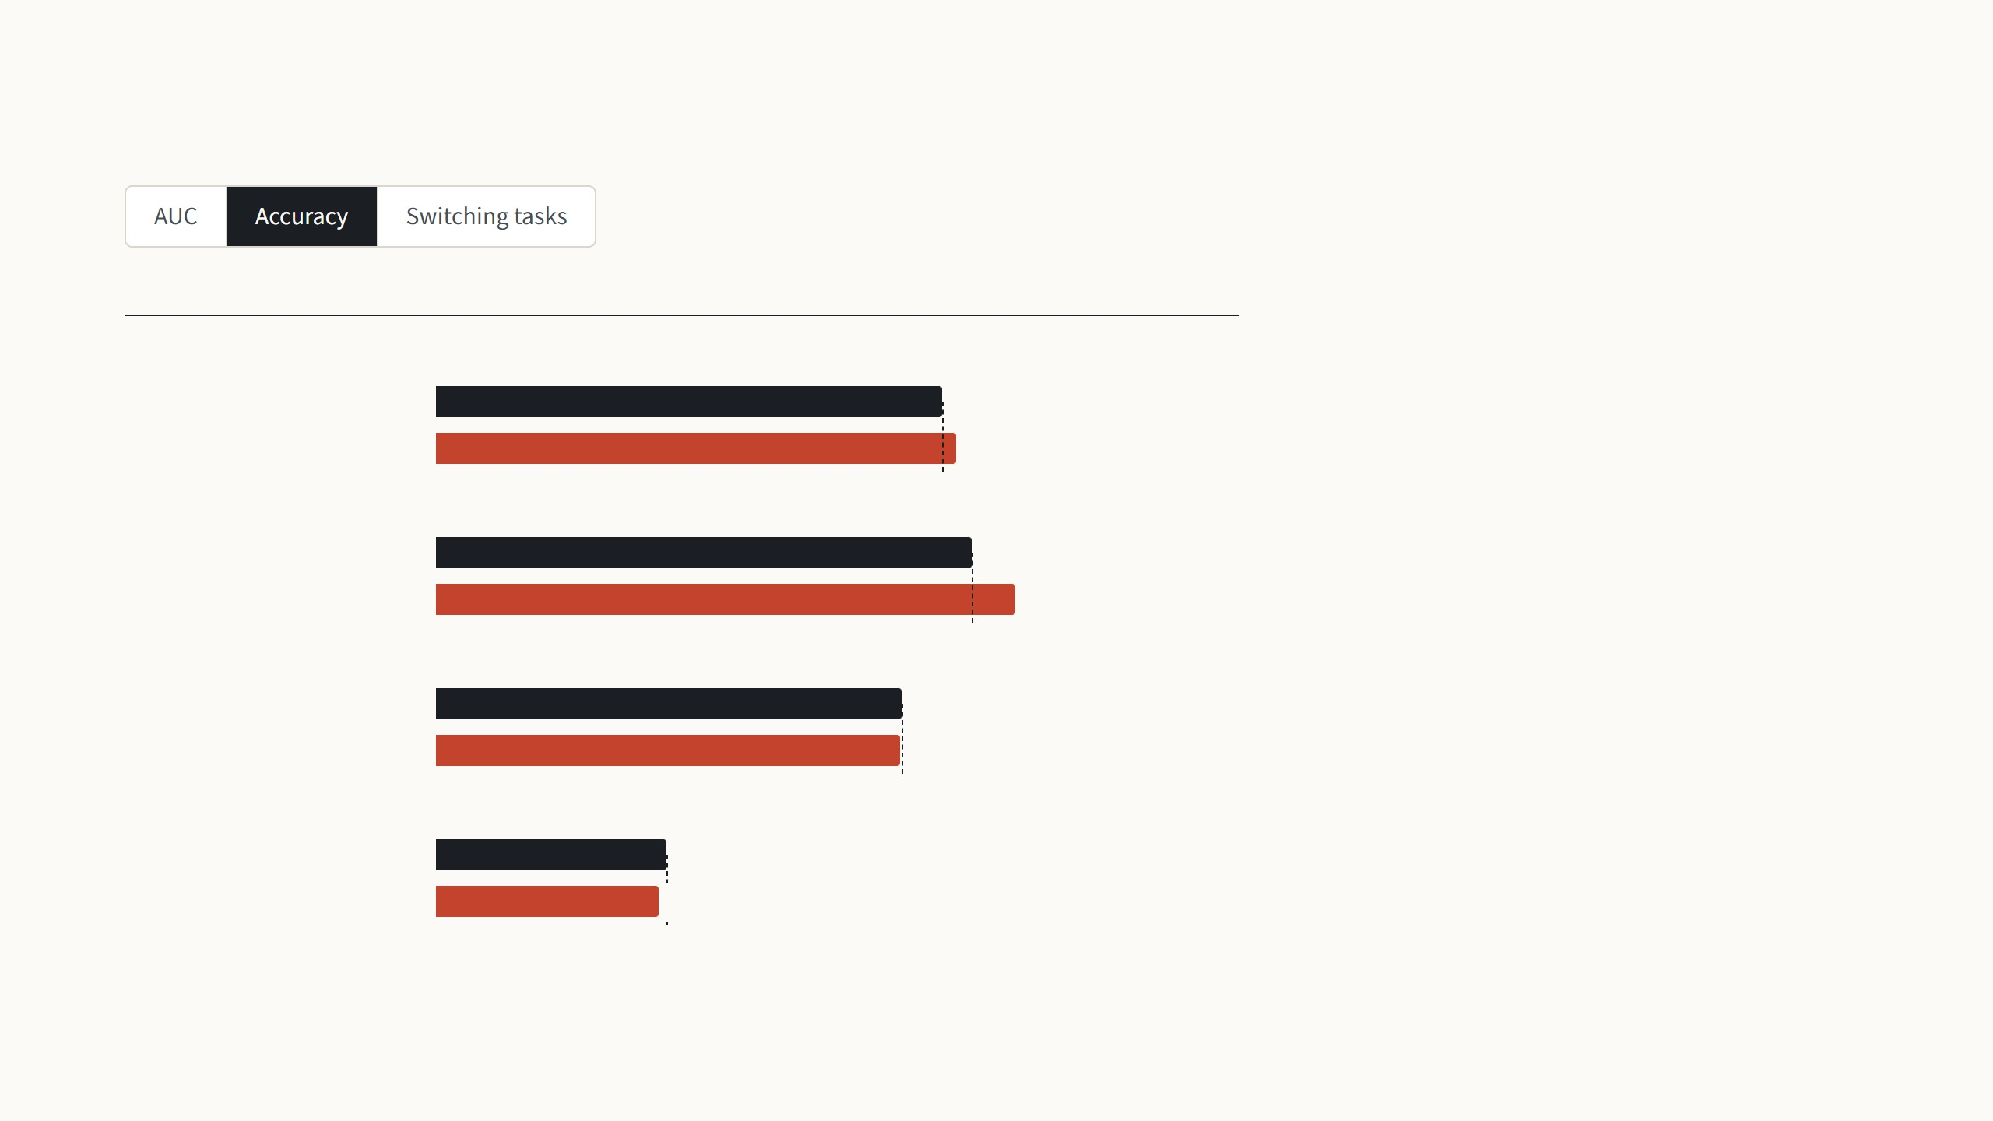
LoRA on medical images
Test accuracy (%)
In accuracy MeLo is ahead on two tasks and
slightly behind on two.
Chest X-ray: tuberculosis, 2 classes
Full fine-tuning
81.2
These are single runs on small test sets,
about 80 mammograms for INbreast, so the
fair reading of the title, "better than fine-
tuning", is "about the same".
LoRA (MeLo)
83.5
Microscopy: blood cell type, 4 classes
Full fine-tuning
85.9
LoRA (MeLo)
93.0
Mammography: malignancy, 2 classes
Full fine-tuning
74.8
LoRA (MeLo)
74.5
Chest X-ray: 14 diseases
Full fine-tuning
36.9
LoRA (MeLo)
35.7
Zhu et al. 2024 (MeLo, ISBI), Table 1: ViT-B pretrained on ImageNet, LoRA rank 4 on query and value, single runs on their own test splits. The 14-disease task is multi-label.
21
Notes:
MeLo, ISBI 2024, from ShanghaiTech and Shanghai Jiao Tong: LoRA with rank 4 on the query and value weights of a ViT-B pretrained on ImageNet, applied to four medical tasks: tuberculosis on chest X-rays, four blood cell types, malignancy in mammograms, and 14 thoracic diseases. They train 0.14 million weights, 0.17%. AUC first: within a point of full fine-tuning on three tasks, 3.6 points lower on blood cells. Accuracy, second step: ahead on tuberculosis and blood cells, slightly behind on the other two. The title says "better than fine-tuning", but these are single runs on small test sets, about 80 mammograms for INbreast, so I would read it as "about the same". Third step is their real point, deployment, with a giant CLIP ViT: 25 images from each task in random order. Reloading the right fine-tuned copy for each image takes 218 s for 100 images; keeping all four copies loaded is fast but needs 7 billion weights in GPU memory; one model with four LoRA pairs takes 10.6 s at the memory of a single model.

Slide 48
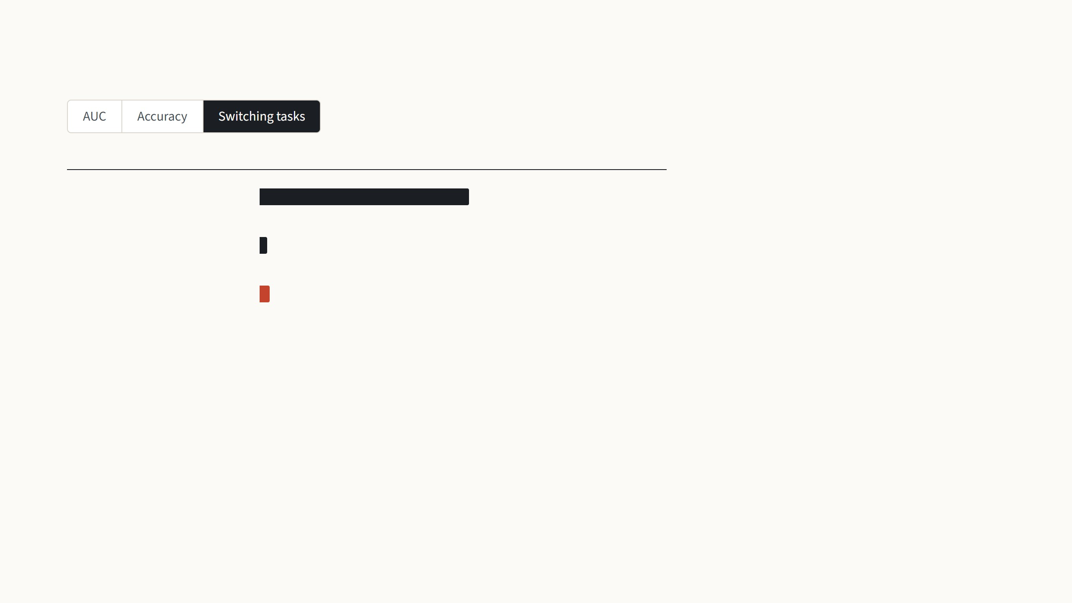
LoRA on medical images
Time for 100 images in random order (s)
Weights in GPU memory
Their practical point is switching between
tasks, measured with a giant CLIP ViT on 25
images from each task in random order.
Fine-tuning, reload a copy
per image
218.5 s
1,759 million
Fine-tuning, all four copies
loaded
8.2 s
7,034 million
Reloading a fine-tuned copy for each image
takes 218 s, and keeping all four copies
loaded needs four times the memory. One
frozen model with four LoRA pairs takes 10.6
s at the memory of one model.
LoRA, one model and four
pairs
10.6 s
1,760 million
Zhu et al. 2024, Table 2: ViT-giga pretrained with CLIP (1.76 billion weights), 100 images, 25 from each of the four datasets, in random order, on one A100 GPU.
21
Notes:
MeLo, ISBI 2024, from ShanghaiTech and Shanghai Jiao Tong: LoRA with rank 4 on the query and value weights of a ViT-B pretrained on ImageNet, applied to four medical tasks: tuberculosis on chest X-rays, four blood cell types, malignancy in mammograms, and 14 thoracic diseases. They train 0.14 million weights, 0.17%. AUC first: within a point of full fine-tuning on three tasks, 3.6 points lower on blood cells. Accuracy, second step: ahead on tuberculosis and blood cells, slightly behind on the other two. The title says "better than fine-tuning", but these are single runs on small test sets, about 80 mammograms for INbreast, so I would read it as "about the same". Third step is their real point, deployment, with a giant CLIP ViT: 25 images from each task in random order. Reloading the right fine-tuned copy for each image takes 218 s for 100 images; keeping all four copies loaded is fast but needs 7 billion weights in GPU memory; one model with four LoRA pairs takes 10.6 s at the memory of a single model.

Slide 49

Where LoRA falls short
The rank and the weights are chosen by hand
Merged weights serve one task at a time
The paper picks the query and value weights and a small rank by
trying settings, and leaves a principled choice to future work. On
VTAB-1k the best method even changes from task to task.
Once BA is added into W, every input in a batch must belong to
that task. Mixing tasks in one batch means keeping the pairs
separate, which brings back a small extra cost; VPT's prompts
mix freely.
A small rank assumes a nearby task
Training still runs through the whole model
The authors expect a small rank to fail when the new task is far
from pretraining, such as a different language. The low-rank
analysis was only done on GPT-3, not on vision models.
LoRA saves the optimizer state of the frozen weights, but the
gradient still passes back through every layer. On ViT-B most
memory is activations: freezing the backbone for VPT only cut it
from 11.7 to 10.3 GB.
Hu et al. 2022, Sec. 4.2 (batching), footnote 6 (a different language), Sec. 7 and 8 (analysis on GPT-3, future work). Zhang et al. 2022, Fig. 1b. Jia et al. 2022, Table 12 (ViT-B/16,
batch 64).
22
Notes:
Four honest limits. First, choices by hand: which matrices, which rank. The paper's guidance comes from GPT-3, and NOAH's per-task spread shows the best choice varies. Second, a deployment detail people miss: merging is what makes LoRA free at test time, but a merged model serves one task. If a server mixes requests of different tasks in one batch, you have to keep the pairs unmerged and pay a small extra computation, while VPT's prompts are just inputs and can differ per sample. Third, the low-rank assumption: the authors themselves say a very different task, like a new language, may need full rank; the evidence for low rank is from GPT-3 only. Fourth, training memory: the 3× saving on GPT-3 came from optimizer state, which dominates for huge models. On ViT-B, activations dominate, and those are still stored for the whole network, as with VPT. My own measurement of this will be part of the experiments next.

Slide 50
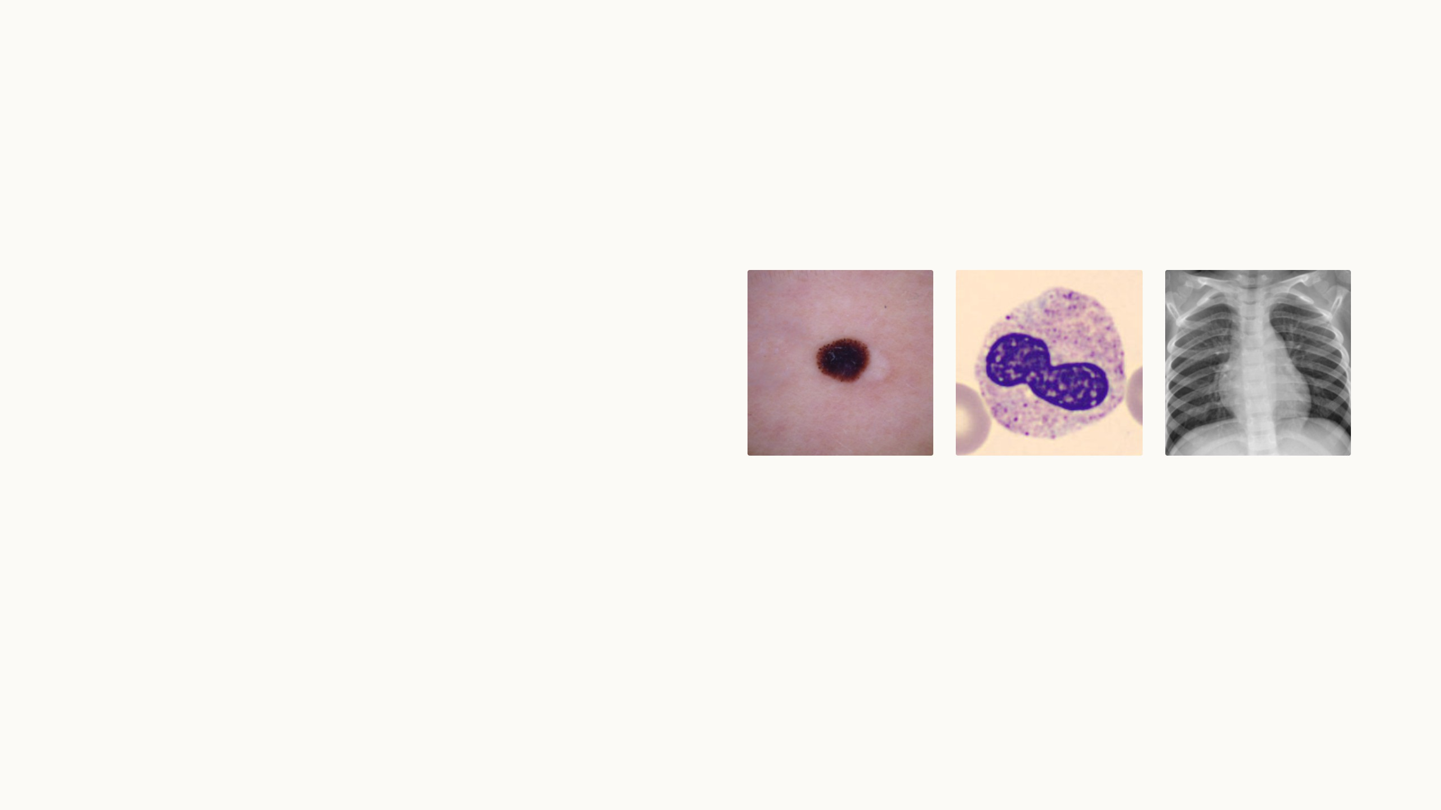
My experiments
I trained LoRA on the same three medical
datasets as my VPT runs, with the same base
model, data and training recipe.
So it sits next to VPT-deep, a linear probe and full
fine-tuning. First the results, then the models
running live.
Skin lesions
Blood cells
Chest X-rays
23
Notes:
From here on it is my own work, not the paper. Last time I trained VPT on three MedMNIST tasks: skin lesions, blood cells and chest X-rays. Now LoRA runs on exactly the same setup: the same ImageNet-21k ViT-B/16, the same splits, the same 1,000-image subsets, the same schedule and model selection. Only the optimizer differs, AdamW as in the LoRA paper. The linear probe, VPT-deep and full fine-tuning numbers are the very runs from last time, so all four methods can be compared directly. Next: the setup, then the results, the costs, and the live demo.

Slide 51
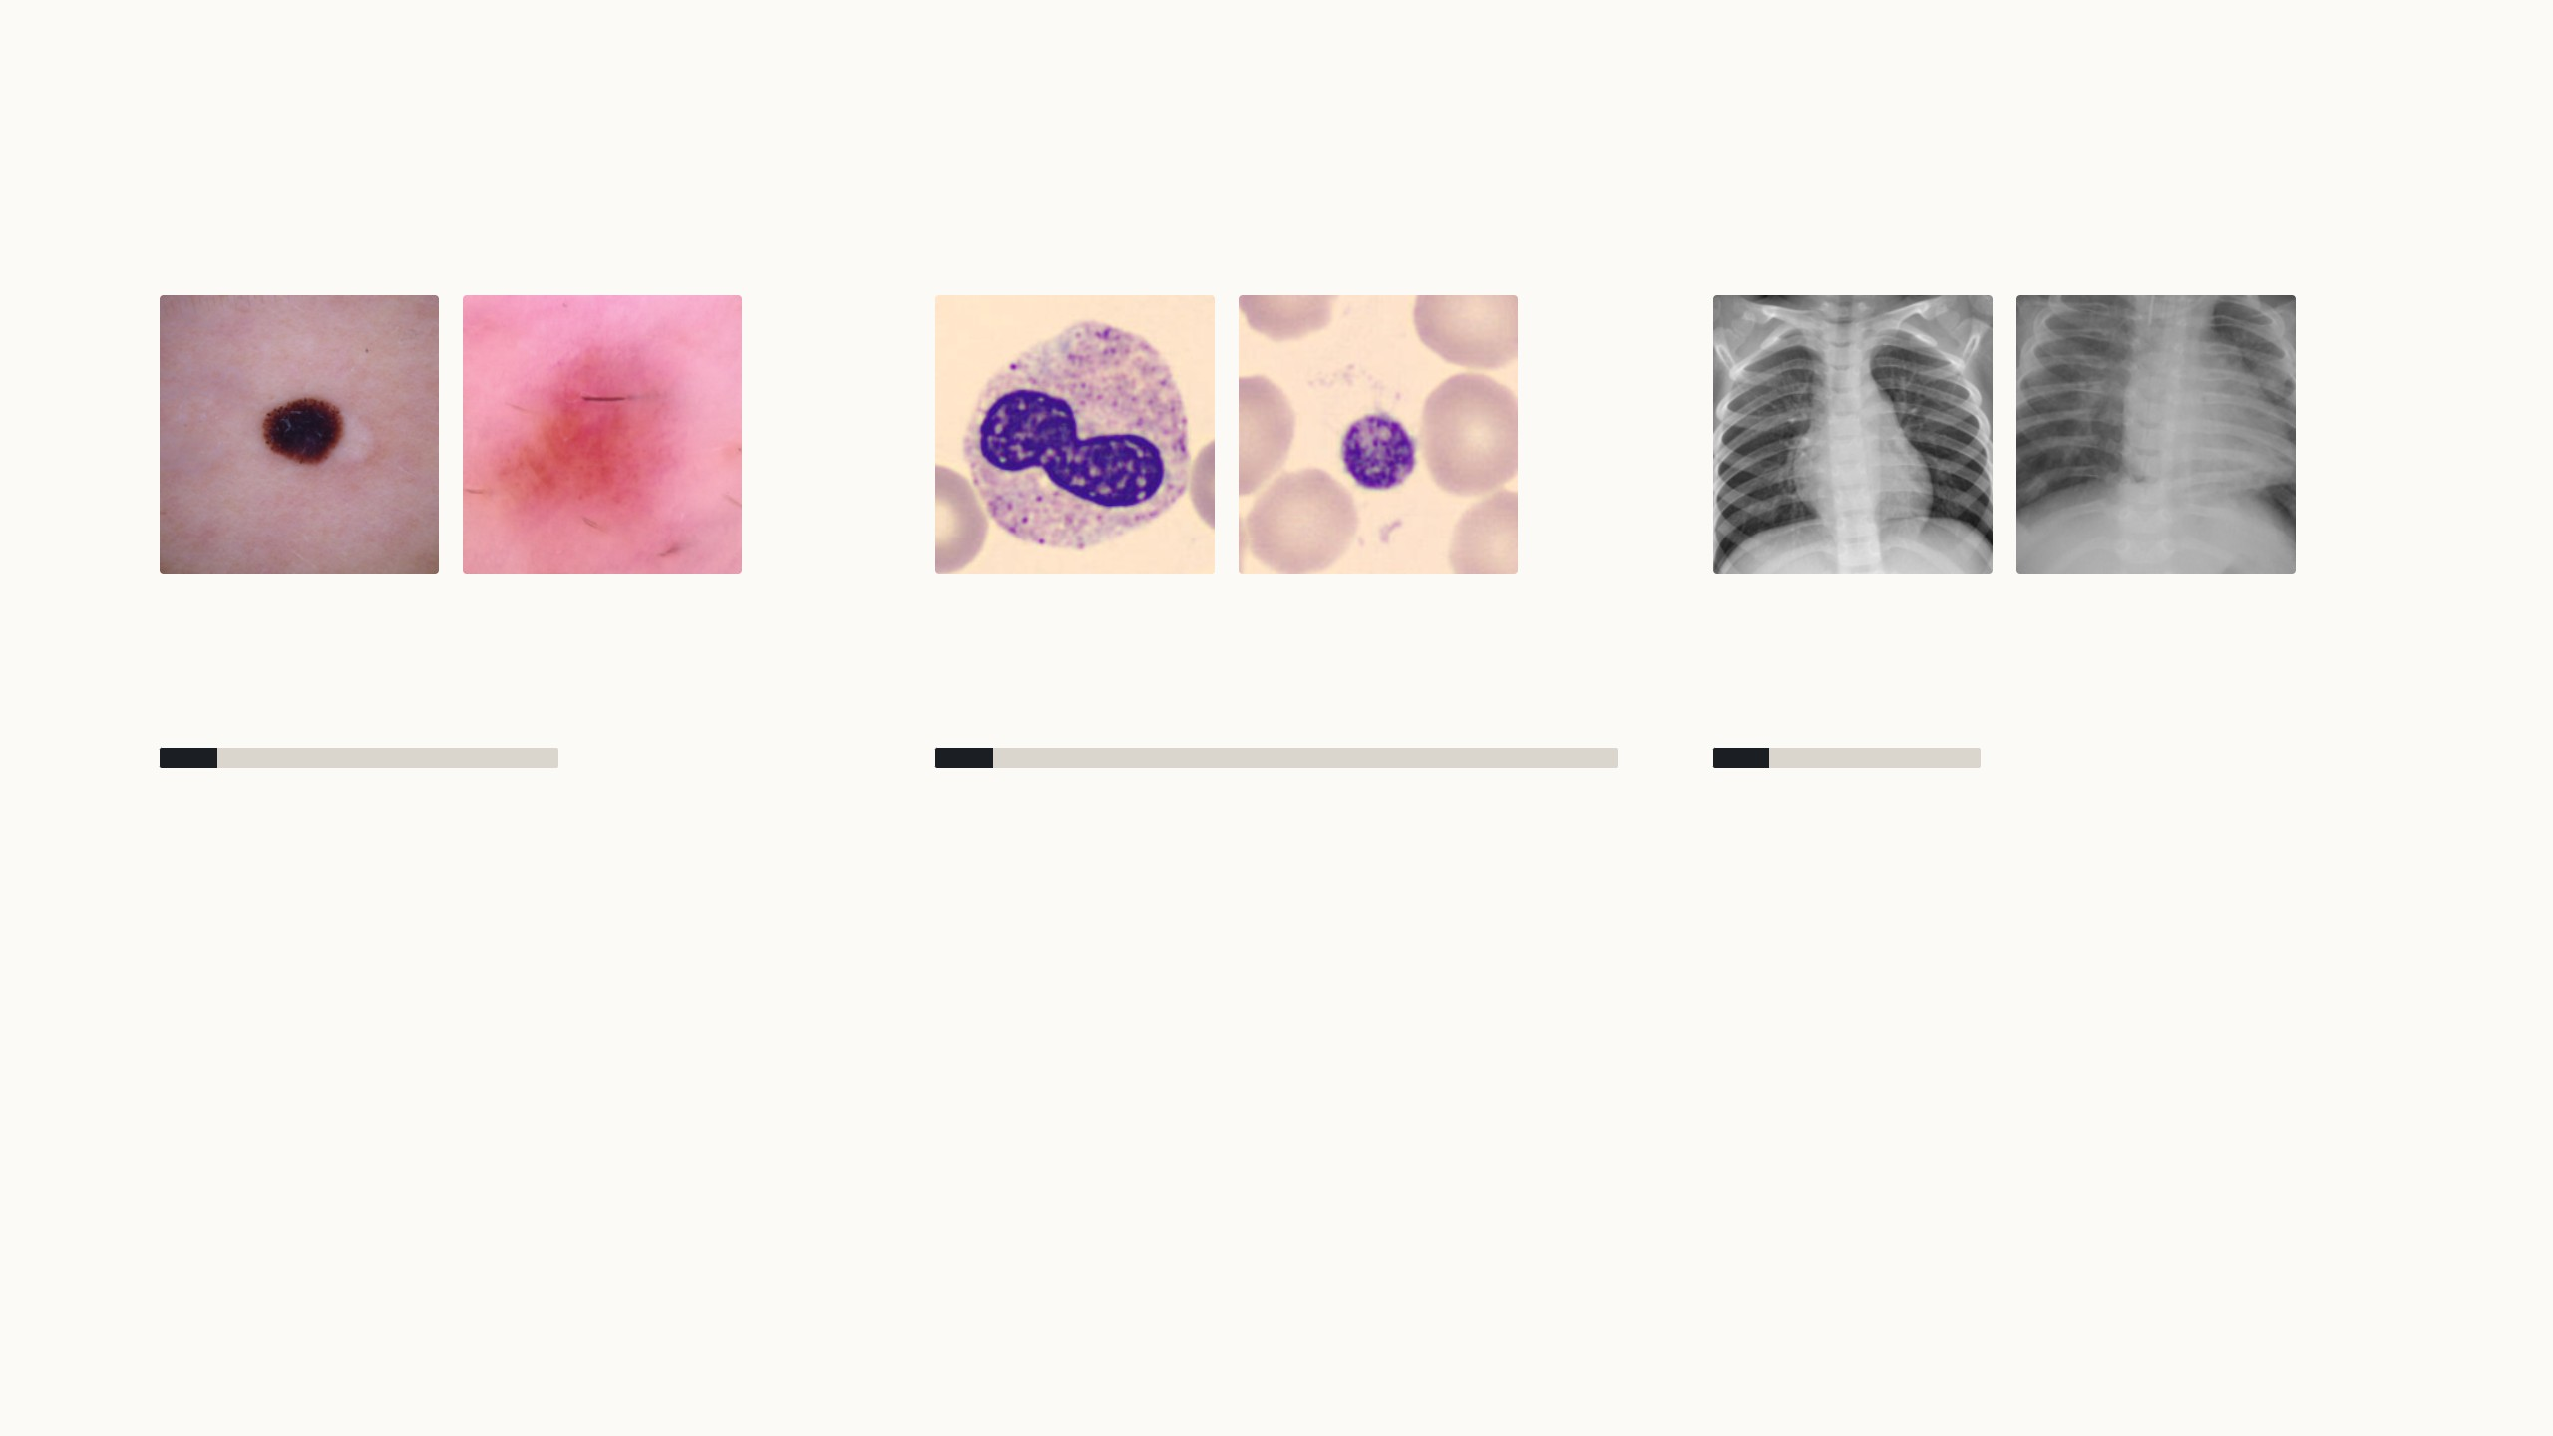
I tested LoRA on the same three medical datasets
Each method was trained twice: on 1,000 images, as in VTAB-1k, and on the full training set.
melanoma
nevus
neutrophil
platelet
normal
pneumonia
Skin lesions
Blood cells
Chest X-rays
Dermoscopy, 7 classes
Microscopy, 8 cell types
Radiographs, pneumonia or normal
1,000 or all 7,007 training images
1,000 or all 11,959 training images
1,000 or all 4,708 training images
MedMNIST+ at 224 × 224 (Yang et al. 2023); skin lesions from HAM10000 (Tschandl et al. 2018). RTX 5070 Ti laptop GPU. SGD for linear probe and VPT, AdamW for LoRA and full
fine-tuning; learning rate picked on validation.
24
Notes:
The same three datasets as last time, at 224 × 224 pixels. Skin lesions are heavily imbalanced, two thirds are nevi, so I report balanced accuracy, the mean per-class recall. Each method was trained on 1,000 random training images, the same 1,000 for every method, and on the whole training split. Next step: the four methods. LoRA is new; it keeps the backbone frozen like VPT, but instead of adding tokens it adds rank-8 pairs beside the query and value weights in all twelve blocks, drawn as the small red hourglass, B over A, beside the blue model. It uses AdamW as in its paper; the learning rate was picked on validation with the 1,000-image subset, the same procedure as for the others.

Slide 52
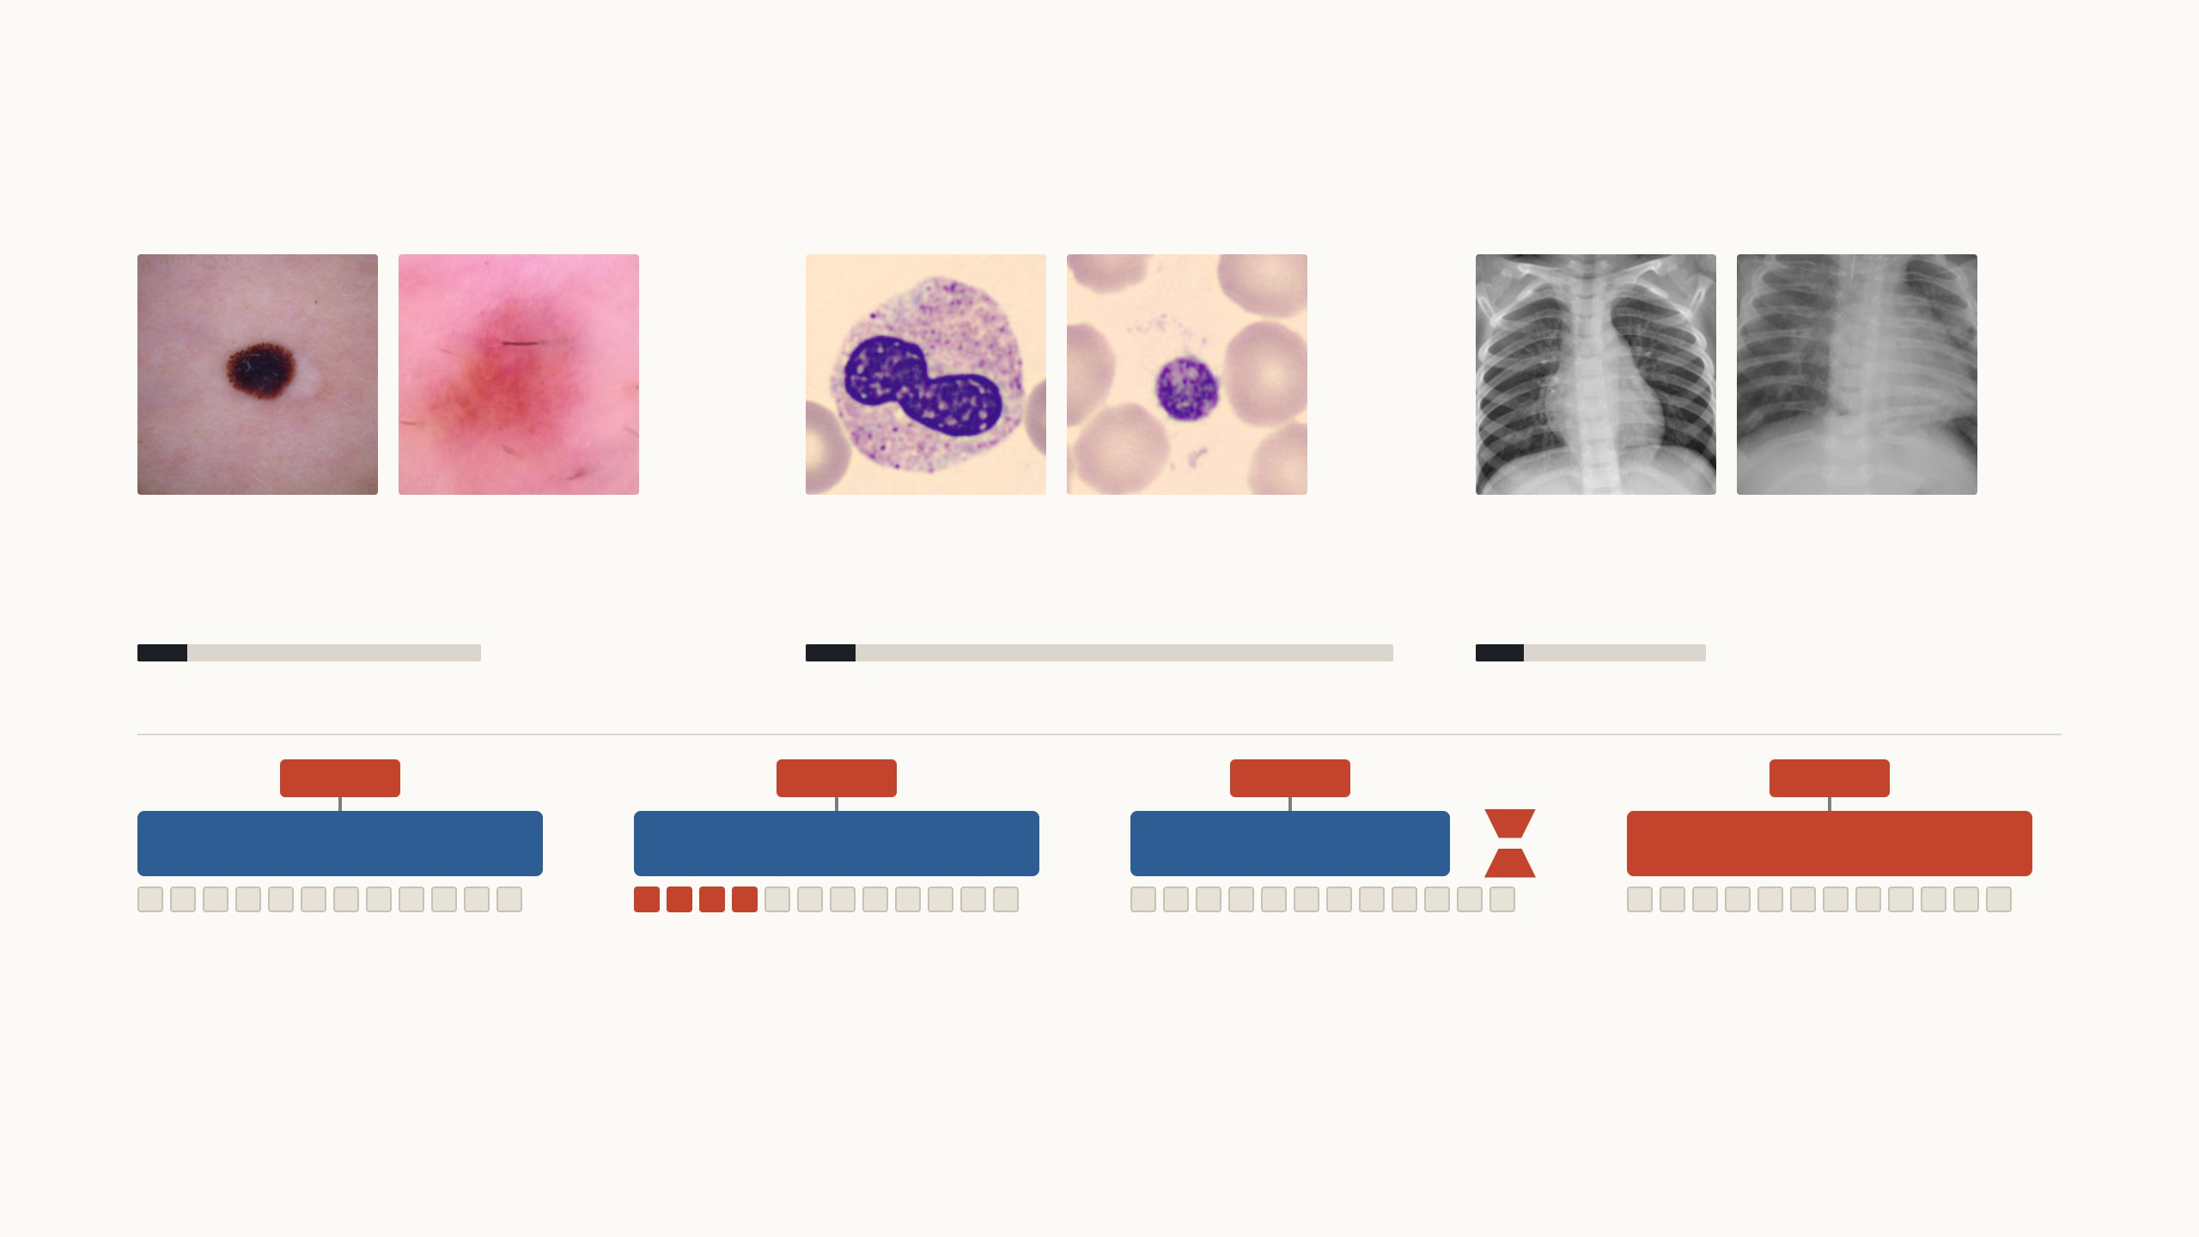
I tested LoRA on the same three medical datasets
Each method was trained twice: on 1,000 images, as in VTAB-1k, and on the full training set.
melanoma
nevus
neutrophil
platelet
normal
pneumonia
Skin lesions
Blood cells
Chest X-rays
Dermoscopy, 7 classes
Microscopy, 8 cell types
Radiographs, pneumonia or normal
1,000 or all 7,007 training images
1,000 or all 11,959 training images
1,000 or all 4,708 training images
head
head
head
head
ViT-B/16 frozen
ViT-B/16 frozen
ViT-B/16 frozen
+
ViT-B/16 retrained
Linear probe
VPT-deep
LoRA
Full fine-tuning
Trains only a new head.
Trains a head and 50 prompts per
layer.
Trains a head and rank-8 pairs
beside Wq and Wv.
Retrains all 85.8 million weights.
MedMNIST+ at 224 × 224 (Yang et al. 2023); skin lesions from HAM10000 (Tschandl et al. 2018). RTX 5070 Ti laptop GPU. SGD for linear probe and VPT, AdamW for LoRA and full
fine-tuning; learning rate picked on validation.
24
Notes:
The same three datasets as last time, at 224 × 224 pixels. Skin lesions are heavily imbalanced, two thirds are nevi, so I report balanced accuracy, the mean per-class recall. Each method was trained on 1,000 random training images, the same 1,000 for every method, and on the whole training split. Next step: the four methods. LoRA is new; it keeps the backbone frozen like VPT, but instead of adding tokens it adds rank-8 pairs beside the query and value weights in all twelve blocks, drawn as the small red hourglass, B over A, beside the blue model. It uses AdamW as in its paper; the learning rate was picked on validation with the 1,000-image subset, the same procedure as for the others.

Slide 53
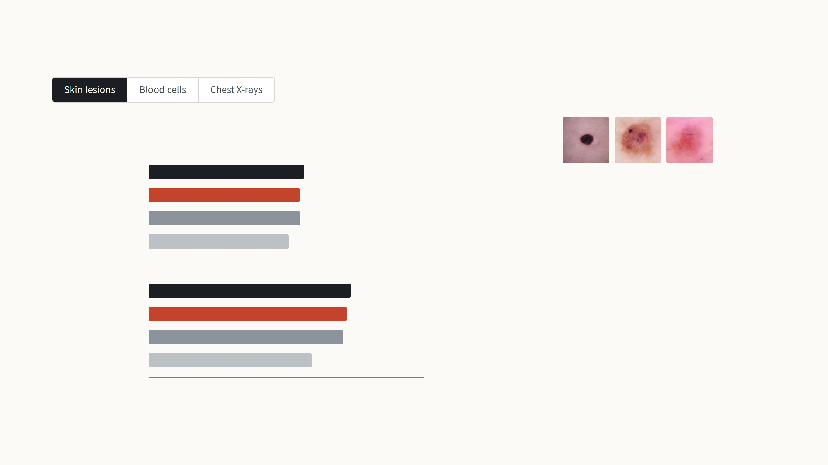
How LoRA compares on my three datasets
Balanced accuracy on the test set (%)
Against LoRA
1,000 training images
Full fine-tuning
64.9
1.9 points higher
Seven kinds of skin lesion, and two thirds
of the images show harmless moles. This
is the hardest of the three tasks.
LoRA
63.0
VPT-deep
63.3
0.3 points higher
Linear probe
58.4
4.6 points lower
With all 7,007 images, LoRA is 1.6 points
ahead of VPT-deep and 1.8 points behind
full fine-tuning.
All 7,007 training images
Full fine-tuning
84.4
1.8 points higher
LoRA
82.6
With 1,000 images, LoRA is 0.3 points
behind VPT-deep and 1.9 points behind
full fine-tuning.
VPT-deep
81.0
1.6 points lower
Linear probe
68.1
14.5 points lower
0
25
50
75
100
My runs: ViT-B/16 (ImageNet-21k), MedMNIST+ 224 × 224, balanced accuracy on the test set (the mean per-class recall), bars start at 0. Each method was trained once with 1,000
images and once with the full training set; there are no points in between.
25
Notes:
Step through the three datasets with the arrow keys. Each tab has two measured settings, 1,000 training images and the full training set, drawn as two separate groups of bars. The score is balanced accuracy on the test set. The text on the right is computed from the runs, so read it out: it says how LoRA does against VPT-deep, the linear probe and full fine-tuning on each dataset.

Slide 54
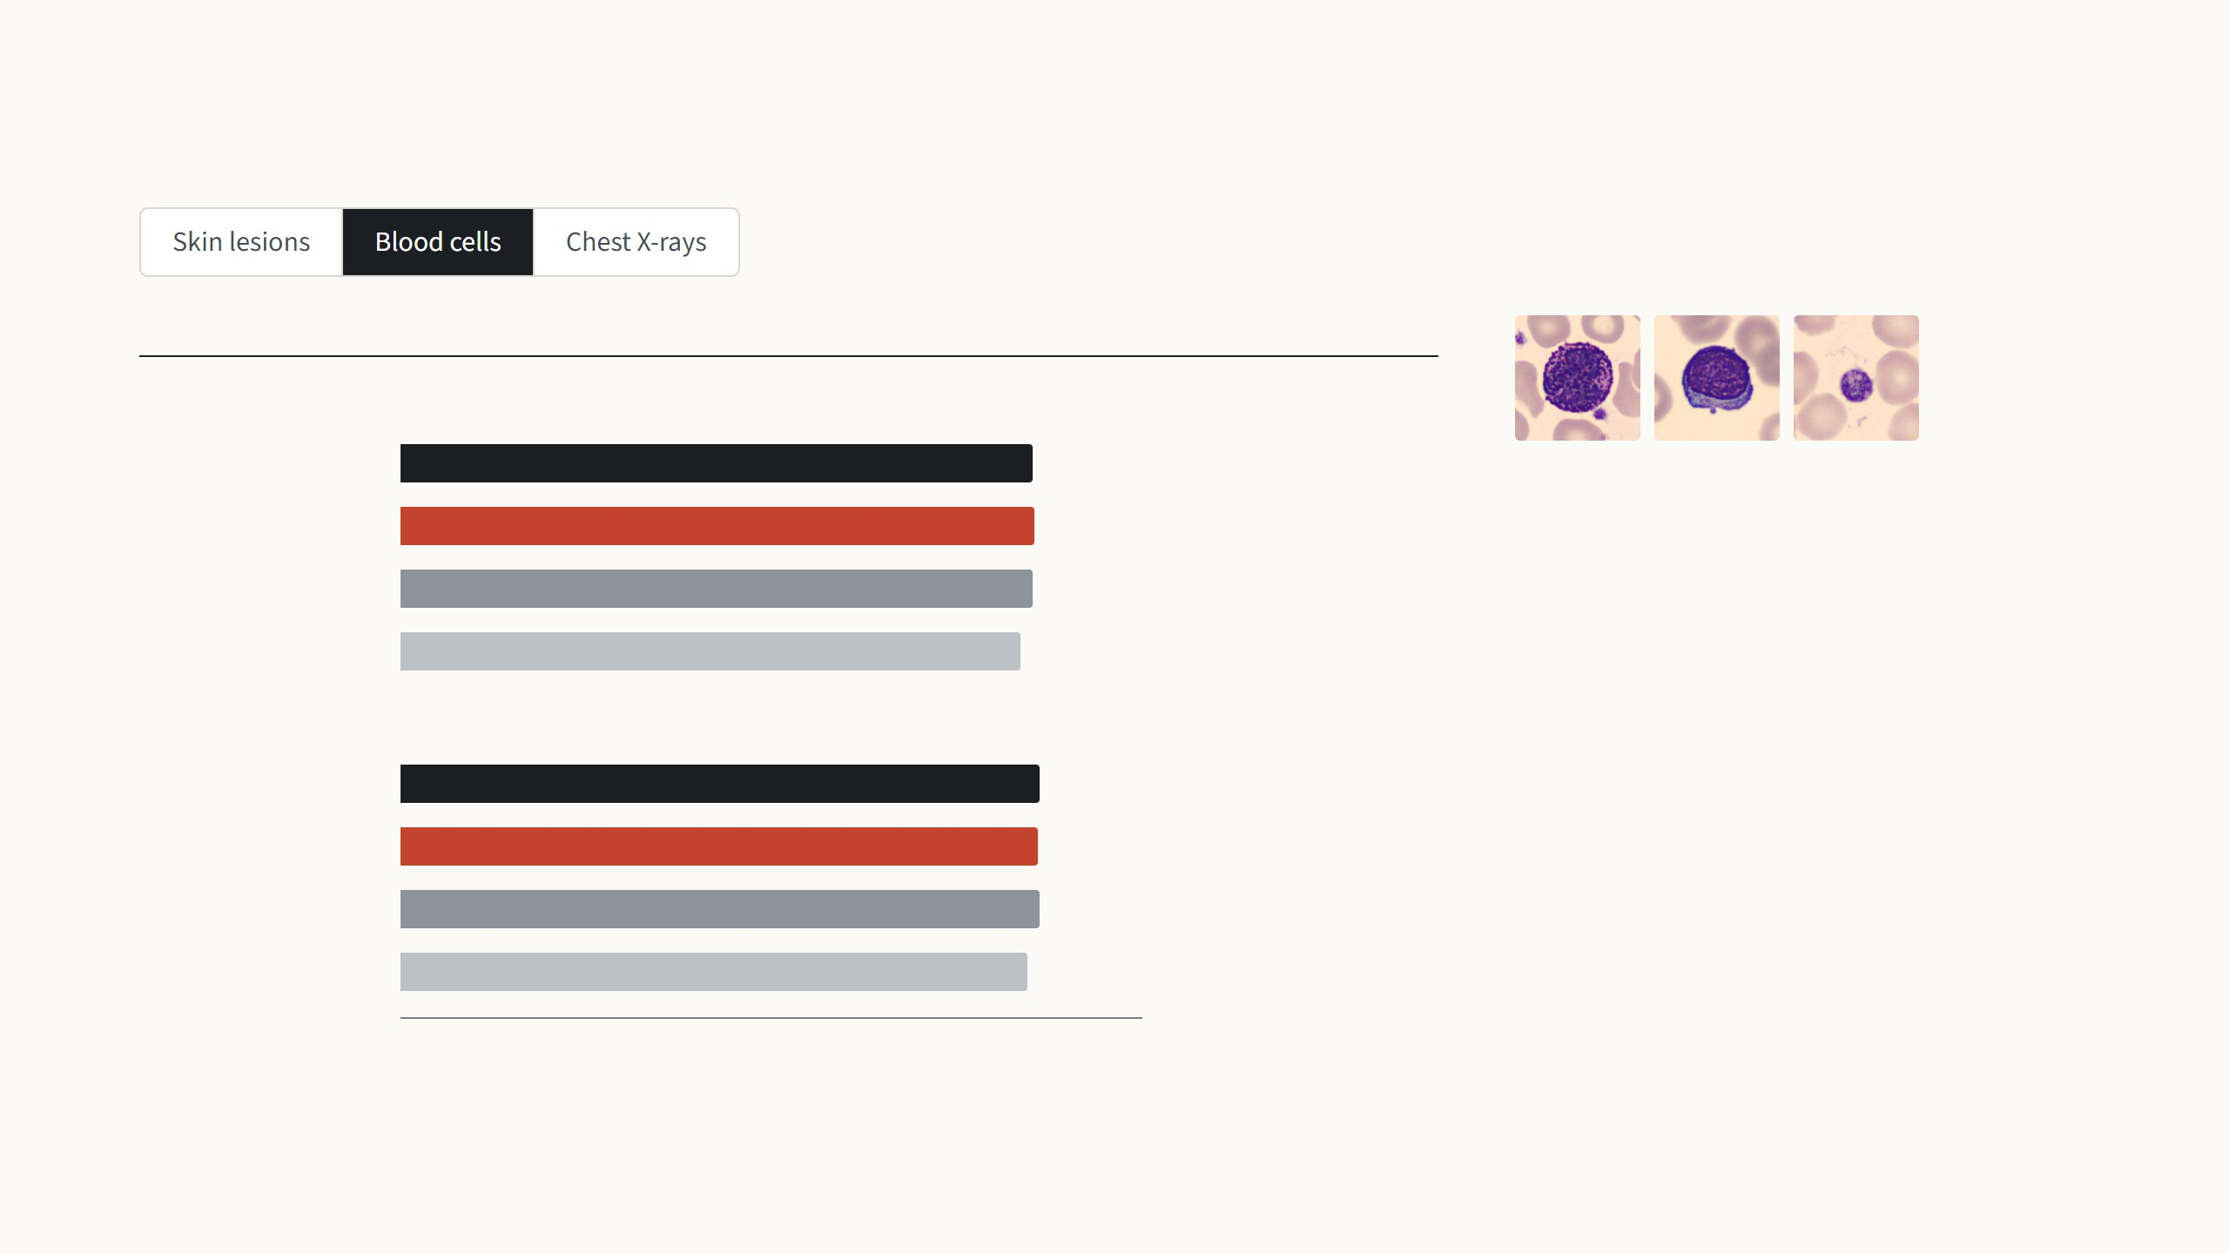
How LoRA compares on my three datasets
Balanced accuracy on the test set (%)
Against LoRA
1,000 training images
Full fine-tuning
98.0
0.4 points lower
Eight kinds of blood cell under a
microscope. Every method does well
here, so the bars are almost the same
length.
LoRA
98.4
VPT-deep
98.2
0.2 points lower
Linear probe
96.1
2.3 points lower
All 11,959 training images
With all 11,959 images, LoRA is 0.1 points
behind VPT-deep and 0.2 points behind
full fine-tuning.
Full fine-tuning
99.2
0.2 points higher
LoRA
99.0
With 1,000 images, LoRA is 0.2 points
ahead of VPT-deep and 0.4 points ahead
of full fine-tuning.
VPT-deep
99.1
0.1 points higher
Linear probe
97.4
1.6 points lower
0
25
50
75
100
My runs: ViT-B/16 (ImageNet-21k), MedMNIST+ 224 × 224, balanced accuracy on the test set (the mean per-class recall), bars start at 0. Each method was trained once with 1,000
images and once with the full training set; there are no points in between.
25
Notes:
Step through the three datasets with the arrow keys. Each tab has two measured settings, 1,000 training images and the full training set, drawn as two separate groups of bars. The score is balanced accuracy on the test set. The text on the right is computed from the runs, so read it out: it says how LoRA does against VPT-deep, the linear probe and full fine-tuning on each dataset.

Slide 55
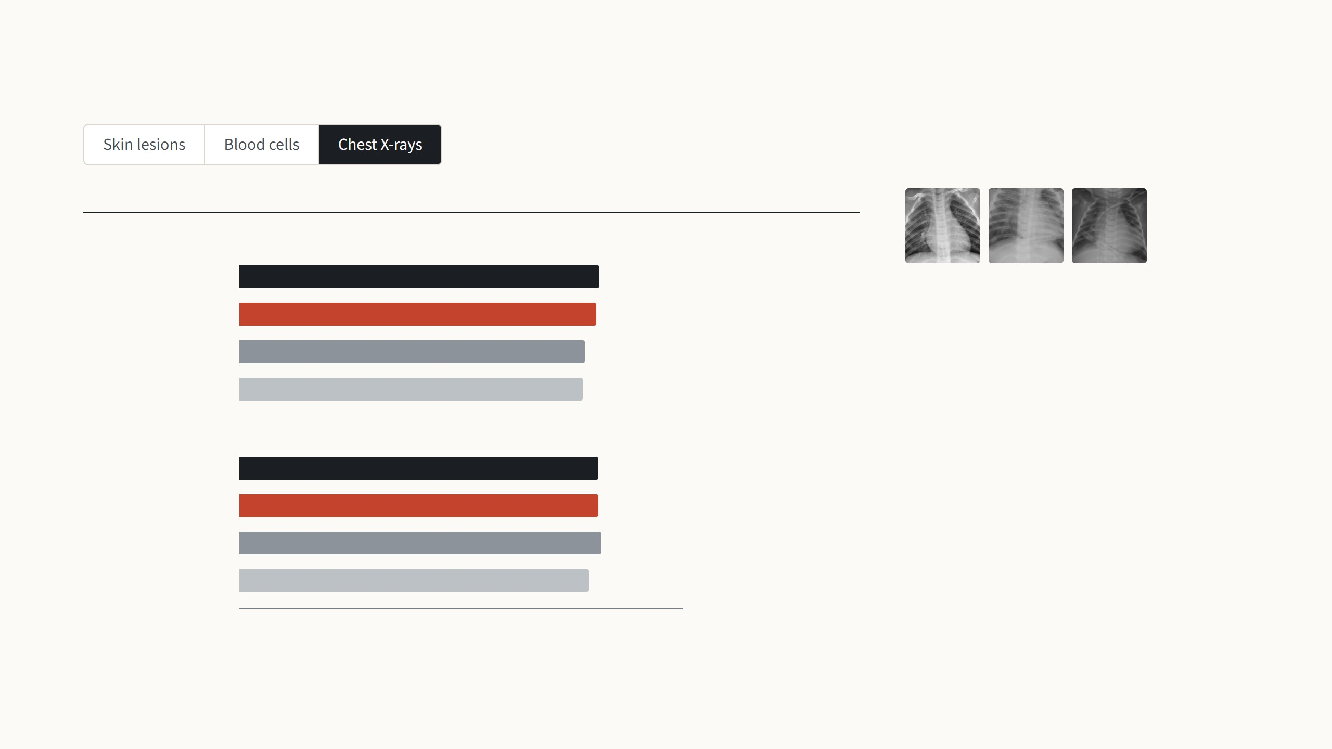
How LoRA compares on my three datasets
Balanced accuracy on the test set (%)
Against LoRA
1,000 training images
Full fine-tuning
93.4
0.6 points higher
Chest X-rays of children, labelled normal
or pneumonia.
LoRA
92.8
VPT-deep
89.7
3.1 points lower
With all 4,708 images, LoRA is 1.0 points
behind VPT-deep and 0.2 points behind
full fine-tuning.
Linear probe
89.2
3.6 points lower
All 4,708 training images
Full fine-tuning
93.3
0.2 points higher
With 1,000 images, LoRA is 3.1 points
ahead of VPT-deep and 0.6 points behind
full fine-tuning.
LoRA
93.1
VPT-deep
94.1
1.0 points higher
Linear probe
90.9
2.2 points lower
0
25
50
75
100
My runs: ViT-B/16 (ImageNet-21k), MedMNIST+ 224 × 224, balanced accuracy on the test set (the mean per-class recall), bars start at 0. Each method was trained once with 1,000
images and once with the full training set; there are no points in between.
25
Notes:
Step through the three datasets with the arrow keys. Each tab has two measured settings, 1,000 training images and the full training set, drawn as two separate groups of bars. The score is balanced accuracy on the test set. The text on the right is computed from the runs, so read it out: it says how LoRA does against VPT-deep, the linear probe and full fine-tuning on each dataset.

Slide 56
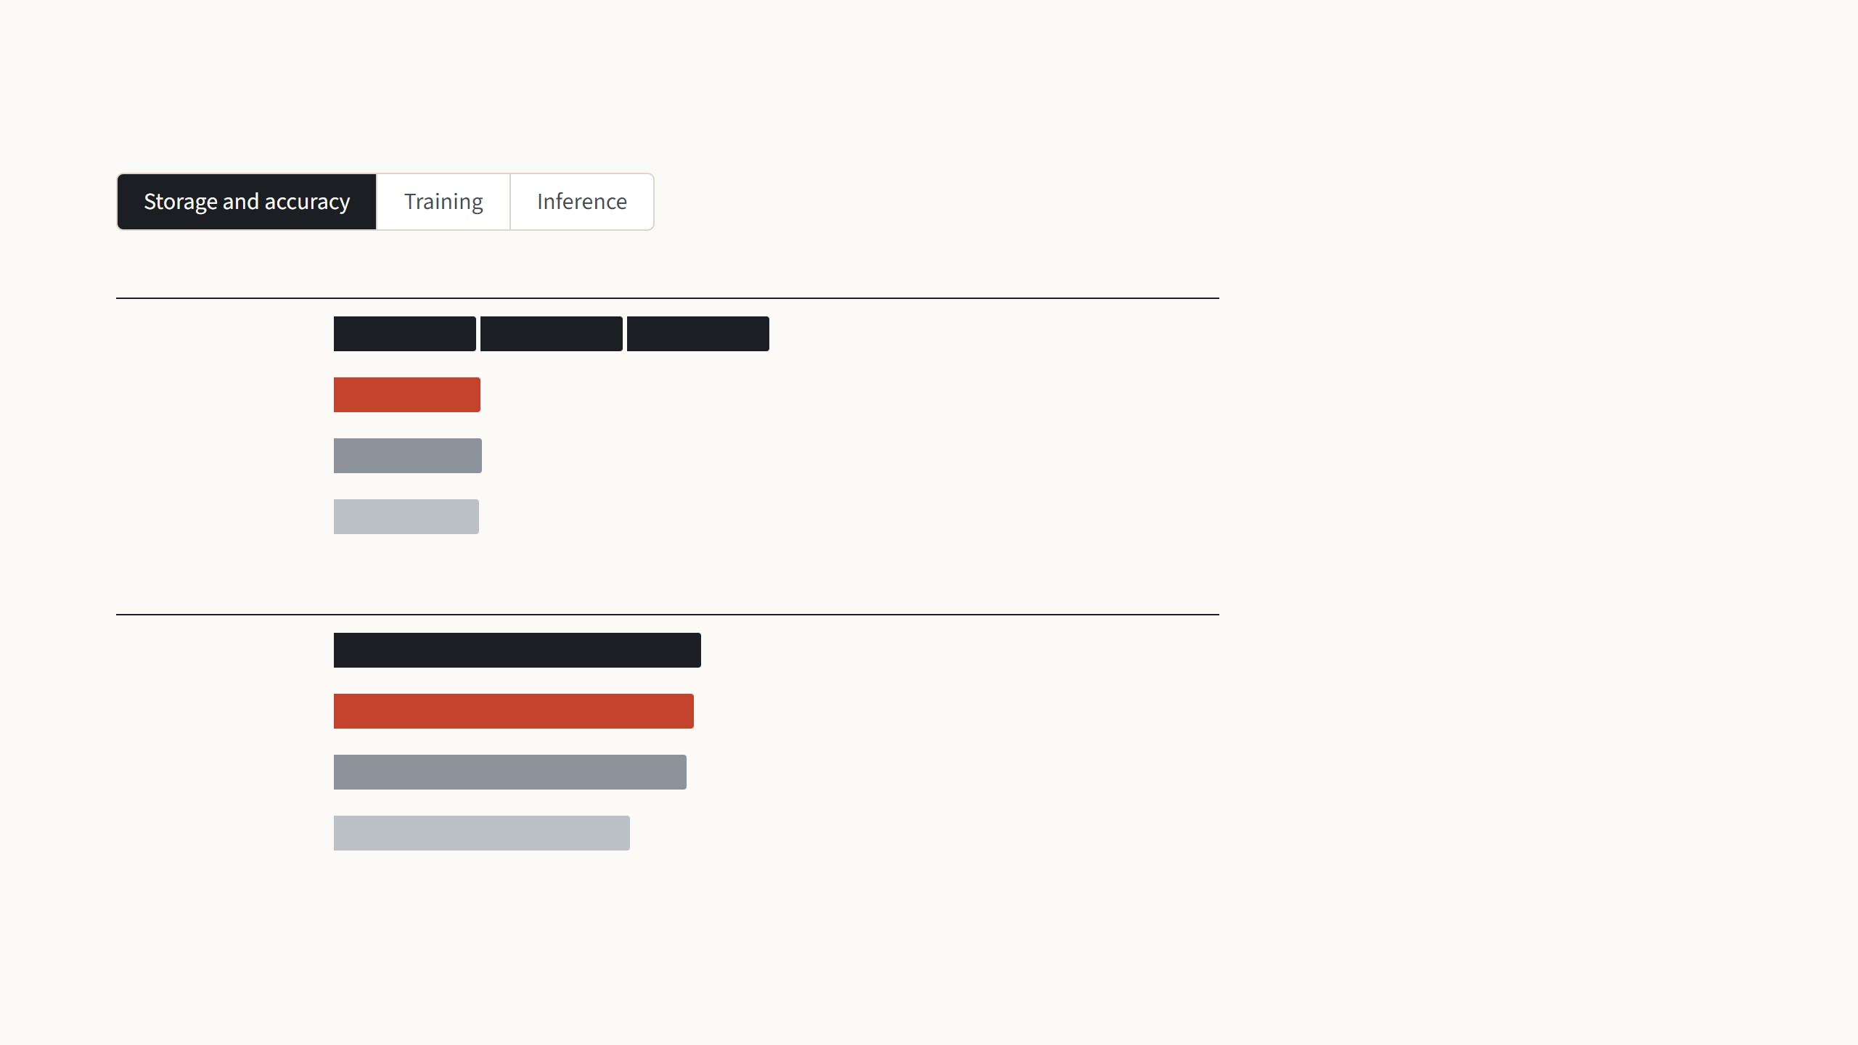
What each method costs on skin lesions
Stored for all three tasks
LoRA stores 1.2 MB per task and
VPT-deep 1.9 MB, against 343 MB for a
fine-tuned copy. Both share one frozen
base model across all tasks.
Full fine-tuning
1,030 MB3 separate models of 343 MB
LoRA
347 MBone base model + 3 × 1.2 MB
VPT-deep
349 MBone base model + 3 × 1.9 MB
Here LoRA reaches 82.6% and
VPT-deep 81.0%, against 84.4% for full
fine-tuning and 68.1% for the
linear probe.
Linear probe
343 MBone base model + 3 × 22 KB
Balanced accuracy on the test set
Full fine-tuning
84.4%
LoRA
82.6%
VPT-deep
81.0%
Linear probe
68.1%
Skin lesions (DermaMNIST), all 7,007 training images. RTX 5070 Ti Laptop GPU, batch 32; CPU inference on 2 threads; 32-bit weights; LoRA rank 8 on the query and value weights.
26
Notes:
Three steps, one cost each, all measured on my laptop for skin lesions trained on the full training split; every number is read from the training logs and the benchmark file. Storage: both LoRA and VPT keep one copy of the base model and add a small file per task, while full fine-tuning needs a whole 343 MB model per task. Training: LoRA and VPT both still send the error signal back through all twelve frozen layers, so neither is cheap like the linear probe; the memory saving compared with full fine-tuning is the optimizer state of the frozen weights. Inference: this is where the two differ. VPT makes every layer process 50 extra tokens. LoRA with its pairs kept separate adds a little extra work, and once merged into the weights it runs exactly as fast as the plain model, which is the paper's main practical claim.

Slide 57
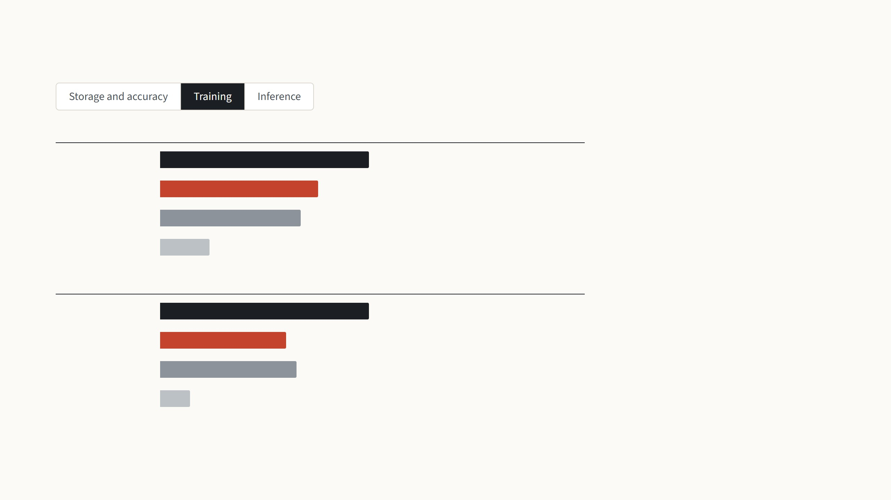
What each method costs on skin lesions
Training time on all 7,007 images
LoRA needed 2.1 GB of GPU memory
and VPT-deep 2.3 GB, against 3.5 GB
for full fine-tuning.
Full fine-tuning
20 min30 epochs
LoRA
15 min30 epochs
Both still pass the error signal back
through all twelve frozen layers, so
only the linear probe is really cheap to
train.
VPT-deep
14 min30 epochs
Linear probe
5 min30 epochs
Peak GPU memory during training, batch 32
Full fine-tuning
3.5 GB
LoRA
2.1 GB
VPT-deep
2.3 GB
Linear probe
0.5 GB
Skin lesions (DermaMNIST), all 7,007 training images. RTX 5070 Ti Laptop GPU, batch 32; CPU inference on 2 threads; 32-bit weights; LoRA rank 8 on the query and value weights.
26
Notes:
Three steps, one cost each, all measured on my laptop for skin lesions trained on the full training split; every number is read from the training logs and the benchmark file. Storage: both LoRA and VPT keep one copy of the base model and add a small file per task, while full fine-tuning needs a whole 343 MB model per task. Training: LoRA and VPT both still send the error signal back through all twelve frozen layers, so neither is cheap like the linear probe; the memory saving compared with full fine-tuning is the optimizer state of the frozen weights. Inference: this is where the two differ. VPT makes every layer process 50 extra tokens. LoRA with its pairs kept separate adds a little extra work, and once merged into the weights it runs exactly as fast as the plain model, which is the paper's main practical claim.

Slide 58

What each method costs on skin lesions
Time per image on the CPU, 2 threads
VPT-deep needs 250 ms per image,
because every layer processes 50 extra
tokens. LoRA with separate pairs needs
190 ms.
Full fine-tuning
189 ms
LoRA
190 msmerged: 188 ms
VPT-deep
250 ms
Merged into the weights, LoRA takes
188 ms, the time of the unchanged
model (189 ms).
Linear probe
195 ms
Tokens that every layer processes
Full fine-tuning
197
LoRA
197
VPT-deep
247197 + 50 prompts
Linear probe
197
Skin lesions (DermaMNIST), all 7,007 training images. RTX 5070 Ti Laptop GPU, batch 32; CPU inference on 2 threads; 32-bit weights; LoRA rank 8 on the query and value weights.
26
Notes:
Three steps, one cost each, all measured on my laptop for skin lesions trained on the full training split; every number is read from the training logs and the benchmark file. Storage: both LoRA and VPT keep one copy of the base model and add a small file per task, while full fine-tuning needs a whole 343 MB model per task. Training: LoRA and VPT both still send the error signal back through all twelve frozen layers, so neither is cheap like the linear probe; the memory saving compared with full fine-tuning is the optimizer state of the frozen weights. Inference: this is where the two differ. VPT makes every layer process 50 extra tokens. LoRA with its pairs kept separate adds a little extra work, and once merged into the weights it runs exactly as fast as the plain model, which is the paper's main practical claim.

Slide 59

Live demo: one image, three models
Skin lesion, one test image, models
trained on all training images.
Linear probe
LoRA
Full fine-tuning
shared frozen model + head
shared frozen model + pairs
its own retrained model
68.5% test accuracy
82.5% test accuracy
84.4% test accuracy
melanocytic nevi
73.7%
melanocytic nevi
92.8%
melanoma
97.7%
melanoma
23.8%
melanoma
7.1%
melanocytic nevi
2.2%
benign keratosis-like
2.1%
benign keratosis-like
0.0%
benign keratosis-like
0.0%
Wrong
Wrong
Correct
177 ms per image
172 ms per image
157 ms per image
Test accuracy is balanced accuracy on the whole test set, for exactly these models. Changing the
training set swaps one 1.2 MB file for LoRA, but a whole second 172 MB model for full fine-tuning.
True label: melanoma
A recorded run. In the HTML version of this deck the three models run live in the browser.
Research demo, not a diagnostic tool
27
Notes:
The same demo as last time, with LoRA in the middle column. Every click runs the image through all three models right here in the browser, with onnxruntime-web. Linear probe and LoRA use the very same frozen copy of the base model in memory: for LoRA the rank-8 pairs of the chosen task are fed in beside the query and value weights of every block; for the linear probe the pairs are zero. That is the unmerged form, so one copy serves every task. Merged, LoRA would run at exactly the speed of the plain model, but then it would be one model per task again. Full fine-tuning retrained every weight, so it is a separate model per task; it is the same model as in the VPT demo. The percentage under each name is that model's balanced accuracy on the whole test set. Now switch to 1,000 training images: for linear probe and LoRA only a small head and a 1.2 MB file change, so it is instant. Full fine-tuning has to download and load a second whole model, 172 MB in 16-bit. The thumbnails are the same random test images as last time, not picked to look good, so a wrong answer can happen; say so. Research demo, not a diagnostic tool.

Slide 60

Live demo: one image, three models
Skin lesion, one test image, models
trained on 1,000 training images.
Linear probe
LoRA
Full fine-tuning
shared frozen model + head
shared frozen model + pairs
its own retrained model
58.1% test accuracy
63.0% test accuracy
64.8% test accuracy
melanocytic nevi
84.5%
melanocytic nevi
86.6%
melanocytic nevi
95.1%
benign keratosis-like
7.9%
melanoma
12.8%
melanoma
4.2%
melanoma
7.5%
benign keratosis-like
0.4%
benign keratosis-like
0.2%
Wrong
Wrong
Wrong
173 ms per image
149 ms per image
184 ms per image
Test accuracy is balanced accuracy on the whole test set, for exactly these models. Changing the
training set swaps one 1.2 MB file for LoRA, but a whole second 172 MB model for full fine-tuning.
True label: melanoma
A recorded run. In the HTML version of this deck the three models run live in the browser.
Research demo, not a diagnostic tool
27
Notes:
The same demo as last time, with LoRA in the middle column. Every click runs the image through all three models right here in the browser, with onnxruntime-web. Linear probe and LoRA use the very same frozen copy of the base model in memory: for LoRA the rank-8 pairs of the chosen task are fed in beside the query and value weights of every block; for the linear probe the pairs are zero. That is the unmerged form, so one copy serves every task. Merged, LoRA would run at exactly the speed of the plain model, but then it would be one model per task again. Full fine-tuning retrained every weight, so it is a separate model per task; it is the same model as in the VPT demo. The percentage under each name is that model's balanced accuracy on the whole test set. Now switch to 1,000 training images: for linear probe and LoRA only a small head and a 1.2 MB file change, so it is instant. Full fine-tuning has to download and load a second whole model, 172 MB in 16-bit. The thumbnails are the same random test images as last time, not picked to look good, so a wrong answer can happen; say so. Research demo, not a diagnostic tool.

Slide 61
Summary
0.44%
of ViT-B's weights are trained with rank 8 on the query and value weights
and a head: a 1.5 MB file per task.
1.00×
the test-time cost of the original model, because the learned change is
added into the weights after training.
74.6
mean VTAB-1k accuracy on ViT-B/16, against 72.0 for VPT-deep and 69.0
for full fine-tuning.
r = 1
was already enough on GPT-3 for the query and value weights: the change
fine-tuning needs is low-rank.
average balanced accuracy of LoRA on my three medical datasets, against
87.6% for VPT-deep, 88.8% for full fine-tuning and 83.3% for the linear
probe.
88.1%
ViT-B/16 with a 102-class head, 32-bit numbers. Zhang et al. 2022, Table 1, mean of the three VTAB-1k groups; VPT-deep and full fine-tuning from Jia et al. 2022. Hu et al. 2022,
Table 6. Medical datasets: my runs, balanced accuracy on the test set.
28
Notes:
Four points to remember. What LoRA is: two thin trained matrices beside frozen weights, about 0.4% of a ViT-B and a 1.5 MB file per task, about what VPT stored. What it fixes compared with VPT: after training, the change is added into the weights, so inference costs exactly what the original model costs. How well it does on images: on the same ViT-B and VTAB-1k tasks, 74.6 on average, above VPT-deep and well above full fine-tuning, though not on every task. And why it works: the change that adaptation needs has a very low rank; on GPT-3 even rank 1 was enough for query and value. Last, my own runs: averaged over the three medical datasets and both training-set sizes, LoRA next to VPT-deep, full fine-tuning and the linear probe, as the demo showed.

Slide 62
References
This paper
Models
Hu, Shen, Wallis, Allen-Zhu, Li, Wang, Wang & Chen 2022. LoRA: low-rank adaptation
of large language models. ICLR. arXiv:2106.09685.
Dosovitskiy et al. 2021. An image is worth 16×16 words: Transformers for image
recognition at scale (ViT). ICLR.
LoRA on images
Brown et al. 2020. Language models are few-shot learners (GPT-3). NeurIPS.
Radford et al. 2019. Language models are unsupervised multitask learners (GPT-2).
OpenAI report.
Zhang, Zhou & Liu 2022. Neural prompt search (NOAH). arXiv:2206.04673.
Zhu et al. 2024. MeLo: low-rank adaptation is better than fine-tuning for medical image
diagnosis. ISBI. arXiv:2311.08236.
Liu et al. 2019. RoBERTa: a robustly optimized BERT pretraining approach.
arXiv:1907.11692.
Ideas LoRA builds on
Radford et al. 2021. Learning transferable visual models from natural language
supervision (CLIP). ICML.
Li, Farkhoor, Liu & Yosinski 2018. Measuring the intrinsic dimension of objective
landscapes. ICLR.
Datasets
Aghajanyan, Zettlemoyer & Gupta 2021. Intrinsic dimensionality explains the
effectiveness of language model fine-tuning. ACL.
Zhai et al. 2019. A large-scale study of representation learning with the visual task
adaptation benchmark (VTAB). arXiv:1910.04867.
Methods compared
Zhong, Xiong & Socher 2017. Seq2SQL (WikiSQL). arXiv:1709.00103.
Williams, Nangia & Bowman 2018. A broad-coverage challenge corpus for sentence
understanding through inference (MNLI). NAACL.
Houlsby et al. 2019. Parameter-efficient transfer learning for NLP (adapter). ICML.
Lin, Madotto & Fung 2020. Exploring versatile generative language model via
parameter-efficient transfer learning. Findings of EMNLP.
Wang et al. 2019. GLUE: a multi-task benchmark and analysis platform for natural
language understanding. ICLR.
Rücklé et al. 2021. AdapterDrop: on the efficiency of adapters in Transformers. EMNLP.
Parkhi, Vedaldi, Zisserman & Jawahar 2012. Cats and dogs (Oxford Pets). CVPR.
Li & Liang 2021. Prefix-tuning: optimizing continuous prompts for generation. ACL.
Jaeger et al. 2014; Moreira et al. 2012; Wang et al. 2017. Shenzhen chest X-ray,
INbreast and ChestX-ray14, used by MeLo.
Ben Zaken, Goldberg & Ravfogel 2022. BitFit. ACL.
Jia et al. 2022. Visual prompt tuning. ECCV.
29
Notes:
Leave this up for questions. Grouped by role: the LoRA paper; the two vision papers whose numbers I showed; the intrinsic-dimension papers that motivated the low-rank idea; the methods compared in the tables, including VPT from last time; the models; and the datasets and benchmarks behind every chart.

