Slide 1
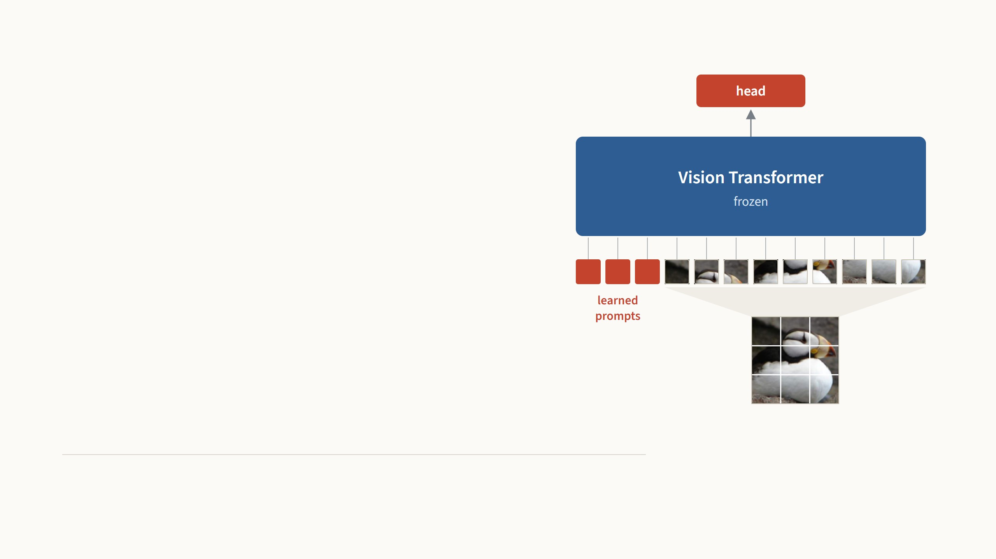
Visual Prompt
Tuning
Teach a frozen Vision Transformer a
new task by learning only a few extra
input vectors.
Menglin Jia, Luming Tang, Bor-Chun Chen, Claire Cardie, Serge Belongie, Bharath Hariharan, Ser-Nam Lim
Cornell University, Meta AI and University of Copenhagen. ECCV 2022.
Presented by Ertugrul Senturk
October 2026
Notes:
Two papers on parameter-efficient fine-tuning today: first VPT, then LoRA, then my own runs of both. The picture is the whole method: the blue Transformer stays frozen, the image goes in as patches, and only the few red vectors in front of them and the red head on top are trained. VPT is the vision paper that took "prompt tuning" from language models and asked whether it works on image encoders. For supervised ViTs it works surprisingly well, and at the end I will run the models I trained, live, in this browser. About seventy minutes in all; please interrupt.

Slide 2
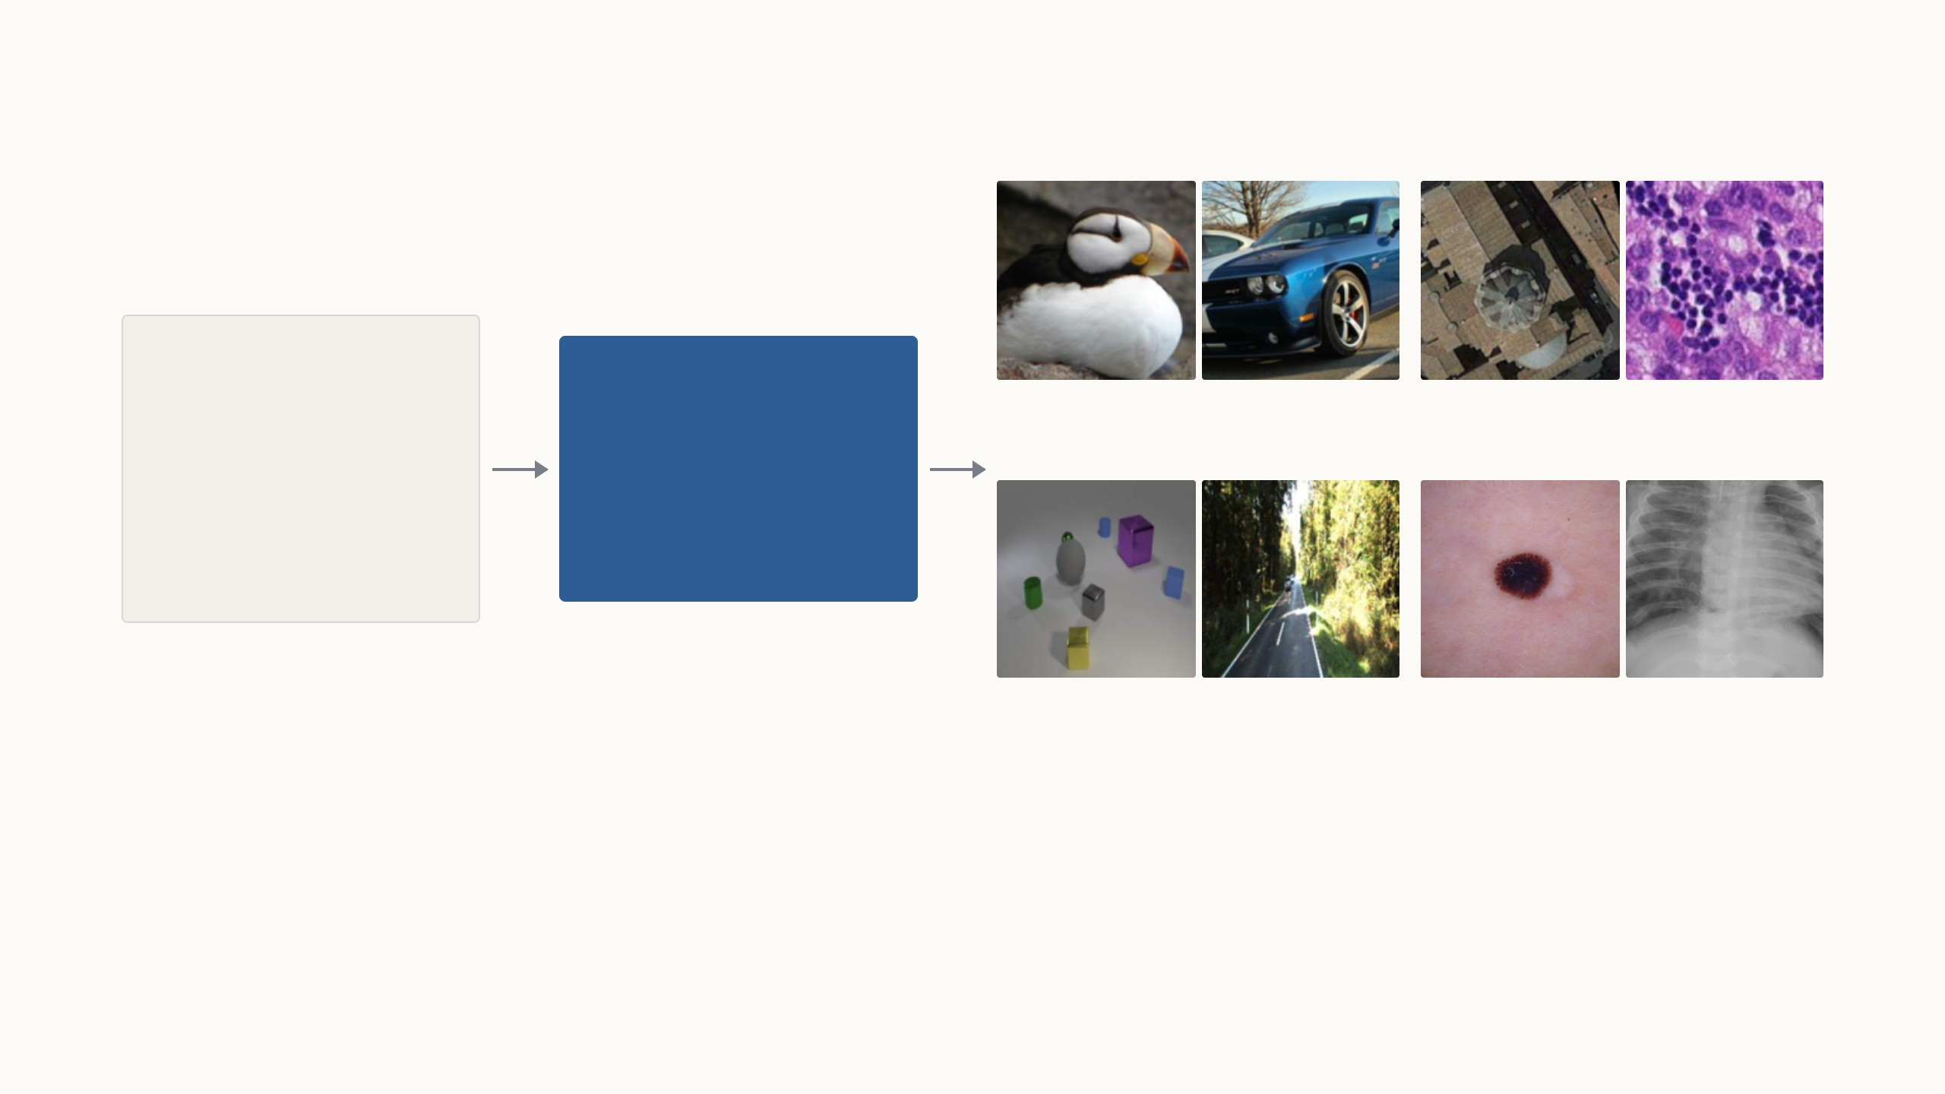
Pretrain one big model once, then adapt it to each task
ImageNet-21k
ViT-B/16
14 million photos in
21,000 everyday
categories. Pretraining
takes weeks and is done
once, by Google.
Fine-grained categories
Satellite and microscope
A Vision Transformer with
85.8 million weights that
has learned general visual
features.
200 bird species, 196 car models
land use from above, tissue slides
Counting and distance
Medical images
how many objects, how far away
my own experiments, shown later
Each new task is small: most tasks in the paper have only 1,000
training images, far too few to train from scratch. So we start
from the pretrained model and adapt it.
The paper asks how to adapt it best: accurately, and cheaply
enough to store for every task. Next, the standard answer and
what it costs, then the cheaper methods tried before VPT.
Dataset examples from Jia et al. 2022, Fig. 10. ViT-B/16: Dosovitskiy et al. 2021. The pretrained checkpoint used here and in the paper is Google's ImageNet-21k ViT-B/16.
2
Notes:
Make sure everyone has the mental model: pretraining is expensive and done once; adaptation is cheap and done for every task. Nothing in this talk touches pretraining. The first three tiles are examples of the paper's task groups (fine-grained, specialised, structured); the fourth, medical images, is what I will show at the end. Then set up the question: which way of adapting is both accurate and cheap to store?

Slide 3
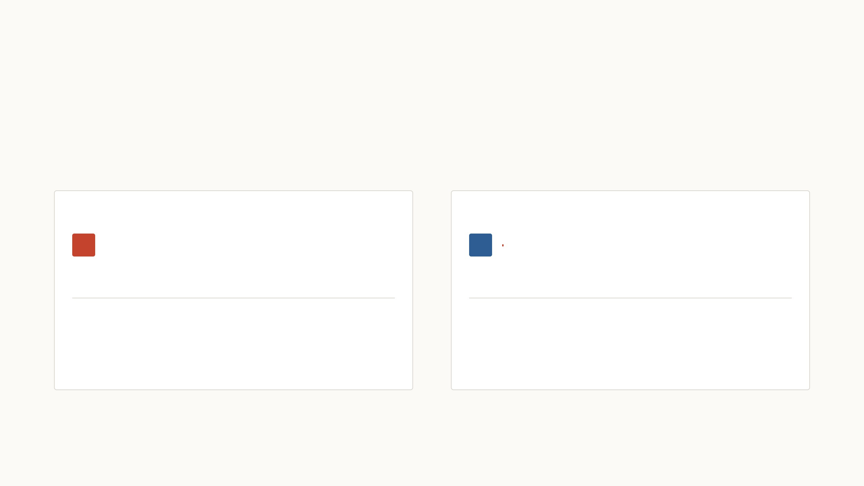
Full fine-tuning stores a new copy of the model per task
Full fine-tuning retrains every weight of the pretrained model on the new
task, and it is usually the most accurate option. The cost is that each task
keeps its own retrained copy, so storage grows with every task and with
the size of the model.
Shown for 1 task on ViT-B, 86 million weights. The
next pages show 24 tasks, then the largest model.
Full fine-tuning: 1 retrained ViT-B copy
VPT: one shared ViT-B plus 1 small file
each red speck is one task file, to scale
343 MB
345 MB
1 copy at 343 MB each
343 MB once, plus 2.2 MB per task
32-bit weights: ViT-B/16 85.8M, ViT-L/16 303M, ViT-H/14 632M. A VPT file is 50 prompts at every layer plus a 102-class head. Squares are sized by area.
3
Notes:
Full fine-tuning is the default and usually the most accurate, but every task gets its own retrained copy. Drag to 24 tasks: about 8 GB of ViT-B copies. Then click ViT-H: about 61 GB, so the problem grows with the model. The right panel is the punchline we are heading for: VPT keeps one shared frozen model (blue) and adds a file of a few megabytes per task (the tiny red specks, drawn to scale).

Slide 4
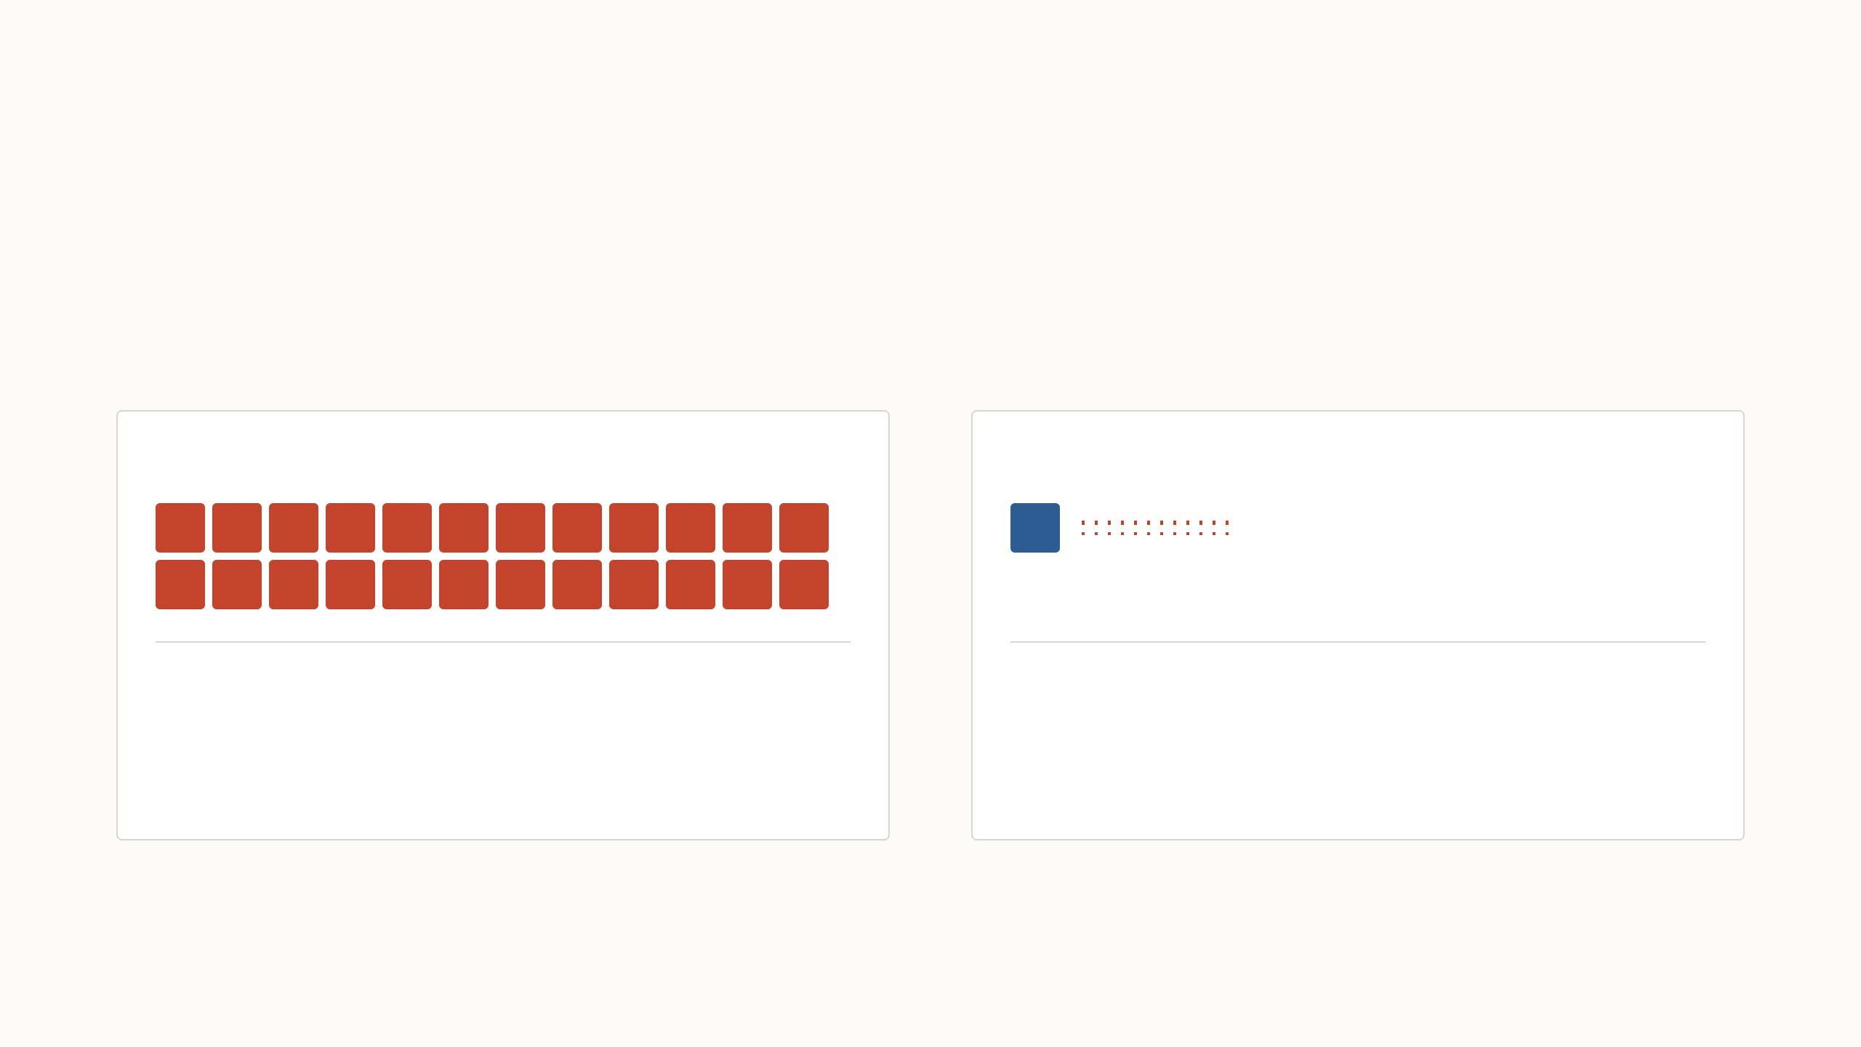
Full fine-tuning stores a new copy of the model per task
Full fine-tuning retrains every weight of the pretrained model on the new
task, and it is usually the most accurate option. The cost is that each task
keeps its own retrained copy, so storage grows with every task and with
the size of the model.
Shown for 24 tasks on ViT-B, 86 million weights.
Full fine-tuning: 24 retrained ViT-B copies
VPT: one shared ViT-B plus 24 small files
each red speck is one task file, to scale
8.2 GB
395 MB
24 copies at 343 MB each
343 MB once, plus 2.2 MB per task
32-bit weights: ViT-B/16 85.8M, ViT-L/16 303M, ViT-H/14 632M. A VPT file is 50 prompts at every layer plus a 102-class head. Squares are sized by area.
3
Notes:
Full fine-tuning is the default and usually the most accurate, but every task gets its own retrained copy. Drag to 24 tasks: about 8 GB of ViT-B copies. Then click ViT-H: about 61 GB, so the problem grows with the model. The right panel is the punchline we are heading for: VPT keeps one shared frozen model (blue) and adds a file of a few megabytes per task (the tiny red specks, drawn to scale).

Slide 5

Full fine-tuning stores a new copy of the model per task
Full fine-tuning retrains every weight of the pretrained model on the new
task, and it is usually the most accurate option. The cost is that each task
keeps its own retrained copy, so storage grows with every task and with
the size of the model.
Shown for 24 tasks on ViT-H, 632 million weights.
Full fine-tuning: 24 retrained ViT-H copies
VPT: one shared ViT-H plus 24 small files
each red speck is one task file, to scale
61 GB
2.7 GB
24 copies at 2.5 GB each
2.5 GB once, plus 8.7 MB per task
32-bit weights: ViT-B/16 85.8M, ViT-L/16 303M, ViT-H/14 632M. A VPT file is 50 prompts at every layer plus a 102-class head. Squares are sized by area.
3
Notes:
Full fine-tuning is the default and usually the most accurate, but every task gets its own retrained copy. Drag to 24 tasks: about 8 GB of ViT-B copies. Then click ViT-H: about 61 GB, so the problem grows with the model. The right panel is the punchline we are heading for: VPT keeps one shared frozen model (blue) and adds a file of a few megabytes per task (the tiny red specks, drawn to scale).

Slide 6

Cheaper methods existed, but none matched full fine-tuning
Mean accuracy (%)
Weights trained
Full fine-tuning
retrain every weight
73.9
100%
Only the top of the model is trained
Partial-1
train the head and the last of 12 layers
66.2
8.35%
Linear probe
train only a new output layer
63.1
0.09%
MLP-3 head
train a bigger, three-layer head
62.8
1.45%
Small parts in or beside the backbone are trained
Bias
train only the bias terms of every layer
71.0
0.21%
Adapter
insert small trainable blocks in every layer
66.7
0.36%
Sidetune
train a small network beside the model
57.0
10.09%
Bias came closest and even beat full fine-tuning on 8 of the 24 tasks, but on average no cheaper method reached it.
VPT takes a third route: it leaves the model alone and changes the input.
Mean test accuracy over the paper's 24 tasks, ViT-B/16 (Jia et al. 2022, Table 1, mean of the four group averages). The right column is the share of weights trained for each task.
4
Notes:
The dashed line is full fine-tuning at 73.9. Two families. The first only changes the top of the model: a new linear layer, a bigger head, or the head plus the last layer. A bigger head does not help, so the frozen features are the bottleneck. The second family trains small parts in or beside the backbone: Bias tunes only the bias vectors, Adapter inserts small MLPs, Sidetune adds a side network. Bias is strong at 71.0, but nothing reaches 73.9. VPT belongs to neither family: it changes the input.

Slide 7
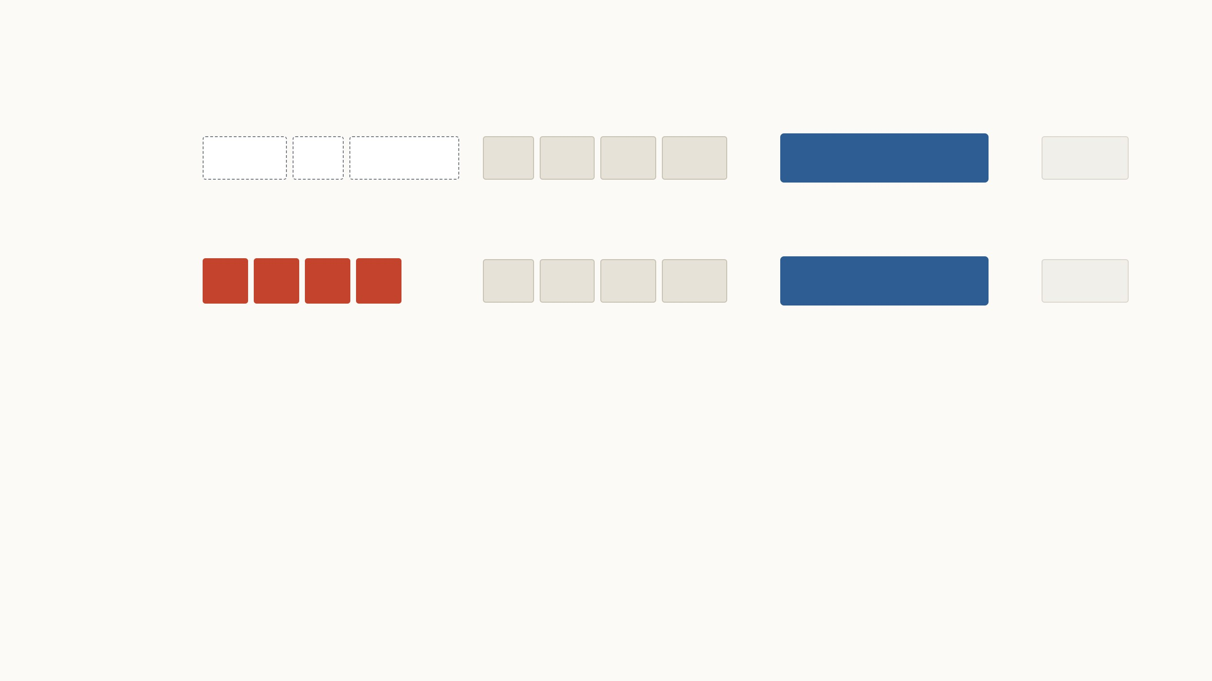
Where the word "prompt" comes from
2020
→
frozen language model
→
Classify
the
sentiment:
the
film
was
great
positive
GPT-3
prompt: words a person chose
input
2021
→
frozen language model
→
the
film
was
great
positive
Prompt tuning
prompt: learned vectors, no words
input
In 2020, a prompt was text. GPT-3, a frozen model with 175
billion weights, was only trained to continue text, yet it does a
new task when you type a description of the task in front of
the input. Not a single weight changes. But words are discrete,
so the only way to improve a prompt is trial and error.
In 2021, prompt tuning (Lester et al.) replaced the words with
learned vectors that correspond to no word. They are trained
by gradient descent on the task's examples while the model
stays frozen, and they are all you store per task. Prefix-tuning
(Li & Liang) does the same at every layer.
The sentiment example is illustrative. Brown et al. 2020 (GPT-3); Lester, Al-Rfou, Constant 2021 (prompt tuning, T5); Li & Liang 2021 (prefix-tuning).
5
Notes:
Two steps, one idea. In 2020, GPT-3 showed that a frozen language model does new tasks if you type a description of the task in front of the input; that text is the prompt, and no weight changes. Its weakness: words are discrete, so you can only improve a prompt by trial and error. In 2021, prompt tuning kept the frozen model and replaced the words with vectors trained by gradient descent: the red squares correspond to no word at all. Per task you store k vectors of 1,024 numbers, roughly 20,000 numbers instead of billions. Prefix-tuning does the same at every layer. LoRA, the second paper in this talk, also dates from 2021 but takes a different route: it changes the weights, not the input.

Slide 8
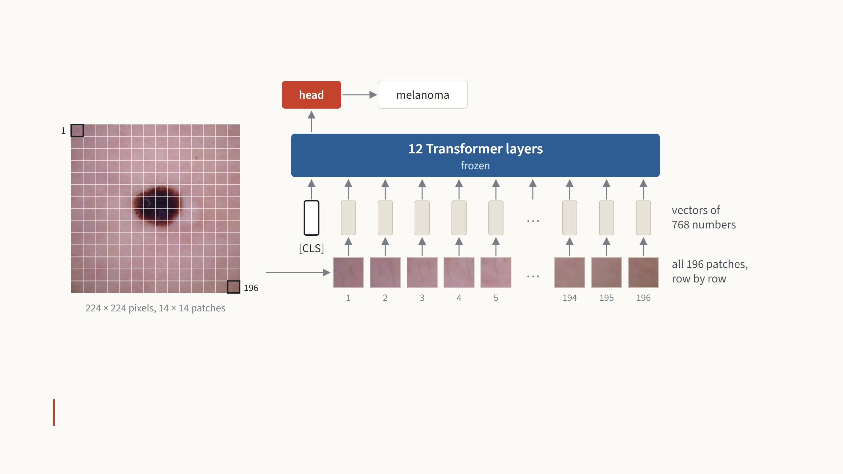
How a Vision Transformer reads an image
A fixed grid cuts the image into 196 patches of 16 × 16 pixels, and each patch, read row by row, becomes a vector of 768
numbers. One extra vector, [CLS], goes in front to collect a summary of the whole image: the 12 layers mix all 197 vectors, and
the head reads only [CLS] to name the class.
The layers only see a sequence of vectors, so we can add a few more.
ViT-B/16: 12 layers, vectors of 768 numbers, 85.8 million weights. Dosovitskiy et al., ICLR 2021. Image: a melanoma from DermaMNIST, 224 × 224 pixels.
6
Notes:
Spend a minute here, it pays off. Walk the picture from left to right and up: a fixed grid cuts the image into 14 by 14 patches, whatever the image shows; nothing is selected, all 196 go in, read row by row from patch 1 at the top left to 196 at the bottom right. Each patch, 16 × 16 × 3 = 768 pixel values, goes through one linear layer to become a grey vector of 768 numbers (the two 768s are a coincidence of ViT-B), with a position vector added so the model knows where it came from. In front sits one extra learned vector, [CLS], which carries no image content and collects a summary as it goes up. The 12 Transformer layers, blue because they will stay frozen in VPT, let every vector look at every other one. At the top, only the [CLS] vector goes to the head, the one task-specific part, which outputs melanoma. The point for VPT: the Transformer does not care how long the sequence is or where a vector came from, so we can add our own vectors.

Slide 9
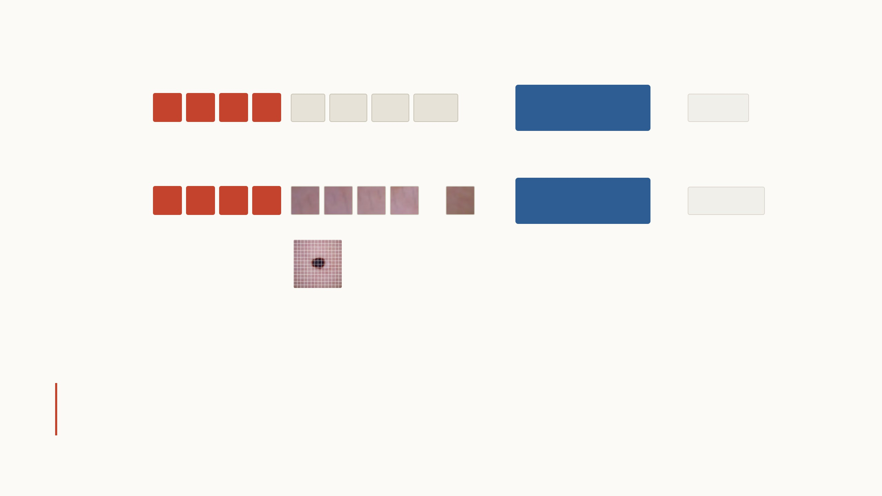
A visual prompt is the same idea applied to image patches
Language
→
frozen language
model
→
the
film
was
great
positive
Lester et al. 2021
learned prompt: random at
first, trained for the task,
same for every input
↑
“the film was great”
Vision
…
→
frozen Vision
Transformer
→
melanoma
Jia et al. 2022
learned prompt: random at
first, trained for the task,
same for every image
↑
all 196 patches
of the image
The grey vectors come from the input, as before. The red ones do not: they start as random numbers, are trained on the task's
examples while the model stays frozen, and are then put in front of every input of that task. A visual prompt is therefore not
text and not a pattern painted on the pixels, only learned numbers in the model's input space.
In language, prompt tuning matched full fine-tuning only once the model had about 10 billion
weights. VPT beats full fine-tuning on 20 of 24 tasks with an 86-million-weight ViT-B.
Lester et al. 2021 (T5); Jia et al. 2022, Table 1. Not to be confused with CoOp (Zhou et al. 2021, text prompts for CLIP) or Bahng et al. 2022 (a pixel pattern).
7
Notes:
The one-sentence version: VPT is prompt tuning for a Vision Transformer. Both rows learn vectors in the model's input space and leave the model alone; the only difference is where the other vectors come from, words or image patches. Say plainly what it is not: not the text prompts for CLIP that CoOp learns, and not a learned pattern painted on the pixels as in Bahng et al.; the paper tests the pixel version too and it is clearly weaker. Then the surprise: in language, learned prompts needed about 10 billion weights to match full fine-tuning; VPT beats it on 20 of 24 tasks with 86 million. The authors themselves suggest vision prompts may behave differently from language prompts. Point at the labels under each row: the grey vectors come from the input, the red ones never do; they start random, are trained on the task, and the same set goes in front of every image of that task.

Slide 10
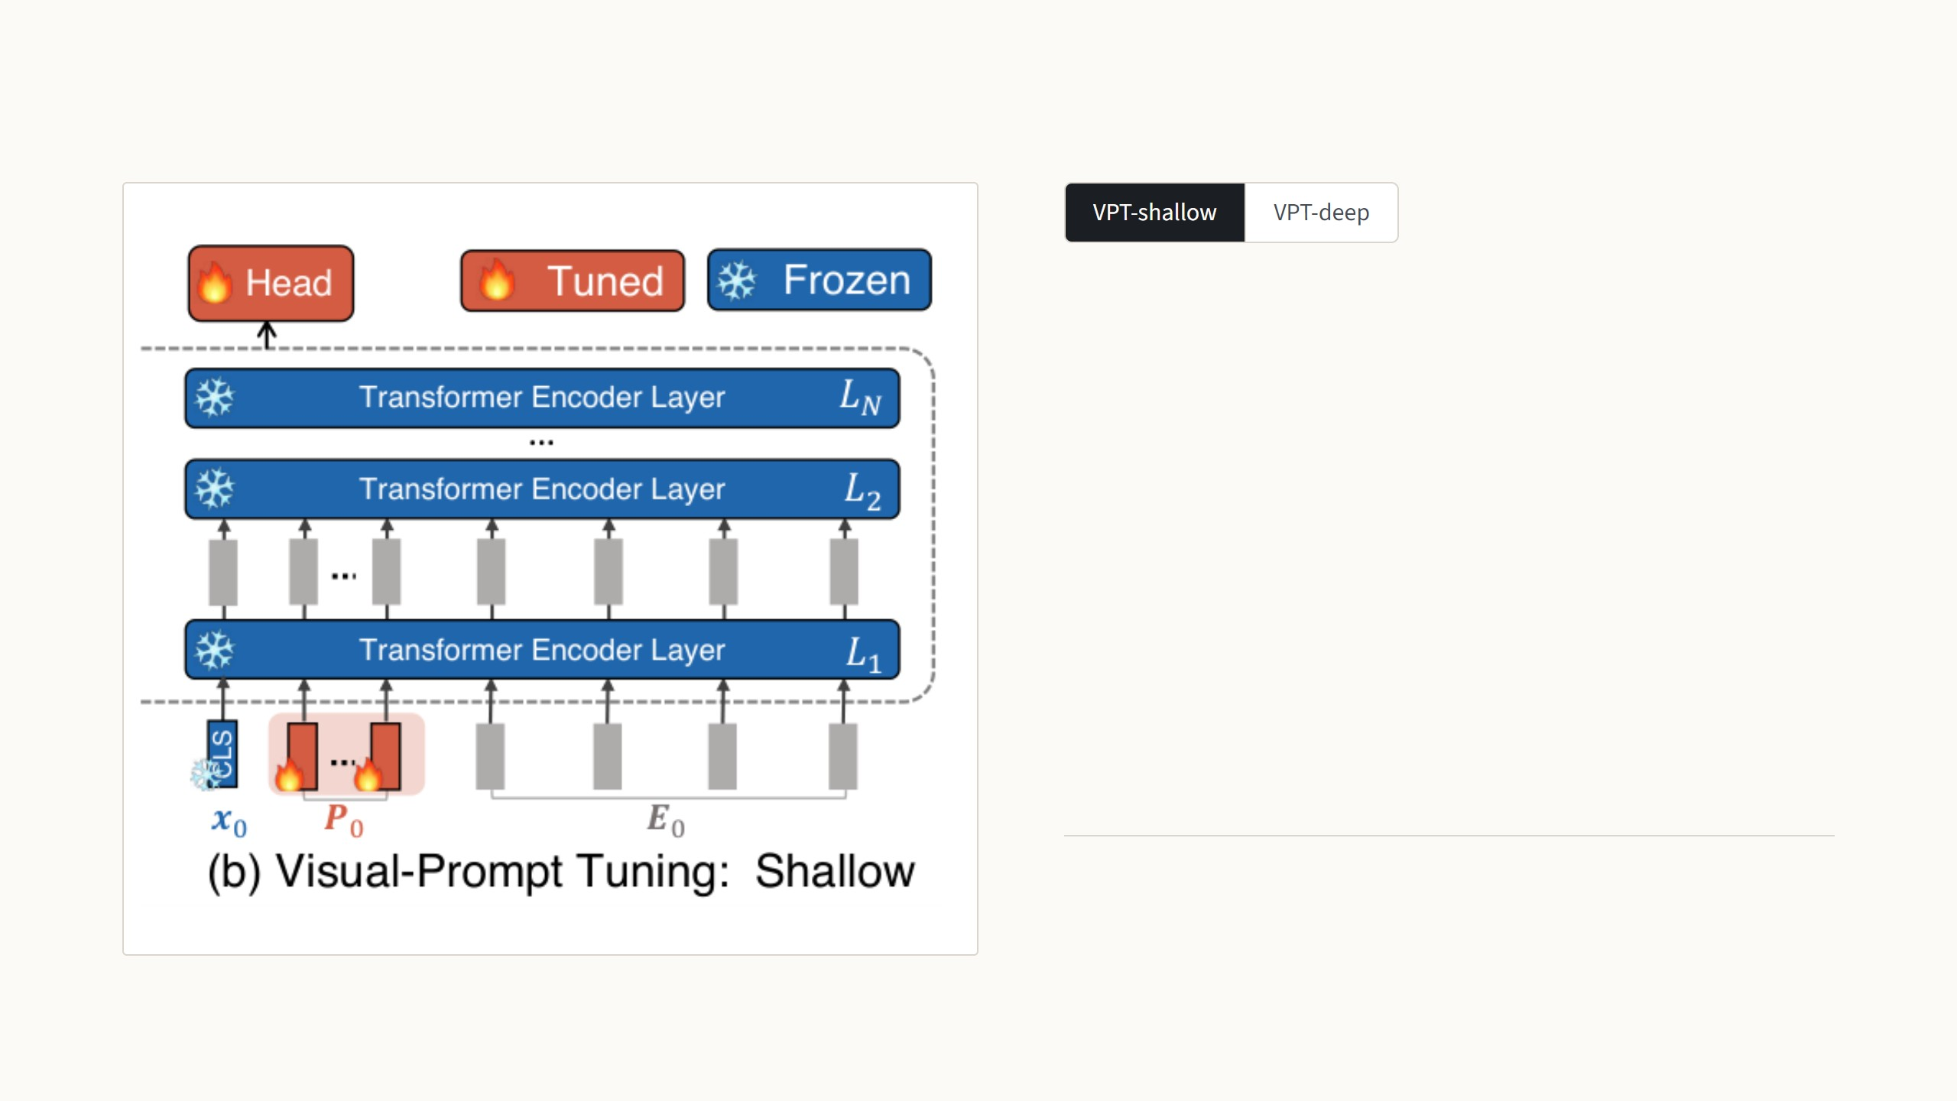
VPT trains a few extra input vectors and the head
The p prompt vectors P are added once, before the first
layer. After that they pass through the 12 frozen layers like
any other token.
[x1, Z1, E1] = L1([x0, P, E0])prompts enter once
[xi, Zi, Ei] = Li([xi−1, Zi−1, Ei−1])i = 2 … 12
y = Head(x12)
Per task, only the red parts are trained and saved: 50 prompt
vectors and the head, 0.14% of the model.
Figures: Jia et al. 2022, Fig. 2. Equations (6) and (8) of the paper: x class token, E patch vectors, P prompts, Z the prompt positions after a layer, Li layer i.
8
Notes:
Shallow first: p red vectors are put in front of the patch vectors once, before layer 1. They then travel through all 12 frozen layers like any other token; the paper calls their outputs Z. Only P and the head are trained, about 0.14% of the model for 50 prompts and a 102-class head. Press the arrow key for deep: every layer gets its own fresh set of p vectors, and whatever came out of the previous layer at those positions is thrown away, the blank in the equation. Twelve times the parameters, still only half a percent of the model, and deep is the variant that beats full fine-tuning. Position does not matter because prompts are added after the position embedding.

Slide 11
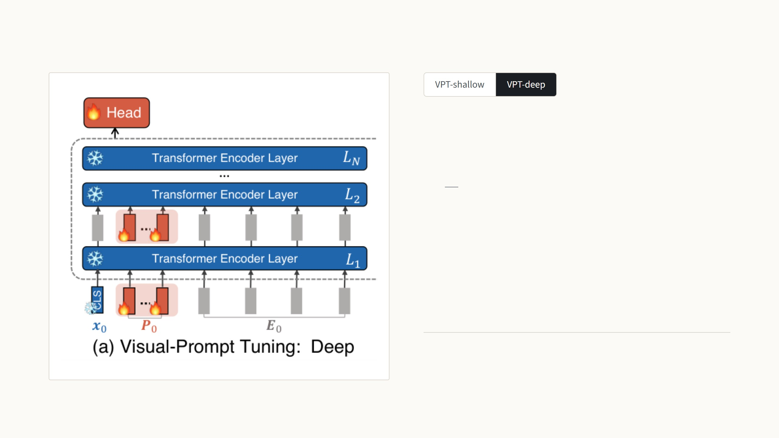
VPT trains a few extra input vectors and the head
Every layer gets its own fresh set of p prompt vectors. What
the previous layer produced at those positions is thrown
away: the blank in the equation.
[xi, , Ei] = Li([xi−1, Pi−1, Ei−1])i = 1 … 12
y = Head(x12)
Per task, only the red parts are trained and saved: 50 prompt
vectors for each layer and the head, 0.63% of the model.
Figures: Jia et al. 2022, Fig. 2. Equations (6) and (8) of the paper: x class token, E patch vectors, P prompts, Z the prompt positions after a layer, Li layer i.
8
Notes:
Shallow first: p red vectors are put in front of the patch vectors once, before layer 1. They then travel through all 12 frozen layers like any other token; the paper calls their outputs Z. Only P and the head are trained, about 0.14% of the model for 50 prompts and a 102-class head. Press the arrow key for deep: every layer gets its own fresh set of p vectors, and whatever came out of the previous layer at those positions is thrown away, the blank in the equation. Twelve times the parameters, still only half a percent of the model, and deep is the variant that beats full fine-tuning. Position does not matter because prompts are added after the position embedding.

Slide 12
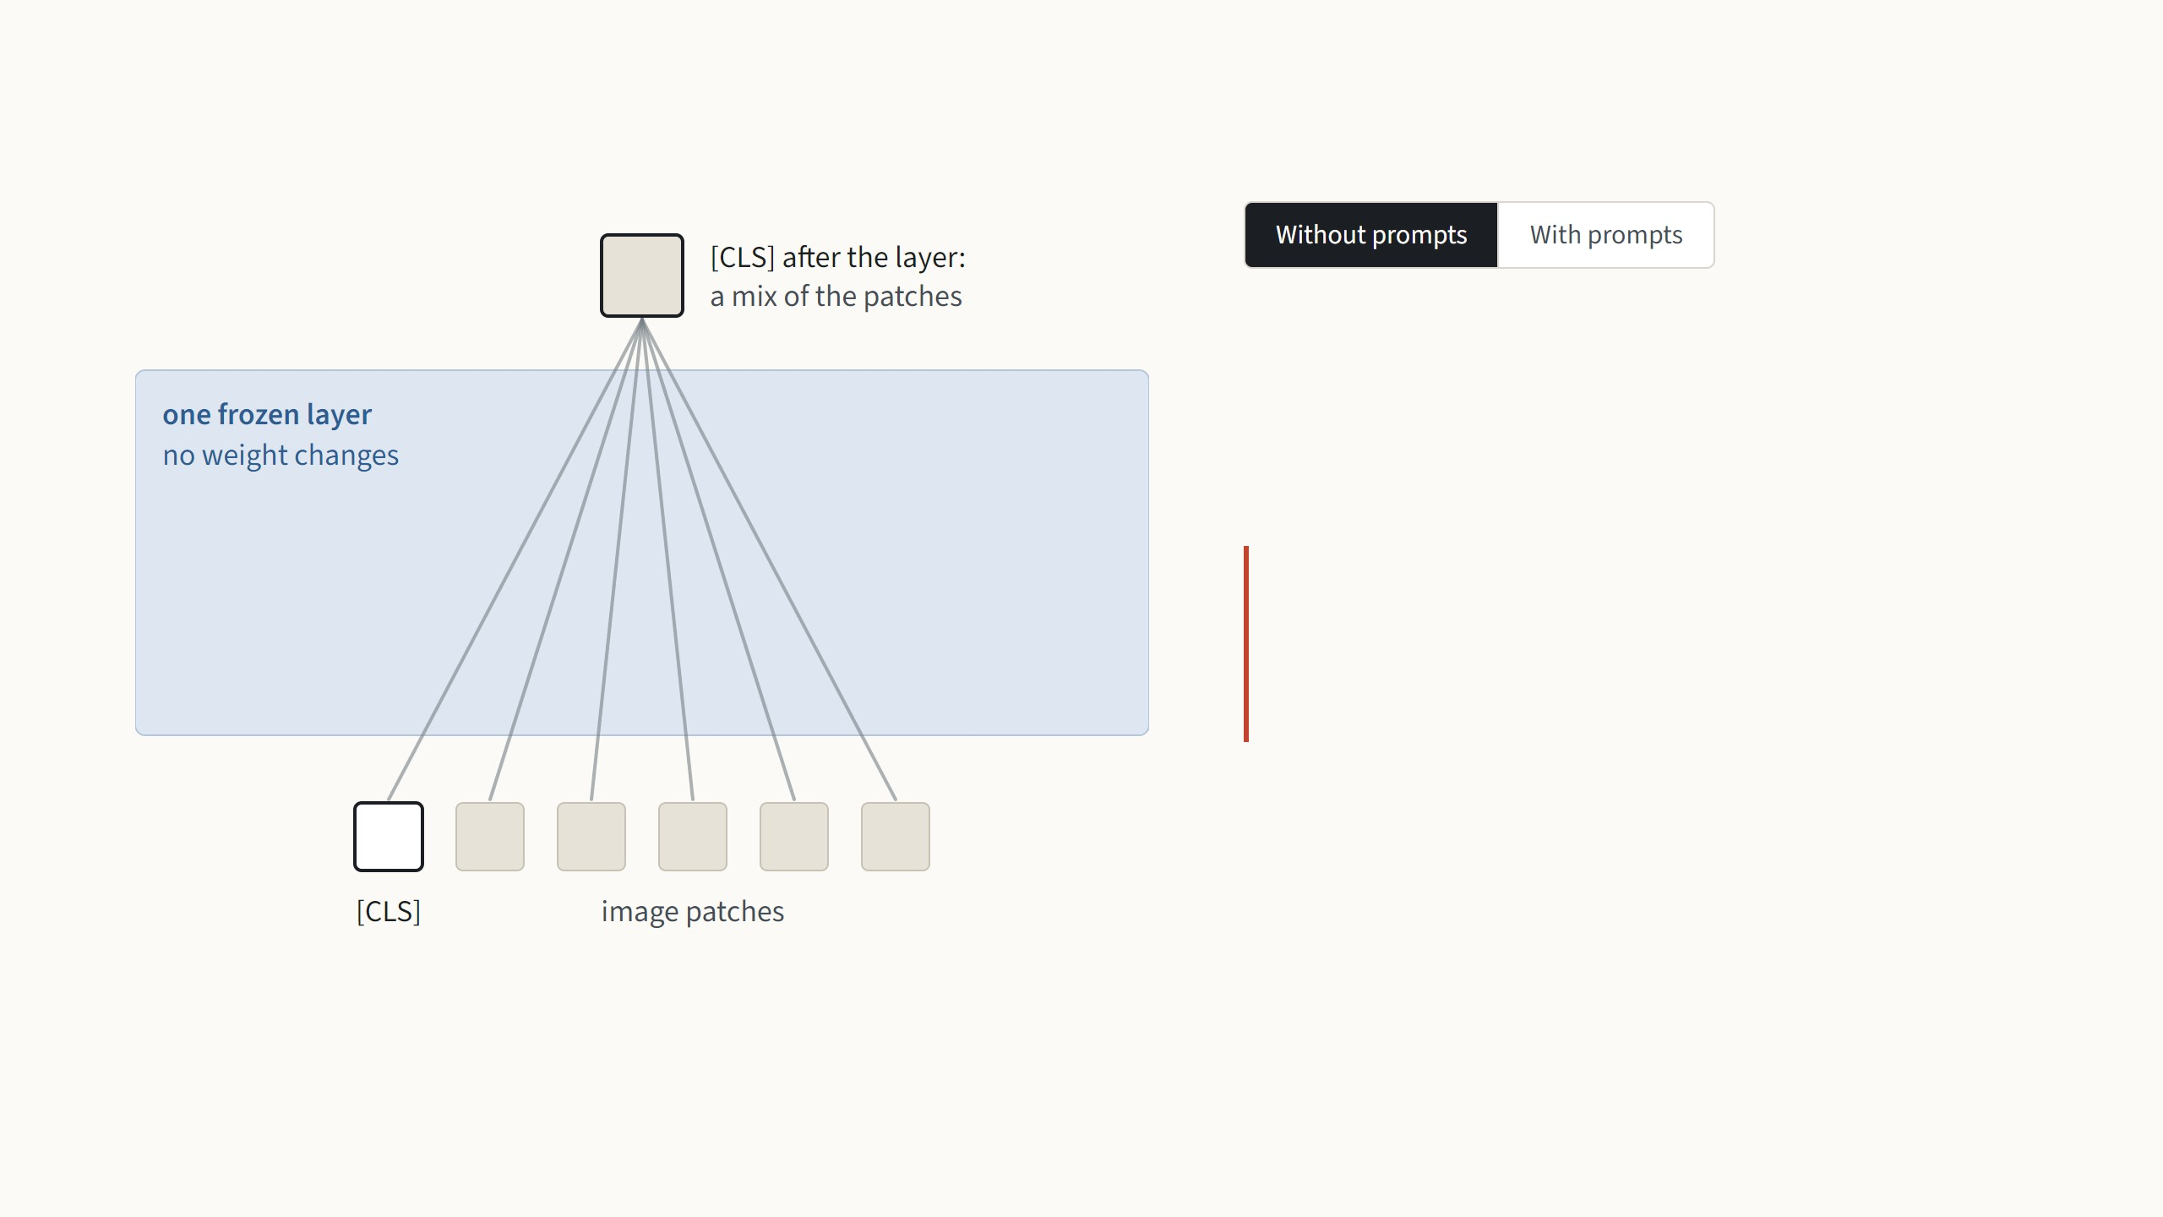
Why a few extra tokens can steer a frozen network
In every layer, each token takes in information from all
the other tokens; this is attention. With prompts in the
sequence, [CLS] and every patch also take in
information from the prompts.
So training the prompts changes what the
frozen network computes, without
changing a single weight.
Mechanism: Sec. 3 of Jia et al. 2022; Appendix B relates it to prefix-tuning ("VPT-prefix"). Line widths and the red share of [CLS] are illustrative, not measured.
9
Notes:
The intuition people need: a frozen function can still be steered if you control part of its input. Start without prompts: inside a frozen layer, the [CLS] token collects a mix of the patch tokens. Press the arrow key: the red prompts join the sequence, and now part of what [CLS] collects comes from them. Every other token sees the prompts too, at every layer. No weight changes, and nothing is read from the prompt outputs themselves; in VPT-deep they are discarded after each layer. If asked: the paper points out this is equivalent to prepending learned keys and values inside attention, which is what prefix-tuning does in NLP.

Slide 13
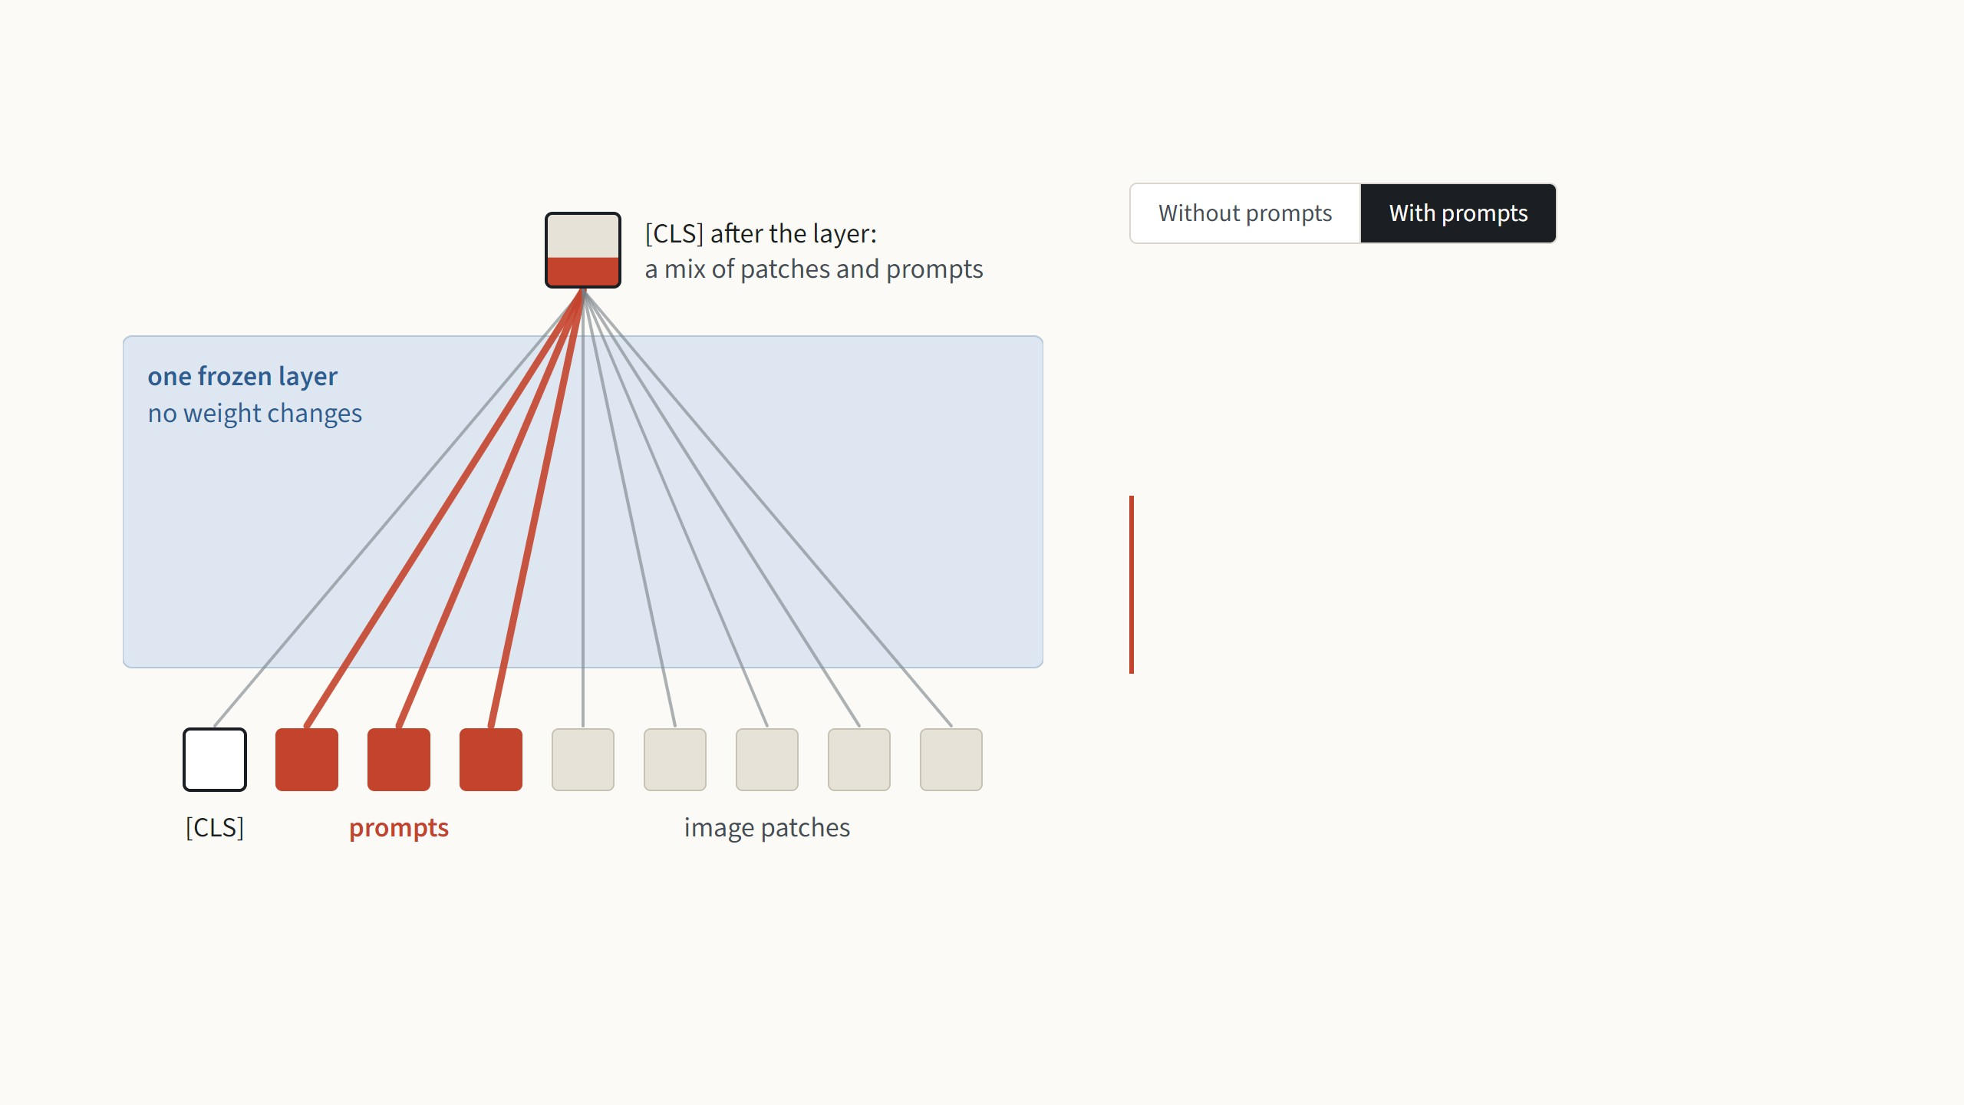
Why a few extra tokens can steer a frozen network
In every layer, each token takes in information from all
the other tokens; this is attention. With prompts in the
sequence, [CLS] and every patch also take in
information from the prompts.
So training the prompts changes what the
frozen network computes, without
changing a single weight.
Mechanism: Sec. 3 of Jia et al. 2022; Appendix B relates it to prefix-tuning ("VPT-prefix"). Line widths and the red share of [CLS] are illustrative, not measured.
9
Notes:
The intuition people need: a frozen function can still be steered if you control part of its input. Start without prompts: inside a frozen layer, the [CLS] token collects a mix of the patch tokens. Press the arrow key: the red prompts join the sequence, and now part of what [CLS] collects comes from them. Every other token sees the prompts too, at every layer. No weight changes, and nothing is read from the prompt outputs themselves; in VPT-deep they are discarded after each layer. If asked: the paper points out this is equivalent to prepending learned keys and values inside attention, which is what prefix-tuning does in NLP.

Slide 14
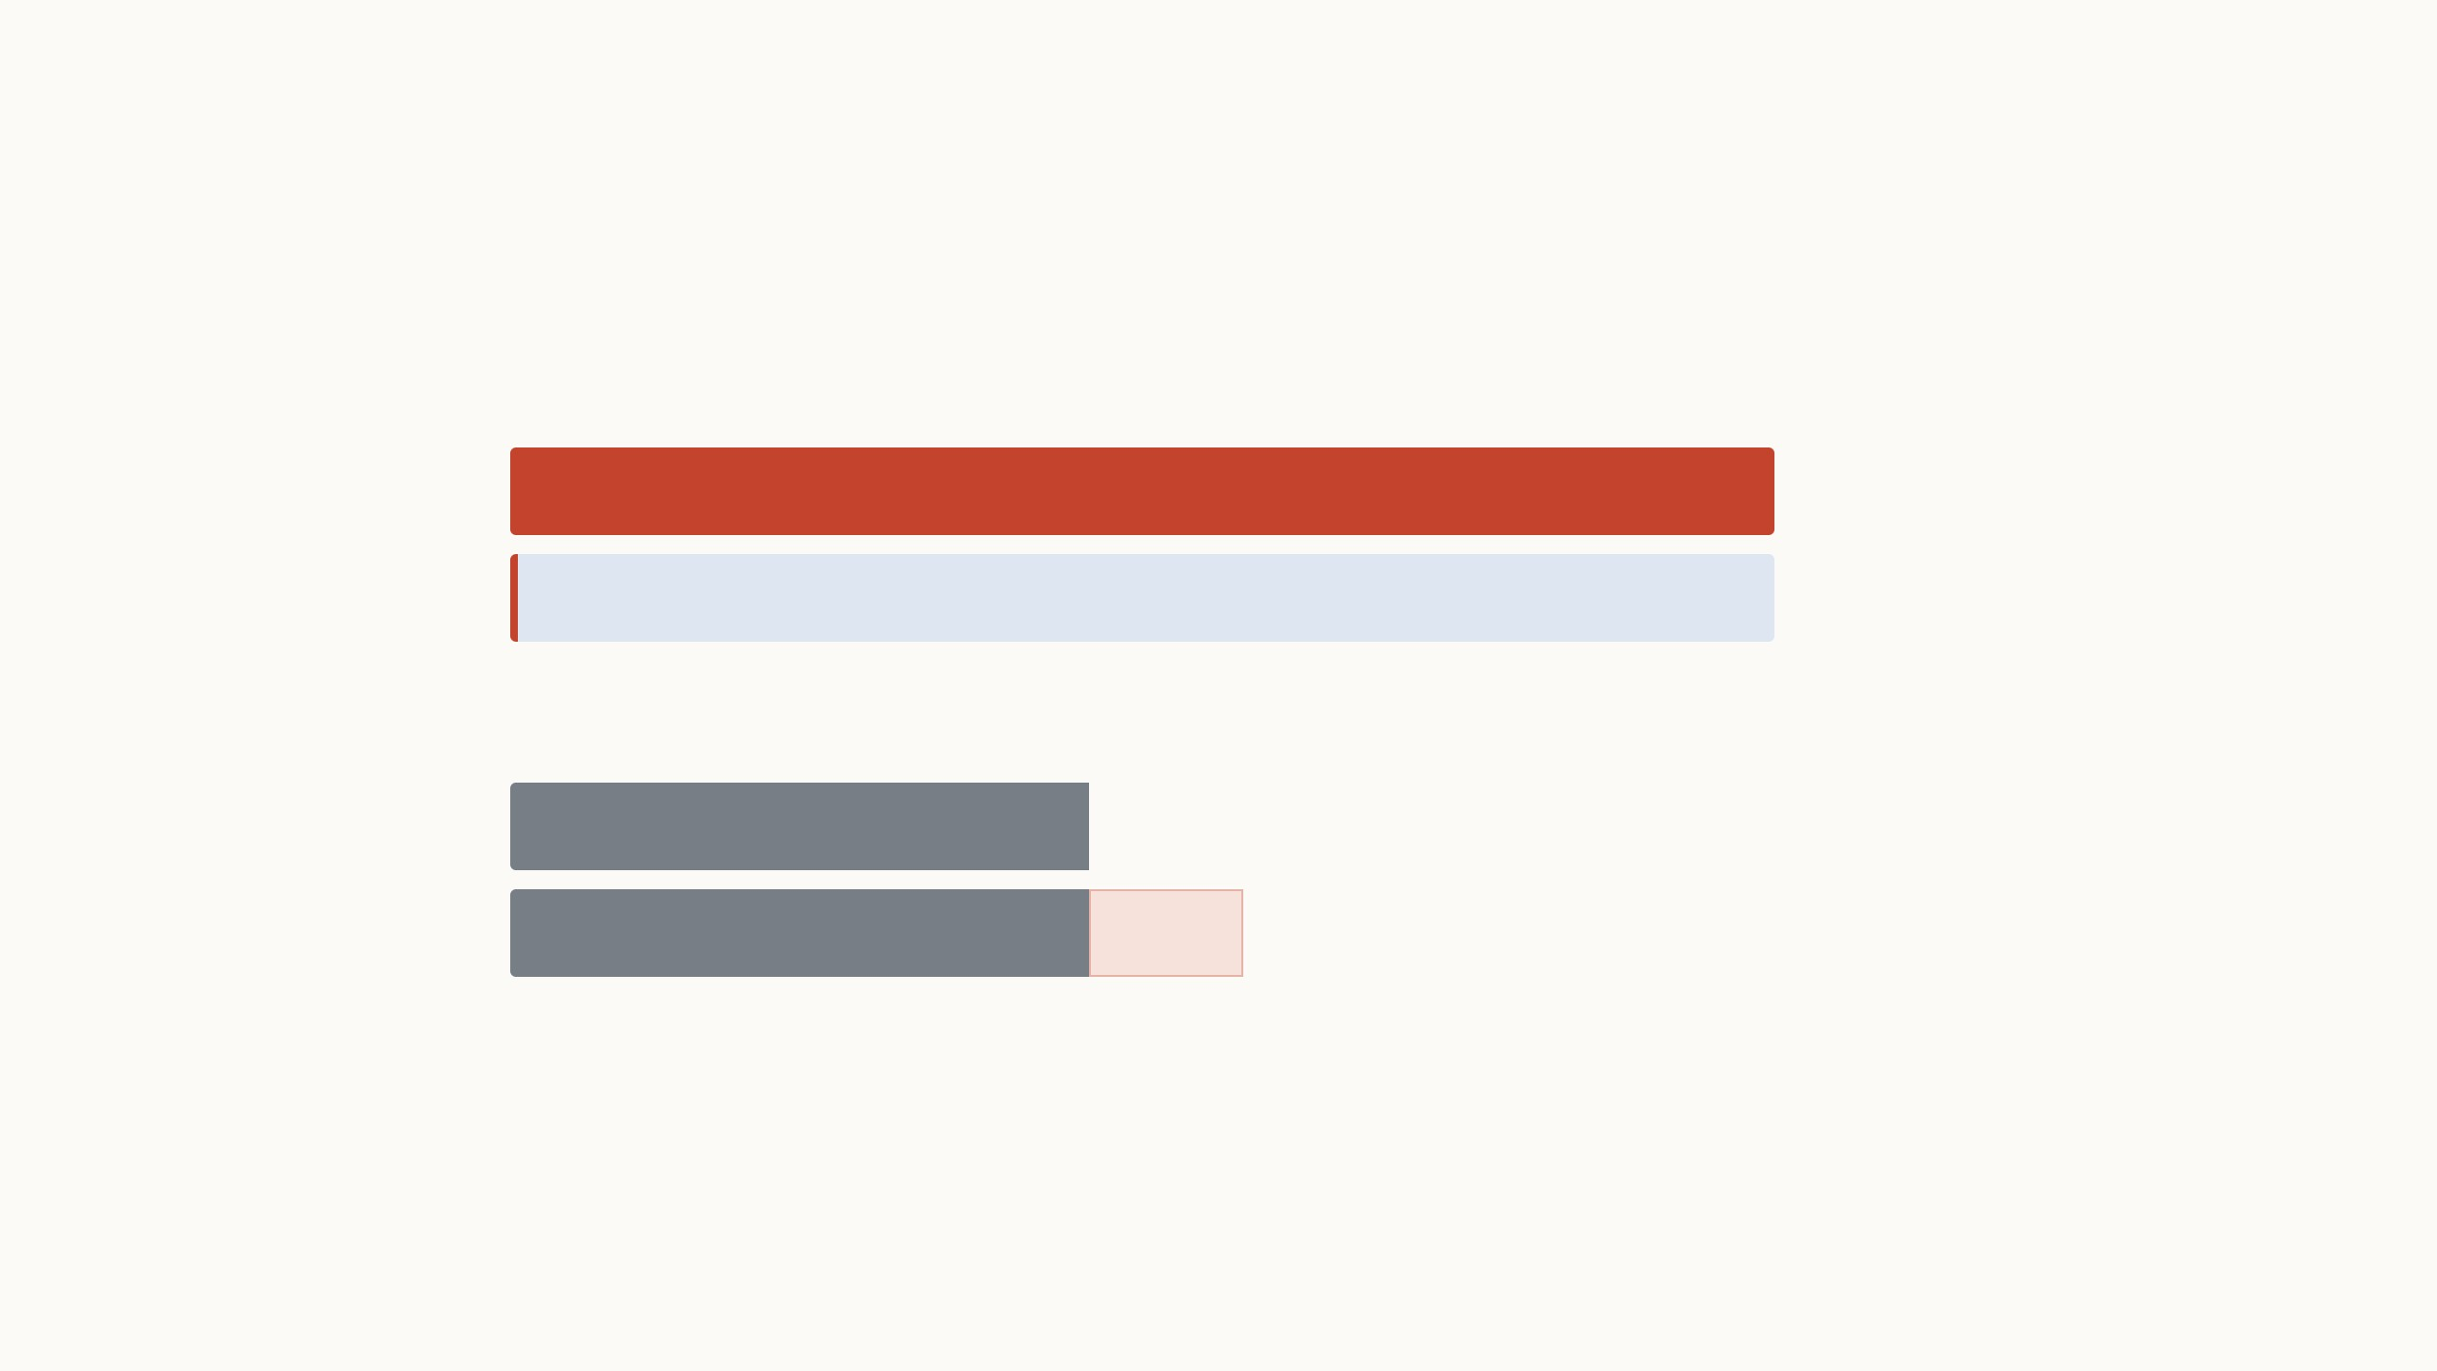
How much VPT trains and stores per task
N · p · d = 12 × 50 × 768 = 460,800prompt numbers, plus 78,438 for a 102-class head
Numbers trained and stored per task
Full fine-tuning
all 85.8 million weights, retrained for this task
343 MB100%
VPT-deep
the same 85.8 million weights, frozen and shared by every task
2.2 MB0.63%
Compute per image
Plain ViT
197 tokens
1.00×
VPT-deep
197 tokens
1.27×+50 prompt tokens
Shown for p = 50; at p = 200 the file is 7.7 MB and compute is about 2.1×. More prompts keep the file small, but every image carries them
through all 12 layers.
ViT-B/16, N = 12 layers, d = 768, 32-bit numbers. Compute counts multiply-adds per layer for n tokens (12nd² + 2n²d). The paper measures about 2× test latency at p = 200 (Jia et
al. 2022, Table 12).
10
Notes:
Section 3.2 in numbers. With 50 prompts at each of the 12 layers, VPT trains 12 × 50 × 768 = 460,800 prompt numbers plus a 78,438-number head for 102 classes: about 0.6% of the model, a 2.2 MB file per task instead of a 343 MB retrained copy. The red sliver is to scale. The honest cost is compute: the prompts are extra tokens, so each image now has 247 tokens instead of 197. Click p = 200: the file is still under 8 MB, but compute is about twice the plain ViT, which matches the roughly 2× test latency the paper measures in Table 12.

Slide 15
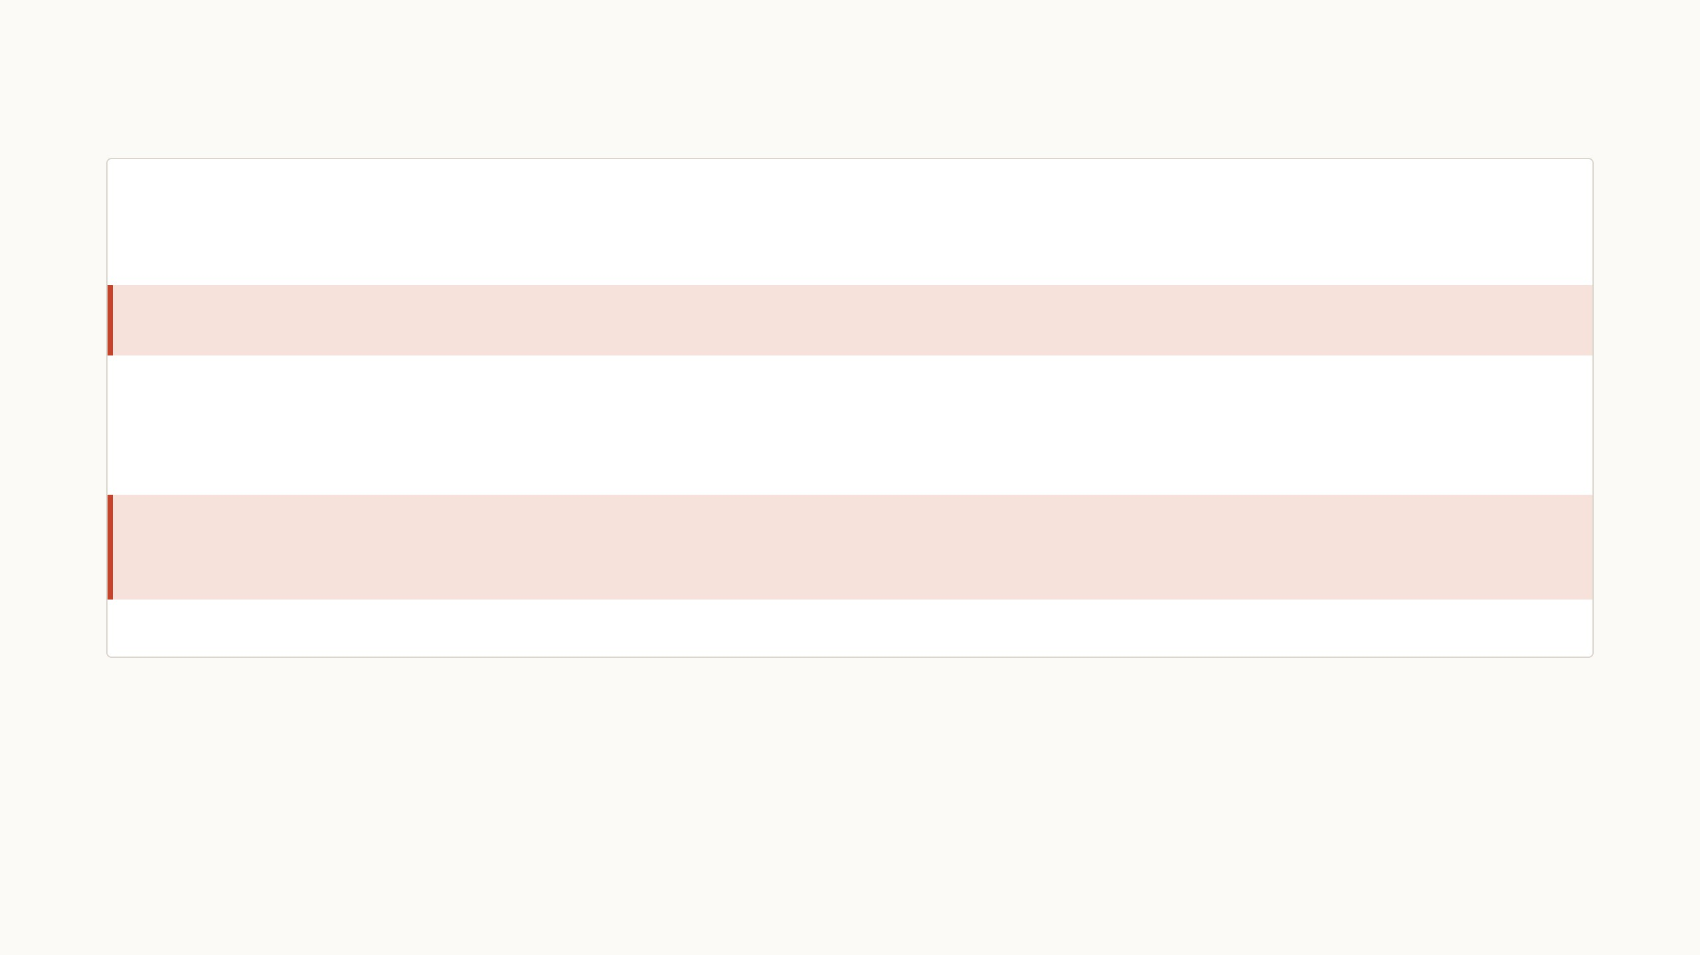
VPT in code: a few lines and one new hyperparameter
# VPT-deep on a frozen ViT-B/16, simplified from demo/vpt/vpt_model.py
vit = timm.create_model(BACKBONE, pretrained=True) # ImageNet-21k ViT-B/16
vit.requires_grad_(False) # backbone frozen
prompts = nn.Parameter(torch.empty(12, p, 768).uniform_(-b, b)) # trained: 12 layers × p × 768
head = nn.Linear(768, num_classes) # trained: the classifier
def forward(img):
x = vit._pos_embed(vit.patch_embed(img)) # [CLS] + 196 patch vectors
for i, layer in enumerate(vit.blocks):
rest = x[:, 1:] if i == 0 else x[:, 1 + p:] # drop last layer's prompts
P = prompts[i].expand(len(x), -1, -1) # this layer's prompts
x = layer(torch.cat([x[:, :1], P, rest], dim=1)) # frozen layer on [CLS, P, rest]
return head(vit.norm(x)[:, 0]) # classify from [CLS]
The prompts start random, with Xavier-
uniform values as in the official code. The
paper tried smarter starts, such as class
prototypes, and random did as well or better.
Training is plain SGD with momentum for 100
epochs on a cosine schedule. Learning rate
and weight decay are picked on a validation
split, for every method alike.
The one new hyperparameter is the prompt
length p, chosen per task from {1, 5, 10, 50,
100, 200} on the validation split.
Recipe: Jia et al. 2022, Sec. 4.1 and Appendix A. Code is my re-implementation, which reproduces the paper's Oxford Flowers result (99.1% vs the paper's 99.0%).
11
Notes:
The code is there to make it concrete, not to read line by line. The red lines are the whole method: a prompt tensor of 12 × p × 768 numbers, a head, and three lines inside the layer loop. The first of those slices away what the previous layer produced at the prompt positions, then this layer's fresh prompts go in next to [CLS] and the patches, and the frozen layer runs as usual. Underneath: random initialisation is fine, the optimiser is standard SGD, and the only new knob is p, picked on validation.

Slide 16
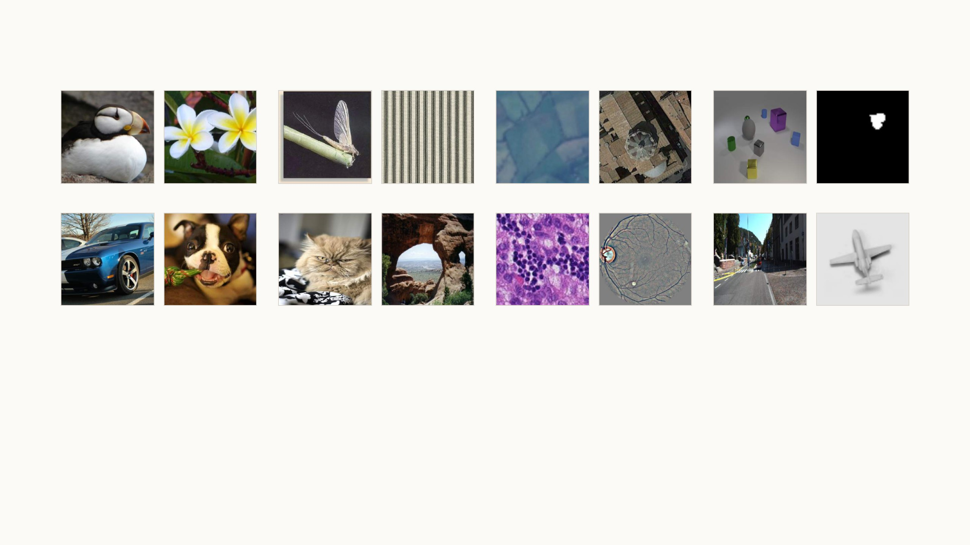
The paper tests VPT on 24 very different tasks
CUB-200
Oxford Flowers
Caltech101
DTD
EuroSAT
Resisc45
CLEVR count
dSprites location
Stanford Cars
Stanford Dogs
Oxford Pets
SUN397
Patch Camelyon
Retinopathy
KITTI distance
SmallNORB azimuth
FGVC, 5 tasks
VTAB Natural, 7 tasks
VTAB Specialized, 4 tasks
VTAB Structured, 8 tasks
Fine-grained categories, such as
200 bird species, with thousands
of training images.
Ordinary photos of objects,
textures, animals and scenes,
close to the pretraining data.
Images from special sensors:
satellites, tissue slides under a
microscope, and retina cameras.
Geometry instead of categories,
such as counting objects or
judging distance.
All 24 tasks use the same frozen ViT-B/16, pretrained on ImageNet-21k. The 19 VTAB tasks have only 1,000 training images each.
Images: Jia et al. 2022, Fig. 10, four example tasks per group. VTAB-1k: Zhai et al. 2019.
12
Notes:
Four groups, four example tasks each, 24 tasks in all. FGVC is fine-grained recognition with plenty of data: bird species, flowers, car models, dog breeds. The other 19 come from VTAB and have only 1,000 training images each, so this is a low-data benchmark. Natural is ordinary photos, closest to what the backbone saw in pretraining. Specialized is special sensors: satellite images, tissue slides, retina scans. Structured asks about geometry, such as how many objects there are or how far away the car in front is, and it is furthest from ImageNet, so it is the group to watch. The backbone is the same frozen ViT-B/16 for every task. Hyperparameters are picked on an 800/200 split of the 1,000 images, then the model is retrained on all 1,000.

Slide 17
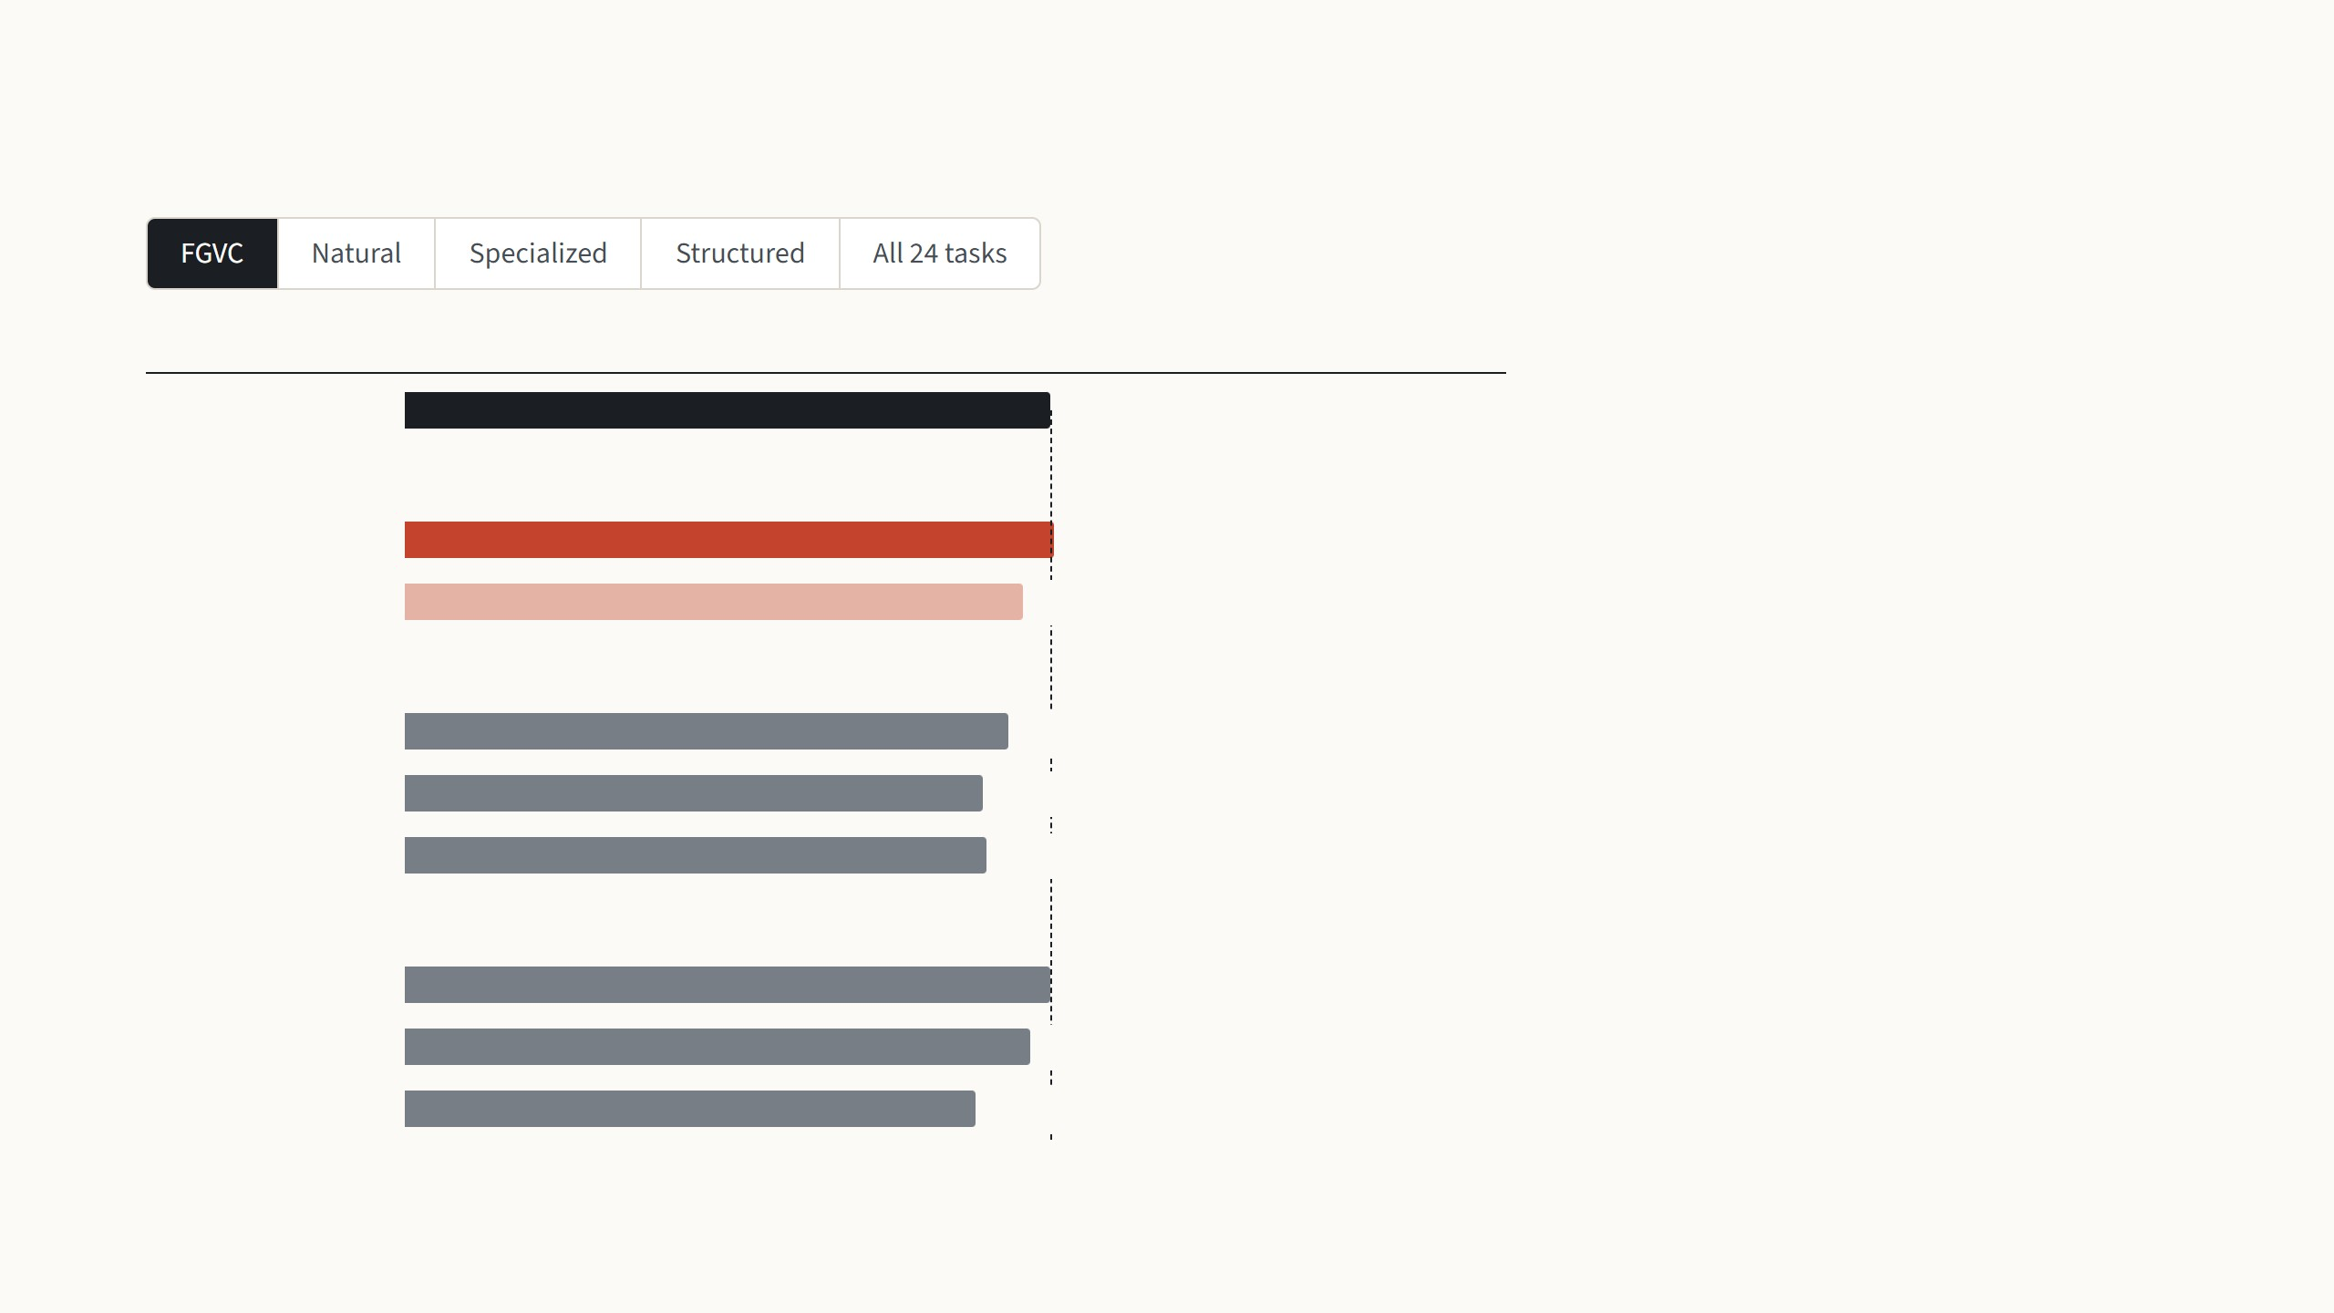
VPT-deep beats full fine-tuning on 20 of 24 tasks
Mean accuracy (%)
Beats full fine-tuning on
These five tasks ask the model to tell
apart 200 bird species, 196 car models,
120 dog breeds or 102 kinds of flower,
with thousands of training images per
task.
Full fine-tuning
88.5
Extra input vectors are trained
VPT-deep
89.1
4 of 5 tasks
VPT-shallow
84.6
1 of 5 tasks
Every method does well on such photos,
and VPT-deep only edges out full fine-
tuning, 89.1 against 88.5.
Only the top of the model is trained
Partial-1
82.6
0 of 5 tasks
Linear probe
79.3
0 of 5 tasks
MLP-3 head
79.8
0 of 5 tasks
Small parts in or beside the backbone are trained
Bias
88.4
3 of 5 tasks
Adapter
85.7
2 of 5 tasks
Sidetune
78.3
0 of 5 tasks
Jia et al. 2022, Table 1 and Tables 13–14: ViT-B/16 pretrained on ImageNet-21k, mean test accuracy within each group. For all 24 tasks, the mean of the four group averages.
13
Notes:
Step through the four groups with the arrow keys, then the summary. The chart keeps the families from the cheaper-methods slide: full fine-tuning on top with the dashed line at its score, VPT in red, the older cheap methods in grey. The right column counts the tasks on which a method beats full fine-tuning. FGVC: everyone is strong, VPT-deep edges ahead, 89.1 vs 88.5, and loses only Stanford Cars. Natural: only 1,000 training images, so full fine-tuning overfits; VPT-deep wins 6 of 7, losing SVHN, and even VPT-shallow is above full. Specialized: the one group VPT-deep loses on average, 82.4 vs 83.4, losing Resisc45 and Retinopathy; medical images come back in my own results. Structured: the biggest gap, 55.0 vs 47.6, all 8 tasks won; the linear probe collapses to 26.8, so the frozen features alone do not hold this information, and the prompts make the frozen network compute it. All 24: VPT-deep is the only cheap method above full fine-tuning, 76.3 vs 73.9, with 20 wins, and its total storage for 24 tasks is 1.18 backbones against 24.02.

Slide 18
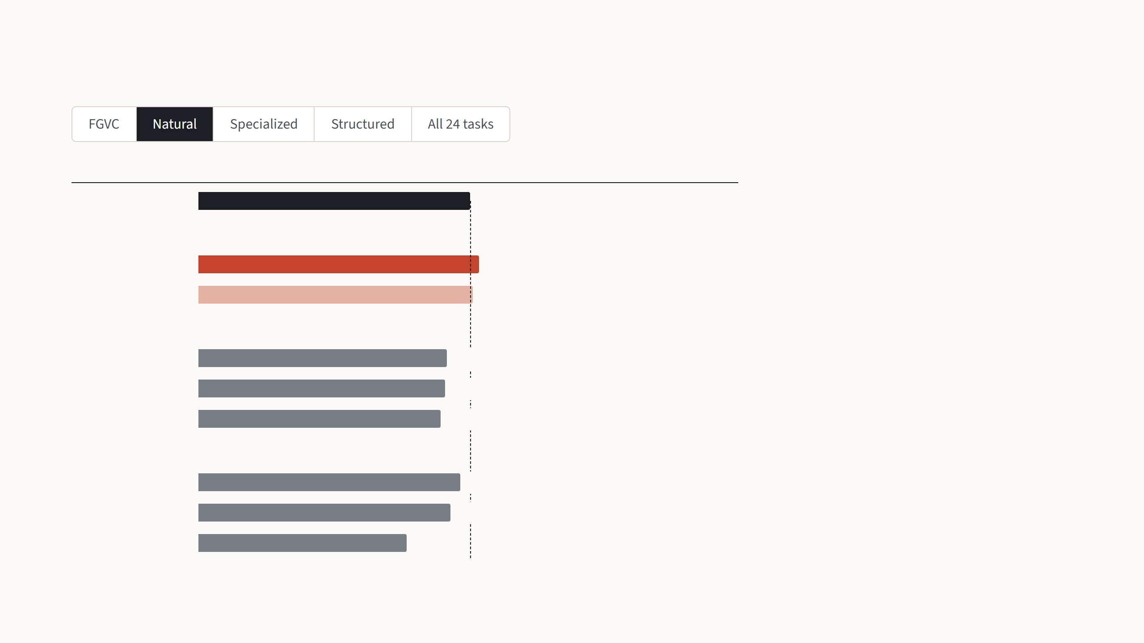
VPT-deep beats full fine-tuning on 20 of 24 tasks
Mean accuracy (%)
Beats full fine-tuning on
These seven tasks use ordinary photos of
objects, pets, textures, scenes and house
numbers, close to what the model saw in
pretraining, but with only 1,000 training
images each.
Full fine-tuning
75.9
Extra input vectors are trained
VPT-deep
78.5
6 of 7 tasks
VPT-shallow
76.8
4 of 7 tasks
With so little data, retraining all 86 million
weights overfits, so even VPT-shallow
beats full fine-tuning here.
Only the top of the model is trained
Partial-1
69.4
2 of 7 tasks
Linear probe
68.9
1 of 7 tasks
MLP-3 head
67.8
2 of 7 tasks
Small parts in or beside the backbone are trained
Bias
73.3
3 of 7 tasks
Adapter
70.4
4 of 7 tasks
Sidetune
58.2
0 of 7 tasks
Jia et al. 2022, Table 1 and Tables 13–14: ViT-B/16 pretrained on ImageNet-21k, mean test accuracy within each group. For all 24 tasks, the mean of the four group averages.
13
Notes:
Step through the four groups with the arrow keys, then the summary. The chart keeps the families from the cheaper-methods slide: full fine-tuning on top with the dashed line at its score, VPT in red, the older cheap methods in grey. The right column counts the tasks on which a method beats full fine-tuning. FGVC: everyone is strong, VPT-deep edges ahead, 89.1 vs 88.5, and loses only Stanford Cars. Natural: only 1,000 training images, so full fine-tuning overfits; VPT-deep wins 6 of 7, losing SVHN, and even VPT-shallow is above full. Specialized: the one group VPT-deep loses on average, 82.4 vs 83.4, losing Resisc45 and Retinopathy; medical images come back in my own results. Structured: the biggest gap, 55.0 vs 47.6, all 8 tasks won; the linear probe collapses to 26.8, so the frozen features alone do not hold this information, and the prompts make the frozen network compute it. All 24: VPT-deep is the only cheap method above full fine-tuning, 76.3 vs 73.9, with 20 wins, and its total storage for 24 tasks is 1.18 backbones against 24.02.

Slide 19
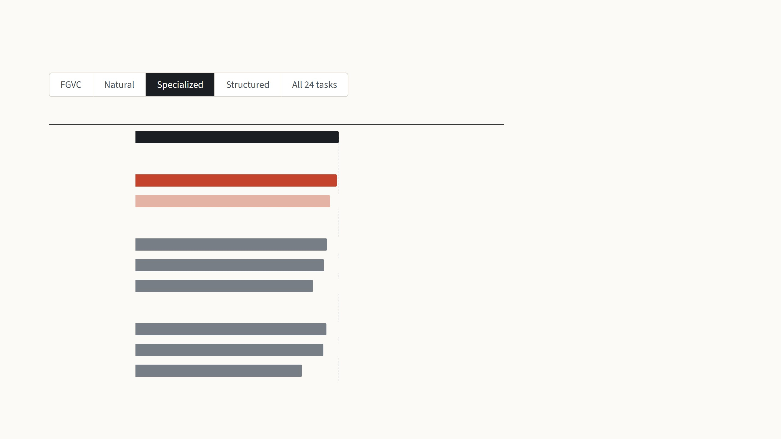
VPT-deep beats full fine-tuning on 20 of 24 tasks
Mean accuracy (%)
Beats full fine-tuning on
These four tasks come from special
cameras: satellite images of land use,
microscope slides of tumour tissue and
photos of the retina, with 1,000 training
images each.
Full fine-tuning
83.4
Extra input vectors are trained
VPT-deep
82.4
2 of 4 tasks
VPT-shallow
79.7
0 of 4 tasks
This is the one group where full fine-
tuning stays ahead, by one point, but
VPT-deep is still the best of the cheap
methods.
Only the top of the model is trained
Partial-1
78.5
0 of 4 tasks
Linear probe
77.2
1 of 4 tasks
MLP-3 head
72.8
0 of 4 tasks
Small parts in or beside the backbone are trained
Bias
78.3
0 of 4 tasks
Adapter
77.1
0 of 4 tasks
Sidetune
68.1
0 of 4 tasks
Jia et al. 2022, Table 1 and Tables 13–14: ViT-B/16 pretrained on ImageNet-21k, mean test accuracy within each group. For all 24 tasks, the mean of the four group averages.
13
Notes:
Step through the four groups with the arrow keys, then the summary. The chart keeps the families from the cheaper-methods slide: full fine-tuning on top with the dashed line at its score, VPT in red, the older cheap methods in grey. The right column counts the tasks on which a method beats full fine-tuning. FGVC: everyone is strong, VPT-deep edges ahead, 89.1 vs 88.5, and loses only Stanford Cars. Natural: only 1,000 training images, so full fine-tuning overfits; VPT-deep wins 6 of 7, losing SVHN, and even VPT-shallow is above full. Specialized: the one group VPT-deep loses on average, 82.4 vs 83.4, losing Resisc45 and Retinopathy; medical images come back in my own results. Structured: the biggest gap, 55.0 vs 47.6, all 8 tasks won; the linear probe collapses to 26.8, so the frozen features alone do not hold this information, and the prompts make the frozen network compute it. All 24: VPT-deep is the only cheap method above full fine-tuning, 76.3 vs 73.9, with 20 wins, and its total storage for 24 tasks is 1.18 backbones against 24.02.

Slide 20
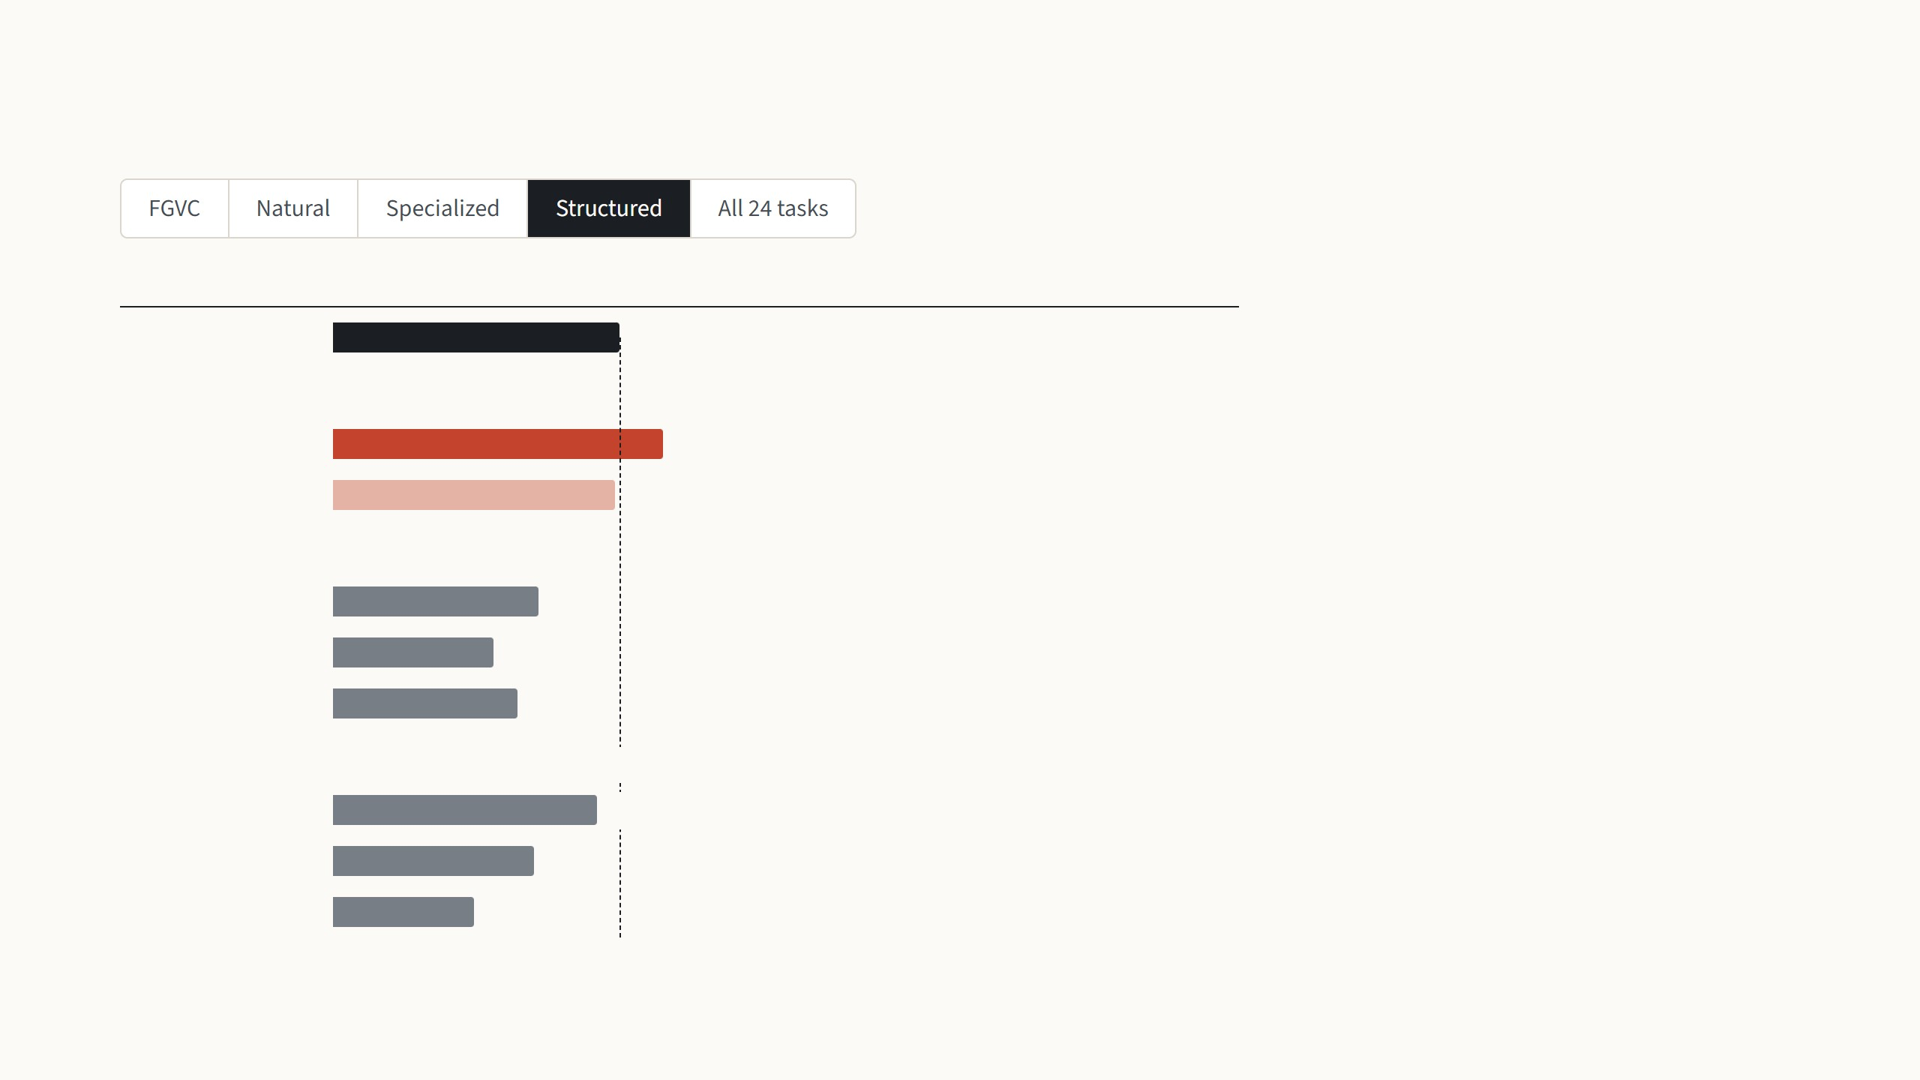
VPT-deep beats full fine-tuning on 20 of 24 tasks
Mean accuracy (%)
Beats full fine-tuning on
These eight tasks ask about geometry
rather than objects: how many things
there are, how far away, at what angle.
Most are synthetic scenes, far from
ImageNet.
Full fine-tuning
47.6
Extra input vectors are trained
VPT-deep
55.0
8 of 8 tasks
VPT-shallow
47.0
4 of 8 tasks
Here VPT-deep wins all eight, 55.0 against
47.6, while the linear probe falls to 26.8,
so the frozen features alone do not hold
this information.
Only the top of the model is trained
Partial-1
34.2
0 of 8 tasks
Linear probe
26.8
0 of 8 tasks
MLP-3 head
30.6
0 of 8 tasks
Small parts in or beside the backbone are trained
Bias
44.1
2 of 8 tasks
Adapter
33.4
0 of 8 tasks
Sidetune
23.4
0 of 8 tasks
Jia et al. 2022, Table 1 and Tables 13–14: ViT-B/16 pretrained on ImageNet-21k, mean test accuracy within each group. For all 24 tasks, the mean of the four group averages.
13
Notes:
Step through the four groups with the arrow keys, then the summary. The chart keeps the families from the cheaper-methods slide: full fine-tuning on top with the dashed line at its score, VPT in red, the older cheap methods in grey. The right column counts the tasks on which a method beats full fine-tuning. FGVC: everyone is strong, VPT-deep edges ahead, 89.1 vs 88.5, and loses only Stanford Cars. Natural: only 1,000 training images, so full fine-tuning overfits; VPT-deep wins 6 of 7, losing SVHN, and even VPT-shallow is above full. Specialized: the one group VPT-deep loses on average, 82.4 vs 83.4, losing Resisc45 and Retinopathy; medical images come back in my own results. Structured: the biggest gap, 55.0 vs 47.6, all 8 tasks won; the linear probe collapses to 26.8, so the frozen features alone do not hold this information, and the prompts make the frozen network compute it. All 24: VPT-deep is the only cheap method above full fine-tuning, 76.3 vs 73.9, with 20 wins, and its total storage for 24 tasks is 1.18 backbones against 24.02.

Slide 21
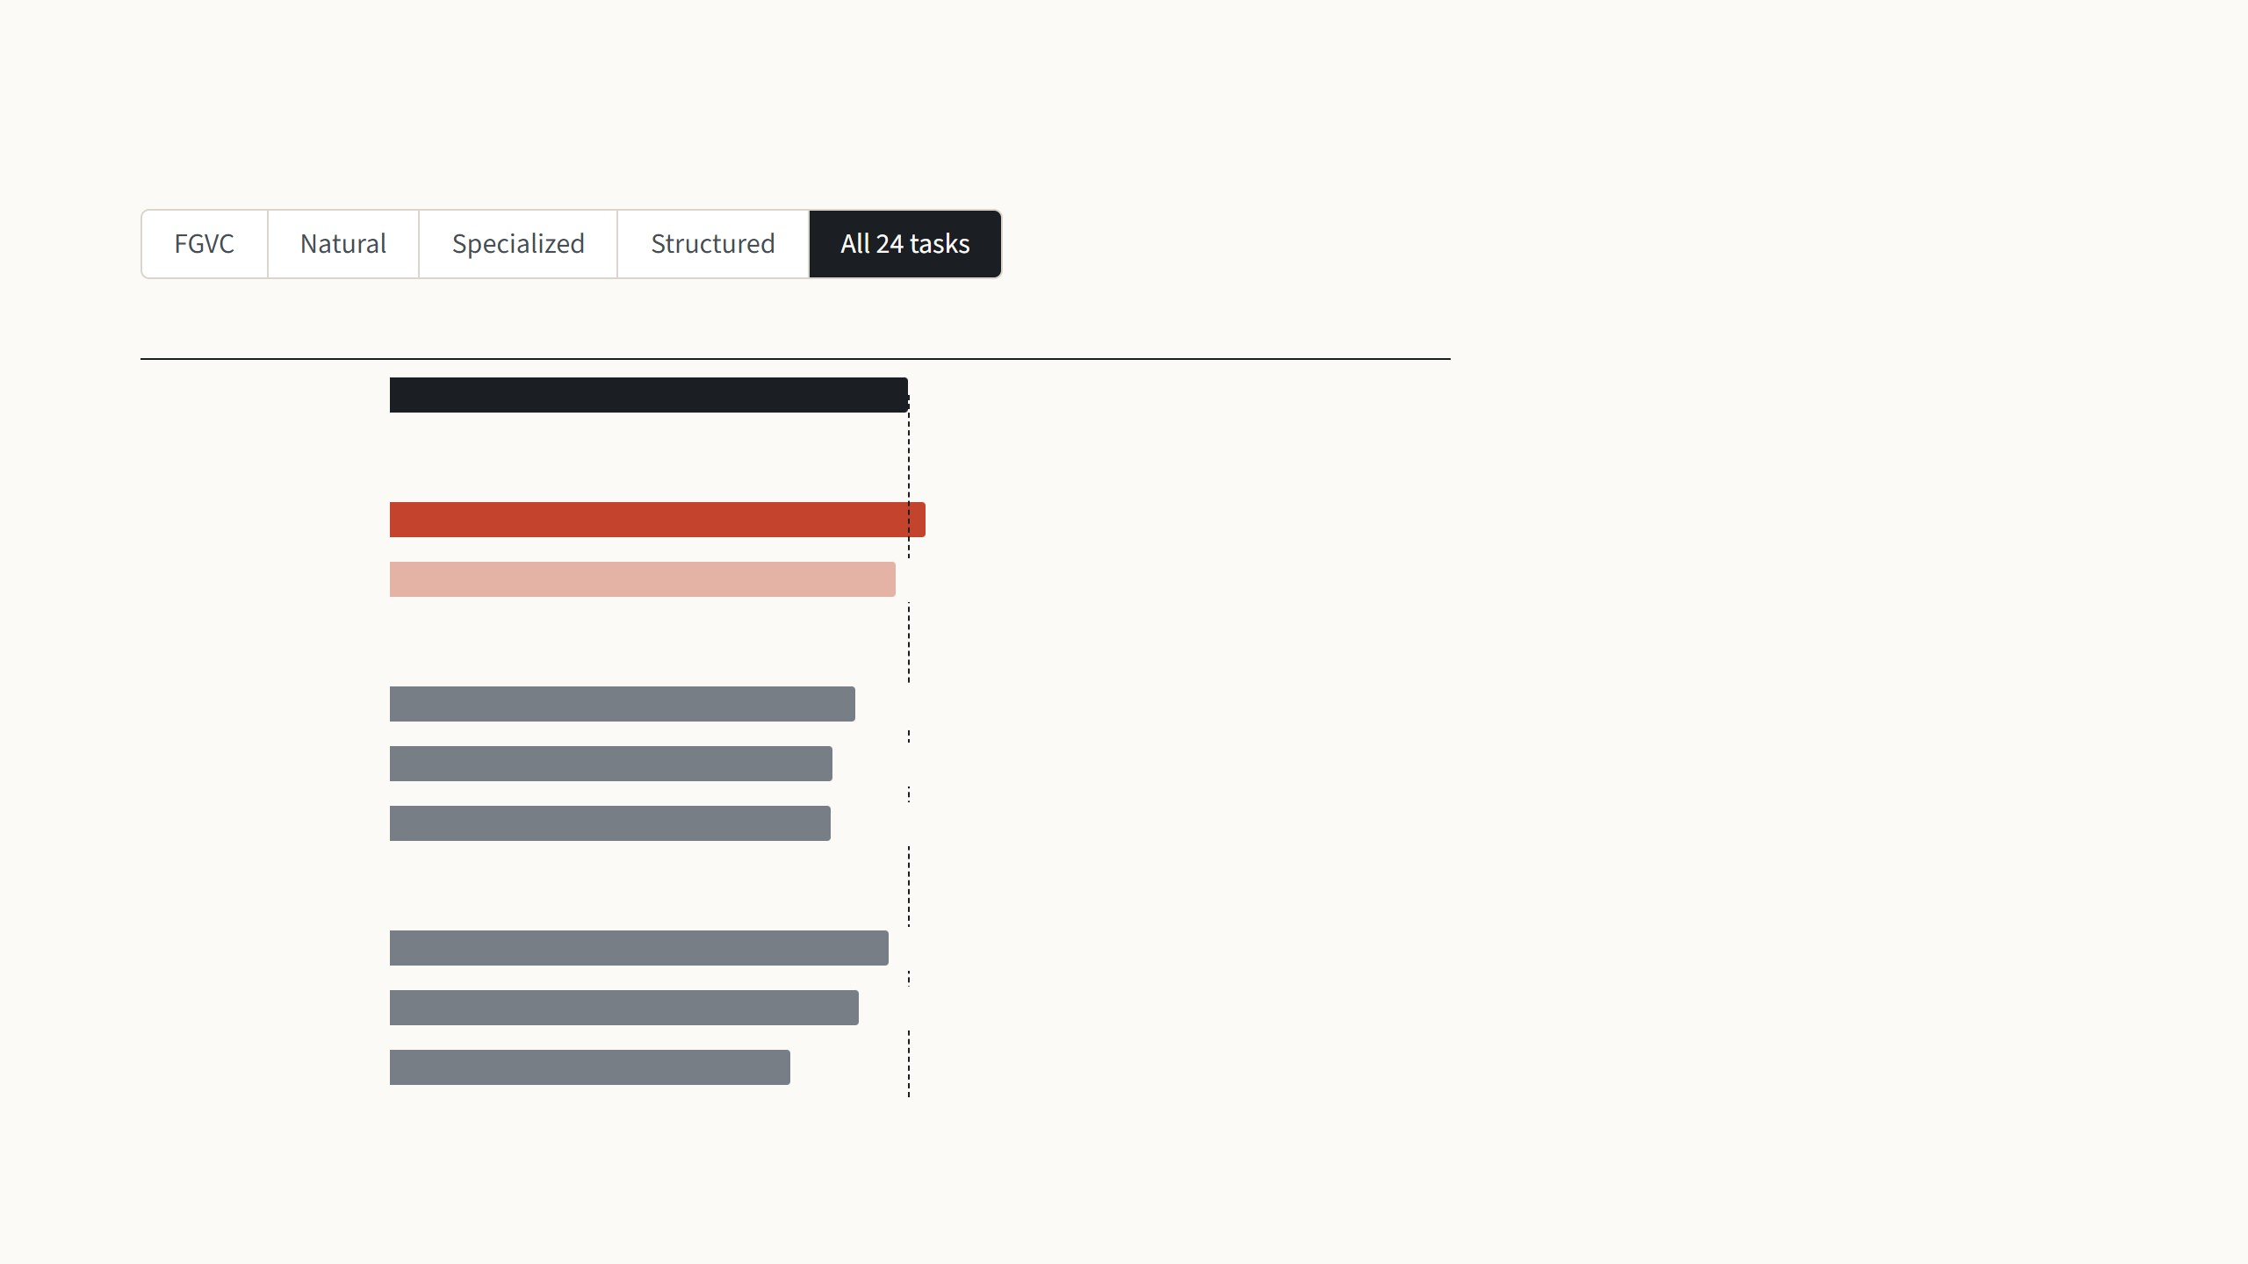
VPT-deep beats full fine-tuning on 20 of 24 tasks
Mean accuracy (%)
Beats full fine-tuning on
Averaged over all 24 tasks, VPT-deep is
the only cheap method above full fine-
tuning, 76.3 against 73.9.
Full fine-tuning
73.9
Extra input vectors are trained
VPT-deep
76.3
20 of 24 tasks
It gets there while storing 1.18
backbones' worth of weights for the 24
tasks, where full fine-tuning stores 24.
VPT-shallow
72.0
9 of 24 tasks
Only the top of the model is trained
Partial-1
66.2
2 of 24 tasks
Linear probe
63.1
2 of 24 tasks
MLP-3 head
62.8
2 of 24 tasks
Small parts in or beside the backbone are trained
Bias
71.0
8 of 24 tasks
Adapter
66.6
6 of 24 tasks
Sidetune
57.0
0 of 24 tasks
Jia et al. 2022, Table 1 and Tables 13–14: ViT-B/16 pretrained on ImageNet-21k, mean test accuracy within each group. For all 24 tasks, the mean of the four group averages.
13
Notes:
Step through the four groups with the arrow keys, then the summary. The chart keeps the families from the cheaper-methods slide: full fine-tuning on top with the dashed line at its score, VPT in red, the older cheap methods in grey. The right column counts the tasks on which a method beats full fine-tuning. FGVC: everyone is strong, VPT-deep edges ahead, 89.1 vs 88.5, and loses only Stanford Cars. Natural: only 1,000 training images, so full fine-tuning overfits; VPT-deep wins 6 of 7, losing SVHN, and even VPT-shallow is above full. Specialized: the one group VPT-deep loses on average, 82.4 vs 83.4, losing Resisc45 and Retinopathy; medical images come back in my own results. Structured: the biggest gap, 55.0 vs 47.6, all 8 tasks won; the linear probe collapses to 26.8, so the frozen features alone do not hold this information, and the prompts make the frozen network compute it. All 24: VPT-deep is the only cheap method above full fine-tuning, 76.3 vs 73.9, with 20 wins, and its total storage for 24 tasks is 1.18 backbones against 24.02.

Slide 22
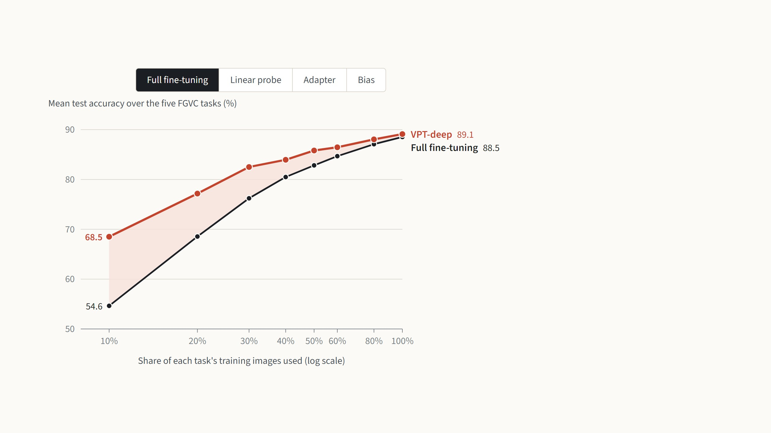
VPT leads with little data and stays ahead with more
VPT-deep against
With a tenth of the training images,
full fine-tuning has too many weights
to fit and falls 14 points behind
VPT-deep.
The gap shrinks as the data grows,
but VPT-deep stays ahead all the way
to the full training set.
Jia et al. 2022, Fig. 3: ViT-B/16, mean test accuracy over the five FGVC tasks, each method trained on a share of every task's training images. The paper gives these values only as a
figure; they were read from its vector drawing in the PDF, and the 100% points match Table 1.
14
Notes:
This is the paper's Fig. 3, redrawn one comparison at a time. Each point is the average test accuracy over the five FGVC tasks when the method is trained on 10% up to 100% of every task's training images; the axis is logarithmic, as in the paper. Start with full fine-tuning: with 10% of the images it falls to 54.6 against 68.5 for VPT-deep, because it has 86 million weights to fit with very few examples. With all the data the two almost meet, 89.1 against 88.5, but VPT-deep is never below. Then step through the baselines. The linear probe is the classic low-data trick: good at 10%, overtaken by full fine-tuning from 30% on. The adapter is overtaken from 40% on. Bias is the strongest rival and beats full fine-tuning up to 80% of the data, but VPT-deep is above it at every point. So VPT is not just a low-data trick. VPT-shallow is left out to keep the chart readable; it always sits between the linear probe and VPT-deep. If asked: the paper publishes these numbers only as a figure; I read them from the figure's vector data in the PDF, and the 100% points match Table 1 to within 0.01.

Slide 23
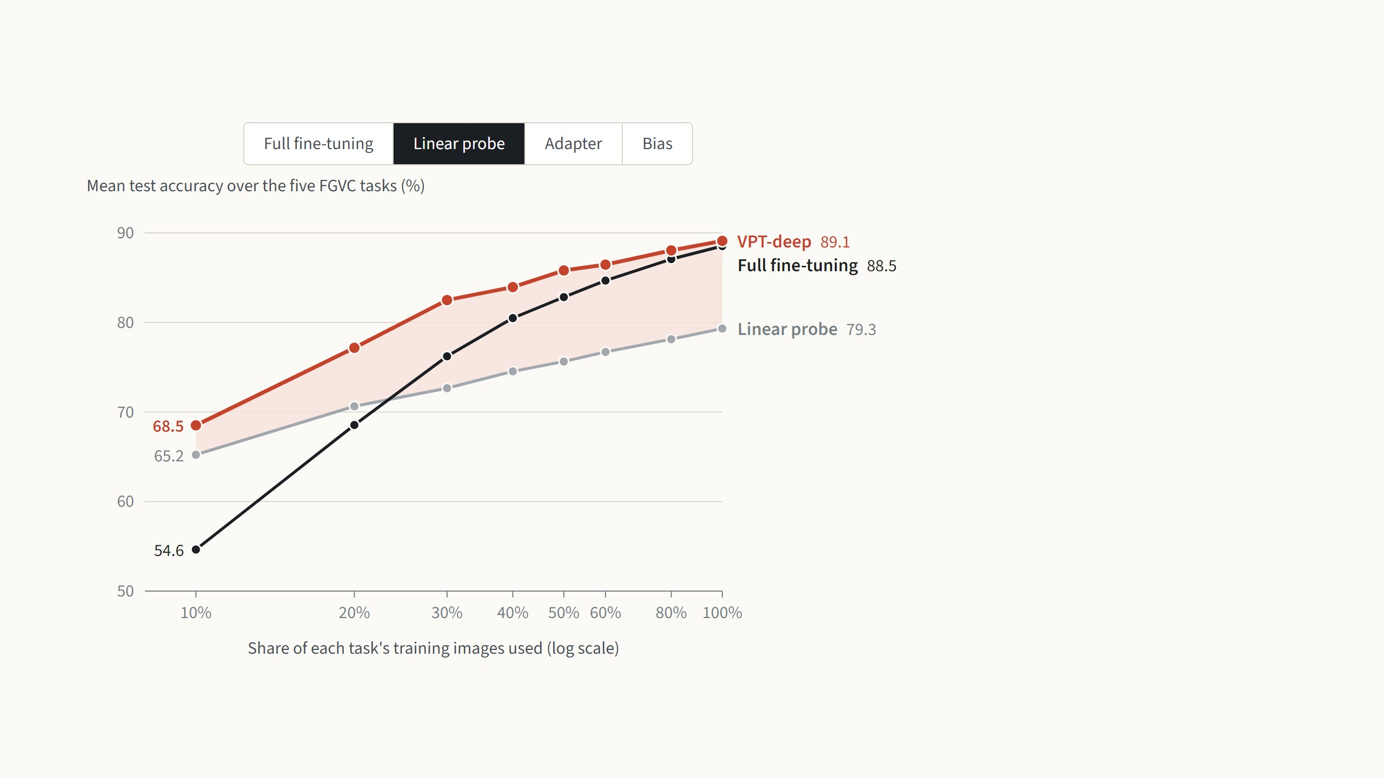
VPT leads with little data and stays ahead with more
VPT-deep against
The linear probe trains only a new
output layer, so it does well when
data is scarce.
From 30% of the data on, full
fine-tuning overtakes it, and with all
the data it trails VPT-deep by almost
10 points.
Jia et al. 2022, Fig. 3: ViT-B/16, mean test accuracy over the five FGVC tasks, each method trained on a share of every task's training images. The paper gives these values only as a
figure; they were read from its vector drawing in the PDF, and the 100% points match Table 1.
14
Notes:
This is the paper's Fig. 3, redrawn one comparison at a time. Each point is the average test accuracy over the five FGVC tasks when the method is trained on 10% up to 100% of every task's training images; the axis is logarithmic, as in the paper. Start with full fine-tuning: with 10% of the images it falls to 54.6 against 68.5 for VPT-deep, because it has 86 million weights to fit with very few examples. With all the data the two almost meet, 89.1 against 88.5, but VPT-deep is never below. Then step through the baselines. The linear probe is the classic low-data trick: good at 10%, overtaken by full fine-tuning from 30% on. The adapter is overtaken from 40% on. Bias is the strongest rival and beats full fine-tuning up to 80% of the data, but VPT-deep is above it at every point. So VPT is not just a low-data trick. VPT-shallow is left out to keep the chart readable; it always sits between the linear probe and VPT-deep. If asked: the paper publishes these numbers only as a figure; I read them from the figure's vector data in the PDF, and the 100% points match Table 1 to within 0.01.

Slide 24
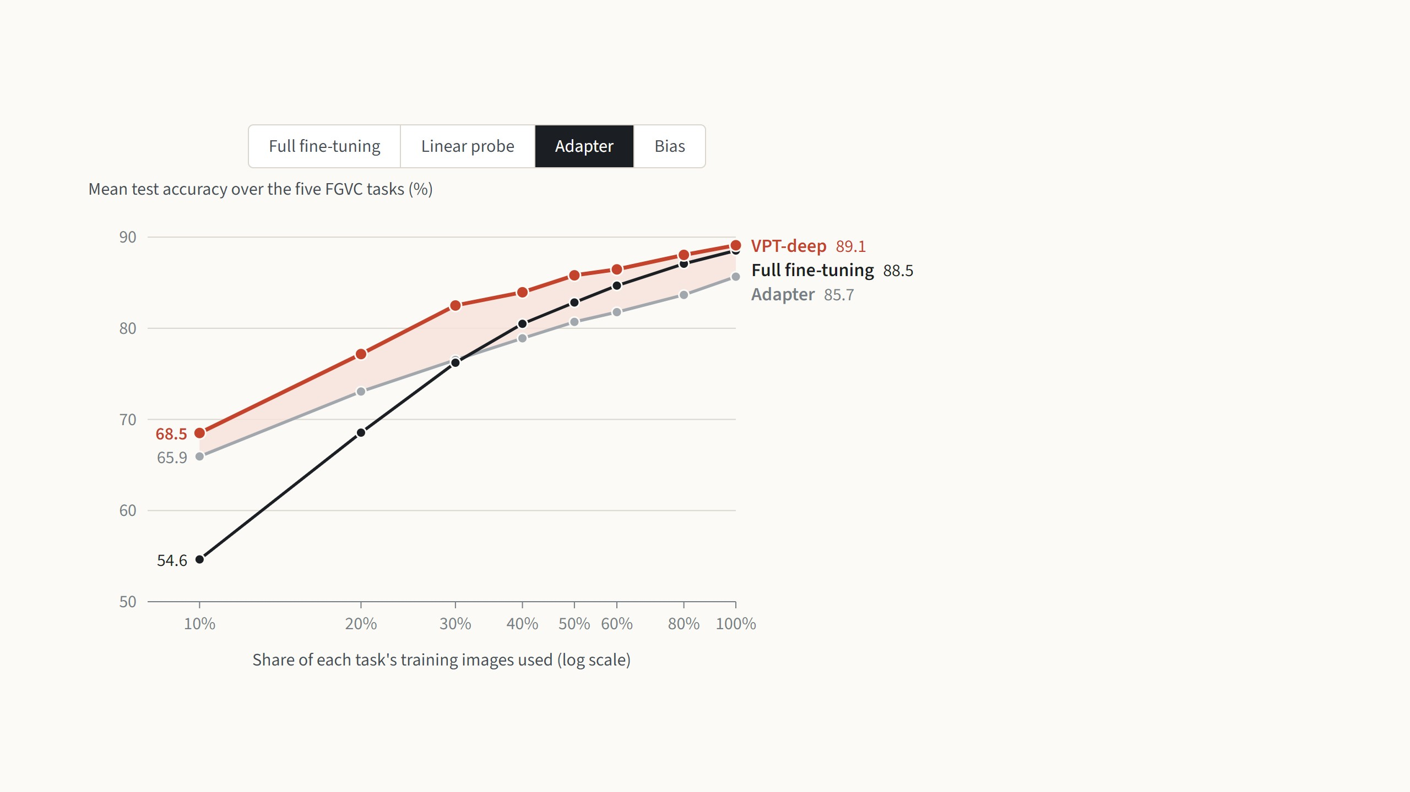
VPT leads with little data and stays ahead with more
VPT-deep against
The adapter inserts small trained
blocks into every layer, and it too
beats full fine-tuning on little data.
Full fine-tuning passes it at 40% of the
data, while VPT-deep stays 3 to 6
points above it throughout.
Jia et al. 2022, Fig. 3: ViT-B/16, mean test accuracy over the five FGVC tasks, each method trained on a share of every task's training images. The paper gives these values only as a
figure; they were read from its vector drawing in the PDF, and the 100% points match Table 1.
14
Notes:
This is the paper's Fig. 3, redrawn one comparison at a time. Each point is the average test accuracy over the five FGVC tasks when the method is trained on 10% up to 100% of every task's training images; the axis is logarithmic, as in the paper. Start with full fine-tuning: with 10% of the images it falls to 54.6 against 68.5 for VPT-deep, because it has 86 million weights to fit with very few examples. With all the data the two almost meet, 89.1 against 88.5, but VPT-deep is never below. Then step through the baselines. The linear probe is the classic low-data trick: good at 10%, overtaken by full fine-tuning from 30% on. The adapter is overtaken from 40% on. Bias is the strongest rival and beats full fine-tuning up to 80% of the data, but VPT-deep is above it at every point. So VPT is not just a low-data trick. VPT-shallow is left out to keep the chart readable; it always sits between the linear probe and VPT-deep. If asked: the paper publishes these numbers only as a figure; I read them from the figure's vector data in the PDF, and the 100% points match Table 1 to within 0.01.

Slide 25
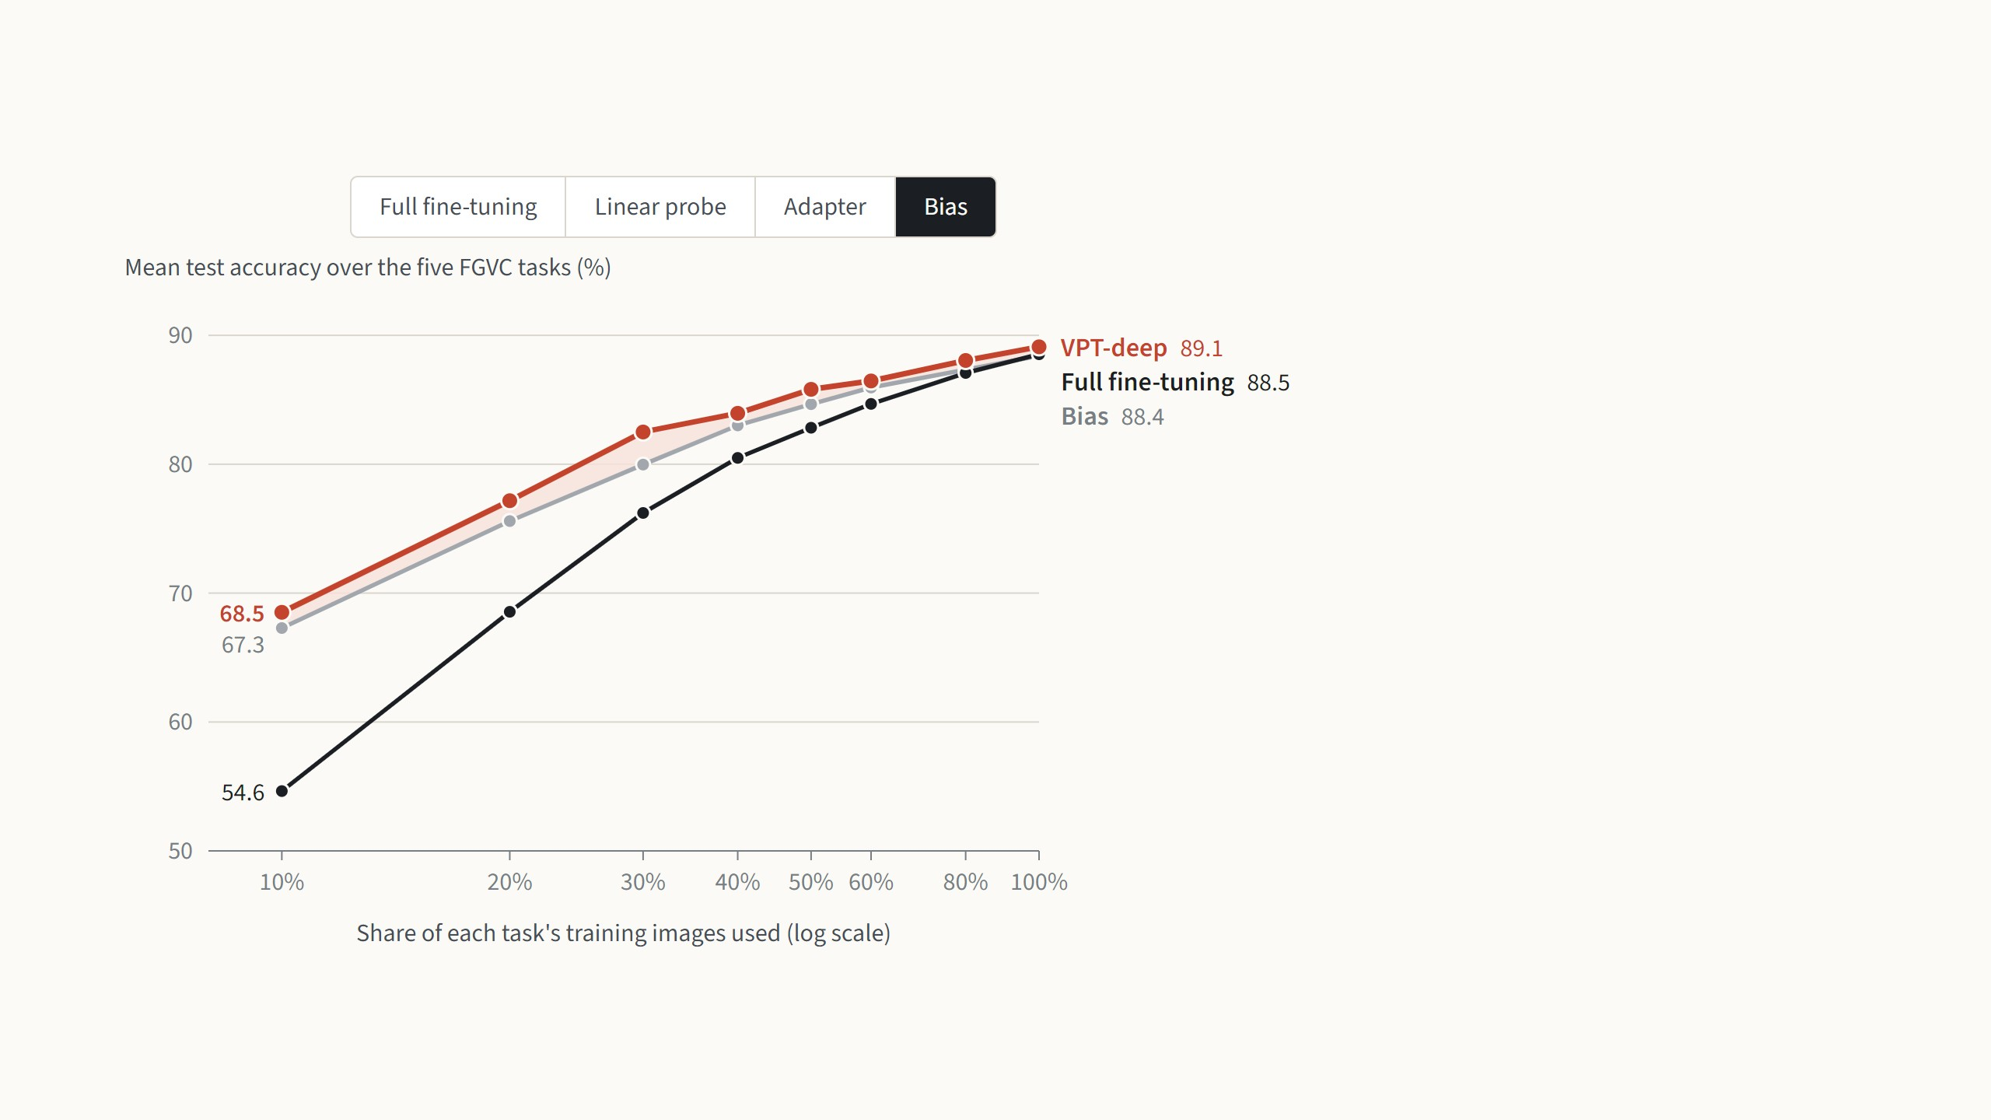
VPT leads with little data and stays ahead with more
VPT-deep against
Bias trains only the bias terms and is
the closest rival: it beats full
fine-tuning up to 80% of the data.
VPT-deep is still ahead at every point,
by half a point to 2.5 points.
Jia et al. 2022, Fig. 3: ViT-B/16, mean test accuracy over the five FGVC tasks, each method trained on a share of every task's training images. The paper gives these values only as a
figure; they were read from its vector drawing in the PDF, and the 100% points match Table 1.
14
Notes:
This is the paper's Fig. 3, redrawn one comparison at a time. Each point is the average test accuracy over the five FGVC tasks when the method is trained on 10% up to 100% of every task's training images; the axis is logarithmic, as in the paper. Start with full fine-tuning: with 10% of the images it falls to 54.6 against 68.5 for VPT-deep, because it has 86 million weights to fit with very few examples. With all the data the two almost meet, 89.1 against 88.5, but VPT-deep is never below. Then step through the baselines. The linear probe is the classic low-data trick: good at 10%, overtaken by full fine-tuning from 30% on. The adapter is overtaken from 40% on. Bias is the strongest rival and beats full fine-tuning up to 80% of the data, but VPT-deep is above it at every point. So VPT is not just a low-data trick. VPT-shallow is left out to keep the chart readable; it always sits between the linear probe and VPT-deep. If asked: the paper publishes these numbers only as a figure; I read them from the figure's vector data in the PDF, and the 100% points match Table 1 to within 0.01.

Slide 26
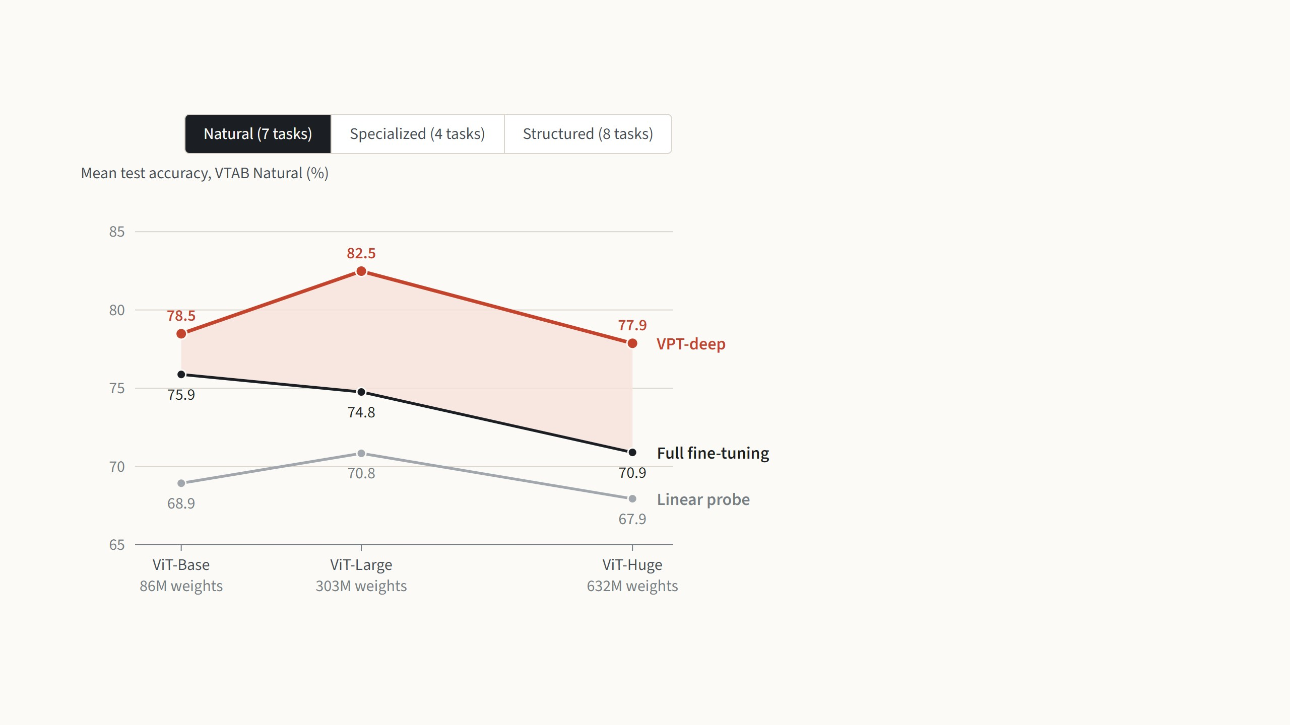
The result holds for larger backbones too
VTAB group
On ordinary photos, VPT-deep beats
full fine-tuning with all three
backbones: by 2.6 points on ViT-Base
and by 7 to 8 points on the larger two.
Full fine-tuning even gets worse as
the model grows, from 75.9 to 70.9.
Jia et al. 2022, Fig. 4: VTAB-1k, mean test accuracy per group, backbones pretrained on ImageNet-21k. The paper gives these values only as a figure; they were read from its
vector drawing in the PDF, and the ViT-B points match Table 1.
15
Notes:
The paper's Fig. 4, redrawn one group at a time: the same VTAB-1k tasks with three backbones, ViT-Base, ViT-Large and ViT-Huge, all pretrained on ImageNet-21k; the horizontal axis is the number of weights. Natural: VPT-deep wins with every backbone, and the gap grows from 2.6 points to about 7, because full fine-tuning gets worse as the model grows, from 75.9 to 70.9, with only 1,000 training images per task. Specialized: a tie, within one point everywhere, the same picture as on ViT-Base. Structured: VPT-deep leads by 6 to 7 points with every backbone, and the linear probe stays near 26, so the frozen features alone do not solve these tasks at any size. Why this matters: the storage argument grows with the model. A fully fine-tuned ViT-Huge is about 2.5 GB per task, while 50 prompts at each of its 32 layers take about 8 MB. It does not hold for every backbone, though, as we will see shortly.

Slide 27
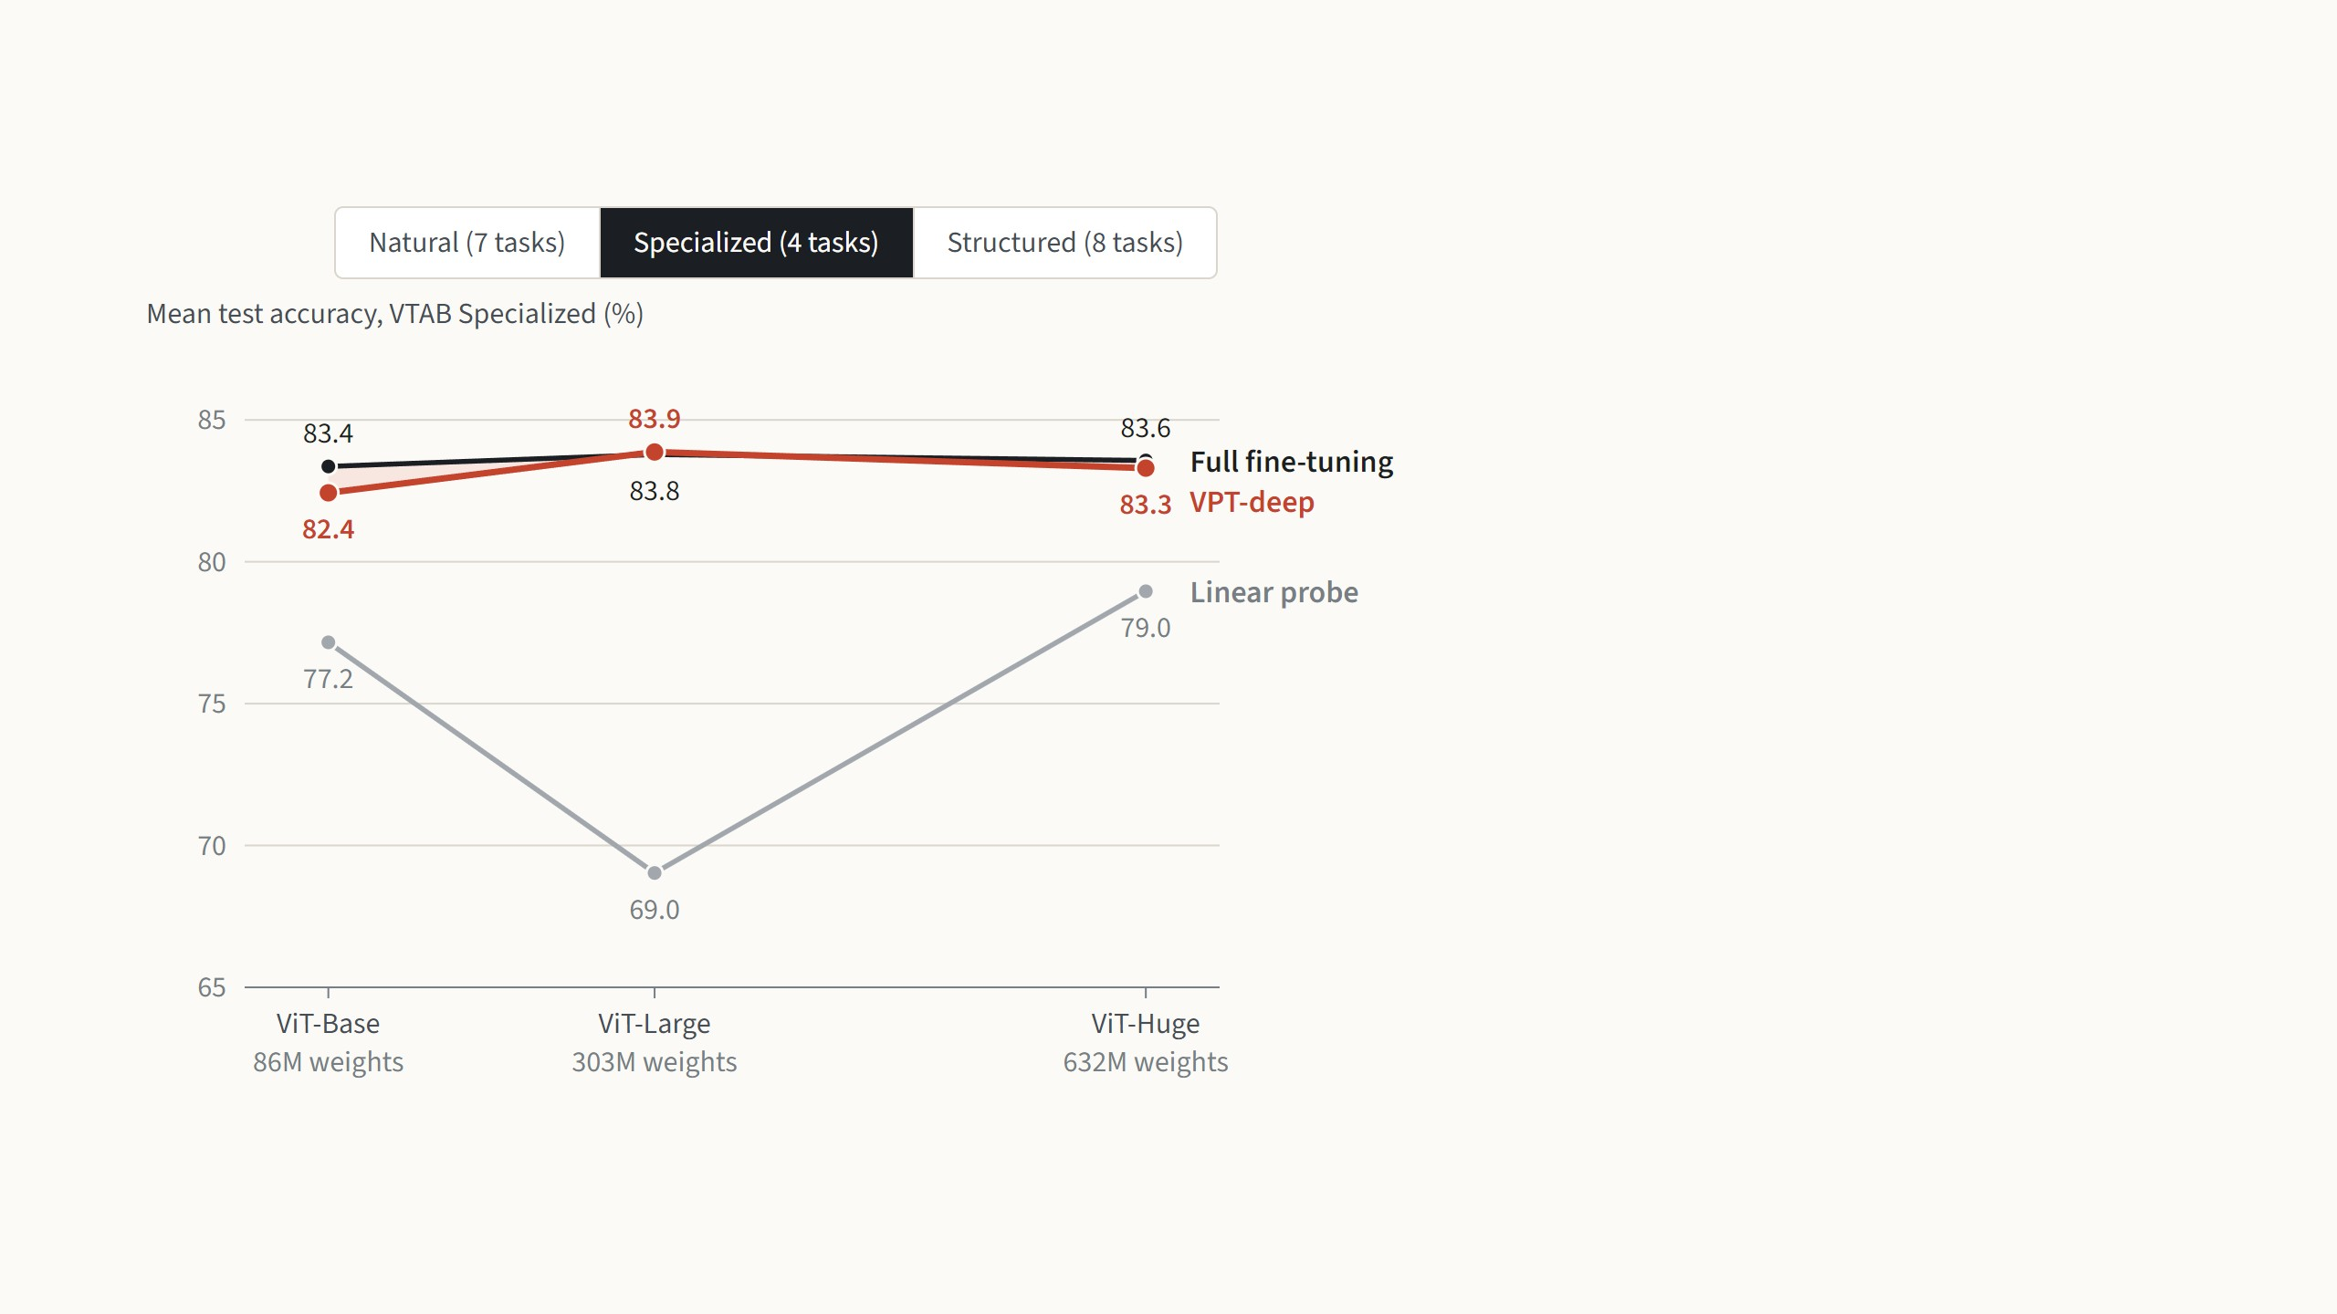
The result holds for larger backbones too
VTAB group
On medical and satellite images, the
two are level with every backbone
and never differ by more than one
point.
This was already the one group where
full fine-tuning kept a small lead on
ViT-Base, and larger backbones do
not change that.
Jia et al. 2022, Fig. 4: VTAB-1k, mean test accuracy per group, backbones pretrained on ImageNet-21k. The paper gives these values only as a figure; they were read from its
vector drawing in the PDF, and the ViT-B points match Table 1.
15
Notes:
The paper's Fig. 4, redrawn one group at a time: the same VTAB-1k tasks with three backbones, ViT-Base, ViT-Large and ViT-Huge, all pretrained on ImageNet-21k; the horizontal axis is the number of weights. Natural: VPT-deep wins with every backbone, and the gap grows from 2.6 points to about 7, because full fine-tuning gets worse as the model grows, from 75.9 to 70.9, with only 1,000 training images per task. Specialized: a tie, within one point everywhere, the same picture as on ViT-Base. Structured: VPT-deep leads by 6 to 7 points with every backbone, and the linear probe stays near 26, so the frozen features alone do not solve these tasks at any size. Why this matters: the storage argument grows with the model. A fully fine-tuned ViT-Huge is about 2.5 GB per task, while 50 prompts at each of its 32 layers take about 8 MB. It does not hold for every backbone, though, as we will see shortly.

Slide 28
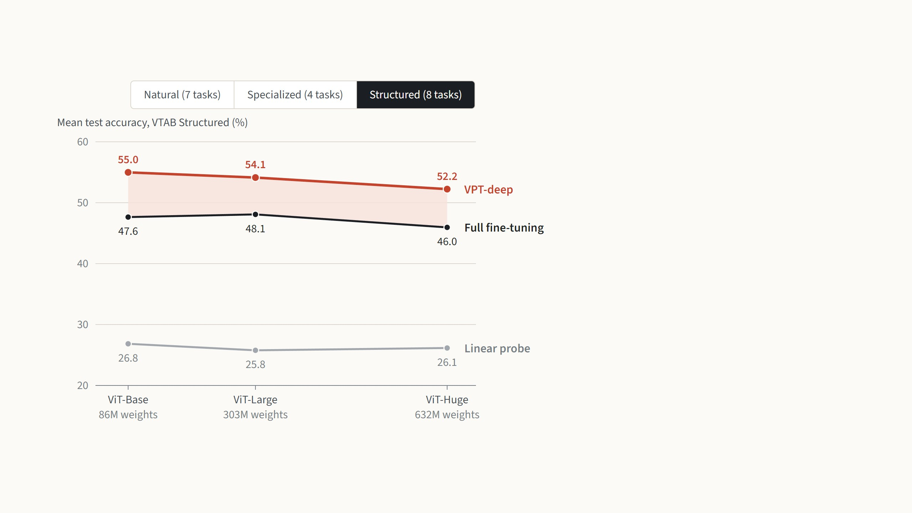
The result holds for larger backbones too
VTAB group
On counting and distance tasks,
VPT-deep leads by 6 to 7 points with
every backbone.
The linear probe stays near 26%, so
the frozen features alone are not
enough here, at any size.
Jia et al. 2022, Fig. 4: VTAB-1k, mean test accuracy per group, backbones pretrained on ImageNet-21k. The paper gives these values only as a figure; they were read from its
vector drawing in the PDF, and the ViT-B points match Table 1.
15
Notes:
The paper's Fig. 4, redrawn one group at a time: the same VTAB-1k tasks with three backbones, ViT-Base, ViT-Large and ViT-Huge, all pretrained on ImageNet-21k; the horizontal axis is the number of weights. Natural: VPT-deep wins with every backbone, and the gap grows from 2.6 points to about 7, because full fine-tuning gets worse as the model grows, from 75.9 to 70.9, with only 1,000 training images per task. Specialized: a tie, within one point everywhere, the same picture as on ViT-Base. Structured: VPT-deep leads by 6 to 7 points with every backbone, and the linear probe stays near 26, so the frozen features alone do not solve these tasks at any size. Why this matters: the storage argument grows with the model. A fully fine-tuned ViT-Huge is about 2.5 GB per task, while 50 prompts at each of its 32 layers take about 8 MB. It does not hold for every backbone, though, as we will see shortly.

Slide 29
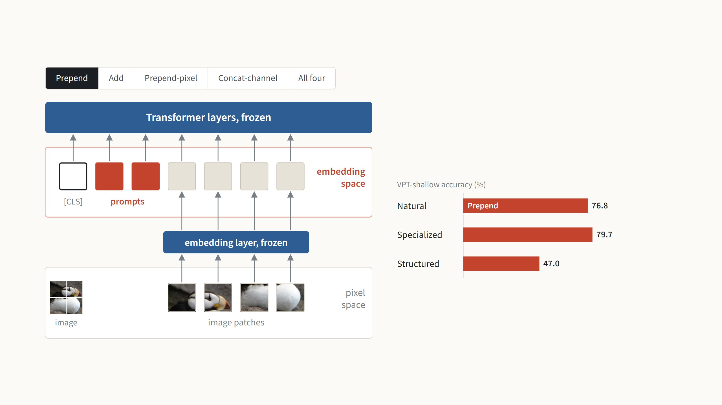
Four places to put the prompt
This is the default. The prompts are extra vectors placed next
to the patch vectors, after the embedding layer, so every
layer can attend to them as tokens of their own.
Numbers from Jia et al. 2022, Fig. 5 (ViT-B/16, prompts in the first layer only); "All four" is the mean of the three groups. Diagrams redrawn.
16
Notes:
The question: where should the learned numbers enter the network? Two places in principle: in the embedding space, as vectors next to the patch vectors, or in pixel space, as part of the image before the embedding layer. Prepend is the default we have seen: extra tokens after the embedding. Add: the prompts are added onto patch vectors, so the sequence is not longer; it loses in all three groups, 8 points on Structured, and the deep version loses too (43.2 against 55.0 on Structured). Prepend-pixel: learned pixel patches next to the image patches, then the frozen embedding layer; loses everywhere, 5 points on Natural. Concat-channel: a learned fourth channel on the image, the embedding layer trained to read it; it collapses, 30 points lower on Natural and below even a linear probe there (68.9). Summary: separate tokens in the embedding space are the right place. All numbers are VPT-shallow because that is the only setting where the paper tests all four options.

Slide 30
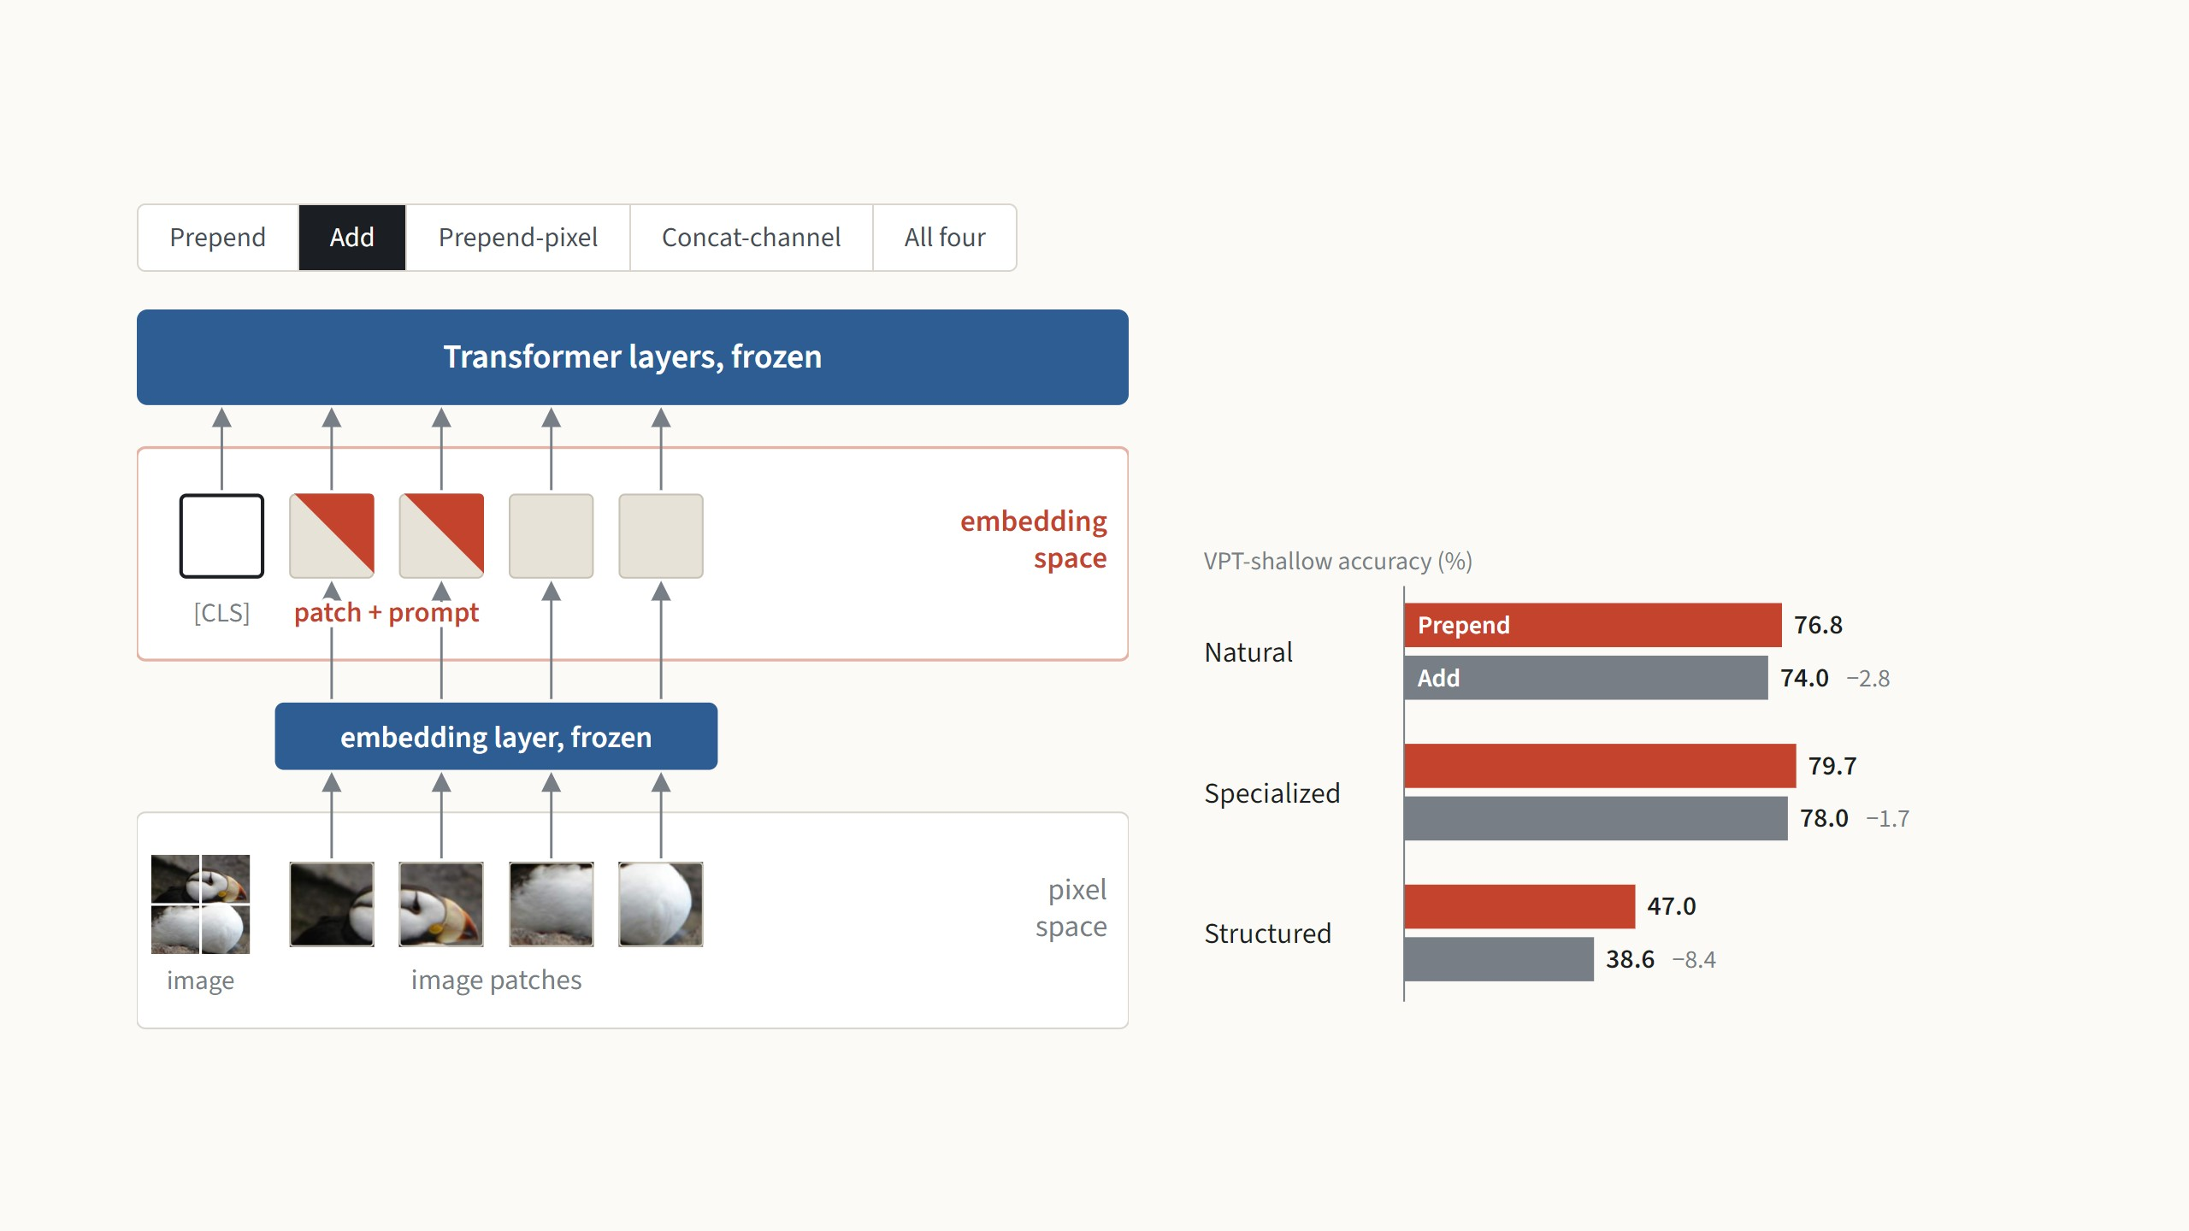
Four places to put the prompt
Here each prompt vector is added onto a patch vector, so the
sequence keeps its length. This scores lower in all three
groups, by 8.4 points on Structured.
Numbers from Jia et al. 2022, Fig. 5 (ViT-B/16, prompts in the first layer only); "All four" is the mean of the three groups. Diagrams redrawn.
16
Notes:
The question: where should the learned numbers enter the network? Two places in principle: in the embedding space, as vectors next to the patch vectors, or in pixel space, as part of the image before the embedding layer. Prepend is the default we have seen: extra tokens after the embedding. Add: the prompts are added onto patch vectors, so the sequence is not longer; it loses in all three groups, 8 points on Structured, and the deep version loses too (43.2 against 55.0 on Structured). Prepend-pixel: learned pixel patches next to the image patches, then the frozen embedding layer; loses everywhere, 5 points on Natural. Concat-channel: a learned fourth channel on the image, the embedding layer trained to read it; it collapses, 30 points lower on Natural and below even a linear probe there (68.9). Summary: separate tokens in the embedding space are the right place. All numbers are VPT-shallow because that is the only setting where the paper tests all four options.

Slide 31
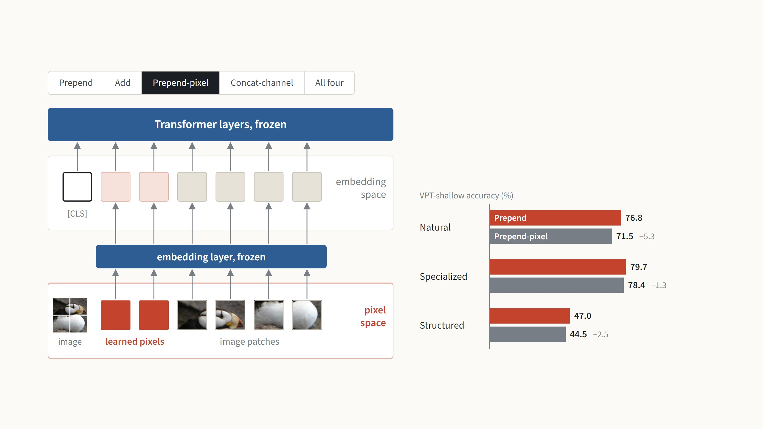
Four places to put the prompt
Here the prompts are learned pixel patches, placed next to
the image patches before the frozen embedding layer. This
also scores lower in every group, by 5.3 points on Natural.
Numbers from Jia et al. 2022, Fig. 5 (ViT-B/16, prompts in the first layer only); "All four" is the mean of the three groups. Diagrams redrawn.
16
Notes:
The question: where should the learned numbers enter the network? Two places in principle: in the embedding space, as vectors next to the patch vectors, or in pixel space, as part of the image before the embedding layer. Prepend is the default we have seen: extra tokens after the embedding. Add: the prompts are added onto patch vectors, so the sequence is not longer; it loses in all three groups, 8 points on Structured, and the deep version loses too (43.2 against 55.0 on Structured). Prepend-pixel: learned pixel patches next to the image patches, then the frozen embedding layer; loses everywhere, 5 points on Natural. Concat-channel: a learned fourth channel on the image, the embedding layer trained to read it; it collapses, 30 points lower on Natural and below even a linear probe there (68.9). Summary: separate tokens in the embedding space are the right place. All numbers are VPT-shallow because that is the only setting where the paper tests all four options.

Slide 32
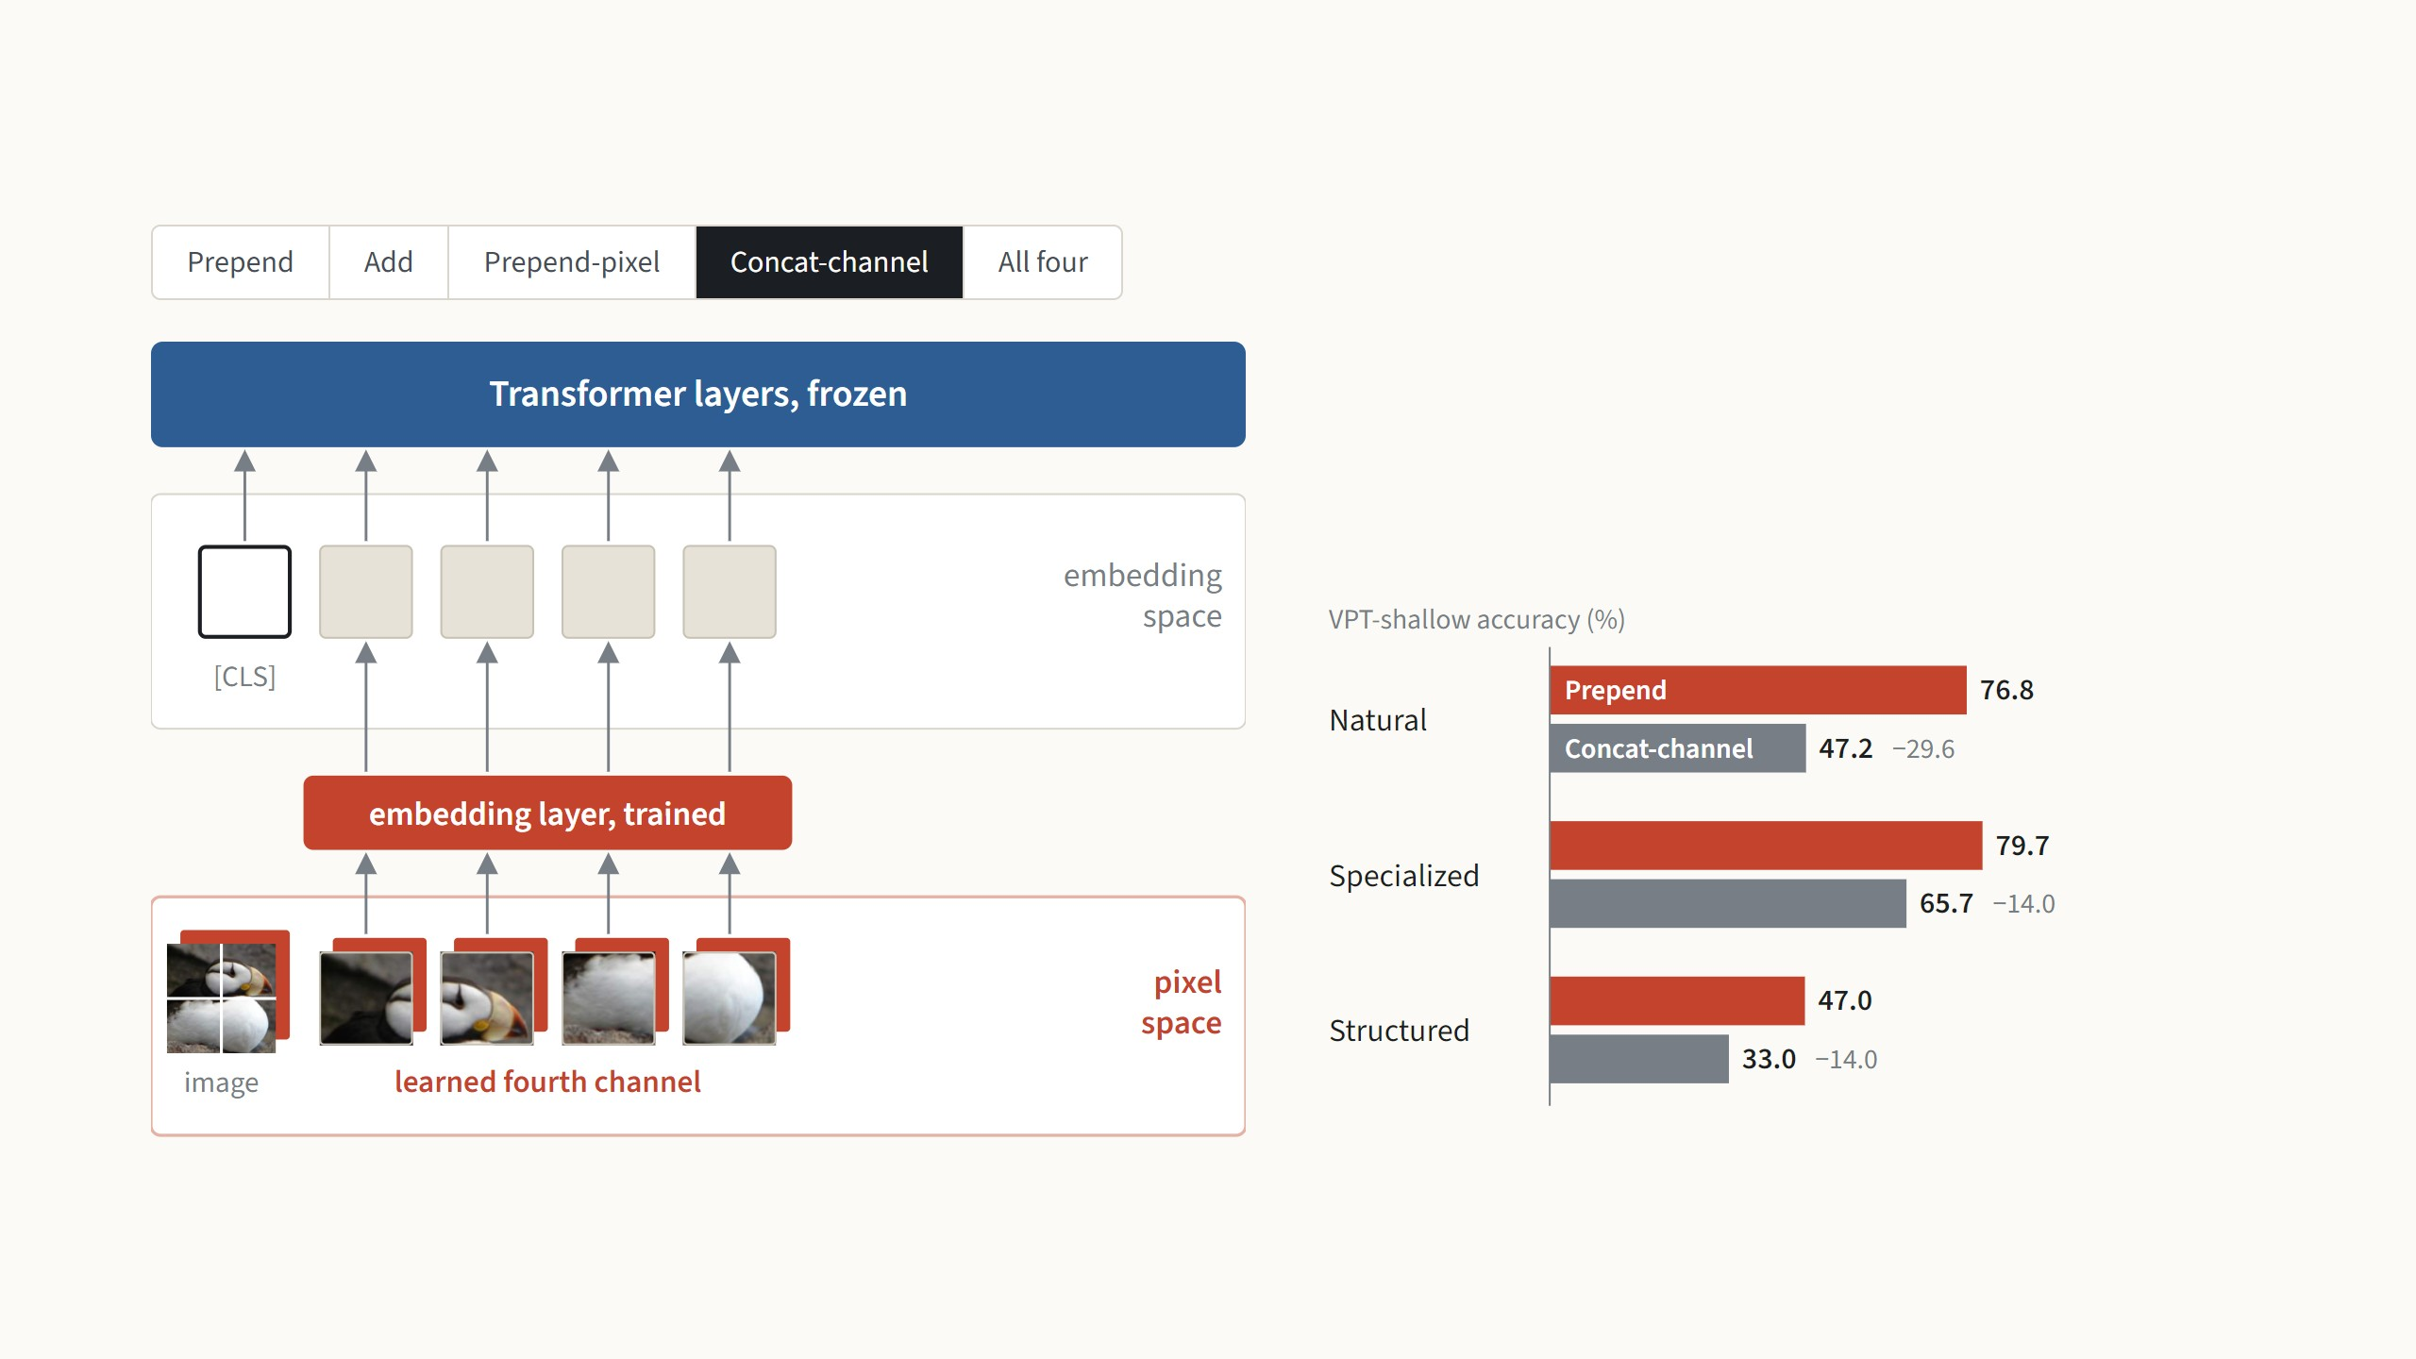
Four places to put the prompt
Here the prompt is a learned fourth colour channel on the
image, and the embedding layer is trained to read it. This is
by far the worst: 29.6 points lower on Natural, below even a
linear probe there.
Numbers from Jia et al. 2022, Fig. 5 (ViT-B/16, prompts in the first layer only); "All four" is the mean of the three groups. Diagrams redrawn.
16
Notes:
The question: where should the learned numbers enter the network? Two places in principle: in the embedding space, as vectors next to the patch vectors, or in pixel space, as part of the image before the embedding layer. Prepend is the default we have seen: extra tokens after the embedding. Add: the prompts are added onto patch vectors, so the sequence is not longer; it loses in all three groups, 8 points on Structured, and the deep version loses too (43.2 against 55.0 on Structured). Prepend-pixel: learned pixel patches next to the image patches, then the frozen embedding layer; loses everywhere, 5 points on Natural. Concat-channel: a learned fourth channel on the image, the embedding layer trained to read it; it collapses, 30 points lower on Natural and below even a linear probe there (68.9). Summary: separate tokens in the embedding space are the right place. All numbers are VPT-shallow because that is the only setting where the paper tests all four options.

Slide 33
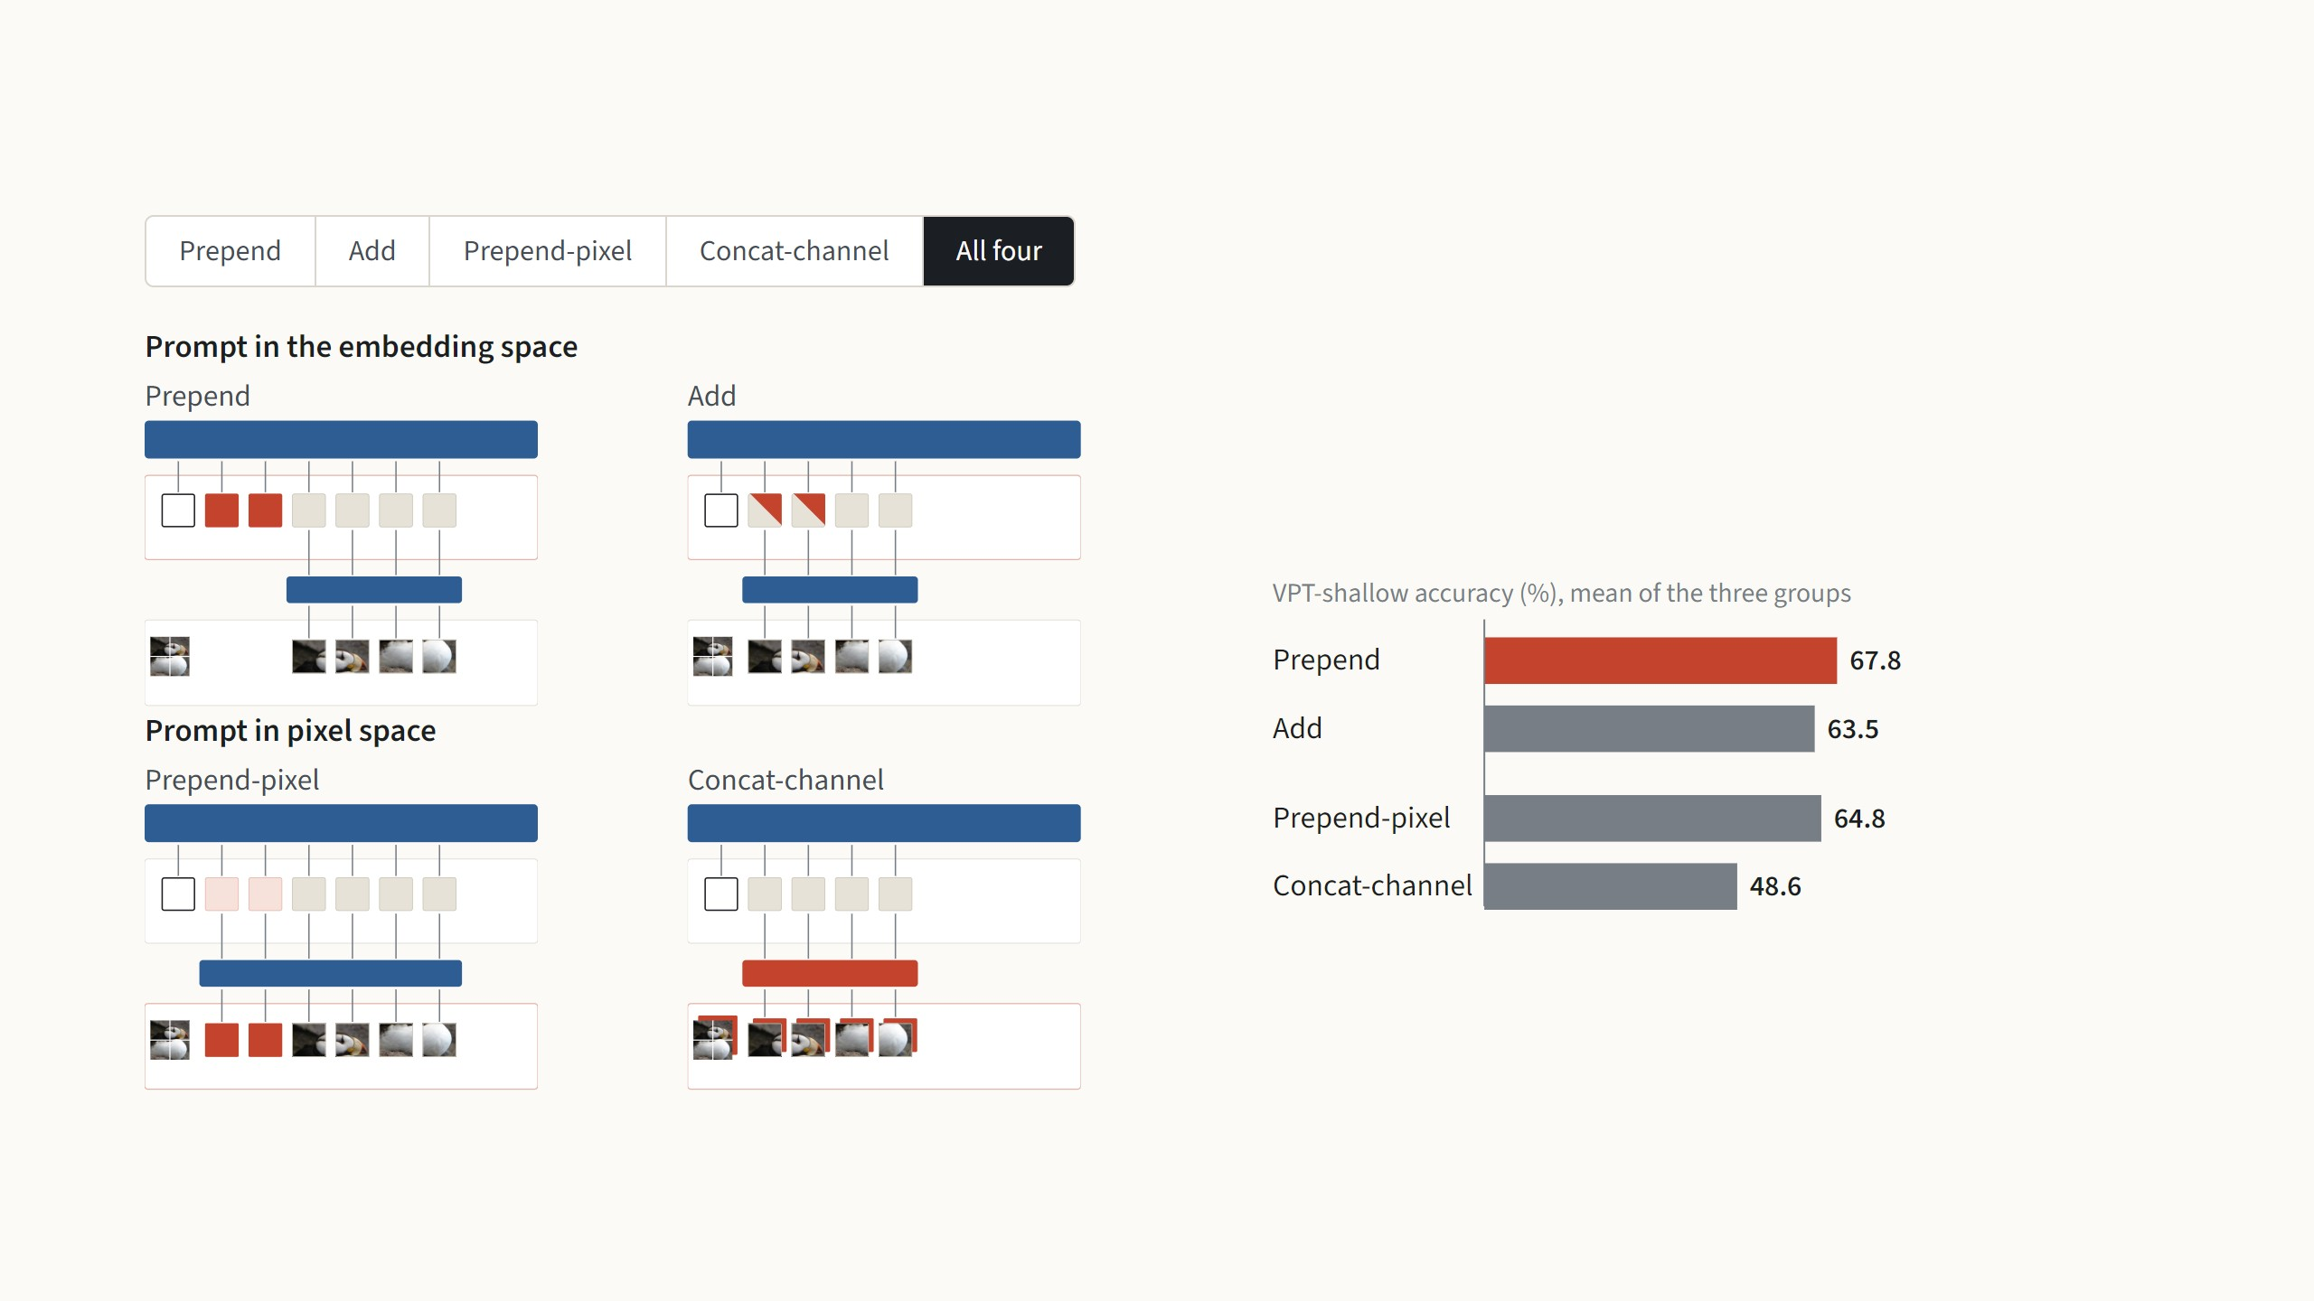
Four places to put the prompt
Prepend scores highest in every group. A prompt works best
as separate vectors in the embedding space; adding it onto
the patches or moving it into the pixels costs accuracy.
Numbers from Jia et al. 2022, Fig. 5 (ViT-B/16, prompts in the first layer only); "All four" is the mean of the three groups. Diagrams redrawn.
16
Notes:
The question: where should the learned numbers enter the network? Two places in principle: in the embedding space, as vectors next to the patch vectors, or in pixel space, as part of the image before the embedding layer. Prepend is the default we have seen: extra tokens after the embedding. Add: the prompts are added onto patch vectors, so the sequence is not longer; it loses in all three groups, 8 points on Structured, and the deep version loses too (43.2 against 55.0 on Structured). Prepend-pixel: learned pixel patches next to the image patches, then the frozen embedding layer; loses everywhere, 5 points on Natural. Concat-channel: a learned fourth channel on the image, the embedding layer trained to read it; it collapses, 30 points lower on Natural and below even a linear probe there (68.9). Summary: separate tokens in the embedding space are the right place. All numbers are VPT-shallow because that is the only setting where the paper tests all four options.

Slide 34
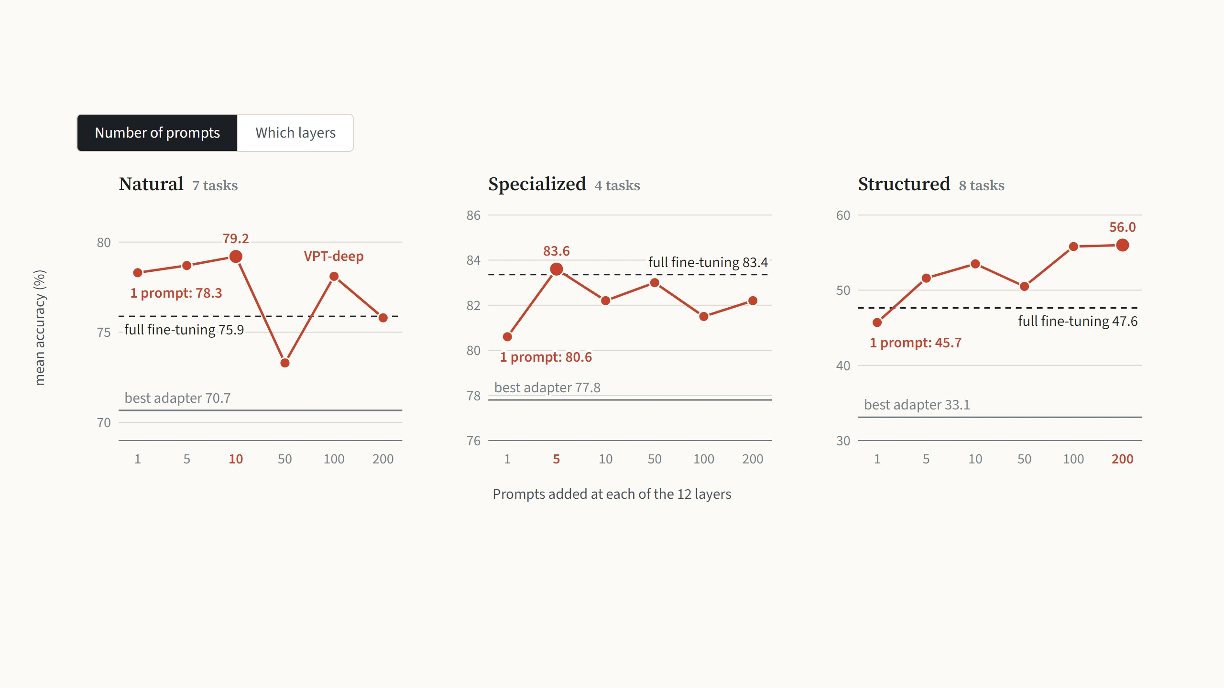
How many prompts, and at which layers
Each group prefers a different number: Natural does best with 10 prompts per layer, Specialized with 5 and Structured with 200.
Even a single prompt per layer beats the best adapter in every group, and on Natural it already beats full fine-tuning.
Jia et al. 2022, Fig. 6: VPT-deep on ViT-B/16, mean test accuracy per VTAB group. The paper gives these only as a figure; values are read off its plotted points. Full fine-tuning and
the adapter (best of three sizes): Table 13.
17
Notes:
First, the number of prompts, the one new hyperparameter. Each panel is one VTAB group: the red line is VPT-deep with 1 to 200 prompts at every layer, the dashed line is full fine-tuning, the grey line the best adapter. The best number is different in every group, 10 on Natural, 5 on Specialized, 200 on Structured, and per task it varies even more, from 5 prompts for Oxford Flowers to 200 for Stanford Cars (Table 14). That is why the paper picks p per task on the validation set. Even a single prompt per layer beats the adapter everywhere, and on Natural it already beats full fine-tuning. Press the arrow key for which layers. The red line adds prompts from the input upwards: layer 1 alone is VPT-shallow, all twelve layers is VPT-deep. The grey line adds them from the output downwards. More prompted layers generally help, and the input side wins: on Structured, prompts in layers 1 to 3 give 50.6, prompts in layers 9 to 12 only 37.6. The authors point out that this is the opposite of what was seen with text prompts. The paper has no table for these two experiments, so the values are read off the plotted points of its figures; the end points match VPT-shallow and VPT-deep in Table 13.

Slide 35
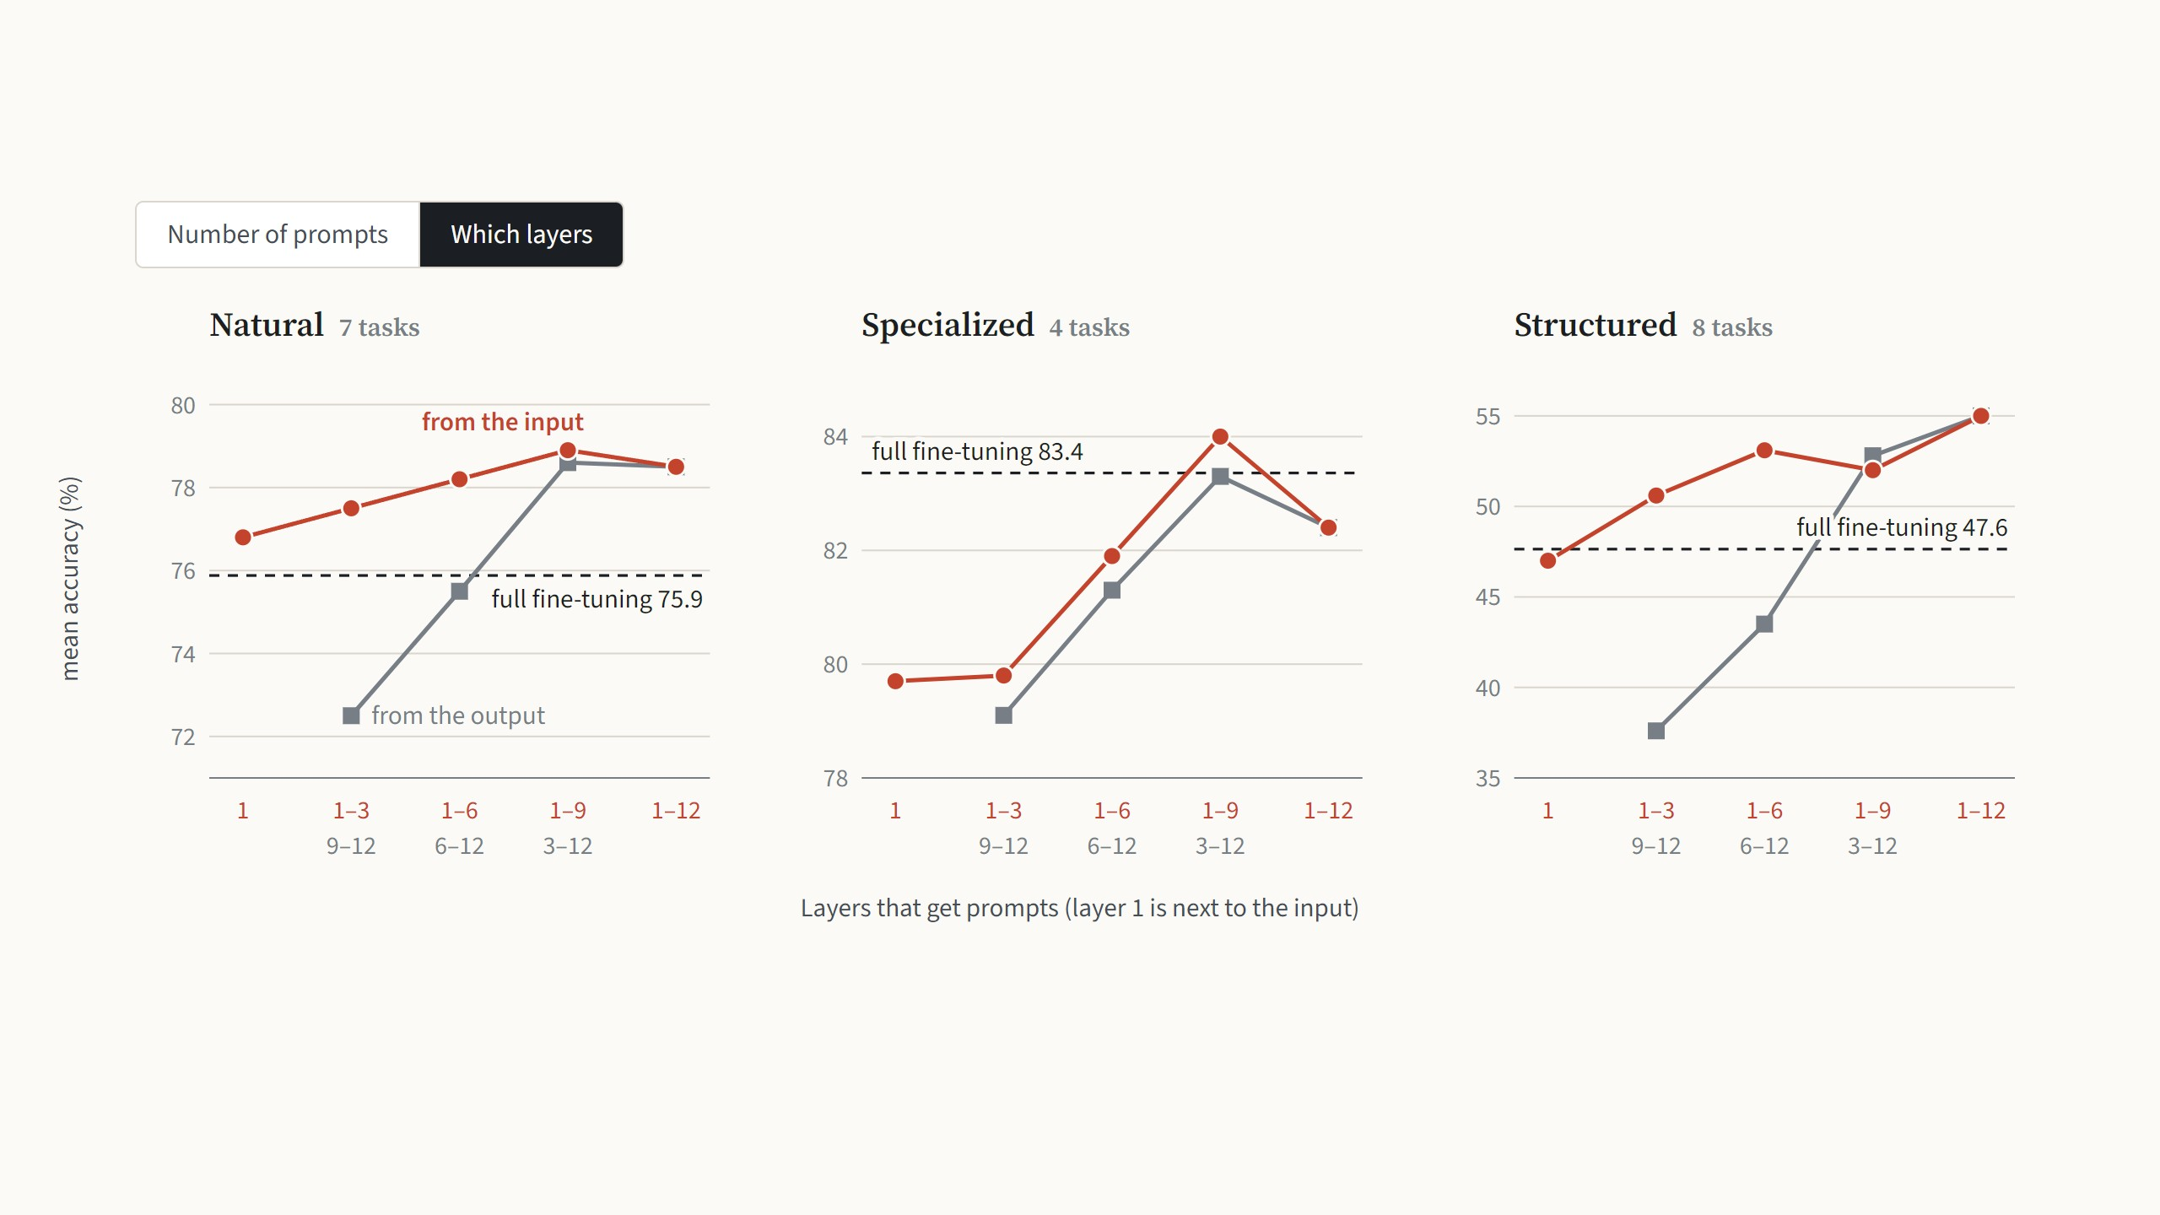
How many prompts, and at which layers
Prompting more layers generally helps: layer 1 alone is VPT-shallow, all twelve is VPT-deep. Layers next to the input matter most:
prompts placed only in the layers near the output score lower, the opposite of what was found for text prompts.
Jia et al. 2022, Fig. 7, each variant with its best prompt length. Values are read off the figure’s plotted points; layer 1 alone and layers 1–12 match VPT-shallow and VPT-deep in
Table 13.
17
Notes:
First, the number of prompts, the one new hyperparameter. Each panel is one VTAB group: the red line is VPT-deep with 1 to 200 prompts at every layer, the dashed line is full fine-tuning, the grey line the best adapter. The best number is different in every group, 10 on Natural, 5 on Specialized, 200 on Structured, and per task it varies even more, from 5 prompts for Oxford Flowers to 200 for Stanford Cars (Table 14). That is why the paper picks p per task on the validation set. Even a single prompt per layer beats the adapter everywhere, and on Natural it already beats full fine-tuning. Press the arrow key for which layers. The red line adds prompts from the input upwards: layer 1 alone is VPT-shallow, all twelve layers is VPT-deep. The grey line adds them from the output downwards. More prompted layers generally help, and the input side wins: on Structured, prompts in layers 1 to 3 give 50.6, prompts in layers 9 to 12 only 37.6. The authors point out that this is the opposite of what was seen with text prompts. The paper has no table for these two experiments, so the values are read off the plotted points of its figures; the end points match VPT-shallow and VPT-deep in Table 13.

Slide 36
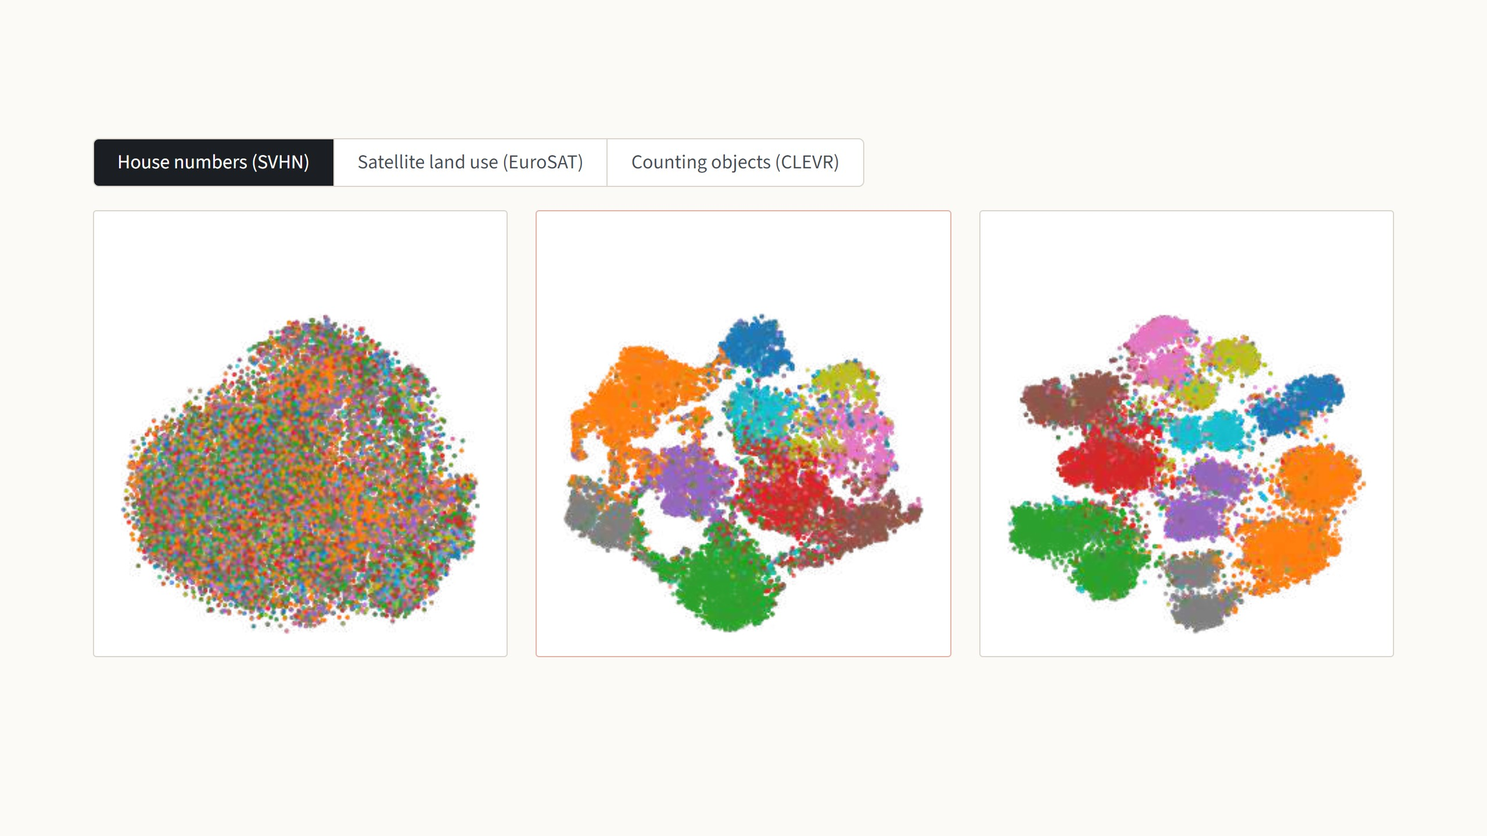
With prompts, the same frozen network separates the classes
Linear probe
36.6%
VPT-deep
78.1%
Full fine-tuning
87.4%
frozen network, no prompts
same frozen network, with prompts
every weight retrained
Each dot is one test image, coloured by its true class; the number is test accuracy. With the frozen features alone, the classes overlap. With
prompts, the same frozen network produces clearly separated groups, so a simple linear head can tell them apart.
t-SNE maps of the final [CLS] vector, test set, from Jia et al. 2022, Fig. 9. Accuracies from Fig. 9 and Table 13.
18
Notes:
This is the payoff of the "why it can work" slide: same weights, different input, completely different output. Each map is a 2-D t-SNE picture of the 768-number [CLS] vector the head receives. House numbers: the frozen features are one mixed blob, 36.6%; with prompts the ten digits form islands, 78.1%. Full fine-tuning is still better here, 87.4%, so be honest about that. Press the arrow key for satellite images: the frozen features are already half sorted, 87.5%, and VPT-deep gives clean clusters, 96.1%, slightly above full fine-tuning at 95.7%. Press again for counting objects in CLEVR: the frozen features know nothing about the count, 34.3%; VPT-deep reaches 68.5%, well above full fine-tuning at 56.3%, and arranges the images along a band that follows the object count. If asked: VPT-shallow sits in between (74.5, 92.0, 50.5); it is in the paper's figure.

Slide 37
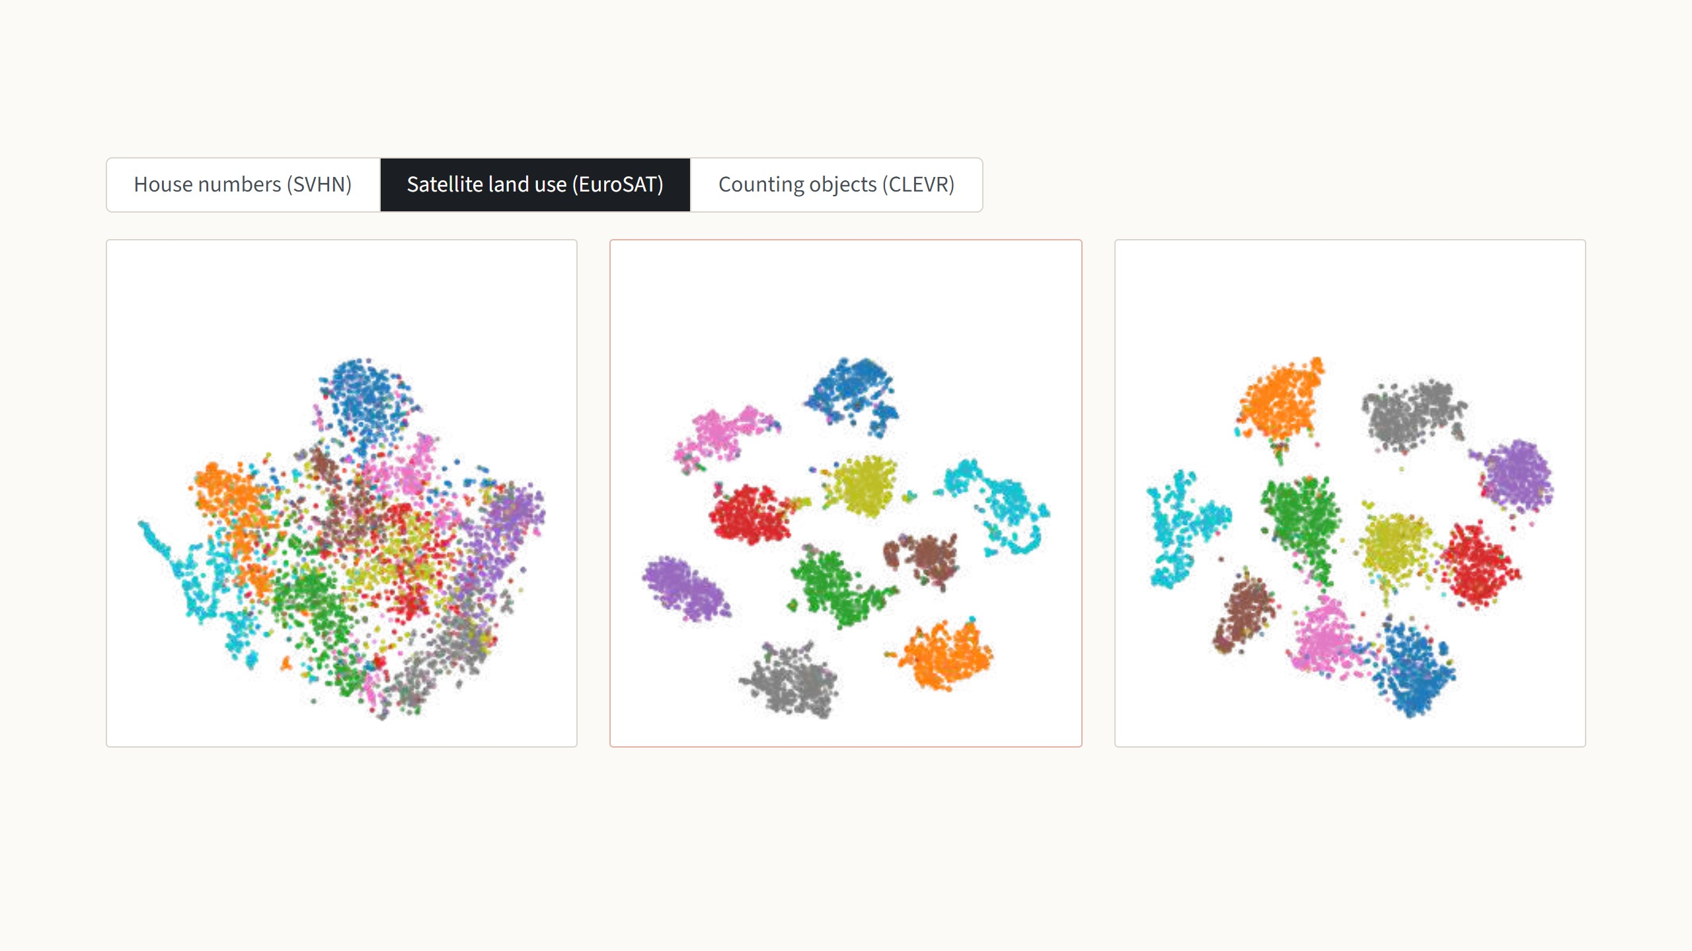
With prompts, the same frozen network separates the classes
Linear probe
87.5%
VPT-deep
96.1%
Full fine-tuning
95.7%
frozen network, no prompts
same frozen network, with prompts
every weight retrained
Each dot is one test image, coloured by its true class; the number is test accuracy. With the frozen features alone, the classes overlap. With
prompts, the same frozen network produces clearly separated groups, so a simple linear head can tell them apart.
t-SNE maps of the final [CLS] vector, test set, from Jia et al. 2022, Fig. 9. Accuracies from Fig. 9 and Table 13.
18
Notes:
This is the payoff of the "why it can work" slide: same weights, different input, completely different output. Each map is a 2-D t-SNE picture of the 768-number [CLS] vector the head receives. House numbers: the frozen features are one mixed blob, 36.6%; with prompts the ten digits form islands, 78.1%. Full fine-tuning is still better here, 87.4%, so be honest about that. Press the arrow key for satellite images: the frozen features are already half sorted, 87.5%, and VPT-deep gives clean clusters, 96.1%, slightly above full fine-tuning at 95.7%. Press again for counting objects in CLEVR: the frozen features know nothing about the count, 34.3%; VPT-deep reaches 68.5%, well above full fine-tuning at 56.3%, and arranges the images along a band that follows the object count. If asked: VPT-shallow sits in between (74.5, 92.0, 50.5); it is in the paper's figure.

Slide 38
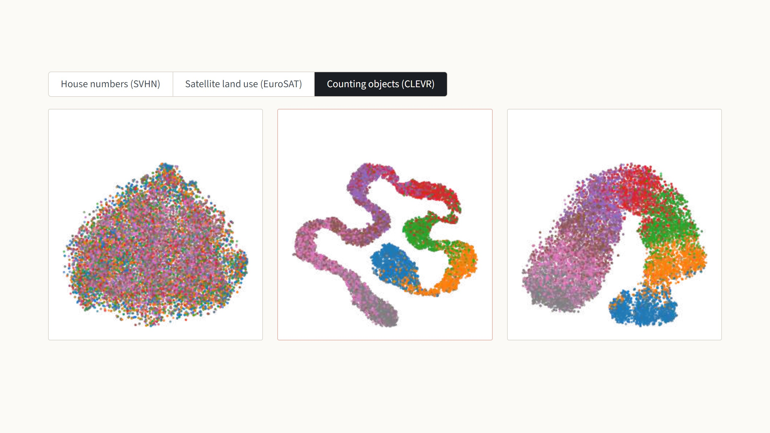
With prompts, the same frozen network separates the classes
Linear probe
34.3%
VPT-deep
68.5%
Full fine-tuning
56.3%
frozen network, no prompts
same frozen network, with prompts
every weight retrained
Each dot is one test image, coloured by its true class; the number is test accuracy. With the frozen features alone, the classes overlap. With
prompts, the same frozen network produces clearly separated groups, so a simple linear head can tell them apart.
t-SNE maps of the final [CLS] vector, test set, from Jia et al. 2022, Fig. 9. Accuracies from Fig. 9 and Table 13.
18
Notes:
This is the payoff of the "why it can work" slide: same weights, different input, completely different output. Each map is a 2-D t-SNE picture of the 768-number [CLS] vector the head receives. House numbers: the frozen features are one mixed blob, 36.6%; with prompts the ten digits form islands, 78.1%. Full fine-tuning is still better here, 87.4%, so be honest about that. Press the arrow key for satellite images: the frozen features are already half sorted, 87.5%, and VPT-deep gives clean clusters, 96.1%, slightly above full fine-tuning at 95.7%. Press again for counting objects in CLEVR: the frozen features know nothing about the count, 34.3%; VPT-deep reaches 68.5%, well above full fine-tuning at 56.3%, and arranges the images along a band that follows the object count. If asked: VPT-shallow sits in between (74.5, 92.0, 50.5); it is in the paper's figure.

Slide 39
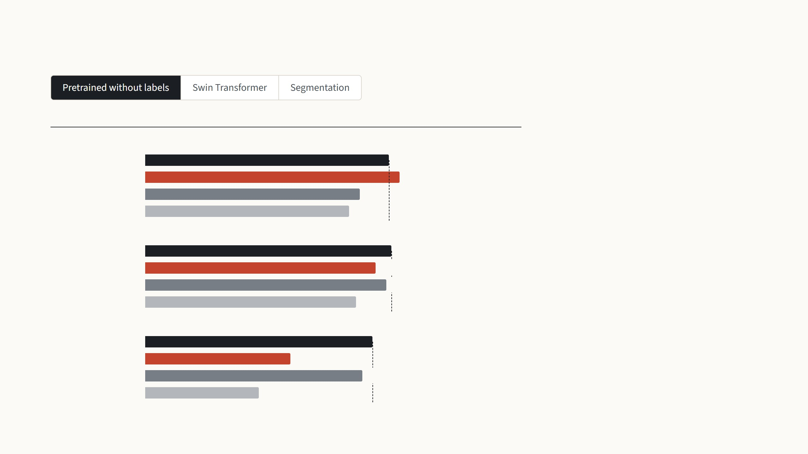
Where VPT falls short
Mean VTAB-1k accuracy (%)
Supervised on ImageNet-21k, with labels
Everything so far used a ViT pretrained
with labels. The paper also tries the same
ViT-B pretrained without labels, and there
VPT loses its lead.
Full fine-tuning
69.0
VPT-deep
72.0
Partial-1
60.7
Linear probe
57.6
With MoCo v3 it ends four points behind
full fine-tuning. With MAE it drops
towards the linear probe, while Partial-1,
which retrains only the last block, stays
close to full fine-tuning. The authors
leave the reason open.
MoCo v3, without labels
Full fine-tuning
69.6
VPT-deep
65.2
Partial-1
68.3
Linear probe
59.6
MAE, without labels
Full fine-tuning
64.3
VPT-deep
41.1
Partial-1
61.5
Linear probe
32.1
Jia et al. 2022, Table 1 (with labels) and Table 4 (MoCo v3, MAE): ViT-B/16, mean of the three VTAB-1k group averages.
19
Notes:
Be honest here; it is what a reading group is for. Three settings where the main result does not carry over. First, the pretraining. Everything so far used a ViT-B pretrained with labels on ImageNet-21k. The paper repeats VTAB-1k with the same architecture pretrained without labels on ImageNet-1k, by MoCo v3 (contrastive) and by MAE (masked autoencoder). The chart shows the mean of the three VTAB group averages. With labels, VPT-deep leads full fine-tuning, 72.0 against 69.0. With MoCo v3 it is 65.2 against 69.6, and Bias (69.2), Partial-1 (68.3) and the adapter (68.2) are all ahead of it. With MAE it collapses to 41.1, closer to the linear probe at 32.1 than to full fine-tuning at 64.3, while Partial-1, which retrains only the last block, reaches 61.5. The authors only say these self-supervised ViTs are fundamentally different and leave the reason open. It connects to the MAE paper from last time: MAE features are known to probe badly, and a few input tokens apparently cannot reorganise them the way retraining the last block can. Press the arrow key for Swin, a hierarchical Transformer that attends within local windows and merges patches in deeper layers; the prompts sit in the windows and are dropped at patch merging. VPT still beats the other cheap methods (Bias, linear probe, Partial, MLP-3) in every group, but full fine-tuning is ahead of VPT-deep in all three, by 6.3 points on Structured. Oddly, VPT-shallow does slightly better than full fine-tuning on Natural, 79.9 against 79.1; it is left out of the chart to keep it simple. Press again for segmentation: ADE20K, 150 classes per pixel, SETR on a ViT-L pretrained on ImageNet-21k; mIoU is the mean overlap between predicted and true regions. The decoder head is trained in every method, which is why even "head only" trains 13 million weights. VPT-deep gets 42.1 against 48.3, a little below Bias at 43.4; prompts plus biases give 44.0, within 1.5 of a fully fine-tuned ResNet-101 with four times the trained weights. This is also where LoRA will come in: it edits weights, so it does not depend on the input space being "steerable".

Slide 40
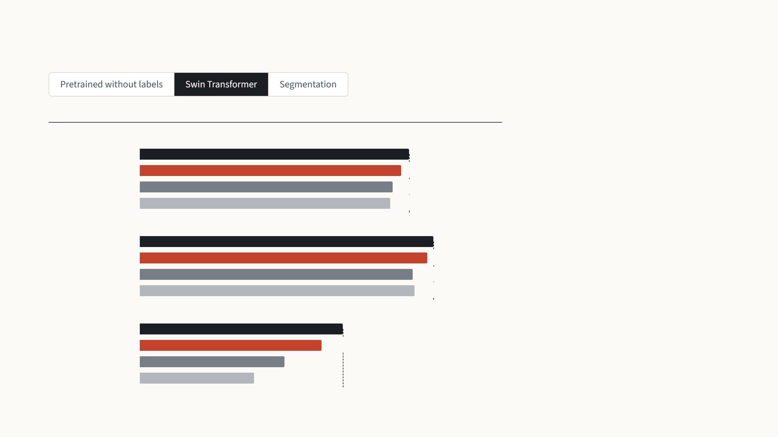
Where VPT falls short
Mean accuracy (%)
Natural, 7 tasks
Swin is a vision Transformer that looks at
small windows of the image and merges
patches as it goes deeper.
Full fine-tuning
79.1
VPT-deep
76.8
Bias
74.2
Linear probe
73.5
On Swin, VPT still beats the other cheap
methods. But full fine-tuning is ahead of
VPT-deep in all three groups, by 6.3
points on Structured.
Specialized, 4 tasks
Full fine-tuning
86.2
VPT-deep
84.5
Bias
80.1
Linear probe
80.8
Structured, 8 tasks
Full fine-tuning
59.7
VPT-deep
53.4
Bias
42.4
Linear probe
33.5
Jia et al. 2022, Table 2: Swin-B pretrained on ImageNet-21k with labels, mean test accuracy per VTAB-1k group.
19
Notes:
Be honest here; it is what a reading group is for. Three settings where the main result does not carry over. First, the pretraining. Everything so far used a ViT-B pretrained with labels on ImageNet-21k. The paper repeats VTAB-1k with the same architecture pretrained without labels on ImageNet-1k, by MoCo v3 (contrastive) and by MAE (masked autoencoder). The chart shows the mean of the three VTAB group averages. With labels, VPT-deep leads full fine-tuning, 72.0 against 69.0. With MoCo v3 it is 65.2 against 69.6, and Bias (69.2), Partial-1 (68.3) and the adapter (68.2) are all ahead of it. With MAE it collapses to 41.1, closer to the linear probe at 32.1 than to full fine-tuning at 64.3, while Partial-1, which retrains only the last block, reaches 61.5. The authors only say these self-supervised ViTs are fundamentally different and leave the reason open. It connects to the MAE paper from last time: MAE features are known to probe badly, and a few input tokens apparently cannot reorganise them the way retraining the last block can. Press the arrow key for Swin, a hierarchical Transformer that attends within local windows and merges patches in deeper layers; the prompts sit in the windows and are dropped at patch merging. VPT still beats the other cheap methods (Bias, linear probe, Partial, MLP-3) in every group, but full fine-tuning is ahead of VPT-deep in all three, by 6.3 points on Structured. Oddly, VPT-shallow does slightly better than full fine-tuning on Natural, 79.9 against 79.1; it is left out of the chart to keep it simple. Press again for segmentation: ADE20K, 150 classes per pixel, SETR on a ViT-L pretrained on ImageNet-21k; mIoU is the mean overlap between predicted and true regions. The decoder head is trained in every method, which is why even "head only" trains 13 million weights. VPT-deep gets 42.1 against 48.3, a little below Bias at 43.4; prompts plus biases give 44.0, within 1.5 of a fully fine-tuned ResNet-101 with four times the trained weights. This is also where LoRA will come in: it edits weights, so it does not depend on the input space being "steerable".

Slide 41

Where VPT falls short
mIoU on ADE20K (%)
Weights trained
ViT-L pretrained on ImageNet-21k
Segmentation labels every pixel of a
scene. The score, mIoU, measures how
well the predicted regions overlap the
true ones.
Full fine-tuning
48.3
318.3 M
VPT-deep
42.1
13.4 M
VPT + Bias
44.0
15.8 M
Here VPT-deep reaches 42.1 against 48.3
for full fine-tuning, about the same as
tuning only the biases. Prompts and
biases together come within 1.5 points of
a fully fine-tuned ResNet-101.
Bias
43.4
13.5 M
Head only
35.1
13.2 M
ResNet-101, a ConvNet
Full fine-tuning
45.5
63.0 M
Jia et al. 2022, Table 3: ADE20K validation, SETR decoder, single-scale mIoU. ResNet-101: DeepLab v3+ (Chen et al. 2018).
19
Notes:
Be honest here; it is what a reading group is for. Three settings where the main result does not carry over. First, the pretraining. Everything so far used a ViT-B pretrained with labels on ImageNet-21k. The paper repeats VTAB-1k with the same architecture pretrained without labels on ImageNet-1k, by MoCo v3 (contrastive) and by MAE (masked autoencoder). The chart shows the mean of the three VTAB group averages. With labels, VPT-deep leads full fine-tuning, 72.0 against 69.0. With MoCo v3 it is 65.2 against 69.6, and Bias (69.2), Partial-1 (68.3) and the adapter (68.2) are all ahead of it. With MAE it collapses to 41.1, closer to the linear probe at 32.1 than to full fine-tuning at 64.3, while Partial-1, which retrains only the last block, reaches 61.5. The authors only say these self-supervised ViTs are fundamentally different and leave the reason open. It connects to the MAE paper from last time: MAE features are known to probe badly, and a few input tokens apparently cannot reorganise them the way retraining the last block can. Press the arrow key for Swin, a hierarchical Transformer that attends within local windows and merges patches in deeper layers; the prompts sit in the windows and are dropped at patch merging. VPT still beats the other cheap methods (Bias, linear probe, Partial, MLP-3) in every group, but full fine-tuning is ahead of VPT-deep in all three, by 6.3 points on Structured. Oddly, VPT-shallow does slightly better than full fine-tuning on Natural, 79.9 against 79.1; it is left out of the chart to keep it simple. Press again for segmentation: ADE20K, 150 classes per pixel, SETR on a ViT-L pretrained on ImageNet-21k; mIoU is the mean overlap between predicted and true regions. The decoder head is trained in every method, which is why even "head only" trains 13 million weights. VPT-deep gets 42.1 against 48.3, a little below Bias at 43.4; prompts plus biases give 44.0, within 1.5 of a fully fine-tuned ResNet-101 with four times the trained weights. This is also where LoRA will come in: it edits weights, so it does not depend on the input space being "steerable".

Slide 42
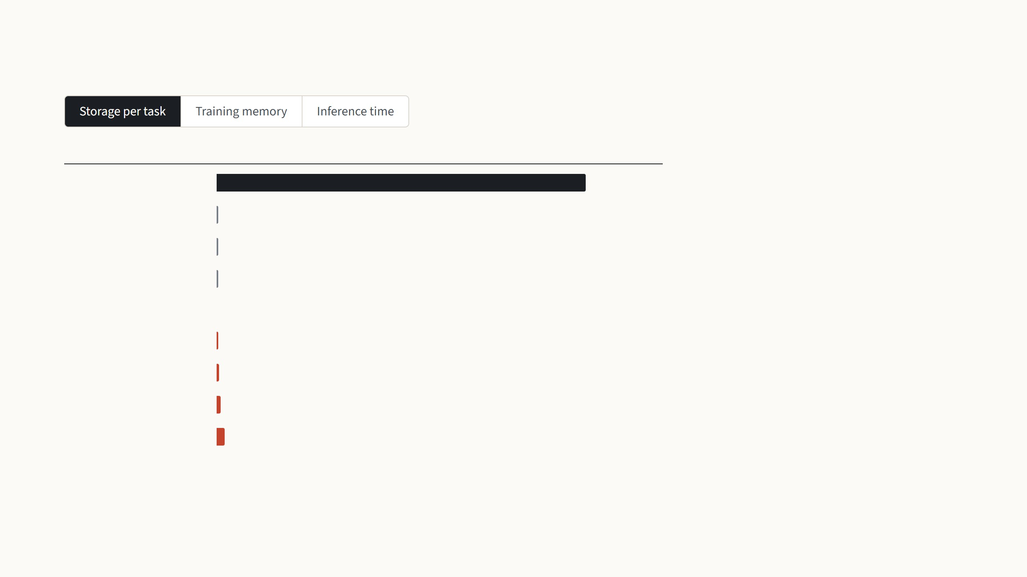
VPT saves storage, not training memory or inference time
Stored per task (MB)
A task trained with VPT-deep keeps only
its prompts and its head: 0.35 MB with
one prompt per layer, 7.7 MB with 200. A
fully fine-tuned copy is 343 MB for every
task.
Full fine-tuning
343 MB
Linear probe
0.31 MB
Bias
0.72 MB
Adapter
1.2 MB
All tasks share one frozen backbone, so
this is the real saving, and it grows with
every task.
VPT-deep, with this many prompts at each layer
1 prompt
0.35 MB
50 prompts
2.2 MB
100 prompts
4.0 MB
200 prompts
7.7 MB
Trained numbers at 4 bytes each. Bias and adapter (r = 64): their share of tuned weights in Jia et al. 2022, Table 12. VPT-deep: 12 × p × 768 prompt numbers plus a 102-class head.
20
Notes:
Easy to miss in the main paper: the saving is disk, not GPU. Three arrow-key steps, same rows each time: full fine-tuning in dark with the dashed line at its value, the cheap baselines in grey, VPT-deep in red with 1, 50, 100 and 200 prompts per layer. Storage: a task keeps only what it trained, so VPT-deep is 0.35 MB with one prompt per layer and 7.7 MB with 200, against 343 MB for a full copy; bias and adapter are as small, so storage is what all these methods buy, and it is VPT's real win. Training memory: no saving. The prompts in the first layer only get a gradient if it travels back through all twelve frozen layers, so their activations are kept, as in full fine-tuning; with 200 prompts the longer sequence makes it 25.8 GB against 11.7. Only the linear probe, 0.9 GB, avoids this. Training time per image is not shown: one prompt trains faster than full fine-tuning, 214 against 359 ms, but 200 prompts are as slow, 360 ms. Inference time: every test image carries the prompts through all twelve layers. Fifty prompts take the sequence from 197 to 247 tokens and the time from 70 to 82 ms; 200 prompts double it, 141 ms. The paper notes this is far from the 4x one would expect from quadratic attention. The prompts cannot be folded into the weights, so the cost stays; the paper's prefix variant, which puts the prompts only into the keys and values, recovers some of it (Fig. 19). LoRA, the second paper, merges its update into the weights and costs nothing at test time. If asked: the table has only 1 and 200 prompts; the 50 and 100 values are read off Fig. 18's plotted points, and the 1 and 200 points of that figure match the table. If someone asks "why not just use this for everything", this is the answer.

Slide 43
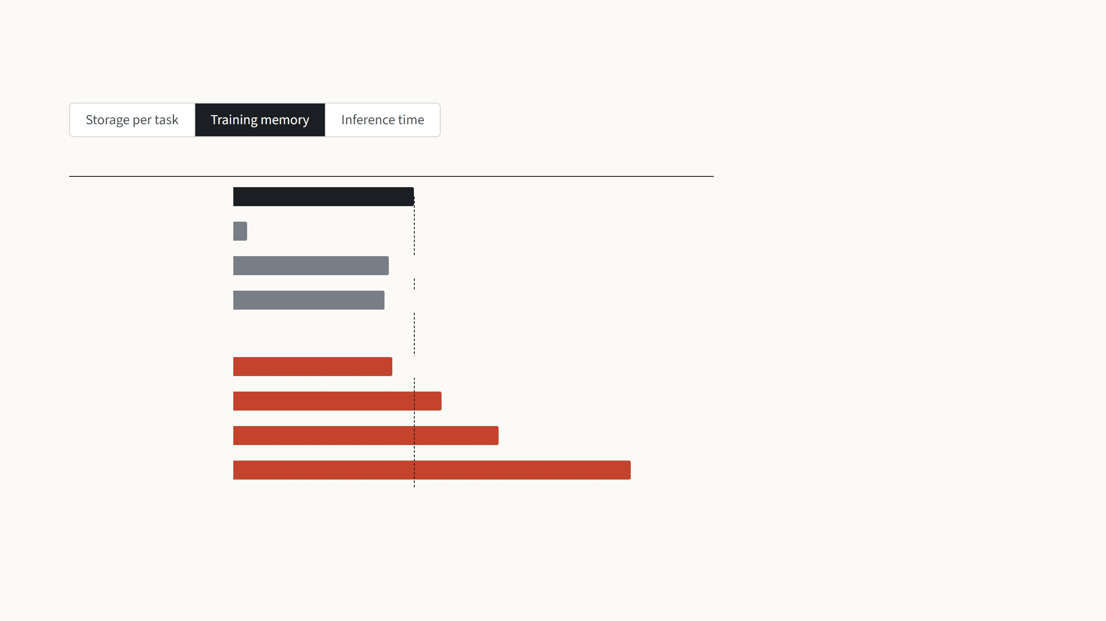
VPT saves storage, not training memory or inference time
Peak GPU memory in training (GB)
In training, VPT-deep needs about as
much GPU memory as full fine-tuning,
and with 200 prompts more than twice as
much.
Full fine-tuning
11.7 GB
Linear probe
0.9 GB
Bias
10.1 GB
To train the prompts in the first layer, the
gradient has to travel back through all
twelve frozen layers, so their activations
must be kept, as in full fine-tuning. Only
the linear probe avoids this.
Adapter
9.8 GB
VPT-deep, with this many prompts at each layer
1 prompt
10.3 GB
50 prompts
13.5 GB
100 prompts
17.2 GB
200 prompts
25.8 GB
Jia et al. 2022, Appendix Table 12: ViT-B/16 on one A100 GPU, batch 64. The table has no rows for 50 and 100 prompts; those values are read from its Fig. 18.
20
Notes:
Easy to miss in the main paper: the saving is disk, not GPU. Three arrow-key steps, same rows each time: full fine-tuning in dark with the dashed line at its value, the cheap baselines in grey, VPT-deep in red with 1, 50, 100 and 200 prompts per layer. Storage: a task keeps only what it trained, so VPT-deep is 0.35 MB with one prompt per layer and 7.7 MB with 200, against 343 MB for a full copy; bias and adapter are as small, so storage is what all these methods buy, and it is VPT's real win. Training memory: no saving. The prompts in the first layer only get a gradient if it travels back through all twelve frozen layers, so their activations are kept, as in full fine-tuning; with 200 prompts the longer sequence makes it 25.8 GB against 11.7. Only the linear probe, 0.9 GB, avoids this. Training time per image is not shown: one prompt trains faster than full fine-tuning, 214 against 359 ms, but 200 prompts are as slow, 360 ms. Inference time: every test image carries the prompts through all twelve layers. Fifty prompts take the sequence from 197 to 247 tokens and the time from 70 to 82 ms; 200 prompts double it, 141 ms. The paper notes this is far from the 4x one would expect from quadratic attention. The prompts cannot be folded into the weights, so the cost stays; the paper's prefix variant, which puts the prompts only into the keys and values, recovers some of it (Fig. 19). LoRA, the second paper, merges its update into the weights and costs nothing at test time. If asked: the table has only 1 and 200 prompts; the 50 and 100 values are read off Fig. 18's plotted points, and the 1 and 200 points of that figure match the table. If someone asks "why not just use this for everything", this is the answer.

Slide 44
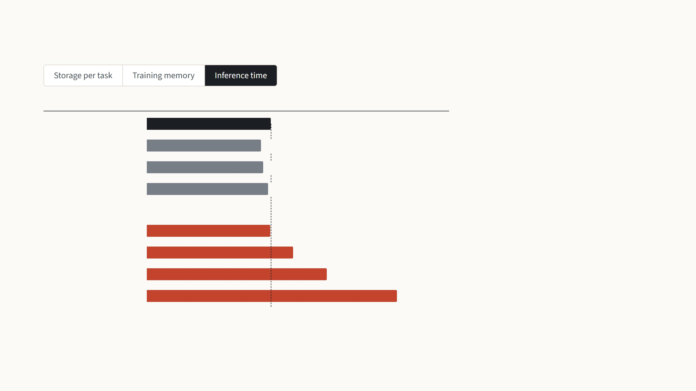
VPT saves storage, not training memory or inference time
Test time per image (ms)
At test time every image carries the
prompts through all twelve layers, so the
sequence is longer. Fifty prompts make it
82 ms instead of 70, and 200 prompts
double it.
Full fine-tuning
70 ms
Linear probe
64 ms
Bias
66 ms
Adapter
68 ms
The prompts cannot be folded into the
weights, so this cost stays. LoRA, the next
paper, avoids it.
VPT-deep, with this many prompts at each layer
1 prompt
69 ms
50 prompts
82 ms
100 prompts
101 ms
200 prompts
141 ms
Jia et al. 2022, Appendix Table 12: ViT-B/16 on one A100 GPU, batch 64. The table has no rows for 50 and 100 prompts; those values are read from its Fig. 18.
20
Notes:
Easy to miss in the main paper: the saving is disk, not GPU. Three arrow-key steps, same rows each time: full fine-tuning in dark with the dashed line at its value, the cheap baselines in grey, VPT-deep in red with 1, 50, 100 and 200 prompts per layer. Storage: a task keeps only what it trained, so VPT-deep is 0.35 MB with one prompt per layer and 7.7 MB with 200, against 343 MB for a full copy; bias and adapter are as small, so storage is what all these methods buy, and it is VPT's real win. Training memory: no saving. The prompts in the first layer only get a gradient if it travels back through all twelve frozen layers, so their activations are kept, as in full fine-tuning; with 200 prompts the longer sequence makes it 25.8 GB against 11.7. Only the linear probe, 0.9 GB, avoids this. Training time per image is not shown: one prompt trains faster than full fine-tuning, 214 against 359 ms, but 200 prompts are as slow, 360 ms. Inference time: every test image carries the prompts through all twelve layers. Fifty prompts take the sequence from 197 to 247 tokens and the time from 70 to 82 ms; 200 prompts double it, 141 ms. The paper notes this is far from the 4x one would expect from quadratic attention. The prompts cannot be folded into the weights, so the cost stays; the paper's prefix variant, which puts the prompts only into the keys and values, recovers some of it (Fig. 19). LoRA, the second paper, merges its update into the weights and costs nothing at test time. If asked: the table has only 1 and 200 prompts; the 50 and 100 values are read off Fig. 18's plotted points, and the 1 and 200 points of that figure match the table. If someone asks "why not just use this for everything", this is the answer.

Slide 45
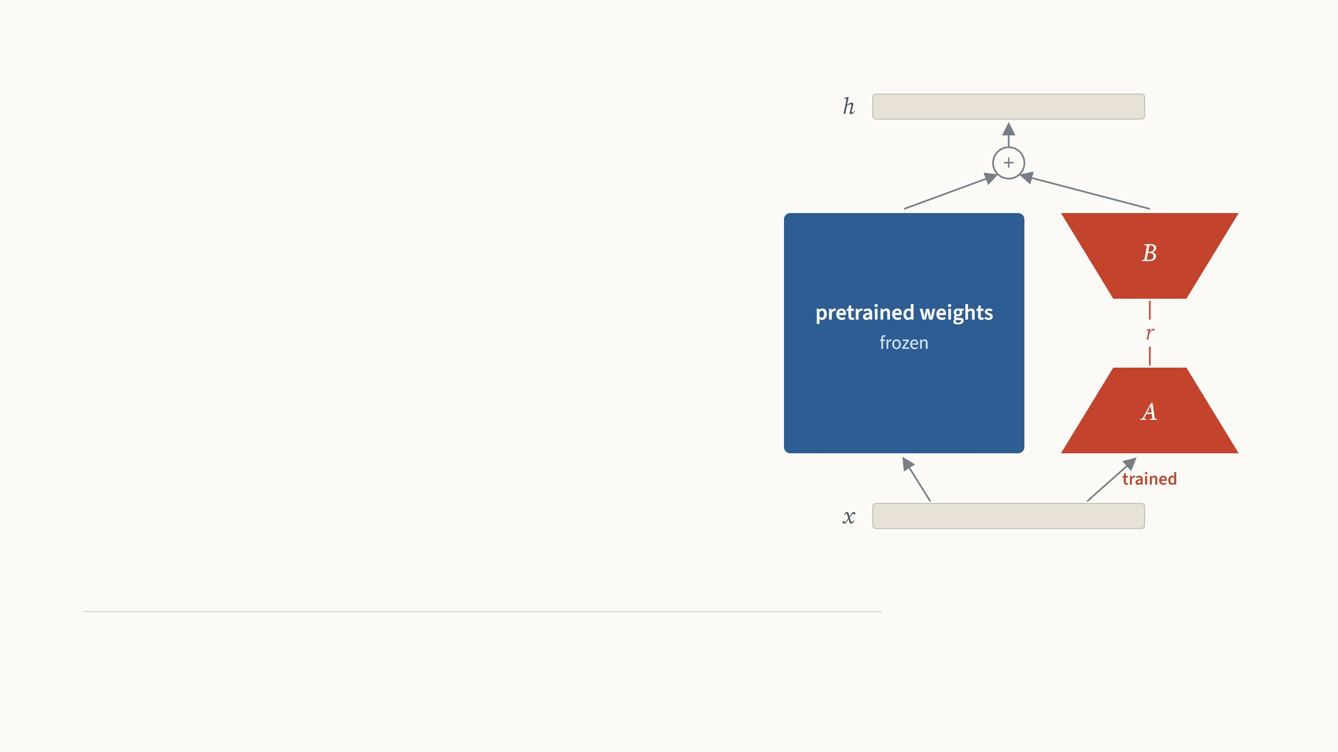
Low-Rank
Adaptation
Teach a frozen model a new task by
learning a small, low-rank change to its
weights.
Edward J. Hu, Yelong Shen, Phillip Wallis, Zeyuan Allen-Zhu, Yuanzhi Li, Shean Wang, Lu Wang, Weizhu Chen
Microsoft. ICLR 2022. Results on images from Zhang, Zhou & Liu 2022 and Zhu et al. 2024.
Presented by Ertugrul Senturk
October 2026
21
Notes:
Second paper: VPT is done, now LoRA. The picture is the whole method: the input goes through the frozen pretrained weight, the blue square, and in parallel through two thin trained matrices, A and B, in red; the two results are added. LoRA was written for language models, at Microsoft, and the paper itself has no image experiments. So the deck has two halves: the method and the paper's own evidence, then what happened when vision groups applied it to Vision Transformers, on the same benchmark and backbone as the VPT results we just saw, and on medical images. After that come my own experiments with both methods.

Slide 46
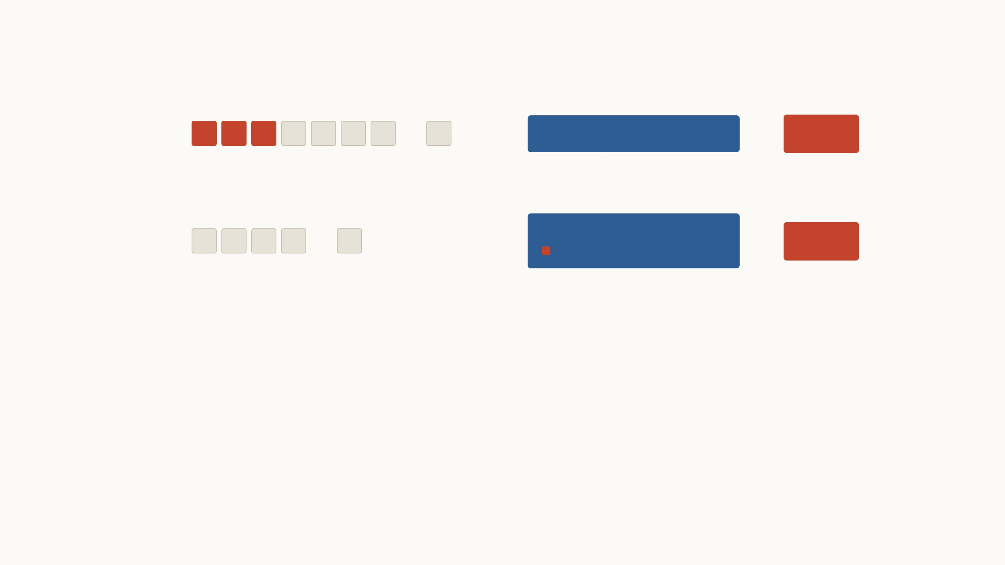
From VPT to LoRA
VPT
…
→
frozen Vision Transformer
→
head
Jia et al. 2022
Learned vectors join the image patches, so every image carries a longer sequence through every layer.
LoRA
…
→
frozen Vision Transformer
→
small trained change to its weights
head
Hu et al. 2022
The input stays as it is. A small change to the weights is learned, and after training it is added into them.
VPT trained 0.6% of the weights and beat full fine-tuning on 20
of 24 tasks. But its prompts make every image slower, and
they can never be folded into the model.
LoRA leaves the input alone and changes the weights instead.
It ends up storing about as little per task as VPT, while the
model runs exactly as fast as before.
VPT: Jia et al., ECCV 2022 (0.6% of the weights with 50 prompts per layer and a 102-class head; 20 of 24 tasks, Table 1). LoRA: Hu et al., ICLR 2022, first posted in June 2021.
22
Notes:
A one-slide bridge from VPT to the second paper. Top row: VPT put learned vectors, red, in front of the image patches, grey, and left the Vision Transformer frozen. It worked well, 20 of 24 tasks above full fine-tuning, but the cost section showed what it does not save: every image now carries 50 extra tokens through all twelve layers, 82 instead of 70 ms, and the prompts cannot be merged into anything. Bottom row: LoRA keeps exactly the same input. The thing it learns lives inside the weights, and after training it is added into them, so the model at test time is an ordinary ViT. LoRA was posted in mid-2021 for language models, VPT in 2022 for vision; both were published in 2022.

Slide 47

Every fine-tuned copy is as big as the model
The paper starts from the largest model of its time, GPT-3, with 175
billion weights. Each fine-tuned copy takes 350 GB, so a service with a
hundred tasks would store 35 TB. LoRA keeps one shared model and only
a small file per task, and the frozen weights also need no optimizer state,
which cuts training memory from 1.2 TB to 350 GB.
Shown for 1 task on ViT-B/16, 86 million weights.
The next pages show 100 tasks, then GPT-3.
Full fine-tuning: 1 retrained ViT-B copy
LoRA: one shared ViT-B plus 1 small file
each red speck is one task file, to
scale
343 MB
345 MB
1 copy at 343 MB each
343 MB once, plus 1.5 MB per task
GPT-3 in 16-bit numbers: 350 GB per copy, 35 MB per LoRA file at rank 4 on the query and value weights (Hu et al. 2022, Sec. 4.2). ViT-B/16 in 32-bit: 343 MB per copy; its LoRA file
is rank 8 on the same weights plus a 102-class head. Squares are sized by area.
23
Notes:
The motivation in the paper is about scale. GPT-3 has 175 billion weights; one fine-tuned copy is 350 GB in 16-bit. Drag the slider to 100 tasks: 35 TB of copies against 354 GB for one shared model plus a hundred 35 MB LoRA files. Then switch to ViT-B, the model from the VPT part and from my experiments: a copy is 343 MB, a LoRA file of rank 8 with a head is 1.5 MB, slightly smaller than VPT's 2.2 MB. The red specks are drawn to scale; for GPT-3 they are far below a pixel, so they are drawn at the minimum size. The training-memory point is new compared with VPT: with Adam, every trained weight needs two extra numbers of optimizer state, so freezing 99.99% of GPT-3 cut training memory from 1.2 TB to 350 GB, and training was 25% faster.

Slide 48
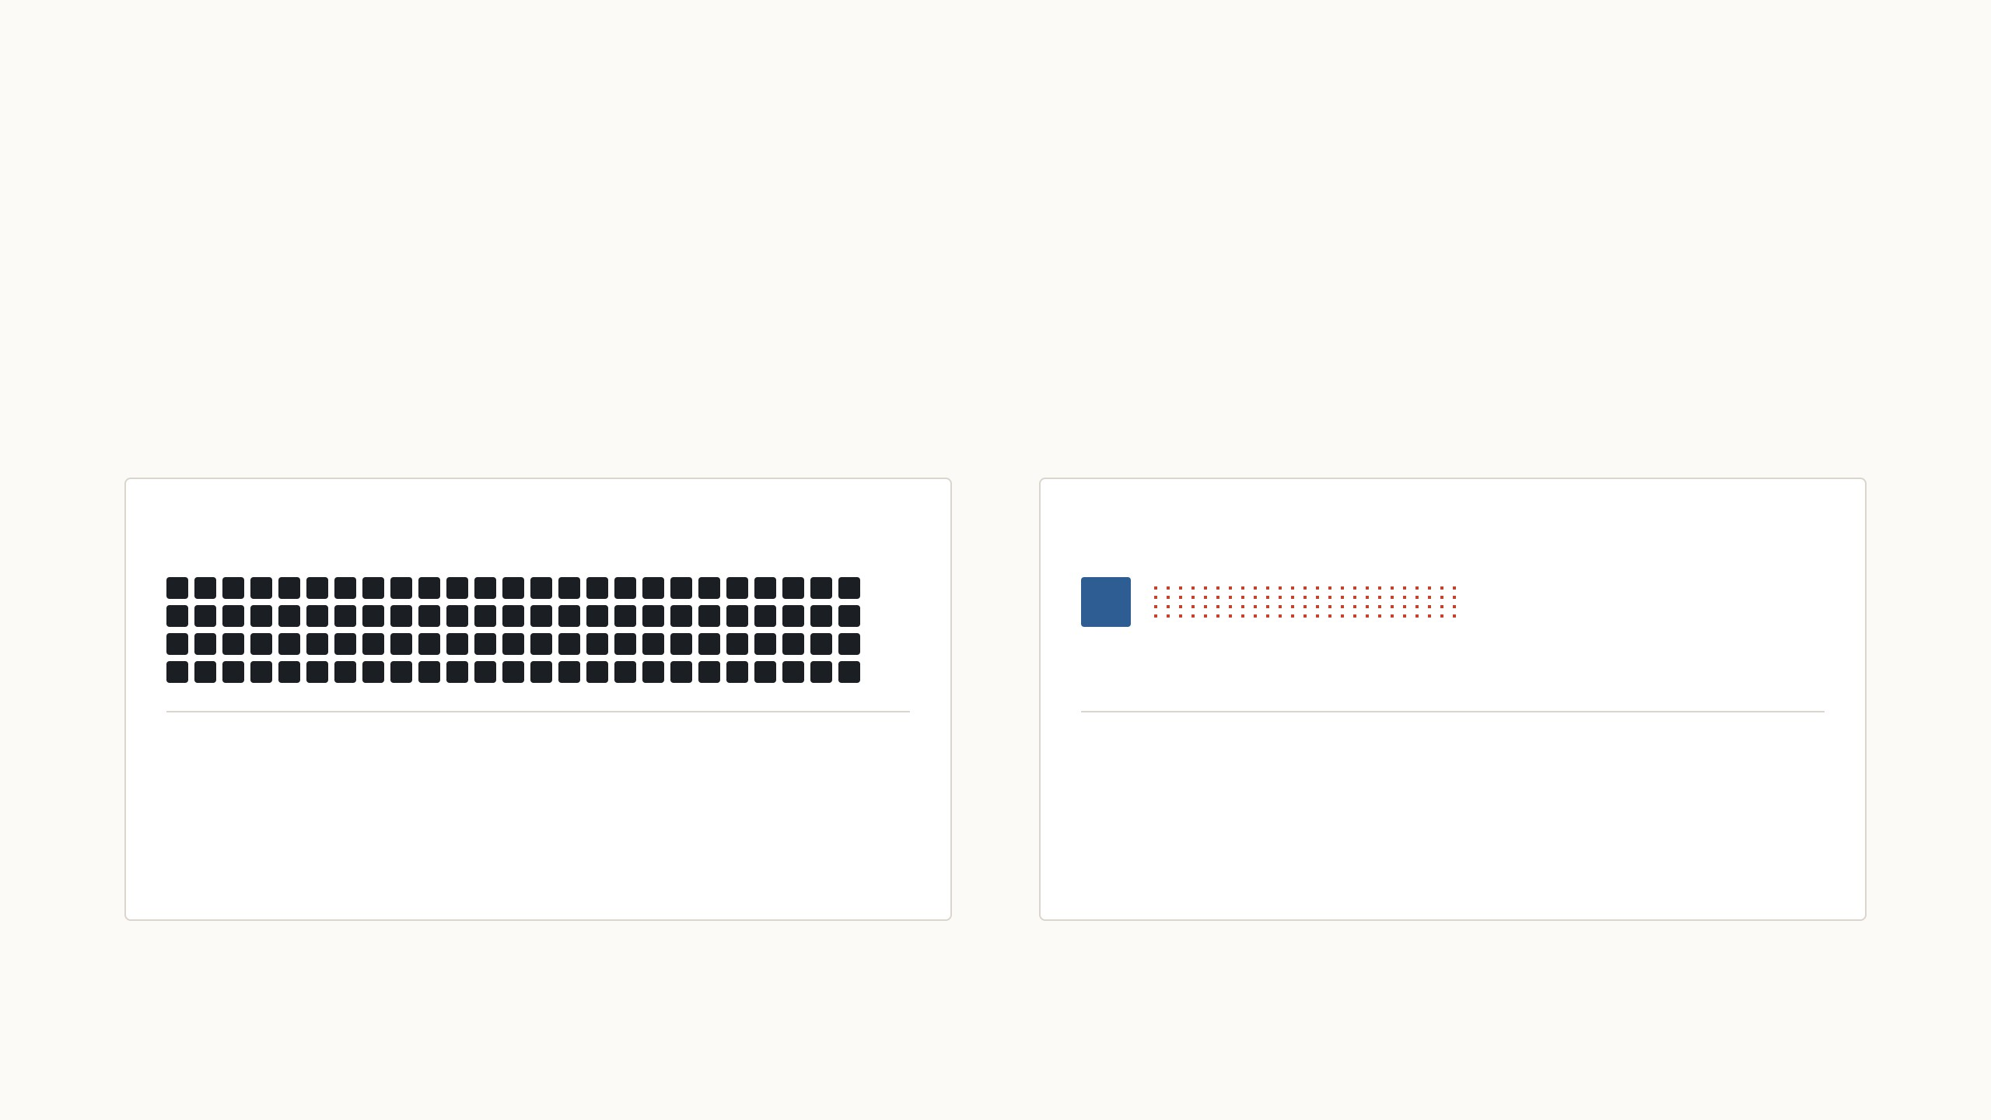
Every fine-tuned copy is as big as the model
The paper starts from the largest model of its time, GPT-3, with 175
billion weights. Each fine-tuned copy takes 350 GB, so a service with a
hundred tasks would store 35 TB. LoRA keeps one shared model and only
a small file per task, and the frozen weights also need no optimizer state,
which cuts training memory from 1.2 TB to 350 GB.
Shown for 100 tasks on ViT-B/16, 86 million
weights.
Full fine-tuning: 100 retrained ViT-B copies
LoRA: one shared ViT-B plus 100 small files
34 GB
493 MB
100 copies at 343 MB each
343 MB once, plus 1.5 MB per task
GPT-3 in 16-bit numbers: 350 GB per copy, 35 MB per LoRA file at rank 4 on the query and value weights (Hu et al. 2022, Sec. 4.2). ViT-B/16 in 32-bit: 343 MB per copy; its LoRA file
is rank 8 on the same weights plus a 102-class head. Squares are sized by area.
23
Notes:
The motivation in the paper is about scale. GPT-3 has 175 billion weights; one fine-tuned copy is 350 GB in 16-bit. Drag the slider to 100 tasks: 35 TB of copies against 354 GB for one shared model plus a hundred 35 MB LoRA files. Then switch to ViT-B, the model from the VPT part and from my experiments: a copy is 343 MB, a LoRA file of rank 8 with a head is 1.5 MB, slightly smaller than VPT's 2.2 MB. The red specks are drawn to scale; for GPT-3 they are far below a pixel, so they are drawn at the minimum size. The training-memory point is new compared with VPT: with Adam, every trained weight needs two extra numbers of optimizer state, so freezing 99.99% of GPT-3 cut training memory from 1.2 TB to 350 GB, and training was 25% faster.

Slide 49

Every fine-tuned copy is as big as the model
The paper starts from the largest model of its time, GPT-3, with 175
billion weights. Each fine-tuned copy takes 350 GB, so a service with a
hundred tasks would store 35 TB. LoRA keeps one shared model and only
a small file per task, and the frozen weights also need no optimizer state,
which cuts training memory from 1.2 TB to 350 GB.
Shown for 100 tasks on GPT-3, 175 billion weights.
Full fine-tuning: 100 retrained GPT-3 copies
LoRA: one shared GPT-3 plus 100 small files
35 TB
354 GB
100 copies at 350 GB each
350 GB once, plus 35 MB per task
GPT-3 in 16-bit numbers: 350 GB per copy, 35 MB per LoRA file at rank 4 on the query and value weights (Hu et al. 2022, Sec. 4.2). ViT-B/16 in 32-bit: 343 MB per copy; its LoRA file
is rank 8 on the same weights plus a 102-class head. Squares are sized by area.
23
Notes:
The motivation in the paper is about scale. GPT-3 has 175 billion weights; one fine-tuned copy is 350 GB in 16-bit. Drag the slider to 100 tasks: 35 TB of copies against 354 GB for one shared model plus a hundred 35 MB LoRA files. Then switch to ViT-B, the model from the VPT part and from my experiments: a copy is 343 MB, a LoRA file of rank 8 with a head is 1.5 MB, slightly smaller than VPT's 2.2 MB. The red specks are drawn to scale; for GPT-3 they are far below a pixel, so they are drawn at the minimum size. The training-memory point is new compared with VPT: with Adam, every trained weight needs two extra numbers of optimizer state, so freezing 99.99% of GPT-3 cut training memory from 1.2 TB to 350 GB, and training was 25% faster.

Slide 50
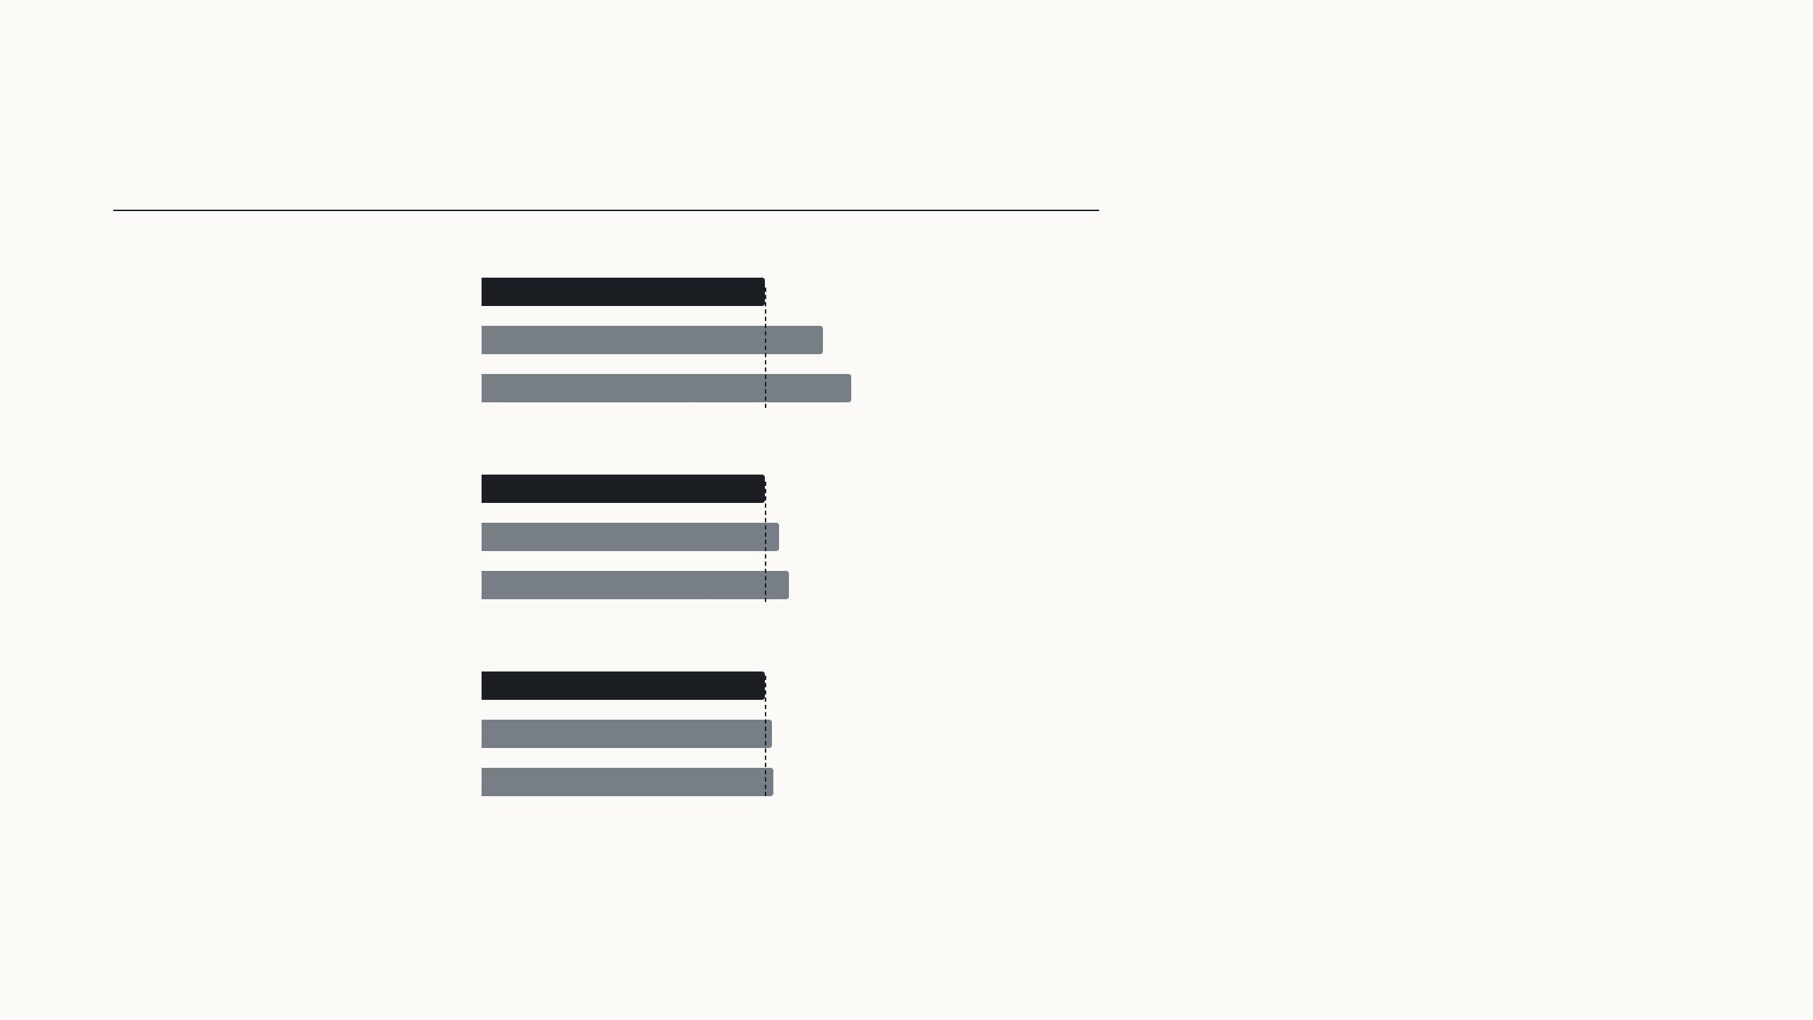
Earlier cheap methods cost time or sequence length
Time for one forward pass
Extra time
Adapters insert small extra layers into every
block. They have few weights, but an image or a
sentence must pass through them one after
another, so serving a single input takes 20 to
30% longer. With large batches the gap shrinks
to 2 or 3%.
One input of 128 tokens
Fine-tuned, or LoRA merged
19.8 ms
Adapter, one per block
23.9 ms
+20.7%
Adapter, two per block
25.8 ms
+30.3%
16 inputs of 256 tokens
Prompt methods such as prefix tuning and VPT
lengthen the input instead. That leaves less
room for the real input and costs compute in
every layer, and on GPT-3 prefix tuning got
worse beyond 256 prompt tokens.
Fine-tuned, or LoRA merged
338 ms
Adapter, one per block
354.8 ms
+5.0%
Adapter, two per block
366.3 ms
+8.4%
32 inputs of 512 tokens
Fine-tuned, or LoRA merged
1449.4 ms
LoRA adds no layer and no token at test time.
Adapter, one per block
1482 ms
+2.2%
Adapter, two per block
1492.2 ms
+3.0%
Hu et al. 2022, Table 1: one forward pass of GPT-2 medium, mean of 100 trials on one NVIDIA Quadro RTX 8000; bars are drawn relative to the fine-tuned model in each setting.
Prefix tuning: Sec. 5.5 and Table 15.
24
Notes:
Section 3 of the paper, "aren't existing solutions good enough?". Two families existed. Adapters, the small bottleneck networks of Houlsby et al., add depth: GPU latency depends on how many layers run one after another, so even a tiny adapter adds time when there is only one input to process, the online case. Measured on GPT-2 medium with one input of 128 tokens: 19.8 ms for the plain or fine-tuned model, 23.9 ms with one adapter per block, 25.8 ms with two. With large batches the overhead almost disappears, 2–3%. The second family is prompts, which we know from VPT: they reserve part of the sequence and every layer has to process them; the paper also found them hard to optimise. LoRA's design goal is to avoid both: nothing extra at test time.

Slide 51
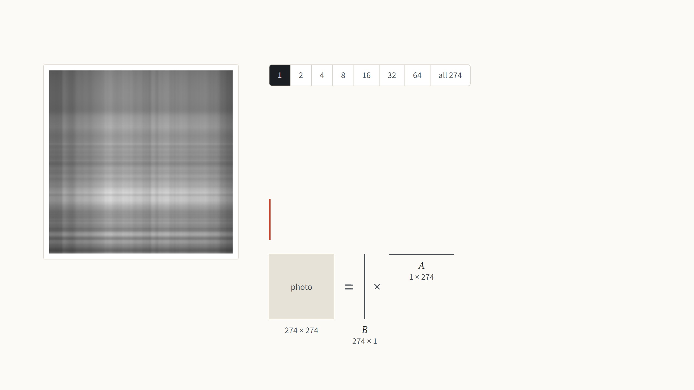
What a low-rank matrix is
A grayscale photo is a matrix of 274 × 274 brightness values. Any matrix can be
written as a sum of simple pieces, where each piece is one column of numbers
times one row. The rank is the number of pieces.
One piece gives only bands of light and dark, because every row of it is the same
pattern, scaled.
LoRA bets that the change fine-tuning makes to a weight
matrix is like this photo: a few pieces carry almost all of it.
Rank 1: 1 × (274 + 274) = 548 numbers, 0.7% of
the photo's 75,076
Not from the paper: the best rank-r approximation (SVD) of an Oxford Pets photo, Jia et al. 2022, Fig. 10. The low-rank bet follows Li et al. 2018 and Aghajanyan et al. 2021.
25
Notes:
One minute of linear algebra, because the whole paper rests on the word rank. Treat the photo as a matrix of brightness values. A rank-one matrix is a column times a row: every row of the image is the same pattern, just scaled, so you get bands. Step through with the arrow keys. Each step doubles the number of pieces. The pieces are ordered by how much they contribute, so the first few capture the big shapes and the later ones only fine detail. At rank 16 the cat is recognisable, from 12% of the numbers; at 64 it is hard to tell from the original, from 47%. Storing r pieces costs r times (rows plus columns) numbers instead of rows times columns. The drawing under the text shows the same thing as matrices, to scale: the r columns side by side are a tall matrix B, the r rows stacked are a wide matrix A, and B times A rebuilds the photo; at rank 1 they are a single line each, at all 274 they are as big as the photo itself. That is the trade LoRA makes for the weight change, with the same names B and A from now on. Why expect the change to be low-rank? Two earlier papers measured the "intrinsic dimension" of fine-tuning: you can freeze the model, train only a few hundred or thousand numbers, map them through a fixed random projection onto all the weights, and still get most of the accuracy. LoRA's assumption is the matrix version of that: each weight change has a low rank, so it can be written as B times A with a small r, chosen by hand.

Slide 52
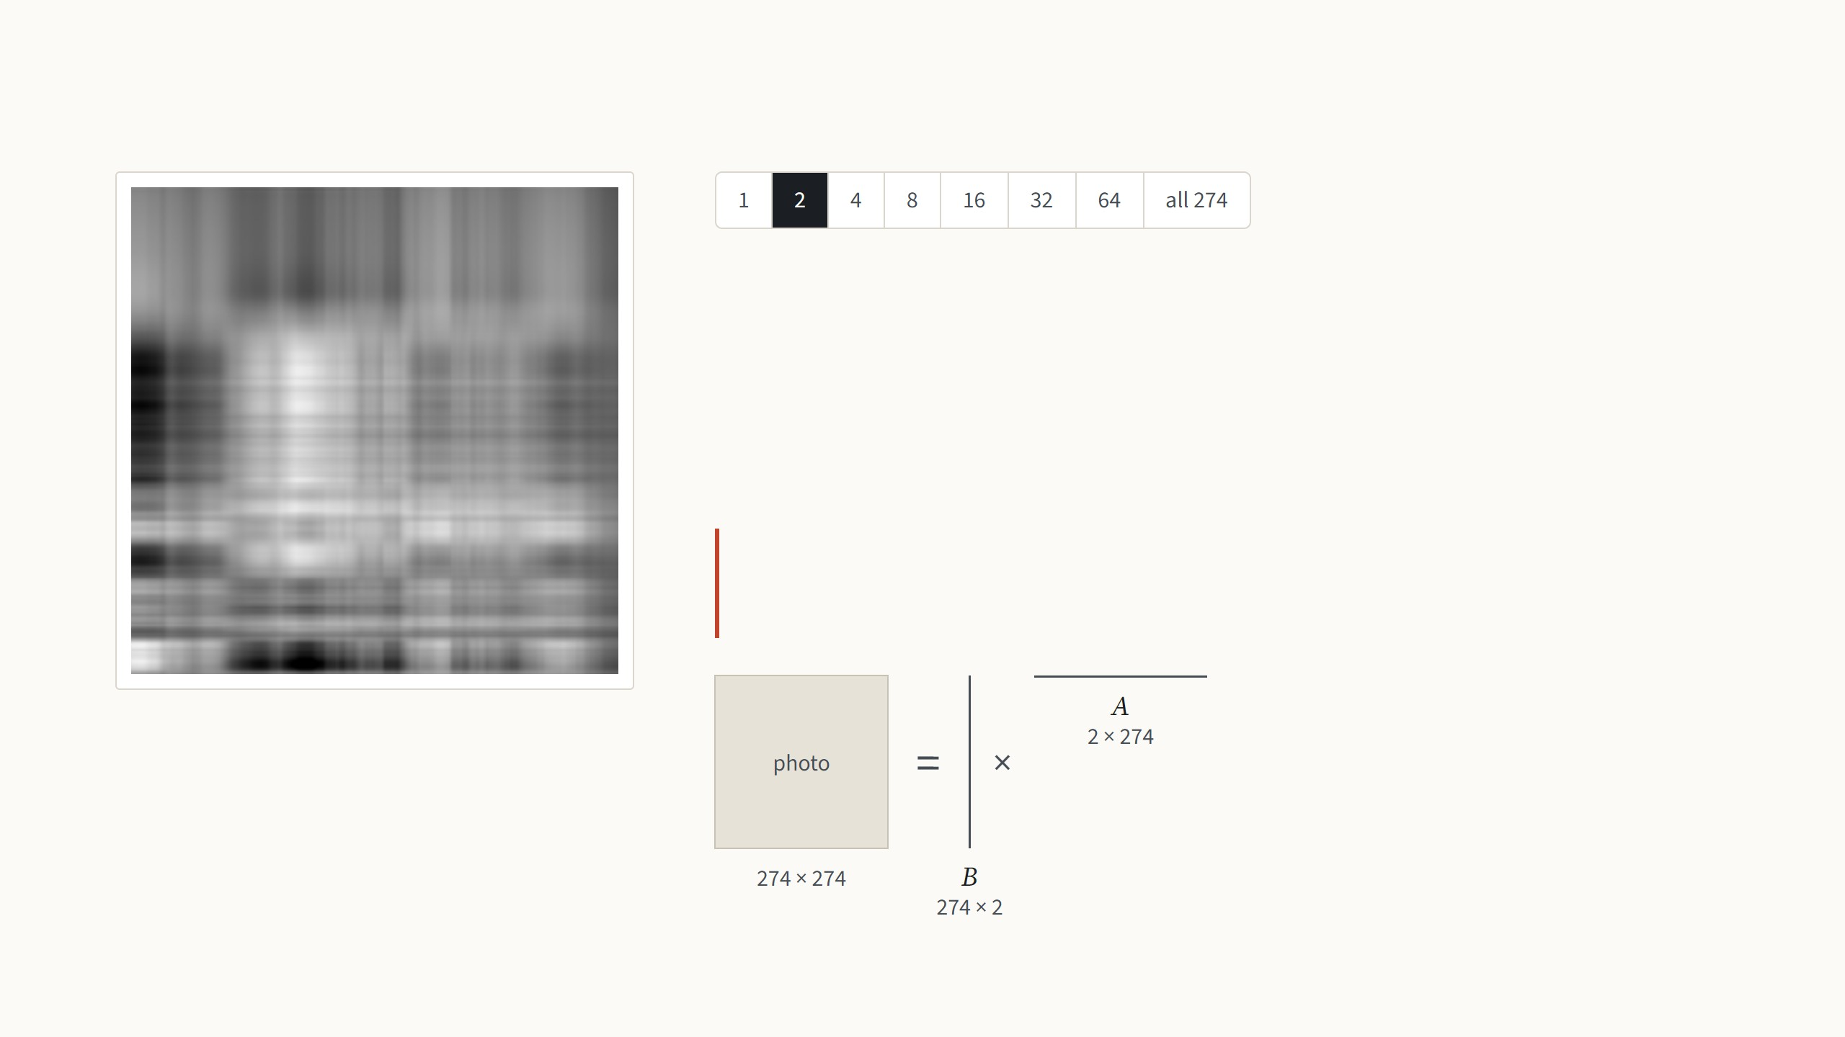
What a low-rank matrix is
A grayscale photo is a matrix of 274 × 274 brightness values. Any matrix can be
written as a sum of simple pieces, where each piece is one column of numbers
times one row. The rank is the number of pieces.
Two pieces are still mostly bands, now in two patterns.
LoRA bets that the change fine-tuning makes to a weight
matrix is like this photo: a few pieces carry almost all of it.
Rank 2: 2 × (274 + 274) = 1,096 numbers, 1.5%
of the photo's 75,076
Not from the paper: the best rank-r approximation (SVD) of an Oxford Pets photo, Jia et al. 2022, Fig. 10. The low-rank bet follows Li et al. 2018 and Aghajanyan et al. 2021.
25
Notes:
One minute of linear algebra, because the whole paper rests on the word rank. Treat the photo as a matrix of brightness values. A rank-one matrix is a column times a row: every row of the image is the same pattern, just scaled, so you get bands. Step through with the arrow keys. Each step doubles the number of pieces. The pieces are ordered by how much they contribute, so the first few capture the big shapes and the later ones only fine detail. At rank 16 the cat is recognisable, from 12% of the numbers; at 64 it is hard to tell from the original, from 47%. Storing r pieces costs r times (rows plus columns) numbers instead of rows times columns. The drawing under the text shows the same thing as matrices, to scale: the r columns side by side are a tall matrix B, the r rows stacked are a wide matrix A, and B times A rebuilds the photo; at rank 1 they are a single line each, at all 274 they are as big as the photo itself. That is the trade LoRA makes for the weight change, with the same names B and A from now on. Why expect the change to be low-rank? Two earlier papers measured the "intrinsic dimension" of fine-tuning: you can freeze the model, train only a few hundred or thousand numbers, map them through a fixed random projection onto all the weights, and still get most of the accuracy. LoRA's assumption is the matrix version of that: each weight change has a low rank, so it can be written as B times A with a small r, chosen by hand.

Slide 53
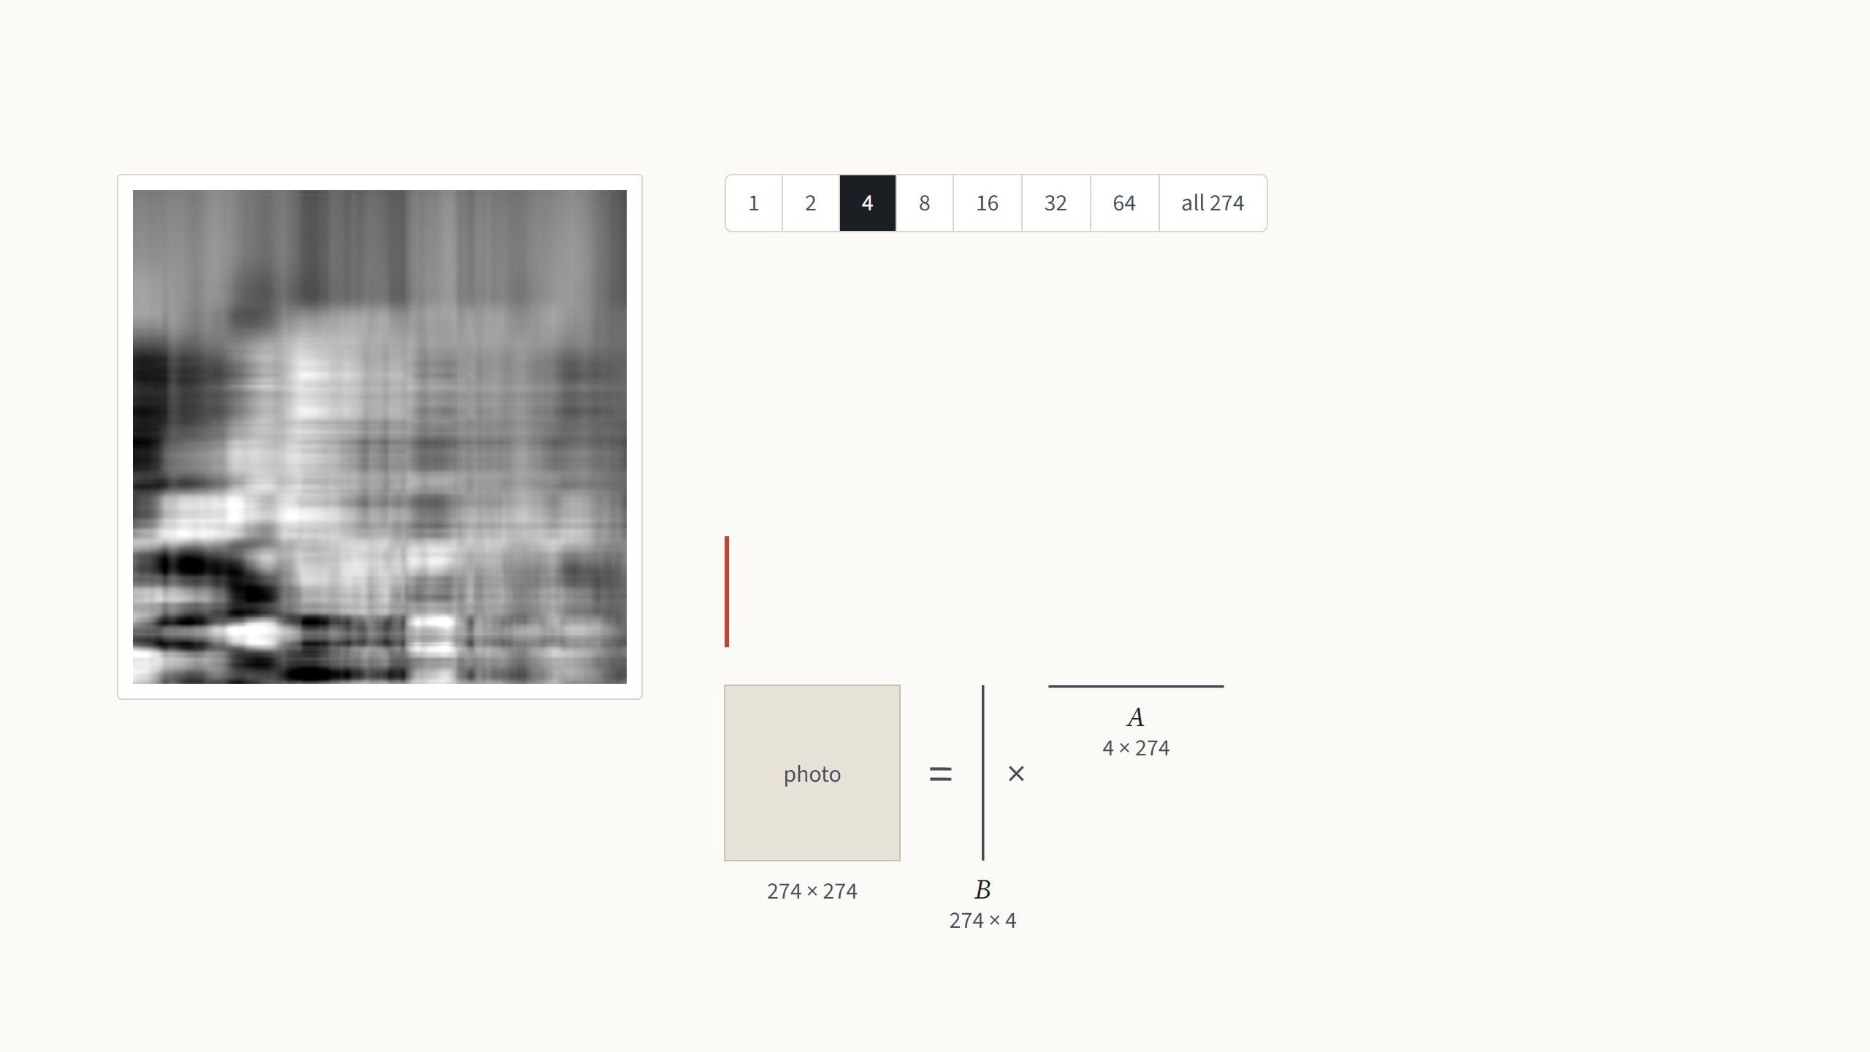
What a low-rank matrix is
A grayscale photo is a matrix of 274 × 274 brightness values. Any matrix can be
written as a sum of simple pieces, where each piece is one column of numbers
times one row. The rank is the number of pieces.
With four pieces the main light and dark areas appear.
LoRA bets that the change fine-tuning makes to a weight
matrix is like this photo: a few pieces carry almost all of it.
Rank 4: 4 × (274 + 274) = 2,192 numbers, 2.9%
of the photo's 75,076
Not from the paper: the best rank-r approximation (SVD) of an Oxford Pets photo, Jia et al. 2022, Fig. 10. The low-rank bet follows Li et al. 2018 and Aghajanyan et al. 2021.
25
Notes:
One minute of linear algebra, because the whole paper rests on the word rank. Treat the photo as a matrix of brightness values. A rank-one matrix is a column times a row: every row of the image is the same pattern, just scaled, so you get bands. Step through with the arrow keys. Each step doubles the number of pieces. The pieces are ordered by how much they contribute, so the first few capture the big shapes and the later ones only fine detail. At rank 16 the cat is recognisable, from 12% of the numbers; at 64 it is hard to tell from the original, from 47%. Storing r pieces costs r times (rows plus columns) numbers instead of rows times columns. The drawing under the text shows the same thing as matrices, to scale: the r columns side by side are a tall matrix B, the r rows stacked are a wide matrix A, and B times A rebuilds the photo; at rank 1 they are a single line each, at all 274 they are as big as the photo itself. That is the trade LoRA makes for the weight change, with the same names B and A from now on. Why expect the change to be low-rank? Two earlier papers measured the "intrinsic dimension" of fine-tuning: you can freeze the model, train only a few hundred or thousand numbers, map them through a fixed random projection onto all the weights, and still get most of the accuracy. LoRA's assumption is the matrix version of that: each weight change has a low rank, so it can be written as B times A with a small r, chosen by hand.

Slide 54

What a low-rank matrix is
A grayscale photo is a matrix of 274 × 274 brightness values. Any matrix can be
written as a sum of simple pieces, where each piece is one column of numbers
times one row. The rank is the number of pieces.
With eight pieces, 6% of the numbers, the rough shape of the cat appears, because
the first pieces carry most of the picture.
LoRA bets that the change fine-tuning makes to a weight
matrix is like this photo: a few pieces carry almost all of it.
Rank 8: 8 × (274 + 274) = 4,384 numbers, 5.8%
of the photo's 75,076
Not from the paper: the best rank-r approximation (SVD) of an Oxford Pets photo, Jia et al. 2022, Fig. 10. The low-rank bet follows Li et al. 2018 and Aghajanyan et al. 2021.
25
Notes:
One minute of linear algebra, because the whole paper rests on the word rank. Treat the photo as a matrix of brightness values. A rank-one matrix is a column times a row: every row of the image is the same pattern, just scaled, so you get bands. Step through with the arrow keys. Each step doubles the number of pieces. The pieces are ordered by how much they contribute, so the first few capture the big shapes and the later ones only fine detail. At rank 16 the cat is recognisable, from 12% of the numbers; at 64 it is hard to tell from the original, from 47%. Storing r pieces costs r times (rows plus columns) numbers instead of rows times columns. The drawing under the text shows the same thing as matrices, to scale: the r columns side by side are a tall matrix B, the r rows stacked are a wide matrix A, and B times A rebuilds the photo; at rank 1 they are a single line each, at all 274 they are as big as the photo itself. That is the trade LoRA makes for the weight change, with the same names B and A from now on. Why expect the change to be low-rank? Two earlier papers measured the "intrinsic dimension" of fine-tuning: you can freeze the model, train only a few hundred or thousand numbers, map them through a fixed random projection onto all the weights, and still get most of the accuracy. LoRA's assumption is the matrix version of that: each weight change has a low rank, so it can be written as B times A with a small r, chosen by hand.

Slide 55

What a low-rank matrix is
A grayscale photo is a matrix of 274 × 274 brightness values. Any matrix can be
written as a sum of simple pieces, where each piece is one column of numbers
times one row. The rank is the number of pieces.
With 16 pieces the cat is recognisable, from 12% of the numbers.
LoRA bets that the change fine-tuning makes to a weight
matrix is like this photo: a few pieces carry almost all of it.
Rank 16: 16 × (274 + 274) = 8,768 numbers,
11.7% of the photo's 75,076
Not from the paper: the best rank-r approximation (SVD) of an Oxford Pets photo, Jia et al. 2022, Fig. 10. The low-rank bet follows Li et al. 2018 and Aghajanyan et al. 2021.
25
Notes:
One minute of linear algebra, because the whole paper rests on the word rank. Treat the photo as a matrix of brightness values. A rank-one matrix is a column times a row: every row of the image is the same pattern, just scaled, so you get bands. Step through with the arrow keys. Each step doubles the number of pieces. The pieces are ordered by how much they contribute, so the first few capture the big shapes and the later ones only fine detail. At rank 16 the cat is recognisable, from 12% of the numbers; at 64 it is hard to tell from the original, from 47%. Storing r pieces costs r times (rows plus columns) numbers instead of rows times columns. The drawing under the text shows the same thing as matrices, to scale: the r columns side by side are a tall matrix B, the r rows stacked are a wide matrix A, and B times A rebuilds the photo; at rank 1 they are a single line each, at all 274 they are as big as the photo itself. That is the trade LoRA makes for the weight change, with the same names B and A from now on. Why expect the change to be low-rank? Two earlier papers measured the "intrinsic dimension" of fine-tuning: you can freeze the model, train only a few hundred or thousand numbers, map them through a fixed random projection onto all the weights, and still get most of the accuracy. LoRA's assumption is the matrix version of that: each weight change has a low rank, so it can be written as B times A with a small r, chosen by hand.

Slide 56
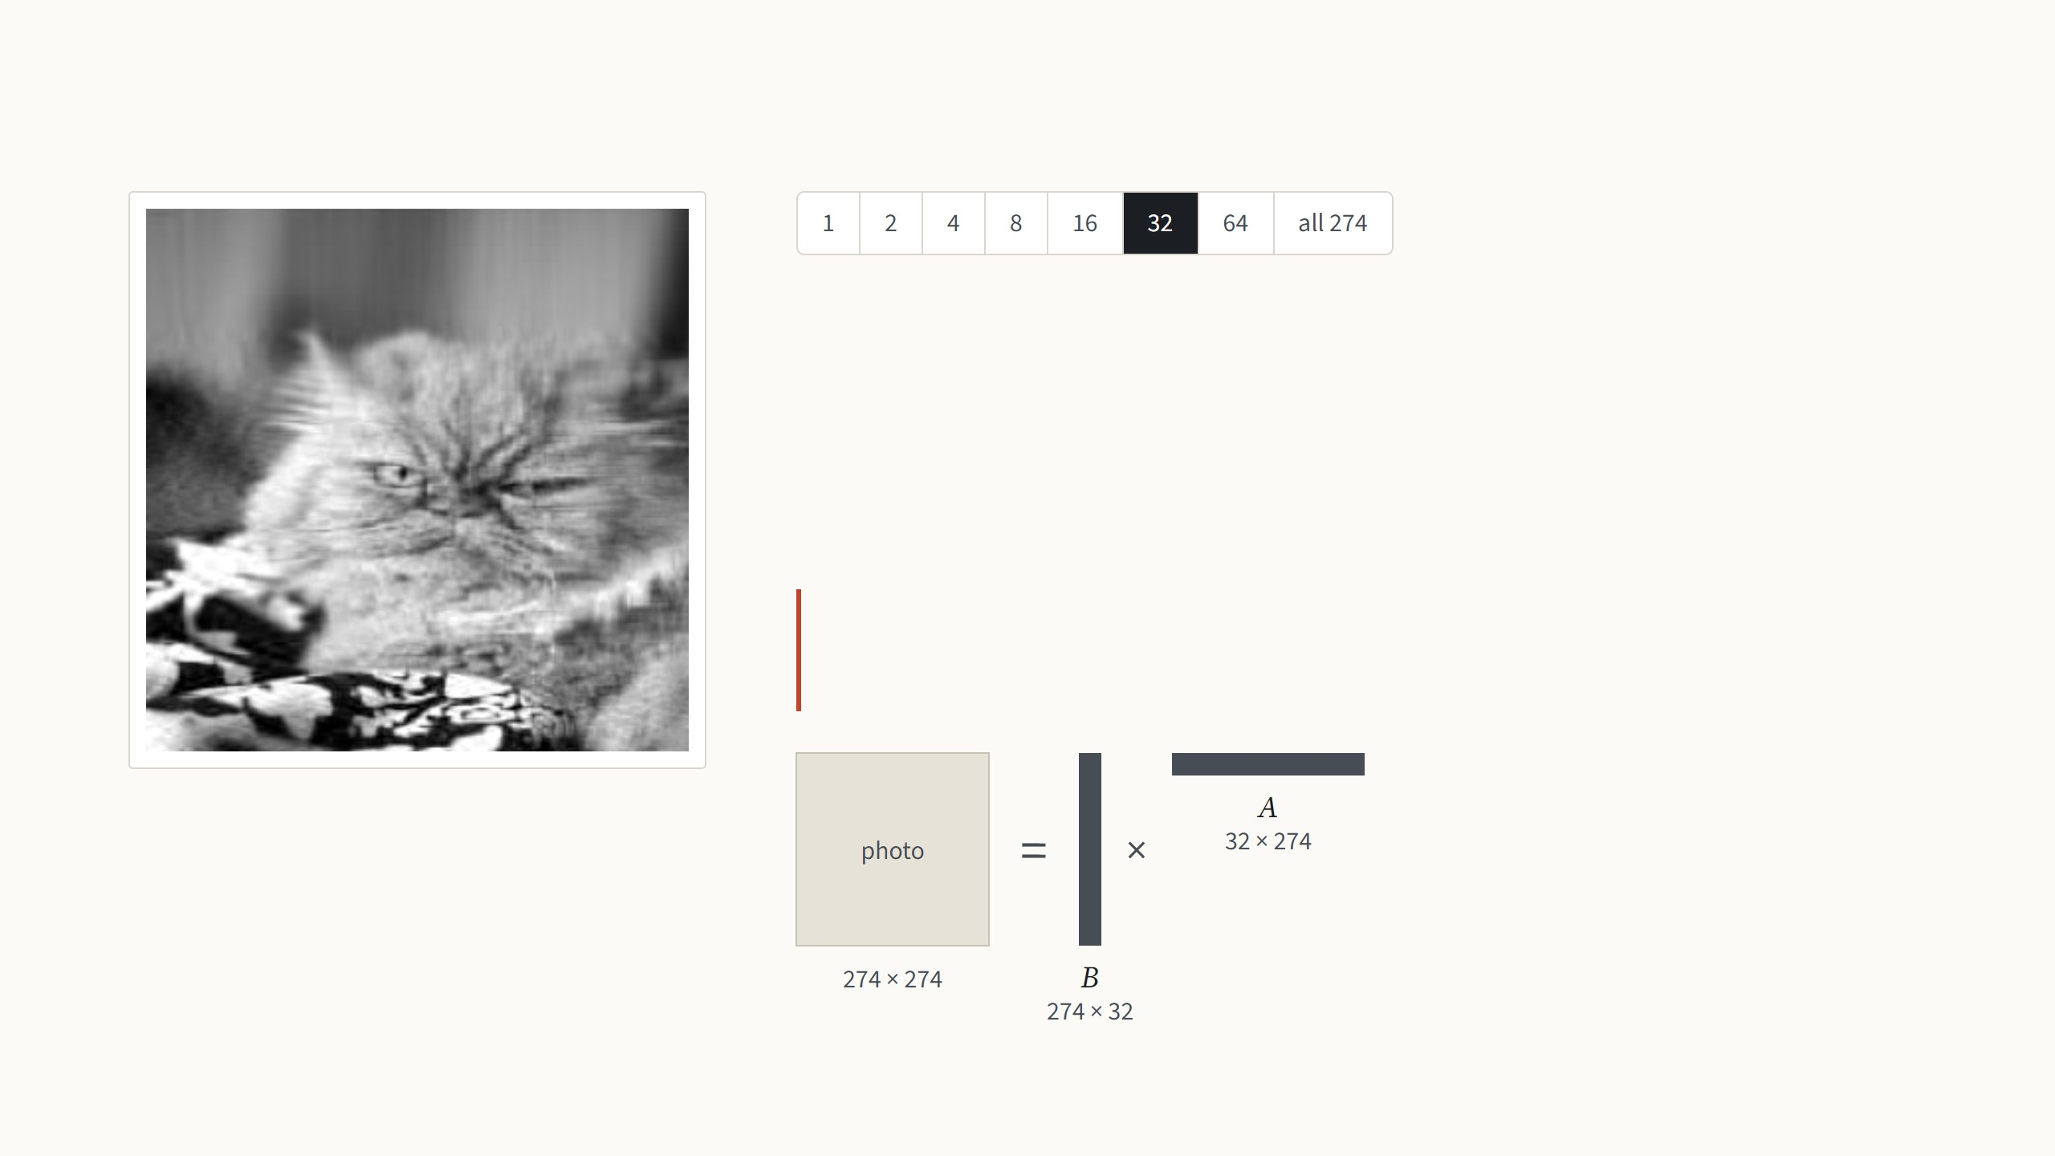
What a low-rank matrix is
A grayscale photo is a matrix of 274 × 274 brightness values. Any matrix can be
written as a sum of simple pieces, where each piece is one column of numbers
times one row. The rank is the number of pieces.
With 32 pieces the face and the fur appear.
LoRA bets that the change fine-tuning makes to a weight
matrix is like this photo: a few pieces carry almost all of it.
Rank 32: 32 × (274 + 274) = 17,536 numbers,
23.4% of the photo's 75,076
Not from the paper: the best rank-r approximation (SVD) of an Oxford Pets photo, Jia et al. 2022, Fig. 10. The low-rank bet follows Li et al. 2018 and Aghajanyan et al. 2021.
25
Notes:
One minute of linear algebra, because the whole paper rests on the word rank. Treat the photo as a matrix of brightness values. A rank-one matrix is a column times a row: every row of the image is the same pattern, just scaled, so you get bands. Step through with the arrow keys. Each step doubles the number of pieces. The pieces are ordered by how much they contribute, so the first few capture the big shapes and the later ones only fine detail. At rank 16 the cat is recognisable, from 12% of the numbers; at 64 it is hard to tell from the original, from 47%. Storing r pieces costs r times (rows plus columns) numbers instead of rows times columns. The drawing under the text shows the same thing as matrices, to scale: the r columns side by side are a tall matrix B, the r rows stacked are a wide matrix A, and B times A rebuilds the photo; at rank 1 they are a single line each, at all 274 they are as big as the photo itself. That is the trade LoRA makes for the weight change, with the same names B and A from now on. Why expect the change to be low-rank? Two earlier papers measured the "intrinsic dimension" of fine-tuning: you can freeze the model, train only a few hundred or thousand numbers, map them through a fixed random projection onto all the weights, and still get most of the accuracy. LoRA's assumption is the matrix version of that: each weight change has a low rank, so it can be written as B times A with a small r, chosen by hand.

Slide 57
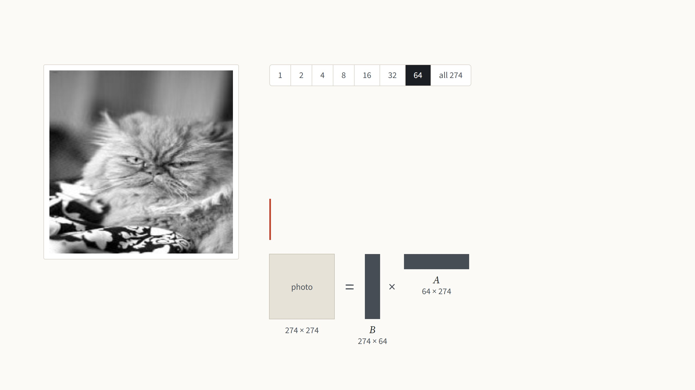
What a low-rank matrix is
A grayscale photo is a matrix of 274 × 274 brightness values. Any matrix can be
written as a sum of simple pieces, where each piece is one column of numbers
times one row. The rank is the number of pieces.
With 64 pieces it is hard to tell from the original.
LoRA bets that the change fine-tuning makes to a weight
matrix is like this photo: a few pieces carry almost all of it.
Rank 64: 64 × (274 + 274) = 35,072 numbers,
46.7% of the photo's 75,076
Not from the paper: the best rank-r approximation (SVD) of an Oxford Pets photo, Jia et al. 2022, Fig. 10. The low-rank bet follows Li et al. 2018 and Aghajanyan et al. 2021.
25
Notes:
One minute of linear algebra, because the whole paper rests on the word rank. Treat the photo as a matrix of brightness values. A rank-one matrix is a column times a row: every row of the image is the same pattern, just scaled, so you get bands. Step through with the arrow keys. Each step doubles the number of pieces. The pieces are ordered by how much they contribute, so the first few capture the big shapes and the later ones only fine detail. At rank 16 the cat is recognisable, from 12% of the numbers; at 64 it is hard to tell from the original, from 47%. Storing r pieces costs r times (rows plus columns) numbers instead of rows times columns. The drawing under the text shows the same thing as matrices, to scale: the r columns side by side are a tall matrix B, the r rows stacked are a wide matrix A, and B times A rebuilds the photo; at rank 1 they are a single line each, at all 274 they are as big as the photo itself. That is the trade LoRA makes for the weight change, with the same names B and A from now on. Why expect the change to be low-rank? Two earlier papers measured the "intrinsic dimension" of fine-tuning: you can freeze the model, train only a few hundred or thousand numbers, map them through a fixed random projection onto all the weights, and still get most of the accuracy. LoRA's assumption is the matrix version of that: each weight change has a low rank, so it can be written as B times A with a small r, chosen by hand.

Slide 58

What a low-rank matrix is
A grayscale photo is a matrix of 274 × 274 brightness values. Any matrix can be
written as a sum of simple pieces, where each piece is one column of numbers
times one row. The rank is the number of pieces.
All 274 pieces give back the photo exactly.
LoRA bets that the change fine-tuning makes to a weight
matrix is like this photo: a few pieces carry almost all of it.
75,076 numbers: the full photo
Not from the paper: the best rank-r approximation (SVD) of an Oxford Pets photo, Jia et al. 2022, Fig. 10. The low-rank bet follows Li et al. 2018 and Aghajanyan et al. 2021.
25
Notes:
One minute of linear algebra, because the whole paper rests on the word rank. Treat the photo as a matrix of brightness values. A rank-one matrix is a column times a row: every row of the image is the same pattern, just scaled, so you get bands. Step through with the arrow keys. Each step doubles the number of pieces. The pieces are ordered by how much they contribute, so the first few capture the big shapes and the later ones only fine detail. At rank 16 the cat is recognisable, from 12% of the numbers; at 64 it is hard to tell from the original, from 47%. Storing r pieces costs r times (rows plus columns) numbers instead of rows times columns. The drawing under the text shows the same thing as matrices, to scale: the r columns side by side are a tall matrix B, the r rows stacked are a wide matrix A, and B times A rebuilds the photo; at rank 1 they are a single line each, at all 274 they are as big as the photo itself. That is the trade LoRA makes for the weight change, with the same names B and A from now on. Why expect the change to be low-rank? Two earlier papers measured the "intrinsic dimension" of fine-tuning: you can freeze the model, train only a few hundred or thousand numbers, map them through a fixed random projection onto all the weights, and still get most of the accuracy. LoRA's assumption is the matrix version of that: each weight change has a low rank, so it can be written as B times A with a small r, chosen by hand.

Slide 59

LoRA adds a trainable bypass to a frozen weight
The input goes through the frozen weight W0 and, in parallel,
through A and B, which are trained. The two results are added.
The full change ΔW is never built; LoRA trains the thin matrices
directly, with a rank r chosen by hand.
h = W0x + (α/r) BAx
B starts at zero, so training begins exactly at the pretrained model.
Only A and B get gradients and optimizer state.
Figure: Hu et al. 2022, Fig. 1, where orange is trained. Equation (3) and Sec. 4.1. The paper sets α to the first r it tries and does not tune it.
26
Notes:
The paper's own figure; orange there is what we call red, the trained part. During training: x goes through the frozen W0 as before, and in parallel through A, which squeezes it down to r numbers, and B, which expands it back. The outputs are added. Two details matter. B starts at zero, so at step one the model is exactly the pretrained model and training starts from a known good point. And the bypass is scaled by alpha over r, so that changing the rank does not mean re-tuning the learning rate. Press the arrow key: after training, B times A is just a d × d matrix, so we add it into W0 once and throw A and B away. The model is again a single matrix per layer, same size, same speed. To switch task you subtract this task's BA and add another task's, a cheap operation. That is the property VPT did not have.

Slide 60

LoRA adds a trainable bypass to a frozen weight
After training, the product BA is added into the weight once. The
model is again one matrix per layer, of the same size, so it runs
exactly as fast as before.
W = W0 + (α/r) BA
h = Wx
To switch task, subtract this BA and add that task's B′A′. Per task,
only A and B are stored.
Figure: Hu et al. 2022, Fig. 1, where orange is trained. Equation (3) and Sec. 4.1. The paper sets α to the first r it tries and does not tune it.
26
Notes:
The paper's own figure; orange there is what we call red, the trained part. During training: x goes through the frozen W0 as before, and in parallel through A, which squeezes it down to r numbers, and B, which expands it back. The outputs are added. Two details matter. B starts at zero, so at step one the model is exactly the pretrained model and training starts from a known good point. And the bypass is scaled by alpha over r, so that changing the rank does not mean re-tuning the learning rate. Press the arrow key: after training, B times A is just a d × d matrix, so we add it into W0 once and throw A and B away. The model is again a single matrix per layer, same size, same speed. To switch task you subtract this task's BA and add another task's, a cheap operation. That is the property VPT did not have.

Slide 61
LoRA on a 3 × 3 weight matrix
2
0
1
1
5
During training
1
3
0
2
=
7
0
1
2
3
8
W
x
Wx
After training, once
At test time
Take a tiny weight W and an input x. The frozen path is just the pretrained layer, and Wx gives 5, 7 and 8.
Made-up numbers with rank r = 1 and α/r = 1, so every product can be checked by eye. In ViT-B the same happens with 768 × 768 weights and r = 8.
27
Notes:
Made-up numbers, rank 1, so every product can be checked by eye. First the frozen path: the pretrained layer computes W times x, which gives 5, 7 and 8. Next step: LoRA adds a second path. A is one row of three numbers, so A times x is a single number, 1 + 2 + 0 = 3; the input is squeezed down to r numbers. B is a column of three, so B times 3 gives 3, 0 and 6, back to full size. The two paths are added: 8, 7, 14. During training only these six red numbers would change. Next step: after training we multiply B by A once. A column times a row is a full 3 × 3 matrix, the same shape as W, so we can add it to W; the red cells are the ones that changed. Last step: the merged W′ times x gives 8, 7, 14 again, exactly the training-time output, because W x + B(A x) equals (W + BA) x. So A and B are deleted and the layer is one ordinary matrix. The point people often miss: B and A are never multiplied with W. They are multiplied with each other, and the product is added to W.

Slide 62
LoRA on a 3 × 3 weight matrix
2
0
1
1
1
1
5
3
8
During training
1
3
0
2
+
0
1
1
0
2
=
7
+
0
=
7
0
1
2
3
2
3
8
6
14
W
x
B
A
x
Wx
BAx
h
After training, once
At test time
LoRA adds a second path. A squeezes the input to r numbers, here a single 3, and B expands it back to three; the two paths are
added. In training, only the six red numbers change.
Made-up numbers with rank r = 1 and α/r = 1, so every product can be checked by eye. In ViT-B the same happens with 768 × 768 weights and r = 8.
27
Notes:
Made-up numbers, rank 1, so every product can be checked by eye. First the frozen path: the pretrained layer computes W times x, which gives 5, 7 and 8. Next step: LoRA adds a second path. A is one row of three numbers, so A times x is a single number, 1 + 2 + 0 = 3; the input is squeezed down to r numbers. B is a column of three, so B times 3 gives 3, 0 and 6, back to full size. The two paths are added: 8, 7, 14. During training only these six red numbers would change. Next step: after training we multiply B by A once. A column times a row is a full 3 × 3 matrix, the same shape as W, so we can add it to W; the red cells are the ones that changed. Last step: the merged W′ times x gives 8, 7, 14 again, exactly the training-time output, because W x + B(A x) equals (W + BA) x. So A and B are deleted and the layer is one ordinary matrix. The point people often miss: B and A are never multiplied with W. They are multiplied with each other, and the product is added to W.

Slide 63
LoRA on a 3 × 3 weight matrix
2
0
1
1
1
1
5
3
8
During training
1
3
0
2
+
0
1
1
0
2
=
7
+
0
=
7
0
1
2
3
2
3
8
6
14
W
x
B
A
x
Wx
BAx
h
1
1
1
0
2
0
1
1
1
0
3
1
1
After training, once
0
1
1
0
=
0
0
0
1
3
0
+
0
0
0
=
1
3
0
2
2
2
0
0
1
2
2
2
0
2
3
2
B
A
BA
W
BA
W′
At test time
After training, B times A is worked out once. A column times a row is a full 3 × 3 matrix, the same shape as W, so it is simply added
to it; the red cells are the ones that changed.
Made-up numbers with rank r = 1 and α/r = 1, so every product can be checked by eye. In ViT-B the same happens with 768 × 768 weights and r = 8.
27
Notes:
Made-up numbers, rank 1, so every product can be checked by eye. First the frozen path: the pretrained layer computes W times x, which gives 5, 7 and 8. Next step: LoRA adds a second path. A is one row of three numbers, so A times x is a single number, 1 + 2 + 0 = 3; the input is squeezed down to r numbers. B is a column of three, so B times 3 gives 3, 0 and 6, back to full size. The two paths are added: 8, 7, 14. During training only these six red numbers would change. Next step: after training we multiply B by A once. A column times a row is a full 3 × 3 matrix, the same shape as W, so we can add it to W; the red cells are the ones that changed. Last step: the merged W′ times x gives 8, 7, 14 again, exactly the training-time output, because W x + B(A x) equals (W + BA) x. So A and B are deleted and the layer is one ordinary matrix. The point people often miss: B and A are never multiplied with W. They are multiplied with each other, and the product is added to W.

Slide 64
LoRA on a 3 × 3 weight matrix
2
0
1
1
1
1
5
3
8
During training
1
3
0
2
+
0
1
1
0
2
=
7
+
0
=
7
0
1
2
3
2
3
8
6
14
W
x
B
A
x
Wx
BAx
h
1
1
1
0
2
0
1
1
1
0
3
1
1
After training, once
0
1
1
0
=
0
0
0
1
3
0
+
0
0
0
=
1
3
0
2
2
2
0
0
1
2
2
2
0
2
3
2
B
A
BA
W
BA
W′
3
1
1
1
8
At test time
1
3
0
2
=
7
2
3
2
3
14
W′
x
h
The merged weight gives exactly the same output, because Wx + B(Ax) = (W + BA)x. B and A are deleted, and the layer is one
ordinary matrix again.
Made-up numbers with rank r = 1 and α/r = 1, so every product can be checked by eye. In ViT-B the same happens with 768 × 768 weights and r = 8.
27
Notes:
Made-up numbers, rank 1, so every product can be checked by eye. First the frozen path: the pretrained layer computes W times x, which gives 5, 7 and 8. Next step: LoRA adds a second path. A is one row of three numbers, so A times x is a single number, 1 + 2 + 0 = 3; the input is squeezed down to r numbers. B is a column of three, so B times 3 gives 3, 0 and 6, back to full size. The two paths are added: 8, 7, 14. During training only these six red numbers would change. Next step: after training we multiply B by A once. A column times a row is a full 3 × 3 matrix, the same shape as W, so we can add it to W; the red cells are the ones that changed. Last step: the merged W′ times x gives 8, 7, 14 again, exactly the training-time output, because W x + B(A x) equals (W + BA) x. So A and B are deleted and the layer is one ordinary matrix. The point people often miss: B and A are never multiplied with W. They are multiplied with each other, and the product is added to W.

Slide 65
Where LoRA goes in a Vision Transformer
LoRA puts a trained pair B A beside the query and value
weights of the attention, in all 12 blocks. The key and output
weights, the MLP and the layer norms stay frozen. After
merging, the block is exactly the original.
One of the 12 blocks of ViT-B/16. Placement as in Hu et al. 2022, Sec. 4.2, and Houlsby et al. 2019. Zhang et al. 2022, Fig. 1a, draws LoRA, the adapter and VPT in one block.
28
Notes:
Where exactly the pairs go. This is one of the twelve blocks of a ViT, frozen in blue. The attention part has four weight matrices: query, key, value and output; the MLP has two. The paper only adapts attention weights, by default the query and value, and leaves everything else frozen, including the MLP. The red pairs sit beside Wq and Wv in every block, 24 pairs in ViT-B. Press the arrow key for an adapter, for contrast: a small trained two-layer network after the MLP, an extra layer every input has to go through, which is where the latency from the earlier chart comes from. LoRA instead sits beside weights that already exist, so after merging it disappears. VPT, the third option, changes nothing inside the block; the next slide compares it with LoRA step by step. NOAH, the vision paper we will see, searches over all three at once.

Slide 66
Where LoRA goes in a Vision Transformer
An adapter, for contrast, is a small trained two-layer network
inserted after the MLP. It is an extra layer that every input
must pass through, which is where its extra time comes from;
LoRA sits beside weights that already exist.
One of the 12 blocks of ViT-B/16. Placement as in Hu et al. 2022, Sec. 4.2, and Houlsby et al. 2019. Zhang et al. 2022, Fig. 1a, draws LoRA, the adapter and VPT in one block.
28
Notes:
Where exactly the pairs go. This is one of the twelve blocks of a ViT, frozen in blue. The attention part has four weight matrices: query, key, value and output; the MLP has two. The paper only adapts attention weights, by default the query and value, and leaves everything else frozen, including the MLP. The red pairs sit beside Wq and Wv in every block, 24 pairs in ViT-B. Press the arrow key for an adapter, for contrast: a small trained two-layer network after the MLP, an extra layer every input has to go through, which is where the latency from the earlier chart comes from. LoRA instead sits beside weights that already exist, so after merging it disappears. VPT, the third option, changes nothing inside the block; the next slide compares it with LoRA step by step. NOAH, the vision paper we will see, searches over all three at once.

Slide 67
VPT and LoRA side by side
VPT learns extra input vectors. The same 50 per layer are placed
in front of every image of the task; they start random and are
not taken from any image.
LoRA learns a correction to the weights, the pair B and A beside
the query and value weights. It is also one pair for the whole
task, and B starts at zero.
One layer of ViT-B/16 drawn for each. VPT-deep with 50 prompts per layer (Jia et al. 2022); LoRA with rank 8 on the query and value weights (Hu et al. 2022). Both train the same
102-class head.
29
Notes:
This is the slide that puts the two methods next to each other, in three steps. What is learned: VPT learns extra input vectors, 50 per layer, and the same ones are used for every image of the task; they start random, they are not cut from any image. LoRA learns a correction to the weights, the pair B and A beside the query and value weights; it is also one pair for the whole task, not per image, and B starts at zero. Next step, training: in both cases every training image goes through the frozen model, the loss is computed, and gradients flow back. In VPT they end in the prompts and the head; in LoRA in B, A and the head. In both, the pretrained weights never change. Next step, test time, which is where the two differ. VPT's prompts are inputs, so they have to be attached to every test image, and every layer processes 247 tokens instead of 197, 27% more compute. LoRA's correction is a matrix of the same shape as W, so it is added into W once, and the layer is an ordinary layer again, exactly the original cost. The next slide puts numbers on both differences: what each stores per task, and what each image costs.

Slide 68
VPT and LoRA side by side
Each training image goes through the frozen model with the
prompts attached. The loss sends gradients back, and only the
prompts and the head change.
Each training image takes both paths, Wx and BAx. Only B, A
and the head change; W never receives a gradient.
One layer of ViT-B/16 drawn for each. VPT-deep with 50 prompts per layer (Jia et al. 2022); LoRA with rank 8 on the query and value weights (Hu et al. 2022). Both train the same
102-class head.
29
Notes:
This is the slide that puts the two methods next to each other, in three steps. What is learned: VPT learns extra input vectors, 50 per layer, and the same ones are used for every image of the task; they start random, they are not cut from any image. LoRA learns a correction to the weights, the pair B and A beside the query and value weights; it is also one pair for the whole task, not per image, and B starts at zero. Next step, training: in both cases every training image goes through the frozen model, the loss is computed, and gradients flow back. In VPT they end in the prompts and the head; in LoRA in B, A and the head. In both, the pretrained weights never change. Next step, test time, which is where the two differ. VPT's prompts are inputs, so they have to be attached to every test image, and every layer processes 247 tokens instead of 197, 27% more compute. LoRA's correction is a matrix of the same shape as W, so it is added into W once, and the layer is an ordinary layer again, exactly the original cost. The next slide puts numbers on both differences: what each stores per task, and what each image costs.

Slide 69
VPT and LoRA side by side
The prompts must be attached to every test image, so each
layer works on 247 tokens instead of 197. They are inputs, so
they can never be folded into the weights.
BA is added into W once, and the layer is one plain matrix
again. The test image goes through exactly the original model.
One layer of ViT-B/16 drawn for each. VPT-deep with 50 prompts per layer (Jia et al. 2022); LoRA with rank 8 on the query and value weights (Hu et al. 2022). Both train the same
102-class head.
29
Notes:
This is the slide that puts the two methods next to each other, in three steps. What is learned: VPT learns extra input vectors, 50 per layer, and the same ones are used for every image of the task; they start random, they are not cut from any image. LoRA learns a correction to the weights, the pair B and A beside the query and value weights; it is also one pair for the whole task, not per image, and B starts at zero. Next step, training: in both cases every training image goes through the frozen model, the loss is computed, and gradients flow back. In VPT they end in the prompts and the head; in LoRA in B, A and the head. In both, the pretrained weights never change. Next step, test time, which is where the two differ. VPT's prompts are inputs, so they have to be attached to every test image, and every layer processes 247 tokens instead of 197, 27% more compute. LoRA's correction is a matrix of the same shape as W, so it is added into W once, and the layer is an ordinary layer again, exactly the original cost. The next slide puts numbers on both differences: what each stores per task, and what each image costs.

Slide 70
How much LoRA trains and stores per task
2 · N · m · d · r = 2 × 12 × 2 × 768 × 8 = 294,912numbers in the pairs, plus 78,438 for a 102-class head
Numbers trained and stored per task
Full fine-tuning
all 85.8 million weights, retrained for this task
343 MB100%
VPT-deep, 50 prompts
frozen and shared by every task
2.2 MB0.63%
LoRA
frozen and shared by every task
1.5 MB0.44%
Compute per image at test time
Plain ViT
197 tokens
1.00×
VPT-deep, 50 prompts
197 tokens
1.27×+50 tokens
LoRA, merged
197 tokens
1.00×nothing extra
Shown for rank 8 on the query and value weights. At rank 64 on all four attention weights the file grows to 19 MB, 5.6% of the model, and the
compute per image does not change.
ViT-B/16: N = 12 blocks, d = 768, m adapted weights per block, 32-bit numbers. VPT-deep as before. Compute counts multiply-adds per layer for n tokens (12nd² + 2n²d).
30
Notes:
The numbers behind the previous slide, with the same accounting as for VPT. Each pair has 2 × 768 × r numbers; with query and value in 12 blocks and rank 8 that is 294,912, plus the same 102-class head as before: 0.44% of the model, a 1.5 MB file. VPT-deep with 50 prompts was 0.63% and 2.2 MB, so storage is about the same. The difference is the second chart: VPT made every image 27% more expensive, LoRA after merging costs exactly what the plain ViT costs. Try rank 64 on all four attention weights: the file grows to 19 MB, 5.6% of the model, but the compute bar does not move. If someone asks about training compute: the pairs still have to be computed during training, and the backward pass still goes through every layer, so training is not much cheaper per image than full fine-tuning; what drops is optimizer memory.

Slide 71
LoRA's saving grows with the width of the model
d × d = d²
A full change to one d × d weight has d²
numbers, while B and A together have 2rd.
Since d is the square root of d², LoRA's cost
grows like the square root of the full size,
times the small constant 2r.
Full change ΔW
589,824 numbers on ViT-B
B and A together
d × r + r × d = 2rd
12,288 numbers on ViT-B
Share of a full weight change stored by B and A, rank 8
width d
So the wider the model, the smaller LoRA's
share. Together with adapting only the query
and value weights, this is why GPT-3's task
file is 10,000 times smaller than a copy.
ViT-B/16
2.08%
768
ViT-L/16
1.56%
1,024
ViT-H/14
1.25%
1,280
GPT-3
0.13%
12,288
One d × d attention weight, rank r = 8 for every model. Widths: ViT-B/16 768, ViT-L/16 1,024, ViT-H/14 1,280 (Dosovitskiy et al. 2021); GPT-3 12,288 (Hu et al. 2022, Sec. 1). 10,000
times: Hu et al. 2022, Sec. 4.2.
31
Notes:
One more way to see the saving. A full change to a d by d weight has d squared numbers. B is d by r and A is r by d, so together 2 r d. Since d is the square root of d squared, LoRA's cost grows like the square root of the full size, multiplied by 2r, and r is a small constant we choose, 1 to 16. The chart keeps the rank fixed at 8 and only changes the width of the model. On ViT-B, 768 wide, the pair is 2.1% of a full change. ViT-H, 1,280 wide, 1.25%. GPT-3 is 12,288 wide, so the same rank is 0.13% of each weight. Add that GPT-3 only gets pairs on two of its weight types per block, and you arrive at the paper's headline: a 35 MB file instead of a 350 GB copy, 10,000 times smaller. For our ViT-B the saving is real but much less dramatic, which is why the file is 1.5 MB and not a few KB.

Slide 72
LoRA on a ViT in a few lines
B starts at zero and A at small random
values, so the first forward pass is exactly
the pretrained model.
vit = timm.create_model(BACKBONE, pretrained=True, num_classes=C)
vit.requires_grad_(False); vit.head.requires_grad_(True)
class LoRAqv(nn.Module): # wraps qkv = Linear(768, 2304)
The two new choices are the rank r and
which weights get a pair. On ViT-B, Zhang
et al. use rank 8 with AdamW at a learning
rate of 0.001 for 100 epochs.
def __init__(self, qkv, r=8, alpha=8):
super().__init__()
d = qkv.in_features
self.qkv, self.s = qkv, alpha / r # frozen W0, scale α/r
self.Aq = nn.Parameter(torch.randn(r, d) / d ** 0.5)
self.Av = nn.Parameter(torch.randn(r, d) / d ** 0.5)
After training, each pair is added into its
qkv weight once, and the model is a plain
timm ViT again.
self.Bq = nn.Parameter(torch.zeros(d, r)) # B = 0
self.Bv = nn.Parameter(torch.zeros(d, r))
def forward(self, x):
q, k, v = self.qkv(x).chunk(3, dim=-1) # W0 x
q = q + self.s * x @ self.Aq.T @ self.Bq.T # + B A x
v = v + self.s * x @ self.Av.T @ self.Bv.T
return torch.cat([q, k, v], dim=-1)
for blk in vit.blocks: blk.attn.qkv = LoRAqv(blk.attn.qkv)
My sketch for timm's ViT-B/16: 294,912 trained numbers in the pairs, and identical outputs before and after merging. Official code: loralib, github.com/microsoft/LoRA. Settings:
Hu et al. 2022, Sec. 4.1; Zhang et al. 2022, App. A.2.
32
Notes:
Not to be read line by line. timm stores query, key and value as one fused linear layer of 768 to 2304, so the wrapper splits its output into three, adds the low-rank term to the query and value parts, and puts them back. The red lines are the whole method: four small matrices per block and two additions. The blue lines are frozen. I checked it on timm's ViT-B/16: it has exactly the 294,912 trained numbers from the counting slide, and after folding B times A into the qkv weight the outputs are identical up to rounding. The recipe on ViT from the NOAH paper is ordinary: AdamW, learning rate 1e-3, cosine schedule, 100 epochs, rank 8.

Slide 73
Results in the paper: language models
Validation accuracy (%)
Weights trained
WikiSQL turns a question into an SQL
query. On GPT-3, LoRA with 4.7 million
trained weights, 0.003% of the model, is
within the run-to-run noise of full fine-
tuning, and slightly above it with 37.7
million.
Full fine-tuning
73.8
175 billion
BitFit (biases)
71.3
14.2 M
Prefix-embedding
63.1
3.2 M
Prefix-layer
70.1
20.2 M
Adapter
71.9
7.1 M
The prefix methods are far behind, and the
adapter needs more weights to come
close.
Adapter
73.2
40.1 M
LoRA
73.4
4.7 M
LoRA
74.0
37.7 M
Hu et al. 2022, Table 4: GPT-3 175B, validation accuracy, noise about ±0.5. Adapter: two per block (Houlsby et al.). BitFit trains only the biases.
33
Notes:
The paper's own evidence is all language, so one slide for it. First GPT-3 175B on WikiSQL, turning a question into an SQL query. Full fine-tuning, dashed line, 73.8. LoRA with 4.7 million trained weights gets 73.4, inside the ±0.5 noise the authors report, and 74.0 with 37.7 million. The prefix methods are far behind, the adapter is close but needs more weights to get there. Second step, MNLI, deciding whether one sentence follows from another: LoRA 91.7, two points above full fine-tuning. Third, a model closer in size to ViT-B: RoBERTa-base, 125 million weights, average over the eight GLUE tasks. LoRA with 0.3 million trained weights has the best average, 87.2 against 86.4. The paper also has DeBERTa and GPT-2 results with the same message.

Slide 74
Results in the paper: language models
Validation accuracy (%)
Weights trained
MNLI asks whether one sentence follows
from another. Here LoRA is two points
above full fine-tuning, 91.7 against 89.5,
and above every other cheap method.
Full fine-tuning
89.5
175 billion
BitFit (biases)
91.0
14.2 M
Prefix-embedding
88.6
3.2 M
Prefix-layer
89.5
20.2 M
Adapter
89.8
7.1 M
Adapter
91.5
40.1 M
LoRA
91.7
4.7 M
LoRA
91.6
37.7 M
Hu et al. 2022, Table 4: GPT-3 175B, validation accuracy on MNLI-matched, noise about ±0.1. Adapter: two per block (Houlsby et al.). BitFit trains only the biases.
33
Notes:
The paper's own evidence is all language, so one slide for it. First GPT-3 175B on WikiSQL, turning a question into an SQL query. Full fine-tuning, dashed line, 73.8. LoRA with 4.7 million trained weights gets 73.4, inside the ±0.5 noise the authors report, and 74.0 with 37.7 million. The prefix methods are far behind, the adapter is close but needs more weights to get there. Second step, MNLI, deciding whether one sentence follows from another: LoRA 91.7, two points above full fine-tuning. Third, a model closer in size to ViT-B: RoBERTa-base, 125 million weights, average over the eight GLUE tasks. LoRA with 0.3 million trained weights has the best average, 87.2 against 86.4. The paper also has DeBERTa and GPT-2 results with the same message.

Slide 75
Results in the paper: language models
Mean GLUE score
Weights trained
RoBERTa-base has 125 million weights,
close to ViT-B. Averaged over the eight
GLUE language tasks, LoRA with 0.3 million
trained weights scores 87.2, against 86.4
for full fine-tuning.
Full fine-tuning
86.4
125 M
BitFit (biases)
85.2
0.1 M
AdapterDrop
84.4
0.3 M
AdapterDrop
85.4
0.9 M
LoRA
87.2
0.3 M
Hu et al. 2022, Table 2: RoBERTa-base, mean over the eight GLUE tasks. Full fine-tuning, BitFit and AdapterDrop (Rücklé et al.) as published in earlier work.
33
Notes:
The paper's own evidence is all language, so one slide for it. First GPT-3 175B on WikiSQL, turning a question into an SQL query. Full fine-tuning, dashed line, 73.8. LoRA with 4.7 million trained weights gets 73.4, inside the ±0.5 noise the authors report, and 74.0 with 37.7 million. The prefix methods are far behind, the adapter is close but needs more weights to get there. Second step, MNLI, deciding whether one sentence follows from another: LoRA 91.7, two points above full fine-tuning. Third, a model closer in size to ViT-B: RoBERTa-base, 125 million weights, average over the eight GLUE tasks. LoRA with 0.3 million trained weights has the best average, 87.2 against 86.4. The paper also has DeBERTa and GPT-2 results with the same message.

Slide 76
What happens when more weights are trained
Each point is one size of a method. Prefix-
embedding tuning improves up to 256
prompt tokens, then drops from 63.1 to
55.9. Prefix-layer tuning also falls after 20
million weights.
LoRA is flat from rank 1 to rank 64, at the
level of full fine-tuning.
Hu et al. 2022, Table 15 (the points of Fig. 2): GPT-3 175B, validation accuracy; LoRA with equal rank on query and value, from rank 1 to 64. Full fine-tuning trains all 175 billion
weights.
34
Notes:
Each method was run with several sizes; the x axis is the number of trained weights on a log scale. Prompt methods are not monotonic: prefix-embedding tuning improves up to 256 tokens and then falls back from 63.1 to 55.9 at 512; prefix-layer tuning peaks at 20 million weights and then drops. The authors suspect many prompt tokens push the input too far from what the model saw in pretraining. The adapter is good and stable once it has enough weights. LoRA is the flat red line at the top: rank 1 is already as good as rank 64, so the rank is an easy choice, at least here. On MNLI the same picture, with LoRA above full fine-tuning at every size.

Slide 77
What happens when more weights are trained
On MNLI the prompt methods again rise
and fall, and the adapter needs about 40
million weights to catch up.
LoRA is above full fine-tuning at every size,
so its rank is an easy choice.
Hu et al. 2022, Table 15 (the points of Fig. 2): GPT-3 175B, validation accuracy; LoRA with equal rank on query and value, from rank 1 to 64. Full fine-tuning trains all 175 billion
weights.
34
Notes:
Each method was run with several sizes; the x axis is the number of trained weights on a log scale. Prompt methods are not monotonic: prefix-embedding tuning improves up to 256 tokens and then falls back from 63.1 to 55.9 at 512; prefix-layer tuning peaks at 20 million weights and then drops. The authors suspect many prompt tokens push the input too far from what the model saw in pretraining. The adapter is good and stable once it has enough weights. LoRA is the flat red line at the top: rank 1 is already as good as rank 64, so the rank is an easy choice, at least here. On MNLI the same picture, with LoRA above full fine-tuning at every size.

Slide 78
Which weight matrices to adapt
Validation accuracy (%)
Rank
Every LoRA row trains the same 18 million
weights. Putting them all into the query or
the key weight is about three points worse
than spreading them over query and value
at rank 4.
Full fine-tuning
73.8
One weight type
Query
70.4
8
Key
70.0
8
Value
73.0
8
Adapting all four at rank 2 does as well, so
it pays to adapt more matrices with a
smaller rank.
Output
73.2
8
Two weight types
Query and key
71.4
4
Query and value
73.7
4
Four weight types
All four
73.7
2
Hu et al. 2022, Table 5: GPT-3 175B with the same 18 million trained weights in every LoRA row, validation accuracy (noise ±0.5 on WikiSQL, ±0.1 on MNLI). Full fine-tuning: Table
4.
35
Notes:
A fixed budget of 18 million trained weights, 35 MB, spent in different ways. One weight type at rank 8: the query or the key alone is clearly worse, about three points on WikiSQL. Two types at rank 4: query and value is the best combination. All four at rank 2 is as good. The conclusion the authors draw: it is better to adapt more weight matrices with a smaller rank than one matrix with a large rank, which is also a hint that rank 4 already holds what each matrix needs. This is why query and value became the default, including on ViT.

Slide 79
Which weight matrices to adapt
Validation accuracy (%)
Rank
On MNLI the differences are smaller, but
the order is similar: the query or key alone
is lowest, and all four at rank 2 is highest,
91.7.
Full fine-tuning
89.5
One weight type
Query
91.0
8
Key
90.8
8
Every LoRA setting is above full fine-tuning
here.
Value
91.0
8
Output
91.3
8
Two weight types
Query and key
91.3
4
Query and value
91.3
4
Four weight types
All four
91.7
2
Hu et al. 2022, Table 5: GPT-3 175B with the same 18 million trained weights in every LoRA row, validation accuracy (noise ±0.5 on WikiSQL, ±0.1 on MNLI). Full fine-tuning: Table
4.
35
Notes:
A fixed budget of 18 million trained weights, 35 MB, spent in different ways. One weight type at rank 8: the query or the key alone is clearly worse, about three points on WikiSQL. Two types at rank 4: query and value is the best combination. All four at rank 2 is as good. The conclusion the authors draw: it is better to adapt more weight matrices with a smaller rank than one matrix with a large rank, which is also a hint that rank 4 already holds what each matrix needs. This is why query and value became the default, including on ViT.

Slide 80
How small the rank can be
With the query and value weights
together, rank 1 already gives 73.4, and no
rank does better than 73.8, inside the
noise of ±0.5.
The query weight alone needs rank 4 to
reach its best, and stays three points
lower.
Hu et al. 2022, Table 6: GPT-3 175B, validation accuracy at five ranks; noise ±0.5 on WikiSQL and ±0.1 on MNLI. On GPT-2 the best rank was between 4 and 16 (App. H.2).
36
Notes:
Five ranks, one dot each; the lines only connect the settings that were run. The surprise of the paper: for query and value together, rank 1 is as good as rank 64 on both tasks; the spread across ranks is at most 0.4 points on WikiSQL, inside its noise, and 0.3 on MNLI. The query weight alone is the exception, it needs rank 4 or more on WikiSQL. The authors are careful: they do not expect a tiny rank to work for every task. If the new task were in a different language than pretraining, retraining everything would likely win. On the smaller GPT-2 the best rank was 4 to 16. For ViT, NOAH used rank 8, which is the setting we will see.

Slide 81
How small the rank can be
On MNLI, too, rank 1 for query and value is
within 0.3 points of the best rank.
So the change fine-tuning needs has very
few real directions, at least on GPT-3.
Hu et al. 2022, Table 6: GPT-3 175B, validation accuracy at five ranks; noise ±0.5 on WikiSQL and ±0.1 on MNLI. On GPT-2 the best rank was between 4 and 16 (App. H.2).
36
Notes:
Five ranks, one dot each; the lines only connect the settings that were run. The surprise of the paper: for query and value together, rank 1 is as good as rank 64 on both tasks; the spread across ranks is at most 0.4 points on WikiSQL, inside its noise, and 0.3 on MNLI. The query weight alone is the exception, it needs rank 4 or more on WikiSQL. The authors are careful: they do not expect a tiny rank to work for every task. If the new task were in a different language than pretraining, retraining everything would likely win. On the smaller GPT-2 the best rank was 4 to 16. For ViT, NOAH used rank 8, which is the setting we will see.

Slide 82
Why a small rank is enough
The authors trained rank 8 and rank 64 separately and compared the directions each learned. Bright means the two runs found
the same direction. Only the first direction is clearly shared, with similarity above 0.5, and the rest overlap little, so most of the
extra rank holds noise.
Hu et al. 2022, Fig. 3 (layer 48 of 96, GPT-3; values are normalized subspace similarity, 0 to 1) and Table 7 (rank 4, Frobenius norms).
37
Notes:
Section 7 asks why this works. First analysis: train rank 8 and rank 64 on the same task, take the directions each one learned, and measure how much the top i directions of one lie inside the top j of the other. In the heat maps rows are rank-8 directions, columns rank-64 directions; colour is overlap from 0 to 1. Only the first row lights up: both runs agree on one direction and disagree on the rest, so the useful part of the change is about one-dimensional and the rest is noise that training accumulates. That explains rank 1 working. Press the arrow key for the second analysis, Table 7. Project the pretrained weight onto the four directions of the learned change: 0.32, small, though larger than for random directions, 0.02. Its own top directions are 21.67, so the change is not about what the model already does strongly. The change itself has strength 6.91 in those directions, an amplification of about 21. The authors' reading: LoRA amplifies features that pretraining learned but did not emphasise, and the task needs. This is measured on GPT-3; nobody in these papers repeats it for ViT.

Slide 83
Why a small rank is enough
21.67
is how strongly the pretrained weight Wq acts along its own top 4 directions.
0.32
is how strongly it acts along the 4 directions of the learned change ΔWq: weak, but more than the 0.02 of
random directions.
6.91
is the strength of the change along those directions, about 21 times what the pretrained weight had there.
The change does not repeat what the model already does. It strongly amplifies directions the model
learned in pretraining but used weakly.
Hu et al. 2022, Fig. 3 (layer 48 of 96, GPT-3; values are normalized subspace similarity, 0 to 1) and Table 7 (rank 4, Frobenius norms).
37
Notes:
Section 7 asks why this works. First analysis: train rank 8 and rank 64 on the same task, take the directions each one learned, and measure how much the top i directions of one lie inside the top j of the other. In the heat maps rows are rank-8 directions, columns rank-64 directions; colour is overlap from 0 to 1. Only the first row lights up: both runs agree on one direction and disagree on the rest, so the useful part of the change is about one-dimensional and the rest is noise that training accumulates. That explains rank 1 working. Press the arrow key for the second analysis, Table 7. Project the pretrained weight onto the four directions of the learned change: 0.32, small, though larger than for random directions, 0.02. Its own top directions are 21.67, so the change is not about what the model already does strongly. The change itself has strength 6.91 in those directions, an amplification of about 21. The authors' reading: LoRA amplifies features that pretraining learned but did not emphasise, and the task needs. This is measured on GPT-3; nobody in these papers repeats it for ViT.

Slide 84
LoRA on images
The paper itself has no image experiments.
Vision groups tested it next, first on the same 19
VTAB-1k tasks as VPT, then on medical images.
Both use a ViT-B/16, so the numbers sit next to
the VPT results.
Natural
Specialized
Structured
38
Notes:
Second half. Everything so far was the LoRA paper, and its experiments are all on language models. Two papers bring it to images. NOAH, from NTU Singapore in 2022, re-ran LoRA, adapters and VPT on the same ViT-B/16 and the same VTAB-1k benchmark as the VPT paper, which gives a fair three-way comparison. MeLo, at ISBI 2024, applies LoRA to medical image classification. The three images are one example from each VTAB group, the same groups as in the VPT part.

Slide 85
LoRA, VPT and adapters on the same ViT
Mean test accuracy (%)
Beats full fine-tuning on
Ordinary photos, with 1,000 training
images per task. LoRA, the adapter and
VPT-deep all beat full fine-tuning by two to
four points, and LoRA is narrowly the best.
Full fine-tuning
75.9
LoRA
79.5
5 of 7 tasks
Adapter
79.0
6 of 7 tasks
VPT-deep
78.5
6 of 7 tasks
Linear probe
68.9
1 of 7 tasks
Zhang et al. 2022, Table 1: ViT-B/16 pretrained on ImageNet-21k, VTAB-1k test accuracy. LoRA (rank 8) and the adapter were trained by Zhang et al.; the other rows are Jia et al.
2022, Table 1. Group means computed from the per-task values; "all 19" is the mean of the three groups.
39
Notes:
Same backbone and benchmark as the VPT paper: 1,000 training images per task, three groups. The adapter here is NOAH's re-run with the best recipe, which is much stronger than the adapter in the VPT paper's table. Natural: all three cheap methods are two to four points above full fine-tuning, LoRA narrowly best, 79.5. Specialized: LoRA 84.6 and the adapter 84.1 are slightly above full fine-tuning at 83.4; VPT-deep is a point below. Structured: the big gap again, all three beat full fine-tuning on all eight tasks, LoRA the most, 59.8 against 47.6. All 19: LoRA 74.6, adapter 73.9, VPT-deep 72.0, full 69.0. VPT-deep beats full fine-tuning on one more task, 16 against 15, but by smaller margins. Two caveats if asked: NOAH's table prints 87.2 for full fine-tuning on Flowers where the VPT paper has 97.2, so I used the VPT paper's numbers for those rows; and NOAH prints 74.5 for LoRA's average, while its own per-task numbers give 74.6.

Slide 86
LoRA, VPT and adapters on the same ViT
Mean test accuracy (%)
Beats full fine-tuning on
Satellite, microscope and retina images.
LoRA and the adapter are slightly above
full fine-tuning, 84.6 and 84.1 against 83.4,
while VPT-deep is a point below.
Full fine-tuning
83.4
LoRA
84.6
2 of 4 tasks
Adapter
84.1
2 of 4 tasks
VPT-deep
82.4
2 of 4 tasks
Linear probe
77.2
1 of 4 tasks
Zhang et al. 2022, Table 1: ViT-B/16 pretrained on ImageNet-21k, VTAB-1k test accuracy. LoRA (rank 8) and the adapter were trained by Zhang et al.; the other rows are Jia et al.
2022, Table 1. Group means computed from the per-task values; "all 19" is the mean of the three groups.
39
Notes:
Same backbone and benchmark as the VPT paper: 1,000 training images per task, three groups. The adapter here is NOAH's re-run with the best recipe, which is much stronger than the adapter in the VPT paper's table. Natural: all three cheap methods are two to four points above full fine-tuning, LoRA narrowly best, 79.5. Specialized: LoRA 84.6 and the adapter 84.1 are slightly above full fine-tuning at 83.4; VPT-deep is a point below. Structured: the big gap again, all three beat full fine-tuning on all eight tasks, LoRA the most, 59.8 against 47.6. All 19: LoRA 74.6, adapter 73.9, VPT-deep 72.0, full 69.0. VPT-deep beats full fine-tuning on one more task, 16 against 15, but by smaller margins. Two caveats if asked: NOAH's table prints 87.2 for full fine-tuning on Flowers where the VPT paper has 97.2, so I used the VPT paper's numbers for those rows; and NOAH prints 74.5 for LoRA's average, while its own per-task numbers give 74.6.

Slide 87
LoRA, VPT and adapters on the same ViT
Mean test accuracy (%)
Beats full fine-tuning on
Counting, distances and angles, far from
ImageNet. All three cheap methods beat
full fine-tuning on all eight tasks, LoRA by
the most: 59.8 against 47.6, with VPT-deep
at 55.0.
Full fine-tuning
47.6
LoRA
59.8
8 of 8 tasks
Adapter
58.5
8 of 8 tasks
VPT-deep
55.0
8 of 8 tasks
Linear probe
26.8
0 of 8 tasks
Zhang et al. 2022, Table 1: ViT-B/16 pretrained on ImageNet-21k, VTAB-1k test accuracy. LoRA (rank 8) and the adapter were trained by Zhang et al.; the other rows are Jia et al.
2022, Table 1. Group means computed from the per-task values; "all 19" is the mean of the three groups.
39
Notes:
Same backbone and benchmark as the VPT paper: 1,000 training images per task, three groups. The adapter here is NOAH's re-run with the best recipe, which is much stronger than the adapter in the VPT paper's table. Natural: all three cheap methods are two to four points above full fine-tuning, LoRA narrowly best, 79.5. Specialized: LoRA 84.6 and the adapter 84.1 are slightly above full fine-tuning at 83.4; VPT-deep is a point below. Structured: the big gap again, all three beat full fine-tuning on all eight tasks, LoRA the most, 59.8 against 47.6. All 19: LoRA 74.6, adapter 73.9, VPT-deep 72.0, full 69.0. VPT-deep beats full fine-tuning on one more task, 16 against 15, but by smaller margins. Two caveats if asked: NOAH's table prints 87.2 for full fine-tuning on Flowers where the VPT paper has 97.2, so I used the VPT paper's numbers for those rows; and NOAH prints 74.5 for LoRA's average, while its own per-task numbers give 74.6.

Slide 88
LoRA, VPT and adapters on the same ViT
Mean test accuracy (%)
Beats full fine-tuning on
Over all three groups LoRA reaches 74.6,
VPT-deep 72.0 and full fine-tuning 69.0.
Full fine-tuning
69.0
LoRA trains 0.29 million weights here and
VPT-deep 0.64 million on average, so LoRA
is both smaller and more accurate.
LoRA
74.6
15 of 19 tasks
Adapter
73.9
16 of 19 tasks
VPT-deep
72.0
16 of 19 tasks
Linear probe
57.6
2 of 19 tasks
Zhang et al. 2022, Table 1: ViT-B/16 pretrained on ImageNet-21k, VTAB-1k test accuracy. LoRA (rank 8) and the adapter were trained by Zhang et al.; the other rows are Jia et al.
2022, Table 1. Group means computed from the per-task values; "all 19" is the mean of the three groups.
39
Notes:
Same backbone and benchmark as the VPT paper: 1,000 training images per task, three groups. The adapter here is NOAH's re-run with the best recipe, which is much stronger than the adapter in the VPT paper's table. Natural: all three cheap methods are two to four points above full fine-tuning, LoRA narrowly best, 79.5. Specialized: LoRA 84.6 and the adapter 84.1 are slightly above full fine-tuning at 83.4; VPT-deep is a point below. Structured: the big gap again, all three beat full fine-tuning on all eight tasks, LoRA the most, 59.8 against 47.6. All 19: LoRA 74.6, adapter 73.9, VPT-deep 72.0, full 69.0. VPT-deep beats full fine-tuning on one more task, 16 against 15, but by smaller margins. Two caveats if asked: NOAH's table prints 87.2 for full fine-tuning on Flowers where the VPT paper has 97.2, so I used the VPT paper's numbers for those rows; and NOAH prints 74.5 for LoRA's average, while its own per-task numbers give 74.6.

Slide 89
Neither LoRA nor VPT wins every task
LoRA is ahead on 15 of the 19 tasks, by up to
14 points on counting objects in CLEVR. VPT-
deep is ahead on 4, and on CIFAR-100 by 12
points.
Zhang et al. conclude that no single method
fits every task. Their method, NOAH,
searches for a mix of LoRA, adapter and
prompts per task, and reaches 75.5 on
average.
Zhang et al. 2022, Table 1: per-task test accuracy of LoRA minus VPT-deep on VTAB-1k, ViT-B/16. Right of the line, LoRA is ahead.
40
Notes:
The averages hide a lot of spread, so here is every task. Right of the axis, in red, LoRA is better; left, in grey, VPT-deep. LoRA's biggest wins are in the Structured group: counting in CLEVR, distances in CLEVR and KITTI, elevation in SmallNORB, and SVHN digits. VPT's one large win is CIFAR-100, 78.8 against 67.1, which is odd for a natural-image task; NOAH's own result there is also low, 69.6, so it may be a recipe issue in the re-runs rather than a property of LoRA. The authors' answer to this spread is NOAH: put all three modules in every block and search for their sizes per dataset; it gains about one point over LoRA, at the cost of a search. For us the lesson is simpler: LoRA is the stronger single choice on this benchmark, not a universal winner.

Slide 90
LoRA on medical images
Test AUC (%)
MeLo adds LoRA pairs of rank 4 to the query
and value weights of an ImageNet ViT-B,
training 0.14 million weights, 0.17% of the
model.
Chest X-ray: tuberculosis, 2 classes
Full fine-tuning
89.4
LoRA (MeLo)
89.8
Its AUC is within a point of full fine-tuning on
three tasks and 3.6 points lower on blood
cells.
Microscopy: blood cell type, 4 classes
Full fine-tuning
98.3
LoRA (MeLo)
94.7
Mammography: malignancy, 2 classes
Full fine-tuning
68.4
LoRA (MeLo)
68.7
Chest X-ray: 14 diseases
Full fine-tuning
78.8
LoRA (MeLo)
79.4
Zhu et al. 2024 (MeLo, ISBI), Table 1: ViT-B pretrained on ImageNet, LoRA rank 4 on query and value, single runs on their own test splits. The 14-disease task is multi-label.
41
Notes:
MeLo, ISBI 2024, from ShanghaiTech and Shanghai Jiao Tong: LoRA with rank 4 on the query and value weights of a ViT-B pretrained on ImageNet, applied to four medical tasks: tuberculosis on chest X-rays, four blood cell types, malignancy in mammograms, and 14 thoracic diseases. They train 0.14 million weights, 0.17%. AUC first: within a point of full fine-tuning on three tasks, 3.6 points lower on blood cells. Accuracy, second step: ahead on tuberculosis and blood cells, slightly behind on the other two. The title says "better than fine-tuning", but these are single runs on small test sets, about 80 mammograms for INbreast, so I would read it as "about the same". Third step is their real point, deployment, with a giant CLIP ViT: 25 images from each task in random order. Reloading the right fine-tuned copy for each image takes 218 s for 100 images; keeping all four copies loaded is fast but needs 7 billion weights in GPU memory; one model with four LoRA pairs takes 10.6 s at the memory of a single model.

Slide 91
LoRA on medical images
Test accuracy (%)
In accuracy MeLo is ahead on two tasks and
slightly behind on two.
Chest X-ray: tuberculosis, 2 classes
Full fine-tuning
81.2
These are single runs on small test sets,
about 80 mammograms for INbreast, so the
fair reading of the title, "better than fine-
tuning", is "about the same".
LoRA (MeLo)
83.5
Microscopy: blood cell type, 4 classes
Full fine-tuning
85.9
LoRA (MeLo)
93.0
Mammography: malignancy, 2 classes
Full fine-tuning
74.8
LoRA (MeLo)
74.5
Chest X-ray: 14 diseases
Full fine-tuning
36.9
LoRA (MeLo)
35.7
Zhu et al. 2024 (MeLo, ISBI), Table 1: ViT-B pretrained on ImageNet, LoRA rank 4 on query and value, single runs on their own test splits. The 14-disease task is multi-label.
41
Notes:
MeLo, ISBI 2024, from ShanghaiTech and Shanghai Jiao Tong: LoRA with rank 4 on the query and value weights of a ViT-B pretrained on ImageNet, applied to four medical tasks: tuberculosis on chest X-rays, four blood cell types, malignancy in mammograms, and 14 thoracic diseases. They train 0.14 million weights, 0.17%. AUC first: within a point of full fine-tuning on three tasks, 3.6 points lower on blood cells. Accuracy, second step: ahead on tuberculosis and blood cells, slightly behind on the other two. The title says "better than fine-tuning", but these are single runs on small test sets, about 80 mammograms for INbreast, so I would read it as "about the same". Third step is their real point, deployment, with a giant CLIP ViT: 25 images from each task in random order. Reloading the right fine-tuned copy for each image takes 218 s for 100 images; keeping all four copies loaded is fast but needs 7 billion weights in GPU memory; one model with four LoRA pairs takes 10.6 s at the memory of a single model.

Slide 92
LoRA on medical images
Time for 100 images in random order (s)
Weights in GPU memory
Their practical point is switching between
tasks, measured with a giant CLIP ViT on 25
images from each task in random order.
Fine-tuning, reload a copy
per image
218.5 s
1,759 million
Fine-tuning, all four copies
loaded
8.2 s
7,034 million
Reloading a fine-tuned copy for each image
takes 218 s, and keeping all four copies
loaded needs four times the memory. One
frozen model with four LoRA pairs takes 10.6
s at the memory of one model.
LoRA, one model and four
pairs
10.6 s
1,760 million
Zhu et al. 2024, Table 2: ViT-giga pretrained with CLIP (1.76 billion weights), 100 images, 25 from each of the four datasets, in random order, on one A100 GPU.
41
Notes:
MeLo, ISBI 2024, from ShanghaiTech and Shanghai Jiao Tong: LoRA with rank 4 on the query and value weights of a ViT-B pretrained on ImageNet, applied to four medical tasks: tuberculosis on chest X-rays, four blood cell types, malignancy in mammograms, and 14 thoracic diseases. They train 0.14 million weights, 0.17%. AUC first: within a point of full fine-tuning on three tasks, 3.6 points lower on blood cells. Accuracy, second step: ahead on tuberculosis and blood cells, slightly behind on the other two. The title says "better than fine-tuning", but these are single runs on small test sets, about 80 mammograms for INbreast, so I would read it as "about the same". Third step is their real point, deployment, with a giant CLIP ViT: 25 images from each task in random order. Reloading the right fine-tuned copy for each image takes 218 s for 100 images; keeping all four copies loaded is fast but needs 7 billion weights in GPU memory; one model with four LoRA pairs takes 10.6 s at the memory of a single model.

Slide 93
Where LoRA falls short
The rank and the weights are chosen by hand
Merged weights serve one task at a time
The paper picks the query and value weights and a small rank by
trying settings, and leaves a principled choice to future work. On
VTAB-1k the best method even changes from task to task.
Once BA is added into W, every input in a batch must belong to
that task. Mixing tasks in one batch means keeping the pairs
separate, which brings back a small extra cost; VPT's prompts
mix freely.
A small rank assumes a nearby task
Training still runs through the whole model
The authors expect a small rank to fail when the new task is far
from pretraining, such as a different language. The low-rank
analysis was only done on GPT-3, not on vision models.
LoRA saves the optimizer state of the frozen weights, but the
gradient still passes back through every layer. On ViT-B most
memory is activations: freezing the backbone for VPT only cut it
from 11.7 to 10.3 GB.
Hu et al. 2022, Sec. 4.2 (batching), footnote 6 (a different language), Sec. 7 and 8 (analysis on GPT-3, future work). Zhang et al. 2022, Fig. 1b. Jia et al. 2022, Table 12 (ViT-B/16,
batch 64).
42
Notes:
Four honest limits. First, choices by hand: which matrices, which rank. The paper's guidance comes from GPT-3, and NOAH's per-task spread shows the best choice varies. Second, a deployment detail people miss: merging is what makes LoRA free at test time, but a merged model serves one task. If a server mixes requests of different tasks in one batch, you have to keep the pairs unmerged and pay a small extra computation, while VPT's prompts are just inputs and can differ per sample. Third, the low-rank assumption: the authors themselves say a very different task, like a new language, may need full rank; the evidence for low rank is from GPT-3 only. Fourth, training memory: the 3× saving on GPT-3 came from optimizer state, which dominates for huge models. On ViT-B, activations dominate, and those are still stored for the whole network, as with VPT. My own measurement of this will be part of the experiments next.

Slide 94
My experiments
I re-implemented VPT and LoRA and trained
both on three medical imaging datasets from
MedMNIST. A linear probe and full fine-tuning
ran next to them, all four starting from the same
ViT-B/16.
Skin lesions
Blood cells
Chest X-rays
First the results, then all four models running
live in this browser.
43
Notes:
From here on it is my own work, not the papers. I implemented both methods myself on top of a timm ViT-B/16, the same ImageNet-21k checkpoint the VPT paper uses, and trained them on three MedMNIST tasks: skin lesions, blood cells and chest X-rays. Why medical: these images are far from ImageNet, like the Specialized group of VTAB, and an easy dataset such as Oxford Flowers was already at 99%. A linear probe and full fine-tuning ran next to them as the two reference points. Next: the setup, then the results, the costs, and the live demo with all four models.

Slide 95
I tested VPT and LoRA on three medical datasets
Each method was trained twice: on 1,000 images, as in VTAB-1k, and on the full training set.
melanoma
nevus
neutrophil
platelet
normal
pneumonia
Skin lesions
Blood cells
Chest X-rays
Dermoscopy, 7 classes
Microscopy, 8 cell types
Radiographs, pneumonia or normal
1,000 or all 7,007 training images
1,000 or all 11,959 training images
1,000 or all 4,708 training images
MedMNIST+ at 224 × 224 (Yang et al. 2023); skin lesions from HAM10000 (Tschandl et al. 2018). RTX 5070 Ti laptop GPU. SGD for linear probe and VPT, AdamW for LoRA and full
fine-tuning; learning rate picked on validation.
44
Notes:
Three public datasets from MedMNIST+, at 224 × 224 pixels, all far from ImageNet photos. Skin lesions are heavily imbalanced, two thirds are nevi, so I report balanced accuracy, the mean per-class recall: always answering nevus would score 67% plain accuracy. Each task was trained twice, on 1,000 random training images, the size of VTAB-1k, and on the whole training split; the bars show how small 1,000 is next to each full set. Next step: the four methods. All start from the same ViT-B/16 ImageNet-21k checkpoint. The linear probe, VPT and LoRA keep it frozen and train only the red parts: a head, prompts in every layer, or low-rank pairs beside the query and value weights. Full fine-tuning retrains every weight, so each task needs its own 343 MB copy. Each method uses its paper's optimizer, the learning rate was picked on the validation split, and the reported model is the one with the best validation balanced accuracy, the same rule for all four.

Slide 96
I tested VPT and LoRA on three medical datasets
Each method was trained twice: on 1,000 images, as in VTAB-1k, and on the full training set.
melanoma
nevus
neutrophil
platelet
normal
pneumonia
Skin lesions
Blood cells
Chest X-rays
Dermoscopy, 7 classes
Microscopy, 8 cell types
Radiographs, pneumonia or normal
1,000 or all 7,007 training images
1,000 or all 11,959 training images
1,000 or all 4,708 training images
head
head
head
head
ViT-B/16 frozen
ViT-B/16 frozen
ViT-B/16 frozen
+
ViT-B/16 retrained
Linear probe
VPT-deep
LoRA
Full fine-tuning
Trains only a new head.
Trains a head and 50 prompts per
layer.
Trains a head and rank-8 pairs
beside Wq and Wv.
Retrains all 85.8 million weights.
MedMNIST+ at 224 × 224 (Yang et al. 2023); skin lesions from HAM10000 (Tschandl et al. 2018). RTX 5070 Ti laptop GPU. SGD for linear probe and VPT, AdamW for LoRA and full
fine-tuning; learning rate picked on validation.
44
Notes:
Three public datasets from MedMNIST+, at 224 × 224 pixels, all far from ImageNet photos. Skin lesions are heavily imbalanced, two thirds are nevi, so I report balanced accuracy, the mean per-class recall: always answering nevus would score 67% plain accuracy. Each task was trained twice, on 1,000 random training images, the size of VTAB-1k, and on the whole training split; the bars show how small 1,000 is next to each full set. Next step: the four methods. All start from the same ViT-B/16 ImageNet-21k checkpoint. The linear probe, VPT and LoRA keep it frozen and train only the red parts: a head, prompts in every layer, or low-rank pairs beside the query and value weights. Full fine-tuning retrains every weight, so each task needs its own 343 MB copy. Each method uses its paper's optimizer, the learning rate was picked on the validation split, and the reported model is the one with the best validation balanced accuracy, the same rule for all four.

Slide 97
VPT and LoRA on my three datasets
Balanced accuracy on the test set (%)
Against full fine-tuning
1,000 training images
Full fine-tuning
64.9
Seven kinds of skin lesion, and two thirds
of the images show harmless moles. This
is the hardest of the three tasks.
VPT-deep
63.3
1.6 points lower
LoRA
63.0
1.9 points lower
Linear probe
58.4
6.5 points lower
With all 7,007 images, LoRA is 1.6 points
ahead of VPT-deep and 1.8 points behind
full fine-tuning.
All 7,007 training images
Full fine-tuning
84.4
VPT-deep
81.0
3.4 points lower
With 1,000 images, LoRA is 0.3 points
behind VPT-deep and 1.9 points behind
full fine-tuning.
LoRA
82.6
1.8 points lower
Linear probe
68.1
16.3 points lower
0
25
50
75
100
My runs: ViT-B/16 (ImageNet-21k), MedMNIST+ 224 × 224, balanced accuracy on the test set (the mean per-class recall), bars start at 0. Each method was trained once with 1,000
images and once with the full training set; there are no points in between.
45
Notes:
Step through the three datasets with the arrow keys. Each tab has two measured settings, 1,000 training images and the full training set, drawn as two separate groups of bars. The score is balanced accuracy on the test set. The text on the right is computed from the runs, so read it out: it says how LoRA does against VPT-deep, the linear probe and full fine-tuning on each dataset.

Slide 98
VPT and LoRA on my three datasets
Balanced accuracy on the test set (%)
Against full fine-tuning
1,000 training images
Full fine-tuning
98.0
Eight kinds of blood cell under a
microscope. Every method does well
here, so the bars are almost the same
length.
VPT-deep
98.2
0.2 points higher
LoRA
98.4
0.4 points higher
Linear probe
96.1
1.9 points lower
All 11,959 training images
With all 11,959 images, LoRA is 0.1 points
behind VPT-deep and 0.2 points behind
full fine-tuning.
Full fine-tuning
99.2
VPT-deep
99.1
0.1 points lower
With 1,000 images, LoRA is 0.2 points
ahead of VPT-deep and 0.4 points ahead
of full fine-tuning.
LoRA
99.0
0.2 points lower
Linear probe
97.4
1.8 points lower
0
25
50
75
100
My runs: ViT-B/16 (ImageNet-21k), MedMNIST+ 224 × 224, balanced accuracy on the test set (the mean per-class recall), bars start at 0. Each method was trained once with 1,000
images and once with the full training set; there are no points in between.
45
Notes:
Step through the three datasets with the arrow keys. Each tab has two measured settings, 1,000 training images and the full training set, drawn as two separate groups of bars. The score is balanced accuracy on the test set. The text on the right is computed from the runs, so read it out: it says how LoRA does against VPT-deep, the linear probe and full fine-tuning on each dataset.

Slide 99
VPT and LoRA on my three datasets
Balanced accuracy on the test set (%)
Against full fine-tuning
1,000 training images
Full fine-tuning
93.4
Chest X-rays of children, labelled normal
or pneumonia.
VPT-deep
89.7
3.7 points lower
LoRA
92.8
0.6 points lower
With all 4,708 images, LoRA is 1.0 points
behind VPT-deep and 0.2 points behind
full fine-tuning.
Linear probe
89.2
4.2 points lower
All 4,708 training images
Full fine-tuning
93.3
With 1,000 images, LoRA is 3.1 points
ahead of VPT-deep and 0.6 points behind
full fine-tuning.
VPT-deep
94.1
0.8 points higher
LoRA
93.1
0.2 points lower
Linear probe
90.9
2.4 points lower
0
25
50
75
100
My runs: ViT-B/16 (ImageNet-21k), MedMNIST+ 224 × 224, balanced accuracy on the test set (the mean per-class recall), bars start at 0. Each method was trained once with 1,000
images and once with the full training set; there are no points in between.
45
Notes:
Step through the three datasets with the arrow keys. Each tab has two measured settings, 1,000 training images and the full training set, drawn as two separate groups of bars. The score is balanced accuracy on the test set. The text on the right is computed from the runs, so read it out: it says how LoRA does against VPT-deep, the linear probe and full fine-tuning on each dataset.

Slide 100
What each method costs on skin lesions
Stored for all three tasks
LoRA stores 1.2 MB per task and
VPT-deep 1.9 MB, against 343 MB for a
fine-tuned copy. Both share one frozen
base model across all tasks.
Full fine-tuning
1,030 MB3 separate models of 343 MB
VPT-deep
349 MBone base model + 3 × 1.9 MB
LoRA
347 MBone base model + 3 × 1.2 MB
Here LoRA reaches 82.6% and
VPT-deep 81.0%, against 84.4% for full
fine-tuning and 68.1% for the
linear probe.
Linear probe
343 MBone base model + 3 × 22 KB
Balanced accuracy on the test set
Full fine-tuning
84.4%
VPT-deep
81.0%
LoRA
82.6%
Linear probe
68.1%
Skin lesions (DermaMNIST), all 7,007 training images. RTX 5070 Ti Laptop GPU, batch 32; CPU inference on 2 threads; 32-bit weights; LoRA rank 8 on the query and value weights.
46
Notes:
Three steps, one cost each, all measured on my laptop for skin lesions trained on the full training split; every number is read from the training logs and the benchmark file. Storage: both LoRA and VPT keep one copy of the base model and add a small file per task, while full fine-tuning needs a whole 343 MB model per task. Training: LoRA and VPT both still send the error signal back through all twelve frozen layers, so neither is cheap like the linear probe; the memory saving compared with full fine-tuning is the optimizer state of the frozen weights. Inference: this is where the two differ. VPT makes every layer process 50 extra tokens. LoRA with its pairs kept separate adds a little extra work, and once merged into the weights it runs exactly as fast as the plain model, which is the paper's main practical claim.

Slide 101
What each method costs on skin lesions
Training time on all 7,007 images
LoRA needed 2.1 GB of GPU memory
and VPT-deep 2.3 GB, against 3.5 GB
for full fine-tuning.
Full fine-tuning
20 min30 epochs
VPT-deep
14 min30 epochs
Both still pass the error signal back
through all twelve frozen layers, so
only the linear probe is really cheap to
train.
LoRA
15 min30 epochs
Linear probe
5 min30 epochs
Peak GPU memory during training, batch 32
Full fine-tuning
3.5 GB
VPT-deep
2.3 GB
LoRA
2.1 GB
Linear probe
0.5 GB
Skin lesions (DermaMNIST), all 7,007 training images. RTX 5070 Ti Laptop GPU, batch 32; CPU inference on 2 threads; 32-bit weights; LoRA rank 8 on the query and value weights.
46
Notes:
Three steps, one cost each, all measured on my laptop for skin lesions trained on the full training split; every number is read from the training logs and the benchmark file. Storage: both LoRA and VPT keep one copy of the base model and add a small file per task, while full fine-tuning needs a whole 343 MB model per task. Training: LoRA and VPT both still send the error signal back through all twelve frozen layers, so neither is cheap like the linear probe; the memory saving compared with full fine-tuning is the optimizer state of the frozen weights. Inference: this is where the two differ. VPT makes every layer process 50 extra tokens. LoRA with its pairs kept separate adds a little extra work, and once merged into the weights it runs exactly as fast as the plain model, which is the paper's main practical claim.

Slide 102
What each method costs on skin lesions
Time per image on the CPU, 2 threads
VPT-deep needs 250 ms per image,
because every layer processes 50 extra
tokens. LoRA with separate pairs needs
190 ms.
Full fine-tuning
189 ms
VPT-deep
250 ms
LoRA
190 msmerged: 188 ms
Merged into the weights, LoRA takes
188 ms, the time of the unchanged
model (189 ms).
Linear probe
195 ms
Tokens that every layer processes
Full fine-tuning
197
VPT-deep
247197 + 50 prompts
LoRA
197
Linear probe
197
Skin lesions (DermaMNIST), all 7,007 training images. RTX 5070 Ti Laptop GPU, batch 32; CPU inference on 2 threads; 32-bit weights; LoRA rank 8 on the query and value weights.
46
Notes:
Three steps, one cost each, all measured on my laptop for skin lesions trained on the full training split; every number is read from the training logs and the benchmark file. Storage: both LoRA and VPT keep one copy of the base model and add a small file per task, while full fine-tuning needs a whole 343 MB model per task. Training: LoRA and VPT both still send the error signal back through all twelve frozen layers, so neither is cheap like the linear probe; the memory saving compared with full fine-tuning is the optimizer state of the frozen weights. Inference: this is where the two differ. VPT makes every layer process 50 extra tokens. LoRA with its pairs kept separate adds a little extra work, and once merged into the weights it runs exactly as fast as the plain model, which is the paper's main practical claim.

Slide 103
Live demo: one image, four models
Skin lesion, one test image, models
trained on all training images.
Linear probe
VPT-deep
LoRA
Full fine-tuning
shared model + head
shared model + prompts
shared model + pairs
own retrained model
68.5% test accuracy
81.0% test accuracy
82.5% test accuracy
84.4% test accuracy
melanocytic nevi
73.7%
melanoma
99.5%
melanocytic nevi
92.8%
melanoma
97.7%
melanoma
23.8%
benign keratosis-like
0.3%
melanoma
7.1%
melanocytic nevi
2.2%
benign keratosis-like
2.1%
melanocytic nevi
0.1%
benign keratosis-like
0.0%
benign keratosis-like
0.0%
Wrong
Correct
Wrong
Correct
178 ms per image
204 ms per image
173 ms per image
163 ms per image
True label: melanoma
Test accuracy is balanced accuracy on the whole test set, for exactly these models. Changing the training set
swaps one 1.2 MB file for LoRA, but a whole second 172 MB model for full fine-tuning.
A recorded run. In the HTML version of this deck the four models run live in the browser.
Research demo, not a diagnostic tool
47
Notes:
Every click runs the image through all four models right here in the browser, with onnxruntime-web. Linear probe, VPT-deep and LoRA all use the very same frozen copy of the base model in memory: VPT-deep feeds its 50 prompts per layer in beside the patches, LoRA feeds its rank-8 pairs in beside the query and value weights, and the linear probe uses neither. That is the unmerged form of LoRA, so one copy serves every task; merged, it would run at exactly the speed of the plain model, but it would be one model per task again. Full fine-tuning retrained every weight, so it is a separate model per task. Compare the times: VPT-deep is the slowest of the three shared models, because every layer carries 50 extra tokens. The percentage under each name is that model's balanced accuracy on the whole test set. Now switch to 1,000 training images: for linear probe, VPT-deep and LoRA only a small head and a file of a megabyte or two change, so it is instant; full fine-tuning has to download and load a second whole model, 172 MB in 16-bit. The thumbnails are random test images, not picked to look good, so a wrong answer can happen; say so. Research demo, not a diagnostic tool.

Slide 104
Live demo: one image, four models
Skin lesion, one test image, models
trained on 1,000 training images.
Linear probe
VPT-deep
LoRA
Full fine-tuning
shared model + head
shared model + prompts
shared model + pairs
own retrained model
58.1% test accuracy
62.5% test accuracy
63.0% test accuracy
64.8% test accuracy
melanocytic nevi
84.5%
melanoma
69.2%
melanocytic nevi
86.6%
melanocytic nevi
95.1%
benign keratosis-like
7.9%
melanocytic nevi
30.8%
melanoma
12.8%
melanoma
4.2%
melanoma
7.5%
dermatofibroma
0.0%
benign keratosis-like
0.4%
benign keratosis-like
0.2%
Wrong
Correct
Wrong
Wrong
142 ms per image
218 ms per image
166 ms per image
169 ms per image
True label: melanoma
Test accuracy is balanced accuracy on the whole test set, for exactly these models. Changing the training set
swaps one 1.2 MB file for LoRA, but a whole second 172 MB model for full fine-tuning.
A recorded run. In the HTML version of this deck the four models run live in the browser.
Research demo, not a diagnostic tool
47
Notes:
Every click runs the image through all four models right here in the browser, with onnxruntime-web. Linear probe, VPT-deep and LoRA all use the very same frozen copy of the base model in memory: VPT-deep feeds its 50 prompts per layer in beside the patches, LoRA feeds its rank-8 pairs in beside the query and value weights, and the linear probe uses neither. That is the unmerged form of LoRA, so one copy serves every task; merged, it would run at exactly the speed of the plain model, but it would be one model per task again. Full fine-tuning retrained every weight, so it is a separate model per task. Compare the times: VPT-deep is the slowest of the three shared models, because every layer carries 50 extra tokens. The percentage under each name is that model's balanced accuracy on the whole test set. Now switch to 1,000 training images: for linear probe, VPT-deep and LoRA only a small head and a file of a megabyte or two change, so it is instant; full fine-tuning has to download and load a second whole model, 172 MB in 16-bit. The thumbnails are random test images, not picked to look good, so a wrong answer can happen; say so. Research demo, not a diagnostic tool.

Slide 105
Summary
20of 24
tasks where VPT-deep beat full fine-tuning, training 0.6% of a ViT-B pretrained
with labels.
99.4%
less storage per task than a fully fine-tuned copy: 2.2 MB for VPT instead of 343
MB, and 1.5 MB for LoRA.
1.00×
the test-time cost of the original model with LoRA, because its change is added
into the weights. VPT's prompts cost 1.27×.
74.6
mean VTAB-1k accuracy of LoRA on ViT-B/16, against 72.0 for VPT-deep and
69.0 for full fine-tuning.
88.1%
average balanced accuracy of LoRA on my three medical datasets, against
87.6% for VPT-deep, 88.8% for full fine-tuning and 83.3% for the linear probe.
Jia et al. 2022, Table 1 (24 tasks, ViT-B/16) and Table 12; 0.6% is VPT-deep with 50 prompts per layer and a 102-class head, LoRA is rank 8 on the query and value weights with the
same head. Zhang et al. 2022, Table 1, mean of the three VTAB-1k groups. Medical datasets: my runs, balanced accuracy on the test set.
48
Notes:
The slide to leave up while summing up. First, VPT: on a ViT-B pretrained with labels, VPT-deep beat full fine-tuning on 20 of the 24 tasks while training 0.6% of the weights. Second, what both methods buy: a small file per task instead of a whole copy, 99.4% less storage for VPT, and LoRA's file is even smaller. Third, where they differ: VPT's prompts are inputs, so every image pays for them, 1.27 times the compute with 50 prompts; LoRA's change is added into the weights, so the model runs exactly as fast as before. Fourth, accuracy on the same benchmark: LoRA 74.6 on VTAB-1k, VPT-deep 72.0, full fine-tuning 69.0, though neither cheap method wins every task. Last, my own runs on the three medical datasets, with all four methods side by side.

Slide 106
References
The two papers
Other parameter-efficient methods
Jia, Tang, Chen, Cardie, Belongie, Hariharan & Lim 2022. Visual prompt tuning.
ECCV. arXiv:2203.12119.
Houlsby et al. 2019. Parameter-efficient transfer learning for NLP (adapter). ICML.
Lin, Madotto & Fung 2020. Exploring versatile generative language model via
parameter-efficient transfer learning. Findings of EMNLP.
Hu, Shen, Wallis, Allen-Zhu, Li, Wang, Wang & Chen 2022. LoRA: low-rank
adaptation of large language models. ICLR. arXiv:2106.09685.
Rücklé et al. 2021. AdapterDrop: on the efficiency of adapters in Transformers.
EMNLP.
Prompting before VPT
Ben Zaken, Goldberg & Ravfogel 2022. BitFit: simple parameter-efficient fine-tuning
for Transformer-based masked language-models (Bias). ACL.
Lester, Al-Rfou & Constant 2021. The power of scale for parameter-efficient prompt
tuning. EMNLP.
Zhang, Sax, Zamir, Guibas & Malik 2020. Side-tuning: a baseline for network
adaptation via additive side networks (Sidetune). ECCV.
Li & Liang 2021. Prefix-tuning: optimizing continuous prompts for generation. ACL.
Zhou, Yang, Loy & Liu 2022. Learning to prompt for vision-language models (CoOp).
IJCV. arXiv:2109.01134.
LoRA on images
Bahng, Jahanian, Sankaranarayanan & Isola 2022. Exploring visual prompts for
adapting large-scale models. arXiv:2203.17274.
Zhang, Zhou & Liu 2022. Neural prompt search (NOAH). arXiv:2206.04673.
Zhu et al. 2024. MeLo: low-rank adaptation is better than fine-tuning for medical
image diagnosis. ISBI. arXiv:2311.08236.
Ideas LoRA builds on
Li, Farkhoor, Liu & Yosinski 2018. Measuring the intrinsic dimension of objective
landscapes. ICLR.
Aghajanyan, Zettlemoyer & Gupta 2021. Intrinsic dimensionality explains the
effectiveness of language model fine-tuning. ACL.
49
Notes:
Leave this up for questions. The references cover both papers and are split over two slides. This one has the two papers, the prompting work VPT builds on, the intrinsic-dimension papers behind LoRA's low-rank idea, the other cheap methods in the comparisons, and the two papers that tested LoRA on images. The next slide has the models and the datasets.

Slide 107
References, continued
Models
Datasets and benchmarks
Dosovitskiy et al. 2021. An image is worth 16×16 words: Transformers for image
recognition at scale (ViT). ICLR.
Zhai et al. 2019. A large-scale study of representation learning with the visual task
adaptation benchmark (VTAB). arXiv:1910.04867.
Liu et al. 2021. Swin Transformer: hierarchical vision Transformer using shifted
windows. ICCV.
Parkhi, Vedaldi, Zisserman & Jawahar 2012. Cats and dogs (Oxford Pets). CVPR.
Zhou et al. 2019. Semantic understanding of scenes through the ADE20K dataset.
IJCV.
Chen, Xie & He 2021. An empirical study of training self-supervised vision
Transformers (MoCo v3). ICCV.
Zhong, Xiong & Socher 2017. Seq2SQL: generating structured queries from natural
language using reinforcement learning (WikiSQL). arXiv:1709.00103.
He et al. 2022. Masked autoencoders are scalable vision learners (MAE). CVPR.
Zheng et al. 2021. Rethinking semantic segmentation from a sequence-to-sequence
perspective with Transformers (SETR). CVPR.
Williams, Nangia & Bowman 2018. A broad-coverage challenge corpus for sentence
understanding through inference (MNLI). NAACL.
Chen et al. 2018. Encoder-decoder with atrous separable convolution for semantic
image segmentation (DeepLab v3+). ECCV.
Wang et al. 2019. GLUE: a multi-task benchmark and analysis platform for natural
language understanding. ICLR.
Radford et al. 2021. Learning transferable visual models from natural language
supervision (CLIP). ICML.
Jaeger et al. 2014; Moreira et al. 2012; Wang et al. 2017. Shenzhen chest X-ray,
INbreast and ChestX-ray14, used by MeLo.
Brown et al. 2020. Language models are few-shot learners (GPT-3). NeurIPS.
Yang et al. 2023. MedMNIST v2: a large-scale lightweight benchmark for 2D and 3D
biomedical image classification. Scientific Data.
Radford et al. 2019. Language models are unsupervised multitask learners (GPT-2).
OpenAI report.
Tschandl, Rosendahl & Kittler 2018. The HAM10000 dataset, a large collection of
multi-source dermatoscopic images of common pigmented skin lesions.
Scientific Data.
Liu et al. 2019. RoBERTa: a robustly optimized BERT pretraining approach.
arXiv:1907.11692.
50
Notes:
The backbones and segmentation models from the VPT results, the language models from the LoRA paper, and every dataset and benchmark behind the charts, including the medical ones from my own runs.

