Slide 1
Identification of Thyroid Cancer by Using Machine Learning
Ertuğrul Sağdıç 150116061
Defne ÇIĞ 150816004
Kasım Anlatır 150816019
Cem Telliağaoğlu 150216031
Lukas Eckerle 199520021

Slide 2
TABLE OF CONTENTS
01
02
03
04
Proposal
Explore your Data
Explore your
Data Part 2
Predictive Analysis

Slide 3
Proposal
01

Slide 4
The dataset was made of three classes:
Exposed (34 instances)
Not-exposed (33 instances)
Healthy (52 instances)
It was aimed to determine whether thyroid cancer is caused by radiation or not, by Linear Discriminant Analysis (LDA) in order to classify Exposed, Not-Exposed, and the Healthy groups.

Slide 5
However, 0.4583 accuracy of LDA was not enough since exposed and not-exposed groups have the same cancer type and these classes have shown similar expression levels. So, the algorithm wasn’t able to catch any significant difference.
Therefore, it was decided to change the dataset by eliminating one of the three classes, which would leave the Healthy and the Diseased Groups as remainder.

Slide 6
Description of the Project
The thyroid gland is an organ located under the thyroid cartilage thats sits low on the front of the neck and has an endocrine function. A type of cancer caused by the transformation of cells in the thyroid gland into cancerous cells is called thyroid cancer and it has 4 subtypes: papillary, follicular, medullary, and anaplastic. Among these subtypes the most commonly seen is the papillary thyroid cancer (PTC)
The aim of this project is to classify samples that were taken from patients that are known to be diagnosed with the thyroid cancer and from the patients that are known to be healthy by using different classification algorithms such as k-NN and Neural Network.

Slide 7
Explore your Data
02
1
02

Slide 8
The data set contains gene expression levels of 54,675 genes as attributes.
The type of the attributes is numeric. There are two different class labels which are Diseased and Healthy.
67
Diseased
52
Healthy

Slide 9
The minimum, maximum, average, standard deviation, and entropy of the attributes for each group's gene expression levels were investigated.
Only the first 10 attributes were investigated since there were too many attributes. Also, visualization of these attributes with plotting may provide better understanding of the data.

Slide 10
10 investigated attributes
Gene ID | 1007_s_at | 1053_at | 117_at | 121_at | 1255_g_at | 1294_at | 1316_at | 1320_at | 1405_i_at | 1431_at
Min expression | 8.216887 | 5.839823 | 2.505232 | 9.240184 | 2.249185 | 5.415159 | 2.386696 | 2.489 | 4.026917 | 2.249185
Max expression | 11.59505 | 8.063517 | 8.714269 | 12.57491 | 2.508066 | 7.83027 | 4.154933 | 6.061259 | 12.14334 | 2.579561
Avg | 10.17743 | 6.805636 | 3.323691 | 11.49767 | 2.253513 | 6.428938 | 2.868082 | 4.280523 | 7.376009 | 2.274973
Std.Dev. | 0.460819 | 0.363002 | 1.188412 | 0.626009 | 0.03276 | 0.571834 | 0.305475 | 0.803372 | 2.012789 | 0.059632
Entropy | 4.75359 | 4.705787 | 4.416789 | 4.75359 | 0.197798 | 4.75359 | 4.308748 | 4.75359 | 4.75359 | 2.05356

Slide 11
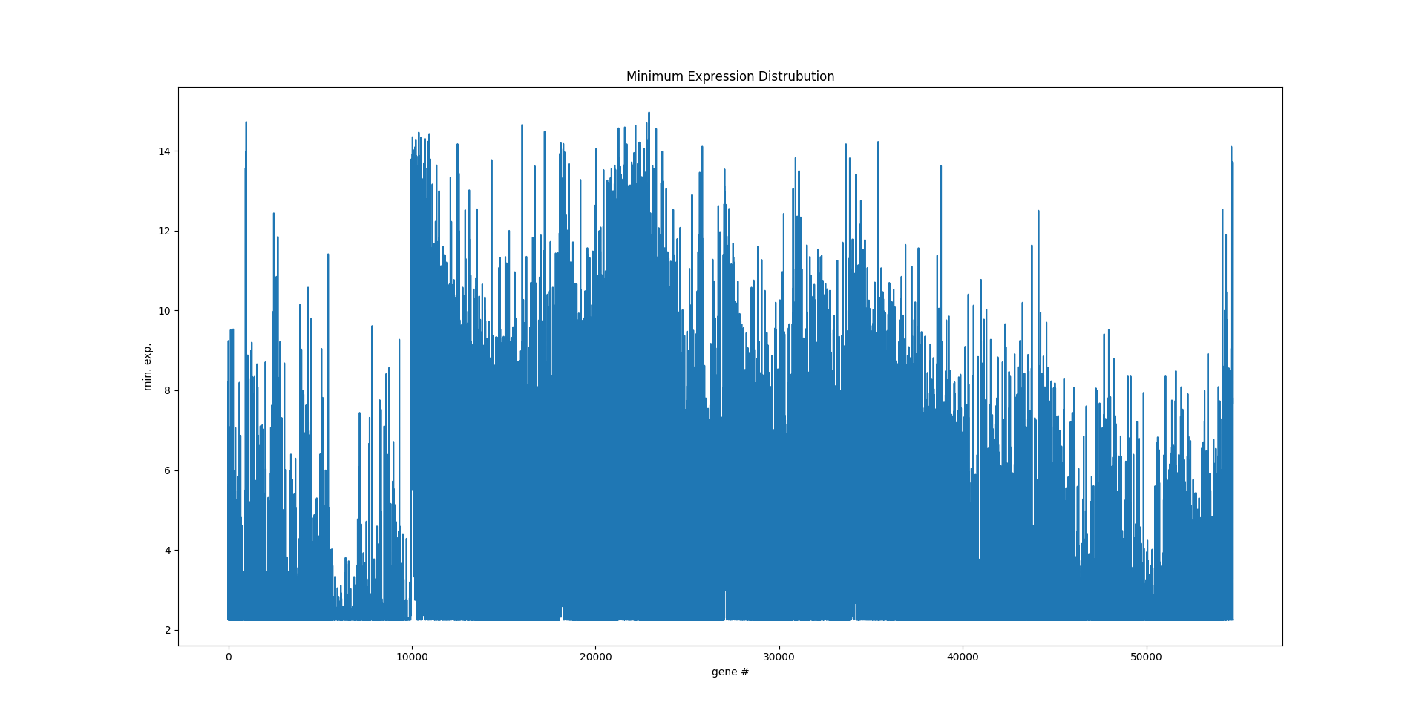
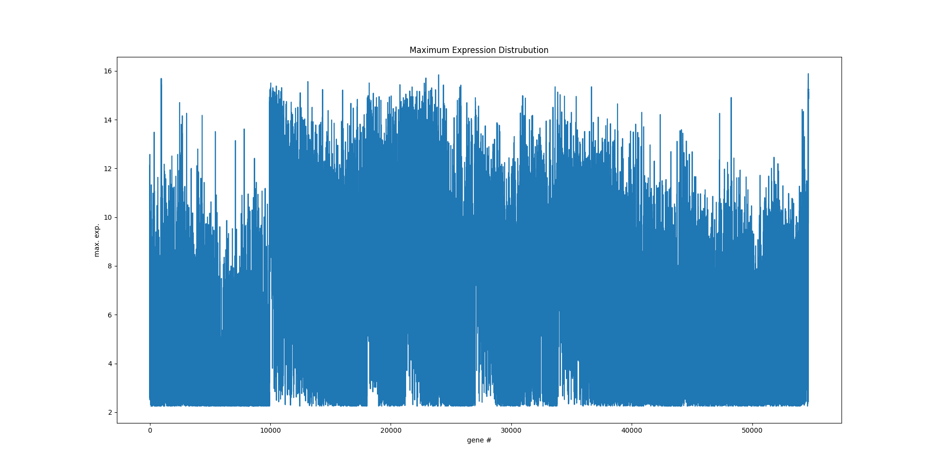
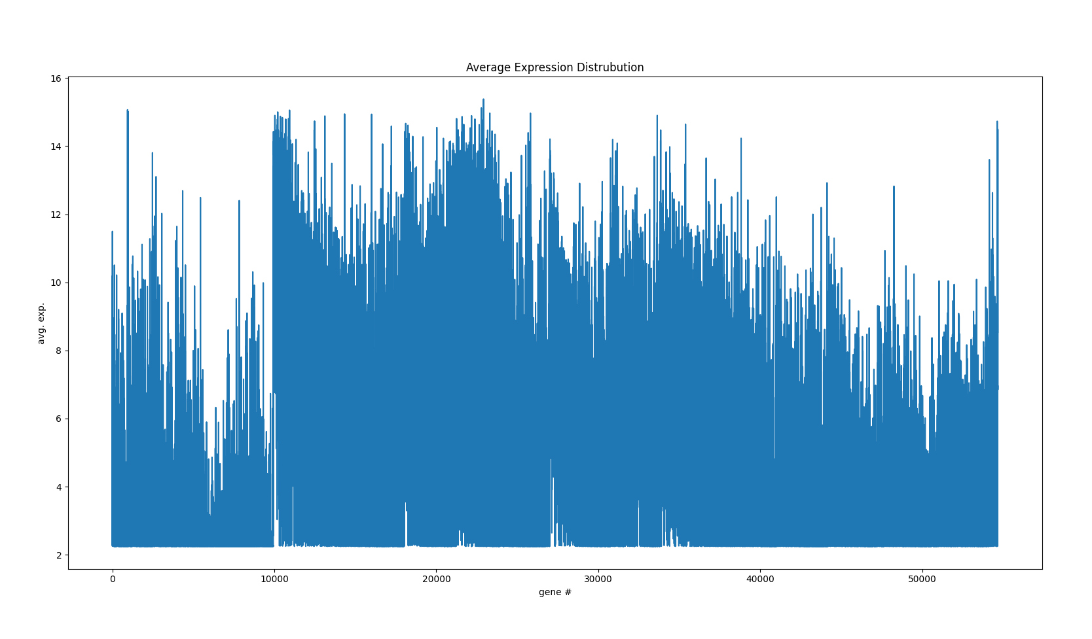
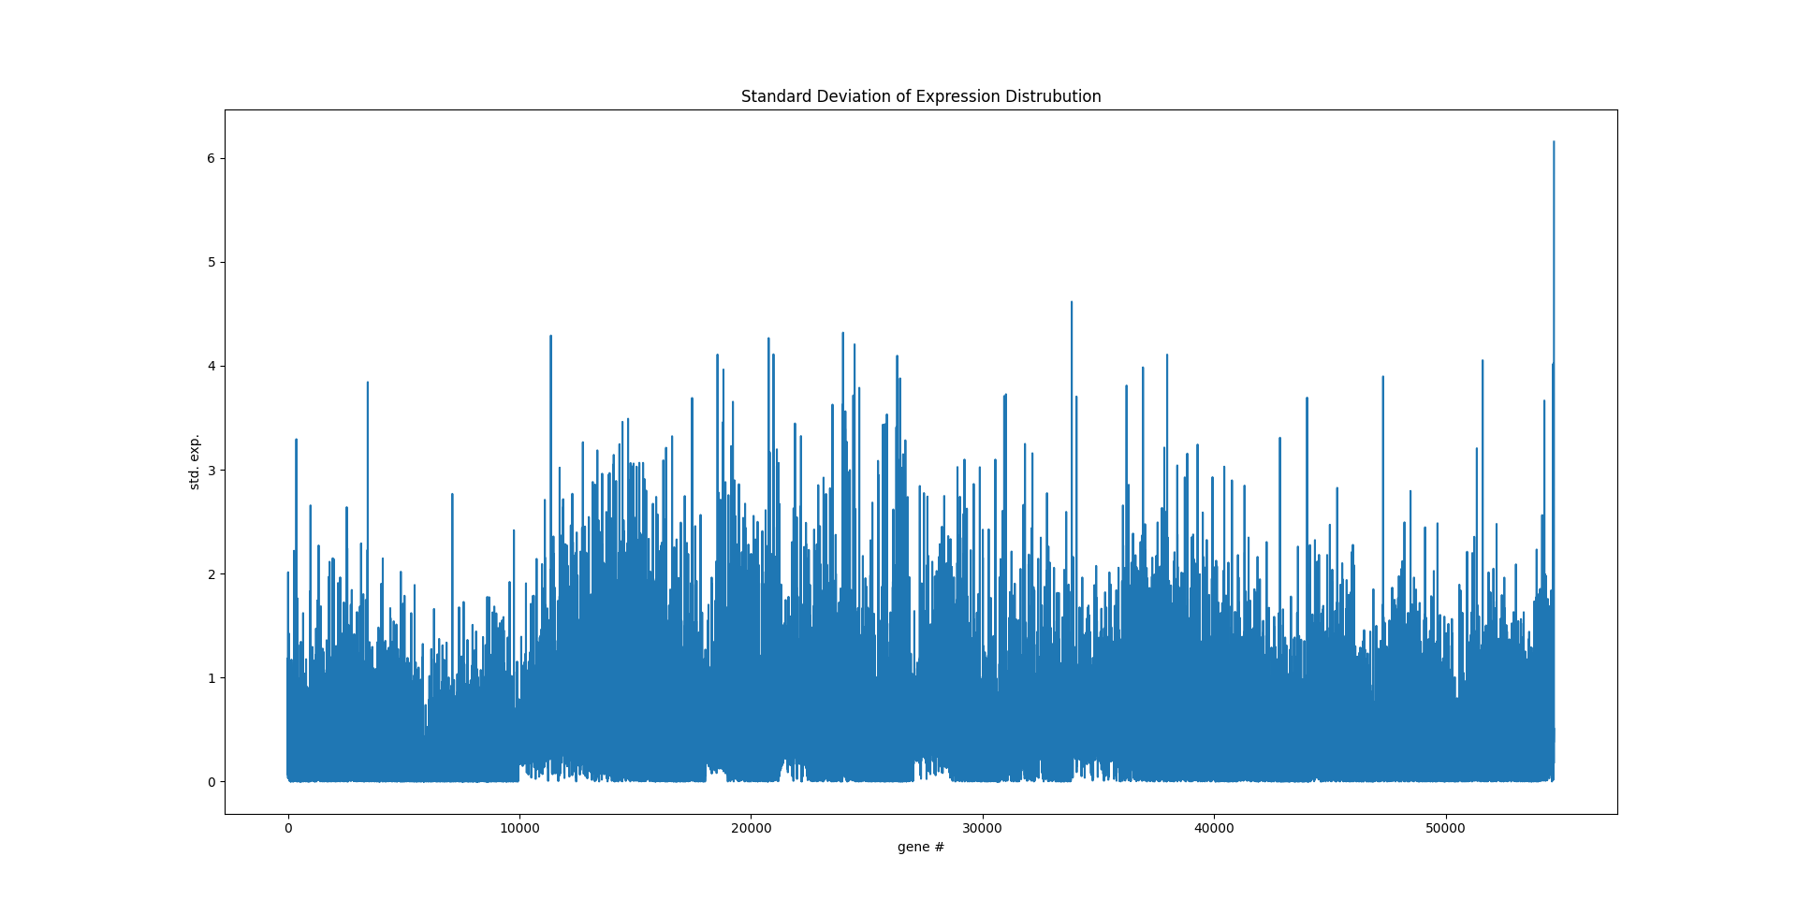
Minimum Expression Distribution
Maximum Expression Distribution
Average Expression Distribution
Standard Deviation Expression Distribution

Slide 12
Explore your Data Part 2
03
03

Slide 13
Тhe dataset was split into two sets for each investigation group. 70% of the data was split for the training set, 30% of the data was split for the test set.
The expression levels of the genes were checked by the decision tree algorithm and trees were constructed by checking the entropy values.
30%
70%
Test
Training

Slide 14
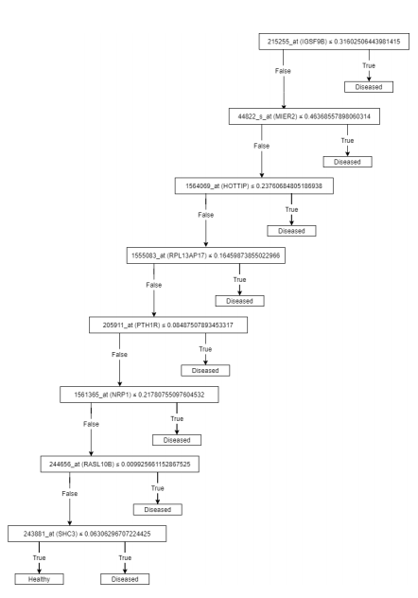
Then, the trees were added to the random forest with the accuracy level higher than 90% of the accuracy level. Then, the samples were classified based on the trees in the random forest.

Slide 15
 | Gene ID | Gene Symbols | Cancer related findings
1 | 215255_at | IGSF9B | Favorable ovarian cancer biomarker
2 | 44822_s_at | MIER2 | Possible biomarker in renal cancer, endometrial cancer and colorectal cancer
3 | 1564069_at | HOTTIP | Strong relation with the papillary thyroid carcinoma cells
4 | 1555083_at | RPL13AP17 | No cancer related finding
5 | 205911_at | PTH1R | Enhanced cancer specificity in renal cancer
6 | 1561365_at | NRP1 | Prognostic marker in stomach cancer, cervical cancer and renal cancer
7 | 244656_at | RASL10B | Unfavorable prognosis in endometrial cancer
8 | 243881_at | SHC3 | Favorable hepatocellular carcinoma and unfavorable gastric cancer related findings
8 differentially expressed genes (DEGs) were discovered.

Slide 16
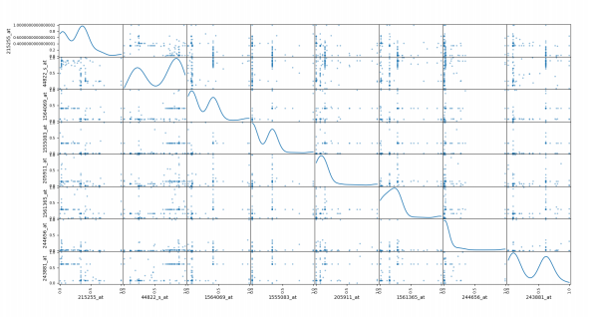
Differentially expressed genes were scattered by matrix plotting.
The points where the graph forms a positively inclined diagonal are positive correlations and the points where it forms a negatively inclined diagonal are negative correlations. However, in our case, no correlation was not observed

Slide 17
Predictive Analysis
04
04

Slide 18
Predictive analysis of our dataset is made by using classification algorithms, including K-Nearest Neighbors (k-NN) and Neural Network by using the differentially expressed genes found in the previous step.
We compared the performances of these classification algorithms trained with the training set which is 70% of our dataset and the classification capabilities on the test set by using the evaluation metrics. These metrics are accuracy, sensitivity, specification, precision, and F1 score

Slide 19
The evaluation metrics are calculated by using the Confusion Matrix.
Condition | Being Healthy | Having Disease
Being Healthy | TP | FN
Having Disease | FP | TN

Slide 20
We made experiments with models constructed consisting of 4 of the Neural Network and 4 of the k-NN algorithms.
We constructed 4 models for the Neural Network algorithm by changing the learning rate. For each model the learning rate changes as follows:
0.1, 0.01, 0.001, 0.0001.
We constructed 4 models for the k-NN algorithm by using different k values. For each model k value changes as follows:
3, 5, 9, 15.

Slide 21
Evaluation Metrics for each algorithm with different parameters
Algorithm | Experiment | Accuracy | Sensitivity | Specification | Precision | F1 Score
Neural Network | LR = 0.1 | 1.0 | 1.0 | 1.0 | 1.0 | 1.0
 | LR = 0.01 | 1.0 | 1.0 | 1.0 | 1.0 | 1.0
 | LR = 0.001 | 0.942 | 0.714 | 1.0 | 1.0 | 0.947
 | LR = 0.0001 | 0.828 | 0.684 | 1.0 | 1.0 | 0.812
k-NN | k = 3 | 0.987 | 0.976 | 1.0 | 1.0 | 0.987
 | k = 5 | 0.987 | 0.972 | 1.0 | 1.0 | 0.985
 | k = 9 | 0.987 | 0.971 | 1.0 | 1.0 | 0.985
 | k = 15 | 0.975 | 0.972 | 0.978 | 0.972 | 0.972

Slide 22
Thank you for listening
Any questions?

