Slide 1
Bınary ımage processıng

Slide 2
What ıs the problem?
Sometimes people need to analyze an image to get effective data from it.
An image is not stable for human eye, if we want examine an image, there different ways to do like drawing but it is not very compatible for every person.
This is the point that we need digital image processing.

Slide 3

How we can use a dıgıtal ımage?
If you have a digital image, you can do any kind of work to get the meaningful data.
A digital is just like a set of numbers.
And numbers are concrete datas for everyone.
There a limitless operations for them.

Slide 4
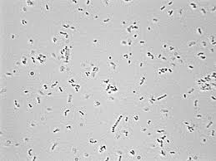
If you are scientist who had work with microscope may develop a algorithm for count the number of bacterias in that picture. Because every object has a specific color plate.
And that needs becomes with PROCESSİNG.

Slide 5
For Processing…
To process on a digital image you will need algorithms.
You can develop your own algorithms or choose the most efficient algorithm.
And you can modify this algorithm for your work.
One the most efficient algorithm for that is called Levialdi’s Shrink Algorithm.

Slide 6
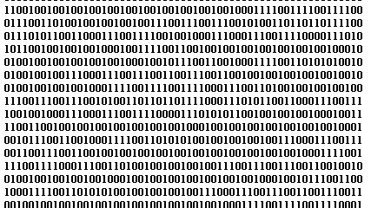
Levialdi’s Shrink algorithm
That algorithm can start any corner of the image.
And checking conditions for every pixel(iterations).
If a pixel right for the condition algorithm erase to 0 or 1 .
If iteration catches a pixel whose 8 neighbors are zero.
That means this point was a component in that picture.
For this way we can find the number of components in a picture.

Slide 7
My code
Library of tkinter for GUI
Library of PILLOW for Image processing
I took the image as input from user. And user can select the image from file explorer.
I started the Levialdi’s algorithm from bottom left corner.
After the selection of image user can see binary format of the image or insert it to levialdi’s algorithm and watch the iterations or get the information of number of components and number of iterations for the image.

Slide 8

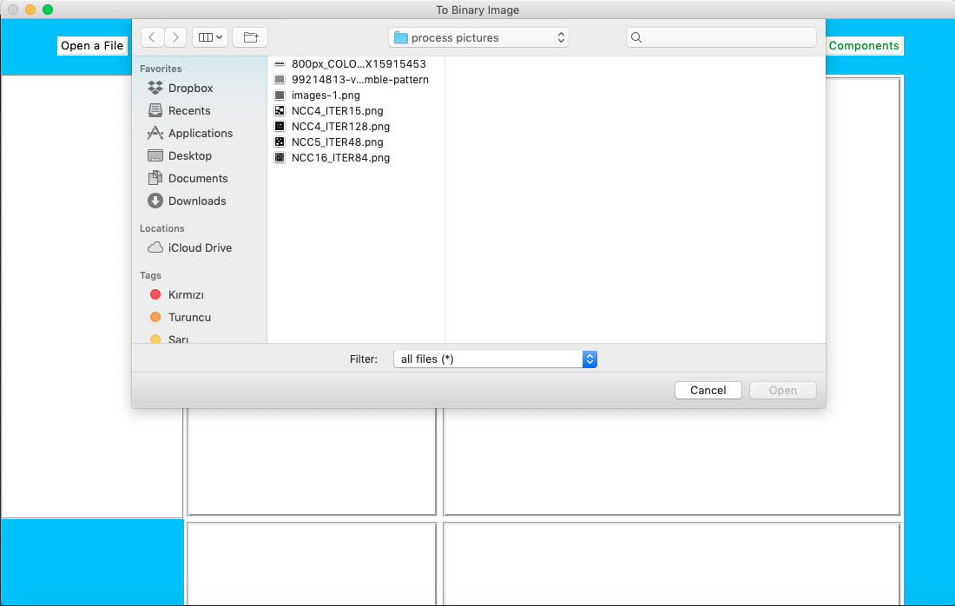
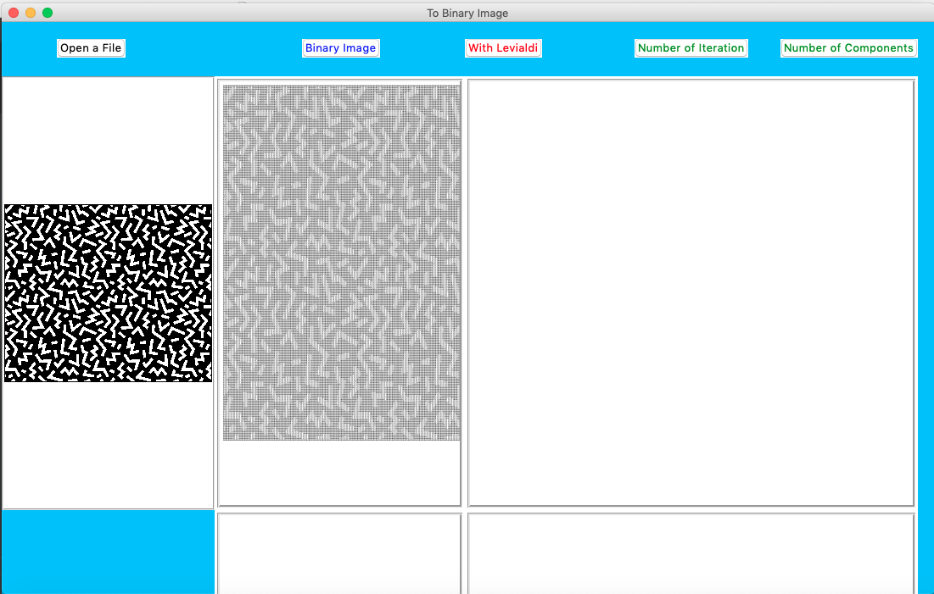

Slide 9
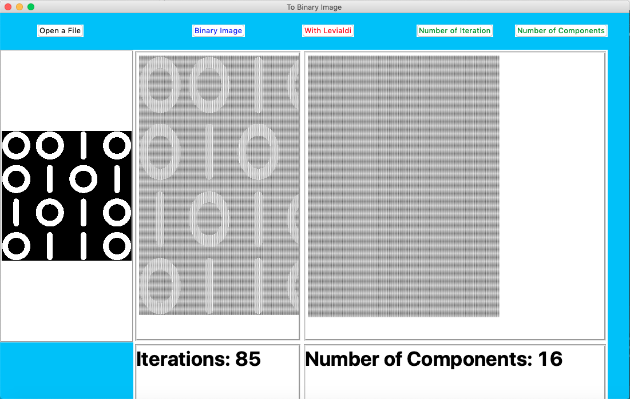
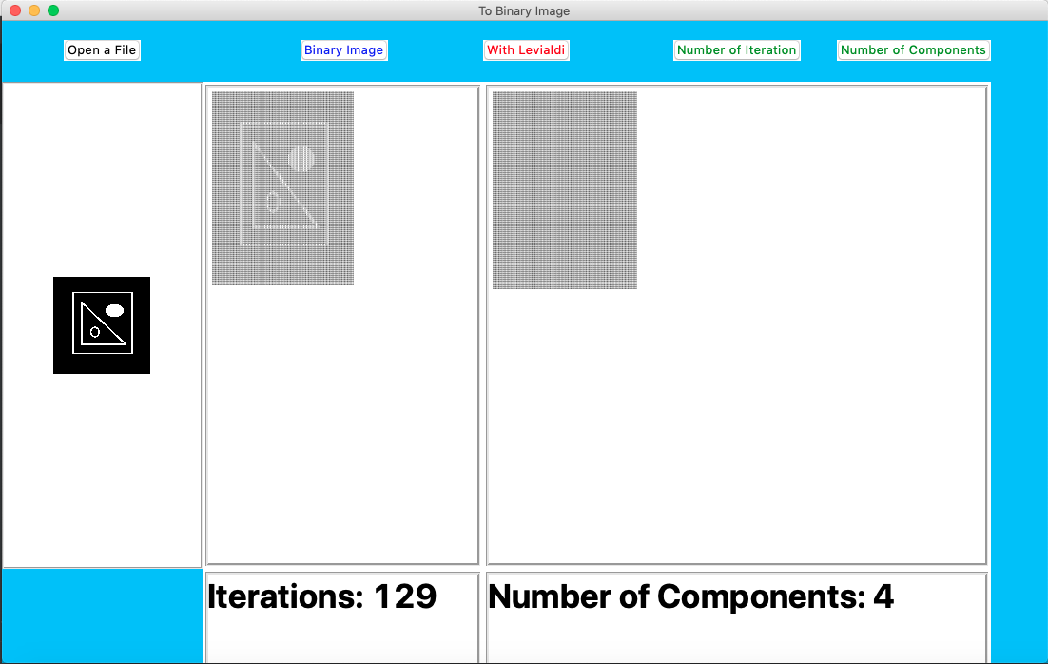
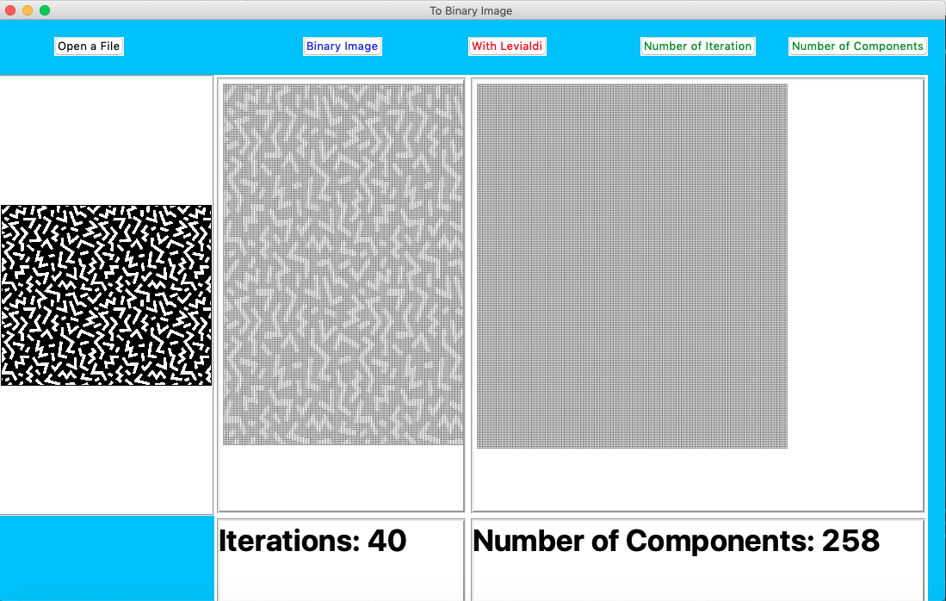
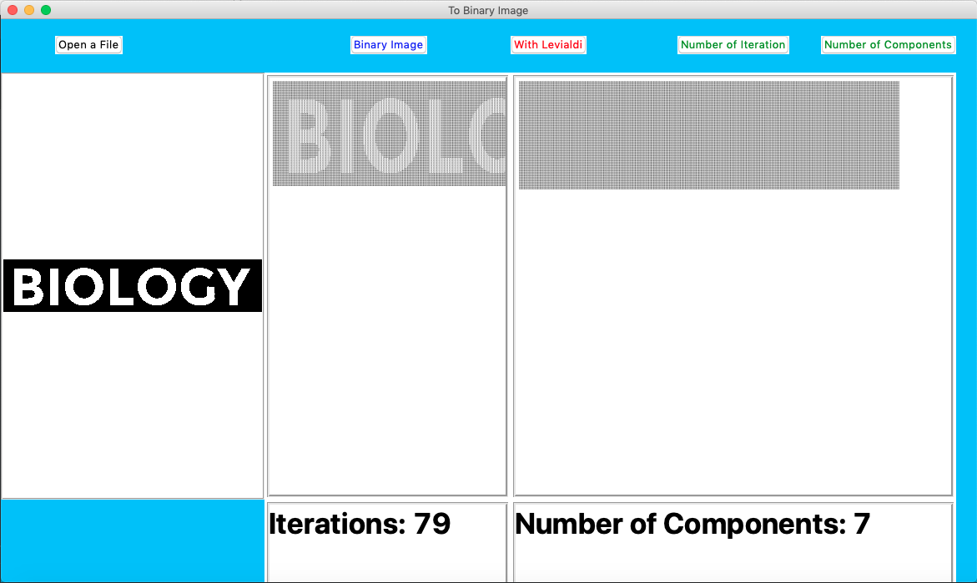
SAMPLES

Slide 10
Ertuğrul Yılmaz

