Slide 1
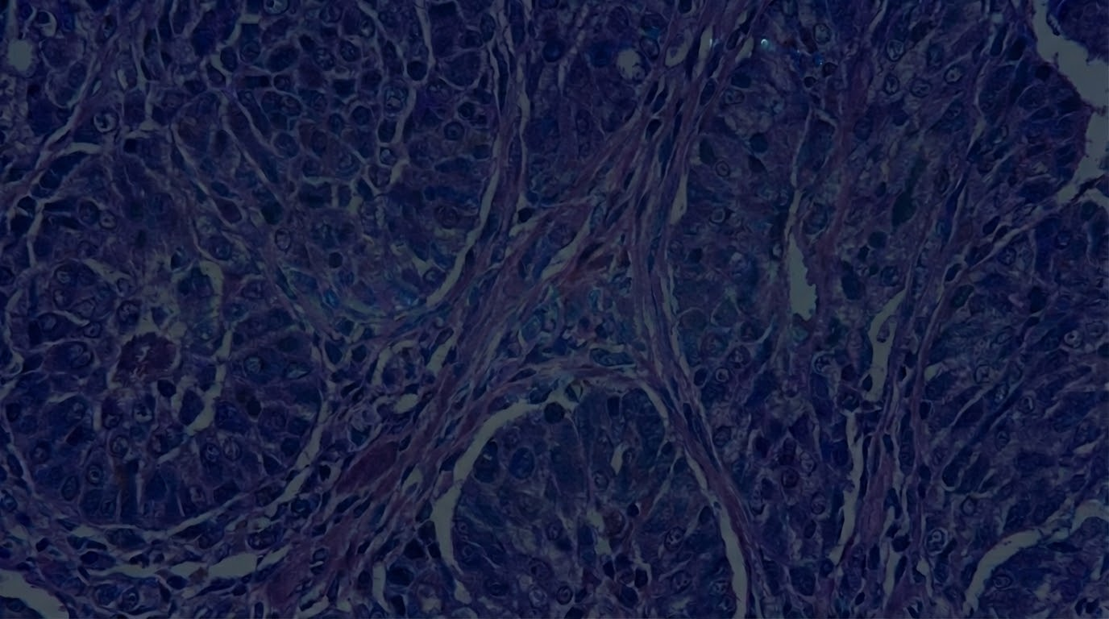
Heatmap and Vector Field Visualization of Whole-Slide Images in Digital Pathology
Group Members:
Jingyi Xu
Erturk Ocak
Sushmita Bajgain

Slide 2
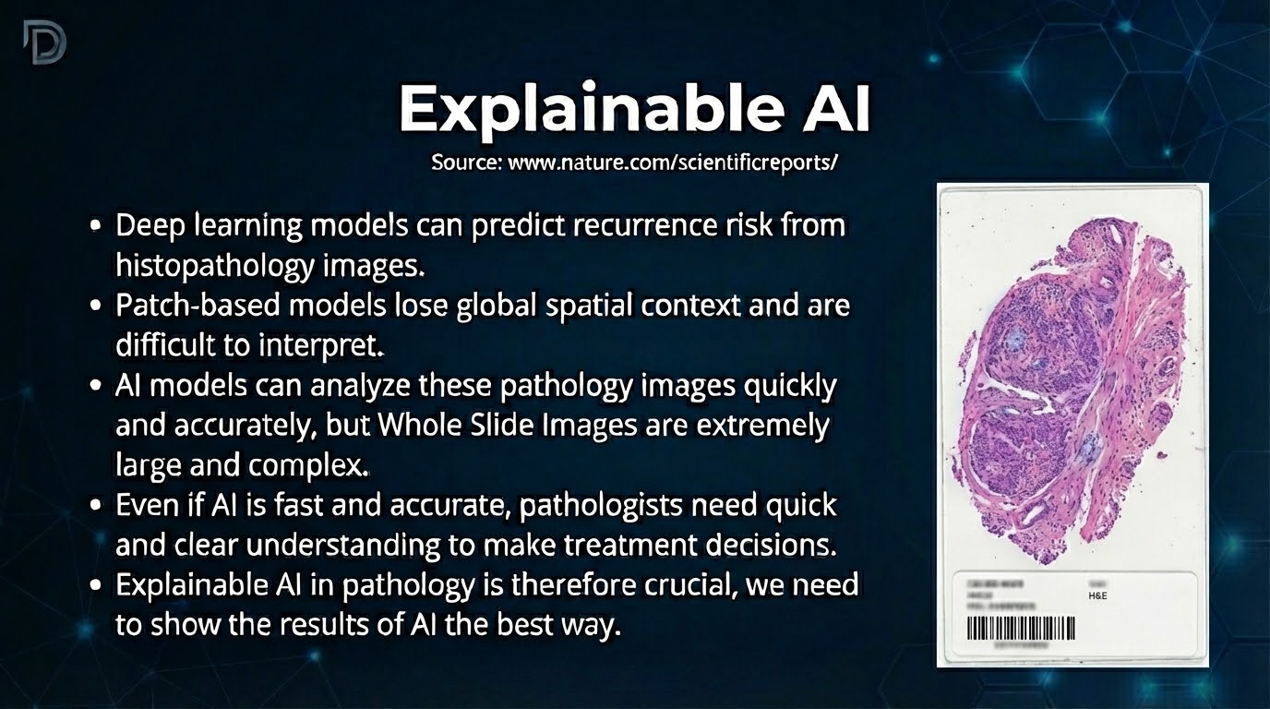
Notes:
Explainable AI refers to artificial intelligence systems that not only make predictions but also clearly explain how and why those decisions are made. In medical imaging, especially histopathology, this is extremely important because clinicians need to trust and validate the model’s reasoning. Instead of acting like a black box, explainable AI highlights specific regions, labels infected or abnormal areas, and provides visual evidence that pathologists can interpret. This ensures that AI supports clinical decision-making rather than replacing expert judgment without transparency.

Slide 3
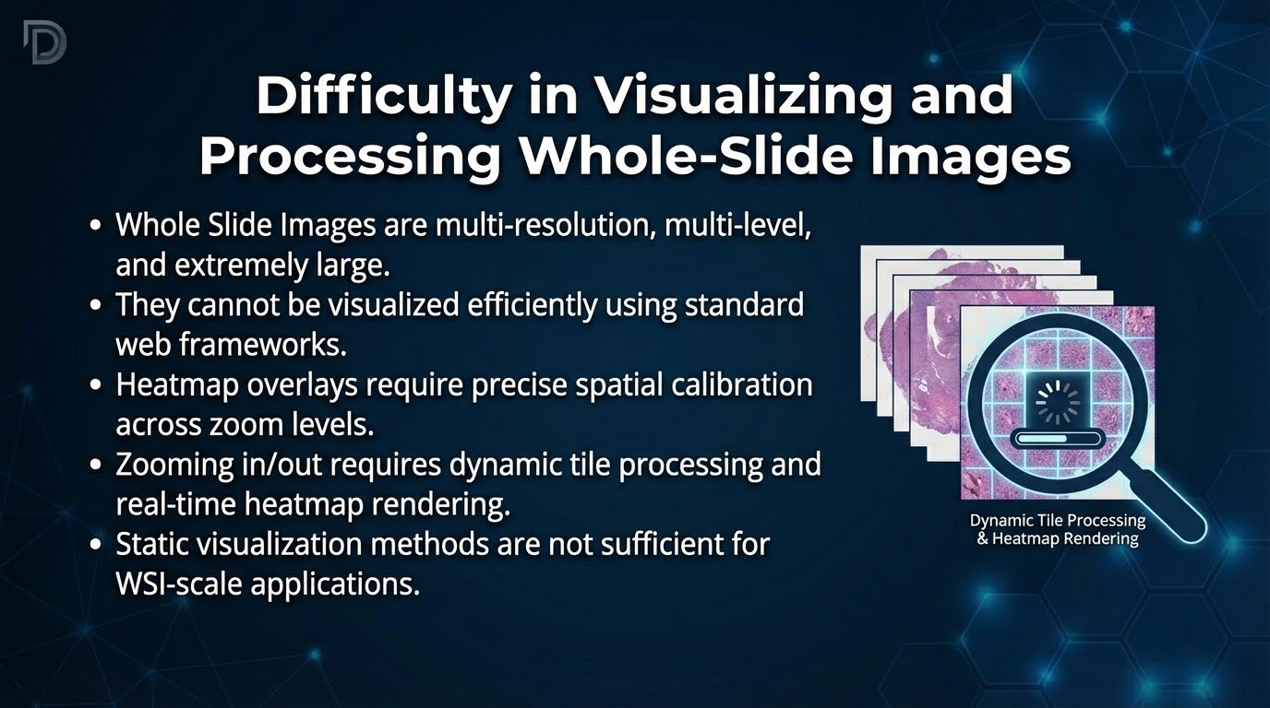
Notes:
However, there is a clear gap in current approaches. Whole Slide Images are extremely large and complex, making them computationally expensive and time-consuming to process. Patch-based models break images into small regions, but they are difficult to interpret in a global context. Additionally, heatmaps require dynamic processing and real-time rendering during zooming, and static visualizations are often insufficient. Therefore, we need an explainable AI model that efficiently handles large WSIs while providing clear, interpretable visual outputs. By addressing this gap, we can make AI systems more practical, trustworthy, and clinically useful.

Slide 4
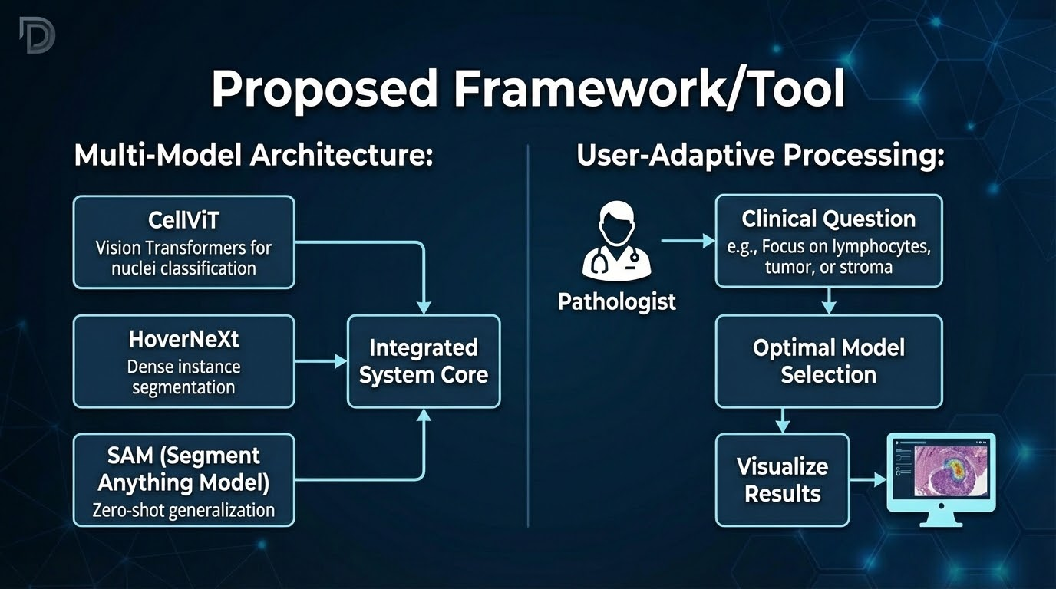

Slide 5
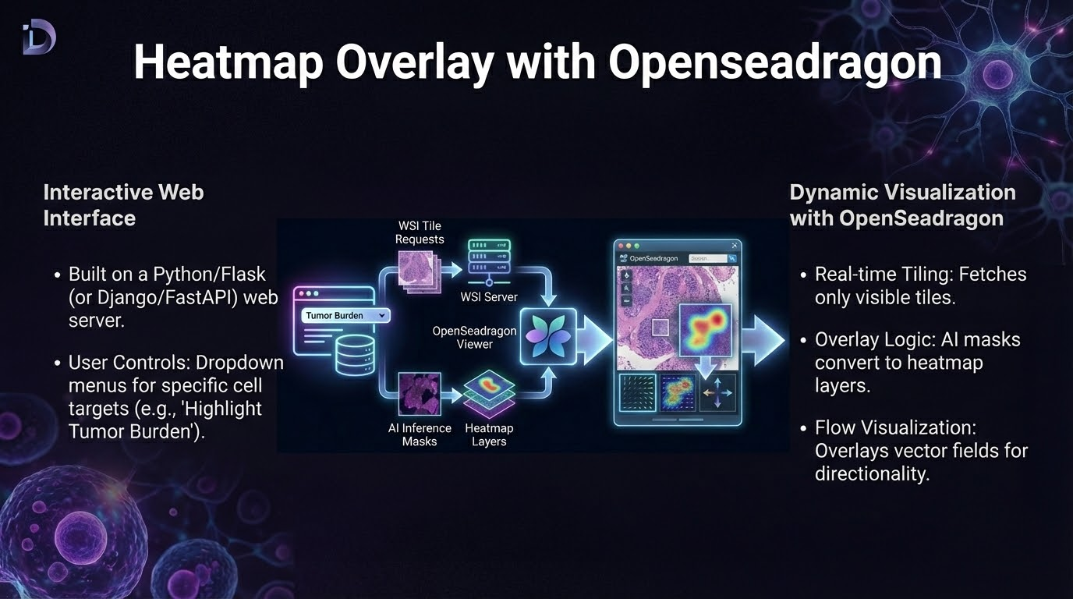

Slide 6
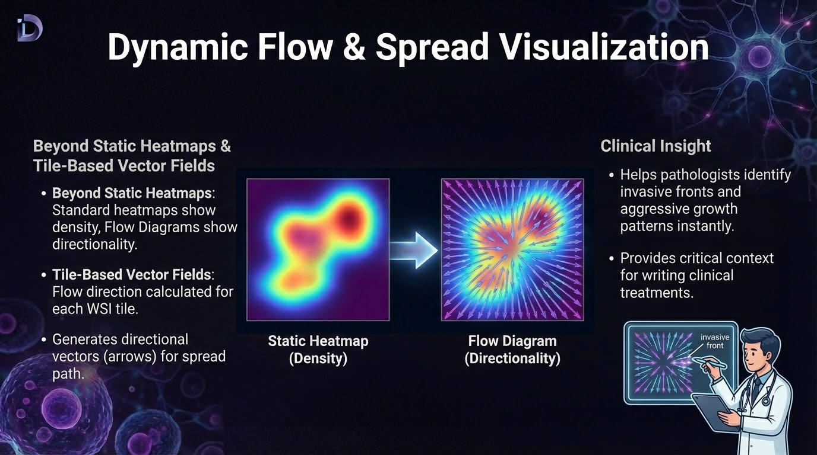

Slide 7


Slide 8


