Slide 1
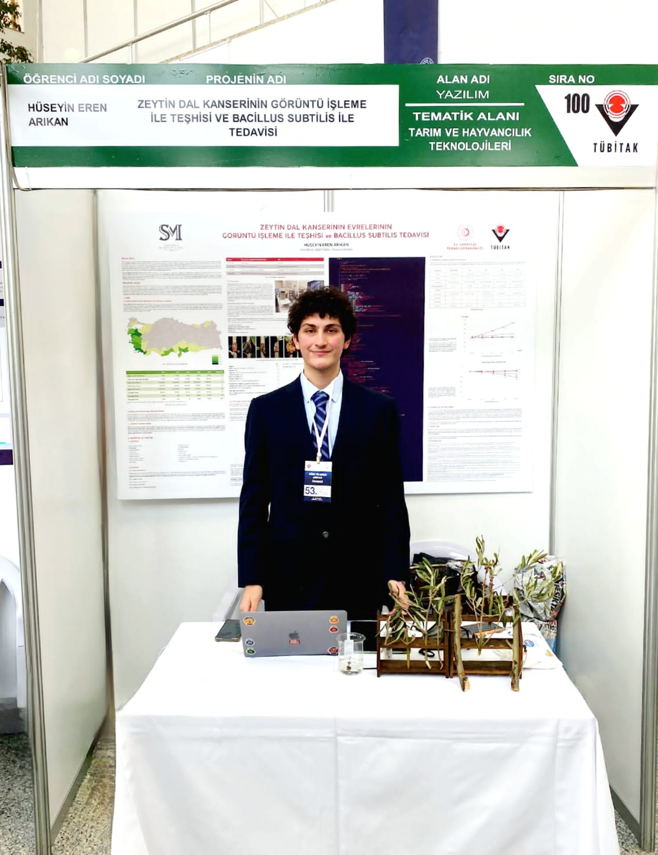
Olive Knot AI
Computer vision and plant research
National second place in Software
TÜBİTAK 2204-A, 2022
Hüseyin Eren Arıkan
Notes:
Original exhibition photograph supplied by the project author. National result: https://web.archive.org/web/20240520125501id_/https://tubitak.gov.tr/sites/default/files/2750/final_sonuc_web_son.pdf

Slide 2
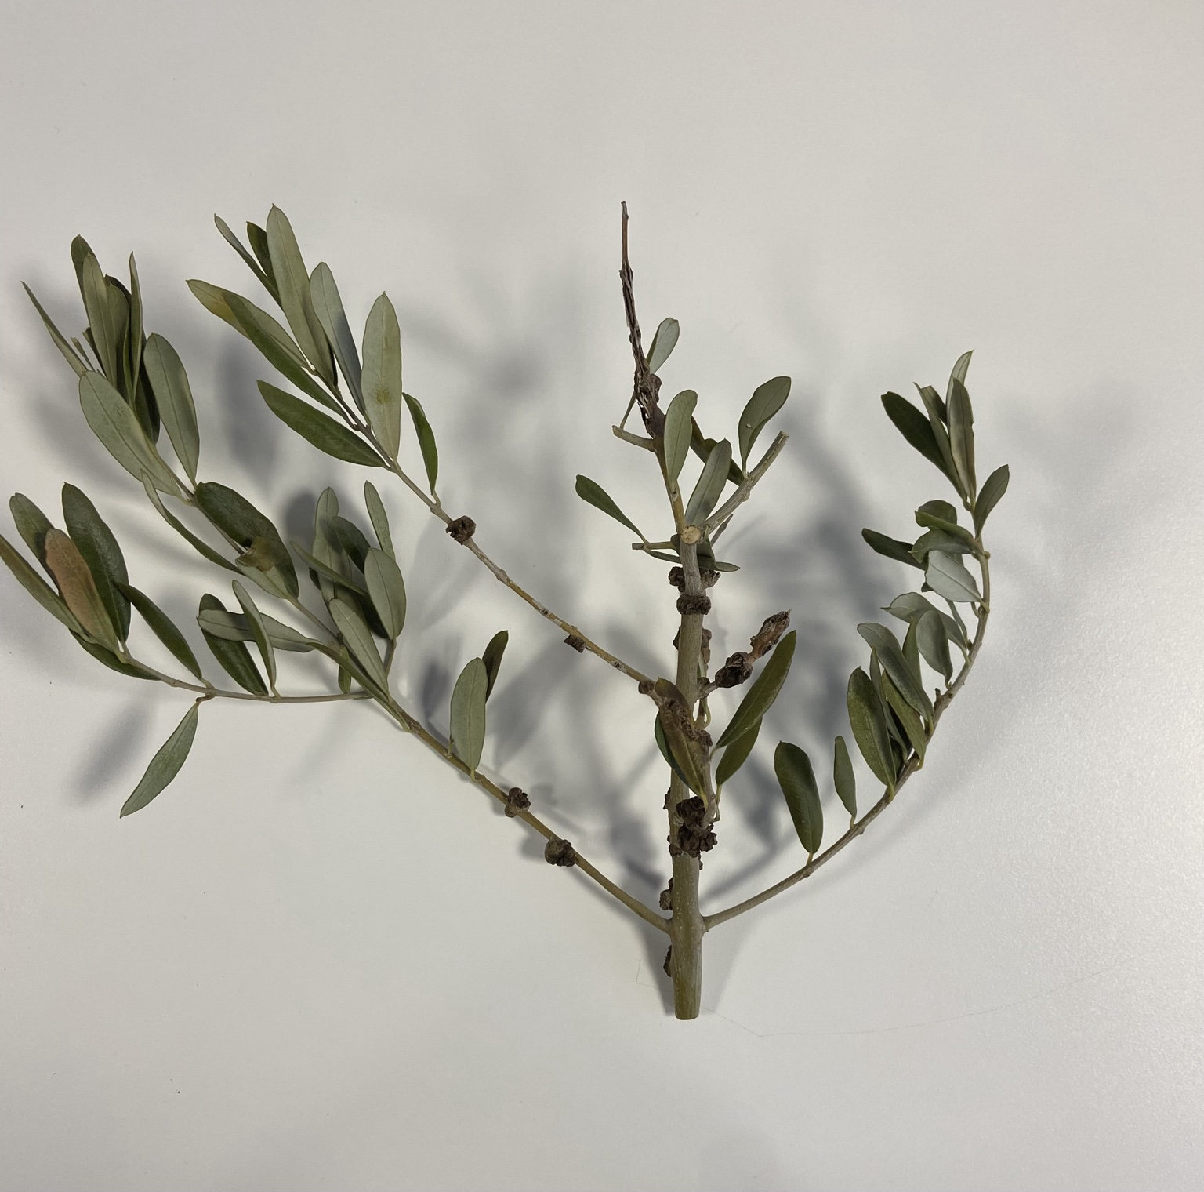
Research question
Can a plant image help identify the visible stage of olive knot disease?
A CNN-based classifier grouped images into four stages. I put the predictions into a mobile research prototype.
Research prototype — not a certified diagnosis.
OLIVE KNOT AI • 2022 RESEARCH
02
Notes:
Original specimen photograph supplied by the project author. The matching English edition of the 2022 research poster accompanies this deck.

Slide 3
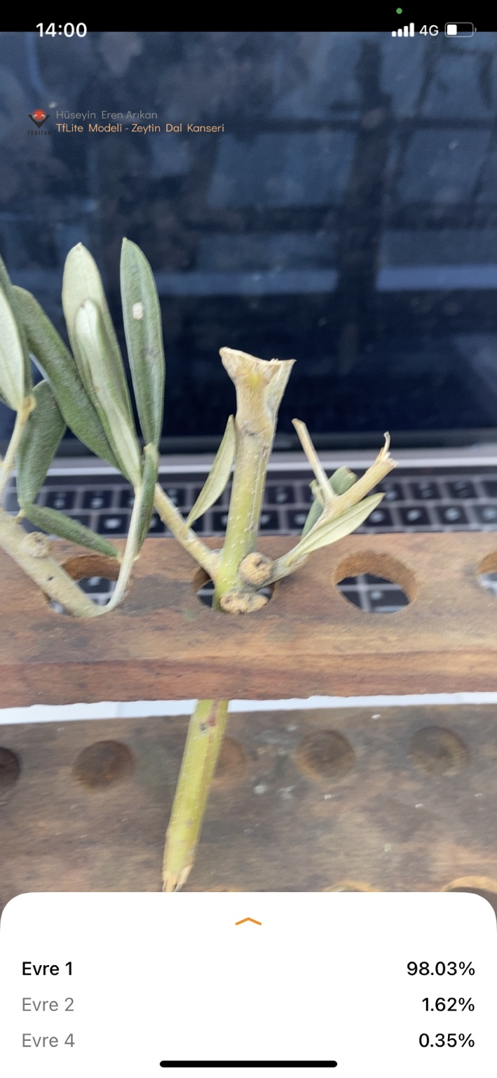
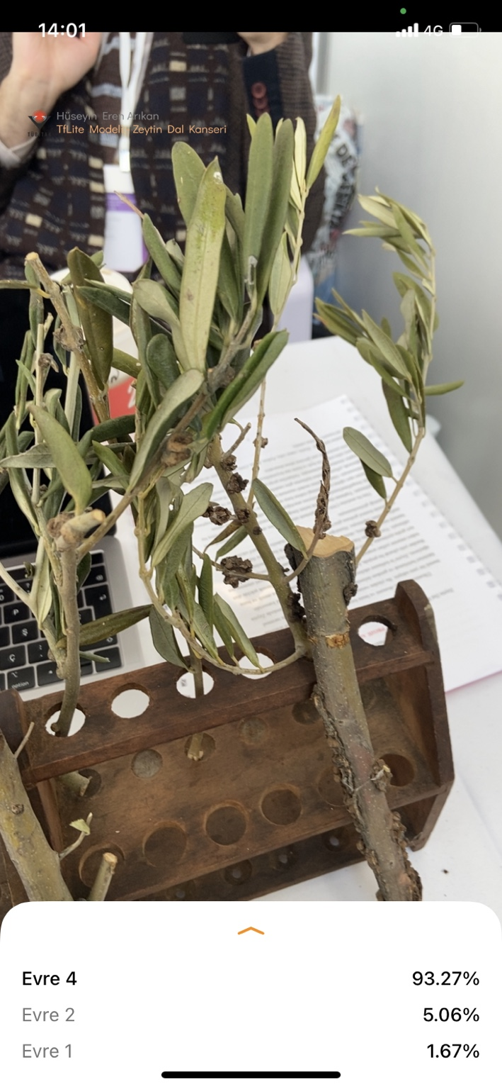
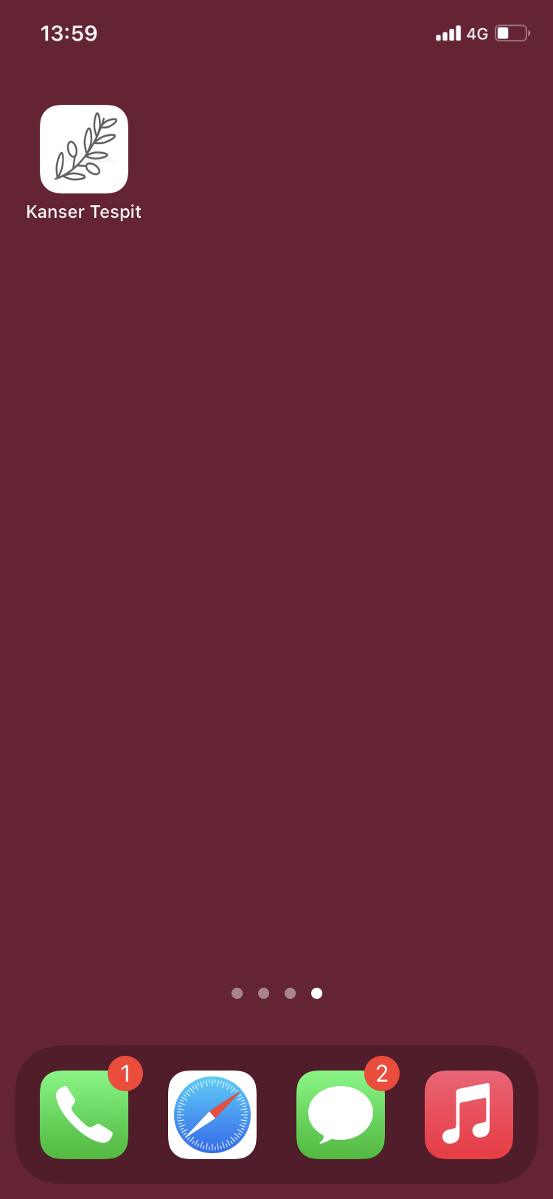
Mobile prototype
Confidence on these two images, not an overall accuracy measure.
98.03% • stage 1
93.27% • stage 4
OLIVE KNOT AI • 2022 RESEARCH
03
Notes:
Original mobile screenshots and home-screen image supplied by the project author. Per-image confidence values are visible on the screenshots.

Slide 4
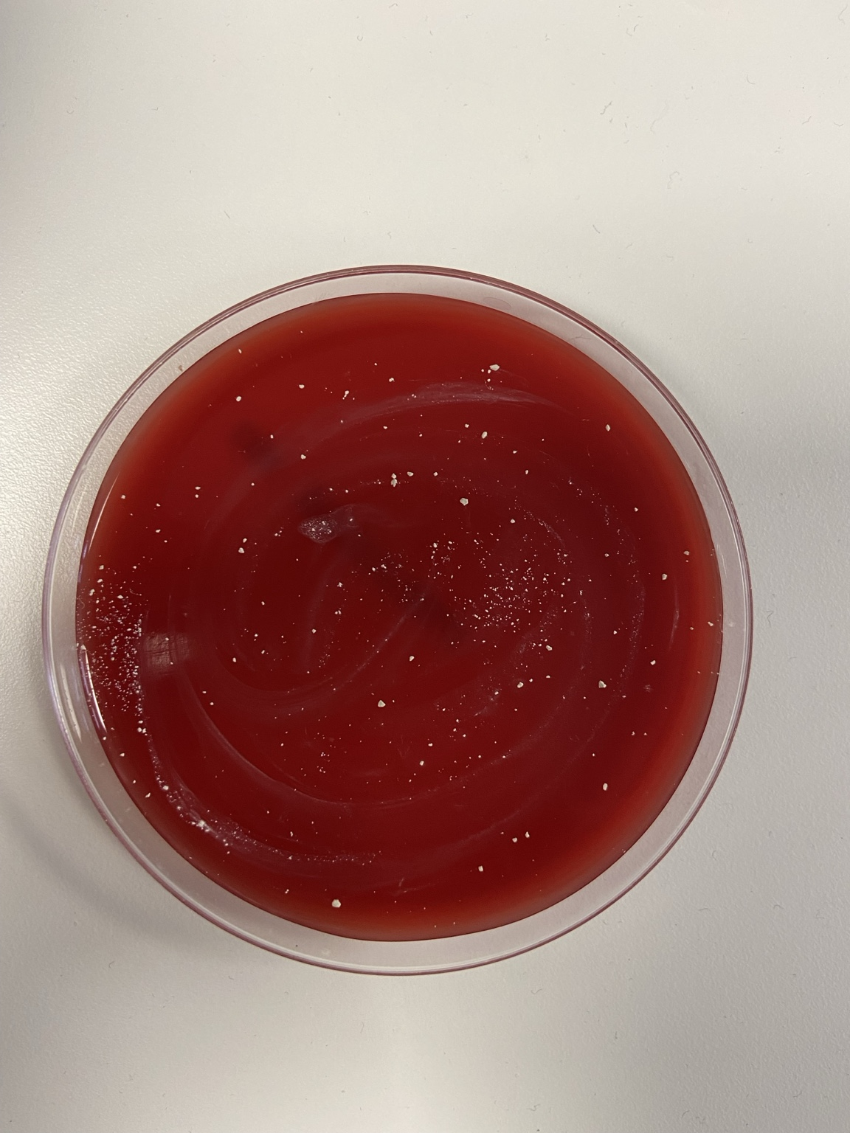
Plant and laboratory study
12 olive saplings
Four comparison groups
About four months of observation
The poster reports preliminary observations about disease progression and Bacillus subtilis. More samples and independent replication would be needed for a treatment claim.
OLIVE KNOT AI • 2022 RESEARCH
04
Notes:
Original laboratory image supplied by the project author. Study size, duration, and methods are reported in the 2022 research poster; its English edition accompanies this deck.

Slide 5
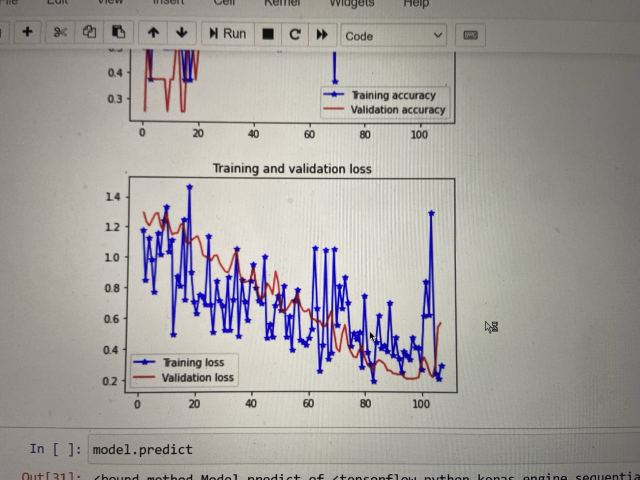
Training and evaluation
88.33%
classification accuracy reported in the 2022 poster
Self-reported research result. No independent field validation is claimed.
OLIVE KNOT AI • 2022 RESEARCH
05
Notes:
Training chart photograph supplied by the project author. The poster gives a 0.88333 score for the model. Public poster PDF accompanies this presentation.

Slide 6
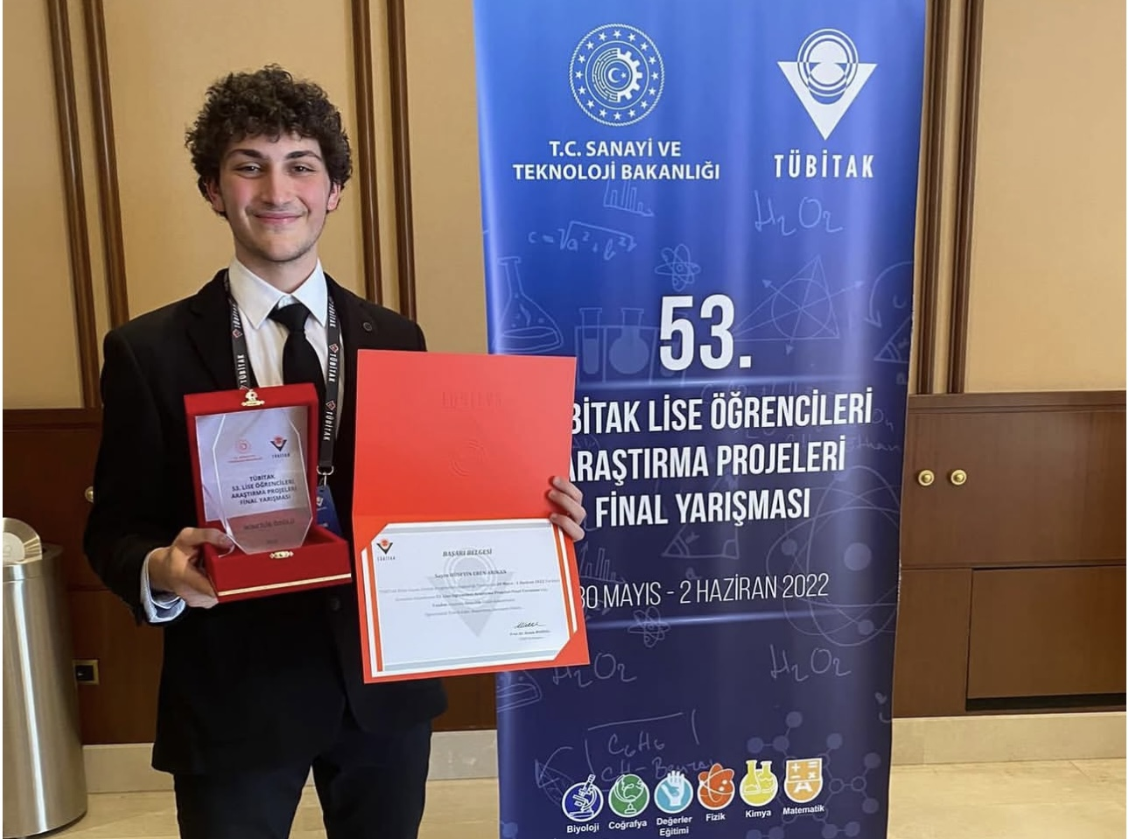
Regional and national recognition
Regional first place
National second place in Software
TÜBİTAK 2204-A • 2022
25,095 project submissions and 37,283 students across all 12 fields.
OLIVE KNOT AI • 2022 RESEARCH
06
Notes:
The portrait was supplied for this showcase; camera provenance was not independently verified. Award evidence is the official national result: https://web.archive.org/web/20240520125501id_/https://tubitak.gov.tr/sites/default/files/2750/final_sonuc_web_son.pdf . Competition totals: https://tubitak.gov.tr/tr/haber/53-lise-ogrencileri-arastirma-projeleri-yarismasinin-kazananlari-odullerini-cumhurbaskani-erdoganin-elinden-aldi . Regional graphic is on the project page. National winners could enter a further ISEF selection process, not automatic ISEF participation.

Slide 7
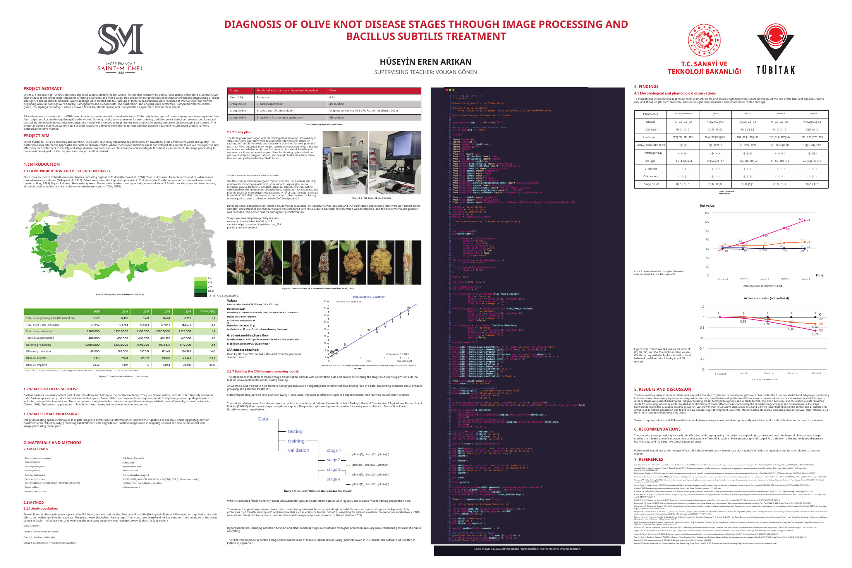
The research poster in English
The original layout, figures and results remain. The code screenshot shows a 2022 development representation.
OLIVE KNOT AI • 2022 RESEARCH
07
Notes:
English poster PDF: media/public-research-poster.pdf in the GitHub project archive. The original Turkish PDF remains in the author's private archive. The code screenshot is historical development work, not the finished implementation.

Slide 8
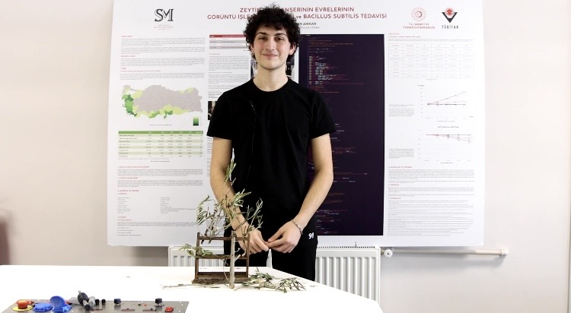
Demonstrating the work
The project was built, presented and awarded.
The finished code, model weights and training data remain private. The poster and research record are open to inspect.
OLIVE KNOT AI • 2022 RESEARCH
08
Notes:
Original demonstration photo supplied by the project author. Copyright © 2026 Hüseyin Eren Arıkan for original user-owned content. All rights reserved. Institutional graphics and marks remain with their owners.

