Slide 1
CS210 - MiniProject II
Tower of Hanoi
Erum Meraj
2201CS24

Slide 2
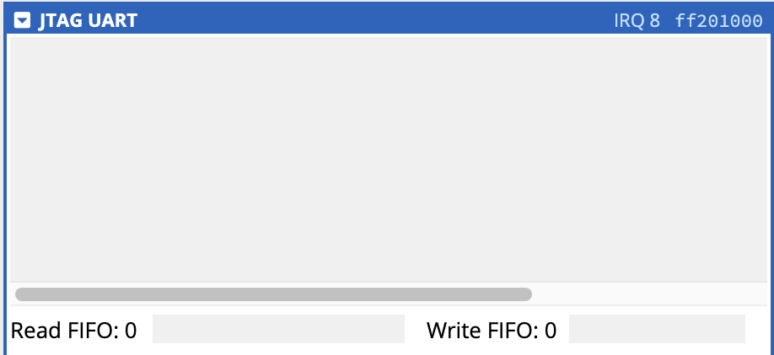
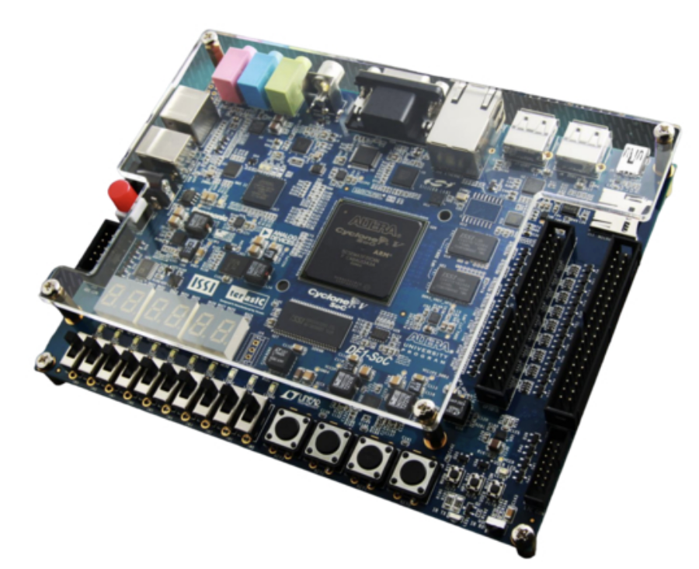
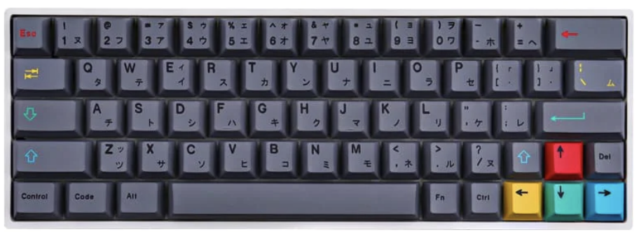
Inputs Utilised
DE1-SOC key interrupt
JTAG
JTAG UART terminal
DE1-SOC and its switches
PlayStation Mechanical Keyboard (JTAG)

Slide 3
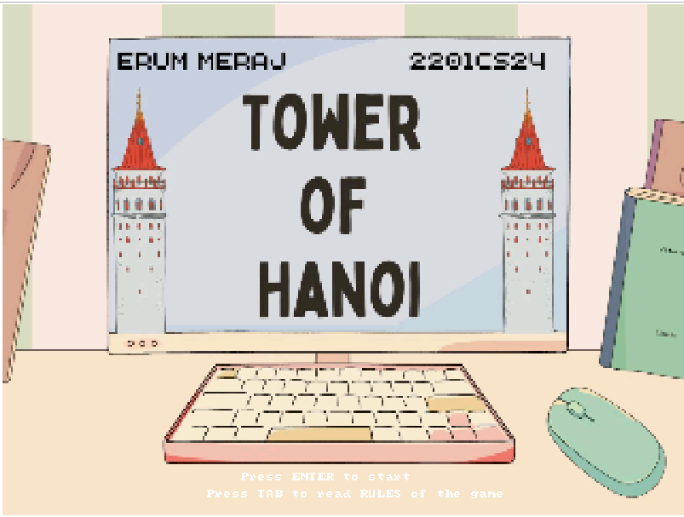
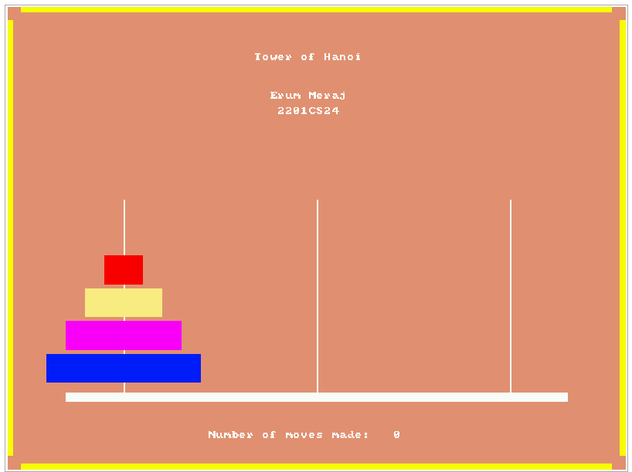
outputs Utilised
VGA display

Slide 4
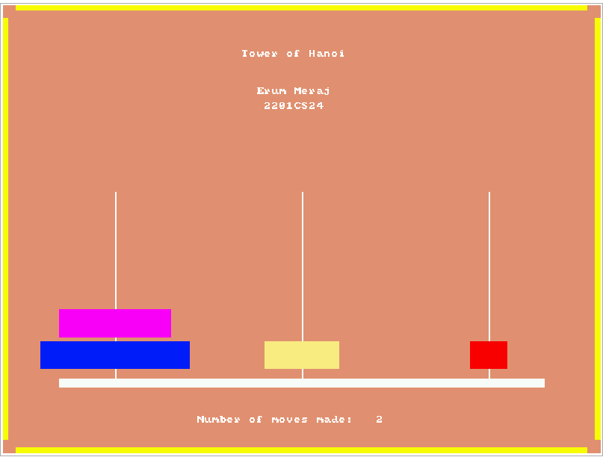
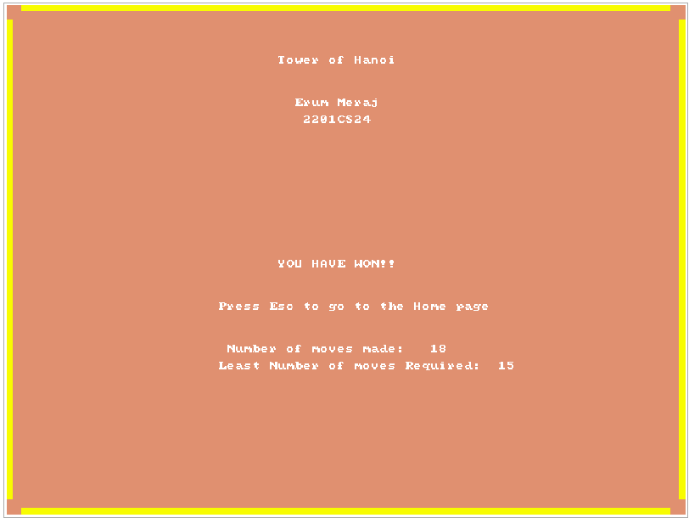
Game screens

Slide 5
Game play
1. Home Screen:
- Users are presented with a home screen upon starting the game.
- They can choose to read the rules or start the game.
- Controls: Press `TAB` to read rules and `ENTER` to start.
2. Rules:
- Users can read the rules of the Tower of Hanoi game.
- The objective is to stack all disks on Rod C.
- Players must move disks from Rod A (source) to Rod C (destination), adhering to certain rules.
- Controls: Press `ESC` to return to the home screen.
3. Gameplay:
- Players interact using the JTAG UART terminal.
- They select the source and destination rods using the switches.
- Larger disks cannot be placed on top of smaller disks.
- The game tracks the number of moves made.
- The game ends when all disks are moved to Rod C.
4. Game Over:
- Upon completing the game, players are notified of their victory.
- They can choose to return to the home screen.
- The minimum number of moves required is displayed.

Slide 6
Learnings
The most challenging aspect was integrating the JTAG UART for user input and synchronizing it with the game logic. This involved understanding the communication protocol and implementing it within the game loop effectively.
Developing the gameplay mechanics involved creating functions to manage the movement of disks on the VGA display and handling events such as correct placement or misplacement of disks. This required careful consideration of the game's rules and visual feedback to the player.
Learning to utilize the I/O devices provided valuable insights into their functionality and usage. Specifically, integrating the following devices enhanced our understanding:
1. JTAG UART: Used for user input, requiring comprehension of its input/output mechanisms.
2. VGA Display: Implemented for rendering the game interface, involving coordination with other game elements.
Through this project, we gained practical experience in integrating various input/output devices, each with its specific memory locations and data storage functions. This hands-on approach allowed us to appreciate how these components collaborate to create a cohesive and functional system, mirroring real-world applications.

Slide 7
Thank you
Erum Meraj
2201CS24

