Slide 1
MDPs

Slide 2
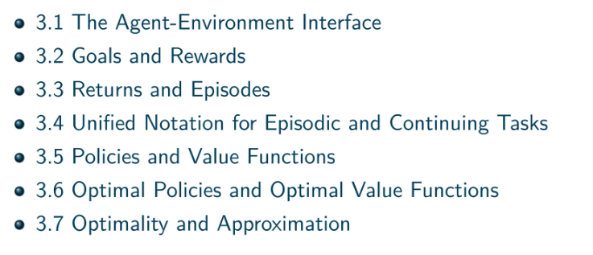
Finite Markov Decision Processes

Slide 3
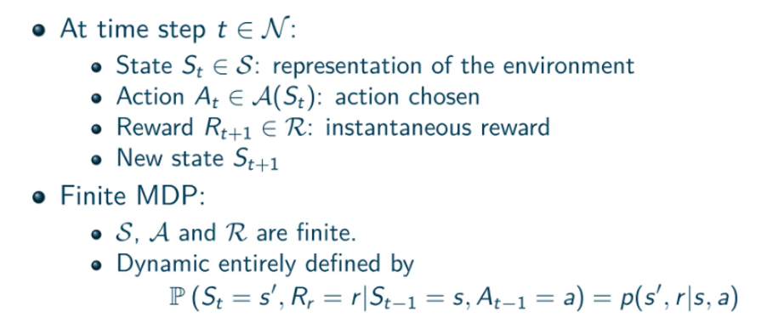

Slide 4
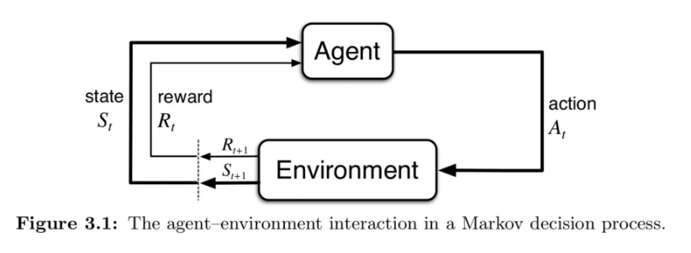

Slide 5

Agent-Environment Interface
p specifies a probability distribution for each choice of s and a, that is, that
The state must include information about all aspects of the past agent–environment interaction that make a difference for the future. If it does, then the state is said to have the Markov property.

Slide 6

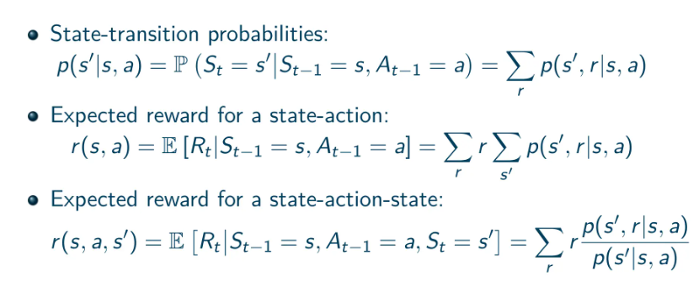

Slide 7
Agent-Environment Interface
The MDP framework is abstract and flexible and can be applied to many different problems in many different ways. For example, the time steps need not refer to fixed intervals of real time; they can refer to arbitrary successive stages of decision making and acting.
Some of what makes up a state could be based on memory of past sensations or even be entirely mental or subjective.
some actions might be totally mental or computational. For example, some actions might control what an agent chooses to think about, or where it focuses its attention.

Slide 8
Agent-Environment Interface
The boundary between agent and environment is typically not the same as the physical boundary of a robot’s or animal’s body.
The general rule we follow is that anything that cannot be changed arbitrarily by the agent is considered to be outside of it and thus part of its environment.
We do not assume that everything in the environment is unknown to the agent.
In fact, in some cases the agent may know everything about how its environment works and still face a difficult reinforcement learning task

Slide 9
MDP as Goal Directed Learning
The agent–environment boundary can be located at di↵erent places for different purposes
The MDP framework is a considerable abstraction of the problem of goal-directed learning from interaction.
Goal-directed behavior can be reduced to three signals passing back and forth between an agent and its environment

Slide 10
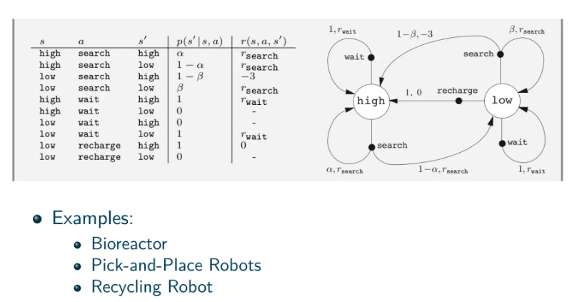

Slide 11
Example1
Bioreactor: (Actions) target temperatures and target stirring rates
(States) thermocouple and other sensory readings, perhaps filtered and delayed, plus symbolic inputs representing the ingredients in the vat and the target chemical
(Reward) moment-by-moment measures of the rate at which the useful chemical is produced by the bioreactor

Slide 12
Example 2
Pick and Place Robots: (Action) voltages applied to each motor at each joint
(States) latest readings of joint angles and velocities
(Rewards) +1 for each object successfully picked up and placed

Slide 13
Recycling Robot
High-level decisions about how to search for cans are made by a reinforcement learning agent based on the current charge level of the battery.
a small state set S = {high, low}
Agent can decide whether to (1) actively search for a can for a certain period of time, (2) remain stationary and wait for someone to bring it a can, or (3) head back to its home base to recharge its battery. When the energy level is high, recharging would always be foolish, so we do not include it in the action set for this state. The action sets are then A(high) = {search, wait} and A(low) = {search, wait, recharge}.

Slide 14

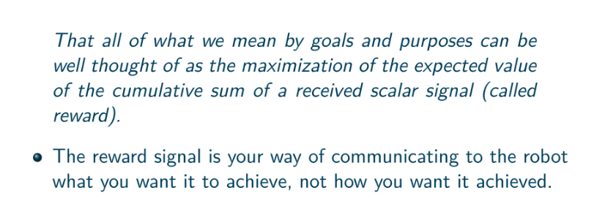

Slide 15
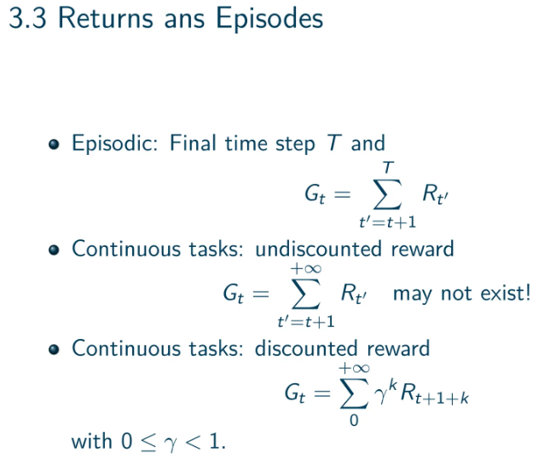

Slide 16

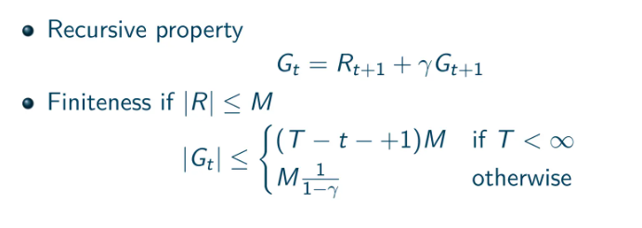

Slide 17

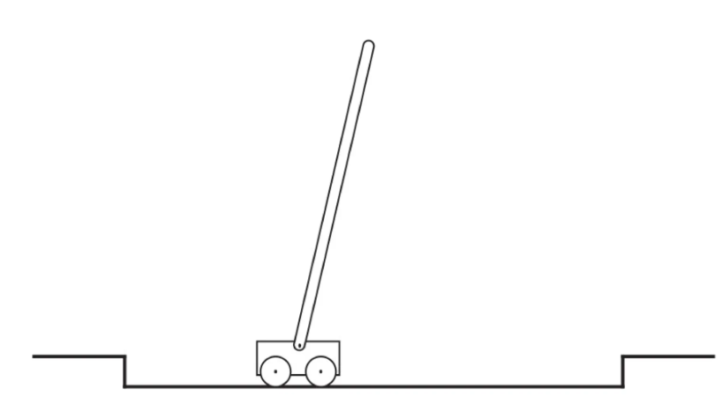

Slide 18

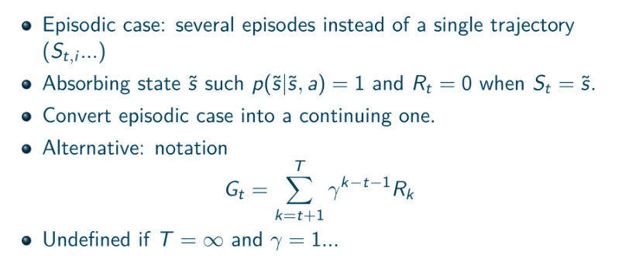

Slide 19

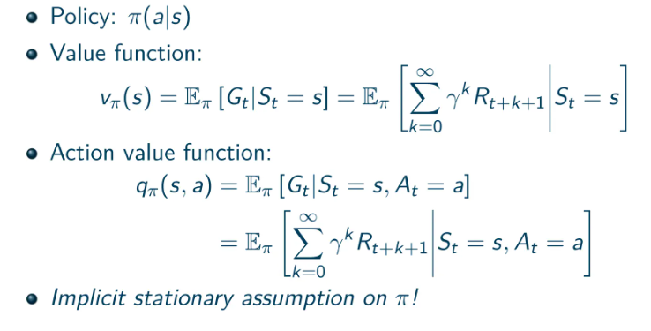

Slide 20
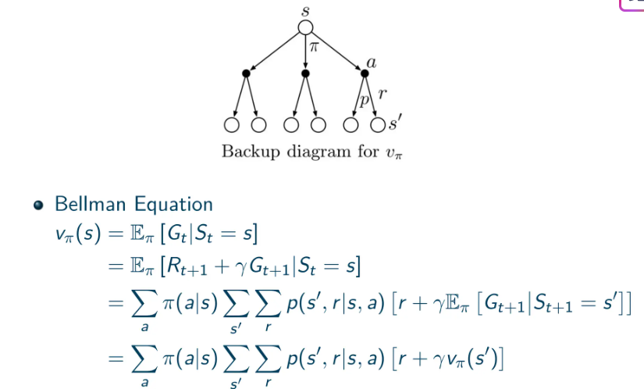

Slide 21
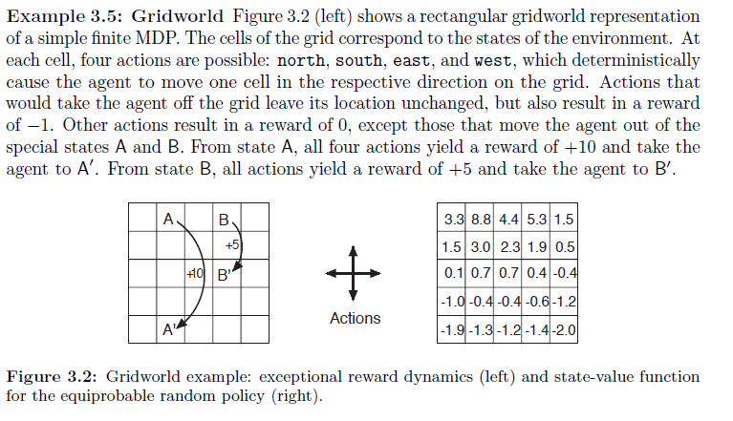

Slide 22

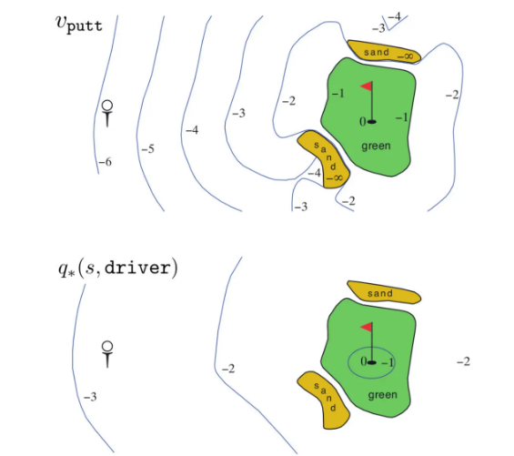


Slide 23

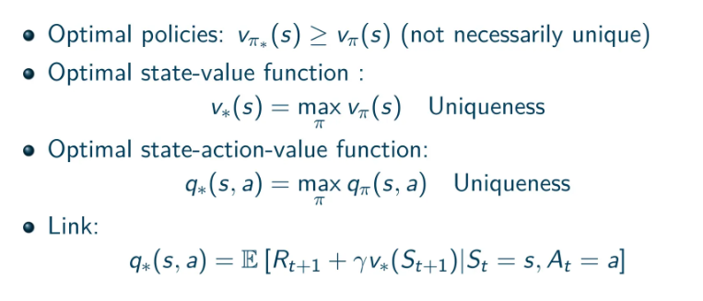

Slide 24
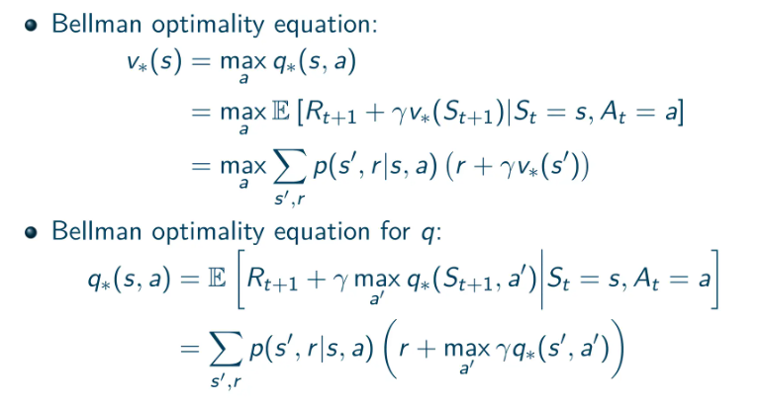

Slide 25

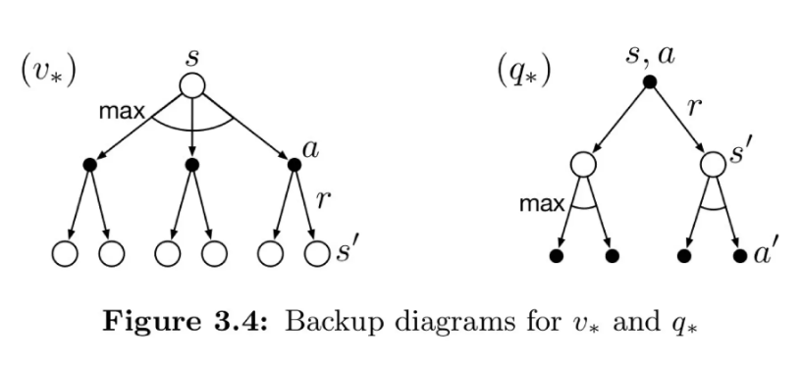

Slide 26

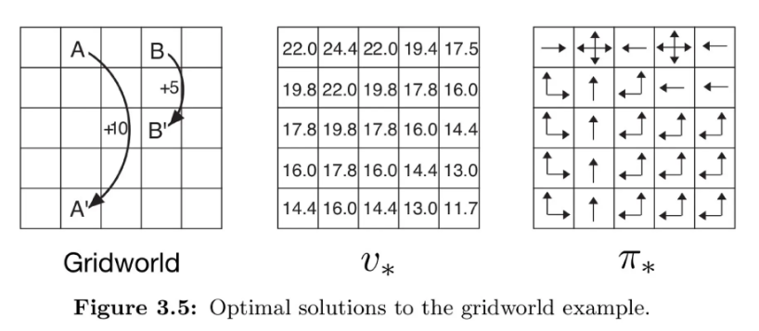

Slide 27
